Slide 1
Compilers
Lecture-17

Slide 2
Today’s lecture
NFA
NFA to DFA
RE to NFA

Slide 3
Steps in generating a lexical analyzer
Specification using regular expression (input of Lex tool)
Convert regular expression to NFA
Convert NFA to DFA
Implementation of DFA

Slide 4

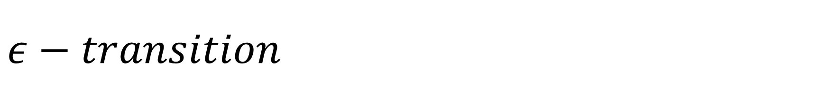


$$ε−transition$$
$ε−transition:$ A transition on empty string, $ε,$ that doesn’t advance the input
S0
$$ε$$
S1
$$a$$
S2

Slide 5
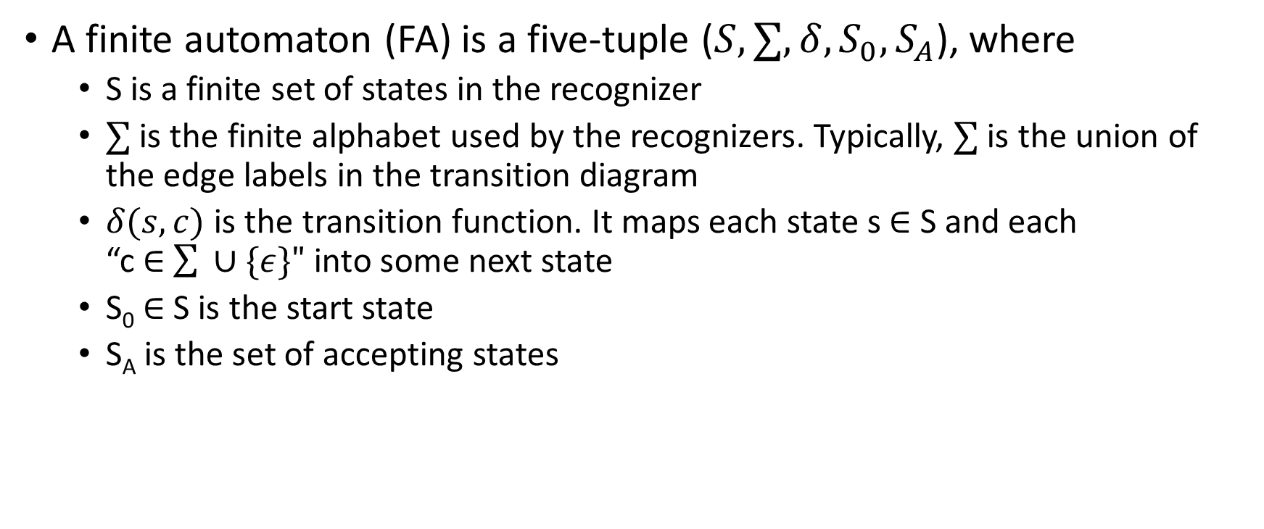
Finite automaton
A finite automaton (FA) is a five-tuple ($S,∑,δ,S_{0},S_{A}$), where
S is a finite set of states in the recognizer
$∑$ is the finite alphabet used by the recognizers. Typically, $∑$ is the union of the edge labels in the transition diagram
$δ(s,c)$ is the transition function. It maps each state s $∈$ S and each “c $∈$ $\sum{ ∪\{ε\}"}$ into some next state
S₀ $∈$ S is the start state
S_{A} is the set of accepting states

Slide 6
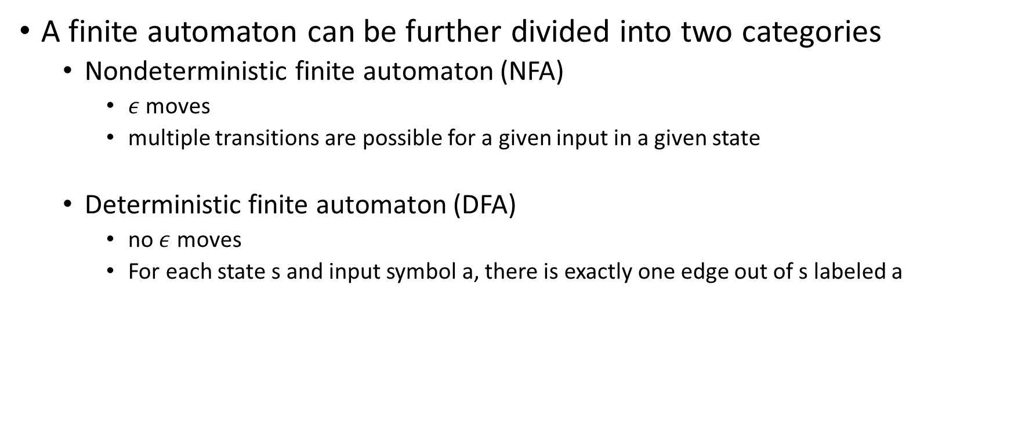
FA
A finite automaton can be further divided into two categories
Nondeterministic finite automaton (NFA)
$ε$ moves
multiple transitions are possible for a given input in a given state
Deterministic finite automaton (DFA)
no $ε$ moves
For each state s and input symbol a, there is exactly one edge out of s labeled a

Slide 7


NFA
$$b$$
S0
$$b$$
S1
$$a$$
S2

Slide 8


NFA
S3
$$a$$
$$b$$
S0
$$ε$$
S1
$$a$$
S2

Slide 9
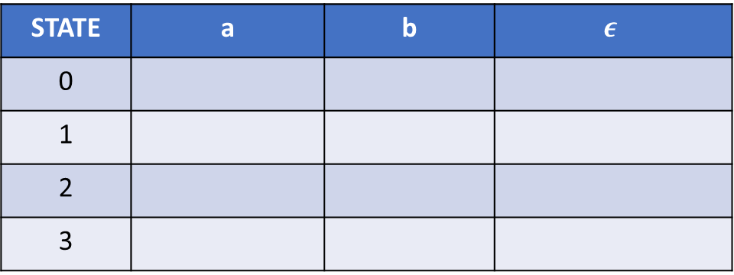
NFA
Draw the transition table for the following NFA.
a
S0
b
2
b
3
0
a
1
b
STATE | a | b | $$ε$$
0
1
2
3

Slide 10
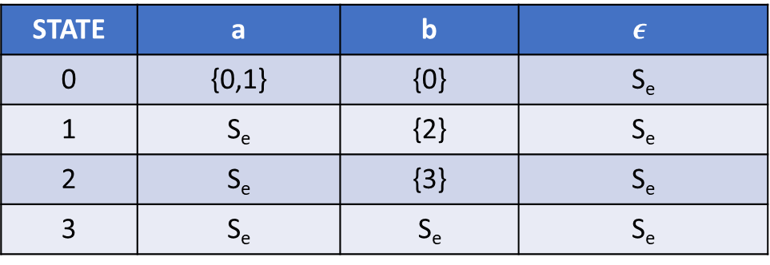
Transition table
STATE | a | b | $$ε$$
0 | {0,1} | {0} | S_{e}
1 | S_{e} | {2} | S_{e}
2 | S_{e} | {3} | S_{e}
3 | S_{e} | S_{e} | S_{e}

Slide 11
Acceptance of input string by NFA
In NFA, multiple transitions are possible for a given input
Let us say S is the set of states after consuming string x
NFA accepts x, if at least one of the states in S is an accepting state

Slide 12
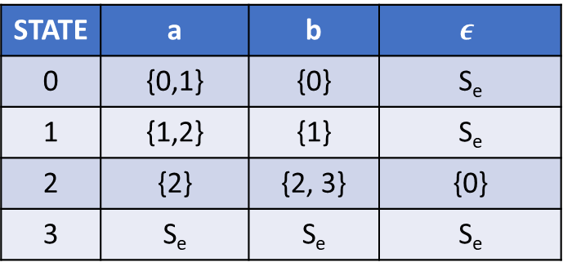

Example
STATE | a | b | $$ε$$
0 | {0,1} | {0} | S_{e}
1 | {1,2} | {1} | S_{e}
2 | {2} | {2, 3} | {0}
3 | S_{e} | S_{e} | S_{e}
Does the following NFA consume aabb?
$$ε$$
S0
b
2
b
3
0
a
1
a, b
a, b
a, b

Slide 13





NFA
Does the following NFA consume aabb?
$$ε$$
S0
b
2
b
3
0
a
1
$$ε$$
$$ε$$
$$ε$$
$$a$$

Slide 14
Acceptance of input string by DFA
In DFA, only one transition is possible for a given input
One final state
DFA accepts a string only if the final state is also an accepting state

Slide 15
DFA
DFA corresponding to previous NFA
Does this DFA accept aabb?
a
0
b

Slide 16
Steps in building lexical analyzer from RE
Regular expression to NFA
NFA to DFA
Implementation of DFA

Slide 17

NFA
multiple transitions are possible for a given input in a given state
$ε$ moves
a
S0
b
2
b
3
0
a
1
b

Slide 18
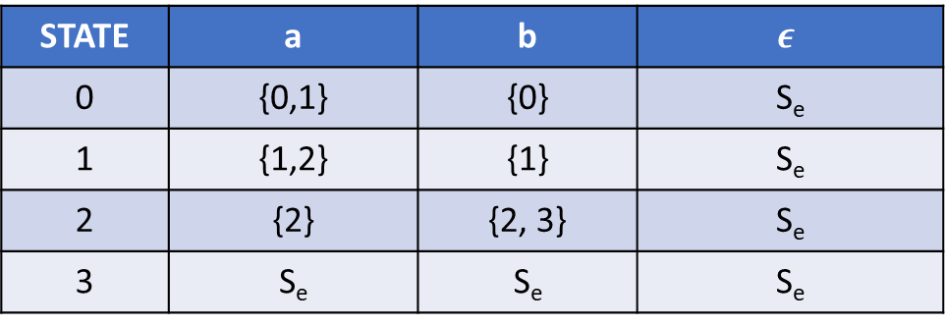
Transition table
STATE | a | b | $$ε$$
0 | {0,1} | {0} | S_{e}
1 | {1,2} | {1} | S_{e}
2 | {2} | {2, 3} | S_{e}
3 | S_{e} | S_{e} | S_{e}

Slide 19
NFA to DFA
a
a
0
a
1
2
3
b
b
b
a
b

Slide 20
Transition table
STATE | a | b
0 | 1 | 0
1 | 1 | 2
2 | 1 | 3
3 | 1 | 0

Slide 21
NFA to DFA
The basic idea behind NFA to DFA is the follows
At a given point during the scanning of a string, the NFA can be in many states
The set of these states is the subset of the number of states in NFA
After accepting an input x in a set of states S1, the NFA may end up in another set of states S2
If we treat S1 and S2 as states in the equivalent DFA; then there will be only one possible transition corresponding to input x when the DFA is in state S1
The number of states in DFA can be exponential in the number of NFA states

Slide 22
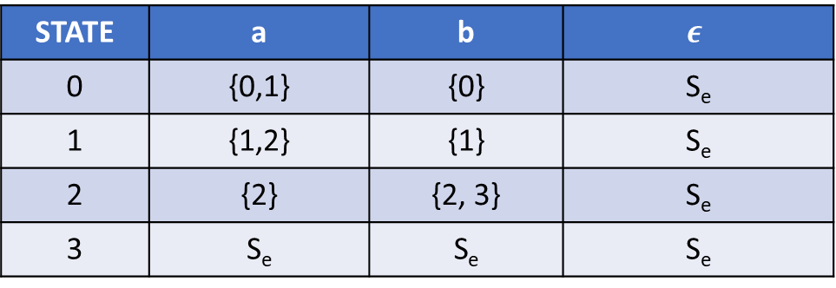
NFA
STATE | a | b | $$ε$$
0 | {0,1} | {0} | S_{e}
1 | {1,2} | {1} | S_{e}
2 | {2} | {2, 3} | S_{e}
3 | S_{e} | S_{e} | S_{e}
a
S0
b
2
b
3
0
a
1
b
At a given point during the acceptance of a string, the NFA can be in which states?

Slide 23
NFA
Possible sets of states at a given point:
{0}, {1}, {2}, {3},
{0,1}, {0,2}, {0,3}, {1,2}, {1,3}, {2,3},
{0,1,2}, {0,1,3}, {0,2,3}, {1,2,3},
{0,1,2,3}
a
S0
b
2
b
3
0
a
1
b
At a given point during the acceptance of a string, the NFA can be in which states?

Slide 24
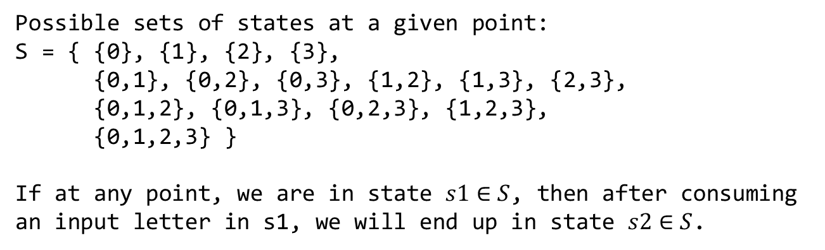
NFA
Possible sets of states at a given point:
S = { {0}, {1}, {2}, {3},
{0,1}, {0,2}, {0,3}, {1,2}, {1,3}, {2,3},
{0,1,2}, {0,1,3}, {0,2,3}, {1,2,3},
{0,1,2,3} }
If at any point, we are in state $s1∈S$, then after consuming an input letter in s1, we will end up in state $s2∈S$.
a
S0
b
2
b
3
0
a
1
b
At a given point during the acceptance of a string, the NFA can be in which states?

Slide 25
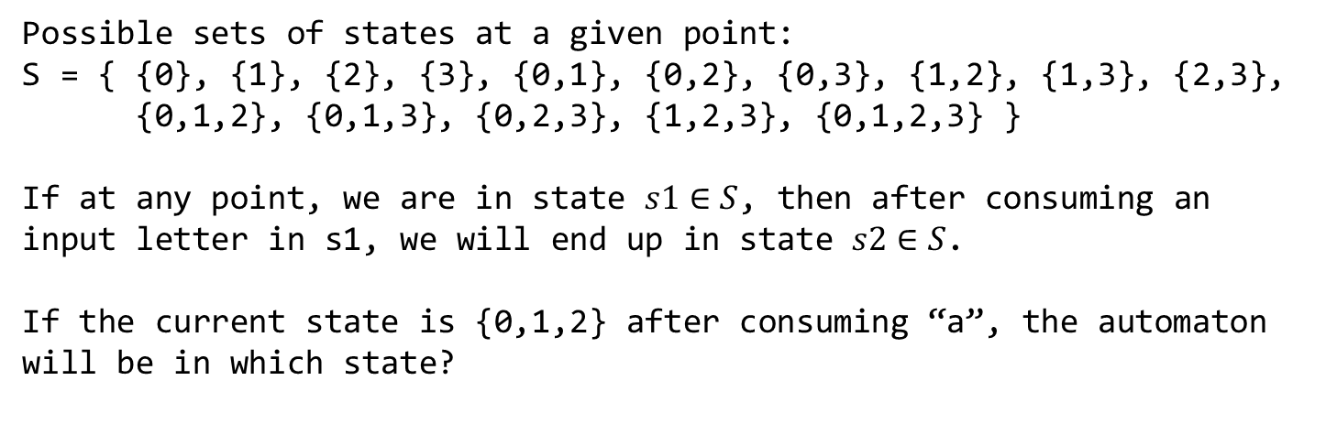
NFA
Possible sets of states at a given point:
S = { {0}, {1}, {2}, {3}, {0,1}, {0,2}, {0,3}, {1,2}, {1,3}, {2,3},
{0,1,2}, {0,1,3}, {0,2,3}, {1,2,3}, {0,1,2,3} }
If at any point, we are in state $s1∈S$, then after consuming an input letter in s1, we will end up in state $s2∈S$.
If the current state is {0,1,2} after consuming “a”, the automaton will be in which state?
a
S0
b
2
b
3
0
a
1
b
At a given point during the acceptance of a string, the NFA can be in which states?

Slide 26
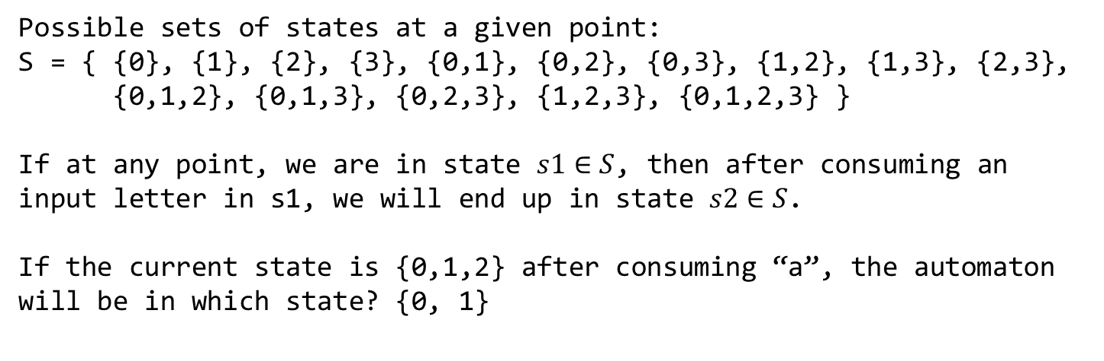
NFA
Possible sets of states at a given point:
S = { {0}, {1}, {2}, {3}, {0,1}, {0,2}, {0,3}, {1,2}, {1,3}, {2,3},
{0,1,2}, {0,1,3}, {0,2,3}, {1,2,3}, {0,1,2,3} }
If at any point, we are in state $s1∈S$, then after consuming an input letter in s1, we will end up in state $s2∈S$.
If the current state is {0,1,2} after consuming “a”, the automaton will be in which state? {0, 1}
a
S0
b
2
b
3
0
a
1
b
At a given point during the acceptance of a string, the NFA can be in which states?

Slide 27
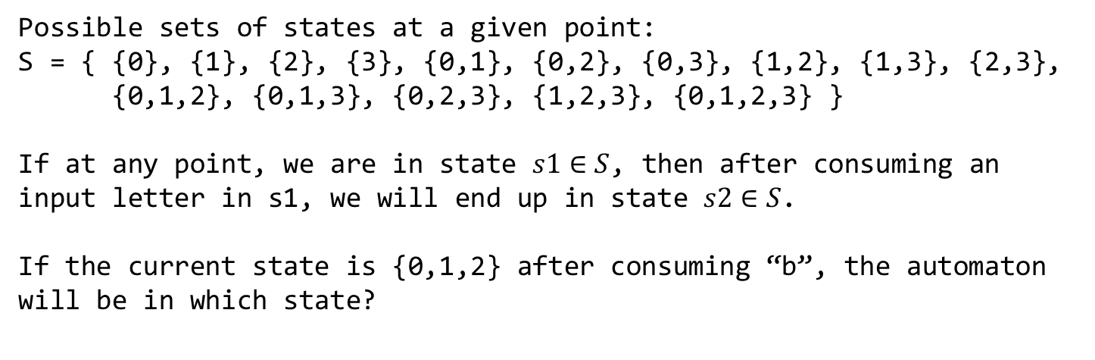
NFA
Possible sets of states at a given point:
S = { {0}, {1}, {2}, {3}, {0,1}, {0,2}, {0,3}, {1,2}, {1,3}, {2,3},
{0,1,2}, {0,1,3}, {0,2,3}, {1,2,3}, {0,1,2,3} }
If at any point, we are in state $s1∈S$, then after consuming an input letter in s1, we will end up in state $s2∈S$.
If the current state is {0,1,2} after consuming “b”, the automaton will be in which state?
a
S0
b
2
b
3
0
a
1
b
At a given point during the acceptance of a string, the NFA can be in which states?

Slide 28
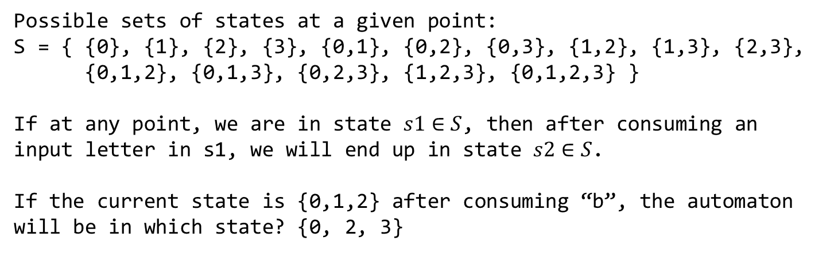
NFA
Possible sets of states at a given point:
S = { {0}, {1}, {2}, {3}, {0,1}, {0,2}, {0,3}, {1,2}, {1,3}, {2,3},
{0,1,2}, {0,1,3}, {0,2,3}, {1,2,3}, {0,1,2,3} }
If at any point, we are in state $s1∈S$, then after consuming an input letter in s1, we will end up in state $s2∈S$.
If the current state is {0,1,2} after consuming “b”, the automaton will be in which state? {0, 2, 3}
a
S0
b
2
b
3
0
a
1
b
At a given point during the acceptance of a string, the NFA can be in which states?

Slide 29
NFA to DFA
a
S0
b
2
b
3
0
a
1
b
NFA
CORRESPONDING DFA

Slide 30
NFA to DFA
a
S0
b
2
b
3
0
a
1
b
NFA
a
a
0
a
01
02
03
b
b
b
a
b
CORRESPONDING DFA

Slide 31
NFA to DFA
ε
a
2
3
ε
ε
ε
0
1
6
7
8
9
10
ε
a
b
b
ε
ε
4
b
5
ε

Slide 32

NFA to DFA
$ε−closure\left(s\right):$ Set of NFA states reachable from NFA state s on $"ε−transitions"$ alone including s

Slide 33
ε-closure
ε
a
2
3
ε
ε
ε
0
1
6
7
8
9
10
ε
a
b
b
ε
ε
4
b
5
ε
ε-closure(0)=
ε-closure(6)=

Slide 34
ε-closure
ε
a
2
3
ε
ε
ε
0
1
6
7
8
9
10
ε
a
b
b
ε
ε
4
b
5
ε
ε-closure(0)={0,1,2,4,7}
ε-closure(6)={1,2,4,6,7}

Slide 35
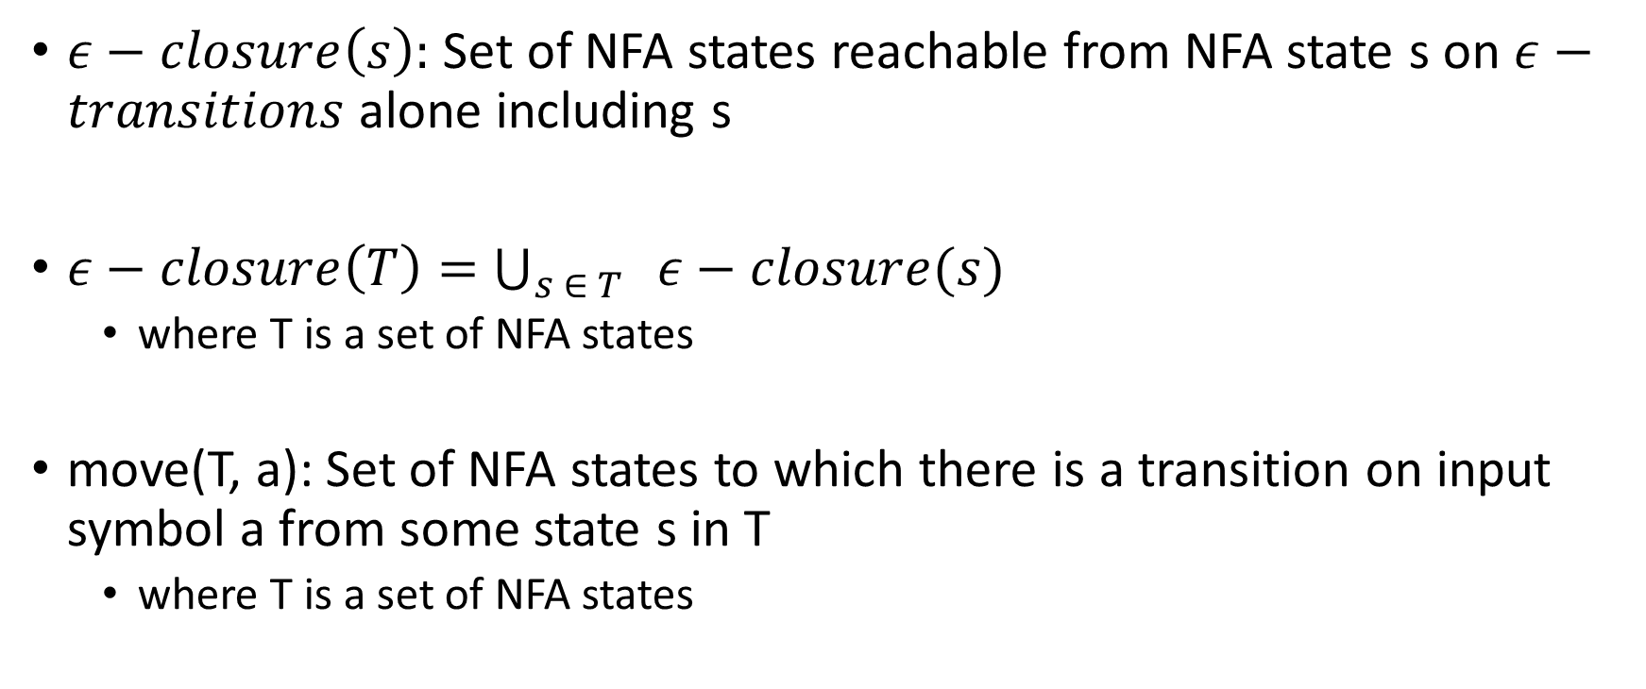
NFA to DFA
$ε−closure\left(s\right):$ Set of NFA states reachable from NFA state s on $ε−transitions$ alone including s
$ε−closure\left(T\right)=$ $\bigcup_{s ∈ T}{ ε−closure(s)}$
where T is a set of NFA states
move(T, a): Set of NFA states to which there is a transition on input symbol a from some state s in T
where T is a set of NFA states

Slide 36
ε-closure
ε
a
2
3
ε
ε
ε
0
1
6
7
8
9
10
ε
a
b
b
ε
ε
4
b
5
ε
T={0,1,2,4,7}
move(T, a) =
move(T, b) =

Slide 37
ε-closure
ε
a
2
3
ε
ε
ε
0
1
6
7
8
9
10
ε
a
b
b
ε
ε
4
b
5
ε
T={0,1,2,4,7}
move(T, a) = {3,8}
move(T, b) = {5}

Slide 38
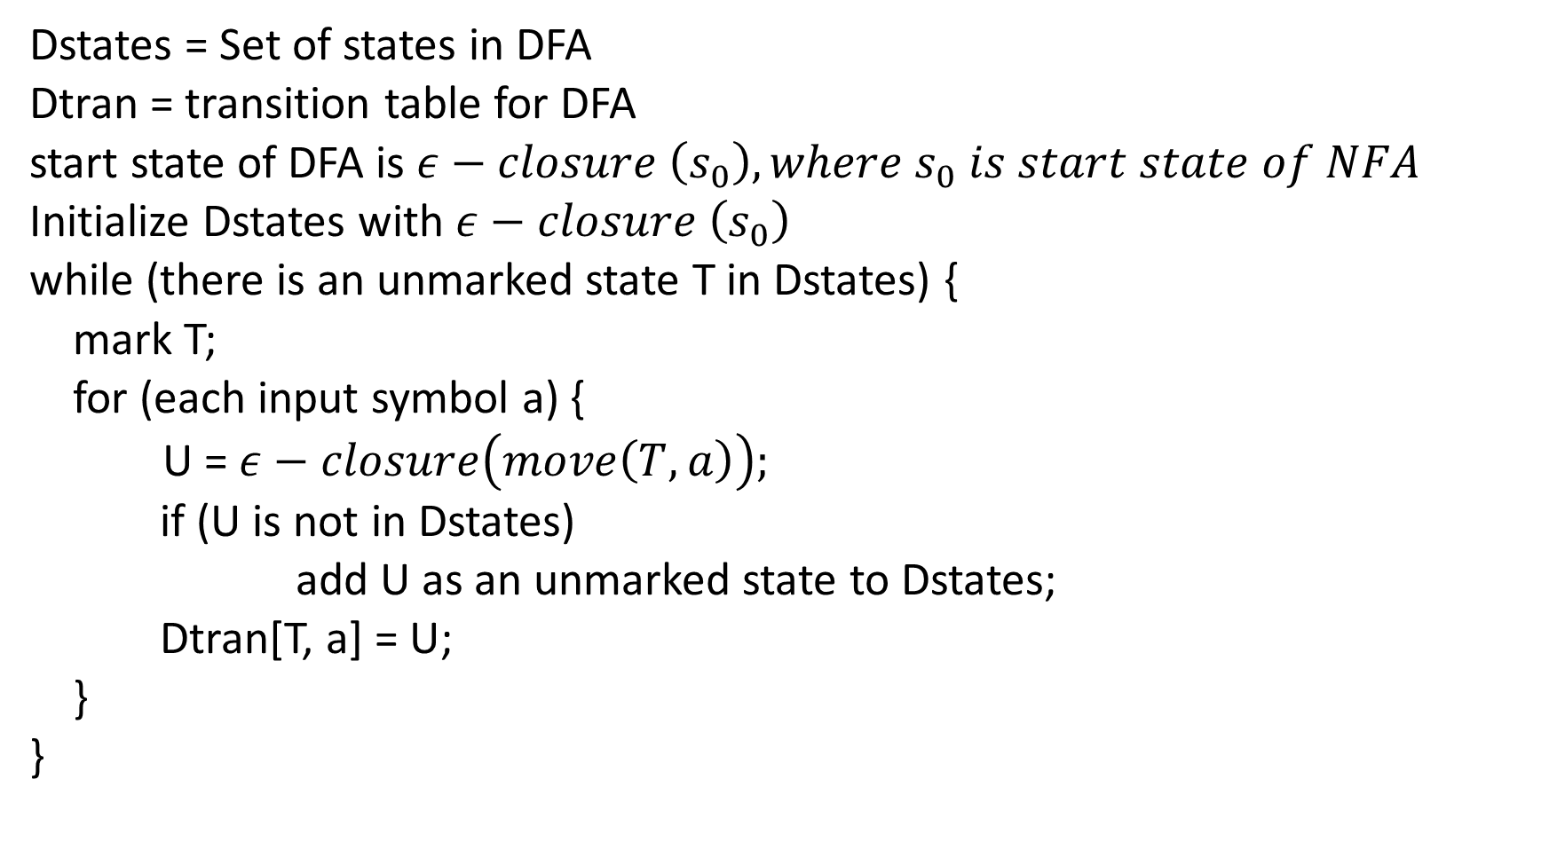
Dstates = Set of states in DFA
Dtran = transition table for DFA
start state of DFA is $ε−closure \left(s_{0}\right), where s_{0} is start state of NFA$
Initialize Dstates with $ε−closure \left(s_{0}\right)$
while (there is an unmarked state T in Dstates) {
mark T;
for (each input symbol a) {
U = $ε−closure\left(move\left(T, a\right)\right);$
if (U is not in Dstates)
add U as an unmarked state to Dstates;
Dtran[T, a] = U;
}
}
NFA TO DFA

Slide 39
NFA to DFA
ε
a
Figure 3.34 from the Aho, Ullman, Sethi, Lam book
2
3
ε
ε
ε
0
1
6
7
8
9
10
ε
a
b
b
ε
ε
4
b
5
ε

Slide 40
NFA to DFA
ε
a
2
3
ε
ε
ε
0
1
6
7
8
9
10
ε
a
b
b
ε
ε
4
b
5
ε
What is the starting state in the corresponding DFA?

Slide 41
NFA to DFA
ε
a
2
3
ε
ε
ε
0
1
6
7
8
9
10
ε
a
b
b
ε
ε
4
b
5
ε
What is the starting state in the corresponding DFA? $ε−closure(0)$

Slide 42
NFA to DFA
A = {0,1,2,4,7}
B = {1,2,3,4,6,7,8}
C = {1,2,4,5,6,7}
D = {1,2,4,5,6,7,9}
E = {1,2,4,5,6,7,10}

Slide 43
NFA to DFA
Dtran[A,a] = B Dtran[A,b] = C
Dtran[B,a] = B Dtran[B,b] = D
Dtran[C,a] = B Dtran[C,b] = C
Dtran[D,a] = B Dtran[D,b] = E
Dtran[E,a] = B Dtran[E,b] = C

Slide 44
DFA
a
a
B
D
b
a
A
a
b
a
b
C
E
b
b

Slide 45
Steps in building lexical analyzer from RE
Regular expression to NFA
NFA to DFA
Implementation of DFA

Slide 46


Regular expression to NFA
$ε$
i
$$ε$$
f

Slide 47


Regular expression to NFA
$a∈∑$
i
$$a$$
f

Slide 48
Compound regular expression
The left circle is the start state and the right circle is the final state
The way we are constructing NFA, every regular expression has a unique start and final state
N(s)

Slide 49





Regular expression to NFA
$r=s|t, where s and t are regular expressions$
N(s) and N(t) are the NFA’s for regular expressions s and t, respectively
N(s)
$$ε$$
$$ε$$
ii
f
$$ε$$
$$ε$$
N(t)

Slide 50

Regular expression to NFA
$∑$ = {a, b}
r = a | b
Does it accept a?
Does it accept b?

Slide 51




Regular expression to NFA
a
$∑$ = {a, b}
r = a | b
Does it accept a?
Does it accept b?
$$ε$$
$$ε$$
$$ε$$
$$ε$$
b

Slide 52

Regular expression to NFA
$∑$ = {a, b}
s = (a | b) | c
Does it accept $ε?$
Does it accept a?
Does it accept ac?

Slide 53








Regular expression to NFA
$∑$ = {a, b}
s = (a | b) | c
Does it accept $ε?$
Does it accept a?
Does it accept ac?
a
$$ε$$
$$ε$$
$$ε$$
$$ε$$
b
$$ε$$
$$ε$$
$$ε$$
$$ε$$
c

Slide 54

Regular expression to NFA
$r=st, where s and t are regular expressions$
N(s) and N(t) are the NFA’s for regular expressions s and t, respectively
i
N(s)
N(t)
f

Slide 55

Regular expression to NFA
$∑$ = {a, b}
r = ab
Does it accept a?
Does it accept ab?

Slide 56


Regular expression to NFA
$∑$ = {a, b}
r = ab
Does it accept a?
Does it accept ab?
$$a$$
$$b$$

Slide 57

Regular expression to NFA
$∑$ = {a, b}
s = a(b|c)
Does it accept ab?
Does it accept ac?
Does it accept bc?

Slide 58
Regular expression to NFA
b
$∑$ = {a, b}
s = a(b|c)
Does it accept ab?
Does it accept ac?
Does it accept bc?
$$ε$$
$$ε$$
a
$$ε$$
$$ε$$
c

Slide 59





Regular expression to NFA
r = s*$, where s is a regular expression$
N(s) is the NFA for s
$$ε$$
ii
N(s)
f
$$ε$$
$$ε$$
$$ε$$

Slide 60

Regular expression to NFA
$∑$ = {a, b}
r = a*
Does it accept $ε?$
Does it accept aaaa?

Slide 61





Regular expression to NFA
$$ε$$
$∑$ = {a, b}
r = a*
Does it accept $ε?$
Does it accept aaaa?
$$ε$$
$$a$$
$$ε$$
$$ε$$

Slide 62

Regular expression to NFA
$∑$ = {a, b}
r = (a|b)*
Does it accept aabab?

Slide 63

Regular expression to NFA
$$ε$$
a
$∑$ = {a, b}
r = (a|b)*
Does it accept aabab?
$$ε$$
$$ε$$
$$ε$$
$$ε$$
$$ε$$
$$ε$$
b
$$ε$$

Slide 64

Regular expression to NFA
$∑$ = {a, b}
r = (ab)*
Does it accept $ε$?
Does it accept ababab?
Does it accept abb?

Slide 65

Regular expression to NFA
$$ε$$
$∑$ = {a, b}
r = (ab)*
Does it accept $ε$?
Does it accept ababab?
Does it accept abb?
$$ε$$
$$a$$
$$b$$
$$ε$$
$$ε$$

