Slide 1
Compilers
Lecture-20

Slide 2
Today’s lecture
Parsing
Recursive descent parsing
Predictive parsing

Slide 3
Top-down parsing

Slide 4
Top-down parsing
Build the parse tree for an input string, starting from the root and creating the nodes in preorder
Leftmost derivation of the input string

Slide 5

Top-down parsing
E → TE’
E’ → +TE’ | $ε$
T → FT’
T’ → *FT’ | $ε$
F → (E) | id
id + id * id

Slide 6



Top-down parsing
E
E → TE’
E’ → +TE’ | $ε$
T → FT’
T’ → *FT’ | $ε$
F → (E) | id
id + id * id
T
E’
F
T’
+
T
E’
id
$$ε$$
F
T’
$$ε$$
id
*
F
T’
id
$$ε$$
id + id * id

Slide 7
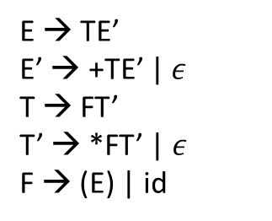
Leftmost derivation (rollbacks)
E → TE’
E’ → +TE’ | $ε$
T → FT’
T’ → *FT’ | $ε$
F → (E) | id
id + id * id
ip

Slide 8

Leftmost derivation (rollbacks)
E
E
E
T
E’
T
E’
T
E’
E → TE’
E’ → +TE’ | $ε$
T → FT’
T’ → *FT’ | $ε$
F → (E) | id
F
T’
+
T
E’
F
T’
F
T’
id
$$ε$$
F
T’
(
E
)
id
*
F
T’
(
E
)
id + id * id
id + id * id
id + id * id
id + id * id
STEP-1
( is not matching with id. rollback
STEP-2
* is not matching with +. rollback
STEP-3
( is not matching with id. rollback
ip

Slide 9


Leftmost derivation (rollbacks)
E
E
T
E’
T
E’
E → TE’
E’ → +TE’ | $ε$
T → FT’
T’ → *FT’ | $ε$
F → (E) | id
F
T’
+
T
E’
F
T’
+
E’
T
id
$$ε$$
F
T’
F
id
$$ε$$
T’
id
*
F
T’
id
*
F
T’
id + id * id
id + id * id
(
E
)
id + id * id
id
*
F
T’
STEP-4
( is not matching with id. rollback
STEP-5
We have reached end of string. rollback
ip

Slide 10


Leftmost derivation (rollbacks)
E
E
T
E’
T
E’
E → TE’
E’ → +TE’ | $ε$
T → FT’
T’ → *FT’ | $ε$
F → (E) | id
F
T’
+
T
E’
F
T’
+
T
E’
id
$$ε$$
F
T’
+
T
E’
id
F
T’
$$ε$$
$$ε$$
id
*
F
T’
id
*
F
T’
id + id * id
id + id * id
id + id * id
id
$$ε$$
id
$$ε$$
ip
STEP-6
We have reached end of string. rollback
STEP-6
We have reached end of string. No further non-terminal to expand. This is the final parse tree.

Slide 11
Recursive descent parsing
Recursive descent parsing is a top-down parsing algorithm
Recursive descent parser recursively tries and rollback different production rules to derive a parse tree corresponding to a given input string

Slide 12

Recursive descent parsing
Initially, $ip$ points to the start of the input string

Slide 13

Recursive descent parsing
For every non-terminal: A$→α_{1} \left| α_{2} \right|…| α_{k}$
define a procedure:
bool A() {
return (temp = ip, A₁()) || (ip = temp, A₂()) || … || (ip = temp, A_{k}());
}
E → T | T + E
T → F | F * T
F → (E) | id

Slide 14
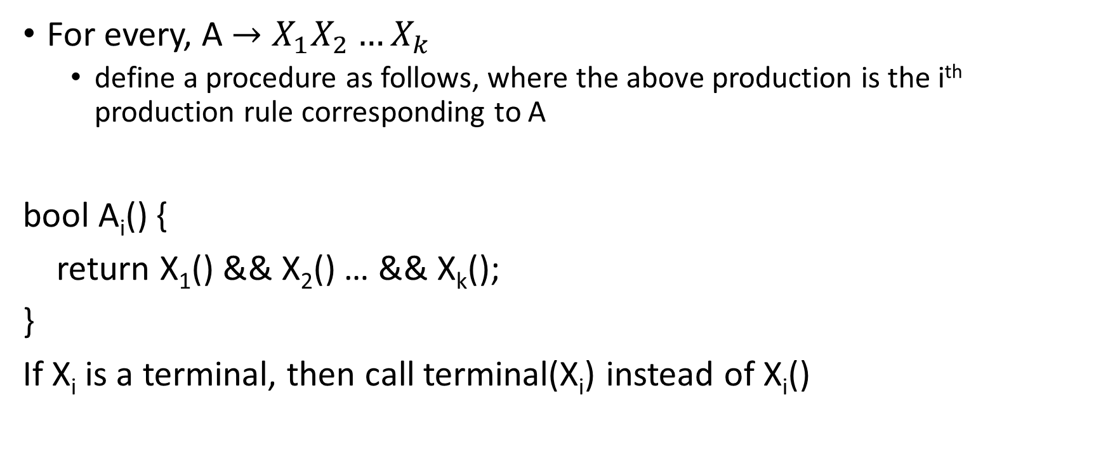
Recursive descent parsing
For every, A$→X_{1}X_{2}…X_{k}$
define a procedure as follows, where the above production is the i^{th} production rule corresponding to A
bool A_{i}() {
return X₁() && X₂() … && X_{k}();
}
If X_{i} is a terminal, then call terminal(X_{i}) instead of X_{i}()
E → T | T + E
T → F | F * T
F → (E) | id

Slide 15

Recursive descent parsing
bool terminal(x)
{
if (x == $ε$) { return true; }
if (ip[0] == x) {
ip++;
return true;
}
return false;
}

Slide 16
Recursive descent parsing
To generate the parse tree:
set ip to the input string
call A(), where A is the start symbol
If A() returns true and ip points to the end of the string, then the parsing was successful

Slide 17
Recursive descent parsing
E → T | T + E
T → F | F * T
F → (E) | id

Slide 18
Recursive descent parsing
E → T | T + E
T → F | F * T
F → (E) | id
E() { return (t = ip, E₁()) || (ip = t, E₂()); }
E₁() { return T(); }
E₂() { return T() && terminal(‘+’) && E(); }
T() { return (t = ip, T₁()) || (ip = t, T₂()); }
T₁() { return F(); }
T₂() { return F() && terminal(‘*’) && T(); }
F() { return (t = ip, F₁()) || (ip = t, F₂()); }
F₁() { return terminal(‘(’) && E() && terminal(‘)’); }
F₂() { return terminal(id); }

Slide 19
Recursive descent parsing
(id)
E() { return (t = ip, E₁()) || (ip = t, E₂()); }
E₁() { return T(); }
E₂() { return T() && terminal(‘+’) && E(); }
T() { return (t = ip, T₁()) || (ip = t, T₂()); }
T₁() { return F(); }
T₂() { return F() && terminal(‘*’) && T(); }
F() { return (t = ip, F₁()) || (ip = t, F₂()); }
F₁() { return terminal(‘(’) && E() && terminal(‘)’); }
F₂() { return terminal(id); }

Slide 20
Recursive descent parsing
(id)
E() { return (t = ip, E₁()) || (ip = t, E₂()); }
E₁() { return T(); }
E₂() { return T() && terminal(‘+’) && E(); }
T() { return (t = ip, T₁()) || (ip = t, T₂()); }
T₁() { return F(); }
T₂() { return F() && terminal(‘*’) && T(); }
F() { return (t = ip, F₁()) || (ip = t, F₂()); }
F₁() { return terminal(‘(’) && E() && terminal(‘)’); }
F₂() { return terminal(id); }
1. E() calls 2. E₁() calls 3. T() calls 4. T₁() calls
5. F() calls 6. F₁() calls 7. terminal(‘(’) → returns true
6. F₁() calls 7. E() calls 8. E₁() calls 9. T() calls
10. T₁() calls 11. F() calls 12. F₁() calls
13. terminal(‘(’) → returns false
12. F₁() → returns false
11. F() calls 12. F₂() calls
13. terminal(id) → returns true
12. F₂() → returns true 11. F() → return true
10. T₁() → returns true 9. T() → returns true
8. E() → returns true 7. E() → returns true
6. F₁() calls 7. terminal (‘)’) → returns true
6. F₁() → returns true 5. F() → returns true
4. T₁() → returns true 3. T() → returns true
2. E₁() → returns true 1. E() → returns true
E() returns true and ip points to end of string
Therefore, the parse tree generation is successful

Slide 21
Recursive descent parsing
id + id
E() { return (t = ip, E₁()) || (ip = t, E₂()); }
E₁() { return T(); }
E₂() { return T() && terminal(‘+’) && E(); }
T() { return (t = ip, T₁()) || (ip = t, T₂()); }
T₁() { return F(); }
T₂() { return F() && terminal(‘*’) && T(); }
F() { return (t = ip, F₁()) || (ip = t, F₂()); }
F₁() { return terminal(‘(’) && E() && terminal(‘)’); }
F₂() { return terminal(id); }

Slide 22
Recursive descent parsing
id + id
E() { return (t = ip, E₁()) || (ip = t, E₂()); }
E₁() { return T(); }
E₂() { return T() && terminal(‘+’) && E(); }
T() { return (t = ip, T₁()) || (ip = t, T₂()); }
T₁() { return F(); }
T₂() { return F() && terminal(‘*’) && T(); }
F() { return (t = ip, F₁()) || (ip = t, F₂()); }
F₁() { return terminal(‘(’) && E() && terminal(‘)’); }
F₂() { return terminal(id); }
E() returns true, but ip doesn’t point to end of string
Therefore, the parse tree generation is unsuccessful

Slide 23
Recursive descent parsing
General recursive-descent may require backtracking
i.e., it may require repeated scans over the input
Backtracking is inefficient but works for all context-free grammars
Many other techniques exist that don’t require backtracking
they work for a subset of context-free grammars
however, they work for most programming languages
used in practice

Slide 24
Recursive descent parsing (left recursion)
E → E + T | T
T → F | F * T
F → id | (E)

Slide 25
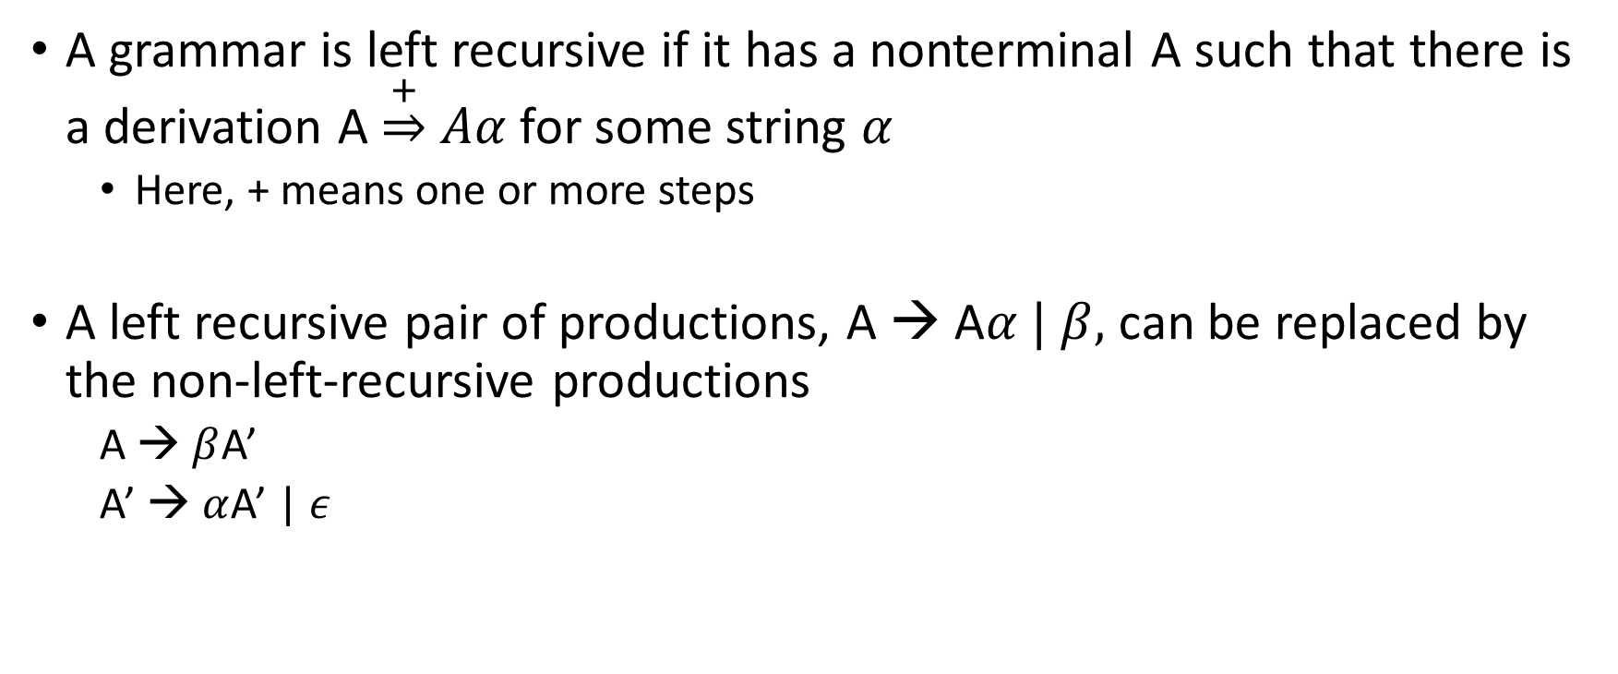
Left recursion
A grammar is left recursive if it has a nonterminal A such that there is a derivation A $\underset{⇒}{+} Aα$ for some string $α$
Here, + means one or more steps
A left recursive pair of productions, A → A$α | β,$ can be replaced by the non-left-recursive productions
A → $β$A’
A’ → $α$A’ | $ε$

Slide 26

Left recursion
$$A→Aα | β$$
A → $β$A’
A’ → $α$A’ | $ε$
E → E + T | T
T → T * F | F
F → (E) | id
----------------------------

Slide 27

Left recursion
E → E + T | T
T → T * F | F
F → (E) | id
----------------------------
E → TE’
E’ → +TE’ | $ε$
T→ FT’
T’ → *FT’ | $ε$
F → (E) | id

Slide 28

Left recursion
In general,
$$A →Aα_{1} \left| Aα_{2}\right|…\left| Aα_{m} \right|{ β}_{1} \left| β_{2}\right|…| β_{n}$$
where, no $β_{i}$ starts with A,
can be replaced with
$$A →β_{1}A^{′}\left| β_{2}A^{′}\right|…| β_{n}A^{′}$$
$$A^{′}→α_{1}A^{′}\left| α_{2}A^{′}\right|…\left| α_{m}A^{′}\right|ε$$

Slide 29
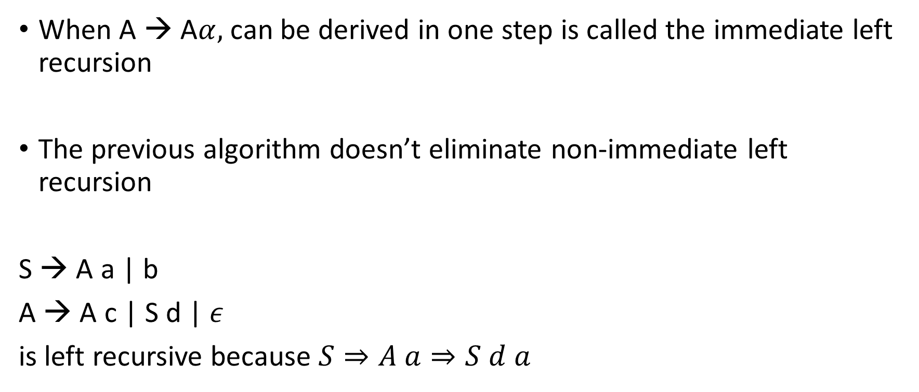
Left recursion
When A → A$α,$ can be derived in one step is called the immediate left recursion
The previous algorithm doesn’t eliminate non-immediate left recursion
S → A a | b
A → A c | S d | $ε$
is left recursive because $S⇒A a⇒S d a$

Slide 30
Left recursion
There are general algorithms for removing non-immediate left recursion
However, people prefer removing left recursion by hand
Future phases of the compiler need to know the exact grammar

Slide 31
Predictive parsing

Slide 32
Predictive parsing
A predictive parser is top-down parser that requires no backtracking
Predictive parsers work for LL(k) grammars
First “L” in LL stands for the left to right, the second “L” for producing the leftmost derivation, and “k” for using “k” input symbol of lookahead
At each step, a predictive parser examines next “k” input symbols to decide which production to use

Slide 33
LL(1) grammars
The parse tree can be constructed by just looking at the next input symbol
Left recursive grammars are not LL(1)

Slide 34

LL(1) parsing
E → TE’
E’ → +TE’ | $ε$
T→ FT’
T’ → *FT’ | $ε$
F → (E) | id

Slide 35
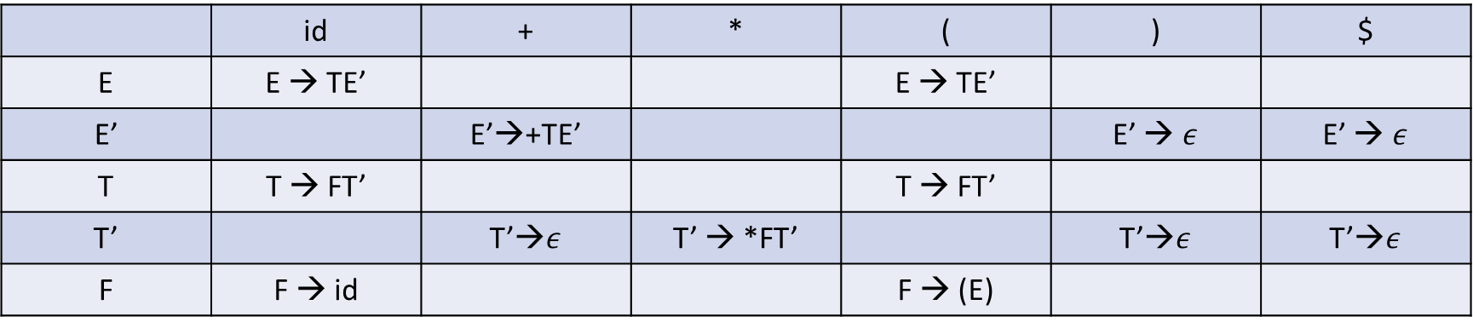
LL(1) parsing
If grammar is in LL(1), we can generate a parsing table.
Below is the parsing table corresponding to grammar on the previous slide.
 | id | + | * | ( | ) | $
E | E → TE’ |  |  | E → TE’
E’ |  | E’→+TE’ |  |  | E’ → $ε$ | E’ → $ε$
T | T → FT’ |  |  | T → FT’
T’ |  | T’→$ε$ | T’ → *FT’ |  | T’→$ε$ | T’→$ε$
F | F → id |  |  | F → (E)

Slide 36
LL(1) parsing
Blanks are error entries. Let us say, M represents this two-dimensional table, then M[E, id] = E → TE’, indicates that if the leftmost nonterminal is E, replace it with TE’
 | id | + | * | ( | ) | $
E | E → TE’ |  |  | E → TE’
E’ |  | E’→+TE’ |  |  | E’ → $ε$ | E’ → $ε$
T | T → FT’ |  |  | T → FT’
T’ |  | T’→$ε$ | T’ → *FT’ |  | T’→$ε$ | T’→$ε$
F | F → id |  |  | F → (E)

Slide 37
Table-driven predictive parsing
Input: A string w and parsing table M for grammar G.
Output: If w is in L(G), a leftmost derivation of w; otherwise, an error indication
put w$ in the input buffer ($ indicates end of input, $ doesn’t match with the symbol of any grammar)
push $ followed by S to the stack (S is the start symbol)

Slide 38
Table-driven predictive parsing
 |  |  |  | a | + | b | * | c | $
Predictive Parser
X
Y
Z
$
Parsing Table M

Slide 39

Table-driven predictive parsing
set ip to point to the first symbol of w;
set X to the top stack symbol;
while (X $≠$ $) {
if (X is ip[0]) pop the stack and advance ip;
else if (X is a terminal) error();
else if (M[X, ip[0]] is an error entry) error();
else if (M[X, ip[0]] = X → Y₁Y₂ …Y_{k}) {
output the production X → Y₁Y₂ …Y_{k}
pop the stack;
push Y_{k}, Y_{k-1}, …, Y₁ onto the stack, with Y₁ on top;
}
set X to the top stack symbol;
}

Slide 40
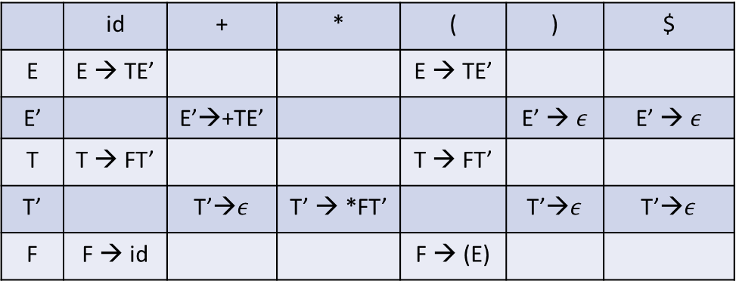
Example
MATCHED | STACK | INPUT | ACTION
 | E$ | id+id*id$
 | id | + | * | ( | ) | $
E | E → TE’ |  |  | E → TE’
E’ |  | E’→+TE’ |  |  | E’ → $ε$ | E’ → $ε$
T | T → FT’ |  |  | T → FT’
T’ |  | T’→$ε$ | T’ → *FT’ |  | T’→$ε$ | T’→$ε$
F | F → id |  |  | F → (E)

Slide 41
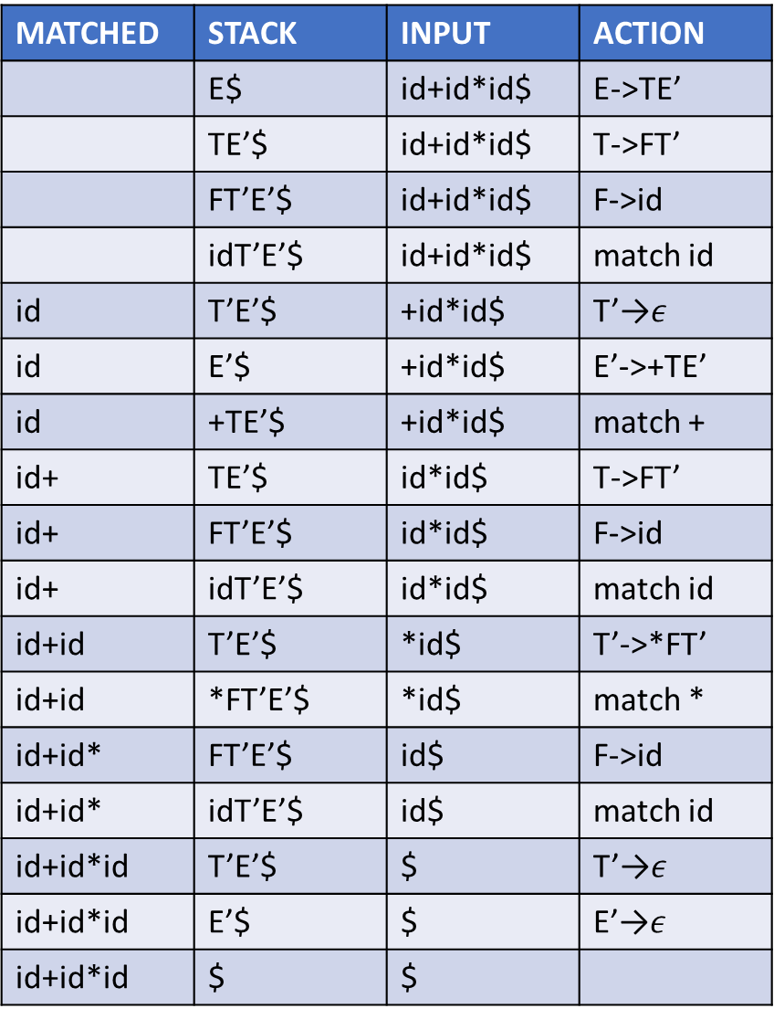
Example
MATCHED | STACK | INPUT | ACTION
 | E$ | id+id*id$ | E->TE’
 | TE’$ | id+id*id$ | T->FT’
 | FT’E’$ | id+id*id$ | F->id
 | idT’E’$ | id+id*id$ | match id
id | T’E’$ | +id*id$ | T’→$ε$
id | E’$ | +id*id$ | E’->+TE’
id | +TE’$ | +id*id$ | match +
id+ | TE’$ | id*id$ | T->FT’
id+ | FT’E’$ | id*id$ | F->id
id+ | idT’E’$ | id*id$ | match id
id+id | T’E’$ | *id$ | T’->*FT’
id+id | *FT’E’$ | *id$ | match *
id+id* | FT’E’$ | id$ | F->id
id+id* | idT’E’$ | id$ | match id
id+id*id | T’E’$ | $ | T’→$ε$
id+id*id | E’$ | $ | E’→$ε$
id+id*id | $ | $
 | id | + | * | ( | ) | $
E | E → TE’ |  |  | E → TE’
E’ |  | E’→+TE’ |  |  | E’ → $ε$ | E’ → $ε$
T | T → FT’ |  |  | T → FT’
T’ |  | T’→$ε$ | T’ → *FT’ |  | T’→$ε$ | T’→$ε$
F | F → id |  |  | F → (E)

Slide 42
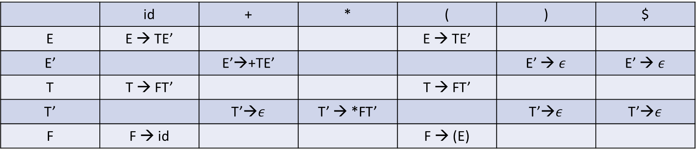
How to construct LL(1) parsing table?
 | id | + | * | ( | ) | $
E | E → TE’ |  |  | E → TE’
E’ |  | E’→+TE’ |  |  | E’ → $ε$ | E’ → $ε$
T | T → FT’ |  |  | T → FT’
T’ |  | T’→$ε$ | T’ → *FT’ |  | T’→$ε$ | T’→$ε$
F | F → id |  |  | F → (E)

Slide 43
FIRST and FOLLOW
FIRST($α$) is the set of terminals that begin strings derived from $α$
If $α \underset{⇒}{∗} ε,$ then $ε$ is also in FIRST($α$)
e.g., if $A⇒cB$, then $c∈FIRST\left(A\right)$
FOLLOW(A), for nonterminal A, is the set of terminals that appear immediately to right of A in some sentential form
If A is the rightmost symbol in some sentential form, then $\$∈FOLLOW\left(A\right)$
e.g., $S \underset{⇒}{∗} αAaβ,$then $a∈FOLLOW(A)$

Slide 44

FIRST set
A $→$ aB | b
B $→$ CD
C $→$ a |b |$ε$
D $→$ c | d

Slide 45

FIRST
If X is a terminal, what is FIRST(X)?
If X is a nonterminal and X → Y₁Y₂…Y_{k} , what is FIRST(X)?
If X → $ε$ is a production, what is FIRST(X)?

Slide 46
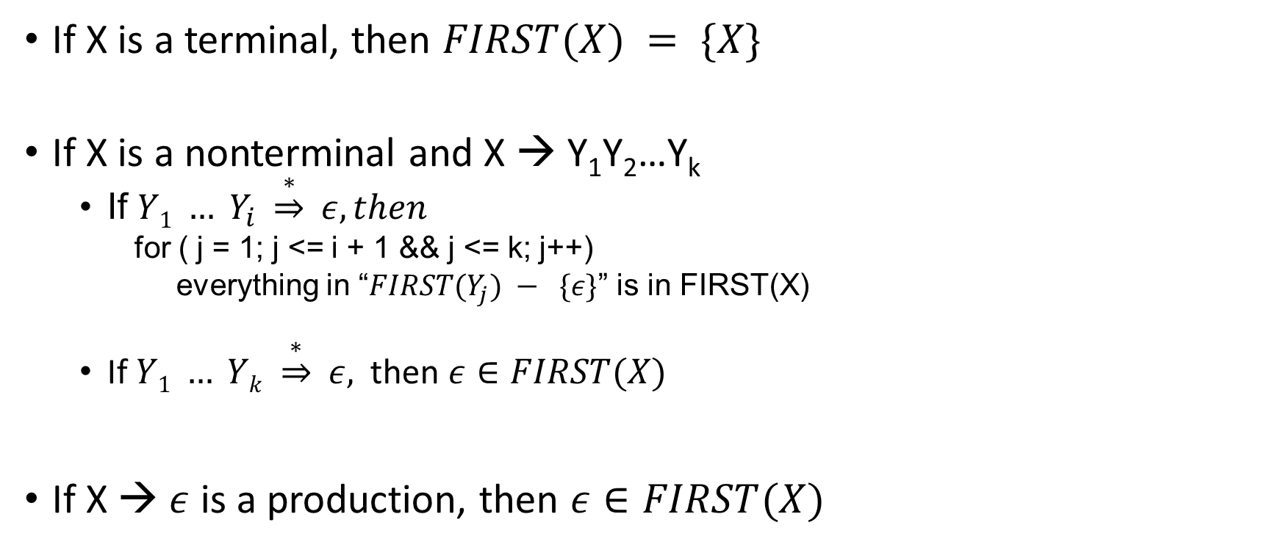
FIRST
If X is a terminal, then $FIRST(X) = \{X\}$
If X is a nonterminal and X → Y₁Y₂…Y_{k}
If $Y1 … Y_{i} \underset{⇒}{∗} ε, then$
for ( j = 1; j <= i + 1 && j <= k; j++)
everything in “$FIRST(Y_{j}) − \{ε\}$” is in FIRST(X)
If $Y1 … Yk \underset{⇒}{∗} ε,$ then $ε∈FIRST(X)$
If X → $ε$ is a production, then $ε∈FIRST(X)$

Slide 47

FIRST set
FIRST(E) =
FIRST(E’)’=
FIRST(T) =
FIRST(T’) =
FIRST(F) =
FIRST(T’F) =
FIRST(T’E’) =
FIRST(+) =
FIRST(*) =
FIRST(‘(’) =
FIRST(‘)’) =
FIRST(id) =
FIRST($ε)$ =
E → TE’
E’ → +TE’ | $ε$
T→ FT’
T’ → *FT’ | $ε$
F → (E) | id

Slide 48

FIRST set
FIRST(T) $⊂$ FIRST(E)
FIRST(E’) = {+, $ε$}
FIRST(F) $⊂$ FIRST(T)
FIRST(T’) = {*, $ε$}
FIRST(F) = {‘(’, id}
FIRST(T) = {‘(’, id}
FIRST(E) = {‘(’, id}
FIRST(T’F) = {*, ‘(’, id}
FIRST(T’E’) = {*, +, $ε$}

Slide 49


FIRST($α$)
FIRST(X₁ X₂ …X_{n}):
RES = $φ$
i = 1;
while ($ε∈FIRST(i)$ && i < n) {
RES = RES $∪$ (FIRST(i) - $ε);$
i++;
}
RES = RES $∪$ FIRST(i);
FIRST(X₁ X₂ …X_{n}) = RES

