Slide 1
Compilers
Lecture-21

Slide 2
Today’s lecture
Predictive parsing
Error recovery

Slide 3
Predictive parsing

Slide 4
Table-driven predictive parsing
 |  |  |  | a | + | b | * | c | $
Predictive Parser
X
Y
Z
$
Parsing Table M

Slide 5

Table-driven predictive parsing
set ip to point to the first symbol of w;
set X to the top stack symbol;
while (X $≠$ $) {
if (X is ip[0]) pop the stack and advance ip;
else if (X is a terminal) error();
else if (M[X, ip[0]] is an error entry) error();
else if (M[X, ip[0]] = X → Y₁Y₂ …Y_{k}) {
output the production X → Y₁Y₂ …Y_{k}
pop the stack;
push Y_{k}, Y_{k-1}, …, Y₁ onto the stack, with Y₁ on top;
}
set X to the top stack symbol;
}

Slide 6
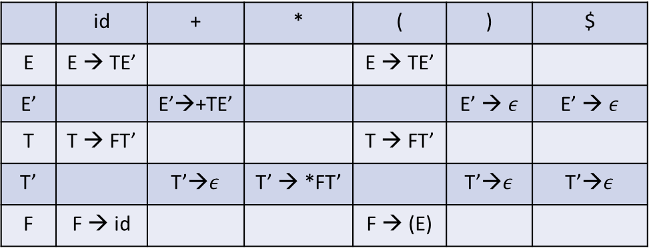
Example
MATCHED | STACK | INPUT | ACTION
 | E$ | id+id*id$
 | id | + | * | ( | ) | $
E | E → TE’ |  |  | E → TE’
E’ |  | E’→+TE’ |  |  | E’ → $ε$ | E’ → $ε$
T | T → FT’ |  |  | T → FT’
T’ |  | T’→$ε$ | T’ → *FT’ |  | T’→$ε$ | T’→$ε$
F | F → id |  |  | F → (E)

Slide 7
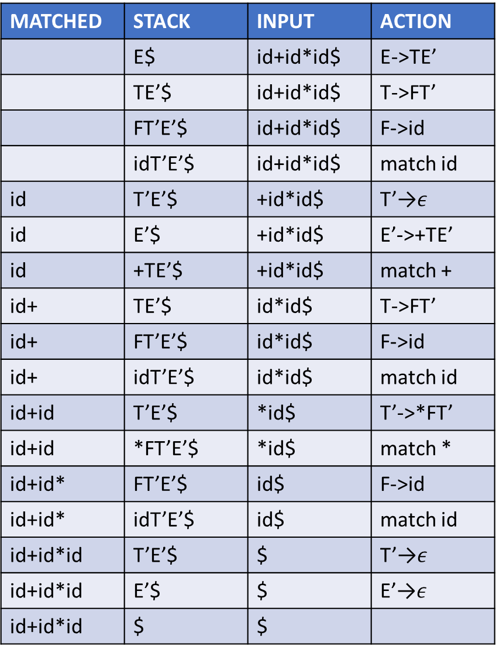
Example
MATCHED | STACK | INPUT | ACTION
 | E$ | id+id*id$ | E->TE’
 | TE’$ | id+id*id$ | T->FT’
 | FT’E’$ | id+id*id$ | F->id
 | idT’E’$ | id+id*id$ | match id
id | T’E’$ | +id*id$ | T’→$ε$
id | E’$ | +id*id$ | E’->+TE’
id | +TE’$ | +id*id$ | match +
id+ | TE’$ | id*id$ | T->FT’
id+ | FT’E’$ | id*id$ | F->id
id+ | idT’E’$ | id*id$ | match id
id+id | T’E’$ | *id$ | T’->*FT’
id+id | *FT’E’$ | *id$ | match *
id+id* | FT’E’$ | id$ | F->id
id+id* | idT’E’$ | id$ | match id
id+id*id | T’E’$ | $ | T’→$ε$
id+id*id | E’$ | $ | E’→$ε$
id+id*id | $ | $
 | id | + | * | ( | ) | $
E | E → TE’ |  |  | E → TE’
E’ |  | E’→+TE’ |  |  | E’ → $ε$ | E’ → $ε$
T | T → FT’ |  |  | T → FT’
T’ |  | T’→$ε$ | T’ → *FT’ |  | T’→$ε$ | T’→$ε$
F | F → id |  |  | F → (E)

Slide 8
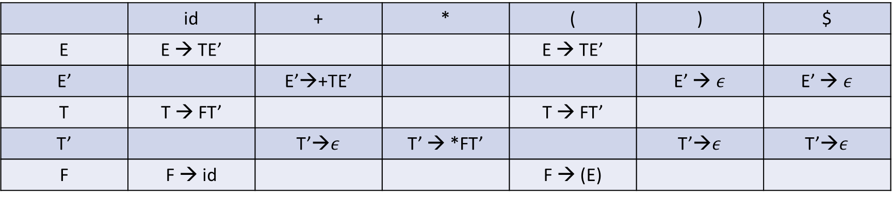
How to construct LL(1) parsing table?
 | id | + | * | ( | ) | $
E | E → TE’ |  |  | E → TE’
E’ |  | E’→+TE’ |  |  | E’ → $ε$ | E’ → $ε$
T | T → FT’ |  |  | T → FT’
T’ |  | T’→$ε$ | T’ → *FT’ |  | T’→$ε$ | T’→$ε$
F | F → id |  |  | F → (E)

Slide 9
FIRST and FOLLOW
FIRST($α$) is the set of terminals that begin strings derived from $α$
If $α \underset{⇒}{∗} ε,$ then $ε$ is also in FIRST($α$)
e.g., if $A⇒cB$, then $c∈FIRST\left(A\right)$
FOLLOW(A), for nonterminal A, is the set of terminals that appear immediately to right of A in some sentential form
If A is the rightmost symbol in some sentential form, then $\$∈FOLLOW\left(A\right)$
e.g., $S \underset{⇒}{∗} αAaβ,$then $a∈FOLLOW(A)$

Slide 10

FIRST set
A $→$ aB | b
B $→$ CD
C $→$ a |b |$ε$
D $→$ c | d

Slide 11

FIRST
If X is a terminal, what is FIRST(X)?
If X is a nonterminal and X → Y₁Y₂…Y_{k} , what is FIRST(X)?
If X → $ε$ is a production, what is FIRST(X)?

Slide 12
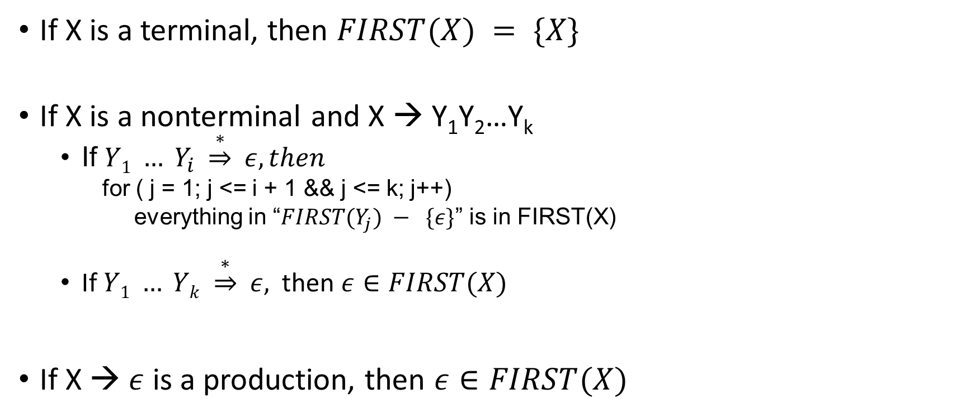
FIRST
If X is a terminal, then $FIRST(X) = \{X\}$
If X is a nonterminal and X → Y₁Y₂…Y_{k}
If $Y1 … Y_{i} \underset{⇒}{∗} ε, then$
for ( j = 1; j <= i + 1 && j <= k; j++)
everything in “$FIRST(Y_{j}) − \{ε\}$” is in FIRST(X)
If $Y1 … Yk \underset{⇒}{∗} ε,$ then $ε∈FIRST(X)$
If X → $ε$ is a production, then $ε∈FIRST(X)$

Slide 13


FIRST set
FIRST(E) =
FIRST(E’)’=
FIRST(T) =
FIRST(T’) =
FIRST(F) =
FIRST(T’F) =
FIRST(T’E’) =
FIRST(+) =
FIRST(*) =
FIRST(‘(’) =
FIRST(‘)’) =
FIRST(id) =
FIRST($ε)$ =
E → TE’
E’ → +TE’ | $ε$
T→ FT’
T’ → *FT’ | $ε$
F → (E) | id

Slide 14

FIRST set
FIRST(T) $⊂$ FIRST(E)
FIRST(E’) = {+, $ε$}
FIRST(F) $⊂$ FIRST(T)
FIRST(T’) = {*, $ε$}
FIRST(F) = {‘(’, id}
FIRST(T) = {‘(’, id}
FIRST(E) = {‘(’, id}
FIRST(T’F) = {*, ‘(’, id}
FIRST(T’E’) = {*, +, $ε$}

Slide 15


FIRST($α$)
FIRST(X₁ X₂ …X_{n}):
RES = $φ$
i = 1;
while ($ε∈FIRST(i)$ && i < n) {
RES = RES $∪$ (FIRST(i) - $ε);$
i++;
}
RES = RES $∪$ FIRST(i);
FIRST(X₁ X₂ …X_{n}) = RES

Slide 16

FOLLOW set
FOLLOW(A), for nonterminal A, is the set of terminals that appear immediately to right of A in some sentential form
If A is the rightmost symbol in some sentential form, then $\$∈FOLLOW\left(A\right)$
e.g., $S \underset{⇒}{∗} αAaβ,$then $a∈FOLLOW(A)$

Slide 17

FOLLOW set
A $→$ aBC
B $→$ aBa | b
C $→$ c | $ε$
Follow A
Follow B
Follow C

Slide 18
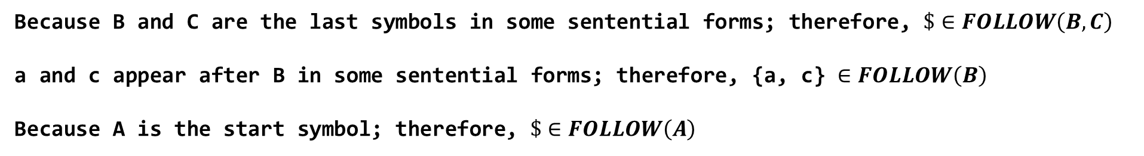
FOLLOW set
A $→$ aBC
B $→$ aBa | b
C $→$ c | $ε$
A → aBC
A → aB
A → aBc
A → aaBaC
Some possible sentential forms
Follow A = {$}
Follow B = {a, c, $}
Follow C = {$}
Because B and C are the last symbols in some sentential forms; therefore, $\$∈FOLLOW\left(B, C\right)$
a and c appear after B in some sentential forms; therefore, {a, c} $∈FOLLOW\left(B\right)$
Because A is the start symbol; therefore, $\$∈FOLLOW\left(A\right)$

Slide 19
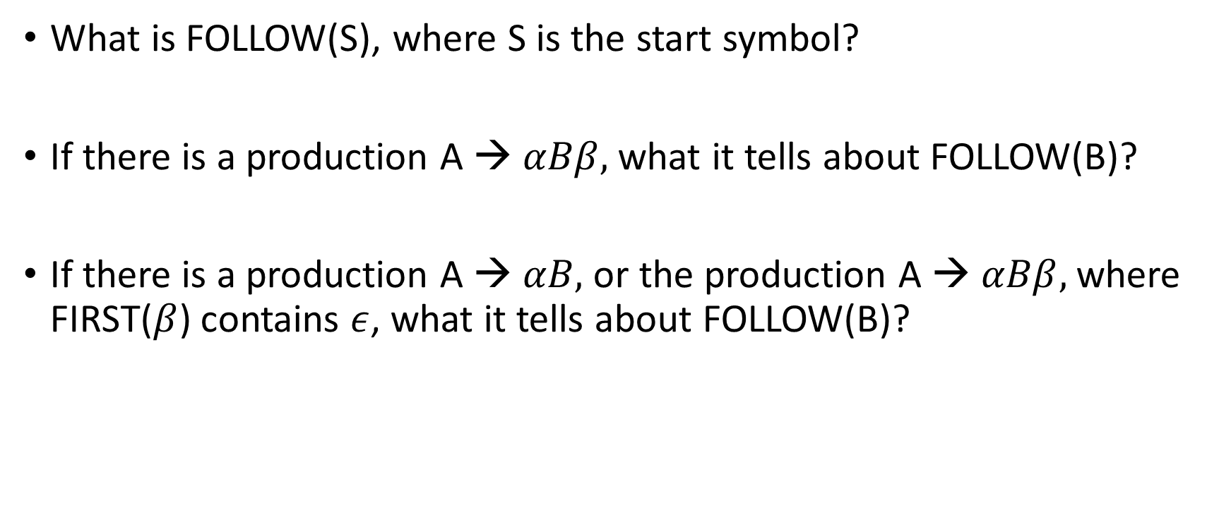
FOLLOW set
What is FOLLOW(S), where S is the start symbol?
If there is a production A → $αBβ,$ what it tells about FOLLOW(B)?
If there is a production A → $αB,$ or the production A → $αBβ,$ where FIRST($β$) contains $ε$, what it tells about FOLLOW(B)?

Slide 20
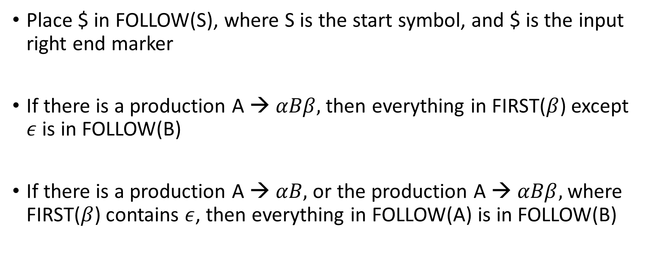
FOLLOW set
Place $ in FOLLOW(S), where S is the start symbol, and $ is the input right end marker
If there is a production A → $αBβ,$ then everything in FIRST($β$) except $ε$ is in FOLLOW(B)
If there is a production A → $αB,$ or the production A → $αBβ,$ where FIRST($β$) contains $ε$, then everything in FOLLOW(A) is in FOLLOW(B)

Slide 21
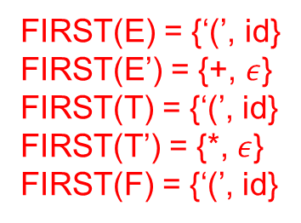
FOLLOW set
FIRST(E) = {‘(’, id}
FIRST(E’) = {+, $ε$}
FIRST(T) = {‘(’, id}
FIRST(T’) = {*, $ε$}
FIRST(F) = {‘(’, id}
E → TE’
E’ → +TE’ | $ε$
T→ FT’
T’ → *FT’ | $ε$
F → (E) | id

Slide 22
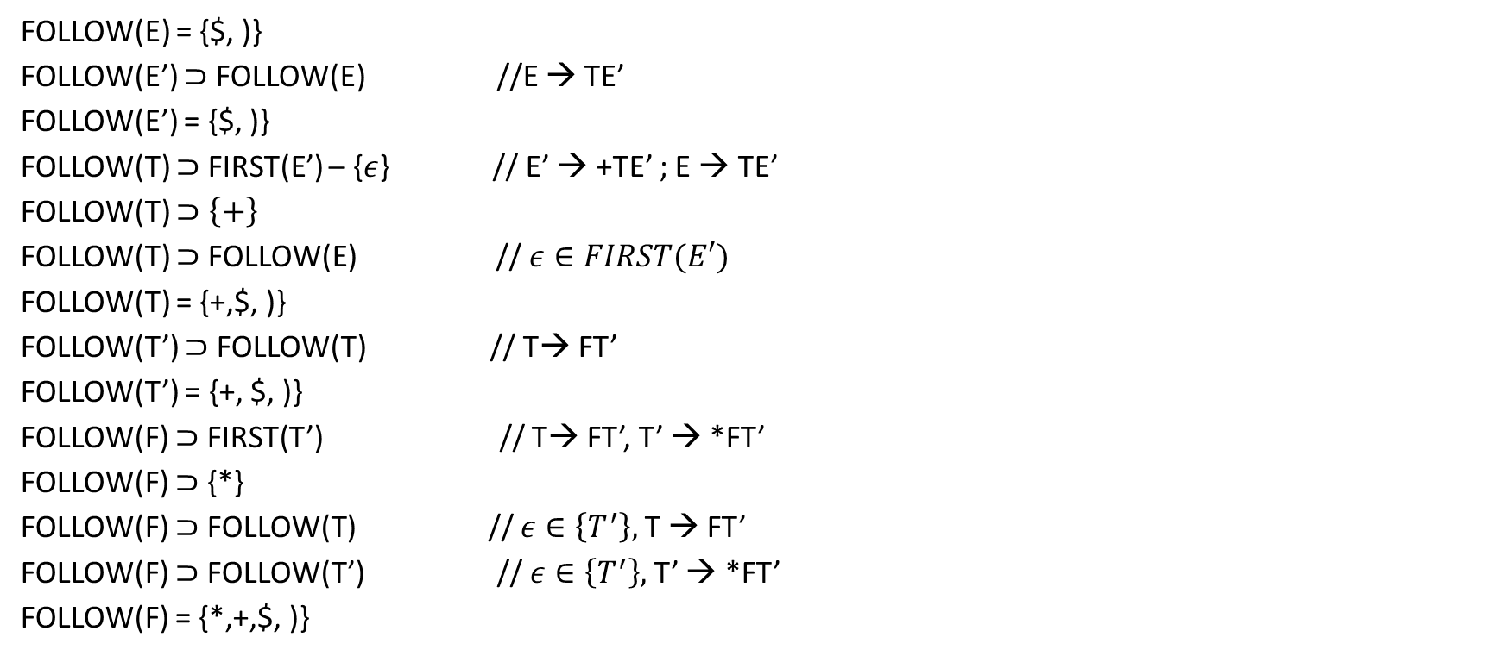
FOLLOW set
FOLLOW(E) = {$, )}
FOLLOW(E’) $⊃$ FOLLOW(E) //E → TE’
FOLLOW(E’) = {$, )}
FOLLOW(T) $⊃$ FIRST(E’) – {$ε$} // E’ → +TE’ ; E → TE’
FOLLOW(T) $⊃\left\{+\right\}$
FOLLOW(T) $⊃$ FOLLOW(E) // $ε∈FIRST(E′)$
FOLLOW(T) = {+,$, )}
FOLLOW(T’) $⊃$ FOLLOW(T) // T→ FT’
FOLLOW(T’) = {+, $, )}
FOLLOW(F) $⊃$ FIRST(T’) // T→ FT’, T’ → *FT’
FOLLOW(F) $⊃$ {*}
FOLLOW(F) $⊃$ FOLLOW(T) // $ε∈\left\{T^{′}\right\},$ T → FT’
FOLLOW(F) $⊃$ FOLLOW(T’) // $ε∈\left\{T^{′}\right\},$ T’ → *FT’
FOLLOW(F) = {*,+,$, )}

Slide 23

LL(1) parsing table
For each production, A → $α$
For each terminal $a∈FIRST(α)$, add A → $α$ to M[A, a]
If $ε in FIRST\left(α\right),$ for each terminal b in FOLLOW(A), add A → $α$ to M[A, b]
If $ε in FIRST\left(α\right),$ and $ $∈$ FOLLOW(A), add A → $α$ to M[A, $]

Slide 24
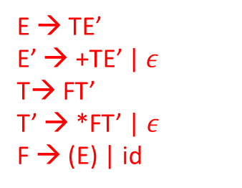
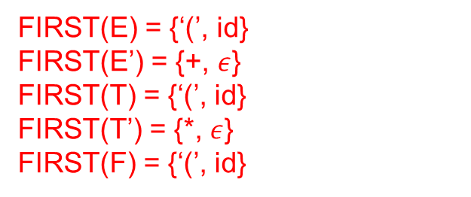
LL(1) parsing table
 | id | + | * | ( | ) | $
E
E’
T
T’
F
FIRST(E) = {‘(’, id}
FIRST(E’) = {+, $ε$}
FIRST(T) = {‘(’, id}
FIRST(T’) = {*, $ε$}
FIRST(F) = {‘(’, id}
FOLLOW(E) = {$, )}
FOLLOW(E’) = {$, )}
FOLLOW(T) = {+,$, )}
FOLLOW(T’) = {+, $, )}
FOLLOW(F) = {*,+,$, )}
E → TE’
E’ → +TE’ | $ε$
T→ FT’
T’ → *FT’ | $ε$
F → (E) | id

Slide 25
LL(1) parsing table
 | id | + | * | ( | ) | $
E | E → TE’ |  |  | E → TE’
E’ |  | E’→+TE’ |  |  | E’ → $ε$ | E’ → $ε$
T | T → FT’ |  |  | T → FT’
T’ |  | T’→$ε$ | T’ → *FT’ |  | T’→$ε$ | T’→$ε$
F | F → id |  |  | F → (E)

Slide 26
Example
MATCHED | STACK | INPUT | ACTION
 | E$ | id+id*id$ | E->TE’
 | TE’$ | id+id*id$ | T->FT’
 | FT’E’$ | id+id*id$ | F->id
 | idT’E’$ | id+id*id$ | match id
id | T’E’$ | +id*id$ | T’→$ε$
id | E’$ | +id*id$ | E’->+TE’
id | +TE’$ | +id*id$ | match +
id+ | TE’$ | id*id$ | T->FT’
id+ | FT’E’$ | id*id$ | F->id
id+ | idT’E’$ | id*id$ | match id
id+id | T’E’$ | *id$ | T’->*FT’
id+id | *FT’E’$ | *id$ | match *
id+id* | FT’E’$ | id$ | F->id
id+id* | idT’E’$ | id$ | match id
id+id*id | T’E’$ | $ | T’→$ε$
id+id*id | E’$ | $ | E’→$ε$
id+id*id | $ | $
 | id | + | * | ( | ) | $
E | E → TE’ |  |  | E → TE’
E’ |  | E’→+TE’ |  |  | E’ → $ε$ | E’ → $ε$
T | T → FT’ |  |  | T → FT’
T’ |  | T’→$ε$ | T’ → *FT’ |  | T’→$ε$ | T’→$ε$
F | F → id |  |  | F → (E)

Slide 27
Left factoring
When the multiple productions corresponding to a non-terminal start with a common nonempty string of terminals and non-terminals, then we can’t predict which production to choose by looking at the next symbol. Left factoring rewrites the grammar to remove this dilemma.
S → if E then S else S
| if E then S

Slide 28

Left factoring
When the multiple productions corresponding to a non-terminal start with a common nonempty string of terminals and non-terminals, then we can’t predict which production to choose by looking at the next symbol. Left factoring rewrites the grammar to remove this dilemma.
S → if E then S else S
| if E then S
S → if E then S S’
S’ → else S | $ε$

Slide 29
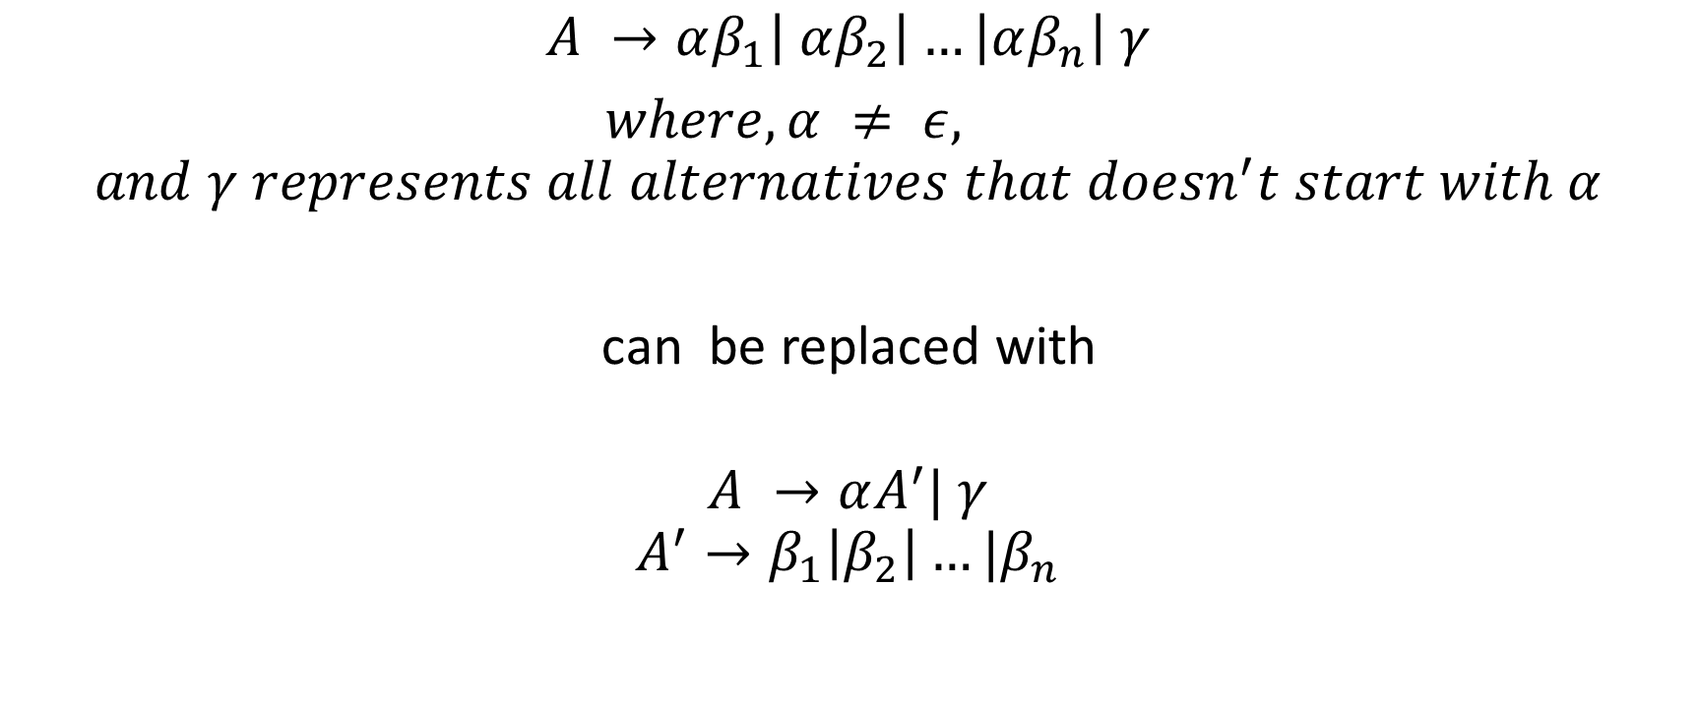
Left factoring
$$A →αβ_{1}\left| αβ_{2}\right|…\left|αβ_{n}\right| γ$$
$where, α ≠ ε,$
$$and γ represents all alternatives that doesn^{′}t start with α$$
can be replaced with
$$A →αA^{′}| γ$$
$$A^{′}→β_{1}\left|β_{2}\right|…|β_{n}$$

Slide 30
Left recursive
Draw parsing table.
A → Sa
S → Aa | b

Slide 31
Left factored
A → aA | a

Slide 32

Ambiguous
S → iEtSS’ | a
S’ → eS | $ε$
E → b

Slide 33
LL(1) grammar
Grammar is not LL(1)
if it is left recursive
if it is not left factored
if it is ambiguous
Apart from these other grammars are also not in LL(1)
to detect them, we have to build the parsing table
grammar is not in LL(1) if some entries are multiply defined

Slide 34
Error recovery in predictive parsing
 | id | + | * | ( | ) | $
E | E → TE’ |  |  | E → TE’
E’ |  | E’→+TE’ |  |  | E’ → $ε$ | E’ → $ε$
T | T → FT’ |  |  | T → FT’
T’ |  | T’→$ε$ | T’ → *FT’ |  | T’→$ε$ | T’→$ε$
F | F → id |  |  | F → (E)

Slide 35
Error recovery in predictive parsing
An error is detected when the terminal on the top does not match input token or M[A, a] is blank, where nonterminal “A” is on the top of the stack, and “a” is the next input symbol
In the error recovery mode, the parser tries to report as many syntax errors as possible

Slide 36
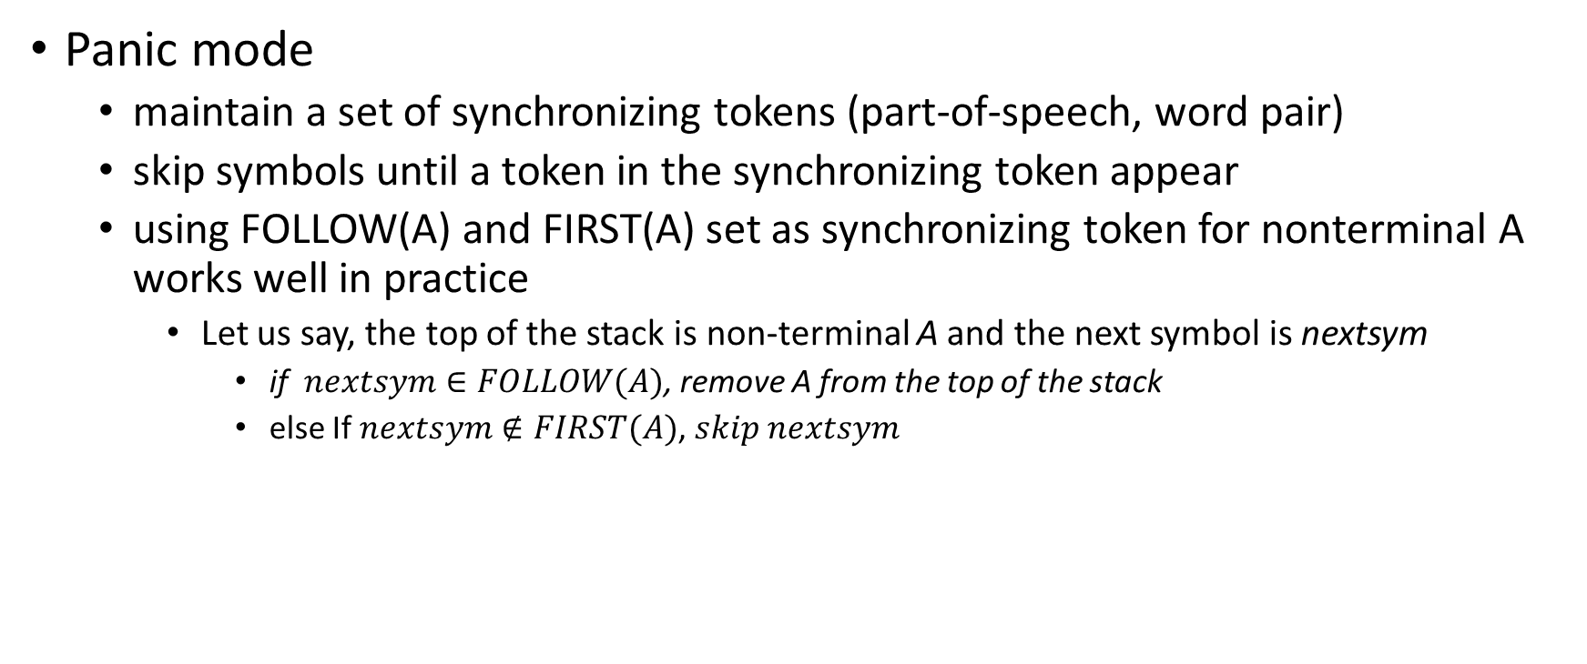
Error recovery in predictive parsing
Panic mode
maintain a set of synchronizing tokens (part-of-speech, word pair)
skip symbols until a token in the synchronizing token appear
using FOLLOW(A) and FIRST(A) set as synchronizing token for nonterminal A works well in practice
Let us say, the top of the stack is non-terminal A and the next symbol is nextsym
if $nextsym∈FOLLOW(A)$, remove A from the top of the stack
else If $nextsym∉FIRST(A)$, $skip nextsym$

Slide 37
Error recovery in predictive parsing
 | id | + | * | ( | ) | $
E | E → TE’ |  |  | E → TE’
E’ |  | E’→+TE’ |  |  | E’ → $ε$ | E’ → $ε$
T | T → FT’ |  |  | T → FT’
T’ |  | T’→$ε$ | T’ → *FT’ |  | T’→$ε$ | T’→$ε$
F | F → id |  |  | F → (E)
FIRST(E) = {‘(’, id}
FIRST(E’) = {+, $ε$}
FIRST(T) = {‘(’, id}
FIRST(T’) = {*, $ε$}
FIRST(F) = {‘(’, id}
FOLLOW(E) = {$, )}
FOLLOW(E’) = {$, )}
FOLLOW(T) = {+,$, )}
FOLLOW(T’) = {+, $, )}
FOLLOW(F) = {*,+,$, )}

Slide 38
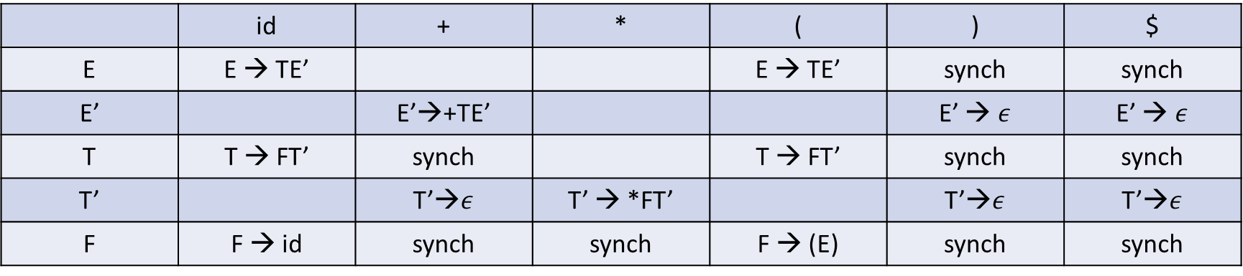
Error recovery in predictive parsing
 | id | + | * | ( | ) | $
E | E → TE’ |  |  | E → TE’ | synch | synch
E’ |  | E’→+TE’ |  |  | E’ → $ε$ | E’ → $ε$
T | T → FT’ | synch |  | T → FT’ | synch | synch
T’ |  | T’→$ε$ | T’ → *FT’ |  | T’→$ε$ | T’→$ε$
F | F → id | synch | synch | F → (E) | synch | synch
skip input symbol if the table entry is blank
pop terminal from the stack if it doesn’t match with the input
pop non-terminal from the stack if the table entry is synch

Slide 39
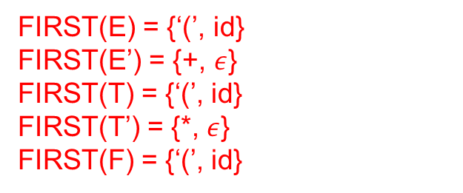
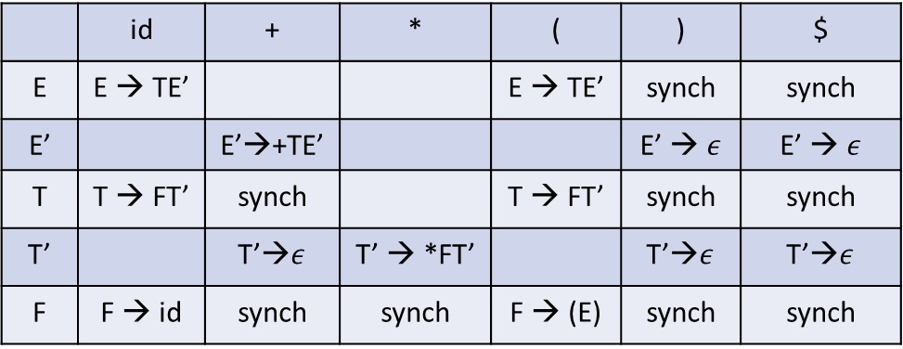
Error recovery
MATCHED | STACK | INPUT | ACTION
 | E$ | id*+id$
 | id | + | * | ( | ) | $
E | E → TE’ |  |  | E → TE’ | synch | synch
E’ |  | E’→+TE’ |  |  | E’ → $ε$ | E’ → $ε$
T | T → FT’ | synch |  | T → FT’ | synch | synch
T’ |  | T’→$ε$ | T’ → *FT’ |  | T’→$ε$ | T’→$ε$
F | F → id | synch | synch | F → (E) | synch | synch
FIRST(E) = {‘(’, id}
FIRST(E’) = {+, $ε$}
FIRST(T) = {‘(’, id}
FIRST(T’) = {*, $ε$}
FIRST(F) = {‘(’, id}
FOLLOW(E) = {$, )}
FOLLOW(E’) = {$, )}
FOLLOW(T) = {+,$, )}
FOLLOW(T’) = {+, $, )}
FOLLOW(F) = {*,+,$, )}

Slide 40
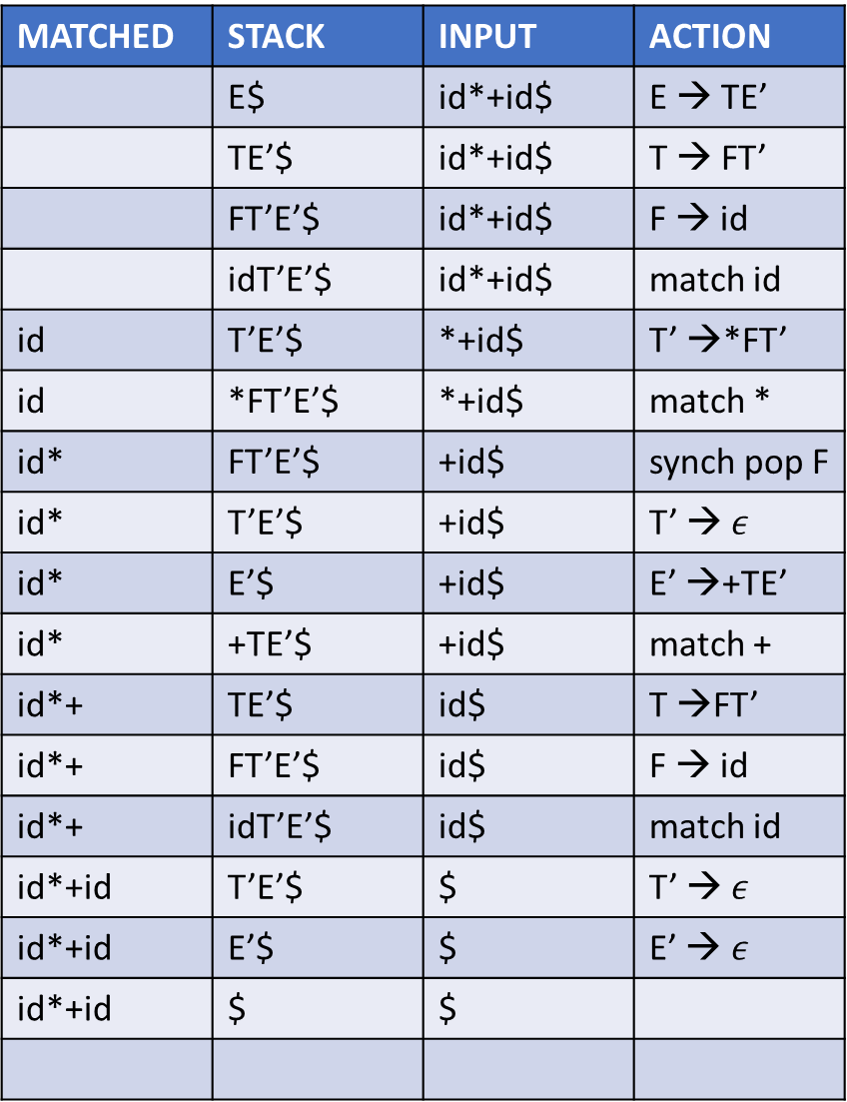
Error recovery
MATCHED | STACK | INPUT | ACTION
 | E$ | id*+id$ | E → TE’
 | TE’$ | id*+id$ | T → FT’
 | FT’E’$ | id*+id$ | F → id
 | idT’E’$ | id*+id$ | match id
id | T’E’$ | *+id$ | T’ →*FT’
id | *FT’E’$ | *+id$ | match *
id* | FT’E’$ | +id$ | synch pop F
id* | T’E’$ | +id$ | T’ → $ε$
id* | E’$ | +id$ | E’ →+TE’
id* | +TE’$ | +id$ | match +
id*+ | TE’$ | id$ | T →FT’
id*+ | FT’E’$ | id$ | F → id
id*+ | idT’E’$ | id$ | match id
id*+id | T’E’$ | $ | T’ → $ε$
id*+id | E’$ | $ | E’ → $ε$
id*+id | $ | $
 | id | + | * | ( | ) | $
E | E → TE’ |  |  | E → TE’ | synch | synch
E’ |  | E’→+TE’ |  |  | E’ → $ε$ | E’ → $ε$
T | T → FT’ | synch |  | T → FT’ | synch | synch
T’ |  | T’→$ε$ | T’ → *FT’ |  | T’→$ε$ | T’→$ε$
F | F → id | synch | synch | F → (E) | synch | synch
FIRST(E) = {‘(’, id}
FIRST(E’) = {+, $ε$}
FIRST(T) = {‘(’, id}
FIRST(T’) = {*, $ε$}
FIRST(F) = {‘(’, id}
FOLLOW(E) = {$, )}
FOLLOW(E’) = {$, )}
FOLLOW(T) = {+,$, )}
FOLLOW(T’) = {+, $, )}
FOLLOW(F) = {*,+,$, )}

Slide 41
Panic-mode recovery
Although panic-mode recovery can discover parsing errors, they fail to generate informative error messages

Slide 42
Error productions
Additional productions to catch common programming errors
The parser generates good error messages if a string is parsed using an error-production

Slide 43

Error productions
Lines -> Lines Expr ‘\n’
| Lines ‘\n’
| $ε$
| error ‘\n’
Expr -> Expr + Term
Term -> Term * Factor
Factor -> (Expr) | id | (error)
On encountering an error while parsing a line, skip tokens until a newline character is reached
On encountering an error while parsing an expression after an open parenthesis, skip tokens until a close parenthesis is reached

Slide 44
Bottom-up parsing
Builds a parse tree from leaves to root
E → E + T | T
T → T * F | F
F → (E) | id
id * id

Slide 45
Bottom-up parsing
id * id F * id T * id T * F E
id F F id T
id id T * F
F id
id

Slide 46
Reductions
The end goal of bottom-up parsing is to reduce a string w to the start symbol of the grammar
To achieve this bottom-up parser does a series of reductions
at each reduction step, a specific substring matching the RHS of a production is replaced by LHS of the production
id * id (reduce using F → id)
F * id (reduce using T → F)
T * id (reduce using F → id)
T * F (reduce using T → T * F)
T (reduce using E → T)
E
E → E + T | T
T → T * F | F
F → (E) | id

Slide 47
Bottom-up parsing
We can do bottom-up parsing without backtracking for a subset of context-free grammars called LR(k) grammar
LR(k) grammars are the superset of LL(k) grammars

Slide 48
Yacc
Yacc(yet another compiler-compiler) is a widely used parser generator
Automatically generates a program for the parser from an input grammar
recent implementation of Yacc is Bison
Yacc uses bottom-up parsing
translate.y
Yacc
compiler
y.tab.c
y.tab.c
C
compiler
a.out
input
a.out
output

Slide 49
Yacc program
parser declarations
%%
grammar rules
%%
programs

Slide 50
Parser declaration
Parser declaration is a list of terminal symbols, nonterminals, header files, etc
%token PLUS 1
%token MUL 2
%token OPEN 3
%token CLOSE 4
%token ID 5

Slide 51
Grammar rules
Grammar rules are productions of the form
expr : expr PLUS expr { /* semantic action */ }
| expr MUL expr { }
| ID { }
Programs are ordinary C code usable from the semantic actions

Slide 52
Ambiguity
Yaac allows programmers to specify precedence and associativity rules to eliminate ambiguity
An ambiguous grammar results in shift-reduce conflict in the parser

Slide 53
Associativity
“1 + 2 + 5” can be interpreted in two ways
(1 + 2) + 5 or 1 + (2 + 5)
Yaac allows %left and %right declarations to resolve this ambiguity
declaring plus as %left allows Yaac to treat “1 + 2 + 5” as “(1 + 2) + 5”
declaring plus as %right allows Yaac to treat “1 + 2 + 5” as “1 + (2 + 5)”
another declaration %nonassoc creates runtime errors if such ambiguities exist in the input
i.e., the parser generates a runtime error on input “1 + 2 + 5”, where plus is declared as %nonassoc

Slide 54
Precedence
“1 + 2 * 3” can be interpreted in two ways
(1 + 2) * 3 or 1 + (2 * 3)
“%precedence” operator can be used to define the precedence of operators
The operator listed before has lower priority than the operator listed after
%precedence PLUS
%precedence MUL
The above declaration gives MUL higher a priority than PLUS.

Slide 55
Precedence and associativity
%left PLUS MINUS
%left MUL
The above declaration suggests that PLUS and MINUS have the same priority, and both are left-associative.
MUL is left-associative and has a higher priority than PLUS.

Slide 56
Error productions
Yaac supports error production to recover from parse errors
expr : (expr)
expr : (error)
…
The above rule suggests that on encountering an error while parsing an expression after an open parenthesis, skip tokens until a close parenthesis is reached.

Slide 57
Next homework
Extend a language of arithmetic operations with if-else constructs
Remove dangling if-else ambiguity
Generate lexical analyzer and parser for the extended grammar
Read the FLEX and BISON manuals for the syntax of lexical analyzer and parser generators

