Slide 2
Today’s topics
Types
Symbol table
Type interference

Slide 3
Statically typed language
In a statically typed language, the compiler must infer the type of every variable and expression at compile time
e.g., C language

Slide 4
Dynamically typed language
In a dynamically typed language, type checking happens during runtime
e.g., Python, Perl, etc.
good for prototyping
type checking is done for the part of code that actually executes
cons: Runtime overhead of type checking!
What is the other big disadvantage to dynamically typed language?
Type errors are deferred to runtime
Not good for a software product (statically typed languages are more reliable)

Slide 5
Java inheritance
class Animal
{
public boolean hasLegs()
{ return true; }
}
class Dog extends Animal
{
public int numberOfLegs()
{ return 4; }
}
public class Test
{
public static void main(String args[])
{
Animal a = new Dog();
int legs = a.numberOfLegs();
/* compiler error */
}
}
What is the static type of a?
What is the dynamic type of a?

Slide 6
Java inheritance
class Animal
{
int a, b, c;
public boolean hasLegs()
{ return true; }
}
class Dog extends Animal
{
int d;
public int numberOfLegs()
{ return 4; }
}
public class Test
{
public static void main(String args[])
{
Animal o = new Dog();
if (o instanceof Dog) {
Dog d = (Dog)o;
int legs = d.numberOfLegs();
}
}
}

Slide 7
Java inheritance
class Animal
{
public boolean hasLegs()
{ return true; }
}
class Dog extends Animal
{
public int numberOfLegs()
{ return 4; }
}
public class Test
{
public static void main(String args[])
{
Dog[] dogArr = new Dog[100];
Animal[] AnimalArr = dogArr;
AnimalArr[0] = new Animal();
/* runtime error */
/* Dynamic checks on every store
* to an array of references */
}
}

Slide 8
Mixed type
Java is mostly statically typed language but it also does some type checking at runtime, e.g.,
instanceof operator in Java dynamically checks the type of an object
stores to an array of references are dynamically checked

Slide 9
Scope
The scope of a variable is the region in the program’s text where the variable can be used

Slide 10
C scoping rules
Scopes can be nested one inside another
A name can not be declared twice in the same scope
For a given program point the viable scopes are the current scope and all the outer scopes of the current scope
Use of a variable refers to the declaration of the variable in the nearest viable scope of the current program point

Slide 11
Scopes
int w, x; /* scope 0 */
void example(int a, int b) /*scope 1 */
{
int c; /* scope 2 */
{
int b, z; … /* scope 3a */
}
{
int a, x; /* scope 3b */
{
int c, x; /* scope 4 */
b = a + b + c + w;
}
}
}
What are the viable scopes for the statement S: “b = a + b +c +w;”?
Which declaration of “a” is used at S?
Which declaration of “b” is used at S?
Which declaration of “c” is used at S?
Which declaration of “w” is used at S?

Slide 12
Dynamic scope
The use of a variable is bind to a name that was most recently created
e.g., LISP has dynamic scoping, Perl has both static and dynamic scoping
most languages have static scoping
int a = 10;
foo() {
// static scoping a is 10
// dynamic scoping a is 20
printf(“a=%d\n”, a);
}
main() {
int a = 20;
foo();
}

Slide 13
Dynamic scope
The use of a variable is bind to a name that was most recently created
e.g., LISP has dynamic scoping, Perl has both static and dynamic scoping
most languages have static scoping
int a = 10;
foo() {
// static scoping a is 10
// dynamic scoping a is 20
printf(“a=%d\n”, a);
}
int main() {
int a = 20;
foo();
}
Let’s say that a program is using dynamic scope. For every use of a variable v at statement S, do we know at which point v was allocated at compile time?
Let’s say that a program is using static scope. For every use of a variable v at statement S, do we know at which point v was allocated at compile time?
How can we generate code when dynamic scoping is used?

Slide 14
Symbol table
Symbol table maps a name to its type
A simple symbol table interface would be:
insert(name, type) ➔ insert (name, type) in a hash table; if the name already exists, throw an error
type = lookup(name) ➔ search name in the hash table
remove(name) ➔ delete name from the hash table

Slide 15
Symbol table
int x, y, x;
insert(x)
insert(y)
insert(x) // multiple definitions error

Slide 16
Symbol table
insert, lookup, and remove are not sufficient to handle nested scopes
int x, y;
{
int x;
}
insert(x)
insert(y)
insert(x) // multiple definitions but not an error

Slide 17
Symbol table
enter_scope() ➔ create a new scope
exit_scope() ➔ delete the last scope that was created
check_and_insert(name, type) ➔ insert (name, type) in the current scope; if the name already exists, throw an error
lookup(name) ➔ search the name in scopes starting from n to 1, where n is the number of scopes

Slide 18
Symbol table
int x, y;
{
float x, y;
}
{
int x, y;
float x;
}
1. enter_scope();
2. check_and_insert(x, int);
3. check_and_insert(y, int);
4. enter_scope();
5. check_and_insert(x, float);
6. check_and_insert(y, float);
7. exit_scope();
8. enter_scope();
9. check_and_insert(x, int);
10. check_and_insert(y, int);
11. check_and_insert(x, float);

Slide 19
Symbol table implementation
Symbol table can be implemented using a stack
enter_scope() puts a marker on the stack that can be used to identify the current scope
exit_scope() deletes all the elements (including the marker) until a marker is encountered
check_and_insert(s, t) puts (s, t) on the stack only if none of the entries after the last marker contain s
lookup(s) iterates all entries from top to bottom on the stack and returns the first entry that contains s

Slide 20
Symbol table
int x, y;
{
float x, y;
}
{
int x, y;
float x;
}

Slide 21
Symbol table
marker
1. enter_scope();
int x, y;
{
float x, y;
}
{
int x, y;
float x;
}

Slide 22
Symbol table
marker
x: int
1. enter_scope();
2. check_and_insert(x, int);
int x, y;
{
float x, y;
}
{
int x, y;
float x;
}

Slide 23
Symbol table
marker
x: int
y: int
1. enter_scope();
2. check_and_insert(x, int);
3. check_and_insert(y, int);
int x, y;
{
float x, y;
}
{
int x, y;
float x;
}

Slide 24
Symbol table
marker
x: int
y: int
marker
1. enter_scope();
2. check_and_insert(x, int);
3. check_and_insert(y, int);
4. enter_scope();
int x, y;
{
float x, y;
}
{
int x, y;
float x;
}

Slide 25
Symbol table
marker
x: int
y: int
marker
x: float
1. enter_scope();
2. check_and_insert(x, int);
3. check_and_insert(y, int);
4. enter_scope();
5. check_and_insert(x, float);
int x, y;
{
float x, y;
}
{
int x, y;
float x;
}

Slide 26
Symbol table
marker
x: int
y: int
marker
x: float
y: float
1. enter_scope();
2. check_and_insert(x, int);
3. check_and_insert(y, int);
4. enter_scope();
5. check_and_insert(x, float);
6. check_and_insert(y, float);
int x, y;
{
float x, y;
}
{
int x, y;
float x;
}

Slide 27
Symbol table
marker
x: int
y: int
marker
x: float
y: float
1. enter_scope();
2. check_and_insert(x, int);
3. check_and_insert(y, int);
4. enter_scope();
5. check_and_insert(x, float);
6. check_and_insert(y, float);
7. exit_scope();
int x, y;
{
float x, y;
}
{
int x, y;
float x;
}

Slide 28
Symbol table
marker
x: int
y: int
marker
x: float
y: float
marker
1. enter_scope();
2. check_and_insert(x, int);
3. check_and_insert(y, int);
4. enter_scope();
5. check_and_insert(x, float);
6. check_and_insert(y, float);
7. exit_scope();
8. enter_scope();
int x, y;
{
float x, y;
}
{
int x, y;
float x;
}

Slide 29
Symbol table
marker
x: int
y: int
marker
x: float
y: float
marker
x: int
1. enter_scope();
2. check_and_insert(x, int);
3. check_and_insert(y, int);
4. enter_scope();
5. check_and_insert(x, float);
6. check_and_insert(y, float);
7. exit_scope();
8. enter_scope();
9. check_and_insert(x, int);
int x, y;
{
float x, y;
}
{
int x, y;
float x;
}

Slide 30
Symbol table
marker
x: int
y: int
marker
x: float
y: float
marker
x: int
y: int
1. enter_scope();
2. check_and_insert(x, int);
3. check_and_insert(y, int);
4. enter_scope();
5. check_and_insert(x, float);
6. check_and_insert(y, float);
7. exit_scope();
8. enter_scope();
9. check_and_insert(x, int);
10. check_and_insert(y, int);
int x, y;
{
float x, y;
}
{
int x, y;
float x;
}

Slide 31
Symbol table
marker
x: int
y: int
marker
x: float
y: float
marker
x: int
y: int
int x, y;
{
float x, y;
}
{
int x, y;
float x;
}
1. enter_scope();
2. check_and_insert(x, int);
3. check_and_insert(y, int);
4. enter_scope();
5. check_and_insert(x, float);
6. check_and_insert(y, float);
7. exit_scope();
8. enter_scope();
9. check_and_insert(x, int);
10. check_and_insert(y, int);
11. check_and_insert(x, float); // x already exists in the current scope; error

Slide 32
Type inference

Slide 33
Type inference
The goal of the type inference is to infer the types of all the nodes in the AST
Type inference is made by traversing the abstract syntax tree
Sometimes type information is passed from parents to children
Sometimes type information is passed from children to parent

Slide 34
Type inference
If types of all nodes can be inferred using the types of their children
Type checking can be done while building the abstract syntax tree

Slide 35
Parse tree
“a” * 2 + “a” * 2 * “b”
E
E → E + T
| E – T
| T
T → T * F
| T / F
| F
F → (E)
| num
| str
E
+
T
T
T
*
F
T
F
T
F
*
*
<str, b>
F
<num, 2>
F
<num, 2>
<str, a>
<str, a>
What would be the type of each of these nodes?
Can we infer the types of all parent nodes from their children?

Slide 36
Parse tree
a * 2 + a * 2 * b
E
E → E + T
| E – T
| T
T → T * F
| T / F
| F
F → (E)
| num
| str
| id
E
+
T
T
T
*
F
T
F
T
F
*
*
<id, b>
F
<num, 2>
F
<num, 2>
<id, a>
<id, a>
What would be the type of each of these nodes?
Can we infer the types of all parent nodes from their children?

Slide 37
Type inference rules
1 * 2 + “a”
E → E + T { $$ = MakeNode2(plus, $1, $3 );
$$->type = TypeInferPlus($1->type, $3->type);
}
| T { $$ = $1; }
T → T * F { $$ = MakeNode2(times, $1, $3);
$$->type = TypeInferMul($1->type, $3->type);
}
| F { $$ = $1; }
F → (E) { $$ = $2; }
| num { $$ = MakeNodeNum(number, $1);
$$->type = IntTy; }
| str { $$ = MakeNodeStr(string, $1);
$$->type = StringTy; }

Slide 38
Type inference rules
int TypeInferMul(int Ty1, int Ty2)
{
if (Ty1 != IntTy || Ty2 != IntTy)
ReportError();
return IntTy;
}

Slide 39
Type inference rules
int TypeInferPlus(int Ty1, int Ty2)
{
if (Ty1 != IntTy || Ty2 != IntTy)
ReportError();
return IntTy;
}

Slide 40
Type inference
The goal of the type inference is to infer the types of all the nodes in the AST
For most programming languages, types of children are not sufficient to infer the type of a parent node
For these languages, type inference is performed using traversing the parse tree from top to bottom using type inference rules specific to that language

Slide 41
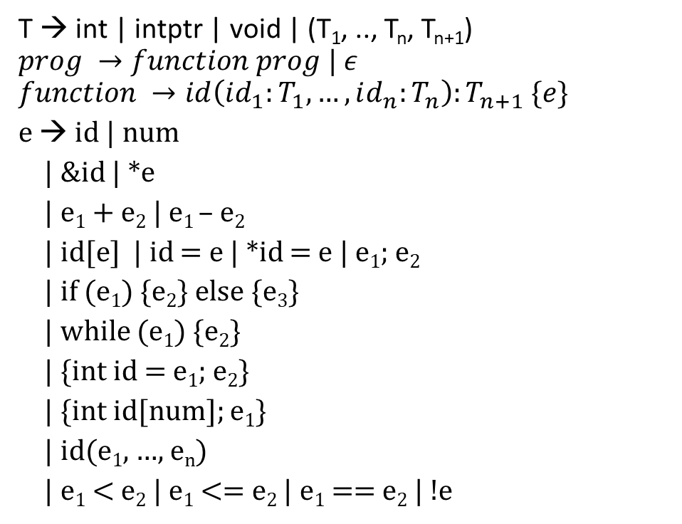
Grammar (subset of C)
T → int | intptr | void | (T₁, .., T_{n}, T_{n+1})
$$prog →function prog | ε$$
$$function →id\left(id_{1}:T_{1}, …, id_{n}:T_{n}\right):T_{n+1} \{e\}$$
e → id | num
| &id | *e
| e₁ + e₂ | e₁ – e₂
| id[e] | id = e | *id = e | e₁; e₂
| if (e₁) {e₂} else {e₃}
| while (e₁) {e₂}
| {int id = e₁; e₂}
| {int id[num]; e₁}
| id(e₁, …, e_{n})
| e₁ < e₂ | e₁ <= e₂ | e₁ == e₂ | !e

Slide 42
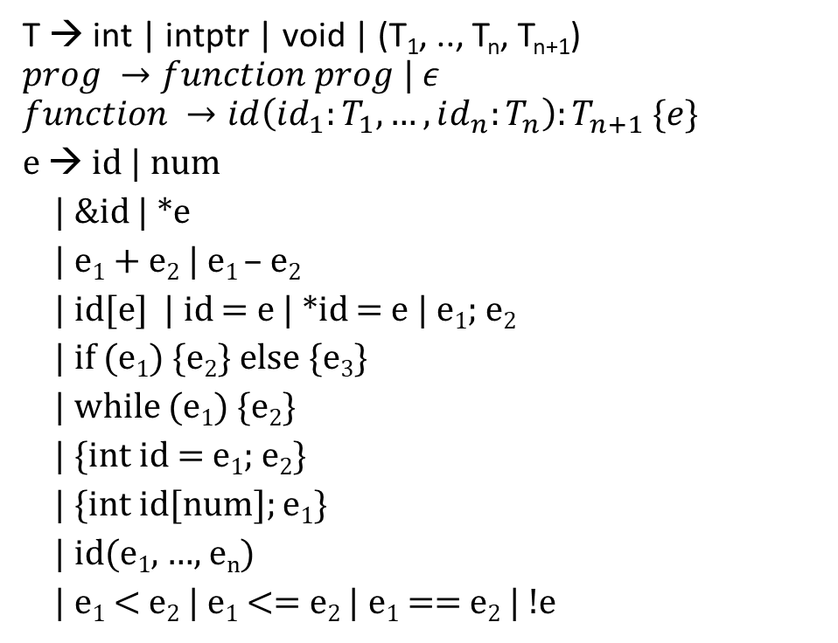
Grammar (subset of C)
T → int | intptr | void | (T₁, .., T_{n}, T_{n+1})
$$prog →function prog | ε$$
$$function →id\left(id_{1}:T_{1}, …, id_{n}:T_{n}\right):T_{n+1} \{e\}$$
e → id | num
| &id | *e
| e₁ + e₂ | e₁ – e₂
| id[e] | id = e | *id = e | e₁; e₂
| if (e₁) {e₂} else {e₃}
| while (e₁) {e₂}
| {int id = e₁; e₂}
| {int id[num]; e₁}
| id(e₁, …, e_{n})
| e₁ < e₂ | e₁ <= e₂ | e₁ == e₂ | !e
swap(x:intptr, y:intptr):void
{
{
int t = *x;
*x = * y;
*y = t
}
}

Slide 43
Grammar (subset of C)
reverse(a:intptr, n:intptr):void
{
{
int i = 0;
while (i < n - 1 - i)
{
swap(a+i, a+n-1-i);
i = i+ 1
}
}
}
T → int | intptr | void | (T₁, .., T_{n}, T_{n+1})
$$prog →function prog | ε$$
$$function →id\left(id_{1}:T_{1}, …, id_{n}:T_{n}\right):T_{n+1} \{e\}$$
e → id | num
| &id | *e
| e₁ + e₂ | e₁ – e₂
| id[e] | id = e | *id = e | e₁; e₂
| if (e₁) {e₂} else {e₃}
| while (e₁) {e₂}
| {int id = e₁; e₂}
| {int id[num]; e₁}
| id(e₁, …, e_{n})
| e₁ < e₂ | e₁ <= e₂ | e₁ == e₂ | !e

Slide 44
Grammar (subset of C)
T → int | intptr | void | (T₁, .., T_{n}, T_{n+1})
$$prog →function prog | ε$$
$$function →id\left(id_{1}:T_{1}, …, id_{n}:T_{n}\right):T_{n+1} \{e\}$$
e → id | num
| &id | *e
| e₁ + e₂ | e₁ – e₂
| id[e] | id = e | *id = e | e₁; e₂
| if (e₁) {e₂} else {e₃}
| while (e₁) {e₂}
| {int id = e₁; e₂}
| {int id[num]; e₁}
| id(e₁, …, e_{n})
| e₁ < e₂ | e₁ <= e₂ | e₁ == e₂ | !e
swapsections(a:intptr, i:int, n:int):void
{
reverse(a, i);
reverse(a+i, n-i);
reverse(a, n)
}

Slide 45
Example grammar
Function declaration rule is different
Semicolon rules are slightly different
A variable declaration always creates a new scope

Slide 46
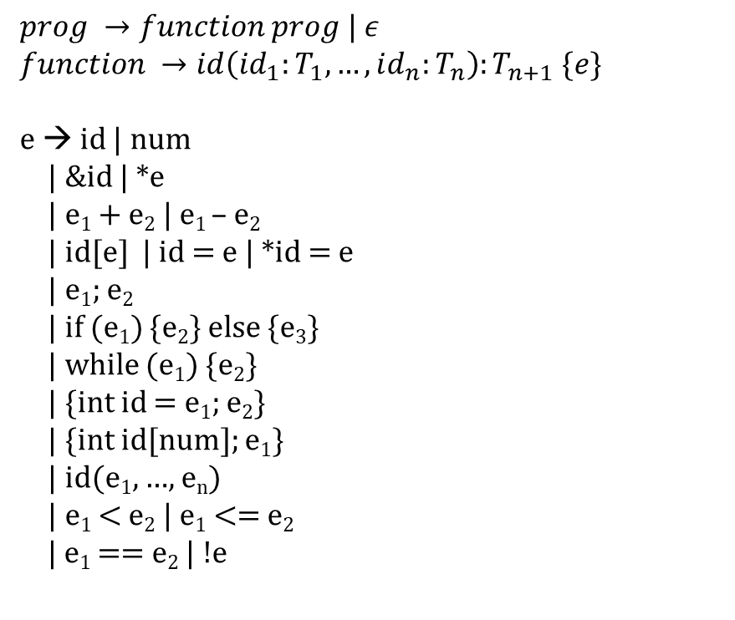
Type inference
swap(x:intptr, y:intptr):void {e}
$$prog →function prog | ε$$
$$function →id\left(id_{1}:T_{1}, …, id_{n}:T_{n}\right):T_{n+1} \{e\}$$
e → id | num
| &id | *e
| e₁ + e₂ | e₁ – e₂
| id[e] | id = e | *id = e
| e₁; e₂
| if (e₁) {e₂} else {e₃}
| while (e₁) {e₂}
| {int id = e₁; e₂}
| {int id[num]; e₁}
| id(e₁, …, e_{n})
| e₁ < e₂ | e₁ <= e₂
| e₁ == e₂ | !e
e₁; e₂
{int t = e₁; e₂}
swap(x:intptr, y:intptr):void
{
{
int t = *x;
*x = * y;
*y = t
}
}
*e
e₁;e₂
x
*x = e
*y = e
*e
t
y
Notes:
Type-inference is made using the recursive descent of the AST. The goal of the type inference is to infer types of all the nodes in the AST. The type system specifies the type-inference rules. To infer the type of an AST node, we need to infer the types for its children. Sometimes some preprocessing and postprocessing are also required to compute the type of an AST node. For example, to infer the type of a scope, we need to call enter_scope before we infer the type of statements in the scope. After the type-inference of the scope is done, we may want to call exit_scope before returning its type to parent. A type-inference rule should also specify the order in which the types of children are computed. In other words, type-inference rules must handle cases where the type-inference of a child depends on its siblings. In the next slides, we give some examples of type-inference rules in the form of C code snippets.

Slide 47
Ty TypeInfer({int id = e₁; e₂}) {
Ty ret;
ret = TypeInfer(e₁);
if (ret != IntTy)
error;
enter_scope();
check_and_insert(id, IntTy);
ret = TypeInfer(e₂);
exit_scope();
return ret;
}
Ty TypeInfer(id = e)
{
Ty ty1 = TypeInfer(id);
if (!isValid(ty1))
error;
Ty ty2 = TypeInfer(e);
if (!equals(ty1, ty2))
error;
return ty1;
}
Ty TypeInfer(id(id₁:T₁, …, id_{n}:T_{n}):T_{n+1}{e})
{
Ty ret;
int i;
enter_scope();
for (i = 1; i <=n; i++) {
check_and_insert(id_{i}, T_{i});
}
ret = TypeInfer(e);
if (T_{n+1} != VoidTy && ret != T_{n+1})
error;
exit_scope();
return T_{n+1};
}
Ty TypeInfer(*e)
{
Ty ty1 = TypeInfer(e);
if (ty1 != IntPtrTy)
error;
return IntTy;
}
Ty TypeInfer(*id = e)
{
Ty ty1 = TypeInfer(id);
if (ty1 != IntPtrTy)
error;
Ty ty2 = TypeInfer(e);
if (ty2 != IntTy)
error;
return IntTy;
}
Ty TypeInfer(e₁; e₂) {
Ty ret;
TypeInfer(e₁);
ret = TypeInfer(e₂);
return ret;
}
Ty TypeInfer(id)
{ return lookup(id); }
Ty TypeInfer(num)
{ return IntTy; }

Slide 48
Type inference
swap(x:intptr, y:intptr):void {e}
e₁; e₂
{int t = e₁; e₂}
*e
e₁;e₂
x
*x = e
*y = e
*e
t
y

Slide 49
Type inference
swap(x:intptr, y:intptr):void {e}
e₁; e₂
C1: TypeCheck(swap(x:intptr, y:intptr):void{e}):: e == {int t = e₁; e₂}
C1: enter_scope();
C1: check_and_insert(x, intptr);
C1: check_and_insert(y, intptr);
C1 -> C2: TypeCheck({int t = e₁; e₂}) :: e₁ == *e and e₂ == e₁;e₂
C2 -> C3: TypeCheck(*e); :: e == x, x is id
C3 -> C4: TypeCheck(x) ➔ intptr, using lookup
C3: TypeCheck(*e) ➔ int, using C4
C2: C3 returns int
C2: enter_scope();
C2: check_and_insert(t, int);
C2 -> C4: TypeCheck(e₁;e₂) :: e1 == “*x = e” and e2 == “*y = e”
{int t = e₁; e₂}
*e
e₁;e₂
x
*x = e
*y = e
*e
t
y

Slide 50
Type inference
swap(x:intptr, y:intptr):void {e}
e₁; e₂
{int t = e₁; e₂}
C4 -> C5: TypeCheck(*x = e) :: e == *e
C5 -> C6: TypeCheck(x) ➔ intptr, using lookup
C5 -> C7: TypeCheck(*e) :: e == y, y is id
C7 -> C8: TypeCheck(y) ➔ intptr, using lookup
C7: TypeCheck(*e) ➔ int, using C8
C5: TypeCheck(*x = e) ➔ int, using C6, C7
C4 -> C9: TypeCheck(*y = e) :: e == t, t is id
C9 -> C10: TypeCheck(y) ➔ intptr, using lookup
C9 -> C11: TypeCheck(t) ➔ int, using lookup
C9: TypeCheck(*y = e) ➔ int, using C10, C11
C4: TypeCheck(e₁;e₂) ➔ int using C5, C9
*e
e₁;e₂
x
*x = e
*y = e
*e
t
y

Slide 51
Type inference
swap(x:intptr, y:intptr):void {e}
e₁; e₂
{int t = e₁; e₂}
C2: exit_scope();
C2: TypeCheck({int t = e₁; e₂}) ➔ int, using C4
C1: exit_scope();
C1: TypeCheck(swap(x:intptr, y:intptr):void{e}) ➔ void,
because T_{n+1} is void
*e
e₁;e₂
x
*x = e
*y = e
*e
t
y

Slide 52
Type inference
t = e
e → id | num
| &id | *e
| e₁ + e₂ | e₁ – e₂
| id[e] | id = e | e₁; e₂
| if (e₁) {e₂} else {e₃}
| while (e₁) {e₂}
| {int id = e₁; e₂}
| {int id[num]; e₁}
| id(id₁, … , id_{n}) {e}
| id(e₁, …, e_{n})
| e₁ < e₂ | e₁ <= e₂
| e₁ == e₂ | !e
t = foo(10 + 20, 30)
foo(e₁, e₂)
e₁+e₂
30
10
20

Slide 53
Symbol table
Symbol table also maps function names to their signatures
Signature includes the types of parameters and the return type

Slide 54
Type inference
TypeInfer(id(e₁, …, e_{n}))
{
Ty fnty = lookup(foo); // symbol table also maps a function to the function type
if (fnty.numArgs != n)
error;
for (i = 1; i <= n ; i++) {
if (TypeInfer(e_{i}) != fnty.argTy[i]) // fnty.argTy[i] is the type of i^{th} parameter
error;
} // end for-loop
return fnty.returnTy; // fnty.returnTy is the return type in the function type
}

Slide 55
Type inference
Ty TypeInfer(e₁+e₂)
{
Ty ty1 = TypeInter(e₁);
if (ty1 != IntTy)
error;
Ty ty2 = TypeInfer(e₂);
if (ty2 != IntTy)
error;
return IntTy;
}

Slide 56
Type inference
t = e
foo(e₁, e₂)
t = foo(10 + 20, 30)
e₁+e₂
30
10
20

Slide 57
Type inference
t = e
t = foo(10 + 20, 30)
C1: TypeCheck(t=e) :: e == foo(e1, e2)
C1 -> C2: TypeCheck(foo(e1, e2)):: e1 == e1+e2 and e2 == 30
lookup returns (ArgTy[0], ArgTy[1]) = (int, int) RetTy = int
C2 -> C3: TypeCheck(e1+e2) :: e1 == 10 and e2 == 20
C3 -> C4: TypeCheck(10) ➔ int
C3 -> C5: TypeCheck(20) ➔ int
C3: TypeCheck(e1+e2) ➔ int, using C4, C5
C2 -> C6: TypeCheck(30) ➔ int
C2: TypeCheck(foo(e1, e2)) ➔ int,
using C3, C6, ArgTy[0], ArgTy[1], RetTy
C1: TypeCheck(t=e) ➔ int, using C2 and assuming
lookup(t) = int
How does TypeChecker ensure that
foo indeed returns a value of type Int?
foo(e₁, e₂)
e₁+e₂
30
10
20

Slide 58
References
A sound polymorphic type system for a dialect of C

