Slide 2
Today’s topics
Type interference
Code generation

Slide 3
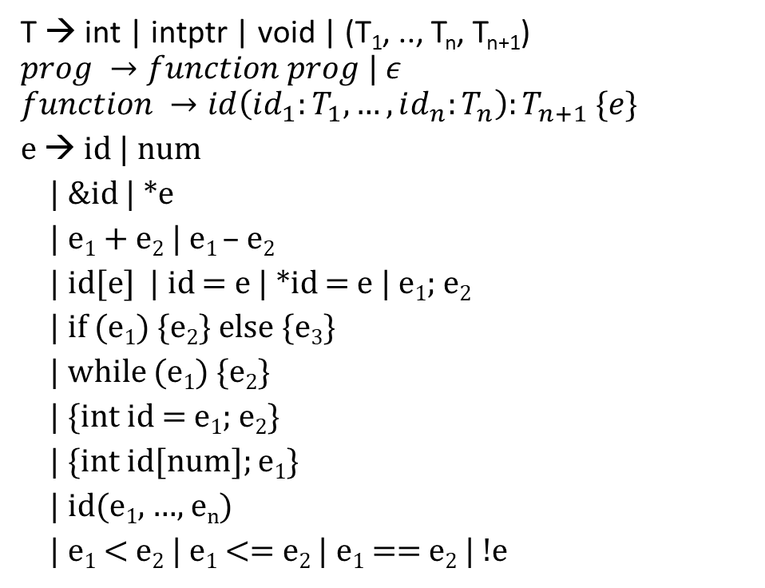
Grammar (subset of C)
reverse(a:intptr, n:intptr):void
{
{
int i = 0;
while (i < n - 1 - i)
{
swap(a+i, a+n-1-i);
i = i+ 1
}
}
}
T → int | intptr | void | (T₁, .., T_{n}, T_{n+1})
$$prog →function prog | ε$$
$$function →id\left(id_{1}:T_{1}, …, id_{n}:T_{n}\right):T_{n+1} \{e\}$$
e → id | num
| &id | *e
| e₁ + e₂ | e₁ – e₂
| id[e] | id = e | *id = e | e₁; e₂
| if (e₁) {e₂} else {e₃}
| while (e₁) {e₂}
| {int id = e₁; e₂}
| {int id[num]; e₁}
| id(e₁, …, e_{n})
| e₁ < e₂ | e₁ <= e₂ | e₁ == e₂ | !e

Slide 4
Ty TypeInfer({int id = e₁; e₂}) {
Ty ret;
ret = TypeInfer(e₁);
if (ret != IntTy)
error;
enter_scope();
check_and_insert(id, IntTy);
ret = TypeInfer(e₂);
exit_scope();
return ret;
}
Ty TypeInfer(id = e)
{
Ty ty1 = TypeInfer(id);
if (!isValid(ty1))
error;
Ty ty2 = TypeInfer(e);
if (!equals(ty1, ty2))
error;
return ty1;
}
Ty TypeInfer(id(id₁:T₁, …, id_{n}:T_{n}):T_{n+1}{e})
{
Ty ret;
int i;
enter_scope();
for (i = 1; i <=n; i++) {
check_and_insert(id_{i}, T_{i});
}
ret = TypeInfer(e);
if (T_{n+1} != VoidTy && ret != T_{n+1})
error;
exit_scope();
return T_{n+1};
}
Ty TypeInfer(*e)
{
Ty ty1 = TypeInfer(e);
if (ty1 != IntPtrTy)
error;
return IntTy;
}
Ty TypeInfer(*id = e)
{
Ty ty1 = TypeInfer(id);
if (ty1 != IntPtrTy)
error;
Ty ty2 = TypeInfer(e);
if (ty2 != IntTy)
error;
return IntTy;
}
Ty TypeInfer(e₁; e₂) {
Ty ret;
TypeInfer(e₁);
ret = TypeInfer(e₂);
return ret;
}
Ty TypeInfer(id)
{ return lookup(id); }
Ty TypeInfer(num)
{ return IntTy; }

Slide 5
References
A sound polymorphic type system for a dialect of C

Slide 6

Type inference
Type inference rules are written as follows:
$$\frac{\begin{aligned}Cond_{1} \\ Cond_{2} \\ … \\ Cond_{n}\end{aligned}}{⊢Conclusion}$$

Slide 7
Type inference
Type inference rules are a sequence of preconditions followed by a conclusion
The preconditions and conclusion are written in logical forms
Preconditions are written above the horizontal bar
The conclusion is written below the horizontal bar

Slide 8
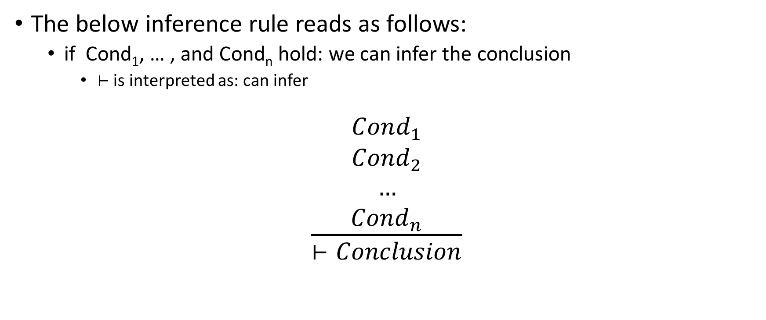
Type inference
The below inference rule reads as follows:
if Cond₁, … , and Cond_{n} hold: we can infer the conclusion
$⊢$ is interpreted as: can infer
$$\frac{\begin{aligned}Cond_{1} \\ Cond_{2} \\ … \\ Cond_{n}\end{aligned}}{⊢Conclusion}$$

Slide 9
Type inference
In type inference rules,
“x:T” is read as “x has type T”

Slide 10
Symbol table
A symbol table stores the type information of identifiers
In inference rules
“S(x) = T,” mean there is an entry “x:T” in the symbol table S
Symbol table contains at most one entry corresponding to an identifier

Slide 11
Symbol table
S_{x} represents the symbol table S without an entry corresponding to x

Slide 12

Symbol table
S$[\frac{T}{x}]$ is a new symbol table, where
$$S\left[\frac{T}{x}\right]=S_{x}∪\{x:T\}$$

Slide 13

Symbol table
$S[\frac{T_{1}}{α_{1}}, …,\frac{T_{n}}{α_{n}}]$ is:
${∀i, j∈\left\{1, …, n\right\}, α}_{i} ≠α_{j}, where i ≠j$
$$\{\bigcap_{i=1}^{n}{S_{α_{i}}\}}∪\{α_{1}:T_{1},…,α_{n}:T_{n}\}$$

Slide 14
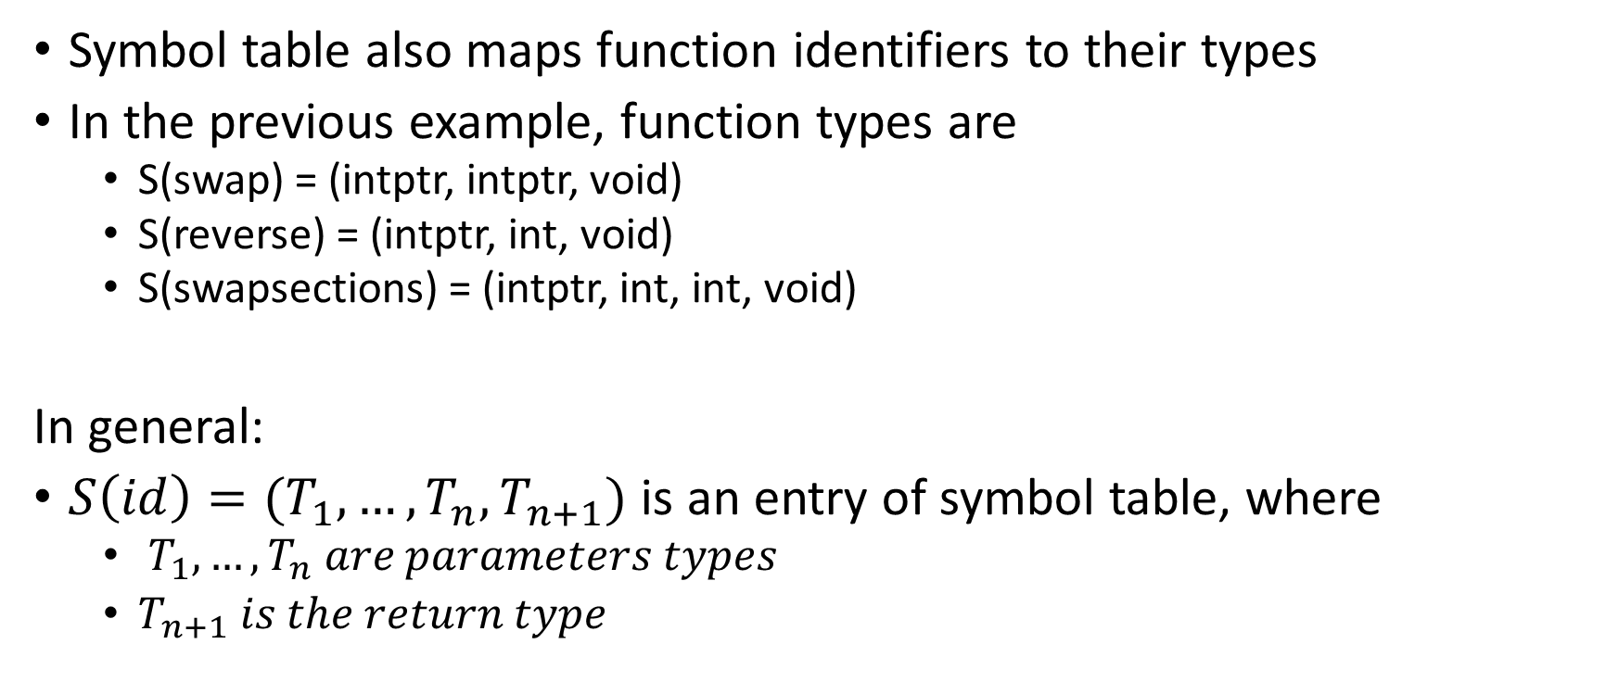
Symbol table
Symbol table also maps function identifiers to their types
In the previous example, function types are
S(swap) = (intptr, intptr, void)
S(reverse) = (intptr, int, void)
S(swapsections) = (intptr, int, int, void)
In general:
$S\left(id\right)=(T_{1}, …,T_{n},T_{n+1})$ is an entry of symbol table, where
$T_{1},…,T_{n} are parameters types$
$T_{n+1} is the return type$

Slide 15
Types
T → int | intptr | void| (T₁, .., T_{n}, T_{n+1})

Slide 16

Integer literal
$$\frac{}{S⊢num :int}$$
This rule is read as follows:
Using symbol table S, we can infer the type of “num” as “int”

Slide 17

Variable
$$\frac{S\left(id\right)=T}{S⊢id:T}$$

Slide 18

Address
$$\frac{S⊢id:int}{S⊢\&id:intptr}$$

Slide 19

Load
$$\frac{S⊢e:intptr}{S⊢∗e:int}$$

Slide 20

Addition
$$\frac{\begin{aligned}S⊢e_{1}:T \\ T∈\{int, intptr\} \\ S⊢e_{2}:int\end{aligned}}{S⊢e_{1}+e_{2}:T}$$

Slide 21

Subscript
$$\frac{\begin{aligned}S⊢id:intptr \\ S⊢e:int\end{aligned}}{S⊢id[e]:int}$$

Slide 22

Assign
$$\frac{\begin{aligned}S⊢id:T \\ S⊢e:T\end{aligned}}{S⊢id=e:T}$$

Slide 23

Assign
$$\frac{\begin{aligned}S⊢id:intptr \\ S⊢e:int\end{aligned}}{S⊢∗id=e:int}$$

Slide 24

Block
$$\frac{\begin{aligned}S⊢e_{1}:T_{1} \\ S⊢e_{2}:T_{2}\end{aligned}}{S⊢e_{1};e_{2}:T_{2}}$$

Slide 25

IF
$$\frac{\begin{aligned}S⊢e_{1}:int \\ S⊢e_{2}:T_{2} \\ S⊢e_{3}:T_{3}\end{aligned}}{S⊢if\left(e_{1}\right)\left\{e_{2}\right\} else \left\{e_{3}\right\}:void}$$

Slide 26

IF
$$\frac{\begin{aligned}S⊢e_{1}:int \\ S⊢e_{2}:T_{} \\ S⊢e_{3}:T_{}\end{aligned}}{S⊢if\left(e_{1}\right)\left\{e_{2}\right\} else \left\{e_{3}\right\}:T}$$
What might be a problem with this rule?

Slide 27
QUIZ

Slide 28

While (QUIZ)
$$\frac{\begin{aligned}S⊢e_{1}:int \\ S⊢e_{2}:T_{2}\end{aligned}}{S⊢while \left(e_{1}\right)\left\{e_{2}\right\}:T_{2}}$$
What is wrong with this rule?

Slide 29

While
$$\frac{\begin{aligned}S⊢e_{1}:int \\ S⊢e_{2}:T_{2}\end{aligned}}{S⊢while \left(e_{1}\right)\left\{e_{2}\right\}:void}$$

Slide 30

Variable declaration
$$\frac{\begin{aligned}S⊢e_{1}:int \\ S\left[\frac{int}{id}\right]⊢e_{2}:T_{2}\end{aligned}}{S⊢\left\{int id=e_{1};e_{2}\right\}:T_{2}}$$

Slide 31
Variable declaration
$$\frac{\begin{aligned}S⊢e_{1}:int \\ S\left[\frac{int}{id}\right]⊢e_{2}:T_{2}\end{aligned}}{S⊢\left\{int id=e_{1};e_{2}\right\}:T_{2}}$$
{
int x = 20;
x + 30
}

Slide 32

Variable declaration
foo(i: int): int {
{
int x = 20;
x + 30
}
}
Before the red block, the symbol table contains i:int
STEP-1: Infer the type of 20
STEP-2: Add x:int to symbol table
STEP-3: Infer type of x+ 30 in the modified symbol table, i.e., int
STEP-4: Use the old symbol table without x in the current scope
STEP-5: Conclude type of the whole block is int
$$\frac{\begin{aligned}S⊢e_{1}:int \\ S\left[\frac{int}{id}\right]⊢e_{2}:T_{2}\end{aligned}}{S⊢\left\{int id=e_{1};e_{2}\right\}:T_{2}}$$

Slide 33
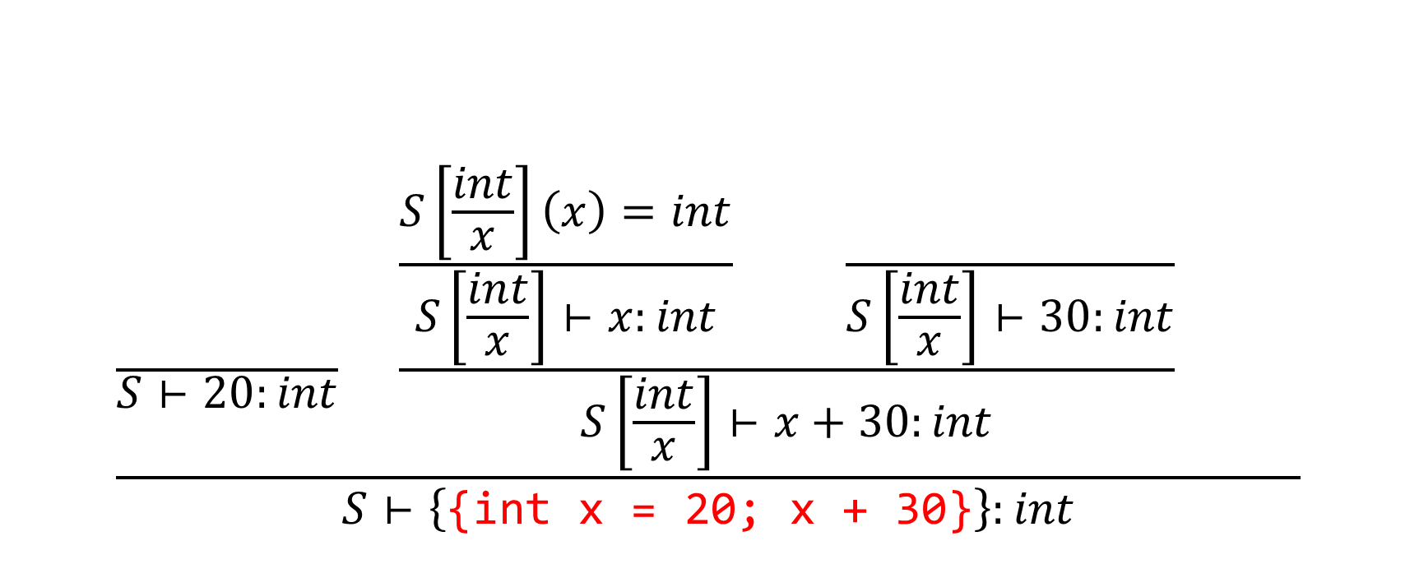
Variable declaration
$$\frac{\frac{}{S⊢20:int} \frac{\frac{S\left[\frac{int}{x}\right]\left(x\right)=int}{S\left[\frac{int}{x}\right]⊢x:int} \frac{}{S\left[\frac{int}{x}\right]⊢30:int}}{S\left[\frac{int}{x}\right]⊢x+30:int} }{S⊢\left\{\text{\{}\text{int} \text{x}\text{ = 20; }\text{x}\text{ + 3}\text{0\}}\right\}:int}$$

Slide 34
Variable declaration
foo(x: int) : int
{
{
int x = x;
x + 30
}
}
Before the red block, the symbol table contains x:int
STEP-1: Infer the type of x
If x is not present in the symbol table, you’ll get some error
STEP-2: Add x:int to symbol table
STEP-3: Infer type of x+ 30 in the modified symbol table, i.e., int
STEP-4: Use the old symbol table without x in the current scope
STEP-5: Conclude type of the whole block is int
$$\frac{\begin{aligned}S⊢e_{1}:int \\ S\left[\frac{int}{id}\right]⊢e_{2}:T_{2}\end{aligned}}{S⊢\left\{int id=e_{1};e_{2}\right\}:T_{2}}$$

Slide 35
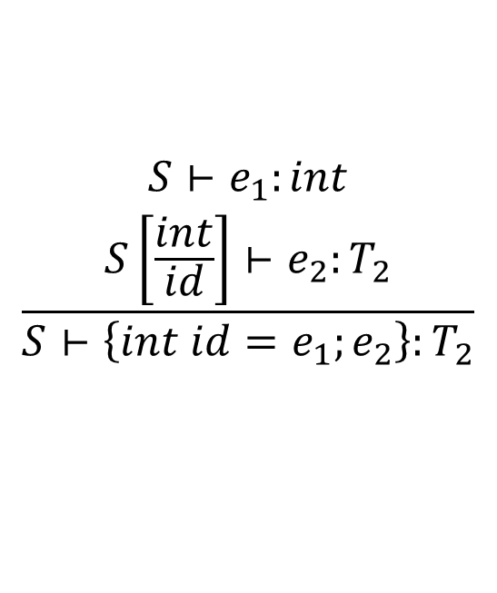
Variable declaration
foo(i: int) : int {
{ // block-1
int x = 10;
{ // block-2
int y = x;
y + 30
}
}
}
$$\frac{\begin{aligned}S⊢e_{1}:int \\ S\left[\frac{int}{id}\right]⊢e_{2}:T_{2}\end{aligned}}{S⊢\left\{int id=e_{1};e_{2}\right\}:T_{2}}$$
Before the block-1, the symbol table contains i:int
TYPE-CHECK BLOCK-1
STEP-1: Infer the type of 10, i.e., int
STEP-2: Add x:int to symbol table
TYPE-CHECK BLOCK-2 using the modified symbol table
STEP-3: Infer type of x, i.e., int
STEP-4: Add y:int to symbol table
STEP-5: Infer type of y + 30, i.e., int
STEP-6: Infer type of BLOCK-2 as int using the symbol table after STEP-2
STEP-5: Infer type of BLOCk-1 as int using the symbol table before STEP-1.

Slide 36
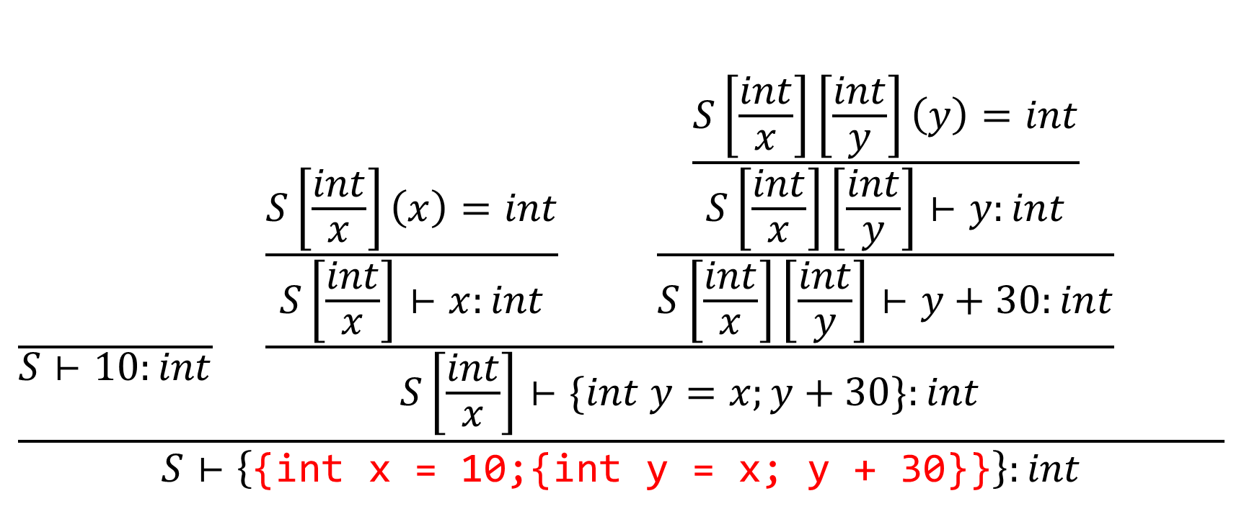
Variable declaration
$$\frac{\frac{}{S⊢10:int} \frac{\frac{S\left[\frac{int}{x}\right]\left(x\right)=int}{S\left[\frac{int}{x}\right]⊢x:int} \frac{\frac{S\left[\frac{int}{x}\right]\left[\frac{int}{y}\right]\left(y\right)=int}{S\left[\frac{int}{x}\right]\left[\frac{int}{y}\right]⊢y:int}}{S\left[\frac{int}{x}\right]\left[\frac{int}{y}\right]⊢y+30:int}}{S\left[\frac{int}{x}\right]⊢\{int y=x;y+30\}:int} }{S⊢\left\{\text{\{}\text{int} \text{x}\text{ = 10;\{}\text{int} \text{y}\text{ = }\text{x}\text{; }\text{y}\text{ + 30\}}\text{\}}\right\}:int}$$

Slide 37

Array declaration
$$\frac{S\left[\frac{intptr}{id}\right]⊢e_{1}:T_{1}}{S⊢\{int id\left[num\right];e_{1}\}:T_{1}}$$

Slide 38

Function definition
$$\frac{\begin{aligned}S\left(id\right)=(T_{1},…,T_{n},T_{n+1}) \\ S\left[\frac{T_{1}}{id_{1}},…,\frac{T_{n}}{id_{n}}\right]⊢e:T_{n+1}\end{aligned}}{S⊢id\left(id_{1}:T_{1}, …, id_{n}:T_{n}\right):T_{n+1}\left\{e\right\}:T_{n+1}}$$

Slide 39


Function call
$$\frac{\begin{aligned}S\left(id\right)=(T_{1},…,T_{n},T_{n+1}) \\ \\ \\ \end{aligned}}{S⊢id\left(e_{1}, …, e_{n}\right):T_{n+1}}$$
$S⊢$ e:T

Slide 40
Function call
$$\frac{\begin{aligned}S\left(id\right)=(T_{1},…,T_{n},T_{n+1}) \\ S⊢e_{1}:T_{1} \\ … \\ S⊢e_{n}:T_{n}\end{aligned}}{S⊢id\left(e_{1}, …, e_{n}\right):T_{n+1}}$$

Slide 41
Inheritance in C++
class Animal {
};
class Dog : public Animal {
};
All Dogs are Animals, but all Animals are not Dogs.
Dog is a subclass of Animal. Animal is a superclass of Dog.

Slide 42
Subtype relationship
A partial order “<=” is defined to represent the subtype relationship
$$T≤T^{′}, where T is the subtype of T′$$

Slide 43
Subtype
Reflexive: $A≤A$
Transitive: $if A≤B and B≤C then A≤C$
Antisymmetric: $if A≤B and B≤A then A=B$

Slide 44
Assign
$$\frac{\begin{aligned}S⊢id:T \\ S⊢e:T\end{aligned}}{S⊢id=e:T}$$

Slide 45
Assign (using subtype)
$$\frac{\begin{aligned}S⊢id:T_{1} \\ S⊢e:T_{2} \\ T_{2}≤T_{1}\end{aligned}}{S⊢id=e:T_{2}}$$

Slide 46
IF
$$\frac{\begin{aligned}S⊢e_{1}:int \\ S⊢e_{2}:T_{2} \\ S⊢e_{3}:T_{3}\end{aligned}}{S⊢if\left(e_{1}\right)\left\{e_{2}\right\} else \left\{e_{3}\right\}:void}$$

Slide 47
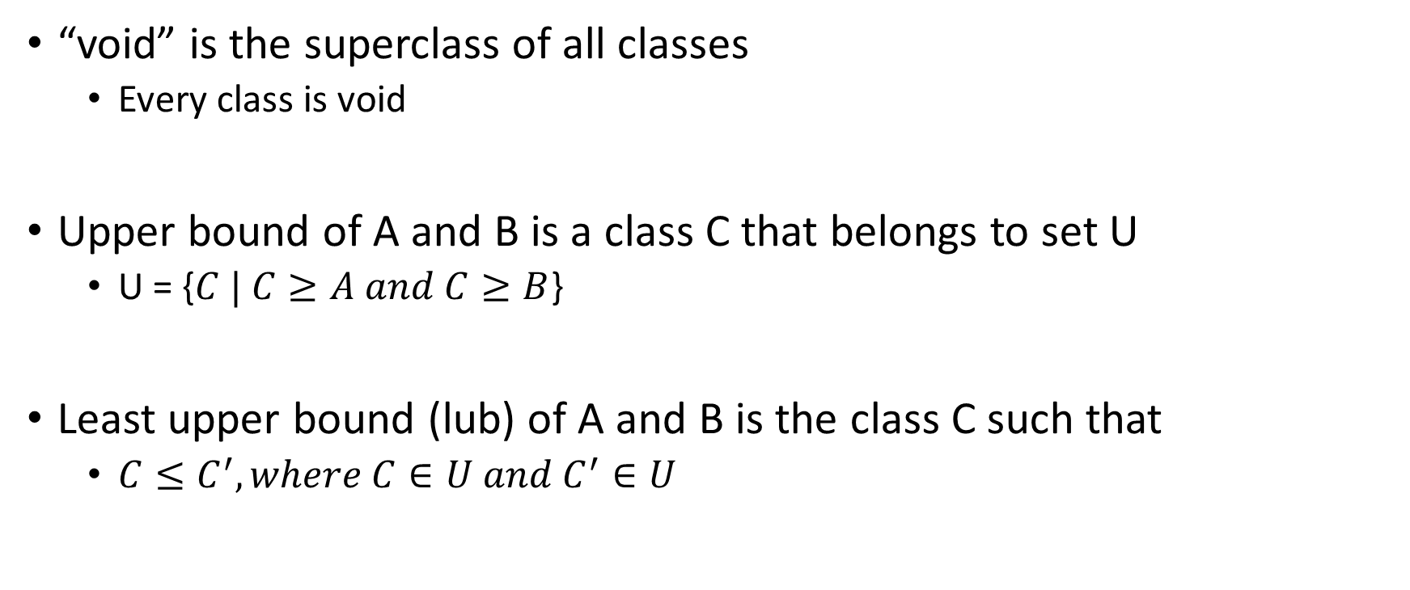
Least upper bound
“void” is the superclass of all classes
Every class is void
Upper bound of A and B is a class C that belongs to set U
U = {$C | C≥A and C≥B$}
Least upper bound (lub) of A and B is the class C such that
$C≤C^{′}, where C∈U and C^{′}∈U$

Slide 48
IF (using subtype)
$$\frac{\begin{aligned}S⊢e_{1}:int \\ S⊢e_{2}:T_{2} \\ S⊢e_{3}:T_{3}\end{aligned}}{S⊢if\left(e_{1}\right)\left\{e_{2}\right\} else \left\{e_{3}\right\}:lub(T_{2},T_{3})}$$

Slide 49
Exercise: Function call using subtype relation
$$\frac{\begin{aligned}S\left(id\right)=(T_{1},…,T_{n},T_{n+1}) \\ S⊢e_{1}:T_{1} \\ … \\ S⊢e_{n}:T_{n}\end{aligned}}{S⊢id\left(e_{1}, …, e_{n}\right):T_{n+1}}$$

Slide 50
Function call using subtype relation
$$\frac{\begin{aligned}S\left(id\right)=(T_{1},…,T_{n},T_{n+1}) \\ S⊢e_{1}:T_{1}′ \\ … \\ S⊢e_{n}:T_{n}′ \\ T_{1}^{′}≤T_{1} \\ … \\ T_{n}^{′}≤T_{n}\end{aligned}}{S⊢id\left(e_{1}, …, e_{n}\right):T_{n+1}}$$

Slide 51
Function definition (subtype)
$$\frac{\begin{aligned}S\left(id\right)=(T_{1},…,T_{n},T_{n+1}) \\ S\left[\frac{T_{1}}{id_{1}},…,\frac{T_{n}}{id_{n}}\right]⊢e:T \\ T≤T_{n+1}\end{aligned}}{S⊢id\left(id_{1}:T_{1}, …, id_{n}:T_{n}\right):T_{n+1}\left\{e\right\}:T_{n+1}}$$

Slide 52
Implementation
$$\frac{\begin{aligned}S\left(id\right)=(T_{1},…,T_{n},T_{n+1}) \\ S⊢e_{1}:T_{1}′ \\ … \\ S⊢e_{n}:T_{n}′ \\ T_{1}^{′}≤T_{1} \\ … \\ T_{n}^{′}≤T_{n}\end{aligned}}{S⊢id\left(e_{1}, …, e_{n}\right):T_{n+1}}$$

Slide 53
Implementation
$$\frac{\begin{aligned}S\left(id\right)=(T_{1},…,T_{n},T_{n+1}) \\ S\left[\frac{T_{1}}{id_{1}},…,\frac{T_{n}}{id_{n}}\right]⊢e:T \\ T≤T_{n+1}\end{aligned}}{S⊢id\left(id_{1}:T_{1}, …, id_{n}:T_{n}\right):T_{n+1}\left\{e\right\}:T_{n+1}}$$

Slide 54
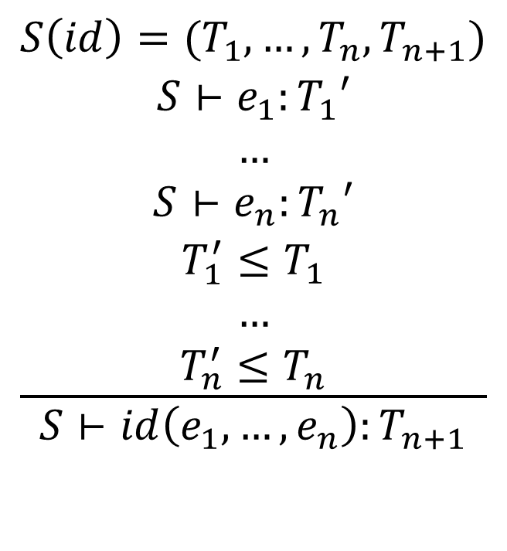
Implementation
$$\frac{\begin{aligned}S\left(id\right)=(T_{1},…,T_{n},T_{n+1}) \\ S⊢e_{1}:T_{1}′ \\ … \\ S⊢e_{n}:T_{n}′ \\ T_{1}^{′}≤T_{1} \\ … \\ T_{n}^{′}≤T_{n}\end{aligned}}{S⊢id\left(e_{1}, …, e_{n}\right):T_{n+1}}$$
Type_t TypeInfer(S, id(e₁, …,e_{n}):T_{n+1}) {
Type_t fnTy = lookup(id);
assert(fnTy.nArgs == n);
Type_t argsTy[n+1];
for (i = 1; i <= n; i++) {
argsTy[i] = TypeInfer(S, e_{i});
}
for (i = 1; i <= n; i++) {
if (!isSubtype(argsTy[i], fnTy.types[i]))
error
} // end for
return fnTy.types[n+1];
}

Slide 55
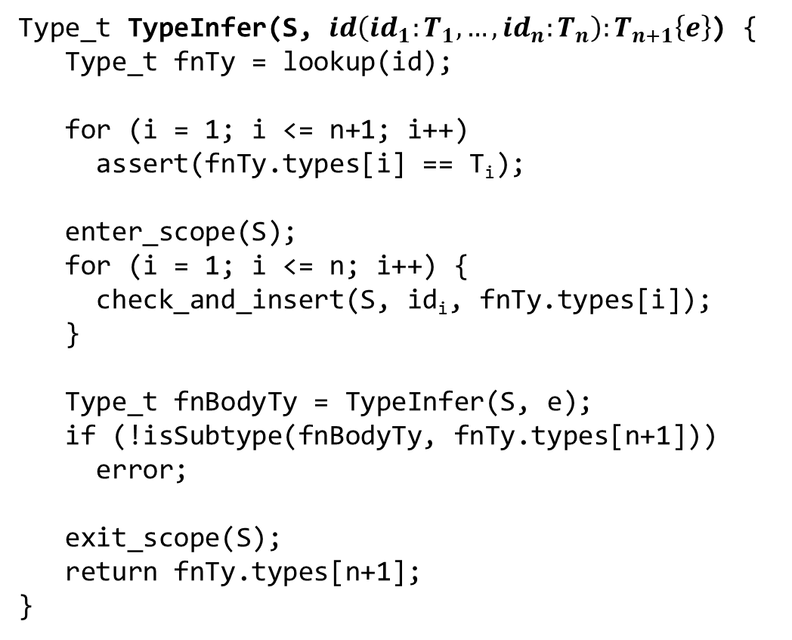
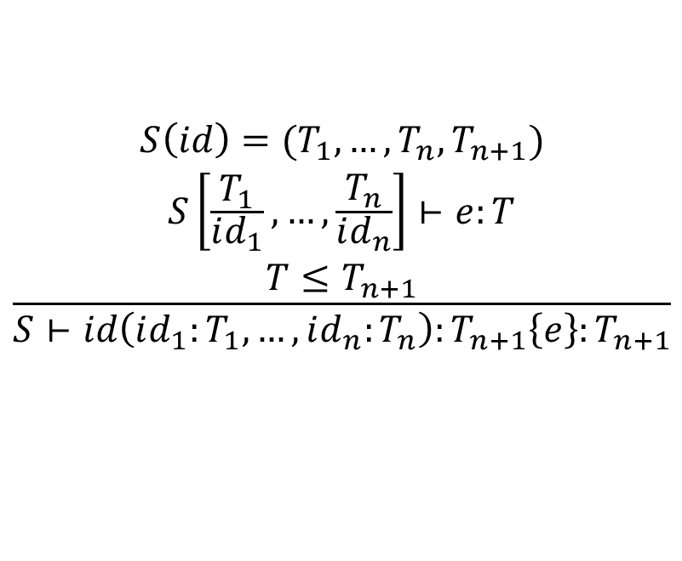
Implementation
Type_t TypeInfer(S, $id\left(id_{1}:T_{1}, …, id_{n}:T_{n}\right):T_{n+1}\left\{e\right\}$) {
Type_t fnTy = lookup(id);
for (i = 1; i <= n+1; i++)
assert(fnTy.types[i] == T_{i});
enter_scope(S);
for (i = 1; i <= n; i++) {
check_and_insert(S, id_{i}, fnTy.types[i]);
}
Type_t fnBodyTy = TypeInfer(S, e);
if (!isSubtype(fnBodyTy, fnTy.types[n+1]))
error;
exit_scope(S);
return fnTy.types[n+1];
}
$$\frac{\begin{aligned}S\left(id\right)=(T_{1},…,T_{n},T_{n+1}) \\ S\left[\frac{T_{1}}{id_{1}},…,\frac{T_{n}}{id_{n}}\right]⊢e:T \\ T≤T_{n+1}\end{aligned}}{S⊢id\left(id_{1}:T_{1}, …, id_{n}:T_{n}\right):T_{n+1}\left\{e\right\}:T_{n+1}}$$

