Slide 2
Today’s topics
Code generation

Slide 3
Lab 4
The demos for lab 4 will be scheduled for Thursday (8th Dec)

Slide 4
Code generation

Slide 5
Extra reading
Read chapter-7 from Keith and Linda

Slide 6
Code generation
After the semantic analysis, the next step is to generate an IR from the AST
The goal of an IR to transform different languages into a common language
e.g., x86 assembly is one example of IR
A compiler may transform the code into different IR(s) before generating the final code
LLVM IR, LLVM MIR

Slide 7
Code generation
After the generation of an initial IR from AST (after semantic analysis), the IR goes through multiple transformations before the final assembly code
Read Life of an instruction in LLVM IR
https://eli.thegreenplace.net/2012/11/24/life-of-an-instruction-in-llvm
In this lecture, we will discuss how to transform the AST into x86

Slide 8
Process address space
0
DATA(globals)
In 32-bit mode, all virtual addresses are 32-bit.
BSS
TEXT
main,foo,…
STACK(locals)
HEAP
0xFFFFFFFF

Slide 9
x86 32-bit mode
Eight general purpose registers
%eax, %ebx, %ecx, %edx, %esi, %edi, %esp, %ebp

Slide 10
Calling convention
For the code generation, we are going to follow a simple calling convention in which all arguments are passed via the stack
Argument passing via stack
On entry to a function call
%eip points to the first instruction of a function
%esp points to the return address
1st argument is stored at %esp+4
2nd argument is stored at %esp+8
and so on

Slide 11
Calling convention
Argument passing via stack
After the callee returns
%eip points to the return address
%esp points to the first argument passed by the caller
called function may have trashed arguments
%eax contains the return value

Slide 12
Calling convention
int foo(int a, int b) {
int c = a + b;
return c;
}
int main() {
int a = 0;
int b = 10;
return foo(a, b);
}

Slide 13
Code generation
Code generation can be done by recursive descent of the AST
• Frame pointer (%ebp) saves/restores the stack address during the function entry/exit

Slide 14
Frame pointer
int foo(int a, int b) {
int c = a + b;
return c;
}
int main() {
int a = 0;
int b = 10;
return foo(a, b);
}

Slide 15
Local variables
Local variables are allocated on the stack
fixed offset relative to %ebp
The symbol table is modified to store the offsets of local variables relative to %ebp

Slide 16
Global variables
Global variables are stored in the data section
The symbol table also contains the address of the global variables

Slide 17
Code generation
“emit” routine generates the code corresponding to an AST node
The “emit” routine may recursively call other “emit” routines to generate the code corresponding to children nodes in AST before returning to the caller
The final output of the code-generator is stored in the output assembly file

Slide 18
Code generation
In code-generation rules, we define a macro P(x) as follows:
P(x) {write string x to the output assembly file}

Slide 19
emit
“emit” preserves the stack
“emit” returns the value of the AST node in the %eax register
“%esp” register contains the stack pointer
Other registers (%ecx, %edx, %ebx, %esi, %edi, etc.) may be used to keep temporary values

Slide 20
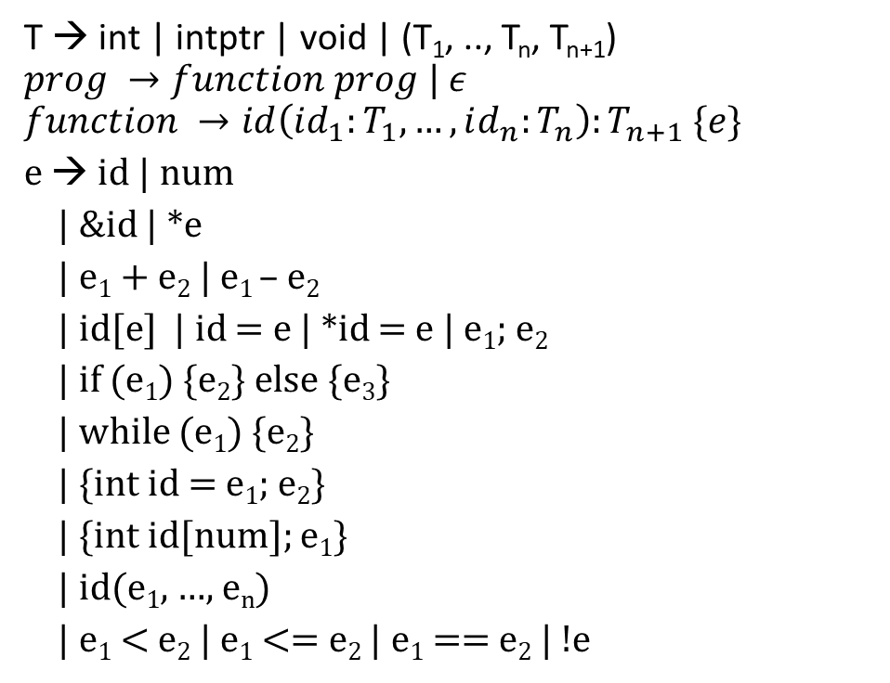
Grammar (subset of C)
T → int | intptr | void | (T₁, .., T_{n}, T_{n+1})
$$prog →function prog | ε$$
$$function →id\left(id_{1}:T_{1}, …, id_{n}:T_{n}\right):T_{n+1} \{e\}$$
e → id | num
| &id | *e
| e₁ + e₂ | e₁ – e₂
| id[e] | id = e | *id = e | e₁; e₂
| if (e₁) {e₂} else {e₃}
| while (e₁) {e₂}
| {int id = e₁; e₂}
| {int id[num]; e₁}
| id(e₁, …, e_{n})
| e₁ < e₂ | e₁ <= e₂ | e₁ == e₂ | !e

Slide 21
num
emit(num):
P(mov $num, %eax) /* replace num with integer literal */

Slide 22

Addition
emit($e_{1}+e_{2}$) :
emit(e₁)
P(mov %eax, %ecx)
emit(e₂)
P(add %ecx, %eax)

Slide 23

AST
emit($e_{1}+e_{2}$) :
emit(e₁)
P(mov %eax, %ecx)
emit(e₂)
P(add %ecx, %eax)
emit(num):
P(mov $num, %eax)
+1
+2
+3
3
5
1
2
3 + 5 + 1 + 2

Slide 24
AST
emit($e_{1}+e_{2}$) :
emit(e₁)
P(mov %eax, %ecx)
emit(e₂)
P(add %ecx, %eax)
emit(num):
P(mov $num, %eax)
+1
+2
+3
emit(+1):
emit(+2)
mov %eax, %ecx
emit(+3)
add %ecx, %eax
emit(num):
mov $num, %eax
3
5
1
2
3 + 5 + 1 + 2

Slide 25
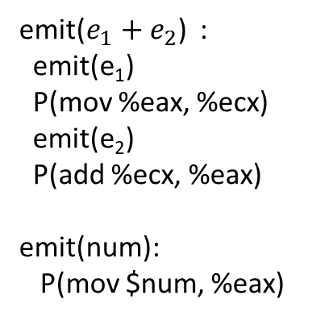
AST
emit(+2):
emit(3)
mov %eax, %ecx
emit(5)
add %ecx, %eax
+1
+2
+3
emit(+1):
emit(+2)
mov %eax, %ecx
emit(+3)
add %ecx, %eax
emit(num):
mov $num, %eax
emit(+3):
emit(1)
mov %eax, %ecx
emit(2)
add %ecx, %eax
3
5
1
2
emit($e_{1}+e_{2}$) :
emit(e₁)
P(mov %eax, %ecx)
emit(e₂)
P(add %ecx, %eax)
emit(num):
P(mov $num, %eax)
3 + 5 + 1 + 2

Slide 26
AST
emit(+2):
emit(3)
mov %eax, %ecx
emit(5)
add %ecx, %eax
+1
mov $3, %eax
mov $5, %eax
+2
+3
emit(+1):
emit(+2)
mov %eax, %ecx
emit(+3)
add %ecx, %eax
emit(num):
mov $num, %eax
emit(+3):
emit(1)
mov %eax, %ecx
emit(2)
add %ecx, %eax
mov $1, %eax
3
5
1
2
mov $2, %eax
emit($e_{1}+e_{2}$) :
emit(e₁)
P(mov %eax, %ecx)
emit(e₂)
P(add %ecx, %eax)
emit(num):
P(mov $num, %eax)
3 + 5 + 1 + 2

Slide 27
emit(+1) assembly
mov $3, %eax
mov %eax, %ecx
mov $5, %eax
add %ecx, %eax
mov %eax, %ecx
mov $1, %eax
mov %eax, %ecx
mov $2, %eax
add %ecx, %eax
add %ecx, %eax
+1
+2
+3
3
5
1
2
3 + 5 + 1 + 2

Slide 28

What is wrong with this code generation?
emit($e_{1}+e_{2}$) :
emit(e₁)
P(mov %eax, %ecx)
emit(e₂)
P(add %ecx, %eax)

Slide 29

What is wrong with this code generation?
emit($e_{1}+e_{2}$) :
emit(e₁)
P(mov %eax, %ecx)
emit(e₂) /* emit(e₂) might clobber %ecx */
P(add %ecx, %eax)

Slide 30
Stack allocation
int __off;
int stackmalloc(int x) {
__off -= x;
P(sub $x, %esp);
return __off;
}
void stackfree(int x) {
P(add $x, %esp);
__off += x
}
void stackinitialize() {
__off = 0;
}

Slide 31

Addition
emit($e_{1}+e_{2}$) :
emit(e₁)
off = stackmalloc(4)
P(mov %eax, off(%ebp))
emit(e₂)
P(mov off(%ebp), %ecx)
stackfree(4)
P(add %ecx, %eax)
What if e₂ is also an addition. Can it clobber the value of e₁ saved at offset off from the %ebp register?

Slide 32
Addition
emit($e_{1}+e_{2}$) :
emit(e₁)
off = stackmalloc(4)
P(mov %eax, off(%ebp))
emit(e₂)
P(mov off(%ebp), %ecx)
stackfree(4)
P(add %ecx, %eax)
What if e₂ is also an addition. Can it clobber the value of e₁ saved at offset off from the %ebp register?
No, because stackmalloc for e₂ will return a different offset.

Slide 33
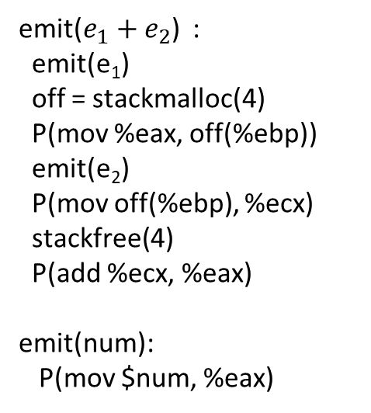
AST
emit($e_{1}+e_{2}$) :
emit(e₁)
off = stackmalloc(4)
P(mov %eax, off(%ebp))
emit(e₂)
P(mov off(%ebp), %ecx)
stackfree(4)
P(add %ecx, %eax)
emit(num):
P(mov $num, %eax)
+1
+2
+3
3
5
1
2

Slide 34
AST
emit($e_{1}+e_{2}$) :
emit(e₁)
off = stackmalloc(4)
P(mov %eax, off(%ebp))
emit(e₂)
P(mov off(%ebp), %ecx)
stackfree(4)
P(add %ecx, %eax)
emit(num):
P(mov $num, %eax)
emit(+1) :
emit(+2)
off = stackmalloc(4)
mov %eax, off(%ebp)
emit(+3)
mov off(%ebp), %ecx
stackfree(4)
add %ecx, %eax
+1
+2
+3
3
5
1
2

Slide 35
AST
emit(+1) :
emit(3)
off = stackmalloc(4)
mov %eax, off(%ebp)
emit(5)
mov off(%ebp), %ecx
stackfree(4)
add %ecx, %eax
off = stackmalloc(4)
mov %eax, off(%ebp)
emit(1)
off = stackmalloc(4)
mov %eax, off(%ebp)
emit(2)
mov off(%ebp), %ecx
stackfree(4)
add %ecx, %eax
mov off(%ebp), %ecx
stackfree(4)
add %ecx, %eax
emit($e_{1}+e_{2}$) :
emit(e₁)
off = stackmalloc(4)
P(mov %eax, off(%ebp))
emit(e₂)
P(mov off(%ebp), %ecx)
stackfree(4)
P(add %ecx, %eax)
emit(num):
P(mov $num, %eax)
+1
emit(+2)
+2
+3
3
5
1
2
emit(+3)

Slide 36
AST
emit(+1) :
emit(3)
off = stackmalloc(4) // off is -4
mov %eax, off(%ebp)
emit(5)
mov off(%ebp), %ecx
stackfree(4) // __off becomes 0
add %ecx, %eax
off = stackmalloc(4) // off is -4
mov %eax, off(%ebp)
emit(1)
off = stackmalloc(4) // off is -8
mov %eax, off(%ebp)
emit(2)
mov off(%ebp), %ecx
stackfree(4) // __off becomes -4
add %ecx, %eax
mov off(%ebp), %ecx
stackfree(4) // __off becomes 0
add %ecx, %eax
+1
emit(+2)
+2
+3
3
5
1
2
emit(+3)

Slide 37
AST
emit(+1) :
mov $3, %eax
off = stackmalloc(4) // off is -4
mov %eax, off(%ebp)
mov $5, %eax
mov off(%ebp), %ecx
stackfree(4) // __off becomes 0
add %ecx, %eax
off = stackmalloc(4) // off is -4
mov %eax, off(%ebp)
mov $1, %eax
off = stackmalloc(4) // off is -8
mov %eax, off(%ebp)
mov $2, %eax
mov off(%ebp), %ecx
stackfree(4) // __off becomes -4
add %ecx, %eax
mov off(%ebp), %ecx
stackfree(4) // __off becomes 0
add %ecx, %eax
+1
emit(+2)
+2
+3
3
5
1
2
emit(+3)

Slide 38
AST
emit(+1) :
mov $3, %eax
sub $4, %esp
mov %eax, off(%ebp)
mov $5, %eax
mov -4(%ebp), %ecx
add $4, %rsp
add %ecx, %eax
sub $4, %esp
mov %eax, -4(%ebp)
mov $1, %eax
sub $4, %esp
mov %eax, -8(%ebp)
mov $2, %eax
mov -8(%ebp), %ecx
add $4, %esp
add %ecx, %eax
mov -4(%ebp), %ecx
add $4, %esp
add %ecx, %eax
+1
emit(+2)
+2
+3
Can we further optimize this code?
3
5
1
2
emit(+3)

Slide 39

Addition
emit($e_{1}+e_{2}$) :
emit(e₁)
off = stackmalloc(4)
P(mov %eax, off(%ebp))
emit(e₂)
P(mov off(%ebp), %ecx)
stackfree(4)
if (e₁.isint())
P(add %ecx, %eax)
else
P(lea (%ecx, %eax, 4), %eax)
integer arithmetic
pointer arithmetic

Slide 40
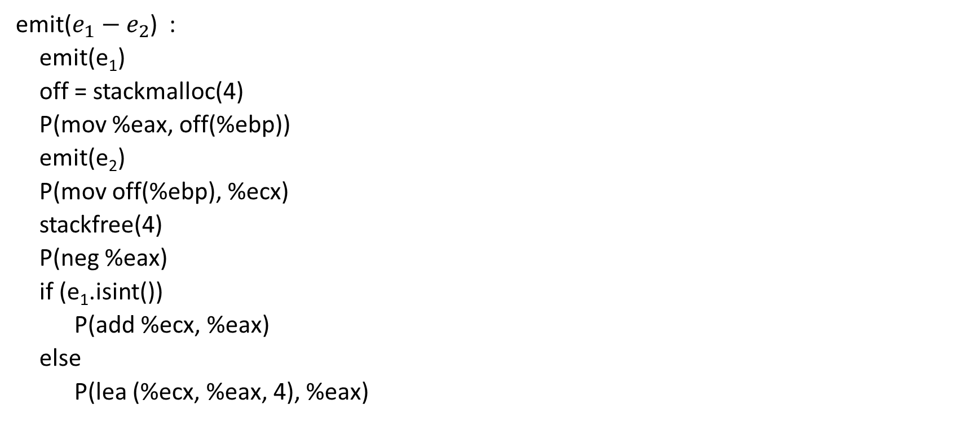
Subtraction
emit($e_{1}−e_{2}$) :
emit(e₁)
off = stackmalloc(4)
P(mov %eax, off(%ebp))
emit(e₂)
P(mov off(%ebp), %ecx)
stackfree(4)
P(neg %eax)
if (e₁.isint())
P(add %ecx, %eax)
else
P(lea (%ecx, %eax, 4), %eax)
integer arithmetic
pointer arithmetic

Slide 41
Variable declaration
{
int a = 10;
a + 20
}
emit({ int id = e₁; e₂ }):
emit(e₁)
off = stackmalloc(4);
enter_scope();
insert(id, off);
P(mov %eax, off(%ebp);)
emit(e₂)
exit_scope();
stackfree(4);

Slide 42
Variable declaration
{
int a = 10;
a + 20
}
emit(10);
off = stackmalloc(4);
enter_scope();
insert(id, off);
mov %eax, off(%ebp)
emit(a + 20);
exit_scope();
stackfree(4);
emit({ int id = e₁; e₂ }):
emit(e₁)
off = stackmalloc(4);
enter_scope();
insert(id, off);
P(mov %eax, off(%ebp);)
emit(e₂)
exit_scope();
stackfree(4);

Slide 43
Variable declaration
{
int a = 10;
a + 20
}
mov $10, %eax
off = stackmalloc(4);
enter_scope();
insert(id, off);
mov %eax, off(%ebp)
emit(a);
off = stackmalloc(4);
mov %eax, off(%ebp)
emit(20);
mov off(%ebp), %ecx
stackfree(4);
add %ecx, %eax
exit_scope();
stackfree(4);
emit({ int id = e₁; e₂ }):
emit(e₁)
off = stackmalloc(4);
enter_scope();
insert(id, off);
P(mov %eax, off(%ebp);)
emit(e₂)
exit_scope();
stackfree(4);

Slide 44
Variable declaration
{
int a = 10;
a + 20
}
mov $10, %eax
sub $4, %esp
mov %eax, -4(%ebp)
emit(a);
sub $4, %eax
mov %eax, -8(%ebp)
mov $20, %eax
mov -8(%ebp), %ecx
add $4, %esp
add %ecx, %eax
exit_scope();
stackfree(4);
emit({ int id = e₁; e₂ }):
emit(e₁)
off = stackmalloc(4);
enter_scope();
insert(id, off);
P(mov %eax, off(%ebp);)
emit(e₂)
exit_scope();
stackfree(4);
marker
(a, -4)

Slide 45
Identifier
{
int a = 10;
a + 20
}
emit(id):
off = lookup(id); // compile time
P(mov off(%ebp), %eax)
How do we ensure that lookup(id) always returns a valid offset?

Slide 46
Variable declaration
{
int a = 10;
a + 20
}
mov $10, %eax
sub $4, %esp
mov %eax, -4(%ebp)
emit(a);
sub $4, %eax
mov %eax, -8(%ebp)
mov $20, %eax
mov -8(%ebp), %ecx
add $4, %esp
add %ecx, %eax
exit_scope();
stackfree(4);
emit({ int id = e₁; e₂ }):
emit(e₁)
off = stackmalloc(4);
enter_scope();
insert(id, off);
P(mov %eax, off(%ebp);)
emit(e₂)
exit_scope();
stackfree(4);
emit(id):
off = lookup(id); // compile time
P(mov off(%ebp), %eax)
marker
(a, -4)

Slide 47
Variable declaration
{
int a = 10;
a + 20
}
mov $10, %eax
sub $4, %esp
mov %eax, -4(%ebp)
off = lookup(a); // off is -4
mov off(%ebp), %eax
sub $4, %eax
mov %eax, -8(%ebp)
mov $20, %eax
mov -8(%ebp), %ecx
add $4, %esp
add %ecx, %eax
exit_scope();
stackfree(4);
emit({ int id = e₁; e₂ }):
emit(e₁)
off = stackmalloc(4);
enter_scope();
insert(id, off);
P(mov %eax, off(%ebp);)
emit(e₂)
exit_scope();
stackfree(4);
emit(id):
off = lookup(id); // compile time
P(mov off(%ebp), %eax)
marker
(a, -4)

Slide 48
Variable declaration
{
int a = 10;
a + 20
}
mov $10, %eax
sub $4, %esp
mov %eax, -4(%ebp)
mov -4(%ebp), %eax
sub $4, %eax
mov %eax, -8(%ebp)
mov $20, %eax
mov -8(%ebp), %ecx
add $4, %esp
add %ecx, %eax
exit_scope();
stackfree(4);
emit({ int id = e₁; e₂ }):
emit(e₁)
off = stackmalloc(4);
enter_scope();
insert(id, off);
P(mov %eax, off(%ebp);)
emit(e₂)
exit_scope();
stackfree(4);
emit(id):
off = lookup(id); // compile time
P(mov off(%ebp), %eax)
marker
(a, -4)

Slide 49
Variable declaration
{
int a = 10;
a + 20
}
mov $10, %eax
sub $4, %esp
mov %eax, -4(%ebp)
mov -4(%ebp), %eax
sub $4, %eax
mov %eax, -8(%ebp)
mov $20, %eax
mov -8(%ebp), %ecx
add $4, %esp
add %ecx, %eax
add $4, %esp
emit({ int id = e₁; e₂ }):
emit(e₁)
off = stackmalloc(4);
enter_scope();
insert(id, off);
P(mov %eax, off(%ebp);)
emit(e₂)
exit_scope();
stackfree(4);
emit(id):
off = lookup(id); // compile time
P(mov off(%ebp), %eax)
marker
(a, -4)

Slide 50
Variable declaration
{
int a = 10;
{
int a = 30;
a + 20;
}
}
emit({ int id = e₁; e₂ }):
emit(e₁)
off = stackmalloc(4);
enter_scope();
insert(id, off);
P(mov %eax, off(%ebp);)
emit(e₂)
exit_scope();
stackfree(4);
emit(id):
off = lookup(id); // compile time
P(mov off(%ebp), %eax)

Slide 51
Variable declaration
{
int a = 10;
{
int a = 30;
a + 20;
}
}
emit(10);
off = stackmalloc(4);
enter_scope();
insert(id, off);
mov %eax, off(%ebp)
emit({int a=30 …});
exit_scope();
stackfree(4);
emit({ int id = e₁; e₂ }):
emit(e₁)
off = stackmalloc(4);
enter_scope();
insert(id, off);
P(mov %eax, off(%ebp);)
emit(e₂)
exit_scope();
stackfree(4);
emit(id):
off = lookup(id); // compile time
P(mov off(%ebp), %eax)

Slide 52
Variable declaration
emit(10);
off = stackmalloc(4);
enter_scope();
insert(id, off);
mov %eax, off(%ebp)
emit(30);
off = stackmalloc(4);
enter_scope();
insert(id, off);
mov %eax, off(%ebp)
emit(a + 20);
exit_scope();
stackfree(4);
exit_scope();
stackfree(4);
{
int a = 10;
{
int a = 30;
a + 20;
}
}
emit({ int id = e₁; e₂ }):
emit(e₁)
off = stackmalloc(4);
enter_scope();
insert(id, off);
P(mov %eax, off(%ebp);)
emit(e₂)
exit_scope();
stackfree(4);
emit(id):
off = lookup(id); // compile time
P(mov off(%ebp), %eax)

Slide 53
Variable declaration
emit(10);
off = stackmalloc(4);
enter_scope();
insert(id, off);
mov %eax, off(%ebp)
emit(30);
off = stackmalloc(4);
enter_scope();
insert(id, off);
mov %eax, off(%ebp)
emit(a); // off is -8
…
exit_scope();
stackfree(4);
exit_scope();
stackfree(4);
{
int a = 10;
{
int a = 30;
a + 20;
}
}
emit({ int id = e₁; e₂ }):
emit(e₁)
off = stackmalloc(4);
enter_scope();
insert(id, off);
P(mov %eax, off(%ebp);)
emit(e₂)
exit_scope();
stackfree(4);
emit(id):
off = lookup(id); // compile time
P(mov off(%ebp), %eax)
marker
(a, -4)
marker
(a, -8)

Slide 54
Variable assignment
{
int a = 10;
a = 20
}
emit({ int id = e₁; e₂ }):
emit(e₁)
off = stackmalloc(4);
enter_scope();
insert(id, off);
P(mov %eax, off(%ebp);)
emit(e₂)
exit_scope();
stackfree(4);
emit(id = e)
emit(e);
off = lookup(id); // compile time
P(mov %eax, off(%ebp))

Slide 55
Variable assignment
{
int a = 10;
a = 20
}
emit(10);
off = stackmalloc(4);
enter_scope();
insert(id, off);
mov %eax, off(%ebp)
emit(a = 20);
exit_scope();
stackfree(4);
emit({ int id = e₁; e₂ }):
emit(e₁)
off = stackmalloc(4);
enter_scope();
insert(id, off);
P(mov %eax, off(%ebp);)
emit(e₂)
exit_scope();
stackfree(4);
emit(id = e)
emit(e);
off = lookup(id); // compile time
P(mov %eax, off(%ebp))

Slide 56
Variable assignment
{
int a = 10;
a = 20
}
emit(10);
off = stackmalloc(4);
enter_scope();
insert(id, off);
mov %eax, off(%ebp)
emit(a = 20);
exit_scope();
stackfree(4);
emit({ int id = e₁; e₂ }):
emit(e₁)
off = stackmalloc(4);
enter_scope();
insert(id, off);
P(mov %eax, off(%ebp);)
emit(e₂)
exit_scope();
stackfree(4);
emit(id = e)
emit(e);
off = lookup(id); // compile time
P(mov %eax, off(%ebp))
emit(20)
off = lookup(a)
mov %eax, off(%ebp)

Slide 57
Variable assignment
{
int a = 10;
a = 20
}
mov $10, %eax
off = stackmalloc(4);
enter_scope();
insert(id, off); // off = -4
mov %eax, off(%ebp)
emit(a = 20);
exit_scope();
stackfree(4);
emit({ int id = e₁; e₂ }):
emit(e₁)
off = stackmalloc(4);
enter_scope();
insert(id, off);
P(mov %eax, off(%ebp);)
emit(e₂)
exit_scope();
stackfree(4);
emit(id = e)
emit(e);
off = lookup(id); // compile time
P(mov %eax, off(%ebp))
mov $20, %eax
off = lookup(a) // -4
mov %eax, off(%ebp)

Slide 58
Variable assignment
{
int a = 10;
a = 20
}
mov $10, %eax
sub $4, %esp
mov %eax, -4(%ebp)
emit(a = 20);
add $4, %esp
emit({ int id = e₁; e₂ }):
emit(e₁)
off = stackmalloc(4);
enter_scope();
insert(id, off);
P(mov %eax, off(%ebp);)
emit(e₂)
exit_scope();
stackfree(4);
emit(id = e)
emit(e);
off = lookup(id); // compile time
P(mov %eax, off(%ebp))
mov $20, %eax
mov %eax, -4(%ebp)

