Slide 2
Today’s topics
Code generation

Slide 3
Code generation

Slide 4
emit
“emit” preserves the stack
“emit” returns the value of the AST node in the %eax register
“%esp” register contains the stack pointer
Other registers (%ecx, %edx, %ebx, %esi, %edi, etc.) may be used to keep temporary values

Slide 5
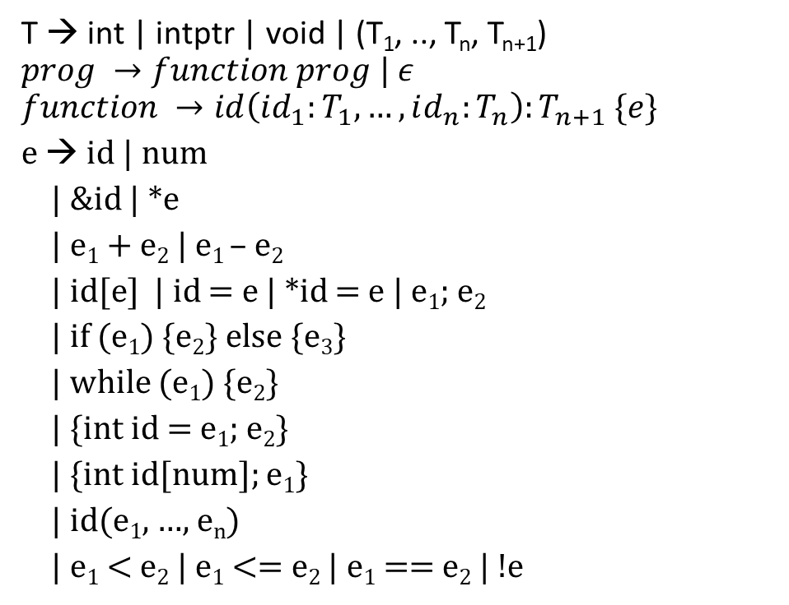
Grammar (subset of C)
T → int | intptr | void | (T₁, .., T_{n}, T_{n+1})
$$prog →function prog | ε$$
$$function →id\left(id_{1}:T_{1}, …, id_{n}:T_{n}\right):T_{n+1} \{e\}$$
e → id | num
| &id | *e
| e₁ + e₂ | e₁ – e₂
| id[e] | id = e | *id = e | e₁; e₂
| if (e₁) {e₂} else {e₃}
| while (e₁) {e₂}
| {int id = e₁; e₂}
| {int id[num]; e₁}
| id(e₁, …, e_{n})
| e₁ < e₂ | e₁ <= e₂ | e₁ == e₂ | !e

Slide 6
Stack allocation
int __off;
int stackmalloc(int x) {
__off -= x;
P(sub $x, %esp);
return __off;
}
void stackfree(int x) {
P(add $x, %esp);
__off += x
}
void stackinitialize() {
__off = 0;
}

Slide 7
Array declaration
{
int a[10];
a[5]
}
emit({ int id[num]; e₁ }):
off = stackmalloc(4 + (num*4));
arroff = off + 4;
P(lea arroff(%ebp), %eax)
P(mov %eax, off(%ebp))
enter_scope();
insert(id, off);
emit(e₁);
exit_scope();
stackfree(4 + (num*4));
x
x+40
int *a;
x

Slide 8
Array dereference
{
int a[10];
a[5]
}
emit(id[e]):
emit(e);
off = lookup(id); // compile time
P(mov off(%ebp), %ecx)
P(mov (%ecx, %eax, 4), %eax)
x
int *id;
x

Slide 9
Array declaration
{
int a[10];
*a
}
emit({ int id[num]; e₁ }):
off = stackmalloc(4 + (num*4));
arroff = off + 4;
P(lea arroff(%ebp), %eax)
P(mov %eax, off(%ebp))
enter_scope();
insert(id, off);
emit(e₁);
exit_scope();
stackfree(4 + (num*4));
x
x+40
int *a;
x

Slide 10
Pointer dereference
{
int a[10];
*a
}
emit(*e):
emit(e);
P(mov (%eax), %eax)
emit(id):
off = lookup(id); // compile time
P(mov off(%ebp), %eax)

Slide 11
Array declaration
{
int a[10];
a[5] = 20
}
emit({ int id[num]; e₁ }):
off = stackmalloc(4 + (num*4));
arroff = off + 4;
P(lea arroff(%ebp), %eax)
P(mov %eax, off(%ebp))
enter_scope();
insert(id, off);
emit(e₁);
exit_scope();
stackfree(4 + (num*4));
x
x+40
int *a;
x

Slide 12
Array assignment
{
int a[10];
a[5] = 20
}
emit(id[e₁] = e₂)
emit(e₂);
t = stackmalloc(4);
P(mov %eax, t(%ebp))
off = lookup(id);
emit(e₁);
P(mov t(%ebp), %ecx)
stackfree(4);
P(mov off(%ebp), %edx)
P(mov %ecx, (%edx, %eax, 4))
P(mov %ecx, %eax)
Why does the order of evaluation of e₁ and e₂ matter?

Slide 13
Array assignment
{
int a[10];
a[5] = 20
}
emit(id[e₁] = e₂)
emit(e₂);
t = stackmalloc(4);
P(mov %eax, t(%ebp))
off = lookup(id);
emit(e₁);
P(mov t(%ebp), %ecx)
stackfree(4);
P(mov off(%ebp), %edx)
P(mov %ecx, (%edx, %eax, 4))
P(mov %ecx, %eax)
Why does the order of evaluation of e₁ and e₂ matter?
Is it possible that e₁ may yield a different value if e₂ executes first?

Slide 14
Function call
foo(10, 20)
emit(id(e₁, …, e_{n}))
z = n * 4;
off = stackalloc(z);
for (i = 1; i <= n; i++) {
emit(e_{i});
arg_off = off + (i-1)*4;
P(mov %eax, arg_off(%ebp))
}
P(call id)
stackfree(z);

Slide 15
Function definition
foo(a:int, b:int):int {
a + b
}
emit(id(id₁, …, id_{n}) {e})
P(id:)
P(push %ebp)
P(mov %esp, %ebp)
stackinitialize();
enter_scope();
for (i = 1; i <= n; i++)
insert(id_{i}, (i * 4) + 4);
emit(e);
exit_scope();
P(mov %ebp, %esp)
P(pop %ebp)
P(ret)

Slide 16
Conditional branch instructions in x86
je, ja, jae, jb, jz, etc.

Slide 17
Loop
Will there be an issue if e₂ is also a while loop?
emit(while(e₁){e₂}):
P(label1:)
emit(e₁)
P(cmp $0, %eax)
P(je label2)
emit(e₂)
P(jmp label1)
P(label2:)

Slide 18
Loop
Will there be an issue if e₂ is also a while loop?
label1:
emit(a < 10)
cmp $0, %eax
je label2
emit(a = a – 1);
label1:
emit(b < 20)
cmp $0, %eax
je label2
emit(b = b -1)
jmp label1
label2:
jmp label1
label2:
emit(while(e₁){e₂}):
P(label1:)
emit(e₁)
P(cmp $0, %eax)
P(je label2)
emit(e₂)
P(jmp label1)
P(label2:)
while (a < 10) {
a = a – 1;
while (b < 20) {
b = b - 1
}
}

Slide 19
Loop
emit(while(e₁){e₂}):
l1 = get_label();
l2 = get_label();
P(l1:)
emit(e₁)
P(cmp $0, %eax)
P(je l2)
emit(e₂)
P(jmp l1)
P(l2:)
The Use of fixed names label1 and label2 in the loop body is ambiguous because e₂ could be a loop. get_label() always returns a unique label. get_label may keep a global counter to implement this functionality.

Slide 20
Condition
emit(if (e₁) {e₂} else {e₃}):
l1 = get_label();
l2 = get_label();
emit(e₁);
P(cmp $0, %eax)
P(je l1)
emit(e₂)
P(jmp l2)
P(l1:) /* else */
emit(e₃);
P(l2:) /* end-if */

Slide 21
address of
emit(&id):
off = lookup(id);
P(lea off(%ebp), %eax)

Slide 22
Address of
emit(id(e₁, …, e_{n}))
z = n * 4;
off = stackalloc(z);
for (i = 1; i <= n; i++) {
emit(e_{i});
arg_off = off + (i-1)*4;
P(mov %eax, arg_off(%ebp))
}
P(call id)
stackfree(z);
emit({ int id = e₁; e₂ }):
emit(e₁)
off = stackmalloc(4);
enter_scope();
insert(id, off);
P(mov %eax, off(%ebp);)
emit(e₂)
exit_scope();
stackfree(4);
{
int a = 10;
foo(&a)
}
emit(&id):
off = lookup(id);
P(lea off(%ebp), %eax)

Slide 23
Block
emit(e₁; e₂)
emit(e₁)
emit(e₂)

Slide 24
Example
sum(inarr:intptr, n:int):int {
{
int ret = 0;
if (n) {
ret = inarr[0] + sum(inarr+1, n-1)
} else {
ret = 0
};
ret
}
}

Slide 25
sum(inarr:intptr, n:int):int {
{
int ret = 0;
if (n) {
ret = inarr[0] + sum(inarr+1, n-1)
} else {
ret = 0
};
ret
}
}
emit(id(id₁, …, id_{n}) {e})
P(id:)
P(push %ebp)
P(mov %esp, %ebp)
stackinitialize();
enter_scope();
for (i = 1; i <= n; i++)
insert(id_{i}, (i * 4) + 4);
emit(e);
exit_scope();
P(mov %ebp, %esp)
P(pop %ebp)
P(ret)

Slide 26
sum(inarr:intptr, n:int):int {
{
int ret = 0;
if (n) {
ret = inarr[0] + sum(inarr+1, n-1)
} else {
ret = 0
};
ret
}
}
MARKER
inarr | 8
n | 12
emit(id(id₁, …, id_{n}) {e})
P(id:)
P(push %ebp)
P(mov %esp, %ebp)
stackinitialize();
enter_scope();
for (i = 1; i <= n; i++)
insert(id_{i}, (i * 4) + 4);
emit(e);
exit_scope();
P(mov %ebp, %esp)
P(pop %ebp)
P(ret)
sum:
push %ebp
mov %esp, %ebp

Slide 27
sum(inarr:intptr, n:int):int {
{
int ret = 0;
if (n) {
ret = inarr[0] + sum(inarr+1, n-1)
} else {
ret = 0
};
ret
}
}
MARKER
inarr | 8
n | 12
emit({ int id = e₁; e₂ }):
emit(e₁)
off = stackmalloc(4);
enter_scope();
insert(id, off);
P(mov %eax, off(%ebp);)
emit(e₂)
exit_scope();
stackfree(4);

Slide 28
sum(inarr:intptr, n:int):int {
{
int ret = 0;
if (n) {
ret = inarr[0] + sum(inarr+1, n-1)
} else {
ret = 0
};
ret
}
}
MARKER
inarr | 8
n | 12
ret | -4
MARKER
emit({ int id = e₁; e₂ }):
emit(e₁)
off = stackmalloc(4);
enter_scope();
insert(id, off);
P(mov %eax, off(%ebp);)
emit(e₂)
exit_scope();
stackfree(4);
mov $0, %eax // 0
sub $4, %esp // allocate ret = ebp - 4
mov %eax, -4(%ebp) // ret = 0

Slide 29
sum(inarr:intptr, n:int):int {
{
int ret = 0;
if (n) {
ret = inarr[0] + sum(inarr+1, n-1)
} else {
ret = 0
};
ret
}
}
MARKER
inarr | 8
n | 12
ret | -4
emit(id):
off = lookup(id); // compile time
P(mov off(%ebp), %eax)
emit(if (e₁) {e₂} else {e₃}):
l1 = get_label();
l2 = get_label();
emit(e₁);
P(cmp $0, %eax)
P(je l1)
emit(e₂)
P(jmp l2)
P(l1:) /* else */
emit(e₃);
P(l2:) /* endif */
MARKER

Slide 30
sum(inarr:intptr, n:int):int {
{
int ret = 0;
if (n) {
ret = inarr[0] + sum(inarr+1, n-1)
} else {
ret = 0
};
ret
}
}
MARKER
inarr | 8
n | 12
ret | -4
emit(id):
off = lookup(id); // compile time
P(mov off(%ebp), %eax)
emit(if (e₁) {e₂} else {e₃}):
l1 = get_label();
l2 = get_label();
emit(e₁);
P(cmp $0, %eax)
P(je l1)
emit(e₂)
P(jmp l2)
P(l1:) /* else */
emit(e₃);
P(l2:) /* endif */
MARKER
mov 12(%ebp), %eax // read n
cmp $0, %eax // n == 0
je else // if n == 0 jump to else

Slide 31
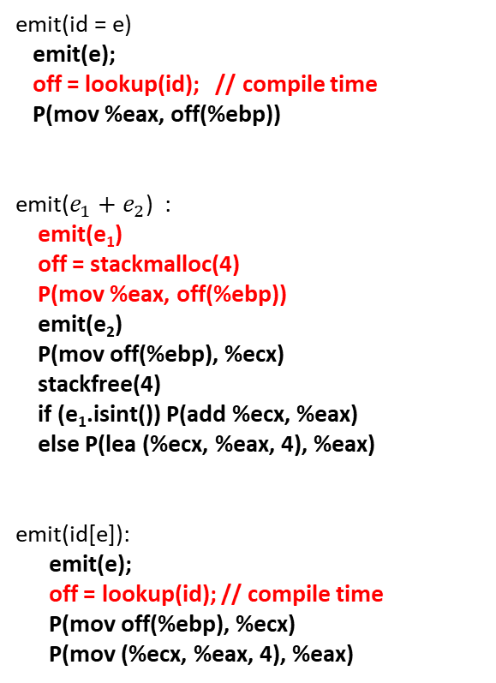
sum(inarr:intptr, n:int):int {
{
int ret = 0;
if (n) {
ret = inarr[0] + sum(inarr+1, n-1)
} else {
ret = 0
};
ret
}
}
emit(id = e)
emit(e);
off = lookup(id); // compile time
P(mov %eax, off(%ebp))
emit($e_{1}+e_{2}$) :
emit(e₁)
off = stackmalloc(4)
P(mov %eax, off(%ebp))
emit(e₂)
P(mov off(%ebp), %ecx)
stackfree(4)
if (e₁.isint()) P(add %ecx, %eax)
else P(lea (%ecx, %eax, 4), %eax)
emit(id[e]):
emit(e);
off = lookup(id); // compile time
P(mov off(%ebp), %ecx)
P(mov (%ecx, %eax, 4), %eax)
MARKER
inarr | 8
n | 12
ret | -4
MARKER

Slide 32
sum(inarr:intptr, n:int):int {
{
int ret = 0;
if (n) {
ret = inarr[0] + sum(inarr+1, n-1)
} else {
ret = 0
};
ret
}
}
emit(id = e)
emit(e);
off = lookup(id); // compile time
P(mov %eax, off(%ebp))
emit($e_{1}+e_{2}$) :
emit(e₁)
off = stackmalloc(4)
P(mov %eax, off(%ebp))
emit(e₂)
P(mov off(%ebp), %ecx)
stackfree(4)
if (e₁.isint()) P(add %ecx, %eax)
else P(lea (%ecx, %eax, 4), %eax)
emit(id[e]):
emit(e);
off = lookup(id); // compile time
P(mov off(%ebp), %ecx)
P(mov (%ecx, %eax, 4), %eax)
MARKER
inarr | 8
n | 12
ret | -4
inarr[0] | -8
MARKER
mov $0, %eax // eax = 0
mov 8(%ebp), %ecx // read inarr
mov (%ecx, %eax, 4), %eax // eax = inarr[0]
sub $4, %esp // allocate t = ebp -8
mov %eax, -8(%ebp) // t = inarr[0]

Slide 33

sum(inarr:intptr, n:int):int {
{
int ret = 0;
if (n) {
ret = inarr[0] + sum(inarr+1, n-1)
} else {
ret = 0
};
ret
}
}
emit(id = e)
emit(e);
off = lookup(id); // compile time
P(mov %eax, off(%ebp))
emit($e_{1}+e_{2}$) :
emit(e₁)
off = stackmalloc(4)
P(mov %eax, off(%ebp))
emit(e₂)
P(mov off(%ebp), %ecx)
stackfree(4)
if (e₁.isint()) P(add %ecx, %eax)
else P(lea (%ecx, %eax, 4), %eax)
emit(id(e₁, …, e_{n}))
z = n * 4;
off = stackalloc(z);
for (i = 1; i <= n; i++) {
emit(e₁);
arg_off = off + (i-1)*4;
P(mov %eax, arg_off(%ebp))
}
P(call id)
stackfree(z);
MARKER
inarr | 8
n | 12
ret | -4
inarr[0] | -8
MARKER

Slide 34
sum(inarr:intptr, n:int):int {
{
int ret = 0;
if (n) {
ret = inarr[0] + sum(inarr+1, n-1)
} else {
ret = 0
};
ret
}
}
emit(id = e)
emit(e);
off = lookup(id); // compile time
P(mov %eax, off(%ebp))
emit($e_{1}+e_{2}$) :
emit(e₁)
off = stackmalloc(4)
P(mov %eax, off(%ebp))
emit(e₂)
P(mov off(%ebp), %ecx)
stackfree(4)
if (e₁.isint()) P(add %ecx, %eax)
else P(lea (%ecx, %eax, 4), %eax)
emit(id(e₁, …, e_{n}))
z = n * 4;
off = stackalloc(z);
for (i = 1; i <= n; i++) {
emit(e₁);
arg_off = off + (i-1)*4;
P(mov %eax, arg_off(%ebp))
}
P(call id)
stackfree(z);
MARKER
inarr | 8
n | 12
ret | -4
inarr[0] | -8
off | -16
MARKER
sub $8, %esp // allocate 8 bytes for args = ebp - 16

Slide 35

sum(inarr:intptr, n:int):int {
{
int ret = 0;
if (n) {
ret = inarr[0] + sum(inarr+1, n-1)
} else {
ret = 0
};
ret
}
}
emit(id = e)
emit(e);
off = lookup(id); // compile time
P(mov %eax, off(%ebp))
emit($e_{1}+e_{2}$) :
emit(e₁)
off = stackmalloc(4)
P(mov %eax, off(%ebp))
emit(e₂)
P(mov off(%ebp), %ecx)
stackfree(4)
if (e₁.isint()) P(add %ecx, %eax)
else P(lea (%ecx, %eax, 4), %eax)
emit(id(e₁, …, e_{n}))
z = n * 4;
off = stackalloc(z);
for (i = 1; i <= n; i++) {
emit(e₁);
arg_off = off + (i-1)*4;
P(mov %eax, arg_off(%ebp))
}
P(call id)
stackfree(z);
emit(id):
off = lookup(id); // compile time
P(mov off(%ebp), %eax
MARKER
inarr | 8
n | 12
ret | -4
inarr[0] | -8
off | -16
MARKER

Slide 36
sum(inarr:intptr, n:int):int {
{
int ret = 0;
if (n) {
ret = inarr[0] + sum(inarr+1, n-1)
} else {
ret = 0
};
ret
}
}
emit(id = e)
emit(e);
off = lookup(id); // compile time
P(mov %eax, off(%ebp))
emit($e_{1}+e_{2}$) :
emit(e₁)
off = stackmalloc(4)
P(mov %eax, off(%ebp))
emit(e₂)
P(mov off(%ebp), %ecx)
stackfree(4)
if (e₁.isint()) P(add %ecx, %eax)
else P(lea (%ecx, %eax, 4), %eax)
emit(id(e₁, …, e_{n}))
z = n * 4;
off = stackalloc(z);
for (i = 1; i <= n; i++) {
emit(e₁);
arg_off = off + (i-1)*4;
P(mov %eax, arg_off(%ebp))
}
P(call id)
stackfree(z);
emit(id):
off = lookup(id); // compile time
P(mov off(%ebp), %eax
MARKER
inarr | 8
n | 12
ret | -4
inarr[0] | -8
off | -16
inarr | -20
MARKER
mov 8(%ebp), %eax // read inarr
sub $4, %esp // allocate t2 = ebp -20
mov %eax, -20(%ebp) // t2 = inarr
mov $1, %eax // eax = 1
mov -20(%ebp), %ecx // ecx = t2 = inarr
add $4, %esp // free t2
lea (%ecx, %eax, 4), %eax // eax = inarr + 1
mov %eax, -16(%ebp) // args[0] = inarr + 1

Slide 37

sum(inarr:intptr, n:int):int {
{
int ret = 0;
if (n) {
ret = inarr[0] + sum(inarr+1, n-1)
} else {
ret = 0
};
ret
}
}
emit(id = e)
emit(e);
off = lookup(id); // compile time
P(mov %eax, off(%ebp))
emit($e_{1}+e_{2}$) :
emit(e₁)
off = stackmalloc(4)
P(mov %eax, off(%ebp))
emit(e₂)
P(mov off(%ebp), %ecx)
stackfree(4)
if (e₁.isint()) P(add %ecx, %eax)
else P(lea (%ecx, %eax, 4), %eax)
emit(id(e₁, …, e_{n}))
z = n * 4;
off = stackalloc(z);
for (i = 1; i <= n; i++) {
emit(e₁);
arg_off = off + (i-1)*4;
P(mov %eax, arg_off(%ebp))
}
P(call id)
stackfree(z);
emit(id):
off = lookup(id); // compile time
P(mov off(%ebp), %eax
MARKER
inarr | 8
n | 12
ret | -4
inarr[0] | -8
off | -16
MARKER

Slide 38
sum(inarr:intptr, n:int):int {
{
int ret = 0;
if (n) {
ret = inarr[0] + sum(inarr+1, n-1)
} else {
ret = 0
};
ret
}
}
emit(id = e)
emit(e);
off = lookup(id); // compile time
P(mov %eax, off(%ebp))
emit($e_{1}+e_{2}$) :
emit(e₁)
off = stackmalloc(4)
P(mov %eax, off(%ebp))
emit(e₂)
P(mov off(%ebp), %ecx)
stackfree(4)
if (e₁.isint()) P(add %ecx, %eax)
else P(lea (%ecx, %eax, 4), %eax)
emit(id(e₁, …, e_{n}))
z = n * 4;
off = stackalloc(z);
for (i = 1; i <= n; i++) {
emit(e₁);
arg_off = off + (i-1)*4;
P(mov %eax, arg_off(%ebp))
}
P(call id)
stackfree(z);
emit(id):
off = lookup(id); // compile time
P(mov off(%ebp), %eax
MARKER
inarr | 8
n | 12
ret | -4
inarr[0] | -8
off | -16
n | -20
MARKER
mov 12(%ebp), %eax // eax = n
sub $4, %esp // allocate t3 = ebp -20
mov %eax, -20(%ebp) // t3 = n
mov $1, %eax // eax = 1
neg %eax // eax = -eax
mov -20(%ebp), %ecx // ecx = t3 = n
add $4, %esp // free t3
add %ecx, %eax // eax = n – 1
mov %eax, -12(%ebp) // args[1] = n-1

Slide 39

sum(inarr:intptr, n:int):int {
{
int ret = 0;
if (n) {
ret = inarr[0] + sum(inarr+1, n-1)
} else {
ret = 0
};
ret
}
}
emit(id = e)
emit(e);
off = lookup(id); // compile time
P(mov %eax, off(%ebp))
emit($e_{1}+e_{2}$) :
emit(e₁)
off = stackmalloc(4)
P(mov %eax, off(%ebp))
emit(e₂)
P(mov off(%ebp), %ecx)
stackfree(4)
if (e₁.isint()) P(add %ecx, %eax)
else P(lea (%ecx, %eax, 4), %eax)
emit(id(e₁, …, e_{n}))
z = n * 4;
off = stackalloc(z);
for (i = 1; i <= n; i++) {
emit(e₁);
arg_off = off + (i-1)*4;
P(mov %eax, arg_off(%ebp))
}
P(call id)
stackfree(z);
MARKER
inarr | 8
n | 12
ret | -4
inarr[0] | -8
off | -16
MARKER

Slide 40
sum(inarr:intptr, n:int):int {
{
int ret = 0;
if (n) {
ret = inarr[0] + sum(inarr+1, n-1)
} else {
ret = 0
};
ret
}
}
emit(id = e)
emit(e);
off = lookup(id); // compile time
P(mov %eax, off(%ebp))
emit($e_{1}+e_{2}$) :
emit(e₁)
off = stackmalloc(4)
P(mov %eax, off(%ebp))
emit(e₂)
P(mov off(%ebp), %ecx)
stackfree(4)
if (e₁.isint()) P(add %ecx, %eax)
else P(lea (%ecx, %eax, 4), %eax)
emit(id(e₁, …, e_{n}))
z = n * 4;
off = stackalloc(z);
for (i = 1; i <= n; i++) {
emit(e₁);
arg_off = off + (i-1)*4;
P(mov %eax, arg_off(%ebp))
}
P(call id)
stackfree(z);
MARKER
inarr | 8
n | 12
ret | -4
inarr[0] | -8
off | -16
MARKER
call sum
add $8, %esp // free args
mov -8(%ebp), %ecx // ecx = inarr[0]
add $4, %esp // free inarr[0]
add %ecx, %eax // %eax = inarr[0] + sum(inarr+1, n-1)
mov %eax, -4(%ebp) // ret = inarr[0] + sum(inarr+1, n-1)

Slide 41
sum(inarr:intptr, n:int):int {
{
int ret = 0;
if (n) {
ret = inarr[0] + sum(inarr+1, n-1)
} else {
ret = 0
};
ret
}
}
MARKER
inarr | 8
n | 12
ret | -4
emit(if (e₁) {e₂} else {e₃}):
l1 = get_label();
l2 = get_label();
emit(e₁);
P(cmp $0, %eax)
P(je l1)
emit(e₂)
P(jmp l2)
P(l1:) /* else */
emit(e₃);
P(l2:) /* endif */
MARKER

Slide 42
sum(inarr:intptr, n:int):int {
{
int ret = 0;
if (n) {
ret = inarr[0] + sum(inarr+1, n-1)
} else {
ret = 0
};
ret
}
}
MARKER
inarr | 8
n | 12
ret | -4
emit(id = e)
emit(e);
off = lookup(id); // compile time
P(mov %eax, off(%ebp))
emit(if (e₁) {e₂} else {e₃}):
l1 = get_label();
l2 = get_label();
emit(e₁);
P(cmp $0, %eax)
P(je l1)
emit(e₂)
P(jmp l2)
P(l1:) /* else */
emit(e₃);
P(l2:) /* endif */
MARKER

Slide 43
sum(inarr:intptr, n:int):int {
{
int ret = 0;
if (n) {
ret = inarr[0] + sum(inarr+1, n-1)
} else {
ret = 0
};
ret
}
}
MARKER
inarr | 8
n | 12
ret | -4
emit(id = e)
emit(e);
off = lookup(id); // compile time
P(mov %eax, off(%ebp))
emit(if (e₁) {e₂} else {e₃}):
l1 = get_label();
l2 = get_label();
emit(e₁);
P(cmp $0, %eax)
P(je l1)
emit(e₂)
P(jmp l2)
P(l1:) /* else */
emit(e₃);
P(l2:) /* endif */
MARKER
else:
mov $0, %eax // eax = 0
mov %eax, -4(%ebp) // ret = 0
endif:

Slide 44
sum(inarr:intptr, n:int):int {
{
int ret = 0;
if (n) {
ret = inarr[0] + sum(inarr+1, n-1)
} else {
ret = 0
};
ret
}
}
MARKER
inarr | 8
n | 12
ret | -4
MARKER
emit(id):
off = lookup(id); // compile time
P(mov off(%ebp), %eax)

Slide 45
sum(inarr:intptr, n:int):int {
{
int ret = 0;
if (n) {
ret = inarr[0] + sum(inarr+1, n-1)
} else {
ret = 0
};
ret
}
}
MARKER
inarr | 8
n | 12
ret | -4
MARKER
emit(id):
off = lookup(id); // compile time
P(mov off(%ebp), %eax)
mov -4(%ebp), %eax // eax = ret

Slide 46
sum(inarr:intptr, n:int):int {
{
int ret = 0;
if (n) {
ret = inarr[0] + sum(inarr+1, n-1)
} else {
ret = 0
};
ret
}
}
MARKER
inarr | 8
n | 12
ret | -4
MARKER
emit({ int id = e₁; e₂ }):
emit(e₁)
off = stackmalloc(4);
enter_scope();
insert(id, off);
P(mov %eax, off(%ebp);)
emit(e₂)
exit_scope();
stackfree(4);

Slide 47
sum(inarr:intptr, n:int):int {
{
int ret = 0;
if (n) {
ret = inarr[0] + sum(inarr+1, n-1)
} else {
ret = 0
};
ret
}
}
MARKER
inarr | 8
n | 12
ret | -4
emit({ int id = e₁; e₂ }):
emit(e₁)
off = stackmalloc(4);
enter_scope();
insert(id, off);
P(mov %eax, off(%ebp);)
emit(e₂)
exit_scope();
stackfree(4);
add $4, %esp // free ret

Slide 48
sum(inarr:intptr, n:int):int {
{
int ret = 0;
if (n) {
ret = inarr[0] + sum(inarr+1, n-1)
} else {
ret = 0
};
ret
}
}
MARKER
inarr | 8
n | 12
emit(id(id₁, …, id_{n}) {e})
P(id:)
P(push %ebp)
P(mov %esp, %ebp)
stackinitialize();
enter_scope();
for (i = 1; i <= n; i++)
insert(id_{i}, (i * 4) + 4);
emit(e);
exit_scope();
P(mov %ebp, %esp)
P(pop %ebp)
P(ret)

Slide 49
sum(inarr:intptr, n:int):int {
{
int ret = 0;
if (n) {
ret = inarr[0] + sum(inarr+1, n-1)
} else {
ret = 0
};
ret
}
}
inarr | 8
n | 12
emit(id(id₁, …, id_{n}) {e})
P(id:)
P(push %ebp)
P(mov %esp, %ebp)
stackinitialize();
enter_scope();
for (i = 1; i <= n; i++)
insert(id_{i}, (i * 4) + 4);
emit(e);
exit_scope();
P(mov %ebp, %esp)
P(pop %ebp)
P(ret)
mov %ebp, %esp
pop %ebp
ret

Slide 50
Operational semantics
Operation rules can be expressed similar to logical rules of inference
In operational semantics rules, the preconditions and conclusion are evaluation judgments
We are going to skip this discussion in this course

Slide 51
PL research
Memory safety
software security
overheads of memory safety
need to port Windows, Linux, libraries, etc., to a memory-safe language (unrealistic)
retrofitting memory safety to legacy code
new hardware for memory safety
Program verification
failure of critical software, e.g., software running: aircraft, medical equipment, power stations, banking, etc., may have severe consequences
much better if we have formal proof
existing techniques are not scalable

Slide 52
PL research
Program synthesis
Automatic generation of code from a specification
e.g., automatically generate type-checker from the logical rules of inference
Improve existing program
Program itself is a specification, and the goal is to generate the optimal program
Generate program from input-output examples
e.g., Flash Fill in Microsoft Excel
Domain-specific language
SQL (database), P4 (network data forwarding), HTML (web pages), compilers for IoT etc.
Concurrency, semantics, and many more

Slide 53
Questions

Slide 54
Thank you

