Slide 1
Compilers
Lecture-5

Slide 2
Today’s topics
Data flow analysis
Constant propagation
Live variable analysis

Slide 3
Data-flow analysis
Data-flow analysis is a static analysis
The goal of a data-flow analysis is to extract some facts of the program at a given program point
Data-flow analysis considers all program paths that are possible during the execution
Infinite number of possible execution paths
Data-flow analysis summarizes all possible program states at a given program point with a finite set of facts
Read Section-9.2 and 9.4 from the dragon book

Slide 4
Constant propagation
ENTRY
BB0
The goal of constant propagation data-flow analysis is to find out whether the value of a variable is constant at a given program point or not.
In this example, we are trying to find the value of variable c at all program points.
1.
2.
3.
arg a
c = 3
if (a > 2) goto label
BB1
BB2
label:
c = c + c
x = y - z
x = y + z
z = c * c
4.
5.
6.
7.
BB3
a = c * c
return a
8.
9.
EXIT
Notes:
This exercise aims to compute the value of variable “c” at all program points. Notice that for BB3, the value of c coming from BB1 is 6, and BB2 is 3. When the compiler is unable to determine a unique constant value for c at a given point, then the compiler assumes that the value of c is not a constant at that point. In this example, the value c is not constant in BB3.

Slide 5
IN and OUT
In a data-flow analysis framework, we maintain two maps IN and OUT
IN contains the mapping from a statement to the set of facts that are true before the statement
OUT contains the mapping from a statement to the set of facts that are true after the statement

Slide 6
Data-flow analysis
Forward data-flow analysis
In the forward data-flow analysis, we start from the ENRTY node and compute the facts (IN and OUT) in the forward direction (from ENTRY to EXIT)
Backward data-flow analysis
In the backward data-flow analysis, we start from the EXIT node and compute the facts (IN and OUT) in the backward direction (from EXIT to ENRTY)

Slide 7
Forward data-flow analysis
Constant propagation is a forward data-flow analysis

Slide 8

Constant propagation
ENTRY
Compute the value of “c” at all program points.
Initialization:
for (each basic block BB)
OUT[BB] = UNDEF;
Meet operator:
$$c∧c=c$$
$$c_{1}∧c_{2}=NAC$$
$$UNDEF∧c=c$$
$$c∧NAC=NAC$$
$$UNDEF∧NAC=NAC$$
$$NAC∧NAC=NAC$$
$$UNDEF∧UNDEF=UNDEF$$
arg a
c = 3
if (a > 2) goto label
label:
c = c + c
x = y – z
if (c > 10 ) goto label
x = y + z
z = c * c
a = c * c
return a
EXIT
Notes:
There are multiple possible values of the variable “c”. It can be undefined (UNDEF), or not a constant (NAC), or a constant c (any constant integer). We initialize the output of all basic blocks with UNDEF. The meet operator operations are listed on this slide.

Slide 9
Initialization
For each basic block BB in the CFG
OUT[BB] = UNDEF

Slide 10
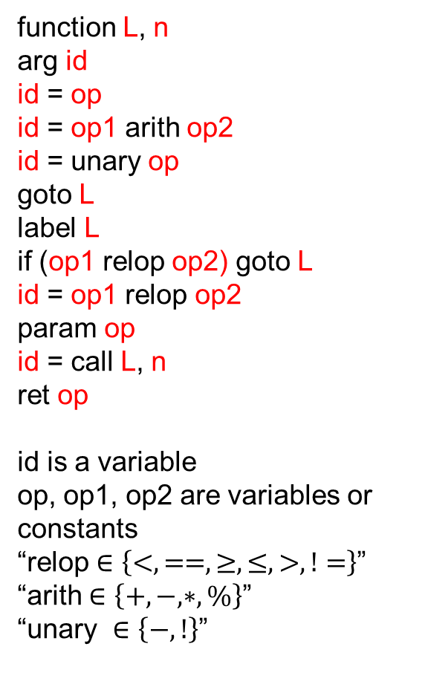
Transfer function
function L, n
arg id
id = op
id = op1 arith op2
id = unary op
goto L
label L
if (op1 relop op2) goto L
id = op1 relop op2
param op
id = call L, n
ret op
id is a variable
op, op1, op2 are variables or constants
“relop $∈\left\{<, ==, ≥, ≤, >, !=\right\}$”
“arith $∈\left\{+, −, ∗,\%\right\}$”
“unary $∈\left\{−, !\right\}$”
f_{id = op}(IN[s]):

Slide 11
Transfer function
function L, n
arg id
id = op
id = op1 arith op2
id = unary op
goto L
label L
if (op1 relop op2) goto L
id = op1 relop op2
param op
id = call L, n
ret op
id is a variable
op, op1, op2 are variables or constants
“relop $∈\left\{<, ==, ≥, ≤, >, !=\right\}$”
“arith $∈\left\{+, −, ∗,\%\right\}$”
“unary $∈\left\{−, !\right\}$”
f_{id = op}(IN[s]):
if (id.getName().equals(“c”)) {
if (op.isConst()) {
OUT[s] = op.getValue();
}
else if (op.getName().equals(“c”)) {
OUT[s] = IN[s];
}
else
OUT[s] = NAC;
}
else {
OUT[s] = IN[s];
}
Notes:
In this case, if both id and op are the variable c or id is some other variable, then the OUT[s] would be the same as IN[s]. Otherwise, if op is constant, OUT[s] contains the constant value. If op is some other variable, OUT[s] is set to NAC.

Slide 12
Transfer function
function L, n
arg id
id = op
id = op1 arith op2
id = unary op
goto L
label L
if (op1 relop op2) goto L
id = op1 relop op2
param op
id = call L, n
ret op
id is a variable
op, op1, op2 are variables or constants
“relop $∈\left\{<, ==, ≥, ≤, >, !=\right\}$”
“arith $∈\left\{+, −, ∗,\%\right\}$”
“unary $∈\left\{−, !\right\}$”
f_{id = op1 arith op2}(IN[s]):

Slide 13
Transfer function
function L, n
arg id
id = op
id = op1 arith op2
id = unary op
goto L
label L
if (op1 relop op2) goto L
id = op1 relop op2
param op
id = call L, n
ret op
id is a variable
op, op1, op2 are variables or constants
“relop $∈\left\{<, ==, ≥, ≤, >, !=\right\}$”
“arith $∈\left\{+, −, ∗,\%\right\}$”
“unary $∈\left\{−, !\right\}$”
f_{id = op1 arith op2}(IN[s]):
if (id.getName().equals(“c”)) {
v1 = v2 = NAC;
if (op1.isConst())
v1 = op1.getValue();
else if (op1.getName().equals(“c”))
v1 = IN[s];
if (op2.isConst())
v2 = op2.getValue();
else if (op2.getName().equals(“c”))
v2 = IN[s];
if (v1 == NAC || v2 == NAC)
OUT[s] = NAC
else
OUT[s] = v1 arith v2; // UNDEF arith anything == UNDEF
}
else {
OUT[s] = IN[s];
}
Notes:
In this case, if id is not variable c, then the OUT[s] would be the same as IN[s]. Otherwise, if both op1 and op2 are constant, OUT[s] contains the result of arithmetic on constant values. If op1 or op2 corresponds to a variable other than c, then the OUT[s] is NAC. If op1 or op2 corresponds to variable "c", then the OUT[s] is computed based on the value of IN[s].

Slide 14
Transfer function
function L, n
arg id
id = op
id = op1 arith op2
id = unary op
goto L
label L
if (op1 relop op2) goto L
id = op1 relop op2
param op
id = call L, n
ret op
id is a variable
op, op1, op2 are variables or constants
“relop $∈\left\{<, ==, ≥, ≤, >, !=\right\}$”
“arith $∈\left\{+, −, ∗,\%\right\}$”
“unary $∈\left\{−, !\right\}$”
f_{id = op1 relop op2}(IN[s]):

Slide 15
Transfer function
f_{id = op1 relop op2}(IN[s]):
if (id.getName().equals(“c”)) {
v1 = v2 = NAC;
if (op1.isConst())
v1 = op1.getValue();
else if (op1.getName().equals(“c”))
v1 = IN[s];
if (op2.isConst())
v2 = op2.getValue();
else if (op2.getName().equals(“c”))
v2 = IN[s];
if (v1 == NAC || v2 == NAC) {
if (op1.getName().equals(op2.getName()))
OUT[s] = 1 relop 1;
else
OUT[s] = NAC
}
else
OUT[s] = v1 relop v2; // UNDEF relop anything == UNDEF
}
else {
OUT[s] = IN[s];
}
function L, n
arg id
id = op
id = op1 arith op2
id = unary op
goto L
label L
if (op1 relop op2) goto L
id = op1 relop op2
param op
id = call L, n
ret op
id is a variable
op, op1, op2 are variables or constants
“relop $∈\left\{<, ==, ≥, ≤, >, !=\right\}$”
“arith $∈\left\{+, −, ∗,\%\right\}$”
“unary $∈\left\{−, !\right\}$”
Notes:
We can do better for relop than arith operation in the sense that if both op1 and op2 are the same variables, then we can statically compute the result of the relop operation.

Slide 16
Transfer function
function L, n
arg id
id = op
id = op1 arith op2
id = unary op
goto L
label L
if (op1 relop op2) goto L
id = op1 relop op2
param op
id = call L, n
ret op
id is a variable
op, op1, op2 are variables or constants
“relop $∈\left\{<, ==, ≥, ≤, >, !=\right\}$”
“arith $∈\left\{+, −, ∗,\%\right\}$”
“unary $∈\left\{−, !\right\}$”
f_{id = unary op}(IN[s]):

Slide 17
Transfer function
function L, n
arg id
id = op
id = op1 arith op2
id = unary op
goto L
label L
if (op1 relop op2) goto L
id = op1 relop op2
param op
id = call L, n
ret op
id is a variable
op, op1, op2 are variables or constants
“relop $∈\left\{<, ==, ≥, ≤, >, !=\right\}$”
“arith $∈\left\{+, −, ∗,\%\right\}$”
“unary $∈\left\{−, !\right\}$”
f_{id = unary op}(IN[s]):
if (id.getName().equals(“c”)) {
if (op.isConst()) {
OUT[s] = unary op.getValue();
}
else if (op.getName().equals(“c”) && IN[s] != NAC) {
OUT[s] = unary IN[s]; // unary UNDEF == UNDEF
}
else
OUT[s] = NAC;
}
else {
OUT[s] = IN[s];
}

Slide 18
Transfer function
function L, n
arg id
id = op
id = op1 arith op2
id = unary op
goto L
label L
if (op1 relop op2) goto L
id = op1 relop op2
param op
id = call L, n
ret op
id is a variable
op, op1, op2 are variables or constants
“relop $∈\left\{<, ==, ≥, ≤, >, !=\right\}$”
“arith $∈\left\{+, −, ∗,\%\right\}$”
“unary $∈\left\{−, !\right\}$”
f_{arg id}(IN[s]):
Notes:
If “c” is an argument, then its value would be NAC after the instruction. If the argument variable is not “c”, then the statement will not affect the previous value of “c”.

Slide 19
Transfer function
function L, n
arg id
id = op
id = op1 arith op2
id = unary op
goto L
label L
if (op1 relop op2) goto L
id = op1 relop op2
param op
id = call L, n
ret op
id is a variable
op, op1, op2 are variables or constants
“relop $∈\left\{<, ==, ≥, ≤, >, !=\right\}$”
“arith $∈\left\{+, −, ∗,\%\right\}$”
“unary $∈\left\{−, !\right\}$”
f_{arg id}(IN[s]):
if (id.getName().equals(“c”)) {
OUT[s] = NAC;
}
else {
OUT[s] = IN[s];
}
Notes:
If “c” is an argument, then its value would be NAC after the instruction. If the argument variable is not “c”, then the statement will not affect the previous fact about “c”.

Slide 20
Transfer function
function L, n
arg id
id = op
id = op1 arith op2
id = unary op
goto L
label L
if (op1 relop op2) goto L
id = op1 relop op2
param op
id = call L, n
ret op
id is a variable
op, op1, op2 are variables or constants
“relop $∈\left\{<, ==, ≥, ≤, >, !=\right\}$”
“arith $∈\left\{+, −, ∗,\%\right\}$”
“unary $∈\left\{−, !\right\}$”
f_{id = call L,n}(IN[s]):

Slide 21
Transfer function
function L, n
arg id
id = op
id = op1 arith op2
id = unary op
goto L
label L
if (op1 relop op2) goto L
id = op1 relop op2
param op
id = call L, n
ret op
id is a variable
op, op1, op2 are variables or constants
“relop $∈\left\{<, ==, ≥, ≤, >, !=\right\}$”
“arith $∈\left\{+, −, ∗,\%\right\}$”
“unary $∈\left\{−, !\right\}$”
f_{id = call L,n}(IN[s]):
if (id.getName().equals(“c”)) {
OUT[s] = NAC;
}
else {
OUT[s] = IN[s];
}
Notes:
Because the return value of a target function is not known at compile time, if the return value of a call is stored in variable “c” then “c” will not be constant after the call instruction.

Slide 22
Transfer function
function L, n
arg id
id = op
id = op1 arith op2
id = unary op
goto L
label L
if (op1 relop op2) goto L
id = op1 relop op2
param op
id = call L, n
ret op
id is a variable
op, op1, op2 are variables or constants
“relop $∈\left\{<, ==, ≥, ≤, >, !=\right\}$”
“arith $∈\left\{+, −, ∗,\%\right\}$”
“unary $∈\left\{−, !\right\}$”
f_{goto L}(IN[s]):
f_{label L}(IN[s]):
f_{if (op1 relop op2) goto L}(IN[s]):
f_{param op}(IN[s]):
f_{ret op}(IN[s]):

Slide 23
Transfer function
function L, n
arg id
id = op
id = op1 arith op2
id = unary op
goto L
label L
if (op1 relop op2) goto L
id = op1 relop op2
param op
id = call L, n
ret op
id is a variable
op, op1, op2 are variables or constants
“relop $∈\left\{<, ==, ≥, ≤, >, !=\right\}$”
“arith $∈\left\{+, −, ∗,\%\right\}$”
“unary $∈\left\{−, !\right\}$”
f_{goto L}(IN[s]): OUT[s] = IN[s]
f_{label L}(IN[s]): OUT[s] = IN[s]
f_{if (op1 relop op2) goto L}(IN[s]): OUT[s] = IN[s]
f_{param op}(IN[s]): OUT[s] = IN[s]
f_{ret op}(IN[s]): OUT[s] = IN[s]
Notes:
For other instructions which don’t change the value of “c”, the OUT is the same as IN.

Slide 24

OUT of a basic block
For a basic block B consists of statements s₁, s₂, …, s_{n} with transfer functions f₁, f₂, …, f_{n}
$IN\left[B\right]=IN[s_{1}]$
$OUT\left[B\right]= IN[B]$

Slide 25

OUT of a basic block
For a basic block B consists of statements s₁, s₂, …, s_{n} with transfer functions f₁, f₂, …, f_{n}
$IN\left[B\right]=IN[s_{1}]$
$OUT\left[B\right]={f_{n}({…(f}_{2}(f}_{1}(IN\left[B\right]))))$
Notes:
The output of a basic block is computed by applying the transfer functions of all statements in the basic block to the basic block's input sequentially, as shown on this slide.

Slide 26
Data-flow analysis
The data-flow analysis is an iterative algorithm
In the forward data-flow analysis
We iterate all basic blocks in a loop
We stop iterating if there are no changes in any OUT in an iteration

Slide 27
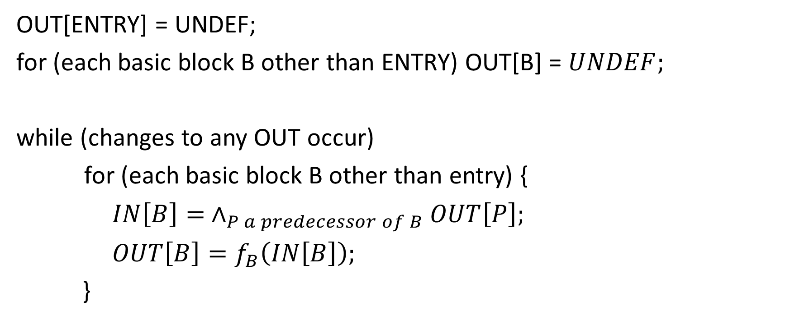
Constant propagation
OUT[ENTRY] = UNDEF;
for (each basic block B other than ENTRY) OUT[B] = $UNDEF;$
while (changes to any OUT occur)
for (each basic block B other than entry) {
$IN\left[B\right]= ∧_{P a predecessor of B}OUT\left[P\right];$
$OUT\left[B\right]=f_{B}\left(IN\left[B\right]\right);$
}
Why does this algorithm terminate? What stops OUT from changing in every iteration?

Slide 28
Why does constant propagation terminate?
UNDEF
… -3 -2 -1 0 1 2 3 ...
NAC
$$x∧y is the greatest lower bound of x and y$$
Notes:
The possible outputs of constant propagation form a meet semilattice of height 3. Values at the same level are not comparable. There is an ordering between the values at different levels. The topmost level (UNDEF) is the largest value, the intermediate level (constant values) are lower than UNDEF, and NAC is lower than constant values. As we see, that the meet operator on two values v1 and v2, always yields a value that the largest of all values v, where v <= v1 and v <= v2. Under this assumption, the output value can change at most two times (UNDEF to constant or constant to NAC) after the meet operation. This will ensure that the iterative algorithm terminates, assuming the transfer functions also work in a certain way (discussed next).

Slide 29

Monotonic transfer function
Edge-1
$$f_{s}(UNDEF) = UNDEF$$
$$f_{s}(constant)= NAC$$
$$f_{s}(NAC) = UNDEF$$
$$(infinite loop)$$
$$if (x <= y)$$
$$then$$
$$f_{s}\left(x\right)<=f_{s}\left(y\right)$$
must hold to ensure termination.
Edge-2
statement S
Edge-3
Notes:
Consider the transfer function shown on this slide. If the initial values on Edge-1 and Edge-2 are constant c and UNDEF respectively, and S is the only statement in the basic block, then the data-flow algorithm will be stuck in an infinite loop. The transfer functions must be monotonic to guarantee termination. A monotonic function always satisfy the following condition: if (x <= y) then f_{s}(x) <= f_{s}(y).

Slide 30
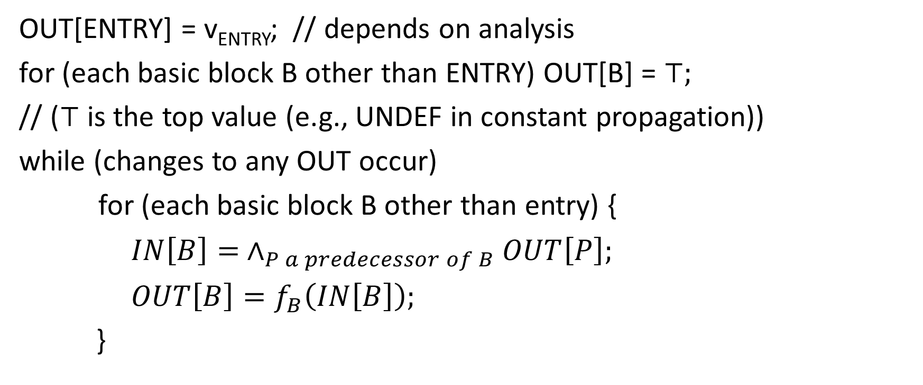
Forward data-flow analysis
OUT[ENTRY] = v_{ENTRY}; // depends on analysis
for (each basic block B other than ENTRY) OUT[B] = $⊤;$
// ($⊤$ is the top value (e.g., UNDEF in constant propagation))
while (changes to any OUT occur)
for (each basic block B other than entry) {
$IN\left[B\right]= ∧_{P a predecessor of B}OUT\left[P\right];$
$OUT\left[B\right]=f_{B}\left(IN\left[B\right]\right);$
}

Slide 31
Live variable analysis
A variable x is live at point p in a CFG, if the value of x at point p due to some prior definitions can be used along some path in the CFG starting at p
Live variable analysis is backward data-flow analysis

Slide 32
Live variable analysis
A variable x is live at point p in a CFG, if the value of x at point p due to some prior definitions can be used along some path in the CFG starting at p.
Which variables are live after line-3?
Which variables are live after line-8?
Which variables are live before line-8?
1. int foo(int a, int b, int c) {
2. int d = 20;
3. int i = 0;
4. for (i = 0; i < c; i ++) {
d = a + b;
b = a;
7. }
8. d = 20;
9. return b + d;
10. }

Slide 33
Live variable analysis
A variable x is live at point p in a CFG, if the value of x at point p due to some prior definitions can be used along some path in the CFG starting at p.
Which variables are live after line-3?
a, b
Which variables are live after line-8?
b, d
Which variables are live before line-8?
b
1. int foo(int a, int b, int c) {
2. int d = 20;
3. int i = 0;
4. for (i = 0; i < c; i ++) {
d = a + b;
b = a;
7. }
8. d = 20;
9. return b + d;
10. }
Notes:
d is not live after line-3 because d is only used at line-9, and at line-9, the program is using the definition at line-8 (not the value of d after line-3 due to the definition at line-1). a is not live before line-8 because it is not used after the execution reaches line-8.

Slide 34
Live variable analysis
ENTRY
a = 2
c = 3
if (a > 2) goto label
If a variable is used in an instruction, then the variable is live before the instruction.
If a variable is defined in an instruction but not used in the instruction, then the variable is not live before the instruction.
label:
c = c + c
x = y - z
x = y + w
z = c * c
a = c * c
return a
EXIT

Slide 35
Live variable analysis
ENTRY
{y,w,z}
a = 2
c = 3
if (a > 2) goto label
If a variable is used in an instruction, then the variable is live before the instruction.
If a variable is defined in an instruction but not used in the instruction, then the variable is not live before the instruction.
{y,w,z,a}
{c,y,w,z,a}
{c,y,z}
{c,y,w,z}
{c,y,w}
label:
c = c + c
x = y - z
{c,y,w}
x = y + w
z = c * c
{c,y,z}
{c,y,z}
{c}
{c}
{c}
{c}
a = c * c
return a
{a}
{}
EXIT
Notes:
The liveness is calculated in the backward direction. The transfer function implements the two rules listed on this slide to compute the IN from the OUT of a statement. A meet operator combines the live variables coming from different successors to compute the live variable at the end of the basic block. The meet operator for liveness analysis is the union operator.

Slide 36
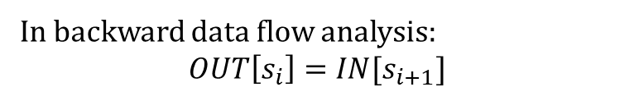
IN/OUT
ENTRY
1.
2.
3.
a = 2
c = 3
if (a > 2) goto label
label:
c = c + c
x = y - z
x = y + w
z = c * c
a = c * c
return a
In backward data flow analysis:
$$OUT\left[s_{i}\right]=IN[s_{i+1}]$$
EXIT
Notes:
Like a forward data-flow analysis, in a backward data-flow analysis, the OUT of a statement is the same as IN of the next statement. Unlike forward data-flow analysis, we compute the facts in the reverse direction in the backward data-flow analysis, i.e., IN[S_{i+1}] is computed before IN[S_{i}]. After, computing IN[S_{i+1}], we set OUT[S_{i}] to IN[S_{i+1}].

Slide 37
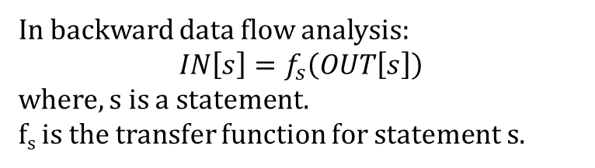
Transfer function
ENTRY
1.
2.
3.
a = 2
c = 3
if (a > 2) goto label
label:
c = c + c
x = y - z
x = y + w
z = c * c
a = c * c
return a
In backward data flow analysis:
$$IN\left[s\right]=f_{s}\left(OUT\left[s\right]\right)$$
where, s is a statement.
f_{s} is the transfer function for statement s.
EXIT
Notes:
For every statement, we need to define a transfer function. In a backward data-flow analysis, the transfer function for statement S computes IN[S] from OUT[S].

Slide 38
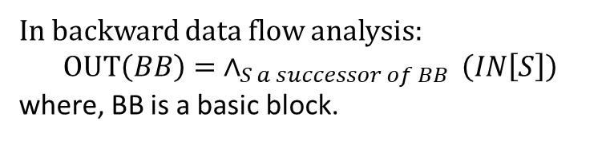
Meet operator
ENTRY
a = 2
c = 3
if (a > 2) goto label
BB0
label:
c = c + c
x = y - z
BB2
BB1
x = y + w
z = c * c
BB3
a = c * c
return a
In backward data flow analysis:
$$OUT\left(BB\right)= ∧_{S a successor of BB }\left(IN\left[S\right]\right)$$
where, BB is a basic block.
EXIT
Notes:
A meet operator combines the INs of successor basic blocks to compute the OUT of a basic block.

Slide 39
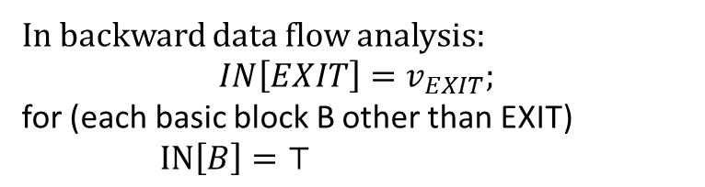
Initialization
ENTRY
a = 2
c = 3
if (a > 2) goto label
BB0
BB1
BB2
label:
c = c + c
x = y – z
if (c > 10 ) goto label
x = y + w
z = c * c
BB3
a = c * c
return a
In backward data flow analysis:
$$IN\left[EXIT\right]=v_{EXIT};$$
for (each basic block B other than EXIT)
$IN\left[B\right]=⊤$
EXIT
Notes:
In a backward data-flow analysis, we need to initialize IN[EXIT]. The INs of other basic blocks are initialized with the top value in the meet semilattice.

Slide 40
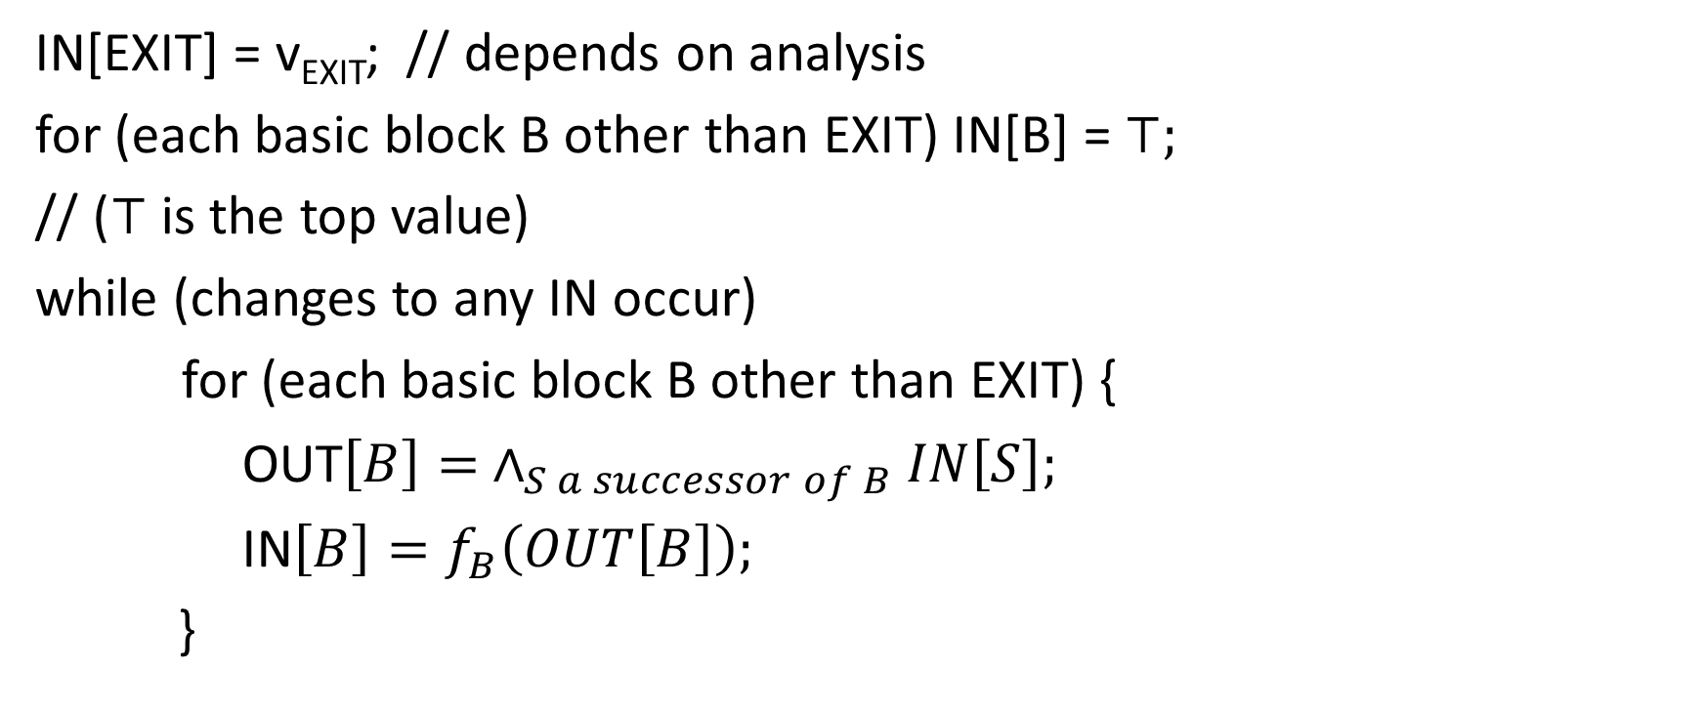
Backward data-flow analysis algorithm
IN[EXIT] = v_{EXIT}; // depends on analysis
for (each basic block B other than EXIT) IN[B] = $⊤;$
// ($⊤$ is the top value)
while (changes to any IN occur)
for (each basic block B other than EXIT) {
OUT$\left[B\right]= ∧_{S a successor of B}IN\left[S\right];$
IN$\left[B\right]=f_{B}\left(OUT\left[B\right]\right);$
}
Notes:
In a backward data-flow analysis, we need to iterate all the basic blocks until there is no change in any IN from the last iteration.

Slide 41
Live variable analysis
ENRY
a = 2
c = 3
if (a > 2) goto label
Meet:
label:
c = c + c
x = y - z
x = y + w
z = c * c
a = c * c
return a
IN[EXIT] = {}
EXIT
Notes:
The meet operator is union.

Slide 42
Live variable analysis
ENTRY
a = 2
c = 3
if (a > 2) goto label
Initialization:
label:
c = c + c
x = y – z
if (c > 10 ) goto label
x = y + w
z = c * c
a = c * c
return a
IN[EXIT] = {}
EXIT

Slide 43
Live variable analysis
meet-semilattice:
{}
{a} {b} {c}
{a,b} {b,c} {c, a}
{a,b,c}
ENTRY
a = 2
c = 3
if (a > 2) goto label
Initialization:
forall BB other than EXIT:
IN[BB] = {}
label:
c = c + c
x = y – z
if (c > 10 ) goto label
x = y + w
z = c * c
a = c * c
return a
IN[EXIT] = {}
EXIT
Notes:
IN[EXIT] is initialized with the empty set. INs of other basic blocks are also initialized with the empty set. Notice that the empty set is also the top in the meet semilattice.

Slide 44
Live variable analysis
ENTRY
ITERATION-1
a = 2
c = 3
if (a > 2) goto label
{y,z,w}
{y,z,c,w}
{y,z,c,w,a}
{y,z,c,w}
{y,z,c}
label:
c = c + c
x = y – z
if (c > 10 ) goto label
x = y + w
z = c * c
{y,w,c}
{y,z,c}
{c}
{c}
{c}
{c}
{}
a = c * c
return a
{c}
{a}
IN[EXIT] = {}
EXIT

Slide 45
Live variable analysis
ENTRY
ITERATION-2
a = 2
c = 3
if (a > 2) goto label
{y,z,w}
{y,z,c,w}
{y,z,c,w,a}
{y,z,c,w}
{y,z,c}
label:
c = c + c
x = y – z
if (c > 10 ) goto label
x = y + w
z = c * c
{y,w,c}
{y,z,c}
{c}
{y,c,z}
{c}
{c}
{y,c,z}
a = c * c
return a
{c}
{a}
IN[EXIT] = {}
EXIT

Slide 46

Meet operator
$OUT\left[BB\right]= \bigcup_{S a successor of BB}{IN[S]}$
BB is a basic block

Slide 47
Initialization
for (each basic block B) {
IN[B] = {};
}

Slide 48
Transfer function
function L, n
arg id
id = op
id = op1 arith op2
id = unary op
goto L
label L
if (op1 relop op2) goto L
id = op1 relop op2
param op
id = call L, n
ret op
id is a variable
op, op1, op2 are variables or constants
“relop $∈\left\{<, ==, ≥, ≤, >, !=\right\}$”
“arith $∈\left\{+, −, ∗,\%\right\}$”
“unary $∈\left\{−, !\right\}$”
f_{id = op}(OUT[s]):

Slide 49
Transfer function
function L, n
arg id
id = op
id = op1 arith op2
id = unary op
goto L
label L
if (op1 relop op2) goto L
id = op1 relop op2
param op
id = call L, n
ret op
id is a variable
op, op1, op2 are variables or constants
“relop $∈\left\{<, ==, ≥, ≤, >, !=\right\}$”
“arith $∈\left\{+, −, ∗,\%\right\}$”
“unary $∈\left\{−, !\right\}$”
f_{id = op}(OUT[s]):
IN[s] = OUT[s] – id.getName();
if (!op.isConst()) {
IN[s] = OUT[s] U op.getName();
}

Slide 50
Transfer function
function L, n
arg id
id = op
id = op1 arith op2
id = unary op
goto L
label L
if (op1 relop op2) goto L
id = op1 relop op2
param op
id = call L, n
ret op
id is a variable
op, op1, op2 are variables or constants
“relop $∈\left\{<, ==, ≥, ≤, >, !=\right\}$”
“arith $∈\left\{+, −, ∗,\%\right\}$”
“unary $∈\left\{−, !\right\}$”
f_{id = op1 arith op2}(OUT[s]):

Slide 51
Transfer function
function L, n
arg id
id = op
id = op1 arith op2
id = unary op
goto L
label L
if (op1 relop op2) goto L
id = op1 relop op2
param op
id = call L, n
ret op
id is a variable
op, op1, op2 are variables or constants
“relop $∈\left\{<, ==, ≥, ≤, >, !=\right\}$”
“arith $∈\left\{+, −, ∗,\%\right\}$”
“unary $∈\left\{−, !\right\}$”
f_{id = op1 arith op2}(OUT[s]):
IN[s] = OUT[s] – id.getName();
if (!op1.isConst()) {
IN[s] = OUT[s] U op1.getName();
}
if (!op2.isConst()) {
IN[s] = OUT[s] U op2.getName();
}

Slide 52
Transfer function
function L, n
arg id
id = op
id = op1 arith op2
id = unary op
goto L
label L
if (op1 relop op2) goto L
id = op1 relop op2
param op
id = call L, n
ret op
id is a variable
op, op1, op2 are variables or constants
“relop $∈\left\{<, ==, ≥, ≤, >, !=\right\}$”
“arith $∈\left\{+, −, ∗,\%\right\}$”
“unary $∈\left\{−, !\right\}$”
f_{id = op1 relop op2}(OUT[s]):
IN[s] = OUT[s] – id.getName();
if (!op1.isConst()) {
IN[s] = OUT[s] U op1.getName();
}
if (!op2.isConst()) {
IN[s] = OUT[s] U op2.getName();
}

Slide 53
Transfer function
function L, n
arg id
id = op
id = op1 arith op2
id = unary op
goto L
label L
if (op1 relop op2) goto L
id = op1 relop op2
param op
id = call L, n
ret op
id is a variable
op, op1, op2 are variables or constants
“relop $∈\left\{<, ==, ≥, ≤, >, !=\right\}$”
“arith $∈\left\{+, −, ∗,\%\right\}$”
“unary $∈\left\{−, !\right\}$”
f_{id = unary op}(OUT[s]):

Slide 54
Transfer function
function L, n
arg id
id = op
id = op1 arith op2
id = unary op
goto L
label L
if (op1 relop op2) goto L
id = op1 relop op2
param op
id = call L, n
ret op
id is a variable
op, op1, op2 are variables or constants
“relop $∈\left\{<, ==, ≥, ≤, >, !=\right\}$”
“arith $∈\left\{+, −, ∗,\%\right\}$”
“unary $∈\left\{−, !\right\}$”
f_{id = unary op}(OUT[s]):
IN[s] = OUT[s] – id.getName();
if (!op.isConst()) {
IN[s] = OUT[s] U op.getName();
}

Slide 55
Transfer function
function L, n
arg id
id = op
id = op1 arith op2
id = unary op
goto L
label L
if (op1 relop op2) goto L
id = op1 relop op2
param op
id = call L, n
ret op
id is a variable
op, op1, op2 are variables or constants
“relop $∈\left\{<, ==, ≥, ≤, >, !=\right\}$”
“arith $∈\left\{+, −, ∗,\%\right\}$”
“unary $∈\left\{−, !\right\}$”
f_{arg id}(OUT[s]):

Slide 56
Transfer function
function L, n
arg id
id = op
id = op1 arith op2
id = unary op
goto L
label L
if (op1 relop op2) goto L
id = op1 relop op2
param op
id = call L, n
ret op
id is a variable
op, op1, op2 are variables or constants
“relop $∈\left\{<, ==, ≥, ≤, >, !=\right\}$”
“arith $∈\left\{+, −, ∗,\%\right\}$”
“unary $∈\left\{−, !\right\}$”
f_{arg id}(OUT[s]):
IN[s] = OUT[s] – id.getName();

Slide 57
Transfer function
function L, n
arg id
id = op
id = op1 arith op2
id = unary op
goto L
label L
if (op1 relop op2) goto L
id = op1 relop op2
param op
id = call L, n
ret op
id is a variable
op, op1, op2 are variables or constants
“relop $∈\left\{<, ==, ≥, ≤, >, !=\right\}$”
“arith $∈\left\{+, −, ∗,\%\right\}$”
“unary $∈\left\{−, !\right\}$”
f_{id = call L,n}(OUT[s]):

Slide 58
Transfer function
function L, n
arg id
id = op
id = op1 arith op2
id = unary op
goto L
label L
if (op1 relop op2) goto L
id = op1 relop op2
param op
id = call L, n
ret op
id is a variable
op, op1, op2 are variables or constants
“relop $∈\left\{<, ==, ≥, ≤, >, !=\right\}$”
“arith $∈\left\{+, −, ∗,\%\right\}$”
“unary $∈\left\{−, !\right\}$”
f_{id = call L,n}(OUT[s]):
IN[s] = OUT[s] – id.getName();

Slide 59
Transfer function
function L, n
arg id
id = op
id = op1 arith op2
id = unary op
goto L
label L
if (op1 relop op2) goto L
id = op1 relop op2
param op
id = call L, n
ret op
id is a variable
op, op1, op2 are variables or constants
“relop $∈\left\{<, ==, ≥, ≤, >, !=\right\}$”
“arith $∈\left\{+, −, ∗,\%\right\}$”
“unary $∈\left\{−, !\right\}$”
f_{if (op1 relop op2) goto L}(OUT[s]):

Slide 60
Transfer function
function L, n
arg id
id = op
id = op1 arith op2
id = unary op
goto L
label L
if (op1 relop op2) goto L
id = op1 relop op2
param op
id = call L, n
ret op
id is a variable
op, op1, op2 are variables or constants
“relop $∈\left\{<, ==, ≥, ≤, >, !=\right\}$”
“arith $∈\left\{+, −, ∗,\%\right\}$”
“unary $∈\left\{−, !\right\}$”
f_{if (op1 relop op2) goto L}(OUT[s]):
if (!op1.isConst()) {
IN[s] = OUT[s] U op1.getName();
}
if (!op2.isConst()) {
IN[s] = OUT[s] U op2.getName();
}

Slide 61
Transfer function
function L, n
arg id
id = op
id = op1 arith op2
id = unary op
goto L
label L
if (op1 relop op2) goto L
id = op1 relop op2
param op
id = call L, n
ret op
id is a variable
op, op1, op2 are variables or constants
“relop $∈\left\{<, ==, ≥, ≤, >, !=\right\}$”
“arith $∈\left\{+, −, ∗,\%\right\}$”
“unary $∈\left\{−, !\right\}$”
f_{param op}(OUT[s]):

Slide 62
Transfer function
function L, n
arg id
id = op
id = op1 arith op2
id = unary op
goto L
label L
if (op1 relop op2) goto L
id = op1 relop op2
param op
id = call L, n
ret op
id is a variable
op, op1, op2 are variables or constants
“relop $∈\left\{<, ==, ≥, ≤, >, !=\right\}$”
“arith $∈\left\{+, −, ∗,\%\right\}$”
“unary $∈\left\{−, !\right\}$”
f_{param op}(OUT[s]):
if (!op.isConst()) {
IN[s] = OUT[s] U op.getName();
}

Slide 63
Transfer function
function L, n
arg id
id = op
id = op1 arith op2
id = unary op
goto L
label L
if (op1 relop op2) goto L
id = op1 relop op2
param op
id = call L, n
ret op
id is a variable
op, op1, op2 are variables or constants
“relop $∈\left\{<, ==, ≥, ≤, >, !=\right\}$”
“arith $∈\left\{+, −, ∗,\%\right\}$”
“unary $∈\left\{−, !\right\}$”
f_{ret op}(OUT[s]):

Slide 64
Transfer function
function L, n
arg id
id = op
id = op1 arith op2
id = unary op
goto L
label L
if (op1 relop op2) goto L
id = op1 relop op2
param op
id = call L, n
ret op
id is a variable
op, op1, op2 are variables or constants
“relop $∈\left\{<, ==, ≥, ≤, >, !=\right\}$”
“arith $∈\left\{+, −, ∗,\%\right\}$”
“unary $∈\left\{−, !\right\}$”
f_{ret op}(OUT[s]):
if (!op.isConst()) {
IN[s] = OUT[s] U op.getName();
}

Slide 65
Transfer function
function L, n
arg id
id = op
id = op1 arith op2
id = unary op
goto L
label L
if (op1 relop op2) goto L
id = op1 relop op2
param op
id = call L, n
ret op
id is a variable
op, op1, op2 are variables or constants
“relop $∈\left\{<, ==, ≥, ≤, >, !=\right\}$”
“arith $∈\left\{+, −, ∗,\%\right\}$”
“unary $∈\left\{−, !\right\}$”
f_{goto L}(OUT[s]):
f_{label L}(OUT[s]):

Slide 66
Transfer function
function L, n
arg id
id = op
id = op1 arith op2
id = unary op
goto L
label L
if (op1 relop op2) goto L
id = op1 relop op2
param op
id = call L, n
ret op
id is a variable
op, op1, op2 are variables or constants
“relop $∈\left\{<, ==, ≥, ≤, >, !=\right\}$”
“arith $∈\left\{+, −, ∗,\%\right\}$”
“unary $∈\left\{−, !\right\}$”
f_{goto L}(OUT[s]): IN[s] = OUT[s]
f_{label L}(OUT[s]): IN[s] = OUT[s]

Slide 67
Finding uninitialized variables
ENTRY
a = 2
c = 2
if (a > 2) goto label
label:
c = c + c
x = y - z
x = y + w
z = c * c
a = c * c
return a
EXIT
Notes:
All the variables that are live at the ENTRY basic block are uninitialized variables.

Slide 68
Other uses of live variable
Global register allocation
SSA construction
Discover useless stores

Slide 69
Live variables at basic block granularity
ENTRY
Computing live variables before basic block instead of statement.
USE[BB] = set of variables whose values may be used in BB before any definition in BB
DEF[BB] = set of variables defined in BB
OUT[BB] = set of variables that are live after the BB
IN[BB] = ?
BB0
USE
DEF
a = 2
c = 2
if (a > 2) goto label
label:
c = c + c
x = y - z
BB2
BB1
USE
DEF
x = y + w
z = c * c
USE
DEF
BB3
USE
DEF
a = c * c
return a
EXIT

Slide 70
Live variables at basic block granularity
ENTRY
Computing live variables before basic block instead of statement.
USE[BB] = set of variables whose values may be used in BB before any definition in BB
DEF[BB] = set of variables defined in BB
OUT[BB] = set of variables that are live after the BB
IN[BB] = ?
BB0
USE = {}
DEF= {a, c}
a = 2
c = 2
if (a > 2) goto label
label:
c = c + c
x = y - z
BB2
BB1
USE = {y, w, c}
DEF = {x, z}
x = y + w
z = c * c
USE = {c, y, z}
DEF = {c, x}
BB3
a = c * c
return a
USE = {c}
DEF = {a}
EXIT
Notes:
In this example, we are only interested in the live variables before or after a basic block. If we can pre-compute the USE and DEF set (defined on this slide) of all basic blocks, we can define a transfer function that can be used for any basic block. The transfer function is shown on the next slide.

Slide 71
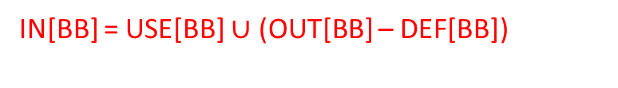
Live variables at basic block granularity
ENTRY
Computing live variables before basic block instead of statement.
USE[BB] = set of variables whose values may be used in BB before any definition in BB
DEF[BB] = set of variables defined in BB
OUT[BB] = set of variables that are live after the BB
a = 2
c = 2
if (a > 2) goto label
label:
c = c + 1
x = y - z
x = y + z
z = c * 2
a = c * c
return a
IN[BB] = USE[BB] $∪$ (OUT[BB] – DEF[BB])
EXIT

Slide 72
Data-flow analysis
The goal of the data-flow analysis is to extract some facts of the program at a given program point
IN[s] contains the set of facts that are true before statement s
OUT[s] contains the set of facts that are true after statement s
In the forward data-flow analysis, we compute the facts (IN and OUT) in the forward direction (from ENTRY to EXIT)
In the backward data-flow analysis, we compute the facts (IN and OUT) in the backward direction (from EXIT to ENRTY)

Slide 73

Meet operator
In the forward data-flow analysis:
$IN\left(BB\right)= ∧_{P a predecessor of BB }(OUT[P])$
In the backward data-flow analysis:
$OUT\left(BB\right)= ∧_{S a successor of BB }\left(IN\left[S\right]\right)$

Slide 74
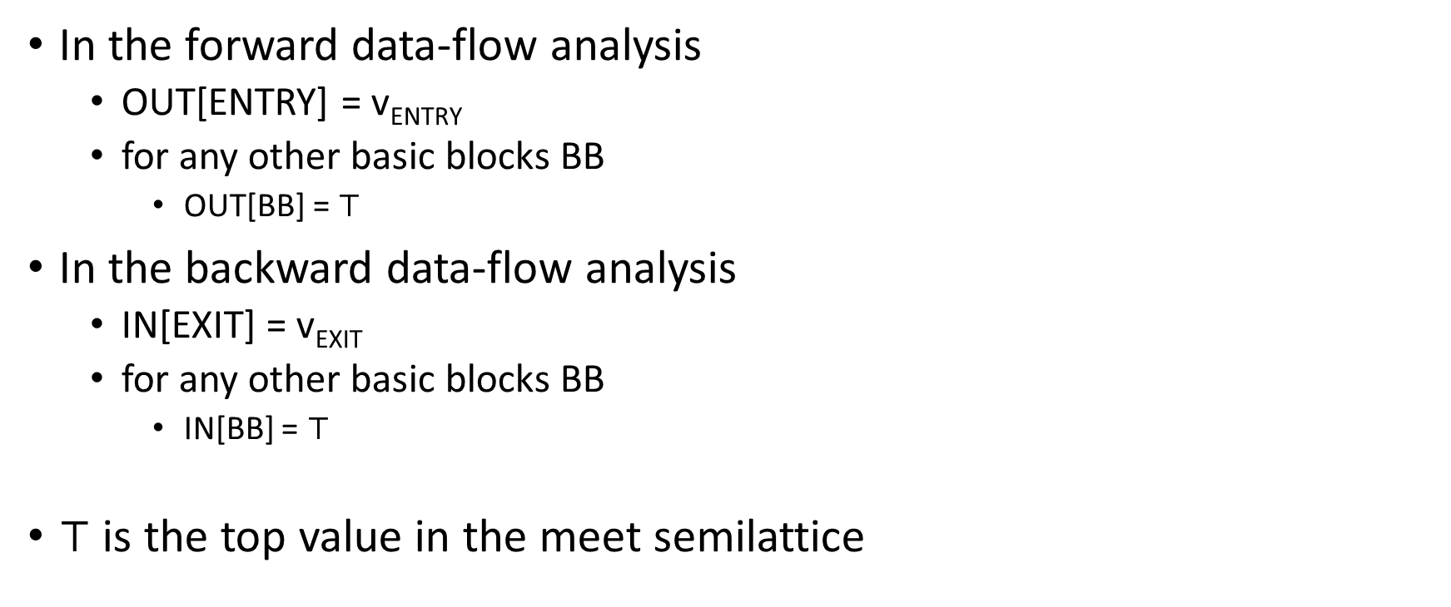
Initialization
In the forward data-flow analysis
OUT[ENTRY] = v_{ENTRY}
for any other basic blocks BB
OUT[BB] = $⊤$
In the backward data-flow analysis
IN[EXIT] = v_{EXIT}
for any other basic blocks BB
IN[BB] = $⊤$
$⊤$ is the top value in the meet semilattice

Slide 75
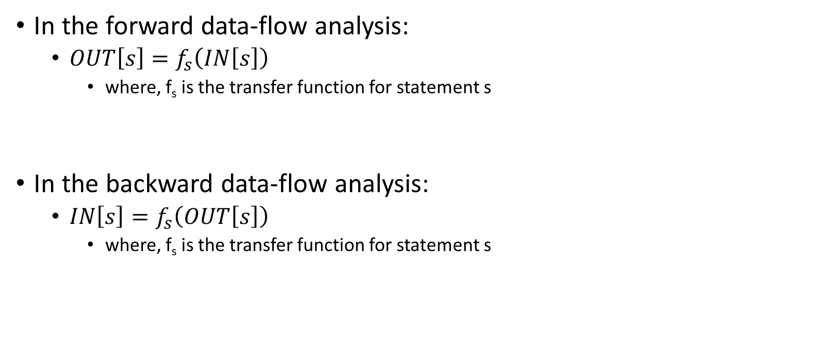
Transfer function
In the forward data-flow analysis:
$OUT\left[s\right]=f_{s}\left(IN\left[s\right]\right)$
where, f_{s} is the transfer function for statement s
In the backward data-flow analysis:
$IN\left[s\right]=f_{s}\left(OUT\left[s\right]\right)$
where, f_{s} is the transfer function for statement s

Slide 76
Reaching definitions
A definition “D” reaches a point “P” if there exists a path from “D” to “P” where “D” is not killed
assignment to a variable creates a new definition and kills other definitions in the CFG
Section: 9.2.4 – Aho, Ullman, Sethi, Lam

Slide 77
Reaching definitions
D1
D2
int foo(int a, int b) {
D3: int c = a + b;
D4: a = 10;
D5: b = 20;
if (c > 20) {
D6: b = c + a;
D7: c = 20;
}
else {
D8: a = c + b;
D9: c = 20;
}
// which definitions are reaching here
return a + b + c;
}
A definition “D” reaches a point “P” if there exists a path from “D” to “P” where “D” is not killed.
Assignment to a variable creates a new definition and kills other definitions in the CFG.
Notes:
In this example, D1 and D2 don't reach the return statement because they are killed at D4 and D5. Similarly, D3 is not reaching before the return because it is killed at D7 and D9. However, D4 is reaching before the return because a is not killed in the if-body. Similarly, D5 is reaching because b is not killed in the else-body. D6, D7, D8, and D9 reach the return statement.

