Slide 1
Compilers
Lecture-7

Slide 2
Today’s topics
LLVM
Reaching definitions
Dominator analysis
SSA

Slide 3
Module, function, basic block, instruction
A program file (e.g., main.c) is a module
A module contains functions and global variables
A function contains basic blocks and arguments
A basic block contains instructions
Notes:
The program file is an LLVM module.

Slide 4
LLVM module
A module is represented using “class Module”
A function is represented using “class Function”
Notes:
You can check the LLVM documentation to find all methods available in the Module and Function classes.

Slide 5
LLVM module
//main.c
int global = 0;
void foo() {
…
}
int bar(int a) {
…
}
int main() {
…
}
To iterate all the functions in a module
for (Function &F : M)
where M is of type “class Module”
e.g., foo, bar, main are the functions in the main.c module
Get module from a function
Module *M = F.getParent();
Notes:
The Module class provides APIs to iterate all functions (Function class) in a module.

Slide 6
Control flow graph
Models the flow of control between basic blocks
Represented using a directed graph
A directed edge between “BB1 → BB2” shows the possibility that BB2 may execute after BB1 at runtime

Slide 7
Control flow graph
BB0:
arg a
arg b
arg c
i = 0
function main, 3
arg a
arg b
arg x
i = 0
label for_start
if (i >= 10000) goto for_end
t1 = a * b
t2 = a * c
a = t1 + t2
i = i + 1
goto for_start
for_end
ret a
ENTRY
BB1:
label for_start
if (i >= 10000) goto for_end
BB0
BB1
BB2:
t1 = a * b
t2 = a * c
a = t1 + t2
i = i + 1
goto for_start
BB2
BB3
EXIT
BB3:
for_end
ret a
Notes:
An edge represents the possible flow between a source and a target basic block.

Slide 8
CFG in LLVM
A basic block is represented using “class BasicBlock”
An instruction is represented using “class Instruction”

Slide 9
CFG in LLVM
define dso_local void @foo(i32* %arr) #0 {
entry:
%arr.addr = alloca i32*, align 8
%ptr.addr = alloca i32*, align 8
store i32* %arr, i32** %arr.addr, align 8
%0 = load i32*, i32** %arr.addr, align 8
store i32* %0, i32** %ptr.addr, align 8
%ptr = load i32*, i32** %ptr.addr, align 8
%arrayidx = getelementptr inbounds i32, i32* %ptr, i64 20
store i32 100, i32* %arrayidx, align 4
%2 = load i32*, i32** %ptr.addr, align 8
%cmp = icmp eq i32* %2, null
br i1 %cmp, label %if.then, label %if.end
if.then: ; preds = %entry
%call = call i8* @mymalloc(i32 4)
%3 = bitcast i8* %call to i32*
store i32* %3, i32** %ptr.addr, align 8
br label %if.end
if.end: ; preds = %if.then, %entry
ret void
}
To walk all the basic block in a function
for (BasicBlock &BB : F)
F is an object of “class Function”
e.g., entry, if.then, if.end are the basic blocks in foo
To walk all the instructions in a basic block
for (Instruction &I : BB)
BB is an object of “class BasicBlock”
e.g., %arr.addr, %ptr, store, etc. are the instructions in entry
Notes:
The BasicBlock class provides APIs to walk all instructions, predecessors, and successors of a basic block.

Slide 10
CFG in LLVM
Get function from basic block
Function *F = BB.getParent();
Get basic block from instruction
BasicBlock *BB = I.getParent();

Slide 11
CFG in LLVM
define dso_local void @foo(i32* %arr) #0 {
entry:
%arr.addr = alloca i32*, align 8
%ptr.addr = alloca i32*, align 8
store i32* %arr, i32** %arr.addr, align 8
%0 = load i32*, i32** %arr.addr, align 8
store i32* %0, i32** %ptr.addr, align 8
%ptr = load i32*, i32** %ptr.addr, align 8
%arrayidx = getelementptr inbounds i32, i32* %ptr, i64 20
store i32 100, i32* %arrayidx, align 4
%2 = load i32*, i32** %ptr.addr, align 8
%cmp = icmp eq i32* %2, null
br i1 %cmp, label %if.then, label %if.end
if.then: ; preds = %entry
%call = call i8* @mymalloc(i32 4)
%3 = bitcast i8* %call to i32*
store i32* %3, i32** %ptr.addr, align 8
br label %if.end
if.end: ; preds = %if.then, %entry
ret void
}
To walk all the predecessors of a basic block
for (BasicBlock *PredBB : predecessors(BB))
where BB is of type BasicBlock *
e.g., if.then and entry are predecessors of if.end
To walk all the successors of a basic block
for (BasicBlock *SuccBB : successors(BB))
where BB is of type BasicBlock *
e.g., if.then and if.end are successors of entry

Slide 12
Inheritance
class Animal {
public:
void whoAmI();
};
class Dog: public Animal {
string Name;
public:
void printName();
void setName();
};
All dogs are animals.
All animals are not dog.
Base Class
Sub Class

Slide 13
Inheritance
class Animal {
public:
void whoAmI();
};
class Dog: public Animal {
string Name;
public:
void printName();
void setName();
};
void foo(Animal *A) {
A->printName();
}
int main() {
Dog *D = new Dog;
foo(D);
return 0;
}

Slide 14
dynamic_cast
class Animal {
public:
void whoAmI();
};
class Dog: public Animal {
string Name;
public:
void printName();
void setName();
};
void foo(Animal *A) {
Dog *D = dynamic_cast<Dog*>(A);
if (D) {
D->printName();
}
}
int main() {
Dog *D = new Dog;
foo(D);
return 0;
}
Notes:
A dynamic_cast is used to cast an object to its subclass (a class that inherits a base class). If the object indeed belongs to the subclass, dynamic_cast returns a non-null value.

Slide 15
LLVM inheritance
Value
Argument
Instruction
Constant
BasicBlock
LoadInst
StoreInst
GetElementPtrInst
AllocaInst ….

Slide 16
LLVM dyn_cast
AllocaInst *AI = dyn_cast<AllocaInst>(Inst)
/*where Inst is of type “class Instruction*” */
if (AI != NULL) {
/* this means instruction is indeed an AllocaInst */
}

Slide 17
LLVM dyn_cast
Constant *C = dyn_cast<Constant>(V)
/*where V is of type “class Value*” */
if (C != NULL) {
/* this means value is a Constant */
}

Slide 18
Insert instructions in IR
IRBuilder<> IRB(Inst);
// here, Inst is of type Instruction*
IRB.CreateCall(...); // insert a call before Inst
IRB.CreateBr(...); // insert a br before Inst
Notes:
IRBuilder can be initialized with a pointer to instruction class (say Inst). In this case, instructions added using IRB will be inserted before Inst.

Slide 19
Find next instruction
Instruction * NextInstr = Instr->getNextNode();
Here, Instr is of type Instruction*
NextInstr is the subsequent instruction to Instr
IRBuilder<> IRB(NextInstr);
// insert instructions before NextInstr using IRB
Notes:
You can obtain an instruction subsequent to Instr (of type pointer to Instruction class) using Instr->getNextNode().

Slide 20
Implementation
In assignment-2, you are given a routine runOnFunction(Function &F)
Here, F is an object of type Function
This routine will be called for all the functions in the module
You can walk all basic blocks BB of type BasicBlock in the function using F
You can walk all the predecessors and successors of the basic block using BB
You can walk all instructions Inst of type Instruction using BB
You can insert new instructions before Inst using IRBuilder<> IRB(&Inst)

Slide 21
Printing
You can print the IR of a function using
errs() << *Func << “\n”;
Here, Func is of type Function*
You can print a basic block IR using
errs() << *BB << “\n”;
Here, the type of BB is BasicBlock*
You can print an instruction using
errs() << *Inst << “\n”;
Here, Inst is of type Instruction*

Slide 22
Reaching definitions
A definition “D” reaches a point “P” if there exists a path from “D” to “P” where “D” is not killed
assignment to a variable creates a new definition and kills other definitions in the CFG
Section: 9.2.4 – Aho, Ullman, Sethi, Lam

Slide 23
Reaching definitions
D1
D2
int foo(int a, int b) {
D3: int c = a + b;
D4: a = 10;
D5: b = 20;
if (c > 20) {
D6: b = c + a;
D7: c = 20;
}
else {
D8: a = c + b;
D9: c = 20;
}
// which definitions are reaching here
return a + b + c;
}
A definition “D” reaches a point “P” if there exists a path from “D” to “P” where “D” is not killed.
Assignment to a variable creates a new definition and kills other definitions in the CFG.

Slide 24
Reaching definitions
ENTRY
B₀
D1: i = m-n
D2: j = n
D3: a = 1
B₁
D4: i = i + m
D5: j = j - n
B₂
D6: a = 2
B₃
D7: i = 3
B₄
EXIT
B₅

Slide 25
Definition
D: u = v arith w
This statement “generates” a definition D of the variable u and “kills” all other definitions of u.

Slide 26
Gen and Kill
D: u = v arith w
For each statement S
Gen_{S} contains the set of definitions generated by S
Kill_{S} contains the set of definitions killed by S

Slide 27
Reaching definitions
Gen_{D1} =
Kill_{D1} =
Gen_{D2} =
Kill_{D2} =
Gen_{D3} =
Kill_{D3} =
Gen_{D4} =
Kill_{D4} =
Gen_{D5} =
Kill_{D5} =
Gen_{D6} =
Kill_{D6} =
Gen_{D7} =
Kill_{D7} =
ENTRY
B₀
D1: i = m-n
D2: j = n
D3: a = 1
B₁
D4: i = i + m
D5: j = j - n
B₂
D6: a = 2
B₃
D7: i = 3
B₄
EXIT
B₅
Notes:
In this example, the definition D1 of variable i generates a definition D1 and kills other definitions of i, i.e., D4 and D7. Similarly, we can calculate Gen and Kill sets of other definitions.

Slide 28
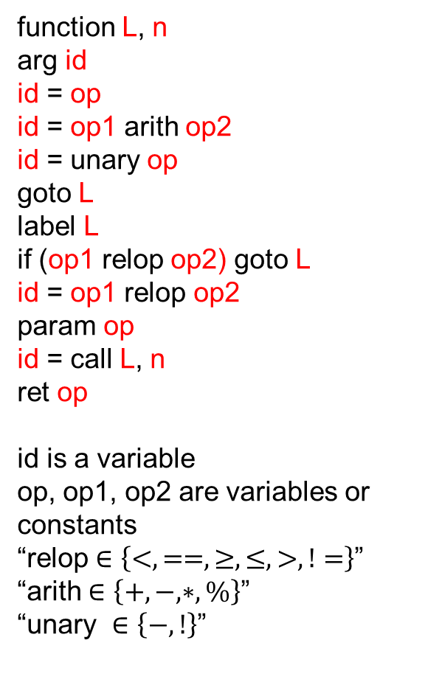
Transfer function
function L, n
arg id
id = op
id = op1 arith op2
id = unary op
goto L
label L
if (op1 relop op2) goto L
id = op1 relop op2
param op
id = call L, n
ret op
id is a variable
op, op1, op2 are variables or constants
“relop $∈\left\{<, ==, ≥, ≤, >, !=\right\}$”
“arith $∈\left\{+, −, ∗,\%\right\}$”
“unary $∈\left\{−, !\right\}$”
f_{S}(OUT[S]):
Gen_{S} is the set of definitions generated by statement S.
Kill_{S} is the set of definitions killed by statement S.
IN[S] is the set of definitions reaching before statement S.
OUT[S] = ?

Slide 29
Transfer function
function L, n
arg id
id = op
id = op1 arith op2
id = unary op
goto L
label L
if (op1 relop op2) goto L
id = op1 relop op2
param op
id = call L, n
ret op
id is a variable
op, op1, op2 are variables or constants
“relop $∈\left\{<, ==, ≥, ≤, >, !=\right\}$”
“arith $∈\left\{+, −, ∗,\%\right\}$”
“unary $∈\left\{−, !\right\}$”
f_{S}(OUT[S]):
Gen_{S} is the set of definitions generated by statement S.
Kill_{S} is the set of definitions killed by statement S.
IN[S] is the set of definitions reaching before statement S.
OUT[S] = (IN[S] – Kill_{S}) U Gen_{S}

Slide 30

Meet operator
IN$\left[BB\right]= \bigcup_{P ∈pred (BB)}{OUT[P]}$

Slide 31
Initialization
for (each basic block BB)
OUT[BB] = {};

Slide 32
Reaching definitions
Gen_{D1} =
Kill_{D1} =
Gen_{D2} =
Kill_{D2} =
Gen_{D3} =
Kill_{D3} =
Gen_{D4} =
Kill_{D4} =
Gen_{D5} =
Kill_{D5} =
Gen_{D6} =
Kill_{D6} =
Gen_{D7} =
Kill_{D7} =
DEFS[i] =
DEFS[j] =
DEFS[a] =
ENTRY
B₀
D1: i = m-n
D2: j = n
D3: a = 1
B₁
D4: i = i + m
D5: j = j - n
B₂
D6: a = 2
B₃
D7: i = 3
B₄
EXIT
B₅

Slide 33
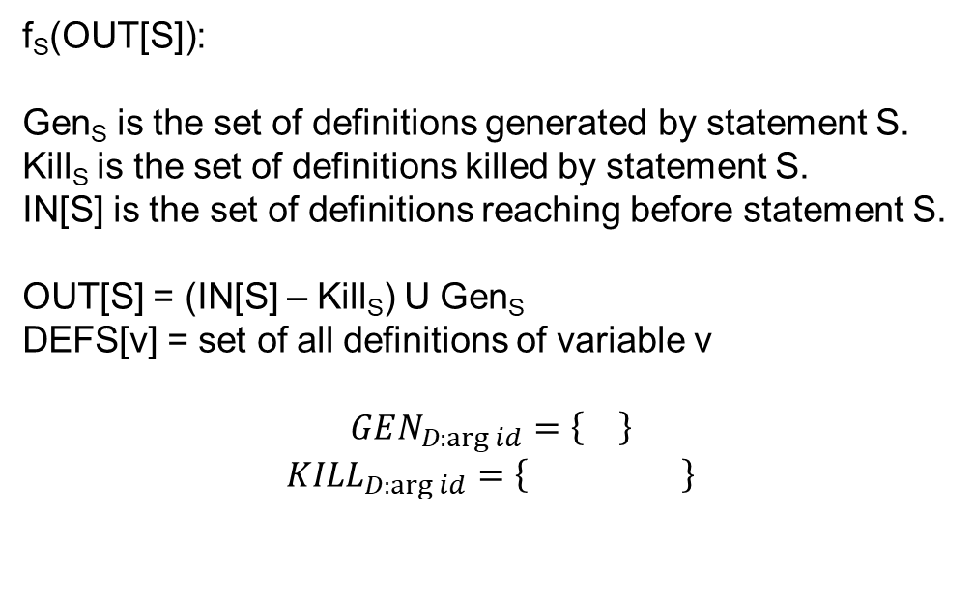
Transfer function
function L, n
arg id
id = op
id = op1 arith op2
id = unary op
goto L
label L
if (op1 relop op2) goto L
id = op1 relop op2
param op
id = call L, n
ret op
id is a variable
op, op1, op2 are variables or constants
“relop $∈\left\{<, ==, ≥, ≤, >, !=\right\}$”
“arith $∈\left\{+, −, ∗,\%\right\}$”
“unary $∈\left\{−, !\right\}$”
f_{S}(OUT[S]):
Gen_{S} is the set of definitions generated by statement S.
Kill_{S} is the set of definitions killed by statement S.
IN[S] is the set of definitions reaching before statement S.
OUT[S] = (IN[S] – Kill_{S}) U Gen_{S}
DEFS[v] = set of all definitions of variable v
$$GEN_{D:\arg{id}}=\left\{\right\}$$
$${KILL}_{D:\arg{id}}=\left\{ \right\}$$

Slide 34
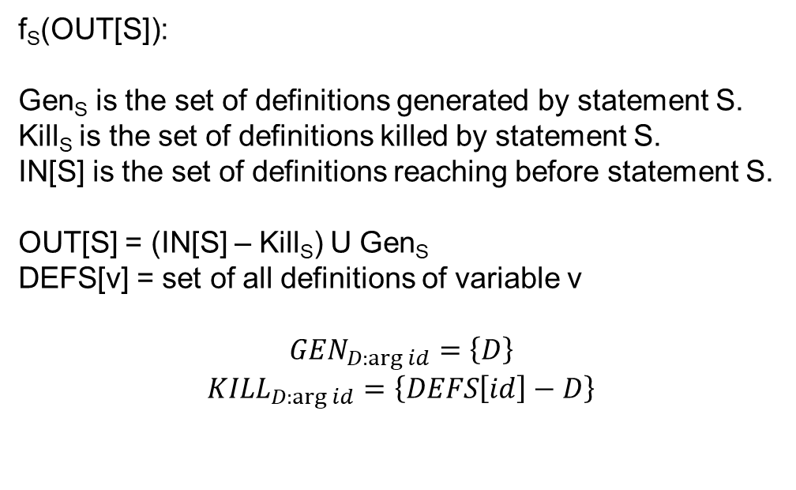
Transfer function
function L, n
arg id
id = op
id = op1 arith op2
id = unary op
goto L
label L
if (op1 relop op2) goto L
id = op1 relop op2
param op
id = call L, n
ret op
id is a variable
op, op1, op2 are variables or constants
“relop $∈\left\{<, ==, ≥, ≤, >, !=\right\}$”
“arith $∈\left\{+, −, ∗,\%\right\}$”
“unary $∈\left\{−, !\right\}$”
f_{S}(OUT[S]):
Gen_{S} is the set of definitions generated by statement S.
Kill_{S} is the set of definitions killed by statement S.
IN[S] is the set of definitions reaching before statement S.
OUT[S] = (IN[S] – Kill_{S}) U Gen_{S}
DEFS[v] = set of all definitions of variable v
$$GEN_{D:\arg{id}}=\left\{D\right\}$$
$${KILL}_{D:\arg{id}}=\left\{DEFS\left[id\right]−D\right\}$$

Slide 35
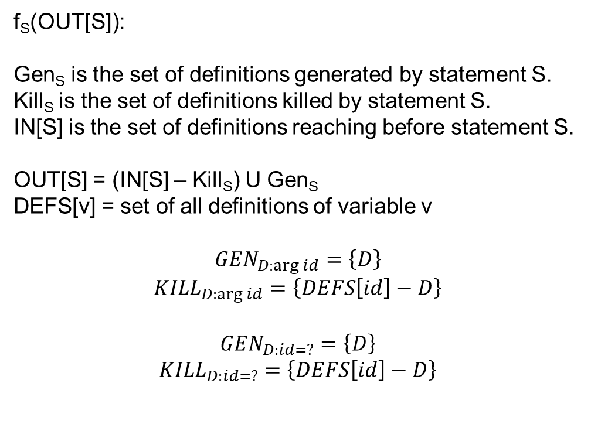
Transfer function
function L, n
arg id
id = op
id = op1 arith op2
id = unary op
goto L
label L
if (op1 relop op2) goto L
id = op1 relop op2
param op
id = call L, n
ret op
id is a variable
op, op1, op2 are variables or constants
“relop $∈\left\{<, ==, ≥, ≤, >, !=\right\}$”
“arith $∈\left\{+, −, ∗,\%\right\}$”
“unary $∈\left\{−, !\right\}$”
f_{S}(OUT[S]):
Gen_{S} is the set of definitions generated by statement S.
Kill_{S} is the set of definitions killed by statement S.
IN[S] is the set of definitions reaching before statement S.
OUT[S] = (IN[S] – Kill_{S}) U Gen_{S}
DEFS[v] = set of all definitions of variable v
$$GEN_{D:\arg{id}}=\left\{D\right\}$$
$${KILL}_{D:\arg{id}}=\left\{DEFS\left[id\right]−D\right\}$$
$$GEN_{D:id=?}=\left\{D\right\}$$
$${KILL}_{D:id=?}=\left\{DEFS\left[id\right]−D\right\}$$

Slide 36
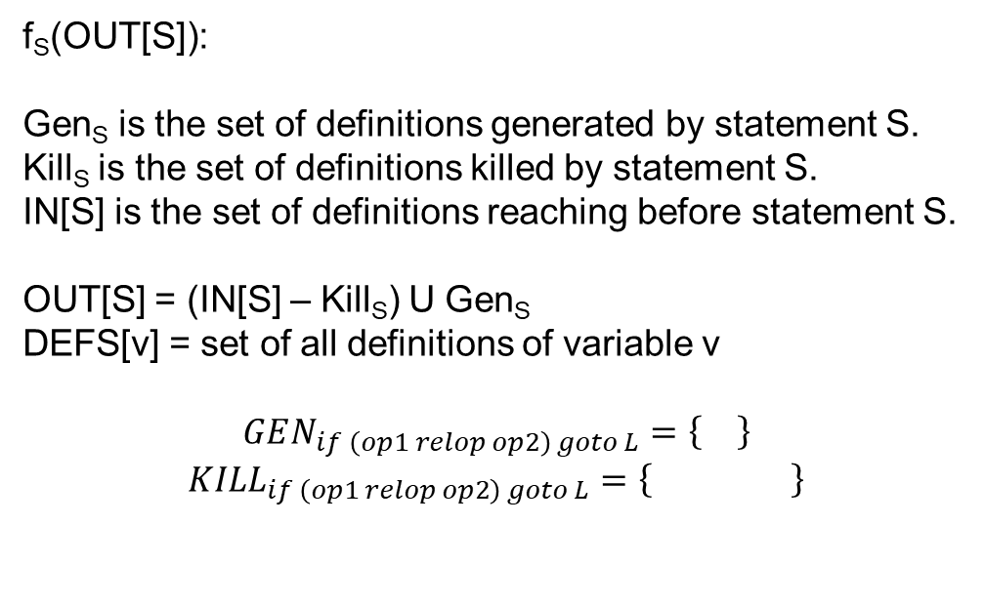
Transfer function
function L, n
arg id
id = op
id = op1 arith op2
id = unary op
goto L
label L
if (op1 relop op2) goto L
id = op1 relop op2
param op
id = call L, n
ret op
id is a variable
op, op1, op2 are variables or constants
“relop $∈\left\{<, ==, ≥, ≤, >, !=\right\}$”
“arith $∈\left\{+, −, ∗,\%\right\}$”
“unary $∈\left\{−, !\right\}$”
f_{S}(OUT[S]):
Gen_{S} is the set of definitions generated by statement S.
Kill_{S} is the set of definitions killed by statement S.
IN[S] is the set of definitions reaching before statement S.
OUT[S] = (IN[S] – Kill_{S}) U Gen_{S}
DEFS[v] = set of all definitions of variable v
$$GEN_{if \left(op1 relop op2\right) goto L}=\left\{\right\}$$
$${KILL}_{if \left(op1 relop op2\right) goto L}=\left\{ \right\}$$

Slide 37
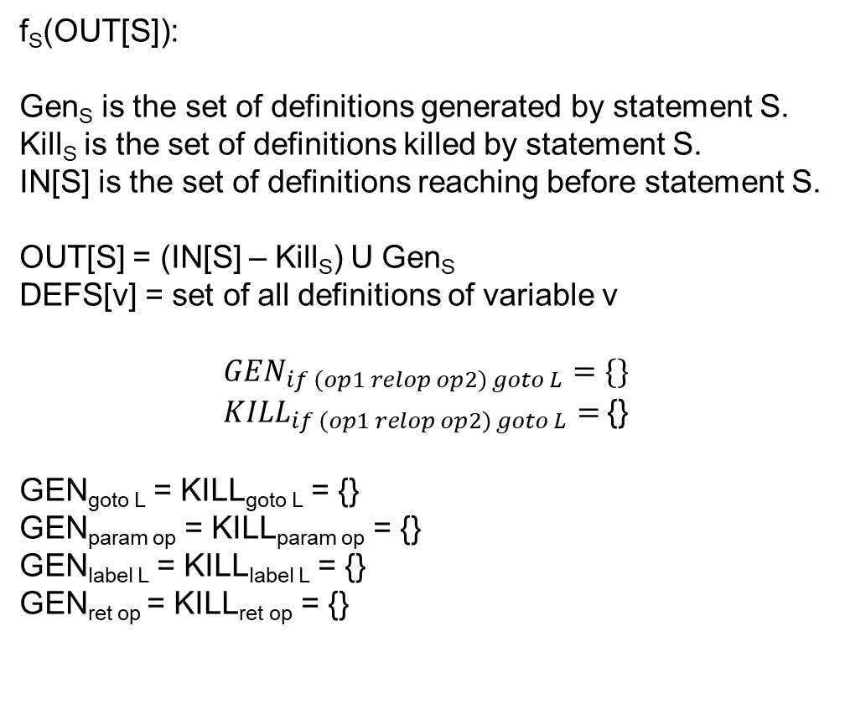
Transfer function
function L, n
arg id
id = op
id = op1 arith op2
id = unary op
goto L
label L
if (op1 relop op2) goto L
id = op1 relop op2
param op
id = call L, n
ret op
id is a variable
op, op1, op2 are variables or constants
“relop $∈\left\{<, ==, ≥, ≤, >, !=\right\}$”
“arith $∈\left\{+, −, ∗,\%\right\}$”
“unary $∈\left\{−, !\right\}$”
f_{S}(OUT[S]):
Gen_{S} is the set of definitions generated by statement S.
Kill_{S} is the set of definitions killed by statement S.
IN[S] is the set of definitions reaching before statement S.
OUT[S] = (IN[S] – Kill_{S}) U Gen_{S}
DEFS[v] = set of all definitions of variable v
$$GEN_{if \left(op1 relop op2\right) goto L}=\{\}$$
${KILL}_{if \left(op1 relop op2\right) goto L}=${}
GEN_{goto L} = KILL_{goto L} = {}
GEN_{param op} = KILL_{param op} = {}
GEN_{label L} = KILL_{label L} = {}
GEN_{ret op} = KILL_{ret op} = {}

Slide 38
Reaching definitions
Gen_{D1} = {D1}
Kill_{D1} = {D4, D7}
Gen_{D2} = {D2}
Kill_{D2} = {D5}
Gen_{D3} = {D3}
Kill_{D3} = {D6}
Gen_{D4} = {D4}
Kill_{D4} = {D1, D7}
Gen_{D5} = {D5}
Kill_{D5} = {D2}
Gen_{D6} = {D6}
Kill_{D6} = {D3}
Gen_{D7} = {D7}
Kill_{D7} = {D1, D4}
DEFS[i] = {D1, D4, D7}
DEFS[j] = {D2, D5}
DEFS[a] = {D3, D6}
ENTRY
B₀
D1: i = m-n
D2: j = n
D3: a = 1
B₁
D4: i = i + m
D5: j = j - n
B₂
D6: a = 2
B₃
D7: i = 3
B₄
EXIT
B₅

Slide 39
Reaching definitions
Gen_{D1} = {D1}
Kill_{D1} = {D4, D7}
Gen_{D2} = {D2}
Kill_{D2} = {D5}
Gen_{D3} = {D3}
Kill_{D3} = {D6}
Gen_{D4} = {D4}
Kill_{D4} = {D1, D7}
Gen_{D5} = {D5}
Kill_{D5} = {D2}
Gen_{D6} = {D6}
Kill_{D6} = {D3}
Gen_{D7} = {D7}
Kill_{D7} = {D1, D4}
DEFS[i] = {D1, D4, D7}
DEFS[j] = {D2, D5}
DEFS[a] = {D3, D6}
ENTRY
B₀
{}
D1: i = m-n
D2: j = n
D3: a = 1
B₁
{D1}
{D1, D2}
{}
{D1, D2, D3}
{D1, D2, D3}
D4: i = i + m
D5: j = j - n
B₂
{D2, D3, D4}
{D3, D4, D5}
{D3, D4, D5}
D6: a = 2
B₃
{D3, D4, D5}
{D4, D5, D6}
D7: i = 3
{D3, D4, D5, D6}
B₄
{D3, D5, D6, D7}
ITERATION-1
EXIT
B₅

Slide 40
Reaching definitions
Gen_{D1} = {D1}
Kill_{D1} = {D4, D7}
Gen_{D2} = {D2}
Kill_{D2} = {D5}
Gen_{D3} = {D3}
Kill_{D3} = {D6}
Gen_{D4} = {D4}
Kill_{D4} = {D1, D7}
Gen_{D5} = {D5}
Kill_{D5} = {D2}
Gen_{D6} = {D6}
Kill_{D6} = {D3}
Gen_{D7} = {D7}
Kill_{D7} = {D1, D4}
DEFS[i] = {D1, D4, D7}
DEFS[j] = {D2, D5}
DEFS[a] = {D3, D6}
ENTRY
B₀
{}
D1: i = m-n
D2: j = n
D3: a = 1
B₁
{D1}
{D1, D2}
{D3, D5, D6, D7}
{D1, D2, D3}
{D1, D2, D3, D5, D6, D7}
D4: i = i + m
D5: j = j - n
B₂
{D2, D3, D4, D5, D6}
{D3, D4, D5, D6}
{D3, D4, D5, D6}
D6: a = 2
B₃
{D3, D4, D5, D6}
{D4, D5, D6}
D7: i = 3
{D3, D4, D5, D6}
B₄
{D3, D5, D6, D7}
ITERATION-2
EXIT
B₅

Slide 41
Reaching definition
SSA construction

Slide 42
Dominator
Dominator analysis is useful in many compiler transformations
Node D in a CFG dominates node N if every path from the entry node to N goes through D
We write “D dom N” to articulate that D dominates N
Every node dominates itself

Slide 43
Dominator
ENTRY
BB0
DOM(BB0) =
DOM(BB1) =
DOM(BB2) =
DOM(BB3) =
DOM(BB4) =
DOM(BB5) =
a = 2
c = 2
if (a > 2) goto label
BB1
BB2
label:
c = c + 1
x = y - z
x = y + z
z = c * 2
BB3
a = c * c
return a
BB4
EXIT
BB5
Notes:
BB1 is the dominator of BB4 because every path from ENTRY to BB4 goes via BB1. BB3 is not a dominator of BB4, because every path from ENTRY to BB4 doesn’t go via BB3.

Slide 44
Transfer function
ENTRY
BB0
DOM(BB0) =
DOM(BB1) =
DOM(BB2) =
DOM(BB3) =
DOM(BB4) =
DOM(BB5) =
a = 2
c = 2
if (a > 2) goto label
BB1
BB2
label:
c = c + 1
x = y - z
x = y + z
z = c * 2
BB3
a = c * c
return a
BB4
OUT[BB] = f_{BB}(IN[BB])
OUT[BB] =
EXIT
BB5
Notes:
BB1 is the dominator of BB4 because every path from ENTRY to BB4 goes via BB1. BB3 is not a dominator of BB4, because every path from ENTRY to BB4 doesn’t go via BB3.

Slide 45

Transfer function
$$OUT\left[BB\right]=BB∪IN[BB]$$
Section: 9.6.1 Aho, Ullman, Lam, Sethi

Slide 46
Dominator
ENTRY
BB0
DOM(BB0) =
DOM(BB1) =
DOM(BB2) =
DOM(BB3) =
DOM(BB4) =
DOM(BB5) =
a = arg
c = 2
if (a > 2) goto label
BB1
BB2
label:
c = c + 1
x = y – z
if (c > 10 ) goto label
x = y + z
z = c * 2
BB3
Initialization:?
a = c * c
return a
BB4
Meet operator:?
EXIT
BB5
Notes:
The OUTs of the basic blocks other than entry is initialized to a set of all basic blocks. If we draw the meet semilattice, the set of all nodes will be the top of the semilattice. The meet operator is the intersection (∩) operator.

Slide 47

Meet operator
$$IN\left[BB\right]=∩_{P∈pred\left(BB\right)}OUT[P]$$

Slide 48
Initialization
OUT[ENTRY] = ENTRY;
N = Set of all nodes in the CFG
for (each basic block BB other than ENTRY)
OUT[BB] = N;

Slide 49
Dominator
ENTRY
BB0
OUT[BB0] = IN[BB1] = {BB0}
a = arg
c = 2
if (a > 2) goto label
BB1
OUT[BB2] = {BB0, BB1, BB2, BB3, BB4, BB5}
OUT[BB1] = {BB0, BB1}
IN[BB2] = {BB0, BB1}
BB2
label:
c = c + 1
x = y – z
if (c > 10 ) goto label
x = y + z
z = c * 2
BB3
OUT[BB3] = {BB0, BB1, BB3}
OUT[BB2] = {BB0, BB1, BB2}
a = c * c
return a
BB4
IN[BB4] = {BB0, BB1}
ITERATION-1
OUT[BB4] = {BB0, BB1, BB4}
EXIT
BB5

Slide 50
Dominator
ENTRY
BB0
OUT[BB0] = IN[BB1] = {BB0}
a = arg
c = 2
if (a > 2) goto label
BB1
OUT[BB2] = {BB0, BB1, BB2}
OUT[BB1] = {BB0, BB1}
IN[BB2] = {BB0, BB1}
BB2
label:
c = c + 1
x = y – z
if (c > 10 ) goto label
x = y + z
z = c * 2
BB3
OUT[BB3] = {BB0, BB1, BB3}
OUT[BB2] = {BB0, BB1, BB2}
a = c * c
return a
BB4
IN[BB4] = {BB0, BB1}
ITERATION-2
OUT[BB4] = {BB0, BB1, BB4}
EXIT
BB5

Slide 51
Static single-assignment (SSA) form
SSA form has the following properties
each definition has a distinct name
each use refers to a single definition
Read section-9.3 from the “Engineering a Compiler” book

Slide 52
SSA
START
x = 20
z = 10
y = 30
r = 10
x = 40
p = x + y + z
END
Notes:
In this example, we have two definitions of the variable x. In SSA form, two definitions can’t have the same name. To convert this into SSA form, we can rename the second definition of x to x2, and replace all its usages with x2.

Slide 53
SSA
START
x1 = 20
z = 10
y = 30
r = 10
x2 = 40
p = x2 + y + z
END

Slide 54
SSA
START
x1 = 20
z = 10
r = 20
y = 30
r = 10
y = 20
x2 = 40
p = x2 + y + z
END
Notes:
In this example, we can rename the two definitions of y with y1 and y2, but the use of y can refer to both the definitions y1 and y2 depending upon which path is taken during runtime. To consider both possibilities during compile time, we need to insert a phi function. A phi function takes multiple definitions of a variable, say v, as input and generates a new definition of v.

Slide 55
SSA
START
x1 = 20
z = 10
r1 = 20
y1 = 30
r2 = 10
y2 = 20
y3 = phi(y1, y2)
x2 = 40
p = x2 + y3 + z
END

Slide 56
SSA
START
x1 = 20
z = 10
r1 = 20
y1 = 30
r2 = 10
y2 = 20
y = phi(y, y)
x= phi(x, x)
z = phi(z, z)
r = phi(r, r)
x2 = 40
p = x + y + z
Insert phi function for each variable at every join
END
Notes:
Because phi functions will be needed at joins, a naïve approach would be to insert phi functions for all variables (whose definitions are reaching) at every join.

Slide 57
SSA
START
x1 = 20
z = 10
r1 = 20
y1 = 30
r2 = 10
y2 = 20
y = phi(y, y)
x= phi(x, x)
z = phi(z, z)
r = phi(r, r)
x2 = 40
p = x + y + z
Insert phi functions for live variables at every join
END
Notes:
Inserting phi functions for all reaching variables may create extra definitions that are not needed. Some of these definitions can be removed by doing a live variable analysis.

Slide 58
SSA
START
x1 = 20
z = 10
r1 = 20
y1 = 30
r2 = 10
y2 = 20
y3 = phi(y1, y2)
x= phi(x, x)
z = phi(z, z)
r = phi(r, r)
x2 = 40
p = x + y + z
Insert phi function if multiple definitions of the same variable reach a join
END
Notes:
Even after the live variable analysis, some extra phi functions remain. We need to insert a phi function only if multiple definitions of a variable reach a join.

Slide 59
SSA
For each block i, “which are the nodes that will need a phi function for a definition “D” in block i?”

Slide 60
SSA
START
x = 20
z = 10
y = 30
BB1
r = 30
BB2
r = 10
y = 20
BB3
y = phi(y, y)
x= phi(x, x)
z = phi(z, z)
r = phi(r, r)
x = 40
p = x + y + z
BB4
We need a phi function for a definition D in basic block B1 in some other basic block B2 if B1 doesn’t dominate B2.
END
Notes:
If B1 dominates B2, all definitions in B1 can reach B2 without need for a phi function, because all paths from entry to B2 goes via B1. We only need a phi function if an intermediate node between B1 and B2 redefines the variable defined in B1. In that case, we need a phi function because of the redefinition, not because of the definition in the dominator node (i.e., B1). In this case, y is defined in BB1. Even though BB1 dominates BB4, we need a phi function for y in BB4. This is because y gets redefined in BB3 that doesn’t dominate BB4. The phi function is required because of the redefinition in BB3.

Slide 61
SSA
START
x = 20
BB1
BB2
x = 30
BB3
foo()
z = 10
BB4
BB5
r = 10
y = 20
y = 30
BB6
y = phi(y, y)
x= phi(x, x)
z = phi(z, z)
r = phi(r, r)
x = 40
p = x + y + z
BB7
We need a phi function for a definition D in basic block B1 in some other basic block B2 if B1 doesn’t dominate B2.
END
Notes:
In this example, BB1 doesn’t dominate BB7. BB1 is defining x. However, we don’t need a phi function in BB7 for x, even though x is live in BB7. A definition in basic block B needs phi functions in the nodes that lie just outside the region of CFG that B dominates.

Slide 62
SSA
START
x = 20
BB1
BB2
x = 30
BB3
foo()
We need a phi function for a definition D in basic block B1 in some other basic block B2 if B1 doesn’t dominate B2, but B1 dominates at least one predecessor of B2.
z = 10
BB4
BB5
r = 10
y = 20
y = 30
BB6
y = phi(y, y)
x= phi(x, x)
z = phi(z, z)
r = phi(r, r)
x = 40
p = x + y + z
BB7
END

