Slide 1
Compilers
Lecture-8

Slide 2
Today’s topics
SSA

Slide 3
Static single-assignment (SSA) form
SSA form has the following properties
each definition has a distinct name
each use refers to a single definition
Read section-9.3 from the “Engineering a Compiler” book

Slide 4
SSA
START
x = 20
z = 10
y = 30
r = 10
x = 40
p = x + y + z
END
Notes:
In this example, we have two definitions of the variable x. In SSA form, two definitions can’t have the same name. To convert this into SSA form, we can rename the second definition of x to x2, and replace all its usages with x2.

Slide 5
SSA
START
x1 = 20
z = 10
y = 30
r = 10
x2 = 40
p = x2 + y + z
END

Slide 6
SSA
START
x1 = 20
z = 10
r = 20
y = 30
r = 10
y = 20
x2 = 40
p = x2 + y + z
END
Notes:
In this example, we can rename the two definitions of y with y1 and y2, but the use of y can refer to both the definitions y1 and y2 depending upon which path is taken during runtime. To consider both possibilities during compile time, we need to insert a phi function. A phi function takes multiple definitions of a variable, say v, as input and generates a new definition of v.

Slide 7
SSA
START
x1 = 20
z = 10
r1 = 20
y1 = 30
r2 = 10
y2 = 20
y3 = phi(y1, y2)
x2 = 40
p = x2 + y3 + z
END

Slide 8
SSA
START
x1 = 20
z = 10
r1 = 20
y1 = 30
r2 = 10
y2 = 20
y = phi(y, y)
x= phi(x, x)
z = phi(z, z)
r = phi(r, r)
x2 = 40
p = x + y + z
Insert phi function for each variable at every join
END
Notes:
Because phi functions will be needed at joins, a naïve approach would be to insert phi functions for all variables (whose definitions are reaching) at every join.

Slide 9
SSA
START
x1 = 20
z = 10
r1 = 20
y1 = 30
r2 = 10
y2 = 20
y = phi(y, y)
x= phi(x, x)
z = phi(z, z)
r = phi(r, r)
x2 = 40
p = x + y + z
Insert phi functions for live variables at every join
END
Notes:
Inserting phi functions for all reaching variables may create extra definitions that are not needed. Some of these definitions can be removed by doing a live variable analysis.

Slide 10
SSA
START
x1 = 20
z = 10
r1 = 20
y1 = 30
r2 = 10
y2 = 20
y3 = phi(y1, y2)
x= phi(x, x)
z = phi(z, z)
r = phi(r, r)
x2 = 40
p = x + y + z
Insert phi function if multiple definitions of the same variable reach a join
END
Notes:
Even after the live variable analysis, some extra phi functions remain. We need to insert a phi function only if multiple definitions of a variable reach a join.

Slide 11
SSA
For each block i, “which are the nodes that will need a phi function for a definition “D” in block i?”

Slide 12
SSA
START
x = 20
z = 10
y = 30
BB1
r = 30
BB2
r = 10
y = 20
BB3
y = phi(y, y)
x= phi(x, x)
z = phi(z, z)
r = phi(r, r)
x = 40
p = x + y + z
BB4
We need a phi function for a definition D in basic block B1 in some other basic block B2 if B1 doesn’t dominate B2.
END
Notes:
If B1 dominates B2, all definitions in B1 can reach B2 without need for a phi function, because all paths from entry to B2 goes via B1. We only need a phi function if an intermediate node between B1 and B2 redefines the variable defined in B1. In that case, we need a phi function because of the redefinition, not because of the definition in the dominator node (i.e., B1). In this case, y is defined in BB1. Even though BB1 dominates BB4, we need a phi function for y in BB4. This is because y gets redefined in BB3 that doesn’t dominate BB4. The phi function is required because of the redefinition in BB3.

Slide 13
SSA
START
x = 20
BB1
BB2
x = 30
BB3
foo()
z = 10
BB4
BB5
r = 10
y = 20
y = 30
BB6
y = phi(y, y)
x= phi(x, x)
z = phi(z, z)
r = phi(r, r)
x = 40
p = x + y + z
BB7
We need a phi function for a definition D in basic block B1 in some other basic block B2 if B1 doesn’t dominate B2.
END
Notes:
In this example, BB1 doesn’t dominate BB7. BB1 is defining x. However, we don’t need a phi function in BB7 for x, even though x is live in BB7. A definition in basic block B needs phi functions in the nodes that lie just outside the region of CFG that B dominates.

Slide 14
SSA
START
x = 20
BB1
BB2
x = 30
BB3
foo()
We need a phi function for a definition D in basic block B1 in some other basic block B2 if B1 doesn’t dominate B2, but B1 dominates at least one predecessor of B2.
z = 10
BB4
BB5
r = 10
y = 20
y = 30
BB6
y = phi(y, y)
x= phi(x, x)
z = phi(z, z)
r = phi(r, r)
x = 40
p = x + y + z
BB7
END

Slide 15
SSA
START
BB1
x = 30
BB2
x = 20
z = 10
BB3
We need a phi function for a definition D in basic block B1 in some other basic block B2 if B1 doesn’t dominate B2, but B1 dominates at least one predecessor of B2.
y = 30
BB4
r = 10
y = 20
BB5
y = phi(y, y)
x= phi(x, x)
z = phi(z, z)
r = phi(r, r)
x = 40
p = x + y + z
BB6
END
Notes:
In this case, x is defined in BB2, and we need a phi function for x in BB6 even though BB2 doesn’t dominate any predecessor of BB6. This is because using the rule listed on this slide; we need a phi function in BB5 and BB3. If we apply the rule listed on this slide on the new definitions (phi nodes) created in BB3 and BB5, we will need a phi function in BB6.

Slide 16
SSA
A definition in a basic block B1 can reach to the B1 itself (via a loop)
In that case, we may need a phi function
ENTRY
In this example, we need a phi function for definition in BB2 in the BB2 itself, but BB2 dominates BB2.
x = 10
BB1
x = 20
BB2
EXIT
Notes:
In this example, a phi node for x is needed in BB2 even if one of the definitions of x is coming from a dominator node (i.e., BB2). This can happen because of a loop. We can handle this case, with the minor modification in our algorithm for finding phi candidates as discussed next.

Slide 17
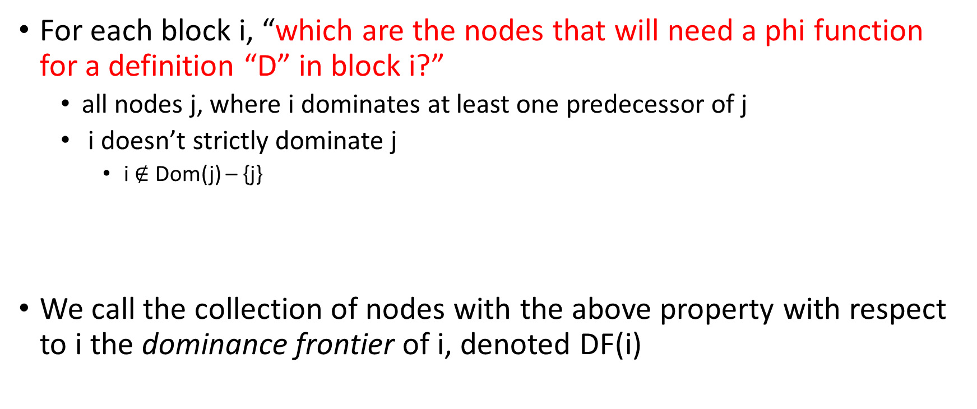
SSA
For each block i, “which are the nodes that will need a phi function for a definition “D” in block i?”
all nodes j, where i dominates at least one predecessor of j
i doesn’t strictly dominate j
i $∉$ Dom(j) – {j}
We call the collection of nodes with the above property with respect to i the dominance frontier of i, denoted DF(i)

Slide 18
Immediate dominator
Given a node n in a flow graph, the set of nodes that strictly dominate n is given by Dom(n) – {n}
Where Dom(n) is the set of dominators of n
The node which is closest to n in the set of strict dominators is called the immediate dominator of n, denoted IDom(n)

Slide 19
Immediate dominator
B0
B1
B2
B5
B6
B8
B7
B3
B4
Notes:
In this example, we are computing the set of strict dominators for each basic block. An immediate dominator is the closest strict dominator.

Slide 20
Immediate dominator
 | B0 | B1 | B2 | B3 | B4 | B5 | B6 | B7 | B8
DOM | {0} | {0,1} | {0,1,2} | {0,1,3} | {0,1,3,4} | {0,1,5} | {0,1,5,6} | {0,1,5,7} | {0,1,5,8}
IDOM | - | 0 | 1 | 1 | 3 | 1 | 5 | 5 | 5

Slide 21
Dominator tree
Dominator tree is made up of all the nodes in the CFG
An edge between two nodes m and n encodes the fact m = IDom(n)

Slide 22
 | B0 | B1 | B2 | B3 | B4 | B5 | B6 | B7 | B8
DOM | {0} | {0,1} | {0,1,2} | {0,1,3} | {0,1,3,4} | {0,1,5} | {0,1,5,6} | {0,1,5,7} | {0,1,5,8}
IDOM | - | 0 | 1 | 1 | 3 | 1 | 5 | 5 | 5
B0
Dominator Tree
B1
B2
B5
B6
B8
B7
B3
B4
Notes:
In the dominator tree, the parent node is the immediate dominator of its children. All the nodes in the path from the root to a given node x (including x) are the dominators of x.

Slide 23
 | B0 | B1 | B2 | B3 | B4 | B5 | B6 | B7 | B8
DOM | {0} | {0,1} | {0,1,2} | {0,1,3} | {0,1,3,4} | {0,1,5} | {0,1,5,6} | {0,1,5,7} | {0,1,5,8}
IDOM | - | 0 | 1 | 1 | 3 | 1 | 5 | 5 | 5
B0
B0
Dominator Tree
B1
B1
B2
B5
B2
B5
B6
B8
B6
B8
B7
B7
B3
B3
B4
B4
Notes:
In the dominator tree, the parent node is the immediate dominator of its children. All the nodes in the path from the root to a given node x (including x) are the dominators of x.

Slide 24
Dominator tree
Dominator tree encodes both IDom and dominators set for each node
The parent node of node m is the IDom(m)
The nodes in the path from the root to a node m are the dominators of m

Slide 25
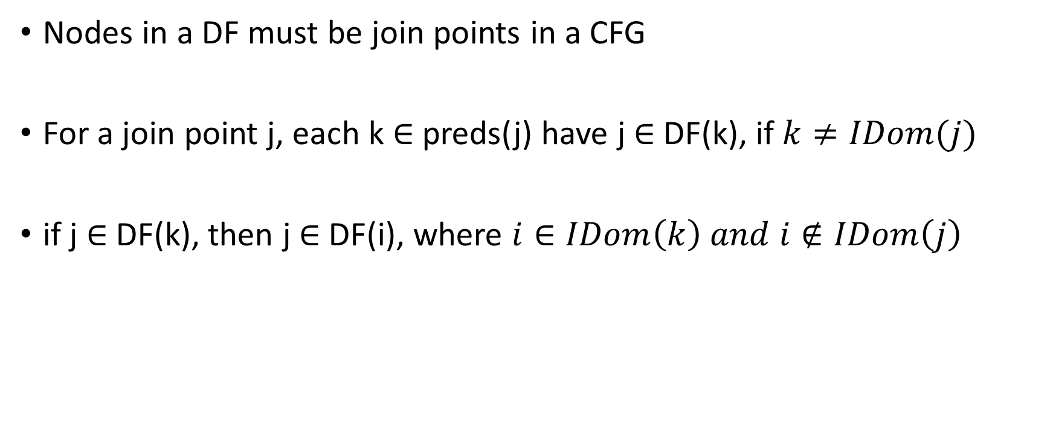
Dominance frontier
Nodes in a DF must be join points in a CFG
For a join point j, each k $∈$ preds(j) have j $∈$ DF(k), if $k≠IDom(j)$
if j $∈$ DF(k), then j $∈$ DF(i), where $i∈IDom\left(k\right) and i∉IDom\left(j\right)$
Notes:
To compute the dominance frontier, we look at all join nodes. For a join node x, first, we look at the predecessors that don’t strictly dominate x. Then we recursively walk the immediate dominators of such predecessors until we reach a node that is also the immediate dominator of x.

Slide 26

Dominance frontier
for all nodes n in the CFG
DF(n) = $φ$
for all nodes n in the CFG
if n has multiple predecessors
for each predecessor p of n
iter = p
while iter $≠$ IDom(n)
DF(iter) = DF(iter) $∪$ {n}
iter = IDom(iter)

Slide 27
Dominance frontier
B0
B0
B1
B1
B2
B5
B2
B5
B6
B8
B6
B8
B7
B7
B3
B3
B4
B4
Notes:
Here, B2 and B7 are the predecessors of B3. Because both don't strictly dominate B3, we add B3 to the set of dominance frontiers of B2 and B7. Now we look at the immediate dominators of B2 and B7. The immediate dominator of B2 (i.e., B1) is also the immediate dominator of B3. Because of this, we don't look at the immediate dominator of B1. The immediate dominator of B7 is B5, which is not the immediate dominator of B3. Thus we add B3 to the set of dominance frontier of B5. Next, we look at the immediate dominator of B5. The immediate dominator of B5 is B1 that is also the immediate dominator of B3; we stop at this point. Similarly, we look at other join nodes. Notice that one of the predecessors of B1 is B0 that also strictly dominates B1. So, B1 is not a dominance frontier of B0. Because B1 is the immediate dominator of B3 (a predecessor of B1) and B1 is not an immediate dominator of B1, we add B1 to the set of dominance frontiers of B1.

Slide 28
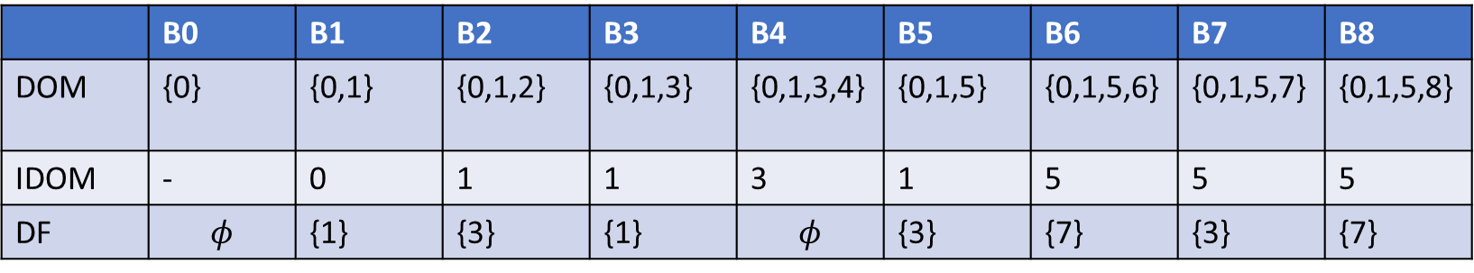
Dominance frontier
 | B0 | B1 | B2 | B3 | B4 | B5 | B6 | B7 | B8
DOM | {0} | {0,1} | {0,1,2} | {0,1,3} | {0,1,3,4} | {0,1,5} | {0,1,5,6} | {0,1,5,7} | {0,1,5,8}
IDOM | - | 0 | 1 | 1 | 3 | 1 | 5 | 5 | 5
DF | $$φ$$ | {1} | {3} | {1} | $$φ$$ | {3} | {7} | {3} | {7}

Slide 29
SSA
START
BB1
x = 30
BB2
x = 40
z = 10
BB3
y = 30
BB4
r = 10
y = 20
BB5
y = phi(y, y)
x= phi(x, x)
z = phi(z, z)
r = phi(r, r)
x = 40
p = x + y + z
BB6
END

Slide 30
SSA
START
BB1
x = 30
BB2
x is defined in BB2. BB3 and BB5 are in the dominance frontier of BB2.
After inserting a phi function for x in BB3 and BB5, we need to check if we need phi functions for these new definitions.
Because BB6 is in the dominance frontiers of both BB5 and BB3, we need a phi function for x in BB6.
x = 40
z = 10
BB3
y = 30
BB4
r = 10
y = 20
BB5
y = phi(y, y)
x= phi(x, x)
z = phi(z, z)
r = phi(r, r)
x = 40
p = x + y + z
BB6
END

Slide 31
B0
i = 1
a = p
c = q
if (a < c) goto B2
B1
b = p
c = q
d = 10
a = p
d = q
if (a <= d) goto B6
B2
B5
B6
d = 10
c = 30
B8
b = 40
B7
a = a + b
c = c + d
i = i + 1
if (i <= 100) goto B1
B3
B4
return
Notes:
We will compute the SSA for this example. Earlier, we have computed the dominance frontier for this CFG.

Slide 32
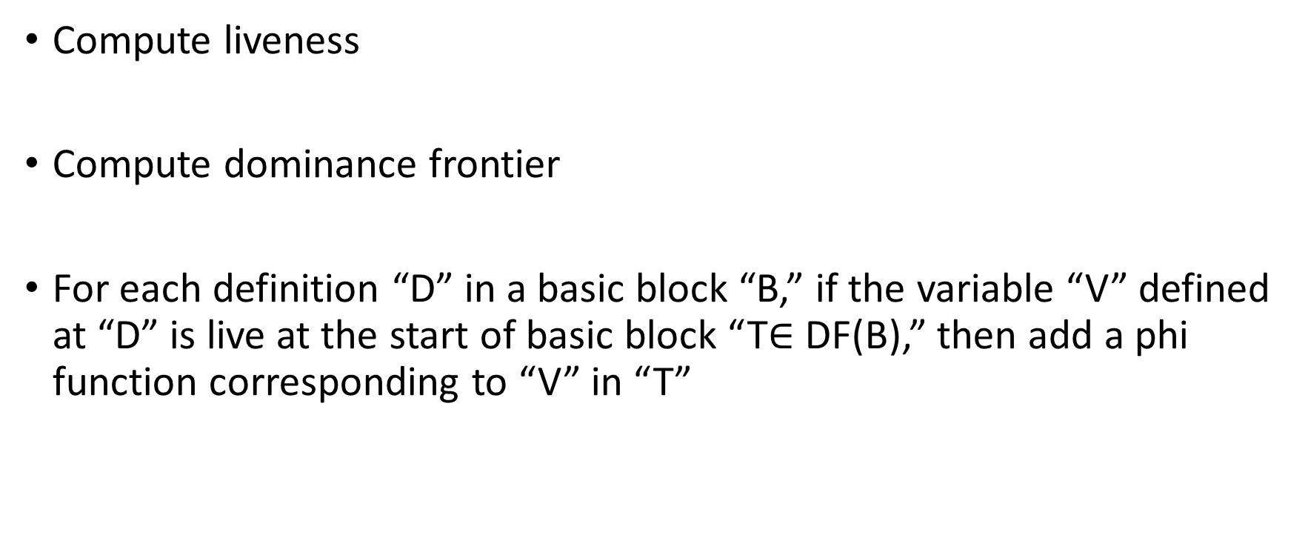
Building SSA
Compute liveness
Compute dominance frontier
For each definition “D” in a basic block “B,” if the variable “V” defined at “D” is live at the start of basic block “T$∈$ DF(B),” then add a phi function corresponding to “V” in “T”

Slide 33
Building SSA
Compute liveness information
LiveIN(B) := set of all variables that are live at the start of basic block B
2. Compute Dominance frontiers
DF(B) := dominance frontier of basic block B

Slide 34
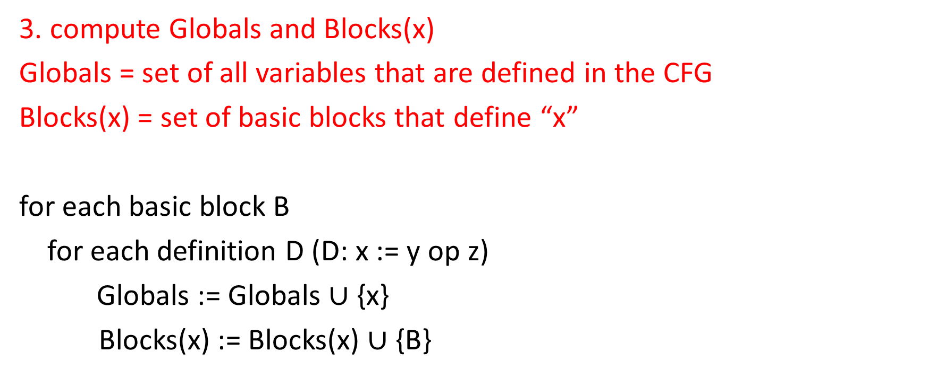
Building SSA
3. compute Globals and Blocks(x)
Globals = set of all variables that are defined in the CFG
Blocks(x) = set of basic blocks that define “x”
for each basic block B
for each definition D (D: x := y op z)
Globals := Globals $∪$ {x}
Blocks(x) := Blocks(x) $∪${B}

Slide 35
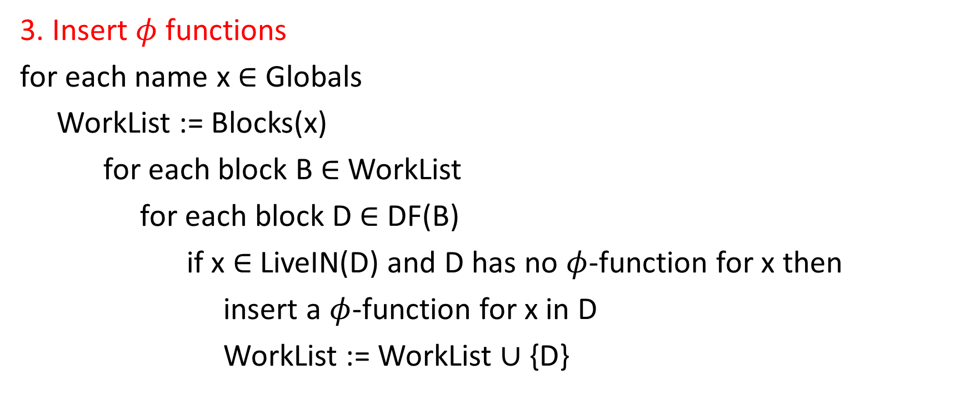
Building SSA
3. Insert $φ$ functions
for each name x $∈$ Globals
WorkList := Blocks(x)
for each block B $∈$ WorkList
for each block D $∈$ DF(B)
if x $∈$ LiveIN(D) and D has no $φ$-function for x then
insert a $φ$-function for x in D
WorkList := WorkList $∪$ {D}
Notes:
After adding a new phi function (say P) in a basic block D, we need to reiterate D's dominance frontiers to check if a phi function is required for P.

Slide 36
Live variables
B0
i = 1
a = p
c = q
if (a < c) goto B2
B1
BB | DF
0 | -
1 | 1
2 | 3
3 | 1
4 | -
5 | 3
6 | 7
7 | 3
8 | 7
b = p
c = q
d = 10
a = p
d = q
if (a <= d) goto B6
B2
B5
B6
d = 10
c = 30
B8
b = 40
B7
a = a + b
c = c + d
i = i + 1
if (i <= 100) goto B1
B3
B4
return

Slide 37
Live variables iteration-1
B0
i = 1
{i, p, q}
a = p
c = q
if (a < c) goto B2
B1
BB | DF
0 | -
1 | 1
2 | 3
3 | 1
4 | -
5 | 3
6 | 7
7 | 3
8 | 7
{i, a, p, q}
{i, c, p, q}
b = p
c = q
d = 10
a = p
d = q
if (a <= d) goto B6
B2
B5
{i, c, a}
{i, d, a}
B6
d = 10
c = 30
B8
{i, c, d, a}
{i, c, d, a, b}
b = 40
B7
a = a + b
c = c + d
i = i + 1
if (i <= 100) goto B1
B3
B4
return
Notes:
This is the first iteration of the computation of live variables.

Slide 38
Live variables iteration-2
B0
i = 1
{i, p, q}
a = p
c = q
if (a < c) goto B2
B1
BB | DF
0 | -
1 | 1
2 | 3
3 | 1
4 | -
5 | 3
6 | 7
7 | 3
8 | 7
{i, a, p, q}
{i, c, p, q}
b = p
c = q
d = 10
a = p
d = q
if (a <= d) goto B6
B2
B5
{i, c, a, p, q}
{i, d, a, p, q}
B6
d = 10
c = 30
B8
{i, c, d, a, p, q}
{i, c, d, a, b, p, q}
b = 40
B7
a = a + b
c = c + d
i = i + 1
if (i <= 100) goto B1
B3
{i, p, q}
B4
return
Notes:
This is the second iteration of the computation of live variables.

Slide 39
phi insertion
B0
i = 1
{i, p, q}
a = p
c = q
if (a < c) goto B2
B1
BB | DF
0 | -
1 | 1
2 | 3
3 | 1
4 | -
5 | 3
6 | 7
7 | 3
8 | 7
{i, a, p, q}
{i, c, p, q}
b = p
c = q
d = 10
a = p
d = q
if (a <= d) goto B6
B2
B5
{i, c, a, p, q}
{i, d, a, p, q}
B6
d = 10
c = 30
B8
{i, c, d, a, p, q}
{i, c, d, a, b, p, q}
b = 40
B7
a = a + b
c = c + d
i = i + 1
if (i <= 100) goto B1
B3
{i, p, q}
B4
return
Notes:
We have two definitions a and c in B1. Because none of them are live at the start of B1 ∈ DF(B1), we don’t need a phi function for them in B1. We have three definitions b, c, and d in B2. Because all of them are live at the start of B3 ∈ DF(B2), we need phi functions for all of them in B3. We have five definitions a, c(phi), i, b(phi), d(phi) in B3. Because i is live in B1 ∈ DF(B3), we need a phi function for i in B1. For the new definition i (phi) in B1, because there is already a phi function in B1 ∈ DF(B1), we don’t need to do anything else. We have two definitions a and d in B5. Because both of them are live at B3 ∈ DF(B5), we need to add a phi function for both of them in B3. We already had a phi function for d in B3, so we only need to add a phi function for a. We don’t need to add anything in B1 ∈ DF(B3) for newly added phi(a) in B3 because a is not live in B1. B6 is defining d. Because d is live at the start of B7 ∈ B6, we need to add a phi function for d in B7. Similarly, we need to add a phi function for definition c in B8 in B7. Now we have three definitions b, c(phi), d(phi) in B7. Because all of them are live at B3 ∈ DF(B7), but B7 already has phi functions for all of them, we don’t need to do anything.

Slide 40
after phi insertion
B0
i = 1
{i, p, q}
i = phi(i, i)
a = p
c = q
if (a < c) goto B2
B1
BB | DF
0 | -
1 | 1
2 | 3
3 | 1
4 | -
5 | 3
6 | 7
7 | 3
8 | 7
{i, a, p, q}
{i, c, p, q}
b = p
c = q
d = 10
a = p
d = q
if (a <= d) goto B6
B2
B5
{i, c, a, p, q}
{i, d, a, p, q}
B6
d = 10
c = 30
B8
{i, c, d, a, p, q}
c = phi(c, c)
d = phi(d, d)
b = 40
{i, c, d, a, b, p, q}
B7
b = phi(b, b)
c = phi(c, c)
d = phi(d, d)
a = phi(a, a)
a = a + b
c = c + d
i = i + 1
if (i <= 100) goto B1
B3
B4
return
Notes:
This is the CFG after adding the phi functions. The next goal is to give each definition a new name.

Slide 41
Renaming
Compute reaching definitions
Rename each definition
Replace each use by the corresponding reaching definition

Slide 42
B0
i1: i = 1
Reaching definitions
i2: i= phi(i, i)
a3: a = p
c4: c = q
if (a < c) goto B2
B1
b5: b = p
c6: c = q
d7: d = 10
a8: a = p
d9: d = q
if (a <= d) goto B6
B2
B5
B6
d10: d = 10
c11: c = 30
B8
c12: c = phi(c, c)
d13: d = phi(d, d)
b14: b= 40
B7
b15: b = phi(b, b)
c16: c = phi(c, c)
d17: d = phi(d, d)
a18: a = phi(a, a)
a19: a = a + b
c20: c = c + d
i21: i = i + 1
if (i <= 100) goto B1
B3
B4
return
Notes:
Here, we have assigned a unique label to each definition. To rename each use, we need to compute reaching definitions.

Slide 43
B0
i1: i = 1
ITERATION-1
{i1}
i2: i= phi(i, i)
a3: a = p
c4: c = q
if (a < c) goto B2
B1
{i2,a3,c4}
{i2,a3,c4}
b5: b = p
c6: c = q
d7: d = 10
a8: a = p
d9: d = q
if (a <= d) goto B6
B2
B5
{i2,c4,a8,d9}
{i2,c4,a8,d9}
B6
d10: d = 10
c11: c = 30
B8
{i2,c4,a8,d10}
{i2,c11,a8,d9}
c12: c = phi(c, c)
d13: d = phi(d, d)
b14: b= 40
{i2,a3,b5,c6,d7}
B7
{i2,c4,a8,d9,d10,c11}
b15: b = phi(b, b)
c16: c = phi(c, c)
d17: d = phi(d, d)
a18: a = phi(a, a)
a19: a = a + b
c20: c = c + d
i21: i = i + 1
if (i <= 100) goto B1
{i2,a8,c12,d13,b14}
B3
{i2,a3,b5,c6,d7,a8,c12,d13,b14}
{b15,d17,a19,c20,i21}
B4
return
Notes:
This is the first iteration of the computation of reaching definitions.

Slide 44
B0
i1: i = 1
ITERATION-2
{i1,b15,d17,a19,c20,i21}
i2: i= phi(i, i)
a3: a = p
c4: c = q
if (a < c) goto B2
B1
{i2,a3,c4,b15,d17}
{i2,a3,c4,b15,d17}
b5: b = p
c6: c = q
d7: d = 10
a8: a = p
d9: d = q
if (a <= d) goto B6
B2
B5
{i2,c4,a8,d9, b15}
{i2,c4,a8,d9,b15}
B6
d10: d = 10
c11: c = 30
B8
{i2,c4,a8,d10,b15}
{i2,c11,a8,d9,b15}
c12: c = phi(c, c)
d13: d = phi(d, d)
b14: b= 40
{i2,a3,b5,c6,d7}
B7
{i2,c4,a8,d9,d10,c11,b15}
b15: b = phi(b, b)
c16: c = phi(c, c)
d17: d = phi(d, d)
a18: a = phi(a, a)
a19: a = a + b
c20: c = c + d
i21: i = i + 1
if (i <= 100) goto B1
{i2,a8,c12,d13,b14}
B3
{i2,a3,b5,c6,d7,a8,c12,d13,b14}
{b15,d17,a19,c20,i21}
B4
return
Notes:
This is the second iteration of the computation of reaching definitions.

Slide 45
B0
i1: i = 1
Renaming
{i1,b15,d17,a19,c20,i21}
i2: i= phi(i, i)
a3: a = p
c4: c = q
if (a < c) goto B2
B1
{i2,a3,c4,b15,d17}
{i2,a3,c4,b15,d17}
b5: b = p
c6: c = q
d7: d = 10
a8: a = p
d9: d = q
if (a <= d) goto B6
B2
B5
{i2,c4,a8,d9, b15}
{i2,c4,a8,d9,b15}
B6
d10: d = 10
c11: c = 30
B8
{i2,c4,a8,d10,b15}
{i2,c11,a8,d9,b15}
c12: c = phi(c, c)
d13: d = phi(d, d)
b14: b= 40
{i2,a3,b5,c6,d7}
B7
{i2,c4,a8,d9,d10,c11,b15}
b15: b = phi(b, b)
c16: c = phi(c, c)
d17: d = phi(d, d)
a18: a = phi(a, a)
a19: a = a + b
c20: c = c + d
i21: i = i + 1
if (i <= 100) goto B1
{i2,a8,c12,d13,b14}
B3
{i2,a3,b5,c6,d7,a8,c12,d13,b14}
{b15,d17,a19,c20,i21}
B4
return

Slide 46
B0
i1: i1 = 1
Renaming
{i1,b15,d17,a19,c20,i21}
i2: i2= phi(i1, i21)
a3: a3 = p
c4: c4 = q
if (a3 < c4) goto B2
B1
{i2,a3,c4,b15,d17}
{i2,a3,c4,b15,d17}
b5: b5 = p
c6: c6 = q
d7: d7 = 10
a8: a8 = p
d9: d9 = q
if (a8 <= d9) goto B6
B2
B5
{i2,c4,a8,d9, b15}
{i2,c4,a8,d9,b15}
B6
d10: d10 = 10
c11: c11 = 30
B8
{i2,c4,a8,d10,b15}
{i2,c11,a8,d9,b15}
c12: c12 = phi(c4, c11)
d13: d13 = phi(d9, d10)
b14: b14= 40
{i2,a3,b5,c6,d7}
B7
{i2,c4,a8,d9,d10,c11,b15}
b15: b15 = phi(b5, b14)
c16: c16 = phi(c6, c12)
d17: d17 = phi(d7, d13)
a18: a18 = phi(a3, a8)
a19: a19 = a18 + b15
c20: c20 = c16 + d17
i21: i21 = i2 + 1
if (i21 <= 100) goto B1
{i2,a8,c12,d13,b14}
B3
{i2,a3,b5,c6,d7,a8,c12,d13,b14}
{b15,d17,a19,c20,i21}
B4
return
Notes:
After computing the reaching definition, we will see that exactly one definition reaches each non-phi use. For a phi node, the operands are the definitions that are reaching via predecessors. To convert into an SSA form, we can rename all definitions with their unique labels and replace each use with the corresponding definition.

