Slide 2
Today’s topics
Quantified formulas

Slide 3
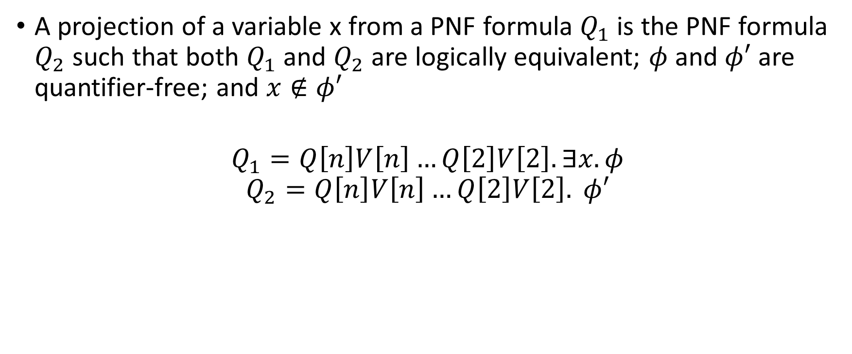
Projection
A projection of a variable x from a PNF formula $Q_{1}$ is the PNF formula $Q_{2}$ such that both $Q_{1}$ and $Q_{2}$ are logically equivalent; $φ$ and $φ′$ are quantifier-free; and $x∉φ′$
$$Q_{1}=Q\left[n\right]V\left[n\right]…Q\left[2\right]V\left[2\right]. ∃x. φ$$
$$Q_{2}=Q\left[n\right]V\left[n\right]…Q\left[2\right]V\left[2\right]. φ′$$

Slide 4

Quantifier-elimination
Quantifier_Elimination
Input: $Q\left[n\right]V\left[n\right]…Q\left[1\right]V\left[1\right]. φ$
Output: A quantifier-free formula over constants $φ′$, which is valid if and only if $φ$ is valid

Slide 5
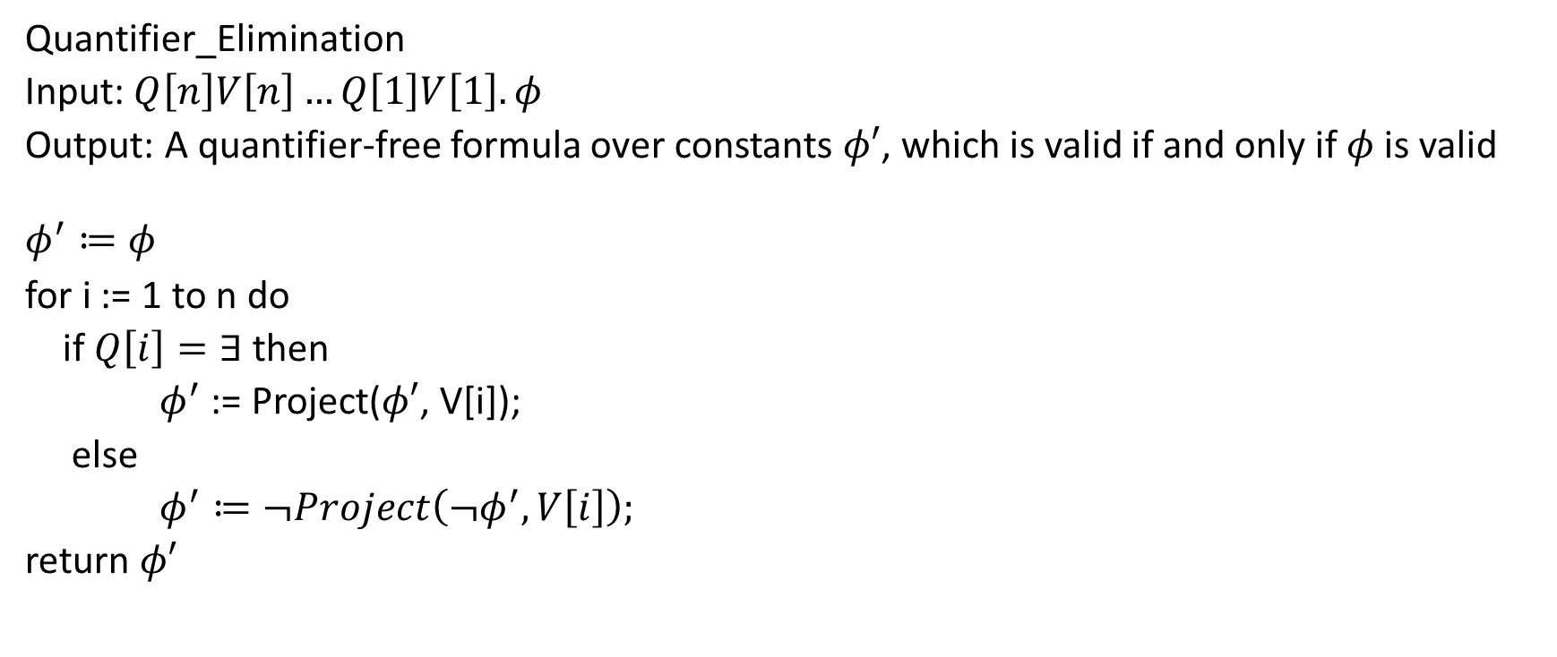
Quantifier-elimination
Quantifier_Elimination
Input: $Q\left[n\right]V\left[n\right]…Q\left[1\right]V\left[1\right]. φ$
Output: A quantifier-free formula over constants $φ′$, which is valid if and only if $φ$ is valid
$$φ^{′}≔φ$$
for i := 1 to n do
if $Q\left[i\right]=∃$ then
$φ^{′}$ := Project($φ′$, V[i]);
else
$φ^{′}≔¬Project\left(¬φ^{′}, V\left[i\right]\right);$
return $φ′$

Slide 6

Projection with Binary resolution
For Boolean formulas in the CNF form, we can eliminate an existentially quantified variable $x$ by applying resolution to all pairs of clauses where $x$ appears with opposite phases

Slide 7
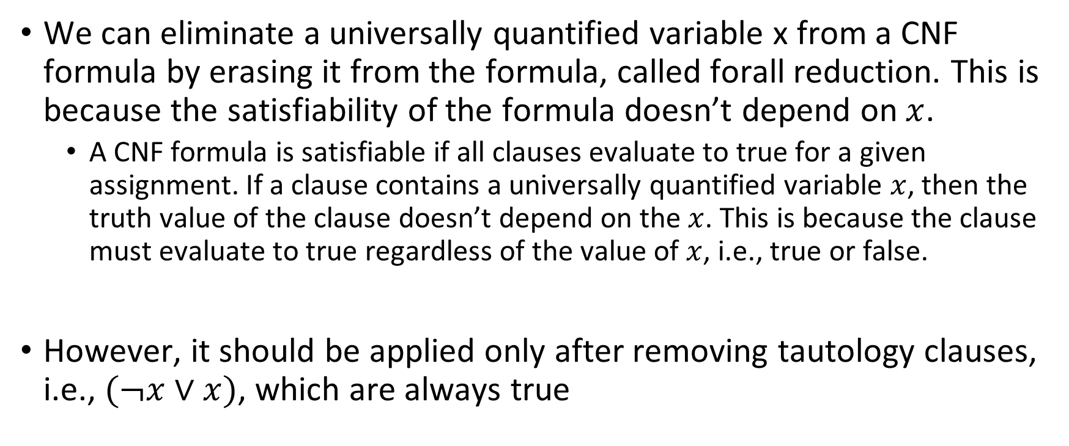
Projection with Binary resolution
We can eliminate a universally quantified variable x from a CNF formula by erasing it from the formula, called forall reduction. This is because the satisfiability of the formula doesn’t depend on $x$.
A CNF formula is satisfiable if all clauses evaluate to true for a given assignment. If a clause contains a universally quantified variable $x$, then the truth value of the clause doesn’t depend on the $x$. This is because the clause must evaluate to true regardless of the value of $x$, i.e., true or false.
However, it should be applied only after removing tautology clauses, i.e., $(¬x∨x)$, which are always true

Slide 8

Example
Is the following formula satisfiable?
$$∀u_{1}.∀u_{2}.∃e_{1}.∀u_{3}.∃e_{3}.∃e_{2}. \left(u_{1}∨¬e_{1}\right)∧\left(¬u_{1}∨¬e_{2}∨e_{3}\right)∧\left(u_{2}∨¬u_{3}∨¬e_{1}\right)∧\left(e_{1}∨e_{2}\right)∧(e_{1}∨¬e_{3})$$

Slide 9
Example
Is the following formula satisfiable?
$$∀u_{1}.∀u_{2}.∃e_{1}.∀u_{3}.∃e_{3}.∃e_{2}. \left(u_{1}∨¬e_{1}\right)∧\left(¬u_{1}∨¬e_{2}∨e_{3}\right)∧\left(u_{2}∨¬u_{3}∨¬e_{1}\right)∧\left(e_{1}∨e_{2}\right)∧(e_{1}∨¬e_{3})$$
Removing $e_{2}$
$$∀u_{1}.∀u_{2}.∃e_{1}.∀u_{3}.∃e_{3}. \left(u_{1}∨¬e_{1}\right)∧\left(¬u_{1}∨e_{3}∨e_{1}\right)∧\left(u_{2}∨¬u_{3}∨¬e_{1}\right)∧(e_{1}∨¬e_{3})$$
Removing $e_{3}$
$$∀u_{1}.∀u_{2}.∃e_{1}.∀u_{3}. \left(u_{1}∨¬e_{1}\right)∧\left(¬u_{1}∨e_{1}\right)∧\left(u_{2}∨¬u_{3}∨¬e_{1}\right)$$
Removing $u_{3}$
$$∀u_{1}.∀u_{2}.∃e_{1}. \left(u_{1}∨¬e_{1}\right)∧\left(¬u_{1}∨e_{1}\right)∧\left(u_{2}∨¬e_{1}\right)$$
Removing $e_{1}$
$$∀u_{1}.∀u_{2}.\left(u_{1}∨¬u_{1}\right)∧\left(¬u_{1}∨u_{2}\right)$$
Removing $Tautologies$
$$∀u_{1}.∀u_{2}. \left(¬u_{1}∨u_{2}\right)$$
Removing $u_{2}$
$$∀u_{1}. \left(¬u_{1}\right)$$
Removing $u_{1}$
$An empty clause.$ Therefore, the formula is unsatisfiable.

Slide 10

Example
Is the following formula satisfiable?
$$∀u_{1}.∀u_{2}.∃e_{3}.∀u_{3}.∃e_{1}.∃e_{2}. \left(u_{1}∨¬e_{1}\right)∧\left(¬u_{1}∨¬e_{2}∨e_{3}\right)∧\left(u_{2}∨¬u_{3}∨¬e_{1}\right)∧\left(e_{1}∨e_{2}\right)∧(e_{1}∨¬e_{3})$$

Slide 11
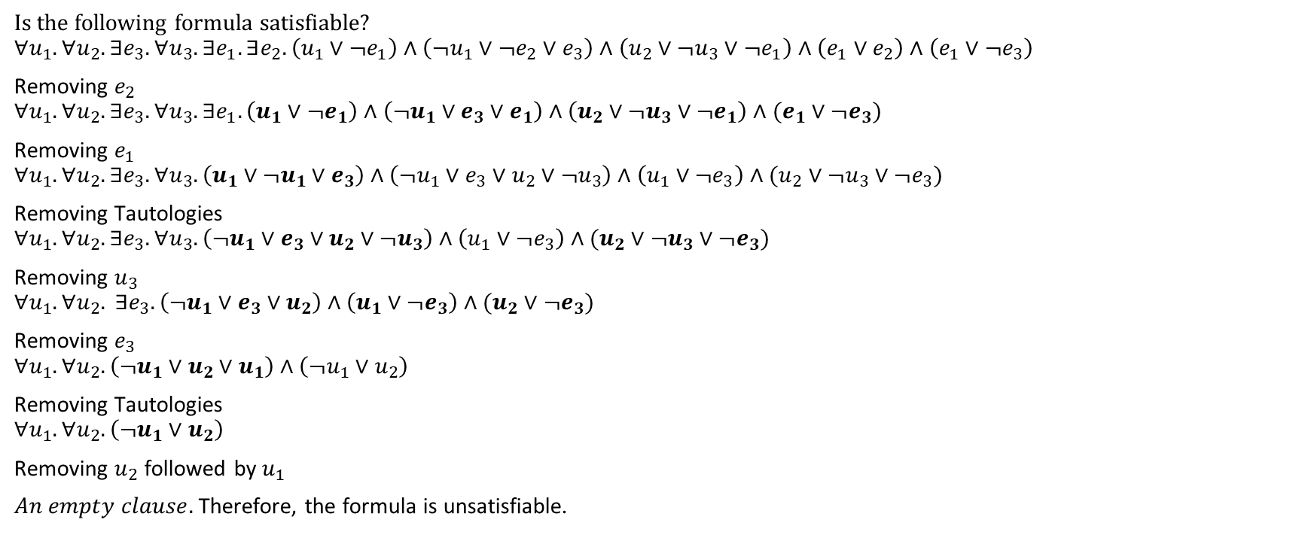
Example
Is the following formula satisfiable?
$$∀u_{1}.∀u_{2}.∃e_{3}.∀u_{3}.∃e_{1}.∃e_{2}. \left(u_{1}∨¬e_{1}\right)∧\left(¬u_{1}∨¬e_{2}∨e_{3}\right)∧\left(u_{2}∨¬u_{3}∨¬e_{1}\right)∧\left(e_{1}∨e_{2}\right)∧\left(e_{1}∨¬e_{3}\right)$$
Removing $e_{2}$
$$∀u_{1}.∀u_{2}.∃e_{3}.∀u_{3}.∃e_{1}. \left(u_{1}∨¬e_{1}\right)∧\left(¬u_{1}∨e_{3}∨e_{1}\right)∧\left(u_{2}∨¬u_{3}∨¬e_{1}\right)∧(e_{1}∨¬e_{3})$$
Removing $e_{1}$
$$∀u_{1}.∀u_{2}.∃e_{3}.∀u_{3}. \left(u_{1}∨¬u_{1}∨e_{3}\right)∧\left(¬u_{1}∨e_{3}∨u_{2}∨¬u_{3}\right)∧\left(u_{1}∨¬e_{3}\right)∧(u_{2}∨¬u_{3}∨¬e_{3})$$
Removing Tautologies
$$∀u_{1}.∀u_{2}.∃e_{3}.∀u_{3}.\left(¬u_{1}∨e_{3}∨u_{2}∨¬u_{3}\right)∧\left(u_{1}∨¬e_{3}\right)∧(u_{2}∨¬u_{3}∨¬e_{3})$$
Removing $u_{3}$
$$∀u_{1}.∀u_{2}. ∃e_{3}.\left(¬u_{1}∨e_{3}∨u_{2}\right)∧\left(u_{1}∨¬e_{3}\right)∧(u_{2}∨¬e_{3})$$
Removing $e_{3}$
$$∀u_{1}.∀u_{2}.\left(¬u_{1}∨u_{2}∨u_{1}\right)∧\left(¬u_{1}∨u_{2}\right)$$
Removing Tautologies
$$∀u_{1}.∀u_{2}. \left(¬u_{1}∨u_{2}\right)$$
Removing $u_{2}$ followed by $u_{1}$
$An empty clause.$ Therefore, the formula is unsatisfiable.

Slide 12
Quantifier elimination
Can we not simply move all existential quantifiers before all universal quantifiers, remove all universal quantified variables and their occurrences in the formula, and solve the remaining existentially quantified formula using DPLL?

Slide 13
Quantifier elimination
Can we not simply move all existential quantifiers before all universal quantifiers, remove all universal quantified variables and their occurrences in the formula, and solve the remaining existentially quantified formula using DPLL?
No, because the order of universally and existentially quantified variables matters, as discussed before

Slide 14

Example
Is the following formula satisfiable?
$$∀x.∃y.\left(x∨y\right)∧(¬x∨¬y)$$

Slide 15

Example
Is the following formula satisfiable?
$$∀x.∃y.\left(x∨y\right)∧(¬x∨¬y)$$
Removing y
$∀x.$ (x $∨¬x$)
Removing Tautologies
$∀x.$ T
Removing x
T
Thus, the formula is satisfiable.

Slide 16

Example
Is the following formula satisfiable?
$$∃y.∀x.\left(x∨y\right)∧(¬x∨¬y)$$
Removing x
$$∃y.\left(y\right)∧(¬y)$$
Removing $y$
an empty clause
Thus, the formula is unsatisfiable.

Slide 17

Time complexity
Let $n, m$ denote the number of quantifiers and the clauses, respectively.
What would be the worst-case time complexity?

Slide 18
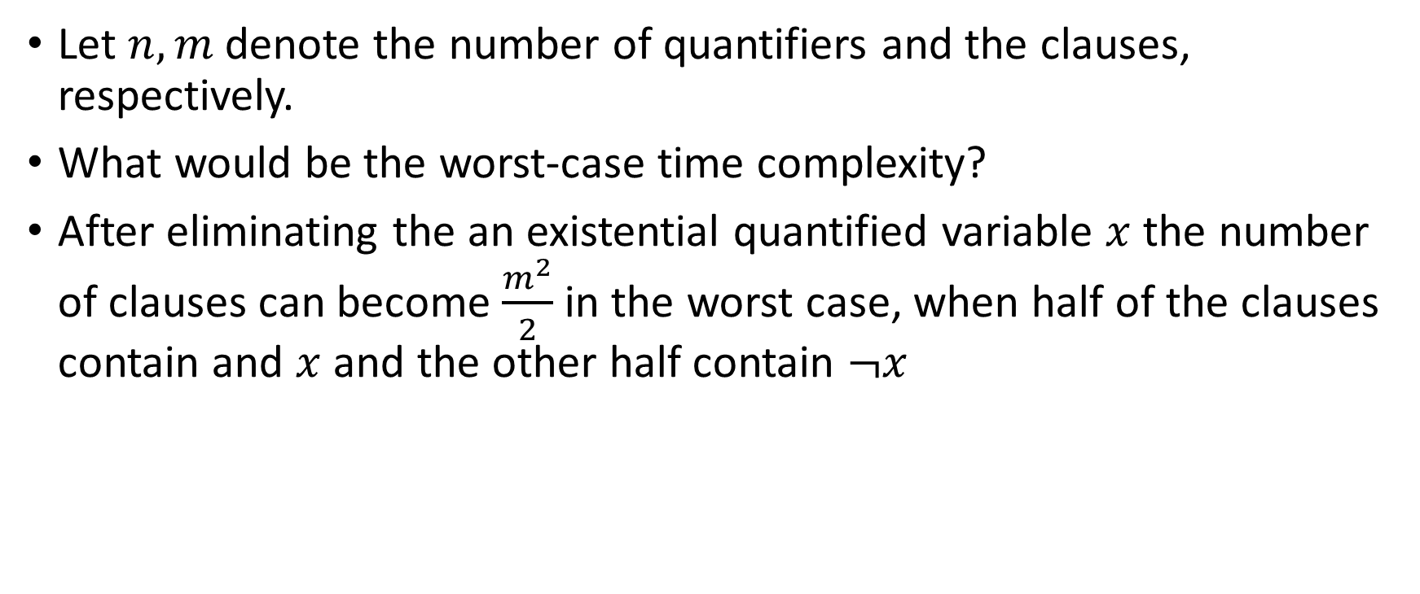
Time complexity
Let $n, m$ denote the number of quantifiers and the clauses, respectively.
What would be the worst-case time complexity?
After eliminating the an existential quantified variable $x$ the number of clauses can become $\frac{m^{2}}{2}$ in the worst case, when half of the clauses contain and $x$ and the other half contain $¬x$

Slide 19
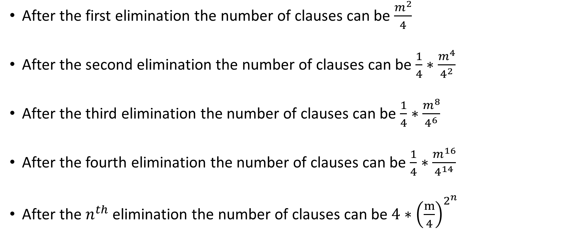
Time complexity
After the first elimination the number of clauses can be $\frac{m^{2}}{4}$
After the second elimination the number of clauses can be $\frac{1}{4}∗\frac{m^{4}}{4^{2}}$
After the third elimination the number of clauses can be $\frac{1}{4}∗\frac{m^{8}}{4^{6}}$
After the fourth elimination the number of clauses can be $\frac{1}{4}∗\frac{m^{16}}{4^{14}}$
After the $n^{th}$ elimination the number of clauses can be $4∗{\left(\frac{m}{4}\right)}^{2^{n}}$

Slide 20
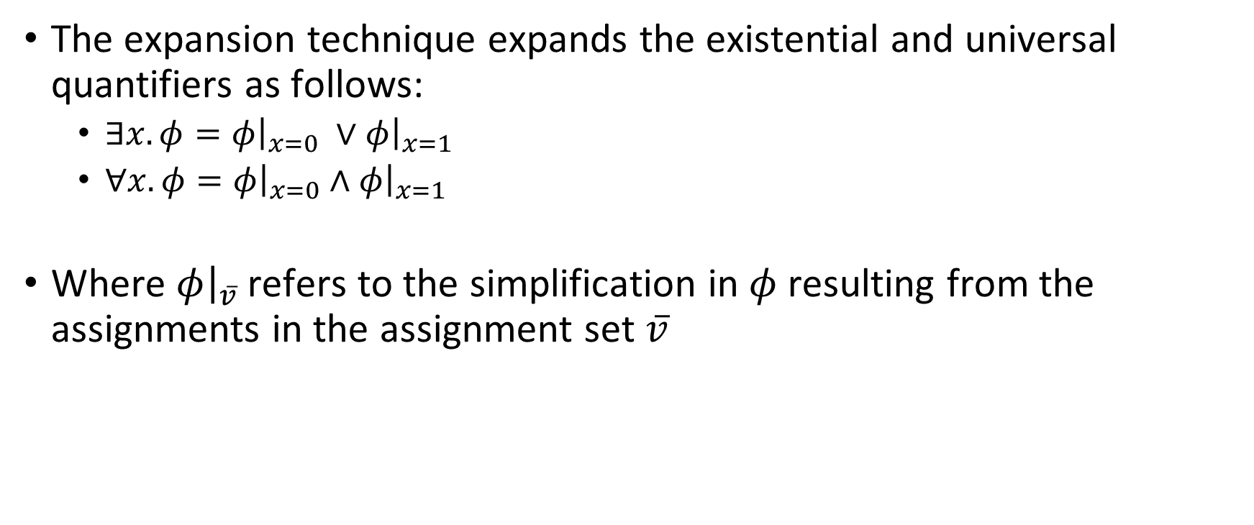
Expansion-based quantifier elimination
The expansion technique expands the existential and universal quantifiers as follows:
$∃x. φ=φ{\left.​\right|}_{x=0} ∨φ{\left.​\right|}_{x=1}$
$∀x. φ=φ{\left.​\right|}_{x=0}∧φ{\left.​\right|}_{x=1}$
Where $φ{\left.​\right|}_{v̅}$ refers to the simplification in $φ$ resulting from the assignments in the assignment set $v̅$

Slide 21

Example
$∃y.∀z.∃x.(y∨(x∧z))$

Slide 22

Example
$∃y.∀z.∃x.(y∨(x∧z))$
Expanding $x$
$∃y.∀z. \left(y∨\left(x∧z\right)\right){\left.​\right|}_{x=0}∨\left(y∨\left(x∧z\right)\right){\left.​\right|}_{x=1}$
$$∃y. ∀z. \left(y\right)∨\left(y∨z\right)$$
Expanding $z$
$∃y. \left(\left(y\right)∨\left(y∨z\right)\right){\left.​\right|}_{z=0}∧\left(\left(y\right)∨\left(y∨z\right)\right){\left.​\right|}_{z=1}$
$∃y. \left(y\right)∧$ T
Expanding y
$y{\left.​\right|}_{y=0 }∨y{\left.​\right|}_{y=1}$
$⊥ ∨$ T = T
Thus, the formula is satisfiable.

Slide 23
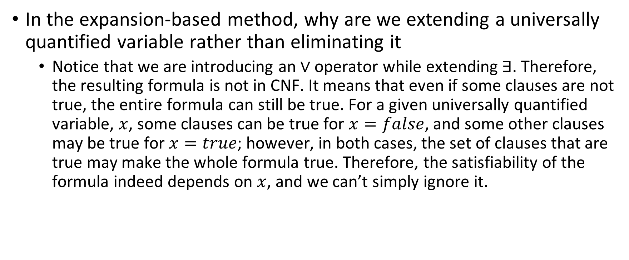
Expansion-based method
In the expansion-based method, why are we extending a universally quantified variable rather than eliminating it
Notice that we are introducing an $∨$ operator while extending ∃. Therefore, the resulting formula is not in CNF. It means that even if some clauses are not true, the entire formula can still be true. For a given universally quantified variable, $x$, some clauses can be true for $x=false$, and some other clauses may be true for $x=true$; however, in both cases, the set of clauses that are true may make the whole formula true. Therefore, the satisfiability of the formula indeed depends on $x$, and we can’t simply ignore it.

Slide 24
Example
Is the following formula satisfiable?
$$∀x.∃y.\left(x∨y\right)∧(¬x∨¬y)$$

Slide 25
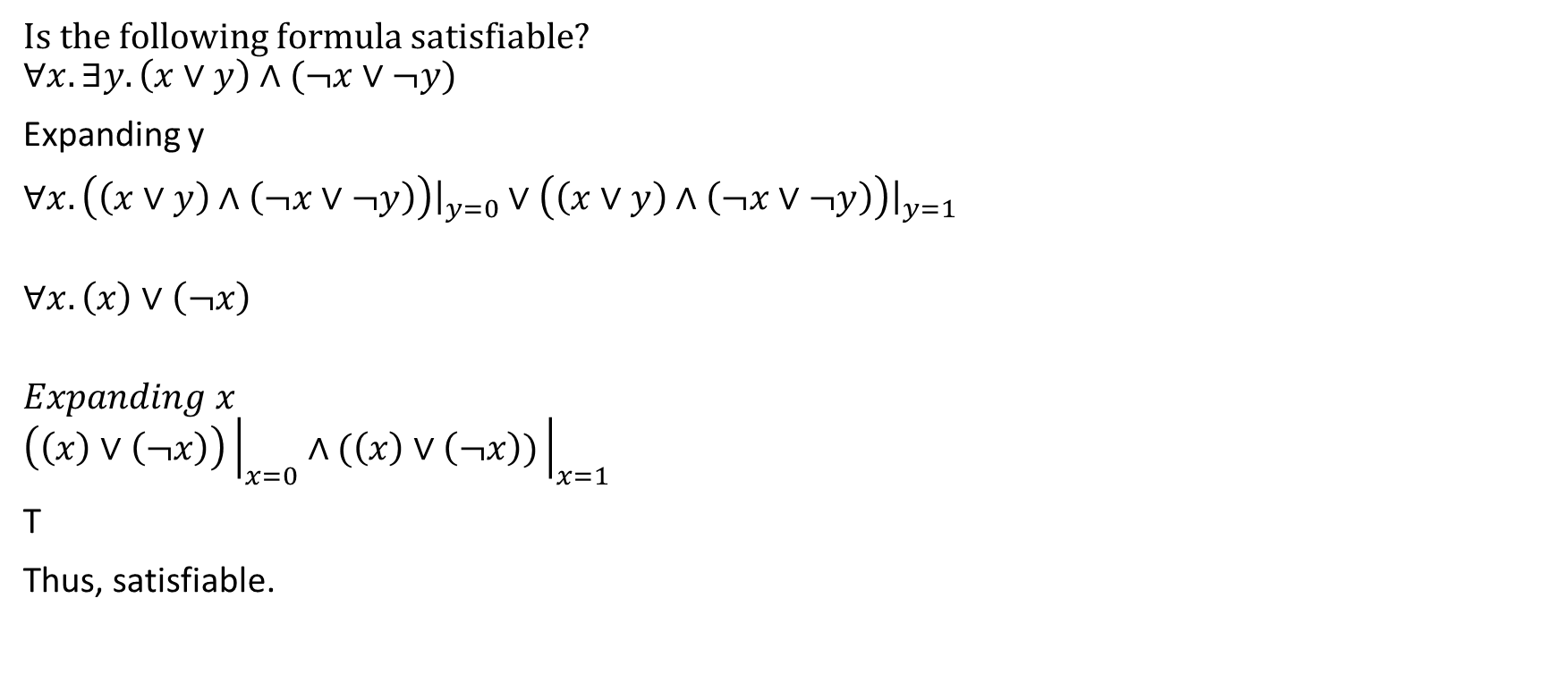
Example
Is the following formula satisfiable?
$$∀x.∃y.\left(x∨y\right)∧(¬x∨¬y)$$
Expanding y
$∀x.\left(\left(x∨y\right)∧\left(¬x∨¬y\right)\right){\left.​\right|}_{y=0}∨$ $\left(\left(x∨y\right)∧\left(¬x∨¬y\right)\right){\left.​\right|}_{y=1}$
$$∀x. \left(x\right)∨\left(¬x\right)$$
$$Expanding x$$
$$\left(\left(x\right)∨\left(¬x\right)\right){\left.​\right|}_{x=0}∧(\left(x\right)∨\left(¬x\right)){\left.​\right|}_{x=1}$$
T
Thus, satisfiable.

Slide 26

Example
Is the following formula satisfiable?
$$∃y.∀x.\left(x∨y\right)∧(¬x∨¬y)$$

Slide 27
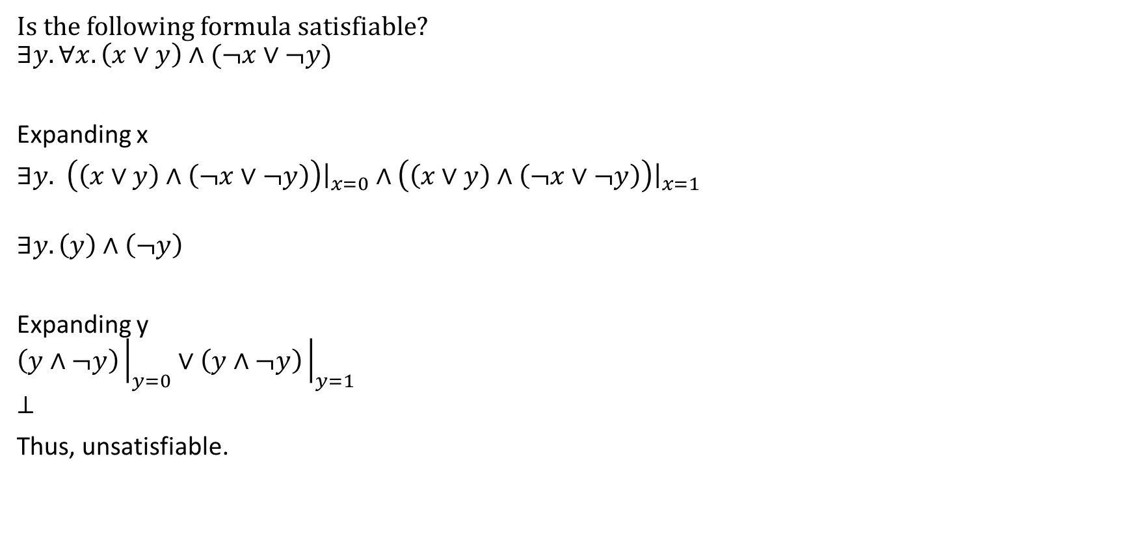
Example
Is the following formula satisfiable?
$$∃y.∀x.\left(x∨y\right)∧(¬x∨¬y)$$
Expanding x
$∃y.$ $\left(\left(x∨y\right)∧\left(¬x∨¬y\right)\right){\left.​\right|}_{x=0}∧$ $\left(\left(x∨y\right)∧\left(¬x∨¬y\right)\right){\left.​\right|}_{x=1}$
$$∃y. \left(y\right)∧\left(¬y\right)$$
Expanding y
$$\left(y∧¬y\right){\left.​\right|}_{y=0}∨\left(y∧¬y\right){\left.​\right|}_{y=1}$$
$$⊥$$
Thus, unsatisfiable.

Slide 28
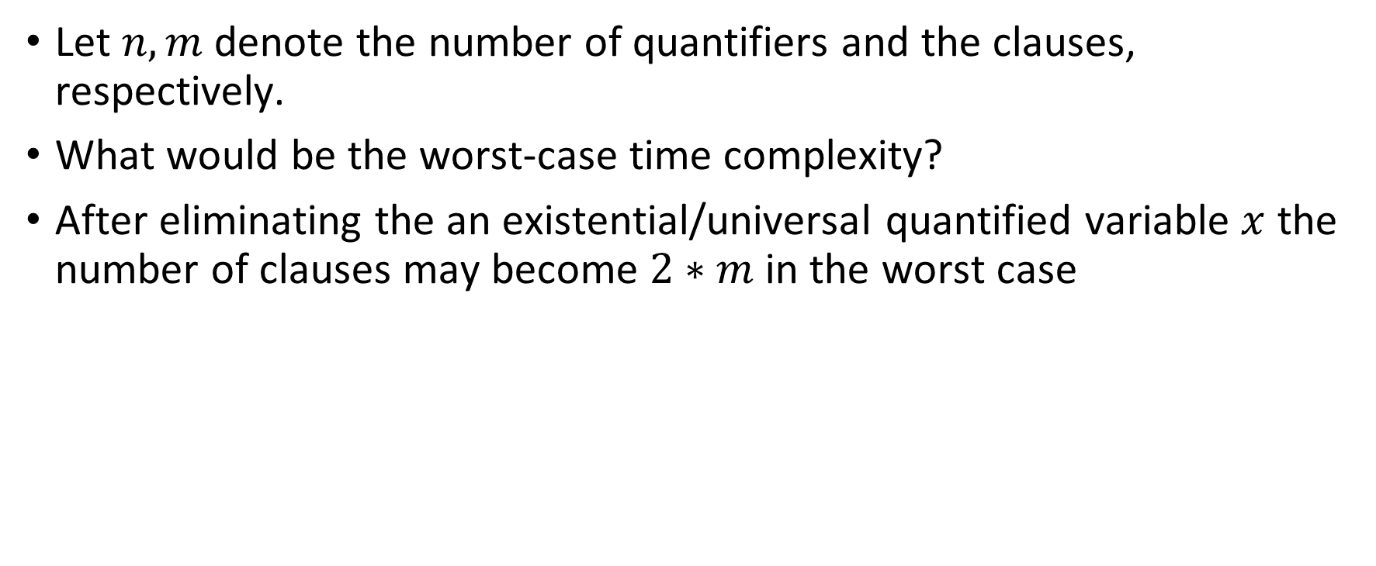
Time complexity
Let $n, m$ denote the number of quantifiers and the clauses, respectively.
What would be the worst-case time complexity?
After eliminating the an existential/universal quantified variable $x$ the number of clauses may become $2∗m$ in the worst case

Slide 29
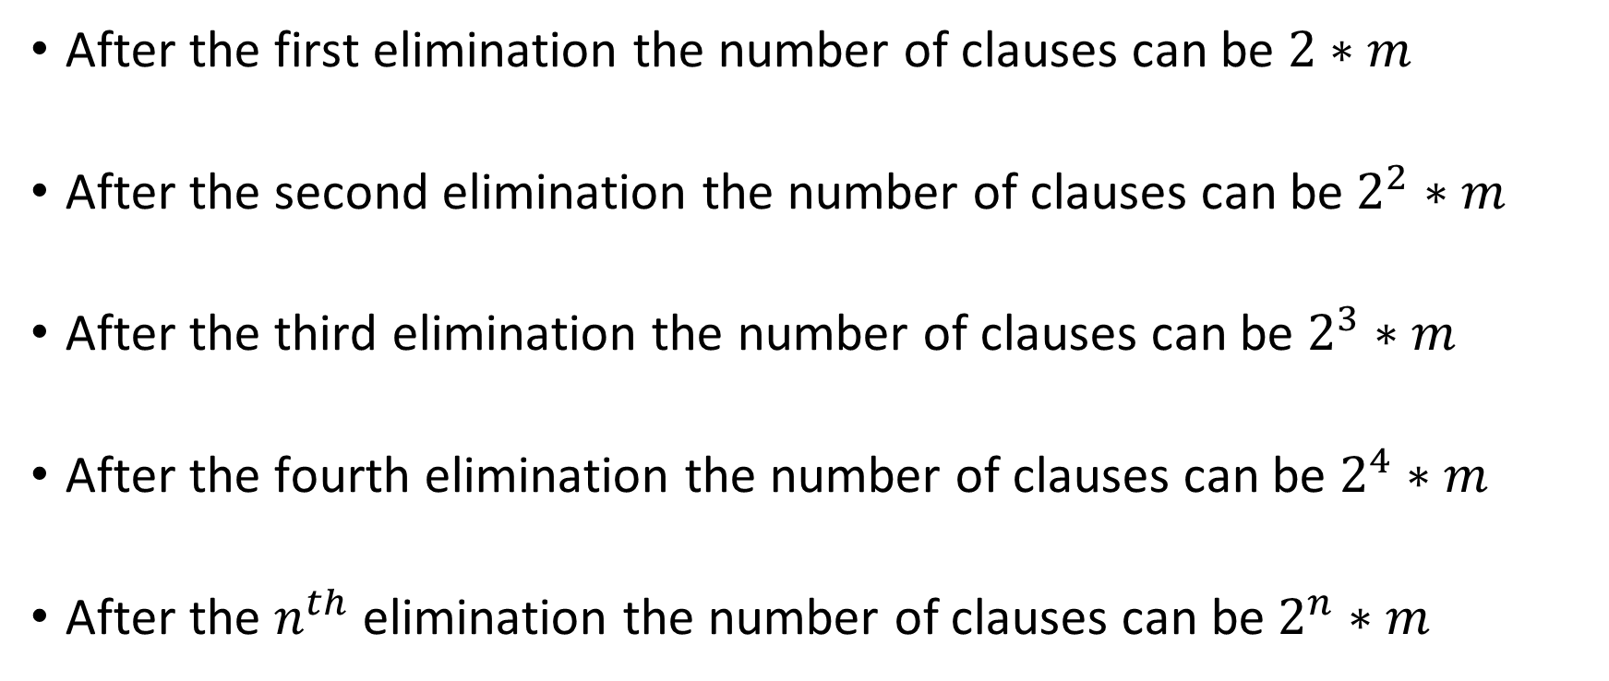
Time complexity
After the first elimination the number of clauses can be $2∗m$
After the second elimination the number of clauses can be$2^{2}∗m$
After the third elimination the number of clauses can be $2^{3}∗m$
After the fourth elimination the number of clauses can be $2^{4}∗m$
After the $n^{th}$ elimination the number of clauses can be $2^{n}∗m$

Slide 30
Quantified Disjunctive Linear Arithmetic (QDLA)

Slide 31
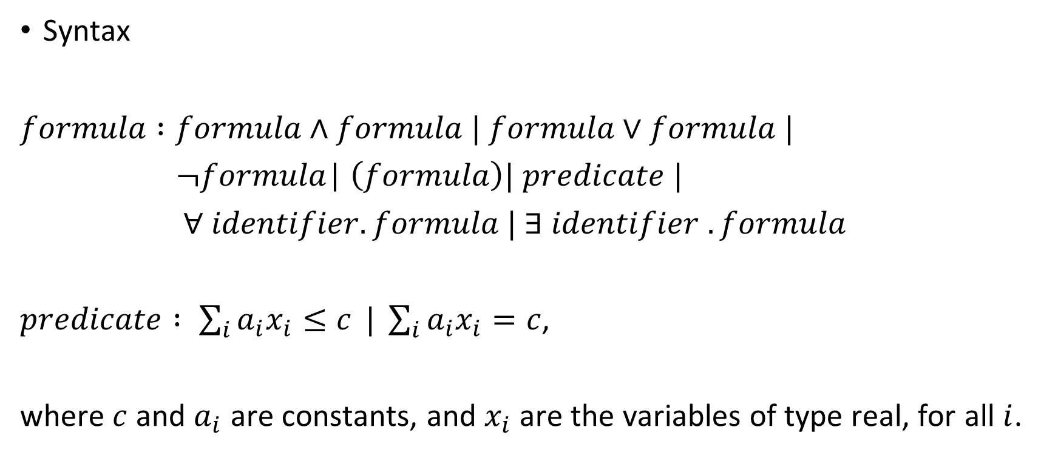
Quantified Disjunctive Linear Arithmetic (QDLA)
Syntax
$formula :formula∧formula$ $| formula∨formula$ $|$
$¬formula$| $\left(formula\right)| predicate |$
$∀ identifier. formula | ∃ identifier . formula$
$predicate : \sum_{i}{a_{i}x_{i}≤c} | \sum_{i}{a_{i}x_{i}=c}$,
where $c$ and $a_{i}$ are constants, and $x_{i}$ are the variables of type real, for all $i$.

Slide 32

QDLA
$∀x.∃y.∃z. (\left(y+1≤x∨z+1≤y\right)∧2x+1≤z)$ is a QDLA formula.

Slide 33
Quantifier elimination for QDLA
We can use the Fourier-Motzkin algorithm to eliminate an existential quantifier
Fourier-Motzkin works for conjunction of literal atoms, and therefore, the formula must be converted into DNF first

Slide 34

Quantifier elimination for QDLA
$$∀x.∃y.∃z. (y+1≤x∧z+1≤y∧2x+1≤z)$$

Slide 35
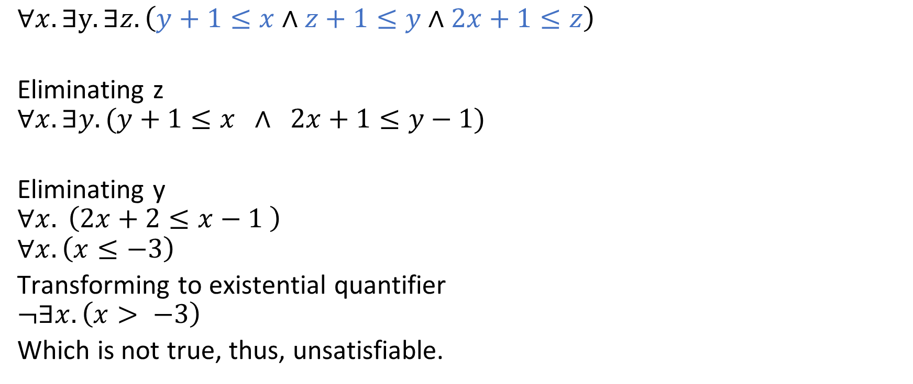
Quantifier elimination for QDLA
$$∀x.∃y.∃z. \left(y+1≤x∧z+1≤y∧2x+1≤z\right)$$
Eliminating z
$$∀x. ∃y. (y+1≤x ∧ 2x+1≤y−1)$$
Eliminating y
$$∀x. \left(2x+2≤x−1 \right)$$
$$∀x. \left(x≤−3\right)$$
Transforming to existential quantifier
$$¬∃x.\left(x> −3\right)$$
Which is not true, thus, unsatisfiable.

Slide 36

Quantifier elimination for QDLA
$$∀x. ∀y.∃z. \left(y+1≤x∧z+1≤y∧2x+1≤z\right)$$

Slide 37
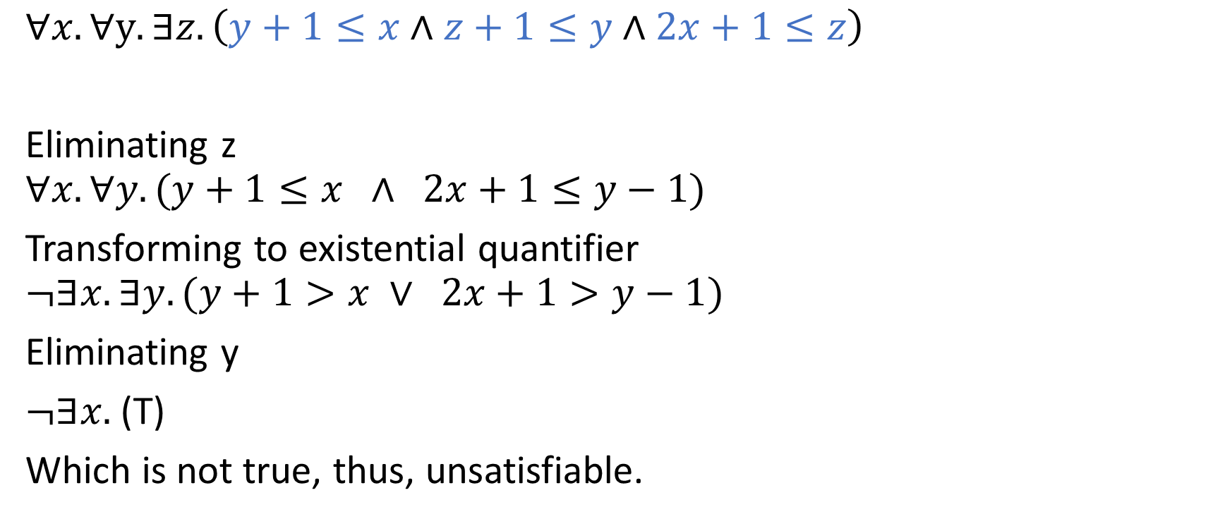
Quantifier elimination for QDLA
$$∀x. ∀y.∃z. \left(y+1≤x∧z+1≤y∧2x+1≤z\right)$$
Eliminating z
$$∀x. ∀y. (y+1≤x ∧ 2x+1≤y−1)$$
Transforming to existential quantifier
$$¬∃x. ∃y. (y+1>x ∨ 2x+1>y−1)$$
Eliminating y
$¬∃x.$ (T)
Which is not true, thus, unsatisfiable.

Slide 38

Quantifier elimination for QDLA
$$∀x. ∃y.∃z. \left((y+1≤x∨z+1≤y)∧2x+1≤z\right)$$

Slide 39
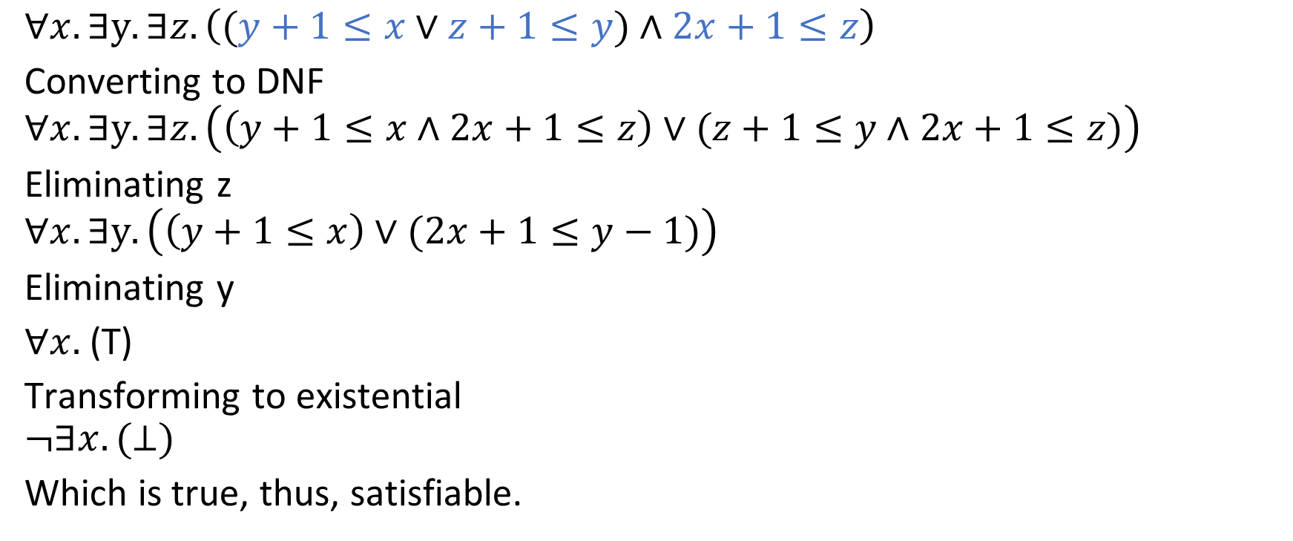
Quantifier elimination for QDLA
$$∀x. ∃y.∃z. \left((y+1≤x∨z+1≤y)∧2x+1≤z\right)$$
Converting to DNF
$$∀x. ∃y.∃z. \left(\left(y+1≤x∧2x+1≤z\right)∨(z+1≤y∧2x+1≤z)\right)$$
Eliminating z
$$∀x. ∃y.\left(\left(y+1≤x\right)∨(2x+1≤y−1)\right)$$
Eliminating y
$∀x.$(T)
Transforming to existential
$$¬∃x.(⊥)$$
Which is true, thus, satisfiable.

Slide 40
Search-based algorithm for quantified Boolean formulas

Slide 41
Search-based algorithm
Both resolution and expansion based algorithms make the formula exponentially large
Instead, a search-based algorithm (e.g., similar to DPLL) can also be used to solve quantified Boolean formulas (QBF)

Slide 42
Example
Is the following formula satisfiable?
$$∀x.∃y.\left(x∨y\right)∧(¬x∨¬y)$$

Slide 43





Example
Is the following formula satisfiable?
$$∀x.∃y.\left(x∨y\right)∧(¬x∨¬y)$$
y=0
$$⊥$$
For a ∃ node, one of the children must be true.
For a ∀ node, both children must be true.
Because the root is true, the formula is satisfiable.
x=0
T
$$∃$$
y=1
T
T
$$∀$$
y=0
T
x=1
T
$$∃$$
y=1
$$⊥$$

Slide 44
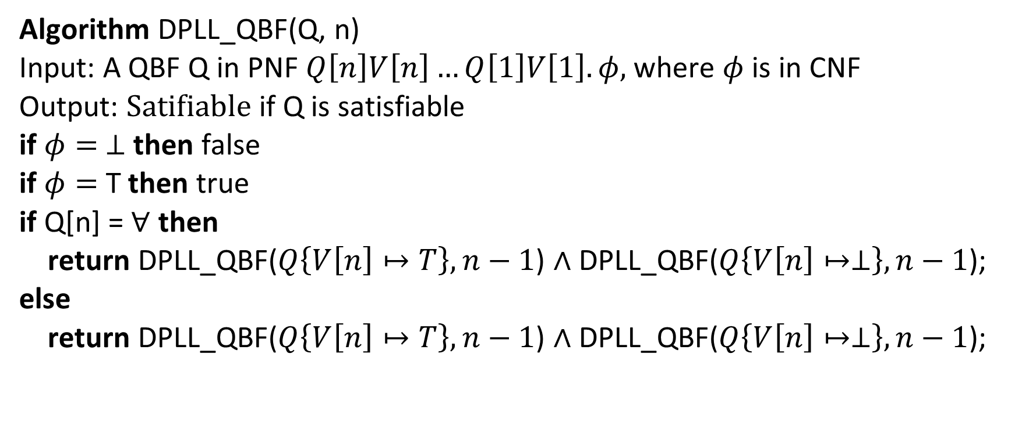
DPLL_QBF
Algorithm DPLL_QBF(Q, n)
Input: A QBF Q in PNF $Q\left[n\right]V\left[n\right]…Q\left[1\right]V\left[1\right]. φ,$ where $φ$ is in CNF
Output: $\text{Satifiable}$ if Q is satisfiable
if $φ= ⊥$ then false
if $φ=$ T then true
if Q[n] = $∀$ then
return DPLL_QBF($Q\left\{V\left[n\right]↦T\right\}, n−1$) $∧$ DPLL_QBF($Q\left\{V\left[n\right]↦⊥\right\},n−1$);
else
return DPLL_QBF($Q\left\{V\left[n\right]↦T\right\}, n−1$) $∧$ DPLL_QBF($Q\left\{V\left[n\right]↦⊥\right\},n−1$);

Slide 45

DPLL_QBF
Can’t we choose variables in arbitrary order similar to the original DPLL algorithm?
As discussed before, in a quantified formula, the order of the quantifiers matters. However, we can reorder the two consecutive quantifiers if both of them are of the same type, i.e., $∀$ or $∃$

Slide 46
Example
Is the following formula satisfiable?
$$∃y. ∀x.\left(x∨y\right)∧(¬x∨¬y)$$

Slide 47






Example
Is the following formula satisfiable?
$$∃y. ∀x.\left(x∨y\right)∧(¬x∨¬y)$$
x=0
$$⊥$$
For a ∃ node, one of the children must be true.
For a ∀ node, both children must be true.
Because the root is false, the formula is unsatisfiable.
y=0
$$⊥$$
$$∀$$
x=1
T
$$⊥$$
$$∃$$
x=0
T
y=1
$$⊥$$
$$∀$$
x=1
$$⊥$$

Slide 48
Skolem normal form

Slide 49
Skolem normal form
A formula is in Skolem normal form if it is in PNF and has only universal quantifiers
To Skolemize an FOL formula in PNF, we need to remove all existential quantifiers

Slide 50
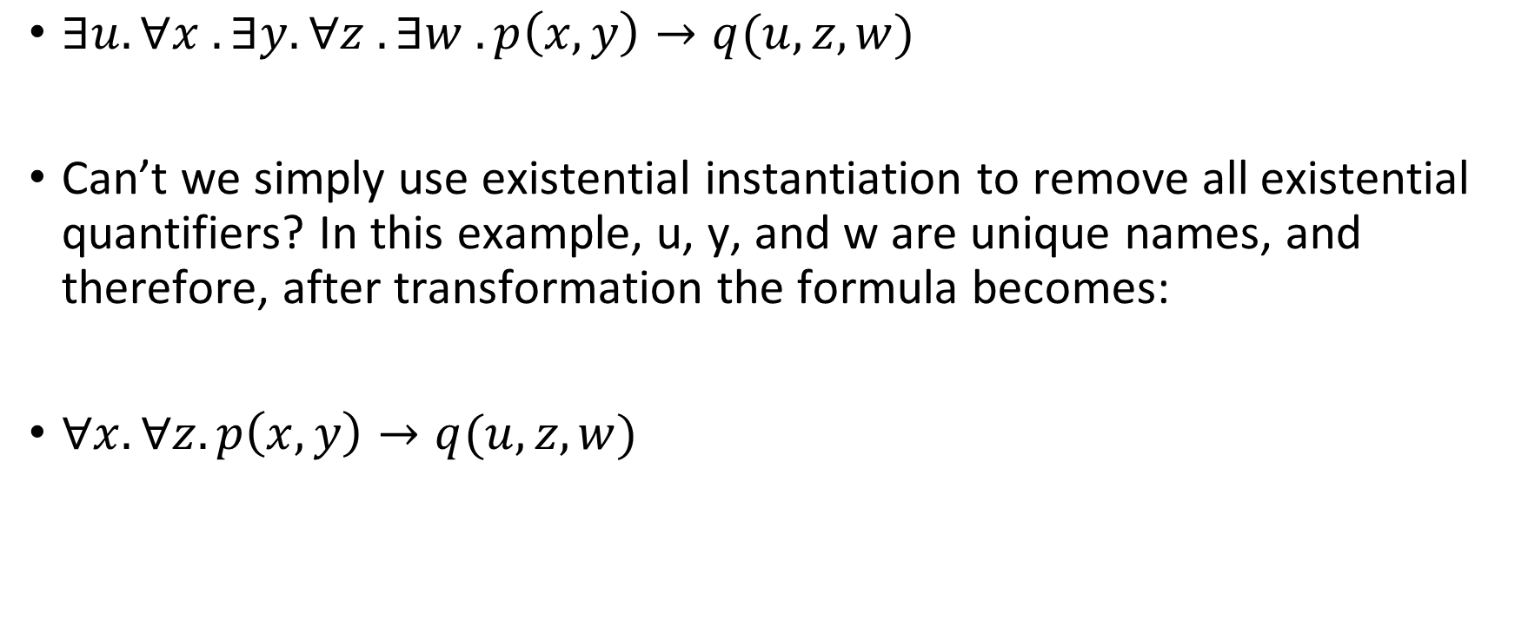
Skolem normal form
$∃u. ∀x . ∃y. ∀z . ∃w . p\left(x,y\right)→q(u,z,w)$
Can’t we simply use existential instantiation to remove all existential quantifiers? In this example, u, y, and w are unique names, and therefore, after transformation the formula becomes:
$∀x. ∀z. p\left(x,y\right)→q(u,z,w)$

Slide 51
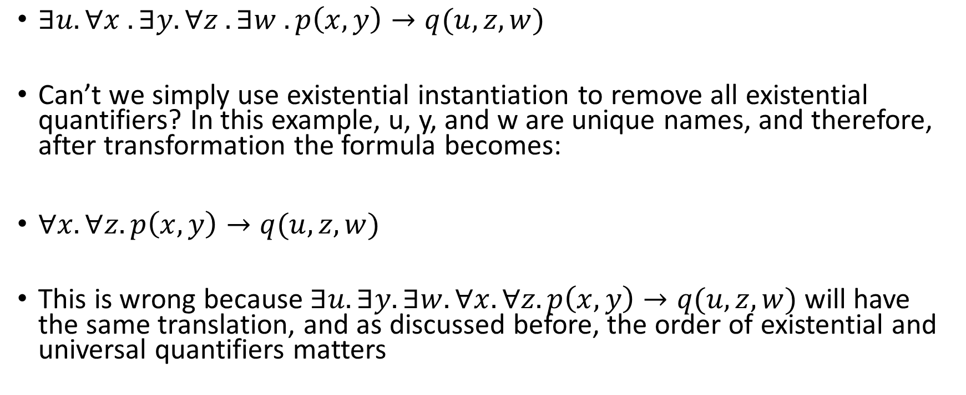
Skolem normal form
$∃u. ∀x . ∃y. ∀z . ∃w . p\left(x,y\right)→q(u,z,w)$
Can’t we simply use existential instantiation to remove all existential quantifiers? In this example, u, y, and w are unique names, and therefore, after transformation the formula becomes:
$∀x. ∀z. p\left(x,y\right)→q(u,z,w)$
This is wrong because $∃u. ∃y. ∃w. ∀x. ∀z. p\left(x,y\right)→q(u,z,w)$ will have the same translation, and as discussed before, the order of existential and universal quantifiers matters

Slide 52
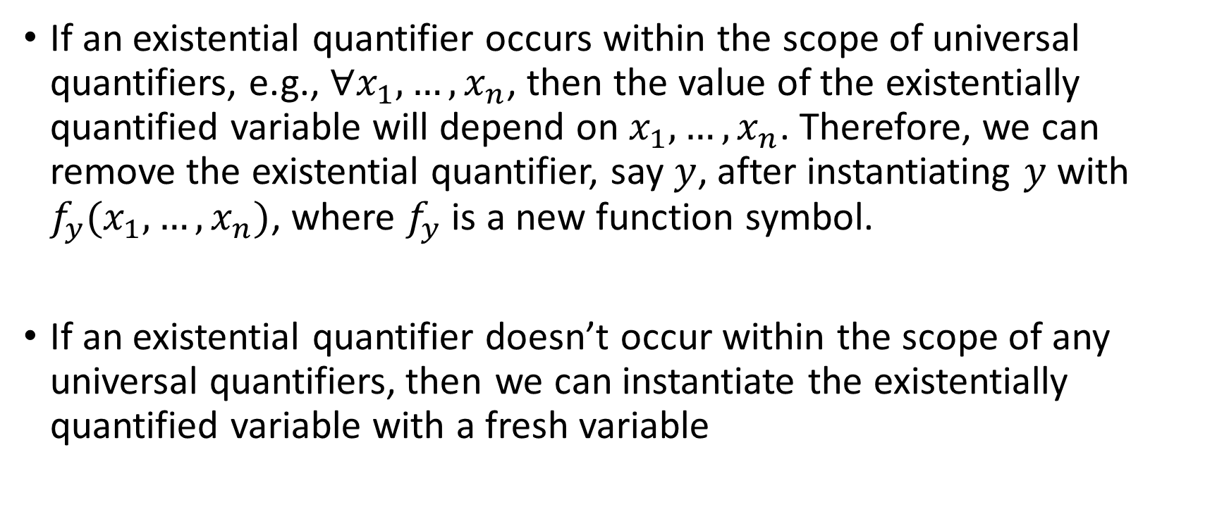
Skolem normal form
If an existential quantifier occurs within the scope of universal quantifiers, e.g., $∀x_{1},…,x_{n}$, then the value of the existentially quantified variable will depend on $x_{1},…,x_{n}$. Therefore, we can remove the existential quantifier, say $y$, after instantiating $y$ with $f_{y}(x_{1},…,x_{n})$, where $f_{y}$ is a new function symbol.
If an existential quantifier doesn’t occur within the scope of any universal quantifiers, then we can instantiate the existentially quantified variable with a fresh variable

Slide 53

Skolem normal form
Skolemize
$∃u. ∀x . ∃y. ∀z . ∃w . p\left(x,y\right)→q\left(u,z,w\right)$
$∀x. ∃y. ∃z.p\left(x,y\right)→p(x,z)$

Slide 54

Skolem normal form
Skolemize
$∃u. ∀x . ∃y. ∀z . ∃w . p\left(x,y\right)→q\left(u,z,w\right)$
$∀x. ∀z. p\left(x, f_{y}\left(x\right)\right)→q\left(u, z, f_{w}\left(x,z\right)\right)$
$∀x. ∃y. ∃z.p\left(x,y\right)→p(x,z)$
$∀x. p\left(x,f_{y}\left(x\right)\right)→p\left(x,f_{z}\left(x\right)\right)$

