Slide 2
Today’s topics
Quantified formulas

Slide 3
General quantification

Slide 4
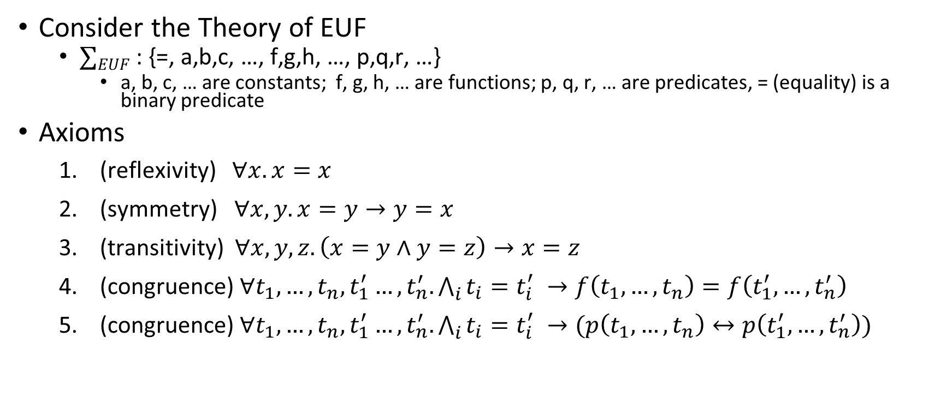
General quantification
Consider the Theory of EUF
$∑EUF$ : {=, a,b,c, …, f,g,h, …, p,q,r, …}
a, b, c, … are constants; f, g, h, … are functions; p, q, r, … are predicates, = (equality) is a binary predicate
Axioms
(reflexivity) $∀x. x=x$
(symmetry) $∀x,y. x=y→y=x$
(transitivity) $∀x,y,z. \left(x=y∧y=z\right)→x=z$
(congruence) $∀t_{1},…,t_{n},t_{1}^{′}…,t_{n}^{′}. \bigwedge_{i}{t_{i}=t_{i}^{′} →f\left(t_{1}, …, t_{n}\right)=f\left(t_{1}^{′}, …, t_{n}^{′}\right)}$
(congruence) $∀t_{1},…,t_{n},t_{1}^{′}…,t_{n}^{′}. \bigwedge_{i}{t_{i}=t_{i}^{′} →(p\left(t_{1}, …, t_{n}\right)↔p\left(t_{1}^{′}, …, t_{n}^{′}\right))}$

Slide 5
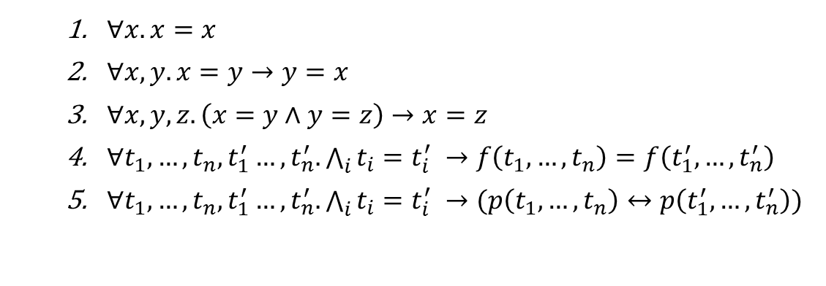

General quantification
Solve $"a=b ∧b=c∧a≠c"$ using the semantic argument method for FOL.
$∀x. x=x$
$∀x,y. x=y→y=x$
$∀x,y,z. \left(x=y∧y=z\right)→x=z$
$∀t_{1},…,t_{n},t_{1}^{′}…,t_{n}^{′}. \bigwedge_{i}{t_{i}=t_{i}^{′} →f\left(t_{1}, …, t_{n}\right)=f\left(t_{1}^{′}, …, t_{n}^{′}\right)}$
$∀t_{1},…,t_{n},t_{1}^{′}…,t_{n}^{′}. \bigwedge_{i}{t_{i}=t_{i}^{′} →(p\left(t_{1}, …, t_{n}\right)↔p\left(t_{1}^{′}, …, t_{n}^{′}\right))}$

Slide 6
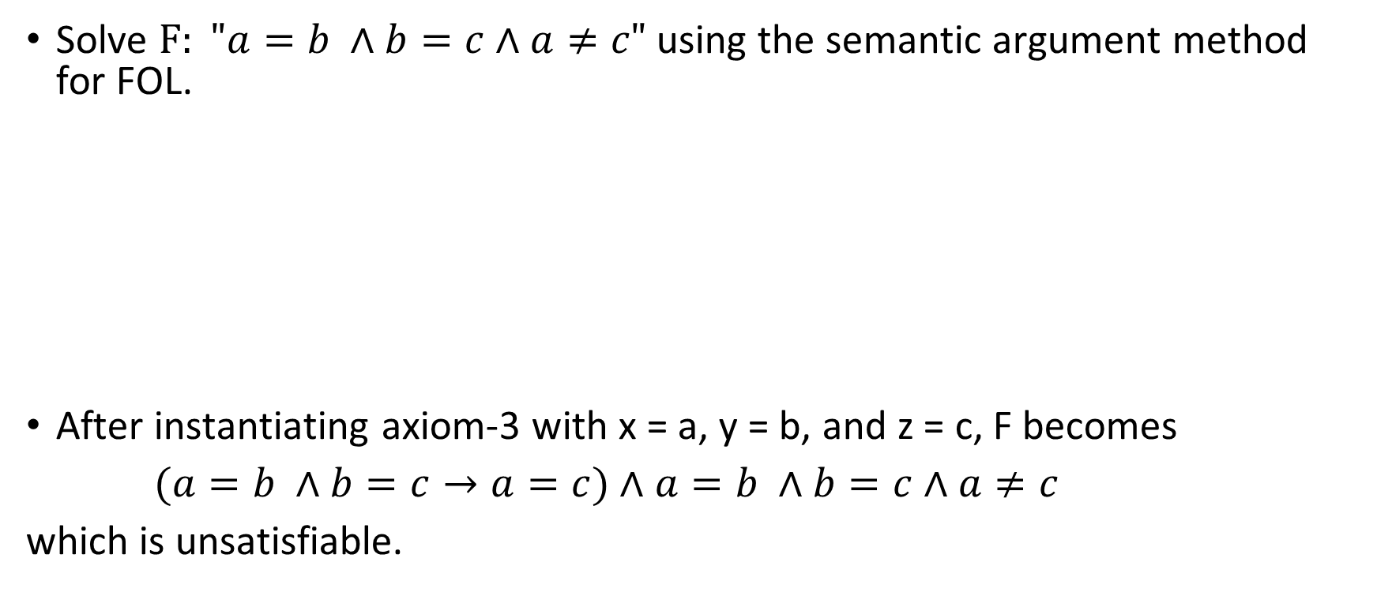
General quantification
Solve $F: "a=b ∧b=c∧a≠c"$ using the semantic argument method for FOL.
After instantiating axiom-3 with x = a, y = b, and z = c, F becomes
$(a=b ∧b=c→a=c)$ $∧$ $a=b ∧b=c∧a≠c$
which is unsatisfiable.
$∀x. x=x$
$∀x,y. x=y→y=x$
$∀x,y,z. \left(x=y∧y=z\right)→x=z$
$∀t_{1},…,t_{n},t_{1}^{′}…,t_{n}^{′}. \bigwedge_{i}{t_{i}=t_{i}^{′} →f\left(t_{1}, …, t_{n}\right)=f\left(t_{1}^{′}, …, t_{n}^{′}\right)}$
$∀t_{1},…,t_{n},t_{1}^{′}…,t_{n}^{′}. \bigwedge_{i}{t_{i}=t_{i}^{′} →(p\left(t_{1}, …, t_{n}\right)↔p\left(t_{1}^{′}, …, t_{n}^{′}\right))}$

Slide 7
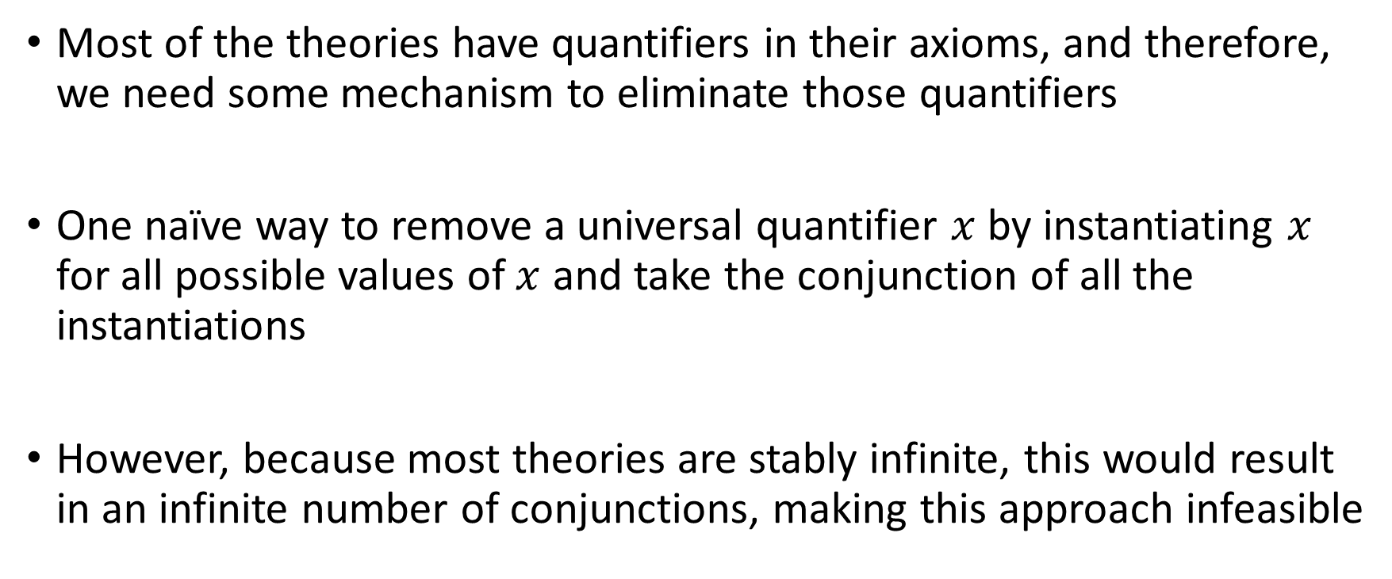
General quantification
Most of the theories have quantifiers in their axioms, and therefore, we need some mechanism to eliminate those quantifiers
One naïve way to remove a universal quantifier $x$ by instantiating $x$ for all possible values of $x$ and take the conjunction of all the instantiations
However, because most theories are stably infinite, this would result in an infinite number of conjunctions, making this approach infeasible

Slide 8
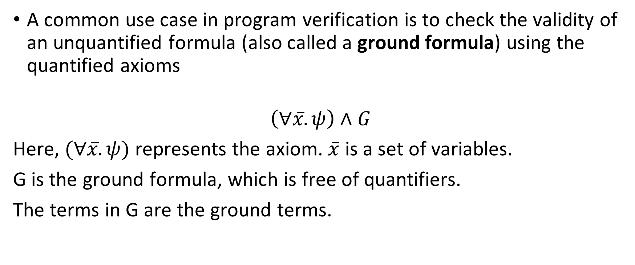
General quantification
A common use case in program verification is to check the validity of an unquantified formula (also called a ground formula) using the quantified axioms
$$\left(∀x̅.ψ\right)∧G$$
Here, $(∀x̅. ψ)$ represents the axiom. $\overline{x}$ is a set of variables.
G is the ground formula, which is free of quantifiers.
The terms in G are the ground terms.

Slide 9
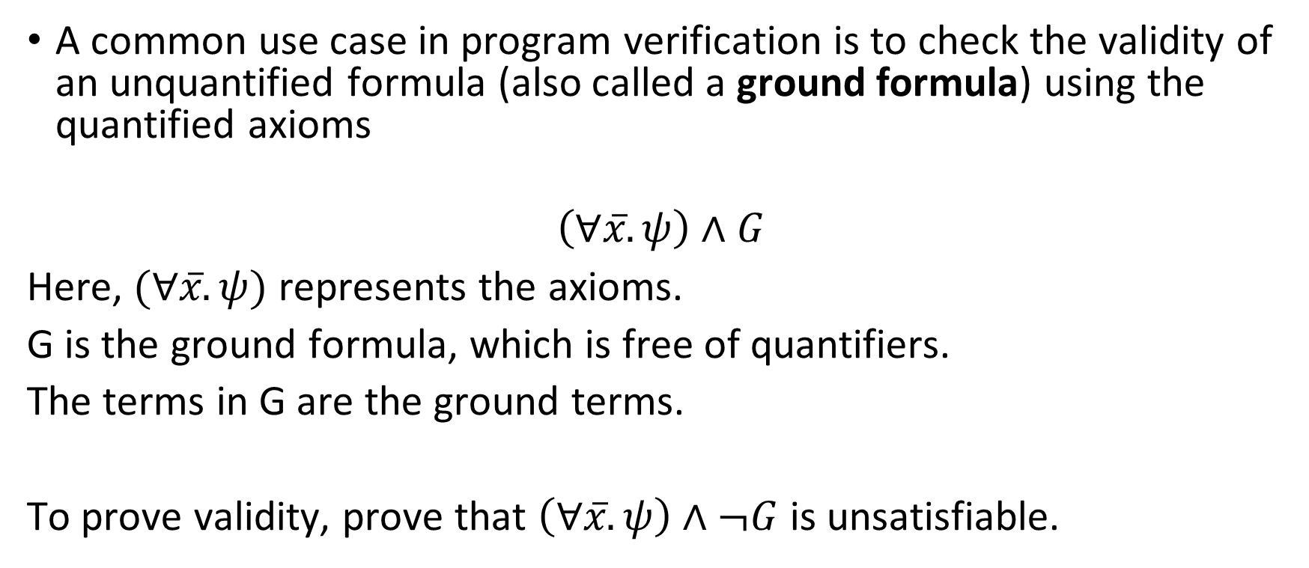
General quantification
A common use case in program verification is to check the validity of an unquantified formula (also called a ground formula) using the quantified axioms
$$\left(∀x̅.ψ\right)∧G$$
Here, $(∀x̅. ψ)$ represents the axioms.
G is the ground formula, which is free of quantifiers.
The terms in G are the ground terms.
To prove validity, prove that $\left(∀x̅. ψ\right)∧¬G$ is unsatisfiable.

Slide 10

Example
Prove the validity of
Ground formula, G : $f\left(h\left(a\right),b\right)=f(b,h(a))$
Axiom: $∀x. ∀y. f\left(x,y\right)=f(y,x)$

Slide 11
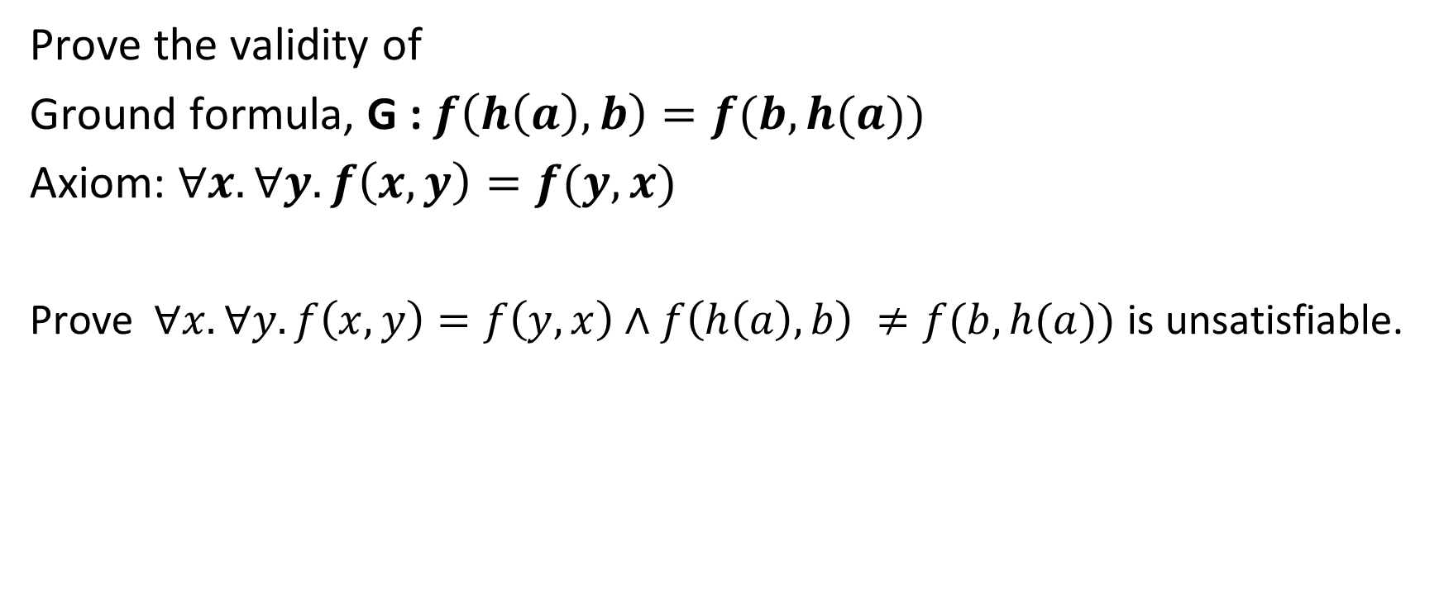
Example
Prove the validity of
Ground formula, G : $f\left(h\left(a\right),b\right)=f(b,h(a))$
Axiom: $∀x. ∀y. f\left(x,y\right)=f(y,x)$
Prove$∀x. ∀y. f\left(x,y\right)=f\left(y,x\right)∧f\left(h\left(a\right),b\right) ≠f(b,h(a))$ is unsatisfiable.

Slide 12
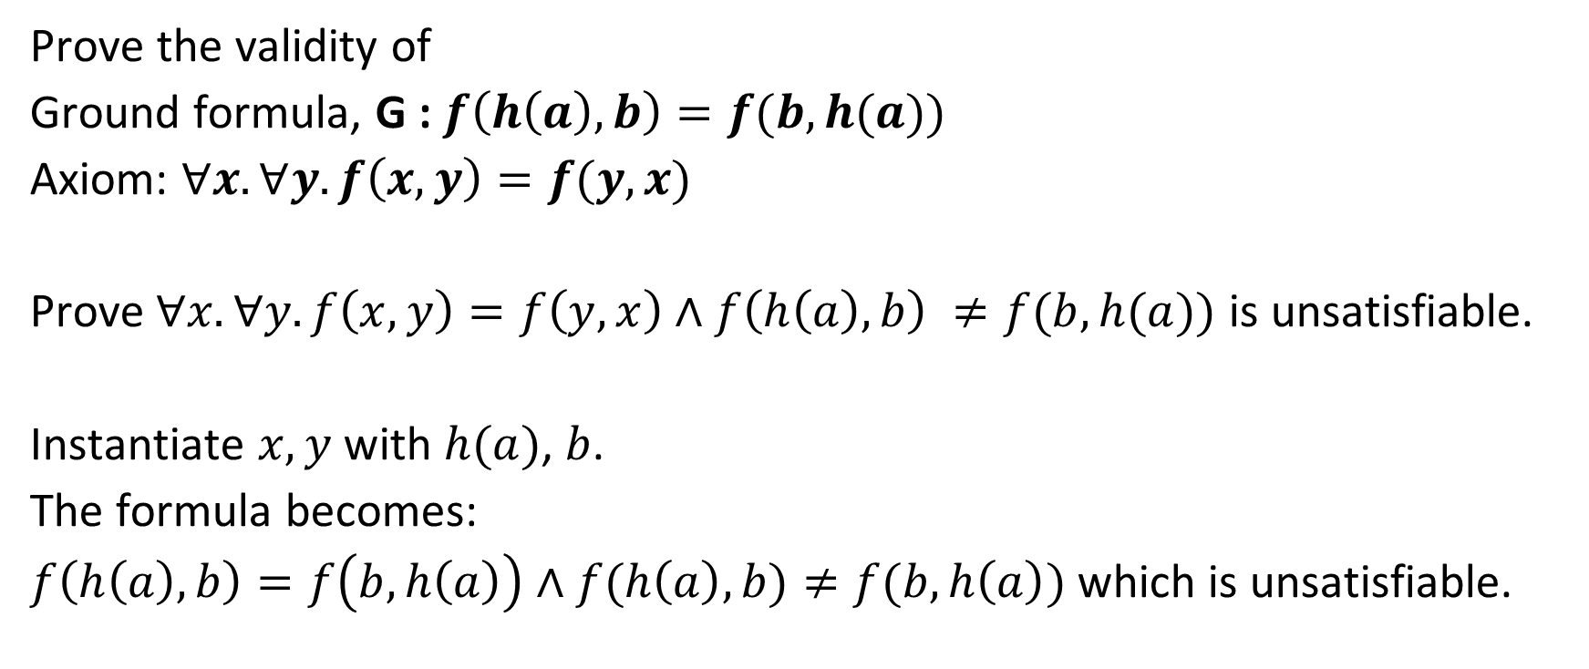
Example
Prove the validity of
Ground formula, G : $f\left(h\left(a\right),b\right)=f(b,h(a))$
Axiom: $∀x. ∀y. f\left(x,y\right)=f(y,x)$
Prove$∀x. ∀y. f\left(x,y\right)=f\left(y,x\right)∧f\left(h\left(a\right),b\right) ≠f(b,h(a))$ is unsatisfiable.
Instantiate $x, y$ with $h(a)$, $b$.
The formula becomes:
$f\left(h\left(a\right),b\right)=f\left(b,h\left(a\right)\right)∧f(h\left(a\right),b)≠f(b,h\left(a\right))$ which is unsatisfiable.

Slide 13
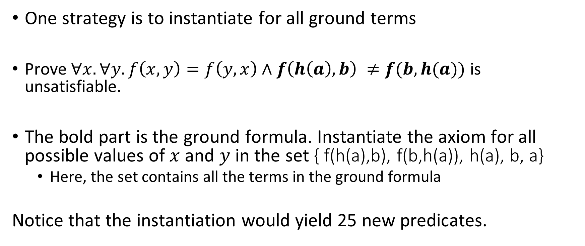
Instantiation
One strategy is to instantiate for all ground terms
Prove$∀x. ∀y. f\left(x,y\right)=f\left(y,x\right)∧f\left(h\left(a\right),b\right) ≠f(b,h(a))$ is unsatisfiable.
The bold part is the ground formula. Instantiate the axiom for all possible values of $x$ and $y$ in the set { f(h(a),b), f(b,h(a)), h(a), b, a}
Here, the set contains all the terms in the ground formula
Notice that the instantiation would yield 25 new predicates.

Slide 14
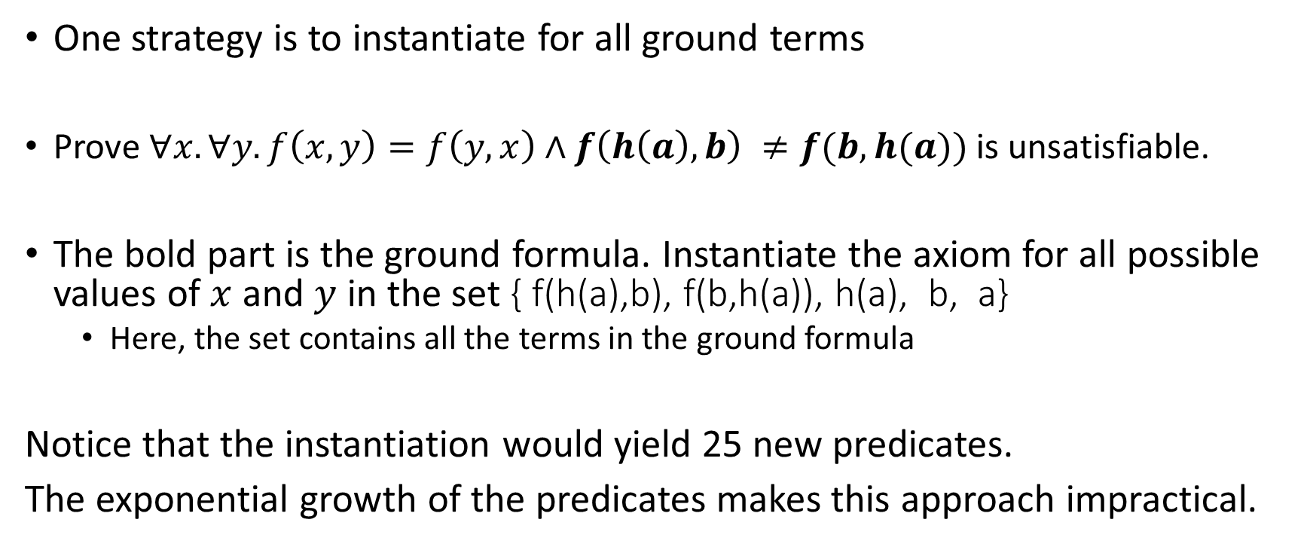
Instantiation
One strategy is to instantiate for all ground terms
Prove$∀x. ∀y. f\left(x,y\right)=f\left(y,x\right)∧f\left(h\left(a\right),b\right) ≠f(b,h(a))$ is unsatisfiable.
The bold part is the ground formula. Instantiate the axiom for all possible values of $x$ and $y$ in the set { f(h(a),b), f(b,h(a)), h(a), b, a}
Here, the set contains all the terms in the ground formula
Notice that the instantiation would yield 25 new predicates.
The exponential growth of the predicates makes this approach impractical.

Slide 15
Instantiation
The techniques used in practice use some heuristics to find a contradiction
Because most of the theories allow the equality predicate, these techniques try to instantiate the axioms (in the hope of deriving a contradiction) in such a way that it augments the ground formula with additional equalities and inequalities between the existing terms in the ground formula
A DAG with the union-find data structure is used to check for contradiction

Slide 16
Instantiation
After the instantiation, one of the terms in the axiom becomes a ground term, i.e., a term in the ground formula
To achieve this, we need to do some sort of pattern matching between the terms of axioms and the ground terms
The pattern-matching algorithm generates a substitution for all quantified variables in the axioms

Slide 17
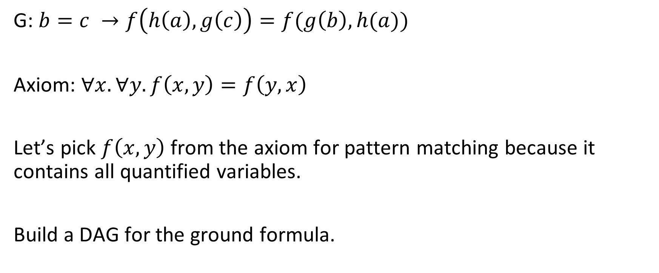
Example
G: $b=c →f\left(h\left(a\right),g\left(c\right)\right)=f(g\left(b\right),h(a))$
Axiom: $∀x. ∀y. f\left(x,y\right)=f\left(y,x\right)$
Let’s pick $f\left(x,y\right)$ from the axiom for pattern matching because it contains all quantified variables.
Build a DAG for the ground formula.

Slide 18
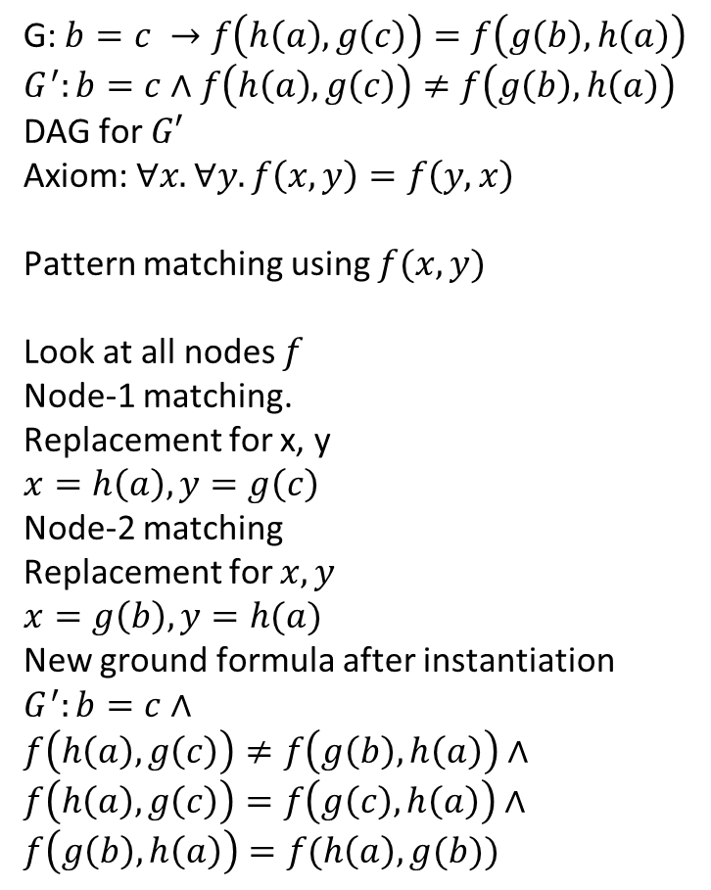
Example
G: $b=c →f\left(h\left(a\right),g\left(c\right)\right)=f\left(g\left(b\right),h\left(a\right)\right)$
$$G^{′}:b=c∧f\left(h\left(a\right),g\left(c\right)\right)≠f\left(g\left(b\right),h\left(a\right)\right)$$
DAG for $G′$
Axiom: $∀x. ∀y. f\left(x,y\right)=f\left(y,x\right)$
Pattern matching using $f(x, y)$
Look at all nodes $f$
Node-1 matching.
Replacement for x, y
$$x=h\left(a\right), y=g\left(c\right)$$
Node-2 matching
Replacement for $x, y$
$$x=g\left(b\right), y=h(a)$$
New ground formula after instantiation
$$G^{′}:b=c∧$$
$$f\left(h\left(a\right),g\left(c\right)\right)≠f\left(g\left(b\right),h\left(a\right)\right)∧$$
$$f\left(h\left(a\right),g\left(c\right)\right)=f\left(g\left(c\right), h\left(a\right)\right)∧$$
$$f\left(g\left(b\right),h\left(a\right)\right)=f(h\left(a\right), g(b))$$
f
1
2
f
h
g
g
a
c
b

Slide 19
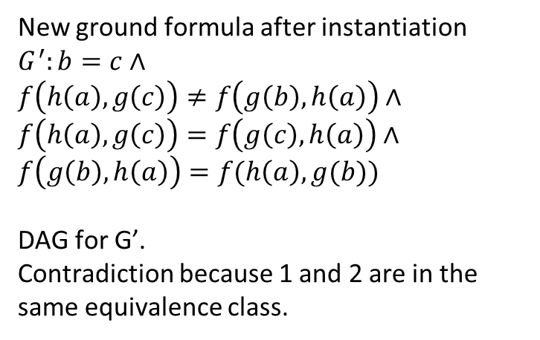
Example
f
1
2
f
f
f
h
g
g
a
c
b
New ground formula after instantiation
$$G^{′}:b=c∧$$
$$f\left(h\left(a\right),g\left(c\right)\right)≠f\left(g\left(b\right),h\left(a\right)\right)∧$$
$$f\left(h\left(a\right),g\left(c\right)\right)=f\left(g\left(c\right), h\left(a\right)\right)∧$$
$$f\left(g\left(b\right),h\left(a\right)\right)=f(h\left(a\right), g(b))$$
DAG for G’.
Contradiction because 1 and 2 are in the same equivalence class.

Slide 20

Example
$$G: g\left(f\left(g\left(a\right)\right)\right)=a$$
Axioms:
$$∀x. f\left(x\right)=x$$
$$∀x.g\left(g\left(x\right)\right)=x$$

Slide 21
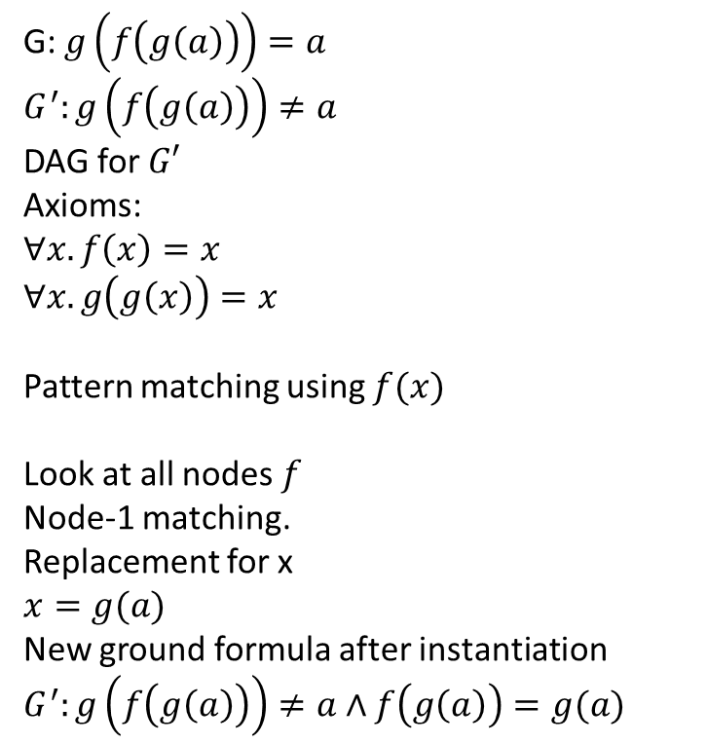
Example
G: $g\left(f\left(g\left(a\right)\right)\right)=a$
$$G^{′}:g\left(f\left(g\left(a\right)\right)\right)≠a$$
DAG for $G′$
Axioms:
$$∀x. f\left(x\right)=x$$
$$∀x.g\left(g\left(x\right)\right)=x$$
Pattern matching using $f(x)$
Look at all nodes $f$
Node-1 matching.
Replacement for x
$$x=g(a)$$
New ground formula after instantiation
$G^{′}:g\left(f\left(g\left(a\right)\right)\right)≠a∧f\left(g\left(a\right)\right)=g(a)$
g
1
f
g
a

Slide 22
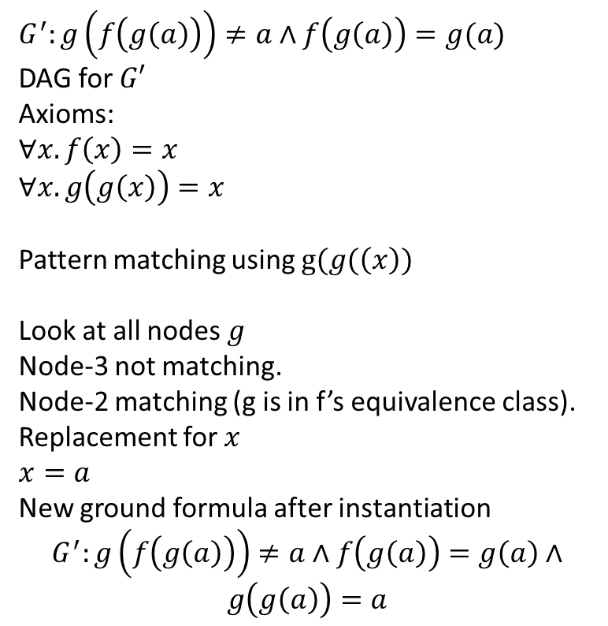
Example
$G^{′}:g\left(f\left(g\left(a\right)\right)\right)≠a∧f\left(g\left(a\right)\right)=g(a)$
DAG for $G′$
Axioms:
$$∀x. f\left(x\right)=x$$
$$∀x.g\left(g\left(x\right)\right)=x$$
Pattern matching using $g(g(\left(x\right))$
Look at all nodes $g$
Node-3 not matching.
Node-2 matching (g is in f’s equivalence class).
Replacement for $x$
$$x=a$$
New ground formula after instantiation
$$G^{′}:g\left(f\left(g\left(a\right)\right)\right)≠a∧f\left(g\left(a\right)\right)=g\left(a\right)∧$$
$$g\left(g\left(a\right)\right)=a$$
2
g
1
f
3
g
a

Slide 23

Example
$$G^{′}:g\left(f\left(g\left(a\right)\right)\right)≠a∧f\left(g\left(a\right)\right)=g\left(a\right)∧$$
$g\left(g\left(a\right)\right)=a$
DAG for $G′$
Contradiction because 2 and 5 are in the same equivalence class.
4
2
g
g
1
f
3
g
a
5

Slide 24
Observation
Sometimes, multiple candidates for pattern matching are needed to derive a contradiction

Slide 25

Example
$$G: cons\left(a,b\right)=cons\left(c,d\right)→a=c$$
Axiom: $∀x. ∀y.car(cons(x,y))=x$

Slide 26
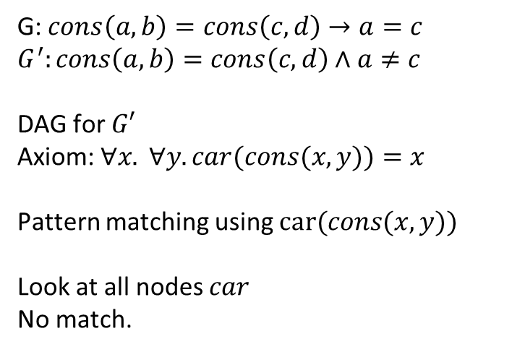
Example
G: $cons\left(a,b\right)=cons\left(c,d\right)→a=c$
$$G^{′}:cons\left(a,b\right)=cons\left(c,d\right)∧a≠c$$
DAG for $G′$
Axiom: $∀x. ∀y.car(cons(x,y))=x$
Pattern matching using $car(cons(x,y))$
Look at all nodes $car$
No match.
cons
cons
a
b
c
d

Slide 27
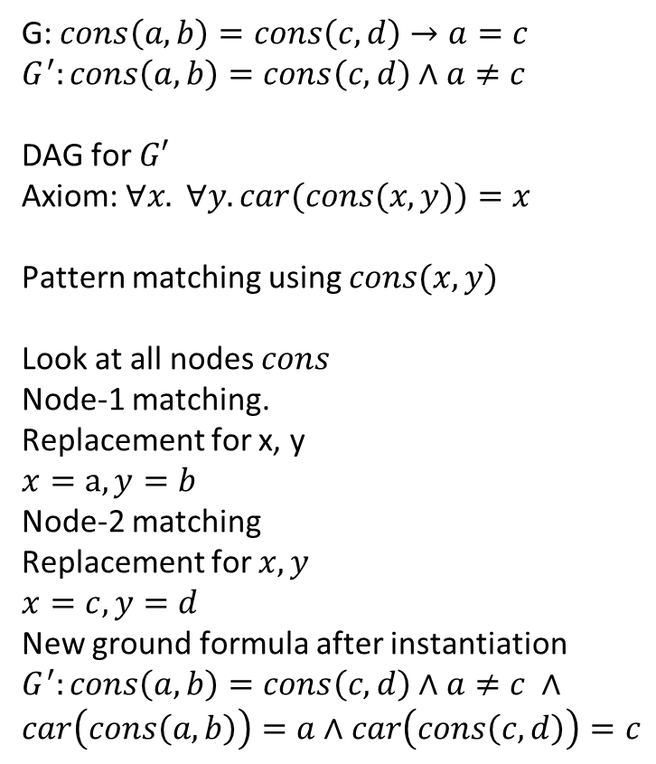
Example
G: $cons\left(a,b\right)=cons\left(c,d\right)→a=c$
$$G^{′}:cons\left(a,b\right)=cons\left(c,d\right)∧a≠c$$
DAG for $G′$
Axiom: $∀x. ∀y.car(cons(x,y))=x$
Pattern matching using $cons(x,y)$
Look at all nodes $cons$
Node-1 matching.
Replacement for x, y
$$x=a, y=b$$
Node-2 matching
Replacement for $x, y$
$$x=c, y=d$$
New ground formula after instantiation
$$G^{′}:cons\left(a,b\right)=cons\left(c,d\right)∧a≠c ∧$$
$$car\left(cons\left(a,b\right)\right)=a∧car\left(cons\left(c,d\right)\right)=c$$
1
2
cons
cons
a
b
c
d

Slide 28
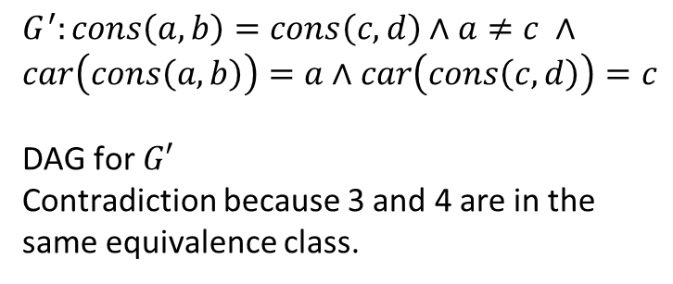
Example
$$G^{′}:cons\left(a,b\right)=cons\left(c,d\right)∧a≠c ∧$$
$$car\left(cons\left(a,b\right)\right)=a∧car\left(cons\left(c,d\right)\right)=c$$
DAG for $G′$
Contradiction because 3 and 4 are in the same equivalence class.
car
car
1
2
cons
cons
a
b
c
d
3
4

Slide 29
Observation
A candidate chosen for pattern matching may match with anything; in those cases, a weaker candidate might allow the proof to go through

Slide 30
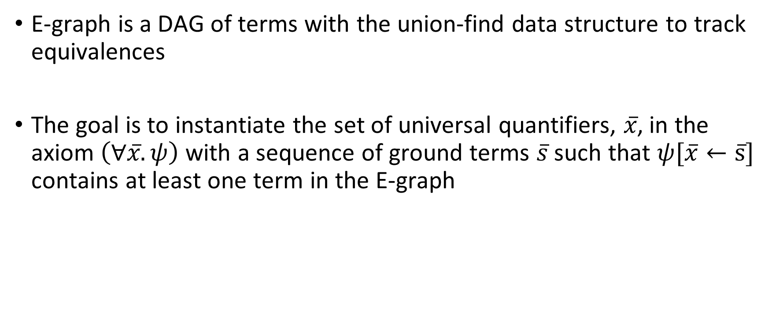
E-graph
E-graph is a DAG of terms with the union-find data structure to track equivalences
The goal is to instantiate the set of universal quantifiers, $x̅̅̅$, in the axiom $\left(∀x̅.ψ\right)$ with a sequence of ground terms $s̅$ such that $ψ[\overline{x}←s̅]$ contains at least one term in the E-graph

Slide 31
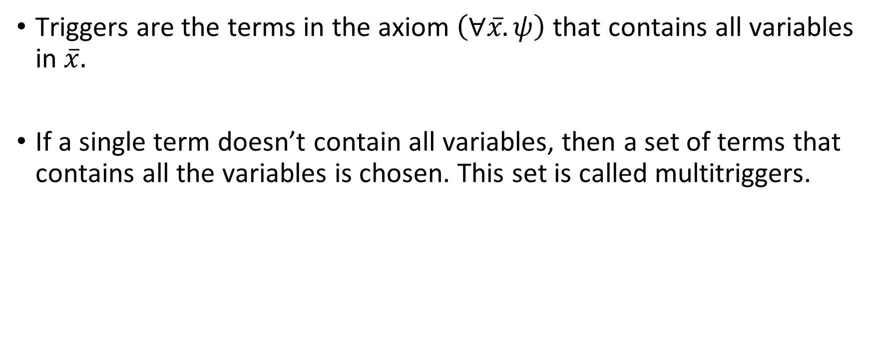
Triggers
Triggers are the terms in the axiom $\left(∀x̅.ψ\right)$ that contains all variables in $\overline{x}.$
If a single term doesn’t contain all variables, then a set of terms that contains all the variables is chosen. This set is called multitriggers.

Slide 32

Triggers
$∀x. ∀y. f\left(x,y\right)=f\left(y,x\right)$
What are the triggers in this axiom?

Slide 33

Triggers
$∀x. ∀y. f\left(x,y\right)=f\left(y,x\right)$
What are the triggers in this axiom?
$f\left(x,y\right)$ and $f(y,x)$

Slide 34
Matching
The goal is to search patterns in the ground formula that matches triggers and compute substitutions for instantiations
After instantiation, the ground formula, G, is augmented with a new constraint that contains at least one term that matches a ground term

Slide 35
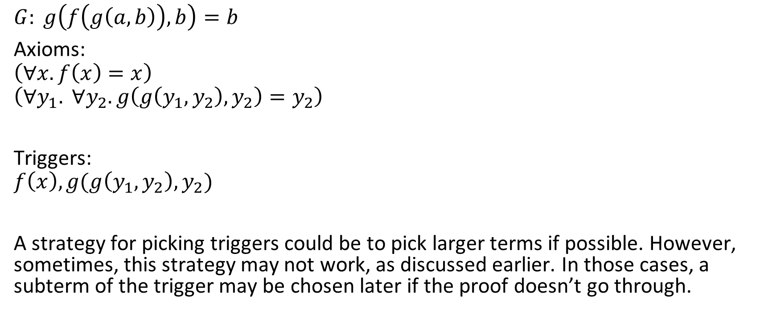
Example
$$G: g\left(f\left(g\left(a,b\right)\right),b\right)=b$$
Axioms:
$$\left(∀x.f\left(x\right)=x\right)$$
$$\left(∀y_{1}. ∀y_{2}. g\left(g\left(y_{1},y_{2}\right),y_{2}\right)=y_{2}\right)$$
Triggers:
$$f\left(x\right), g(g\left(y_{1},y_{2}\right),y_{2})$$
A strategy for picking triggers could be to pick larger terms if possible. However, sometimes, this strategy may not work, as discussed earlier. In those cases, a subterm of the trigger may be chosen later if the proof doesn’t go through.

Slide 36
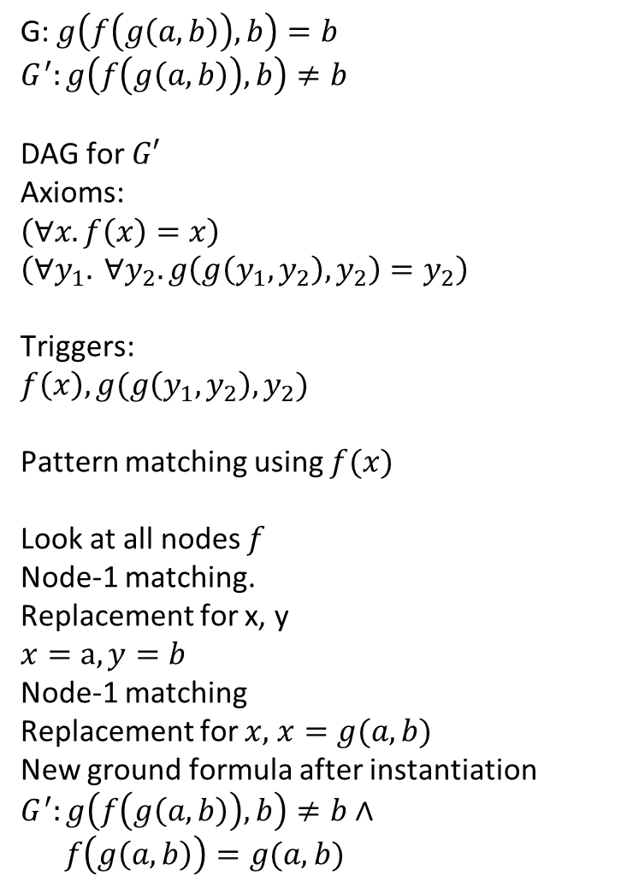
Example
G: $g\left(f\left(g\left(a,b\right)\right),b\right)=b$
$$G^{′}:g\left(f\left(g\left(a,b\right)\right),b\right)≠b$$
DAG for $G′$
Axioms:
$$\left(∀x.f\left(x\right)=x\right)$$
$$\left(∀y_{1}. ∀y_{2}. g\left(g\left(y_{1},y_{2}\right),y_{2}\right)=y_{2}\right)$$
Triggers:
$$f\left(x\right), g(g\left(y_{1},y_{2}\right),y_{2})$$
Pattern matching using $f(x)$
Look at all nodes $f$
Node-1 matching.
Replacement for x, y
$$x=a, y=b$$
Node-1 matching
Replacement for $x,$ $x=g(a,b)$
New ground formula after instantiation
$$G^{′}:g\left(f\left(g\left(a,b\right)\right),b\right)≠b∧$$
$f\left(g\left(a,b\right)\right)=g(a,b)$
g
1
f
g
a
b

Slide 37
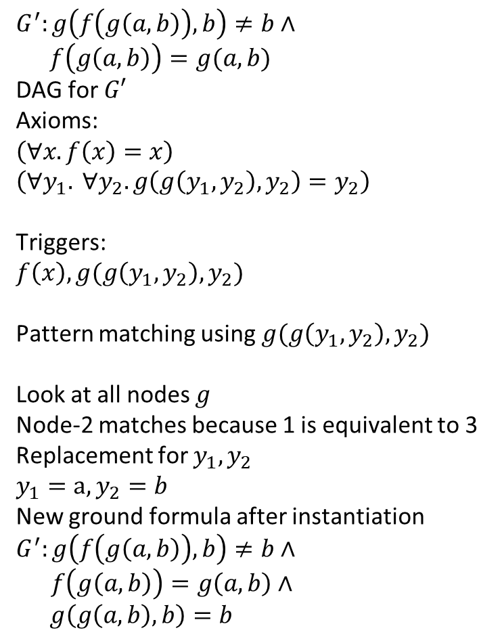
Example
$$G^{′}:g\left(f\left(g\left(a,b\right)\right),b\right)≠b∧$$
$$f\left(g\left(a,b\right)\right)=g(a,b)$$
DAG for $G′$
Axioms:
$$\left(∀x.f\left(x\right)=x\right)$$
$$\left(∀y_{1}. ∀y_{2}. g\left(g\left(y_{1},y_{2}\right),y_{2}\right)=y_{2}\right)$$
Triggers:
$$f\left(x\right), g(g\left(y_{1},y_{2}\right),y_{2})$$
Pattern matching using$g(g\left(y_{1},y_{2}\right),y_{2})$
Look at all nodes $g$
Node-2 matches because 1 is equivalent to 3
Replacement for $y_{1},y_{2}$
$$y_{1}=a, y_{2}=b$$
New ground formula after instantiation
$$G^{′}:g\left(f\left(g\left(a,b\right)\right),b\right)≠b∧$$
$f\left(g\left(a,b\right)\right)=g\left(a,b\right)∧$
$$g\left(g\left(a,b\right),b\right)=b$$
2
g
1
f
g
3
a
b

Slide 38

Example
$$G^{′}:g\left(f\left(g\left(a,b\right)\right),b\right)≠b∧$$
$f\left(g\left(a,b\right)\right)=g\left(a,b\right)∧$
$$g\left(g\left(a,b\right),b\right)=b$$
DAG for $G′$
Contradiction because 2 and 5 are in the same equivalence class.
2
g
4
g
1
f
g
3
a
b
5

Slide 39

Observation
If the argument, $D_{a}$, of a DAG node doesn’t match with the argument in the trigger, $T_{a},$ (because $T_{a}$ is not a variable), then another node in the equivalence class of $D_{a}$ that matches $T_{a}$ can be used to compute the substitution

Slide 40

Matching
Consider a trigger $tr=f(x,y,x)$ and ground term $gr=f\left(a,b,a\right)$
$$G^{′}: f\left(a,b,a\right)=g\left(a\right)∧f\left(c,d,c\right)=g\left(b\right)∧f\left(a,b,a\right)=f\left(c,d,c\right)$$
What would be the substitutions?

Slide 41
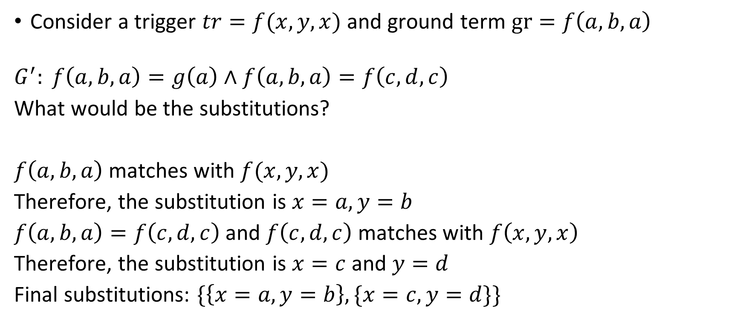
Matching
Consider a trigger $tr=f(x,y,x)$ and ground term $gr=f\left(a,b,a\right)$
$$G^{′}: f\left(a,b,a\right)=g\left(a\right)∧f\left(a,b,a\right)=f\left(c,d,c\right)$$
What would be the substitutions?
$f\left(a,b,a\right)$ matches with $f(x,y,x)$
Therefore, the substitution is $x=a, y=b$
$f\left(a,b,a\right)=f\left(c,d,c\right)$ and $f\left(c,d,c\right)$ matches with $f\left(x,y,x\right)$
Therefore, the substitution is $x=c$ and $y=d$
Final substitutions: $\{\left\{x=a,y=b\right\}, \{x=c,y=d\}\}$

Slide 42

Matching
Consider a trigger $tr=f(x,y,x)$ and ground term $gr=f\left(a,b,a\right)$
$$G^{′}: f\left(a,b,a\right)=g\left(a\right)∧f\left(a,b,a\right)=f\left(c,d,e\right)$$
What would be the substitutions?

Slide 43
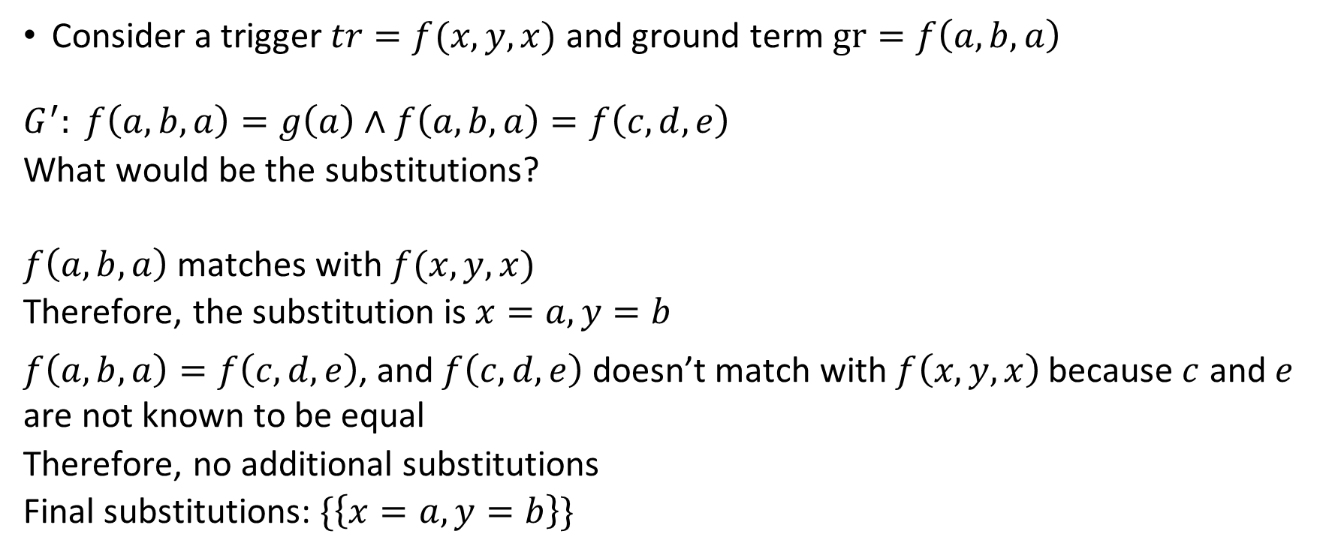
Matching
Consider a trigger $tr=f(x,y,x)$ and ground term $gr=f\left(a,b,a\right)$
$$G^{′}: f\left(a,b,a\right)=g\left(a\right)∧f\left(a,b,a\right)=f\left(c,d,e\right)$$
What would be the substitutions?
$f\left(a,b,a\right)$ matches with $f(x,y,x)$
Therefore, the substitution is $x=a, y=b$
$f\left(a,b,a\right)=f\left(c,d,e\right)$, and $f\left(c,d,e\right)$ doesn’t match with $f\left(x,y,x\right)$ because $c$ and $e$ are not known to be equal
Therefore, no additional substitutions
Final substitutions: $\{\left\{x=a,y=b\right\}\}$

Slide 44

Matching
Consider a trigger $tr=f(g(x),y,x)$ and ground term $gr= f\left(g\left(a\right),b,a\right)$
$$G^{′}: f\left(g\left(a\right),b,a\right)=e∧f\left(g\left(c\right),d,c\right)=e∧g\left(a\right)=g(b)$$
What would be the substitutions?

Slide 45
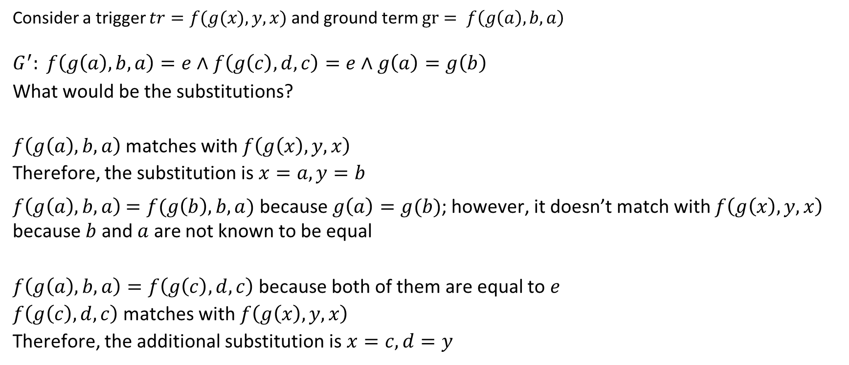
Matching
Consider a trigger $tr=f(g(x),y,x)$ and ground term $gr= f\left(g\left(a\right),b,a\right)$
$$G^{′}: f\left(g\left(a\right),b,a\right)=e∧f\left(g\left(c\right),d,c\right)=e∧g\left(a\right)=g\left(b\right)$$
What would be the substitutions?
$f\left(g\left(a\right),b,a\right)$ matches with $f\left(g\left(x\right),y,x\right)$
Therefore, the substitution is $x=a, y=b$
$f\left(g\left(a\right),b,a\right)$ $=f(g\left(b\right),b,a)$ because $g\left(a\right)=g(b)$; however, it doesn’t match with $f\left(g\left(x\right),y,x\right)$ because $b$ and $a$ are not known to be equal
$f\left(g\left(a\right),b,a\right)=f\left(g\left(c\right),d,c\right)$ because both of them are equal to $e$
$f\left(g\left(c\right),d,c\right)$ matches with $f\left(g\left(x\right),y,x\right)$
Therefore, the additional substitution is $x=c, d=y$

Slide 46

Matching
Consider a trigger $tr=f(g(x),y,x)$ and ground term $gr= f\left(g\left(a\right),b,a\right)$
$$G^{′}: f\left(g\left(a\right),b,a\right)=e∧g\left(a\right)=g\left(g\left(b\right)\right)∧a=g(b)$$
What would be the substitutions?

Slide 47
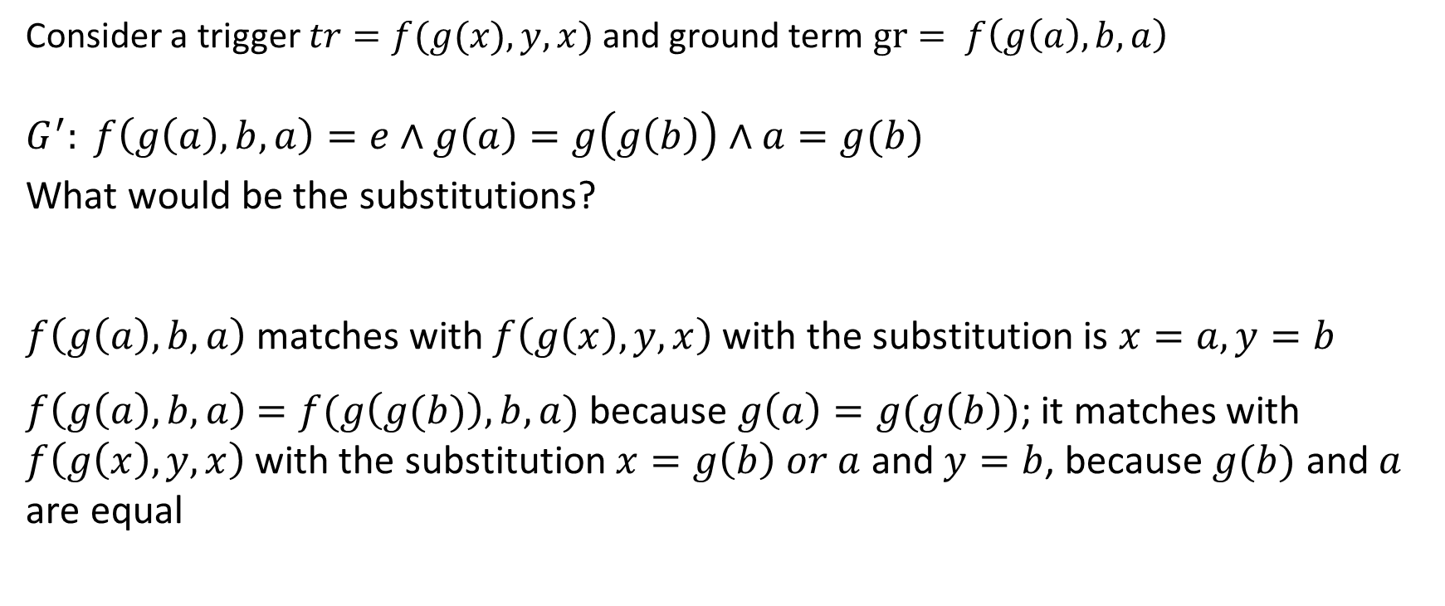
Matching
Consider a trigger $tr=f(g(x),y,x)$ and ground term $gr= f\left(g\left(a\right),b,a\right)$
$$G^{′}: f\left(g\left(a\right),b,a\right)=e∧g\left(a\right)=g\left(g\left(b\right)\right)∧a=g(b)$$
What would be the substitutions?
$f\left(g\left(a\right),b,a\right)$ matches with $f\left(g\left(x\right),y,x\right)$ with the substitution is $x=a, y=b$
$f\left(g\left(a\right),b,a\right)$ $=f(g\left(g(b)\right),b,a)$ because $g\left(a\right)=g(g\left(b\right))$; it matches with $f\left(g\left(x\right),y,x\right)$ with the substitution $x=g\left(b\right) or a$ and $y=b$, because $g(b)$ and $a$ are equal

Slide 48
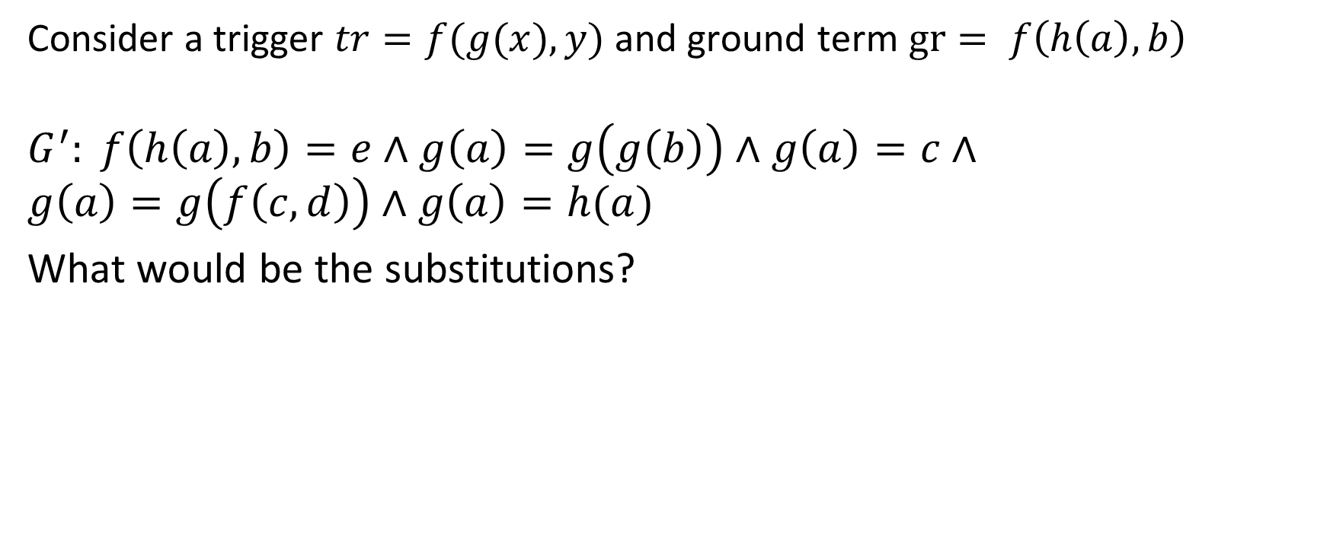
Matching
Consider a trigger $tr=f(g(x),y)$ and ground term $gr= f\left(h\left(a\right),b\right)$
$$G^{′}: f\left(h\left(a\right),b\right)=e∧g\left(a\right)=g\left(g\left(b\right)\right)∧g\left(a\right)=c∧$$
$$g\left(a\right)=g\left(f\left(c,d\right)\right)∧g\left(a\right)=h(a)$$
What would be the substitutions?

Slide 49
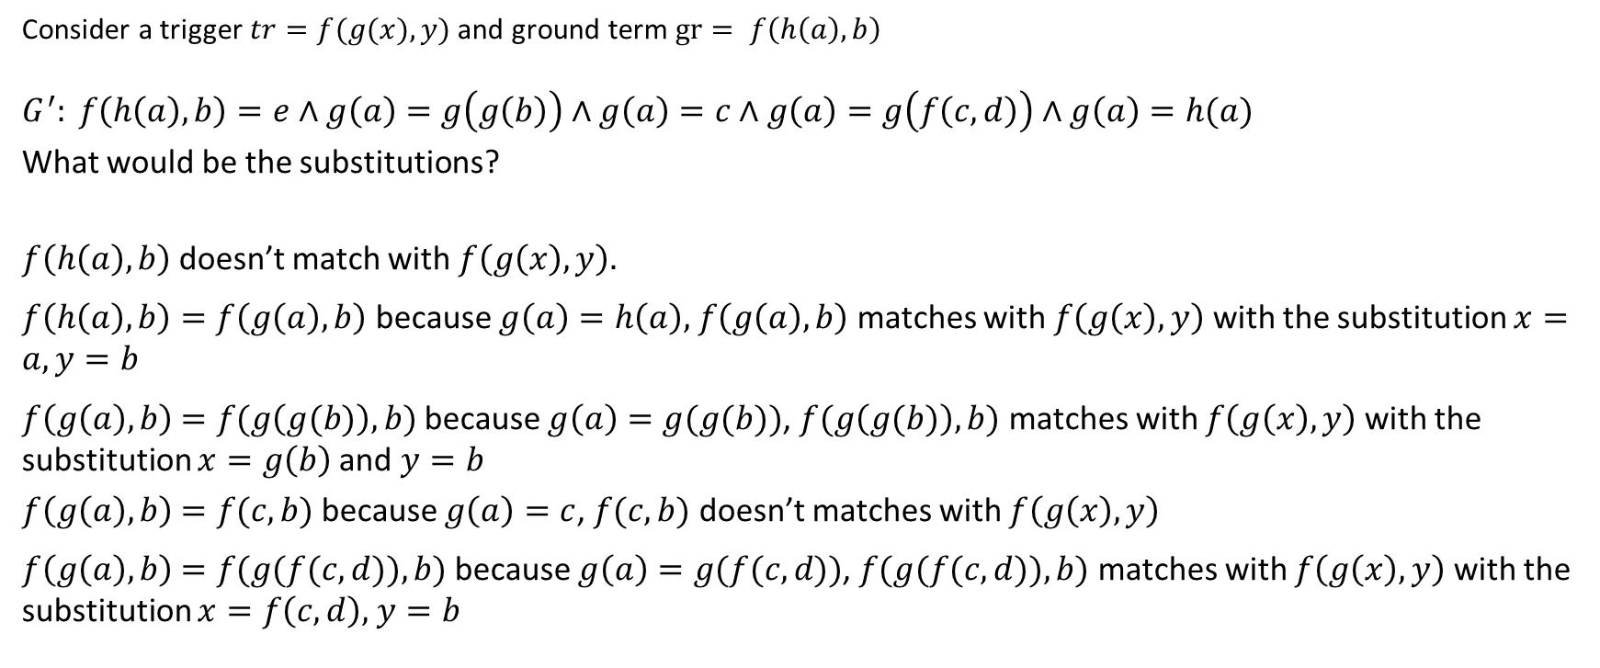
Matching
Consider a trigger $tr=f(g(x),y)$ and ground term $gr= f\left(h\left(a\right),b\right)$
$$G^{′}: f\left(h\left(a\right),b\right)=e∧g\left(a\right)=g\left(g\left(b\right)\right)∧g\left(a\right)=c∧g\left(a\right)=g\left(f\left(c,d\right)\right)∧g\left(a\right)=h(a)$$
What would be the substitutions?
$f\left(h\left(a\right),b\right)$ doesn’t match with $f\left(g\left(x\right),y\right).$
$f\left(h\left(a\right),b\right)=f\left(g\left(a\right),b\right)$ because $g\left(a\right)=h\left(a\right),$ $f\left(g\left(a\right),b\right)$matches with $f\left(g\left(x\right),y\right)$ with the substitution $x=a, y=b$
$f\left(g\left(a\right),b\right)$ $=f(g\left(g(b)\right),b)$ because $g\left(a\right)=g(g(b))$, $f(g\left(g(b)\right),b)$ matches with $f\left(g\left(x\right),y\right)$ with the substitution $x=g\left(b\right)$and $y=b$
$f\left(g\left(a\right),b\right)$ $=f(c,b)$ because $g\left(a\right)=c$, $f(c,b)$ doesn’t matches with $f\left(g\left(x\right),y\right)$
$f\left(g\left(a\right),b\right)$ $=f(g(f(c,d)),b)$ because $g\left(a\right)=g(f(c,d))$, $f(g(f(c,d)),b)$ matches with $f\left(g\left(x\right),y\right)$ with the substitution $x=f\left(c,d\right),$ $y=b$

Slide 50
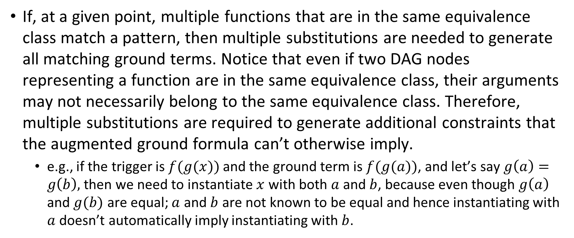
Observation
If, at a given point, multiple functions that are in the same equivalence class match a pattern, then multiple substitutions are needed to generate all matching ground terms. Notice that even if two DAG nodes representing a function are in the same equivalence class, their arguments may not necessarily belong to the same equivalence class. Therefore, multiple substitutions are required to generate additional constraints that the augmented ground formula can’t otherwise imply.
e.g., if the trigger is $f(g(x))$ and the ground term is $f(g(a))$, and let’s say $g\left(a\right)=g\left(b\right),$ then we need to instantiate $x$ with both $a$ and $b$, because even though $g\left(a\right)$ and $g(b)$ are equal; $a$ and $b$ are not known to be equal and hence instantiating with $a$ doesn’t automatically imply instantiating with $b$.

Slide 51
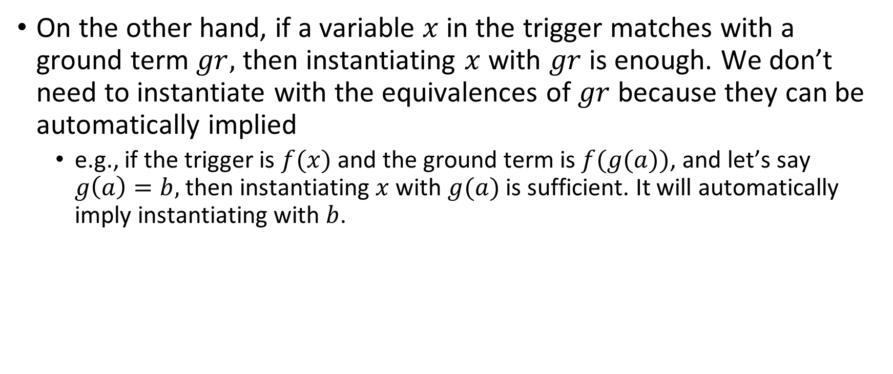
Observation
On the other hand, if a variable $x$ in the trigger matches with a ground term $gr,$ then instantiating $x$ with $gr$ is enough. We don’t need to instantiate with the equivalences of $gr$ because they can be automatically implied
e.g., if the trigger is $f(x)$ and the ground term is $f(g(a))$, and let’s say $g\left(a\right)=b,$ then instantiating $x$ with $g(a)$is sufficient. It will automatically imply instantiating with $b$.

Slide 52
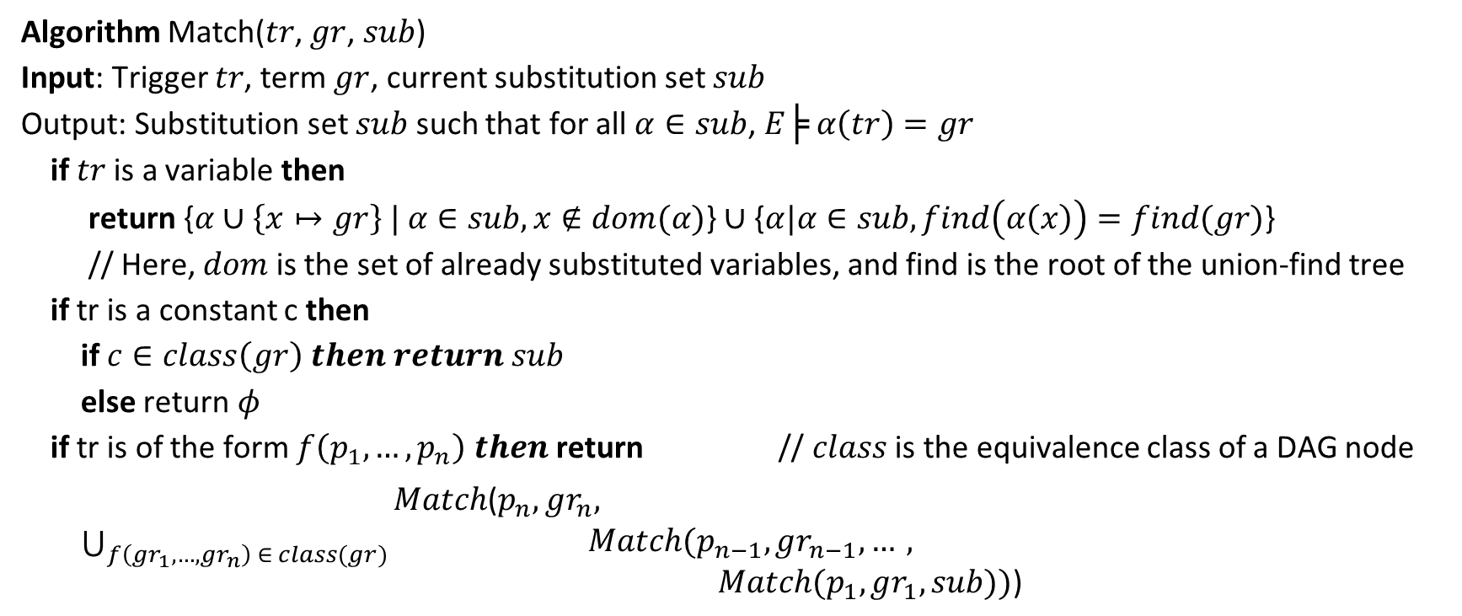
E-Matching algorithm
Algorithm Match($tr$, $gr$, $sub$)
Input: Trigger $tr$, term $gr$, current substitution set $sub$
Output: Substitution set $sub$ such that for all $α∈sub$, $E╞ α\left(tr\right)=gr$
if $tr$ is a variable then
return {$α∪\left\{x↦gr\right\} | α∈sub, x∉dom(α)$} ∪ {$α|α∈sub, find\left(α\left(x\right)\right)=find(gr)$}
// Here, $dom$ is the set of already substituted variables, and find is the root of the union-find tree
if tr is a constant c then
if $c∈class\left(gr\right) then return sub$
else return $φ$
if tr is of the form $f\left(p_{1},…,p_{n}\right) then$ return // $class$ is the equivalence class of a DAG node
$\bigcup_{f\left(gr_{1},…,gr_{n}\right) ∈ class(gr)}{\begin{aligned}Match\text{(}p_{n},gr_{n}, \\ Match(p_{n−1},gr_{n−1}, …, \\ Match(p_{1},gr_{1},sub))\text{) }\end{aligned}}$

Slide 53
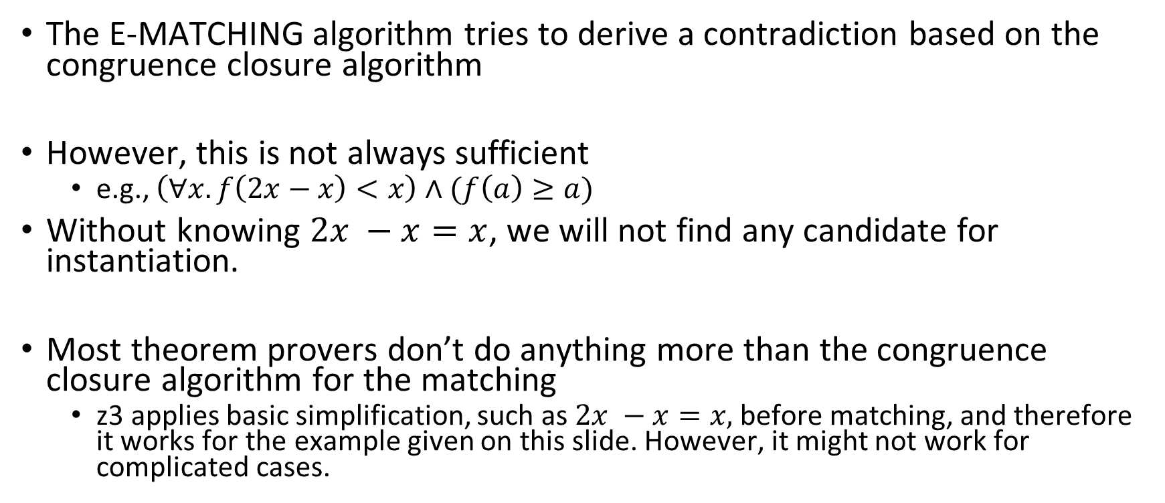
Beyond the congruence closure
The E-MATCHING algorithm tries to derive a contradiction based on the congruence closure algorithm
However, this is not always sufficient
e.g., $\left(∀x.f\left(2x−x\right)<x\right)∧(f\left(a\right)≥a)$
Without knowing $2x −x=x$, we will not find any candidate for instantiation.
Most theorem provers don’t do anything more than the congruence closure algorithm for the matching
z3 applies basic simplification, such as $2x −x=x,$before matching, and therefore it works for the example given on this slide. However, it might not work for complicated cases.

Slide 54

Matching loop
$$G: f\left(g\left(a\right)\right)=a$$
Axiom: $(∀x. f\left(x\right)=f(g(x)))$

Slide 55
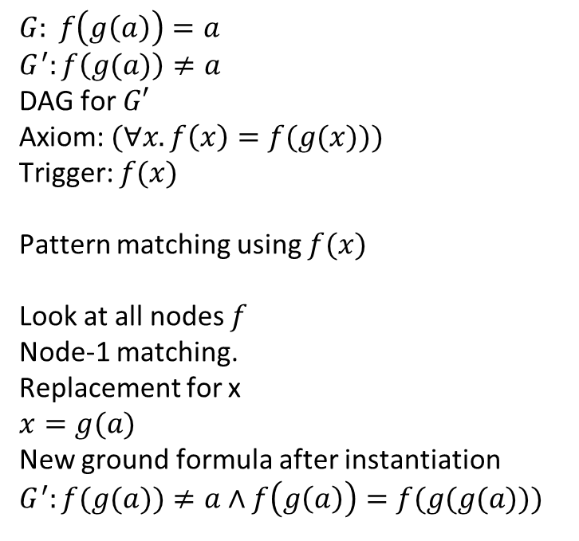
Example
$$G: f\left(g\left(a\right)\right)=a$$
$$G^{′}:f\left(g(a)\right)≠a$$
DAG for $G′$
Axiom: $(∀x. f\left(x\right)=f(g(x)))$
Trigger: $f(x)$
Pattern matching using $f(x)$
Look at all nodes $f$
Node-1 matching.
Replacement for x
$$x=g(a)$$
New ground formula after instantiation
$G^{′}:f(g(a))≠a∧f\left(g\left(a\right)\right)=f(g(g(a)))$
1
f
g
a

Slide 56
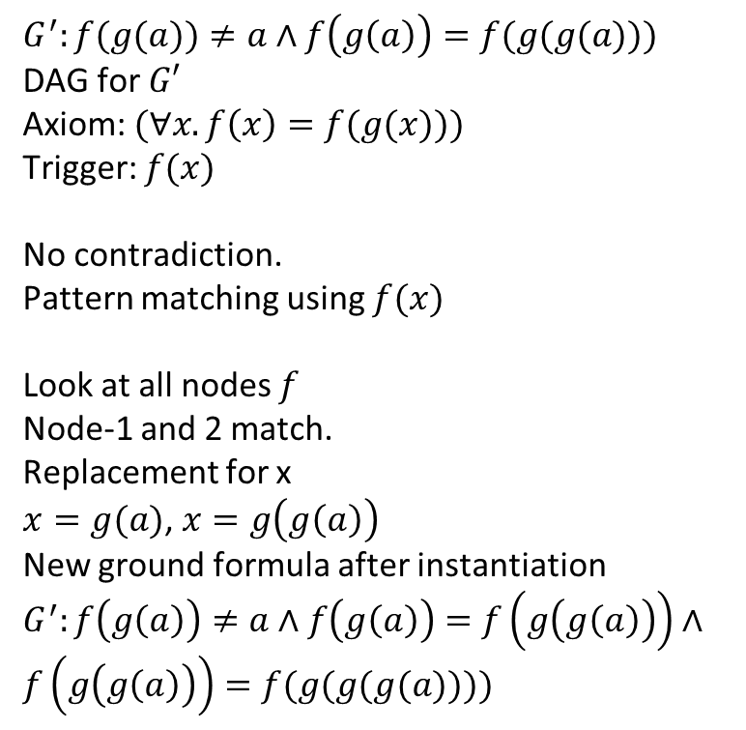
Example
$G^{′}:f(g(a))≠a∧f\left(g\left(a\right)\right)=f(g(g(a)))$
DAG for $G′$
Axiom: $(∀x. f\left(x\right)=f(g(x)))$
Trigger: $f(x)$
No contradiction.
Pattern matching using $f(x)$
Look at all nodes $f$
Node-1 and 2 match.
Replacement for x
$x=g(a)$, $x=g\left(g\left(a\right)\right)$
New ground formula after instantiation
$G^{′}:f\left(g\left(a\right)\right)≠a∧f\left(g\left(a\right)\right)=f\left(g\left(g\left(a\right)\right)\right)∧f\left(g\left(g\left(a\right)\right)\right)=f(g(g(g(a))))$
f
2
1
f
g
g
a

Slide 57
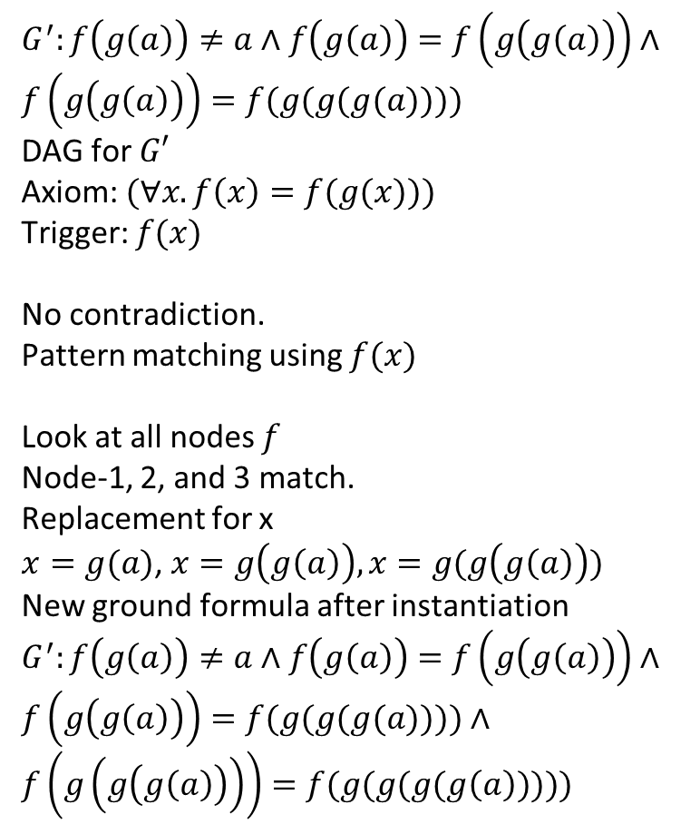
Example
3
$G^{′}:f\left(g\left(a\right)\right)≠a∧f\left(g\left(a\right)\right)=f\left(g\left(g\left(a\right)\right)\right)∧f\left(g\left(g\left(a\right)\right)\right)=f(g(g(g(a))))$
DAG for $G′$
Axiom: $(∀x. f\left(x\right)=f(g(x)))$
Trigger: $f(x)$
No contradiction.
Pattern matching using $f(x)$
Look at all nodes $f$
Node-1, 2, and 3 match.
Replacement for x
$x=g(a)$, $x=g\left(g\left(a\right)\right), x=g(g\left(g\left(a\right)\right))$
New ground formula after instantiation
$G^{′}:f\left(g\left(a\right)\right)≠a∧f\left(g\left(a\right)\right)=f\left(g\left(g\left(a\right)\right)\right)∧f\left(g\left(g\left(a\right)\right)\right)=f(g(g(g(a))))$ $∧f\left(g\left(g\left(g\left(a\right)\right)\right)\right)=f(g(g(g(g\left(a\right)))))$
f
f
2
g
1
f
g
g
a

Slide 58
Matching loop
The instantiations can go into an infinite loop if the Ematch algorithm keeps on adding predicates that match a trigger, resulting in creating more instantiation opportunities
Theorem provers try to detect or prevent matching loops
Read Simplify: a theorem prover for program checking, Detlefs et al.
Read Trigger Selection Strategies to Stabilize Program Verifiers, Leino and Claudel
User-defined triggers in Dafny
Quantifiers splitting

