Slide 2
Grading components
Attendance: 20%
In class quizzes: 80%

Slide 3
Tentative lecture plan
Introduction
TensorFlow
Apache TVM
Ansor
Relay, MLIR
Tensor IR
TPUs
The hardware lottery

Slide 4
Classroom code
nffl26t

Slide 5
Background
Deep neural networks
Dataflow programming
GPU computing

Slide 6
Deep neural networks (DNN)
Guess the output?
INPUT | OUTPUT
3 | 13
7 | 21
8 | 23
11 | 29
15 | 37
20 | ?

Slide 7
Deep neural networks
Guess the output?
How do you design a tool that can solve such kinds of puzzles?
INPUT | OUTPUT
3 | 13
7 | 21
8 | 23
11 | 29
15 | 37
20 | 47

Slide 8
Deep neural networks (DNN)
Identifying a pattern from a set of input-output examples is hard
In supervised learning, DNNs try to learn some patterns from a set of given input-output examples and use the learned information to guess the output corresponding to new inputs
The output is generally an approximated value, i.e., it might differ from the actual output
The performance of a DNN model is measured using the average loss
A loss function is used to compute the average loss
The lesser the average loss, the better the DNN model

Slide 9








A simple DNN model
$$i_{1}$$
Activation Function
f(x) = x
$$i_{2}$$
$$w_{1}$$
$$w_{2}$$
o
$$w_{3}$$
$$i_{3}$$
o
$$i_{4}$$
$$w_{4}$$
b
o
Each neuron or Perceptron (node in the graph) implements an activation function.
A weight is associated with each input edge to a neuron.
A bias is associated with each neuron.
INPUT is the input value.
OUTPUT is the predicted value.
A neuron can have multiple input and output edges.
The output is identical on all output edges.
Input edges can have different inputs.

Slide 10
Neuron (perceptron)
Input to neuron n
in = 0
for each incoming edge e to n:
sum = e.input * e.weight;
sum += n.bias
n.input = sum

Slide 11
Neuron (perceptron)
Output of neuron n
n.output = n.activation_fun(n.input)
for each outgoing edge e from n:
e.input = n.output

Slide 12
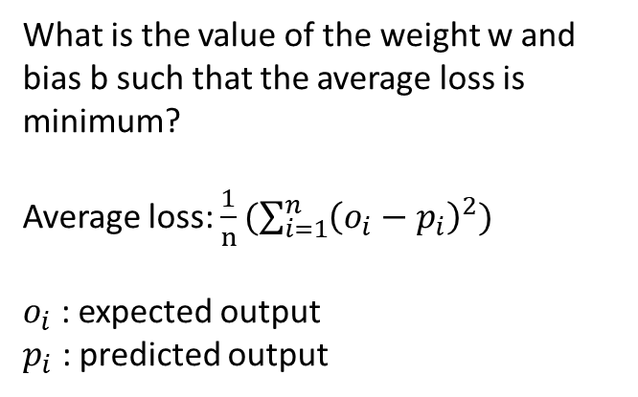
Deep neural networks
Activation Function
f(x) = x
Guess the output?
INPUT
OUTPUT
w
b
INPUT | OUTPUT
3 | 13
7 | 21
8 | 23
11 | 29
15 | 37
20 | ?
What is the value of the weight w and bias b such that the average loss is minimum?
Average loss: $\frac{1}{n}(\sum_{i=1}^{n}{{\left(o_{i}−p_{i}\right)}^{2})}$
$o_{i}$ : expected output
$p_{i}$ : predicted output

Slide 13
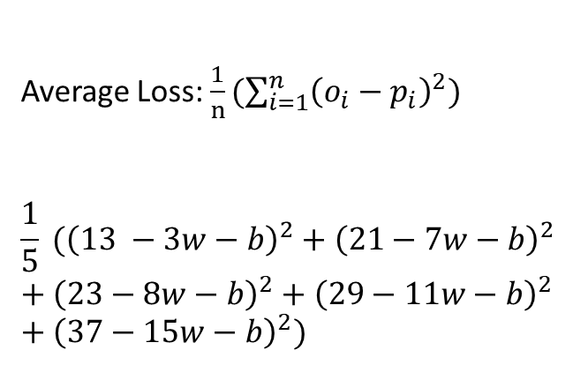
Deep neural networks
Activation Function
f(x) = x
Guess the output?
INPUT
OUTPUT
w
b
INPUT | OUTPUT
3 | 13
7 | 21
8 | 23
11 | 29
15 | 37
20 | ?
Average Loss: $\frac{1}{n}(\sum_{i=1}^{n}{{\left(o_{i}−p_{i}\right)}^{2})}$
$$\frac{1}{5} ({\left(13 −3w−b\right)}^{2}+{\left(21−7w−b\right)}^{2}+{\left(23−8w−b\right)}^{2}+{\left(29−11w−b\right)}^{2}+{\left(37−15w−b\right)}^{2})$$

Slide 14
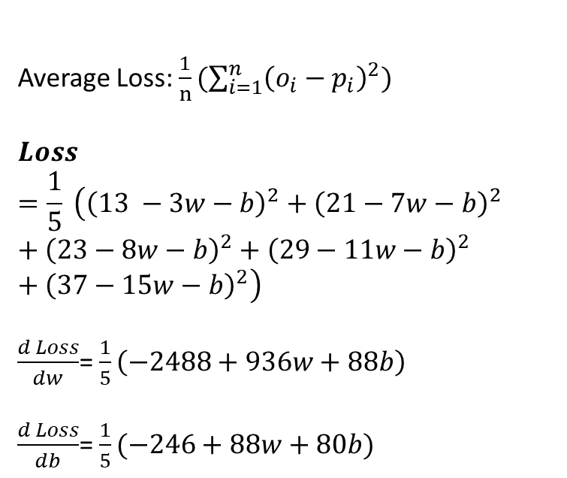
Deep neural networks
Activation Function
f(x) = x
Guess the output?
INPUT
OUTPUT
w
b
INPUT | OUTPUT
3 | 13
7 | 21
8 | 23
11 | 29
15 | 37
20 | ?
Average Loss: $\frac{1}{n}(\sum_{i=1}^{n}{{\left(o_{i}−p_{i}\right)}^{2})}$
$$Loss=\frac{1}{5} \left({\left(13 −3w−b\right)}^{2}+{\left(21−7w−b\right)}^{2}+{\left(23−8w−b\right)}^{2}+{\left(29−11w−b\right)}^{2}+{\left(37−15w−b\right)}^{2}\right)$$
$\frac{d Loss}{dw}$= $\frac{1}{5}\left(−2488+936w+88b\right)$
$\frac{d Loss}{db}$= $\frac{1}{5}(−246+88w+80b)$

Slide 15
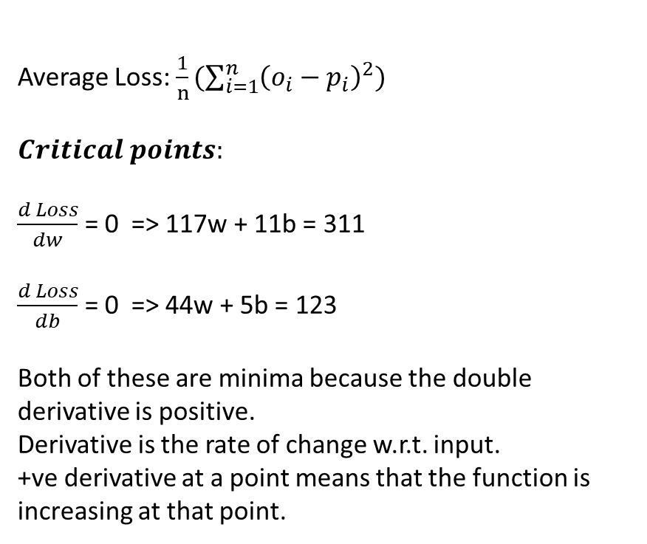
Deep neural networks
Activation Function
f(x) = x
Guess the output?
INPUT
OUTPUT
w
b
Average Loss: $\frac{1}{n}(\sum_{i=1}^{n}{{\left(o_{i}−p_{i}\right)}^{2})}$
$$Critical points:$$
$\frac{d Loss}{dw}$ = 0 => 117w + 11b = 311
$\frac{d Loss}{db}$ = 0 => 44w + 5b = 123
Both of these are minima because the double derivative is positive.
Derivative is the rate of change w.r.t. input.
+ve derivative at a point means that the function is increasing at that point.
INPUT | OUTPUT
3 | 13
7 | 21
8 | 23
11 | 29
15 | 37
20 | ?

Slide 16
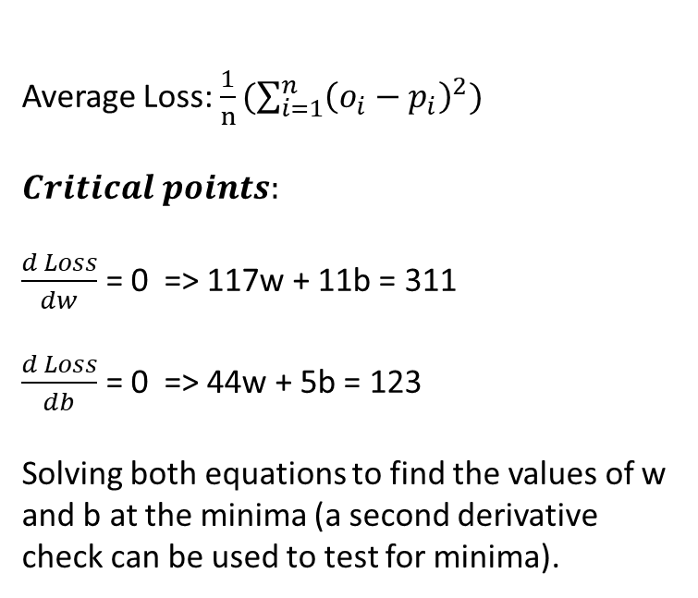
Deep neural networks
Activation Function
f(x) = x
Guess the output?
INPUT
OUTPUT
w
b
INPUT | OUTPUT
3 | 13
7 | 21
8 | 23
11 | 29
15 | 37
20 | ?
Average Loss: $\frac{1}{n}(\sum_{i=1}^{n}{{\left(o_{i}−p_{i}\right)}^{2})}$
$$Critical points:$$
$\frac{d Loss}{dw}$ = 0 => 117w + 11b = 311
$\frac{d Loss}{db}$ = 0 => 44w + 5b = 123
Solving both equations to find the values of w and b at the minima (a second derivative check can be used to test for minima).

Slide 17
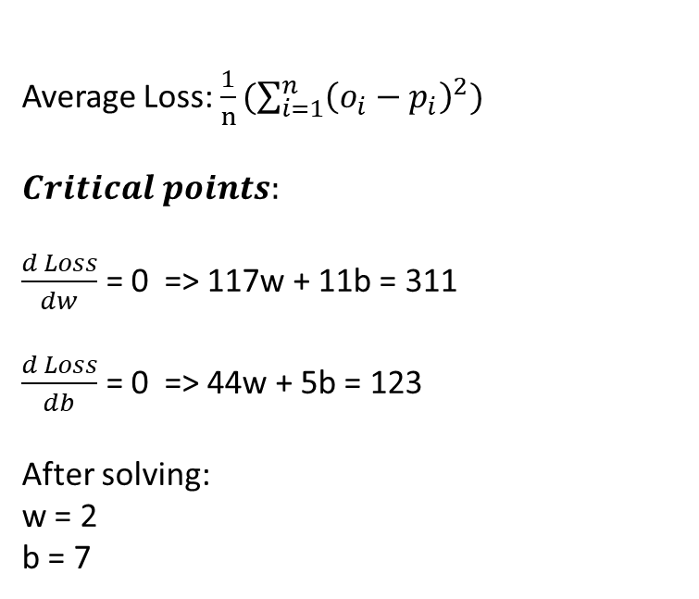
Deep neural networks
Activation Function
f(x) = x
Guess the output?
INPUT
OUTPUT
w
b
INPUT | OUTPUT
3 | 13
7 | 21
8 | 23
11 | 29
15 | 37
20 | ?
Average Loss: $\frac{1}{n}(\sum_{i=1}^{n}{{\left(o_{i}−p_{i}\right)}^{2})}$
$$Critical points:$$
$\frac{d Loss}{dw}$ = 0 => 117w + 11b = 311
$\frac{d Loss}{db}$ = 0 => 44w + 5b = 123
After solving:
w = 2
b = 7

Slide 18
Minimizing loss
Usually, the number of weights, biases, input-output examples is very large, and the activation functions are non-linear. Therefore, sometimes, it’s not feasible or computationally challenging to solve the equations for computing the critical points.
Instead of finding the critical points, the practical algorithms start from an initial value of weights and biases and update them in a direction where there is a hope of finding the minima.
The partial derivative with respect to a given weight or bias tells the possible direction of local minimum

Slide 19
Minimizing loss
A local minimum is a point at which the partial derivate with respect to all weights and biases is zero. The nearby points have a higher value than the value at the local minimum.
Out of all local minima the one with the lowest value is called the global minimum
Our goal is to set all weights and biases to the coordinates at the global minimum
Finding global minimum is an NP-hard problem. In practice, some heuristics are used that work well.

Slide 20
Minimizing loss
The key idea is to compute the gradient at a given point with respect to all weights and biases. The gradient is the rate of change with respect to input.
If the gradient is negative, it looks like \
The function is decreasing at the given point
In this case, we need to move in the positive direction to reach the minimum
If the gradient is positive, it looks like /
The function is increasing at the given point
In this case, we need to move in the negative direction to reach the minimum
The learning rate decides how quickly we want to move
If we move slowly, we might take a very long time to converge
If we move faster, we might overshoot the minimum

Slide 21
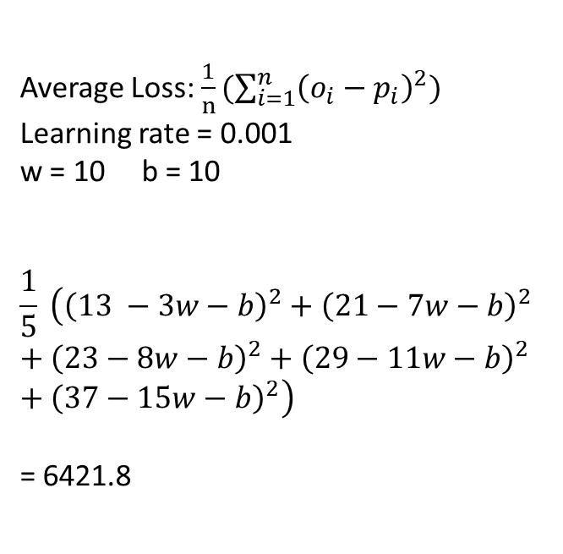
Deep neural networks
Activation Function
f(x) = x
Guess the output?
INPUT
OUTPUT
w
b
INPUT | OUTPUT
3 | 13
7 | 21
8 | 23
11 | 29
15 | 37
20 | ?
Average Loss: $\frac{1}{n}(\sum_{i=1}^{n}{{\left(o_{i}−p_{i}\right)}^{2})}$
Learning rate = 0.001
w = 10 b = 10
$$\frac{1}{5} \left({\left(13 −3w−b\right)}^{2}+{\left(21−7w−b\right)}^{2}+{\left(23−8w−b\right)}^{2}+{\left(29−11w−b\right)}^{2}+{\left(37−15w−b\right)}^{2}\right)$$
= 6421.8

Slide 22
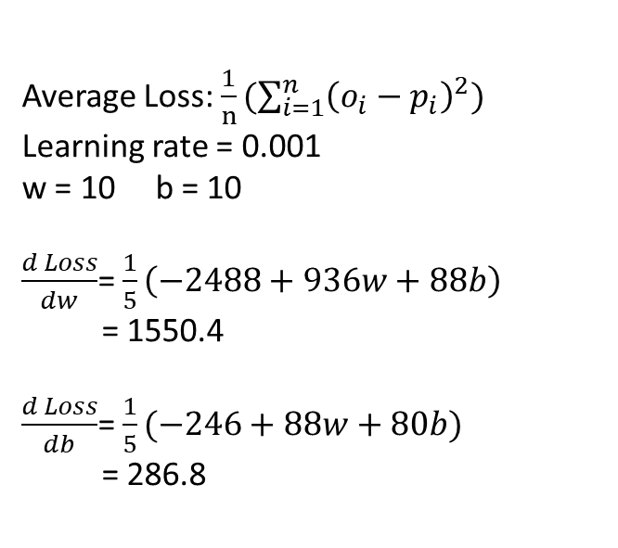
Deep neural networks
Activation Function
f(x) = x
Guess the output?
INPUT
OUTPUT
w
b
INPUT | OUTPUT
3 | 13
7 | 21
8 | 23
11 | 29
15 | 37
20 | ?
Average Loss: $\frac{1}{n}(\sum_{i=1}^{n}{{\left(o_{i}−p_{i}\right)}^{2})}$
Learning rate = 0.001
w = 10 b = 10
$\frac{d Loss}{dw}$= $\frac{1}{5}\left(−2488+936w+88b\right)$
= 1550.4
$\frac{d Loss}{db}$= $\frac{1}{5}(−246+88w+80b)$
= 286.8

Slide 23
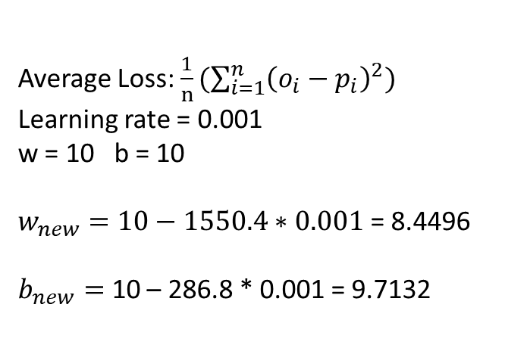
Deep neural networks
Activation Function
f(x) = x
Guess the output?
INPUT
OUTPUT
w
b
INPUT | OUTPUT
3 | 13
7 | 21
8 | 23
11 | 29
15 | 37
20 | ?
Average Loss: $\frac{1}{n}(\sum_{i=1}^{n}{{\left(o_{i}−p_{i}\right)}^{2})}$
Learning rate = 0.001
w = 10 b = 10
$w_{new}=10−1550.4∗0.001$ = 8.4496
$b_{new}=$ 10 – 286.8 * 0.001 = 9.7132

Slide 24
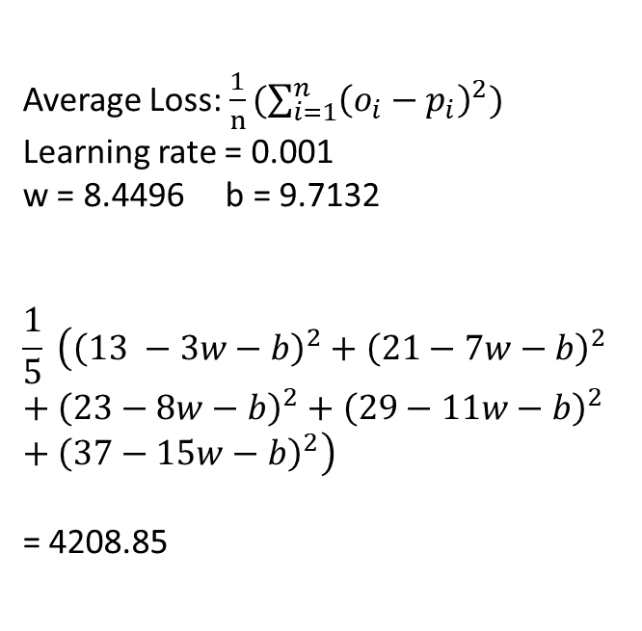
Deep neural networks
Activation Function
f(x) = x
Guess the output?
INPUT
OUTPUT
w
b
INPUT | OUTPUT
3 | 13
7 | 21
8 | 23
11 | 29
15 | 37
20 | ?
Average Loss: $\frac{1}{n}(\sum_{i=1}^{n}{{\left(o_{i}−p_{i}\right)}^{2})}$
Learning rate = 0.001
w = 8.4496 b = 9.7132
$$\frac{1}{5} \left({\left(13 −3w−b\right)}^{2}+{\left(21−7w−b\right)}^{2}+{\left(23−8w−b\right)}^{2}+{\left(29−11w−b\right)}^{2}+{\left(37−15w−b\right)}^{2}\right)$$
= 4208.85

Slide 25
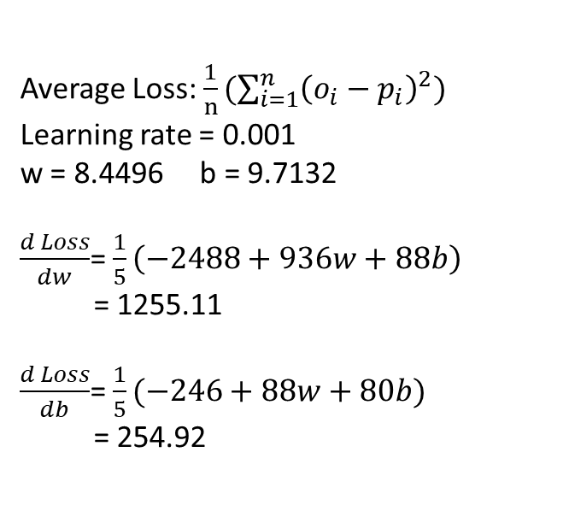
Deep neural networks
Activation Function
f(x) = x
Guess the output?
INPUT
OUTPUT
w
b
INPUT | OUTPUT
3 | 13
7 | 21
8 | 23
11 | 29
15 | 37
20 | ?
Average Loss: $\frac{1}{n}(\sum_{i=1}^{n}{{\left(o_{i}−p_{i}\right)}^{2})}$
Learning rate = 0.001
w = 8.4496 b = 9.7132
$\frac{d Loss}{dw}$= $\frac{1}{5}\left(−2488+936w+88b\right)$
= 1255.11
$\frac{d Loss}{db}$= $\frac{1}{5}(−246+88w+80b)$
= 254.92

Slide 26
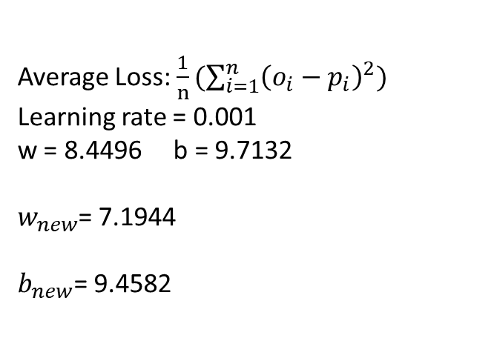
Deep neural networks
Activation Function
f(x) = x
Guess the output?
INPUT
OUTPUT
w
b
INPUT | OUTPUT
3 | 13
7 | 21
8 | 23
11 | 29
15 | 37
20 | ?
Average Loss: $\frac{1}{n}(\sum_{i=1}^{n}{{\left(o_{i}−p_{i}\right)}^{2})}$
Learning rate = 0.001
w = 8.4496 b = 9.7132
$w_{new}$= 7.1944
$b_{new}$= 9.4582

Slide 27
Deep neural networks
Continue for 30 iterations

Slide 28
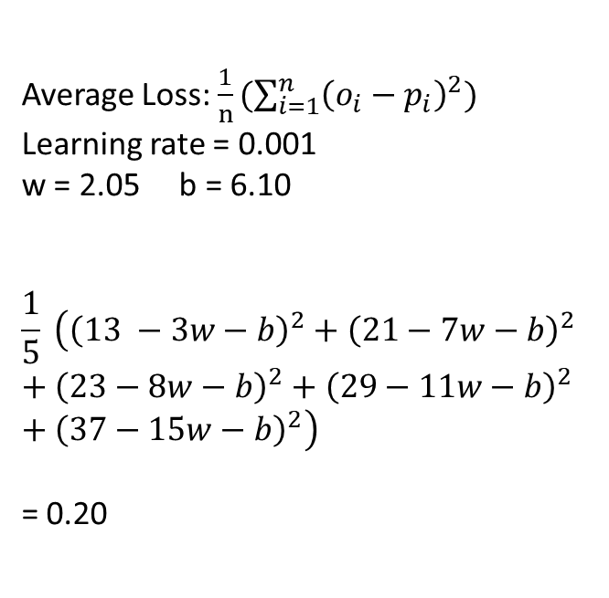
Deep neural networks
Activation Function
f(x) = x
Guess the output?
INPUT
OUTPUT
w
b
INPUT | OUTPUT
3 | 13
7 | 21
8 | 23
11 | 29
15 | 37
20 | 47.1
Average Loss: $\frac{1}{n}(\sum_{i=1}^{n}{{\left(o_{i}−p_{i}\right)}^{2})}$
Learning rate = 0.001
w = 2.05 b = 6.10
$$\frac{1}{5} \left({\left(13 −3w−b\right)}^{2}+{\left(21−7w−b\right)}^{2}+{\left(23−8w−b\right)}^{2}+{\left(29−11w−b\right)}^{2}+{\left(37−15w−b\right)}^{2}\right)$$
= 0.20

Slide 29
Matrix multiplication on CUDA
/* Host Code */
void MatrixMul(float *A, float *B, float *R,
int numRowsA, int numColsA, int numRowsB,
int numColsB) {
int numRowsR = numRowsA;
int numColsR = numColsB;
dim3 block_size(8, 8); // first dimension (x) is cols, second dimension (y) is rows
dim3 num_of_blocks((numColsR + 7) / 8, (numRowsR + 7) / 8);
/* creates a grid with num_of_blocks.x columns and num_of_blocks.y rows */
/* Each block contains 8 columns and 8 rows */
/* Each element in the block is a thread */
MatrixMul<<<num_of_blocks, block_size>>>(A, B, C, numRowsR, numColsR, numColsA);
}

Slide 30
Matrix multiplication on CUDA
/* Device code */
__global__ void MatrixMul( float* A, float* B, float* R, int num_R_rows, int num_R_cols, int num_A_cols) {
// blockDim.x = total number of columns in a block
// blockIdx.x = the column id of the current block
// threadIdx.x = the column id of the current thread in the current block
int col = blockIdx.x * blockDim.x + threadIdx.x;
int row = blockIdx.y * blockDim.y + threadIdx.y;
float R_value = 0;
if (row < num_R_rows && col < num_R_cols) {
for (int i = 0; i < num_A_cols; i++) {
R_value += A[(row * num_A_cols) + i] * B[(i * num_R_cols) + col]; // A[row][i] * B[i][col]
}
R[(row * num_R_cols) + col] = R_value;
}
}

