Slide 2
Example
import tensorflow as tf
b = tf.Variable(tf.zeros([100]))
W = tf.Variable(tf.random_uniform([784,100], -1, 1))
x = tf.placeholder(name=“x”)
relu = tf.nn.relu(tf.matmul(x, W) + b) // relu(x) = max(0, x)
s = tf.Session()
for step in xrange(0, 10):
input = np.random.rand(1, 784)
r = sess.run(relu, feed_dict={x: input})

Slide 3
Example
Relu
Add
b
MatMul
x
W

Slide 4
TensorFlow operations
Category | Examples
Element-wise operations | Add, Sub, Mul, Div, Exp, Log, Greater, Less, Equal, ...
Array operations | Concat, Slice, Split, Constant, Rank, Shape, Shuffle, ...
Matrix operations | MatMul, MatrixInverse, MatrixDeterminant, ...
Stateful operations | Variable, Assign, AssignAdd, ...
Neural-net building blocks | SoftMax, Sigmoid, ReLU, Convolution2D, MaxPool, ...
Checkpointing operations | Save, restore
Queue and sync operations | Enqueue, Dequeue, MutexAcquire, MutexRelease, ...
Control flow operations | Merge, Switch, Enter, Leave, NextIteration

Slide 5
TensorFlow
The TensorFlow user can execute the graph by creating a session
The run interface in session takes a set of output names that need to be computed and a set of tensor values that replace the outputs of some nodes
Using the arguments to run TensorFlow can compute the subgraph that needs to be executed to compute the requested output

Slide 6
Variables
Returns a handle to a persistent mutable state that survives across the execution of the graph
Assign(=), AssignAdd(+=), etc. can be used to update the value of the variable
For DNN, the parameters are stored in variables which are updated during the training process

Slide 7
Main components
Client: The client executes the run command
Worker: A worker process executes a subgraph of the computation graph
Master: The master process partitions the graph and assigns them to the different worker processes

Slide 8
Worker
A worker process owns one or more devices (e.g., CPU cores, GPUs, etc.)
In a distributed setting, the client, master, and workers may execute on different machines. In a non-distributed setting, they all execute on the same machine.

Slide 9
Device
A CPU core or GPU is an example of a device. A device object is responsible for the allocation and deallocation of memory and the execution of the kernel as requested by the worker process.

Slide 10
Single device execution
Everything executes on one device
The worker keeps track of the number of dependencies of every node. When it reaches zero, the node is placed in the ready queue. After the execution of a node, the dependency counts of all nodes that depend on the executed node are decremented.

Slide 11
Multi device execution
Node placement

Slide 12
Multi device execution
Node placement
Predict the cost of executing a node
The cost includes the size of the input/output, the estimated runtime, and the cost of communication
statically or based on prior execution
Greedy approach: predict the cost of running a node on each feasible device
A device is not feasible if it doesn’t implement the node’s kernel
Picks the device that is fastest for the node’s operation
The node placement issue is challenging, and it’s an ongoing work
Conditional branches, backpropagation, communication cost, etc., make it a harder problem

Slide 13
Cross device communication
After placing the nodes to the devices, the graph is partitioned into subgraphs, one per device
Send and receive nodes are added for cross-device communication.
If multiple nodes in a device receive the same tensor, then they are connected to the same receive node

Slide 14
Scheduling
The scheduling of nodes is done in a decentralized manner by the workers

Slide 15
Distributed execution
Distributed execution is implemented in a similar way to multi-device execution
The Send and Receive nodes use TCP/RDMA

Slide 16
Restart training
How can we restart training without losing the progress made so far?

Slide 17
Restart training
Variables store the current state of the computation, possibly in volatile memory
The goal of the DNN learning algorithm is to learn the weight and biases that minimize the average loss
The weights and biases are stored in variables
To restart a training phase without losing the progress made so far, one can save the weight and biases in persistent storage, stop the learning process, and restart the process with the saved weights and biases as initial values

Slide 18
Fault tolerance
A worker process, device, or machine may fail
The master does a periodic health check to detect a failure
When a failure is detected, the entire graph execution is restarted

Slide 19
Fault tolerance
The intermediate states of the computation are kept in variables
Each variable is connected to a Save and Restore node
Save nodes periodically save variable states in persistent storage
Upon restart, variable states are recovered using the Restore nodes (Restore nodes fetch state saved using Save nodes) before executing the graph
Restore is done only once, just after a restart

Slide 20
TensorFlow operations
TensorFlow operations can generate multiple outputs

Slide 21
Gradient computation
import tensorflow as tf
b = tf.Variable(tf.zeros([100]))
W = tf.Variable(tf.random_uniform([784,100], -1, 1))
x = tf.placeholder(name=“x”)
relu = tf.nn.relu(tf.matmul(x, W) + b) // relu(x) = max(0, x)
C = [...]
s = tf.Session()
for step in xrange(0, 10):
input = np.random.rand(1, 784)
r = sess.run(C, feed_dict={x: input})
[db, dW, dx] = tf.gradiants(C, [b,W,x])

Slide 22
Example
C
dC/dC
...
d...
Relu
dRelu
Add
dAdd
b
MatMul
dC/db
dMatMul
x
W
dC/dx
dC/dW

Slide 23
Gradient computation
TensorFlow provides APIs to compute the gradient of an output tensor with respect to a set of input tensors
[db, dW, dx] = tf.gradiants(C, [b,W,x])
Compute dC/db, dC/dW, and dC/dx
To find the gradient of a tensor C w.r.t. the tensor I, TensorFlow first finds all paths from I to C in the forward direction. Afterward, it backtracks from C to I and builds a computation graph G that computes the gradient.

Slide 24
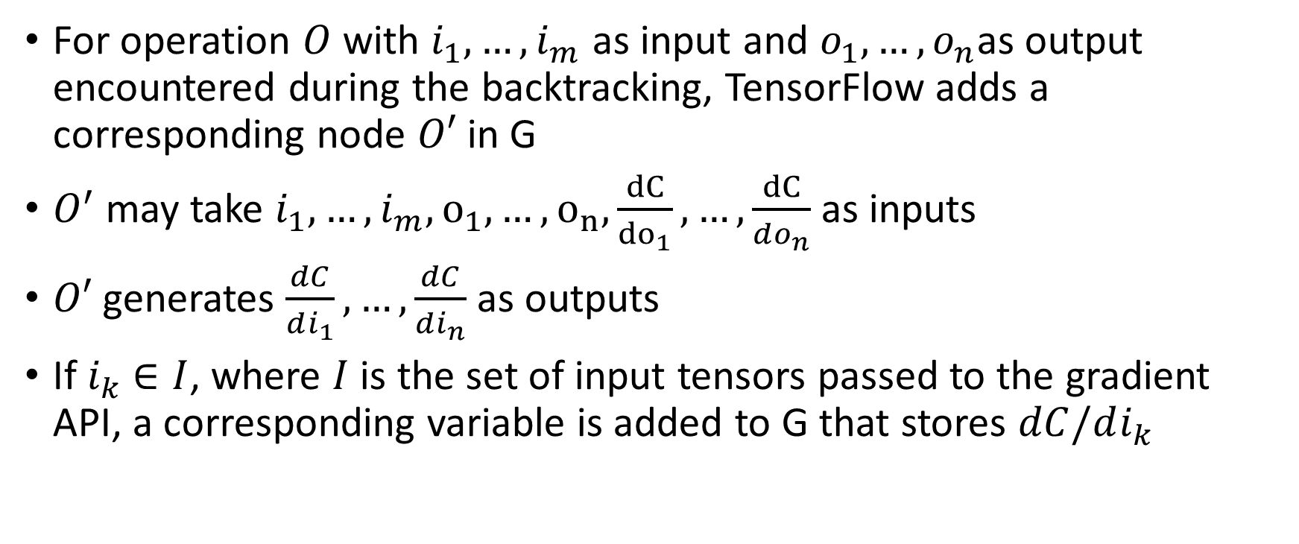
Gradient computation
For operation $O$ with $i_{1},…,i_{m}$ as input and $o_{1},…,o_{n}$as output encountered during the backtracking, TensorFlow adds a corresponding node $O′$ in G
$O^{′}$ may take $i_{1},…,i_{m}, o_{1},…,o_{n},\frac{dC}{{do}_{1}}, …,\frac{dC}{do_{n}}$ as inputs
$O′$ generates $\frac{dC}{di_{1}},…,\frac{dC}{di_{n}}$ as outputs
If $i_{k}$ $∈I$, where $I$ is the set of input tensors passed to the gradient API, a corresponding variable is added to G that stores $dC/di_{k}$

Slide 25
Scheduling
Automatic gradient computation makes the scheduling harder

Slide 26
Scheduling
The scheduling algorithm assumes that the outputs are consumed soon after construction, and thus, memory for outputs can be reused quickly
The memory utilization also depends on the amount of parallelism
If the heuristic used by TensorFlow fails, the user can add control dependencies edges to limit the memory usage and parallelism

Slide 27
Scheduling
When the gradient nodes are added automatically, the user has less control because it can only see the computation graph for forward execution
Some outputs generated during the forward execution may be reused during the backpropagation by the computation nodes added by the TensorFlow automatically
In fact, tensors that are created in the beginning may be frequently needed near the end of the gradient computation and may hold a lot of scarce GPU memory
If the user can’t visualize the graph properly, it can’t precisely add dependency edges to reduce the memory usage

Slide 28
Scheduling
The authors were working on resolving these issues
More sophisticated heuristics to determine the order of execution
Recomputing tensors instead of keeping them in memory
Swapping out long-lived tensors from GPU memory to CPU memory

Slide 29
Partial execution
TensorFlow supports the partial execution of the graph
Each node has a name. If it has multiple outputs, then the output is identified using the name:port pair
The run API takes a list of output nodes (name[:port]), and, optionally, a list of tensors and input nodes (name[:port])
Before executing the subgraph, the input nodes are replaced with special feed nodes that supply the corresponding tensors

Slide 30
Partial execution
The output node is connected to a special fetch node to save the output and return it to the client
To compute the subgraph that needs to be executed, TensorFlow walks the graph in the reverse direction from the output nodes. All the nodes that were encountered in the backward traversal are executed in the order of their dependencies to compute the output.

Slide 31
Partial execution
e
f
d
c
a
b
input == {b=T1}
outputs = {f}

Slide 32
Partial execution
fetch
e
f
f
d
c
c
a
b
a
T1
input == {b=T1}
outputs = {f}

Slide 33
p
r
r
n
o
m
c
T F
Switch
d
T F
Switch
a
b
inputs == {a=T1}, {b=T2}, {m=T3}, {c=T4}, {d=T5}
outputs = {p}
Draw the subgraph that will be executed.

Slide 34
Optimizations
Common subexpression elimination
Iterate over the computation graph and canonicalize multiple copies of an operation with the same inputs to a single node and adjust graph edges appropriately

Slide 35
Controlling memory usage
By default, nodes execute as soon as all the inputs are available
GPU memory is a scarce resource, whereas the main memory is relatively cheaper
One place where the memory utilization can be controlled is the receive nodes
A receive node can possibly copy the data from the main memory to the GPU memory of the device on which the target operation will execute

Slide 36
Controlling memory usage
If the target node can’t process the data copied by a receive node immediately (because it is waiting for other inputs to arrive), then part of GPU memory will be unnecessarily blocked until all the inputs arrive
The blocked memory could have been used by other operations which are waiting for the GPU memory to be freed
TensorFlow uses as-soon-as-possible or as-late-as-possible calculations to decide when to start a receive node

Slide 37
Asynchronous Kernels
Some nodes in the compute graph, such as receive, enqueue, and dequeue, may block
TensorFlow also supports non-blocking kernels that also take a method that is invoked after the execution of the kernel
The thread which invokes a non-blocking kernel is free to execute other operations because the call to the asynchronous kernel immediately returns
This API is useful on systems where the overhead of creating many threads is relatively expensive

Slide 38
Lossy compression
Many DNN algorithms are tolerant of noise and precision arithmetic
TensorFlow uses lossy compression of floating point values while sending data between devices
32-bit float -> 16-bit float -> send -> receive -> 16-bit float -> 32-bit float

