Slide 2
Today’s lecture
TVM: An automated end-to-end optimizing compiler for deep learning

Slide 3
Problems with current DL frameworks
The deep-learning libraries provide implementations of operators
Different implementations for different target-device
e.g., CPU, GPU, TPU, IoT, new accelerators
A lot of engineering effort is needed for the fine-tuned implementation of an operator
An operator can run on a target device if the library has an implementation of the operator for that device

Slide 4
Large schedule space
The performance of an operator also depends on the target hardware specification, e.g., memory hierarchy, cache size, etc.
Manually finding the right set of optimizations, e.g., tiling, reordering, unrolling, caching, etc. is challenging

Slide 5
TVM
TVM introduces a domain-specific language called tensor expression language for tensor expressions
An extended version of Halide
Better code generation for GPU
additional support for new accelerators
Main idea: Operators are implemented in tensor expression language
Operators are atomically compiled to low-level assembly for multiple backends such as CPU, GPU, TPU, new accelerators

Slide 6
TVM
TVM is a compiler that takes a high level specification of a deep learning program from existing frameworks such as TensorFlow, PyTorch, MxNet, and generates low-level optimized code for a diverse set of hardware back-ends
TVM uses an ML-based cost model to automatically find the right schedule for a given operator
Usually, the computations in DL frameworks are expressed using a computational graph
TVM also implements graph-level optimizations

Slide 7
Tensor expression language
Each compute expression specifies the shape of the output tensor and an expression describing how to compute each element
Tensor expression language supports common arithmetic and math operations and covers common DL operator patterns
It supports schedule primitives similar to Halide and extends the schedule primitives to support different specialized backends, such as TPUs

Slide 8
Tensor expression language
// Vector addition
n = te.var(“n”) // symbolic variable n to represent shape
A = te.placeholder((n,), name = “A”) // placeholder tensor A with shape (n,)
B = te.placeholder((n,), name = “B”) // placeholder tensor B with shape (n,)
C = te.compute(A.shape, lambda i: A[i] + B[i], name = “C”) // compute defines a computation
// output shape is A.shape
// lambda function defines the computation
// at each index in the output tensor
// tvm allows users to create a schedule
s = te.create_schedule(C.op)
// by default, the schedule will iterate the elements in row-major order
//tvm.build creates a function. tvm.build takes a schedule, inputs and outputs, and a target language
fadd = tvm.build(s, [A, B, C], tgt, name=“myadd”)

Slide 9
Tensor expression language
Reduction: reduction is an operation is to reduce certain dimension(s) of the input tensor to a scalar (usually)
e.g., np.sum
np.sum([0.5, 1.5]) = 2.0
np.sum([0, 1], [0, 5]) = 6
np.sum([[0, 1], [0, 5]], axis = 0) = [0, 6] // axis 1 columns, axis 0 rows
np.sum([[0, 1], [0, 5]], axis = 1) = [1, 5]

Slide 10
Sum of rows
n = te.var(“n”)
m = te.var(“m”)
A = te.placeholder((n, m), name = “A”)
k = te.reduce_axis((0, m), name = “k”)
B = te.compute((n,), lambda i: te.sum(A[i, k], axis=k), name=“B”)
A is a n x m matrix
B = numpy.sum(A, axis=1)
for (y = 0; y < n; y++) {
B[y] = 0;
for (x = 0; x < m; x++) {
B[y] += A[y][x];
}
}

Slide 11
Sum of rows
n = te.var(“n”)
m = te.var(“m”)
A = te.placeholder((n, m), name = “A”)
k = te.reduce_axis((0, m), name = “k”)
B = te.compute((n,), lambda i: te.sum(A[i, k], axis=k), name=“B”)
s = te.create_schedule(B.op)
ko, ki = s[B].split(B.op.reduce_axis[0], factor=16)
yo, yi = s[B].split(B.op.axis[0], factor=32)
for (yo = 0; yo < (n + 31)/32; yo++) {
for (yi = 0; yi < 32; yi++) {
if (yo * 32 + yi < n) {
B[yo*32+yi] = 0;
for (ko = 0; ko < (m+15)/16; ko++) {
for (ki = 0; ki < 16; ki++) {
if (ko * 16 + ki < m) {
B[yo*32+yi] += A[yo*32+yi][ko*16+ki];
}
}
}
}
}
}

Slide 12
Optimizations

Slide 13
Optimizations
Constant folding: pre-compute graph parts that can be determined statically
Operator fusion
Data layout transformations

Slide 14
Operator fusion
Injective (one-to-one map): e.g., add
Reduction: e.g., sum
Complex-Out-Fusable (can fuse element-wise map to output): e.g., conv2d
Opaque (can’t be fused): e.g., sort

Slide 15
Operator fusion
Multiple injective operators can be fused into another injective operator
A reduction operator can be fused with an input injective operator (e.g., fuse scale and sum)
The output of complex-out-fusable operators such as conv2d can be fused with element-wise operators

Slide 16
Example
conv-bn-relu

Slide 17

Convolution
$\left[\begin{matrix}1 2 & 3 \\ \begin{aligned}4 5 \\ 7 8\end{aligned} & \begin{aligned}6 \\ 9\end{aligned}\end{matrix}\right]$ * $\left[\begin{matrix}0.1 & 0.2 \\ 0.3 & 0.4\end{matrix}\right]$
No padding
Stride = 1
Output = $\left[\begin{matrix}3.7 & 4.7 \\ 6.7 & 7.7\end{matrix}\right]$

Slide 18
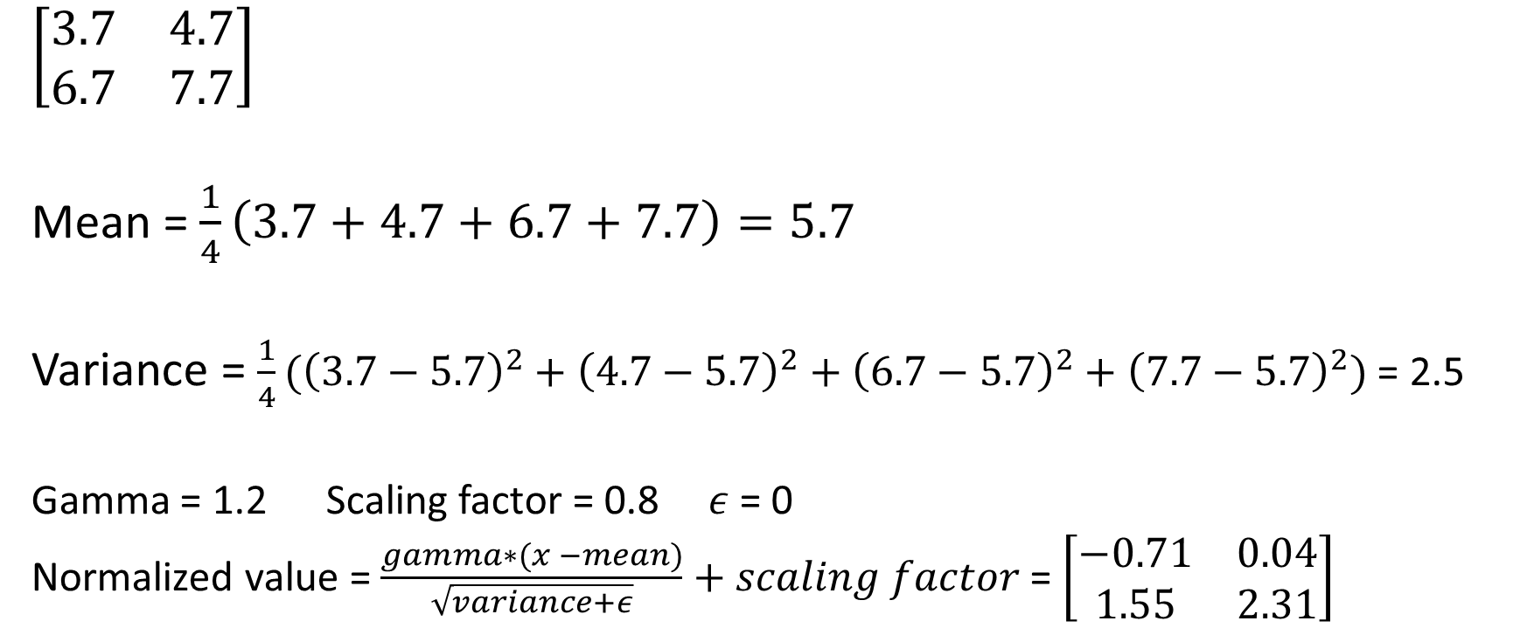
Normalized output
$$\left[\begin{matrix}3.7 & 4.7 \\ 6.7 & 7.7\end{matrix}\right]$$
Mean = $\frac{1}{4}\left(3.7+4.7+6.7+7.7\right)=5.7$
Variance = $\frac{1}{4}({\left(3.7−5.7\right)}^{2}+{\left(4.7−5.7\right)}^{2}+{\left(6.7−5.7\right)}^{2}+{\left(7.7−5.7\right)}^{2})$ = 2.5
Gamma = 1.2 Scaling factor = 0.8 $ε$ = 0
Normalized value = $\frac{gamma∗(x −mean)}{\sqrt{variance+ε}}+scaling factor$ = $\left[\begin{matrix}−0.71 & 0.04 \\ 1.55 & 2.31\end{matrix}\right]$

Slide 19

Relu
Relu(x) = max(0, x)
$\left[\begin{matrix}−0.71 & 0.04 \\ 1.55 & 2.31\end{matrix}\right]$ = $\left[\begin{matrix}0 & 0.04 \\ 1.55 & 2.31\end{matrix}\right]$

Slide 20
Operator fusion
Operator fusion can handle diamond shapes
conv2d
op
op
op
elementwise add
Can we fuse conv2d and elementwise add?
If all paths originating from convd are also passing through elementwise add, and all intermediate nodes between convd2 and elementwise add satisfy the fuse condition, then we can fuse all of them

Slide 21
Operator fusion
Operator fusion is not possible if the operators are implemented in different languages
The existing DL frameworks that support operator fusion require library developers to implement fused operators
However, this requires a lot of human effort. The number of fused operators can grow dramatically with the number of operators and hardware backends

Slide 22
Nested parallelism with cooperation

Slide 23
Code generation for CUDA
The code generation for CUDA is easier for completely data-parallel applications that share nothing
Each thread accesses global/local memory to do its job without worrying about the other threads
However, the GPU applications can improve their performance by cooperatively fetching the data in the shared memory, which is an order of magnitude faster than global memory access

Slide 24
Matrix multiplication on CUDA
/* Device code */
__global__ void MatrixMul( float* A, float* B, float* R, int num_R_rows, int num_R_cols, int num_A_cols) {
// blockDim.x = total number of columns in a block
// blockIdx.x = the column id of the current block
// threadIdx.x = the column id of the current thread in the current block
int col = blockIdx.x * blockDim.x + threadIdx.x;
int row = blockIdx.y * blockDim.y + threadIdx.y;
float R_value = 0;
if (row < num_R_rows && col < num_R_cols) {
for (int i = 0; i < num_A_cols; i++) {
R_value += A[(row * num_A_cols) + i] * B[(i * num_R_cols) + col]; // A[row][i] * B[i][col]
}
R[(row * num_R_cols) + col] = R_value;
}
}

Slide 25
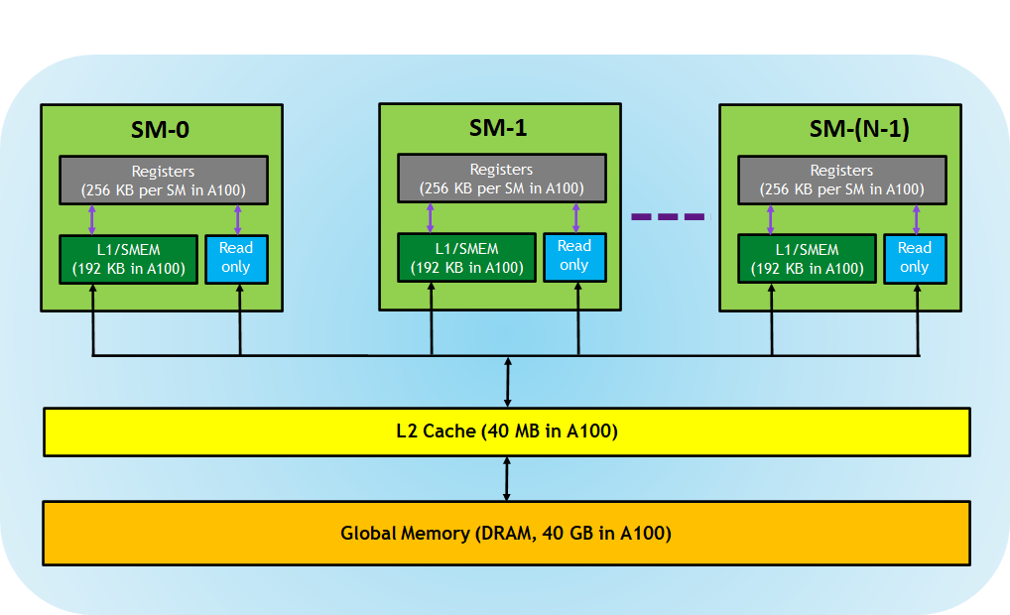
Memory hierarchy

Slide 26
Matrix multiplication using shared memory
#define TILE_SIZE 16 // BLOCK_SIZE = (TILE_SIZE, TILE_SIZE)
// A and B are N x N matrices, N is a multiple of TILE_SIZE
__global__ void MatrixMul( float* A, float* B, float* R, int N) {
__shared__ float As[TILE_SIZE][TILE_SIZE]; // allocate a block in shared memory to fetch a block of A
__shared__ float Bs[TILE_SIZE][TILE_SIZE]; // allocate a block in shared memory to fetch a block of B
int bx = blockIdx.x, by = blockIdx.y;
int tx = threadIdx.x, ty = threadIdx.y;
int row = by * TILE_SIZE + ty;
int col = bx * TILE_SIZE + tx;
float CVal = 0;
for (int t = 0; t < N / TILE_SIZE; t++) {
As[ty][tx] = A[row * N + t * TILE_SIZE + tx]; // load ty, tx value from the t^{th} block (horizontal) that contains row (row) form A
Bs[ty][tx] = B[t * N + ty * N + col]; // load ty, tx value from the t^{th} block (vertical) that contains column (col) from B
__syncthreads(); // wait for copy to finish
for (int k = 0; k < TILE_SIZE; k++)
CVal += As[ty][k] * Bs[k][tx]; // multiply ty^{th} row in As and tx^{th} column in Bs
__syncthreads(); // wait until As, Bs is not needed
}
C[row * N + col] = CVal;
}

Slide 27
Quiz
/* Device code */
__global__ void MatrixMul( float* A, float* B, float* R, int num_R_rows, int num_R_cols, int num_A_cols) {
// blockDim.x = total number of columns in a block
// blockIdx.x = the column id of the current block
// threadIdx.x = the column id of the current thread in the current block
int col = blockIdx.x * blockDim.x + threadIdx.x;
int row = blockIdx.y * blockDim.y + threadIdx.y;
float R_value = 0;
if (row < num_R_rows && col < num_R_cols) {
for (int i = 0; i < num_A_cols; i++) {
R_value += A[(row * num_A_cols) + i] * B[(i * num_R_cols) + col]; // A[row][i] * B[i][col]
}
R[(row * num_R_cols) + col] = R_value;
}
}
Why __syncthreads() is not needed when matrix multiplication is implemented without the shared memory?

Slide 28
TVM
TVM tensor expression language introduced the concept of memory scopes in the schedule space, which enforces TVM to use shared memory and insert barriers for synchronization

Slide 29
Tensorization
Due to the high use of tensor expressions in DL workloads, new hardware platforms, such as TPU, etc., are emerging.
The instructions in the emerging architectures take multidimensional tensors of fixed or variable length as input
The fixed set of primitive operations supported by TVM can’t handle new hardware

Slide 30
Tensorization
To enable new hardware to take advantage of the automatic code generation of TVM, TVM allows users to declare a pattern using the TVM existing primitives and a lowering rule that can use advantage of the new hardware to speedup the computation of the given pattern
TVM introduced a schedule named tensorize that matches the pattern declared for the hardware and lowers the pattern using the lowering rule as specified by the users

Slide 31
Tensorization
w, x = t.placeholder((8, 8)), t.placeholder((8,8))
k = t.reduce_axis(0, 8)
y = t.compute((8, 8), lambda i, j: t.sum(w[i, k] * x[j, k], axis = k))
def gemm_intrin_lower(inputs, outputs):
ww_ptr = inputs[0].access_ptr(“r”)
xx_ptr = inputs[1].access_ptr(“r”)
zz_ptr = outputs[0].access_ptr(“w”)
compute = t.hardware_intrin(“gem8x8”, ww_ptr, xx_ptr, zz_ptr)
return compute
gemm8x8 = t.decl_tensor_intrin(y.op, gemm_intrin_lower)

Slide 32
Latency hiding
The paper discusses latency hiding for decoupled access-execute (DAE) architecture
DAE decouples the access layer from the execute layer
Some DAE architectures require low-level explicit synchronization operation to reduce the memory latency and improve the compute performance
We’ll skip DAE architectures in this course

Slide 33
Schedule
Halide
Loop transformations
Thread bindings
Cache locality
TVM additionally support
Thread cooperation
Tensorization
Latency hiding

Slide 34
Automatic optimization
The number of all possible schedules for a given operator is very high
To minimize the number of possible schedules, TVM requires the programmers to provide a template based on their knowledge of the target hardware
TVM also provides generic templates for each hardware back-end
Despite the template-based annotations, the search space is still very large, in order of billions

Slide 35
Template for schedule
for yo in range(?):
for xo in range(?):
C[...][...] = 0
for ko in range(?):
for yi in range(?):
for xi in range(?):
for ki in range(?):
C[...][...] = A[...][...] * B[...][...]

Slide 36
Automatic optimization
Despite templates, the number of all possible schedules for a given operator is very high
One approach is to run all possible schedules on real hardware and measure the runtime of each of these schedules
This approach may not be feasible due to the large search space, and each schedule may take seconds to finish
Another approach is to predefine a cost model for a given hardware
The cost model needs to consider memory access patterns, data reuse, pipeline dependencies, threading patterns, etc.
However, finding a cost model is hard due to the increasing complexity of modern hardware

Slide 37
TVM approach
TVM uses an ML model to predict the performance of a schedule
The model takes the generated loop program as input
The model is trained by measuring the runtime of a schedule on real hardware
The model automatically learns the features of a given hardware and doesn’t require detailed hardware specification
The model can make very fast predictions (0.67 ms), which is thousands of times faster than the real measurement

Slide 38
TVM approach
In each iteration, during the exploration of a better schedule, the ML model ranks the candidates based on their expected performance
The explorer picks a batch of candidates from the out of the ML model, executes them on the real hardware, and uses the runtimes to train the model
If no initial training data is present, the explorer picks random candidates to measure

Slide 39
Experiments
The experiments show that TVM could outperform cuDNN, which is an operator library implemented by highly skilled Nvidia developers

