Slide 1
Compilers
Lecture-20

Slide 2
Today’s lecture
Bottom-up parsing
Shift-reduce parsing
Handle
LR(k) grammar
Viable prefixes

Slide 3
Bottom-up parsing

Slide 4
Bottom-up parsing
Read Chapter-4.5 from the dragon book

Slide 5
Bottom-up parsing
Builds a parse tree from leaves to root
E → E + T | T
T → T * F | F
F → (E) | id

Slide 6
Bottom-up parsing
The input string is scanned from left to right
Bottom-up parsers, generate the rightmost-derivation in reverse

Slide 7
Rightmost derivation
E
(id + id) * id
E → E + T | T
T → T * F | F
F → (E) | id

Slide 8
Rightmost derivation
E
T
(id + id) * id
E → E + T | T
T → T * F | F
F → (E) | id

Slide 9
Rightmost derivation
E
T
T
*
F
(id + id) * id
E → E + T | T
T → T * F | F
F → (E) | id

Slide 10
Rightmost derivation
E
T
T
*
F
(id + id) * id
E → E + T | T
T → T * F | F
F → (E) | id
id

Slide 11
Rightmost derivation
E
T
T
*
F
(id + id) * id
E → E + T | T
T → T * F | F
F → (E) | id
F
id

Slide 12
Rightmost derivation
E
T
T
*
F
(id + id) * id
E → E + T | T
T → T * F | F
F → (E) | id
F
id
(
E
)

Slide 13
Rightmost derivation
E
T
T
*
F
(id + id) * id
E → E + T | T
T → T * F | F
F → (E) | id
F
id
(
E
)
E
+
T

Slide 14
Rightmost derivation
E
T
T
*
F
(id + id) * id
E → E + T | T
T → T * F | F
F → (E) | id
F
id
(
E
)
E
+
T
F

Slide 15
Rightmost derivation
E
T
T
*
F
(id + id) * id
E → E + T | T
T → T * F | F
F → (E) | id
F
id
(
E
)
E
+
T
F
id

Slide 16
Rightmost derivation
E
T
T
*
F
(id + id) * id
E → E + T | T
T → T * F | F
F → (E) | id
F
id
(
E
)
E
+
T
T
F
id

Slide 17
Rightmost derivation
E
T
T
*
F
(id + id) * id
E → E + T | T
T → T * F | F
F → (E) | id
F
id
(
E
)
E
+
T
T
F
id
F

Slide 18
Rightmost derivation
E
T
T
*
F
(id + id) * id
E → E + T | T
T → T * F | F
F → (E) | id
F
id
(
E
)
E
+
T
T
F
id
F
id

Slide 19
Bottom-up parser
The bottom-up parser does the rightmost derivation in reverse

Slide 20
Rightmost derivation (reverse)
(id + id) * id
E → E + T | T
T → T * F | F
F → (E) | id

Slide 21
Rightmost derivation (reverse)
(id + id) * id
E → E + T | T
T → T * F | F
F → (E) | id
(
SHIFT

Slide 22
Rightmost derivation (reverse)
(id + id) * id
E → E + T | T
T → T * F | F
F → (E) | id
(
SHIFT
id

Slide 23
Rightmost derivation (reverse)
(id + id) * id
E → E + T | T
T → T * F | F
F → (E) | id
(
REDUCE
F
id

Slide 24
Rightmost derivation (reverse)
(id + id) * id
E → E + T | T
T → T * F | F
F → (E) | id
(
REDUCE
T
F
id

Slide 25
Rightmost derivation (reverse)
(id + id) * id
E → E + T | T
T → T * F | F
F → (E) | id
(
REDUCE
E
T
F
id

Slide 26
Rightmost derivation (reverse)
(id + id) * id
E → E + T | T
T → T * F | F
F → (E) | id
(
SHIFT
E
+
T
F
id

Slide 27
Rightmost derivation (reverse)
(id + id) * id
E → E + T | T
T → T * F | F
F → (E) | id
(
SHIFT
E
+
T
id
F
id

Slide 28
Rightmost derivation (reverse)
(id + id) * id
E → E + T | T
T → T * F | F
F → (E) | id
(
REDUCE
E
+
T
F
id
F
id

Slide 29
Rightmost derivation (reverse)
(id + id) * id
E → E + T | T
T → T * F | F
F → (E) | id
(
REDUCE
E
+
T
T
F
id
F
id

Slide 30
Rightmost derivation (reverse)
(id + id) * id
E → E + T | T
T → T * F | F
F → (E) | id
(
E
REDUCE
E
+
T
T
F
id
F
id

Slide 31
Rightmost derivation (reverse)
(id + id) * id
E → E + T | T
T → T * F | F
F → (E) | id
(
E
)
SHIFT
E
+
T
T
F
id
F
id

Slide 32
Rightmost derivation (reverse)
(id + id) * id
E → E + T | T
T → T * F | F
F → (E) | id
F
(
E
)
REDUCE
E
+
T
T
F
id
F
id

Slide 33
Rightmost derivation (reverse)
T
(id + id) * id
E → E + T | T
T → T * F | F
F → (E) | id
F
(
E
)
REDUCE
E
+
T
T
F
id
F
id

Slide 34
Rightmost derivation (reverse)
T
*
(id + id) * id
E → E + T | T
T → T * F | F
F → (E) | id
F
(
E
)
SHIFT
E
+
T
T
F
id
F
id

Slide 35
Rightmost derivation (reverse)
T
*
(id + id) * id
E → E + T | T
T → T * F | F
F → (E) | id
F
id
(
E
)
SHIFT
E
+
T
T
F
id
F
id

Slide 36
Rightmost derivation (reverse)
T
*
F
(id + id) * id
E → E + T | T
T → T * F | F
F → (E) | id
F
id
(
E
)
REDUCE
E
+
T
T
F
id
F
id

Slide 37
Rightmost derivation (reverse)
T
T
*
F
(id + id) * id
E → E + T | T
T → T * F | F
F → (E) | id
F
id
(
E
)
REDUCE
E
+
T
T
F
id
F
id

Slide 38
Rightmost derivation (reverse)
E
T
T
*
F
(id + id) * id
E → E + T | T
T → T * F | F
F → (E) | id
F
id
(
E
)
REDUCE
E
+
T
T
F
id
F
id

Slide 39
Shift-reduce parsing
The end goal of bottom-up parsing is to reduce a string w to the start symbol of the grammar
To achieve this bottom-up parser does a series of shift and reduce operations
at each reduction step, a specific substring matching the RHS of a production is replaced by LHS of the production

Slide 40
Shift-reduce parsing
The basic idea to maintain a stack to store the partially constructed parse tree
STACK | INPUT | ACTION
$ | (id + id) * id $

Slide 41
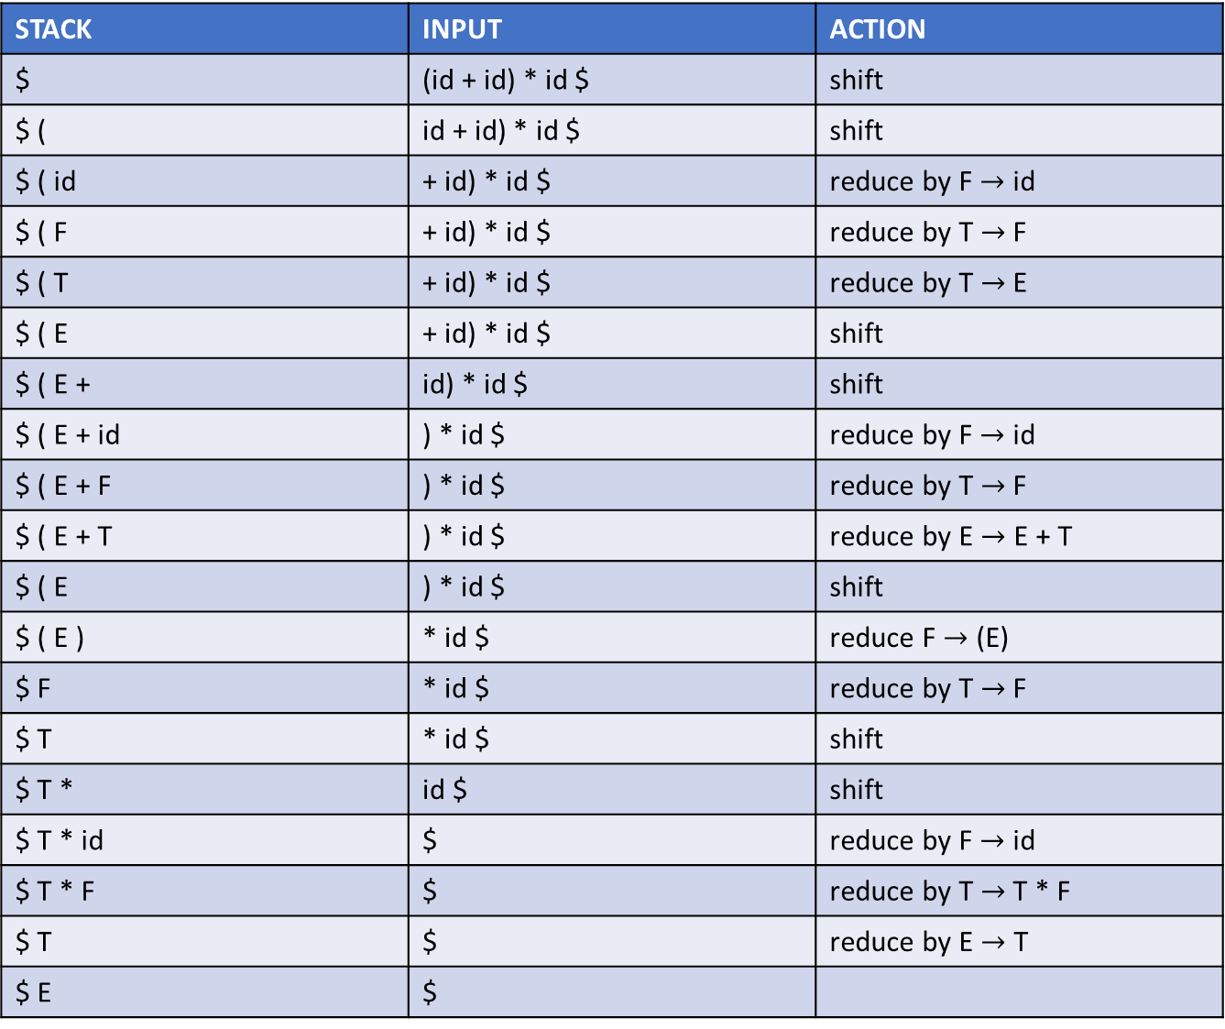
Shift-reduce parsing
STACK | INPUT | ACTION
$ | (id + id) * id $ | shift
$ ( | id + id) * id $ | shift
$ ( id | + id) * id $ | reduce by F $→$ id
$ ( F | + id) * id $ | reduce by T $→$ F
$ ( T | + id) * id $ | reduce by T $→$ E
$ ( E | + id) * id $ | shift
$ ( E + | id) * id $ | shift
$ ( E + id | ) * id $ | reduce by F $→$ id
$ ( E + F | ) * id $ | reduce by T $→$ F
$ ( E + T | ) * id $ | reduce by E $→$ E + T
$ ( E | ) * id $ | shift
$ ( E ) | * id $ | reduce F $→$ (E)
$ F | * id $ | reduce by T $→$ F
$ T | * id $ | shift
$ T * | id $ | shift
$ T * id | $ | reduce by F $→$ id
$ T * F | $ | reduce by T $→$ T * F
$ T | $ | reduce by E $→$ T
$ E | $

Slide 42
Shift-reduce parsing
Initially, $ is placed on the stack to mark the bottom of the stack
$ is appended to the input string to identify the end of the input
The algorithm terminates when the stack contains just the start symbol and the input is empty

Slide 43
Handle
The “handle” is a substring on the top of stack that is replaced by the LHS of some production during the reduction phase

Slide 44
Handle
The handle always appears on the top of the stack
why?
Notes:
Notice that during the shift step, a terminal symbol is pushed on the stack. When a reduction "A → α" takes place on the top of the stack, α is popped from the stack, and A is pushed on the stack. After a shift or reduce move, if a reduction "B →β" is possible in the middle of the stack, then the reduction doesn't depend on the current shift or reduce move (as shift/reduce only add one symbol on the top), i.e., the β was already present on the stack before the current shift or reduce move, and we could've made the reduction as soon as the β was available on the stack. It turns out that we can do the rightmost derivation in reverse, even if we perform a reduction as soon as the handle is available on the stack.

Slide 45
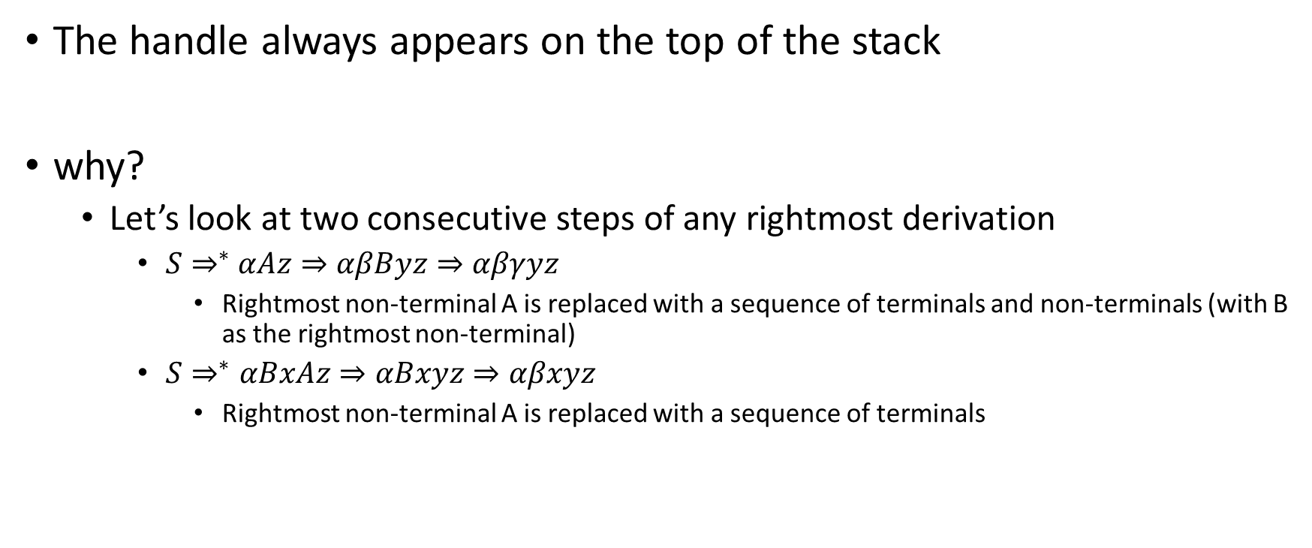
Handle
The handle always appears on the top of the stack
why?
Let’s look at two consecutive steps of any rightmost derivation
$S⇒^{∗}$ $αAz⇒αβByz⇒αβγyz$
Rightmost non-terminal A is replaced with a sequence of terminals and non-terminals (with B as the rightmost non-terminal)
$S⇒^{∗}αBxAz⇒αBxyz⇒αβxyz$
Rightmost non-terminal A is replaced with a sequence of terminals

Slide 46

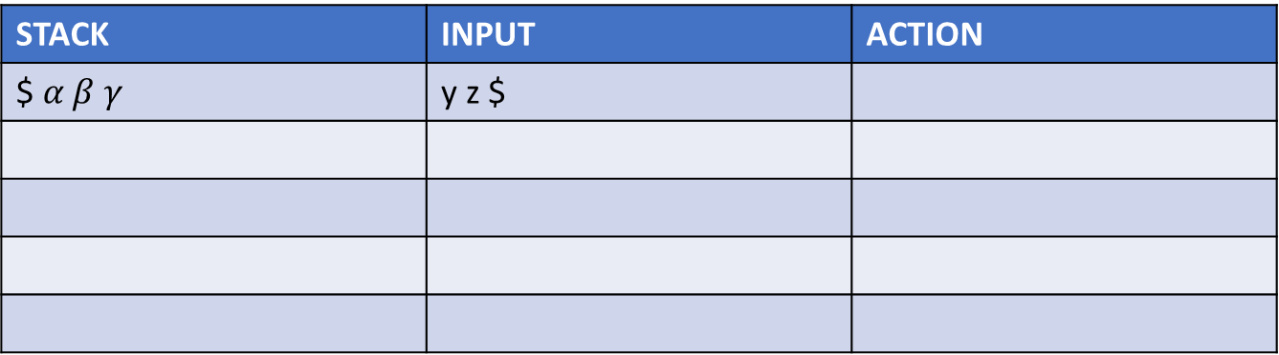
Handle
Case 1:
$S⇒^{∗}$ $αAz⇒αβByz⇒αβγyz$
rightmost-derivation in reverse (handle always appears on top)
STACK | INPUT | ACTION
$ $α β γ$ | y z $

Slide 47
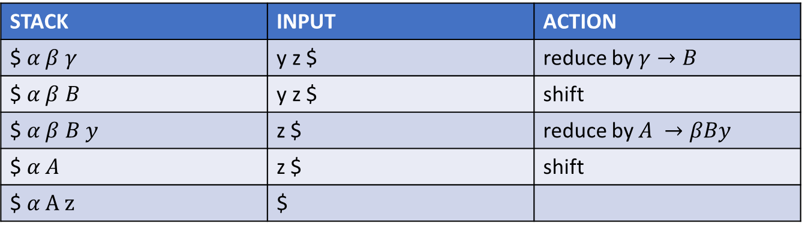
Handle
Case 1:
$S⇒^{∗}$ $αAz⇒αβByz⇒αβγyz$
rightmost-derivation in reverse (handle always appears on top)
STACK | INPUT | ACTION
$ $α β γ$ | y z $ | reduce by $γ→B$
$ $α β B$ | y z $ | shift
$ $α β B y$ | z $ | reduce by $A →βBy$
$ $α A$ | z $ | shift
$ $α A z$ | $
Notes:
Notice that we can derive back αAz for the first case when we perform the reduction as soon as the handle appears on the top of the stack.

Slide 48

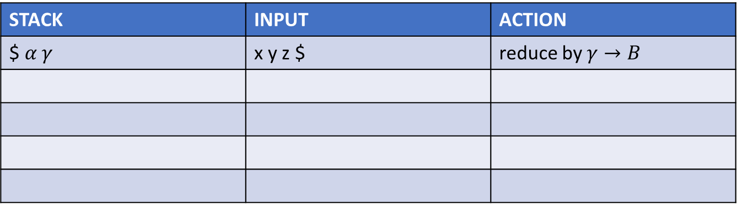
Handle
Case 2:
$S⇒^{∗}$ $αBxAz⇒αBxyz⇒αγxyz$
rightmost-derivation in reverse (handle always appears on top)
STACK | INPUT | ACTION
$ $α γ$ | x y z $ | reduce by $γ→B$

Slide 49
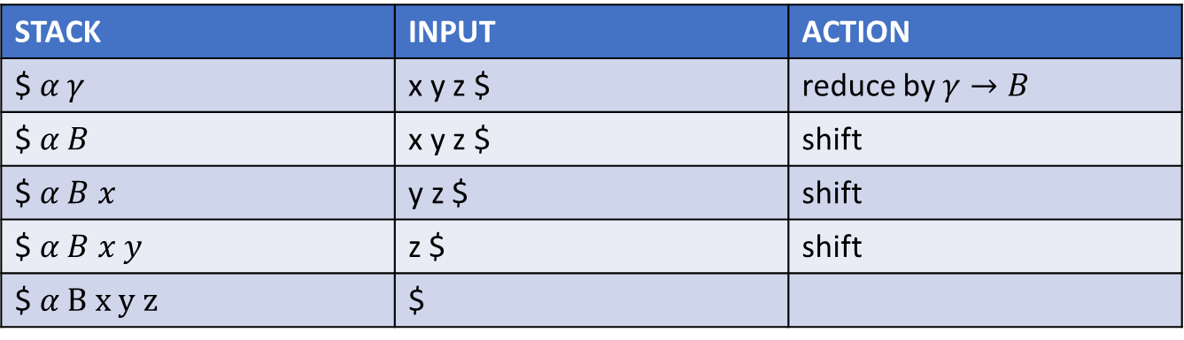
Handle
Case 2:
$S⇒^{∗}$ $αBxAz⇒αBxyz⇒αγxyz$
rightmost-derivation in reverse (handle always appears on top)
STACK | INPUT | ACTION
$ $α γ$ | x y z $ | reduce by $γ→B$
$ $α B$ | x y z $ | shift
$ $α B x$ | y z $ | shift
$ $α B x y$ | z $ | shift
$ $α B x y z$ | $
Notes:
Notice that we can derive back αAz for the second case as well when we perform the reduction as soon as the handle appears on the top of the stack.

Slide 50
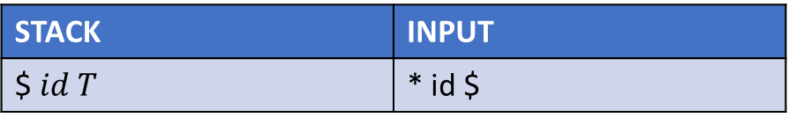
Recognizing handle
Consider the following grammar
E → E + T | T
T → T * F | F
F → (E) | id
The state of the shift-reduce parser is shown in the table below.
Can we consider T as a handle (i.e., the next step would be reduction)?
STACK | INPUT
$ $id T$ | * id $

Slide 51
Recognizing handle
Consider the following grammar
E → E + T | T
T → T * F | F
F → (E) | id
The state of the shift-reduce parser is shown in the table below.
Can we consider T as a handle (i.e., the next step would be reduction)?
STACK | INPUT
$ $id T$ | * id $
Because T * F appears in the RHS of some production, shift could be an option. Another option would be to reduce by E → T. In some variants of shift-reduce parser, it can be considered as a conflict.

Slide 52
Recognizing handle
Consider the following grammar
E → E + T | T
T → T * F | F
F → (E) | id
The state of the shift-reduce parser is shown in the table below.
Can we consider T as a handle (i.e., the next step would be reduction)?
STACK | INPUT
$ $id T$ | * id $
If we are allowed to look at the next input symbol, which is * in this case, we might resolve the conflict in favor of a shift because it’s likely that we will end up reducing by T → T * F in the future.

Slide 53
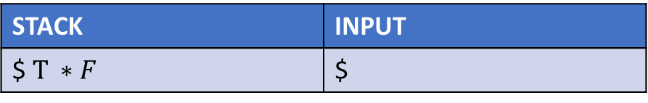
Recognizing handle
Consider the following grammar
E → E + T | T
T → T * F | F
F → (E) | id
The state of the shift-reduce parser is shown in the table below.
Should we consider T * F or F as a handle?
STACK | INPUT
$ $T ∗F$ | $

Slide 54
Recognizing handle
Consider the following grammar
E → E + T | T
T → T * F | F
F → (E) | id
The state of the shift-reduce parser is shown in the table below.
Should we consider T * F or F as a handle?
STACK | INPUT
$ $T ∗F$ | $
In this case, it might be better to pick T * F as a handle, as the input is empty. In some cases, reduce-reduce conflicts can be resolved by looking at the next input symbols.

Slide 55
Recognizing handle
The key idea is to examine all possible reductions at the top of the stack and resolve shift-reduce or reduce-reduce conflicts by considering the next few input symbols.
Additionally, the shift-reduce parser ensures that the stack's contents form a valid prefix of some sentential form; otherwise, the stack contents can’t be reduced to the start symbol

Slide 56

Shift-reduce parser
Initially:
STACK INPUT
$ $ω\$$
where, $ω$ is an input string
Accepting state:
STACK INPUT
$ S $
where, S is the start symbol

Slide 57
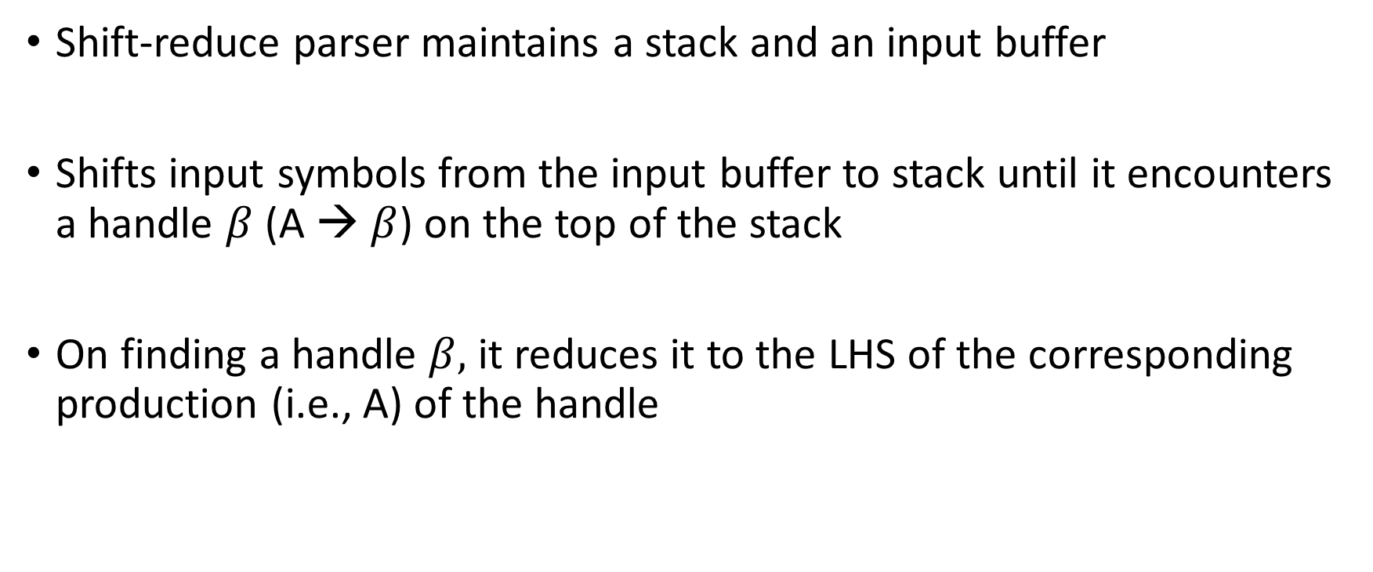
Shift-reduce parsing
Shift-reduce parser maintains a stack and an input buffer
Shifts input symbols from the input buffer to stack until it encounters a handle $β$ (A → $β$) on the top of the stack
On finding a handle $β,$ it reduces it to the LHS of the corresponding production (i.e., A) of the handle

Slide 58
Actions in shift-reduce parser
Shift: shift the next input symbol to the top of the stack
Reduce: reduce a handle on the top of the stack with the LHS of the production corresponding to handle
Accept
Error

Slide 59
Shift-reduce parsing
shift-reduce parsing works for LR(k) grammars
L stands for left-to-right scan
R stands for rightmost derivation in reverse
k refers to the number of symbols of lookahead on the input
For shift-reduce parsing, we need to recognize the handles

Slide 60
LR(k) vs. LL(k)
LR(k)
LL(k)
Scan input string from left-to-right with k symbols lookahead and construct the rightmost-derivation in reverse
Left-recursive and non-left factored grammar could be in LR(k)
An LR(k) grammar may not be an LL(k) grammar.
Ambiguous grammars are not in LR(k)
Scan input string from left-to-right with k symbols lookahead and construct the leftmost-derivation
Left recursive and non-left factored grammars are not in LL(k)
All LL(k) grammar are also LR(k)
Ambiguous grammars are not in LL(k)

Slide 61
LR(0) items
An LR(0) item (item for short) of a grammar G is a production of G with a dot at some position in the body
A → XYZ yields four items
A → .XYZ
A → X.YZ
A → XY.Z
A → XYZ.

Slide 62

LR(0) items
The production “A → $ε$” generates only one item
A → .

Slide 63
Item
Intuitively, an item indicates how much of the production we have seen so far
E.g., A → .XYZ indicates that we hope to see a string derivable from XYZ next on the input
A → X.YZ indicates that we have just seen X and we hope next to see a string derivable from YZ
A → XYZ. indicates that we have seen the body XYZ and it may be a time to reduce XYZ to A

Slide 64
Viable prefixes
In a shift-reduce parser, the stack contents are a prefix of a sentential form that may appear in the rightmost derivation
The handle always appears on the top of the stack
All possible strings on the stack of a shift-reduce parser (i.e., prefixes of a sentential form in the rightmost derivation) are called viable prefixes

Slide 65
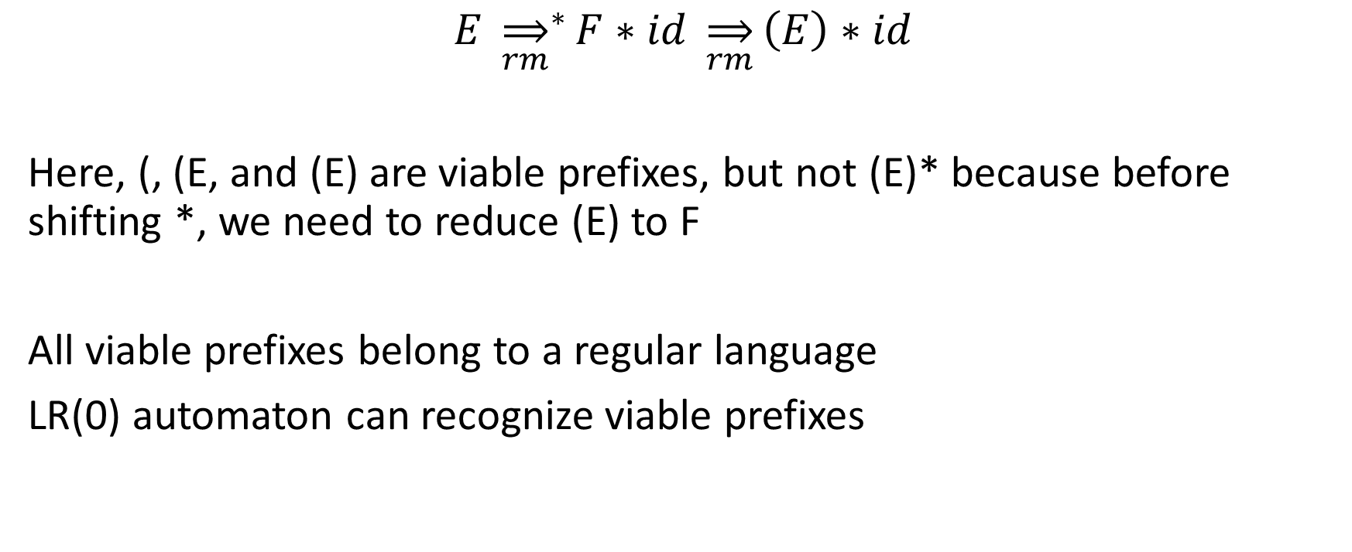
Viable prefixes
$$E {\overset{⇒}{rm}}^{∗}F∗id \overset{⇒}{rm}\left(E\right)∗id$$
Here, (, (E, and (E) are viable prefixes, but not (E)* because before shifting *, we need to reduce (E) to F
All viable prefixes belong to a regular language
LR(0) automaton can recognize viable prefixes

Slide 66
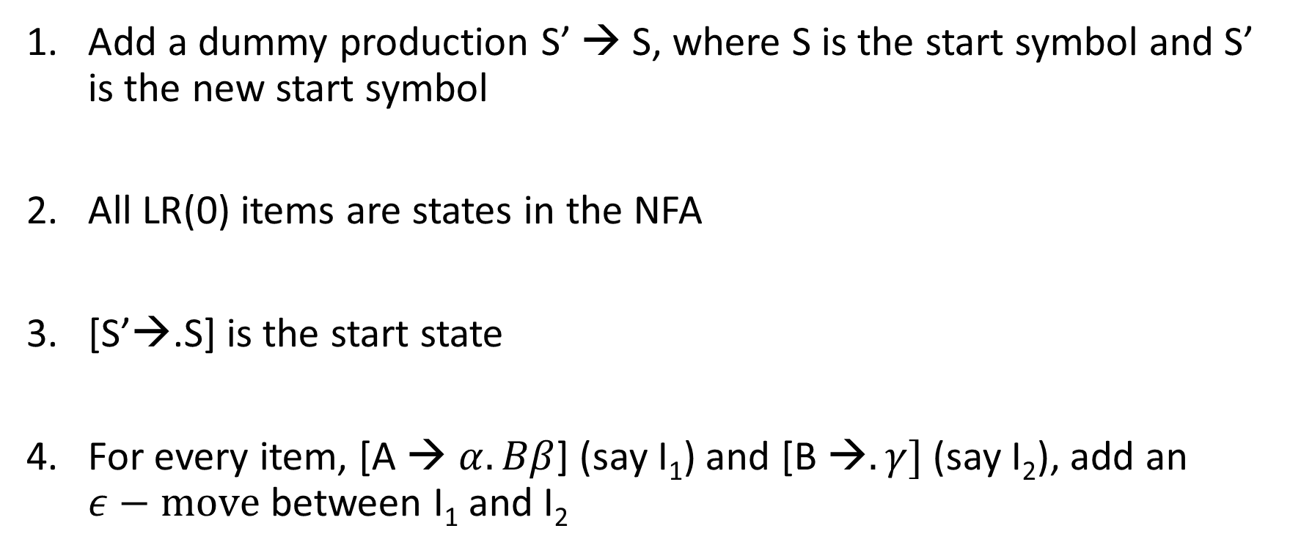
NFA for recognizing viable prefixes
Add a dummy production S’ → S, where S is the start symbol and S’ is the new start symbol
All LR(0) items are states in the NFA
[S’→.S] is the start state
For every item, [A → $α.Bβ$] (say I₁) and [B →$.γ]$ (say I₂), add an $ε−move$ between I₁ and I₂

Slide 67

NFA for recognizing viable prefixes
For every item, [A → $αX.β]$ (say I₁) such that [A →$α.Xβ]$ (say I₂) exists, add a move between I₂ and I₁ on input X
All states are accepting state

Slide 68
NFA
E’ → E
E → E + T | T
T → T * F | F
F → (E) | id

Slide 69



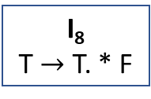






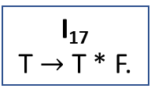


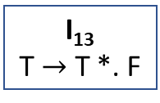


NFA
*
I₁₃
T $→$ T *. F
T
I₈
T $→$ T. * F
I₁
E’ → E.
F
E
$$ε$$
I₁₄
E → E + T.
T
$$ε$$
I₁₇
T $→$ T * F.
I₄
T → .T * F
F
I₉
T→ F.
$$ε$$
I₁₉
F → (E).
I₀
E’ → .E
$$ε$$
I₁₅
F → (.E)
)
$$ε$$
$$ε$$
I₅
T → .F
I₁₀
E → E +. T
I₁₈
F → (E.)
+
(
$$ε$$
I₂
E → .E + T
E
$$ε$$
E
I₆
E → E. + T
I₁₆
F → id.
I₁₁
F → .(E)
$$ε$$
$$ε$$
$$ε$$
id
$$ε$$
I₃
E → .T
I₇
E → T.
I₁₂
F → .id
T
$$ε$$
Notes:
We can build the NFA as shown on this slide and convert it to the DFA. We can also directly build the DFA using the steps discussed next.

Slide 70
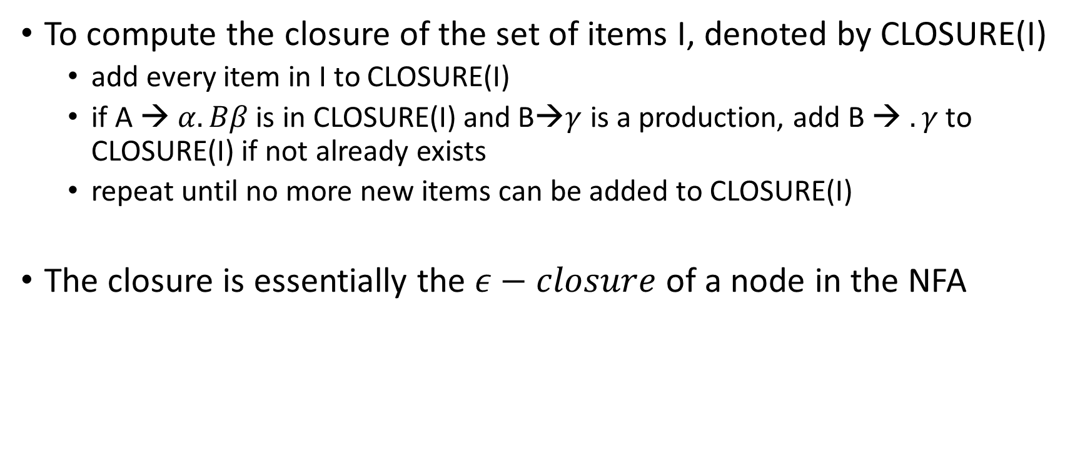
Closure
To compute the closure of the set of items I, denoted by CLOSURE(I)
add every item in I to CLOSURE(I)
if A → $α.Bβ$ is in CLOSURE(I) and B→$γ$ is a production, add B → $.γ$ to CLOSURE(I) if not already exists
repeat until no more new items can be added to CLOSURE(I)
The closure is essentially the $ε−closure$ of a node in the NFA

Slide 71
CLOSURE
E’ → E
E → E + T | T
T → T * F | F
F → (E) | id
CLOSURE of [E’ → .E]

Slide 72
CLOSURE
E’ → E
E → E + T | T
T → T * F | F
F → (E) | id
CLOSURE of [E’ → .E] = {[E’ → .E], [E → .E + T], [E → .T], [T → .T * F],
[T → .F], [F → .(E)], [F → .id]}

Slide 73

GOTO
GOTO(I,X), where I is a set of items and X is a grammar symbol, is:
Closure of set of all items [A → $αX.β$] such that [A → $α.Xβ$] is in I
GOTO(I_{i}, X) is a transition table entry for state I_{i} of DFA on input X

Slide 74
GOTO
E’ → E
E → E + T | T
T → T * F | F
F → (E) | id
I = {[E’ → .E], [E → E. + T]}
GOTO(I,+)

Slide 75
GOTO
E’ → E
E → E + T | T
T → T * F | F
F → (E) | id
I = {[E’ → .E], [E → E. + T]}
GOTO(I,+) = {[E → E +. T], [T → .T * F], [T → .F], [F → .(E)], [F → .id]}

Slide 76
LR(0) automaton (DFA)
CLOSURE([S’→.S]) is the start state
GOTO[I_{i}, X] is the new state after accepting input X in the state I_{i}, where I is a set of LR(0) items and X is a grammar symbol
All states are accepting states

Slide 77
LR(0) automaton (DFA)
void DFA(G’) {
C = {CLOSURE({[S’ -> .S]})};
repeat
changed = False
for (each set of items I in C)
for (each grammar symbol X)
if (GOTO(I, X) is not empty and not in C) {
add GOTO(I, X) to C;
changed = True;
}
until changed != False
}
Notes:
G’ is an augmented grammar that contains an additional production S’ -> S in addition to the productions in G.

Slide 78
LR(0) automaton
E’ → E
E → E + T | T
T → T * F | F
F → (E) | id

Slide 79
DFA
+
I₆
E → E + .T
T → .T * F
T → .F
F → .(E)
F → .id
I₁
E’ → E.
E → E. + T
I₉
E → E + T.
T → T .* F
E
F
T
I₀
E’ → .E
E → .E + T
E → .T
T → .T * F
T → .F
F → .(E)
F → .id
(
I₂
E → T.
T → T. * F
T
*
*
F
I₃
T → F.
I₇
T → T *. F
F → .(E)
F → .id
I₁₀
T → T * F.
(
F
I₄
F → (.E)
E → .E + T
E → .T
T → .T * F
T → .F
F → .(E)
F → .id
T
+
E
I₈
E → E. + T
F → (E.)
I₁₁
F → ( E ).
(
)
(
id
id
id
I₅
F → id.

Slide 80
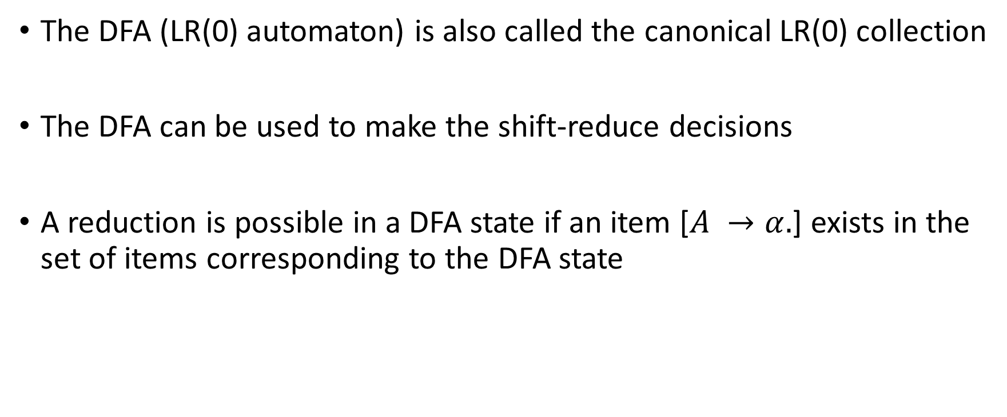
DFA
The DFA (LR(0) automaton) is also called the canonical LR(0) collection
The DFA can be used to make the shift-reduce decisions
A reduction is possible in a DFA state if an item [$A →α.$] exists in the set of items corresponding to the DFA state

Slide 81
Conflicts in LR(0) automaton
A LR(0) automaton can have two kinds of conflicts
shift-reduce conflict
when both shift and reduce moves are possible in a DFA state
reduce-reduce conflict
when multiple items are eligible for reductions in a DFA state

Slide 82
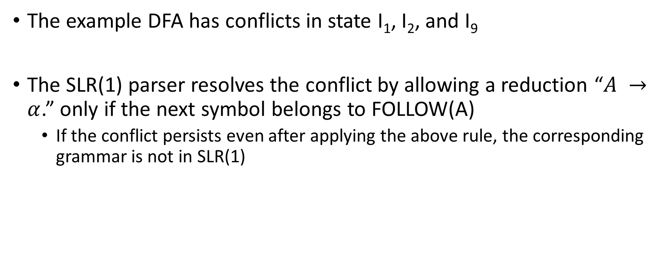
Conflicts in the example DFA
The example DFA has conflicts in state I₁, I₂, and I₉
The SLR(1) parser resolves the conflict by allowing a reduction “$A →α$.” only if the next symbol belongs to FOLLOW(A)
If the conflict persists even after applying the above rule, the corresponding grammar is not in SLR(1)

