Slide 1
Compilers
Lecture-21

Slide 2
Today’s lecture
LR(0) automaton
SLR(1) parser
Using ambiguous grammars
LR(1) items
A hierarchy of grammar classes

Slide 3
LR(0) automaton (DFA)
CLOSURE([S’→.S]) is the start state
GOTO[I_{i}, X] is the new state after accepting input X in the state I_{i}, where I is a set of LR(0) items and X is a grammar symbol
All states are accepting states

Slide 4
LR(0) automaton (DFA)
void DFA(G’) {
C = {CLOSURE({[S’ -> .S]})};
repeat
changed = False
for (each set of items I in C)
for (each grammar symbol X)
if (GOTO(I, X) is not empty and not in C) {
add GOTO(I, X) to C;
changed = True;
}
until changed != False
}
Notes:
G’ is an augmented grammar that contains an additional production S’ -> S in addition to the productions in G.

Slide 5
LR(0) automaton
E’ → E
E → E + T | T
T → T * F | F
F → (E) | id

Slide 6
DFA
+
I₆
E → E + .T
T → .T * F
T → .F
F → .(E)
F → .id
I₁
E’ → E.
E → E. + T
I₉
E → E + T.
T → T .* F
E
F
T
I₀
E’ → .E
E → .E + T
E → .T
T → .T * F
T → .F
F → .(E)
F → .id
(
I₂
E → T.
T → T. * F
T
*
*
F
I₃
T → F.
I₇
T → T *. F
F → .(E)
F → .id
I₁₀
T → T * F.
(
F
I₄
F → (.E)
E → .E + T
E → .T
T → .T * F
T → .F
F → .(E)
F → .id
T
+
E
I₈
E → E. + T
F → (E.)
I₁₁
F → ( E ).
(
)
(
id
id
id
I₅
F → id.

Slide 7
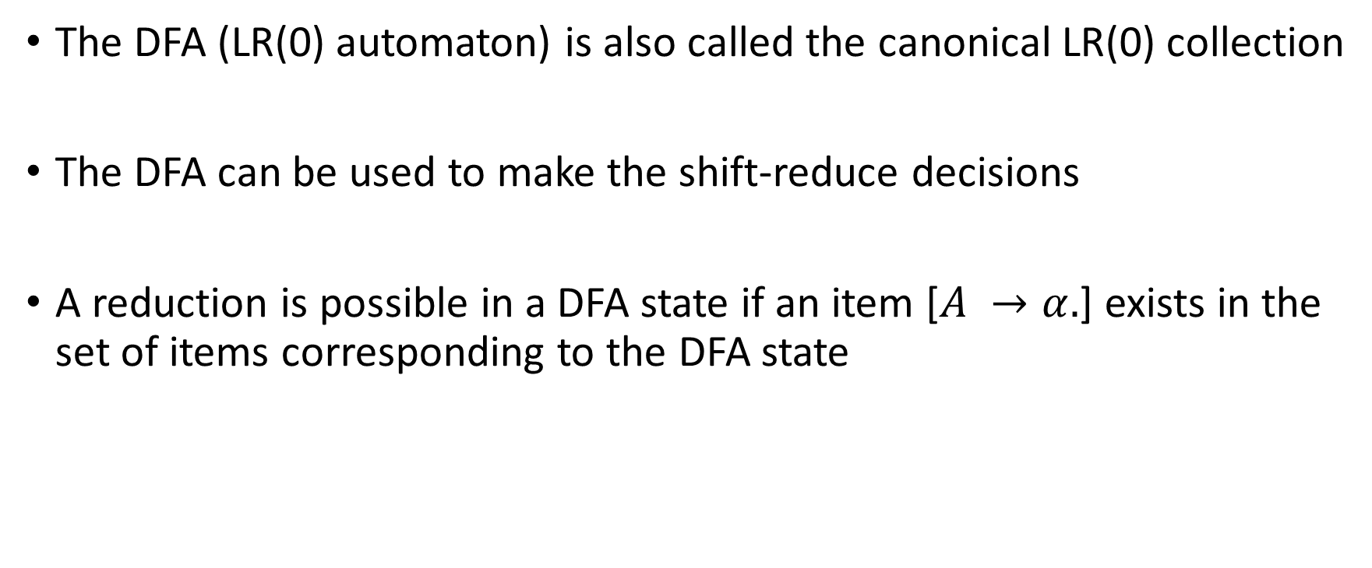
DFA
The DFA (LR(0) automaton) is also called the canonical LR(0) collection
The DFA can be used to make the shift-reduce decisions
A reduction is possible in a DFA state if an item [$A →α.$] exists in the set of items corresponding to the DFA state

Slide 8
Conflicts in LR(0) automaton
A LR(0) automaton can have two kinds of conflicts
shift-reduce conflict
when both shift and reduce moves are possible in a DFA state
reduce-reduce conflict
when multiple items are eligible for reductions in a DFA state

Slide 9
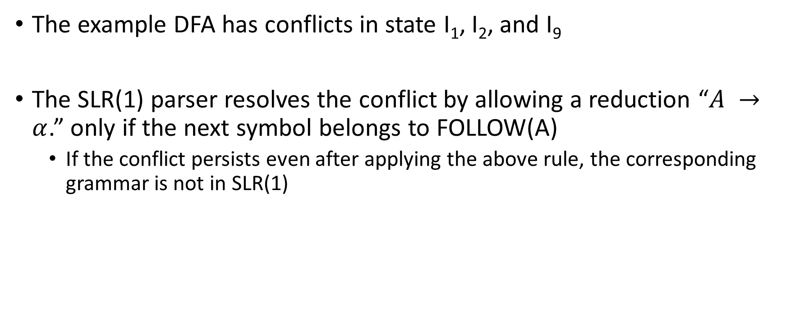
Conflicts in the example DFA
The example DFA has conflicts in state I₁, I₂, and I₉
The SLR(1) parser resolves the conflict by allowing a reduction “$A →α$.” only if the next symbol belongs to FOLLOW(A)
If the conflict persists even after applying the above rule, the corresponding grammar is not in SLR(1)

Slide 10
DFA
+
I₆
E → E + .T
T → .T * F
T → .F
F → .(E)
F → .id
I₁
E’ → E.
E → E. + T
I₉
E → E + T.
T → T .* F
E
F
T
I₀
E’ → .E
E → .E + T
E → .T
T → .T * F
T → .F
F → .(E)
F → .id
(
I₂
E → T.
T → T. * F
T
*
*
F
I₃
T → F.
I₇
T → T *. F
F → .(E)
F → .id
I₁₀
T → T * F.
(
F
I₄
F → (.E)
E → .E + T
E → .T
T → .T * F
T → .F
F → .(E)
F → .id
T
+
E
I₈
E → E. + T
F → (E.)
I₁₁
F → ( E ).
(
)
(
id
id
id
I₅
F → id.

Slide 11
LR(0) automaton (Exercise)
E’ → E
E → E + T | T
T → T * F | F
F → (E) | id
FOLLOW(E’) =
FOLLOW(E) =

Slide 12
LR(0) automaton
E’ → E
E → E + T | T
T → T * F | F
F → (E) | id
FOLLOW(E’) = {$}
FOLLOW(E) = {+, ), $}

Slide 13

LR(0) automaton
E’ → E
E → E + T | T
T → T * F | F
F → (E) | id
FOLLOW(E’) = {$}
FOLLOW(E) = {+, ), $}
No conflict in $I_{1}$
shift if the next symbol is +
reduce if the next symbol is $
No conflict in $I_{2}$
shift if the next symbol is *
reduce if the next symbol is {+, ), $}
No conflict in $I_{9}$
shift if the next symbol is *
reduce if the next symbol is {+, ), $}

Slide 14
SLR(1) parsing
If the DFA accepts a string, then it is a prefix of some sentential form
During shift-reduce parsing, we can verify after every step that the string on the stack is accepted by the DFA -- confirming we're on the right path
Since reductions occur at the top of the stack, the stack always contains a prefix of a sentential form during the reverse rightmost-derivation

Slide 15
SLR(1) parser
The shift-reduce parser start form the state 0 and try to accept the input string as much as possible, by pushing the matched symbols on a stack
If there is no move corresponding to the next input symbol, then we reduce

Slide 16
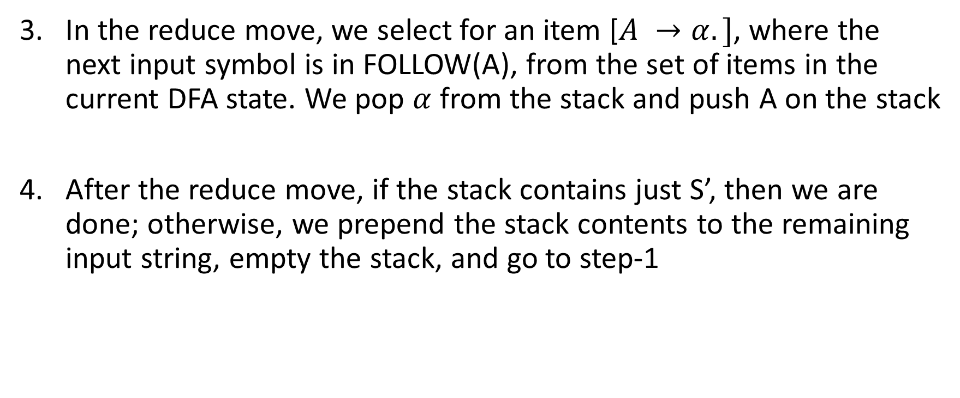
SLR(1) parser
In the reduce move, we select for an item [$A →α.]$, where the next input symbol is in FOLLOW(A), from the set of items in the current DFA state. We pop $α$ from the stack and push A on the stack
After the reduce move, if the stack contains just S’, then we are done; otherwise, we prepend the stack contents to the remaining input string, empty the stack, and go to step-1

Slide 17
DFA
+
I₆
E → E + .T
T → .T * F
T → .F
F → .(E)
F → .id
I₁
E’ → E.
E → E. + T
I₉
E → E + T.
T → T .* F
E
F
T
I₀
E’ → .E
E → .E + T
E → .T
T → .T * F
T → .F
F → .(E)
F → .id
(
I₂
E → T.
T → T. * F
T
*
*
F
I₃
T → F.
I₇
T → T *. F
F → .(E)
F → .id
I₁₀
T → T * F.
(
F
I₄
F → (.E)
E → .E + T
E → .T
T → .T * F
T → .F
F → .(E)
F → .id
T
+
E
I₈
E → E. + T
F → (E.)
I₁₁
F → ( E ).
(
)
(
id
id
id
I₅
F → id.

Slide 18
SLR(1) parsing
STATE | STACK | INPUT | ACTION
0 | $ | id * id$ | shift to 5
5 | $id | * id$ | reduce by F → id
 | $F | * id$
0 | $ | F * id$ | shift to 3
3 | $F | * id$ | reduce by T→F
 | $T | * id$
0 | $ | T * id$ | shift to 2
2 | $T | * id$ | shift to 7
7 | $T * | id$ | shift to 5
5 | $T * id | $ | reduce by F → id
 | $T * F | $
STATE | STACK | INPUT | ACTION
0 | $ | T * F$ | shift to 2
2 | $T | * F$ | shift to 7
7 | $T * | F$ | shift to 10
10 | $T * F | $ | reduce by T → T * F
 | $T | $
0 | $ | T$ | shift to 2
2 | $T | $ | reduce by E → T
 | $E | $
0 | $ | E$ | shift to 1
1 | $E | $ | reduce by E’→E
 | $E’ | $ | ACCEPT
Notes:
$ is added to identify the end of the stack and the end of the input. The initial state is the starting state of the DFA. After every reduction, we prepend the contents of the stack to the rest of the input string and rerun the automaton starting from the initial state. The input is accepted if the start symbol is pushed on the stack. Notice that the start symbol is pushed if and only if $ is on the input stack. The input is rejected if there is no shift/reduce move at a given stage during the acceptance of the string.

Slide 19
SLR(1) parsing
As might have noticed that a lot of work is repeated after a reduce move
The automaton takes the exact same path except for the last few states
We can get rid of all this extra work by keeping a stack of states along with the stack of grammar symbols

Slide 20
SLR(1) parsing
STATE | STACK | INPUT | ACTION
0 | $ | id * id$ | shift to 5
0 5 | $id | * id$ | reduce by F → id
0 3 | $F | * id$ | reduce by T→F
0 2 | $T | * id$ | shift to 7
0 2 7 | $T * | id$ | shift to 5
0 2 7 5 | $T * id | $ | reduce by F → id
0 2 7 10 | $T * F | $ | reduce by T → T* F
0 2 | $T | $ | reduce by E→T
0 1 | $E | $ | reduce by E’ → E
0 | $E’ | $
Notes:
During a reduce move, let’s say k symbols are popped from the stack of symbols, and a non-terminal N is pushed. In this case, we pop k states from the stack of states. Let S be the state on the top of the stack after popping k states. In this case, we push the DFA state obtained after accepting N in state S on the stack of states.

Slide 21
GOTO table
GOTO function, defined on sets of items, is extended to states:
if GOTO[I_{i}, A] = I_{j} , then GOTO maps a state i and a nonterminal A to state j.

Slide 22
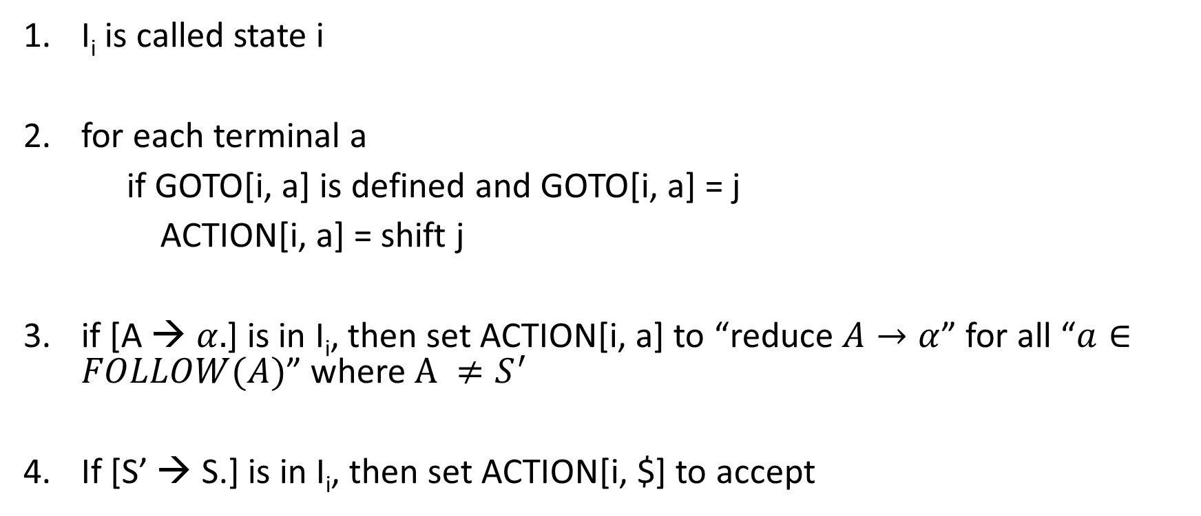
ACTION table
I_{i} is called state i
for each terminal a
if GOTO[i, a] is defined and GOTO[i, a] = j
ACTION[i, a] = shift j
if [A → $α.$] is in I_{i}, then set ACTION[i, a] to “reduce $A→α$” for all “$a∈FOLLOW(A)$” where $A ≠S^{′}$
If [S’ → S.] is in I_{i}, then set ACTION[i, $] to accept

Slide 23
DFA
+
I₆
E → E + .T
T → .T * F
T → .F
F → .(E)
F → .id
I₁
E’ → E.
E → E. + T
I₉
E → E + T.
T → T .* F
E
F
T
I₀
E’ → .E
E → .E + T
E → .T
T → .T * F
T → .F
F → .(E)
F → .id
(
I₂
E → T.
T → T. * F
T
*
*
F
I₃
T → F.
I₇
T → T *. F
F → .(E)
F → .id
I₁₀
T → T * F.
(
F
I₄
F → (.E)
E → .E + T
E → .T
T → .T * F
T → .F
F → .(E)
F → .id
T
+
E
I₈
E → E. + T
F → (E.)
I₁₁
F → ( E ).
(
)
(
id
id
id
I₅
F → id.

Slide 24
ACTION
ACTION[2, *]
ACTION[2, )]
ACTION[2, id]

Slide 25
ACTION
ACTION[2, *] = 7
ACTION[2, )] = “reduce E → T”
ACTION[2, id] = error

Slide 26
Parsing table
(1) E → E + T
(2) E → T
(3) T → T * F
(4) T → F
(5) F → (E)
(6) F → id

Slide 27
Parsing table codes
si means shift and stack state i
rj by reduce by the production numbered j
accept means accept
blank means error

Slide 28
Parsing table
STATE | ACTION | GOTO
0
1
2
3
4
5
6
7
8
9
10
11
id | + | * | ( | ) | $
s5 |  |  | s4
 | s6 |  |  |  | accept
 | r2 | s7 |  | r2 | r2
 | r4 | r4 |  | r4 | r4
s5 |  |  | s4
 | r6 | r6 |  | r6 | r6
s5 |  |  | s4
s5 |  |  | s4
 | s6 |  |  | s11
 | r1 | r7 |  | r1 | r1
 | r3 | r3 |  | r3 | r3
 | r5 | r5 |  | r5 | r5
E | T | F
1 | 2 | 3
8 | 2 | 3
 | 9 | 3
 |  | 10

Slide 29
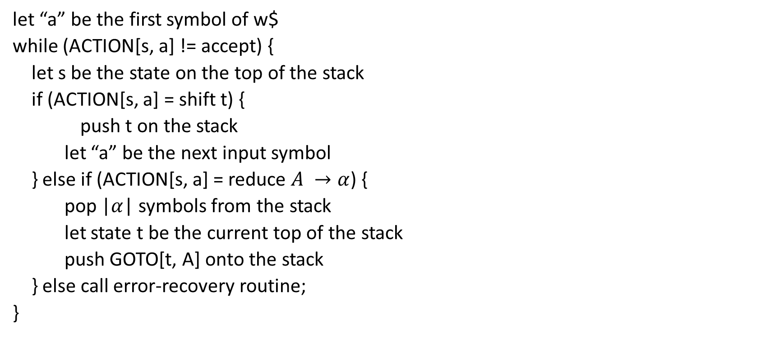
SLR parsing algorithm
let “a” be the first symbol of w$
while (ACTION[s, a] != accept) {
let s be the state on the top of the stack
if (ACTION[s, a] = shift t) {
push t on the stack
let “a” be the next input symbol
} else if (ACTION[s, a] = reduce $A →α$) {
pop |$α$| symbols from the stack
let state t be the current top of the stack
push GOTO[t, A] onto the stack
} else call error-recovery routine;
}

Slide 30
SLR(1) parsing
STATE | STACK | INPUT | ACTION
0 | $ | id * id$ | shift to 5
0 5 | $id | * id$ | reduce by F → id
0 3 | $F | * id$ | reduce by T→F
0 2 | $T | * id$ | shift to 7
0 2 7 | $T * | id$ | shift to 5
0 2 7 5 | $T * id | $ | reduce by F → id
0 2 7 10 | $T * F | $ | reduce by T → T* F
0 2 | $T | $ | reduce by E→T
0 1 | $E | $ | reduce by E’ → E
0 | $E’ | $

Slide 31

Left-recursive grammar (Exercise)
$$S →SA | A$$
$$A →a$$
Write all LR(0) items.

Slide 32

Left-recursive grammar
$$S →SA | A$$
$$A →a$$
Write all LR(0) items.
Build DFA.
Parse aaa

Slide 33

Left-recursive grammar
I₀
S’ → .S
S → .SA
S → .A
A → .a
I₁
S’ → S.
S → S.A
A → .a
A
I₄
S → SA.
S
A
I₂
S → A.
No shift reduce conflict in $I_{1},$ because FOLLOW(S’) = {$}
a
I₃
A → a.
a

Slide 34
SLR(1) parsing
STATE | STACK | INPUT | ACTION
0 | $ | a a a $ | shift to 3
0 3 | $ a | a a $ | reduce by A → a.
0 2 | $ A | a a $ | reduce by S → A.
0 1 | $ S | a a $ | shift to 3
0 1 3 | $ S a | a $ | reduce by S → A.
0 1 4 | $ S A | a $ | reduce by S → SA.
0 1 | $ S | a $ | shift to 3
0 1 3 | $ S a | $ | reduce by S → A.
0 1 4 | $ S A | $ | reduce by S → SA.
0 1 | $ S | $ | reduce by S’ → S.
 | $S’ | $ | Accept

Slide 35

Ambiguous grammars
Compute the set of LR(0) items for the following grammar
E $→$ E + E | E * E | (E) | id

Slide 36










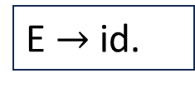
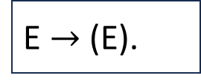








Ambiguous grammar
$$I_{0}$$
$$I_{1}$$
E’ $→$ .E
E $→$ .E + E
E $→$ .E * E
E $→$ .(E)
E $→$ .id
E’ $→$ E.
E $→$ E. + E
E $→$ E. * E
E $→$ (.E)
E $→$ .E + E
E $→$ .E * E
E $→$ .(E)
E $→$ .id
$$I_{4}$$
$$I_{2}$$
$$I_{3}$$
E $→$ E + .E
E $→$ .E + E
E $→$ .E * E
E $→$ .(E)
E $→$ .id
E $→$ id.
$$I_{6}$$
$$I_{7}$$
$$I_{9}$$
$$I_{5}$$
E $→$ (E.)
E $→$ E. + E
E $→$ E. * E
E $→$ (E).
E $→$ E * .E
E $→$ .E + E
E $→$ .E * E
E $→$ .(E)
E $→$ .id
E $→$ E + E.
E $→$ E. + E
E $→$ E. * E
$$I_{8}$$
E $→$ E * E.
E $→$ E. + E
E $→$ E. * E

Slide 37
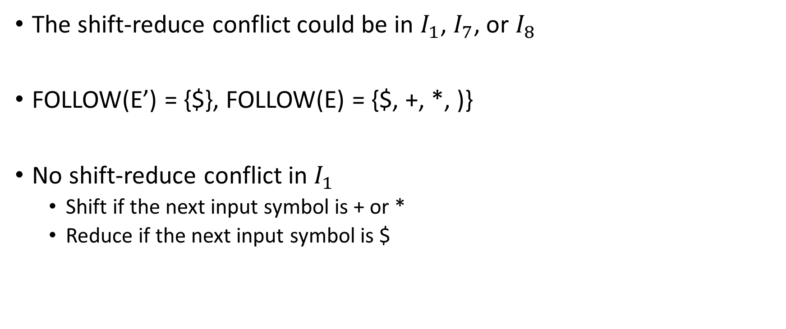
Ambiguous grammar
The shift-reduce conflict could be in $I_{1}$, $I_{7}$, or $I_{8}$
FOLLOW(E’) = {$}, FOLLOW(E) = {$, +, *, )}
No shift-reduce conflict in $I_{1}$
Shift if the next input symbol is + or *
Reduce if the next input symbol is $

Slide 38
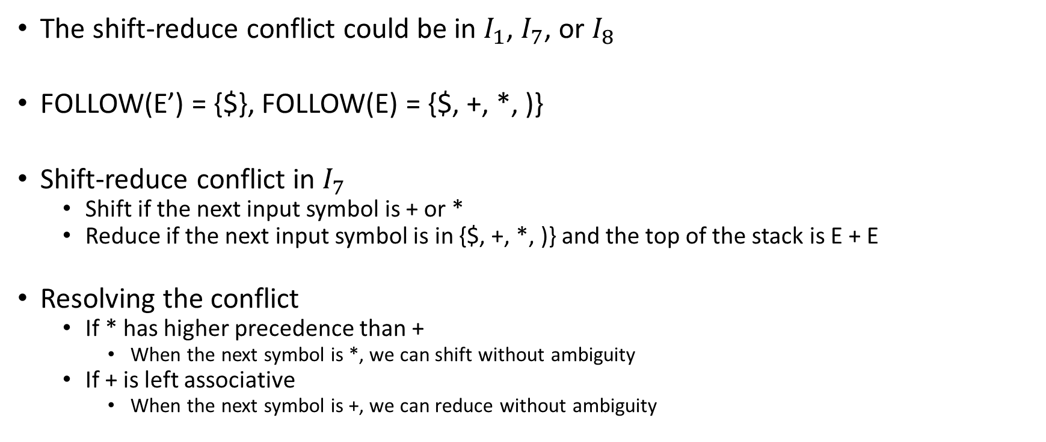
Ambiguous grammar
The shift-reduce conflict could be in $I_{1}$, $I_{7}$, or $I_{8}$
FOLLOW(E’) = {$}, FOLLOW(E) = {$, +, *, )}
Shift-reduce conflict in $I_{7}$
Shift if the next input symbol is + or *
Reduce if the next input symbol is in {$, +, *, )} and the top of the stack is E + E
Resolving the conflict
If * has higher precedence than +
When the next symbol is *, we can shift without ambiguity
If + is left associative
When the next symbol is +, we can reduce without ambiguity

Slide 39
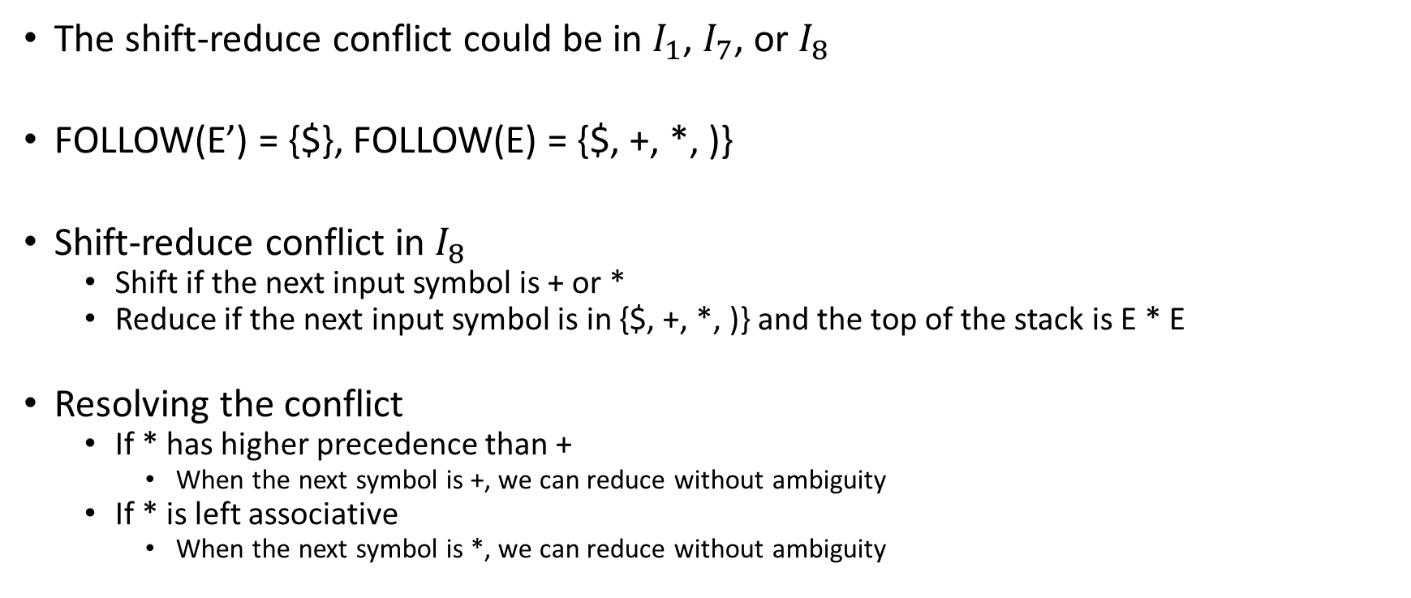
Ambiguous grammar
The shift-reduce conflict could be in $I_{1}$, $I_{7}$, or $I_{8}$
FOLLOW(E’) = {$}, FOLLOW(E) = {$, +, *, )}
Shift-reduce conflict in $I_{8}$
Shift if the next input symbol is + or *
Reduce if the next input symbol is in {$, +, *, )} and the top of the stack is E * E
Resolving the conflict
If * has higher precedence than +
When the next symbol is +, we can reduce without ambiguity
If * is left associative
When the next symbol is *, we can reduce without ambiguity

Slide 40
Parser generators
For ambiguous grammars, modern parser generators allow users to specify the precedence and associativity of grammar constructs to resolve conflicts

Slide 41
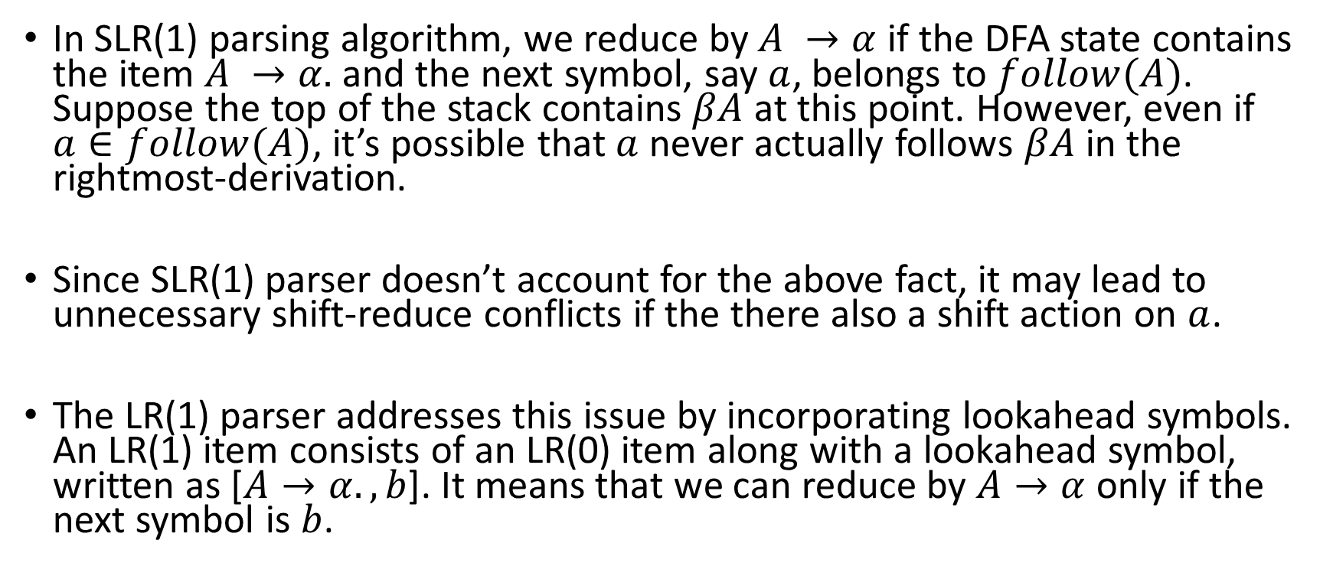
LR(1) items
In SLR(1) parsing algorithm, we reduce by $A →α$ if the DFA state contains the item $A →α.$ and the next symbol, say $a$, belongs to $follow(A)$. Suppose the top of the stack contains $βA$ at this point. However, even if $a∈follow(A)$, it’s possible that $a$ never actually follows $βA$ in the rightmost-derivation.
Since SLR(1) parser doesn’t account for the above fact, it may lead to unnecessary shift-reduce conflicts if the there also a shift action on $a$.
The LR(1) parser addresses this issue by incorporating lookahead symbols. An LR(1) item consists of an LR(0) item along with a lookahead symbol, written as [$A→α., b$]. It means that we can reduce by $A→α$ only if the next symbol is $b$.

Slide 42
A hierarchy of grammar classes
LR(k)
LL(k)
LL(1)
LR(1)
LALR(1)
SLR
Ambiguous
Grammars
LL(0)
LR(0)
Unambiguous
Grammars

