Slide 2
Books
The calculus of computation (COC Book)
Aaron R. Bradley and Zohar Manna
Decision Procedures (An Algorithmic Point of View) (DP Book)
Daniel Kroening and Ofer Strichman
Program Proofs (Optional)
K. Rustan M. Leino

Slide 3
References
Lecture slides
Prof. Zohar Manna course slides (one of the authors of COC)
https://web.stanford.edu/class/cs156/
Decision Procedures book slides
https://www.decision-procedures.org/slides/
The slides also contain materials from the program proofs book

Slide 4
Grading components
Midsem: 25
Endsem: 30
Programming assignments: 30 (Group)
Project: 10 (Individual)
Attendance: 5

Slide 5
Tentative lecture plan
Propositional logic
First order logic
Equality and uninterpreted functions
Linear arithmetic
Bit vectors
Array logic
Pointer logic
Program correctness

Slide 6
Propositional logic

Slide 7
Proposition
A proposition is a sentence that can be either true or false
e.g., The sky is blue. Hari is taller than Gopal. Two is less than three.
In propositional logic, a sentence is represented using a propositional variable

Slide 8
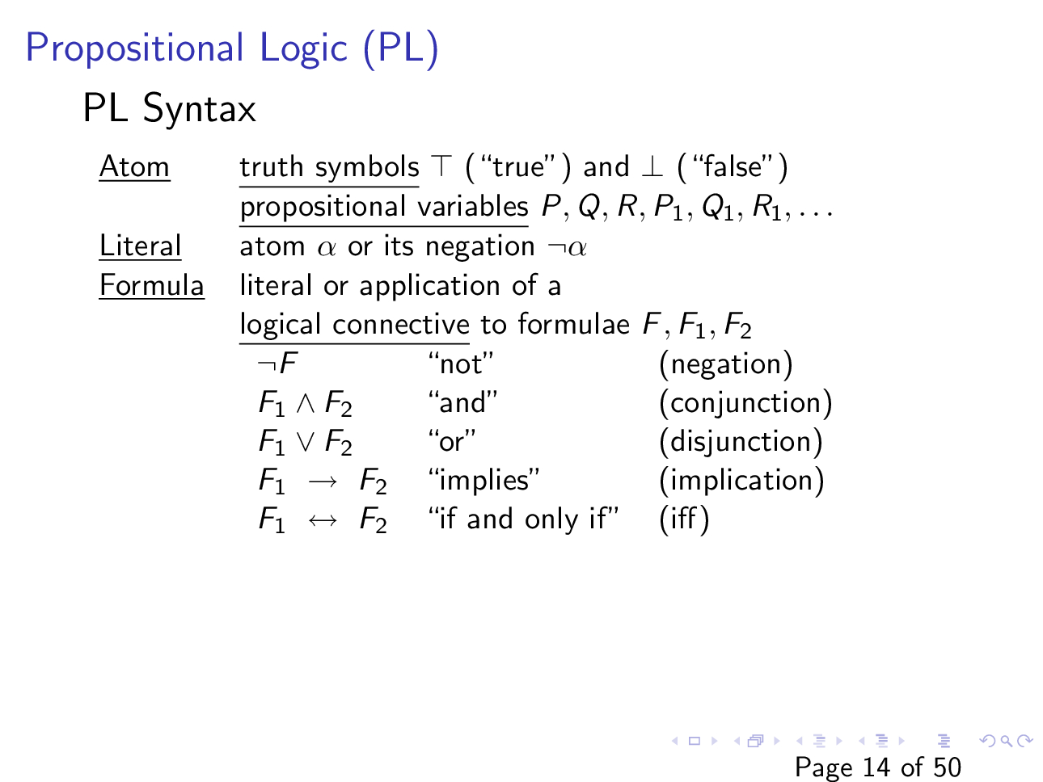
Slide courtesy of https://web.stanford.edu/class/cs156/

Slide 9

Literal
Which of the following is a literal, where P, Q, R are propositional variables
P
Q
R
$P∨Q$
$¬P$
$¬¬P$
$P∧Q$

Slide 10

Formula
Is $\left(P∨Q\right)→(\left(R∧\left(¬S\right)\right)↔Z)$ a formula?
Is $\left(P∧Q\right)→P¬Q∨R$ a formula?

Slide 11

Formula
What are some of the possible interpretations of the following formula?
$$P∧Q →P∨¬Q$$

Slide 12

Formula
What are some of the possible interpretations of the following formula?
$$P∧Q →P∨¬Q$$
$$P∧\left(Q →\left(P∨¬Q\right)\right)$$
$$\left(P∧Q →P\right)∨¬Q$$
$$(P∧Q) →(P∨¬Q)$$

Slide 13
Formula
We can eliminate ambiguities using parentheses
However, parentheses are cumbersome
What is the alternative?

Slide 14
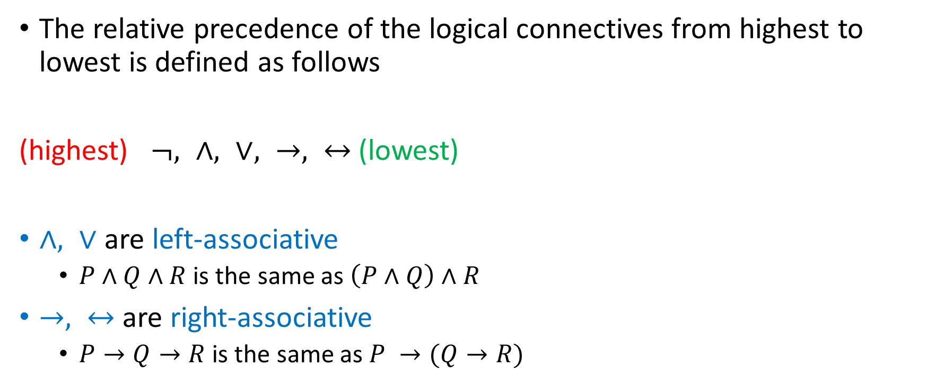
Precedence and associativity
The relative precedence of the logical connectives from highest to lowest is defined as follows
(highest) $¬, ∧, ∨, →, ↔$(lowest)
$∧, ∨$ are left-associative
$P∧Q∧R$ is the same as $\left(P∧Q\right)∧R$
$→, ↔$ are right-associative
$P→Q→R$ is the same as $P →(Q→R)$

Slide 15

Formula
What are some of the possible interpretations of the following formula using the precedence and associativity rules?
$$P∧Q →P∨¬Q →R$$

Slide 16

Subformula
For a propositional variable $P$ and formulae $F, F_{1}, F_{2}$
The only subformula of P is P
The subformulae of $¬F$ are $¬F$ and subformulae of F
The subformulae of $F_{1}∧F_{2}$, $F_{1}∨F_{2}$, $F_{1}→F_{2}$, $F_{1}↔F_{2}$ are the formula itself and subformulae of $F_{1}$ and $F_{2}$

Slide 17

Subformula
What are the subformulae of $F:\left(P∧Q\right) →(T∨¬Q)$

Slide 18
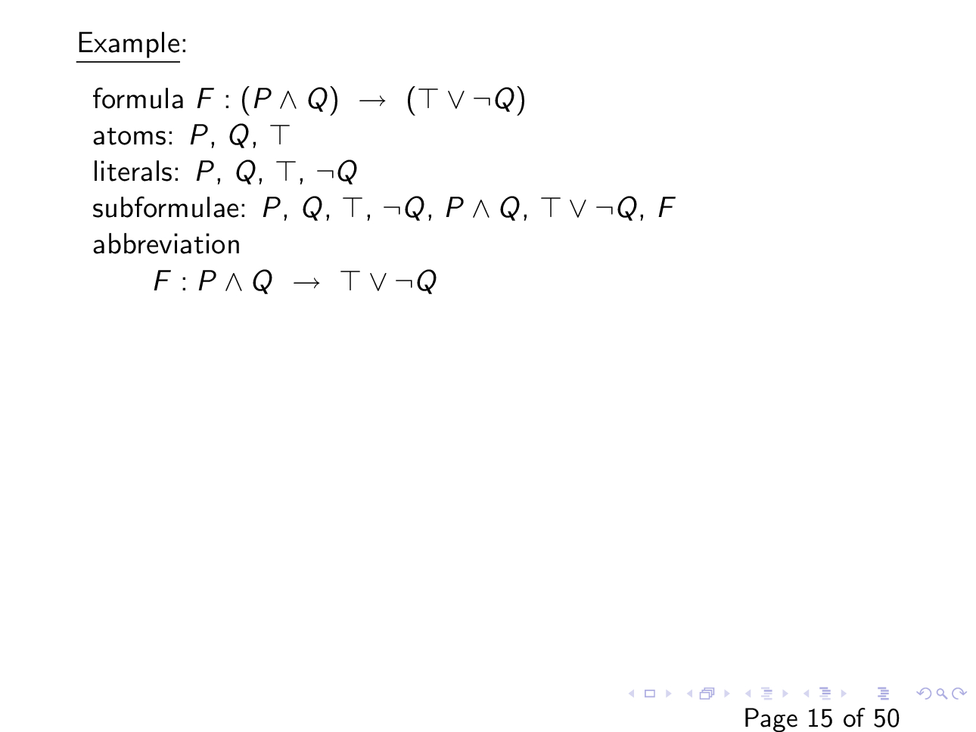
Slide courtesy of https://web.stanford.edu/class/cs156/

Slide 19
Interpretation
An interpretation, I, assigns a truth value to every propositional variable, e.g.,
I : { P = 1, Q = 0 }
assigns true to P and false to Q
The semantics of logical connectives can be expressed using a truth table that contains the values of formulae with connectives for all possible inputs to the connectives

Slide 20
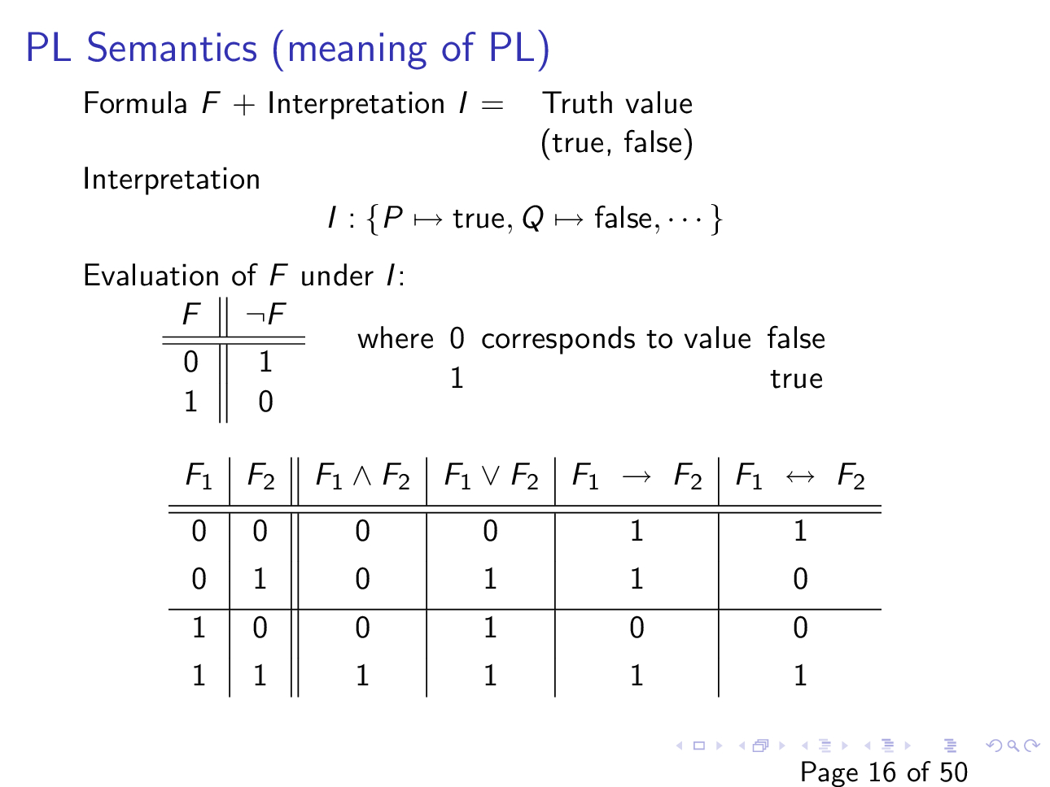
Slide courtesy of https://web.stanford.edu/class/cs156/

Slide 21

Semantics of logical connectives
$F_{1}∧F_{2}$ is true when both F₁ and F₂ are true

Slide 22

Semantics of logical connectives
$F_{1}∨F_{2}$ is false when both F₁ and F₂ are false; otherwise, it is true

Slide 23

Semantics of logical connectives
$F_{1}→F_{2}$ is true when either F₁ is false or F₂ is true

Slide 24

Semantics of logical connectives
$F_{1}↔F_{2}$ is true when either both $F_{1}$ and $F_{2}$ are true or both $F_{1}$ and $F_{2}$ are false

Slide 25
Example: placement of wedding guests
Three chairs in a row: 1,2,3
We need to place Aunt, Sister and Father
Constraints:
Aunt doesn’t want to sit near Father
Aunt doesn’t want to sit in the left chair
Sister doesn’t want to sit to the right of Father
Q: Can we satisfy these constraints?
Slide courtesy of https://www.decision-procedures.org/slides/

Slide 26
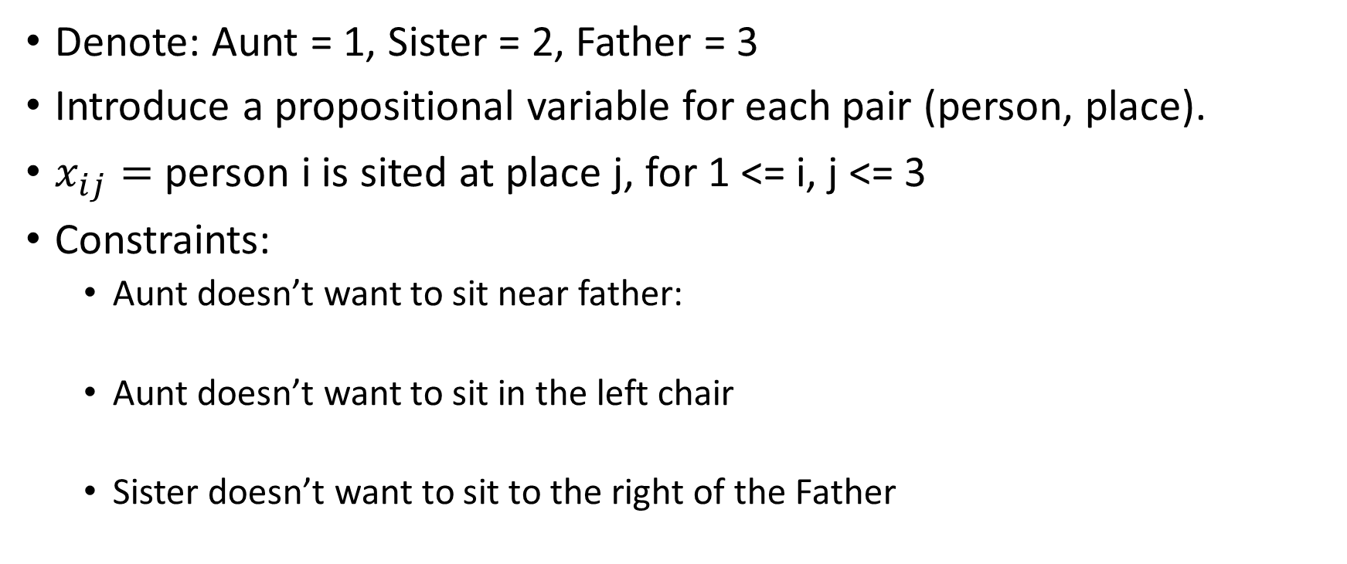
Example
Denote: Aunt = 1, Sister = 2, Father = 3
Introduce a propositional variable for each pair (person, place).
$x_{ij}=$ person i is sited at place j, for 1 <= i, j <= 3
Constraints:
Aunt doesn’t want to sit near father:
Aunt doesn’t want to sit in the left chair
Sister doesn’t want to sit to the right of the Father

Slide 27
Example
More constraints
Each person is placed
No person is placed in more than one place

Slide 28
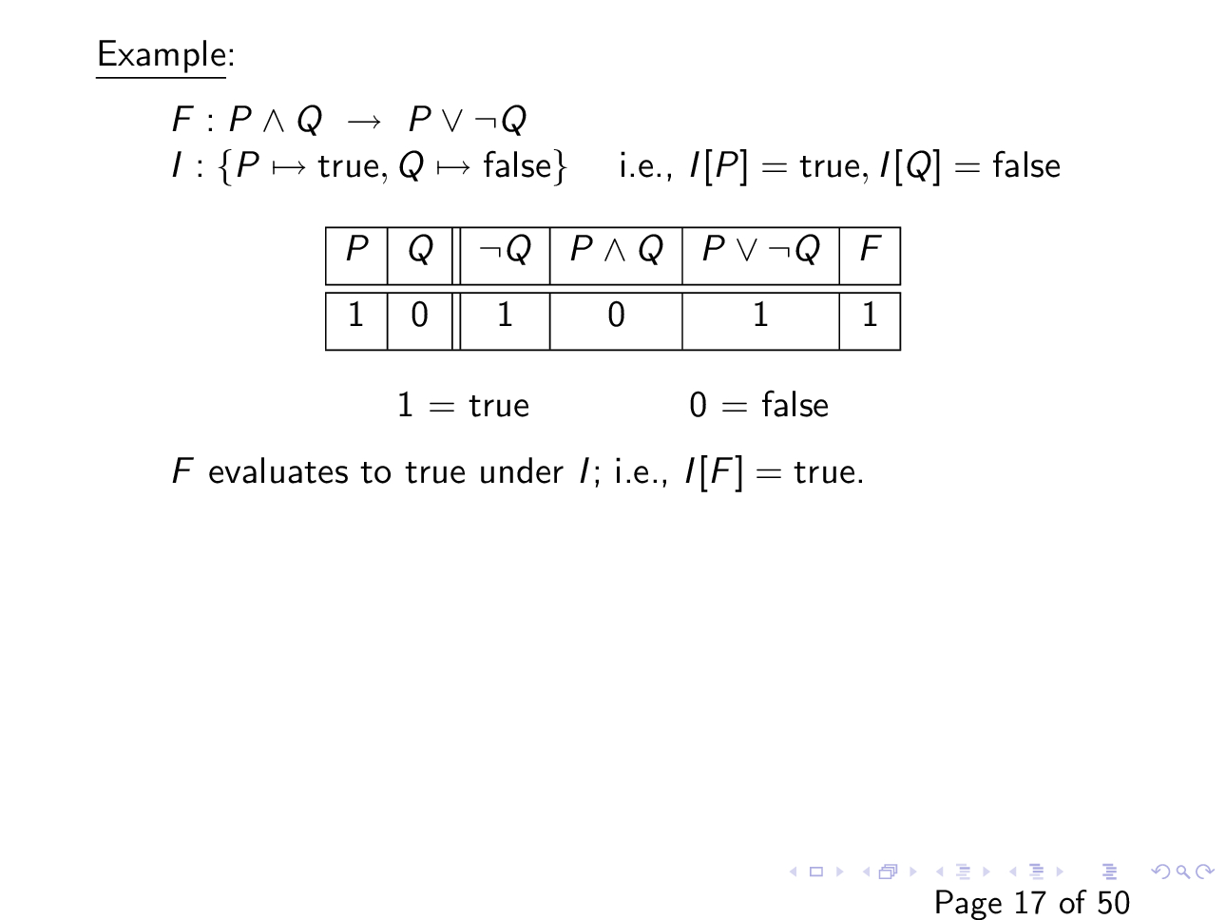
Slide courtesy of https://web.stanford.edu/class/cs156/

