Slide 2
References
Chapter-4 from the DP book
Chapter-5 from the DP book
Integrating Simplex with DPLL(T), Bruno Dutertre and Leonardo de Moura

Slide 3
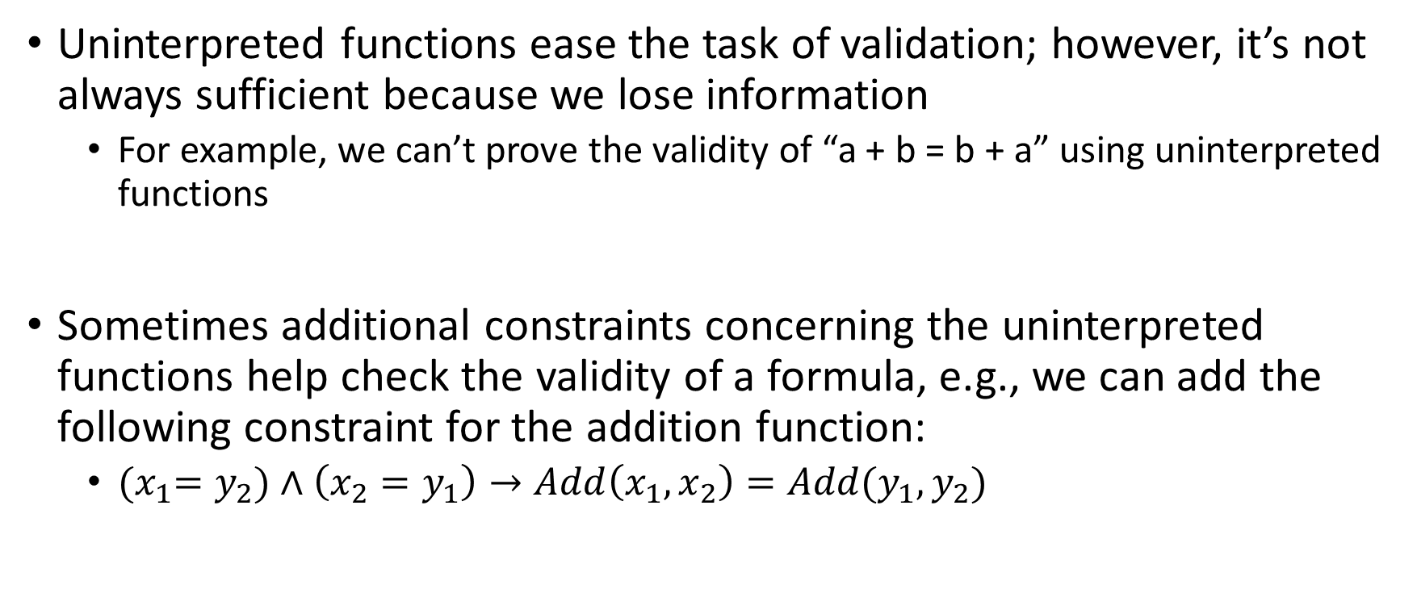
Abstraction refinement
Uninterpreted functions ease the task of validation; however, it’s not always sufficient because we lose information
For example, we can’t prove the validity of “a + b = b + a” using uninterpreted functions
Sometimes additional constraints concerning the uninterpreted functions help check the validity of a formula, e.g., we can add the following constraint for the addition function:
${(x}_{1}=y_{2})∧\left(x_{2}=y_{1}\right)→Add\left(x_{1},x_{2}\right)=Add(y_{1},y_{2})$

Slide 4

Abstraction refinement
If ${(x}_{1}=y_{2})∧\left(x_{2}=y_{1}\right)→Add\left(x_{1},x_{2}\right)=Add(y_{1},y_{2})$ is not sufficient to prove the validity, we can add additional constraints, e.g.,
$Add\left(x_{1},1\right)=Add\left(x_{2}, 1\right) →x_{1}=x_{2}$
In the worst case, we can add all the axioms of Add

Slide 5
Abstraction refinement
Additional constraints make the uninterpreted function partially interpreted
The reason we use uninterpreted functions is that they make the formula simpler, thus making it computationally feasible to find a solution
The goal of the abstract refinement is to find the right level of abstraction that is sufficient to validate the formula

Slide 6
Abstraction refinement
The right level of abstraction can be discovered using a trial-and-error process
This process is also called the abstraction-refinement loop

Slide 7
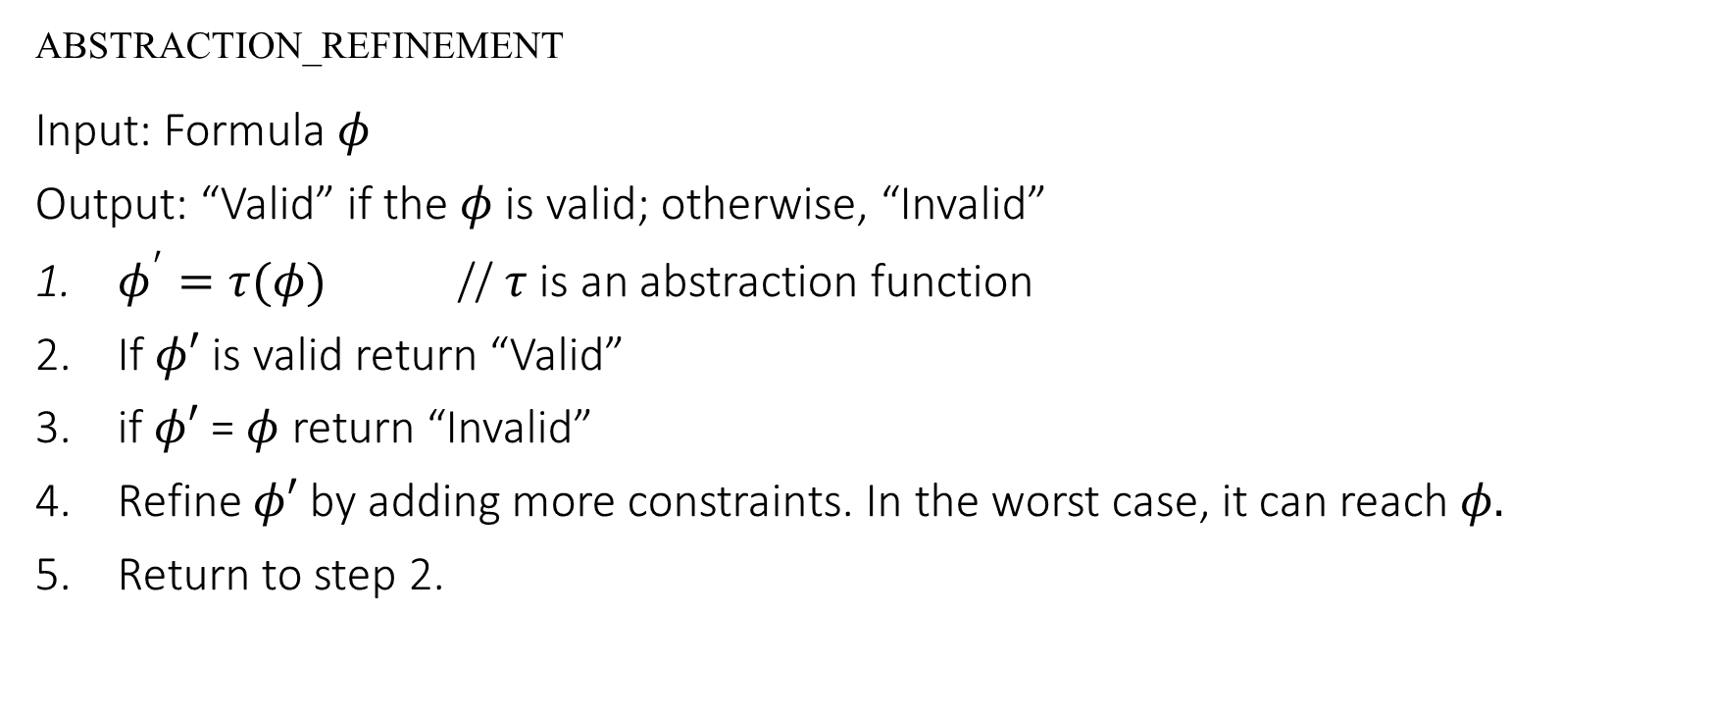
Abstraction refinement
ABSTRACTION_REFINEMENT
Input: Formula $φ$
Output: “Valid” if the $φ$ is valid; otherwise, “Invalid”
$φ^{′}=τ(φ)$ // $τ$ is an abstraction function
If $φ′$ is valid return “Valid”
if $φ′$ = $φ$ return “Invalid”
Refine $φ′$ by adding more constraints. In the worst case, it can reach $φ.$
Return to step 2.

Slide 8
Abstraction refinement
We’ll see examples of abstraction refinement later

Slide 9
Linear arithmetic

Slide 10
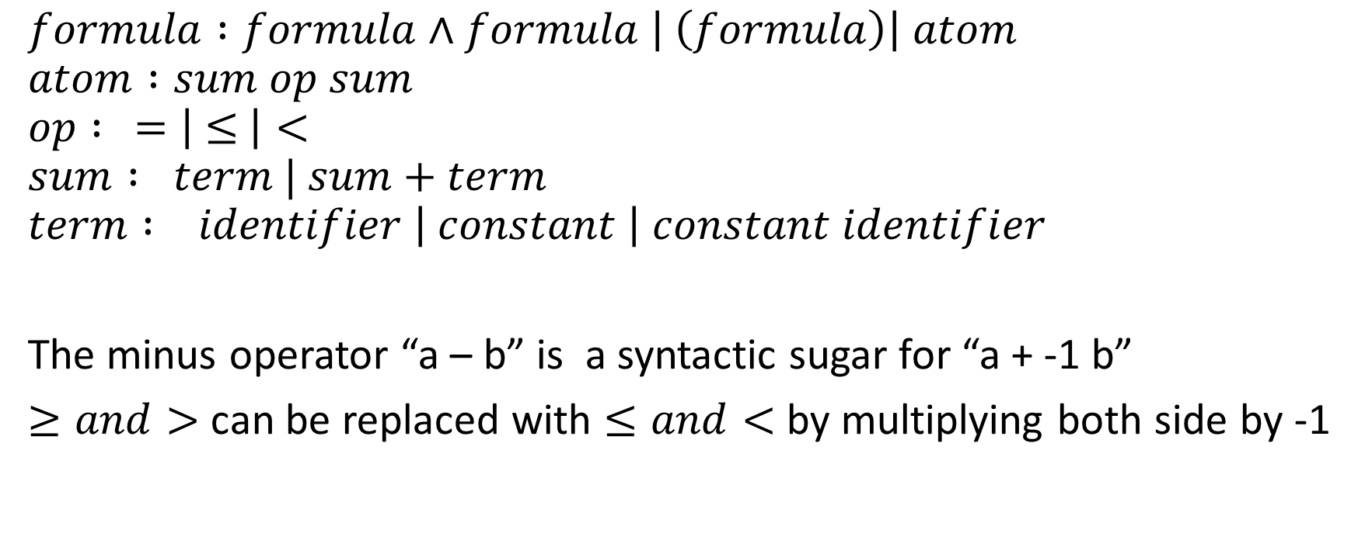
Syntax
$$formula :formula∧formula \left| \left(formula\right)\right| atom$$
$$atom :sum op sum$$
$$op : =\left| ≤ \right|<$$
$$sum : term | sum+term$$
$$term : identifier \left| constant \right| constant identifier$$
The minus operator “a – b” is a syntactic sugar for “a + -1 b”
$≥and>$ can be replaced with $≤and<$ by multiplying both side by -1

Slide 11

Linear arithmetic
The following formula is in linear arithmetic
$$3x_{1}+2x_{2}≤5x_{3} ∧ 2x_{1}−2x_{2}=0$$

Slide 12
Example
for (i = 1; i <= n; i++)
a[j+i] = a[j];
Under which condition, a[j] can be loaded outside the loop.

Slide 13

Example
for (i = 1; i <= n; i++)
a[j+i] = a[j];
Under which condition, a[j] can be loaded outside the loop.
If $(i≥1)∧(i≤n)∧(j+i=j)$ is not satisfiable.

Slide 14
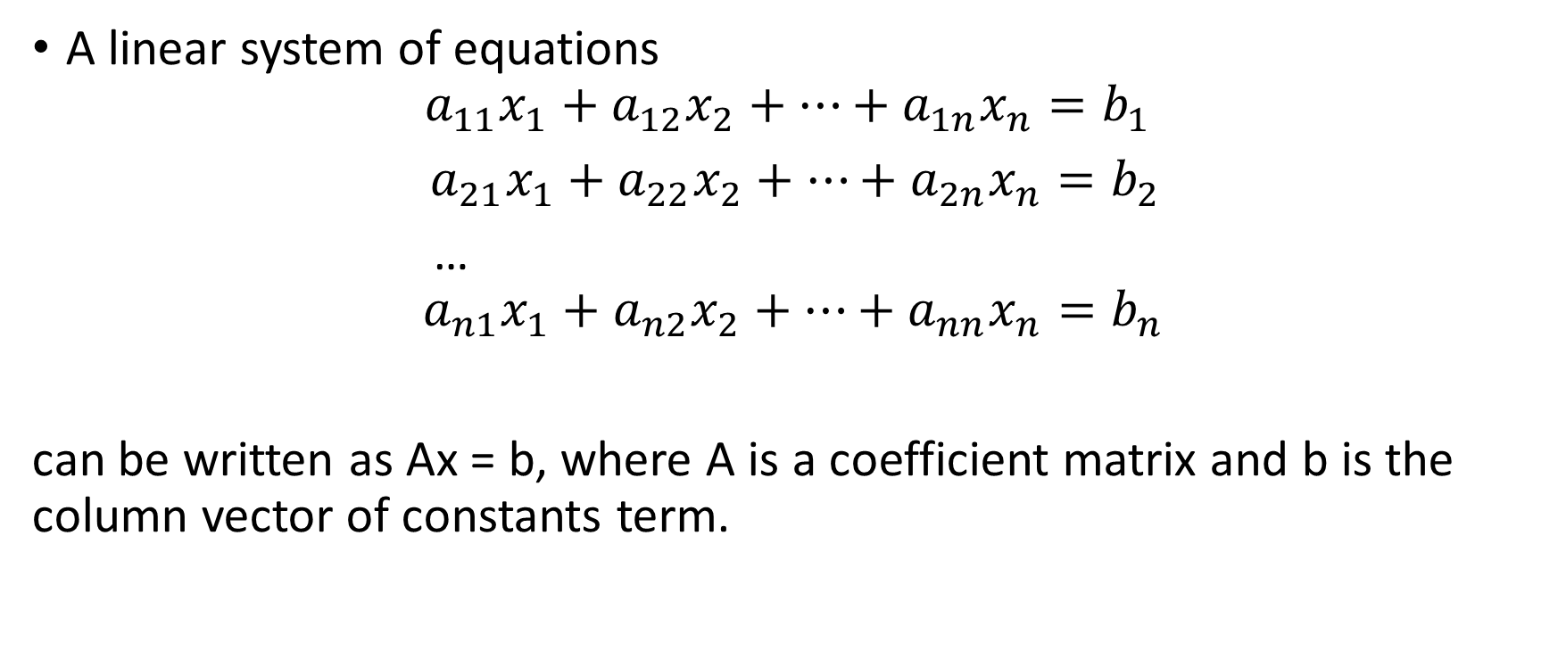
Gaussian’s elimination
A linear system of equations
$$a_{11}x_{1}+a_{12}x_{2}+…+a_{1n}x_{n}=b_{1}$$
$a_{21}x_{1}+a_{22}x_{2}+…+a_{2n}x_{n}=b_{2}$
…
$${ a}_{n1}x_{1}+a_{n2}x_{2}+…+a_{nn}x_{n}=b_{n}$$
can be written as Ax = b, where A is a coefficient matrix and b is the column vector of constants term.

Slide 15
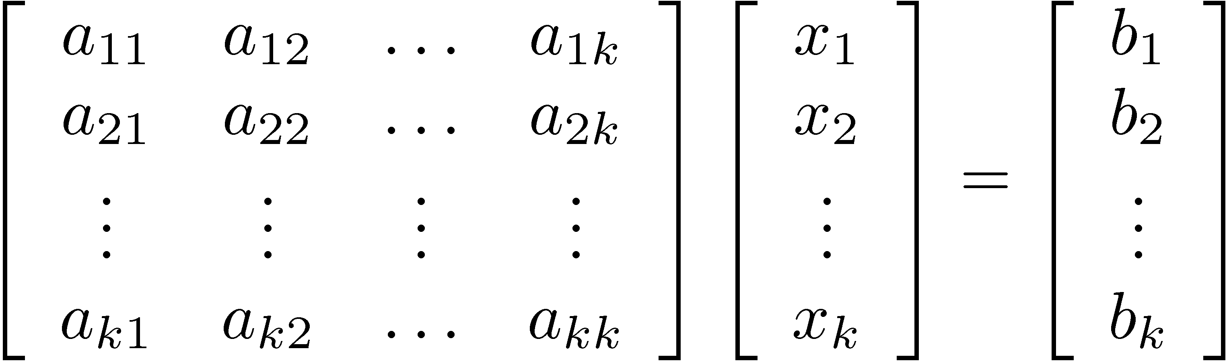
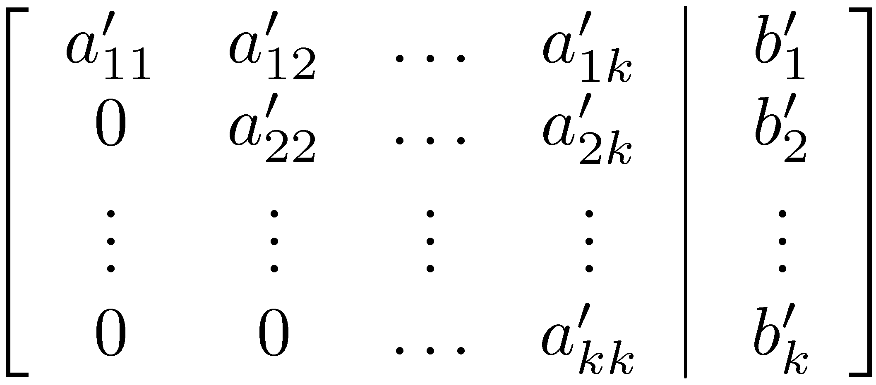
Gaussian’s elimination
Given a linear system Ax = b
Manipulate A|b to an upper-triangular form
A x = b
Daniel Kroening and Ofer Strichman

Slide 16
Gaussian’s elimination
Elementary row operations are used to transform the matrix
There are three types of elementary row operations
Swap two rows
Multiply a row with a non-zero value
Add a multiple of one row to another row

Slide 17
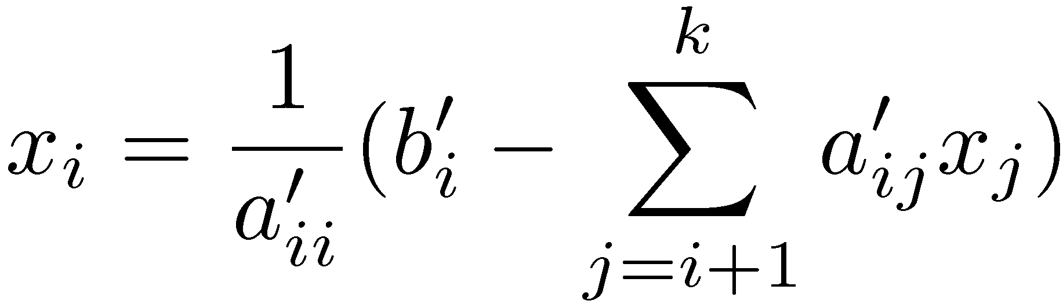
Gaussian’s elimination
After converting to upper-triangular form, solve backwards from the k’s row according to:
Daniel Kroening and Ofer Strichman

Slide 18
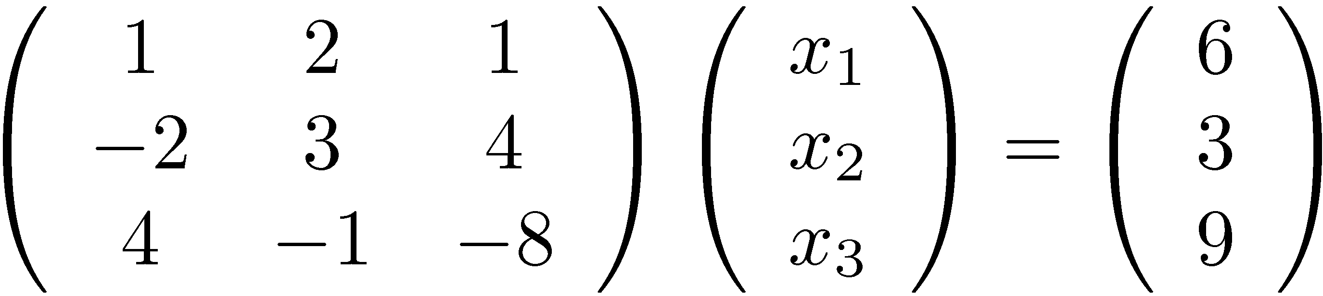
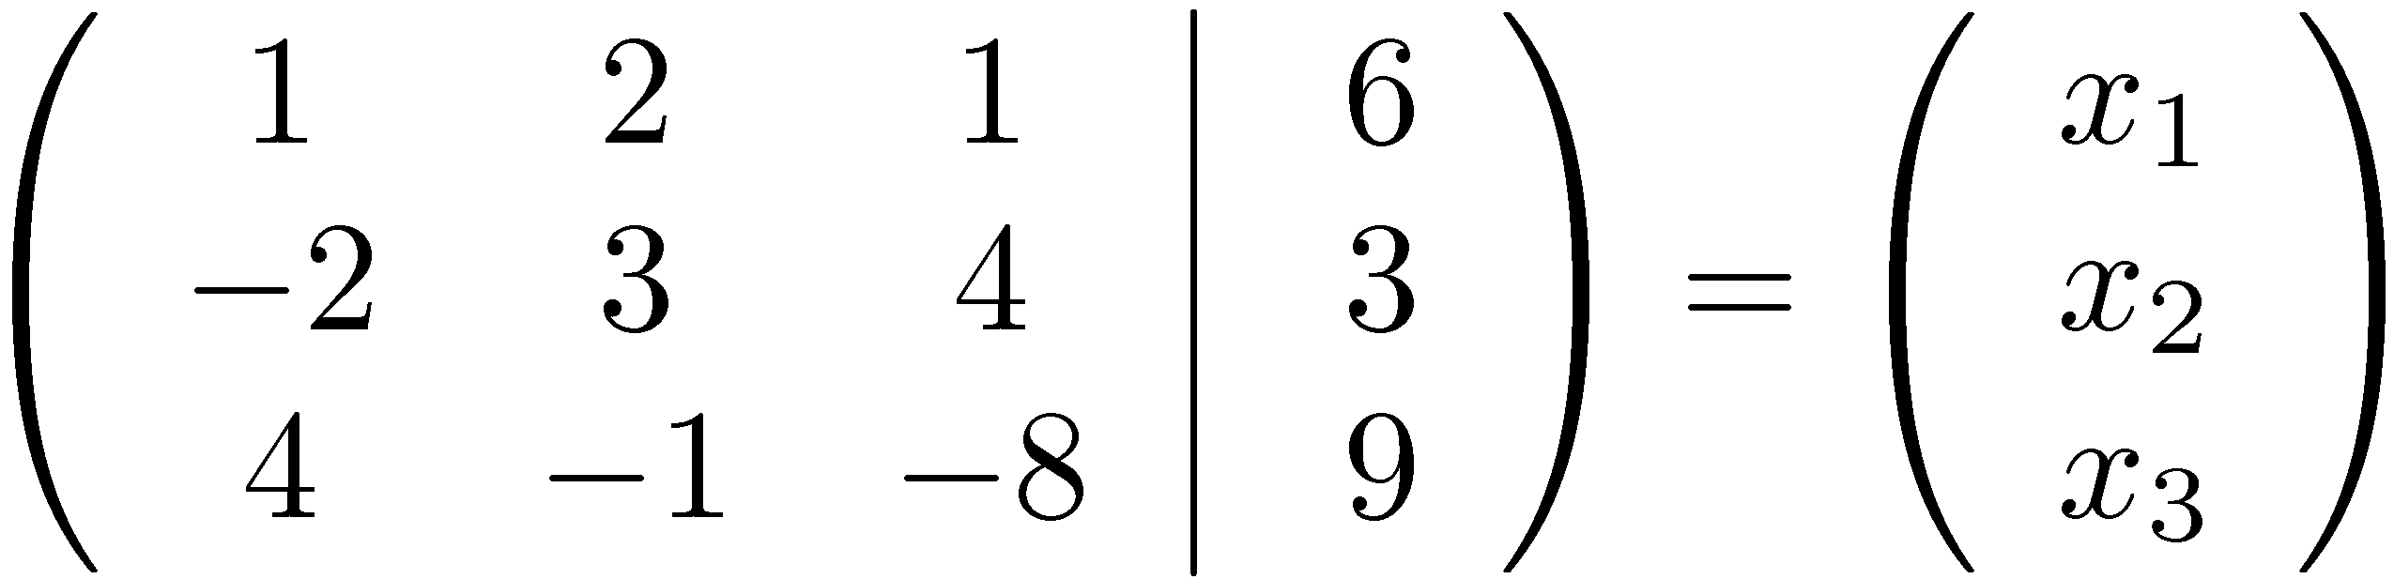
Gaussian elimination - example
Daniel Kroening and Ofer Strichman

Slide 19
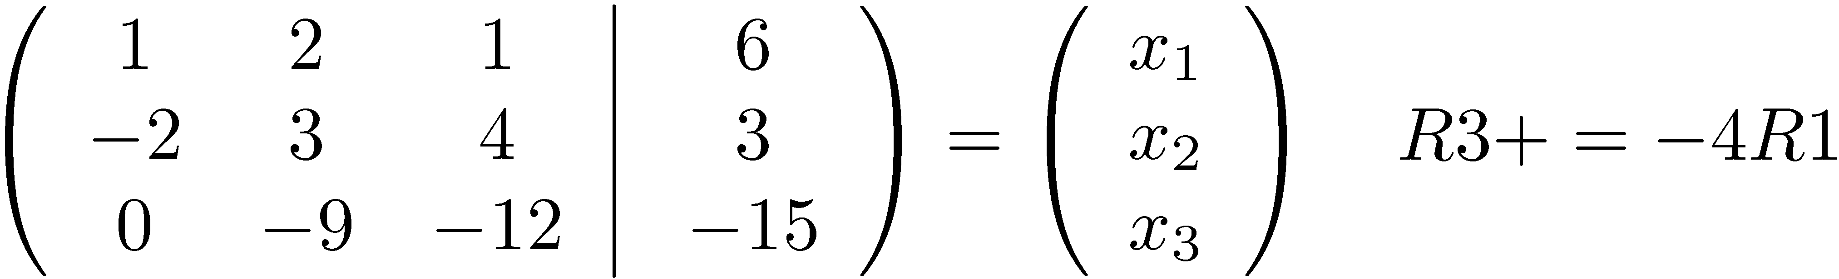
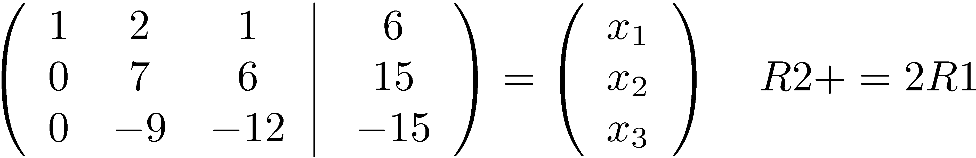
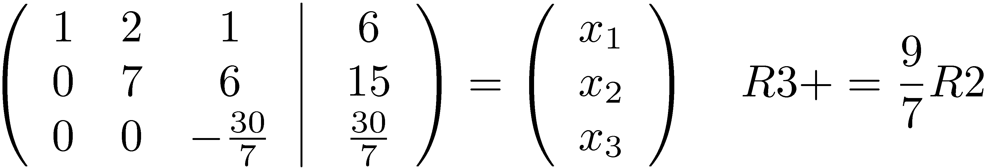
Gaussian elimination - example
And now… x₃ = -1, x₂ = 3, x₁ = 1 problem solved.
Daniel Kroening and Ofer Strichman

Slide 20
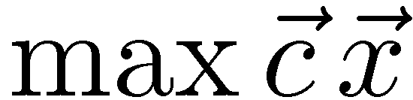
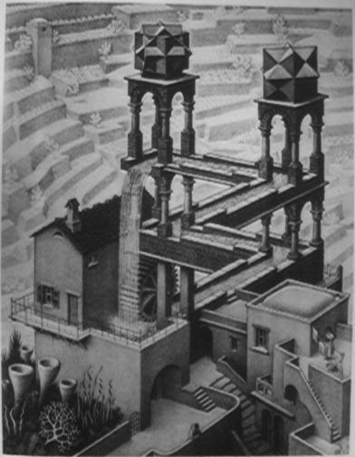
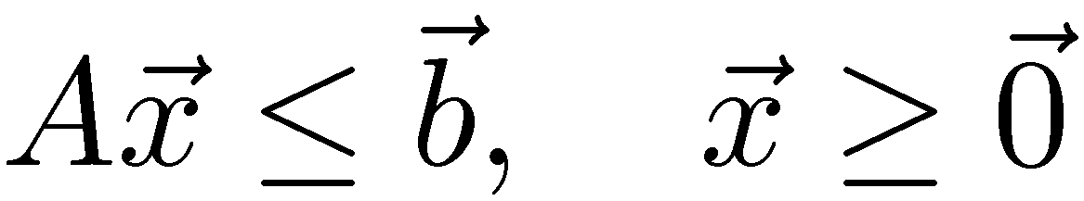
Feasibility with Simplex
Simplex was originally designed for solving the optimization problem:
s.t.
We are only interested in the feasibility problem.
Is this system feasible ?
Daniel Kroening and Ofer Strichman
Is this system optimal ?
Notes:
For a variable x not necessarily greater than 0, replace it with x’ – x’’, where x’, x’’ >=0

Slide 21
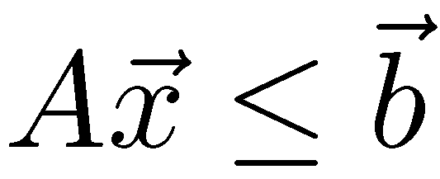
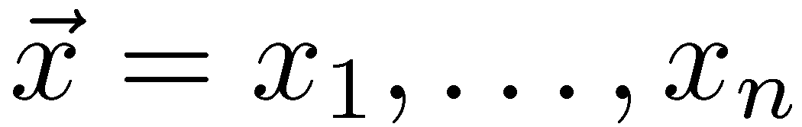
General simplex
We will learn a variant called general simplex.
Very suitable for solving the feasibility problem fast.
The input:
A is a m x n coefficient matrix
The problem variables:
First step: convert the input to general form
Daniel Kroening and Ofer Strichman

Slide 22
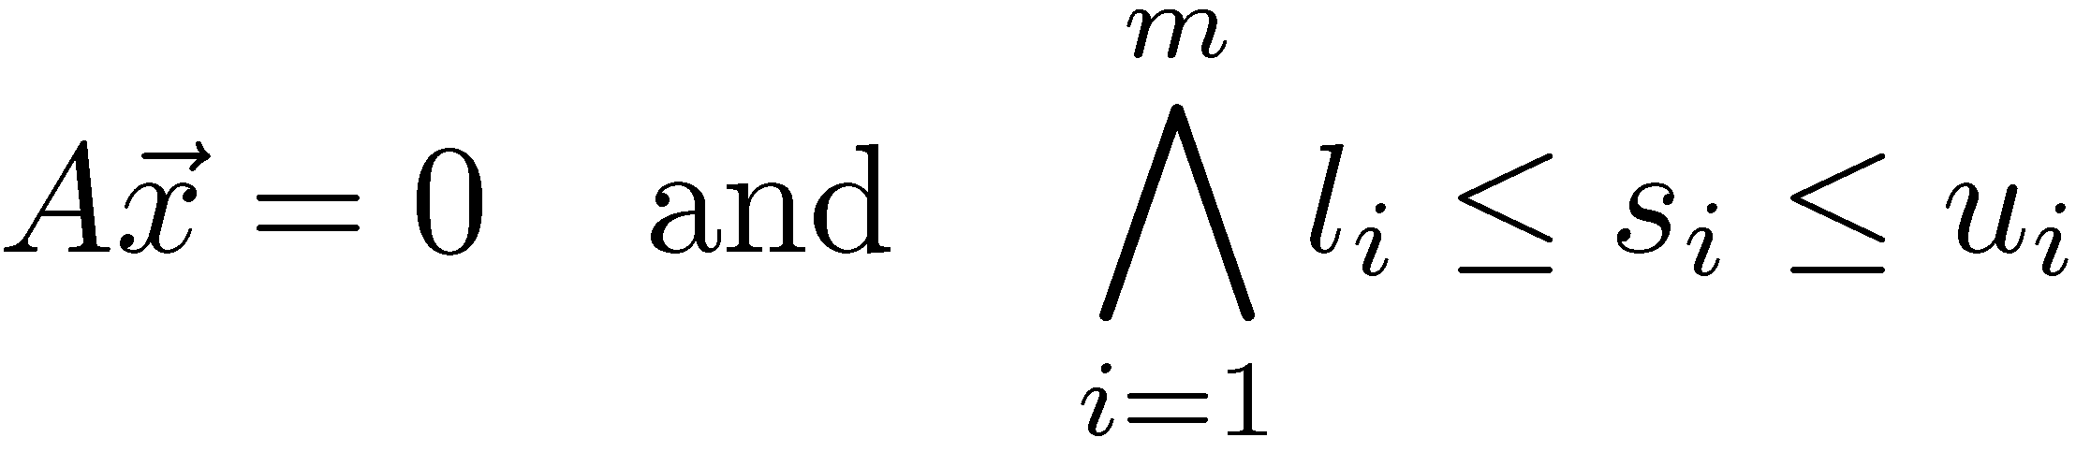
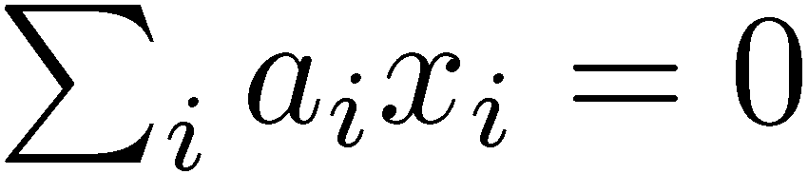
General form
General form:
A combination of:
Linear equalities of the form
Lower and upper bounds on variables.
Daniel Kroening and Ofer Strichman

Slide 23


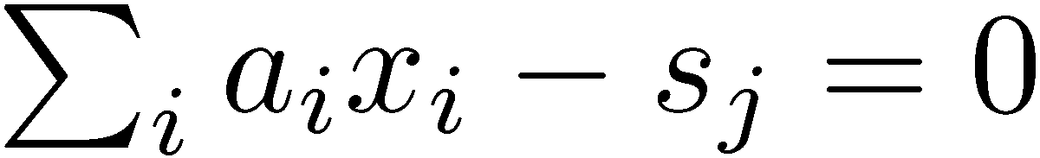
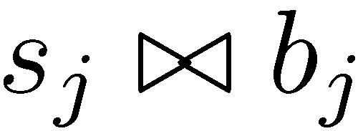
Converting to General Form
A: Replace (where ) with and
s₁,..., s_{m} are called the additional variables.
Daniel Kroening and Ofer Strichman

Slide 24
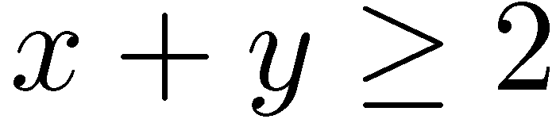
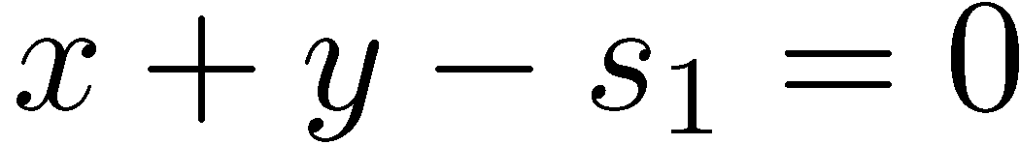
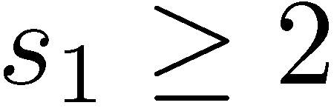
Example 1
Convert to:
It is common to keep the conjunctions implicit
Daniel Kroening and Ofer Strichman

Slide 25
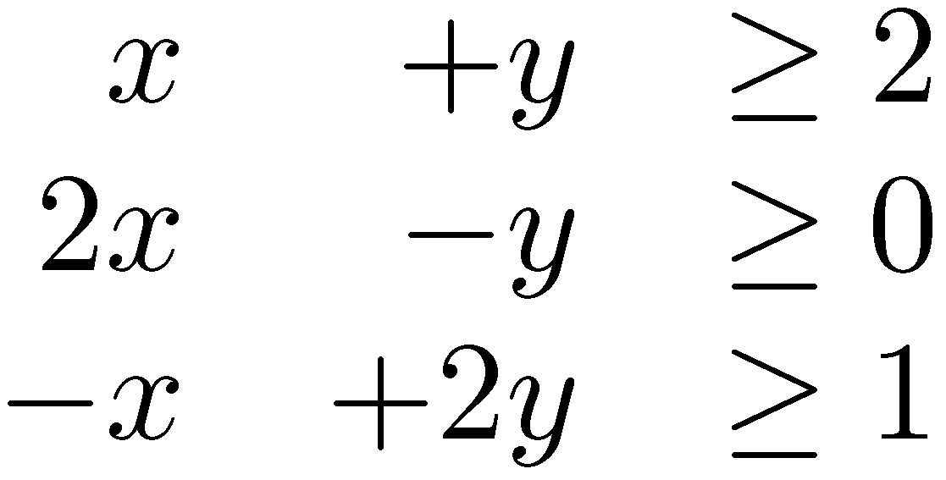
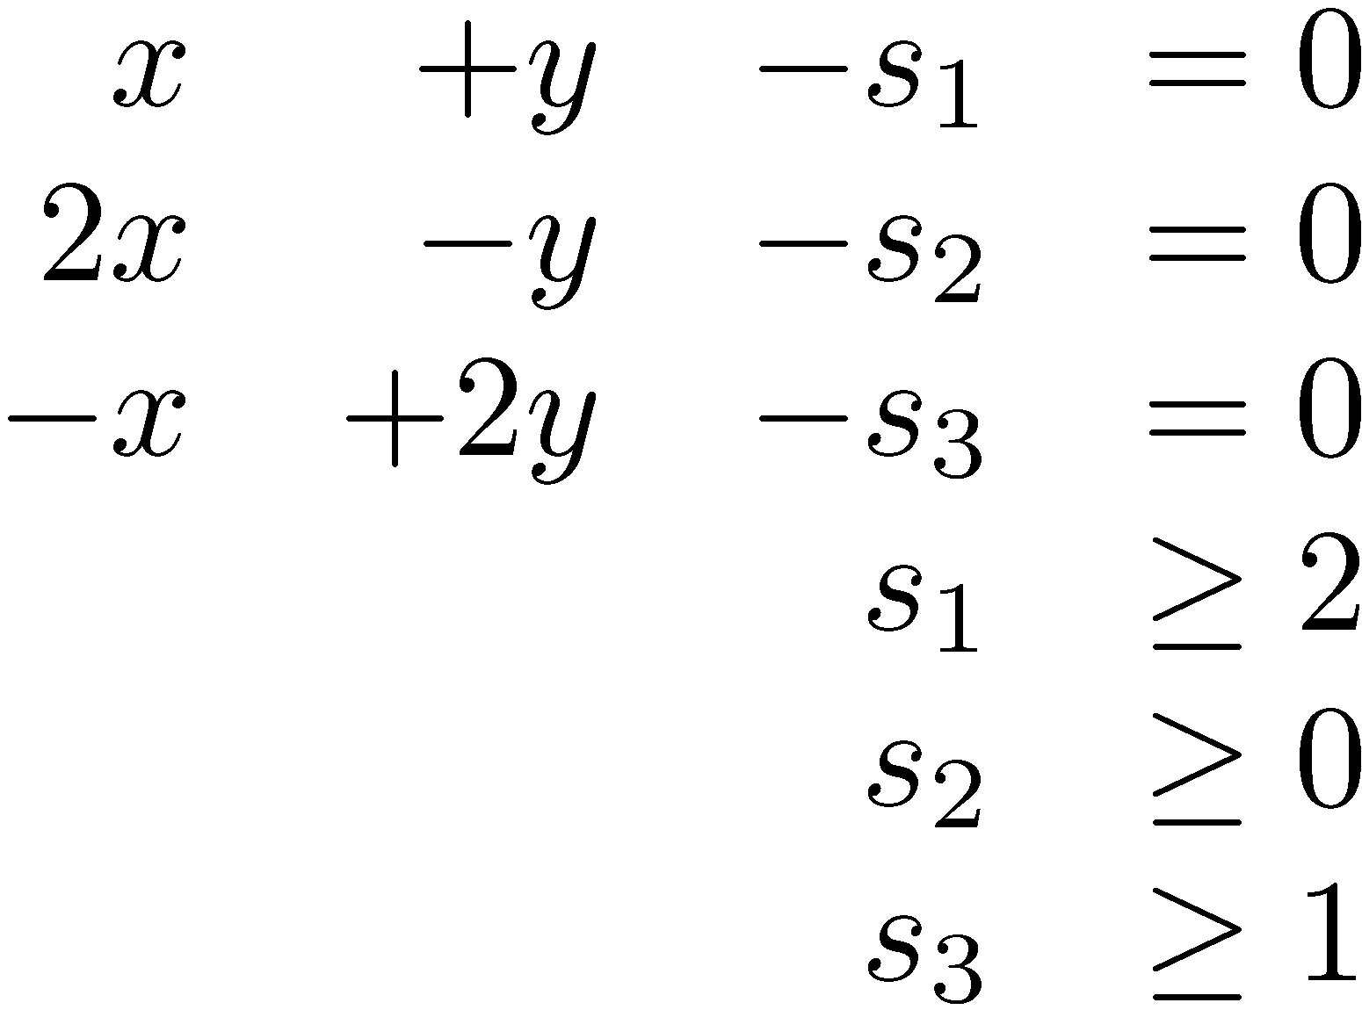
Example 2
Convert to:
Daniel Kroening and Ofer Strichman

Slide 26
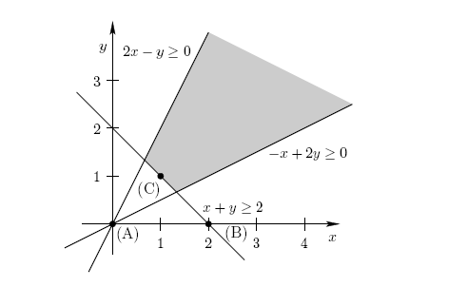
Our example from before, geometrically
General Simplex begins in the origin...
Daniel Kroening and Ofer Strichman

Slide 27
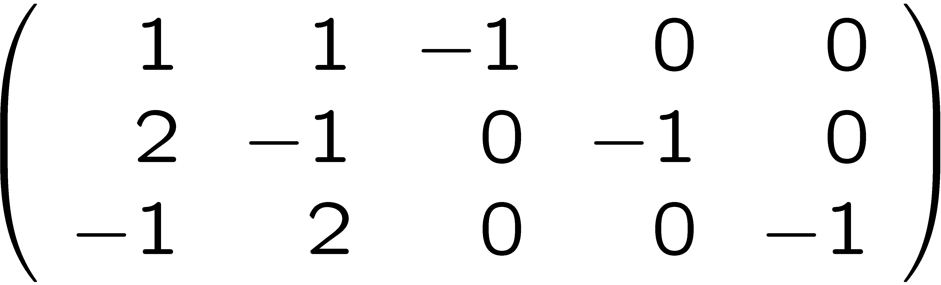
Matrix form
Recall the general form:
Due to the additional variables:
now A is an m x (n + m) matrix.
x y s₁ s₂ s₃
Daniel Kroening and Ofer Strichman

Slide 28
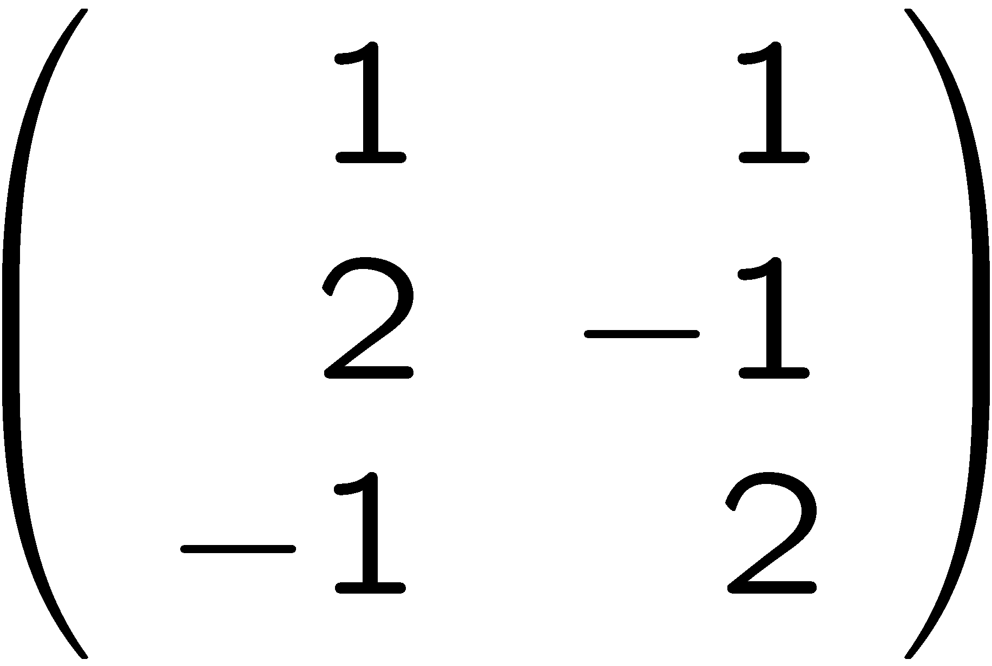
The tableau
The diagonal part is inherent to the general form
We can instead write:
x y s₁ s₂ s₃
x y
This is called the tableau
s₁
s₂
s₃
Daniel Kroening and Ofer Strichman

Slide 29
The tableau
The tableau changes throughout the algorithm, but maintains its m x n structure
Distinguish between basic and nonbasic variables
Initially, basic variables = the additional variables.
Nonbasic variables
x y
s₁
s₂
s₃
Basic variables
Daniel Kroening and Ofer Strichman

Slide 30
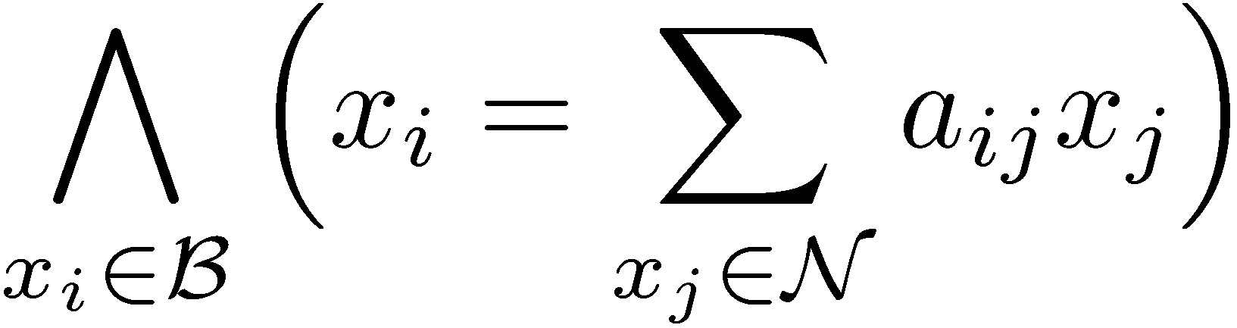
The tableau
Denote by
B – Basic variables
N – Nonbasic variables
The tableau is simply a rewrite of the system:
The basic variables are also called the dependent variables.
Daniel Kroening and Ofer Strichman

Slide 31

The general simplex algorithm
Simplex maintains:
The tableau,
an assignment $α$ to all variables
The bounds
Initially,
B = additional variables
N = problem variables
$α$(x_{i}) = 0 for i $∈$ {1,...,n+m}
Daniel Kroening and Ofer Strichman

Slide 32

Invariants
Two invariants are maintained throughout:
All nonbasic variables satisfy their bounds
Can you see why these invariants are maintained initially ?
We should check that they are indeed maintained
Daniel Kroening and Ofer Strichman
Notes:
1. Because x = 0 for all x.
2. The initial set of nonbasic variables (original variables) do not have a bound...

Slide 33


The general simplex algorithm
The initial assignment satisfies
If the bounds of all basic variables are satisfied by $α$, return `Satisfiable’.
Otherwise... pivot.
Daniel Kroening and Ofer Strichman

Slide 34
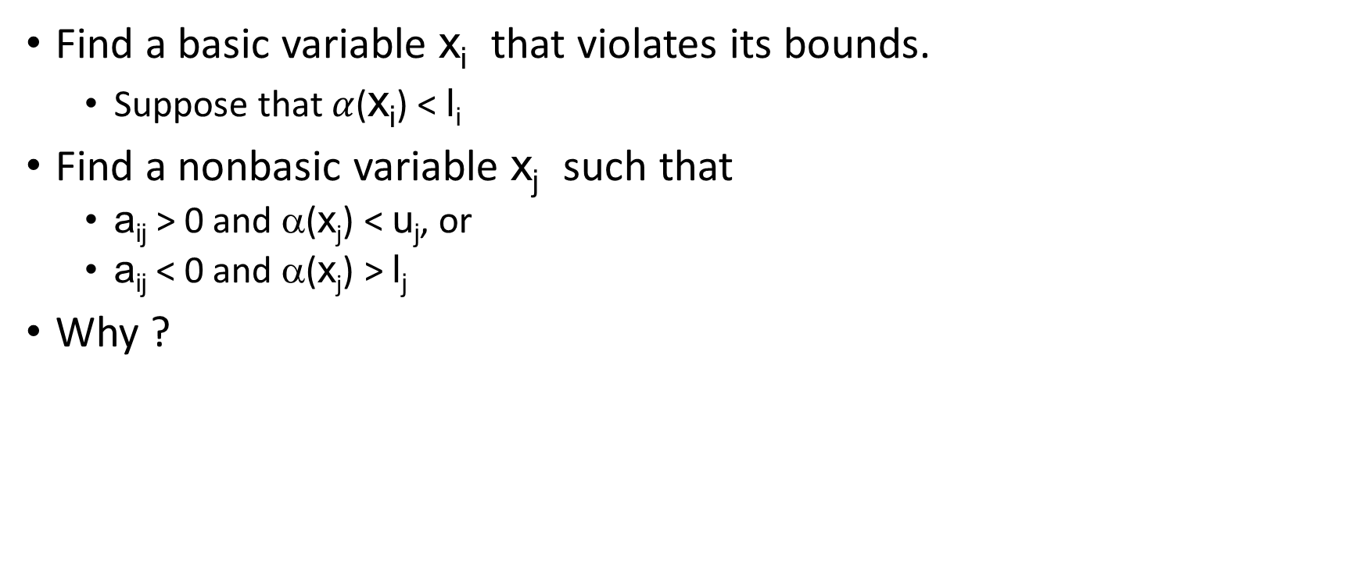
Pivoting
Find a basic variable x_{i} that violates its bounds.
Suppose that $α$(x_{i}) < l_{i}
Find a nonbasic variable x_{j} such that
a_{ij} > 0 and α(x_{j}) < u_{j}, or
a_{ij} < 0 and α(x_{j}) > l_{j}
Why ?
Daniel Kroening and Ofer Strichman
Notes:
Such a variable x_j has slack to allow us to fix the assignment to x_i
For example in the first case we can increase x_j up to u_j. This will also increase the value of x_i.

Slide 35
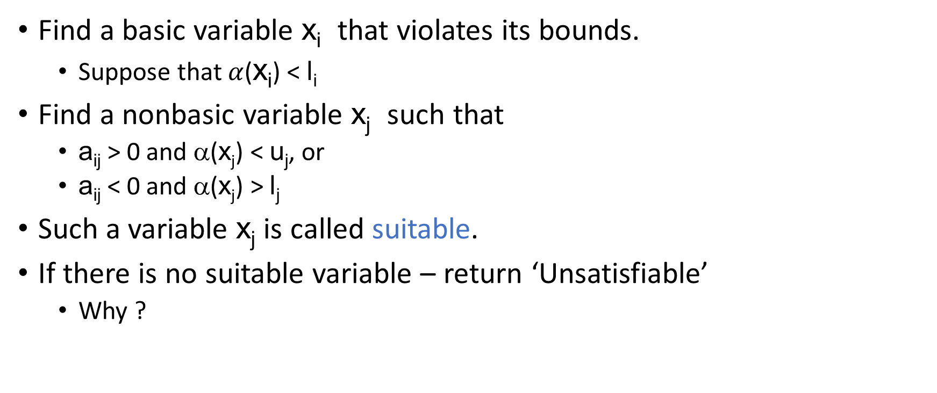
Pivoting
Find a basic variable x_{i} that violates its bounds.
Suppose that $α$(x_{i}) < l_{i}
Find a nonbasic variable x_{j} such that
a_{ij} > 0 and α(x_{j}) < u_{j}, or
a_{ij} < 0 and α(x_{j}) > l_{j}
Such a variable x_{j} is called suitable.
If there is no suitable variable – return ‘Unsatisfiable’
Why ?
Daniel Kroening and Ofer Strichman
Notes:
There is no way to fix the assignment to x_i.

Slide 36
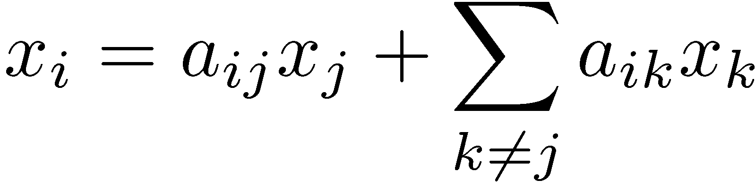
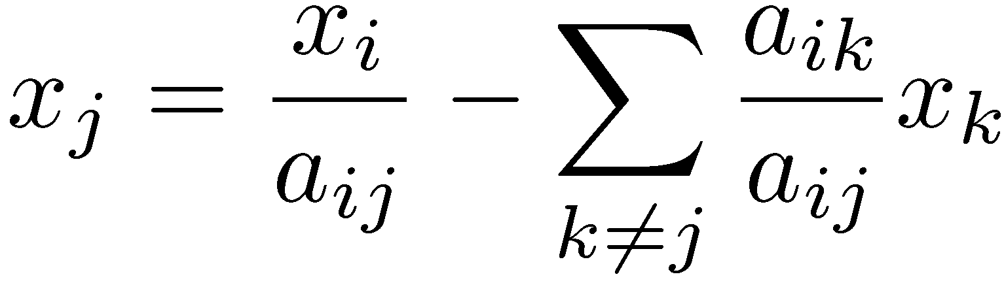
Pivoting x_{i} with x_{j}
Solve equation i for x_{j}:
From:
To:
Swap x_{i} and x_{j}, and update the i-th row accordingly.
From
To:
a_{i1} | ... | a_{ij} | ... | a_{in}
-a_{i1} a_{ij} | ... | 1 a_{ij} | ... | -a_{in} a_{ij}
Daniel Kroening and Ofer Strichman

Slide 37
Pivoting x_{i} with x_{j}
Update all other rows:
Replace x_{j} with its equivalent obtained from row i:
Daniel Kroening and Ofer Strichman

Slide 38
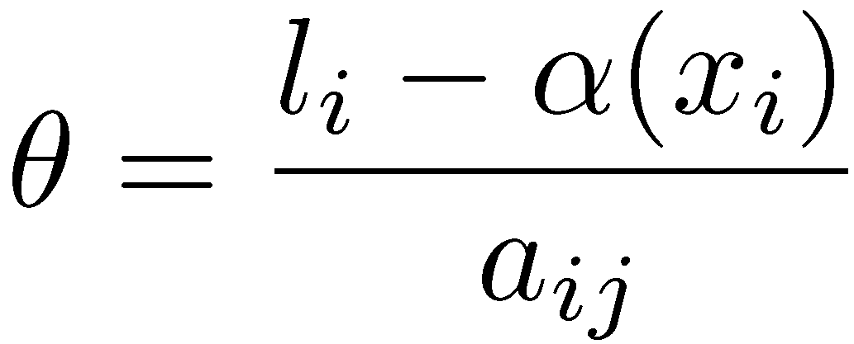
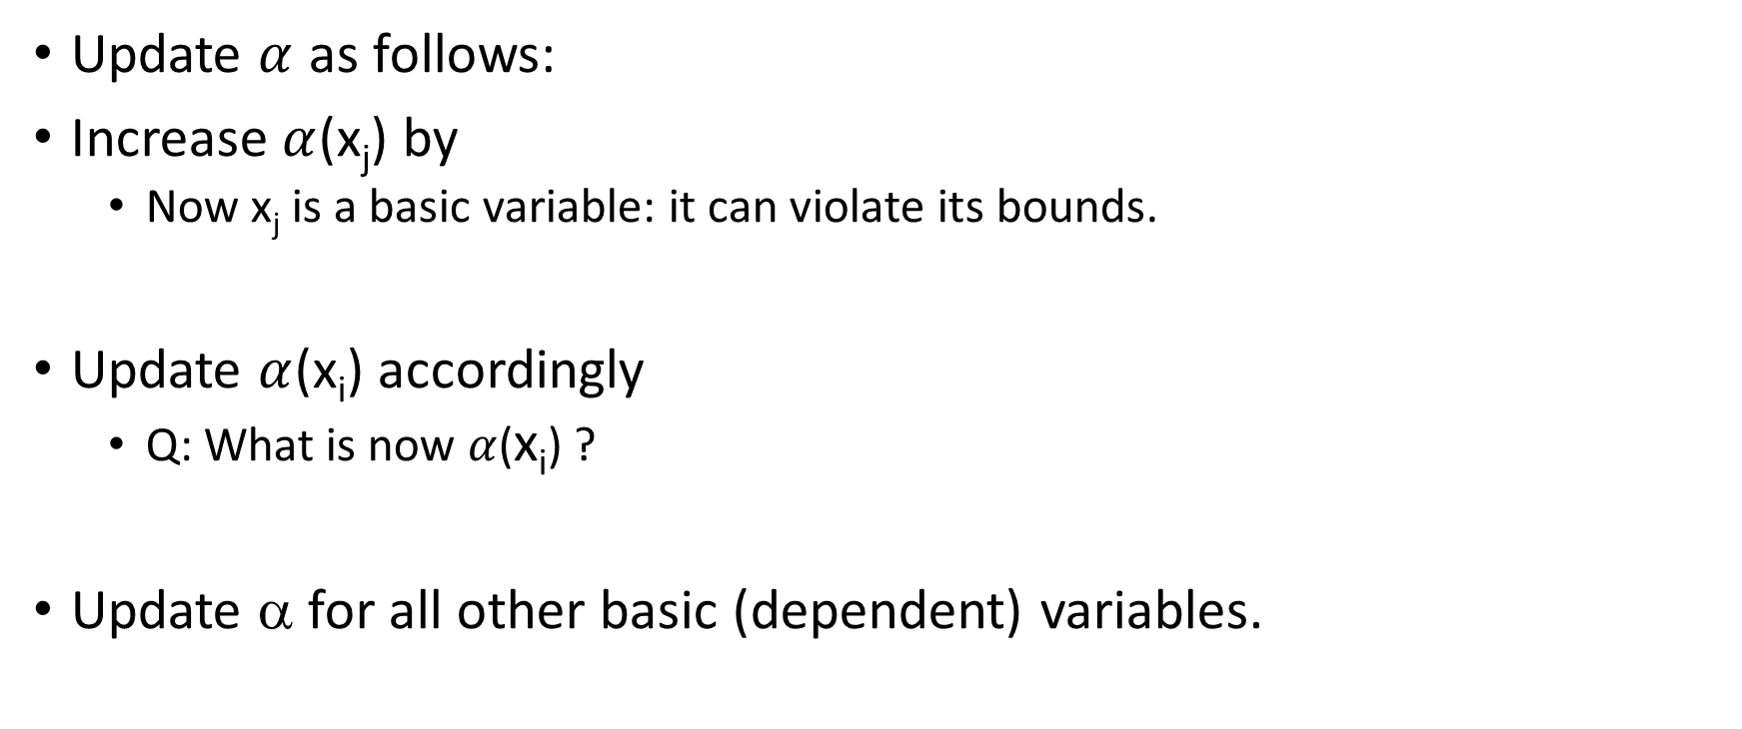
Pivoting
Update $α$ as follows:
Increase $α$(x_{j}) by
Now x_{j} is a basic variable: it can violate its bounds.
Update $α$(x_{i}) accordingly
Q: What is now $α$(x_{i}) ?
Update α for all other basic (dependent) variables.
Daniel Kroening and Ofer Strichman
Notes:
A: \alpha(x_i) = l_i

Slide 39
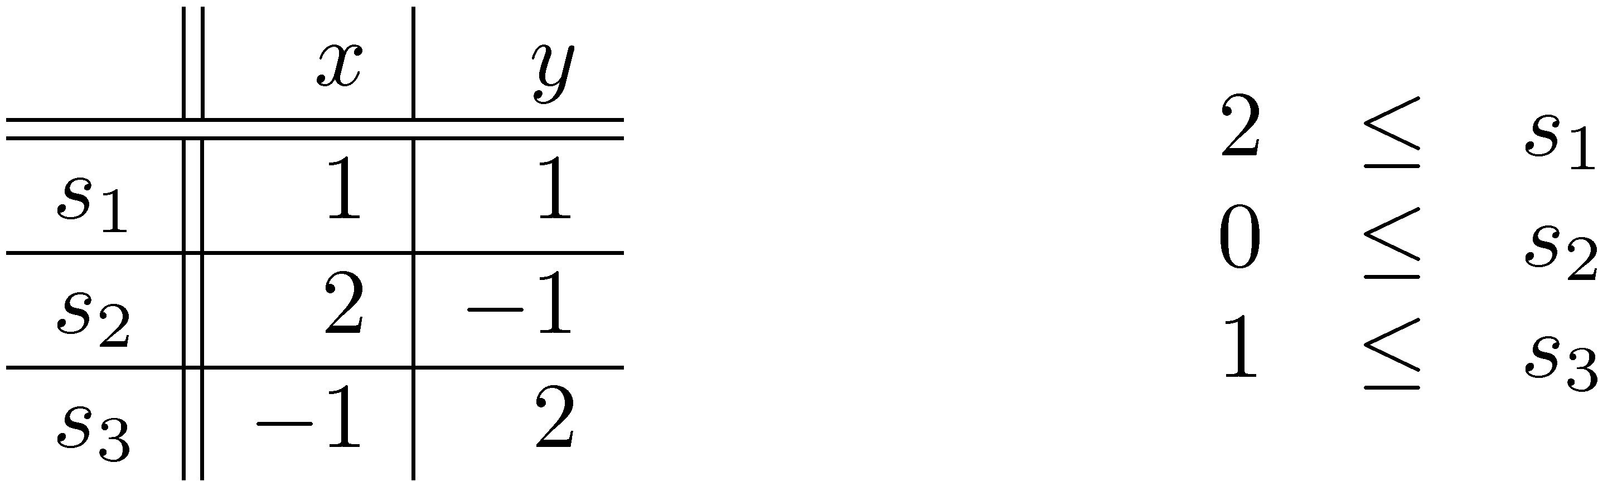
Example
Recall the tableau and constraints in our example:
Initially α assigns 0 to all variables
Bounds of s₁ and s₃ are violated
Daniel Kroening and Ofer Strichman

Slide 40
Example
Recall the tableau and constraints in our example:
We will solve s₁
x is a suitable nonbasic variable for pivoting
It has no upper bound
So now we pivot s₁ with x
Daniel Kroening and Ofer Strichman

Slide 41
Example
Recall the tableau and constraints in our example:
Solve 1st row for x:
Replace x with s₁ in other rows:
Daniel Kroening and Ofer Strichman

Slide 42
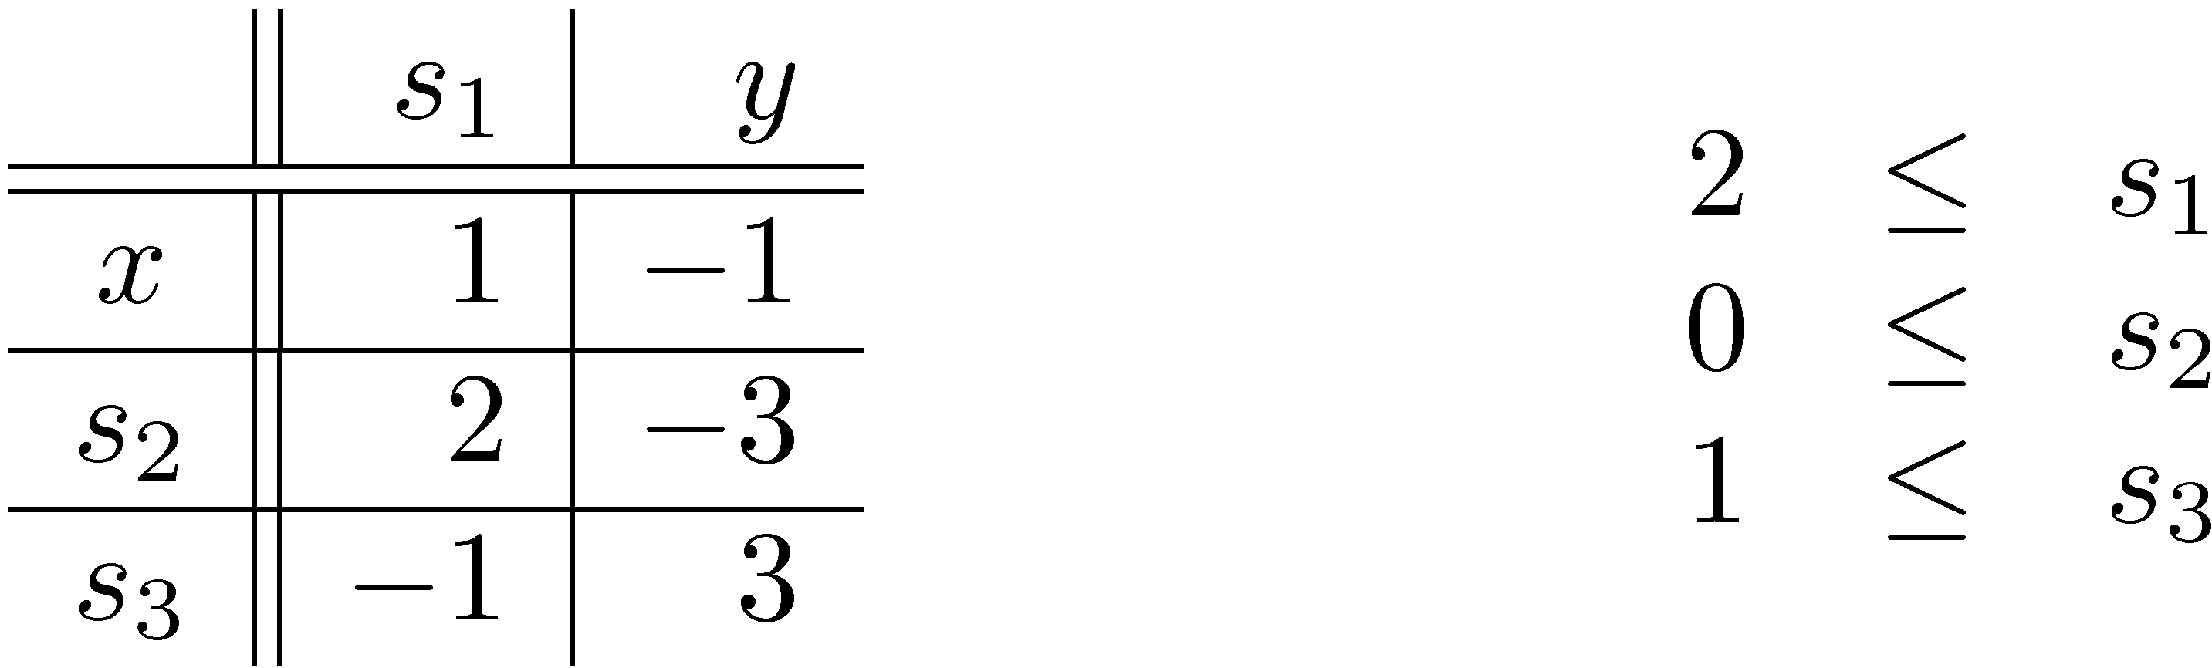
Example
The new state:
Solve 1st row for x:
Replace x with s₁ in other rows:
Daniel Kroening and Ofer Strichman

Slide 43
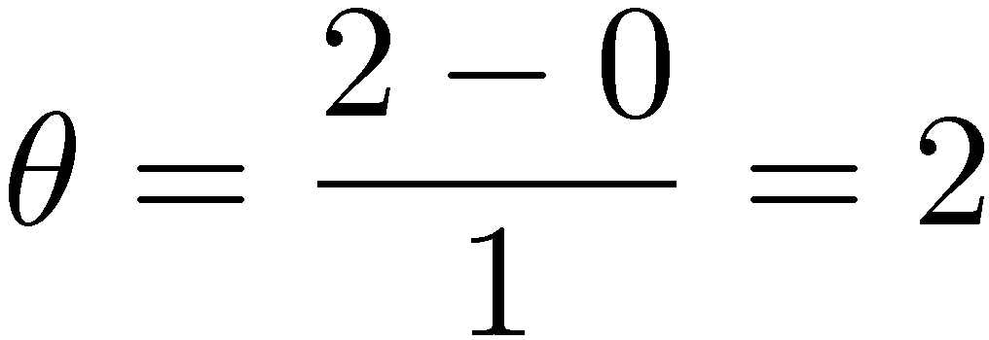
Example
The new state:
What about the assignment ?
We should increase x by
Hence, α(x) = 0 + 2 = 2
Now s₁ is equal to its lower bound: α(s₁) = 2
Update all the others
Daniel Kroening and Ofer Strichman

Slide 44
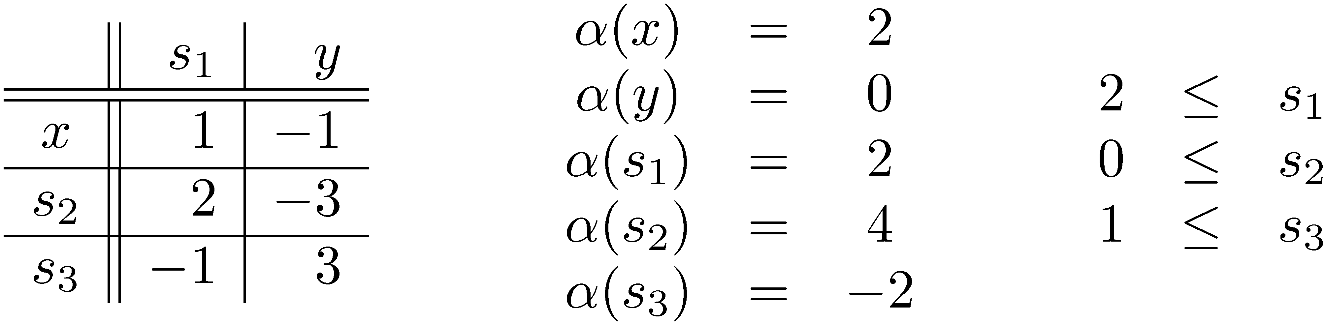
Example
The new state:
Now s₃ violates its lower bound
Which nonbasic variable is suitable for pivoting ?
That’s right… y
Daniel Kroening and Ofer Strichman

Slide 45
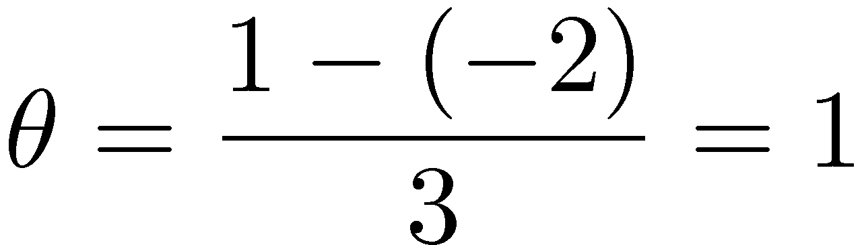
Example
The new state:
We should increase y by
Daniel Kroening and Ofer Strichman

Slide 46
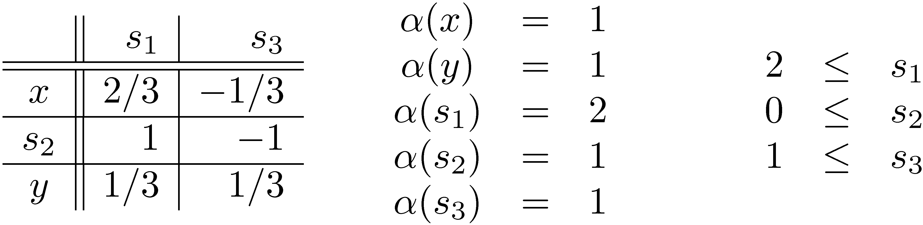
Example
The final state:
All constraints are now satisfied
Daniel Kroening and Ofer Strichman

