Slide 2
References
Chapter-5 from the DP book

Slide 3
Linear arithmetic

Slide 4

Example
$$x+y −2z≥2$$
$$−x−3y+z≥0$$
$$y+z≥1$$

Slide 5

Example
$$x+y −2z−s_{1}=0$$
$$−x−3y+z−s_{2}= 0$$
$$y+z−s_{3}=0$$
$$s_{1}≥2$$
$$s_{2}≥0$$
$$s_{3}≥1$$

Slide 6

Example
$$x+y −2z−s_{1}=0$$
$$−x−3y+z−s_{2}= 0$$
$$y+z−s_{3}=0$$
$$s_{1}≥2$$
$$s_{2}≥0$$
$$s_{3}≥1$$
$$α=\{x=0;y=0;z=0;s_{1}=0;s_{2}=0;s_{3}=0;\}$$
 | x | y | z
s₁ | 1 | 1 | -2
s₂ | -1 | -3 | 1
s₃ | 0 | 1 | 1

Slide 7


Example
$$x+y −2z−s_{1}=0$$
$$−x−3y+z−s_{2}= 0$$
$$y+z−s_{3}=0$$
$$s_{1}≥2$$
$$s_{2}≥0$$
$$s_{3}≥1$$
$$α=\{x=2;y=0;z=0;s_{1}=2;s_{2}=−2;s_{3}=0;\}$$
 | x | y | z
s₁ | 1 | 1 | -2
s₂ | -1 | -3 | 1
s₃ | 0 | 1 | 1
Bounds of s₁ are violated. pivot s₁ with x. $θ$ = (2 – 0)/1 = 2. Increase x by 2. Update $α$.

Slide 8
Example
$$x+y −2z−s_{1}=0$$
$$−x−3y+z−s_{2}= 0$$
$$y+z−s_{3}=0$$
$$s_{1}≥2$$
$$s_{2}≥0$$
$$s_{3}≥1$$
$$α=\{x=2;y=0;z=0;s_{1}=2;s_{2}=−2;s_{3}=0;\}$$
 | s₁ | y | z
x | 1 | -1 | 2
s₂ | -1 | -2 | -1
s₃ | 0 | 1 | 1
Exchange x and s₁ in the tableau.

Slide 9


Example
$$x+y −2z−s_{1}=0$$
$$−x−3y+z−s_{2}= 0$$
$$y+z−s_{3}=0$$
$$s_{1}≥2$$
$$s_{2}≥0$$
$$s_{3}≥1$$
$$α=\{x=3;y=−1;z=0;s_{1}=2;s_{2}=0;s_{3}=−1;\}$$
 | s₁ | y | z
x | 1 | -1 | 2
s₂ | -1 | -2 | -1
s₃ | 0 | 1 | 1
Bounds of s₂ are violated. s₁ is not suitable for pivoting (the coefficient is negative; s₁ is already at the lower limit, can’t decrease further). Pivot s₂ with y. $θ$ = (0 – (-2))/2 = 1. Decrease y by 1, as the coefficient is negative. Update $α$.

Slide 10
Example
$$x+y −2z−s_{1}=0$$
$$−x−3y+z−s_{2}= 0$$
$$y+z−s_{3}=0$$
$$s_{1}≥2$$
$$s_{2}≥0$$
$$s_{3}≥1$$
$$α=\{x=3;y=−1;z=0;s_{1}=2;s_{2}=0;s_{3}=−1;\}$$
 | s₁ | s₂ | z
x | 3/2 | 1/2 | 5/2
y | -1/2 | -1/2 | -1/2
s₃ | -1/2 | -1/2 | 1/2
Exchange y and s₂ in the tableau.

Slide 11
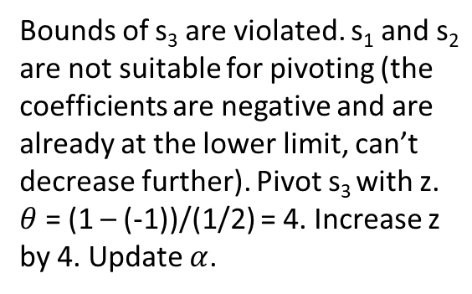

Example
$$x+y −2z−s_{1}=0$$
$$−x−3y+z−s_{2}= 0$$
$$y+z−s_{3}=0$$
$$s_{1}≥2$$
$$s_{2}≥0$$
$$s_{3}≥1$$
$$α=\{x=13;y=−3;z=4;s_{1}=2;s_{2}=0;s_{3}=1;\}$$
 | s₁ | s₂ | z
x | 3/2 | 1/2 | 5/2
y | -1/2 | -1/2 | -1/2
s₃ | -1/2 | -1/2 | 1/2
Bounds of s₃ are violated. s₁ and s₂ are not suitable for pivoting (the coefficients are negative and are already at the lower limit, can’t decrease further). Pivot s₃ with z. $θ$ = (1 – (-1))/(1/2) = 4. Increase z by 4. Update $α$.

Slide 12
Example
$$x+y −2z−s_{1}=0$$
$$−x−3y+z−s_{2}= 0$$
$$y+z−s_{3}=0$$
$$s_{1}≥2$$
$$s_{2}≥0$$
$$s_{3}≥1$$
$$α=\{x=13;y=−3;z=4;s_{1}=2;s_{2}=0;s_{3}=1;\}$$
 | s₁ | s₂ | s₃
x | 4 | 3 | 5
y | -1 | -1 | -1
z | 1 | 1 | 2
Exchange z and s₃ in the tableau.

Slide 13
Example
$$x+y −2z−s_{1}=0$$
$$−x−3y+z−s_{2}= 0$$
$$y+z−s_{3}=0$$
$$s_{1}≥2$$
$$s_{2}≥0$$
$$s_{3}≥1$$
$$α=\{x=13;y=−3;z=4;s_{1}=2;s_{2}=0;s_{3}=1;\}$$
 | s₁ | s₂ | s₃
x | 4 | 3 | 5
y | -1 | -1 | -1
z | 1 | 1 | 2
All constraints hold. Therefore, the formula is satisfiable.

Slide 14
Simplex

Slide 15

Example
$$−x+y ≥0$$
$$−x−2y≥−9$$
$$x+y≥8$$

Slide 16

Example
$$−x+y −s_{1}=0$$
$$−x−2y−s_{2}=−9$$
$$x+y−s_{3}=0$$
$$s_{1}≥0$$
$$s_{2}≥−9$$
$$s_{3}≥8$$

Slide 17

Example
$$−x+y −s_{1}=0$$
$$−x−2y−s_{2}=−9$$
$$x+y−s_{3}=0$$
$$s_{1}≥0$$
$$s_{2}≥−9$$
$$s_{3}≥8$$
$$α=\{x=0;y=0;s_{1}=0;s_{2}=0;s_{3}=0;\}$$
 | x | y
s₁ | -1 | 1
s₂ | -1 | -2
s₃ | 1 | 1

Slide 18


Example
$$−x+y −s_{1}=0$$
$$−x−2y−s_{2}=−9$$
$$x+y−s_{3}=0$$
$$s_{1}≥0$$
$$s_{2}≥−9$$
$$s_{3}≥8$$
$$α=\{x=8;y=0;s_{1}=−8;s_{2}=−8;s_{3}=8;\}$$
 | x | y
s₁ | -1 | 1
s₂ | -1 | -2
s₃ | 1 | 1
Bounds of s₃ are violated. pivot s₃ with x. $θ$ = (8 – 0)/1 = 8. Increase x by 8. Update $α$.

Slide 19
Example
$$−x+y −s_{1}=0$$
$$−x−2y−s_{2}=−9$$
$$x+y−s_{3}=0$$
$$s_{1}≥0$$
$$s_{2}≥−9$$
$$s_{3}≥8$$
$$α=\{x=8;y=0;s_{1}=−8;s_{2}=−8;s_{3}=8;\}$$
 | s₃ | y
s₁ | -1 | 2
s₂ | -1 | -1
x | 1 | -1
Exchange s₃ with x.

Slide 20


Example
$$−x+y −s_{1}=0$$
$$−x−2y−s_{2}=−9$$
$$x+y−s_{3}=0$$
$$s_{1}≥0$$
$$s_{2}≥−9$$
$$s_{3}≥8$$
$$α=\{x=4;y=4;s_{1}=0;s_{2}=−12;s_{3}=8;\}$$
 | s₃ | y
s₁ | -1 | 2
s₂ | -1 | -1
x | 1 | -1
Bounds of s₁ are violated. pivot s₁ with y as s₃ is unsuitable. $θ$ = (0 – (-8))/2 = 4. Increase y by 4. Update $α$.

Slide 21
Example
$$−x+y −s_{1}=0$$
$$−x−2y−s_{2}=−9$$
$$x+y−s_{3}=0$$
$$s_{1}≥0$$
$$s_{2}≥−9$$
$$s_{3}≥8$$
$$α=\{x=4;y=4;s_{1}=0;s_{2}=−12;s_{3}=8;\}$$
 | s₃ | s₁
y | 1/2 | 1/2
s₂ | -3/2 | -1/2
x | 1/2 | -1/2
Exchange s₁ with y.

Slide 22
Example
$$−x+y −s_{1}=0$$
$$−x−2y−s_{2}=−9$$
$$x+y−s_{3}=0$$
$$s_{1}≥0$$
$$s_{2}≥−9$$
$$s_{3}≥8$$
$$α=\{x=4;y=4;s_{1}=0;s_{2}=−12;s_{3}=8;\}$$
 | s₃ | s₁
y | 1/2 | 1/2
s₂ | -3/2 | -1/2
x | 1/2 | -1/2
Bounds of s₂ are violated. Can’t pivot s₂ with both s₃ and s₁ because the coefficients are negative and they are at their lower limit. Thus, the formula is unsatisfiable.

Slide 23
Observations
The additional variables:
Only additional variables have bounds.
These bounds are permanent.
Additional variables exit the base only on extreme points (their lower or upper bounds).
When entering the base, they shift towards the other bound and possibly cross it (violate it).
Daniel Kroening and Ofer Strichman

Slide 24
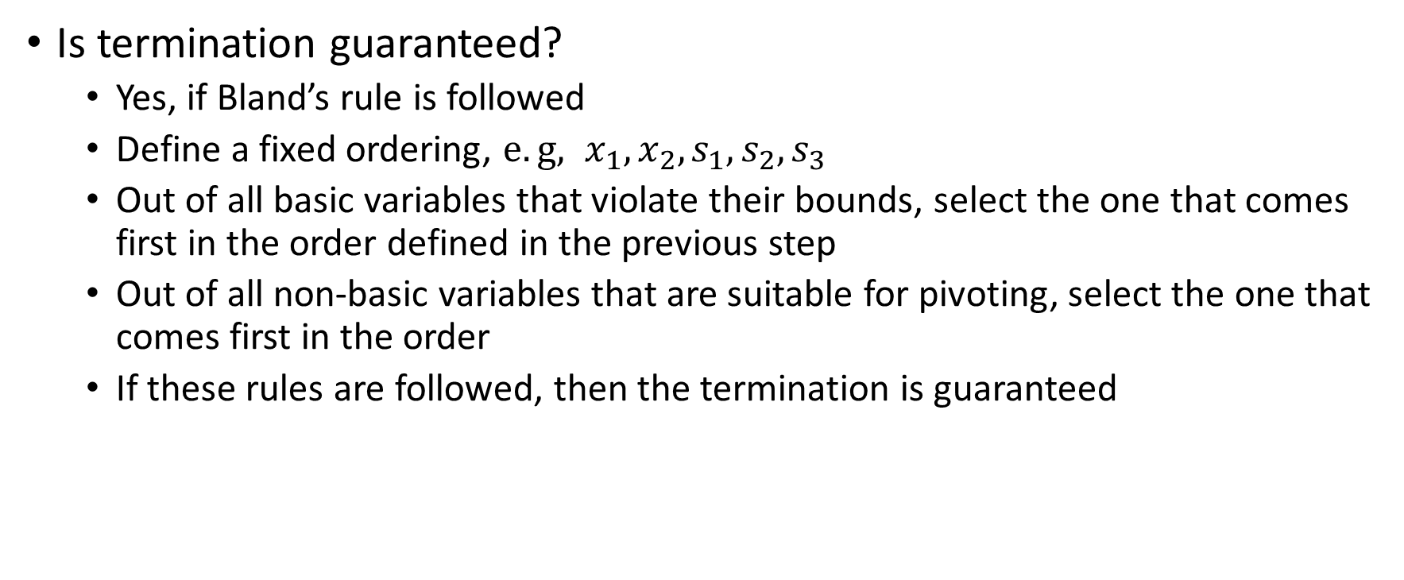
Termination
Is termination guaranteed?
Yes, if Bland’s rule is followed
Define a fixed ordering, $e.g, x_{1},x_{2}, s_{1},s_{2},s_{3}$
Out of all basic variables that violate their bounds, select the one that comes first in the order defined in the previous step
Out of all non-basic variables that are suitable for pivoting, select the one that comes first in the order
If these rules are followed, then the termination is guaranteed

Slide 25
Termination
The basic idea behind the proof of termination is the following:
When a basic variable becomes non-basic, it’s set to either its lower limit or upper limit
Because the number of variables is finite, the set of all possible assignments to the variables is also finite because of the above constraint
The Simplex algorithm will not terminate if and only if a set of assignments is repeated after some iteration
The proof argues that if the fixed ordering of the variables is followed during the pivot selection, then the repetition is not possible
The detailed proof is given in the paper:
Integrating Simplex with DPLL(T), Bruno Dutertre and Leonardo de Moura

Slide 26
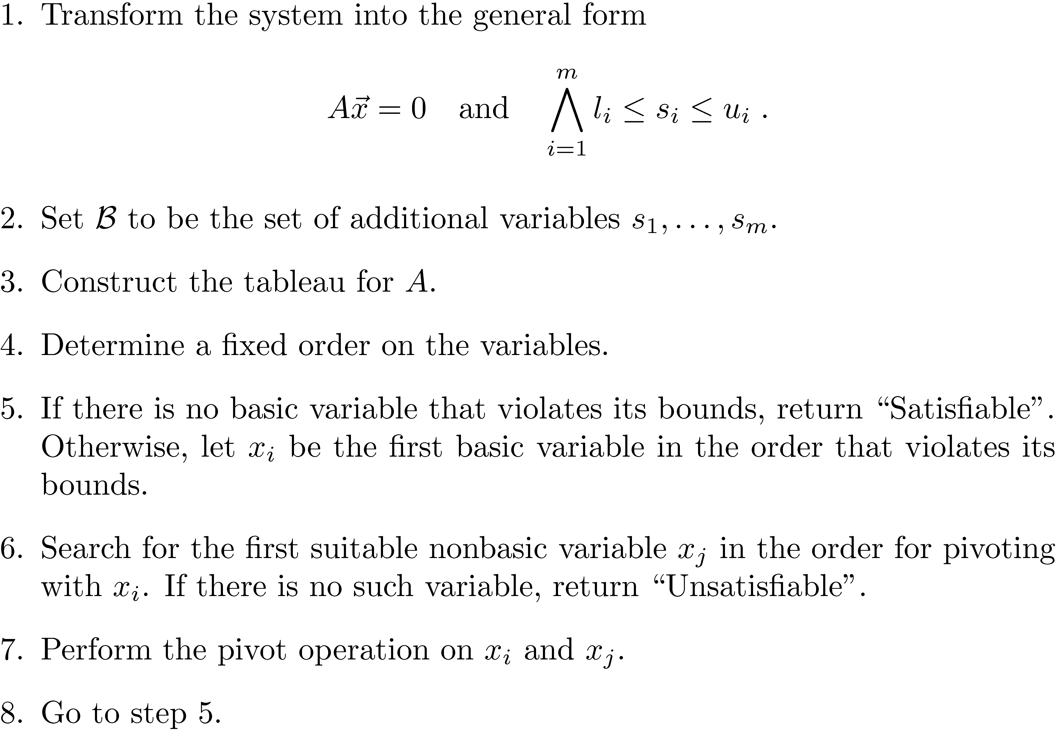
General-Simplex with Bland’s rule

Slide 27
Fourier-Motzkin Variable Elimination

Slide 28
Fourier-Motzkin Variable Elimination
Similar to the Simplex method, Fourier-Motzkin takes conjunction of linear constraints over real variable and decide their satisfiability
Simplex is much faster than the Fourier-Motzkin algorithm
Fourier-Motzkin algorithm is used to eliminate quantifiers

Slide 29

Fourier-Motzkin Variable Elimination
The general form is:
$$\bigwedge_{i=1}^{m}{\sum_{j=1}^{n}{a_{i,j}x_{j}} ≤b_{i}}$$

Slide 30
Example

Slide 31
Fourier-Motzkin Variable Elimination
The Fourier-Motzkin elimination algorithms project these constraints onto the x (or y) axis, thus eliminating y (or x).
In the case of three dimensions, the constraints are projected onto a two-dimensional plane, thereby eliminating a dimension.

Slide 32

Fourier-Motzkin Variable Elimination
Equality constraints
For each $\sum_{j=1}^{n}{a_{i,j}.x_{j}}=b_{i}$
Substitute a variable, say $x_{n}$, with $(\frac{b_{i}}{a_{i,n}} − \sum_{j=1}^{n−1}{\frac{a_{i,j}}{a_{i,n}}.x_{j})}$ in all other constraints.

Slide 33
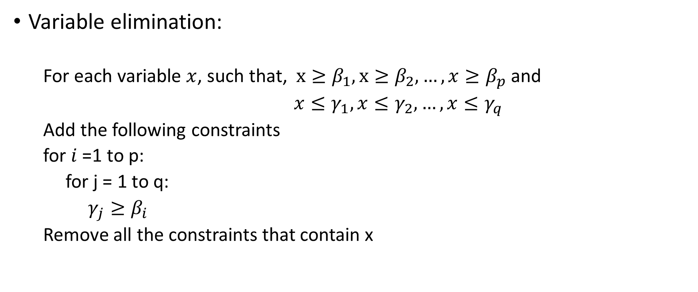
Fourier-Motzkin Variable Elimination
Variable elimination:
For each variable $x$, such that, $x≥β_{1}, x≥β_{2}, …, x≥β_{p}$ and
$x≤γ_{1}, x≤γ_{2}, …, x≤γ_{q}$
Add the following constraints
for $i$ =1 to p:
for j = 1 to q:
$γ_{j}≥β_{i}$
Remove all the constraints that contain x

Slide 34
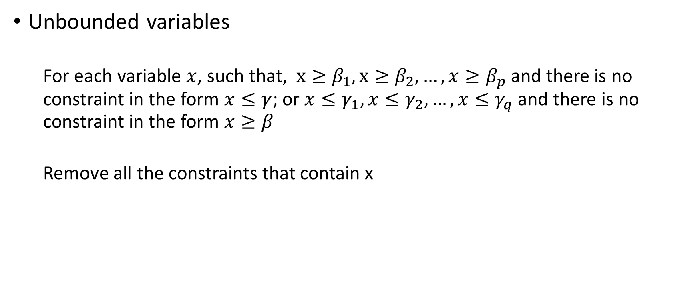
Fourier-Motzkin Variable Elimination
Unbounded variables
For each variable $x$, such that, $x≥β_{1}, x≥β_{2}, …, x≥β_{p}$ and there is no constraint in the form $x≤γ$; or $x≤γ_{1}, x≤γ_{2}, …, x≤γ_{q}$ and there is no constraint in the form $x≥β$
Remove all the constraints that contain x

Slide 35

Example
$$x≤y+10$$
$$y≤15$$
$$y≥−x+20$$

Slide 36

Example
$$x≤y+10$$
$$y≤15$$
$$y≥−x+20$$
---------------------------
$$x −y≤10$$
$$y≤15$$
$$−x −y≤−20$$

Slide 37
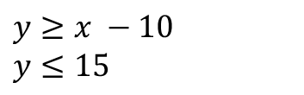



Example
$x −y≤10$ -(i)
$y≤15$ -(ii)
$−x −y≤−20$ -(iii)
x and y have both positive and negative coefficients, so we need to consider all constraints
Eliminating y using (i) and (ii)
$$y≥x −10$$
$$y≤15$$
$$15 ≥x −10$$
$$x≤25$$

Slide 38
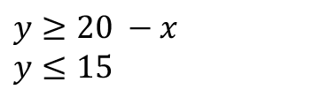



Example
$x −y≤10$ -(i)
$y≤15$ -(ii)
$−x −y≤−20$ -(iii)
x and y have both positive and negative coefficients, so we need to consider all constraints
Eliminating y using (ii) and (iii)
$$y≥20 −x$$
$$y≤15$$
$$15 ≥20 −x$$
$$x≥5$$

Slide 39

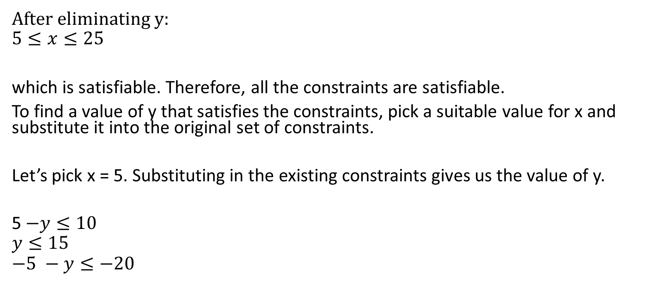

Example
After eliminating y:
$$5≤x≤25$$
which is satisfiable. Therefore, all the constraints are satisfiable.
To find a value of y that satisfies the constraints, pick a suitable value for x and substitute it into the original set of constraints.
Let’s pick x = 5. Substituting in the existing constraints gives us the value of y.
5$−y≤10$
$$y≤15$$
$$−5 −y≤−20$$
$$y≥−5$$
$$y≤15$$
$$y≥15$$
$$y=15$$

Slide 40

Example
$$x+y −2z≥2$$
$$−x −3y+z≥0$$
$$y+z≥1$$

Slide 41

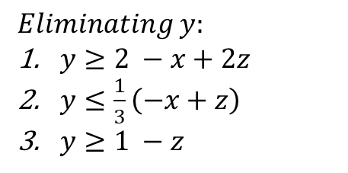




Example
$$x+y −2z≥2$$
$$−x −3y+z≥0$$
$$y+z≥1$$
$$Eliminating y:$$
$y≥2 −x+2z$
$y≤\frac{1}{3}\left(−x+z\right)$
$y≥1 −z$
Using 1 and 2
$$\frac{1}{3}\left(−x+z\right)≥2 −x+2z$$
which simplifies to
$$2x −5z≥6$$
Using 2 and 3
$$\frac{1}{3}\left(−x+z\right)≥1−z$$
which simplifies
$$−x+4z≥3$$
After eliminating y
the constraints are
$2x −5z≥6$
$−x+4z≥3$
Using 1 and 2
$$4z −3≥\frac{1}{2}\left(5z+6\right)$$
which simplifies to
$$z≥4$$
Eliminating x:
$x ≥\frac{1}{2}(5z+ 6)$
$x≤4z−3$

Slide 42
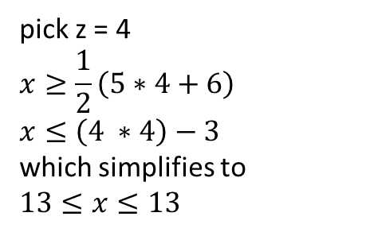
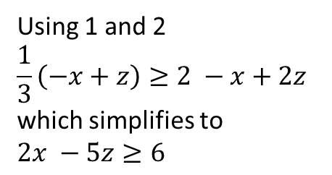
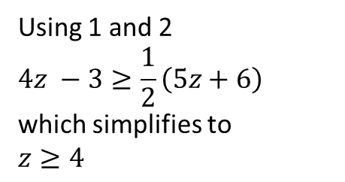
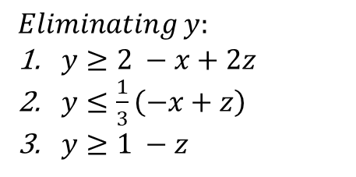
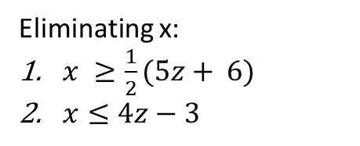
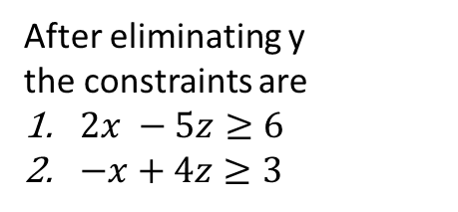
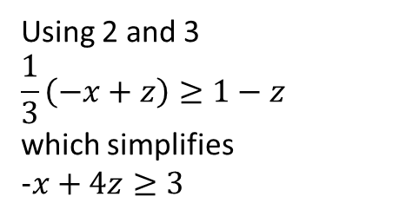
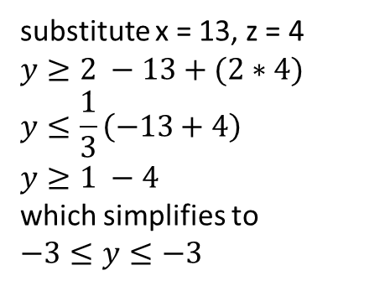
Example
$$Eliminating y:$$
$y≥2 −x+2z$
$y≤\frac{1}{3}\left(−x+z\right)$
$y≥1 −z$
Using 1 and 2
$$\frac{1}{3}\left(−x+z\right)≥2 −x+2z$$
which simplifies to
$$2x −5z≥6$$
Using 2 and 3
$$\frac{1}{3}\left(−x+z\right)≥1−z$$
which simplifies
$$−x+4z≥3$$
After eliminating y
the constraints are
$2x −5z≥6$
$−x+4z≥3$
Using 1 and 2
$$4z −3≥\frac{1}{2}\left(5z+6\right)$$
which simplifies to
$$z≥4$$
Eliminating x:
$x ≥\frac{1}{2}(5z+ 6)$
$x≤4z−3$
pick z = 4
$$x≥\frac{1}{2}\left(5∗4+6\right)$$
$$x≤\left(4 ∗4\right)−3$$
which simplifies to
$$13≤x≤13$$
substitute x = 13, z = 4
$$y≥2 −13+(2∗4)$$
$$y≤\frac{1}{3}\left(−13+4\right)$$
$$y≥1 −4$$
which simplifies to
$$−3≤y≤−3$$
One satisfying solution is:
x = 13, y = -3, z = 4
We can find other solutions if we pick a different value for z.

Slide 43

Example
$$x+y+2z≥1$$
$$−x+y+z≥2$$
$$x −y+z≥1$$
$$−y −3z≥0$$

Slide 44

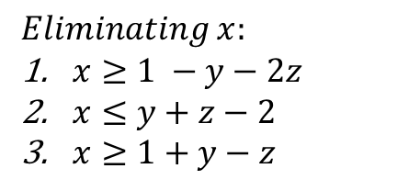

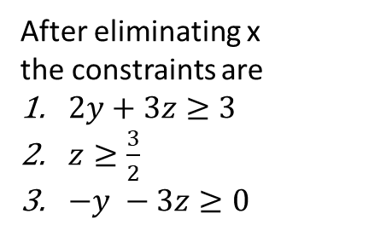



Example
$$x+y+2z≥1$$
$$−x+y+z≥2$$
$$x −y+z≥1$$
$$−y −3z≥0$$
After eliminating x
the constraints are
$2y+3z≥3$
$z≥\frac{3}{2}$
$−y −3z≥0$
$$Eliminating x:$$
$x≥1 −y−2z$
$x≤y+z−2$
$x≥1+y−z$
Using 1 and 2
$$y+z−2≥1 −y−2z$$
which simplifies to
$$2y+3z≥3$$
Using 2 and 3
$$y+z−2≥1+y−z$$
which simplifies
$$z≥\frac{3}{2}$$
Using 1 and 2
$$−3z≥\frac{1}{2}\left(3−3z\right)$$
which simplifies to
$$z≤−1$$
After eliminating y
the constraints are
$z≥\frac{3}{2}$
$z≤−1$
which are unsatisfiable.
Eliminating y:
$y ≥\frac{1}{2}(3−3z)$
$y≤−3z$

Slide 45

Example
$$x+y+2z≥1$$
$$3x+y+z≥2$$
$$4x+y+z≥1$$
$$x+7y+3z≥0$$

Slide 46
Complexity

Slide 47

Complexity
If the number of constraints is m initially, after the first elimination, it can be $\frac{m^{2}}{4}$ in the worst-case
After the second elimination: ${\left(\frac{m^{2}}{4}\right)}^{2}∗\left(\frac{1}{4}\right)=\frac{m^{4}}{4^{3}}$
After the third elimination: ${\left(\frac{m^{4}}{4^{3}}\right)}^{2}∗\left(\frac{1}{4}\right)=\frac{m^{8}}{4^{7}}$
After the fourth elimination:${\left(\frac{m^{8}}{4^{7}}\right)}^{2}∗\left(\frac{1}{4}\right)=\frac{m^{16}}{4^{15}}$
…
After the n^{th} elimination: $4∗{\left(\frac{m}{4}\right)}^{2^{n}}$

