Slide 2
References
Chapter-5 from the DP book

Slide 3
The Omega Test

Slide 4
The Omega Test
The Omega test is used to check the satisfiability of conjunction of linear constraints over integer variables

Slide 5
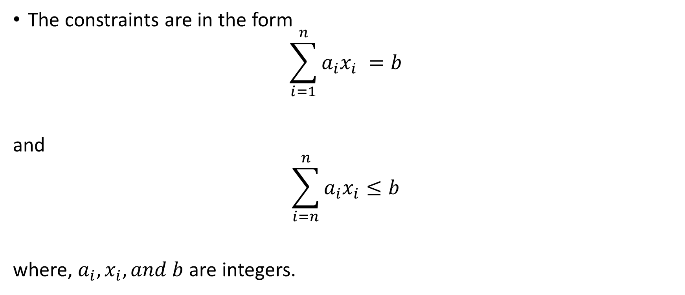
The Omega Test
The constraints are in the form
$$\sum_{i=1}^{n}{a_{i}x_{i}} =b$$
and
$$\sum_{i=n}^{n}{a_{i}x_{i}}≤b$$
where, $a_{i}, x_{i}, and b$ are integers.

Slide 6
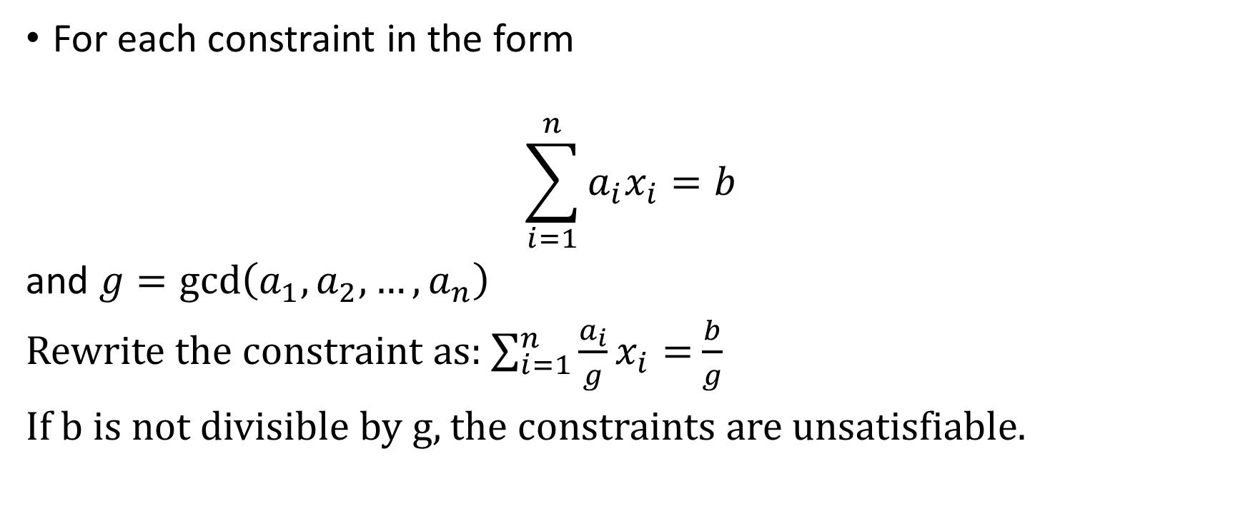
Simplification
For each constraint in the form
$$\sum_{i=1}^{n}{a_{i}x_{i}=b}$$
and $g=\gcd\left(a_{1}, a_{2}, …,a_{n}\right)$
Rewrite the constraint as: $\sum_{i=1}^{n}{\frac{a_{i}}{g}x_{i}=}$ $\frac{b}{g}$
If b is not divisible by g, the constraints are unsatisfiable.

Slide 7

Example
Is $3x+3y=2$ satisfiable?

Slide 8

Simplification
For each constraint in the form
$$\sum_{i=1}^{n}{a_{i}x_{i}≤b}$$
and $g=\gcd\left(a_{1}, a_{2}, …,a_{n}\right)$
Rewrite the constraint as: $\sum_{i=1}^{n}{\frac{a_{i}}{g}x_{i}≤}$ $\left\lfloor \frac{b}{g}\right\rfloor$

Slide 9

Example
Can we simplify $3x+3y≤2$?

Slide 10
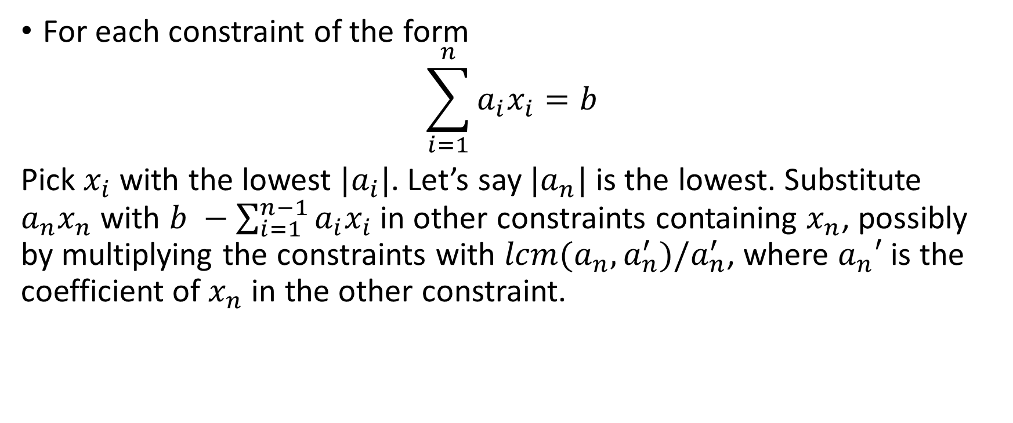
Elimination
For each constraint of the form
$$\sum_{i=1}^{n}{a_{i}x_{i}=b}$$
Pick $x_{i}$ with the lowest ${|a}_{i}|$. Let’s say ${|a}_{n}|$ is the lowest. Substitute $a_{n}x_{n}$ with $b −\sum_{i=1}^{n−1}{a_{i}x_{i}}$ in other constraints containing $x_{n}$, possibly by multiplying the constraints with $lcm(a_{n},a_{n}^{′})/a_{n}^{′}$, where $a_{n}′$ is the coefficient of $x_{n}$ in the other constraint.

Slide 11
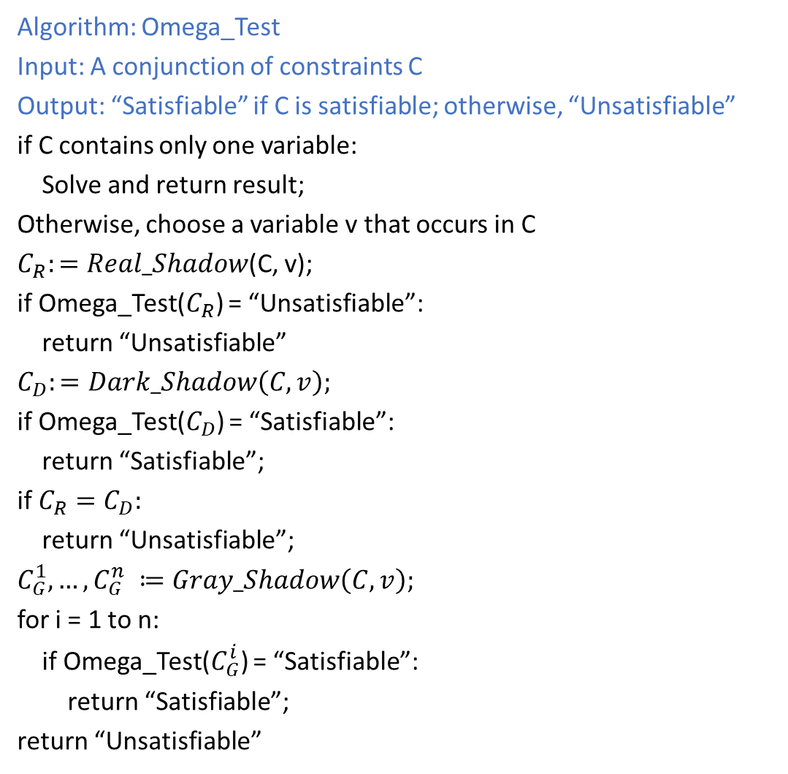
Omega Test
Algorithm: Omega_Test
Input: A conjunction of constraints C
Output: “Satisfiable” if C is satisfiable; otherwise, “Unsatisfiable”
if C contains only one variable:
Solve and return result;
Otherwise, choose a variable v that occurs in C
$C_{R}:=Real_Shadow$(C, v);
if Omega_Test($C_{R}$) = “Unsatisfiable”:
return “Unsatisfiable”
$$C_{D}:=Dark_Shadow\left(C, v\right);$$
if Omega_Test($C_{D}$) = “Satisfiable”:
return “Satisfiable”;
if $C_{R}=C_{D}:$
return “Unsatisfiable”;
$$C_{G}^{1}, …,C_{G}^{n} ≔Gray_Shadow\left(C, v\right);$$
for i = 1 to n:
if Omega_Test($C_{G}^{i}$) = “Satisfiable”:
return “Satisfiable”;
return “Unsatisfiable”

Slide 12
Real_Shadow
Real_Shadow generates constraints to remove a variable in a way similar to the Fourier-Motzkin Variable Elimination

Slide 13
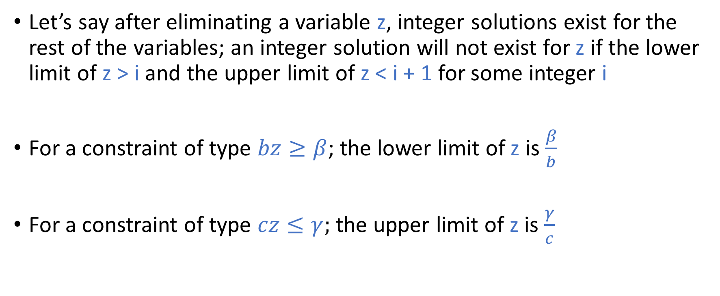
Dark Shadow
Let’s say after eliminating a variable z, integer solutions exist for the rest of the variables; an integer solution will not exist for z if the lower limit of z > i and the upper limit of z < i + 1 for some integer i
For a constraint of type $bz≥β$; the lower limit of z is $\frac{β}{b}$
For a constraint of type $cz≤γ;$ the upper limit of z is $\frac{γ}{c}$

Slide 14




Dark Shadow
i
$$\frac{β}{b}$$
$$\frac{γ}{c}$$
i + 1
$$≥\frac{1}{b}$$
$$≥\frac{1}{c}$$

Slide 15
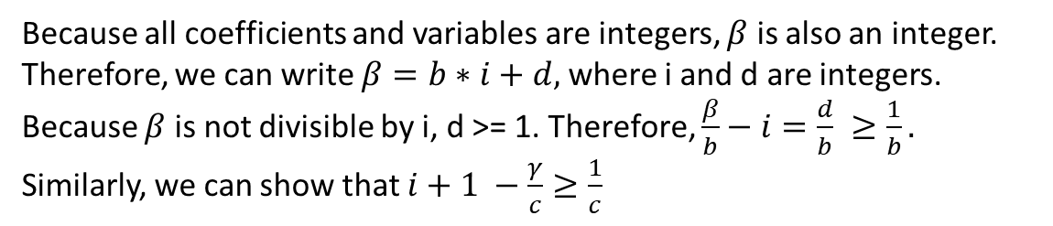

Dark Shadow
i
$$\frac{β}{b}$$
$$\frac{γ}{c}$$
i + 1
$$≥\frac{1}{b}$$
$$≥\frac{1}{c}$$
Because all coefficients and variables are integers, $β$ is also an integer. Therefore, we can write $β=b∗i+d,$ where i and d are integers. Because $β$ is not divisible by i, d >= 1. Therefore, $\frac{β}{b}−i=\frac{d}{b} ≥\frac{1}{b}.$ Similarly, we can show that $i+1 −\frac{γ}{c}≥\frac{1}{c}$

Slide 16

Dark Shadow
i
$$\frac{β}{b}$$
$$\frac{γ}{c}$$
i + 1
$$≥\frac{1}{b}$$
$$≥\frac{1}{c}$$
$$\left(\frac{β}{b}−i≥\frac{1}{b}\right) ∧ \left(i+1−\frac{γ}{c}≥\frac{1}{c}\right)$$

Slide 17
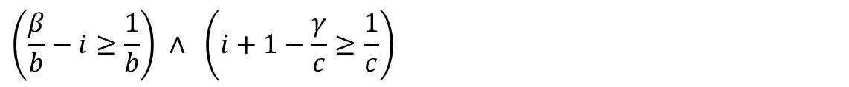
Dark Shadow
$$\left(\frac{β}{b}−i≥\frac{1}{b}\right) ∧ \left(i+1−\frac{γ}{c}≥\frac{1}{c}\right)$$

Slide 18

Dark Shadow
$$\left(\frac{β}{b}−i≥\frac{1}{b}\right)$$
$$\left(i+1−\frac{γ}{c}≥\frac{1}{c}\right)$$
$cβ−cbi≥c$ $→$ $cbi≤c −cβ$ $−(i)$
$cbi+cb −bγ≥b$ $→$ $cbi≥bγ+b−cb$ $−(ii)$
$c−cβ≥bγ+b−cb$ from (i) and (ii)
$$bγ−cβ≤cb −c −b$$
Therefore, z will not lie between two consecutive integers if
$$bγ−cβ>cb−c−b$$
$$bγ−cβ≥cb −c −b+1$$
$$bγ−cβ≥c\left(b−1\right)−1\left(b−1\right)$$
$$bγ−cβ≥\left(c−1\right)\left(b−1\right)$$
Thus, z must have an integer solution if the above condition is true.

Slide 19
Gray Shadow
i
$$\frac{β}{b}$$
$$\frac{γ}{c}$$
i + 1
$$≥\frac{1}{b}$$
$$≥\frac{1}{c}$$
These constraints may hold even if i is real.

Slide 20
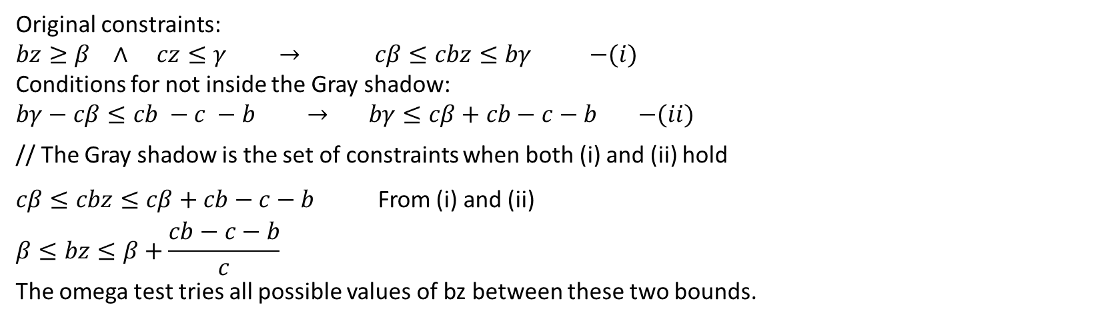
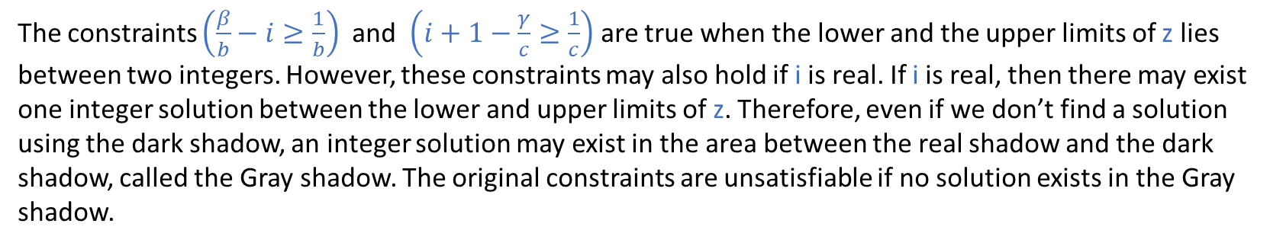
Gray Shadow
The constraints $\left(\frac{β}{b}−i≥\frac{1}{b}\right)$ and $\left(i+1−\frac{γ}{c}≥\frac{1}{c}\right)$ are true when the lower and the upper limits of z lies between two integers. However, these constraints may also hold if i is real. If i is real, then there may exist one integer solution between the lower and upper limits of z. Therefore, even if we don’t find a solution using the dark shadow, an integer solution may exist in the area between the real shadow and the dark shadow, called the Gray shadow. The original constraints are unsatisfiable if no solution exists in the Gray shadow.
Original constraints:
$bz≥β$ $∧$ $cz≤γ$ $→$ $cβ≤cbz≤bγ$ $−(i)$
Conditions for not inside the Gray shadow:
$bγ−cβ≤cb −c −b$ $→$ $bγ≤cβ+cb−c−b$ $−(ii)$
// The Gray shadow is the set of constraints when both (i) and (ii) hold
$cβ≤cbz≤cβ+cb−c−b$ From (i) and (ii)
$$β≤bz≤β+\frac{cb−c−b}{c}$$
The omega test tries all possible values of bz between these two bounds.

Slide 21
Example

Slide 22
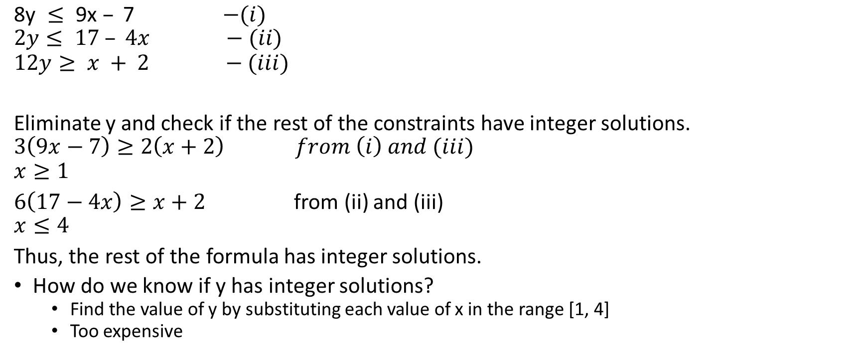
Omega test
$\text{8}\text{y} ≤\text{ 9}\text{x} –\text{ 7}$ $−(i)$
$$2y≤ 17 – 4x −(ii)$$
$$12y≥ x + 2 −(iii)$$
Eliminate y and check if the rest of the constraints have integer solutions.
$$3\left(9x−7\right)≥2\left(x+2\right) from \left(i\right) and (iii)$$
$$x≥1$$
$6\left(17−4x\right)≥x+2$ from (ii) and (iii)
$$x≤4$$
Thus, the rest of the formula has integer solutions.
How do we know if y has integer solutions?
Find the value of y by substituting each value of x in the range [1, 4]
Too expensive

Slide 23
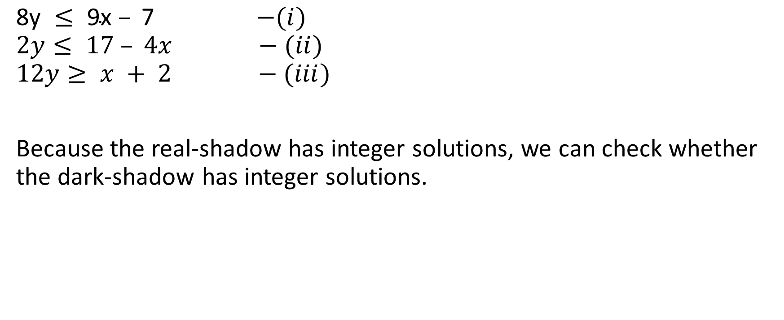
Omega test
$\text{8}\text{y} ≤\text{ 9}\text{x} –\text{ 7}$ $−(i)$
$$2y≤ 17 – 4x −(ii)$$
$$12y≥ x + 2 −(iii)$$
Because the real-shadow has integer solutions, we can check whether the dark-shadow has integer solutions.

Slide 24

Omega test
$\text{8}\text{y} ≤\text{ 9}\text{x} –\text{ 7}$ $−(i)$
$$2y≤ 17 – 4x −(ii)$$
$$12y≥ x + 2 −(iii)$$
Dark-shadow test:
For each $bz≥β$ and $cz≤γ$
eliminate z using $bγ−cβ≥\left(c−1\right)\left(b−1\right)$

Slide 25
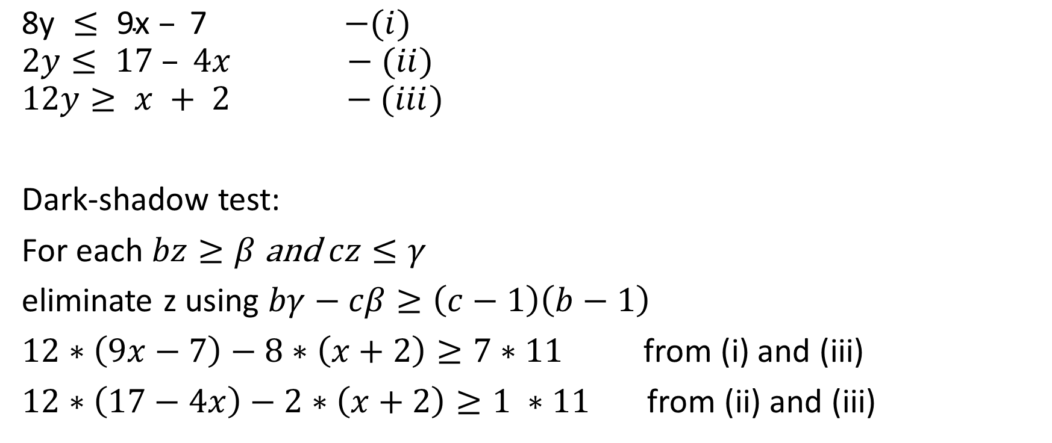
Omega test
$\text{8}\text{y} ≤\text{ 9}\text{x} –\text{ 7}$ $−(i)$
$$2y≤ 17 – 4x −(ii)$$
$$12y≥ x + 2 −(iii)$$
Dark-shadow test:
For each $bz≥β$ and $cz≤γ$
eliminate z using $bγ−cβ≥\left(c−1\right)\left(b−1\right)$
$12∗\left(9x−7\right)−8∗\left(x+2\right)≥7∗11$ from (i) and (iii)
$12∗\left(17−4x\right)−2∗\left(x+2\right)≥1 ∗11$ from (ii) and (iii)

Slide 26
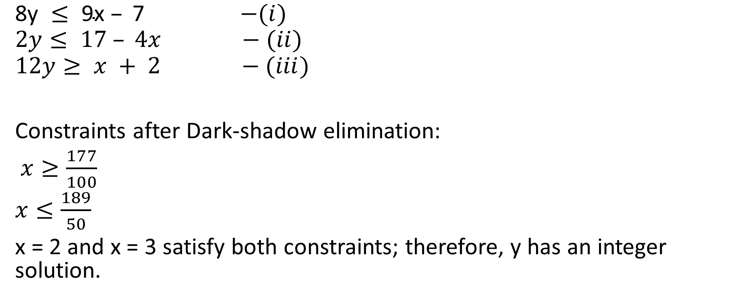
Omega test
$\text{8}\text{y} ≤\text{ 9}\text{x} –\text{ 7}$ $−(i)$
$$2y≤ 17 – 4x −(ii)$$
$$12y≥ x + 2 −(iii)$$
Constraints after Dark-shadow elimination:
$x≥\frac{177}{100}$
$x≤\frac{189}{50}$
x = 2 and x = 3 satisfy both constraints; therefore, y has an integer solution.

Slide 27
Example

Slide 28
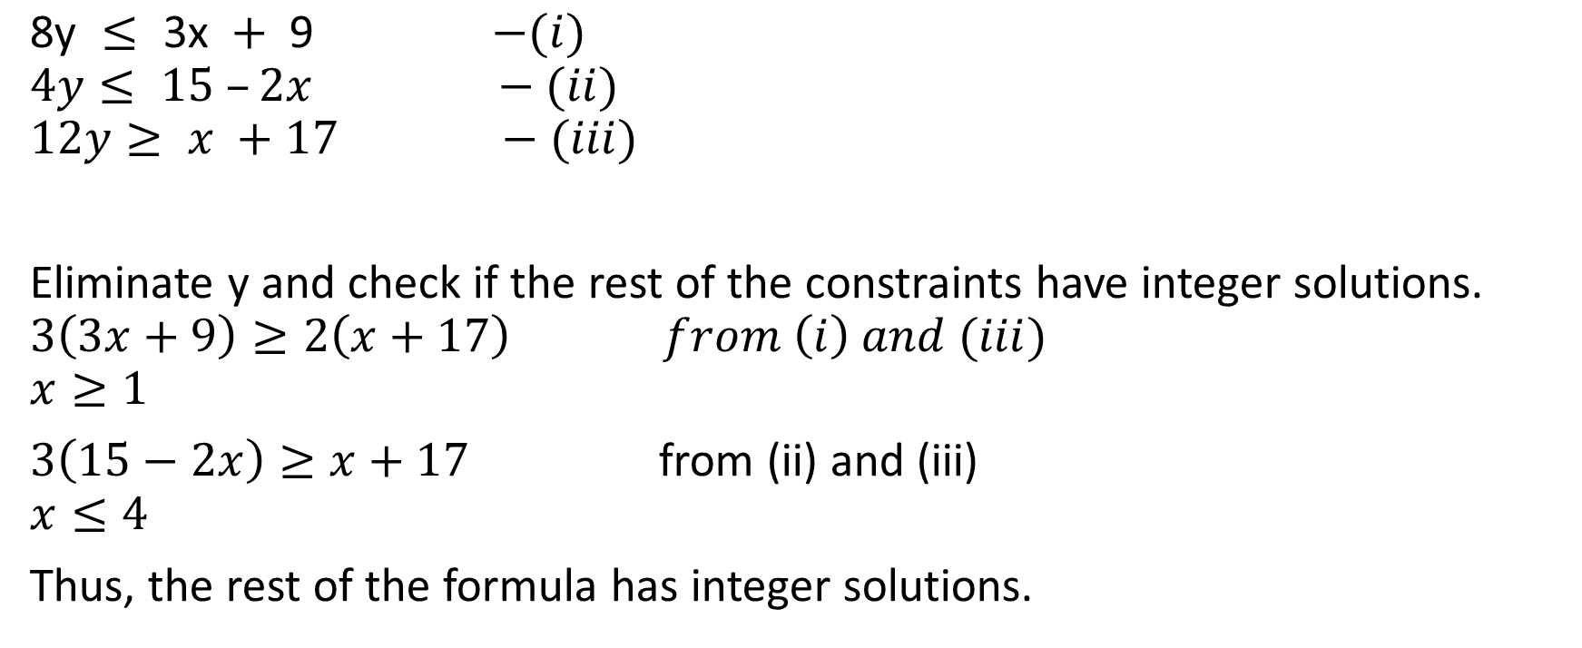
Omega test
$\text{8}\text{y} ≤ \text{3}\text{x} + \text{9 }$ $−(i)$
$$4y≤ 15 –2x −(ii)$$
$$12y≥ x +17 −(iii)$$
Eliminate y and check if the rest of the constraints have integer solutions.
$$3\left(3x+9\right)≥2\left(x+17\right) from \left(i\right) and (iii)$$
$$x≥1$$
$3\left(15−2x\right)≥x+17$ from (ii) and (iii)
$$x≤4$$
Thus, the rest of the formula has integer solutions.

Slide 29
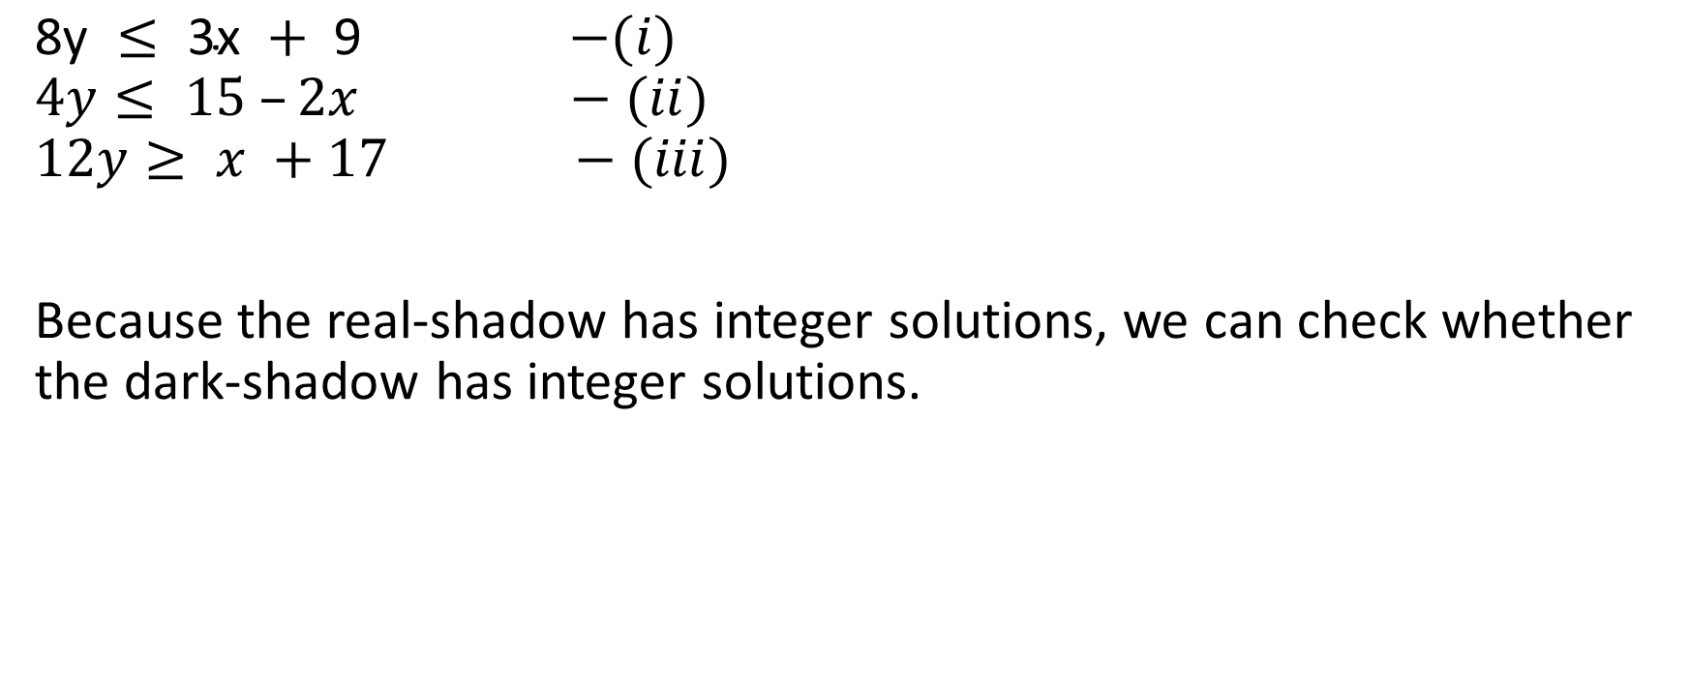
Omega test
$\text{8}\text{y} ≤\text{ 3}\text{x} +\text{ 9 }$ $−(i)$
$$4y≤ 15 –2x −(ii)$$
$$12y≥ x +17 −(iii)$$
Because the real-shadow has integer solutions, we can check whether the dark-shadow has integer solutions.

Slide 30

Omega test
$\text{8}\text{y} ≤\text{ 3}\text{x} +\text{ 9 }$ $−(i)$
$$4y≤ 15 –2x −(ii)$$
$$12y≥ x +17 −(iii)$$
Dark-shadow test:
For each $bz≥β$ and $cz≤γ$
eliminate z using $bγ−cβ≥\left(c−1\right)\left(b−1\right)$

Slide 31
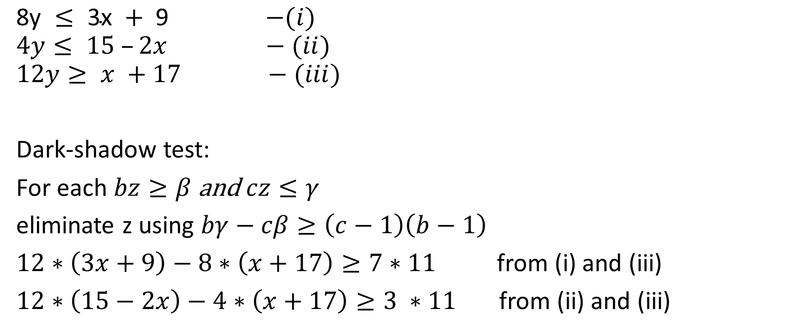
Omega test
$\text{8}\text{y} ≤\text{ 3}\text{x} +\text{ 9 }$ $−(i)$
$$4y≤ 15 –2x −(ii)$$
$$12y≥ x +17 −(iii)$$
Dark-shadow test:
For each $bz≥β$ and $cz≤γ$
eliminate z using $bγ−cβ≥\left(c−1\right)\left(b−1\right)$
$12∗\left(3x+9\right)−8∗\left(x+17\right)≥7∗11$ from (i) and (iii)
$12∗\left(15−2x\right)−4∗\left(x+17\right)≥3 ∗11$ from (ii) and (iii)

Slide 32
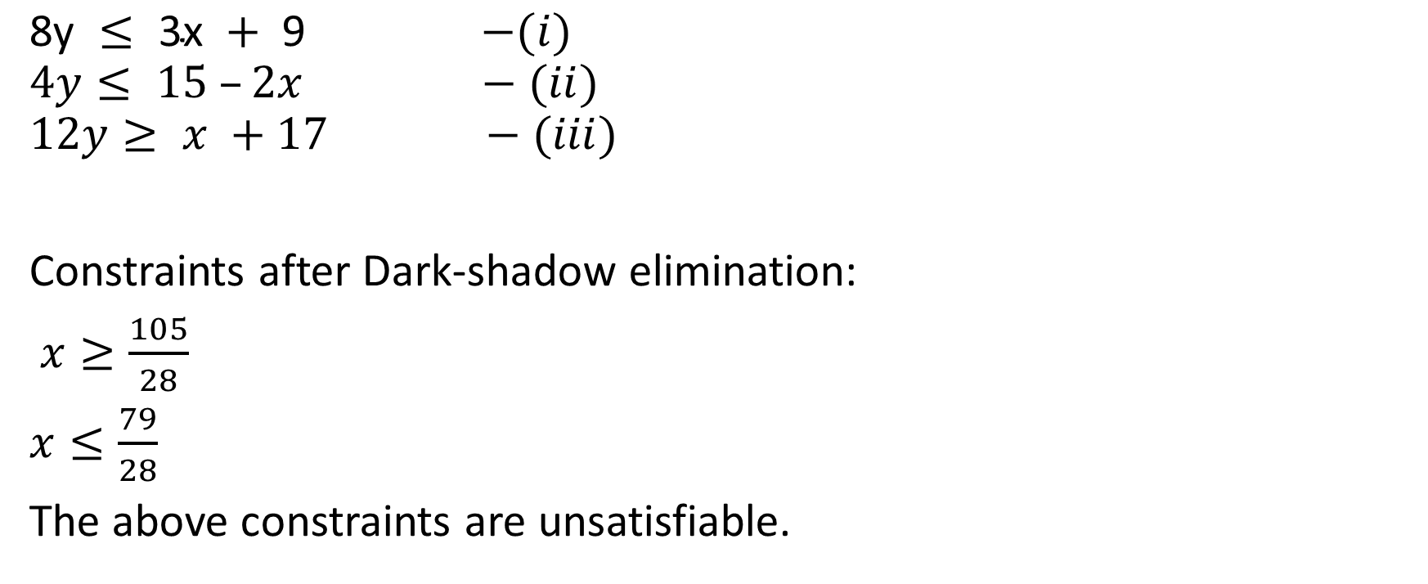
Omega test
$\text{8}\text{y} ≤\text{ 3}\text{x} +\text{ 9 }$ $−(i)$
$$4y≤ 15 –2x −(ii)$$
$$12y≥ x +17 −(iii)$$
Constraints after Dark-shadow elimination:
$x≥\frac{105}{28}$
$x≤\frac{79}{28}$
The above constraints are unsatisfiable.

Slide 33
Omega test
Even though the dark shadow doesn’t have any solution, the Gray shadow might have

Slide 34

Omega test
$\text{8}\text{y} ≤\text{ 3}\text{x} +\text{ 9 }$ $−(i)$
$$4y≤ 15 –2x −(ii)$$
$$12y≥ x +17 −(iii)$$
Gray-shadow test:
For each $bz≥β$ and $cz≤γ$
Try $bz=β+i,$ where $0≤i≤\frac{cb−c−b}{c}$

Slide 35
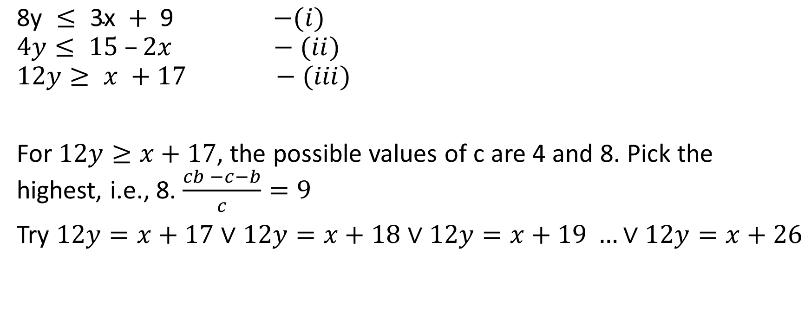
Omega test
$\text{8}\text{y} ≤\text{ 3}\text{x} +\text{ 9 }$ $−(i)$
$$4y≤ 15 –2x −(ii)$$
$$12y≥ x +17 −(iii)$$
For $12y≥x+17$, the possible values of c are 4 and 8. Pick the highest, i.e., 8. $\frac{cb −c−b}{c}=9$
Try $12y=x+17$ $∨$ $12y=x+18$ $∨12y=x+19 …∨12y=x+26$

Slide 36
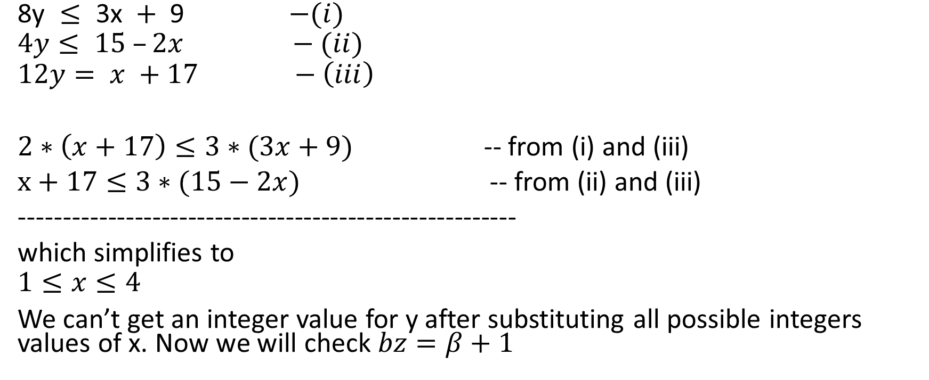
Omega test
$\text{8}\text{y} ≤\text{ 3}\text{x} +\text{ 9 }$ $−(i)$
$$4y≤ 15 –2x −(ii)$$
$$12y= x +17 −\left(iii\right)$$
$2∗\left(x+17\right)≤3∗(3x+9)$ -- from (i) and (iii)
$x+17≤3∗(15−2x)$ -- from (ii) and (iii)
--------------------------------------------------------
which simplifies to
$$1≤x≤4$$
We can’t get an integer value for y after substituting all possible integers values of x. Now we will check $bz=β+1$

Slide 37
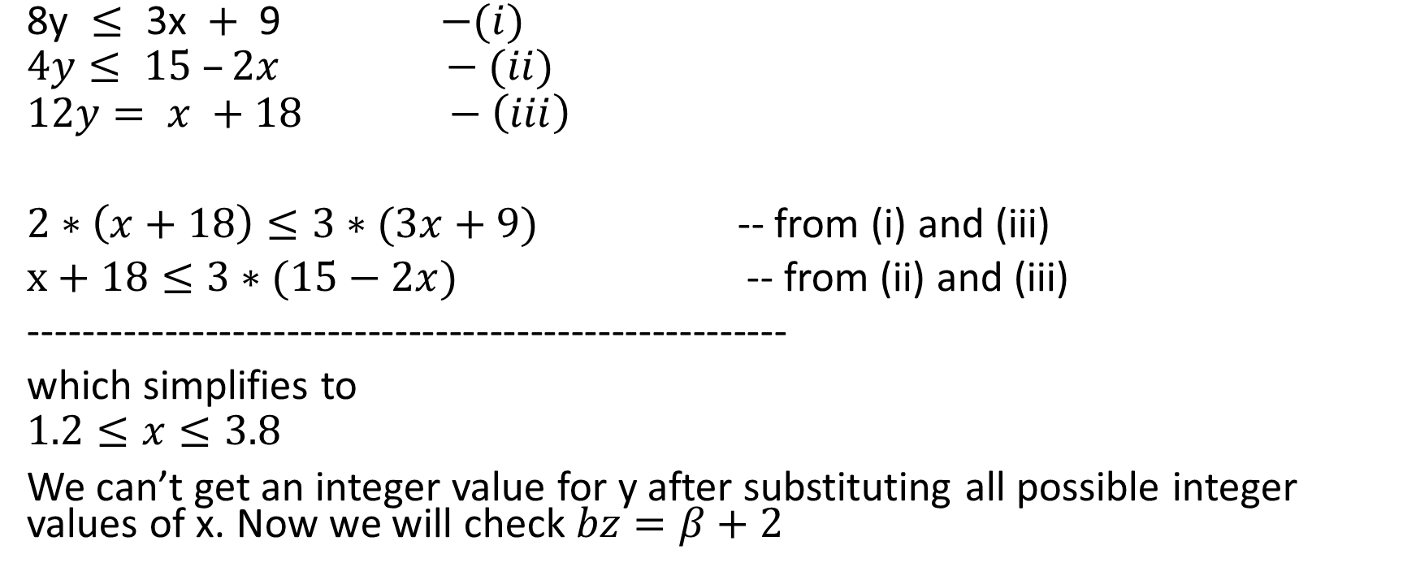
Omega test
$\text{8}\text{y} ≤\text{ 3}\text{x} +\text{ 9 }$ $−(i)$
$$4y≤ 15 –2x −(ii)$$
$$12y= x +18 −\left(iii\right)$$
$2∗\left(x+18\right)≤3∗(3x+9)$ -- from (i) and (iii)
$x+18≤3∗(15−2x)$ -- from (ii) and (iii)
--------------------------------------------------------
which simplifies to
$$1.2≤x≤3.8$$
We can’t get an integer value for y after substituting all possible integer values of x. Now we will check $bz=β+2$

Slide 38
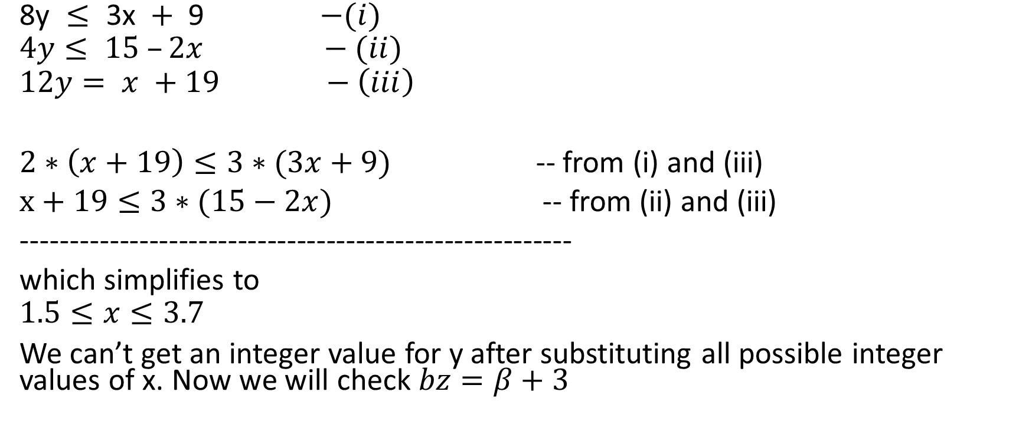
Omega test
$\text{8}\text{y} ≤\text{ 3}\text{x} +\text{ 9 }$ $−(i)$
$$4y≤ 15 –2x −(ii)$$
$$12y= x +19 −\left(iii\right)$$
$2∗\left(x+19\right)≤3∗(3x+9)$ -- from (i) and (iii)
$x+19≤3∗(15−2x)$ -- from (ii) and (iii)
--------------------------------------------------------
which simplifies to
$$1.5≤x≤3.7$$
We can’t get an integer value for y after substituting all possible integer values of x. Now we will check $bz=β+3$

Slide 39
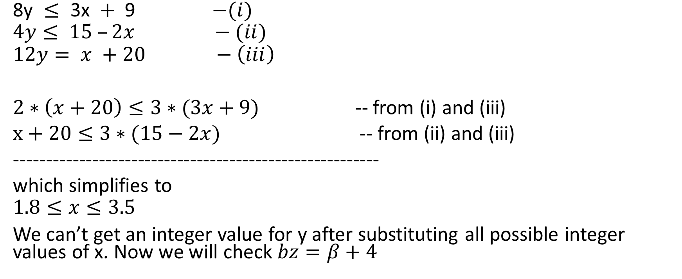
Omega test
$\text{8}\text{y} ≤\text{ 3}\text{x} +\text{ 9 }$ $−(i)$
$$4y≤ 15 –2x −(ii)$$
$$12y= x +20 −\left(iii\right)$$
$2∗\left(x+20\right)≤3∗(3x+9)$ -- from (i) and (iii)
$x+20≤3∗(15−2x)$ -- from (ii) and (iii)
--------------------------------------------------------
which simplifies to
$$1.8≤x≤3.5$$
We can’t get an integer value for y after substituting all possible integer values of x. Now we will check $bz=β+4$

Slide 40
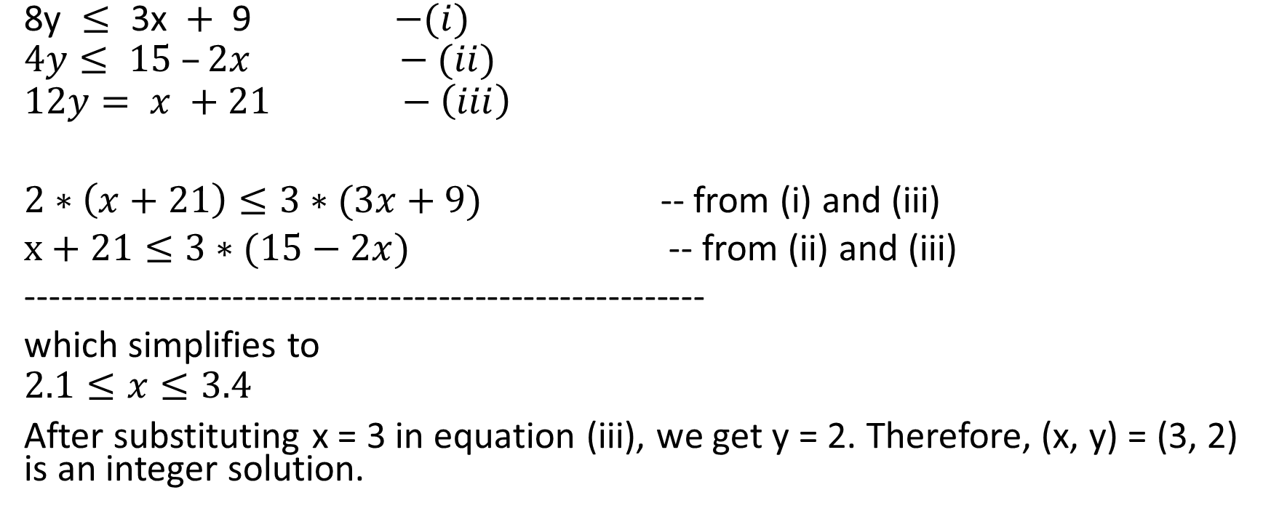
Omega test
$\text{8}\text{y} ≤\text{ 3}\text{x} +\text{ 9 }$ $−(i)$
$$4y≤ 15 –2x −(ii)$$
$$12y= x +21 −\left(iii\right)$$
$2∗\left(x+21\right)≤3∗(3x+9)$ -- from (i) and (iii)
$x+21≤3∗(15−2x)$ -- from (ii) and (iii)
--------------------------------------------------------
which simplifies to
$$2.1≤x≤3.4$$
After substituting x = 3 in equation (iii), we get y = 2. Therefore, (x, y) = (3, 2) is an integer solution.

Slide 41
Omega test

