Slide 2
References
Chapter-5 from the DP book

Slide 3
Today’s topics
The Omega Test
Difference Logic

Slide 4
The Omega Test

Slide 5
The Omega Test
The Omega test is used to check the satisfiability of conjunction of linear constraints over integer variables

Slide 6
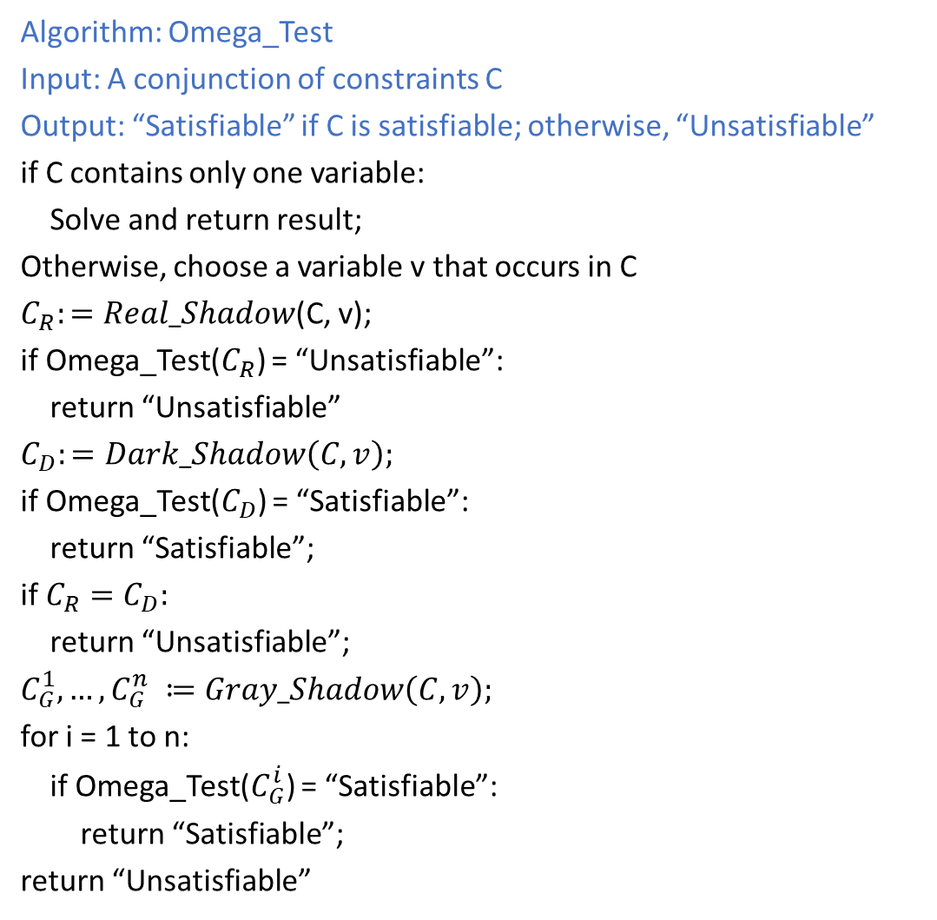
Omega Test
Algorithm: Omega_Test
Input: A conjunction of constraints C
Output: “Satisfiable” if C is satisfiable; otherwise, “Unsatisfiable”
if C contains only one variable:
Solve and return result;
Otherwise, choose a variable v that occurs in C
$C_{R}:=Real_Shadow$(C, v);
if Omega_Test($C_{R}$) = “Unsatisfiable”:
return “Unsatisfiable”
$$C_{D}:=Dark_Shadow\left(C, v\right);$$
if Omega_Test($C_{D}$) = “Satisfiable”:
return “Satisfiable”;
if $C_{R}=C_{D}:$
return “Unsatisfiable”;
$$C_{G}^{1}, …,C_{G}^{n} ≔Gray_Shadow\left(C, v\right);$$
for i = 1 to n:
if Omega_Test($C_{G}^{i}$) = “Satisfiable”:
return “Satisfiable”;
return “Unsatisfiable”

Slide 7

Dark Shadow
$$\left(\frac{β}{b}−i≥\frac{1}{b}\right)$$
$$\left(i+1−\frac{γ}{c}≥\frac{1}{c}\right)$$
$cβ−cbi≥c$ $→$ $cbi≤c −cβ$ $−(i)$
$cbi+cb −bγ≥b$ $→$ $cbi≥bγ+b−cb$ $−(ii)$
$c−cβ≥bγ+b−cb$ from (i) and (ii)
$$bγ−cβ≤cb −c −b$$
Therefore, z will not lie between two consecutive integers if
$$bγ−cβ>cb−c−b$$
$$bγ−cβ≥cb −c −b+1$$
$$bγ−cβ≥c\left(b−1\right)−1\left(b−1\right)$$
$$bγ−cβ≥\left(c−1\right)\left(b−1\right)$$
Thus, z must have an integer solution if the above condition is true.

Slide 8
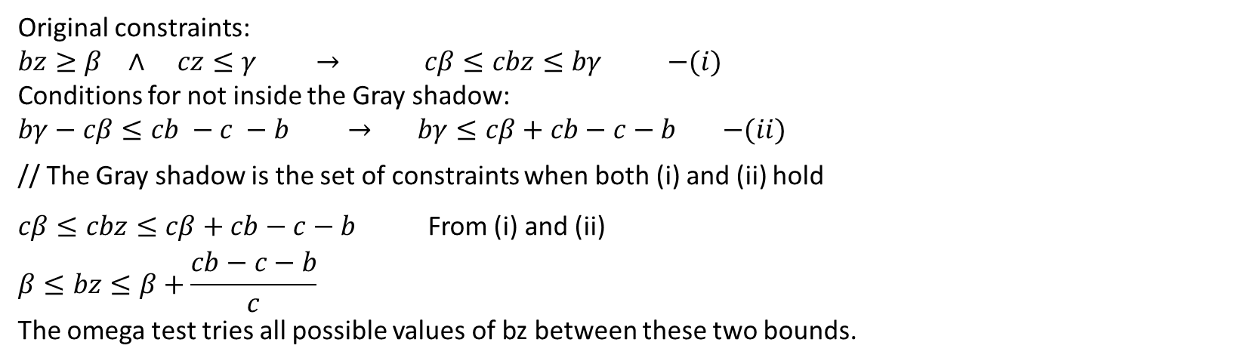
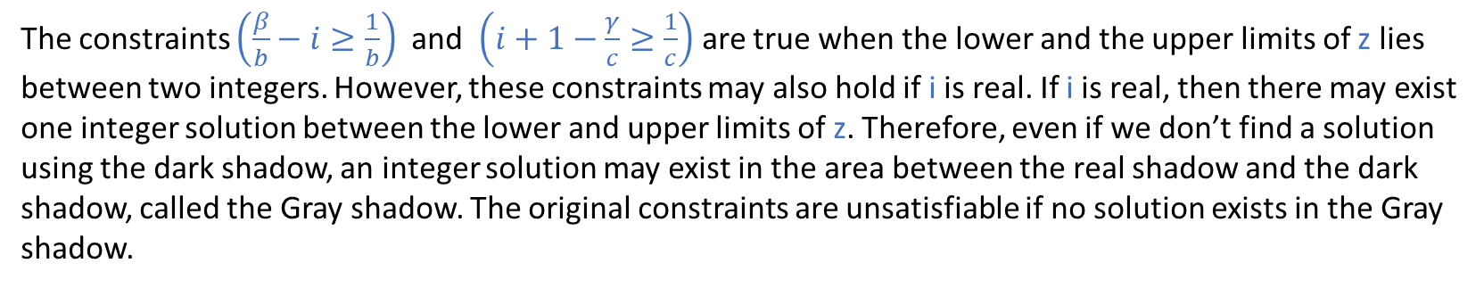
Gray Shadow
The constraints $\left(\frac{β}{b}−i≥\frac{1}{b}\right)$ and $\left(i+1−\frac{γ}{c}≥\frac{1}{c}\right)$ are true when the lower and the upper limits of z lies between two integers. However, these constraints may also hold if i is real. If i is real, then there may exist one integer solution between the lower and upper limits of z. Therefore, even if we don’t find a solution using the dark shadow, an integer solution may exist in the area between the real shadow and the dark shadow, called the Gray shadow. The original constraints are unsatisfiable if no solution exists in the Gray shadow.
Original constraints:
$bz≥β$ $∧$ $cz≤γ$ $→$ $cβ≤cbz≤bγ$ $−(i)$
Conditions for not inside the Gray shadow:
$bγ−cβ≤cb −c −b$ $→$ $bγ≤cβ+cb−c−b$ $−(ii)$
// The Gray shadow is the set of constraints when both (i) and (ii) hold
$cβ≤cbz≤cβ+cb−c−b$ From (i) and (ii)
$$β≤bz≤β+\frac{cb−c−b}{c}$$
The omega test tries all possible values of bz between these two bounds.

Slide 9
Example

Slide 10
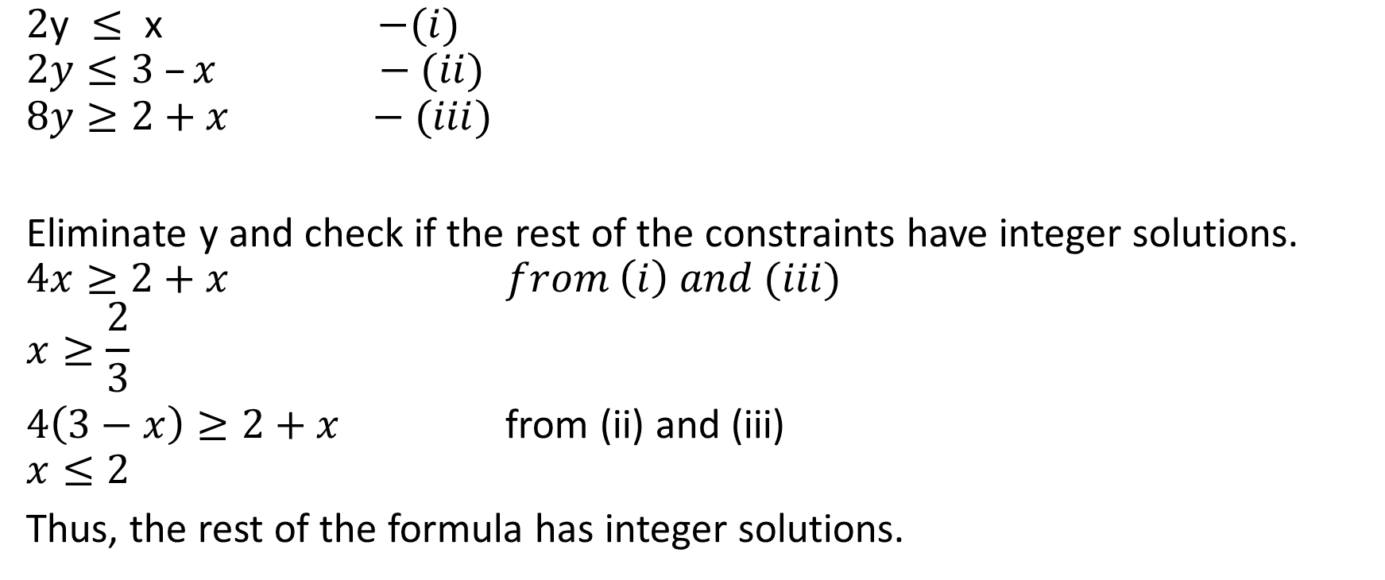
Omega test
$\text{2}\text{y} ≤ \text{x}$ $−(i)$
$$2y≤3 –x −(ii)$$
$$8y≥2+x −(iii)$$
Eliminate y and check if the rest of the constraints have integer solutions.
$$4x≥2+x from \left(i\right) and (iii)$$
$$x≥\frac{2}{3}$$
$4\left(3−x\right)≥2+x$ from (ii) and (iii)
$$x≤2$$
Thus, the rest of the formula has integer solutions.

Slide 11
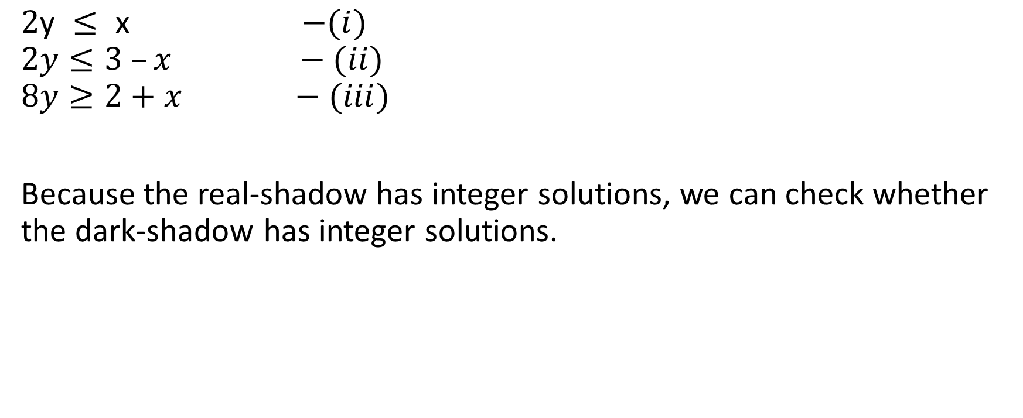
Omega test
$\text{2}\text{y} ≤ \text{x}$ $−(i)$
$$2y≤3 –x −(ii)$$
$$8y≥2+x −(iii)$$
Because the real-shadow has integer solutions, we can check whether the dark-shadow has integer solutions.

Slide 12

Omega test
$\text{2}\text{y} ≤ \text{x}$ $−(i)$
$$2y≤3 –x −(ii)$$
$$8y≥2+x −(iii)$$
Dark-shadow test:
For each $bz≥β$ and $cz≤γ$
eliminate z using $bγ−cβ≥\left(c−1\right)\left(b−1\right)$

Slide 13
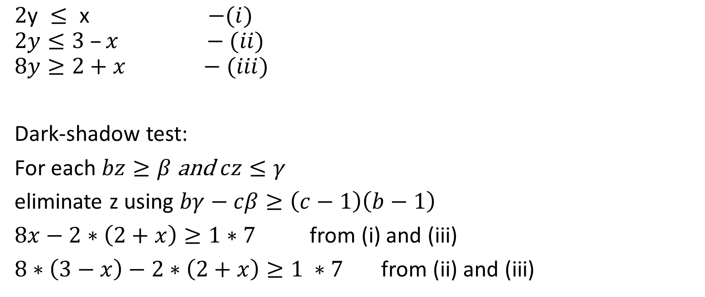
Omega test
$\text{2}\text{y} ≤ \text{x}$ $−(i)$
$$2y≤3 –x −(ii)$$
$$8y≥2+x −(iii)$$
Dark-shadow test:
For each $bz≥β$ and $cz≤γ$
eliminate z using $bγ−cβ≥\left(c−1\right)\left(b−1\right)$
$8x−2∗\left(2+x\right)≥1∗7$ from (i) and (iii)
$8∗\left(3−x\right)−2∗\left(2+x\right)≥1 ∗7$ from (ii) and (iii)

Slide 14
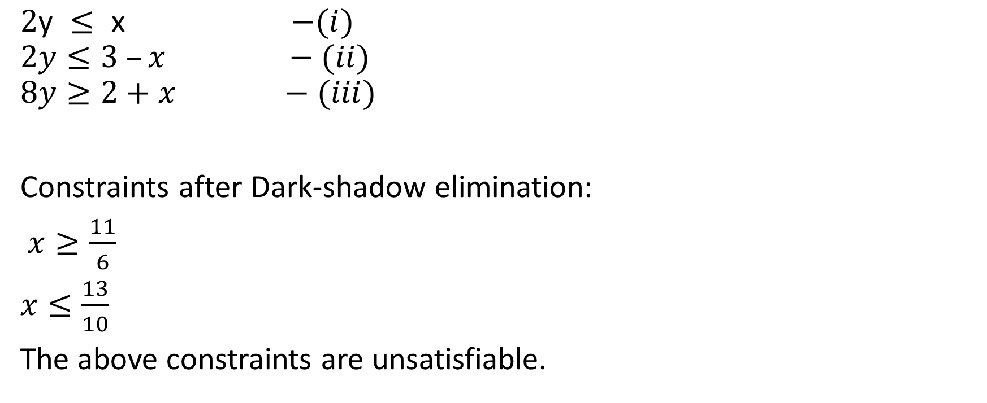
Omega test
$\text{2}\text{y} ≤ \text{x}$ $−(i)$
$$2y≤3 –x −(ii)$$
$$8y≥2+x −(iii)$$
Constraints after Dark-shadow elimination:
$x≥\frac{11}{6}$
$x≤\frac{13}{10}$
The above constraints are unsatisfiable.

Slide 15
Omega test
Even though the dark shadow doesn’t have any solution, the Gray shadow might have

Slide 16

Omega test
$\text{2}\text{y} ≤ \text{x}$ $−(i)$
$$2y≤3 –x −(ii)$$
$$8y≥2+x −(iii)$$
Gray-shadow test:
For each $bz≥β$ and $cz≤γ$
Try $bz=β+i,$ where $0≤i≤\frac{cb−c−b}{c}$

Slide 17

Omega test
$\text{2}\text{y} ≤ \text{x}$ $−(i)$
$$2y≤3 –x −(ii)$$
$$8y≥2+x −(iii)$$
For $8y≥2+x$, the only possible value of c is 2. $\frac{cb −c−b}{c}=3$
Try $8y=2+x$ $∨$ $8y=3+x$ $∨…∨8y=5+x$

Slide 18
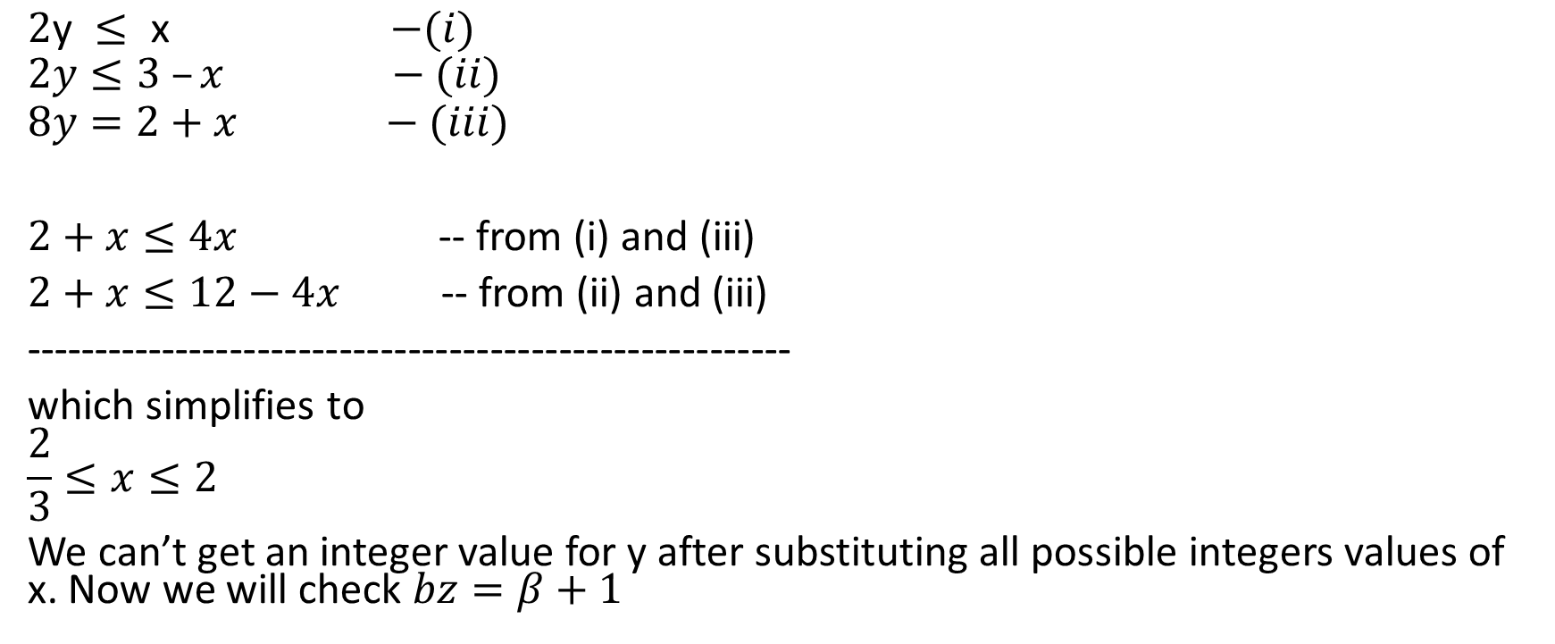
Omega test
$\text{2}\text{y} ≤ \text{x}$ $−(i)$
$$2y≤3 –x −(ii)$$
$$8y=2+x −(iii)$$
$2+x≤4x$ -- from (i) and (iii)
$2+x≤12−4x$ -- from (ii) and (iii)
--------------------------------------------------------
which simplifies to
$$\frac{2}{3}≤x≤2$$
We can’t get an integer value for y after substituting all possible integers values of x. Now we will check $bz=β+1$

Slide 19
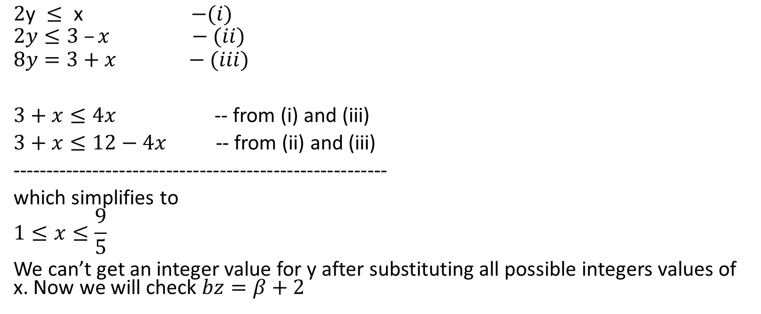
Omega test
$\text{2}\text{y} ≤ \text{x}$ $−(i)$
$$2y≤3 –x −(ii)$$
$$8y=3+x −(iii)$$
$3+x≤4x$ -- from (i) and (iii)
$3+x≤12−4x$ -- from (ii) and (iii)
--------------------------------------------------------
which simplifies to
$$1≤x≤\frac{9}{5}$$
We can’t get an integer value for y after substituting all possible integers values of x. Now we will check $bz=β+2$

Slide 20
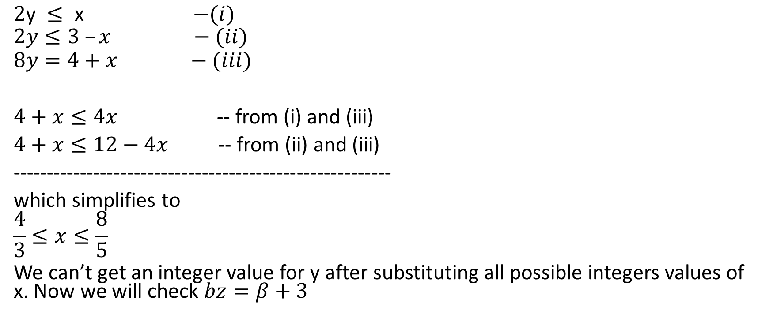
Omega test
$\text{2}\text{y} ≤ \text{x}$ $−(i)$
$$2y≤3 –x −(ii)$$
$$8y=4+x −(iii)$$
$4+x≤4x$ -- from (i) and (iii)
$4+x≤12−4x$ -- from (ii) and (iii)
--------------------------------------------------------
which simplifies to
$$\frac{4}{3}≤x≤\frac{8}{5}$$
We can’t get an integer value for y after substituting all possible integers values of x. Now we will check $bz=β+3$

Slide 21
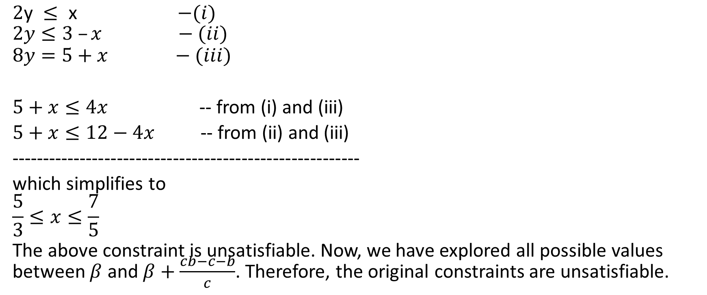
Omega test
$\text{2}\text{y} ≤ \text{x}$ $−(i)$
$$2y≤3 –x −(ii)$$
$$8y=5+x −(iii)$$
$5+x≤4x$ -- from (i) and (iii)
$5+x≤12−4x$ -- from (ii) and (iii)
--------------------------------------------------------
which simplifies to
$$\frac{5}{3}≤x≤\frac{7}{5}$$
The above constraint is unsatisfiable. Now, we have explored all possible values between $β$ and $β+\frac{cb−c−b}{c}$. Therefore, the original constraints are unsatisfiable.

Slide 22

Example
$x+y−2z≥2$ - (i)
$−2x −3y+3z≥0$ - (ii)
$y+3z≥1$ - (iii)

Slide 23
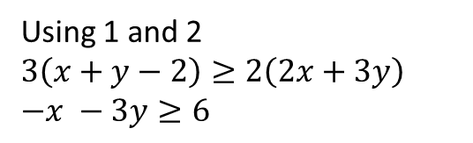

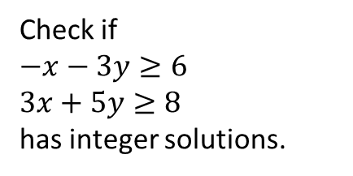
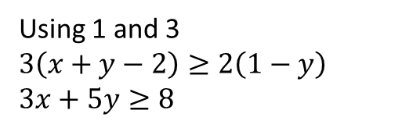
Omega test
$x+y−2z≥2$ - (i)
$−2x −3y+3z≥0$ - (ii)
$y+3z≥1$ - (iii)
Eliminating z using real shadow:
$2z≤x+y−2$ -(1)
$3z≥2x+3y$ -(2)
$3z≥1−y$ -(3)
Using 1 and 2
$$3\left(x+y−2\right)≥2\left(2x+3y\right)$$
$$−x −3y≥6$$
Check if
$$−x−3y≥6$$
$$3x+5y≥8$$
has integer solutions.
Using 1 and 3
$$3\left(x+y−2\right)≥2\left(1−y\right)$$
$$3x+5y≥8$$

Slide 24
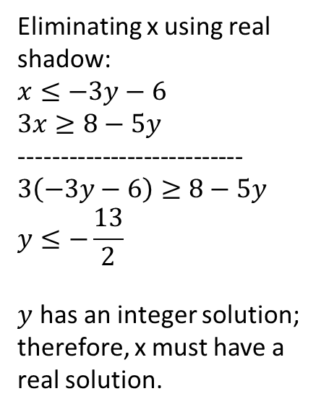
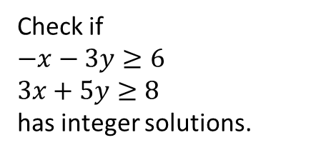
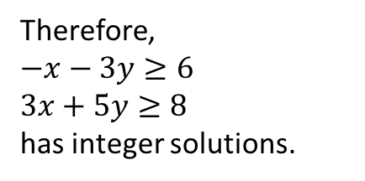
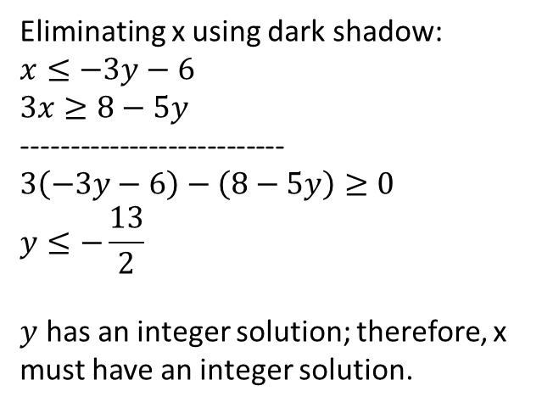
Omega test
Check if
$$−x−3y≥6$$
$$3x+5y≥8$$
has integer solutions.
Eliminating x using real shadow:
$$x≤−3y−6$$
$$3x≥8−5y$$
---------------------------
$$3\left(−3y−6\right)≥8−5y$$
$$y≤−\frac{13}{2}$$
$y$ has an integer solution; therefore, x must have a real solution.
Eliminating x using dark shadow:
$$x≤−3y−6$$
$$3x≥8−5y$$
---------------------------
$$3\left(−3y−6\right)−\left(8−5y\right)≥0$$
$$y≤−\frac{13}{2}$$
$y$ has an integer solution; therefore, x must have an integer solution.
Therefore,
$$−x−3y≥6$$
$$3x+5y≥8$$
has integer solutions.

Slide 25
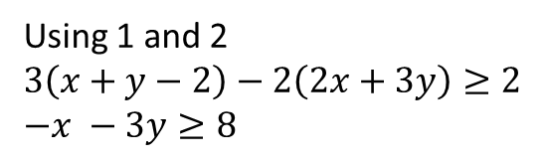

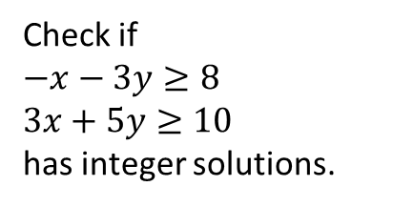
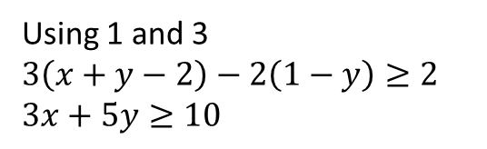
Omega test
$x+y−2z≥2$ - (i)
$−2x −3y+3z≥0$ - (ii)
$y+3z≥1$ - (iii)
Eliminating z using dark shadow:
$2z≤x+y−2$ -(1)
$3z≥2x+3y$ -(2)
$3z≥1−y$ -(3)
Using 1 and 2
$$3\left(x+y−2\right)−2\left(2x+3y\right)≥2$$
$$−x −3y≥8$$
Check if
$$−x−3y≥8$$
$$3x+5y≥10$$
has integer solutions.
Using 1 and 3
$$3\left(x+y−2\right)−2\left(1−y\right)≥2$$
$$3x+5y≥10$$

Slide 26
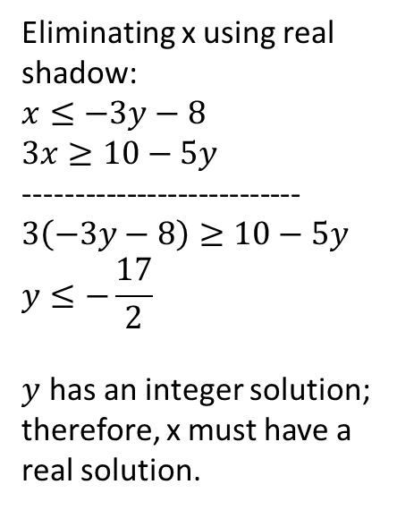
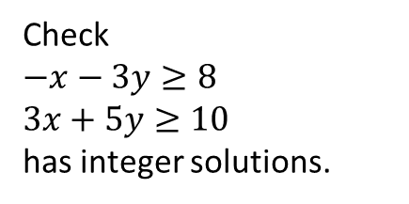
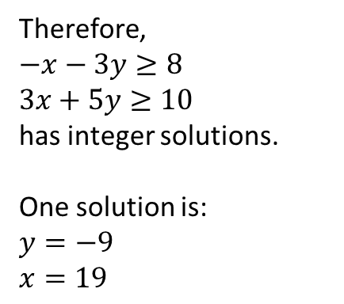
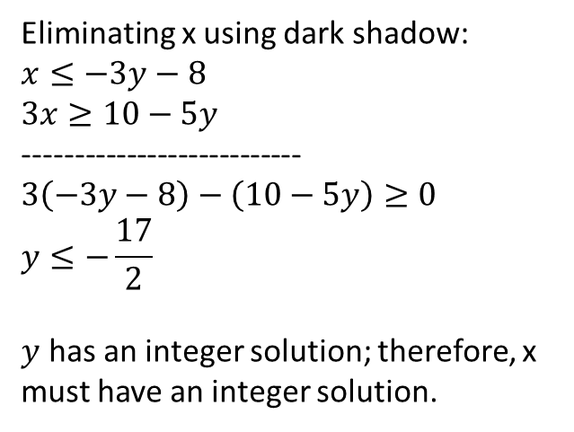
Omega test
Check
$$−x−3y≥8$$
$$3x+5y≥10$$
has integer solutions.
Eliminating x using real shadow:
$$x≤−3y−8$$
$$3x≥10−5y$$
---------------------------
$$3\left(−3y−8\right)≥10−5y$$
$$y≤−\frac{17}{2}$$
$y$ has an integer solution; therefore, x must have a real solution.
Eliminating x using dark shadow:
$$x≤−3y−8$$
$$3x≥10−5y$$
---------------------------
$$3\left(−3y−8\right)−\left(10−5y\right)≥0$$
$$y≤−\frac{17}{2}$$
$y$ has an integer solution; therefore, x must have an integer solution.
Therefore,
$$−x−3y≥8$$
$$3x+5y≥10$$
has integer solutions.
One solution is:
$$y=−9$$
$$x=19$$

Slide 27

Omega test
$x+y−2z≥2$ - (i)
$−2x −3y+3z≥0$ - (ii)
$y+3z≥1$ - (iii)
Eliminating z using dark shadow:
$2z≤x+y−2$ -(1)
$3z≥2x+3y$ -(2)
$3z≥1−y$ -(3)
Because,
$$−x−3y≥8$$
$$3x+5y≥10$$
has integer solutions; therefore, the original constraints have integer solutions.
One solution is:
$x=19, y=−9,z=4$
Using 1 and 2
$$3\left(x+y−2\right)−2\left(2x+3y\right)≥2$$
$$−x −3y≥8$$
Using 1 and 3
$$3\left(x+y−2\right)−2\left(1−y\right)≥2$$
$$3x+5y≥10$$

Slide 28
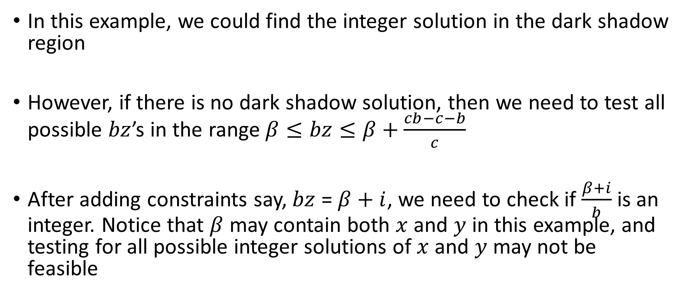
Omega test
In this example, we could find the integer solution in the dark shadow region
However, if there is no dark shadow solution, then we need to test all possible $bz$’s in the range $β≤bz≤β+\frac{cb−c−b}{c}$
After adding constraints say, $bz$ =$β+i$, we need to check if $\frac{β+i}{b}$ is an integer. Notice that $β$ may contain both $x$ and $y$ in this example, and testing for all possible integer solutions of $x$ and $y$ may not be feasible

Slide 29
Omega test
To solve this problem, Section 5.5.2 proposes a solution to transform an equality constraint in a way that at least one coefficient is 1 or -1
In this case, we can eliminate a variable with the unit coefficient from all equations. If the rest of the constraints have integer solutions, then the eliminated variable must have an integer solution

Slide 30
Difference logic

Slide 31
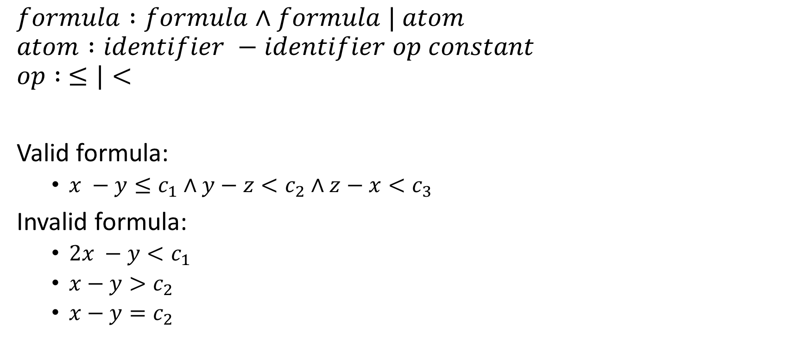
Syntax
$$formula :formula∧formula | atom$$
$$atom :identifier −identifier op constant$$
$$op : ≤|<$$
Valid formula:
$x −y≤c_{1}∧y−z<c_{2}∧z−x<c_{3}$
Invalid formula:
$2x −y<c_{1}$
$x−y>c_{2}$
$x−y=c_{2}$

Slide 32

Difference Logic
The following predicates can be transformed into difference logic
$x−y=c$
$x−y≥c$
$x−y>c$
$x<5$

Slide 33
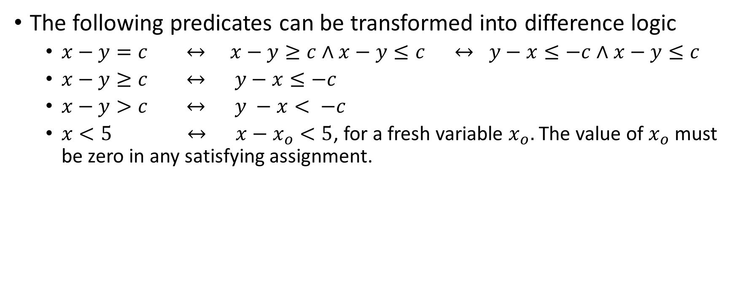
Difference Logic
The following predicates can be transformed into difference logic
$x−y=c ↔ x−y≥c∧x−y≤c ↔ y−x≤−c∧x−y≤c$
$x−y≥c ↔ y−x≤−c$
$x−y>c ↔ y −x< −c$
$x<5 ↔ x−x_{o}<5$, for a fresh variable $x_{o}.$ The value of $x_{o}$ must be zero in any satisfying assignment.

Slide 34
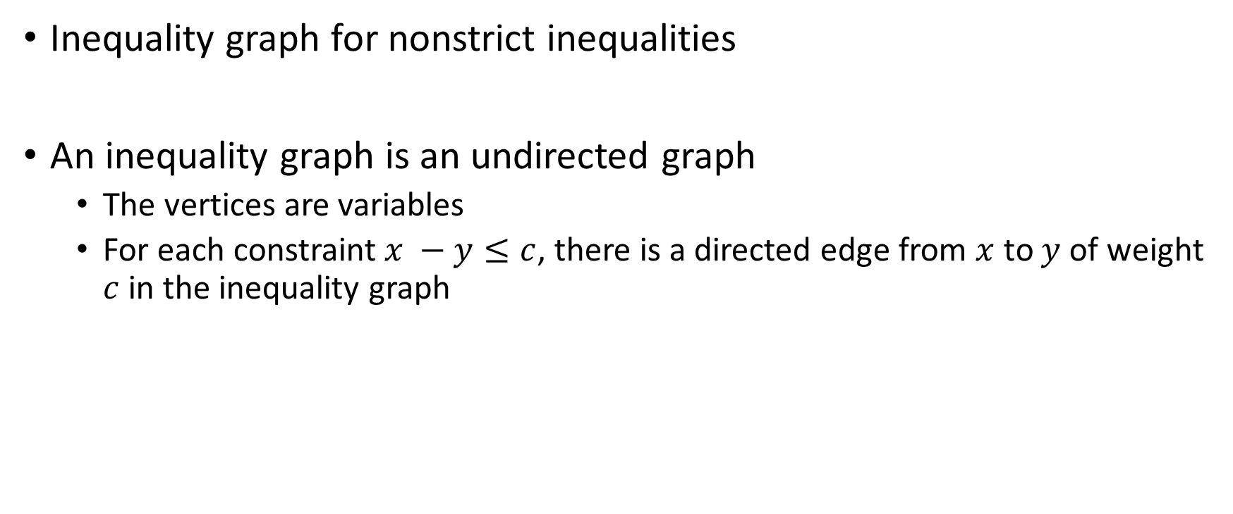
Decision procedure for difference logic
Inequality graph for nonstrict inequalities
An inequality graph is an undirected graph
The vertices are variables
For each constraint $x −y≤c$, there is a directed edge from $x$ to $y$ of weight $c$ in the inequality graph

Slide 35

Decision procedure for difference logic
$$x −y≤20∧y−z≤30∧z−t≤2∧t−p≤4∧p−y≤−50$$
x
20
y
30
z
2
t
-50
4
p

Slide 36
Decision procedure for difference logic
Let ϕ be a conjunction of the inequality predicates and G be the corresponding inequality graph; then ϕ is satisfiable if and only if there is no negative cycle in G.

Slide 37

Decision procedure for difference logic
Strict inequalities
Is $x −y<1∧y−z<1∧z−x<0$ satisfiable?

Slide 38

Decision procedure for difference logic
Strict inequalities
$$x −y<1∧y−z<1∧z−x<0$$
------------------------------------------------
$$x−y≤0∧y−z≤0∧z−x≤−1$$
x
0
y
0
-1
z

Slide 39
Finding negative cycle
Bellman-Ford algorithm
Read from the CORMEN, LEISERSON, RIVEST, STEIN book

Slide 40
Bellman-Ford algorithm
Bellman-Ford algorithm solves the single-source shortest-path problem with negative edge weight
The algorithm returns false if there is a negative-weight cycle in the graph

Slide 41

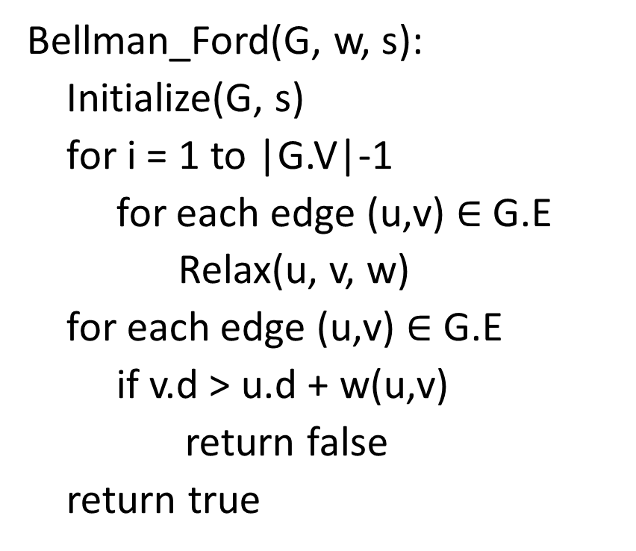
Bellman-Ford algorithm
Bellman_Ford(G, w, s):
Initialize(G, s)
for i = 1 to |G.V|-1
for each edge (u,v) $∈$ G.E
Relax(u, v, w)
for each edge (u,v) $∈$ G.E
if v.d > u.d + w(u,v)
return false
return true
Relax(u, v, w)
if v.d > u.d + w(u, v)
v.d = u.d + w(u, v)
v.$π$ = u

Slide 42




Example
E2 = 5
t
x
$$∞$$
$$∞$$
Let’s say that the edges are visited in the order E1 to E10.
E3 = -2
E1 = 6
E4 = -3
0
E10 = 8
E9 = 7
E5 = -4
s
E8 = 7
E6 = 2
$$∞$$
$$∞$$
E7 = 9
y
z

Slide 43




Example
E2 = 5
t
x
$$6$$
$$9$$
After visiting all edges in the first iteration.
E3 = -2
E1 = 6
E4 = -3
0
E10 = 8
E9 = 7
E5 = -4
s
E8 = 7
E6 = 2
$$7$$
$$2$$
E7 = 9
y
z

Slide 44

Example
E2 = 5
t
x
$$6$$
$$4$$
After visiting all edges in the second iteration.
E3 = -2
E1 = 6
E4 = -3
0
E10 = 8
E9 = 7
E5 = -4
s
E8 = 7
E6 = 2
$$7$$
$$2$$
E7 = 9
y
z

Slide 45


Example
E2 = 5
t
x
$$2$$
$$4$$
After visiting all edges in the third iteration.
E3 = -2
E1 = 6
E4 = -3
0
E10 = 8
E9 = 7
E5 = -4
s
E8 = 7
E6 = 2
$$7$$
$$−2$$
E7 = 9
y
z

Slide 46
Example
E2 = 5
t
x
$$2$$
$$4$$
After visiting all edges in the fourth iteration.
No change during this iteration; therefore, the algorithm terminates.
E3 = -2
E1 = 6
E4 = -3
0
E10 = 8
E9 = 7
E5 = -4
s
E8 = 7
E6 = 2
$$7$$
$$−2$$
E7 = 9
y
z

Slide 47




Bellman-Ford
0
$$∞$$
$$∞$$
$$∞$$
$$∞$$
$$∞$$
u
i₁
i₂
…
i_{k}
v

Slide 48
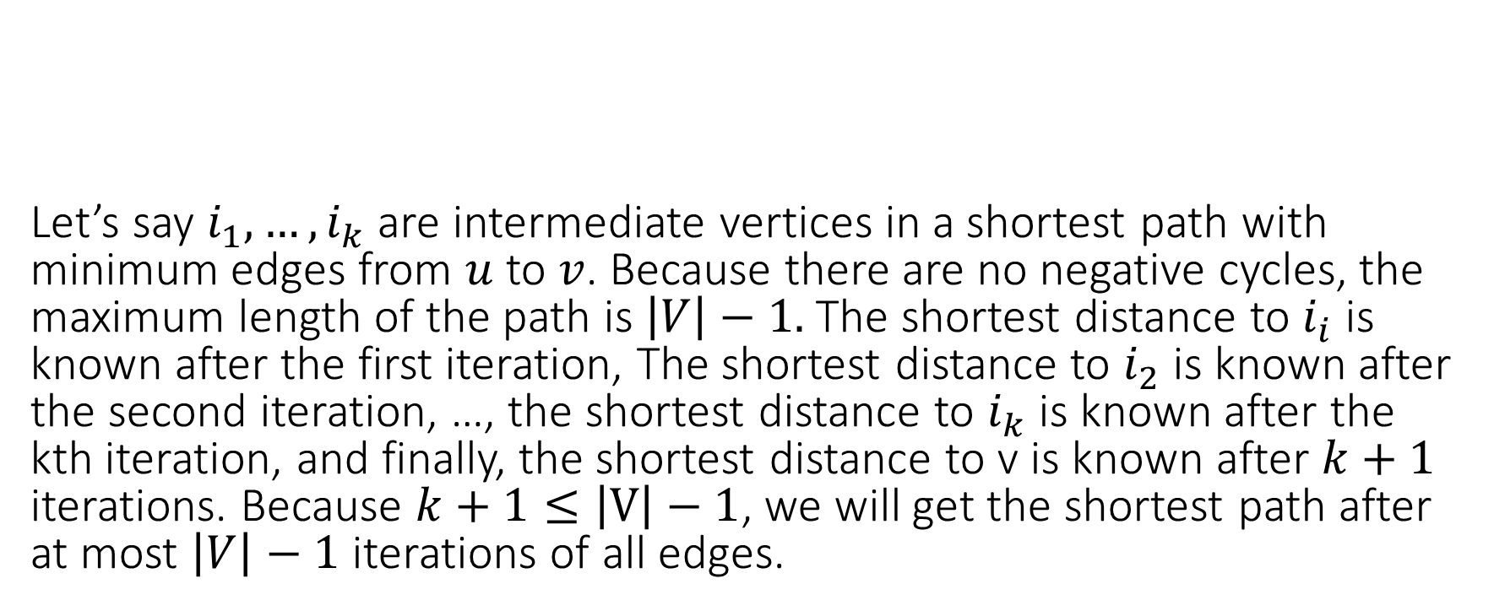
Bellman-Ford
Let’s say $i_{1}, …,i_{k}$ are intermediate vertices in a shortest path with minimum edges from $u$ to $v$. Because there are no negative cycles, the maximum length of the path is $\left|V\right|−1.$ The shortest distance to $i_{i}$ is known after the first iteration, The shortest distance to $i_{2}$ is known after the second iteration, …, the shortest distance to $i_{k}$ is known after the kth iteration, and finally, the shortest distance to v is known after $k+1$ iterations. Because $k+1≤\left|V\right|−1$, we will get the shortest path after at most $\left|V\right|−1$ iterations of all edges.
0
$$∞$$
$$∞$$
$$∞$$
$$∞$$
$$∞$$
u
i₁
i₂
…
i_{k}
v

Slide 49
Decision procedure for difference logic
Notice that the Bellman-Ford works with a single source
If we run Bellman-Ford on a random vertex in the inequality graph, we will not be able to detect negative cycles that are not reachable from the vertex

Slide 50
Decision procedure for difference logic
Notice that the Bellman-Ford works with a single source
If we run Bellman-Ford on a random vertex in the inequality graph, we will not be able to detect negative cycles that are not reachable from the vertex
To detect the presence of a negative cycle, we can add a new vertex and introduce an edge of weight zero from the new vertex to each other vertex in the inequality graph before running the Bellman-Ford on the new vertex

