Slide 2
Today’s topics
Assignment-3
Bit Vectors

Slide 3
References
Read Chapter-6 from the DP book

Slide 4
Bit vectors
Motivation
Does the following assertion always hold in a C program?
int isGreater(int x, int y) {
if (x – y > 0) {
assert(x > y);
return 1;
}
return 0;
}

Slide 5
Bit vectors
Motivation
Does the following assertion always hold in a C program?
int isGreater(int x, int y) {
if (x – y > 0) {
assert(x > y);
return 1;
}
return 0;
}
The assertion fails for x = -2147483648 and y = 1

Slide 6
Bit vectors
What is the output of the following program?
unsigned char number = 200;
number = number + 100;
printf(“Sum: %hhd\n”, number);

Slide 7
Bit vectors
Can we write the following code without an if-else statement?
int isOdd(int x) {
if ((x % 2) == 0) {
return 0;
}
else {
return 1;
}
}

Slide 8
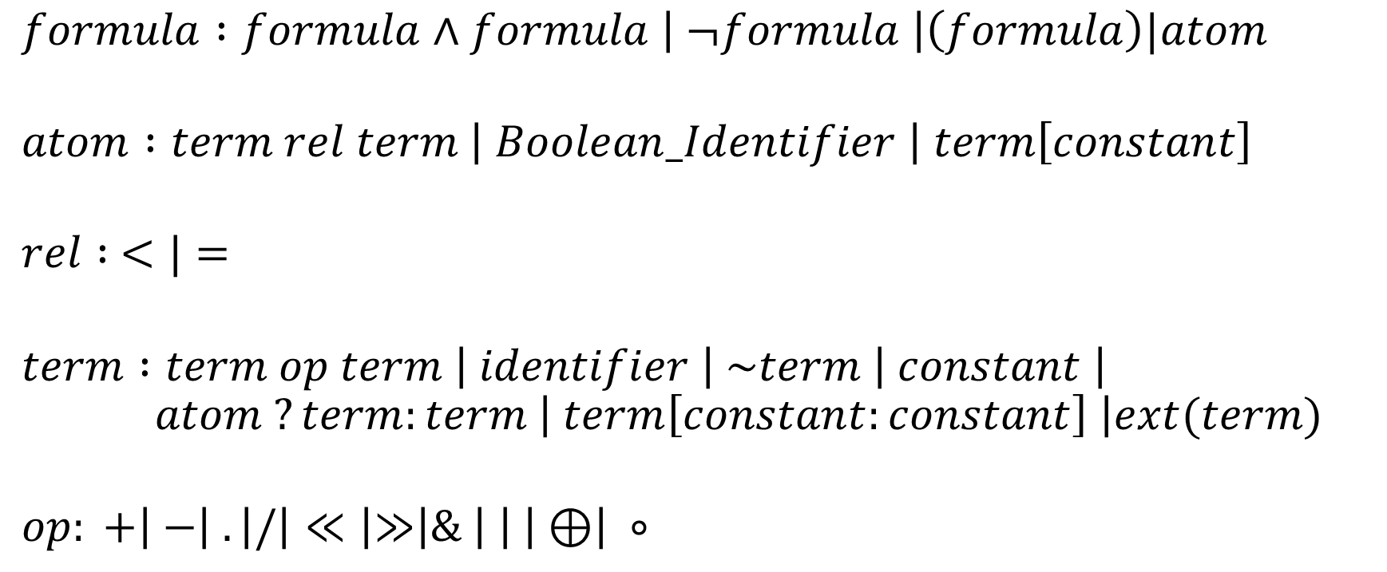
Syntax
$$formula :formula∧formula \left| ¬formula \right|\left(formula\right)|atom$$
$$atom :term rel term \left| Boolean_Identifier \right| term\left[constant\right]$$
$$rel : <|=$$
$$term :term op term \left| identifier \right| \sim term \left| constant \right|$$
$$atom ?term:term \left| term\left[constant:constant\right] \right|ext(term)$$
$$op: +\left| −\right| . \left|/\right|≪\left|≫\right|\& \left| \right| \left| ⊕\right| ∘$$

Slide 9
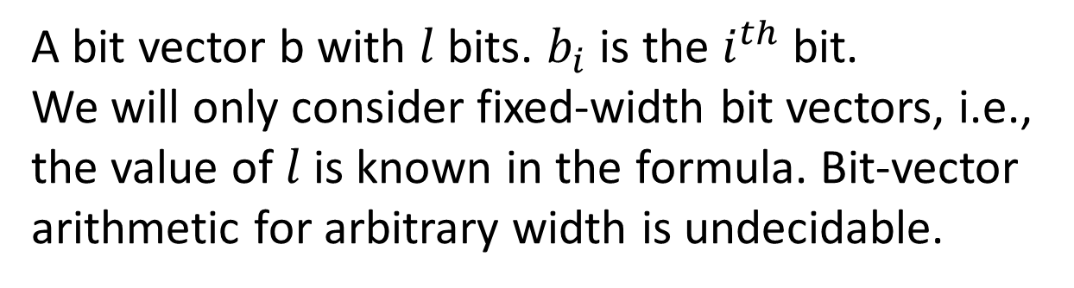
Bit vector
$$b_{l−1}$$ | $$b_{l−2}$$ | … | $$b_{4}$$ | $$b_{3}$$ | $$b_{2}$$ | $$b_{1}$$ | $$b_{0}$$
A bit vector b with $l$ bits. $b_{i}$ is the $i^{th}$ bit.
We will only consider fixed-width bit vectors, i.e., the value of $l$ is known in the formula. Bit-vector arithmetic for arbitrary width is undecidable.

Slide 10

Notation
We will use a variant of $λ−expressions$ to operate on bit vectors
$λi∈\left\{0, …, l−1\right\}.f(i)$ creates a bit vector $b$ of length $l$, such that $b_{i}=f(i)$

Slide 11

Example
$λi∈\left\{0, …, l−1\right\}.0$

Slide 12

Example
$λi∈\left\{0, …, l−1\right\}.0$
A $l$-bit bit-vector whose all bits are zeros.

Slide 13

Example
$$λi∈\left\{0,…7\right\}.\left\{\begin{aligned}0 :i is even \\ 1 :otherwise\end{aligned}\right.$$

Slide 14

Example
$$λi∈\left\{0,…7\right\}.\left\{\begin{aligned}0 :i is even \\ 1 :otherwise\end{aligned}\right.$$
The above expression represents 10101010.

Slide 15

Example
$λi∈\left\{0, …, l−1\right\}. ¬x_{i}$

Slide 16

Example
$λi∈\left\{0, …, l−1\right\}. ¬x_{i}$
The above expression represents the bitwise negation of the bit-vector x.

Slide 17

Bit vectors
Is $x≠y∧x≠z∧y≠z$ satisfiable for bit vectors x, y, and z

Slide 18

Bit vectors
Is $x≠y∧x≠z∧y≠z$ satisfiable for bit vectors x, y, and z
If the width of the bit-vectors x, y, and z is one, then the formula is not satisfiable

Slide 19
Bit vectors
The satisfiability of a bit vector may depend on the width of the bit vector
In addition, a bit vector may be signed or unsigned
Notice that the semantics of signed and unsigned bitwise operations could be different
The type of a bit-vector expression is
The width of the expression in bits
whether it is signed or unsigned

Slide 20

Bit vectors representation
To encode the type, we use the following notation
$$x_{[l]S}=y_{[l]S}+_{[l]S}z_{[l]S}$$
$$x_{{[l}_{1}+l_{2}]U}=y_{{[l}_{1}]U}∘_{\left[l_{1}+l_{2}\right]U}z_{[l_{2}]U}$$
$l, l_{1}, l_{2}$ are the width of the bit vectors
S is signed
U is unsigned

Slide 21
Bit-vector flattening

Slide 22
Bit-vector flattening
Bit-vector flattening, also called bit-blasting, is used to convert a bit-vector formula into a Boolean formula
A SAT solver can be used to solve the Boolean formula
The basic idea is to replace each bit-vector expression with a set of Boolean variables and generate constraints in terms of Boolean variables

Slide 23
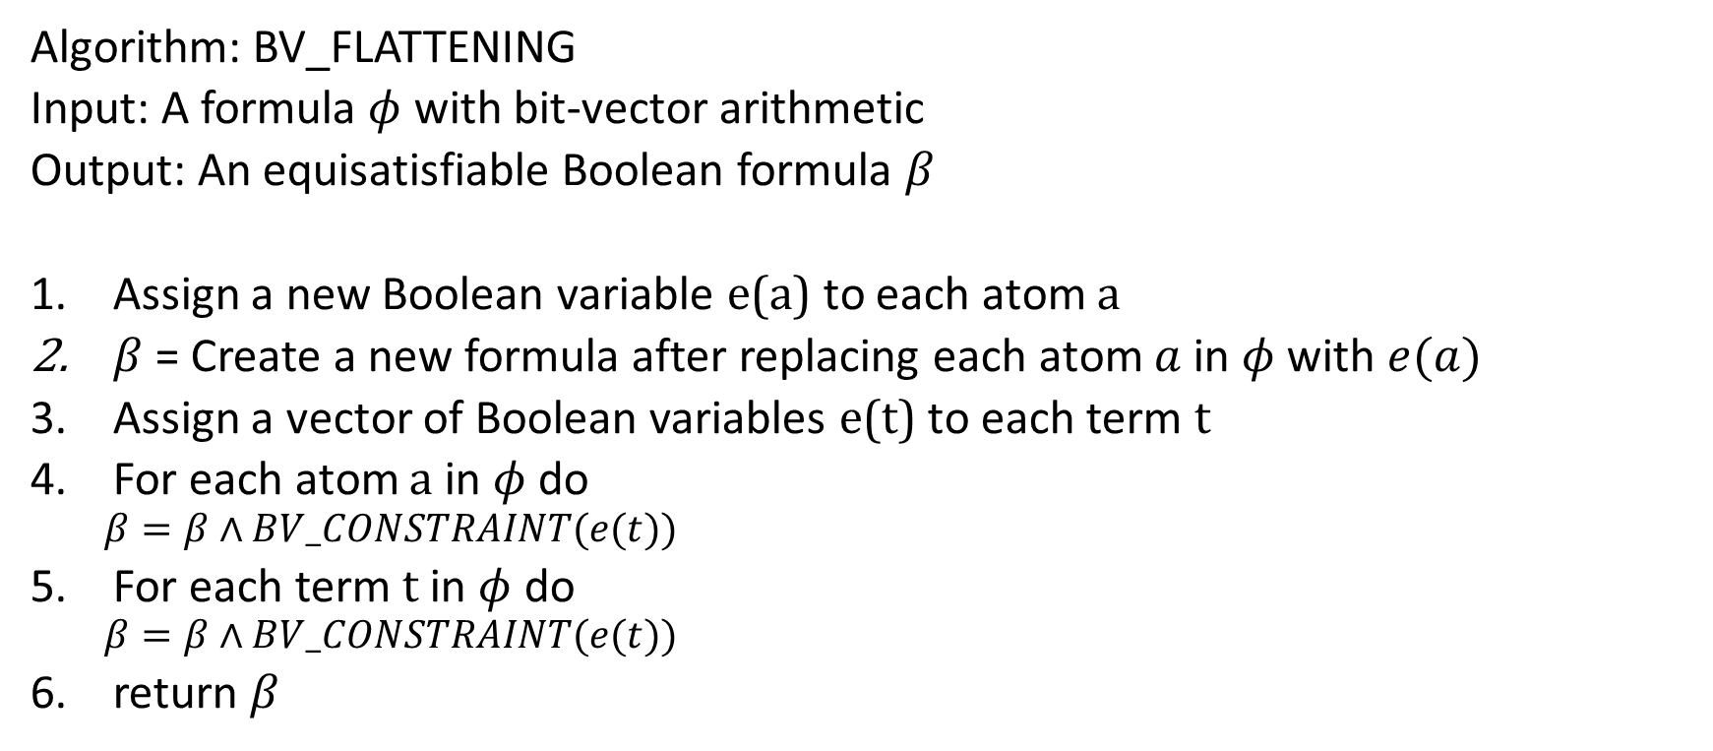
BV_FLATTENING
Algorithm: BV_FLATTENING
Input: A formula $φ$ with bit-vector arithmetic
Output: An equisatisfiable Boolean formula $β$
Assign a new Boolean variable e(a) to each atom a
$β$ = Create a new formula after replacing each atom $a$ in $φ$ with $e(a)$
Assign a vector of Boolean variables e(t) to each term t
For each atom a in $φ$ do
$β=β∧BV_CONSTRAINT(e(t))$
For each term t in $φ$ do
$β=β∧BV_CONSTRAINT(e(t))$
return $β$

Slide 24

Bitwise or
BV_CONSTRAINT(e(t))
// $e\left(t\right)=e\left(t_{1}\right){\left.​\right|}_{\left[l\right]}e(t_{2})$
$$\bigwedge_{i=0}^{l−1}{e{\left(t\right)}_{i}↔(e{\left(t_{1}\right)}_{i}∨e{\left(t_{2}\right)}_{i})}$$

Slide 25

Concatenation
BV_CONSTRAINT(e(t))
// $e\left(t\right)=e{\left(t_{1}\right)}_{{[l}_{1}]}∘_{\left[l_{1}+l_{2}\right]}e{\left(t_{2}\right)}_{{[l}_{2}]}$

Slide 26

Concatenation
BV_CONSTRAINT(e(t))
// $e\left(t\right)=e{\left(t_{1}\right)}_{{[l}_{1}]}∘_{\left[l_{1}+l_{2}\right]}e{\left(t_{2}\right)}_{{[l}_{2}]}$
$$\left(\bigwedge_{i=0}^{l_{2}−1}{e{\left(t\right)}_{i}↔e{\left(t_{2}\right)}_{i}}\right)∧\left(\bigwedge_{i=0}^{l_{1}−1}{e{\left(t\right)}_{l_{2}+i}↔e{\left(t_{1}\right)}_{i}}\right)$$

Slide 27

Extract
BV_CONSTRAINT(e(t))
// $e{\left(t\right)}_{[c_{2}−c_{1}+1]}=e{\left(t_{1}\right)}_{{[l}_{1}]}[c_{1}:c_{2}]$

Slide 28

Extract
BV_CONSTRAINT(e(t))
// $e{\left(t\right)}_{[c_{2}−c_{1}+1]}=e{\left(t_{1}\right)}_{{[l}_{1}]}[c_{1}:c_{2}]$
$$\left(\bigwedge_{i=0}^{c_{2}−c_{1}}{e{\left(t\right)}_{i}↔e{\left(t_{1}\right)}_{i+c_{1}}}\right)$$

Slide 29

Case-split
BV_CONSTRAINT(e(t))
// $e{\left(t\right)}_{[l]}=e\left(a\right)?e{\left(t_{1}\right)}_{[l]}:e{\left(t_{2}\right)}_{[l]}$

Slide 30
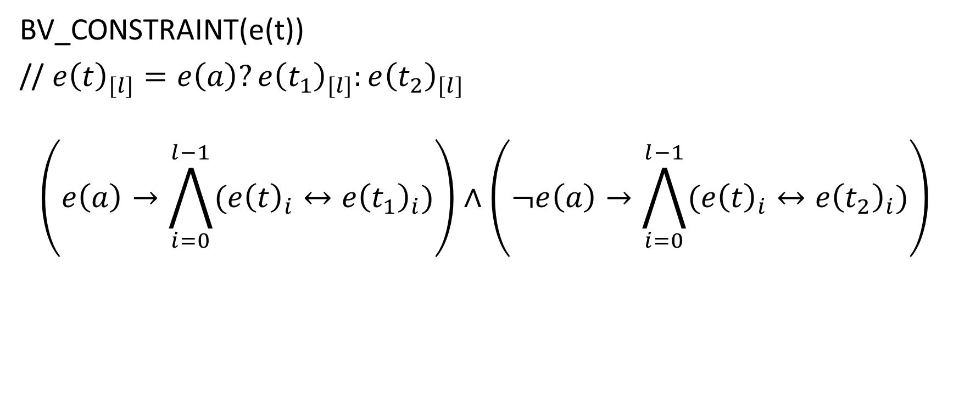
Case-split
BV_CONSTRAINT(e(t))
// $e{\left(t\right)}_{[l]}=e\left(a\right)?e{\left(t_{1}\right)}_{[l]}:e{\left(t_{2}\right)}_{[l]}$
$$\left(e\left(a\right)→\bigwedge_{i=0}^{l−1}{(e{\left(t\right)}_{i}↔e{\left(t_{1}\right)}_{i})}\right)∧\left(¬e\left(a\right)→\bigwedge_{i=0}^{l−1}{(e{\left(t\right)}_{i}↔e{\left(t_{2}\right)}_{i})}\right)$$

Slide 31

Equality
BV_CONSTRAINT(e(a))
// $e\left(a\right)=e{\left(t_{1}\right)}_{[l]}=e{\left(t_{2}\right)}_{[l]}$

Slide 32

Equality
BV_CONSTRAINT(e(a))
// $e\left(a\right)=e{\left(t_{1}\right)}_{[l]}=e{\left(t_{2}\right)}_{[l]}$
$$\left(\bigwedge_{i=0}^{l−1}{(e{\left(t_{1}\right)}_{i}↔e{\left(t_{2}\right)}_{i})}\right)↔e(a)$$

Slide 33

Example
$$φ=$$
$${(d}_{[15]}=a_{[5]}∘b_{[10]})∧$$
$$(e_{[15]}=a_{[5]}∘c_{[10]})∧$$
$$\left(g_{[1]}=f ?d_{[15]}\left[12:12\right] :e_{[15]}\left[12:12\right]\right)∧$$
$$\left(h_{[1]}=a_{[5]}\left[2:2\right]\right)∧$$
$$¬(g_{[1]}=h_{[1]})$$

Slide 34
















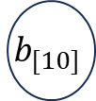










$$∧$$
Parse Tree
$$∧$$
$$∧$$
=
$$¬$$
$$h_{[1]}$$
$$[:]$$
$$∧$$
=
=
$$a_{[5]}$$
2
2
=
=
$$g_{[1]}$$
$$?:$$
$$h_{[1]}$$
$$g_{[1]}$$
$$d_{[15]}$$
$$∘$$
$$e_{[15]}$$
$$∘$$
[:]
$$f$$
[:]
$$a_{[5]}$$
$$c_{[10]}$$
$$d_{[15]}$$
$$12$$
$$12$$
$$e_{[15]}$$
$$12$$
$$12$$
$$a_{[5]}$$
$$b_{[10]}$$

Slide 35

























$$∧$$
Parse Tree
$$∧$$
Parse tree after assigning each atom and term a new Boolean variable and a vector of Boolean variables, respectively.
$$∧$$
$$e(a_{4})$$
=
$$¬$$
$$e(h)$$
$$e(t_{6})$$
$$e(a_{3})$$
$$h_{[1]}$$
$$[:]$$
$$∧$$
=
=
$$e(a_{5})$$
$$e(a)$$
$$e(a_{2})$$
$$e(g)$$
$$e(t_{3})$$
$$a_{[5]}$$
2
2
$$e(g)$$
$$e(h)$$
$$e(a_{1})$$
$$g_{[1]}$$
$$?:$$
=
=
$$g_{[1]}$$
$$h_{[1]}$$
$$e(d)$$
$$e(t_{1})$$
$$e(e)$$
$$e_{[15]}$$
$$∘$$
$$e(t_{2})$$
$$d_{[15]}$$
$$∘$$
$$e(f)$$
$$f$$
[:]
$$e(t_{4})$$
[:]
$$e(t_{5})$$
$$e(c)$$
$$e(e)$$
$$e(a)$$
$$12$$
$$12$$
$$e(a)$$
$$a_{[5]}$$
$$e(b)$$
$$b_{[10]}$$
$$a_{[5]}$$
$$c_{[10]}$$
$$e(d)$$
$$d_{[15]}$$
$$12$$
$$12$$
$$e_{[15]}$$

Slide 36

Example
Initially, $β=e\left(a_{1}\right)∧e\left(a_{2}\right)∧e\left(a_{3}\right)∧e\left(a_{4}\right)∧¬e\left(a_{5}\right)$
Generate BV constraints for each term and atom

Slide 37

Equality
BV_CONSTRAINT(e($a_{1}$))
$$\left(\bigwedge_{i=0}^{14}{(e{\left(d\right)}_{i}↔e{\left(t_{1}\right)}_{i})}\right)↔e(a_{1})$$
BV_CONSTRAINT(e($a_{2}$))
$$\left(\bigwedge_{i=0}^{14}{(e{\left(e\right)}_{i}↔e{\left(t_{2}\right)}_{i})}\right)↔e(a_{2})$$

Slide 38

Equality
BV_CONSTRAINT(e($a_{3}$))
$$\left(\bigwedge_{i=0}^{0}{(e{\left(g\right)}_{i}↔e{\left(t_{3}\right)}_{i})}\right)↔e(a_{3})$$
BV_CONSTRAINT(e($a_{4}$))
$$\left(\bigwedge_{i=0}^{0}{(e{\left(h\right)}_{i}↔e{\left(t_{6}\right)}_{i})}\right)↔e(a_{4})$$

Slide 39

Equality
BV_CONSTRAINT(e($a_{5}$))
$$\left(\bigwedge_{i=0}^{0}{(e{\left(g\right)}_{i}↔e{\left(h\right)}_{i})}\right)↔e(a_{5})$$

Slide 40
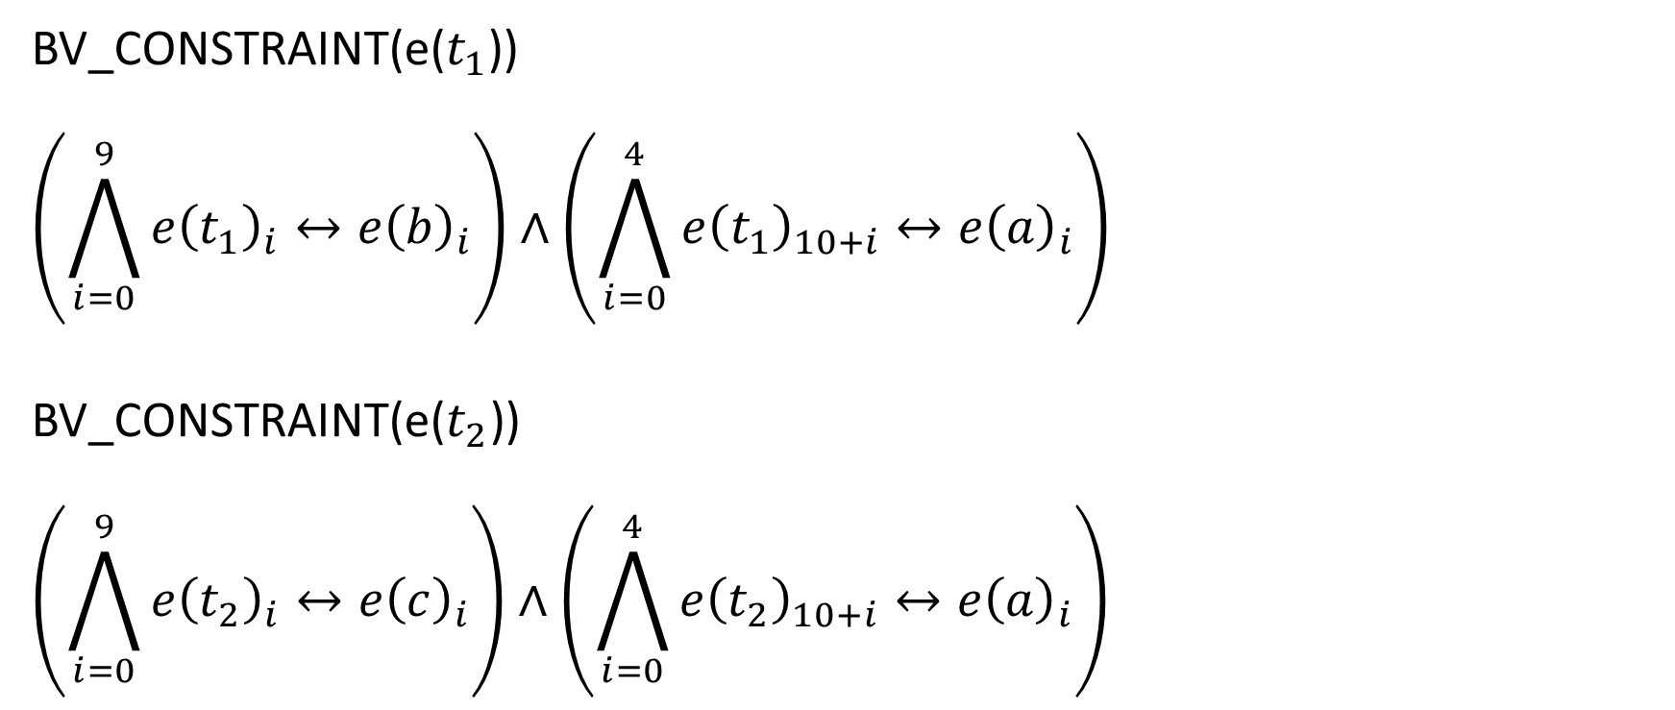
Concatenation
BV_CONSTRAINT(e($t_{1}$))
$$\left(\bigwedge_{i=0}^{9}{e{\left(t_{1}\right)}_{i}↔e{\left(b\right)}_{i}}\right)∧\left(\bigwedge_{i=0}^{4}{e{\left(t_{1}\right)}_{10+i}↔e{\left(a\right)}_{i}}\right)$$
BV_CONSTRAINT(e($t_{2}$))
$$\left(\bigwedge_{i=0}^{9}{e{\left(t_{2}\right)}_{i}↔e{\left(c\right)}_{i}}\right)∧\left(\bigwedge_{i=0}^{4}{e{\left(t_{2}\right)}_{10+i}↔e{\left(a\right)}_{i}}\right)$$

Slide 41

Case-split
BV_CONSTRAINT(e($t_{3}$))
$$\left(e\left(f\right)→\bigwedge_{i=0}^{0}{(e{\left(t_{3}\right)}_{i}↔e{\left(t_{4}\right)}_{i})}\right)∧\left(¬e\left(f\right)→\bigwedge_{i=0}^{0}{(e{\left(t_{3}\right)}_{i}↔e{\left(t_{5}\right)}_{i})}\right)$$

Slide 42

Extract
BV_CONSTRAINT(e($t_{4}$))
$$\left(\bigwedge_{i=0}^{0}{e{\left(t_{4}\right)}_{i}↔e{\left(d\right)}_{i+12}}\right)$$
BV_CONSTRAINT(e($t_{5}$))
$$\left(\bigwedge_{i=0}^{0}{e{\left(t_{5}\right)}_{i}↔e{\left(e\right)}_{i+12}}\right)$$

Slide 43

Extract
BV_CONSTRAINT(e($t_{6}$))
$$\left(\bigwedge_{i=0}^{0}{e{\left(t_{6}\right)}_{i}↔e{\left(a\right)}_{i+2}}\right)$$

Slide 44
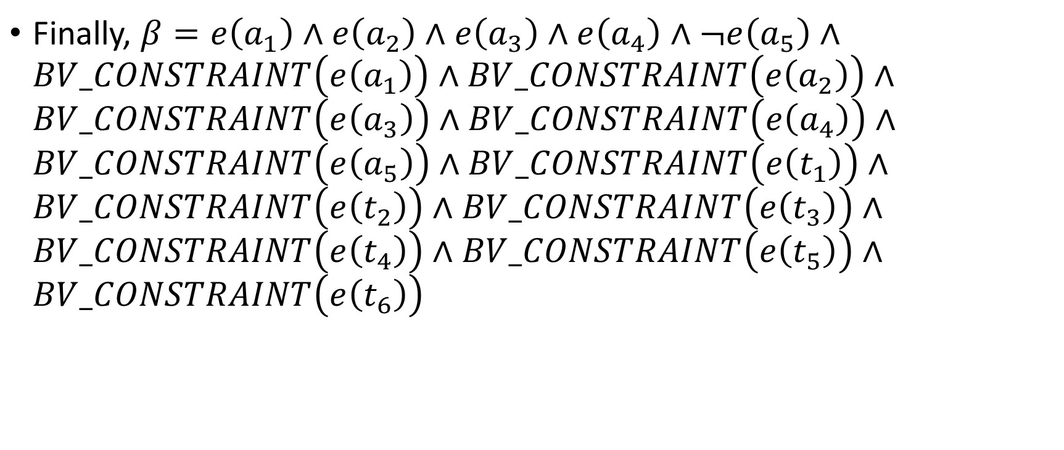
Example
Finally, $β=e\left(a_{1}\right)∧e\left(a_{2}\right)∧e\left(a_{3}\right)∧e\left(a_{4}\right)∧¬e\left(a_{5}\right)∧BV_CONSTRAINT\left(e\left(a_{1}\right)\right)∧BV_CONSTRAINT\left(e\left(a_{2}\right)\right)∧BV_CONSTRAINT\left(e\left(a_{3}\right)\right)∧BV_CONSTRAINT\left(e\left(a_{4}\right)\right)∧BV_CONSTRAINT\left(e\left(a_{5}\right)\right)∧BV_CONSTRAINT\left(e\left(t_{1}\right)\right)∧BV_CONSTRAINT\left(e\left(t_{2}\right)\right)∧BV_CONSTRAINT\left(e\left(t_{3}\right)\right)∧BV_CONSTRAINT\left(e\left(t_{4}\right)\right)∧BV_CONSTRAINT\left(e\left(t_{5}\right)\right)∧BV_CONSTRAINT\left(e\left(t_{6}\right)\right)$

