Slide 2
Today’s topics
Bit Vectors

Slide 3
References
Read Chapter-6 from the DP book

Slide 4

Bitwise or
BV_CONSTRAINT(e(t))
// $e\left(t\right)=e\left(t_{1}\right){\left.​\right|}_{\left[l\right]}e(t_{2})$
$$\bigwedge_{i=0}^{l−1}{e{\left(t\right)}_{i}↔(e{\left(t_{1}\right)}_{i}∨e{\left(t_{2}\right)}_{i})}$$

Slide 5

Concatenation
BV_CONSTRAINT(e(t))
// $e\left(t\right)=e{\left(t_{1}\right)}_{{[l}_{1}]}∘_{\left[l_{1}+l_{2}\right]}e{\left(t_{2}\right)}_{{[l}_{2}]}$
$$\left(\bigwedge_{i=0}^{l_{2}−1}{e{\left(t\right)}_{i}↔e{\left(t_{2}\right)}_{i}}\right)∧\left(\bigwedge_{i=0}^{l_{1}−1}{e{\left(t\right)}_{l_{2}+i}↔e{\left(t_{1}\right)}_{i}}\right)$$

Slide 6

Extract
BV_CONSTRAINT(e(t))
// $e{\left(t\right)}_{[c_{2}−c_{1}+1]}=e{\left(t_{1}\right)}_{{[l}_{1}]}[c_{1}:c_{2}]$
$$\left(\bigwedge_{i=0}^{c_{2}−c_{1}}{e{\left(t\right)}_{i}↔e{\left(t_{1}\right)}_{i+c_{1}}}\right)$$

Slide 7
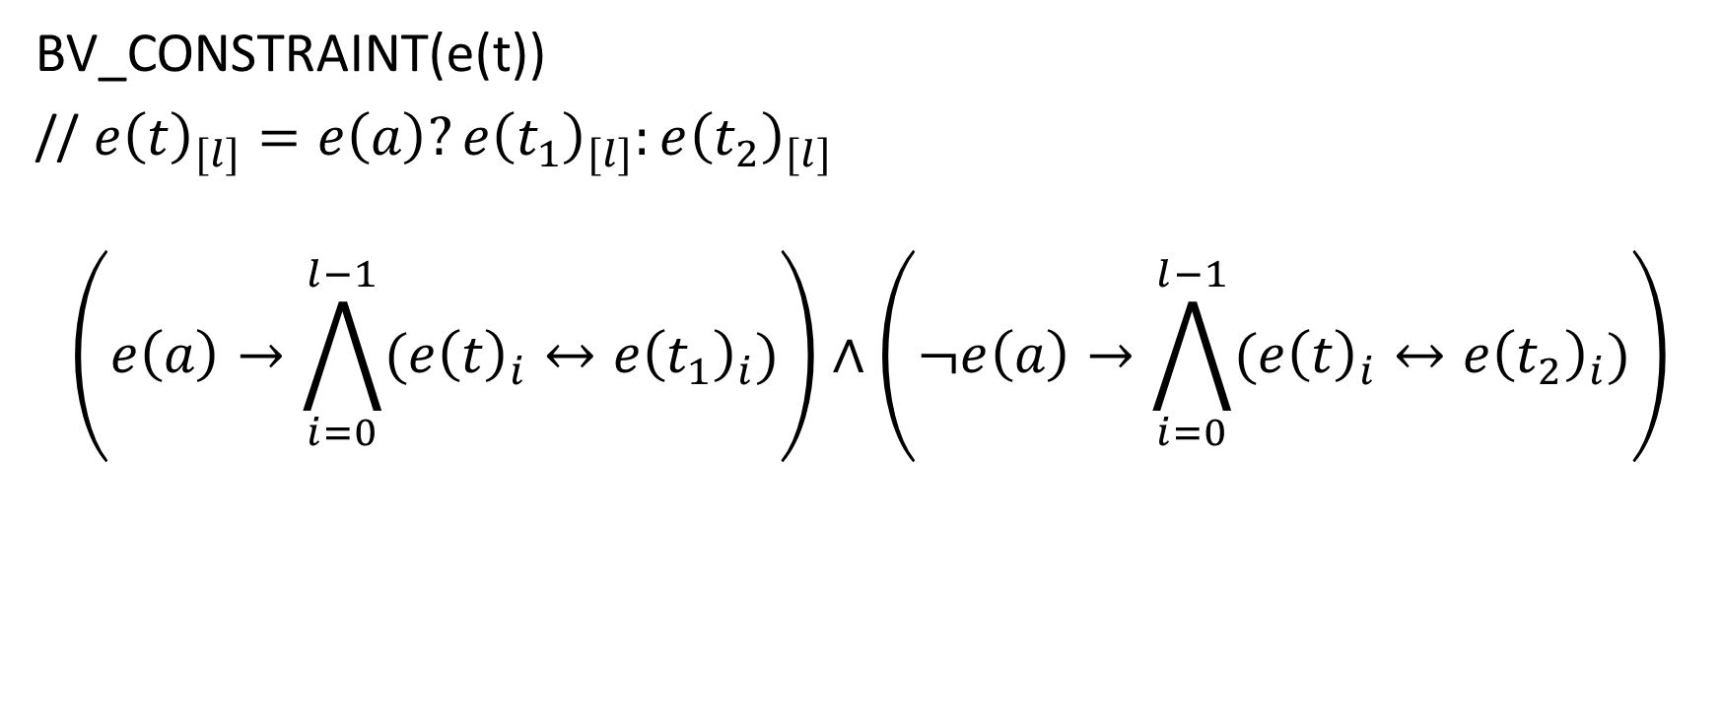
Case-split
BV_CONSTRAINT(e(t))
// $e{\left(t\right)}_{[l]}=e\left(a\right)?e{\left(t_{1}\right)}_{[l]}:e{\left(t_{2}\right)}_{[l]}$
$$\left(e\left(a\right)→\bigwedge_{i=0}^{l−1}{(e{\left(t\right)}_{i}↔e{\left(t_{1}\right)}_{i})}\right)∧\left(¬e\left(a\right)→\bigwedge_{i=0}^{l−1}{(e{\left(t\right)}_{i}↔e{\left(t_{2}\right)}_{i})}\right)$$

Slide 8

Equality
BV_CONSTRAINT(e(a))
// $e\left(a\right)=e{\left(t_{1}\right)}_{[l]}=e{\left(t_{2}\right)}_{[l]}$
$$\left(\bigwedge_{i=0}^{l−1}{(e{\left(t_{1}\right)}_{i}↔e{\left(t_{2}\right)}_{i})}\right)↔e(a)$$

Slide 9

Bitwise negation
BV_CONSTRAINT(e(t))
// $e{\left(t\right)}_{[l]}=\sim e{\left(t_{1}\right)}_{\left[l\right]}$
$$\bigwedge_{i=0}^{l−l}{e{\left(t\right)}_{i}↔¬e{\left(t_{1}\right)}_{i}}$$

Slide 10

Binary encoding
$<b>_{U}$ is binary encoding of bit-vector $b_{[l]}$ such that,
$$<b>_{U}=\sum_{i=0}^{l−1}{b_{i}. 2^{i}}$$

Slide 11

two’s complement
$<b>_{S}$ is 2’s complement encoding of bit-vector $b_{[l]}$ such that,
$$<b>_{U}=(−2^{l−1}.b_{l−1})+\left(\sum_{i=0}^{l−2}{b_{i}. 2^{i}}\right)$$

Slide 12

Example
$$<11001000>_{U}$$
$$<11001000>_{S}$$
$$<01100100>_{S}$$

Slide 13

Example
$<11001000>_{U}$ = 200
$<11001000>_{S}$ = -56
$<01100100>_{S}$ = 100

Slide 14

Modulo
$x=y mod b$ denotes that x and y are equal to modulo b

Slide 15
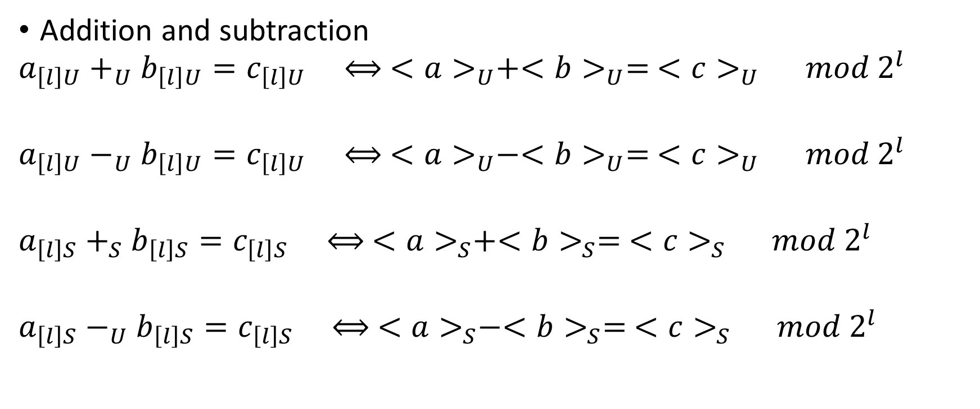
Interpretation of arithmetic operations
Addition and subtraction
$$a_{\left[l\right]U}+_{U}b_{\left[l\right]U}=c_{\left[l\right]U} ⟺ <a>_{U}+<b>_{U}= <c>_{U} mod 2^{l}$$
$$a_{\left[l\right]U}−_{U}b_{\left[l\right]U}=c_{\left[l\right]U} ⟺ <a>_{U}−<b>_{U}= <c>_{U} mod 2^{l}$$
$$a_{\left[l\right]S}+_{S}b_{\left[l\right]S}=c_{\left[l\right]S} ⟺ <a>_{S}+<b>_{S}= <c>_{S} mod 2^{l}$$
$$a_{\left[l\right]S}−_{U}b_{\left[l\right]S}=c_{\left[l\right]S} ⟺ <a>_{S}−<b>_{S}= <c>_{S} mod 2^{l}$$

Slide 16

Interpretation of arithmetic operations
Extension
${ext}_{\left[m\right]U}(a_{[l]}) =b_{\left[m\right]U} ⟺ <a>_{U}= <b>_{U}$, where $m≥l$
${ext}_{\left[m\right]S}(a_{[l]}) =b_{\left[m\right]S} ⟺ <a>_{S}= <b>_{S}$, where $m≥l$

Slide 17

Addition
Arithmetic operators
sum takes one-bit values $a_{0}, b_{0}, and c_{o}$ (carry bit) as input and returns the sum
sum($a_{0}, b_{0}, c_{0}$):

Slide 18

Addition
Arithmetic operators
sum takes one-bit values $a_{0}, b_{0}, and c_{o}$ (carry bit) as input and returns the sum
sum($a_{0}, b_{0}, c_{0}$):
$\left(a_{0}⊕b_{o}\right)⊕c_{o}$

Slide 19

Addition
carry takes one-bit values $a_{0}, b_{0}, and c_{o}$ (carry bit) as input and returns the value of the carry after adding the bits
$$carry\left(a_{0},b_{0},c_{0}\right)$$

Slide 20
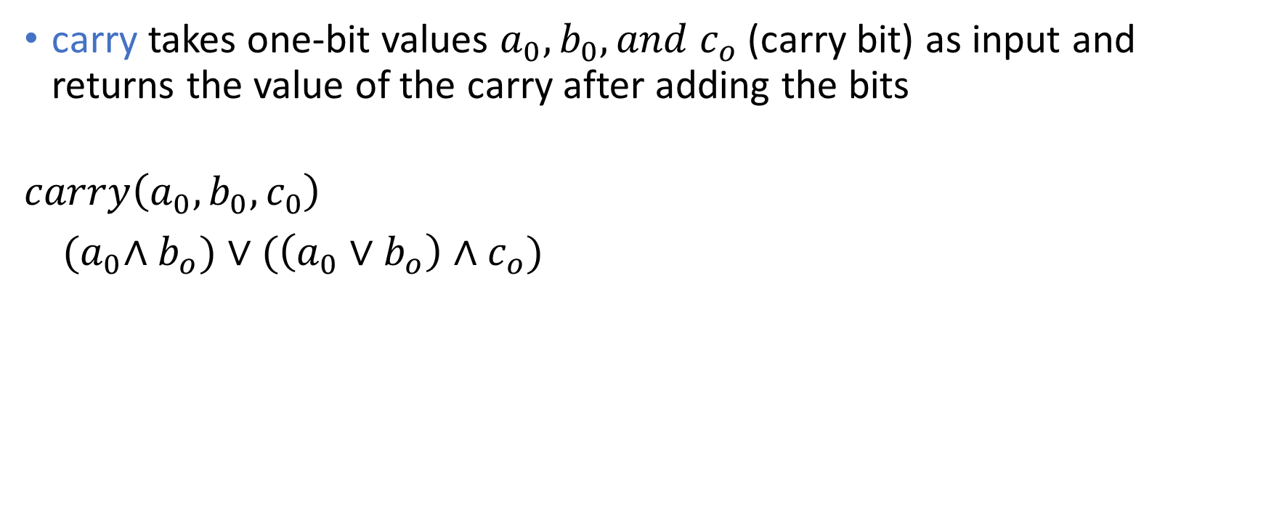
Addition
carry takes one-bit values $a_{0}, b_{0}, and c_{o}$ (carry bit) as input and returns the value of the carry after adding the bits
$$carry\left(a_{0},b_{0},c_{0}\right)$$
${(a}_{0}∧b_{o})∨(\left(a_{0}∨b_{o}\right)∧c_{o})$

Slide 21

Addition
BV_CONSTRAINT(e(t))
// $e{\left(t\right)}_{[l]}=e{\left(t_{1}\right)}_{\left[l\right]}+_{\left[l\right]}e{\left(t_{2}\right)}_{[l]}$

Slide 22

Addition
BV_CONSTRAINT(e(t))
// $e{\left(t\right)}_{[l]}=e{\left(t_{1}\right)}_{\left[l\right]}+_{\left[l\right]}e{\left(t_{2}\right)}_{[l]}$
$$\bigwedge_{i=0}^{l−l}{e{\left(t\right)}_{i}↔sum(e{\left(t_{1}\right)}_{i},e{\left(t_{2}\right)}_{i}, c_{i})}$$
$$\bigwedge_{i=1}^{l}{c_{i}↔carry(e{\left(t_{1}\right)}_{i−1},e{\left(t_{2}\right)}_{i−1}, c_{i−1})}$$
$$c_{o}=0$$

Slide 23

Subtraction
BV_CONSTRAINT(e(t))
// $e{\left(t\right)}_{[l]}=e{\left(t_{1}\right)}_{\left[l\right]}−_{\left[l\right]}e{\left(t_{2}\right)}_{[l]}$

Slide 24

Subtraction
BV_CONSTRAINT(e(t))
// $e{\left(t\right)}_{[l]}=e{\left(t_{1}\right)}_{\left[l\right]}−_{\left[l\right]}e{\left(t_{2}\right)}_{[l]}$
$$e{\left(t_{2}^{′}\right)}_{[l]}=\sim e{\left(t_{2}\right)}_{[l]}$$
$$e{\left(t\right)}_{[l]}=e{\left(t_{1}\right)}_{[l]}+e{\left(t_{2}^{′}\right)}_{[l]} with c_{0}=1$$

Slide 25

Shift
To implement $a_{[l]} << b_{[n]}$or $a_{[l]} >> b_{[n]}$, we can visit each bit $b_{i}$ in $b_{[n]}$ and shift $a$ by $2^{i}$ if $b_{i}$ is true

Slide 26

Shift
$$c_{[l]}= a_{[l]}≪b_{[n]}$$
$$t\left(−1\right)=a$$
foreach $j∈\{0, …,n−1\}$
$$t\left(j\right)=λi∈\left\{0, …, l−1\right\}\left\{\begin{aligned} {t(j−1)}_{i −2^{j}} :(i≥2^{j})∧b_{j} \\ t {\left(j−1\right)}_{i} :¬b_{j } \\ 0 :otherwise \end{aligned}\right.$$
$$c_{[l]}=t(n−1)$$

Slide 27
Multiplication
 |  |  | 1 | 1 | 0 | 1 | 0 | 1
 |  |  |  |  |  | 1 | 0 | 1
 |  |  | 1 | 1 | 0 | 1 | 0 | 1
 |  | 0 | 0 | 0 | 0 | 0 | 0
 | 1 | 1 | 0 | 1 | 0 | 1
1 | 0 | 0 | 0 | 0 | 1 | 0 | 0 | 1

Slide 28

Multiplication
Can we implement $c_{[l]}= a_{[l]} .b_{[l]}$ using shift and add?

Slide 29

Multiplication
Can we implement $c_{[l]}= a_{[l]} .b_{[l]}$ using shift and add?
$$t\left(−1\right)=λi∈\left\{0, …,l−1\right\}. 0$$
foreach $i∈\{0, …,n−1\}$
$$t\left(i\right)=\left(b_{i}\right) ?\left(t\left(i−1\right)+\left(a≪i\right)\right) :t(i−1)$$
$$c=t(n−1)$$

Slide 30

Division
$$c_{[l]}=\frac{a_{\left[l\right]}}{b_{[l]}}$$

Slide 31

Division
$$c_{[l]}=\frac{a_{\left[l\right]}}{b_{[l]}}$$
$${b_{[l]}>0 → c}_{[l]} . b_{[l]}+r_{[l]}=a_{[l]}$$
$$b_{[l]}>0 →r_{[l]}<b_{[l]}$$

Slide 32

Comparison
$$e{\left(t\right)}_{U}=e{\left(a\right)}_{U}<e{\left(b\right)}_{U}$$
$e{\left(t\right)}_{U}=¬\left(e{\left(a\right)}_{U}−e{\left(b\right)}_{U}\right).c_{l}$ , where $c_{l}$ is the $l^{th}$ carry bit

Slide 33
Incremental bit flattening

Slide 34

Multiplication
An $l$-bit multiplication may take $O(l^{2}∗\log_{2}{l})$ operation assuming that the shift can be implemented in $O(l ∗\log_{2}{l)}$ operations
n | Number of variables | Number of clauses
8 | 313 | 1001
16 | 1265 | 4177
24 | 2857 | 9529
32 | 5087 | 17057
64 | 20417 | 68929
Number of variables and clauses after Tseitin’s transformation during multiplication of two n-bit numbers.

Slide 35
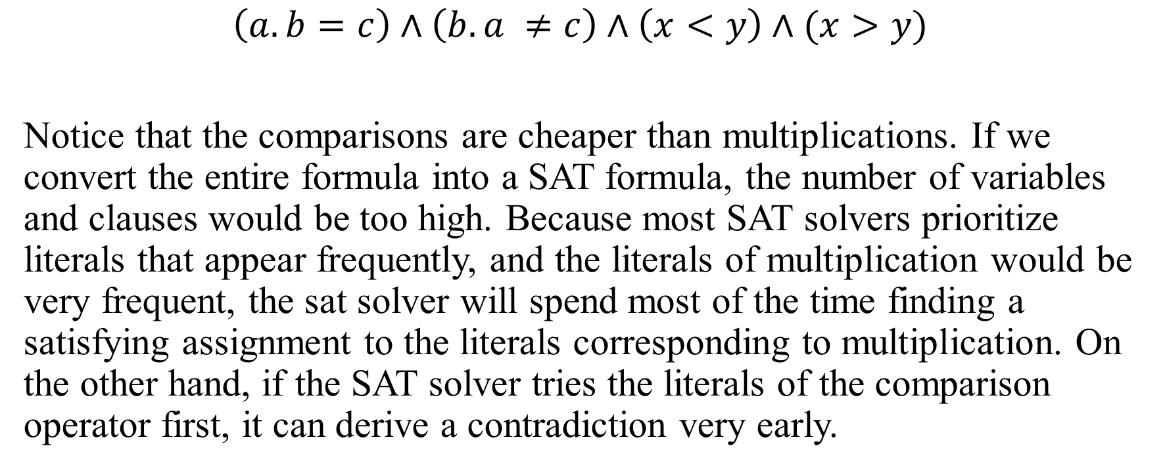
Example
$$\left(a.b=c\right)∧\left(b.a ≠c\right)∧\left(x<y\right)∧(x>y)$$
Notice that the comparisons are cheaper than multiplications. If we convert the entire formula into a SAT formula, the number of variables and clauses would be too high. Because most SAT solvers prioritize literals that appear frequently, and the literals of multiplication would be very frequent, the sat solver will spend most of the time finding a satisfying assignment to the literals corresponding to multiplication. On the other hand, if the SAT solver tries the literals of the comparison operator first, it can derive a contradiction very early.

Slide 36

Incremental bit flattening
$$\left(a.b=c\right)∧\left(b.a ≠c\right)∧\left(x<y\right)∧\left(x>y\right)$$

Slide 37
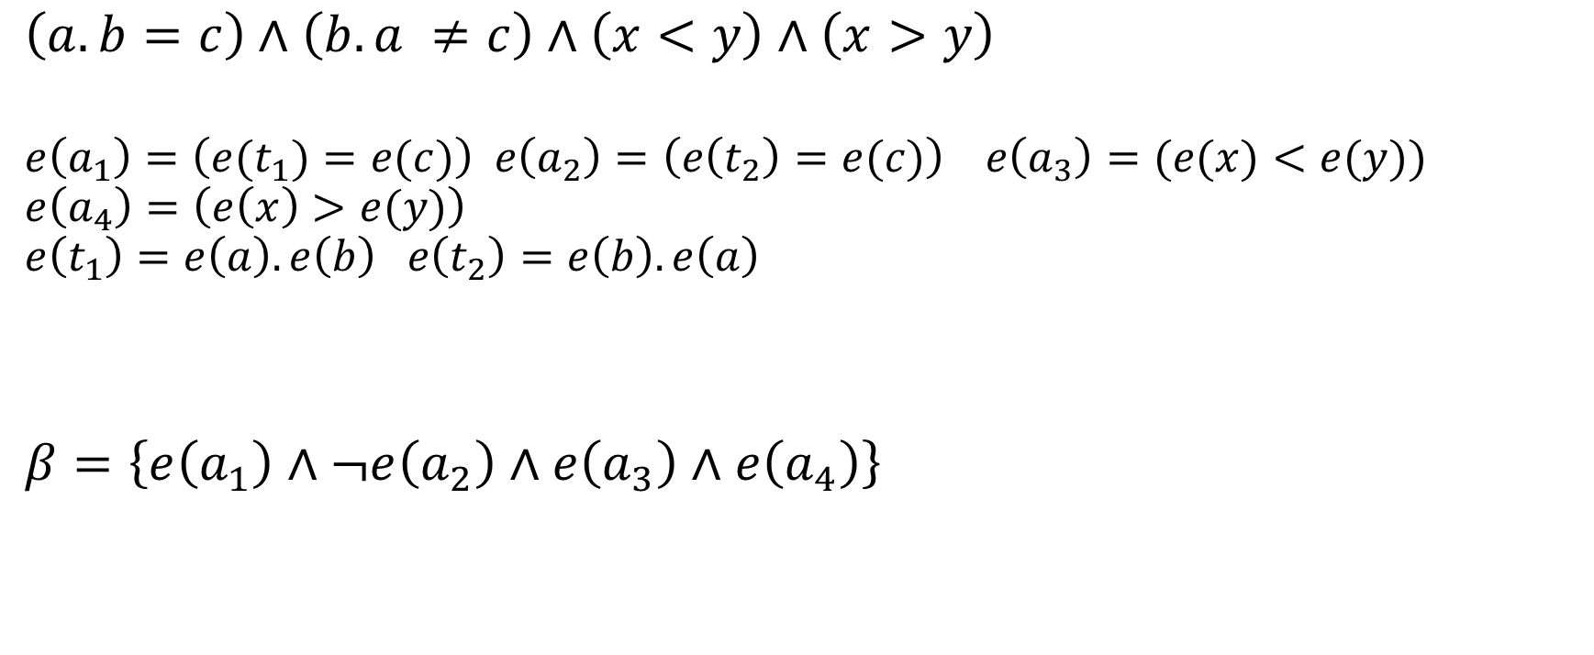
Incremental bit flattening
$$\left(a.b=c\right)∧\left(b.a ≠c\right)∧\left(x<y\right)∧\left(x>y\right)$$
$$e\left(a_{1}\right)=\left(e(t_{1})=e(c)\right) e\left(a_{2}\right)=\left(e\left(t_{2}\right)=e(c)\right) e\left(a_{3}\right)=(e(x)<e(y))$$
$$e\left(a_{4}\right)=\left(e\left(x\right)>e(y)\right)$$
$$e\left(t_{1}\right)=e\left(a\right).e\left(b\right) e\left(t_{2}\right)=e\left(b\right).e\left(a\right)$$
$$β=\left\{e\left(a_{1}\right)∧¬e\left(a_{2}\right)∧e\left(a_{3}\right)∧e\left(a_{4}\right)\right\}$$

Slide 38
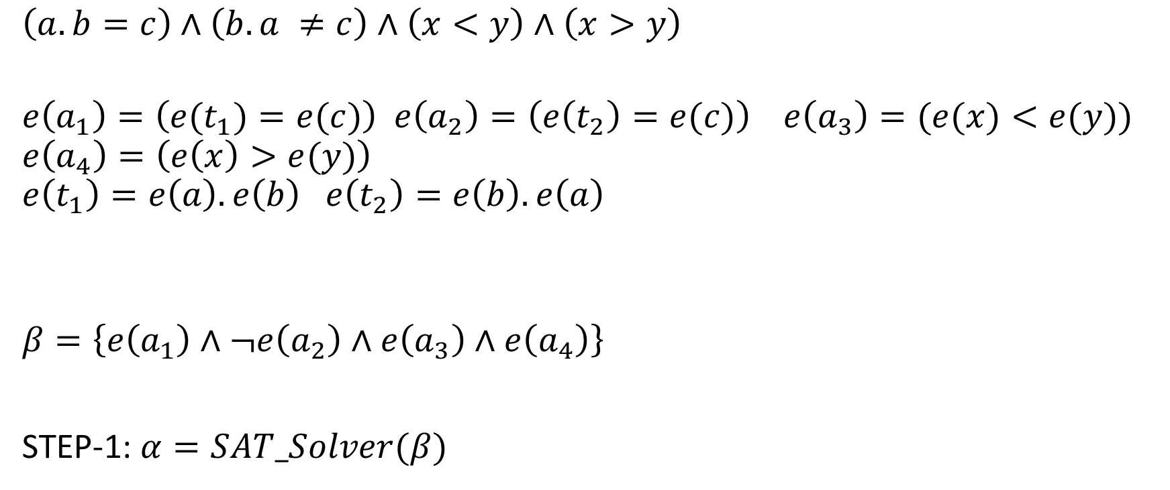
Incremental bit flattening
$$\left(a.b=c\right)∧\left(b.a ≠c\right)∧\left(x<y\right)∧\left(x>y\right)$$
$$e\left(a_{1}\right)=\left(e(t_{1})=e(c)\right) e\left(a_{2}\right)=\left(e\left(t_{2}\right)=e(c)\right) e\left(a_{3}\right)=(e(x)<e(y))$$
$$e\left(a_{4}\right)=\left(e\left(x\right)>e(y)\right)$$
$$e\left(t_{1}\right)=e\left(a\right).e\left(b\right) e\left(t_{2}\right)=e\left(b\right).e\left(a\right)$$
$$β=\left\{e\left(a_{1}\right)∧¬e\left(a_{2}\right)∧e\left(a_{3}\right)∧e\left(a_{4}\right)\right\}$$
STEP-1: $α=SAT_Solver(β)$

Slide 39
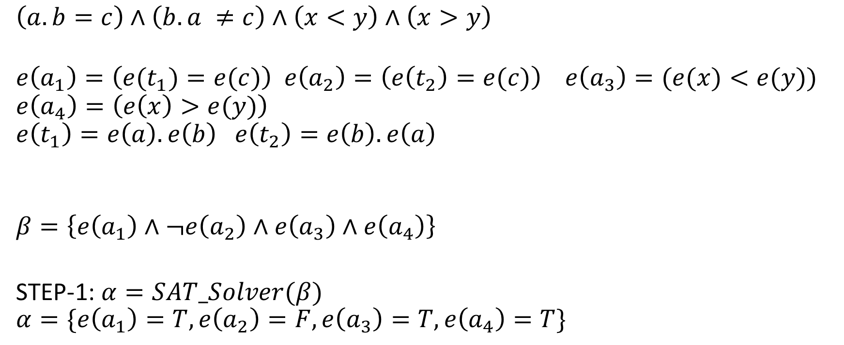
Incremental bit flattening
$$\left(a.b=c\right)∧\left(b.a ≠c\right)∧\left(x<y\right)∧\left(x>y\right)$$
$$e\left(a_{1}\right)=\left(e(t_{1})=e(c)\right) e\left(a_{2}\right)=\left(e\left(t_{2}\right)=e(c)\right) e\left(a_{3}\right)=(e(x)<e(y))$$
$$e\left(a_{4}\right)=\left(e\left(x\right)>e(y)\right)$$
$$e\left(t_{1}\right)=e\left(a\right).e\left(b\right) e\left(t_{2}\right)=e\left(b\right).e\left(a\right)$$
$$β=\left\{e\left(a_{1}\right)∧¬e\left(a_{2}\right)∧e\left(a_{3}\right)∧e\left(a_{4}\right)\right\}$$
STEP-1: $α=SAT_Solver(β)$
$$α=\{e\left(a_{1}\right)=T,e\left(a_{2}\right)=F, e\left(a_{3}\right)=T, e\left(a_{4}\right)=T\}$$

Slide 40
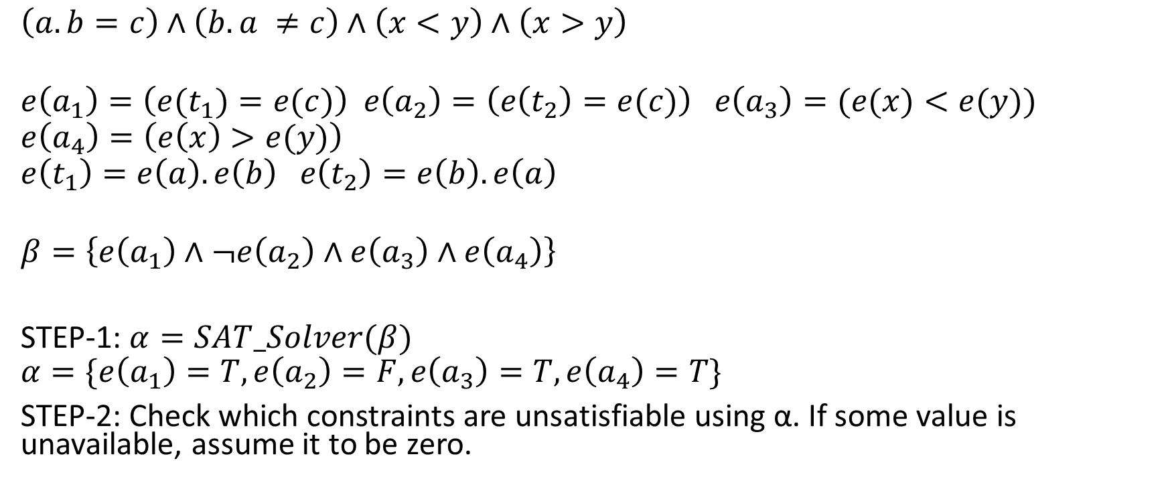
Incremental bit flattening
$$\left(a.b=c\right)∧\left(b.a ≠c\right)∧\left(x<y\right)∧\left(x>y\right)$$
$$e\left(a_{1}\right)=\left(e(t_{1})=e(c)\right) e\left(a_{2}\right)=\left(e\left(t_{2}\right)=e(c)\right) e\left(a_{3}\right)=(e(x)<e(y))$$
$$e\left(a_{4}\right)=\left(e\left(x\right)>e(y)\right)$$
$$e\left(t_{1}\right)=e\left(a\right).e\left(b\right) e\left(t_{2}\right)=e\left(b\right).e\left(a\right)$$
$$β=\left\{e\left(a_{1}\right)∧¬e\left(a_{2}\right)∧e\left(a_{3}\right)∧e\left(a_{4}\right)\right\}$$
STEP-1: $α=SAT_Solver(β)$
$$α=\{e\left(a_{1}\right)=T,e\left(a_{2}\right)=F, e\left(a_{3}\right)=T, e\left(a_{4}\right)=T\}$$
STEP-2: Check which constraints are unsatisfiable using α. If some value is unavailable, assume it to be zero.

Slide 41
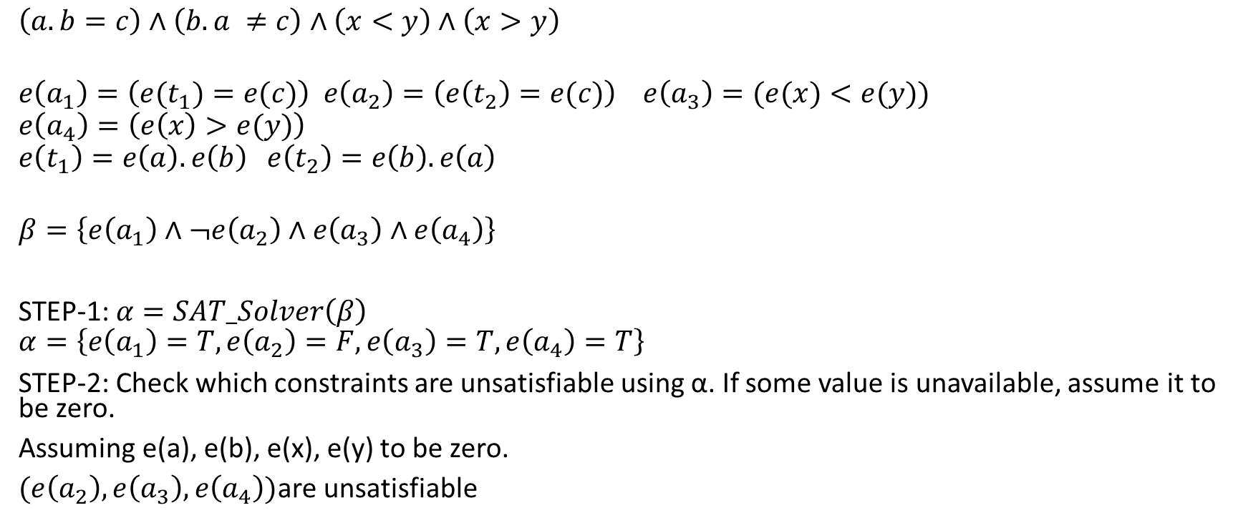
Incremental bit flattening
$$\left(a.b=c\right)∧\left(b.a ≠c\right)∧\left(x<y\right)∧\left(x>y\right)$$
$$e\left(a_{1}\right)=\left(e(t_{1})=e(c)\right) e\left(a_{2}\right)=\left(e\left(t_{2}\right)=e(c)\right) e\left(a_{3}\right)=(e(x)<e(y))$$
$$e\left(a_{4}\right)=\left(e\left(x\right)>e(y)\right)$$
$$e\left(t_{1}\right)=e\left(a\right).e\left(b\right) e\left(t_{2}\right)=e\left(b\right).e\left(a\right)$$
$$β=\left\{e\left(a_{1}\right)∧¬e\left(a_{2}\right)∧e\left(a_{3}\right)∧e\left(a_{4}\right)\right\}$$
STEP-1: $α=SAT_Solver\left(β\right)$
$$α=\left\{e\left(a_{1}\right)=T,e\left(a_{2}\right)=F, e\left(a_{3}\right)=T, e\left(a_{4}\right)=T\right\}$$
STEP-2: Check which constraints are unsatisfiable using α. If some value is unavailable, assume it to be zero.
Assuming e(a), e(b), e(x), e(y) to be zero.
$(e\left(a_{2}\right), e\left(a_{3}\right), e\left(a_{4}\right))$are unsatisfiable

Slide 42
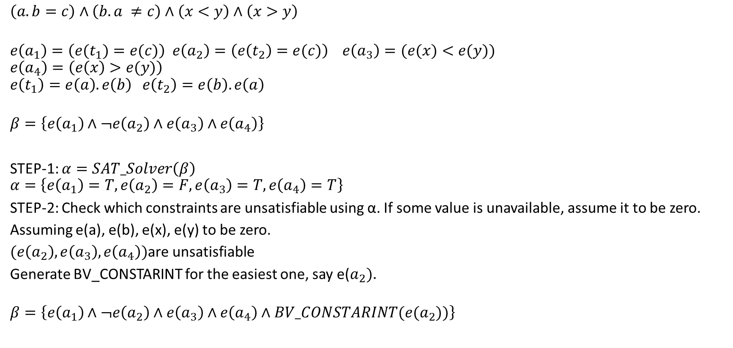
Incremental bit flattening
$$\left(a.b=c\right)∧\left(b.a ≠c\right)∧\left(x<y\right)∧\left(x>y\right)$$
$$e\left(a_{1}\right)=\left(e(t_{1})=e(c)\right) e\left(a_{2}\right)=\left(e\left(t_{2}\right)=e(c)\right) e\left(a_{3}\right)=(e(x)<e(y))$$
$$e\left(a_{4}\right)=\left(e\left(x\right)>e(y)\right)$$
$$e\left(t_{1}\right)=e\left(a\right).e\left(b\right) e\left(t_{2}\right)=e\left(b\right).e\left(a\right)$$
$$β=\left\{e\left(a_{1}\right)∧¬e\left(a_{2}\right)∧e\left(a_{3}\right)∧e\left(a_{4}\right)\right\}$$
STEP-1: $α=SAT_Solver\left(β\right)$
$$α=\left\{e\left(a_{1}\right)=T,e\left(a_{2}\right)=F, e\left(a_{3}\right)=T, e\left(a_{4}\right)=T\right\}$$
STEP-2: Check which constraints are unsatisfiable using α. If some value is unavailable, assume it to be zero.
Assuming e(a), e(b), e(x), e(y) to be zero.
$(e\left(a_{2}\right), e\left(a_{3}\right), e\left(a_{4}\right))$are unsatisfiable
Generate BV_CONSTARINT for the easiest one, say e($a_{2}).$
$$β=\left\{e\left(a_{1}\right)∧¬e\left(a_{2}\right)∧e\left(a_{3}\right)∧e\left(a_{4}\right)∧BV_CONSTARINT(e(a_{2}))\right\}$$

Slide 43
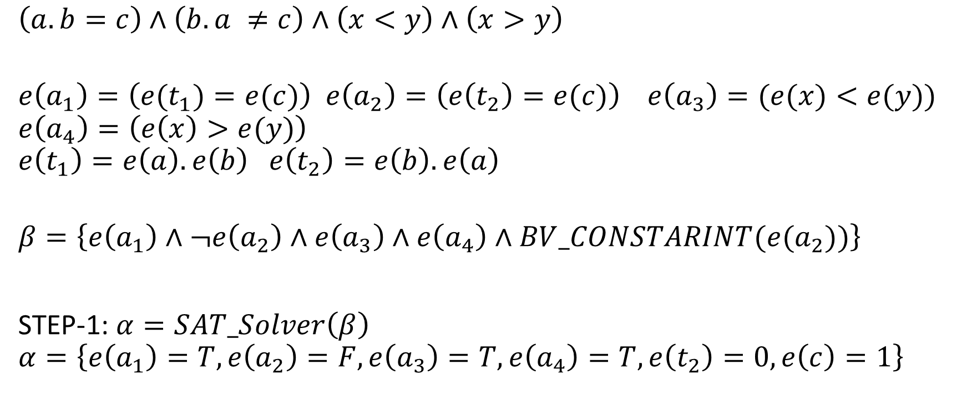
Incremental bit flattening
$$\left(a.b=c\right)∧\left(b.a ≠c\right)∧\left(x<y\right)∧\left(x>y\right)$$
$$e\left(a_{1}\right)=\left(e(t_{1})=e(c)\right) e\left(a_{2}\right)=\left(e\left(t_{2}\right)=e(c)\right) e\left(a_{3}\right)=(e(x)<e(y))$$
$$e\left(a_{4}\right)=\left(e\left(x\right)>e(y)\right)$$
$$e\left(t_{1}\right)=e\left(a\right).e\left(b\right) e\left(t_{2}\right)=e\left(b\right).e\left(a\right)$$
$$β=\left\{e\left(a_{1}\right)∧¬e\left(a_{2}\right)∧e\left(a_{3}\right)∧e\left(a_{4}\right)∧BV_CONSTARINT(e(a_{2}))\right\}$$
STEP-1: $α=SAT_Solver\left(β\right)$
$$α=\left\{e\left(a_{1}\right)=T,e\left(a_{2}\right)=F, e\left(a_{3}\right)=T, e\left(a_{4}\right)=T, e\left(t_{2}\right)=0, e\left(c\right)=1\right\}$$

Slide 44
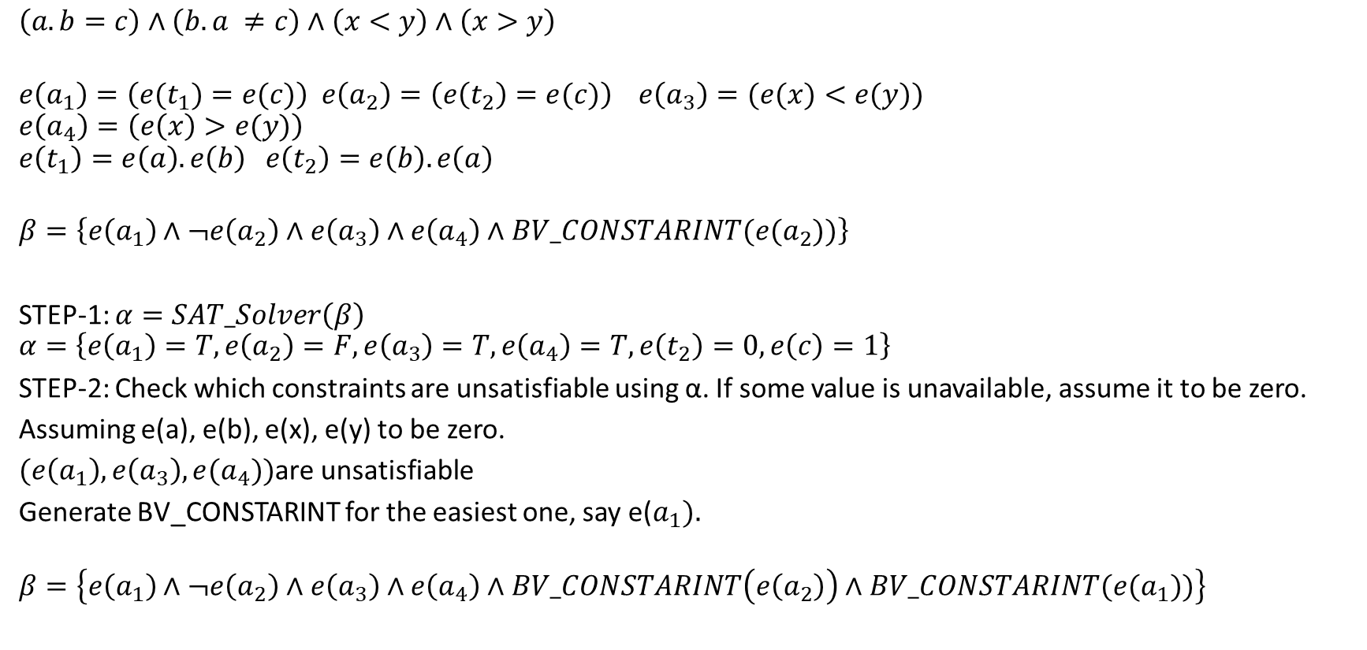
Incremental bit flattening
$$\left(a.b=c\right)∧\left(b.a ≠c\right)∧\left(x<y\right)∧\left(x>y\right)$$
$$e\left(a_{1}\right)=\left(e(t_{1})=e(c)\right) e\left(a_{2}\right)=\left(e\left(t_{2}\right)=e(c)\right) e\left(a_{3}\right)=(e(x)<e(y))$$
$$e\left(a_{4}\right)=\left(e\left(x\right)>e(y)\right)$$
$$e\left(t_{1}\right)=e\left(a\right).e\left(b\right) e\left(t_{2}\right)=e\left(b\right).e\left(a\right)$$
$$β=\left\{e\left(a_{1}\right)∧¬e\left(a_{2}\right)∧e\left(a_{3}\right)∧e\left(a_{4}\right)∧BV_CONSTARINT(e(a_{2}))\right\}$$
STEP-1: $α=SAT_Solver\left(β\right)$
$$α=\left\{e\left(a_{1}\right)=T,e\left(a_{2}\right)=F, e\left(a_{3}\right)=T, e\left(a_{4}\right)=T, e\left(t_{2}\right)=0, e\left(c\right)=1\right\}$$
STEP-2: Check which constraints are unsatisfiable using α. If some value is unavailable, assume it to be zero.
Assuming e(a), e(b), e(x), e(y) to be zero.
$(e\left(a_{1}\right), e\left(a_{3}\right),e(a_{4}))$are unsatisfiable
Generate BV_CONSTARINT for the easiest one, say e($a_{1}).$
$$β=\left\{e\left(a_{1}\right)∧¬e\left(a_{2}\right)∧e\left(a_{3}\right)∧e\left(a_{4}\right)∧BV_CONSTARINT\left(e\left(a_{2}\right)\right)∧BV_CONSTARINT(e(a_{1}))\right\}$$

Slide 45
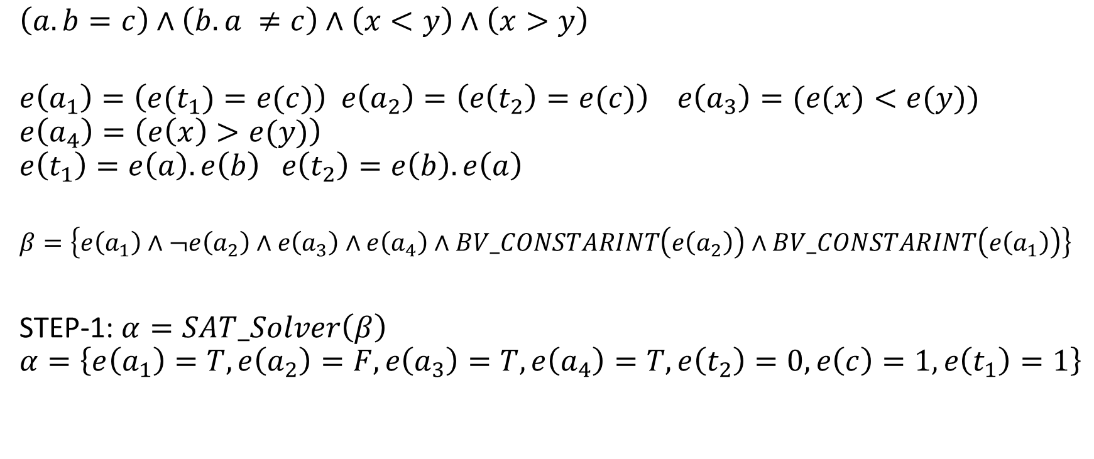
Incremental bit flattening
$$\left(a.b=c\right)∧\left(b.a ≠c\right)∧\left(x<y\right)∧\left(x>y\right)$$
$$e\left(a_{1}\right)=\left(e(t_{1})=e(c)\right) e\left(a_{2}\right)=\left(e\left(t_{2}\right)=e(c)\right) e\left(a_{3}\right)=(e(x)<e(y))$$
$$e\left(a_{4}\right)=\left(e\left(x\right)>e(y)\right)$$
$$e\left(t_{1}\right)=e\left(a\right).e\left(b\right) e\left(t_{2}\right)=e\left(b\right).e\left(a\right)$$
$$β=\left\{e\left(a_{1}\right)∧¬e\left(a_{2}\right)∧e\left(a_{3}\right)∧e\left(a_{4}\right)∧BV_CONSTARINT\left(e\left(a_{2}\right)\right)∧BV_CONSTARINT\left(e\left(a_{1}\right)\right)\right\}$$
STEP-1: $α=SAT_Solver\left(β\right)$
$$α=\left\{e\left(a_{1}\right)=T,e\left(a_{2}\right)=F, e\left(a_{3}\right)=T, e\left(a_{4}\right)=T, e\left(t_{2}\right)=0, e\left(c\right)=1,e\left(t_{1}\right)=1\right\}$$

Slide 46
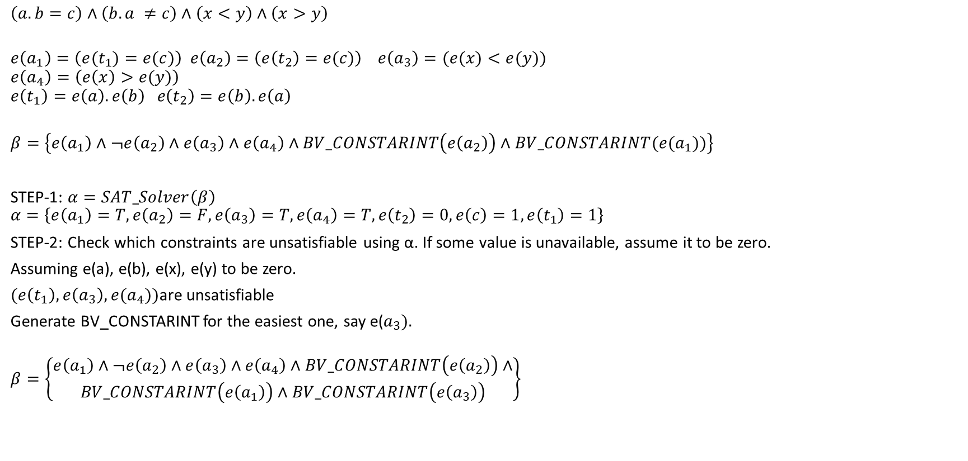
Incremental bit flattening
$$\left(a.b=c\right)∧\left(b.a ≠c\right)∧\left(x<y\right)∧\left(x>y\right)$$
$$e\left(a_{1}\right)=\left(e(t_{1})=e(c)\right) e\left(a_{2}\right)=\left(e\left(t_{2}\right)=e(c)\right) e\left(a_{3}\right)=(e(x)<e(y))$$
$$e\left(a_{4}\right)=\left(e\left(x\right)>e(y)\right)$$
$$e\left(t_{1}\right)=e\left(a\right).e\left(b\right) e\left(t_{2}\right)=e\left(b\right).e\left(a\right)$$
$$β=\left\{e\left(a_{1}\right)∧¬e\left(a_{2}\right)∧e\left(a_{3}\right)∧e\left(a_{4}\right)∧BV_CONSTARINT\left(e\left(a_{2}\right)\right)∧BV_CONSTARINT(e(a_{1}))\right\}$$
STEP-1: $α=SAT_Solver\left(β\right)$
$$α=\left\{e\left(a_{1}\right)=T,e\left(a_{2}\right)=F, e\left(a_{3}\right)=T, e\left(a_{4}\right)=T, e\left(t_{2}\right)=0, e\left(c\right)=1, e\left(t_{1}\right)=1\right\}$$
STEP-2: Check which constraints are unsatisfiable using α. If some value is unavailable, assume it to be zero.
Assuming e(a), e(b), e(x), e(y) to be zero.
$(e\left(t_{1}\right), e\left(a_{3}\right),e(a_{4}))$are unsatisfiable
Generate BV_CONSTARINT for the easiest one, say e($a_{3}).$
$$β=\left\{\begin{aligned}e\left(a_{1}\right)∧¬e\left(a_{2}\right)∧e\left(a_{3}\right)∧e\left(a_{4}\right)∧BV_CONSTARINT\left(e\left(a_{2}\right)\right)∧ \\ BV_CONSTARINT\left(e\left(a_{1}\right)\right)∧BV_CONSTARINT\left(e\left(a_{3}\right)\right)\end{aligned}\right\}$$

Slide 47
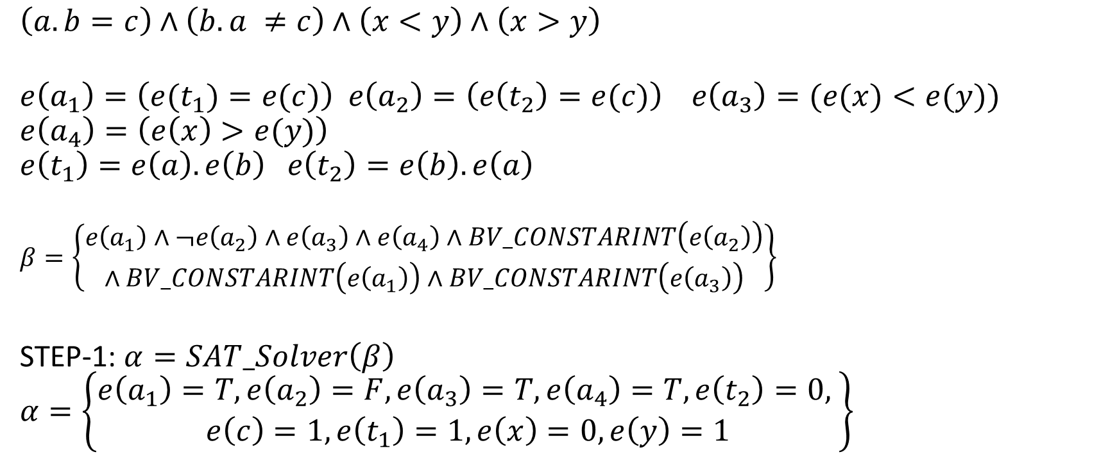
Incremental bit flattening
$$\left(a.b=c\right)∧\left(b.a ≠c\right)∧\left(x<y\right)∧\left(x>y\right)$$
$$e\left(a_{1}\right)=\left(e(t_{1})=e(c)\right) e\left(a_{2}\right)=\left(e\left(t_{2}\right)=e(c)\right) e\left(a_{3}\right)=(e(x)<e(y))$$
$$e\left(a_{4}\right)=\left(e\left(x\right)>e(y)\right)$$
$$e\left(t_{1}\right)=e\left(a\right).e\left(b\right) e\left(t_{2}\right)=e\left(b\right).e\left(a\right)$$
$$β=\left\{\begin{aligned}e\left(a_{1}\right)∧¬e\left(a_{2}\right)∧e\left(a_{3}\right)∧e\left(a_{4}\right)∧BV_CONSTARINT\left(e\left(a_{2}\right)\right) \\ ∧BV_CONSTARINT\left(e\left(a_{1}\right)\right)∧BV_CONSTARINT\left(e\left(a_{3}\right)\right)\end{aligned}\right\}$$
STEP-1: $α=SAT_Solver\left(β\right)$
$$α=\left\{\begin{aligned}e\left(a_{1}\right)=T,e\left(a_{2}\right)=F, e\left(a_{3}\right)=T, e\left(a_{4}\right)=T, e\left(t_{2}\right)=0, \\ e\left(c\right)=1,e\left(t_{1}\right)=1, e\left(x\right)=0, e\left(y\right)=1\end{aligned}\right\}$$

Slide 48
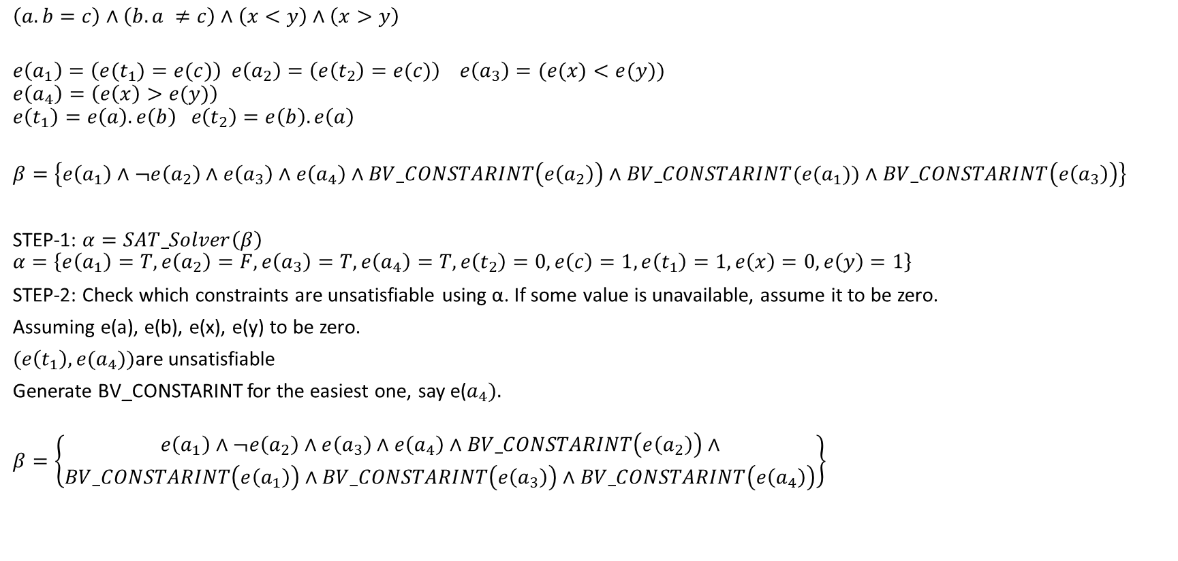
Incremental bit flattening
$$\left(a.b=c\right)∧\left(b.a ≠c\right)∧\left(x<y\right)∧\left(x>y\right)$$
$$e\left(a_{1}\right)=\left(e(t_{1})=e(c)\right) e\left(a_{2}\right)=\left(e\left(t_{2}\right)=e(c)\right) e\left(a_{3}\right)=(e(x)<e(y))$$
$$e\left(a_{4}\right)=\left(e\left(x\right)>e(y)\right)$$
$$e\left(t_{1}\right)=e\left(a\right).e\left(b\right) e\left(t_{2}\right)=e\left(b\right).e\left(a\right)$$
$$β=\left\{e\left(a_{1}\right)∧¬e\left(a_{2}\right)∧e\left(a_{3}\right)∧e\left(a_{4}\right)∧BV_CONSTARINT\left(e\left(a_{2}\right)\right)∧BV_CONSTARINT(e(a_{1}))∧BV_CONSTARINT\left(e\left(a_{3}\right)\right)\right\}$$
STEP-1: $α=SAT_Solver\left(β\right)$
$$α=\left\{e\left(a_{1}\right)=T,e\left(a_{2}\right)=F, e\left(a_{3}\right)=T, e\left(a_{4}\right)=T, e\left(t_{2}\right)=0, e\left(c\right)=1, e\left(t_{1}\right)=1, e\left(x\right)=0,e\left(y\right)=1\right\}$$
STEP-2: Check which constraints are unsatisfiable using α. If some value is unavailable, assume it to be zero.
Assuming e(a), e(b), e(x), e(y) to be zero.
$(e\left(t_{1}\right), e(a_{4}))$are unsatisfiable
Generate BV_CONSTARINT for the easiest one, say e($a_{4}).$
$$β=\left\{\begin{aligned}e\left(a_{1}\right)∧¬e\left(a_{2}\right)∧e\left(a_{3}\right)∧e\left(a_{4}\right)∧BV_CONSTARINT\left(e\left(a_{2}\right)\right)∧ \\ BV_CONSTARINT\left(e\left(a_{1}\right)\right)∧BV_CONSTARINT\left(e\left(a_{3}\right)\right)∧BV_CONSTARINT\left(e\left(a_{4}\right)\right)\end{aligned}\right\}$$

Slide 49
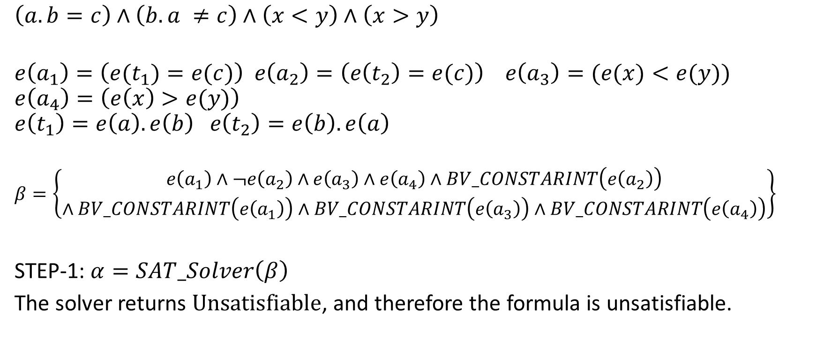
Incremental bit flattening
$$\left(a.b=c\right)∧\left(b.a ≠c\right)∧\left(x<y\right)∧\left(x>y\right)$$
$$e\left(a_{1}\right)=\left(e(t_{1})=e(c)\right) e\left(a_{2}\right)=\left(e\left(t_{2}\right)=e(c)\right) e\left(a_{3}\right)=(e(x)<e(y))$$
$$e\left(a_{4}\right)=\left(e\left(x\right)>e(y)\right)$$
$$e\left(t_{1}\right)=e\left(a\right).e\left(b\right) e\left(t_{2}\right)=e\left(b\right).e\left(a\right)$$
$$β=\left\{\begin{aligned}e\left(a_{1}\right)∧¬e\left(a_{2}\right)∧e\left(a_{3}\right)∧e\left(a_{4}\right)∧BV_CONSTARINT\left(e\left(a_{2}\right)\right) \\ ∧BV_CONSTARINT\left(e\left(a_{1}\right)\right)∧BV_CONSTARINT\left(e\left(a_{3}\right)\right)∧BV_CONSTARINT\left(e\left(a_{4}\right)\right)\end{aligned}\right\}$$
STEP-1: $α=SAT_Solver\left(β\right)$
The solver returns $\text{Unsatisfiable}$, and therefore the formula is unsatisfiable.

Slide 50
Incremental bit flattening
Notice that the bit-vector constraints for all inexpensive operations are generated and checked for satisfiability before generating constraints and checking satisfiability of expensive operations

Slide 51
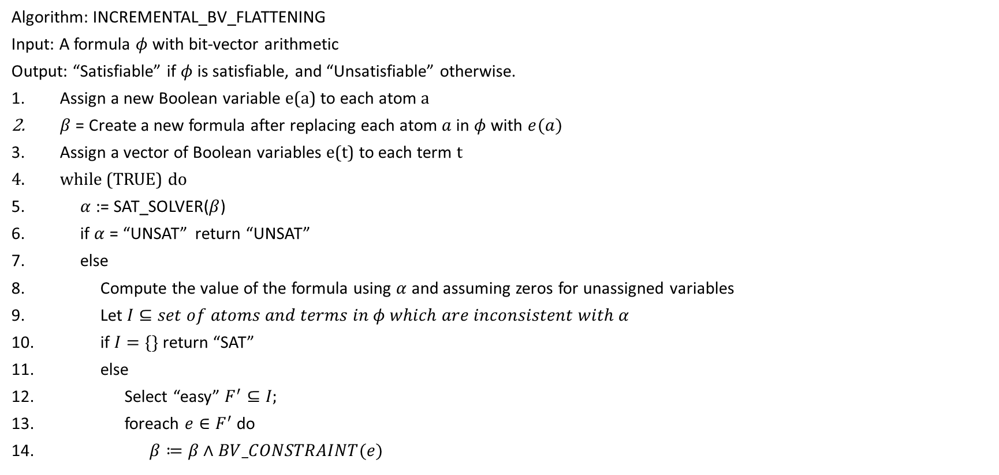
INCREMENTAL_BV_FLATTENING
Algorithm: INCREMENTAL_BV_FLATTENING
Input: A formula $φ$ with bit-vector arithmetic
Output: “Satisfiable” if $φ$ is satisfiable, and “Unsatisfiable” otherwise.
Assign a new Boolean variable e(a) to each atom a
$β$ = Create a new formula after replacing each atom $a$ in $φ$ with $e(a)$
Assign a vector of Boolean variables e(t) to each term t
while (TRUE) do
$α$ := SAT_SOLVER($β$)
if $α$ = “UNSAT” return “UNSAT”
else
Compute the value of the formula using $α$ and assuming zeros for unassigned variables
Let $I⊆set of atoms and terms in φ which are inconsistent with α$
if $I=\{\}$ return “SAT”
else
Select “easy” $F^{′}⊆I;$
foreach $e∈F^{′}$ do
$β≔β∧BV_CONSTRAINT(e)$

Slide 52
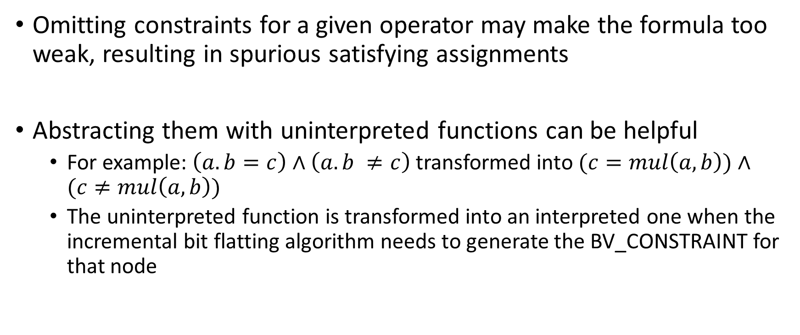
Further optimization
Omitting constraints for a given operator may make the formula too weak, resulting in spurious satisfying assignments
Abstracting them with uninterpreted functions can be helpful
For example: $\left(a.b=c\right)∧\left(a.b ≠c\right)$ transformed into $(c=mul\left(a, b\right))∧(c≠mul\left(a,b\right))$
The uninterpreted function is transformed into an interpreted one when the incremental bit flatting algorithm needs to generate the BV_CONSTRAINT for that node

