Slide 2
Today’s topics
Theory of integers
Theory of arrays
Combining decision procedures

Slide 3
References
Read Chapter-3 from the COC book
Read Chapter-7 from the DP book

Slide 4
First-order theories

Slide 5
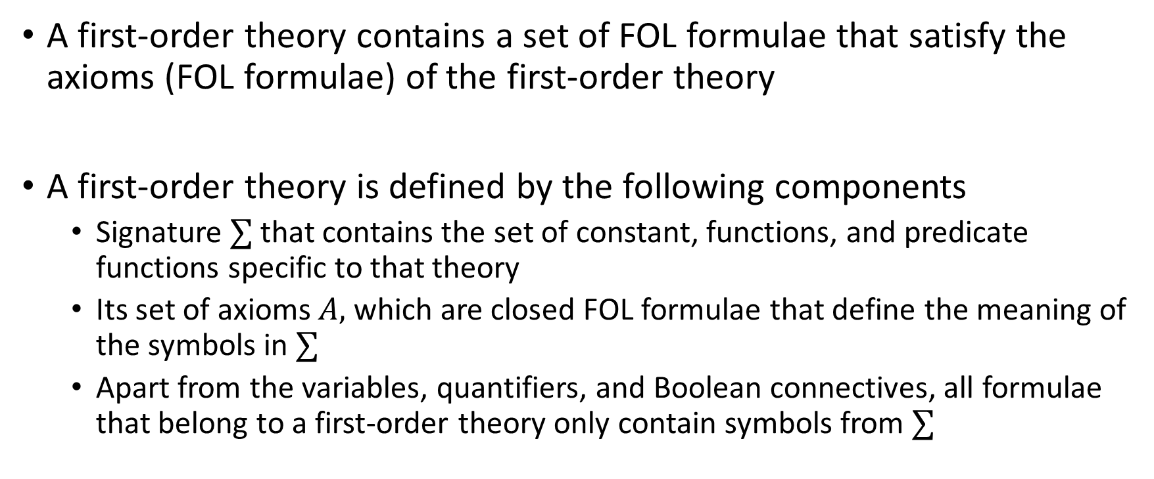
First-order theory
A first-order theory contains a set of FOL formulae that satisfy the axioms (FOL formulae) of the first-order theory
A first-order theory is defined by the following components
Signature $∑$ that contains the set of constant, functions, and predicate functions specific to that theory
Its set of axioms $A,$ which are closed FOL formulae that define the meaning of the symbols in $∑$
Apart from the variables, quantifiers, and Boolean connectives, all formulae that belong to a first-order theory only contain symbols from $∑$

Slide 6
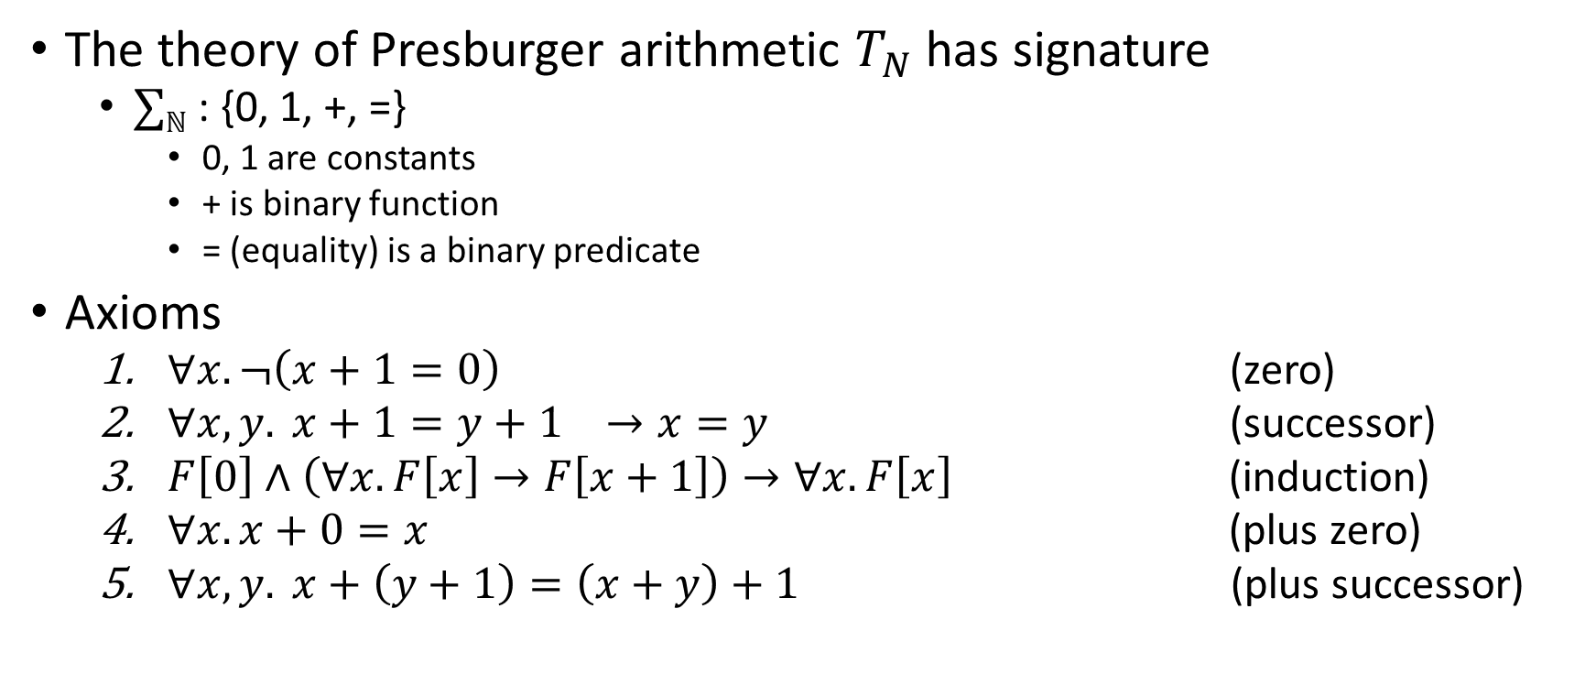
Presburger arithmetic
The theory of Presburger arithmetic $T_{N}$ has signature
$∑ℕ$ : {0, 1, +, =}
0, 1 are constants
+ is binary function
= (equality) is a binary predicate
Axioms
$∀x. ¬\left(x+1=0\right)$ (zero)
$∀x,y. x+1=y+1 →x=y$ (successor)
$F\left[0\right]∧\left(∀x.F\left[x\right]→F\left[x+1\right]\right)→∀x.F\left[x\right]$ (induction)
$∀x. x+0=x$ (plus zero)
$∀x, y. x+\left(y+1\right)=\left(x+y\right)+1$ (plus successor)

Slide 7

Presburger arithmetic
Interpretation
Domain is $ℕ$
$α_{I}\left[0\right] is 0∈ℕ$
$α_{I}\left[1\right] is 1∈ℕ$
$α_{I}\left[+\right] is+_{ℕ}$
$α_{I}\left[=\right] is=_{ℕ}$

Slide 8

Presburger arithmetic
$∑ℕ$ : {0, 1, +, =}
Write $3x+5=2y$ in Presburger arithmetic

Slide 9

Presburger arithmetic
$∑ℕ$ : {0, 1, +, =}
Write $3x+5=2y$ in Presburger arithmetic
x + x + x + 1 + 1 + 1 + 1 + 1 = y + y

Slide 10

Presburger arithmetic
$∑ℕ$ : {0, 1, +, =}
Write $3x+5>2y$ in Presburger arithmetic
$$∃z. \left(x+x+x+1+1+1+1+1=y+y+z\right)∧¬(z=0)$$

Slide 11

Presburger arithmetic
$∑ℕ$ : {0, 1, +, =}
Write $3x+5≥2y$ in Presburger arithmetic

Slide 12

Presburger arithmetic
$∑ℕ$ : {0, 1, +, =}
Write $3x+5≥2y$ in Presburger arithmetic
$$∃z. \left(x+x+x+1+1+1+1+1=y+y+z\right)$$

Slide 13

Presburger arithmetic
$∑ℕ$ : {0, 1, +, =}
Write $∀w,x. ∃y,z.x+2y−z−13>−3w+5$ in Presburger arithmetic, where the domain of x, y, w is $ℤ$, and – is standard subtraction.

Slide 14
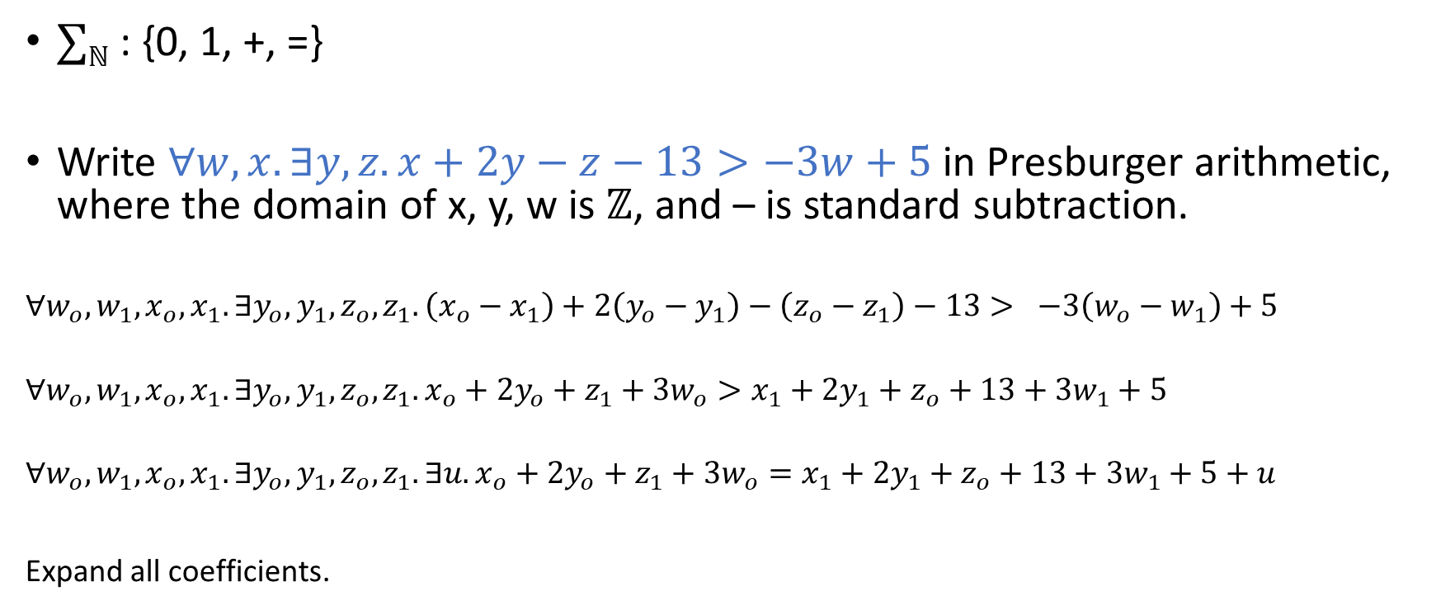
Presburger arithmetic
$∑ℕ$ : {0, 1, +, =}
Write $∀w,x. ∃y,z.x+2y−z−13>−3w+5$ in Presburger arithmetic, where the domain of x, y, w is $ℤ$, and – is standard subtraction.
$$∀w_{o},w_{1},x_{o},x_{1}. ∃y_{o},y_{1},z_{o},z_{1}. \left(x_{o}−x_{1}\right)+2\left(y_{o}−y_{1}\right)−\left(z_{o}−z_{1}\right)−13> −3\left(w_{o}−w_{1}\right)+5$$
$$∀w_{o},w_{1},x_{o},x_{1}. ∃y_{o},y_{1},z_{o},z_{1}. x_{o}+2y_{o}+z_{1}+3w_{o}>x_{1}+2y_{1}+z_{o}+13+3w_{1}+5$$
$$∀w_{o},w_{1},x_{o},x_{1}. ∃y_{o},y_{1},z_{o},z_{1}. ∃u.x_{o}+2y_{o}+z_{1}+3w_{o}=x_{1}+2y_{1}+z_{o}+13+3w_{1}+5+u$$
Expand all coefficients.

Slide 15
Presburger arithmetic
How do we solve the formulae that belongs to Presburger arithmetic?

Slide 16
Presburger arithmetic
How do we solve the formulae that belong to Presburger arithmetic?
Using omega test
Presburger arithmetic is decidable even for quantified formulae

Slide 17
Theory of arrays

Slide 18
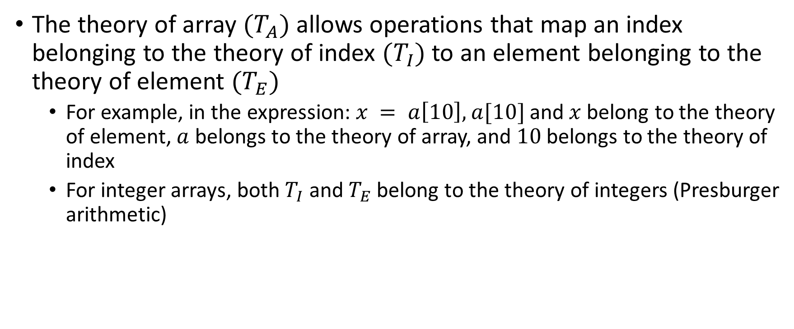
Theory of array
The theory of array $(T_{A})$ allows operations that map an index belonging to the theory of index $(T_{I})$ to an element belonging to the theory of element $(T_{E})$
For example, in the expression: $x = a\left[10\right],$ $a[10]$and$x$belong to the theory of element, $a$ belongs to the theory of array, and $10$ belongs to the theory of index
For integer arrays, both $T_{I}$ and $T_{E}$ belong to the theory of integers (Presburger arithmetic)

Slide 19

Basic operations
Let’s say $a∈T_{A}$ is an array. There are two basic operations
Load: reading an element at index $i∈T_{I}$ from $a$. $a\left[i\right]∈T_{E}$ is the value of the element at index $i$.
Store: writing an element at index $i∈T_{i}$. $a\left\{i←e\right\}∈T_{A}$ is a new array which is the same as $a$ except the value at index $i∈T_{I}$ is $e∈T_{E}$.

Slide 20

Syntax
$$term_{A} :array–identifier | {term}_{A}\{{term}_{I}←term_{E}\}$$
$$term_{E} :term_{A}\left[term_{I}\right] | (previous syntax of T_{E})$$
$$term_{I} :index–identifier | (previous synatx of T_{I})$$
$$formula : term_{A}=term_{A} \left| \left(previous syntax of T_{E}\right)\right|(previous syntax of T_{I})$$

Slide 21
Theory of index
A suitable theory for the theory of index is the one that supports quantifiers, e.g.,
There isn’t exist indices i, j such that a[i] > a[j] and j > i (sorted array)
For all i, a[i] = 0 (array initialization with zeros)

Slide 22
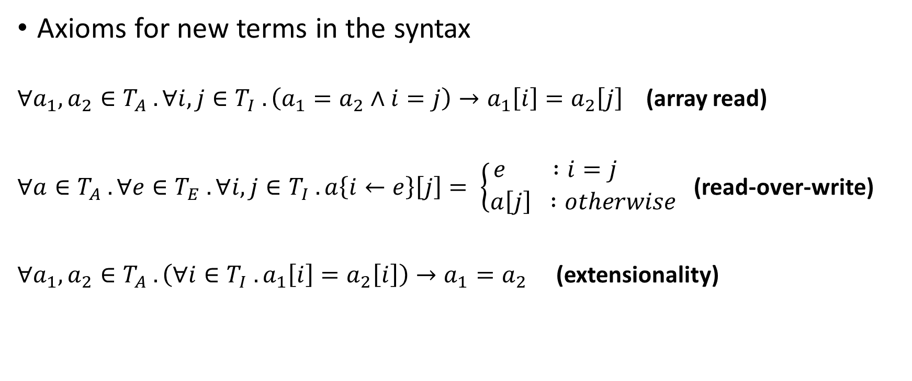
Axioms
Axioms for new terms in the syntax
$∀a_{1}, a_{2}∈T_{A} . ∀i,j∈T_{I} . \left(a_{1}=a_{2}∧i=j\right)→a_{1}\left[i\right]=a_{2}\left[j\right]$ (array read)
$∀a∈T_{A} . ∀e∈T_{E} . ∀i,j∈T_{I} . a\left\{i←e\right\}\left[j\right]= \left\{\begin{aligned}e :i=j \\ a\left[j\right] :otherwise\end{aligned} \right.$ (read-over-write)
$∀a_{1},a_{2}∈T_{A} . \left(∀i∈T_{I} . a_{1}\left[i\right]=a_{2}\left[i\right]\right)→a_{1}=a_{2}$ (extensionality)

Slide 23
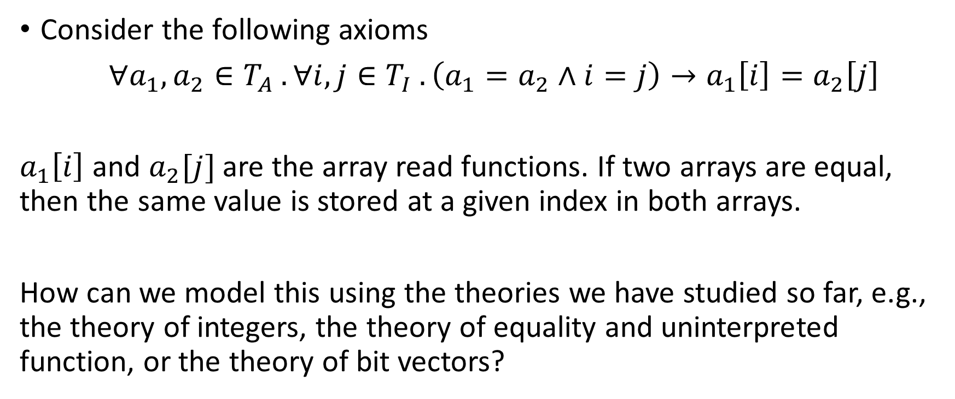
Eliminating array terms
Consider the following axioms
$∀a_{1}, a_{2}∈T_{A} . ∀i,j∈T_{I} . \left(a_{1}=a_{2}∧i=j\right)→a_{1}\left[i\right]=a_{2}\left[j\right]$
$a_{1}\left[i\right]$ and $a_{2}[j]$ are the array read functions. If two arrays are equal, then the same value is stored at a given index in both arrays.
How can we model this using the theories we have studied so far, e.g., the theory of integers, the theory of equality and uninterpreted function, or the theory of bit vectors?

Slide 24
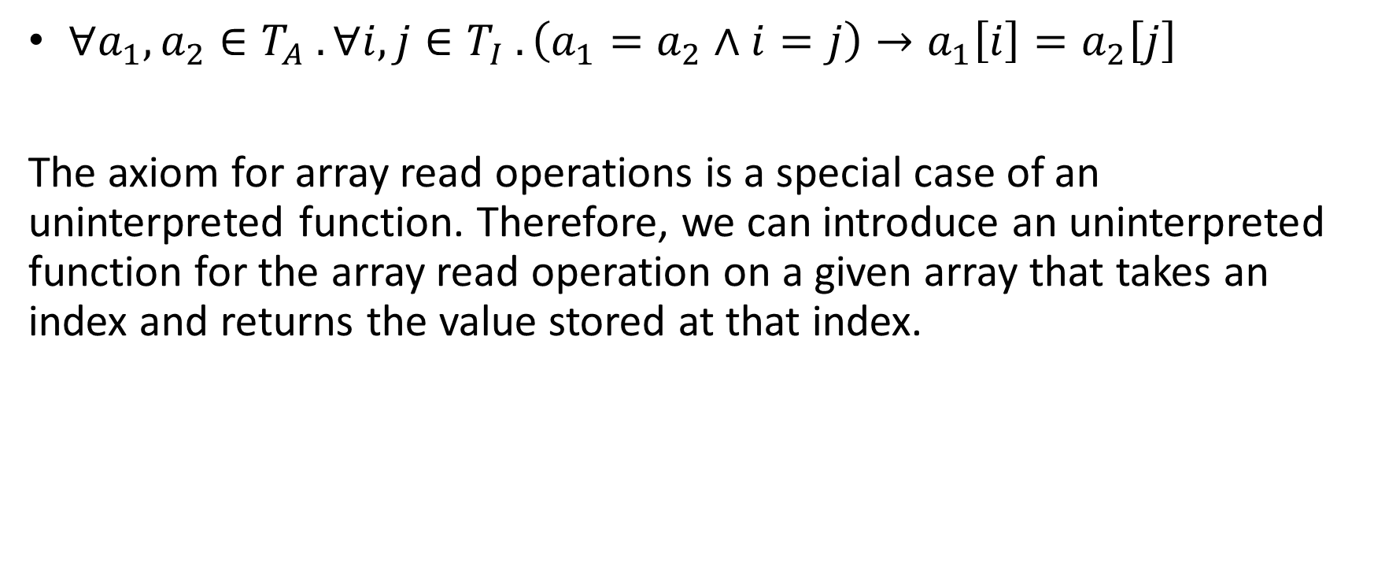
Eliminating array terms
$∀a_{1}, a_{2}∈T_{A} . ∀i,j∈T_{I} . \left(a_{1}=a_{2}∧i=j\right)→a_{1}\left[i\right]=a_{2}\left[j\right]$
The axiom for array read operations is a special case of an uninterpreted function. Therefore, we can introduce an uninterpreted function for the array read operation on a given array that takes an index and returns the value stored at that index.

Slide 25

Example
Remove array terms from the following formula
$$\left(i=j∧a\left[j\right]={′z}^{′}\right)→a\left[i\right]=′z′$$

Slide 26

Example
Remove array terms from the following formula
$$\left(i=j∧a\left[j\right]={′z}^{′}\right)→a\left[i\right]=′z′$$
$$(i=j∧F_{a}\left(j\right)={′z}^{′}) →F_{a}\left(i\right)= ′z′$$

Slide 27

Eliminating array terms
$$t=a\left\{i←e\right\}[j]$$

Slide 28

Eliminating array terms
$$t=a\left\{i←e\right\}[j]$$
$$a^{′}\left[i\right]=e∧\left(∀k. k≠i→a^{′}\left[k\right]=a\left[k\right]\right)∧{t=a}^{′}[j]$$

Slide 29
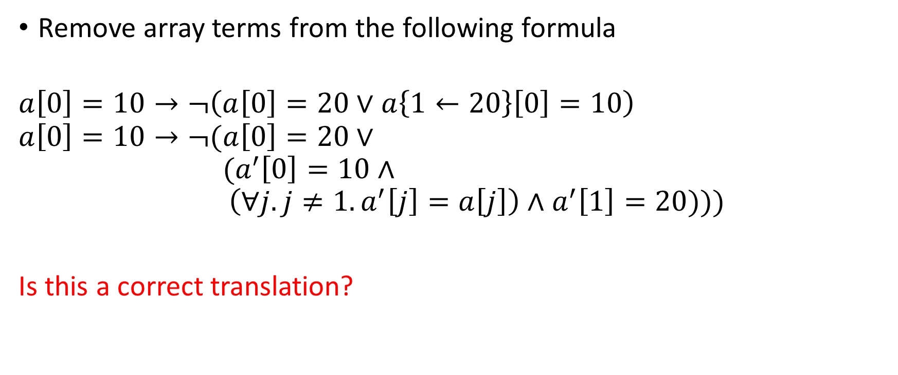
Example
Remove array terms from the following formula
$$a\left[0\right]=10→¬\left(a\left[0\right]=20∨a\left\{1←20\right\}\left[0\right]=10\right)$$
$$a\left[0\right]=10→¬(a\left[0\right]=20∨$$
$${ (a}^{′}\left[0\right]=10∧$$
$$\left(∀j. j≠1.a^{′}\left[j\right]=a\left[j\right]\right)∧a^{′}\left[1\right]=20)))$$
Is this a correct translation?

Slide 30
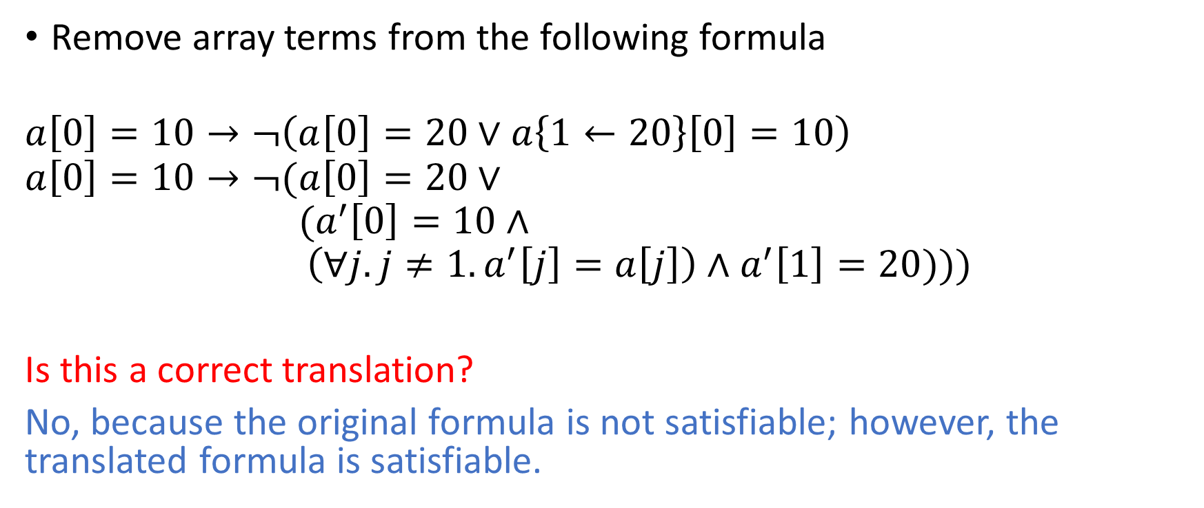
Example
Remove array terms from the following formula
$$a\left[0\right]=10→¬\left(a\left[0\right]=20∨a\left\{1←20\right\}\left[0\right]=10\right)$$
$$a\left[0\right]=10→¬(a\left[0\right]=20∨$$
$${ (a}^{′}\left[0\right]=10∧$$
$$\left(∀j. j≠1.a^{′}\left[j\right]=a\left[j\right]\right)∧a^{′}\left[1\right]=20)))$$
Is this a correct translation?
No, because the original formula is not satisfiable; however, the translated formula is satisfiable.

Slide 31
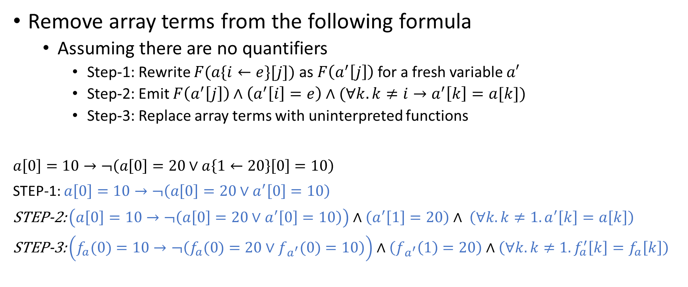
Example
Remove array terms from the following formula
Assuming there are no quantifiers
Step-1: Rewrite $F(a\{i←e\}[j])$ as $F\left(a^{′}\left[j\right]\right)$ for a fresh variable $a′$
Step-2: Emit $F\left(a^{′}\left[j\right]\right)∧\left(a^{′}\left[i\right]=e\right)∧(∀k. k≠i→a^{′}\left[k\right]=a[k])$
Step-3: Replace array terms with uninterpreted functions
$$a\left[0\right]=10→¬\left(a\left[0\right]=20∨a\left\{1←20\right\}\left[0\right]=10\right)$$
STEP-1: $a\left[0\right]=10→¬\left(a\left[0\right]=20∨a^{′}\left[0\right]=10\right)$
STEP-2: $\left(a\left[0\right]=10→¬\left(a\left[0\right]=20∨a^{′}\left[0\right]=10\right)\right)∧\left(a^{′}\left[1\right]=20\right)∧ \left(∀k. k≠1.a^{′}\left[k\right]=a\left[k\right]\right)$
STEP-3: $\left(f_{a}(0)=10→¬\left(f_{a}(0)=20∨f_{a^{′}}(0)=10\right)\right)∧\left(f_{a^{′}}\left(1\right)=20\right)∧\left(∀k. k≠1. f_{a}^{′}\left[k\right]=f_{a}\left[k\right]\right)$

Slide 32

Eliminating array terms
Array equality
$a_{1}=a_{2}$

Slide 33

Eliminating array terms
Array equality
$a_{1}=a_{2}$
We can always replace an array equality $a_{1}=a_{2}$ with
$∀i. a_{1}\left[i\right]=a_{2}[i]$

Slide 34
Theory of array
The theory of array can be reduced to a combination of the index theory and uninterpreted functions
For C programs, Presburger arithmetic can be used as the index theory, which is decidable even for the quantified formulas
However, the combination of Presburger arithmetic with uninterpreted functions is undecidable

Slide 35
Bounds check
int a[N];
for (int i = 0; i < N; i++)
a[i] = a[i+1];
What constraints need to be generated to ensure that the array accesses are always within the bounds?

Slide 36
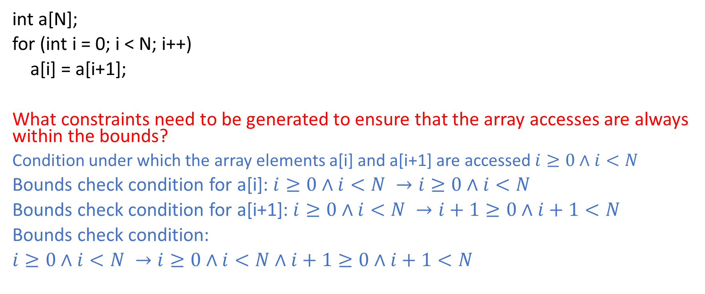
Bounds check
int a[N];
for (int i = 0; i < N; i++)
a[i] = a[i+1];
What constraints need to be generated to ensure that the array accesses are always within the bounds?
Condition under which the array elements a[i] and a[i+1] are accessed $i≥0∧i<N$
Bounds check condition for a[i]: $i≥0∧i<N →i≥0∧i<N$
Bounds check condition for a[i+1]: $i≥0∧i<N →i+1≥0∧i+1<N$
Bounds check condition:
$i≥0∧i<N →i≥0∧i<N∧i+1≥0∧i+1<N$

Slide 37
Deciding a combination of theory

Slide 38
References
Chapter-10 from the DP book
Chapter-10 from the COC book

Slide 39
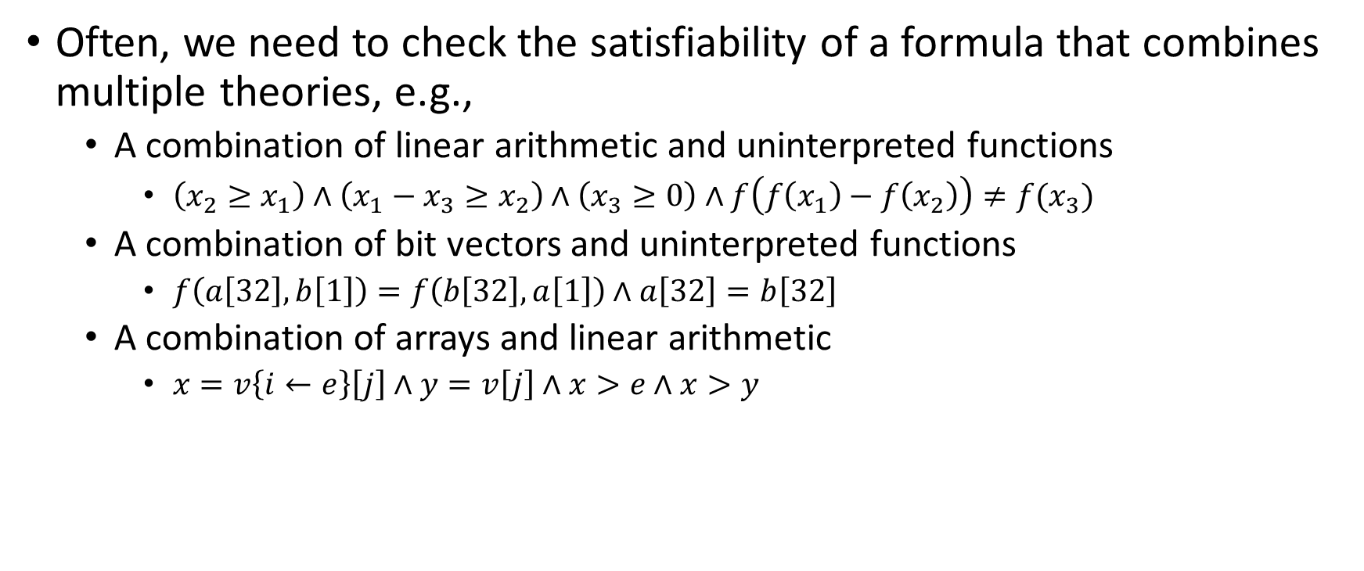
Combining decision procedures
Often, we need to check the satisfiability of a formula that combines multiple theories, e.g.,
A combination of linear arithmetic and uninterpreted functions
$\left(x_{2}≥x_{1}\right)∧\left(x_{1}−x_{3}≥x_{2}\right)∧\left(x_{3}≥0\right)∧f\left(f\left(x_{1}\right)−f\left(x_{2}\right)\right)≠f(x_{3})$
A combination of bit vectors and uninterpreted functions
$f\left(a\left[32\right],b\left[1\right]\right)=f\left(b\left[32\right],a\left[1\right]\right)∧a\left[32\right]=b\left[32\right]$
A combination of arrays and linear arithmetic
$x=v\left\{i←e\right\}\left[j\right]∧y=v\left[j\right]∧x>e∧x>y$

Slide 40
First-order theory
A first-order theory contains a set of FOL formulae that satisfy the axioms (FOL formulae) of the first-order theory
A first-order theory is defined by the following components
Signature $∑$ that contains the set of constant, functions, and predicate functions specific to that theory
Its set of axioms $A,$ which are closed FOL formulae that define the meaning of the symbols in $∑$
Apart from the variables, quantifiers, and Boolean connectives, all formulae that belong to a first-order theory only contain symbols from $∑$

Slide 41
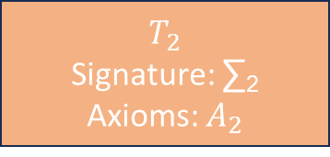
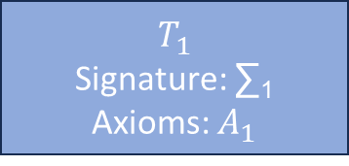
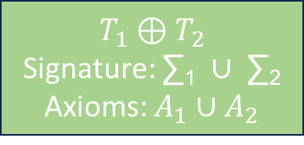
Theory combination
$$T_{1}$$
Signature: ∑₁
Axioms: $A_{1}$
$$T_{2}$$
Signature: ∑₂
Axioms: $A_{2}$
$$T_{1}⊕T_{2}$$
Signature: ∑₁ $∪$ ∑₂
Axioms: $A_{1}∪A_{2}$

Slide 42

Satisfiability
Let $φ$ be $∑$₁ $∪∑$₂ formula. The theory combination problem is to decide whether $φ$ is $T_{1}⊕T_{2}$ valid, i.e., $T_{1}⊕T_{2}⊨φ$

Slide 43
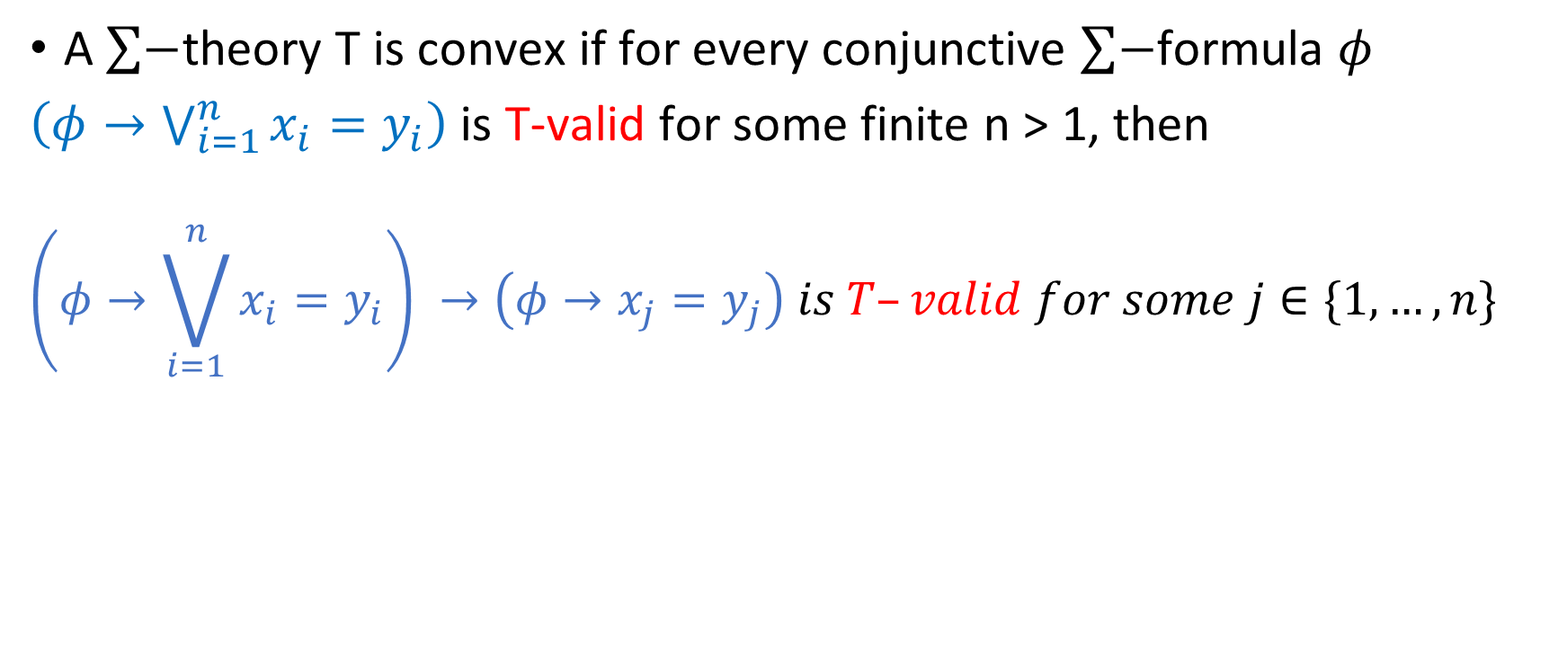
Convex theory
A $\sum{−}$theory T is convex if for every conjunctive $\sum{−}$formula $φ$
$\left(φ→\bigvee_{i=1}^{n}{x_{i}=y_{i}}\right)$ is T-valid for some finite n > 1, then
$$\left(φ→\bigvee_{i=1}^{n}{x_{i}=y_{i}}\right) →\left(φ→x_{j}=y_{j}\right) is T–valid for some j∈\{1,…,n\}$$

Slide 44
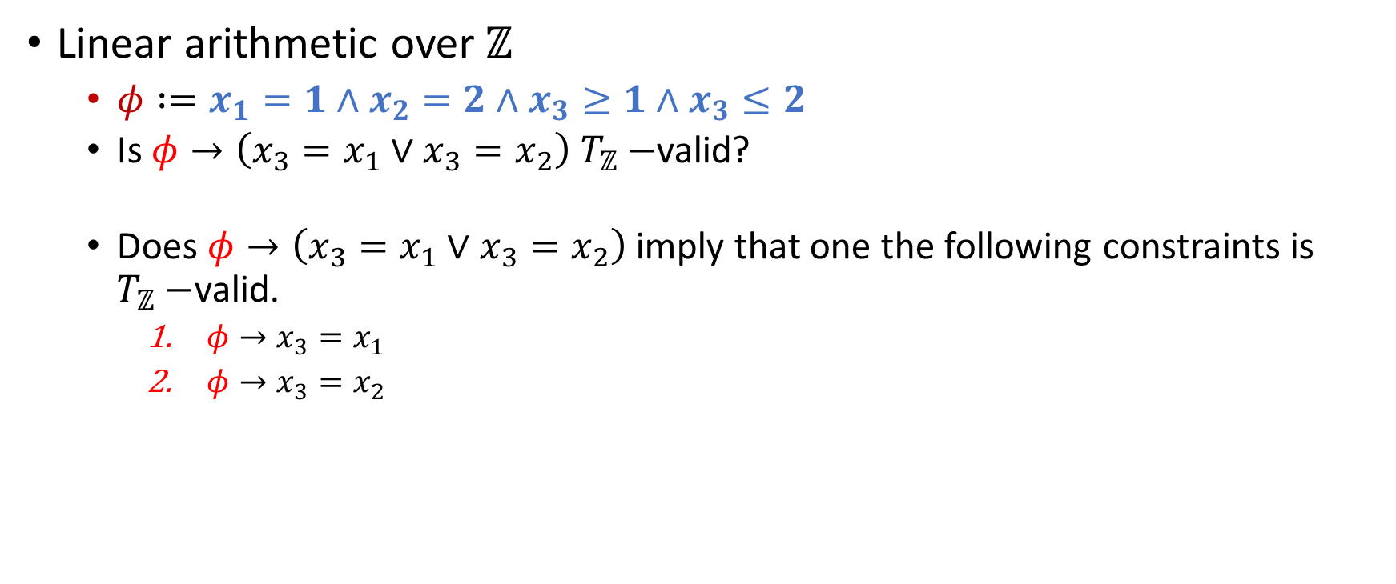
Example
Linear arithmetic over $ℤ$
$φ :=x_{1}=1∧x_{2}=2∧x_{3}≥1∧x_{3}≤2$
Is $φ→\left(x_{3}=x_{1}∨x_{3}=x_{2}\right) T_{ℤ}−$valid?
Does $φ→\left(x_{3}=x_{1}∨x_{3}=x_{2}\right)$ imply that one the following constraints is $T_{ℤ}−$valid.
$φ→x_{3}=x_{1}$
$φ→x_{3}=x_{2}$

Slide 45
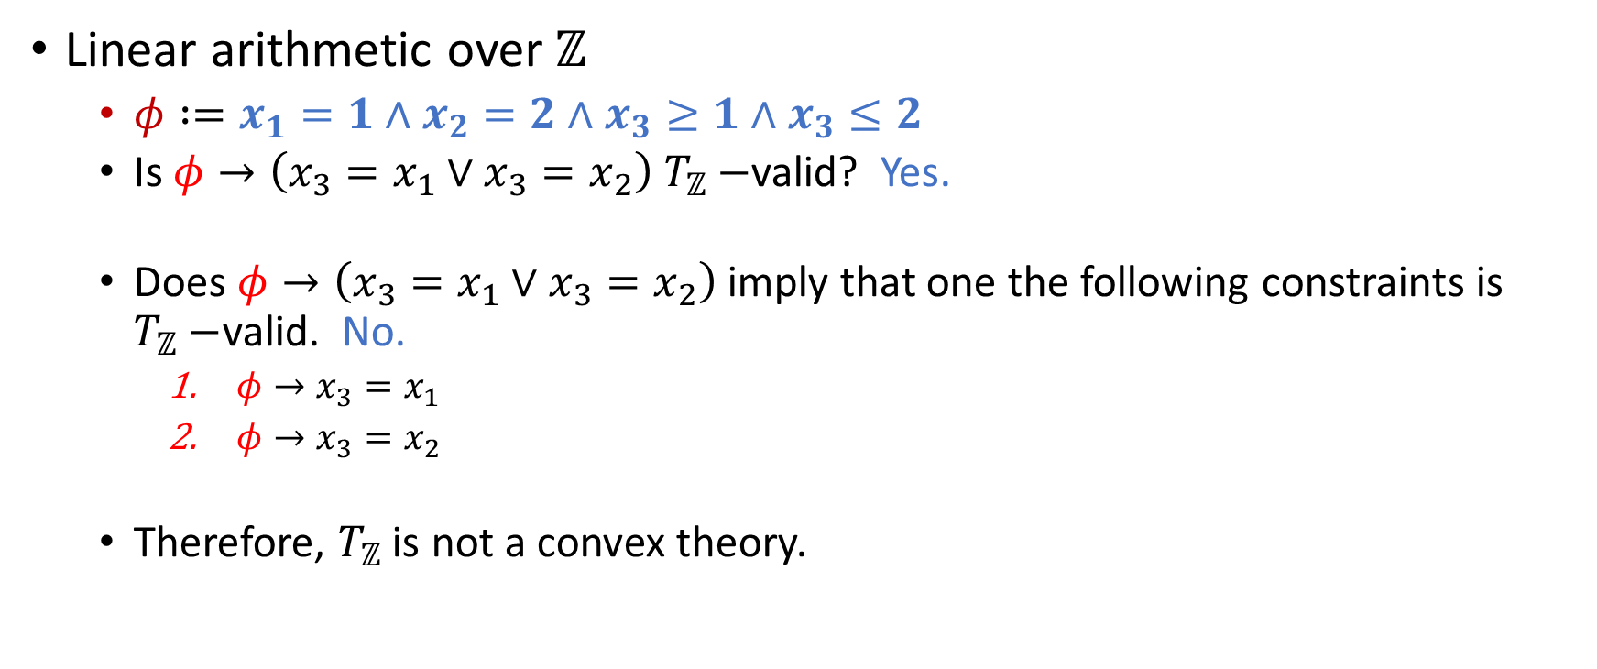
Example
Linear arithmetic over $ℤ$
$φ :=x_{1}=1∧x_{2}=2∧x_{3}≥1∧x_{3}≤2$
Is $φ→\left(x_{3}=x_{1}∨x_{3}=x_{2}\right) T_{ℤ}−$valid? Yes.
Does $φ→\left(x_{3}=x_{1}∨x_{3}=x_{2}\right)$ imply that one the following constraints is $T_{ℤ}−$valid. No.
$φ→x_{3}=x_{1}$
$φ→x_{3}=x_{2}$
Therefore, $T_{ℤ}$ is not a convex theory.

Slide 46

Example
Linear arithmetic over $ℝ$
$φ :=x_{1}=1∧x_{2}=2∧x_{3}≥1∧x_{3}≤2$
Is $φ→\left(x_{3}=x_{1}∨x_{3}=x_{2}\right) T_{ℝ}−$valid?

Slide 47

Example
Linear arithmetic over $ℝ$
$φ :=x_{1}=1∧x_{2}=2∧x_{3}≥1∧x_{3}≤2$
Is $φ→\left(x_{3}=x_{1}∨x_{3}=x_{2}\right) T_{ℝ}−$valid? No.

Slide 48
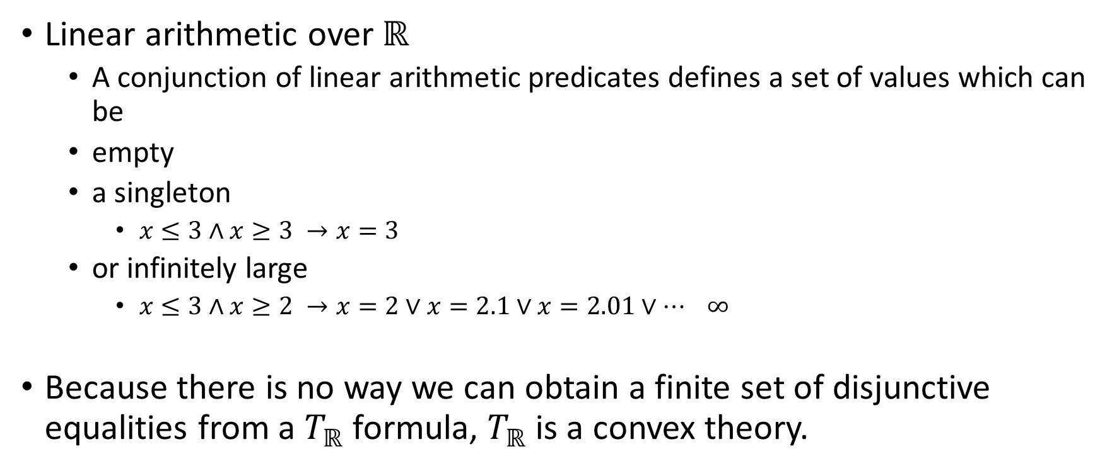
Example
Linear arithmetic over $ℝ$
A conjunction of linear arithmetic predicates defines a set of values which can be
empty
a singleton
$x≤3∧x≥3 →x=3$
or infinitely large
$x≤3∧x≥2 →x=2∨x=2.1∨x=2.01∨… ∞$
Because there is no way we can obtain a finite set of disjunctive equalities from a $T_{ℝ}$ formula, $T_{ℝ}$ is a convex theory.

Slide 49
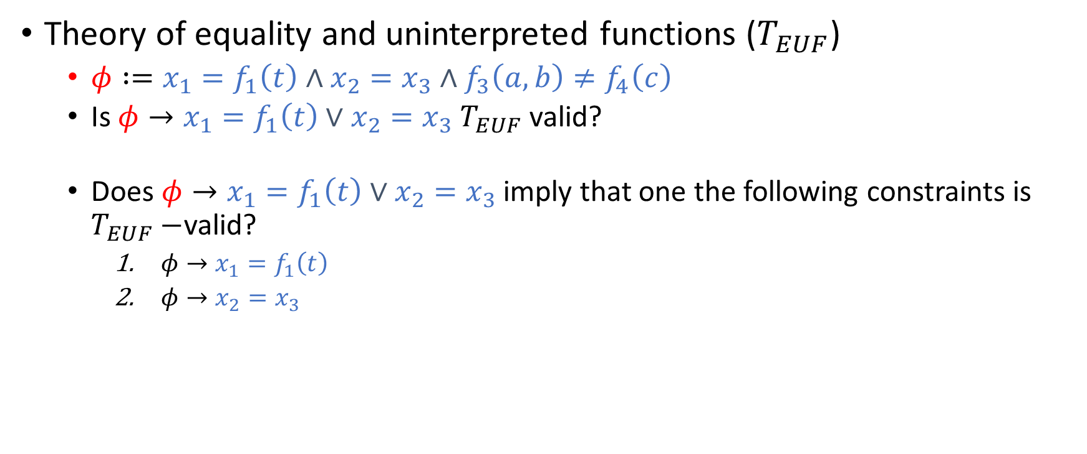
Example
Theory of equality and uninterpreted functions ($T_{EUF}$)
$φ :=x_{1}=f_{1}\left(t\right)∧x_{2}=x_{3}∧f_{3}\left(a, b\right)≠f_{4}\left(c\right)$
Is $φ→x_{1}=f_{1}\left(t\right)∨x_{2}=x_{3} T_{EUF}$ valid?
Does $φ→x_{1}=f_{1}\left(t\right)∨x_{2}=x_{3}$imply that one the following constraints is $T_{EUF}−$valid?
$φ→x_{1}=f_{1}\left(t\right)$
$φ→x_{2}=x_{3}$

Slide 50
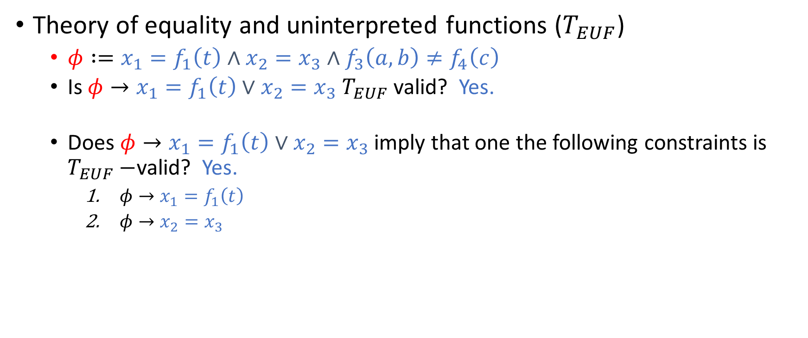
Example
Theory of equality and uninterpreted functions ($T_{EUF}$)
$φ :=x_{1}=f_{1}\left(t\right)∧x_{2}=x_{3}∧f_{3}\left(a, b\right)≠f_{4}\left(c\right)$
Is $φ→x_{1}=f_{1}\left(t\right)∨x_{2}=x_{3} T_{EUF}$ valid? Yes.
Does $φ→x_{1}=f_{1}\left(t\right)∨x_{2}=x_{3}$imply that one the following constraints is $T_{EUF}−$valid? Yes.
$φ→x_{1}=f_{1}\left(t\right)$
$φ→x_{2}=x_{3}$

Slide 51
Theory of EUF
Because a conjunction of equalities also implies individual equality separately, the theory of EUF is convex.

