Slide 2
Today’s topics
Combining decision procedures

Slide 3
Deciding a combination of theory

Slide 4
References
Chapter-10 from the DP book
Chapter-10 from the COC book

Slide 5
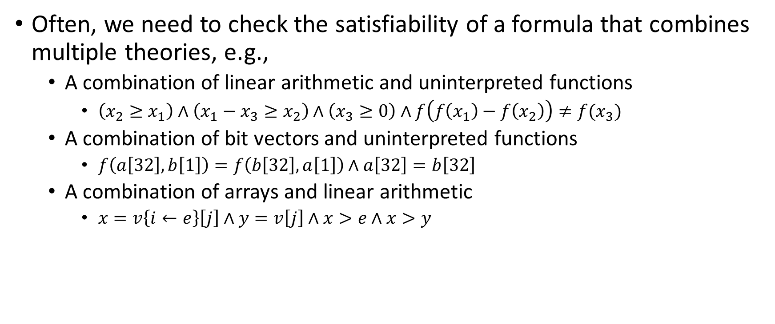
Combining decision procedures
Often, we need to check the satisfiability of a formula that combines multiple theories, e.g.,
A combination of linear arithmetic and uninterpreted functions
$\left(x_{2}≥x_{1}\right)∧\left(x_{1}−x_{3}≥x_{2}\right)∧\left(x_{3}≥0\right)∧f\left(f\left(x_{1}\right)−f\left(x_{2}\right)\right)≠f(x_{3})$
A combination of bit vectors and uninterpreted functions
$f\left(a\left[32\right],b\left[1\right]\right)=f\left(b\left[32\right],a\left[1\right]\right)∧a\left[32\right]=b\left[32\right]$
A combination of arrays and linear arithmetic
$x=v\left\{i←e\right\}\left[j\right]∧y=v\left[j\right]∧x>e∧x>y$

Slide 6
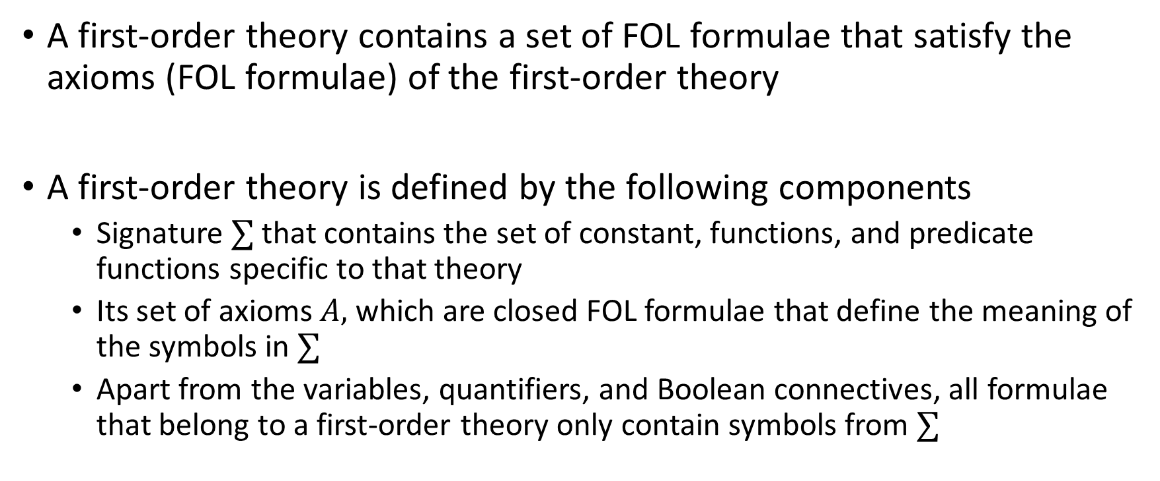
First-order theory
A first-order theory contains a set of FOL formulae that satisfy the axioms (FOL formulae) of the first-order theory
A first-order theory is defined by the following components
Signature $∑$ that contains the set of constant, functions, and predicate functions specific to that theory
Its set of axioms $A,$ which are closed FOL formulae that define the meaning of the symbols in $∑$
Apart from the variables, quantifiers, and Boolean connectives, all formulae that belong to a first-order theory only contain symbols from $∑$

Slide 7
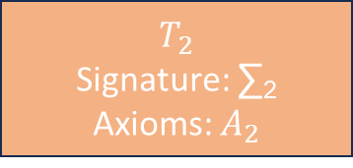
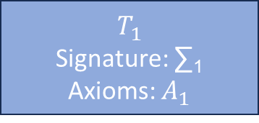
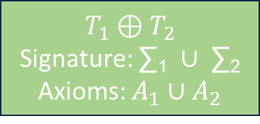
Theory combination
$$T_{1}$$
Signature: ∑₁
Axioms: $A_{1}$
$$T_{2}$$
Signature: ∑₂
Axioms: $A_{2}$
$$T_{1}⊕T_{2}$$
Signature: ∑₁ $∪$ ∑₂
Axioms: $A_{1}∪A_{2}$

Slide 8

Satisfiability
Let $φ$ be $∑$₁ $∪∑$₂ formula. The theory combination problem is to decide whether $φ$ is $T_{1}⊕T_{2}$ valid, i.e., $T_{1}⊕T_{2}⊨φ$

Slide 9
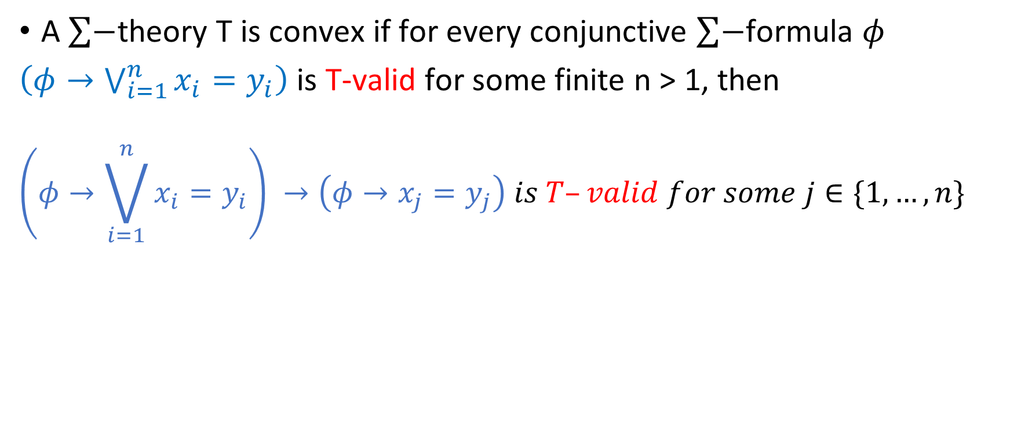
Convex theory
A $\sum{−}$theory T is convex if for every conjunctive $\sum{−}$formula $φ$
$\left(φ→\bigvee_{i=1}^{n}{x_{i}=y_{i}}\right)$ is T-valid for some finite n > 1, then
$$\left(φ→\bigvee_{i=1}^{n}{x_{i}=y_{i}}\right) →\left(φ→x_{j}=y_{j}\right) is T–valid for some j∈\{1,…,n\}$$

Slide 10
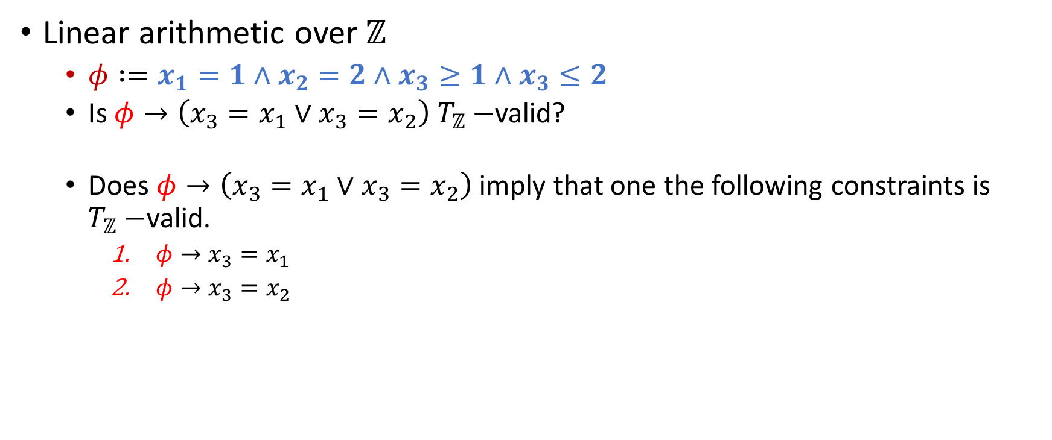
Example
Linear arithmetic over $ℤ$
$φ :=x_{1}=1∧x_{2}=2∧x_{3}≥1∧x_{3}≤2$
Is $φ→\left(x_{3}=x_{1}∨x_{3}=x_{2}\right) T_{ℤ}−$valid?
Does $φ→\left(x_{3}=x_{1}∨x_{3}=x_{2}\right)$ imply that one the following constraints is $T_{ℤ}−$valid.
$φ→x_{3}=x_{1}$
$φ→x_{3}=x_{2}$

Slide 11
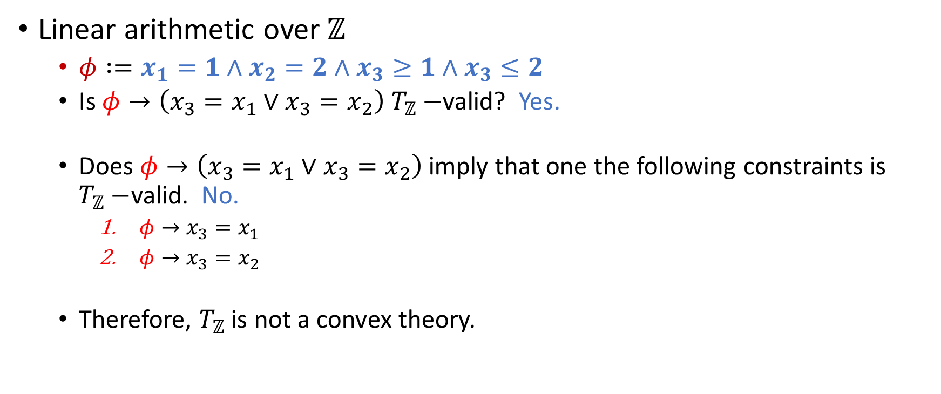
Example
Linear arithmetic over $ℤ$
$φ :=x_{1}=1∧x_{2}=2∧x_{3}≥1∧x_{3}≤2$
Is $φ→\left(x_{3}=x_{1}∨x_{3}=x_{2}\right) T_{ℤ}−$valid? Yes.
Does $φ→\left(x_{3}=x_{1}∨x_{3}=x_{2}\right)$ imply that one the following constraints is $T_{ℤ}−$valid. No.
$φ→x_{3}=x_{1}$
$φ→x_{3}=x_{2}$
Therefore, $T_{ℤ}$ is not a convex theory.

Slide 12

Example
Linear arithmetic over $ℝ$
$φ :=x_{1}=1∧x_{2}=2∧x_{3}≥1∧x_{3}≤2$
Is $φ→\left(x_{3}=x_{1}∨x_{3}=x_{2}\right) T_{ℝ}−$valid?

Slide 13

Example
Linear arithmetic over $ℝ$
$φ :=x_{1}=1∧x_{2}=2∧x_{3}≥1∧x_{3}≤2$
Is $φ→\left(x_{3}=x_{1}∨x_{3}=x_{2}\right) T_{ℝ}−$valid? No.

Slide 14
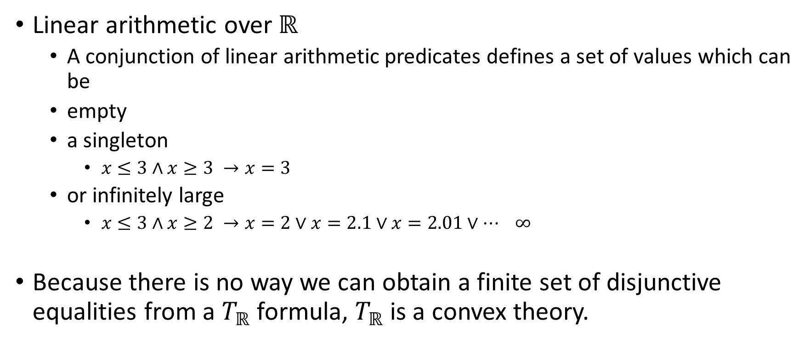
Example
Linear arithmetic over $ℝ$
A conjunction of linear arithmetic predicates defines a set of values which can be
empty
a singleton
$x≤3∧x≥3 →x=3$
or infinitely large
$x≤3∧x≥2 →x=2∨x=2.1∨x=2.01∨… ∞$
Because there is no way we can obtain a finite set of disjunctive equalities from a $T_{ℝ}$ formula, $T_{ℝ}$ is a convex theory.

Slide 15
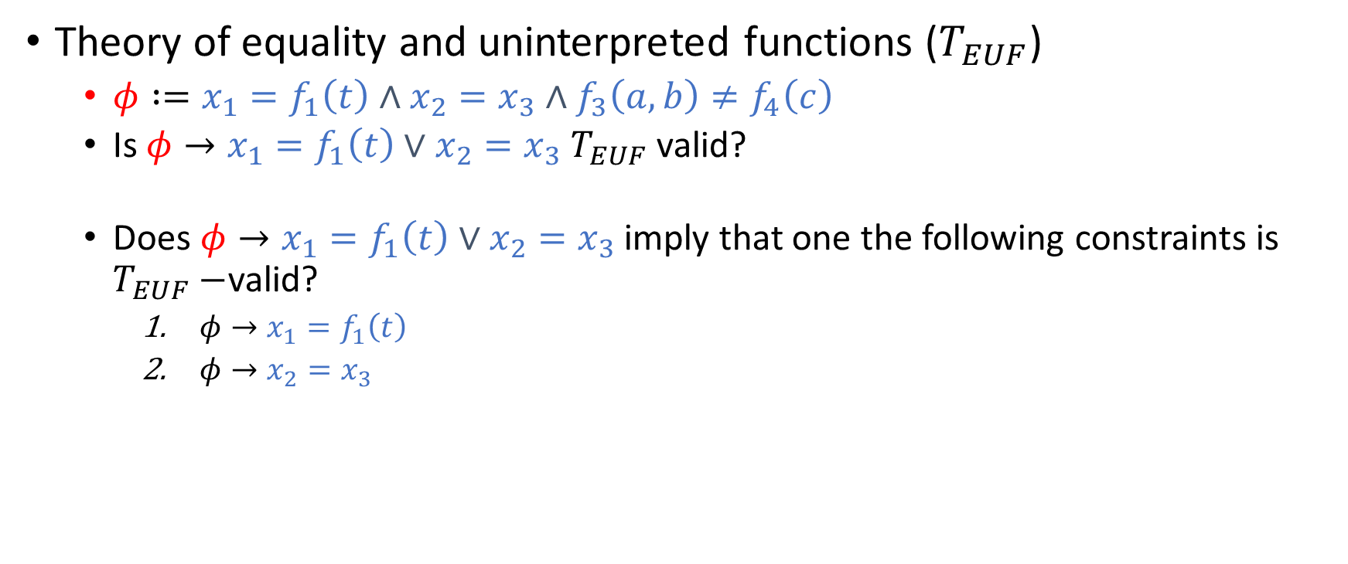
Example
Theory of equality and uninterpreted functions ($T_{EUF}$)
$φ :=x_{1}=f_{1}\left(t\right)∧x_{2}=x_{3}∧f_{3}\left(a, b\right)≠f_{4}\left(c\right)$
Is $φ→x_{1}=f_{1}\left(t\right)∨x_{2}=x_{3} T_{EUF}$ valid?
Does $φ→x_{1}=f_{1}\left(t\right)∨x_{2}=x_{3}$imply that one the following constraints is $T_{EUF}−$valid?
$φ→x_{1}=f_{1}\left(t\right)$
$φ→x_{2}=x_{3}$

Slide 16
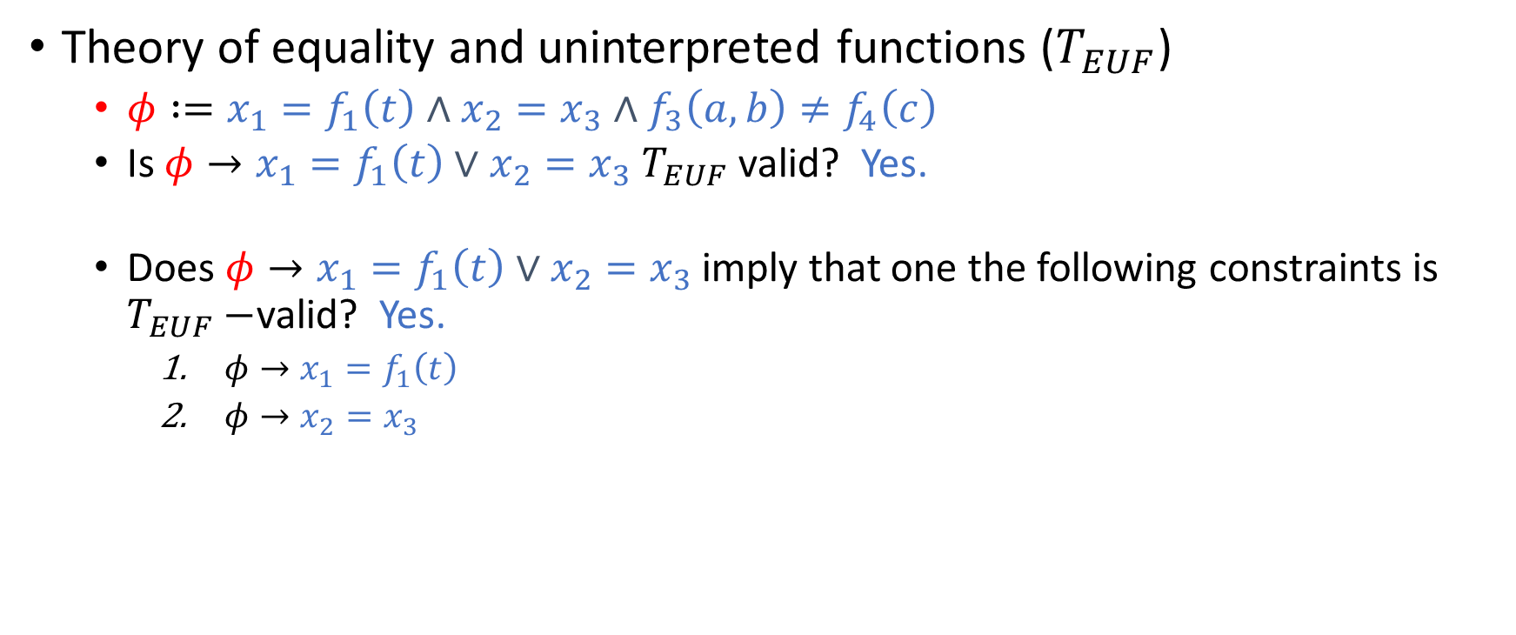
Example
Theory of equality and uninterpreted functions ($T_{EUF}$)
$φ :=x_{1}=f_{1}\left(t\right)∧x_{2}=x_{3}∧f_{3}\left(a, b\right)≠f_{4}\left(c\right)$
Is $φ→x_{1}=f_{1}\left(t\right)∨x_{2}=x_{3} T_{EUF}$ valid? Yes.
Does $φ→x_{1}=f_{1}\left(t\right)∨x_{2}=x_{3}$imply that one the following constraints is $T_{EUF}−$valid? Yes.
$φ→x_{1}=f_{1}\left(t\right)$
$φ→x_{2}=x_{3}$

Slide 17
Theory of EUF
Because a conjunction of equalities also implies individual equality separately, the theory of EUF is convex.

Slide 18
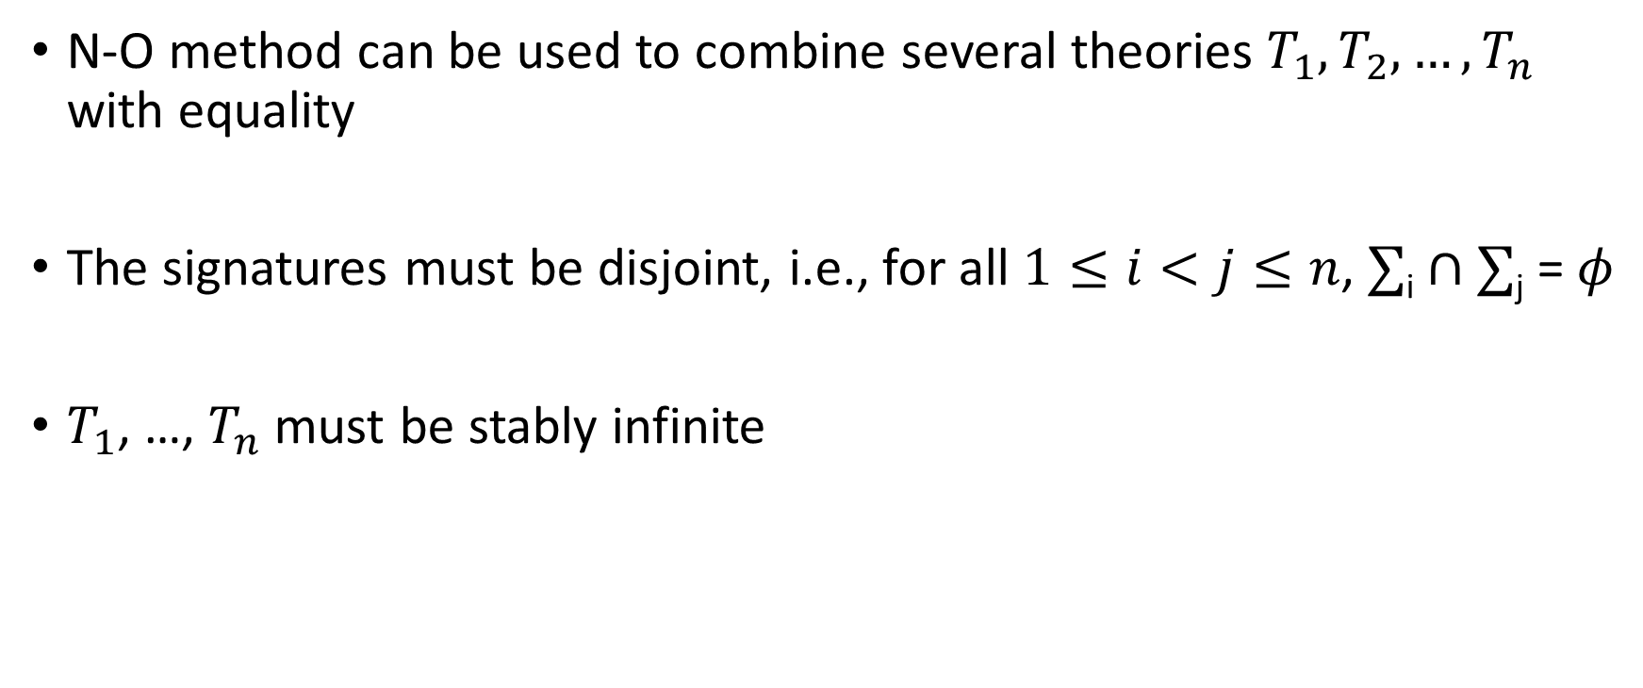
Nelson-Oppen combination (N-O method)
N-O method can be used to combine several theories $T_{1}, T_{2},…,T_{n}$ with equality
The signatures must be disjoint, i.e., for all $1≤i<j≤n$, $∑$_{i} $∩$ $∑$_{j} = $φ$
$T_{1}$, …, $T_{n}$ must be stably infinite

Slide 19
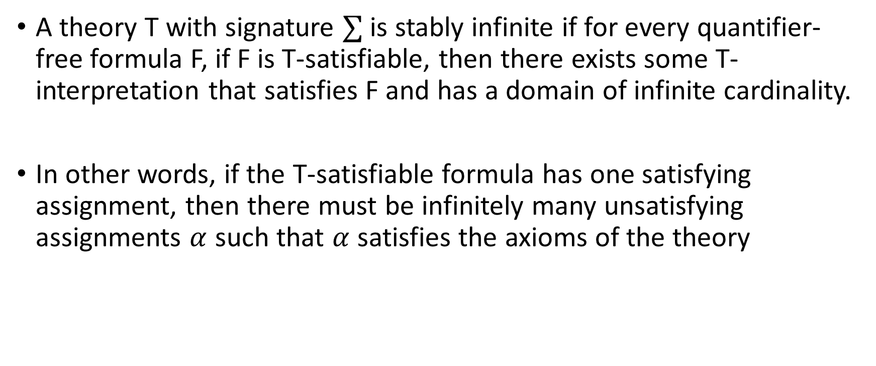
Stably infinite theory
A theory T with signature $∑$ is stably infinite if for every quantifier-free formula F, if F is T-satisfiable, then there exists some T-interpretation that satisfies F and has a domain of infinite cardinality.
In other words, if the T-satisfiable formula has one satisfying assignment, then there must be infinitely many unsatisfying assignments $α$ such that $α$ satisfies the axioms of the theory

Slide 20

Example
Consider the following theory
$∑$ = {a, b, =}, where both a and b are constants
Axiom: $∀x. (x=a)∨(x=b)$
Is this theory stably infinite?

Slide 21

Example
Consider the following theory
$∑$ = {a, b, =}, where both a and b are constants
Axiom: $∀x. (x=a)∨(x=b)$
Is this theory stably infinite? No.

Slide 22
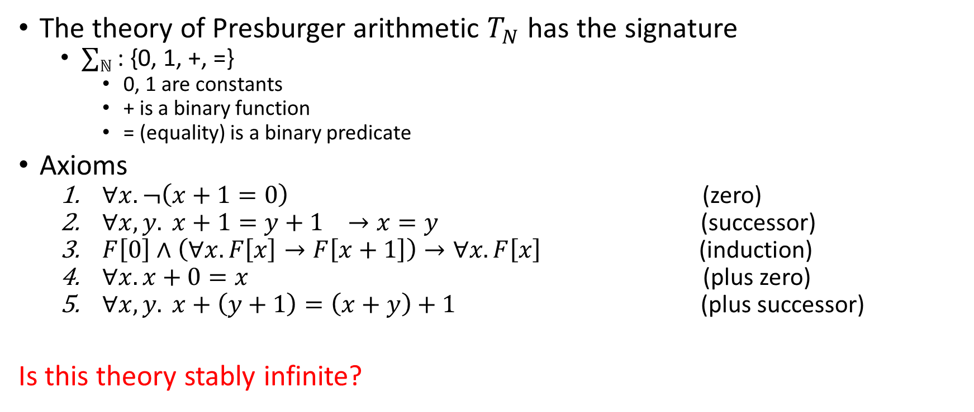
Presburger arithmetic
The theory of Presburger arithmetic $T_{N}$ has the signature
$∑ℕ$ : {0, 1, +, =}
0, 1 are constants
+ is a binary function
= (equality) is a binary predicate
Axioms
$∀x. ¬\left(x+1=0\right)$ (zero)
$∀x,y. x+1=y+1 →x=y$ (successor)
$F\left[0\right]∧\left(∀x.F\left[x\right]→F\left[x+1\right]\right)→∀x.F\left[x\right]$ (induction)
$∀x. x+0=x$ (plus zero)
$∀x, y. x+\left(y+1\right)=\left(x+y\right)+1$ (plus successor)
Is this theory stably infinite?

Slide 23
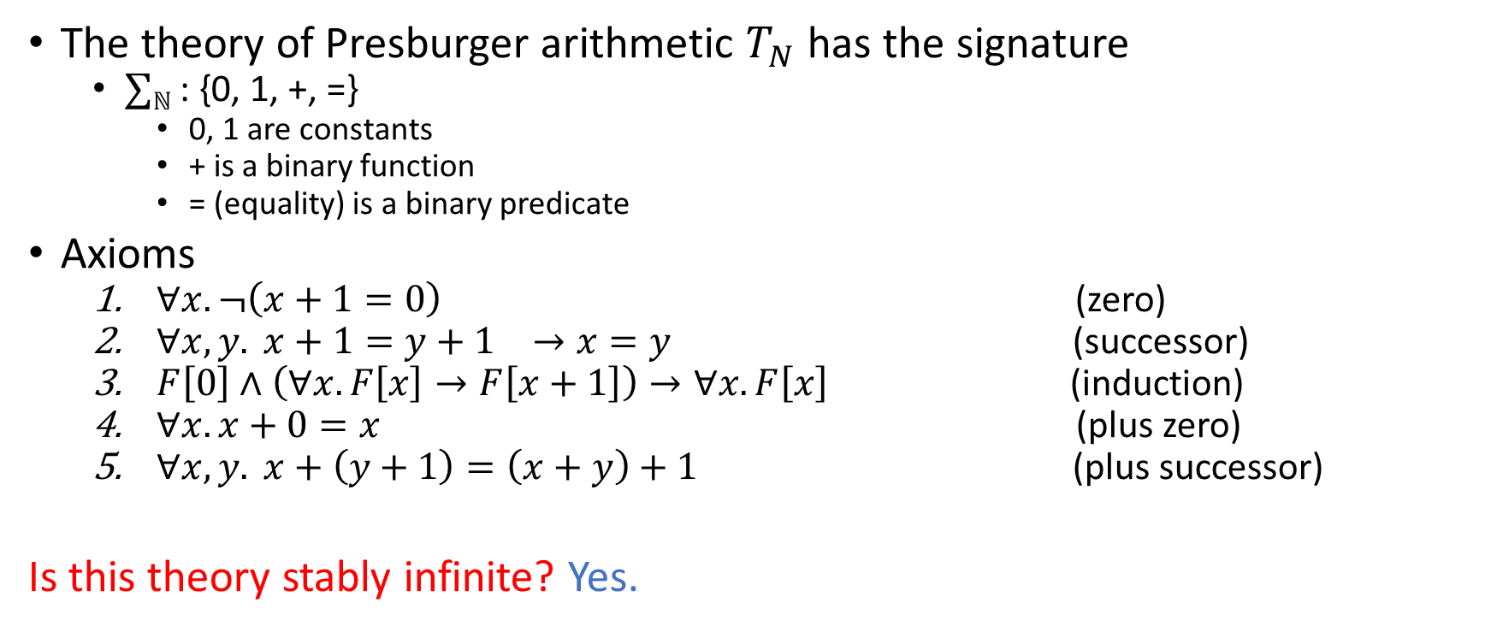
Presburger arithmetic
The theory of Presburger arithmetic $T_{N}$ has the signature
$∑ℕ$ : {0, 1, +, =}
0, 1 are constants
+ is a binary function
= (equality) is a binary predicate
Axioms
$∀x. ¬\left(x+1=0\right)$ (zero)
$∀x,y. x+1=y+1 →x=y$ (successor)
$F\left[0\right]∧\left(∀x.F\left[x\right]→F\left[x+1\right]\right)→∀x.F\left[x\right]$ (induction)
$∀x. x+0=x$ (plus zero)
$∀x, y. x+\left(y+1\right)=\left(x+y\right)+1$ (plus successor)
Is this theory stably infinite? Yes.

Slide 24
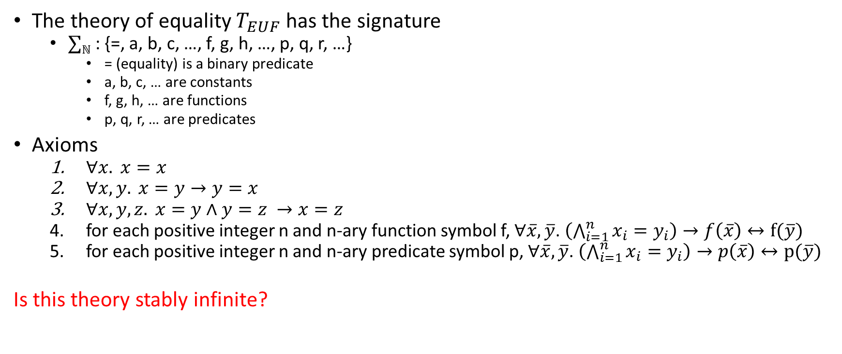
Theory of EUF
The theory of equality $T_{EUF}$ has the signature
$∑ℕ$ : {=, a, b, c, …, f, g, h, …, p, q, r, …}
= (equality) is a binary predicate
a, b, c, … are constants
f, g, h, … are functions
p, q, r, … are predicates
Axioms
$∀x. x=x$
$∀x,y. x=y→y=x$
$∀x,y,z. x=y∧y=z →x=z$
for each positive integer n and n-ary function symbol f, $∀\overline{x}, \overline{y}$. $\left(\bigwedge_{i=1}^{n}{x_{i}=y_{i}}\right)→f\left(\overline{x}\right)↔f(\overline{y})$
for each positive integer n and n-ary predicate symbol p, $∀\overline{x}, \overline{y}$. $\left(\bigwedge_{i=1}^{n}{x_{i}=y_{i}}\right)→p\left(\overline{x}\right)↔p(\overline{y})$
Is this theory stably infinite?

Slide 25
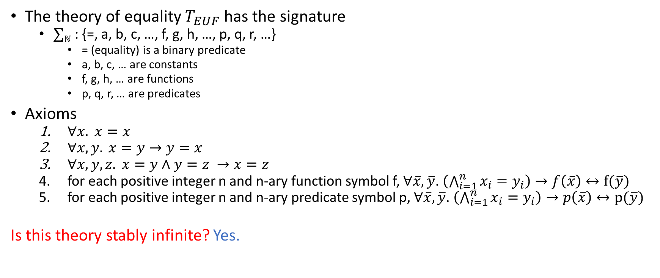
Theory of EUF
The theory of equality $T_{EUF}$ has the signature
$∑ℕ$ : {=, a, b, c, …, f, g, h, …, p, q, r, …}
= (equality) is a binary predicate
a, b, c, … are constants
f, g, h, … are functions
p, q, r, … are predicates
Axioms
$∀x. x=x$
$∀x,y. x=y→y=x$
$∀x,y,z. x=y∧y=z →x=z$
for each positive integer n and n-ary function symbol f, $∀\overline{x}, \overline{y}$. $\left(\bigwedge_{i=1}^{n}{x_{i}=y_{i}}\right)→f\left(\overline{x}\right)↔f(\overline{y})$
for each positive integer n and n-ary predicate symbol p, $∀\overline{x}, \overline{y}$. $\left(\bigwedge_{i=1}^{n}{x_{i}=y_{i}}\right)→p\left(\overline{x}\right)↔p(\overline{y})$
Is this theory stably infinite? Yes.

Slide 26
Bit vectors
Is theory of bit vectors stably infinite?

Slide 27
Bit vectors
Is theory of bit vectors stably infinite? No.

Slide 28
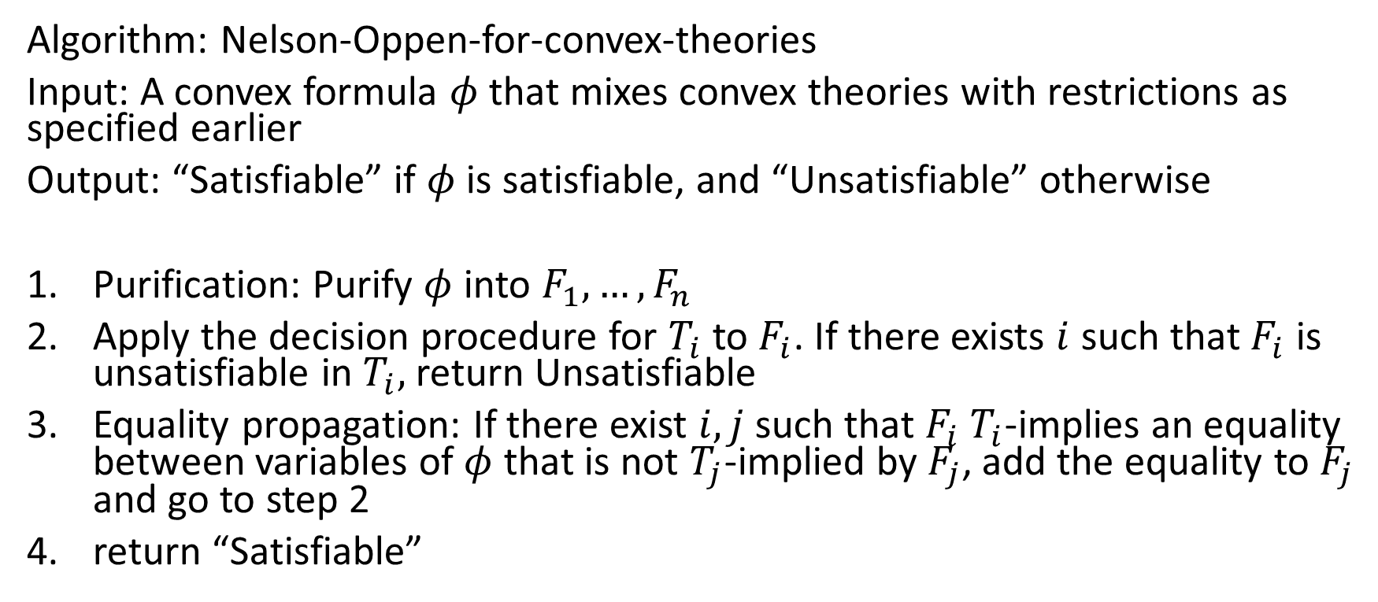
Algorithm
Algorithm: Nelson-Oppen-for-convex-theories
Input: A convex formula $φ$ that mixes convex theories with restrictions as specified earlier
Output: “Satisfiable” if $φ$ is satisfiable, and “Unsatisfiable” otherwise
Purification: Purify $φ$ into $F_{1}, …, F_{n}$
Apply the decision procedure for $T_{i}$ to $F_{i}$. If there exists $i$ such that $F_{i}$ is unsatisfiable in $T_{i},$ return Unsatisfiable
Equality propagation: If there exist $i,j$ such that $F_{i}$ $T_{i}$-implies an equality between variables of $φ$ that is not $T_{j}$-implied by $F_{j}$, add the equality to $F_{j}$ and go to step 2
return “Satisfiable”

Slide 29
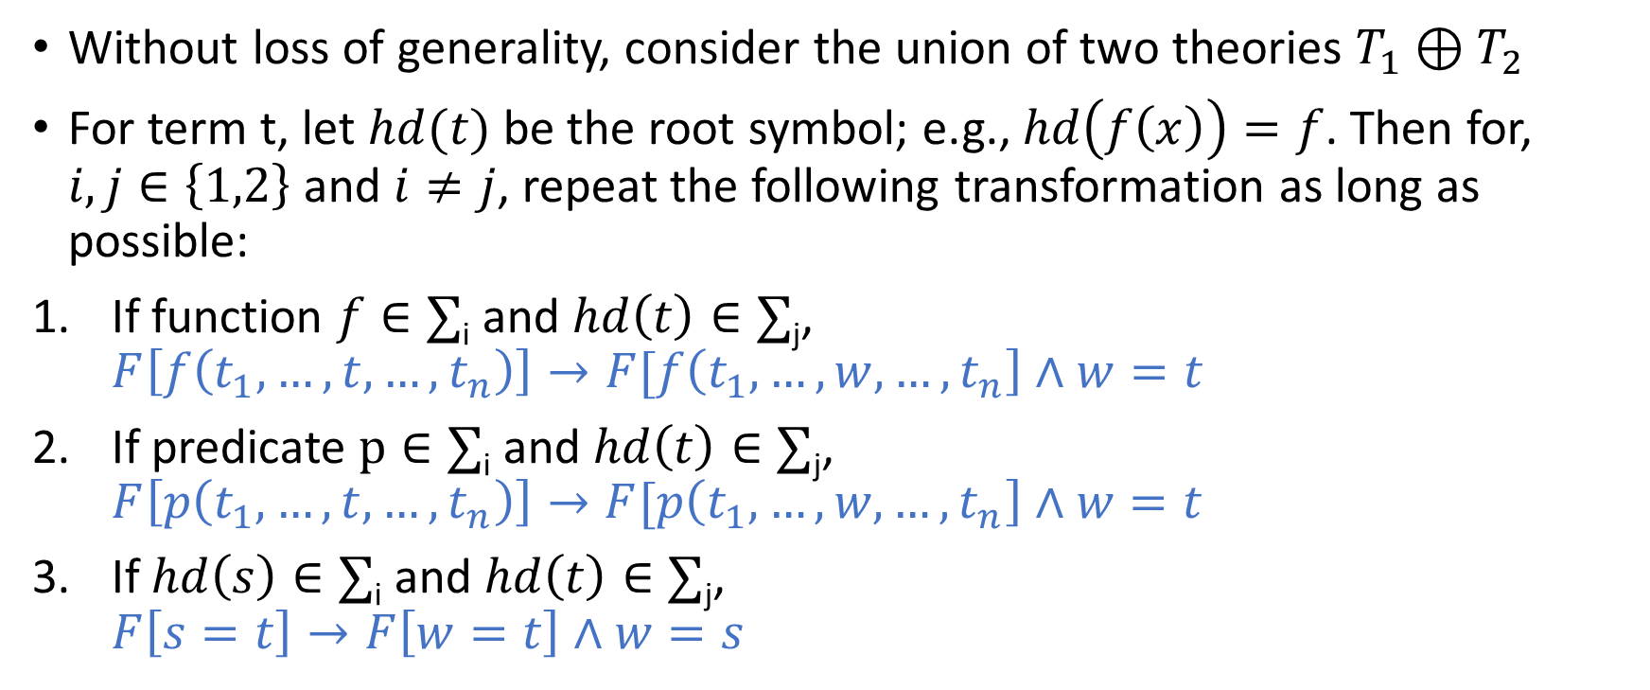
Purification
Without loss of generality, consider the union of two theories $T_{1}⊕T_{2}$
For term t, let $hd(t)$ be the root symbol; e.g., $hd\left(f\left(x\right)\right)=f$. Then for, $i, j∈\left\{1,2\right\}$ and $i≠j$, repeat the following transformation as long as possible:
If function $f∈∑$_{i} and $hd\left(t\right)∈∑$_{j}, $F\left[f\left(t_{1},…,t,…,t_{n}\right)\right]→F[f\left(t_{1},…,w,…,t_{n}\right]∧w=t$
If predicate $p∈∑$_{i} and $hd\left(t\right)∈∑$_{j}, $F\left[p\left(t_{1},…,t,…,t_{n}\right)\right]→F[p\left(t_{1},…,w,…,t_{n}\right]∧w=t$
If $hd\left(s\right)∈∑$_{i} and $hd\left(t\right)∈∑$_{j},
$$F\left[s=t\right]→F\left[w=t\right]∧w=s$$

Slide 30

Example
Purify $∑$_{EUF} $∪$ $∑ℝ$ formula F.
$$F:1≤x∧x≤2∧f\left(x\right)≠f\left(1\right)∧f(x)≠f(2)$$

Slide 31

Example
Purify $∑$_{EUF} $∪$ $∑ℝ$ formula F.
$$F:1≤x∧x≤2∧f\left(x\right)≠f\left(1\right)∧f(x)≠f(2)$$
$$1≤x$$
$$x≤2$$
$$a_{o}=1 f\left(x\right)≠f\left(a_{0}\right)$$
$$a_{1}=2 f\left(x\right)≠f(a_{1})$$

Slide 32
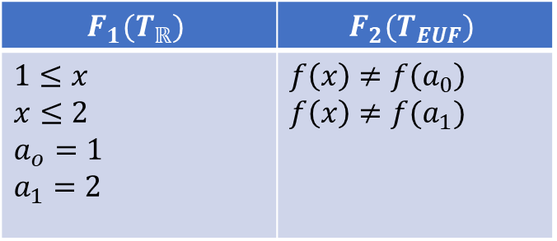

Example
Purify $∑$_{EUF} $∪$ $∑ℝ$ formula F.
$$F:1≤x∧x≤2∧f\left(x\right)≠f\left(1\right)∧f(x)≠f(2)$$
$$1≤x$$
$$x≤2$$
$$a_{o}=1 f\left(x\right)≠f\left(a_{0}\right)$$
$$a_{1}=2 f\left(x\right)≠f(a_{1})$$
$$F_{1}(T_{ℝ})$$ | $$F_{2}(T_{EUF})$$
$$1≤x$$ $$x≤2$$ $$a_{o}=1$$ $$a_{1}=2$$ | $$f\left(x\right)≠f\left(a_{0}\right)$$ $$f\left(x\right)≠f(a_{1})$$

Slide 33

Example
Purify $∑$_{EUF} $∪$ $∑ℝ$ formula F.
$$F:f\left(x\right)=x+y∧x≤y+z∧x+z≤y∧y=1∧f(x)≠f(2)$$

Slide 34

Example
Purify $∑$_{EUF} $∪$ $∑ℝ$ formula F.
$$F:f\left(x\right)=x+y∧x≤y+z∧x+z≤y∧y=1∧f(x)≠f(2)$$
$$a_{0}=x+y a_{0}=f\left(x\right)$$
$$x≤y+z$$
$$x+z≤y$$
$$y=1$$
$$a_{1}=2 f(x)≠f(a_{1})$$

Slide 35
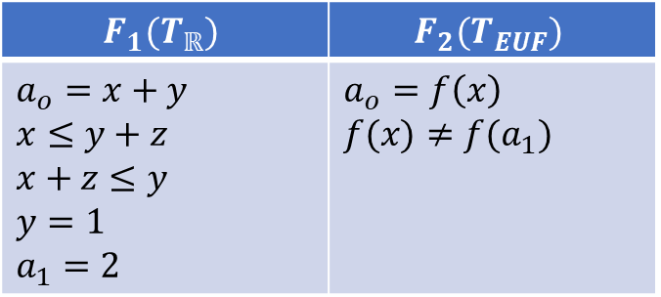
Example
Purify $∑$_{EUF} $∪$ $∑ℝ$ formula F.
$$F:f\left(x\right)=x+y∧x≤y+z∧x+z≤y∧y=1∧f(x)≠f(2)$$
$$a_{0}=x+y a_{0}=f\left(x\right)$$
$$x≤y+z$$
$$x+z≤y$$
$$y=1$$
$$a_{1}=2 f(x)≠f(a_{1})$$
$$F_{1}(T_{ℝ})$$ | $$F_{2}(T_{EUF})$$
$$a_{o}=x+y$$ $$x≤y+z$$ $$x+z≤y$$ $$y=1$$ $$a_{1}=2$$ | $$a_{o}=f\left(x\right)$$ $$f(x)≠f(a_{1})$$

Slide 36
Purification
After purification all the literals except the equalities will belong to one of the two theories
The equalities may belong to all theories
Divide the literals into sets, one for each theory

Slide 37

N/O Example
Is the following $T_{E}⊕T_{ℝ}$ formula satisfiable?
$$F:\left(f\left(x_{1},0\right)≥x_{3}\right)∧\left(f\left(x_{2},0\right)≤x_{3}\right)∧\left(x_{1}≥x_{2}\right)∧\left(x_{2}≥x_{1}\right)∧(x_{3}−f\left(x_{1},0\right)≥1)$$

Slide 38
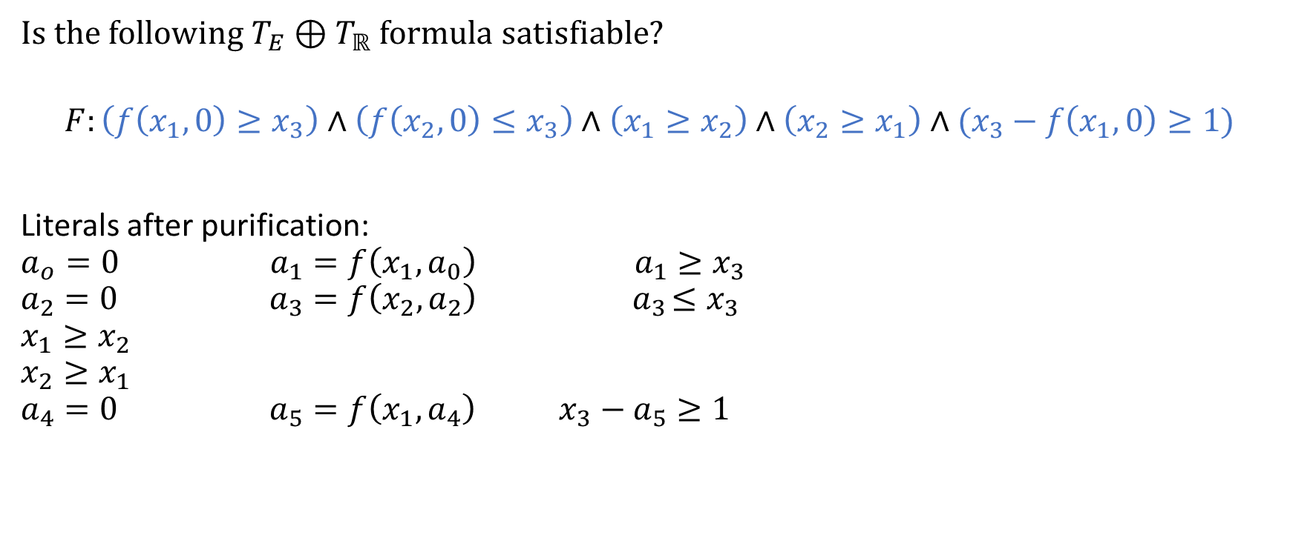
N/O Example
Is the following $T_{E}⊕T_{ℝ}$ formula satisfiable?
$$F:\left(f\left(x_{1},0\right)≥x_{3}\right)∧\left(f\left(x_{2},0\right)≤x_{3}\right)∧\left(x_{1}≥x_{2}\right)∧\left(x_{2}≥x_{1}\right)∧(x_{3}−f\left(x_{1},0\right)≥1)$$
Literals after purification:
$$a_{o}=0 a_{1}=f\left(x_{1},a_{0}\right) a_{1}≥x_{3}$$
$$a_{2}=0 { a}_{3}=f\left(x_{2},a_{2}\right) { a}_{3}≤x_{3}$$
$$x_{1}≥x_{2}$$
$$x_{2}≥x_{1}$$
$$a_{4}=0 { a}_{5}=f\left(x_{1},a_{4}\right) x_{3}−a_{5}≥1$$

Slide 39
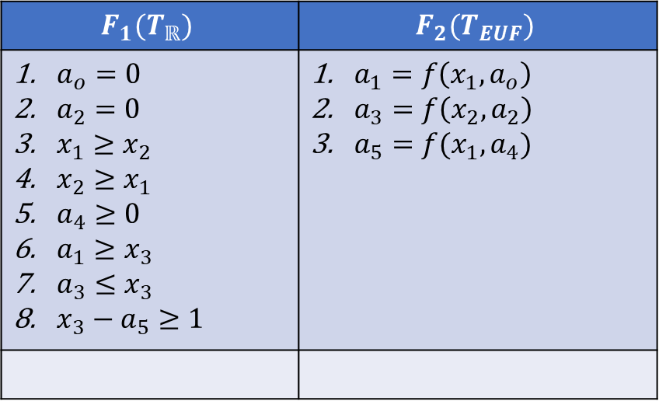
N/O Example
$$F_{1}(T_{ℝ})$$ | $$F_{2}(T_{EUF})$$
$a_{o}=0$ $a_{2}=0$ $x_{1}≥x_{2}$ $x_{2}≥x_{1}$ $a_{4}≥0$ $a_{1}≥x_{3}$ $a_{3}≤x_{3}$ $x_{3}−a_{5}≥1$ | $a_{1}=f\left(x_{1},a_{o}\right)$ $a_{3}=f\left(x_{2},a_{2}\right)$ $a_{5}=f(x_{1},a_{4})$

Slide 40
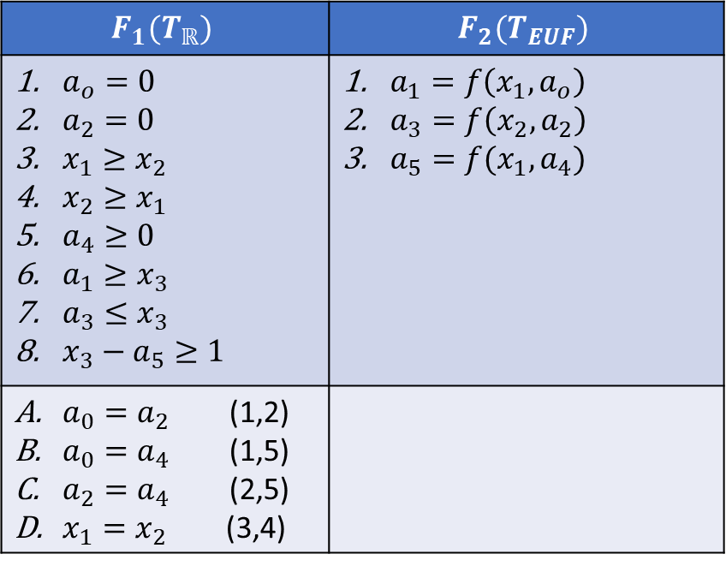
N/O Example
$$F_{1}(T_{ℝ})$$ | $$F_{2}(T_{EUF})$$
$a_{o}=0$ $a_{2}=0$ $x_{1}≥x_{2}$ $x_{2}≥x_{1}$ $a_{4}≥0$ $a_{1}≥x_{3}$ $a_{3}≤x_{3}$ $x_{3}−a_{5}≥1$ | $a_{1}=f\left(x_{1},a_{o}\right)$ $a_{3}=f\left(x_{2},a_{2}\right)$ $a_{5}=f(x_{1},a_{4})$
$a_{0}=a_{2}$ (1,2) $a_{0}=a_{4}$ (1,5) $a_{2}=a_{4}$ (2,5) $x_{1}=x_{2}$ (3,4)

Slide 41
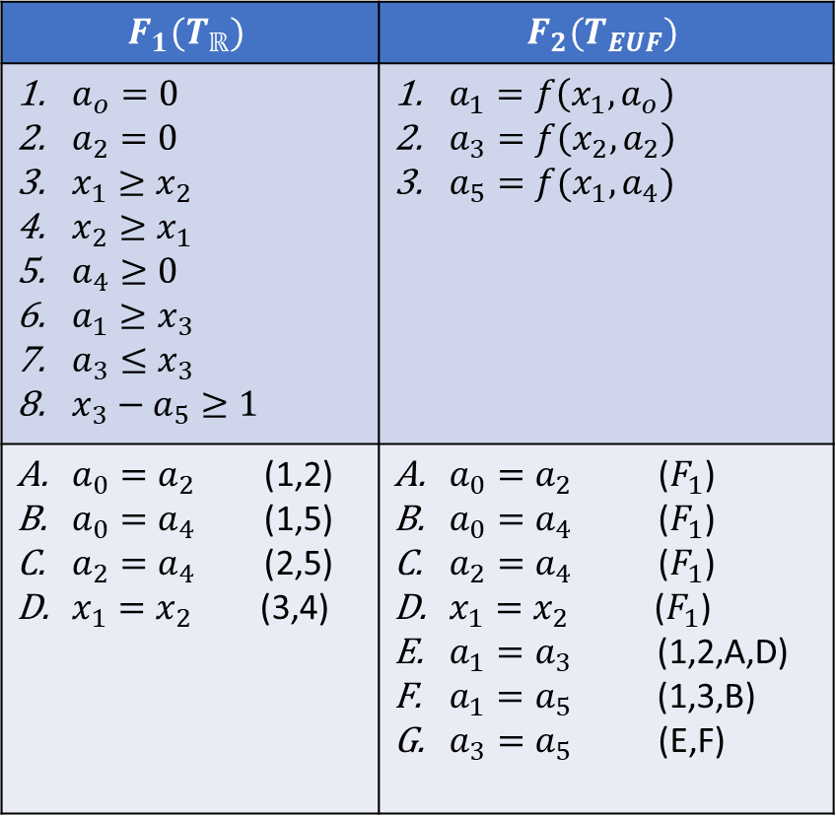
N/O Example
$$F_{1}(T_{ℝ})$$ | $$F_{2}(T_{EUF})$$
$a_{o}=0$ $a_{2}=0$ $x_{1}≥x_{2}$ $x_{2}≥x_{1}$ $a_{4}≥0$ $a_{1}≥x_{3}$ $a_{3}≤x_{3}$ $x_{3}−a_{5}≥1$ | $a_{1}=f\left(x_{1},a_{o}\right)$ $a_{3}=f\left(x_{2},a_{2}\right)$ $a_{5}=f(x_{1},a_{4})$
$a_{0}=a_{2}$ (1,2) $a_{0}=a_{4}$ (1,5) $a_{2}=a_{4}$ (2,5) $x_{1}=x_{2}$ (3,4) | $a_{0}=a_{2}$ ($F_{1}$) $a_{0}=a_{4}$ ($F_{1}$) $a_{2}=a_{4}$ ($F_{1}$) $x_{1}=x_{2}$ ($F_{1}$) $a_{1}=a_{3}$ (1,2,A,D) $a_{1}=a_{5}$ (1,3,B) $a_{3}=a_{5}$ (E,F)

Slide 42
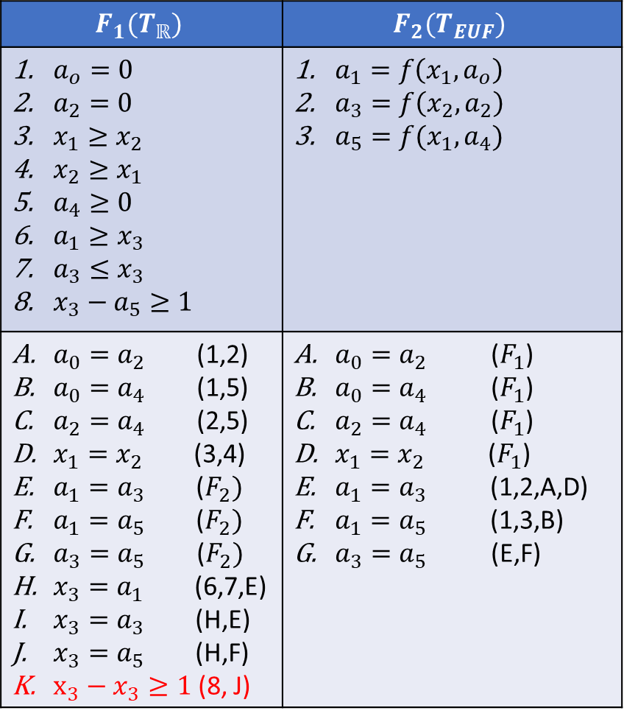
N/O Example
$$F_{1}(T_{ℝ})$$ | $$F_{2}(T_{EUF})$$
$a_{o}=0$ $a_{2}=0$ $x_{1}≥x_{2}$ $x_{2}≥x_{1}$ $a_{4}≥0$ $a_{1}≥x_{3}$ $a_{3}≤x_{3}$ $x_{3}−a_{5}≥1$ | $a_{1}=f\left(x_{1},a_{o}\right)$ $a_{3}=f\left(x_{2},a_{2}\right)$ $a_{5}=f(x_{1},a_{4})$
$a_{0}=a_{2}$ (1,2) $a_{0}=a_{4}$ (1,5) $a_{2}=a_{4}$ (2,5) $x_{1}=x_{2}$ (3,4) $a_{1}=a_{3}$ ($F_{2})$ $a_{1}=a_{5}$ ($F_{2})$ $a_{3}=a_{5}$ ($F_{2})$ $x_{3}=a_{1}$ (6,7,E) $x_{3}=a_{3}$ (H,E) $x_{3}=a_{5}$ (H,F) $x_{3}−x_{3}≥1$ (8, J) | $a_{0}=a_{2}$ ($F_{1}$) $a_{0}=a_{4}$ ($F_{1}$) $a_{2}=a_{4}$ ($F_{1}$) $x_{1}=x_{2}$ ($F_{1}$) $a_{1}=a_{3}$ (1,2,A,D) $a_{1}=a_{5}$ (1,3,B) $a_{3}=a_{5}$ (E,F)
FALSE

Slide 43

N/O Example
Is the following $T_{E}⊕T_{ℝ}$ formula satisfiable?
$$F:\left(x_{2}≥x_{1}\right)∧\left(x_{1}−x_{3}≥x_{2}\right)∧\left(x_{3}≥0\right)∧ (f\left(f\left(x_{1}\right)−f\left(x_{2}\right)\right)≠f(x_{3}))$$

Slide 44

N/O Example
Is the following $T_{E}⊕T_{ℝ}$ formula satisfiable?
$$F:\left(x_{2}≥x_{1}\right)∧\left(x_{1}−x_{3}≥x_{2}\right)∧\left(x_{3}≥0\right)∧ (f\left(f\left(x_{1}\right)−f\left(x_{2}\right)\right)≠f(x_{3}))$$
Literals after purification:
$$x_{2}≥x_{1}$$
$$x_{1}−x_{3}≥x_{2}$$
$$x_{3}≥0$$
$$a_{0}=f\left(x_{1}\right)$$
$$a_{1}=f\left(x_{2}\right)$$
$$a_{2}=a_{0}−a_{1}$$
$$f\left(a_{2}\right)≠f(x_{3})$$

Slide 45
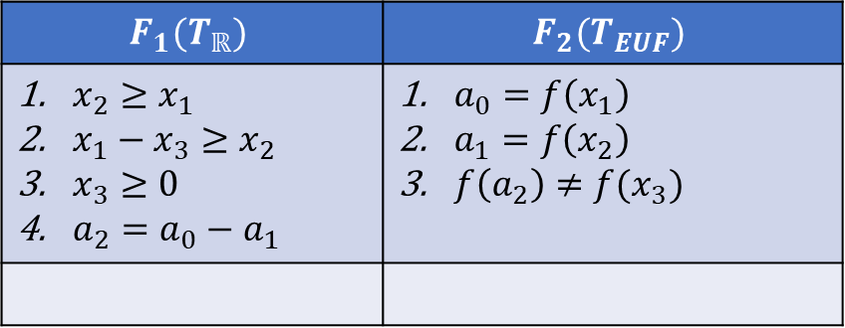
N/O Example
$$F_{1}(T_{ℝ})$$ | $$F_{2}(T_{EUF})$$
$x_{2}≥x_{1}$ $x_{1}−x_{3}≥x_{2}$ $x_{3}≥0$ $a_{2}=a_{0}−a_{1}$ | $a_{0}=f\left(x_{1}\right)$ $a_{1}=f\left(x_{2}\right)$ $f\left(a_{2}\right)≠f(x_{3})$

Slide 46
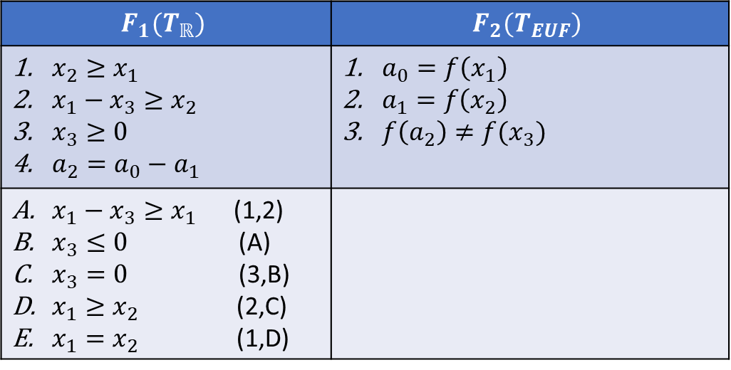
N/O Example
$$F_{1}(T_{ℝ})$$ | $$F_{2}(T_{EUF})$$
$x_{2}≥x_{1}$ $x_{1}−x_{3}≥x_{2}$ $x_{3}≥0$ $a_{2}=a_{0}−a_{1}$ | $a_{0}=f\left(x_{1}\right)$ $a_{1}=f\left(x_{2}\right)$ $f\left(a_{2}\right)≠f(x_{3})$
$x_{1}−x_{3}≥x_{1}$ (1,2) $x_{3}≤0$ (A) $x_{3}=0$ (3,B) $x_{1}≥x_{2}$ (2,C) $x_{1}=x_{2}$ (1,D)

Slide 47
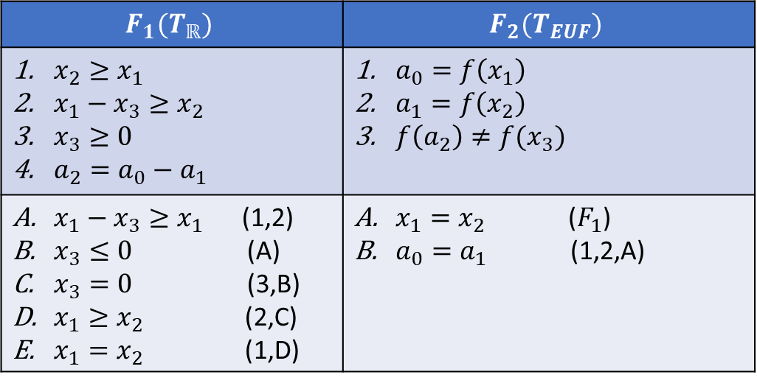
N/O Example
$$F_{1}(T_{ℝ})$$ | $$F_{2}(T_{EUF})$$
$x_{2}≥x_{1}$ $x_{1}−x_{3}≥x_{2}$ $x_{3}≥0$ $a_{2}=a_{0}−a_{1}$ | $a_{0}=f\left(x_{1}\right)$ $a_{1}=f\left(x_{2}\right)$ $f\left(a_{2}\right)≠f(x_{3})$
$x_{1}−x_{3}≥x_{1}$ (1,2) $x_{3}≤0$ (A) $x_{3}=0$ (3,B) $x_{1}≥x_{2}$ (2,C) $x_{1}=x_{2}$ (1,D) | $x_{1}=x_{2}$ ($F_{1}$) $a_{0}=a_{1}$ (1,2,A)

Slide 48
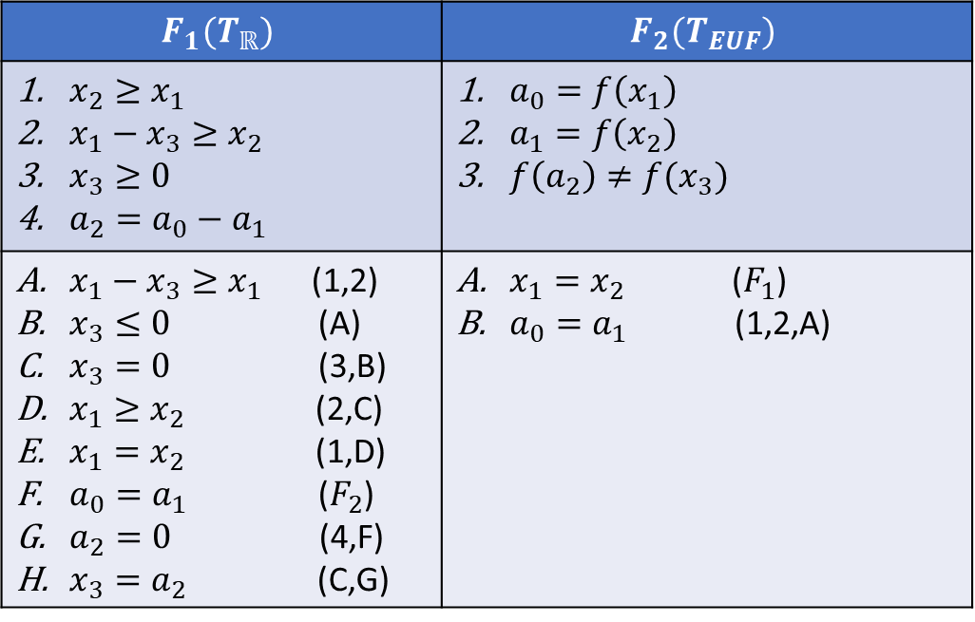
N/O Example
$$F_{1}(T_{ℝ})$$ | $$F_{2}(T_{EUF})$$
$x_{2}≥x_{1}$ $x_{1}−x_{3}≥x_{2}$ $x_{3}≥0$ $a_{2}=a_{0}−a_{1}$ | $a_{0}=f\left(x_{1}\right)$ $a_{1}=f\left(x_{2}\right)$ $f\left(a_{2}\right)≠f(x_{3})$
$x_{1}−x_{3}≥x_{1}$ (1,2) $x_{3}≤0$ (A) $x_{3}=0$ (3,B) $x_{1}≥x_{2}$ (2,C) $x_{1}=x_{2}$ (1,D) $a_{0}=a_{1}$ ($F_{2}$) $a_{2}=0$ (4,F) $x_{3}=a_{2}$ (C,G) | $x_{1}=x_{2}$ ($F_{1}$) $a_{0}=a_{1}$ (1,2,A)

Slide 49
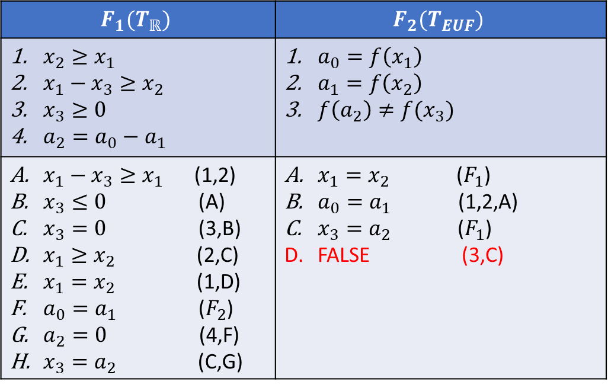
N/O Example
$$F_{1}(T_{ℝ})$$ | $$F_{2}(T_{EUF})$$
$x_{2}≥x_{1}$ $x_{1}−x_{3}≥x_{2}$ $x_{3}≥0$ $a_{2}=a_{0}−a_{1}$ | $a_{0}=f\left(x_{1}\right)$ $a_{1}=f\left(x_{2}\right)$ $f\left(a_{2}\right)≠f(x_{3})$
$x_{1}−x_{3}≥x_{1}$ (1,2) $x_{3}≤0$ (A) $x_{3}=0$ (3,B) $x_{1}≥x_{2}$ (2,C) $x_{1}=x_{2}$ (1,D) $a_{0}=a_{1}$ ($F_{2}$) $a_{2}=0$ (4,F) $x_{3}=a_{2}$ (C,G) | $x_{1}=x_{2}$ ($F_{1}$) $a_{0}=a_{1}$ (1,2,A) $x_{3}=a_{2}$ ($F_{1}$) FALSE (3,C)

Slide 50
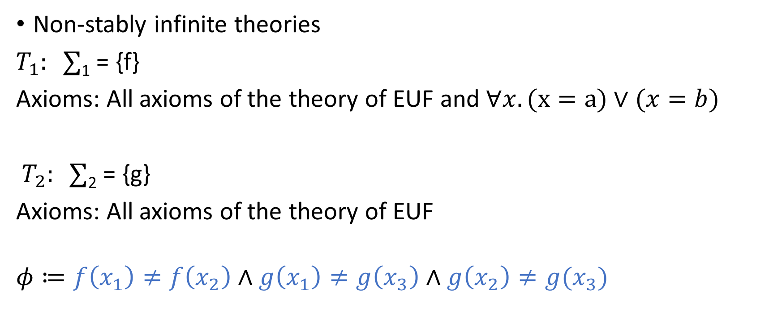
Example
Non-stably infinite theories
$T_{1}: ∑$₁ = {f}
Axioms: All axioms of the theory of EUF and $∀x. (x=a)∨(x=b)$
$T_{2}: ∑$₂ = {g}
Axioms: All axioms of the theory of EUF
$$φ≔f\left(x_{1}\right)≠f\left(x_{2}\right)∧g\left(x_{1}\right)≠g\left(x_{3}\right)∧g\left(x_{2}\right)≠g(x_{3})$$

Slide 51
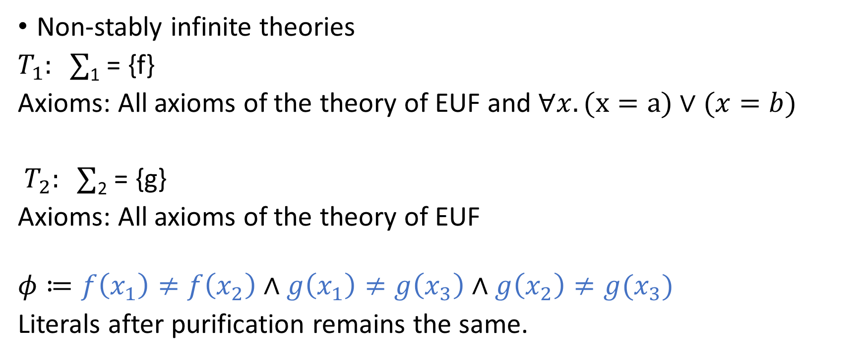
Example
Non-stably infinite theories
$T_{1}: ∑$₁ = {f}
Axioms: All axioms of the theory of EUF and $∀x. (x=a)∨(x=b)$
$T_{2}: ∑$₂ = {g}
Axioms: All axioms of the theory of EUF
$$φ≔f\left(x_{1}\right)≠f\left(x_{2}\right)∧g\left(x_{1}\right)≠g\left(x_{3}\right)∧g\left(x_{2}\right)≠g(x_{3})$$
Literals after purification remains the same.

Slide 52
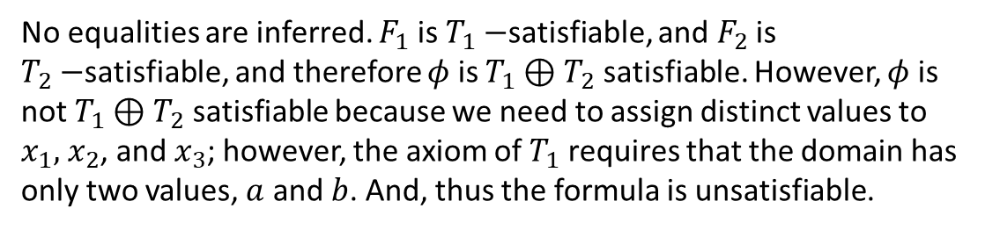
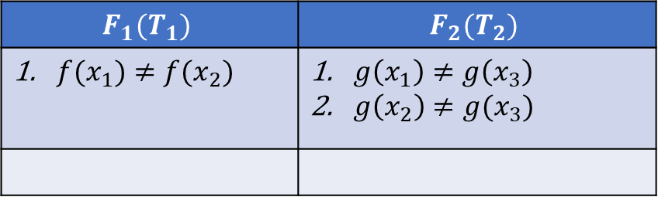
N/O Example
$$F_{1}(T_{1})$$ | $$F_{2}(T_{2})$$
$f(x_{1})≠f(x_{2})$ | $g\left(x_{1}\right)≠g\left(x_{3}\right)$ $g\left(x_{2}\right)≠g(x_{3})$
No equalities are inferred. $F_{1}$ is $T_{1}−$satisfiable, and $F_{2}$ is $T_{2}−$satisfiable, and therefore $φ$ is $T_{1}⊕T_{2}$ satisfiable. However, $φ$ is not $T_{1}⊕T_{2}$ satisfiable because we need to assign distinct values to $x_{1},$ $x_{2}$, and $x_{3}$; however, the axiom of $T_{1}$ requires that the domain has only two values, $a$ and $b$. And, thus the formula is unsatisfiable.

Slide 53
Non-stably infinite theories
A later extension to the N-O method allows a combination of non-stably infinite theories and stably infinite theories with additional properties
The basic idea is to compute the smallest cardinality needed to satisfy a formula in a given theory and pass this information to other theories in the combination
More details in:
Combining Non-Stably Infinite Theories, C. Tinelli and C. Zabra

Slide 54
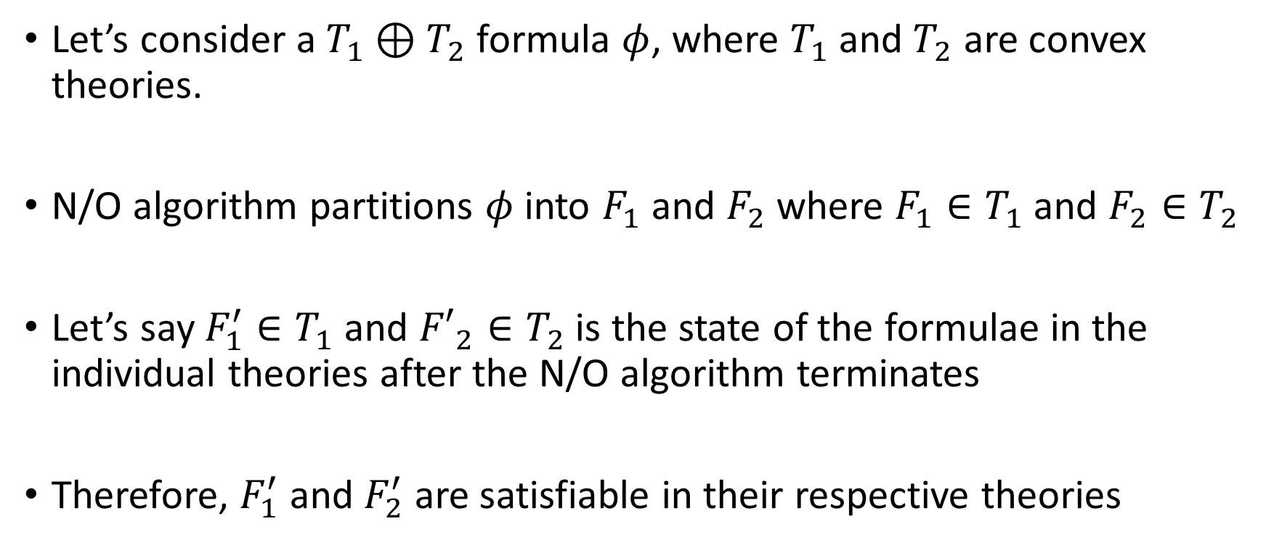
Correctness
Let’s consider a $T_{1}⊕T_{2}$ formula $φ$, where $T_{1}$ and $T_{2}$ are convex theories.
N/O algorithm partitions $φ$ into $F_{1}$ and $F_{2}$ where $F_{1}∈T_{1}$ and $F_{2}∈T_{2}$
Let’s say $F_{1}^{′}∈T_{1}$ and ${F′}_{2}∈T_{2}$ is the state of the formulae in the individual theories after the N/O algorithm terminates
Therefore, $F_{1}^{′}$ and $F_{2}^{′}$ are satisfiable in their respective theories

Slide 55
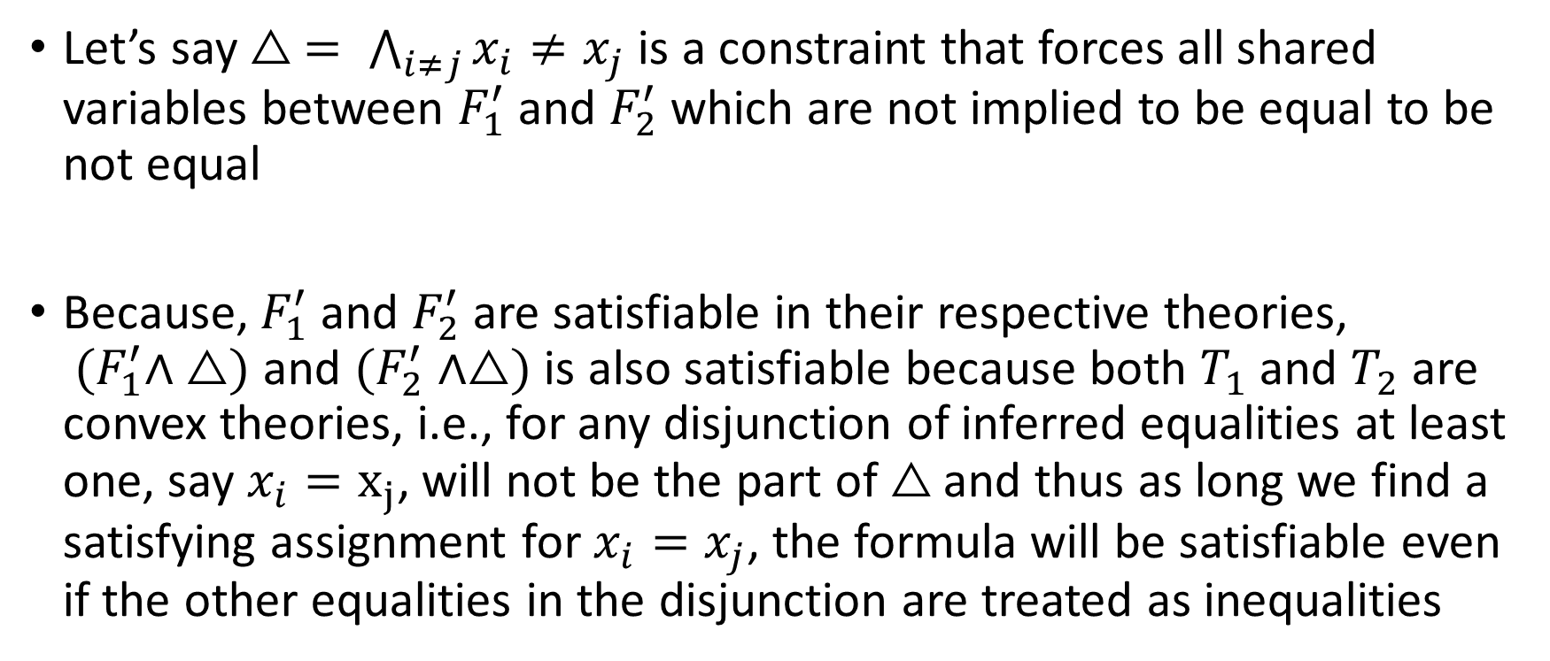
Correctness
Let’s say $△ = \bigwedge_{i≠j}{x_{i}≠x_{j}}$ is a constraint that forces all shared variables between $F_{1}^{′}$ and $F_{2}^{′}$ which are not implied to be equal to be not equal
Because, $F_{1}^{′}$ and $F_{2}^{′}$ are satisfiable in their respective theories, ${ (F}_{1}^{′}∧ △)$ and $(F_{2}^{′}∧△)$ is also satisfiable because both $T_{1}$ and $T_{2}$ are convex theories, i.e., for any disjunction of inferred equalities at least one, say $x_{i}=x_{j}$, will not be the part of$△$ and thus as long we find a satisfying assignment for $x_{i}=x_{j}$, the formula will be satisfiable even if the other equalities in the disjunction are treated as inequalities

Slide 56
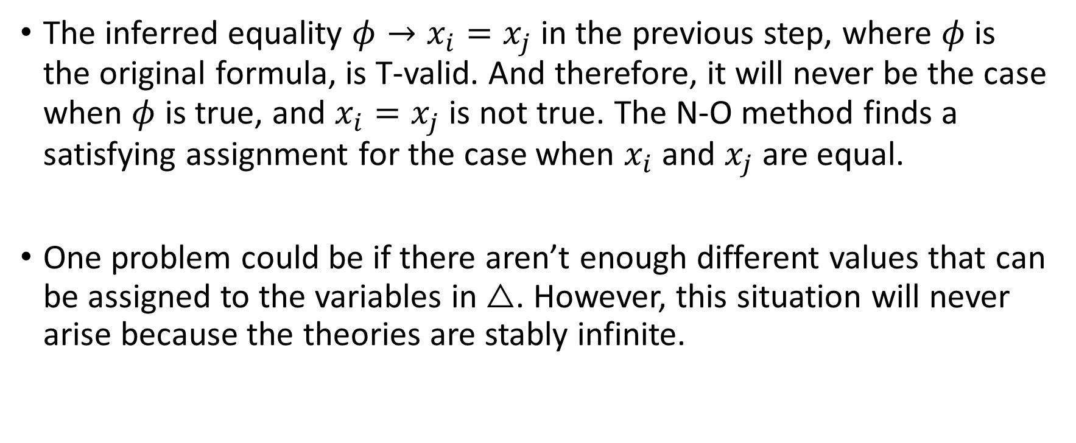
Correctness
The inferred equality $φ→x_{i}=x_{j}$ in the previous step, where $φ$ is the original formula, is T-valid. And therefore, it will never be the case when $φ$ is true, and $x_{i}=x_{j}$ is not true. The N-O method finds a satisfying assignment for the case when $x_{i}$ and $x_{j}$ are equal.
One problem could be if there aren’t enough different values that can be assigned to the variables in $△$. However, this situation will never arise because the theories are stably infinite.

