Slide 2
Today’s topics
Combining decision procedures
Quantified formulas

Slide 3
Combining nonconvex theories

Slide 4
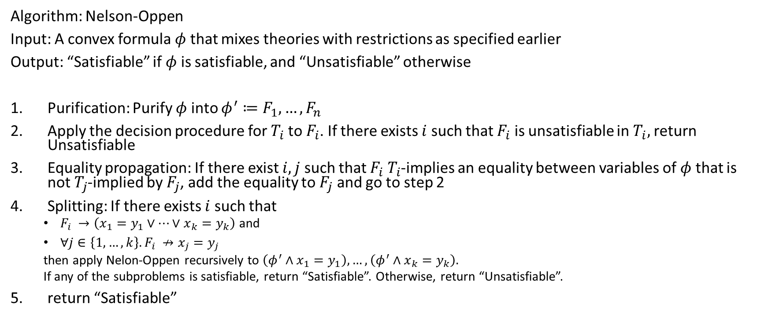
Algorithm
Algorithm: Nelson-Oppen
Input: A convex formula $φ$ that mixes theories with restrictions as specified earlier
Output: “Satisfiable” if $φ$ is satisfiable, and “Unsatisfiable” otherwise
Purification: Purify $φ$ into ${φ^{′}≔F}_{1}, …, F_{n}$
Apply the decision procedure for $T_{i}$ to $F_{i}$. If there exists $i$ such that $F_{i}$ is unsatisfiable in $T_{i},$ return Unsatisfiable
Equality propagation: If there exist $i,j$ such that $F_{i}$ $T_{i}$-implies an equality between variables of $φ$ that is not $T_{j}$-implied by $F_{j}$, add the equality to $F_{j}$ and go to step 2
Splitting: If there exists $i$ such that
$F_{i} →\left(x_{1}=y_{1}∨…∨x_{k}=y_{k}\right)$ and
$∀j∈\left\{1,…,k\right\}. F_{i} ↛x_{j}=y_{j}$
then apply Nelon-Oppen recursively to $\left(φ^{′}∧x_{1}=y_{1}\right),…,\left(φ^{′}∧x_{k}=y_{k}\right).$
If any of the subproblems is satisfiable, return “Satisfiable”. Otherwise, return “Unsatisfiable”.
return “Satisfiable”

Slide 5

Example
Is the following $T_{E}⊕T_{ℤ}$ formula satisfiable?
$$F:\left(1≤x\right)∧\left(x≤2\right)∧p\left(x\right)∧¬p\left(1\right)∧¬p(2)$$

Slide 6

Example
Is the following $T_{E}⊕T_{ℤ}$ formula satisfiable?
$$F:\left(1≤x\right)∧\left(x≤2\right)∧p\left(x\right)∧¬p\left(1\right)∧¬p(2)$$
Literals after purification:
$$1≤x$$
$$x≤2$$
$$p\left(x\right)$$
$$a_{0}=1$$
$$¬p\left(a_{0}\right)$$
$$a_{1}=2$$
$$¬p(a_{1})$$

Slide 7
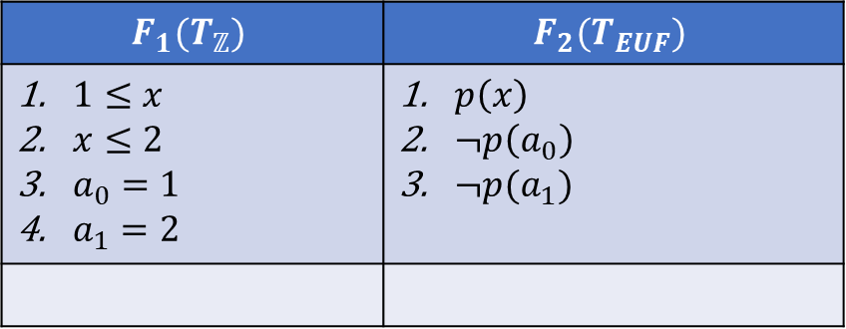
Example
$$F_{1}(T_{ℤ})$$ | $$F_{2}(T_{EUF})$$
$1≤x$ $x≤2$ $a_{0}=1$ $a_{1}=2$ | $p\left(x\right)$ $¬p\left(a_{0}\right)$ $¬p(a_{1})$

Slide 8
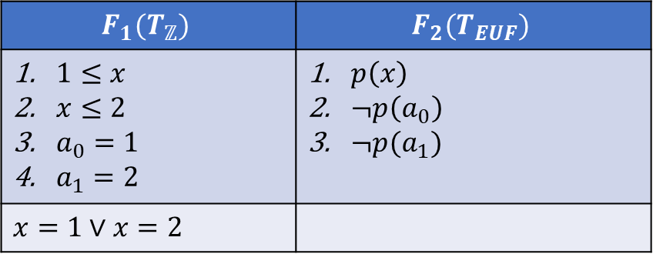
Example
$$F_{1}(T_{ℤ})$$ | $$F_{2}(T_{EUF})$$
$1≤x$ $x≤2$ $a_{0}=1$ $a_{1}=2$ | $p\left(x\right)$ $¬p\left(a_{0}\right)$ $¬p(a_{1})$
$$x=1∨x=2$$

Slide 9
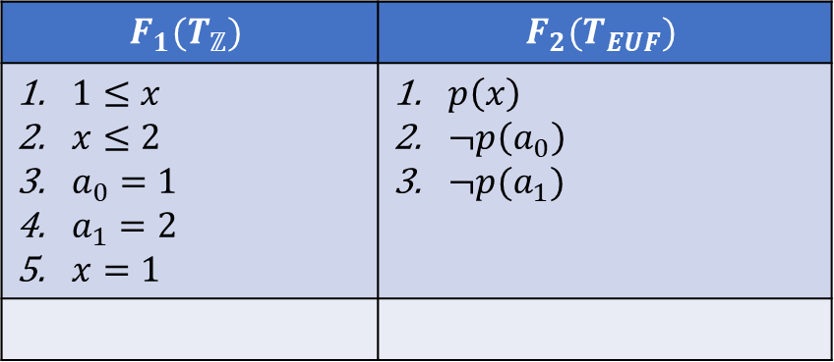
Example (case-1)
$$F_{1}(T_{ℤ})$$ | $$F_{2}(T_{EUF})$$
$1≤x$ $x≤2$ $a_{0}=1$ $a_{1}=2$ $x=1$ | $p\left(x\right)$ $¬p\left(a_{0}\right)$ $¬p(a_{1})$

Slide 10
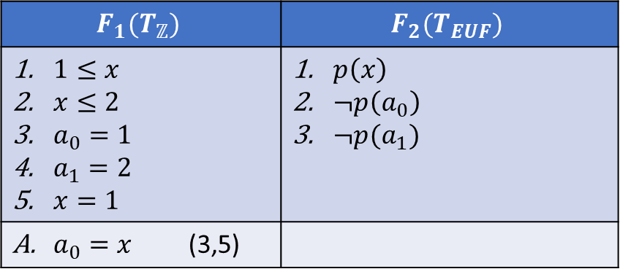
Example (case-1)
$$F_{1}(T_{ℤ})$$ | $$F_{2}(T_{EUF})$$
$1≤x$ $x≤2$ $a_{0}=1$ $a_{1}=2$ $x=1$ | $p\left(x\right)$ $¬p\left(a_{0}\right)$ $¬p(a_{1})$
$a_{0}=x$ (3,5)

Slide 11
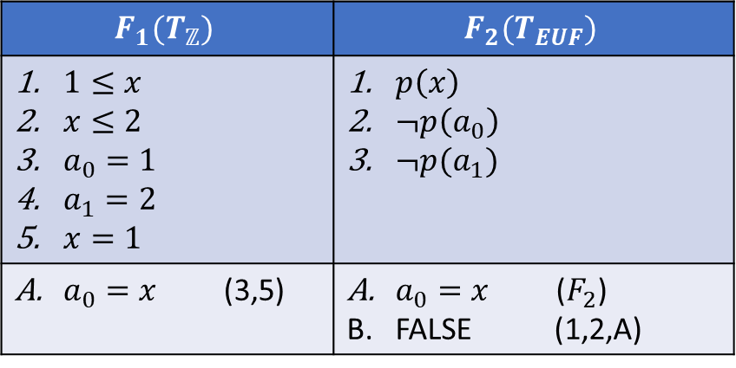
Example (case-1)
$$F_{1}(T_{ℤ})$$ | $$F_{2}(T_{EUF})$$
$1≤x$ $x≤2$ $a_{0}=1$ $a_{1}=2$ $x=1$ | $p\left(x\right)$ $¬p\left(a_{0}\right)$ $¬p(a_{1})$
$a_{0}=x$ (3,5) | $a_{0}=x$ ($F_{2}$) FALSE (1,2,A)

Slide 12
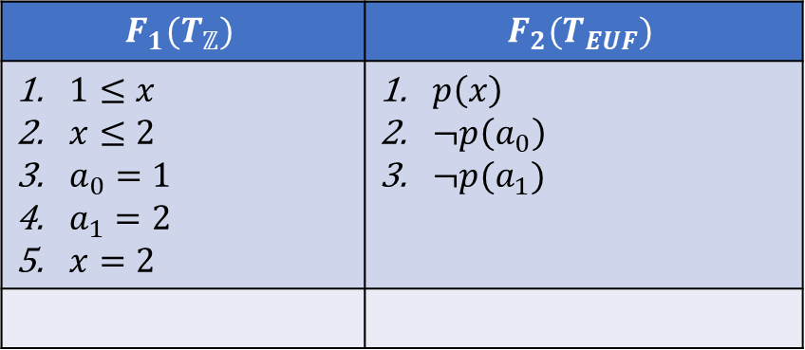
Example (case-2)
$$F_{1}(T_{ℤ})$$ | $$F_{2}(T_{EUF})$$
$1≤x$ $x≤2$ $a_{0}=1$ $a_{1}=2$ $x=2$ | $p\left(x\right)$ $¬p\left(a_{0}\right)$ $¬p(a_{1})$

Slide 13
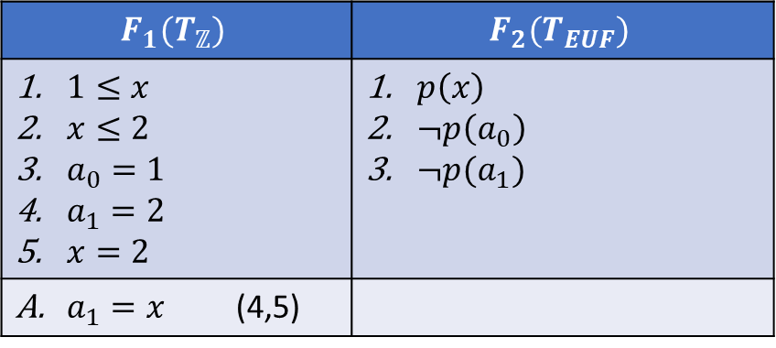
Example (case-2)
$$F_{1}(T_{ℤ})$$ | $$F_{2}(T_{EUF})$$
$1≤x$ $x≤2$ $a_{0}=1$ $a_{1}=2$ $x=2$ | $p\left(x\right)$ $¬p\left(a_{0}\right)$ $¬p(a_{1})$
$a_{1}=x$ (4,5)

Slide 14
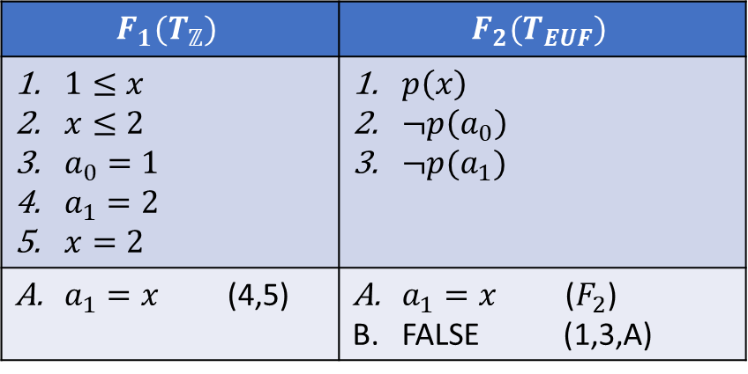
Example (case-2)
$$F_{1}(T_{ℤ})$$ | $$F_{2}(T_{EUF})$$
$1≤x$ $x≤2$ $a_{0}=1$ $a_{1}=2$ $x=2$ | $p\left(x\right)$ $¬p\left(a_{0}\right)$ $¬p(a_{1})$
$a_{1}=x$ (4,5) | $a_{1}=x$ ($F_{2}$) FALSE (1,3,A)

Slide 15
Example
Because, in both branches, the algorithm is unsatisfiable, the original formula is unsatisfiable

Slide 16
Quantified formulas

Slide 17
Quantified formulas
Read Chapter-9 from the DP book
Read Chapter-2 from the COC book

Slide 18
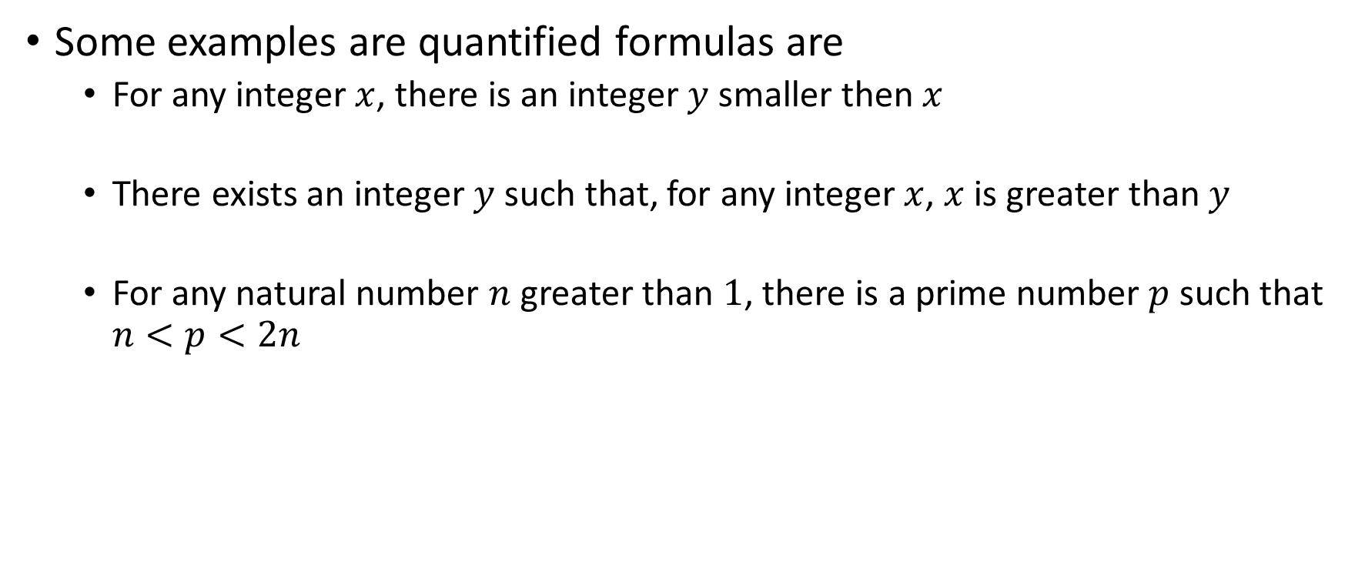
Quantified formulas
Some examples are quantified formulas are
For any integer $x$, there is an integer $y$ smaller then $x$
There exists an integer $y$ such that, for any integer $x$, $x$ is greater than $y$
For any natural number $n$ greater than $1$, there is a prime number $p$ such that $n<p<2n$

Slide 19
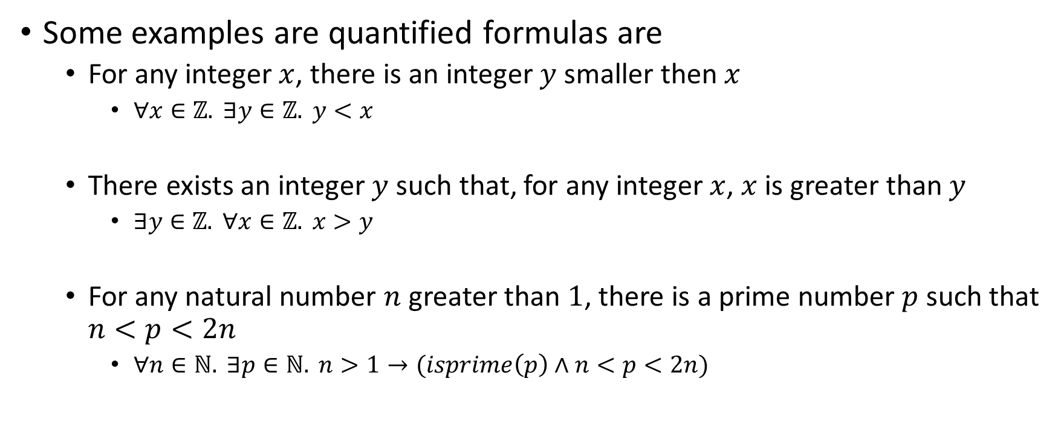
Quantified formulas
Some examples are quantified formulas are
For any integer $x$, there is an integer $y$ smaller then $x$
$∀x∈ℤ. ∃y∈ℤ. y<x$
There exists an integer $y$ such that, for any integer $x$, $x$ is greater than $y$
$∃y∈ℤ. ∀x∈ℤ. x>y$
For any natural number $n$ greater than $1$, there is a prime number $p$ such that $n<p<2n$
$∀n∈ℕ. ∃p∈ℕ. n>1→(isprime\left(p\right)∧n<p<2n)$

Slide 20
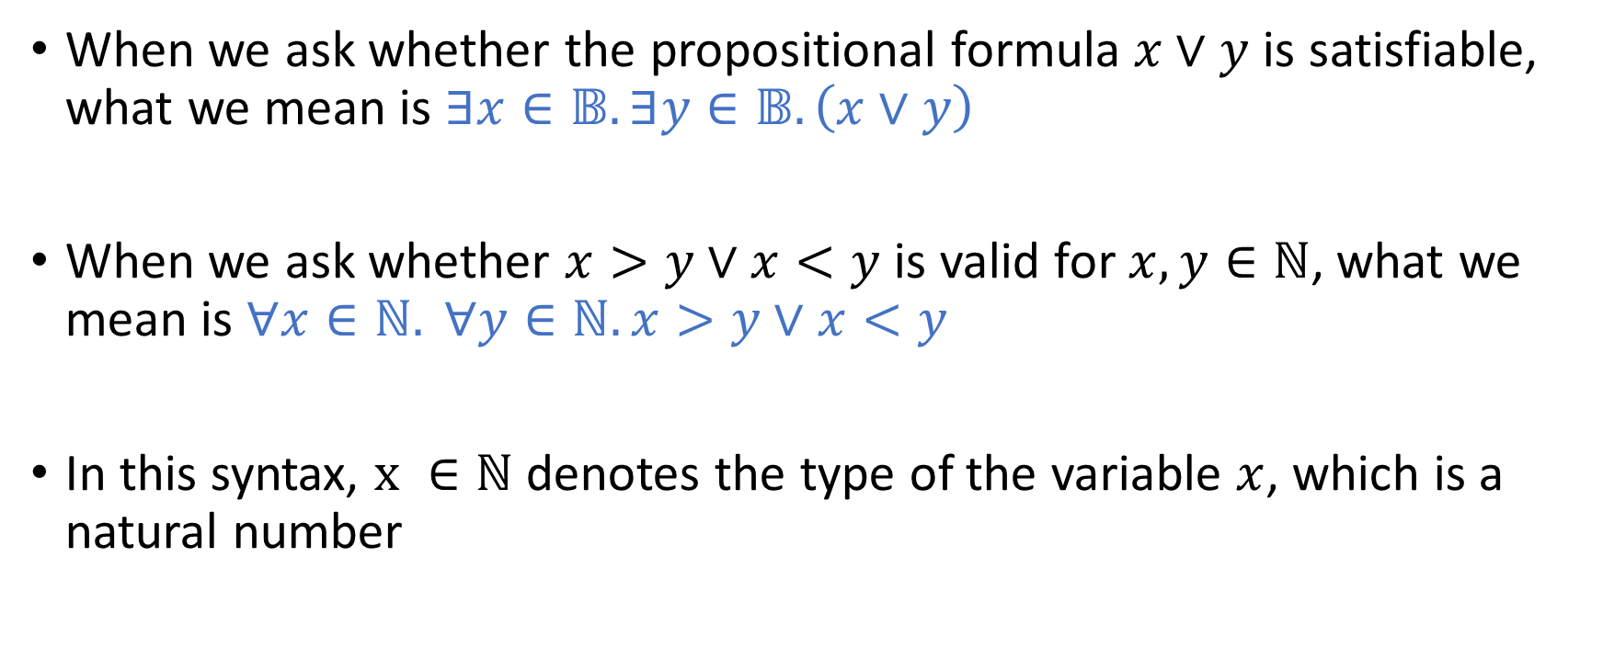
Quantified formulas
When we ask whether the propositional formula $x∨y$ is satisfiable, what we mean is $∃x∈𝔹. ∃y∈𝔹.\left(x∨y\right)$
When we ask whether $x>y∨x<y$ is valid for $x,y∈ℕ$, what we mean is $∀x∈ℕ. ∀y∈ℕ. x>y∨x<y$
In this syntax, $x ∈ℕ$ denotes the type of the variable $x$, which is a natural number

Slide 21
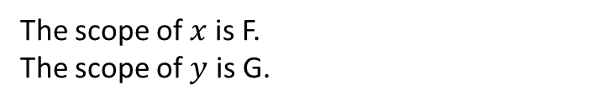

Scope
The scope of a quantified variable extends as far as possible
$$∀x. p\left(f\left(x\right),x\right)→\left(∃y. p\left(f\left(g\left(x,y\right)\right), g\left(x,y\right)\right)\right)∧q(x,f(x))$$
G
The scope of $x$ is F.
The scope of $y$ is G.
F

Slide 22
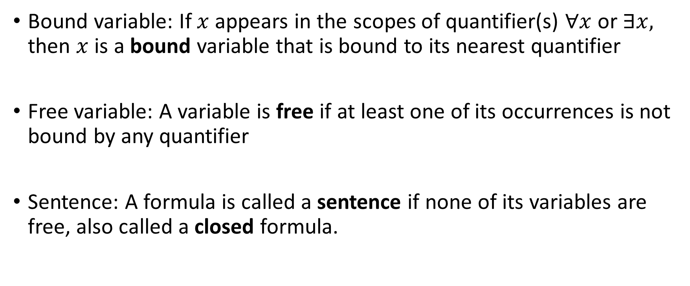
Quantified formulas
Bound variable: If $x$ appears in the scopes of quantifier(s) $∀x$ or $∃x,$ then $x$ is a bound variable that is bound to its nearest quantifier
Free variable: A variable is free if at least one of its occurrences is not bound by any quantifier
Sentence: A formula is called a sentence if none of its variables are free, also called a closed formula.

Slide 23
Normal forms

Slide 24
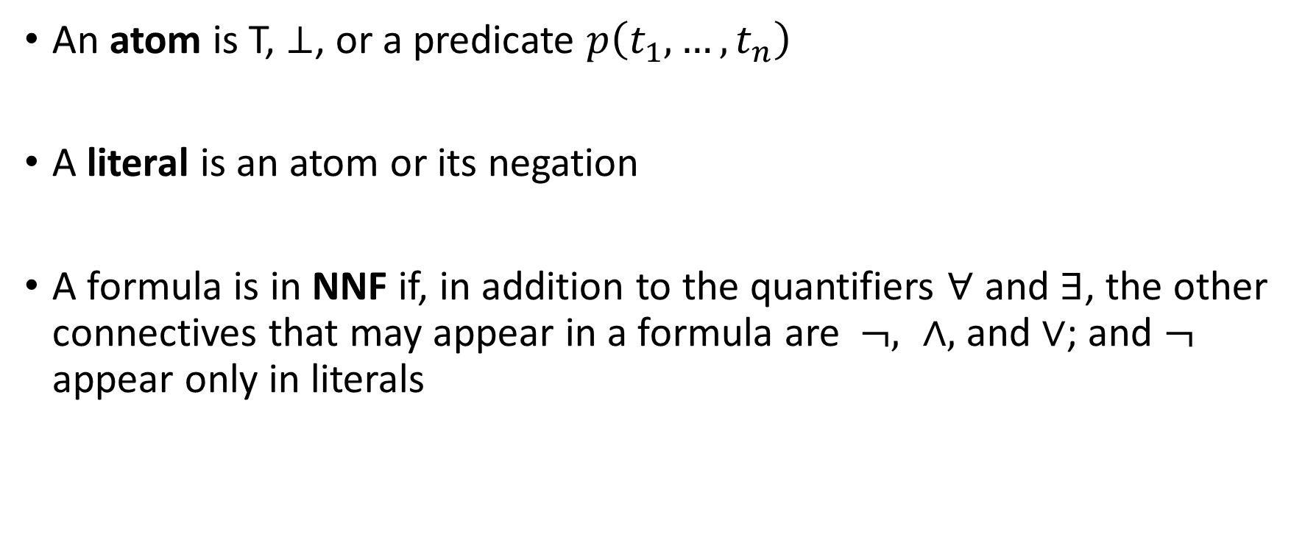
Negation normal form (NNF)
An atom is T, $⊥$, or a predicate $p\left(t_{1},…,t_{n}\right)$
A literal is an atom or its negation
A formula is in NNF if, in addition to the quantifiers $∀$ and $∃$, the other connectives that may appear in a formula are $¬, ∧,$ and $∨$; and $¬$ appear only in literals

Slide 25

NNF
The following equivalences can be used to convert a formula into NNF
$$¬¬F_{1}↔F_{1}$$
$¬$T$↔ ⊥$
$¬⊥ ↔$T
$$¬\left(F_{1}∧F_{2}\right)↔¬F_{1}∨¬F_{2}$$
$$¬\left(F_{1}∨F_{2}\right)↔¬F_{1}∧¬F_{2}$$
$$\left(F_{1}→F_{2}\right)↔\left(¬F_{1}∨F_{2}\right)$$
$${(F}_{1}↔F_{2}) ↔\left(F_{1}→F_{2}\right)∧(F_{2}→F_{1})$$
$$¬\left(∀x. F\left[x\right]\right)↔∃x. ¬F\left[x\right]$$
$$¬\left(∃x. F\left[x\right]\right)↔∀x. ¬F[x]$$

Slide 26

NNF
Convert G to NNF.
$$G:(∀x. \left(∃y. p\left(x,y\right)∧p\left(x,z\right)\right)→∃w.p\left(x,w\right))$$

Slide 27
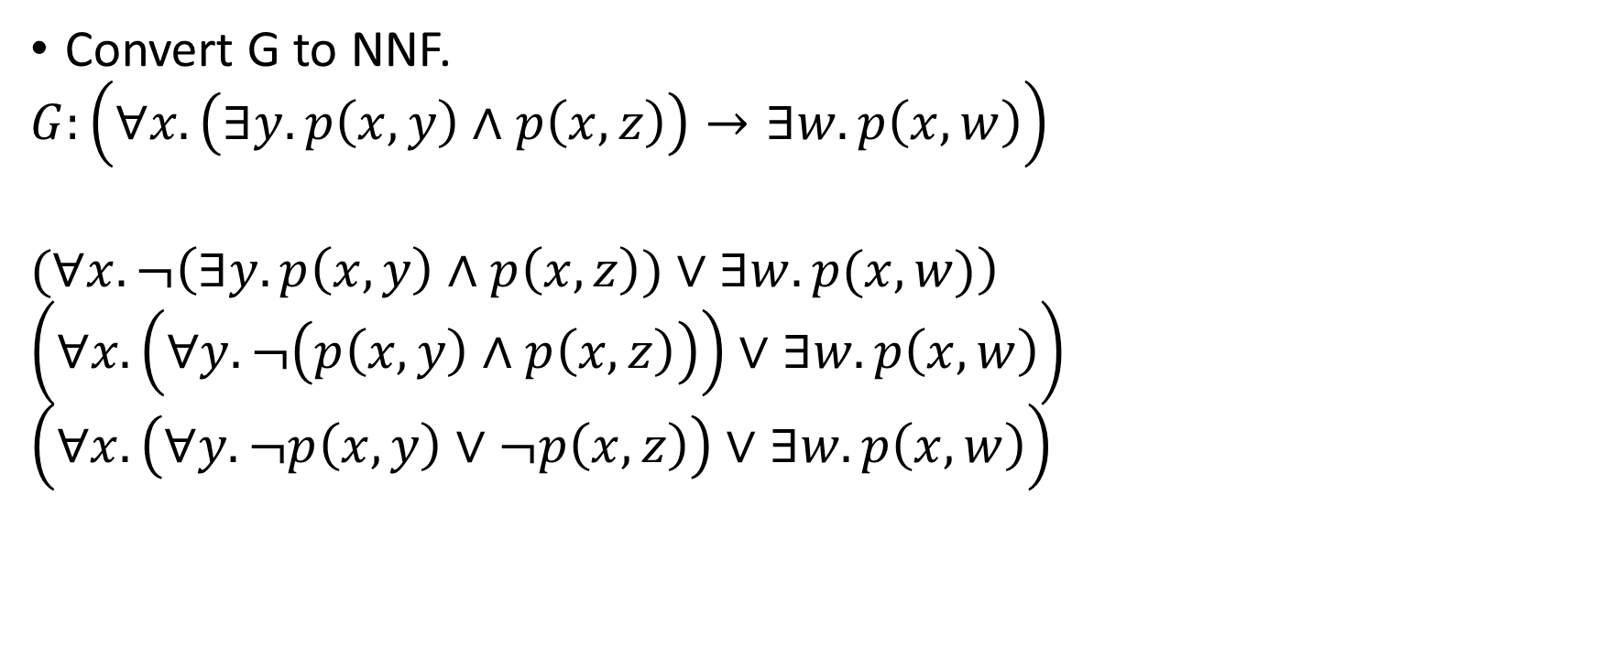
NNF
Convert G to NNF.
$$G:\left(∀x. \left(∃y. p\left(x,y\right)∧p\left(x,z\right)\right)→∃w.p\left(x,w\right)\right)$$
$$(∀x. ¬\left(∃y.p\left(x,y\right)∧p\left(x,z\right))∨∃w.p(x,w)\right)$$
$$\left(∀x.\left(∀y. ¬\left(p\left(x,y\right)∧p\left(x,z\right)\right)\right)∨∃w.p\left(x,w\right)\right)$$
$$\left(∀x.\left(∀y.¬p\left(x,y\right)∨¬p\left(x,z\right)\right)∨∃w.p\left(x,w\right)\right)$$

Slide 28
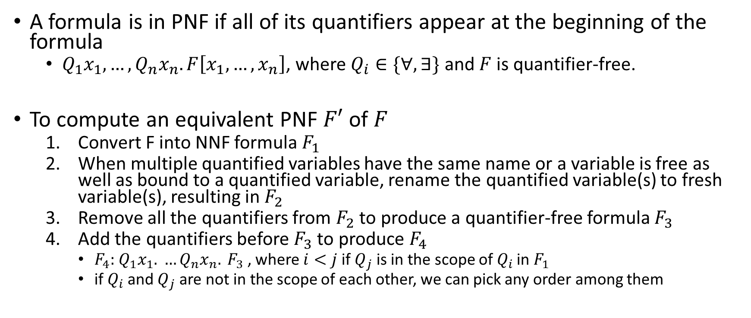
Prenex normal form (PNF)
A formula is in PNF if all of its quantifiers appear at the beginning of the formula
$Q_{1}x_{1},…,Q_{n}x_{n}. F\left[x_{1},…,x_{n}\right]$, where $Q_{i}∈\{∀,∃\}$ and $F$ is quantifier-free.
To compute an equivalent PNF $F′$ of $F$
Convert F into NNF formula $F_{1}$
When multiple quantified variables have the same name or a variable is free as well as bound to a quantified variable, rename the quantified variable(s) to fresh variable(s), resulting in $F_{2}$
Remove all the quantifiers from $F_{2}$ to produce a quantifier-free formula $F_{3}$
Add the quantifiers before $F_{3}$ to produce $F_{4}$
$F_{4}:$ $Q_{1}x_{1}. …Q_{n}x_{n}. F_{3}$ , where $i<j$ if $Q_{j}$ is in the scope of $Q_{i}$ in $F_{1}$
if $Q_{i}$ and $Q_{j}$ are not in the scope of each other, we can pick any order among them

Slide 29

Prenex normal form
Convert the following formula to PNF
$$F:∀x. ¬\left(∃y. p\left(x,y\right)∧p\left(x,z\right)\right)∨∃y. p(x,y)$$

Slide 30
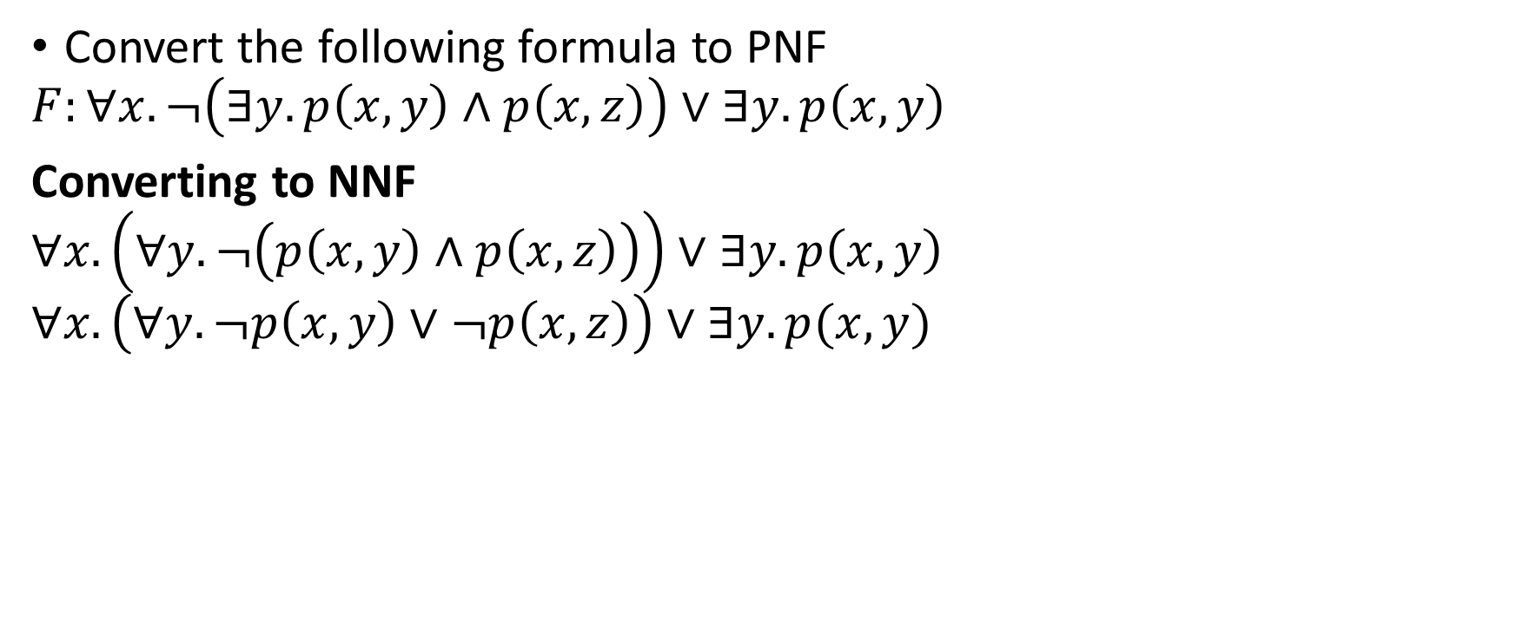
Prenex normal form
Convert the following formula to PNF
$$F:∀x. ¬\left(∃y. p\left(x,y\right)∧p\left(x,z\right)\right)∨∃y. p\left(x,y\right)$$
Converting to NNF
$$∀x. \left(∀y. ¬\left(p\left(x,y\right)∧p\left(x,z\right)\right)\right)∨∃y.p\left(x,y\right)$$
$$∀x.\left(∀y. ¬p\left(x,y\right)∨¬p\left(x,z\right)\right)∨∃y. p(x,y)$$

Slide 31
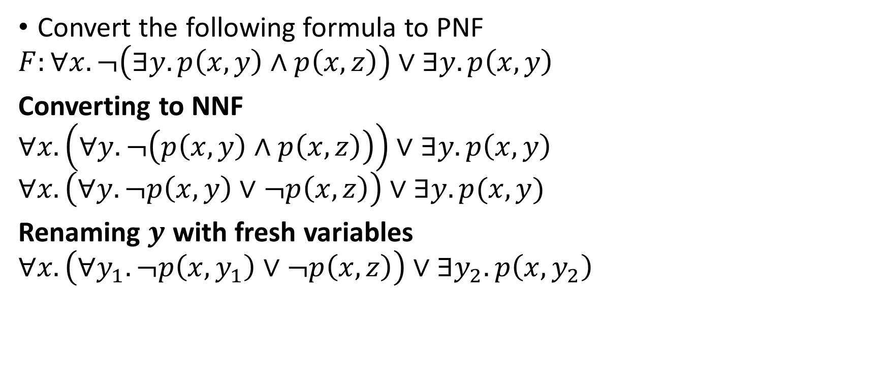
Prenex normal form
Convert the following formula to PNF
$$F:∀x. ¬\left(∃y. p\left(x,y\right)∧p\left(x,z\right)\right)∨∃y. p\left(x,y\right)$$
Converting to NNF
$$∀x. \left(∀y. ¬\left(p\left(x,y\right)∧p\left(x,z\right)\right)\right)∨∃y.p\left(x,y\right)$$
$$∀x.\left(∀y. ¬p\left(x,y\right)∨¬p\left(x,z\right)\right)∨∃y. p(x,y)$$
Renaming $y$ with fresh variables
$$∀x.\left(∀y_{1}. ¬p\left(x,y_{1}\right)∨¬p\left(x,z\right)\right)∨∃y_{2}. p\left(x,y_{2}\right)$$

Slide 32
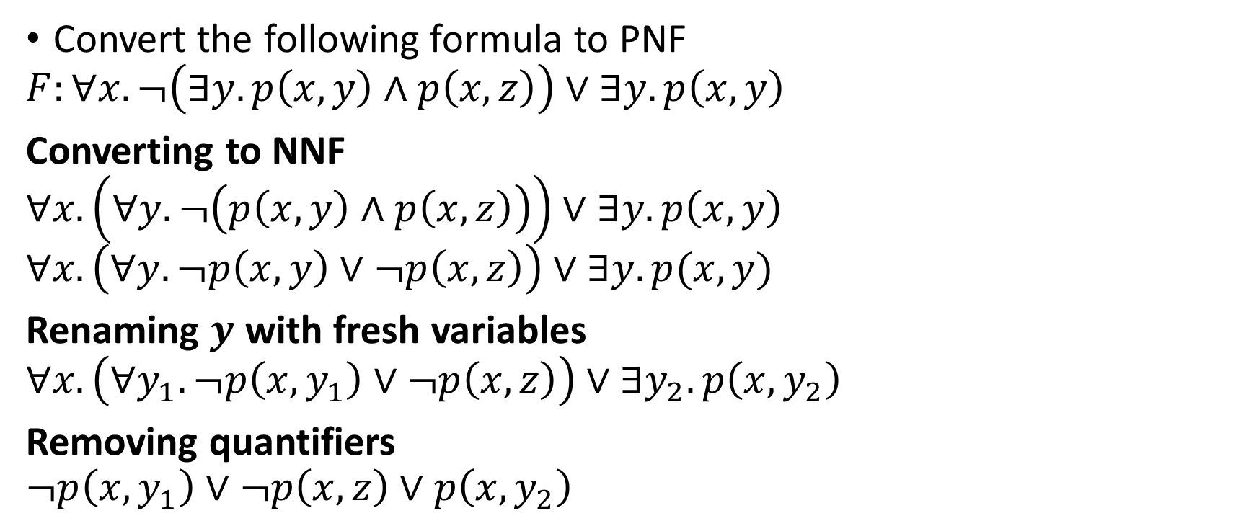
Prenex normal form
Convert the following formula to PNF
$$F:∀x. ¬\left(∃y. p\left(x,y\right)∧p\left(x,z\right)\right)∨∃y. p\left(x,y\right)$$
Converting to NNF
$$∀x. \left(∀y. ¬\left(p\left(x,y\right)∧p\left(x,z\right)\right)\right)∨∃y.p\left(x,y\right)$$
$$∀x.\left(∀y. ¬p\left(x,y\right)∨¬p\left(x,z\right)\right)∨∃y. p(x,y)$$
Renaming $y$ with fresh variables
$$∀x.\left(∀y_{1}. ¬p\left(x,y_{1}\right)∨¬p\left(x,z\right)\right)∨∃y_{2}. p\left(x,y_{2}\right)$$
Removing quantifiers
$$¬p\left(x, y_{1}\right)∨¬p\left(x,z\right)∨p\left(x, y_{2}\right)$$

Slide 33
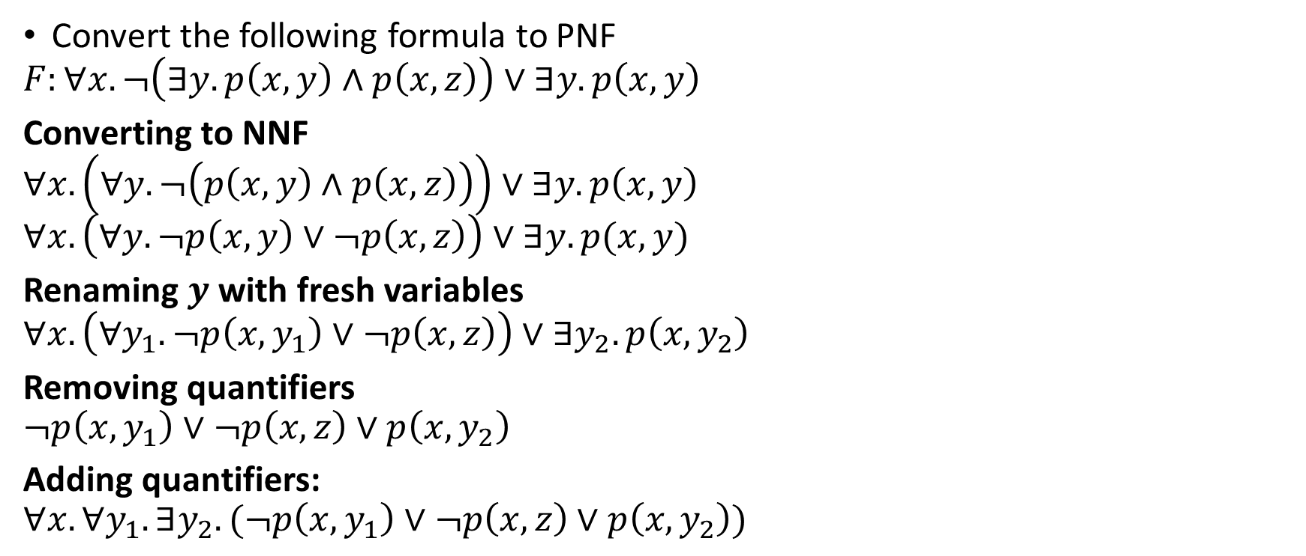
Prenex normal form
Convert the following formula to PNF
$$F:∀x. ¬\left(∃y. p\left(x,y\right)∧p\left(x,z\right)\right)∨∃y. p\left(x,y\right)$$
Converting to NNF
$$∀x. \left(∀y. ¬\left(p\left(x,y\right)∧p\left(x,z\right)\right)\right)∨∃y.p\left(x,y\right)$$
$$∀x.\left(∀y. ¬p\left(x,y\right)∨¬p\left(x,z\right)\right)∨∃y. p(x,y)$$
Renaming $y$ with fresh variables
$$∀x.\left(∀y_{1}. ¬p\left(x,y_{1}\right)∨¬p\left(x,z\right)\right)∨∃y_{2}. p\left(x,y_{2}\right)$$
Removing quantifiers
$$¬p\left(x, y_{1}\right)∨¬p\left(x,z\right)∨p\left(x, y_{2}\right)$$
Adding quantifiers:
$$∀x. ∀y_{1}. ∃y_{2}. (¬p\left(x, y_{1}\right)∨¬p\left(x,z\right)∨p\left(x, y_{2}\right))$$

Slide 34
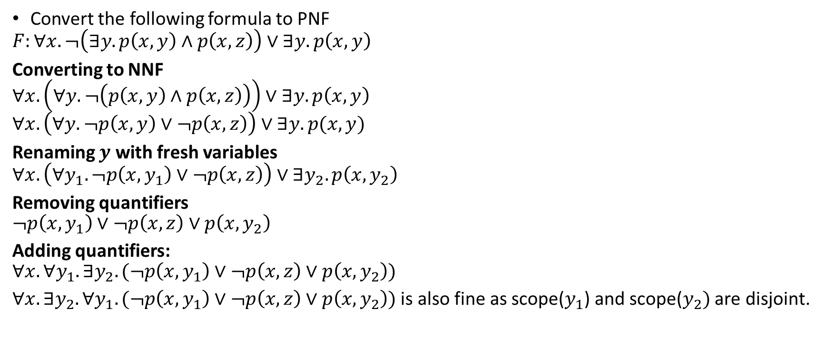
Prenex normal form
Convert the following formula to PNF
$$F:∀x. ¬\left(∃y. p\left(x,y\right)∧p\left(x,z\right)\right)∨∃y. p\left(x,y\right)$$
Converting to NNF
$$∀x. \left(∀y. ¬\left(p\left(x,y\right)∧p\left(x,z\right)\right)\right)∨∃y.p\left(x,y\right)$$
$$∀x.\left(∀y. ¬p\left(x,y\right)∨¬p\left(x,z\right)\right)∨∃y. p(x,y)$$
Renaming $y$ with fresh variables
$$∀x.\left(∀y_{1}. ¬p\left(x,y_{1}\right)∨¬p\left(x,z\right)\right)∨∃y_{2}. p\left(x,y_{2}\right)$$
Removing quantifiers
$$¬p\left(x, y_{1}\right)∨¬p\left(x,z\right)∨p\left(x, y_{2}\right)$$
Adding quantifiers:
$$∀x. ∀y_{1}. ∃y_{2}. (¬p\left(x, y_{1}\right)∨¬p\left(x,z\right)∨p\left(x, y_{2}\right))$$
$∀x. ∃y_{2}. ∀y_{1}. (¬p\left(x, y_{1}\right)∨¬p\left(x,z\right)∨p\left(x, y_{2}\right))$ is also fine as scope($y_{1}$) and scope($y_{2})$ are disjoint.

Slide 35

Prenex normal form
Convert the following formula to PNF
$$F:¬∃x. ¬\left(∃y. \left(y→x\right)∧\left(¬x∨y\right)∧¬\left(∀y. \left(y∧x\right)∨\left(¬x∧¬y\right)\right)\right)$$

Slide 36
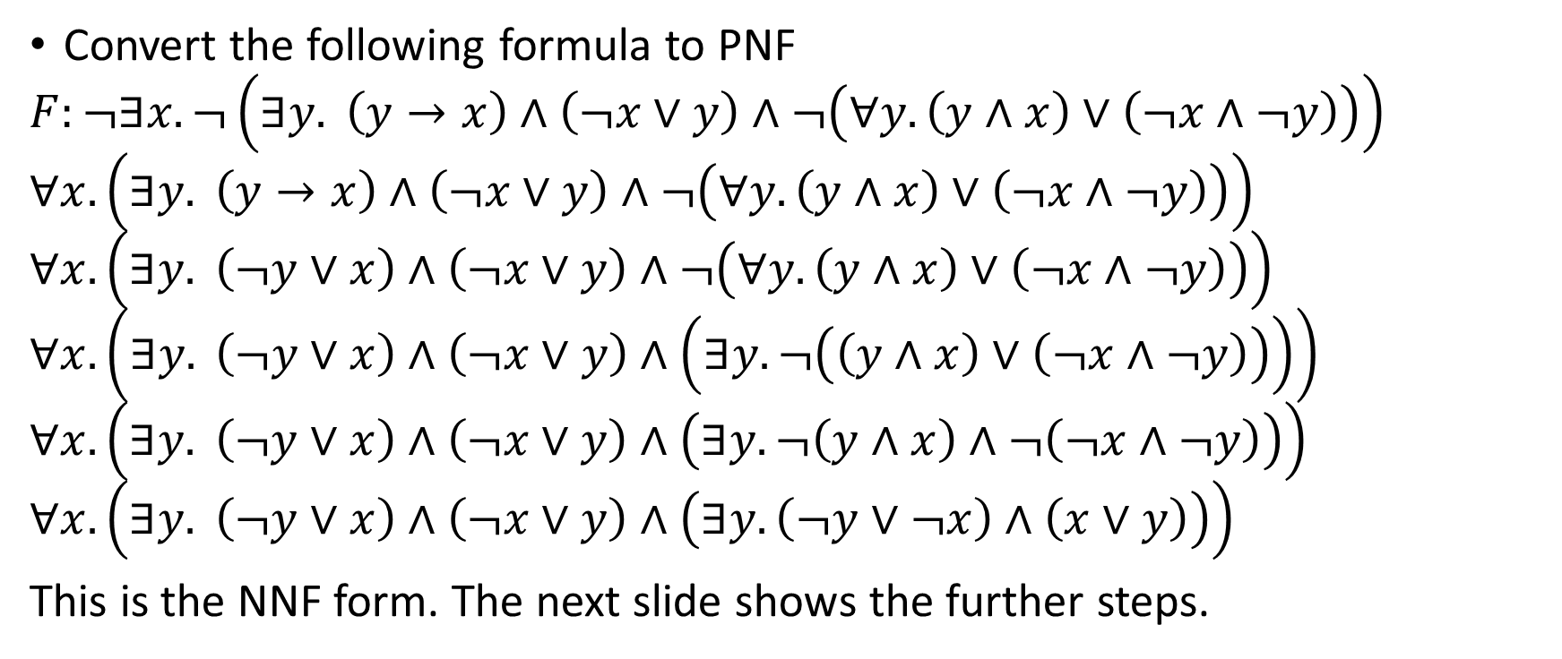
Prenex normal form
Convert the following formula to PNF
$$F:¬∃x. ¬\left(∃y. \left(y→x\right)∧\left(¬x∨y\right)∧¬\left(∀y. \left(y∧x\right)∨\left(¬x∧¬y\right)\right)\right)$$
$$∀x. \left(∃y. \left(y→x\right)∧\left(¬x∨y\right)∧¬\left(∀y. \left(y∧x\right)∨\left(¬x∧¬y\right)\right)\right)$$
$$∀x. \left(∃y. \left(¬y∨x\right)∧\left(¬x∨y\right)∧¬\left(∀y. \left(y∧x\right)∨\left(¬x∧¬y\right)\right)\right)$$
$$∀x. \left(∃y. \left(¬y∨x\right)∧\left(¬x∨y\right)∧\left(∃y. ¬\left(\left(y∧x\right)∨\left(¬x∧¬y\right)\right)\right)\right)$$
$$∀x. \left(∃y. \left(¬y∨x\right)∧\left(¬x∨y\right)∧\left(∃y. ¬\left(y∧x\right)∧¬\left(¬x∧¬y\right)\right)\right)$$
$$∀x. \left(∃y. \left(¬y∨x\right)∧\left(¬x∨y\right)∧\left(∃y. \left(¬y∨¬x\right)∧\left(x∨y\right)\right)\right)$$
This is the NNF form. The next slide shows the further steps.

Slide 37
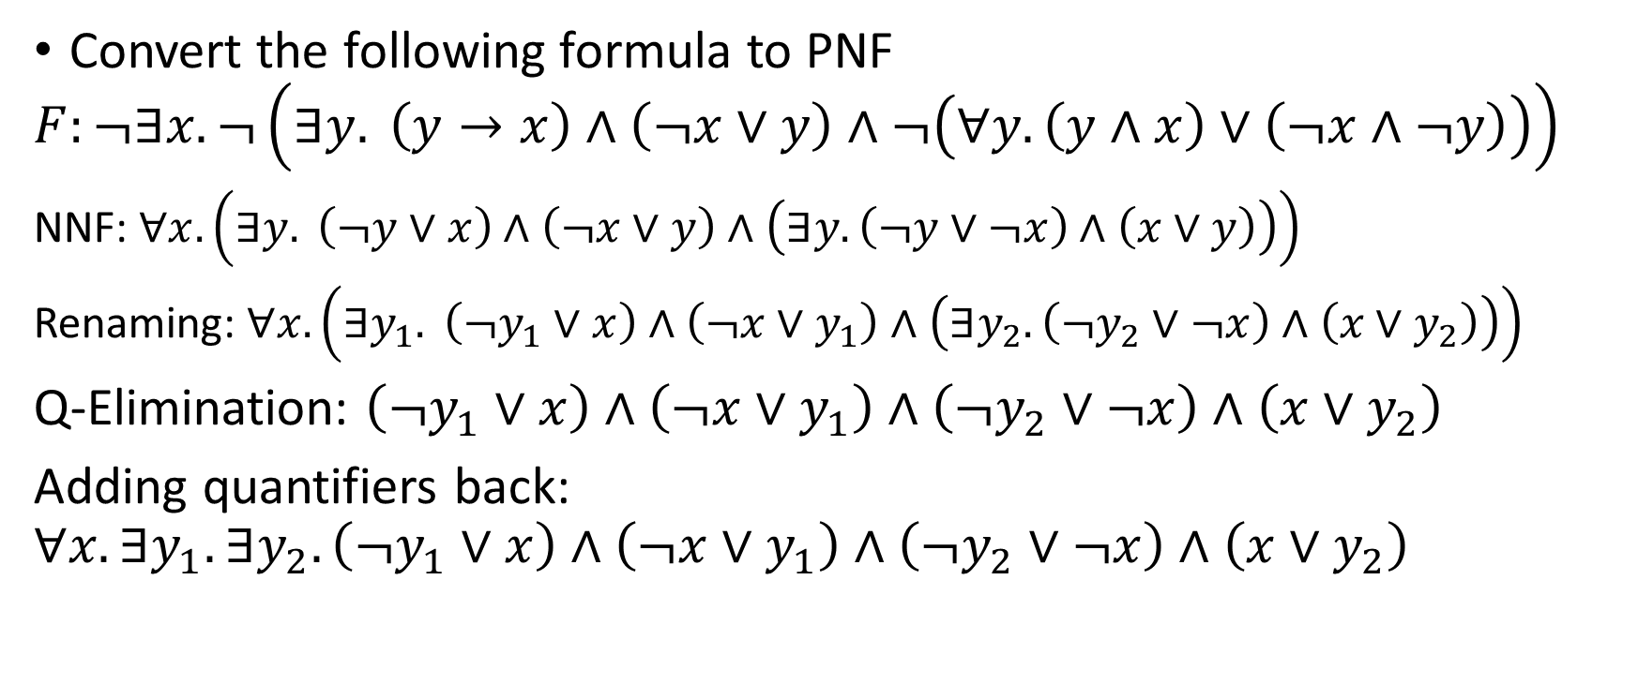
Prenex normal form
Convert the following formula to PNF
$$F:¬∃x. ¬\left(∃y. \left(y→x\right)∧\left(¬x∨y\right)∧¬\left(∀y. \left(y∧x\right)∨\left(¬x∧¬y\right)\right)\right)$$
NNF: $∀x. \left(∃y. \left(¬y∨x\right)∧\left(¬x∨y\right)∧\left(∃y. \left(¬y∨¬x\right)∧\left(x∨y\right)\right)\right)$
Renaming: $∀x. \left(∃y_{1}. \left(¬y_{1}∨x\right)∧\left(¬x∨y_{1}\right)∧\left(∃y_{2}. \left(¬y_{2}∨¬x\right)∧\left(x∨y_{2}\right)\right)\right)$
Q-Elimination: $\left(¬y_{1}∨x\right)∧\left(¬x∨y_{1}\right)∧\left(¬y_{2}∨¬x\right)∧\left(x∨y_{2}\right)$
Adding quantifiers back:
$$∀x.∃y_{1}.∃y_{2}.\left(¬y_{1}∨x\right)∧\left(¬x∨y_{1}\right)∧\left(¬y_{2}∨¬x\right)∧\left(x∨y_{2}\right)$$

Slide 38
Quantified Boolean formulas

Slide 39

Quantified Boolean formulas
Quantified propositional logic = propositional logic + $\left\{∀,∃\right\}$
The formulas in quantified propositional logic are called quantified Boolean formulas

Slide 40
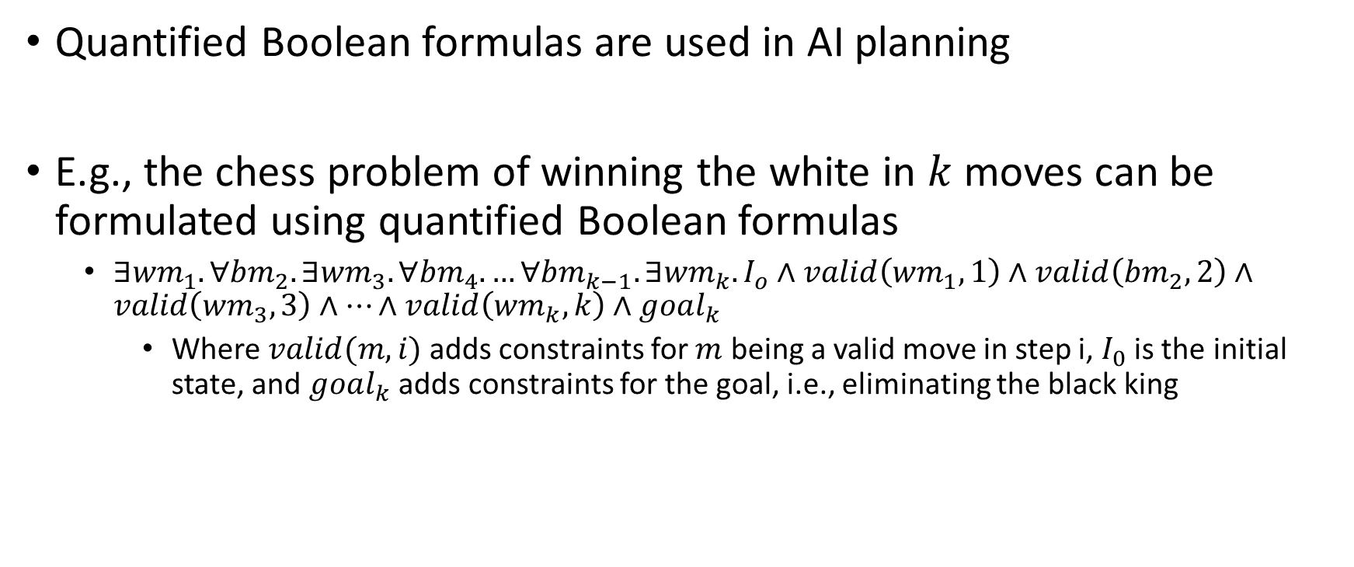
Applications
Quantified Boolean formulas are used in AI planning
E.g., the chess problem of winning the white in $k$ moves can be formulated using quantified Boolean formulas
$∃{wm}_{1}. ∀{bm}_{2}. ∃{wm}_{3}. ∀{bm}_{4}. …∀{bm}_{k−1}. ∃{wm}_{k}. I_{o}∧valid\left({wm}_{1},1\right)∧valid\left({bm}_{2},2\right)∧valid\left({wm}_{3},3\right)∧…∧valid\left({wm}_{k},k\right)∧goal_{k}$
Where $valid(m, i)$ adds constraints for $m$ being a valid move in step i, $I_{0}$ is the initial state, and $goal_{k}$ adds constraints for the goal, i.e., eliminating the black king

Slide 41

Ordering of quantifiers
Does the ordering of existential and universal quantifiers matter?
Is $∀x. ∃y. p\left(x, y\right)$ the same as $∃y.∀x. p\left(x,y\right)?$

Slide 42
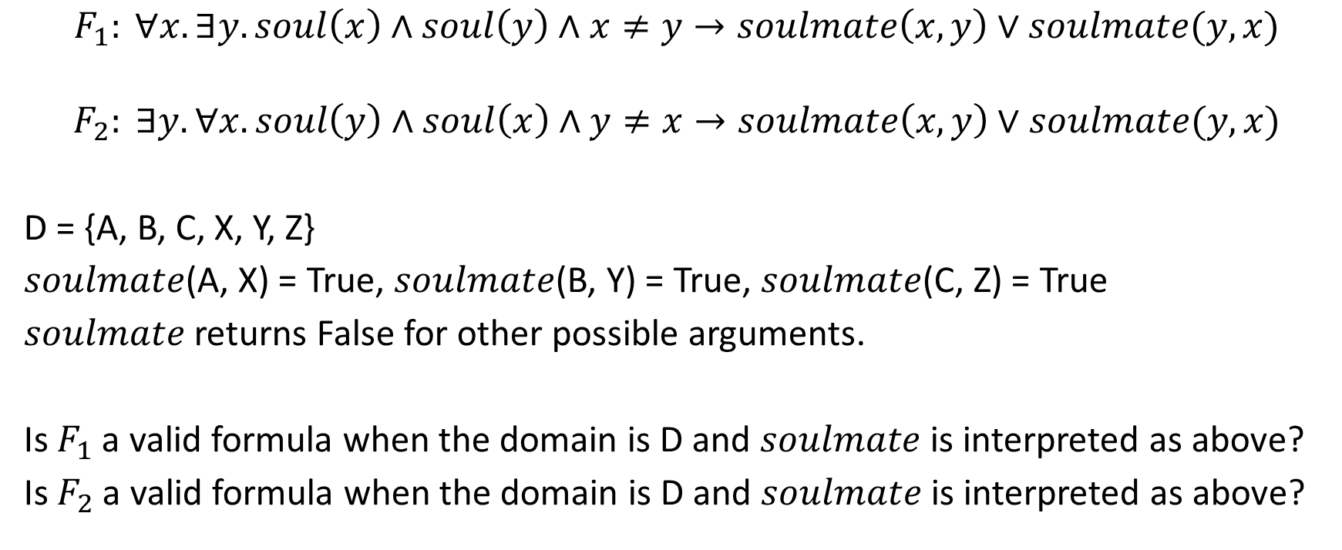
Ordering of quantifiers
$$F_{1}: ∀x.∃y. soul\left(x\right)∧soul\left(y\right)∧x≠y→soulmate\left(x,y\right)∨soulmate(y,x)$$
$$F_{2}: ∃y.∀x. soul\left(y\right)∧soul\left(x\right)∧y≠x→soulmate\left(x,y\right)∨soulmate(y,x)$$
D = {A, B, C, X, Y, Z}
$soulmate$(A, X) = True, $soulmate$(B, Y) = True, $soulmate$(C, Z) = True
$soulmate$ returns False for other possible arguments.
Is $F_{1}$ a valid formula when the domain is D and $soulmate$ is interpreted as above?
Is $F_{2}$ a valid formula when the domain is D and $soulmate$ is interpreted as above?

Slide 43
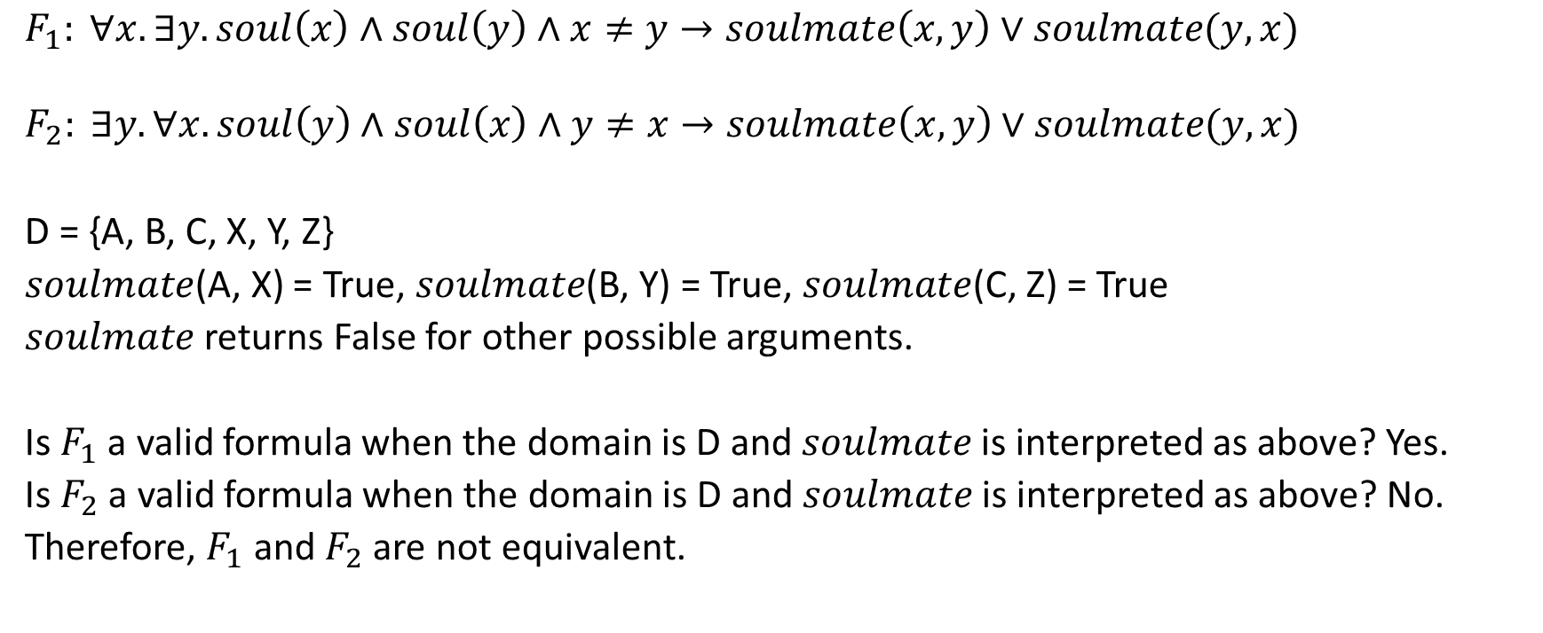
Ordering of quantifiers
$$F_{1}: ∀x.∃y. soul\left(x\right)∧soul\left(y\right)∧x≠y→soulmate\left(x,y\right)∨soulmate(y,x)$$
$$F_{2}: ∃y.∀x. soul\left(y\right)∧soul\left(x\right)∧y≠x→soulmate\left(x,y\right)∨soulmate(y,x)$$
D = {A, B, C, X, Y, Z}
$soulmate$(A, X) = True, $soulmate$(B, Y) = True, $soulmate$(C, Z) = True
$soulmate$ returns False for other possible arguments.
Is $F_{1}$ a valid formula when the domain is D and $soulmate$ is interpreted as above? Yes.
Is $F_{2}$ a valid formula when the domain is D and $soulmate$ is interpreted as above? No.
Therefore, $F_{1}$ and $F_{2}$ are not equivalent.

Slide 44
Quantifier elimination algorithms

Slide 45
Quantifier elimination algorithm
A quantifier elimination algorithm eliminates all the quantifiers from a quantified formula to generate a quantifier-free formula
The quantifier-free formula obtained in the previous step can be solved using the SAT/SMT techniques that we have discussed so far

Slide 46
Quantifier elimination algorithm
If there exists a procedure for eliminating an existential quantifier, then universal quantifiers can also eliminated by converting a universal quantifier to an existential quantifier using the negation rules

Slide 47
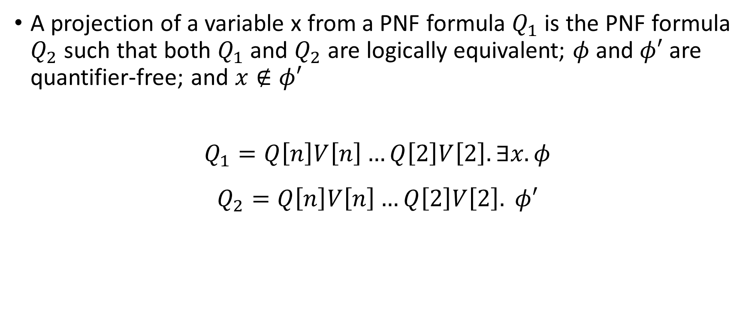
Projection
A projection of a variable x from a PNF formula $Q_{1}$ is the PNF formula $Q_{2}$ such that both $Q_{1}$ and $Q_{2}$ are logically equivalent; $φ$ and $φ′$ are quantifier-free; and $x∉φ′$
$$Q_{1}=Q\left[n\right]V\left[n\right]…Q\left[2\right]V\left[2\right]. ∃x. φ$$
$$Q_{2}=Q\left[n\right]V\left[n\right]…Q\left[2\right]V\left[2\right]. φ′$$

Slide 48

Quantifier-elimination
Algorithm: Quantifier_Elimination
Input: A sentence $Q\left[n\right]V\left[n\right]…Q\left[1\right]V\left[1\right]. φ$, where $φ$ is quantifier-free
Output: A quantifier-free formula $φ^{′},$ which is equisatisfiable to $φ$

Slide 49
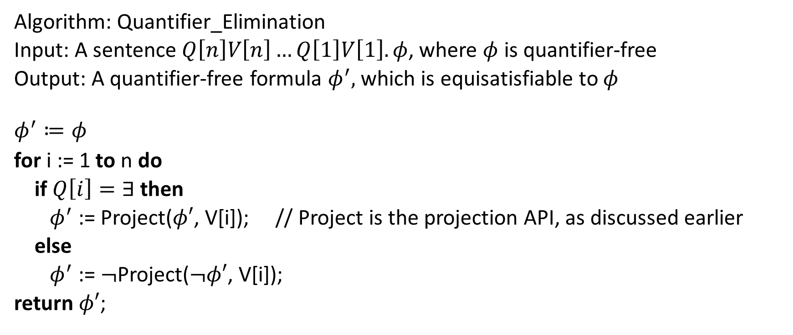
Quantifier-elimination
Algorithm: Quantifier_Elimination
Input: A sentence $Q\left[n\right]V\left[n\right]…Q\left[1\right]V\left[1\right]. φ$, where $φ$ is quantifier-free
Output: A quantifier-free formula $φ^{′},$ which is equisatisfiable to $φ$
$$φ^{′}≔φ$$
for i := 1 to n do
if $Q\left[i\right]=∃$ then
$φ^{′}$ := Project($φ′$, V[i]); // Project is the projection API, as discussed earlier
else
$φ^{′}$ := $¬$Project($¬φ′$, V[i]);
return $φ′$;

Slide 50

Projection with Binary resolution
For Boolean formulas in the CNF form, we can eliminate an existentially quantified variable x by applying resolution to all pairs of clauses where $x$ appears with opposite phases
$$∃w.∃y.∃z.∃x. \left(y∨x\right)∧\left(z∨¬x\right)∧\left(y∨¬z∨¬x\right)∧\left(w∨x\right)∧(¬y∨z∨¬w)$$

Slide 51

Projection with Binary resolution
For Boolean formulas in the CNF form, we can eliminate an existentially quantified variable x by applying resolution to all pairs of clauses where $x$ appears with opposite phases
$$∃w.∃y.∃z.∃x. \left(y∨x\right)∧\left(z∨¬x\right)∧\left(y∨¬z∨¬x\right)∧\left(w∨x\right)∧(¬y∨z∨¬w)$$
Clause-1
Clause-2
Clause-3
Clause-4

Slide 52
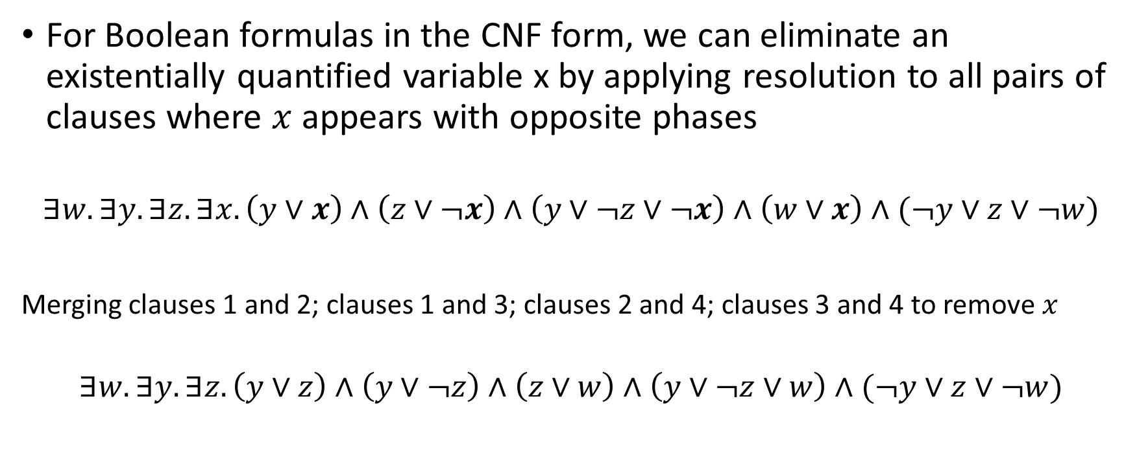
Projection with Binary resolution
For Boolean formulas in the CNF form, we can eliminate an existentially quantified variable x by applying resolution to all pairs of clauses where $x$ appears with opposite phases
$$∃w.∃y.∃z.∃x. \left(y∨x\right)∧\left(z∨¬x\right)∧\left(y∨¬z∨¬x\right)∧\left(w∨x\right)∧(¬y∨z∨¬w)$$
Merging clauses 1 and 2; clauses 1 and 3; clauses 2 and 4; clauses 3 and 4 to remove $x$
$$∃w.∃y.∃z. \left(y∨z\right)∧\left(y∨¬z\right)∧\left(z∨w\right)∧\left(y∨¬z∨w\right)∧(¬y∨z∨¬w)$$
Clause-1
Clause-2
Clause-3
Clause-4

Slide 53
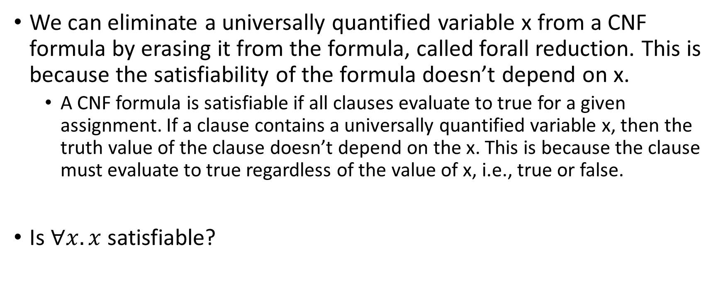
Projection with Binary resolution
We can eliminate a universally quantified variable x from a CNF formula by erasing it from the formula, called forall reduction. This is because the satisfiability of the formula doesn’t depend on x.
A CNF formula is satisfiable if all clauses evaluate to true for a given assignment. If a clause contains a universally quantified variable x, then the truth value of the clause doesn’t depend on the x. This is because the clause must evaluate to true regardless of the value of x, i.e., true or false.
Is $∀x.x$ satisfiable?

Slide 54

Projection with Binary resolution
Is $∀x.x$ satisfiable?
$∀x. x$ becomes an empty clause after erasing $x$, and thus the formula is unsatisfiable
Is $∀x. \left(¬x∨x\right)$ satisfiable?

Slide 55
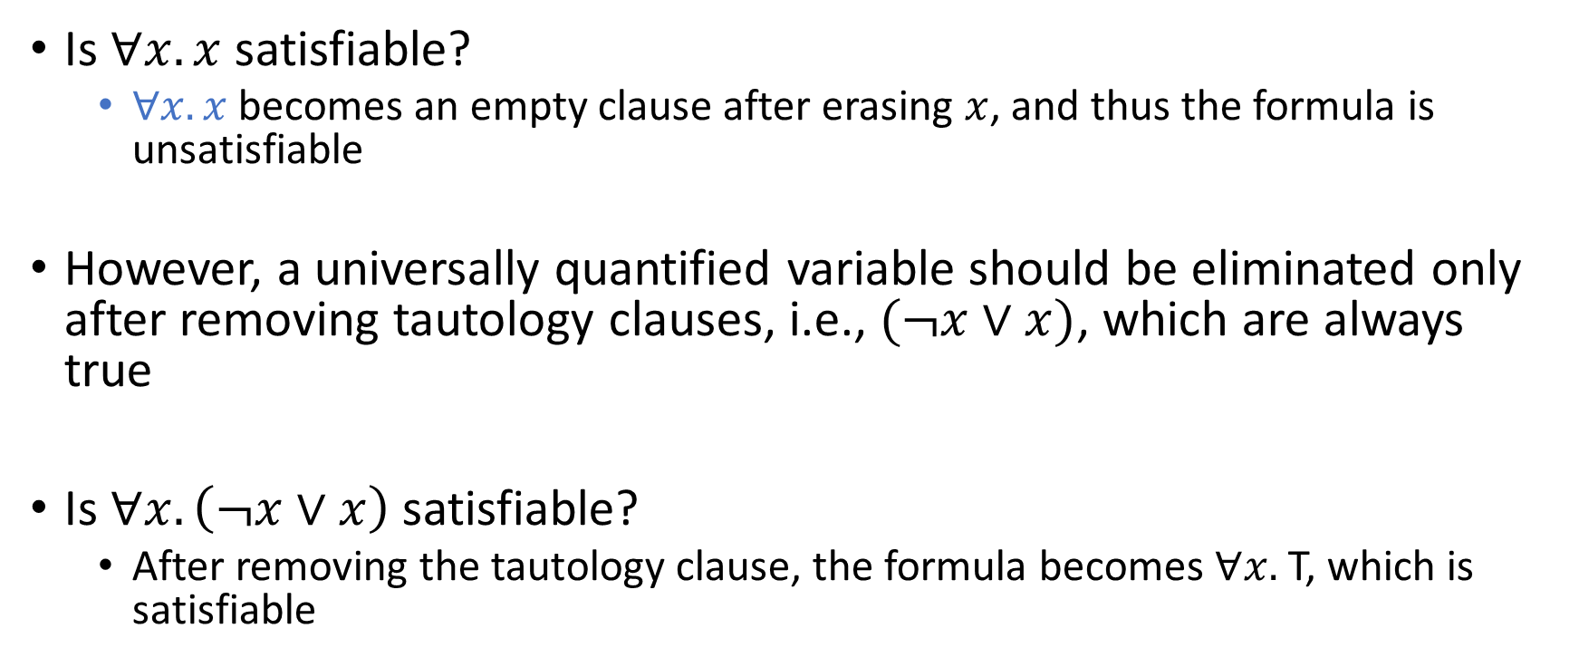
Projection with Binary resolution
Is $∀x.x$ satisfiable?
$∀x. x$ becomes an empty clause after erasing $x$, and thus the formula is unsatisfiable
However, a universally quantified variable should be eliminated only after removing tautology clauses, i.e., $(¬x∨x)$, which are always true
Is $∀x. \left(¬x∨x\right)$ satisfiable?
After removing the tautology clause, the formula becomes $∀x.$T, which is satisfiable

Slide 56

Example
Is the following formula satisfiable?
$$∀u_{1}.∀u_{2}.∃e_{1}.∀u_{3}.∃e_{3}.∃e_{2}. \left(u_{1}∨¬e_{1}\right)∧\left(¬u_{1}∨¬e_{2}∨e_{3}\right)∧\left(u_{2}∨¬u_{3}∨¬e_{1}\right)∧\left(e_{1}∨e_{2}\right)∧(e_{1}∨¬e_{3})$$

Slide 57
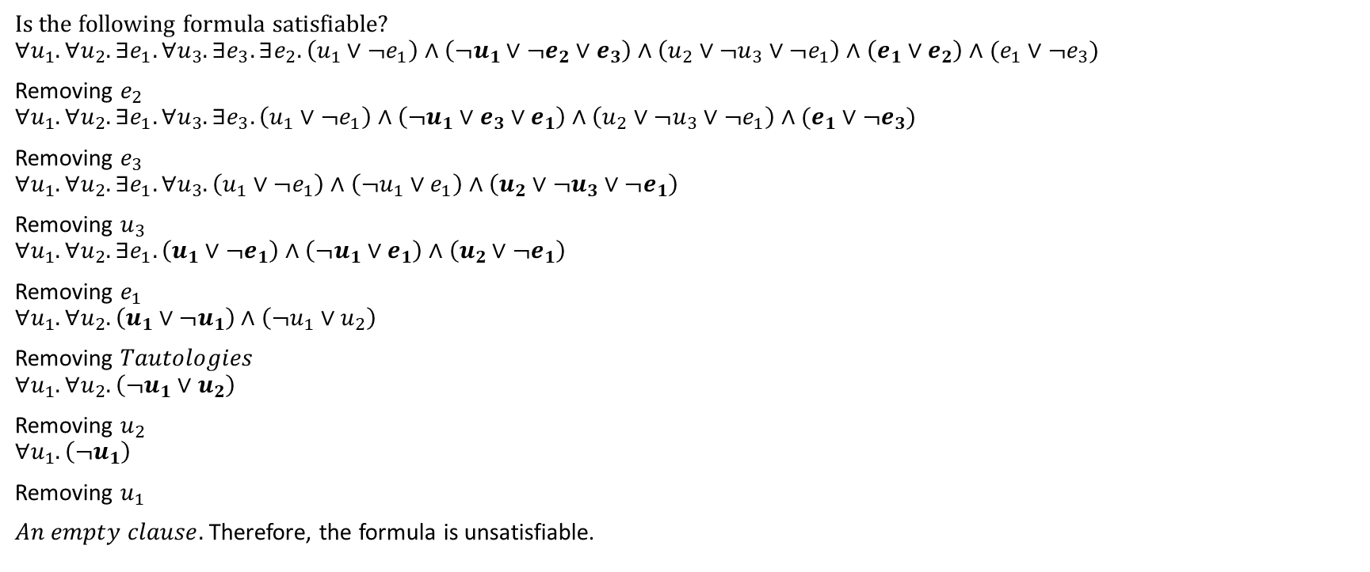
Example
Is the following formula satisfiable?
$$∀u_{1}.∀u_{2}.∃e_{1}.∀u_{3}.∃e_{3}.∃e_{2}. \left(u_{1}∨¬e_{1}\right)∧\left(¬u_{1}∨¬e_{2}∨e_{3}\right)∧\left(u_{2}∨¬u_{3}∨¬e_{1}\right)∧\left(e_{1}∨e_{2}\right)∧(e_{1}∨¬e_{3})$$
Removing $e_{2}$
$$∀u_{1}.∀u_{2}.∃e_{1}.∀u_{3}.∃e_{3}. \left(u_{1}∨¬e_{1}\right)∧\left(¬u_{1}∨e_{3}∨e_{1}\right)∧\left(u_{2}∨¬u_{3}∨¬e_{1}\right)∧(e_{1}∨¬e_{3})$$
Removing $e_{3}$
$$∀u_{1}.∀u_{2}.∃e_{1}.∀u_{3}. \left(u_{1}∨¬e_{1}\right)∧\left(¬u_{1}∨e_{1}\right)∧\left(u_{2}∨¬u_{3}∨¬e_{1}\right)$$
Removing $u_{3}$
$$∀u_{1}.∀u_{2}.∃e_{1}. \left(u_{1}∨¬e_{1}\right)∧\left(¬u_{1}∨e_{1}\right)∧\left(u_{2}∨¬e_{1}\right)$$
Removing $e_{1}$
$$∀u_{1}.∀u_{2}.\left(u_{1}∨¬u_{1}\right)∧\left(¬u_{1}∨u_{2}\right)$$
Removing $Tautologies$
$$∀u_{1}.∀u_{2}. \left(¬u_{1}∨u_{2}\right)$$
Removing $u_{2}$
$$∀u_{1}. \left(¬u_{1}\right)$$
Removing $u_{1}$
$An empty clause.$ Therefore, the formula is unsatisfiable.

