Slide 2
Propositional logic

Slide 3
Proposition
A proposition is a sentence that can be either true or false
e.g., The sky is blue. Hari is taller than Gopal. Two is less than three.
In propositional logic, a sentence is represented using a propositional variable

Slide 4
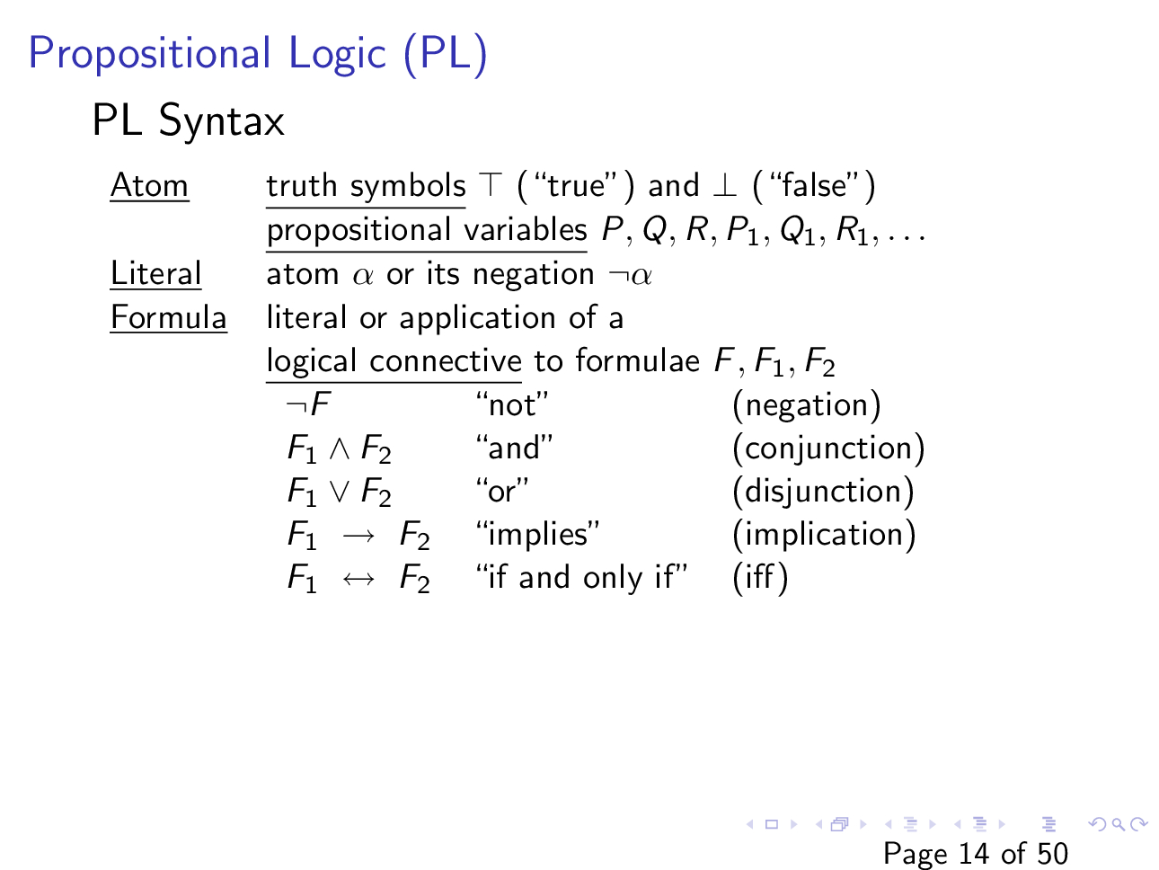
Slide courtesy of https://web.stanford.edu/class/cs156/

Slide 5
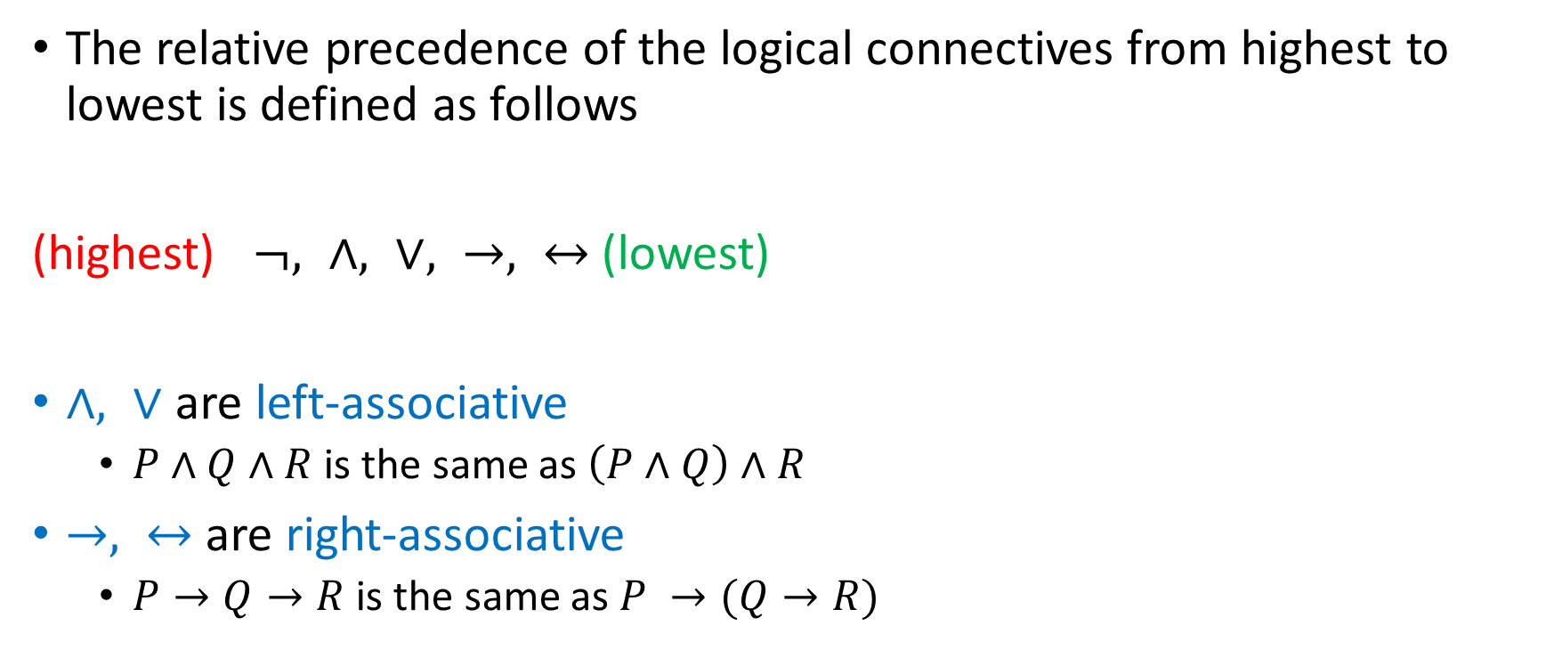
Precedence and associativity
The relative precedence of the logical connectives from highest to lowest is defined as follows
(highest) $¬, ∧, ∨, →, ↔$(lowest)
$∧, ∨$ are left-associative
$P∧Q∧R$ is the same as $\left(P∧Q\right)∧R$
$→, ↔$ are right-associative
$P→Q→R$ is the same as $P →(Q→R)$

Slide 6
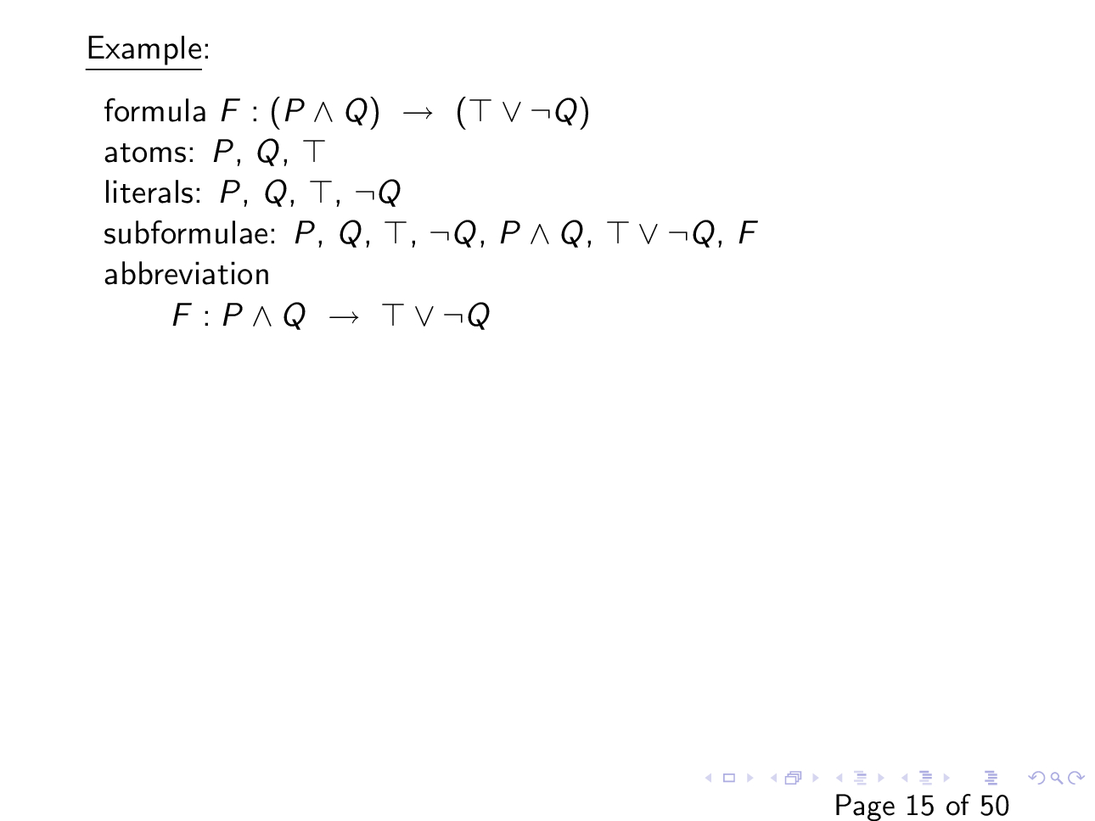
Slide courtesy of https://web.stanford.edu/class/cs156/

Slide 7
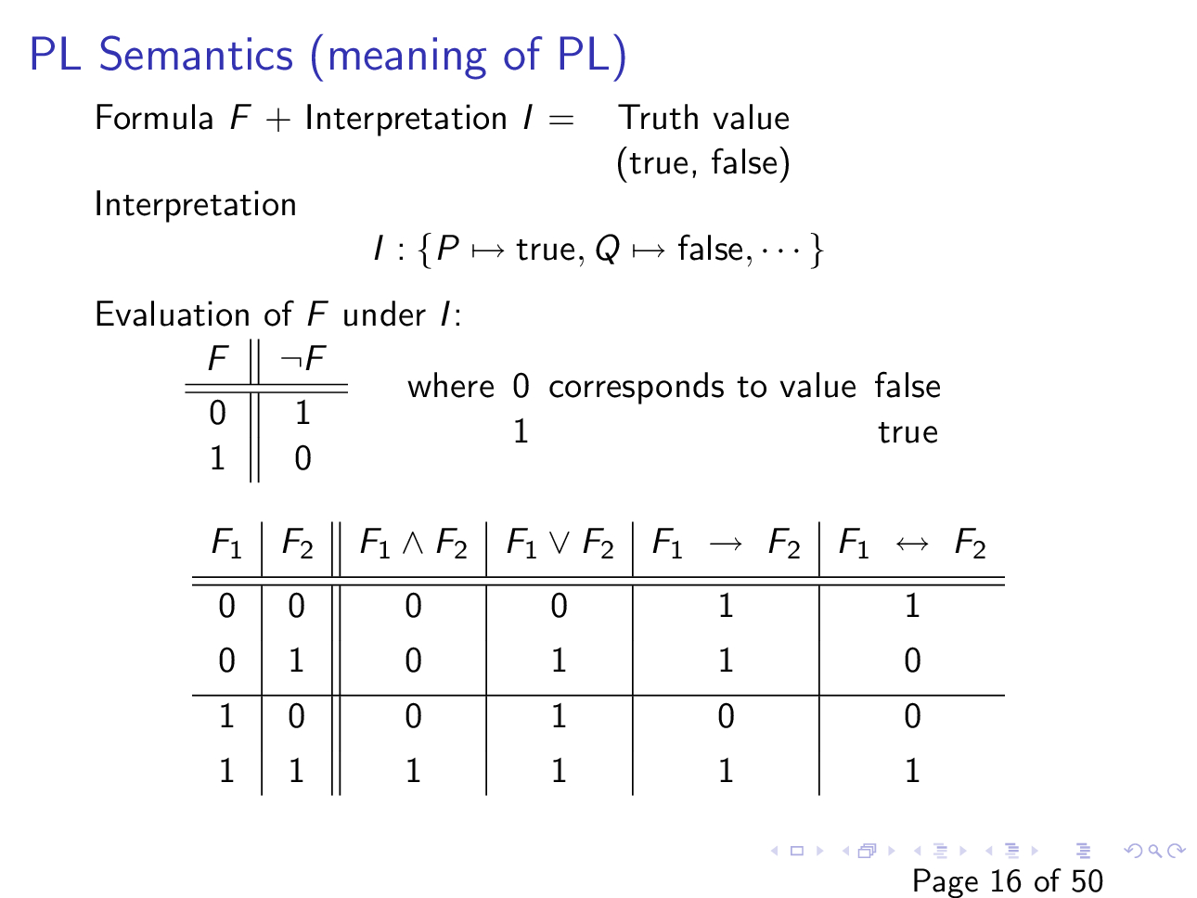
Slide courtesy of https://web.stanford.edu/class/cs156/

Slide 8
Example: placement of wedding guests
Three chairs in a row: 1,2,3
We need to place Aunt, Sister and Father
Constraints:
Aunt doesn’t want to sit near Father
Aunt doesn’t want to sit in the left chair
Sister doesn’t want to sit to the right of Father
Q: Can we satisfy these constraints?
Slide courtesy of https://www.decision-procedures.org/slides/

Slide 9
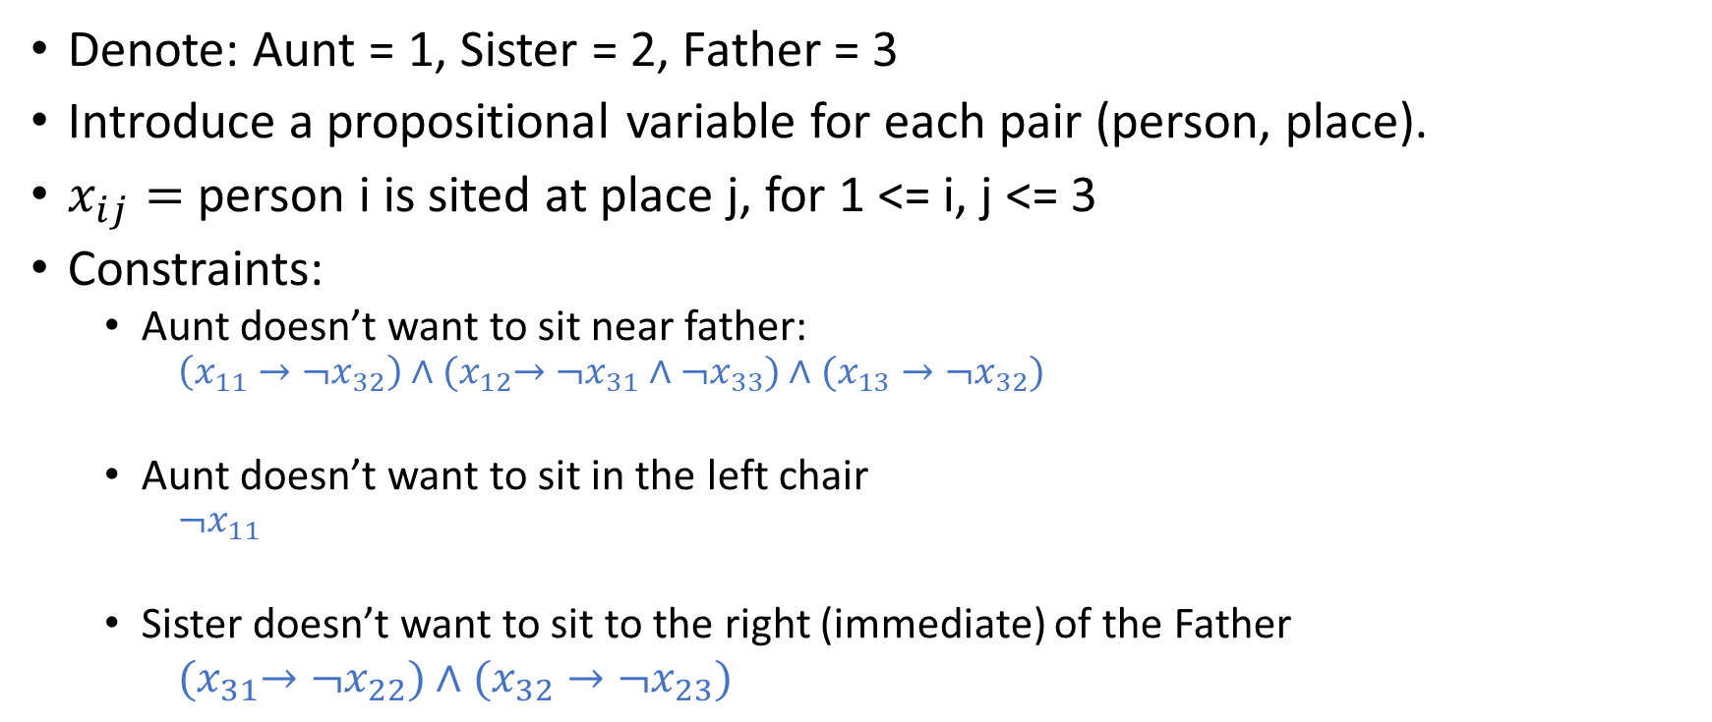
Example
Denote: Aunt = 1, Sister = 2, Father = 3
Introduce a propositional variable for each pair (person, place).
$x_{ij}=$ person i is sited at place j, for 1 <= i, j <= 3
Constraints:
Aunt doesn’t want to sit near father:
$$\left(x_{11}→¬x_{32}\right)∧{(x}_{12}→¬x_{31}∧¬x_{33})∧(x_{13}→¬x_{32})$$
Aunt doesn’t want to sit in the left chair
$$¬x_{11}$$
Sister doesn’t want to sit to the right (immediate) of the Father
${(x}_{31}→{¬x}_{22})∧(x_{32}→¬x_{23})$

Slide 10
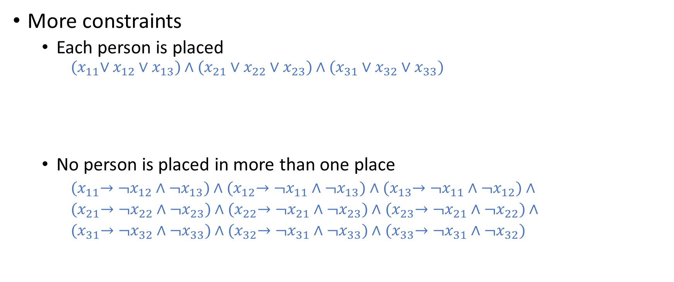
Example
More constraints
Each person is placed
$${(x}_{11}∨x_{12}∨x_{13})∧(x_{21}∨x_{22}∨x_{23})∧(x_{31}∨x_{32}∨x_{33})$$
No person is placed in more than one place
${(x}_{11}→¬x_{12}∧¬x_{13})∧$ ${(x}_{12}→¬x_{11}∧¬x_{13})∧$ ${(x}_{13}→¬x_{11}∧¬x_{12})∧$
${(x}_{21}→¬x_{22}∧¬x_{23})∧$ ${(x}_{22}→¬x_{21}∧¬x_{23})∧$ ${(x}_{23}→¬x_{21}∧¬x_{22})∧$
${(x}_{31}→¬x_{32}∧¬x_{33})∧$ ${(x}_{32}→¬x_{31}∧¬x_{33})∧$ ${(x}_{33}→¬x_{31}∧¬x_{32})$

Slide 11
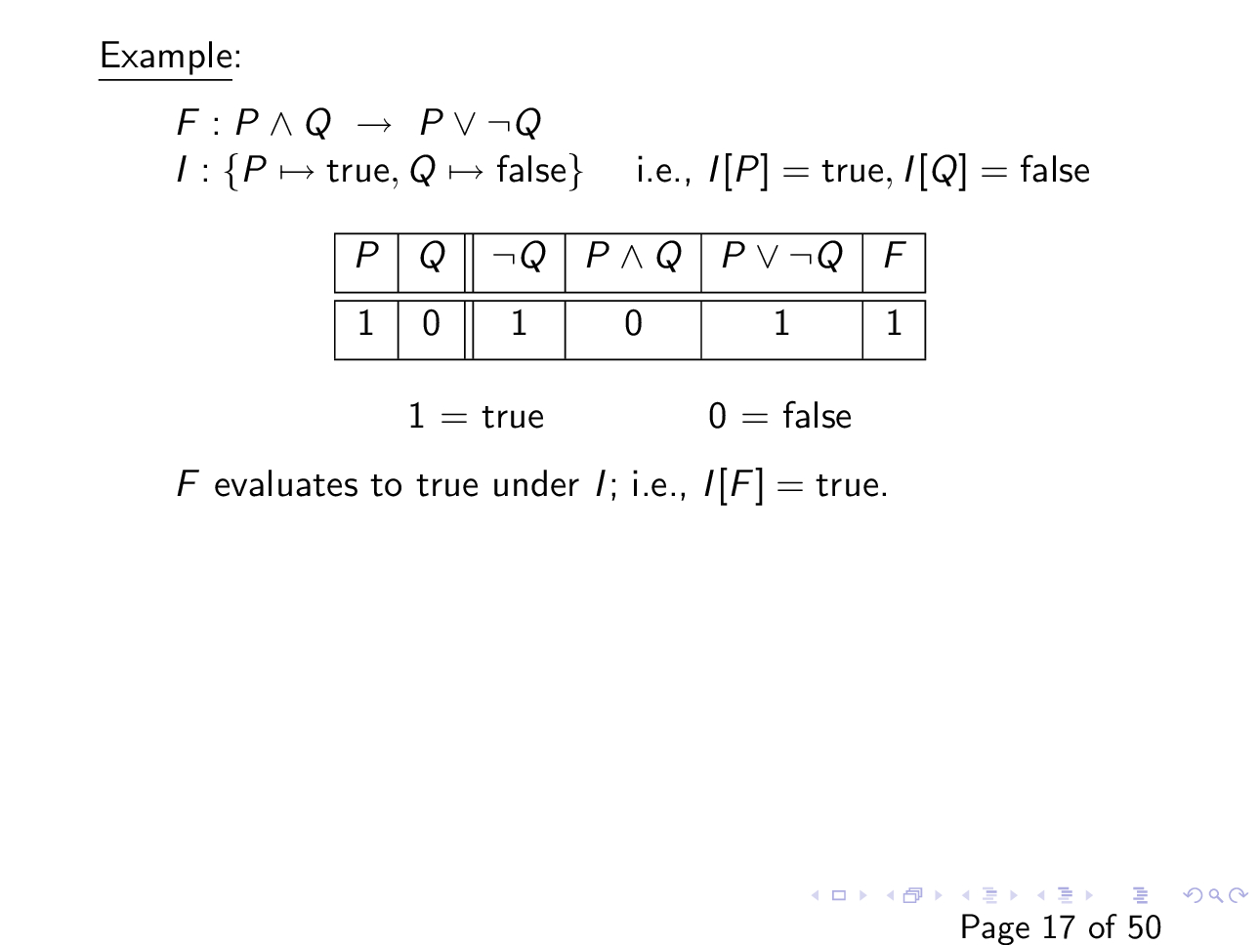
Slide courtesy of https://web.stanford.edu/class/cs156/

Slide 12

Example
$$F :¬\left(P∨Q\right)→(¬P∧¬Q)$$
$$I:\left\{P↦false, Q↦true\right\}$$
$$I\left[F\right]= ?$$

Slide 13

Inductive definition of PL’s semantics
We write, $I⊨F$ if F evaluates to true under I
We write, $I⊭F$ if F evaluates to false under I
Base case:
$I⊨T$
$I$⊭ $⊥$
$I⊨P$ iff I[P] = true

Slide 14

Inductive definition of PL’s semantics
We write, $I⊨F$ if F evaluates to true under I
We write, $I⊭F$ if F evaluates to false under I
Base case:
$I⊨T$
$I$⊭ $⊥$
$I⊨P$ iff I[P] = true
$I$⊭ $P$ iff I[P] = false

Slide 15
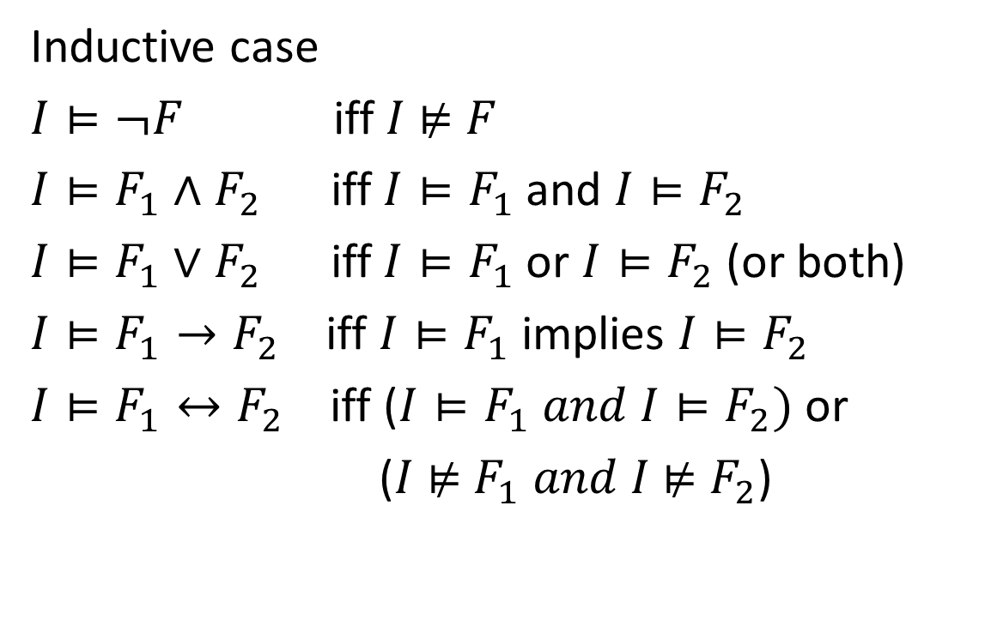

Inductive definition of PL’s semantics
Base case:
$I⊨T$
$I$⊭ $⊥$
$I⊨P$ iff I[P] = true
$I$⊭ $P$ iff I[P] = false
Inductive case
$I⊨¬F$ iff $I$ ⊭ $F$
$I⊨F_{1}∧F_{2}$ iff $I⊨F_{1}$ and $I⊨F_{2}$
$I⊨F_{1}∨F_{2}$ iff $I⊨F_{1}$ or $I⊨F_{2}$ (or both)
$I⊨F_{1}→F_{2}$ iff $I⊨F_{1}$ implies $I⊨F_{2}$
$I⊨F_{1}↔F_{2}$ iff ($I⊨F_{1} and I⊨F_{2})$ or
($I$ ⊭ $F_{1} and I$⊭ $F_{2}$)

Slide 16
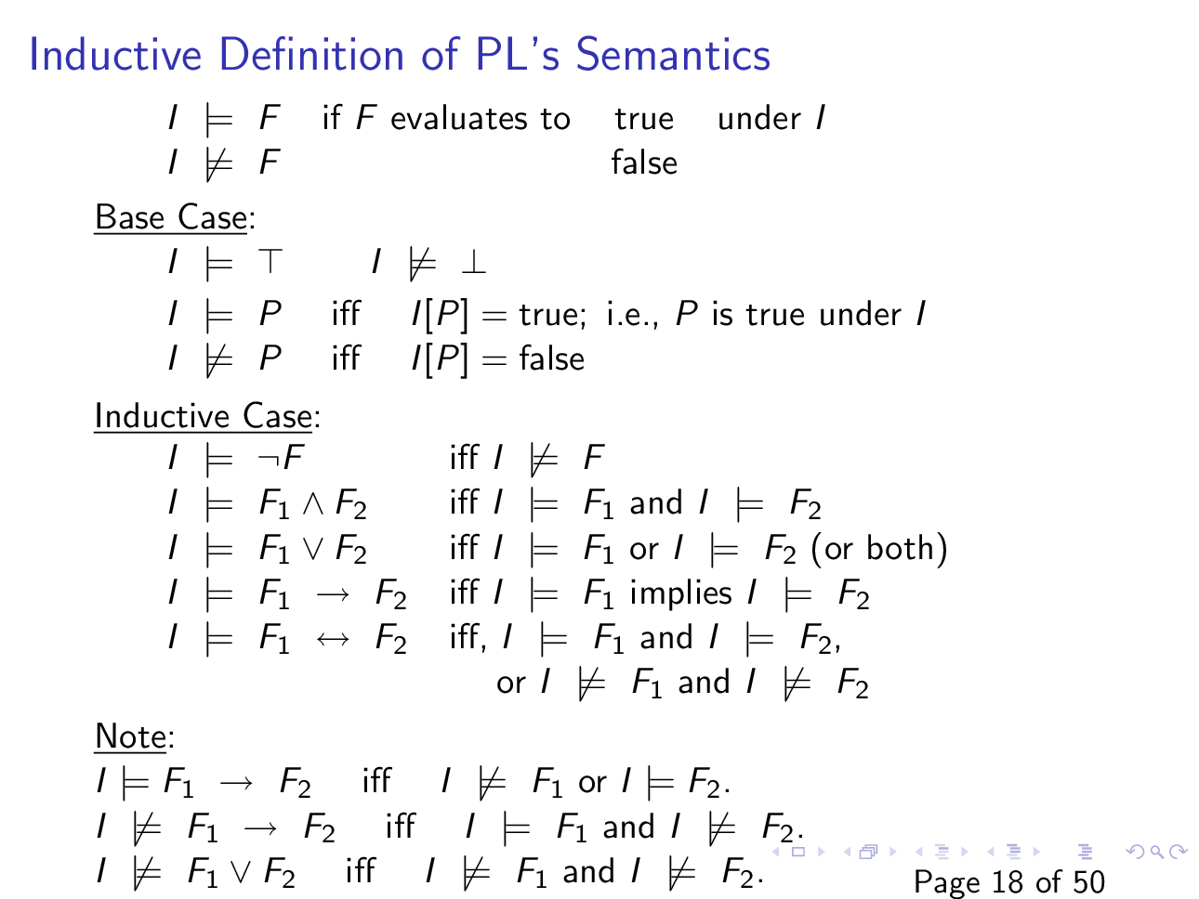
Slide courtesy of
https://web.stanford.edu/class/cs156/

Slide 17

Example of inductive reasoning
$$F :P∨Q →¬P∨Q$$
$$I :\{P↦true, Q↦false\}$$

Slide 18
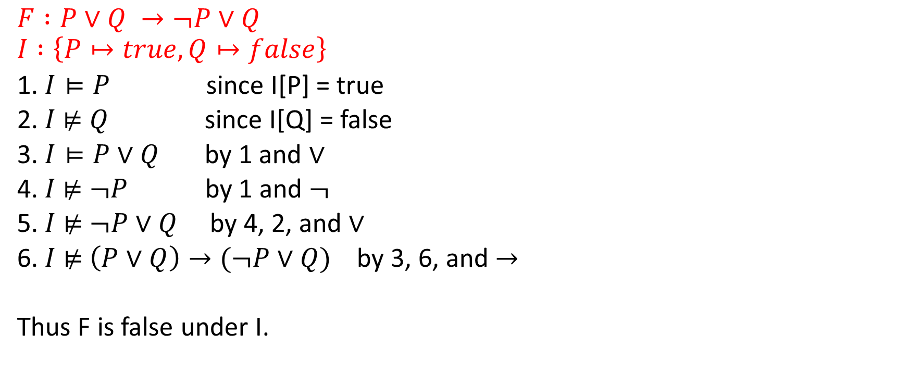
Example of inductive reasoning
$$F :P∨Q →¬P∨Q$$
$$I :\left\{P↦true, Q↦false\right\}$$
1. $I⊨P$ since I[P] = true
2. $I$⊭ $Q$ since I[Q] = false
3. $I⊨P∨Q$ by 1 and $∨$
4. $I$⊭ $¬P$ by 1 and $¬$
5. $I$ ⊭ $¬P∨Q$ by 4, 2, and $∨$
6. $I$ ⊭ $\left(P∨Q\right)→(¬P∨Q)$ by 3, 6, and $→$
Thus F is false under I.

Slide 19
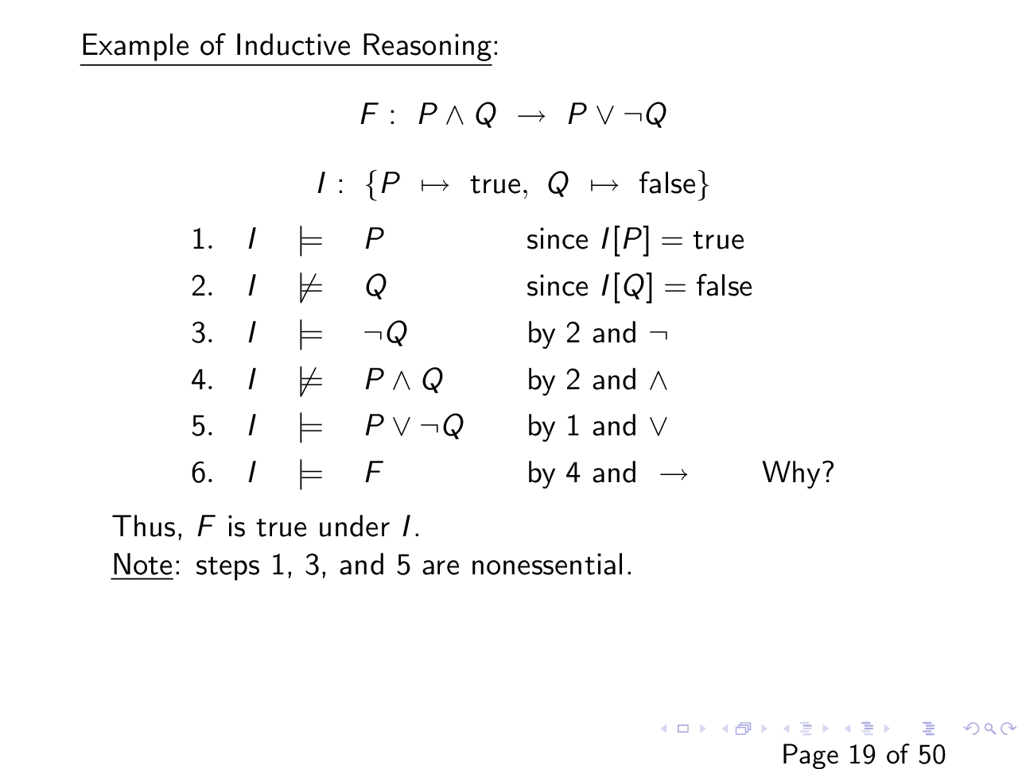
Slide courtesy of https://web.stanford.edu/class/cs156/

Slide 20
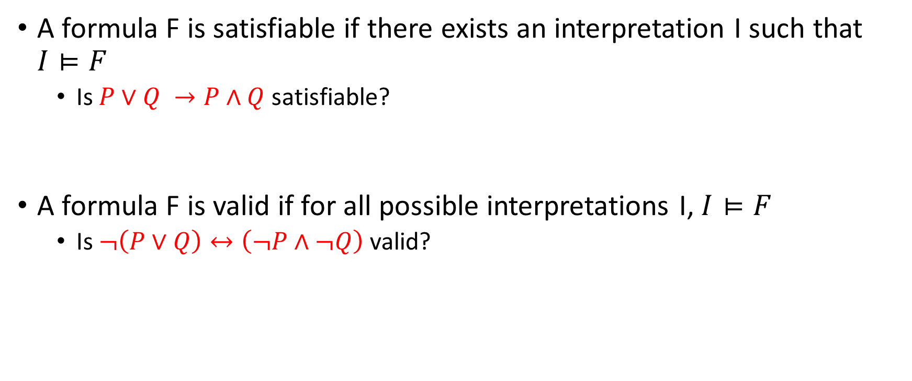
Satisfiability and validity
A formula F is satisfiable if there exists an interpretation I such that $I⊨F$
Is $P∨Q →P∧Q$ satisfiable?
A formula F is valid if for all possible interpretations I, $I⊨F$
Is $¬\left(P∨Q\right)↔\left(¬P∧¬Q\right)$ valid?

Slide 21
Satisfiability and validity
Suppose we have an algorithm A that can check the satisfiability of any formula F -- can we use algorithm A to check the validity of a given formula F?

Slide 22
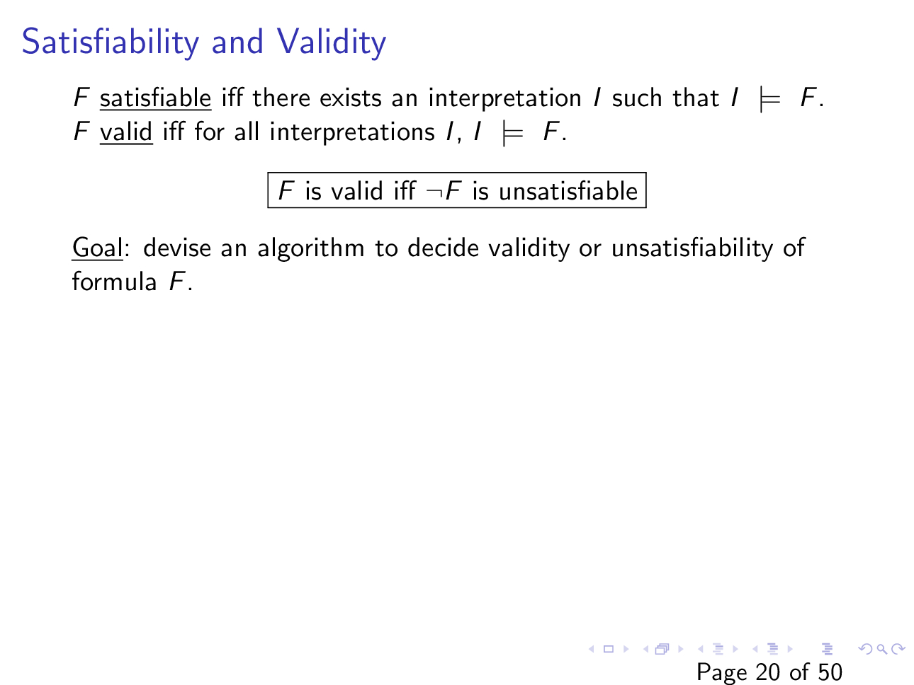
Slide courtesy of https://web.stanford.edu/class/cs156/

Slide 23
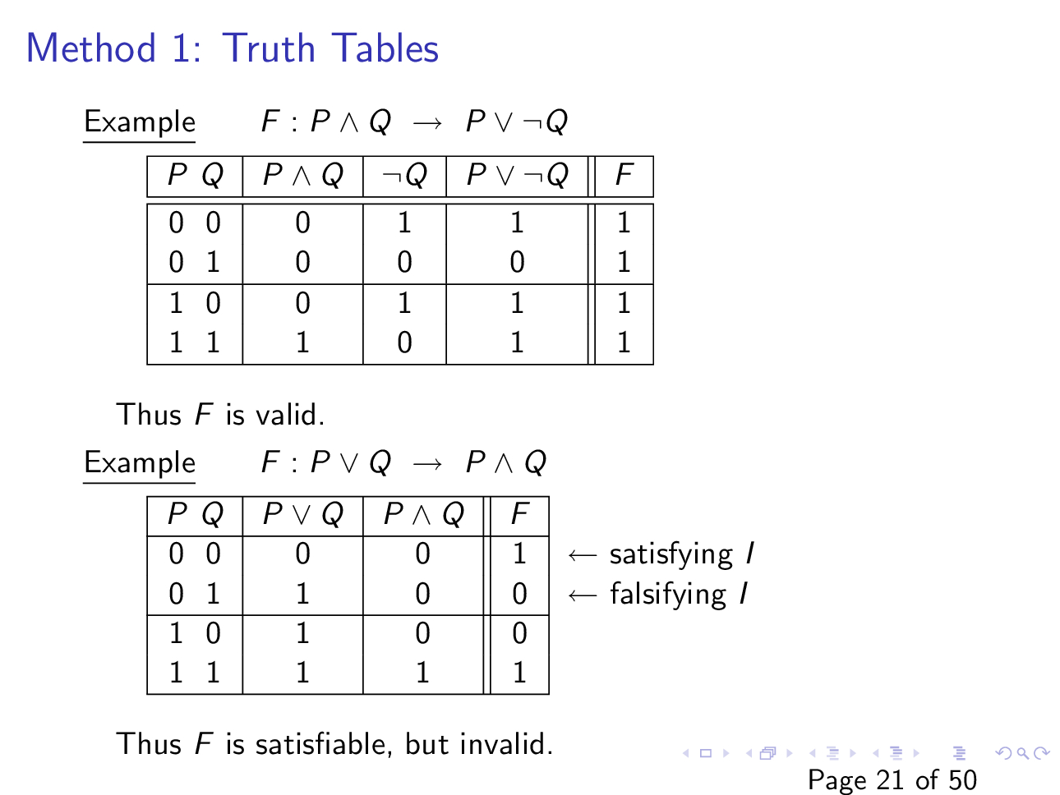
Slide courtesy of
https://web.stanford.edu/class/cs156/

Slide 24
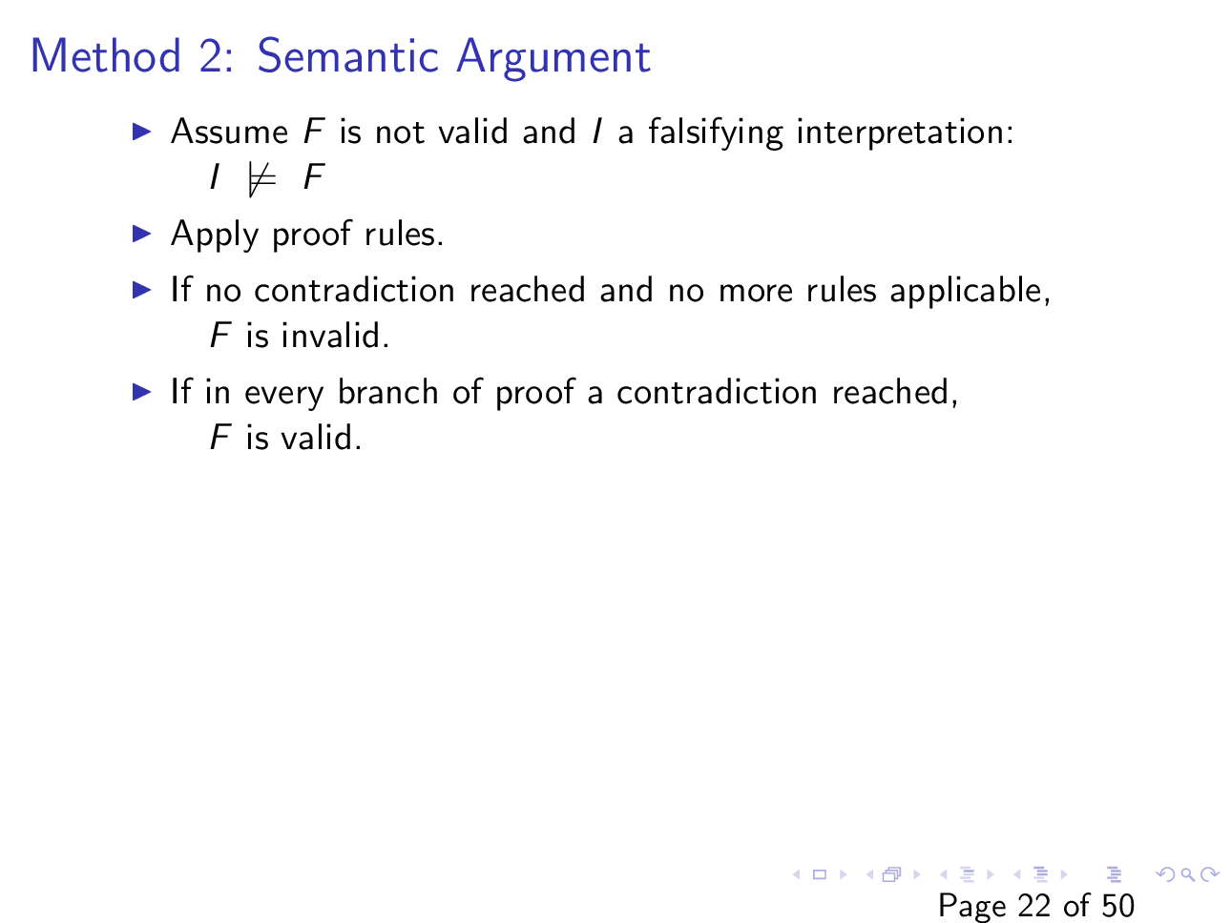
Slide courtesy of https://web.stanford.edu/class/cs156/

Slide 25
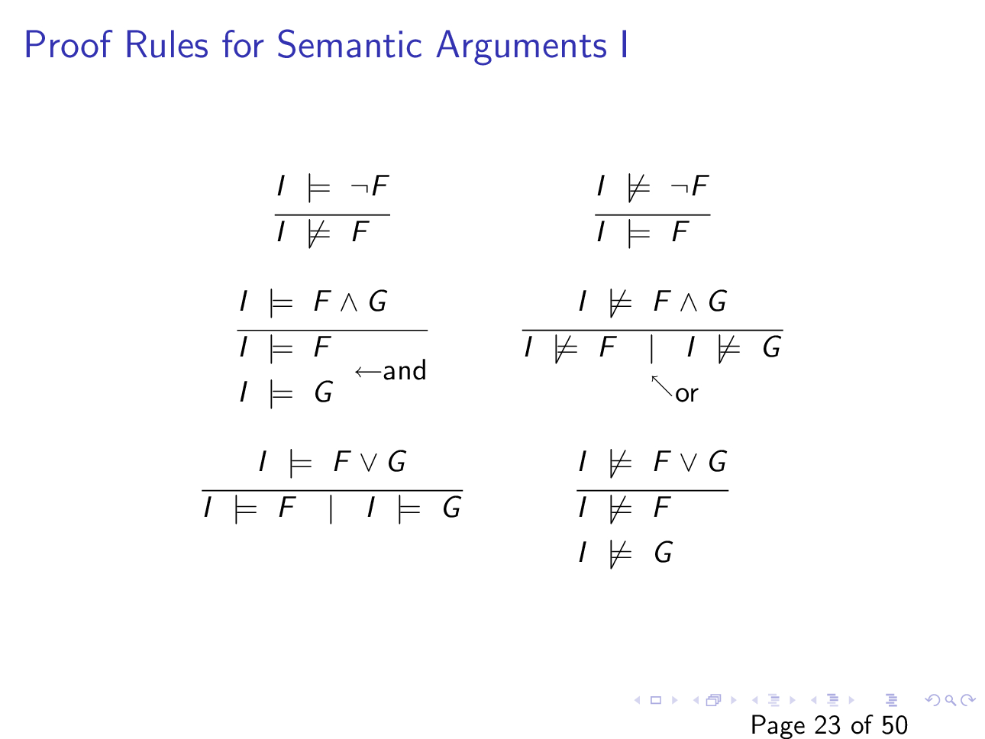
Slide courtesy of https://web.stanford.edu/class/cs156/

Slide 26
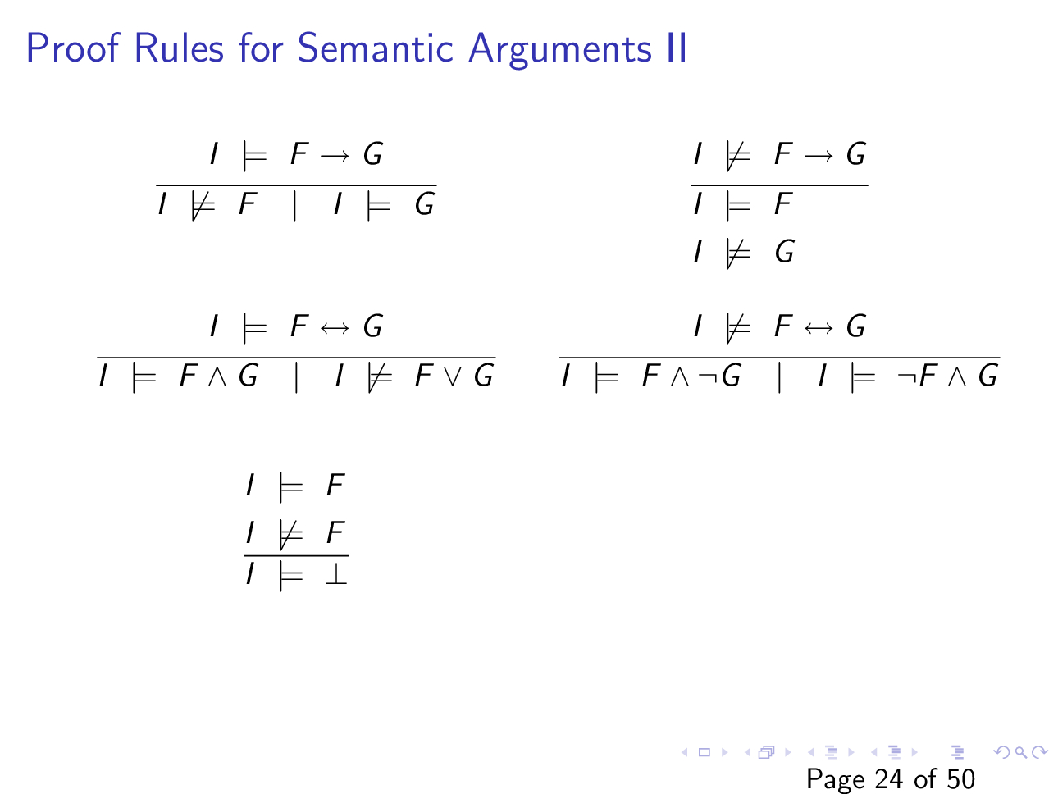
Slide courtesy of https://web.stanford.edu/class/cs156/

Slide 27

Example
Is $F : P∧Q →P∨¬Q$ valid?

Slide 28
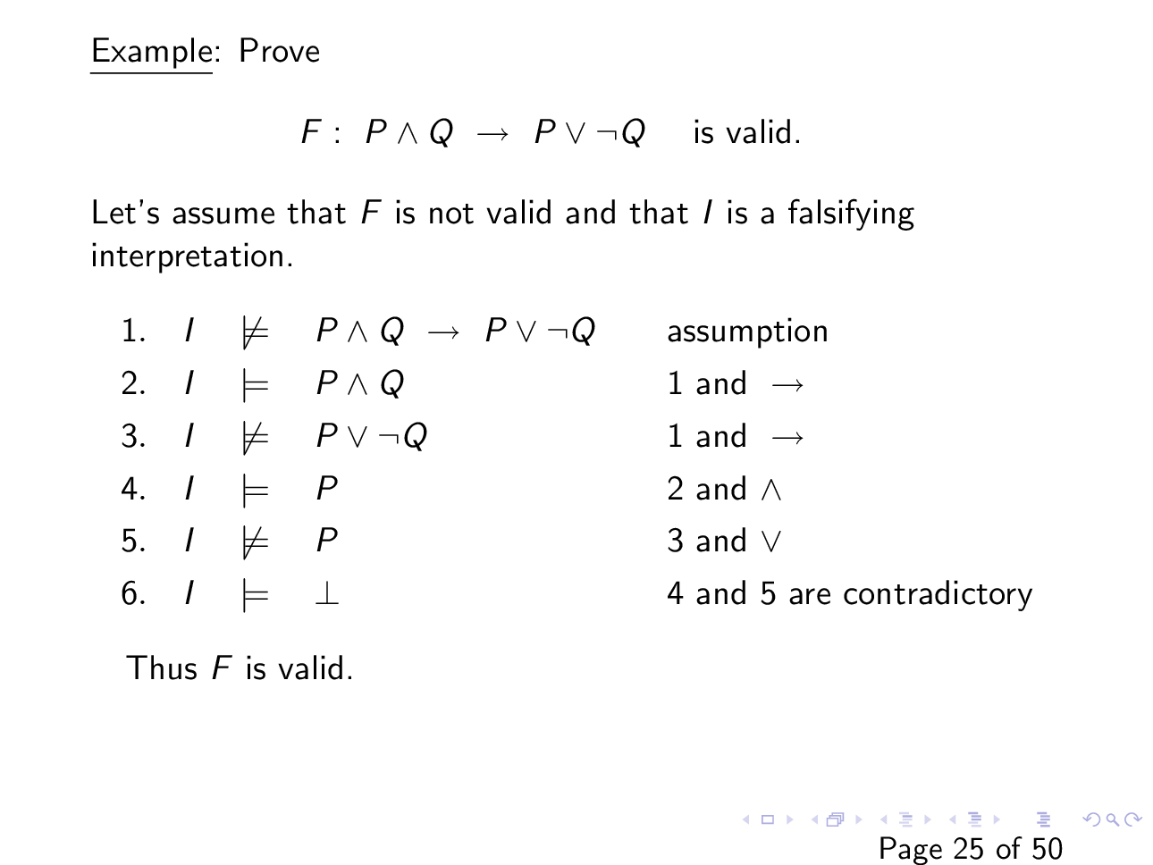
Slide courtesy of https://web.stanford.edu/class/cs156/

Slide 29

Example
Is $F :\left(P→Q\right)∧(Q→R) →(P→R)$ valid?

Slide 30
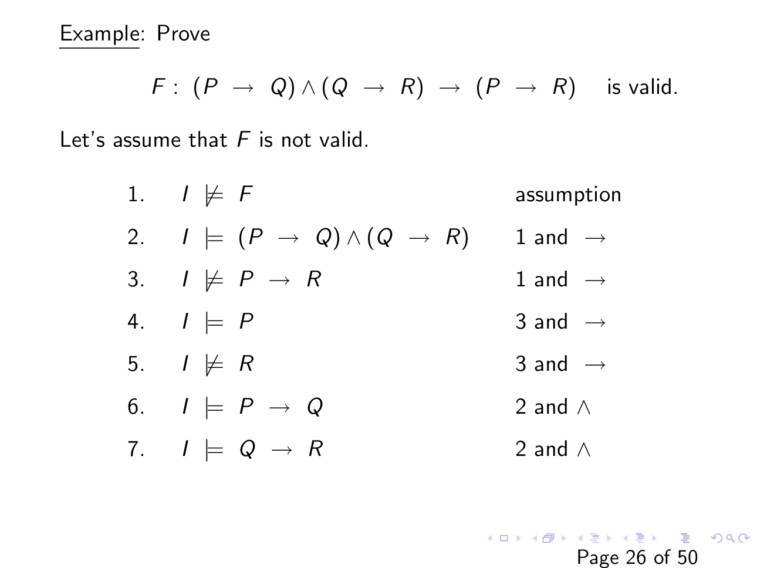
Slide courtesy of https://web.stanford.edu/class/cs156/

Slide 31
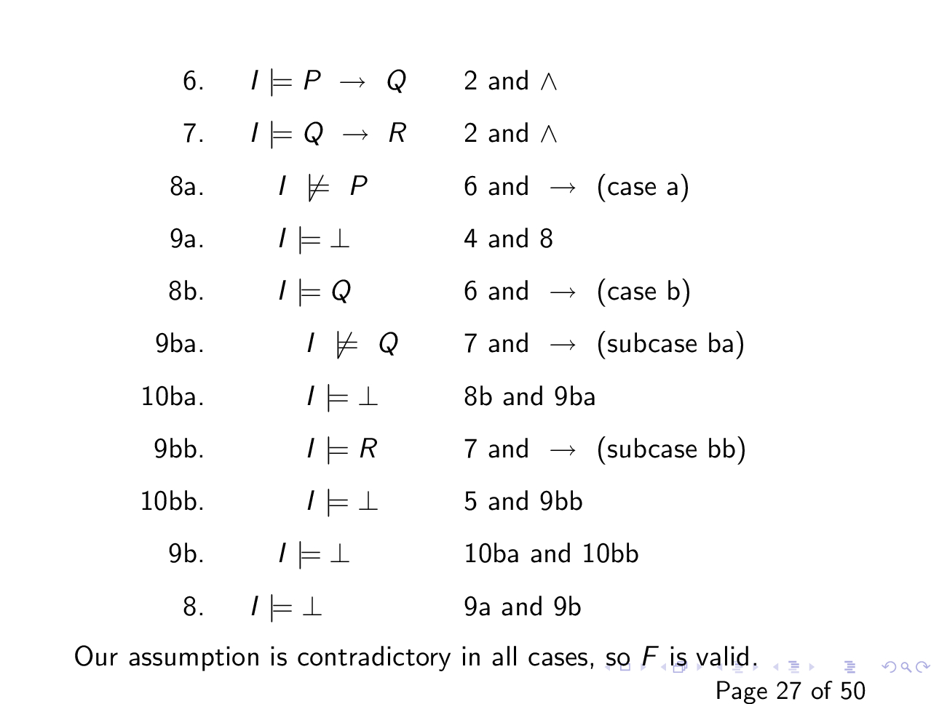

Slide 32

Example
Is $F :\left(P∨Q\right) →(P∧Q)$ is valid?

Slide 33
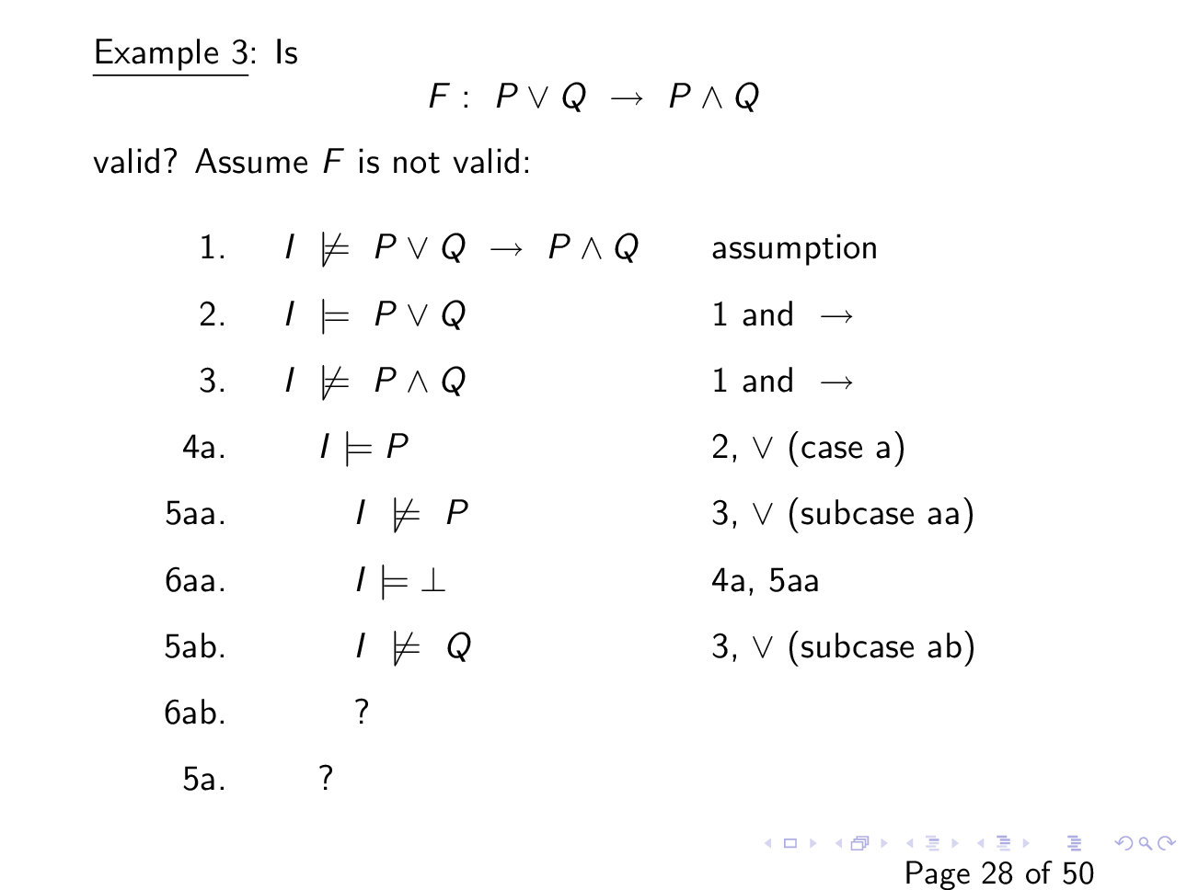
Slide courtesy of https://web.stanford.edu/class/cs156/

Slide 34
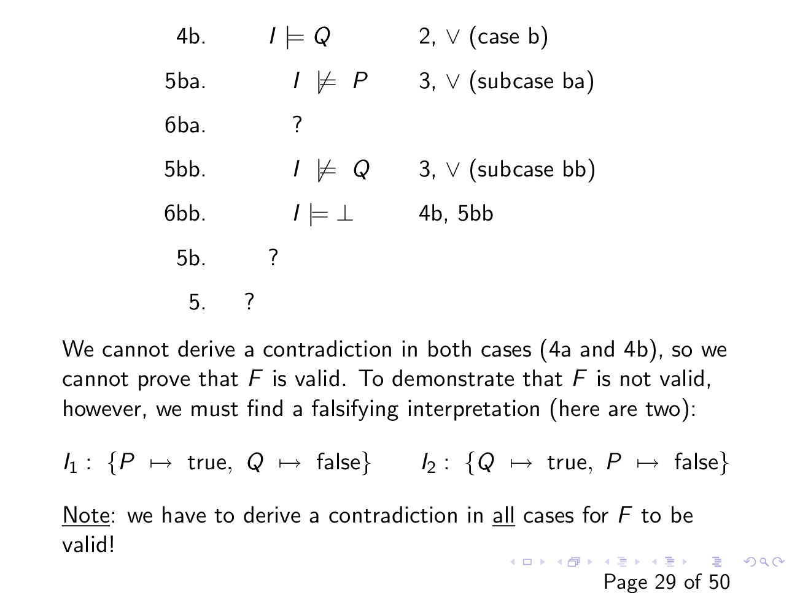

Slide 35
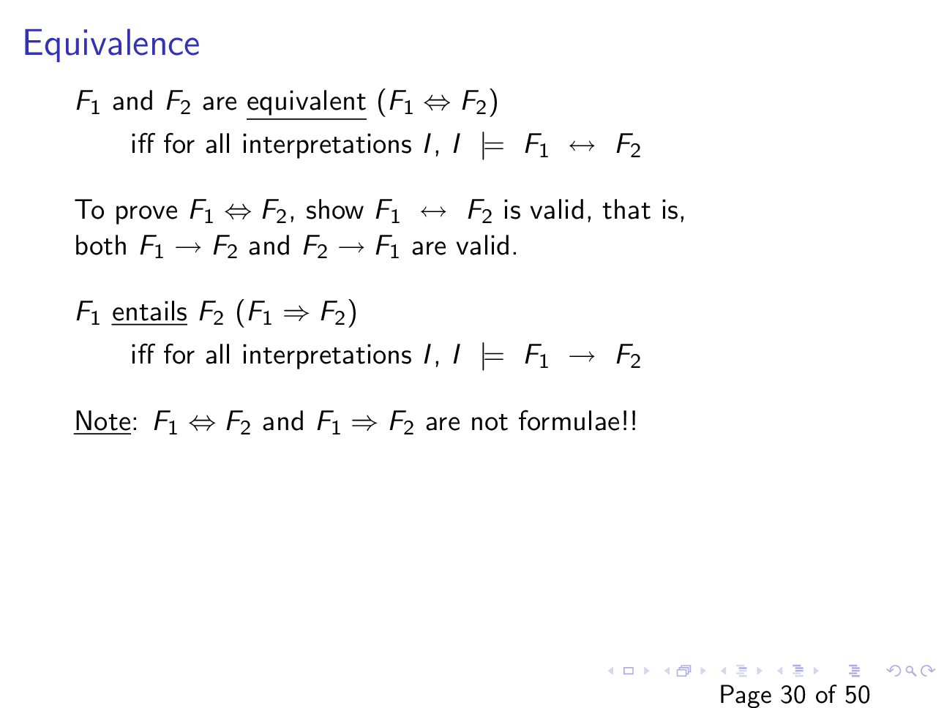
Slide courtesy of https://web.stanford.edu/class/cs156/

Slide 36

Example
Show $¬\left(P∨Q\right) ⟺\left(¬P∧¬Q\right)$
i.e., show $¬\left(P∨Q\right)↔(¬P∧¬Q)$ is valid.

Slide 37
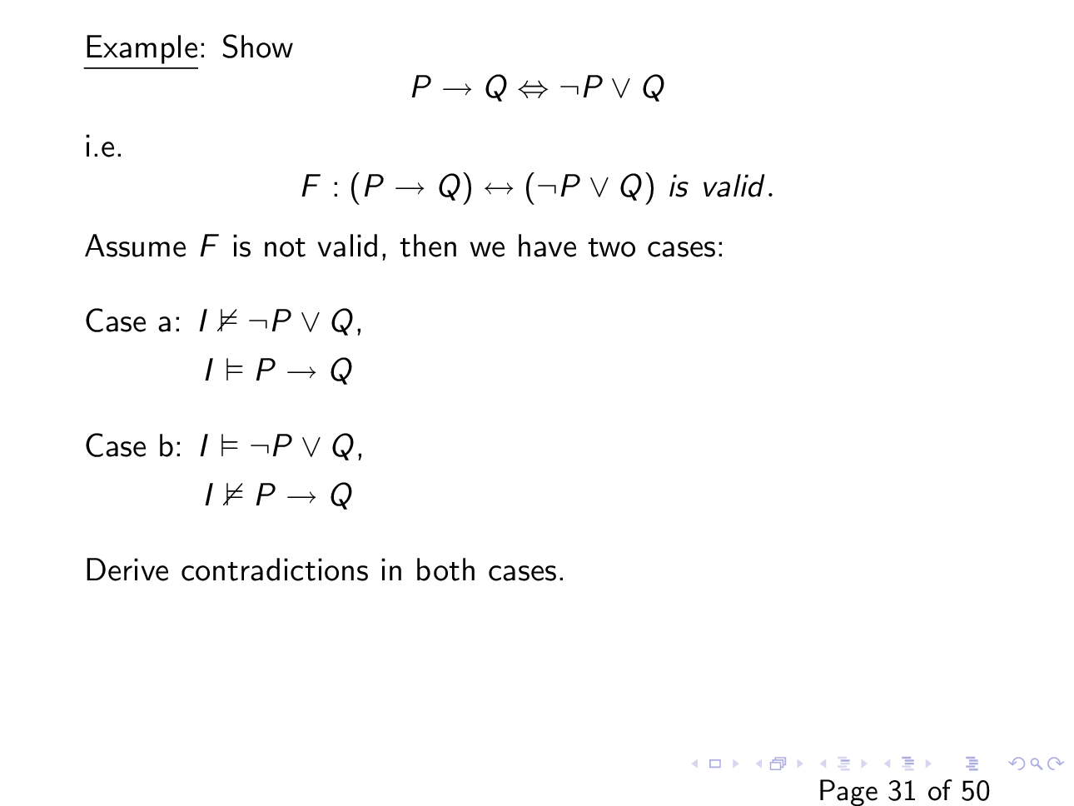
Slide courtesy of https://web.stanford.edu/class/cs156/

Slide 38
Normal forms

Slide 39
Normal forms
A normal form is a syntactic restriction on the formulae
For every formula, there is an equivalent formula in the normal form

Slide 40
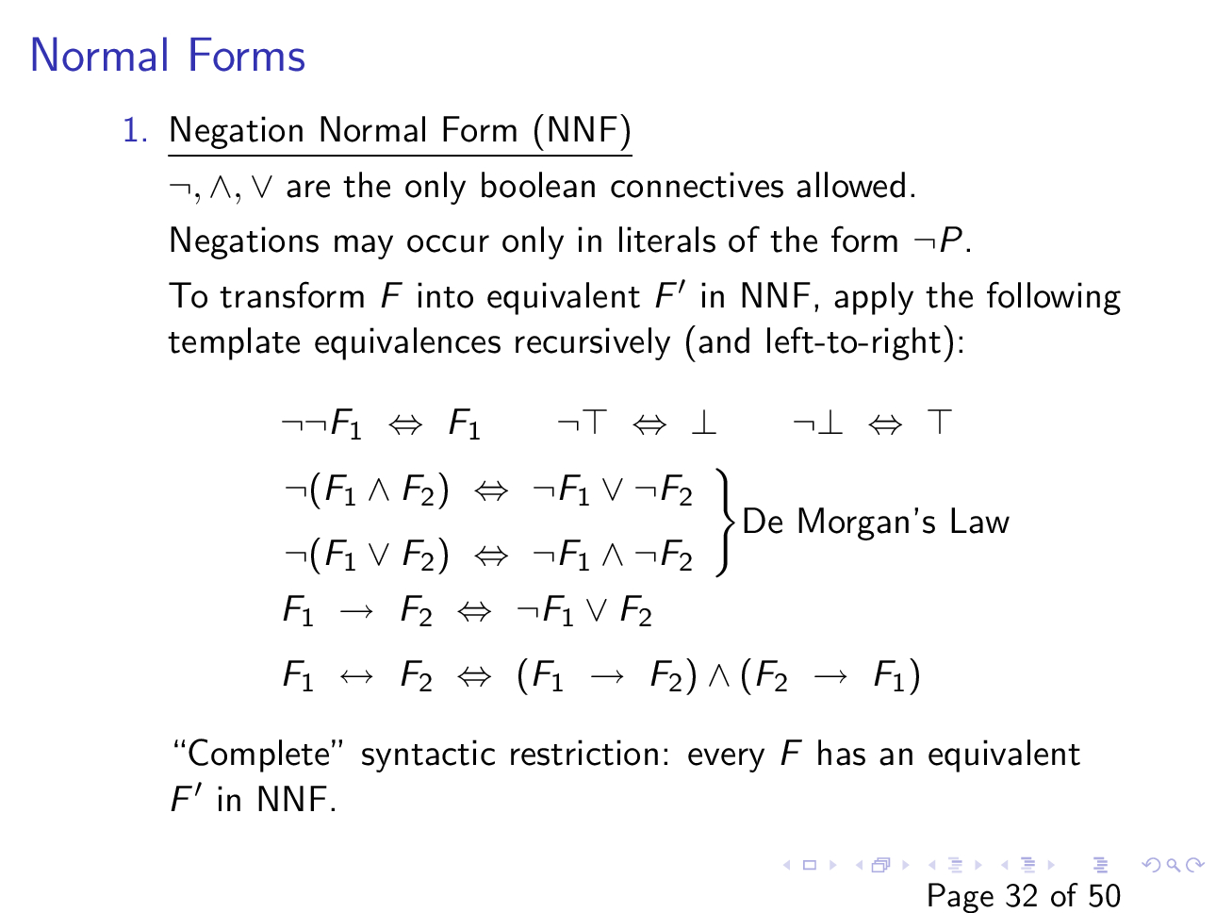
Slide courtesy of https://web.stanford.edu/class/cs156/

Slide 41

Negation normal form (NNF)
Convert $F :¬\left(P →¬\left(P∧Q\right)\right)$ to NNF.

Slide 42
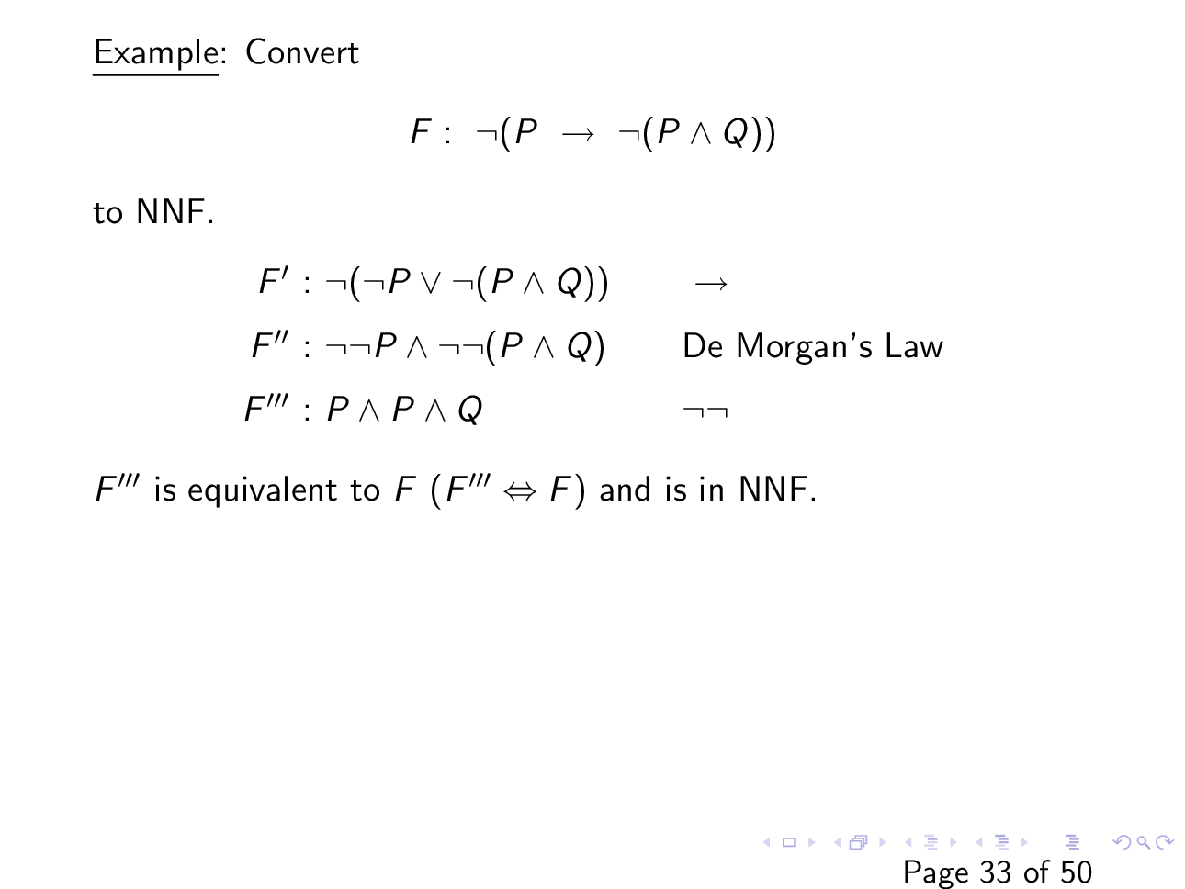
Slide courtesy of https://web.stanford.edu/class/cs156/

Slide 43
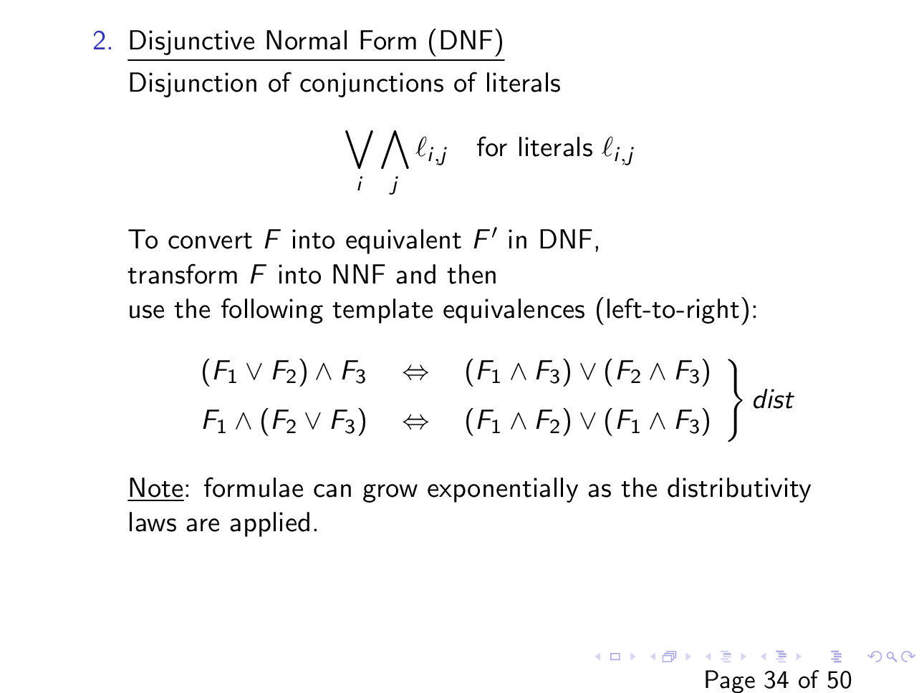
Slide courtesy of https://web.stanford.edu/class/cs156/

Slide 44

Disjunctive normal form (DNF)
Convert $F :¬\left(Q∨¬¬Q_{2}\right)∧(¬R_{1}→R_{2})$ into an equivalent DNF.

Slide 45
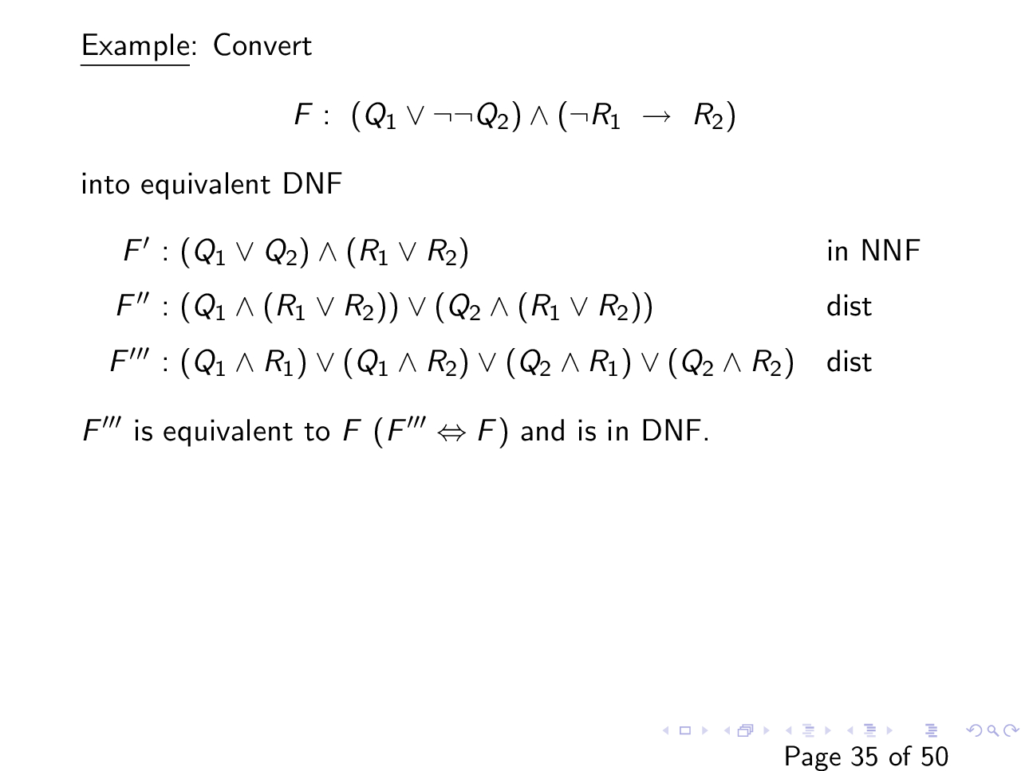
Slide courtesy of https://web.stanford.edu/class/cs156/

Slide 46
DNF using truth table

Slide 47
DNF using truth table
P | Q | R | P <-> (Q <-> R)
0 | 0 | 0 | 0
0 | 0 | 1 | 1
0 | 1 | 0 | 1
0 | 1 | 1 | 0
1 | 0 | 0 | 1
1 | 0 | 1 | 0
1 | 1 | 0 | 0
1 | 1 | 1 | 1

Slide 48
DNF using truth table
P | Q | R | P <-> (Q <-> R)
0 | 0 | 0 | 0
0 | 0 | 1 | 1
0 | 1 | 0 | 1
0 | 1 | 1 | 0
1 | 0 | 0 | 1
1 | 0 | 1 | 0
1 | 1 | 0 | 0
1 | 1 | 1 | 1
One of the red rows must be true.
How can we write a formula that is true if and only if the value of {P, Q, R} is {0, 0, 1}?

Slide 49
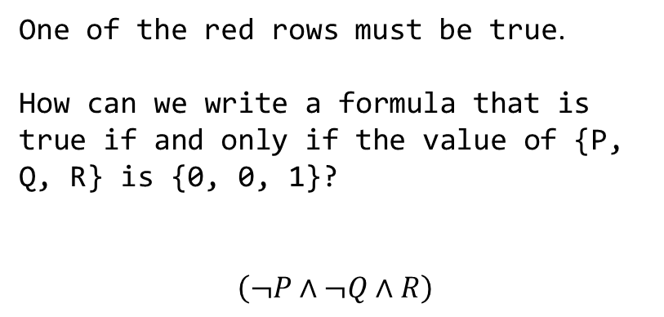
DNF using truth table
P | Q | R | P <-> (Q <-> R)
0 | 0 | 0 | 0
0 | 0 | 1 | 1
0 | 1 | 0 | 1
0 | 1 | 1 | 0
1 | 0 | 0 | 1
1 | 0 | 1 | 0
1 | 1 | 0 | 0
1 | 1 | 1 | 1
One of the red rows must be true.
How can we write a formula that is true if and only if the value of {P, Q, R} is {0, 0, 1}?
$$\left(¬P∧¬Q∧R\right)$$

Slide 50
DNF using truth table
P | Q | R | P <-> (Q <-> R)
0 | 0 | 0 | 0
0 | 0 | 1 | 1
0 | 1 | 0 | 1
0 | 1 | 1 | 0
1 | 0 | 0 | 1
1 | 0 | 1 | 0
1 | 1 | 0 | 0
1 | 1 | 1 | 1
One of the red rows must be true.
How can we write a formula that is true if and only if the value of {P, Q, R} is {0, 1, 0}?

Slide 51
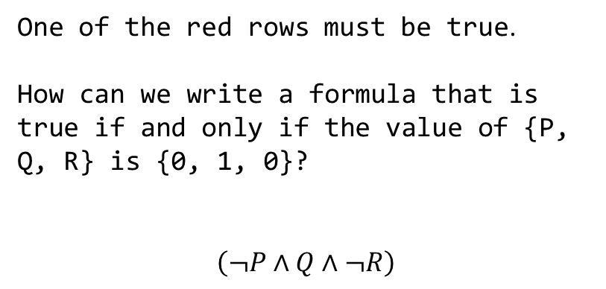
DNF using truth table
P | Q | R | P <-> (Q <-> R)
0 | 0 | 0 | 0
0 | 0 | 1 | 1
0 | 1 | 0 | 1
0 | 1 | 1 | 0
1 | 0 | 0 | 1
1 | 0 | 1 | 0
1 | 1 | 0 | 0
1 | 1 | 1 | 1
One of the red rows must be true.
How can we write a formula that is true if and only if the value of {P, Q, R} is {0, 1, 0}?
$$\left(¬P∧Q∧¬R\right)$$

Slide 52
DNF using truth table
P | Q | R | P <-> (Q <-> R)
0 | 0 | 0 | 0
0 | 0 | 1 | 1
0 | 1 | 0 | 1
0 | 1 | 1 | 0
1 | 0 | 0 | 1
1 | 0 | 1 | 0
1 | 1 | 0 | 0
1 | 1 | 1 | 1
One of the red rows must be true.
How can we write a formula that is true if and only if the value of {P, Q, R} is either {0, 0, 1} or {0, 1, 0}?

Slide 53
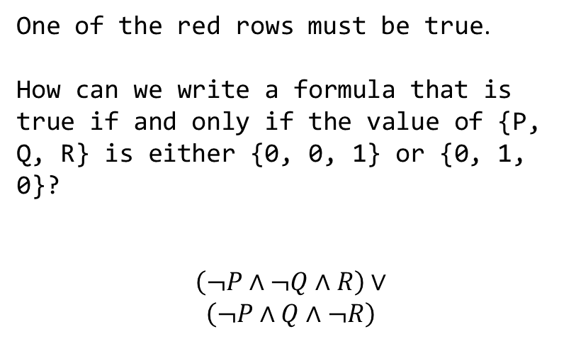
DNF using truth table
P | Q | R | P <-> (Q <-> R)
0 | 0 | 0 | 0
0 | 0 | 1 | 1
0 | 1 | 0 | 1
0 | 1 | 1 | 0
1 | 0 | 0 | 1
1 | 0 | 1 | 0
1 | 1 | 0 | 0
1 | 1 | 1 | 1
One of the red rows must be true.
How can we write a formula that is true if and only if the value of {P, Q, R} is either {0, 0, 1} or {0, 1, 0}?
$$\left(¬P∧¬Q∧R\right)∨$$
$$\left(¬P∧Q∧¬R\right)$$

Slide 54
DNF using truth table
P | Q | R | P <-> (Q <-> R)
0 | 0 | 0 | 0
0 | 0 | 1 | 1
0 | 1 | 0 | 1
0 | 1 | 1 | 0
1 | 0 | 0 | 1
1 | 0 | 1 | 0
1 | 1 | 0 | 0
1 | 1 | 1 | 1
DNF form:

Slide 55
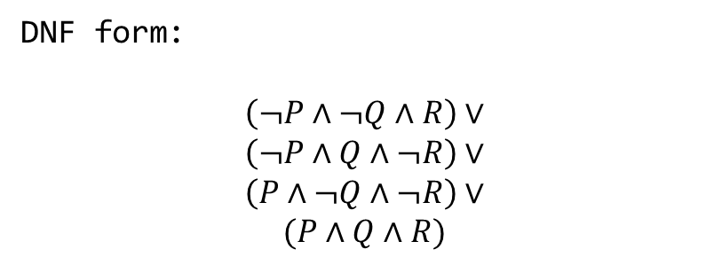
DNF using truth table
P | Q | R | P <-> (Q <-> R)
0 | 0 | 0 | 0
0 | 0 | 1 | 1
0 | 1 | 0 | 1
0 | 1 | 1 | 0
1 | 0 | 0 | 1
1 | 0 | 1 | 0
1 | 1 | 0 | 0
1 | 1 | 1 | 1
DNF form:
$$\left(¬P∧¬Q∧R\right)∨$$
$$\left(¬P∧Q∧¬R\right)∨$$
$$\left(P∧¬Q∧¬R\right)∨$$
$$(P∧Q∧R)$$

Slide 56

DNF complexity
Conversion to DNF using truth table takes exponential time
Even with the distributive law, a formula can grow exponentially
e.g., $\left(P_{1}∨P_{2}\right)∧\left(P_{3}∨P_{4}\right)∧\left(P_{5}∨P_{6}\right)…$

