Slide 2
Normal forms

Slide 3
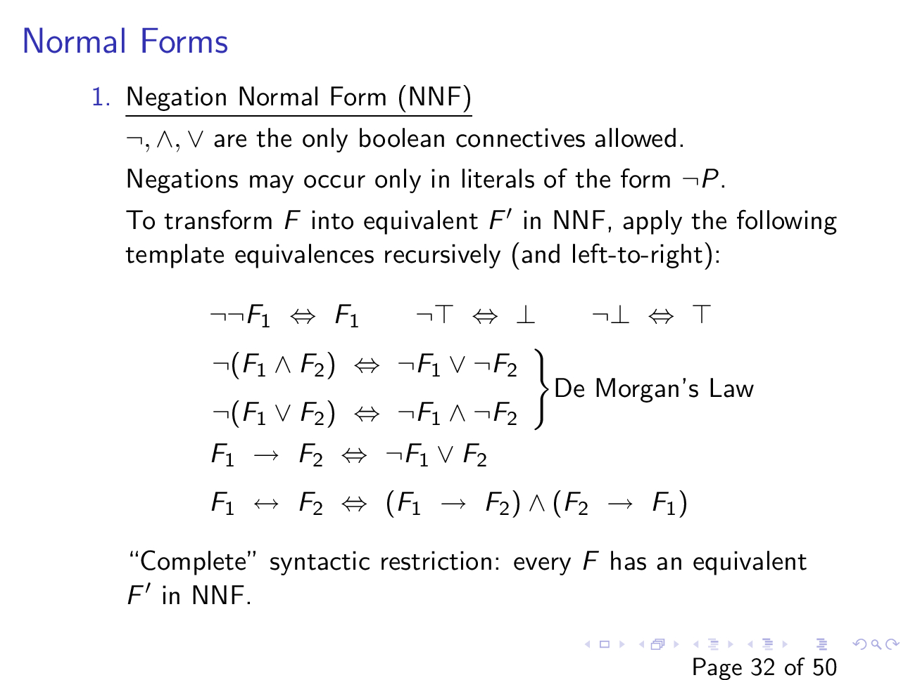
Slide courtesy of https://web.stanford.edu/class/cs156/

Slide 4
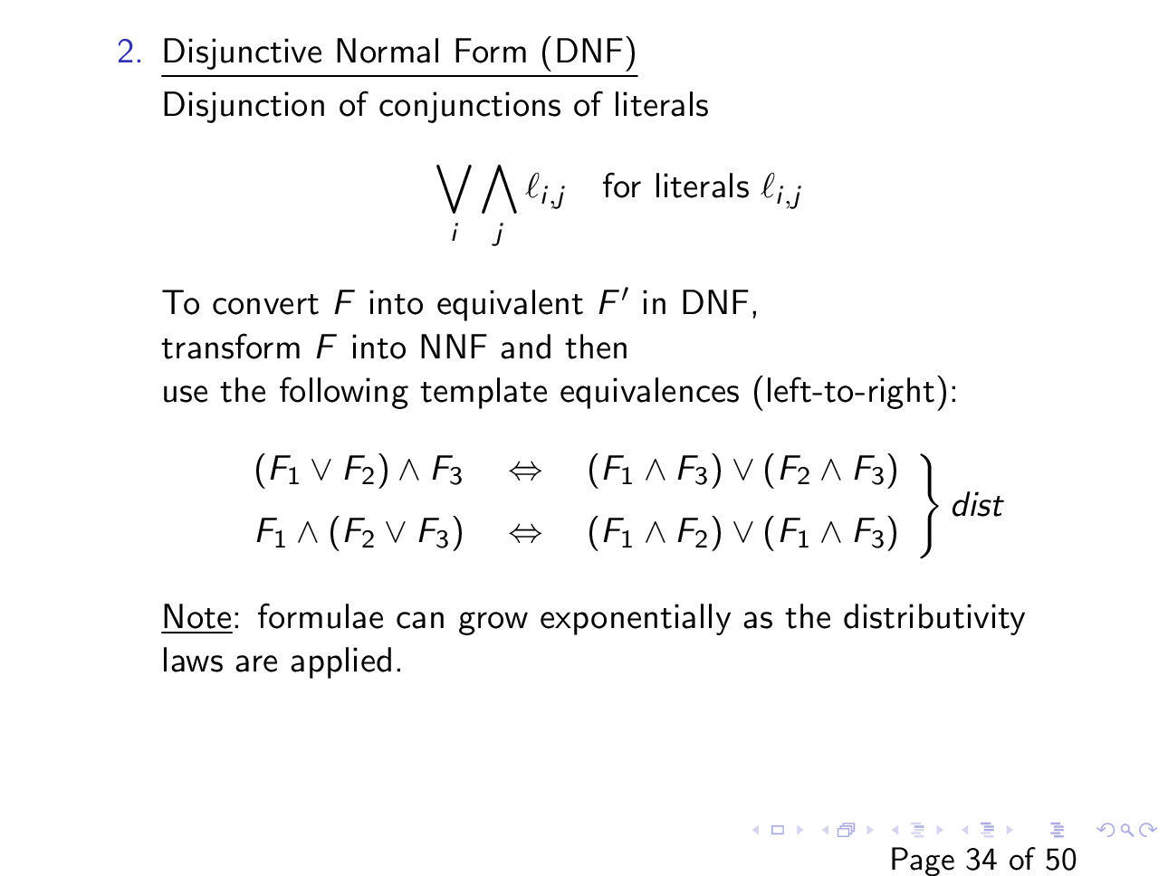
Slide courtesy of https://web.stanford.edu/class/cs156/

Slide 5
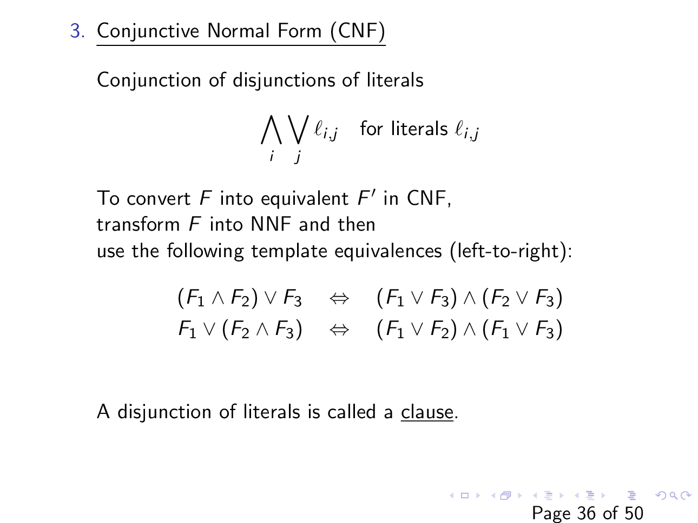
Slide courtesy of https://web.stanford.edu/class/cs156/

Slide 6

Conjunctive normal form (CNF)
Convert $F :P↔(Q→R)$ into an equivalent CNF.

Slide 7
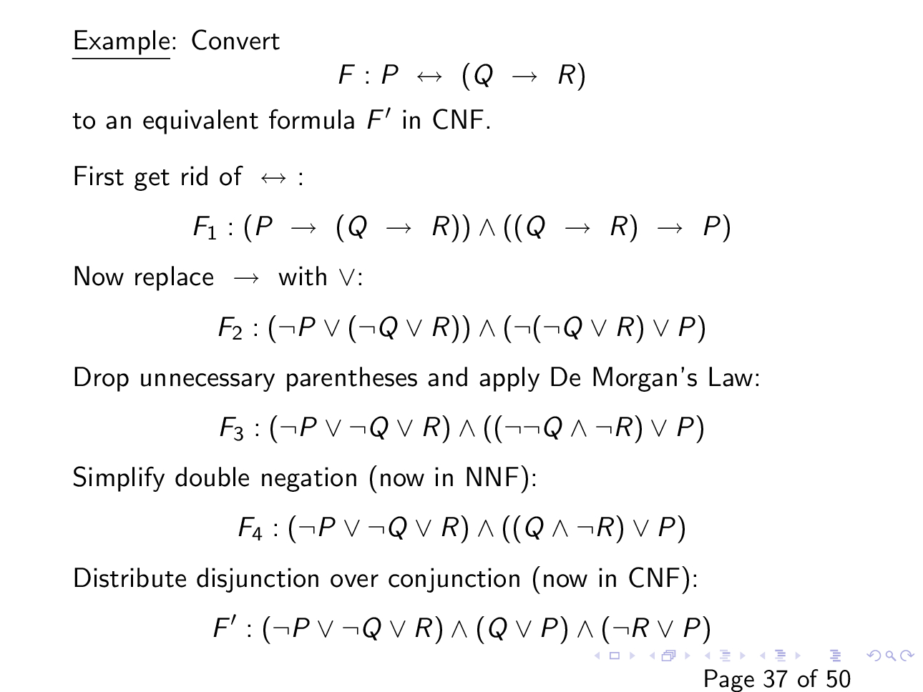

Slide 8
CNF using truth table

Slide 9
CNF using truth table
P | Q | R | P <-> (Q <-> R)
0 | 0 | 0 | 0
0 | 0 | 1 | 1
0 | 1 | 0 | 1
0 | 1 | 1 | 0
1 | 0 | 0 | 1
1 | 0 | 1 | 0
1 | 1 | 0 | 0
1 | 1 | 1 | 1
All red rows must be false.
How can we write a formula that is false if and only if the value of {P, Q, R} is {0, 0, 0}?

Slide 10
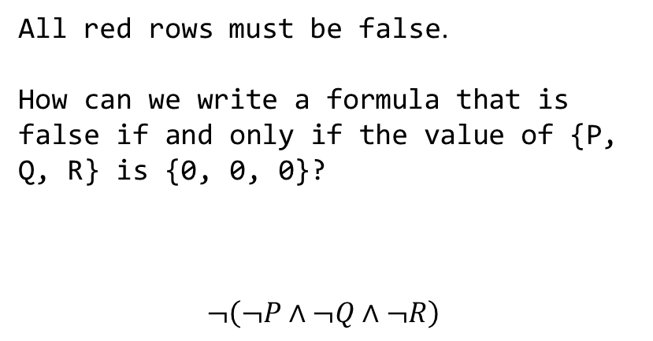
CNF using truth table
P | Q | R | P <-> (Q <-> R)
0 | 0 | 0 | 0
0 | 0 | 1 | 1
0 | 1 | 0 | 1
0 | 1 | 1 | 0
1 | 0 | 0 | 1
1 | 0 | 1 | 0
1 | 1 | 0 | 0
1 | 1 | 1 | 1
All red rows must be false.
How can we write a formula that is false if and only if the value of {P, Q, R} is {0, 0, 0}?
$$¬\left(¬P∧¬Q∧¬R\right)$$

Slide 11
CNF using truth table
P | Q | R | P <-> (Q <-> R)
0 | 0 | 0 | 0
0 | 0 | 1 | 1
0 | 1 | 0 | 1
0 | 1 | 1 | 0
1 | 0 | 0 | 1
1 | 0 | 1 | 0
1 | 1 | 0 | 0
1 | 1 | 1 | 1
All red rows must be false.
How can we write a formula that is false if and only if the value of {P, Q, R} is {0, 1, 1}?

Slide 12
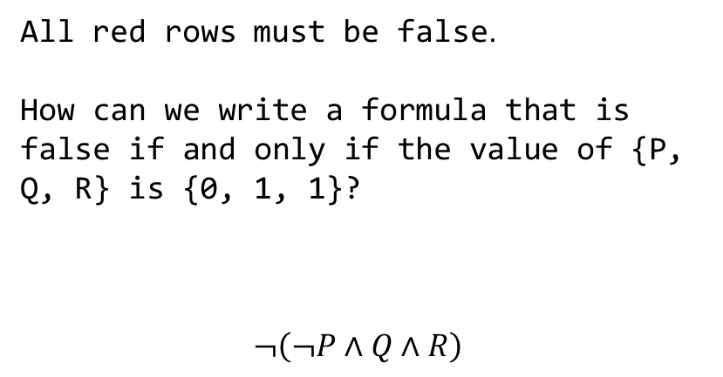
CNF using truth table
P | Q | R | P <-> (Q <-> R)
0 | 0 | 0 | 0
0 | 0 | 1 | 1
0 | 1 | 0 | 1
0 | 1 | 1 | 0
1 | 0 | 0 | 1
1 | 0 | 1 | 0
1 | 1 | 0 | 0
1 | 1 | 1 | 1
All red rows must be false.
How can we write a formula that is false if and only if the value of {P, Q, R} is {0, 1, 1}?
$$¬\left(¬P∧Q∧R\right)$$

Slide 13
CNF using truth table
P | Q | R | P <-> (Q <-> R)
0 | 0 | 0 | 0
0 | 0 | 1 | 1
0 | 1 | 0 | 1
0 | 1 | 1 | 0
1 | 0 | 0 | 1
1 | 0 | 1 | 0
1 | 1 | 0 | 0
1 | 1 | 1 | 1
CNF form

Slide 14

CNF using truth table
P | Q | R | P <-> (Q <-> R)
0 | 0 | 0 | 0
0 | 0 | 1 | 1
0 | 1 | 0 | 1
0 | 1 | 1 | 0
1 | 0 | 0 | 1
1 | 0 | 1 | 0
1 | 1 | 0 | 0
1 | 1 | 1 | 1
CNF form
$$¬\left(¬P∧¬Q∧¬R\right)∧$$
$$¬\left(¬P∧Q∧R\right)∧$$
$$¬\left(P∧¬Q∧R\right)∧$$
$¬(P∧Q∧¬R)$)

Slide 15

CNF using truth table
P | Q | R | P <-> (Q <-> R)
0 | 0 | 0 | 0
0 | 0 | 1 | 1
0 | 1 | 0 | 1
0 | 1 | 1 | 0
1 | 0 | 0 | 1
1 | 0 | 1 | 0
1 | 1 | 0 | 0
1 | 1 | 1 | 1
CNF form
$$\left(P∨Q∨R\right)∧$$
$$\left(P∨¬Q∨¬R\right)∧$$
$$\left(¬P∨Q∨¬R\right)∧$$
$$(¬P∨¬Q∨R)$$

Slide 16

CNF complexity
The truth table method takes exponential time
The distributive law may result in an exponential growth
e.g., $\left(P_{1}∧P_{2}\right)∨\left(P_{3}∧P_{4}\right)∨\left(P_{5}∧P_{6}\right)…$

Slide 17

Satisfiability
How to check if the following formula is satisfiable?
F: $\left(P→Q\right)∧P∧¬Q$

Slide 18

Satisfiability
How to check if the following formula is satisfiable?
F: $\left(P→Q\right)∧P∧¬Q$
$$F_{1}= F\left[P↦T\right]=\left(T →Q\right)∧T∧¬Q$$
$$F_{1}=Q∧¬Q$$
$$F_{2}=F_{1}\left[Q↦T\right]=T∧ ⊥$$
$$F_{2}= ⊥$$
$$F_{3}=F\left[P↦⊥\right]=\left(⊥→Q\right)∧ ⊥ ∧¬Q$$
$$F_{3}= ⊥$$
The formula is unsatisfiable.

Slide 19

Satisfiability
SAT(F):
if $F=T$ return true;
else if $F= ⊥$ return false;
else {
P = pick_a_variable(F);
return SAT($F\left\{P↦T\right\}$) || SAT($F\{P↦⊥\}$);
}

Slide 20

Satisfiability
Check if the following formula is satisfiable?
$$F:\left(¬P∨Q∨R\right)∧\left(¬Q∨R\right)∧\left(¬Q∨¬R\right)∧(P∨¬Q∨¬R)$$

Slide 21
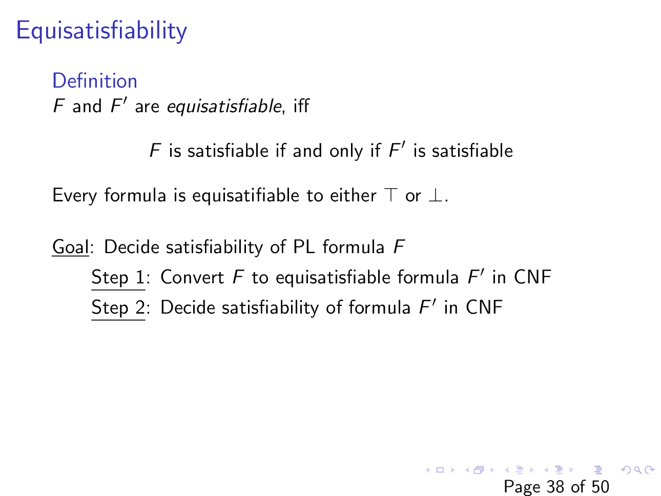
Slide courtesy of https://web.stanford.edu/class/cs156/

Slide 22
Tseitin’s encoding

Slide 23
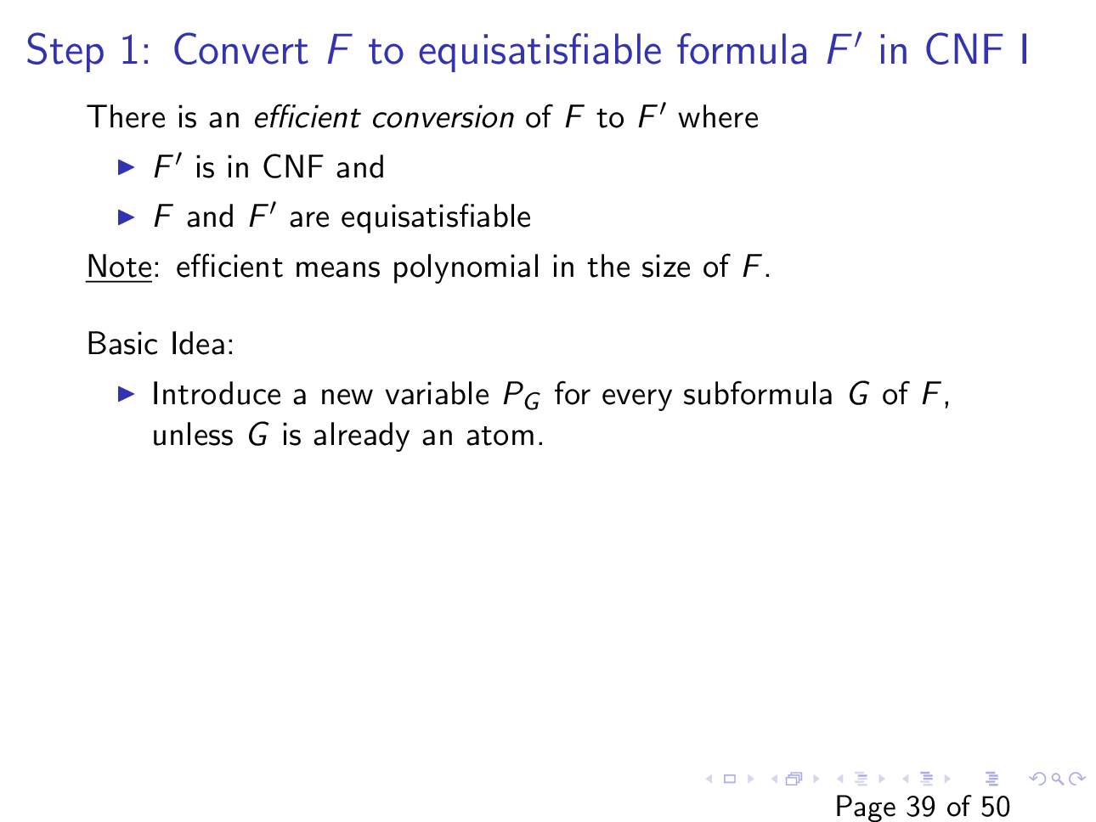
Slide courtesy of https://web.stanford.edu/class/cs156/

Slide 24
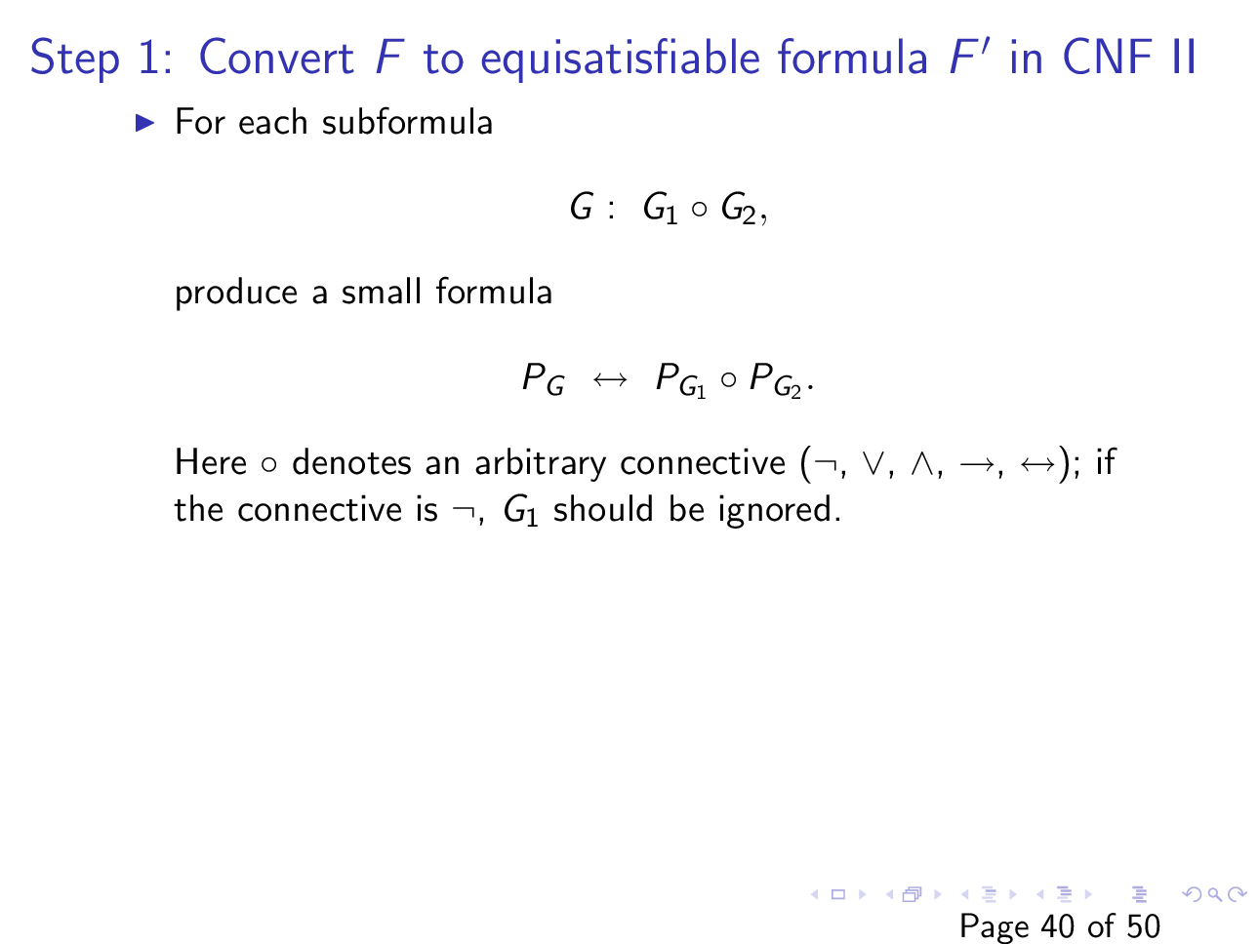
Slide courtesy of https://web.stanford.edu/class/cs156/

Slide 25
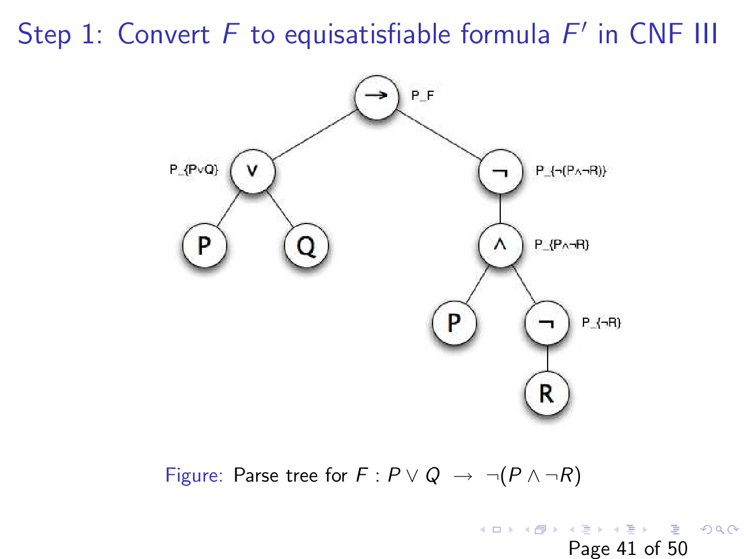
Slide courtesy of https://web.stanford.edu/class/cs156/

Slide 26
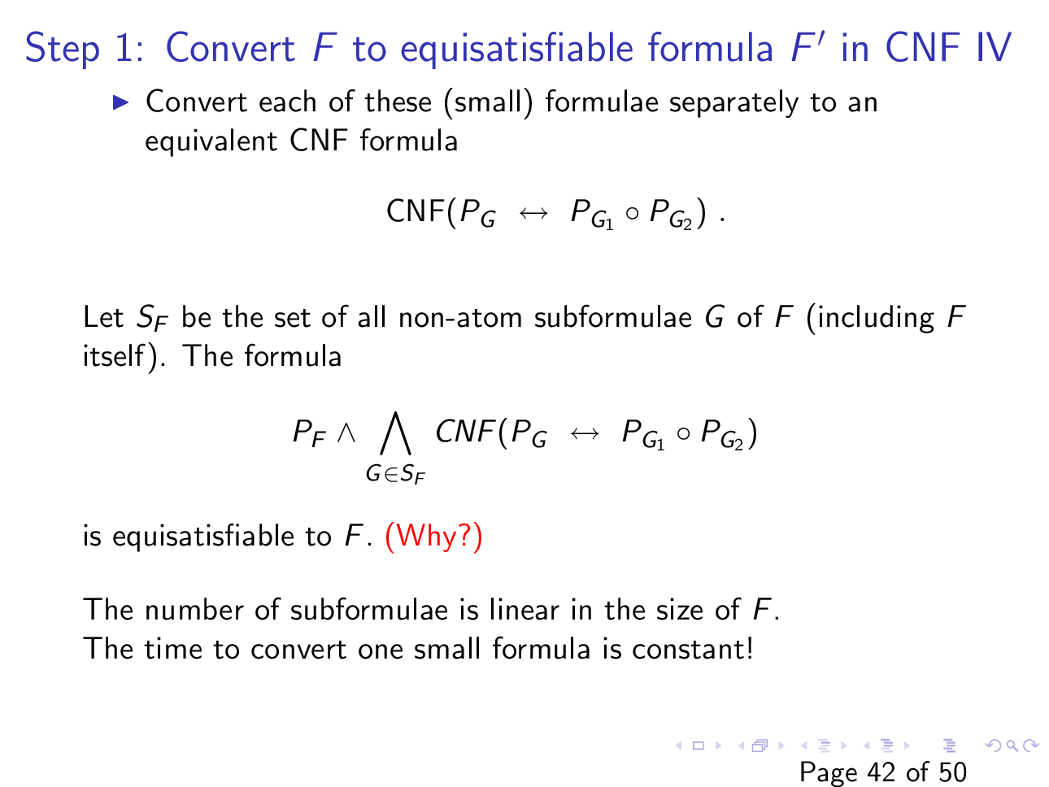
Slide courtesy of https://web.stanford.edu/class/cs156/

Slide 27
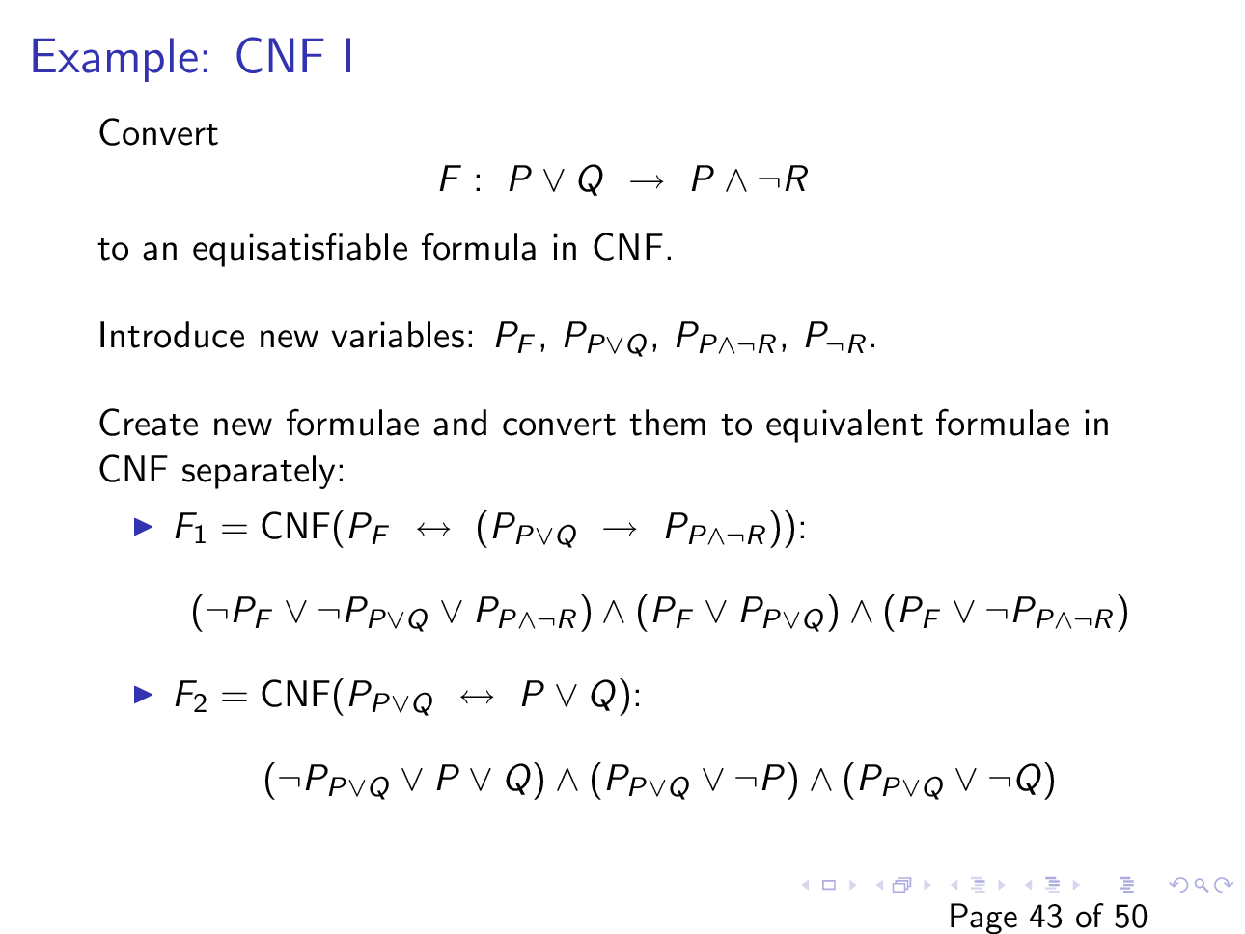
Slide courtesy of https://web.stanford.edu/class/cs156/

Slide 28
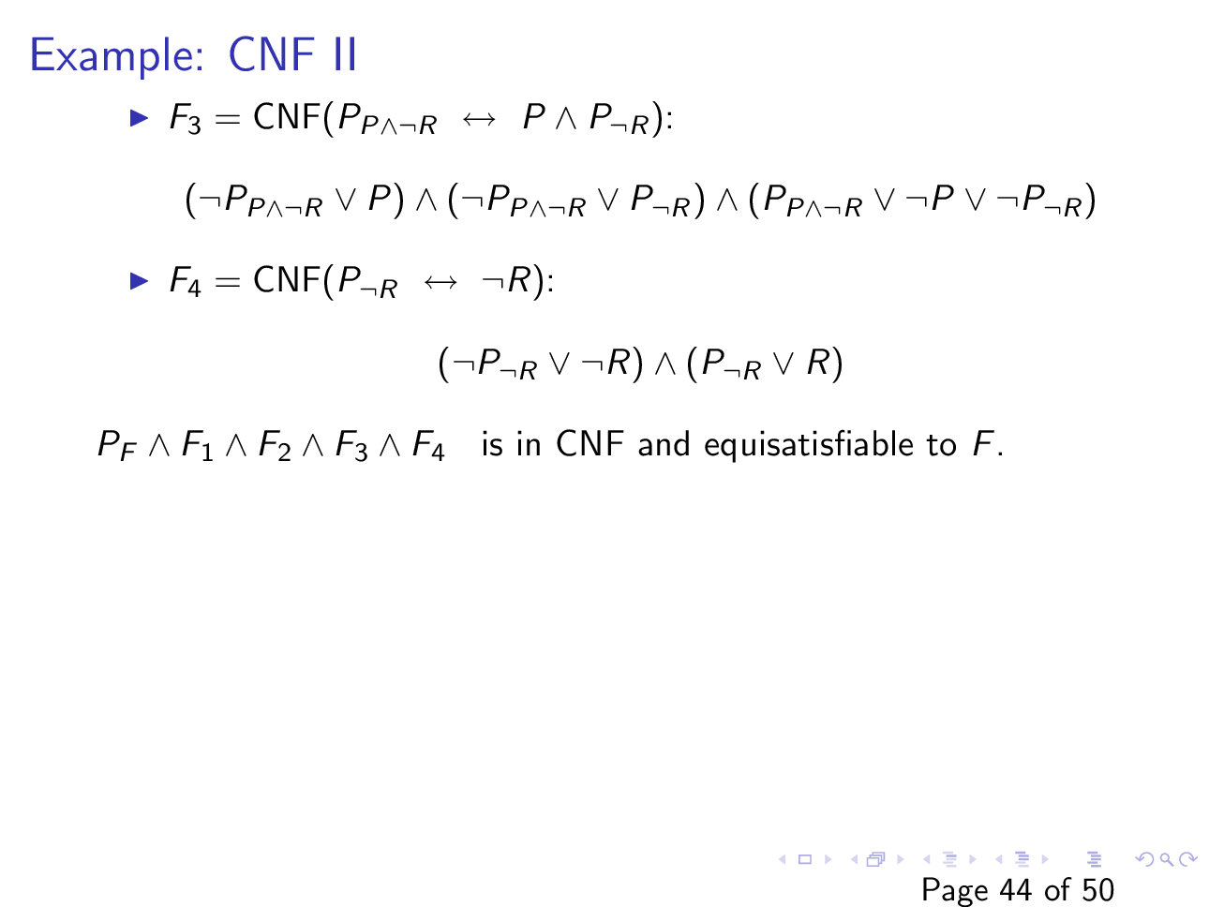
Slide courtesy of https://web.stanford.edu/class/cs156/

Slide 29
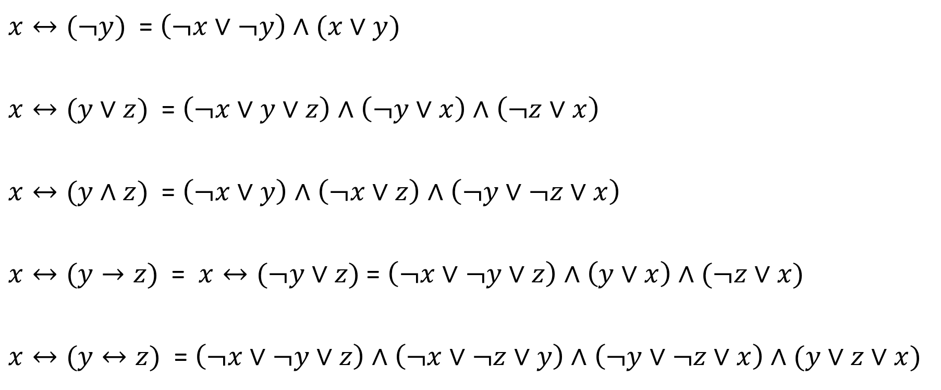
Tseitin’s encoding
$x↔(¬y)$ = $\left(¬x∨¬y\right)∧(x∨y)$
$x↔(y∨z)$ = $\left(¬x∨y∨z\right)∧\left(¬y∨x\right)∧\left(¬z∨x\right)$
$x↔(y∧z)$ = $\left(¬x∨y\right)∧\left(¬x∨z\right)∧\left(¬y∨¬z∨x\right)$
$x↔(y→z)$ = $x↔(¬y∨z)$ = $\left(¬x∨¬y∨z\right)∧\left(y∨x\right)∧(¬z∨x)$
$x↔(y↔z)$ = $\left(¬x∨¬y∨z\right)∧\left(¬x∨¬z∨y\right)∧\left(¬y∨¬z∨x\right)∧(y∨z∨x)$

Slide 30

CNF
Convert $\left(P_{1}∧P_{2}\right)∨\left(P_{3}∧P_{4}\right)∨\left(P_{5}∧P_{6}\right)∨(P_{7}∧P_{8})$ into an equisatisfiable CNF.
$x↔(y∧z)$ = $\left(¬x∨y\right)∧\left(¬x∨z\right)∧\left(¬y∨¬z∨x\right)$

Slide 31
CNF
Using Tseitin’s encoding, we can convert a given formula F to an equisatisfiable formula in CNF whose size is linear w.r.t. the size of F

Slide 32
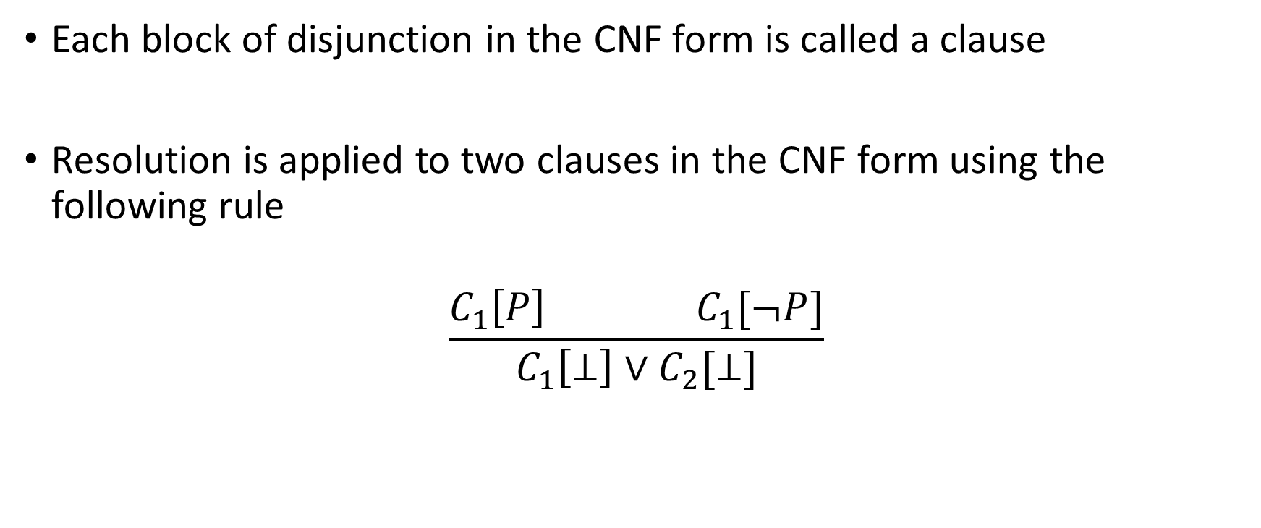
Resolution
Each block of disjunction in the CNF form is called a clause
Resolution is applied to two clauses in the CNF form using the following rule
$$\frac{C_{1}\left[P\right] C_{1}[¬P]}{C_{1}\left[⊥\right]∨C_{2}[⊥]}$$

Slide 33

Resolution
If we can derive $⊥$ (a clause with only false symbol), then the CNF is unsatisfiable

Slide 34

Resolution
Apply resolution to the following CNF formula
$$F:\left(¬P∨Q\right)∧P∧¬Q$$

Slide 35

Resolution
Apply resolution to the following CNF formula
$$F:\left(¬P∨Q\right)∧P∧¬Q$$
$$\frac{\left(¬P∨Q\right) P}{Q}$$
$$\frac{Q ¬Q}{⊥}$$

Slide 36

Resolution
Apply resolution to the following CNF formula
$$F:\left(¬P∨Q\right)∧¬Q$$

Slide 37
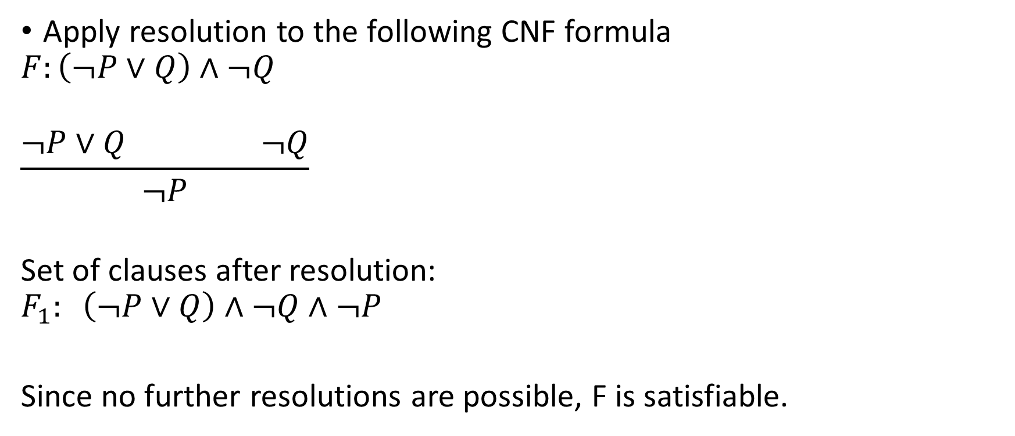
Resolution
Apply resolution to the following CNF formula
$$F:\left(¬P∨Q\right)∧¬Q$$
$$\frac{¬P∨Q ¬Q}{¬P}$$
Set of clauses after resolution:
$$F_{1}: \left(¬P∨Q\right)∧¬Q∧¬P$$
Since no further resolutions are possible, F is satisfiable.

Slide 38
DPLL
DPLL combines the exhaustive search with a restricted form of resolution
We will discuss the basic DPLL algorithms
A lot of research has been done to improve the performance of satisfiability procedures
We will discuss some of those techniques later in this course

Slide 39
Boolean constraint propagation (BCP)
BCP is applied when a clause contains only one literal

Slide 40
Pure literal propagation (PLP)
PLP is applied when a literal always appears as either positive or negative in different clauses

Slide 41
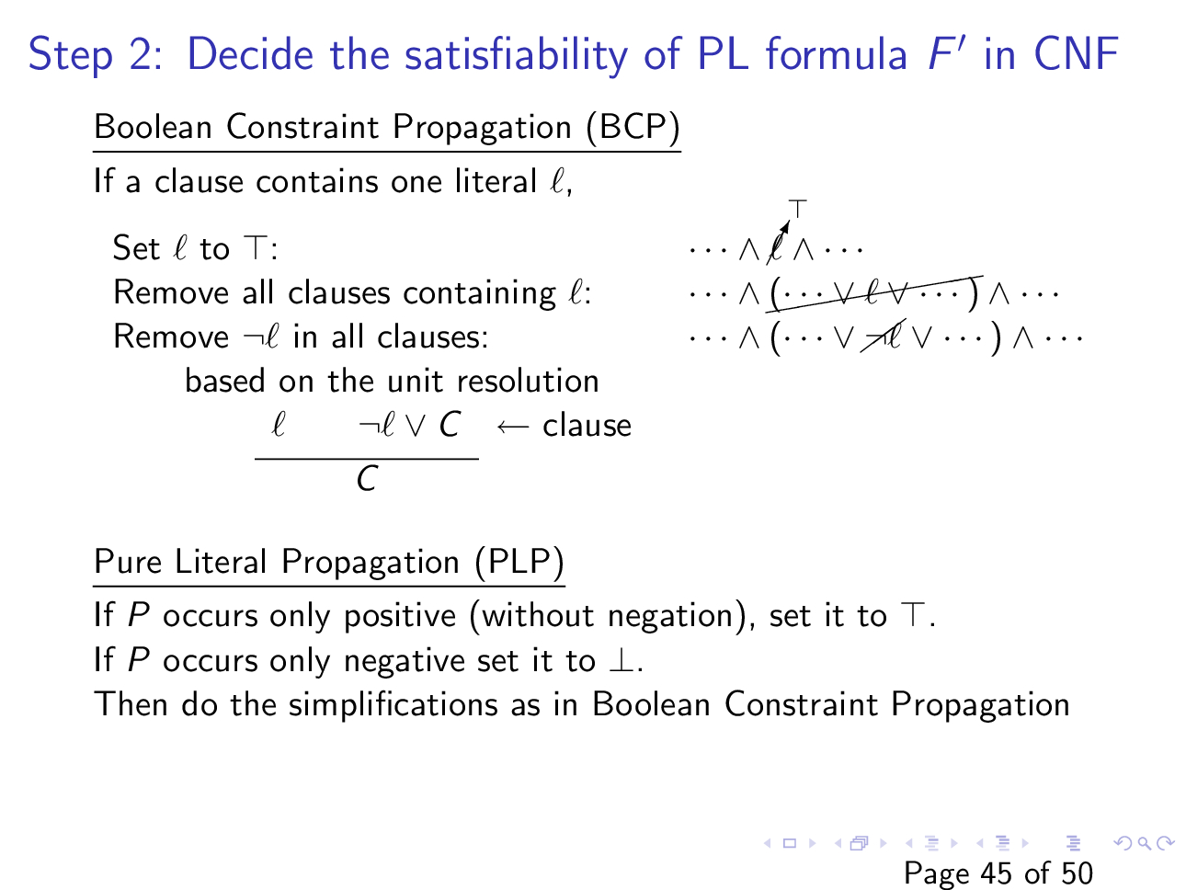
Slide courtesy of https://web.stanford.edu/class/cs156/

Slide 42
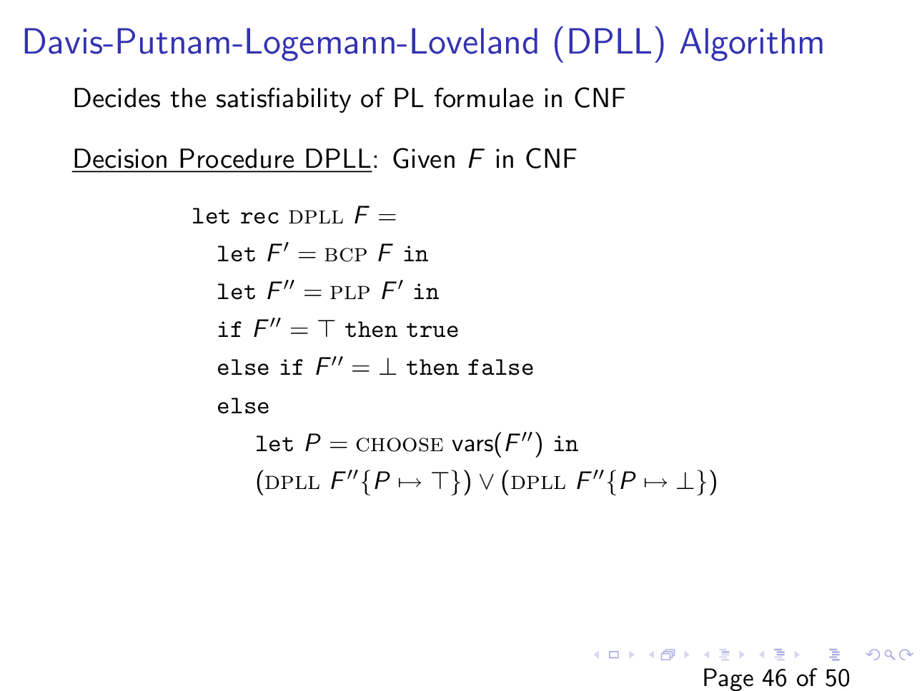
Slide courtesy of https://web.stanford.edu/class/cs156/

Slide 43
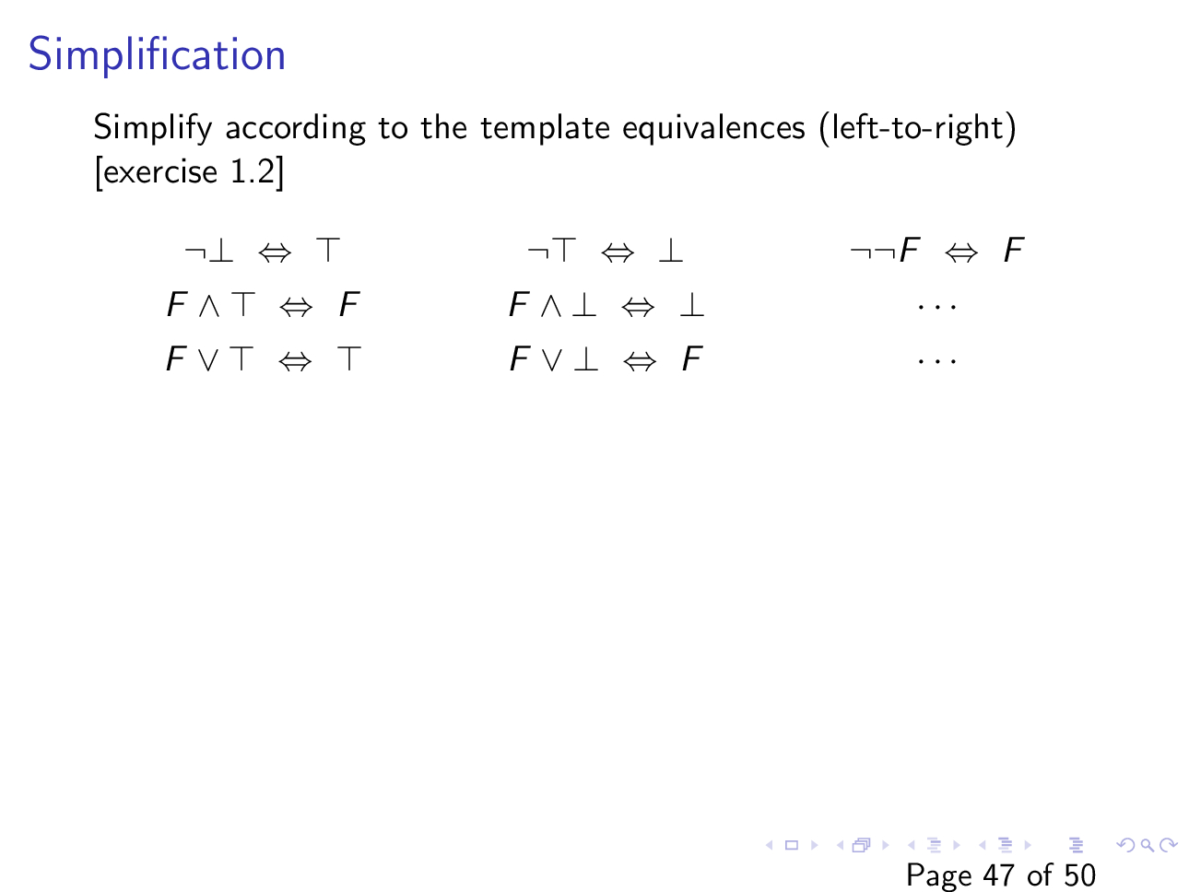
Slide courtesy of https://web.stanford.edu/class/cs156/

Slide 44

Example
Find a satisfying assignment to the following CNF formula
$F : \left(P\right)∧\left(¬P∨Q\right)∧\left(R∨¬Q∨S\right)$ $∧(R∨¬S)$

Slide 45
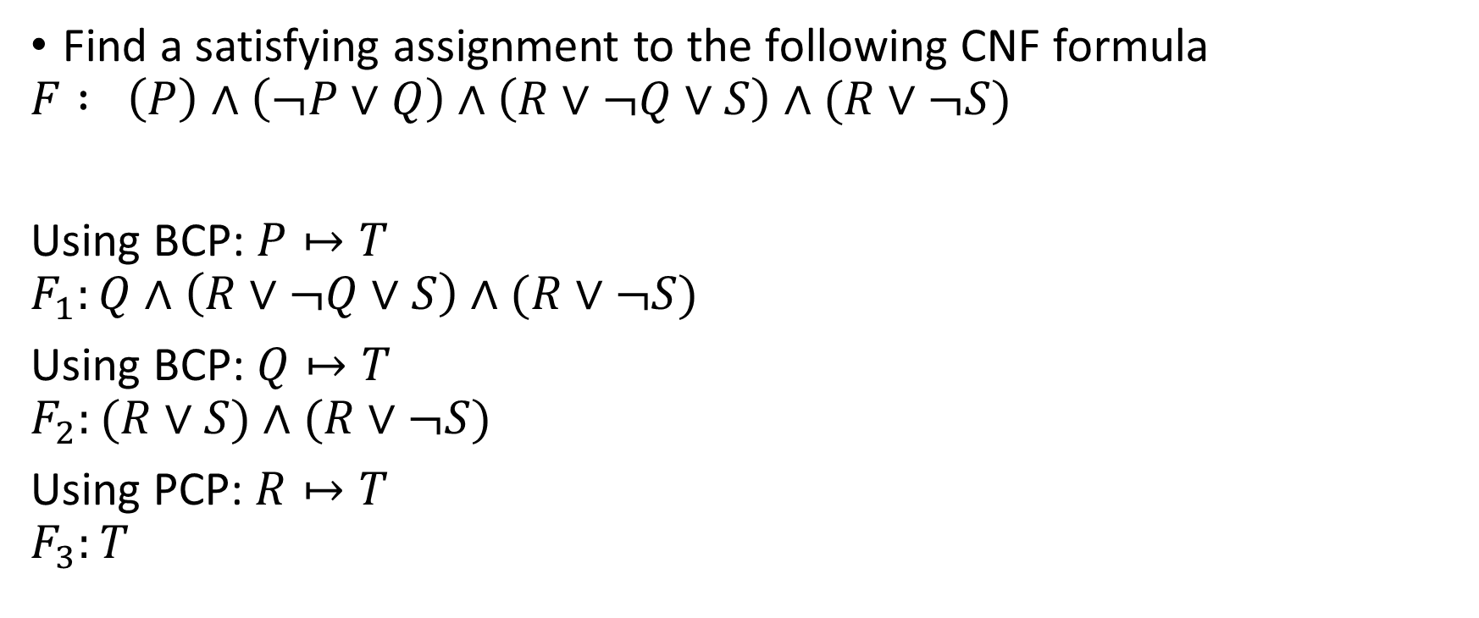
Example
Find a satisfying assignment to the following CNF formula
$$F : \left(P\right)∧\left(¬P∨Q\right)∧\left(R∨¬Q∨S\right)∧(R∨¬S)$$
Using BCP: $P↦T$
$$F_{1}:Q∧\left(R∨¬Q∨S\right)∧(R∨¬S)$$
Using BCP: $Q↦T$
$$F_{2}:(R∨S)∧(R∨¬S)$$
Using PCP: $R↦T$
$$F_{3}:T$$

Slide 46

Example
Find a satisfying assignment to the following CNF formula
$F : \left(¬P∨Q∨R\right)∧\left(¬Q∨R\right)∧\left(¬Q∨¬R\right)$ $∧(P∨¬Q∨¬R)$

Slide 47
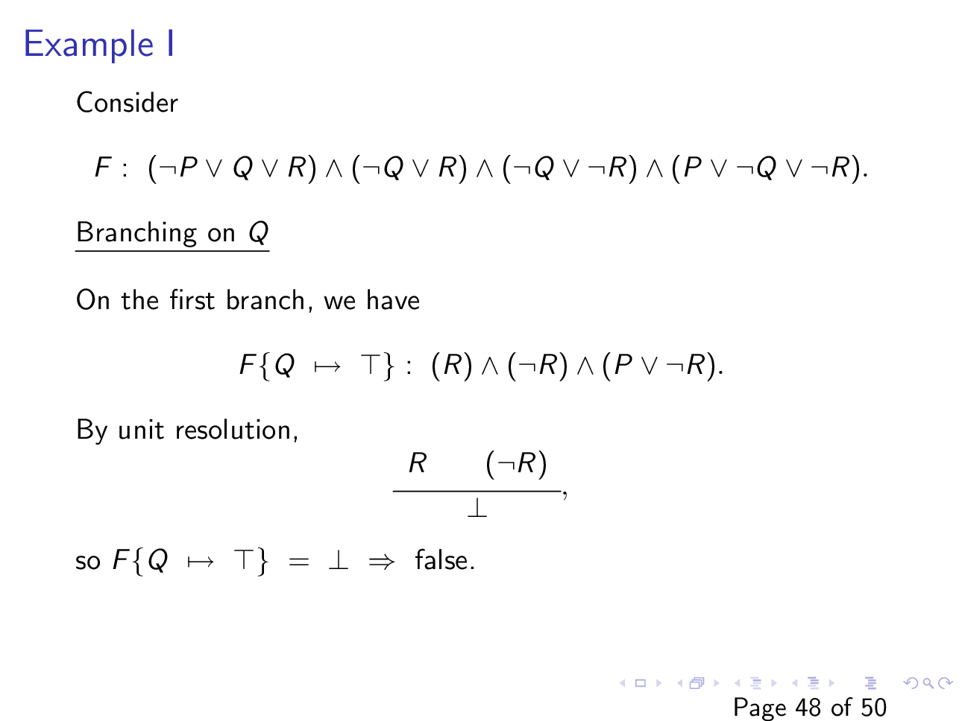
Slide courtesy of https://web.stanford.edu/class/cs156/

Slide 48
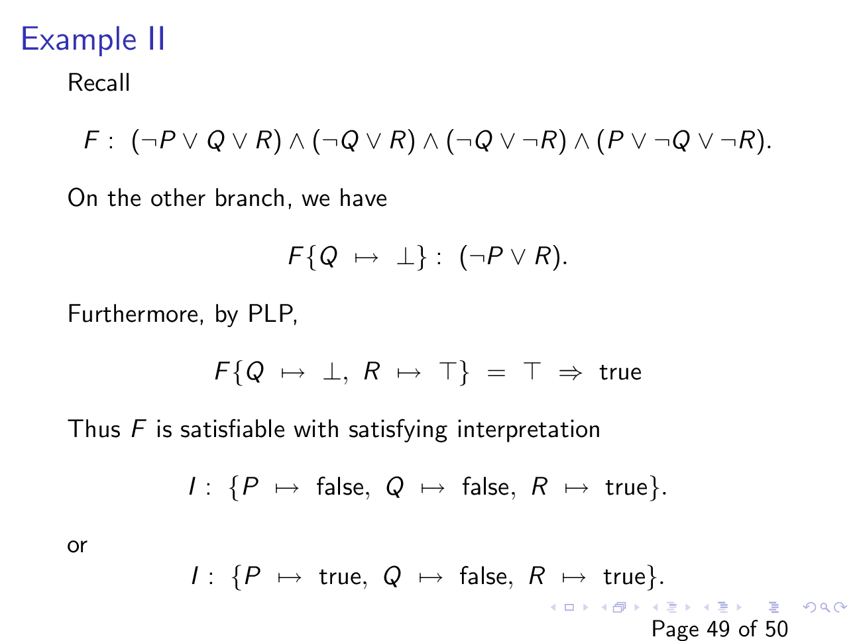

Slide 49
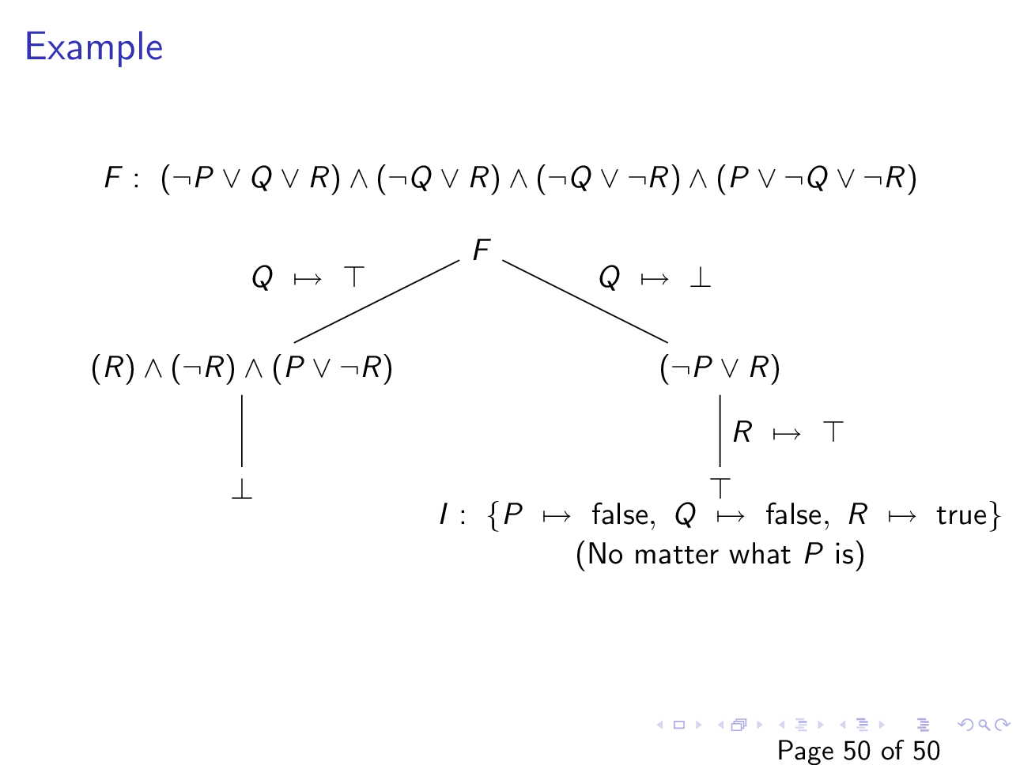
Slide courtesy of https://web.stanford.edu/class/cs156/

Slide 50
Homework
Do the exercises from chapter-1 in the COC book

