Slide 1
References
Read chapter-2 from the COC book

Slide 2
First order logic (FOL)
In propositional logic (PL), we can write true and false statements about a specific person or object, e.g.,
Ram is a dwarf and lives in the city of Moria.
Seven of Hearts is a card.
FOL is an extension of PL that also allows us to write statements about a set of people or objects
All men in the city of Moria are dwarfs.
At least one seven of Hearts is present in a deck of cards.

Slide 3
First order logic (FOL)
FOL is also called predicate logic
Syntax:
Variables: x, y, z, …
Constants: a, b, c, …
Functions: f, g, h, …
Functions are similar to a function in a functional programming language
Functions can return anything, e.g., integers, people, cards of a deck, etc.
A n-ary function takes n arguments
We write a constant for the 0-ary function
Terms: variables, constants, or n-ary function applied to n terms as arguments
Terms may evaluate to integers, people, cards of a deck, etc.

Slide 4
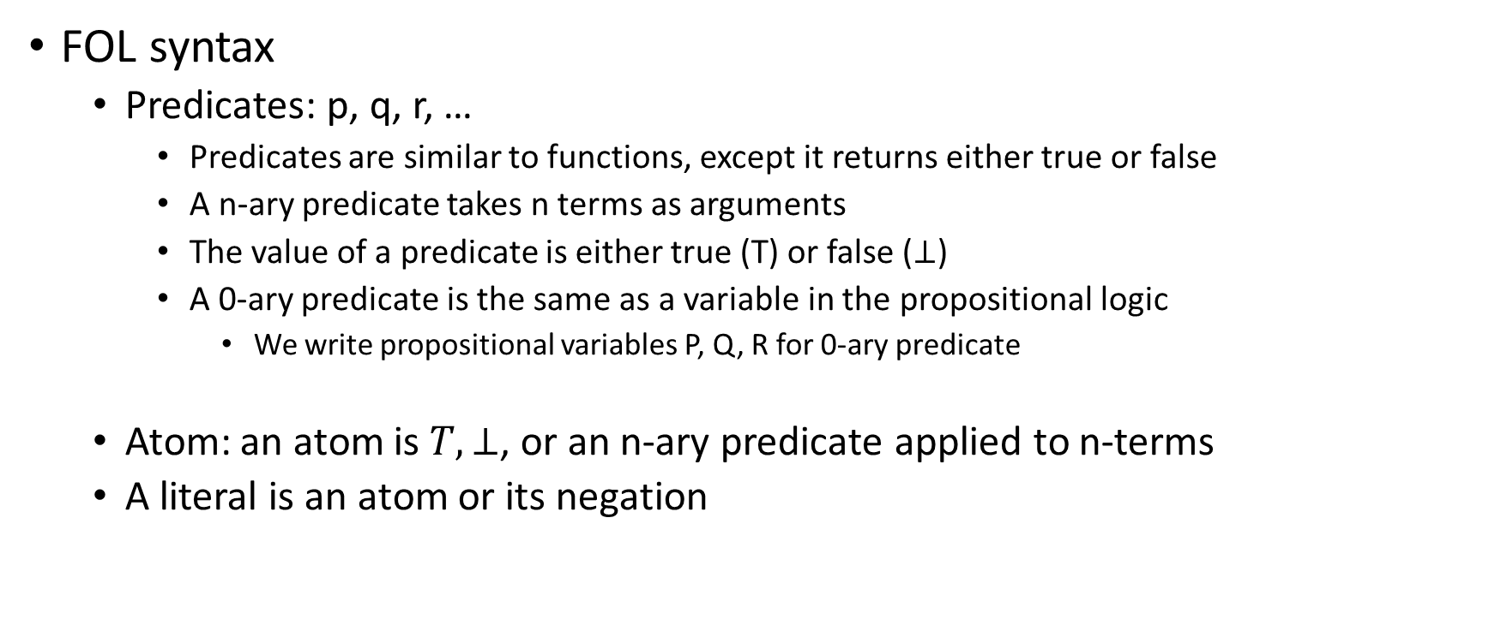
FOL
FOL syntax
Predicates: p, q, r, …
Predicates are similar to functions, except it returns either true or false
A n-ary predicate takes n terms as arguments
The value of a predicate is either true (T) or false ($⊥$)
A 0-ary predicate is the same as a variable in the propositional logic
We write propositional variables P, Q, R for 0-ary predicate
Atom: an atom is $T, ⊥$, or an n-ary predicate applied to n-terms
A literal is an atom or its negation

Slide 5

Example
Identify terms or literals
f(a, b)
f(a, f(c))
g(x, y)
f(g(x, f(x, y)))
x
P
p(a, b)
$¬p\left(f\left(a,b\right)\right)$
$p(f\left(a\right), g(x, y))$
$¬¬p\left(a\right)$
$¬f(a)$

Slide 6
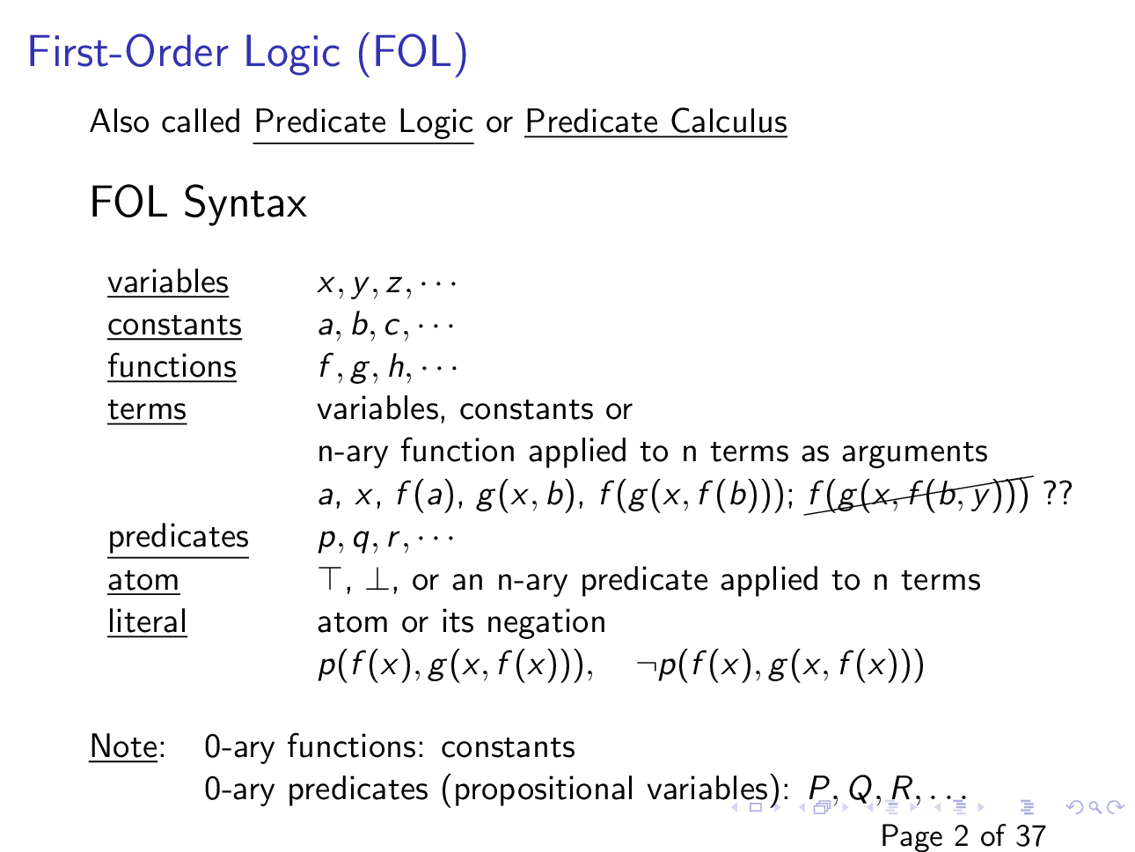

Slide 7

FOL formula
A FOL formula is a literal; the application of a logical connectives $¬, ∧, ∨, →, or↔$ to a formula or formulae; or the application of a quantifier to a formula

Slide 8
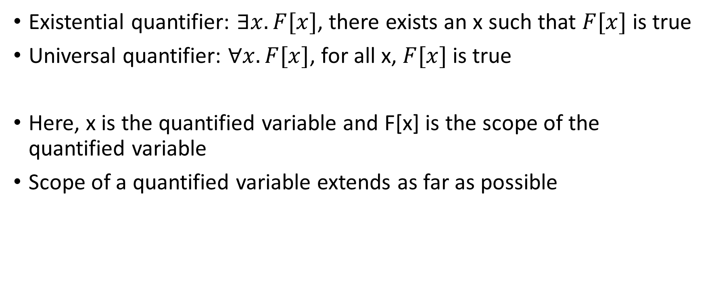
Quantifiers
Existential quantifier: $∃x. F[x]$, there exists an x such that $F[x]$ is true
Universal quantifier: $∀x. F[x]$, for all x, $F[x]$ is true
Here, x is the quantified variable and F[x] is the scope of the quantified variable
Scope of a quantified variable extends as far as possible

Slide 9
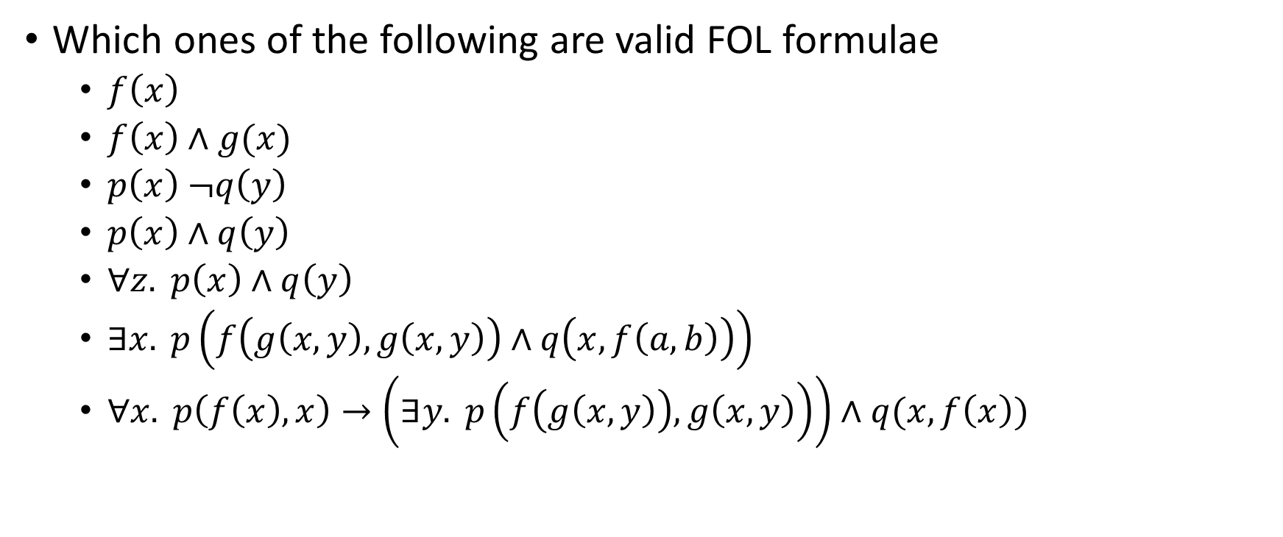
FOL formula
Which ones of the following are valid FOL formulae
$f\left(x\right)$
$f\left(x\right)∧g(x)$
$p\left(x\right) ¬q\left(y\right)$
$p\left(x\right)∧q\left(y\right)$
$∀z. p\left(x\right)∧q\left(y\right)$
$∃x. p\left(f\left(g\left(x, y\right), g\left(x, y\right)\right)∧q\left(x, f\left(a, b\right)\right)\right)$
$∀x. p\left(f\left(x\right), x\right)→\left(∃y. p\left(f\left(g\left(x, y\right)\right), g\left(x,y\right)\right)\right)∧q(x, f\left(x\right))$

Slide 10
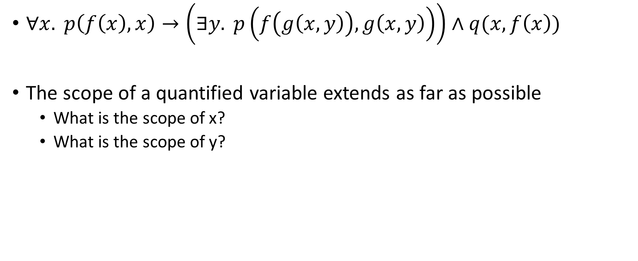
Scope
$∀x. p\left(f\left(x\right), x\right)→\left(∃y. p\left(f\left(g\left(x, y\right)\right), g\left(x,y\right)\right)\right)∧q(x, f\left(x\right))$
The scope of a quantified variable extends as far as possible
What is the scope of x?
What is the scope of y?

Slide 11
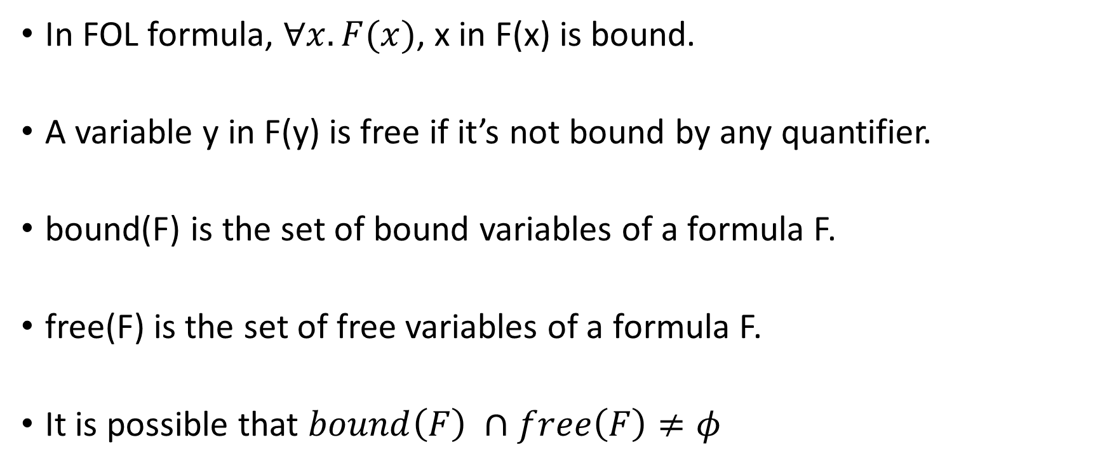
Free and bound variables
In FOL formula, $∀x. F(x)$, x in F(x) is bound.
A variable y in F(y) is free if it’s not bound by any quantifier.
bound(F) is the set of bound variables of a formula F.
free(F) is the set of free variables of a formula F.
It is possible that $bound\left(F\right) ∩free\left(F\right)≠φ$

Slide 12

Free and bound variables
$F :∀x. p\left(f\left(x\right), y\right)→∀y.p(f\left(x\right), y)$
What are the bound and free sets?

Slide 13
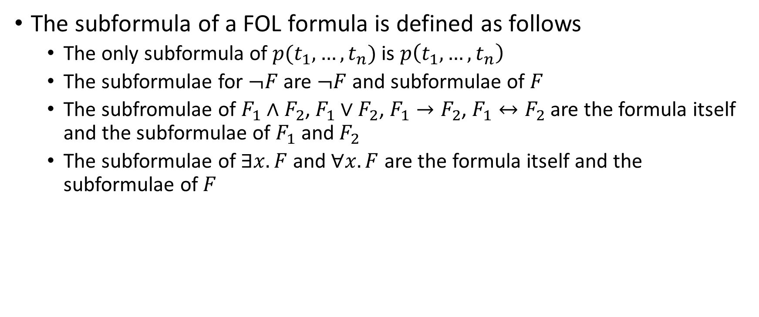
Subformula
The subformula of a FOL formula is defined as follows
The only subformula of $p(t_{1}, …, t_{n})$ is $p\left(t_{1}, …, t_{n}\right)$
The subformulae for $¬F$ are $¬F$ and subformulae of $F$
The subfromulae of $F_{1}∧F_{2}$, $F_{1}∨F_{2}$, $F_{1}→F_{2}$, $F_{1}↔F_{2}$ are the formula itself and the subformulae of $F_{1}$ and $F_{2}$
The subformulae of $∃x. F$ and $∀x. F$ are the formula itself and the subformulae of $F$

Slide 14

Subformula
What are the subformulae of $F : ∀x. p\left(f\left(x\right), y\right)→∀y.p(f\left(x\right), y)$

Slide 15
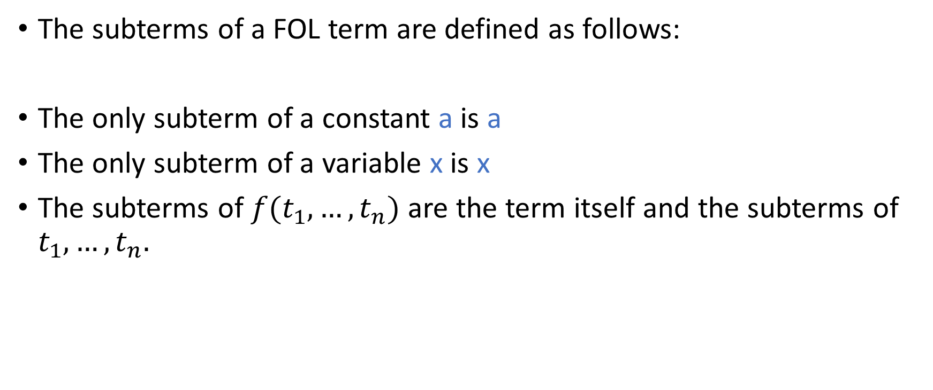
Subterms
The subterms of a FOL term are defined as follows:
The only subterm of a constant a is a
The only subterm of a variable x is x
The subterms of $f(t_{1}, …, t_{n})$ are the term itself and the subterms of $t_{1}, …, t_{n}.$

Slide 16

Subterms
What are the subterms of $g\left(f\left(x\right), f\left(h\left(f\left(x\right)\right)\right)\right)$

Slide 17
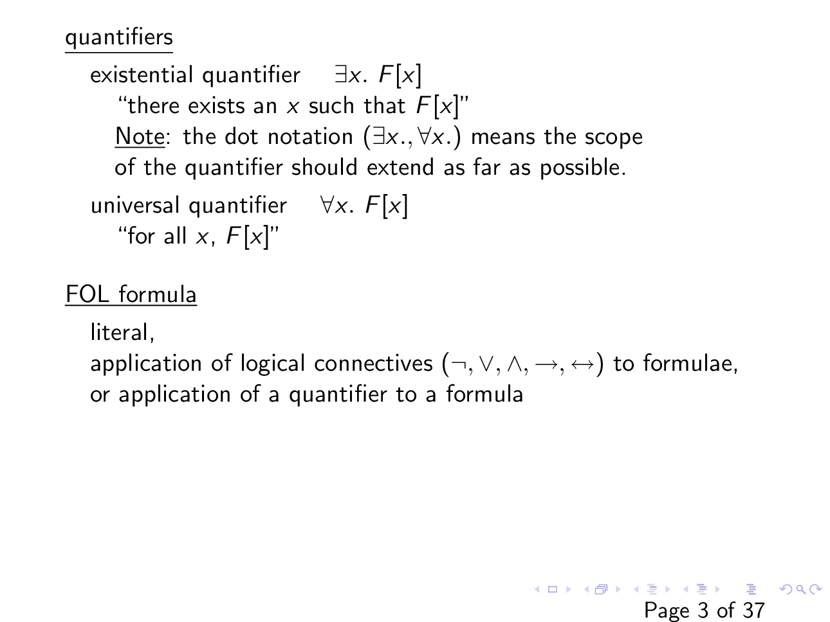

Slide 18
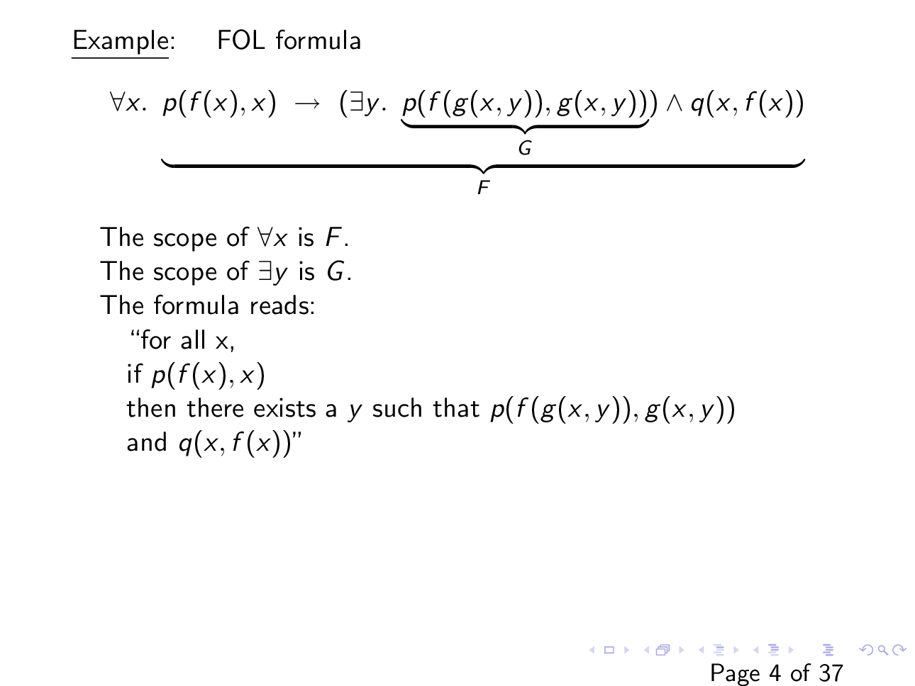

Slide 19
Examples
All men in the city of Moria are dwarfs.
At least one seven of Hearts is present in a deck of cards.

Slide 20
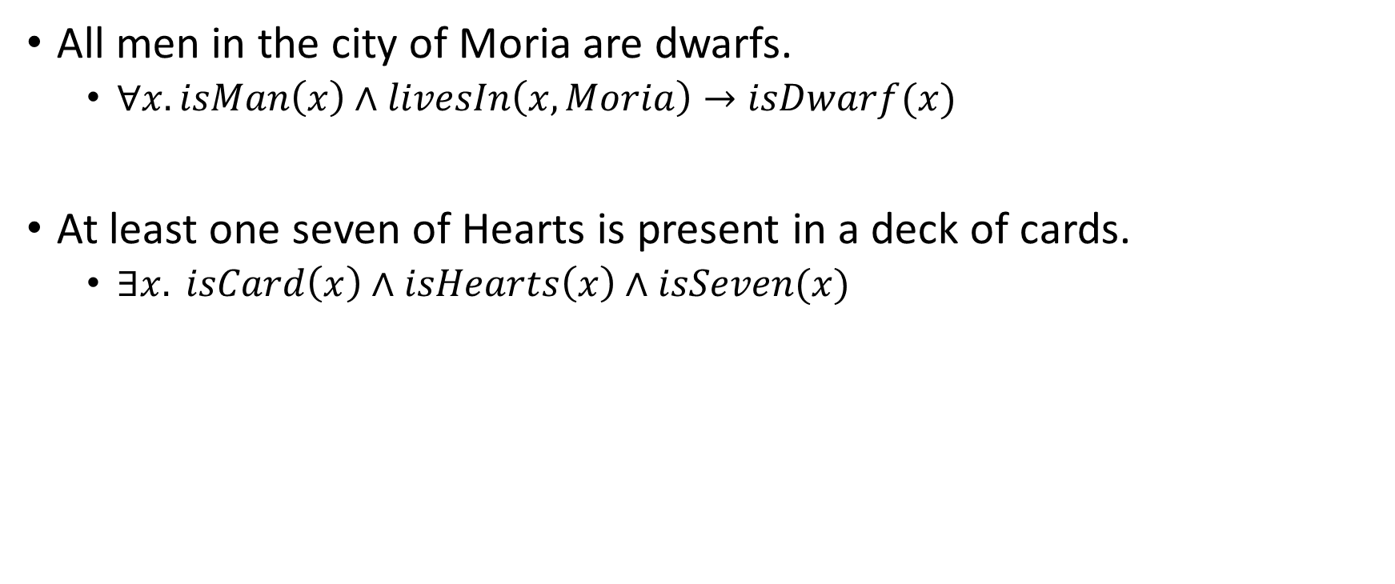
Examples
All men in the city of Moria are dwarfs.
$∀x. isMan\left(x\right)∧livesIn\left(x, Moria\right)→isDwarf(x)$
At least one seven of Hearts is present in a deck of cards.
$∃x. isCard\left(x\right)∧isHearts\left(x\right)∧isSeven(x)$

Slide 21
Examples
Every dog has its day.
Some dogs have more days than others.
All cats have more days than dogs.
Fido is a dog. Furrball is a cat. Fido has fewer days than Furrball.

Slide 22
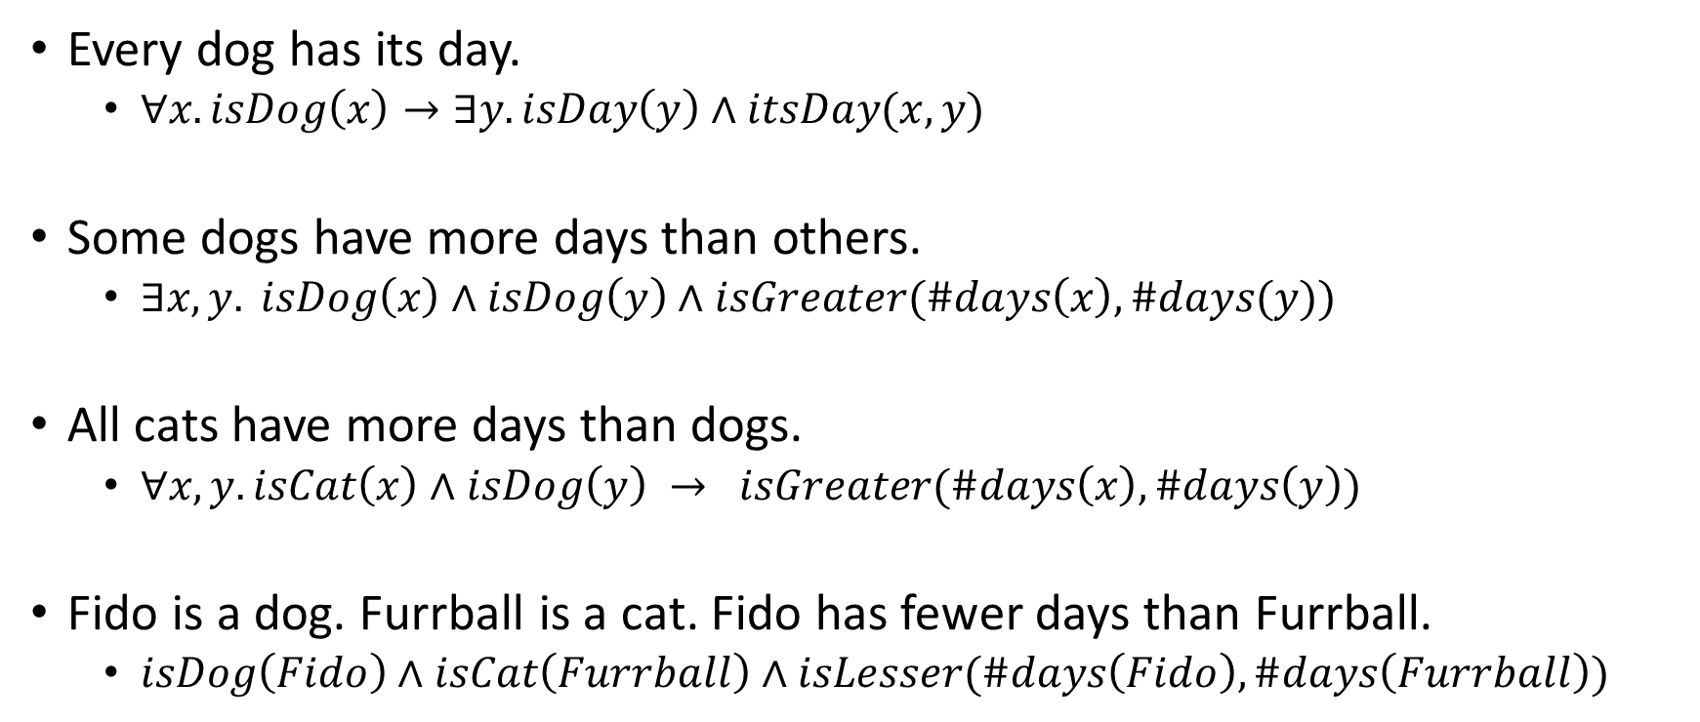
Examples
Every dog has its day.
$∀x. isDog\left(x\right)→∃y. isDay\left(y\right)∧itsDay(x, y)$
Some dogs have more days than others.
$∃x, y. isDog\left(x\right)∧isDog\left(y\right)∧isGreater(\#days\left(x\right), \#days(y))$
All cats have more days than dogs.
$∀x, y. isCat\left(x\right)∧isDog\left(y\right) → isGreater(\#days\left(x\right), \#days\left(y\right))$
Fido is a dog. Furrball is a cat. Fido has fewer days than Furrball.
$isDog\left(Fido\right)∧isCat\left(Furrball\right)∧isLesser(\#days\left(Fido\right), \#days\left(Furrball\right))$

Slide 23
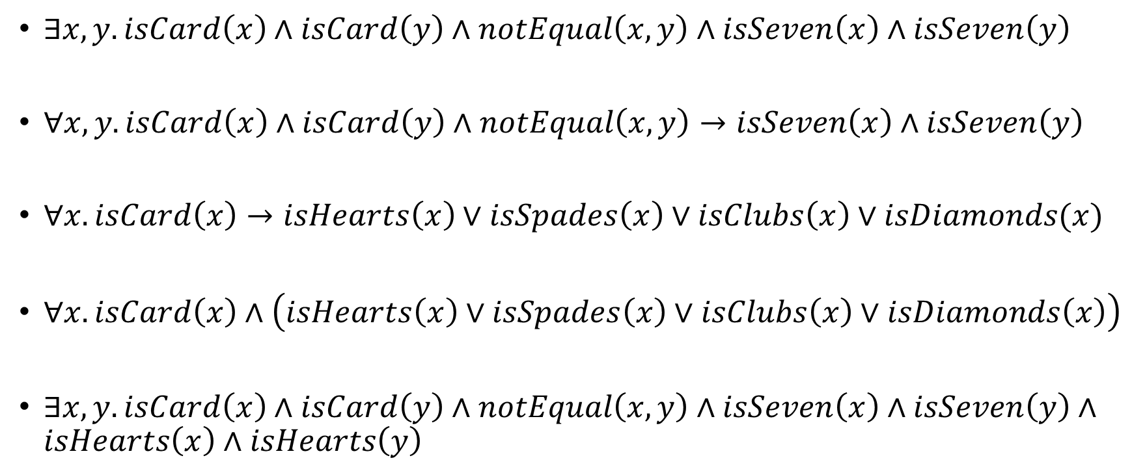
Example
$∃x, y. isCard\left(x\right)∧isCard\left(y\right)∧notEqual\left(x, y\right)∧isSeven\left(x\right)∧isSeven\left(y\right)$
$∀x, y. isCard\left(x\right)∧isCard\left(y\right)∧notEqual\left(x, y\right)→isSeven\left(x\right)∧isSeven\left(y\right)$
$∀x. isCard\left(x\right)→isHearts\left(x\right)∨isSpades\left(x\right)∨isClubs\left(x\right)∨isDiamonds(x)$
$∀x. isCard\left(x\right)∧\left(isHearts\left(x\right)∨isSpades\left(x\right)∨isClubs\left(x\right)∨isDiamonds\left(x\right)\right)$
$∃x, y. isCard\left(x\right)∧isCard\left(y\right)∧notEqual\left(x, y\right)∧isSeven\left(x\right)∧isSeven\left(y\right)∧isHearts\left(x\right)∧isHearts\left(y\right)$

Slide 24
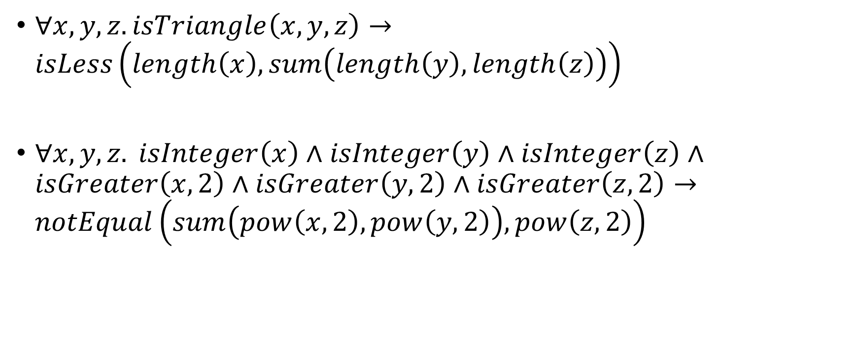
Example
$∀x, y, z. isTriangle\left(x, y, z\right)→isLess\left(length\left(x\right), sum\left(length\left(y\right), length\left(z\right)\right)\right)$
$∀x, y, z. isInteger\left(x\right)∧isInteger\left(y\right)∧isInteger\left(z\right)∧isGreater\left(x, 2\right)∧isGreater\left(y, 2\right)∧isGreater\left(z, 2\right)→notEqual\left(sum\left(pow\left(x, 2\right), pow\left(y, 2\right)\right), pow\left(z, 2\right)\right)$

Slide 25
Example
Everybody loves Raymond.
Nobody loves Raymond.

Slide 26

Example
Everybody loves Raymond.
$∀x. loves\left(x, Raymond\right)$
$¬∃x. ¬loves(x, Raymond)$
Nobody loves Raymond.
$∀x. ¬loves\left(x, Raymond\right)$
$¬∃x. loves(x, Raymond)$

Slide 27

Interpretation
An interpretation I in FOL contains domain $(D_{I})$ and assignment($α_{I}$)

Slide 28
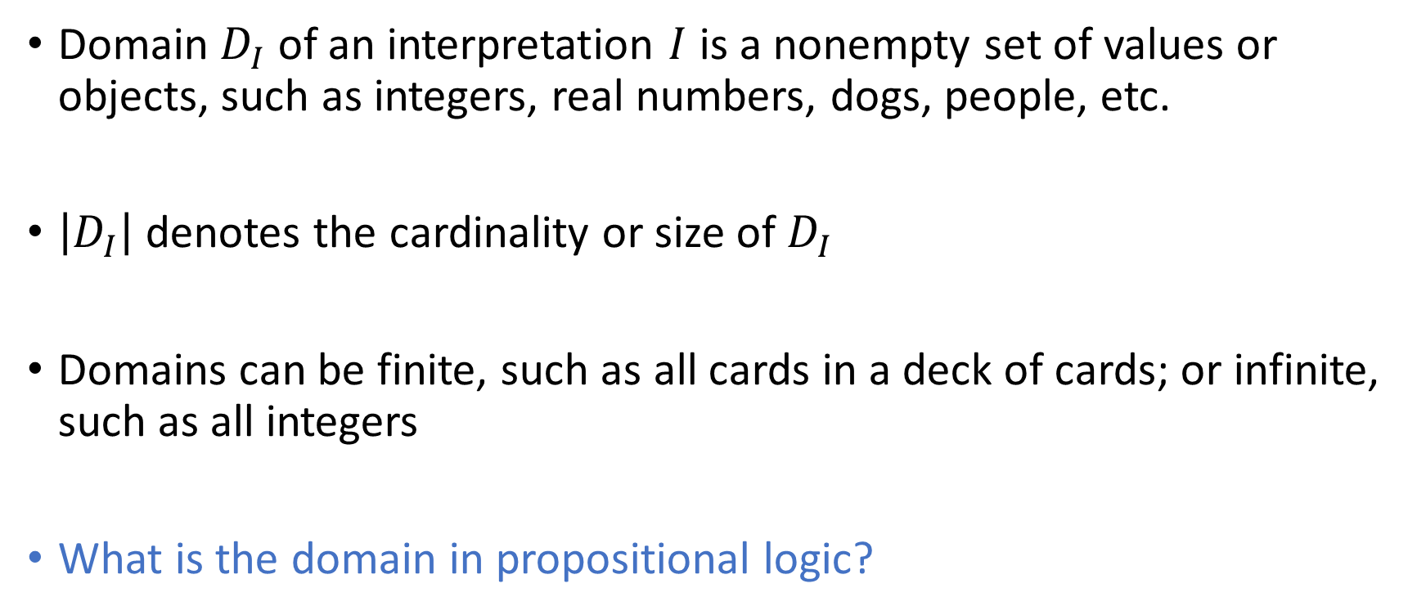
Domain
Domain $D_{I}$ of an interpretation $I$ is a nonempty set of values or objects, such as integers, real numbers, dogs, people, etc.
$\left|D_{I}\right|$ denotes the cardinality or size of $D_{I}$
Domains can be finite, such as all cards in a deck of cards; or infinite, such as all integers
What is the domain in propositional logic?

Slide 29
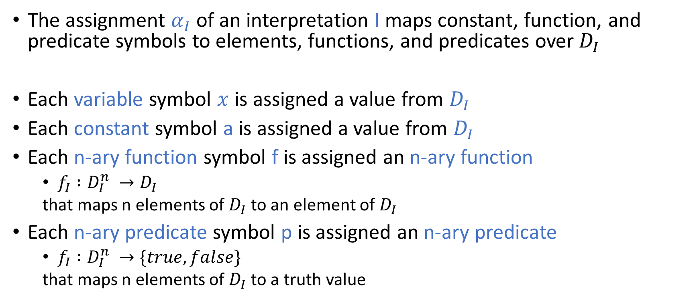
Assignment
The assignment $α_{I}$ of an interpretation I maps constant, function, and predicate symbols to elements, functions, and predicates over$D_{I}$
Each variable symbol $x$ is assigned a value from $D_{I}$
Each constant symbol a is assigned a value from $D_{I}$
Each n-ary function symbol f is assigned an n-ary function
$f_{I} :D_{I}^{n} →D_{I}$
that maps n elements of $D_{I}$ to an element of $D_{I}$
Each n-ary predicate symbol p is assigned an n-ary predicate
$f_{I} :D_{I}^{n} →\{true, false\}$
that maps n elements of $D_{I}$ to a truth value

Slide 30
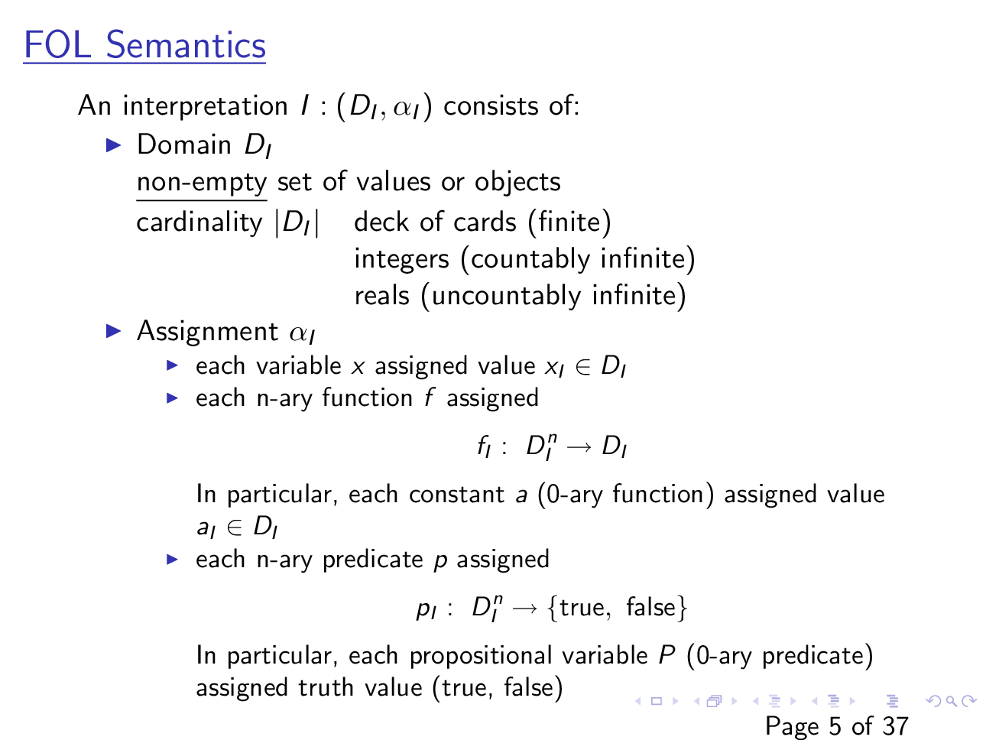

Slide 31
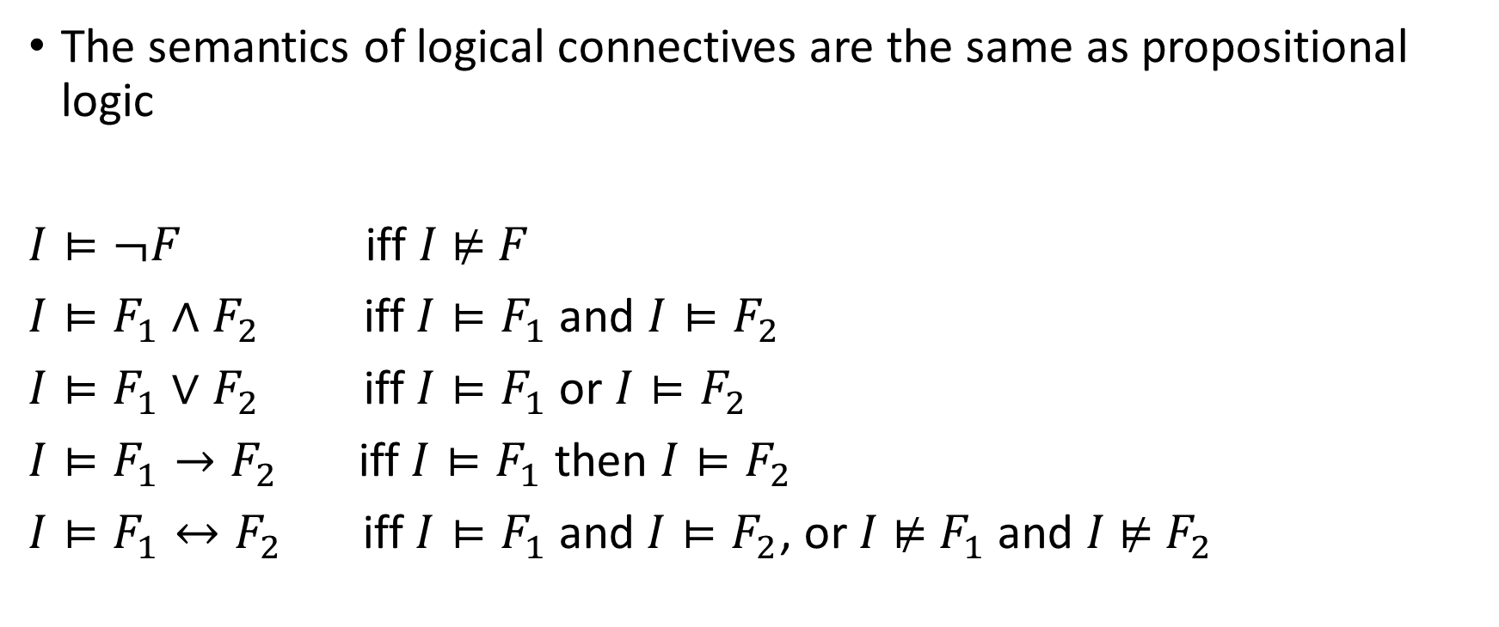
Semantics: Logical connectives
The semantics of logical connectives are the same as propositional logic
$I⊨¬F$ iff $I$ ⊭ $F$
$I⊨F_{1}∧F_{2}$ iff $I⊨F_{1}$ and $I⊨F_{2}$
$I⊨F_{1}∨F_{2}$ iff $I⊨F_{1}$ or $I⊨F_{2}$
$I⊨F_{1}→F_{2}$ iff $I⊨F_{1}$ then $I⊨F_{2}$
$I⊨F_{1}↔F_{2}$ iff $I⊨F_{1}$ and $I⊨F_{2}$, or $I$ ⊭ $F_{1}$ and $I$⊭ $F_{2}$

Slide 32

Example
$$F: p\left(f\left(x, y\right), z\right)→p\left(y, g\left(z,x\right)\right)$$
$I:\left(Z, α_{I}\right)$ // Z is the set of integers
$α_{I}:$ {$f↦+_{Z}, g↦−_{Z}, p↦>_{Z}, x↦13, y↦42, z↦1$}

Slide 33
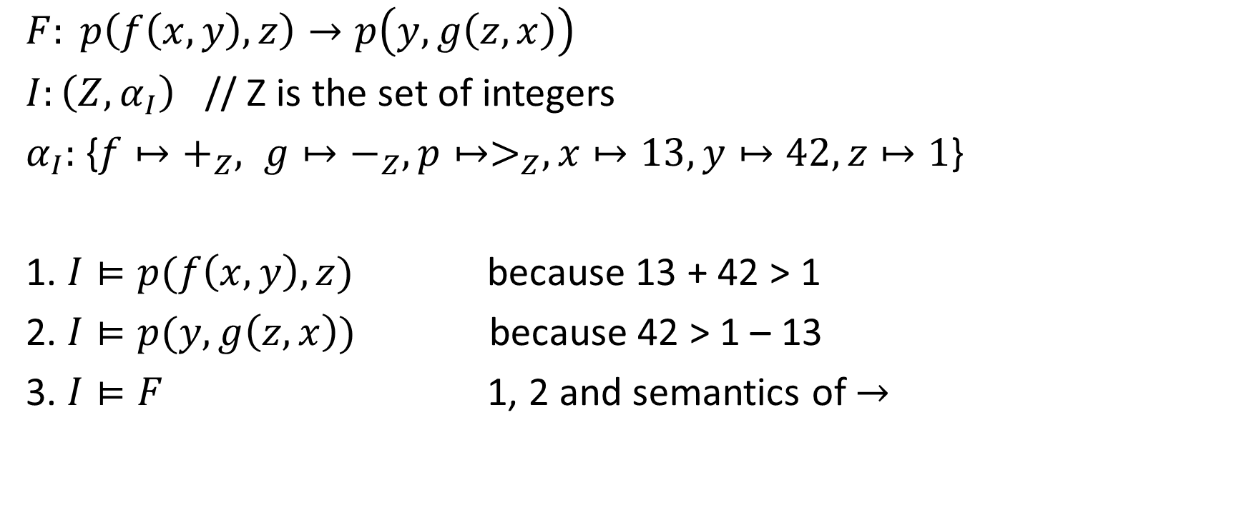
Example
$$F: p\left(f\left(x, y\right), z\right)→p\left(y, g\left(z,x\right)\right)$$
$I:\left(Z, α_{I}\right)$ // Z is the set of integers
$α_{I}:$ {$f↦+_{Z}, g↦−_{Z}, p↦>_{Z}, x↦13, y↦42, z↦1$}
1. $I⊨p(f\left(x, y\right), z)$ because 13 + 42 > 1
2. $I⊨p(y, g\left(z,x\right))$ because 42 > 1 – 13
3. $I⊨F$ 1, 2 and semantics of $→$

Slide 34
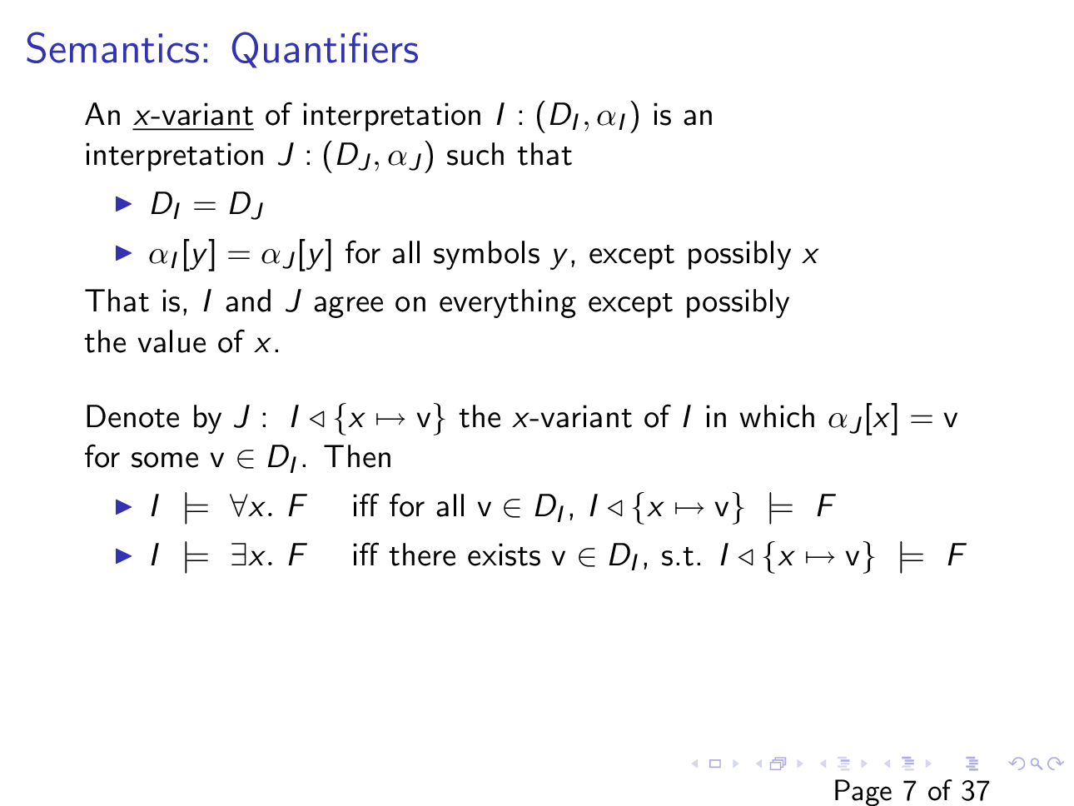

Slide 35
