Slide 2
References
Read chapter-2 from the COC book

Slide 3
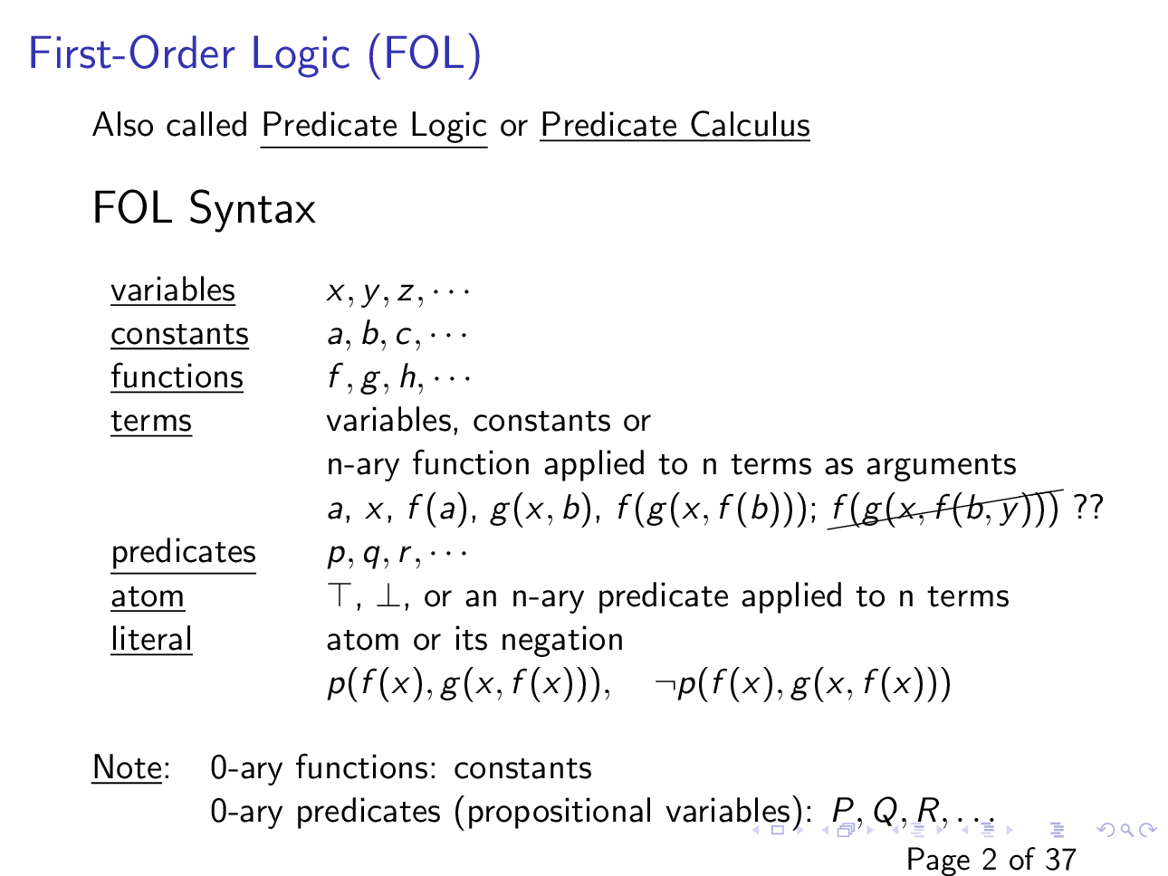

Slide 4
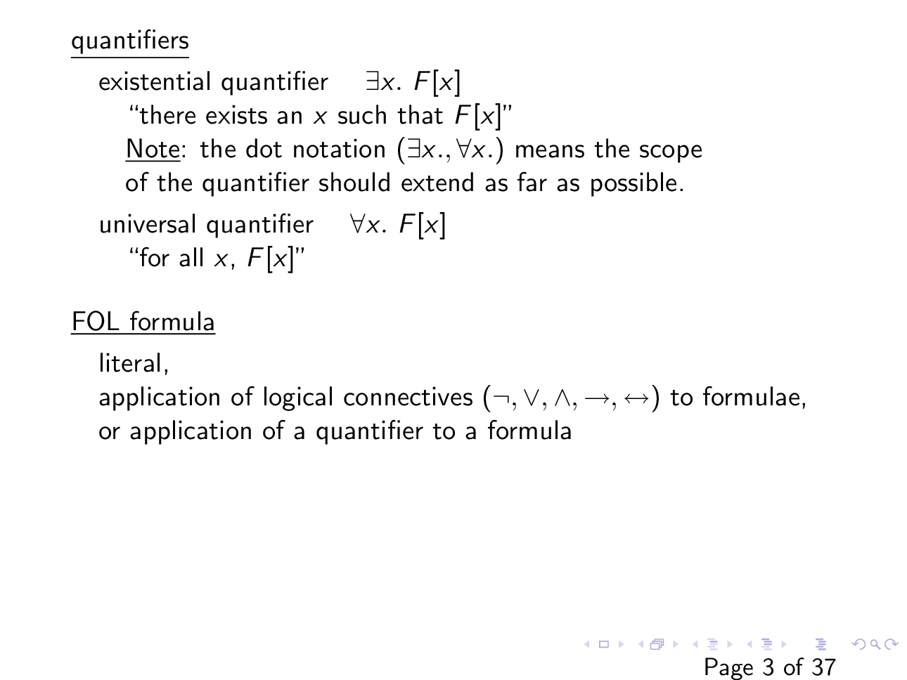

Slide 5
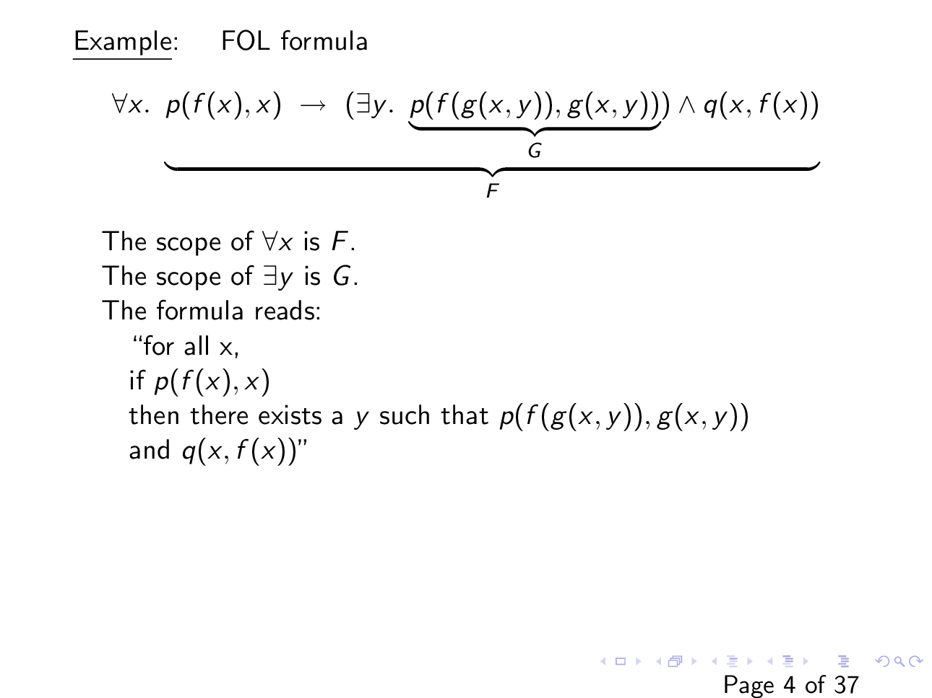

Slide 6
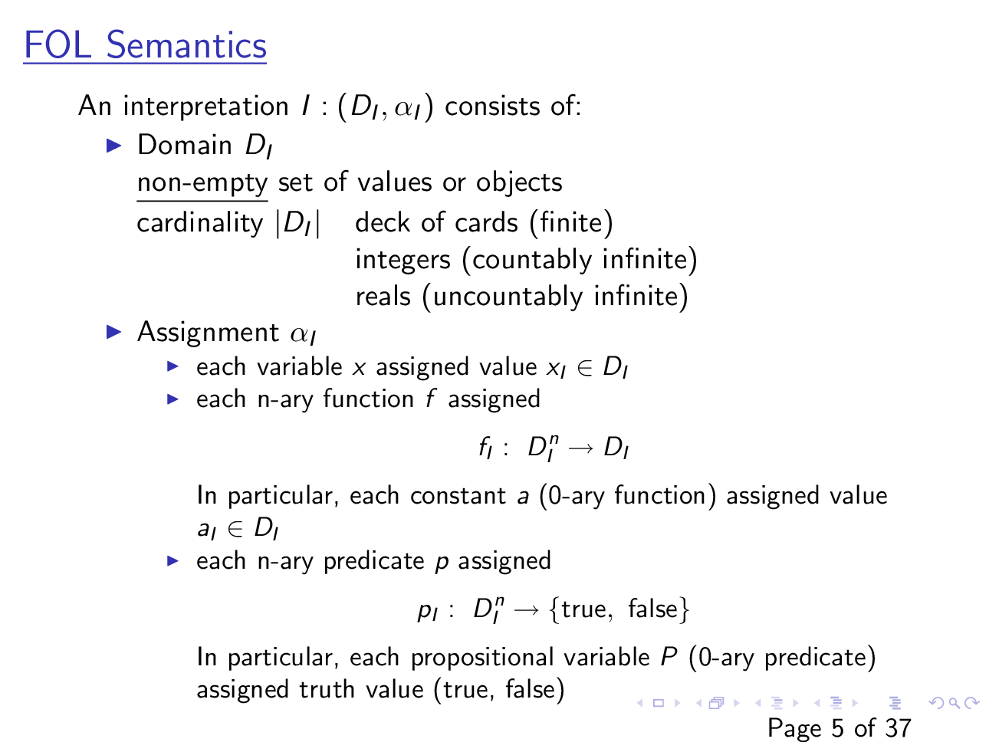

Slide 7
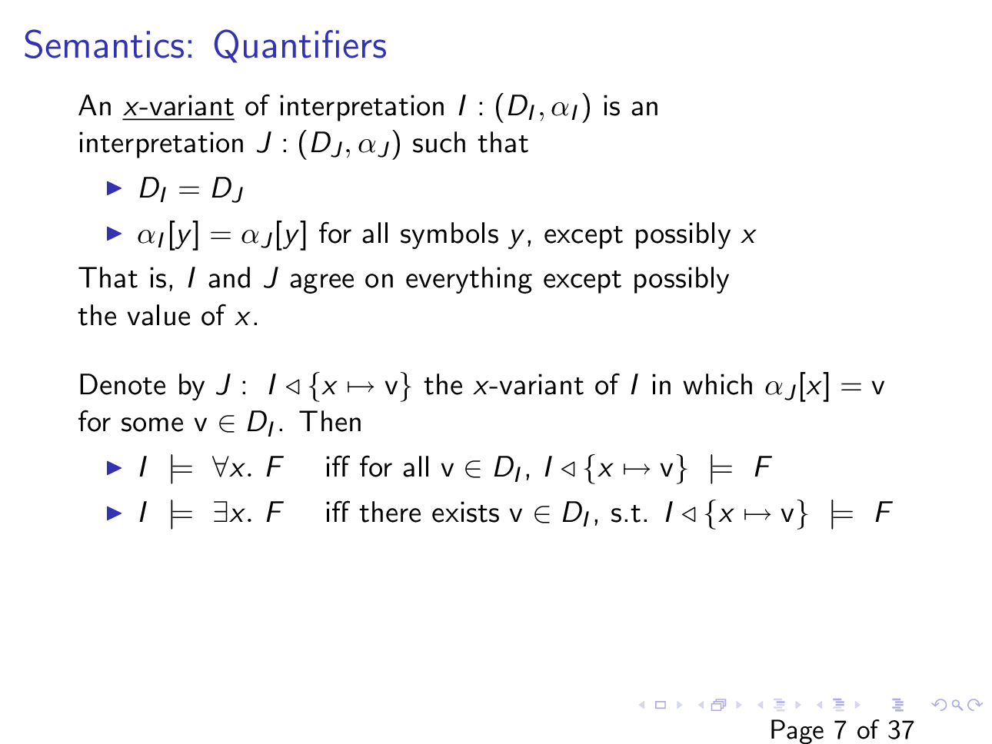

Slide 8
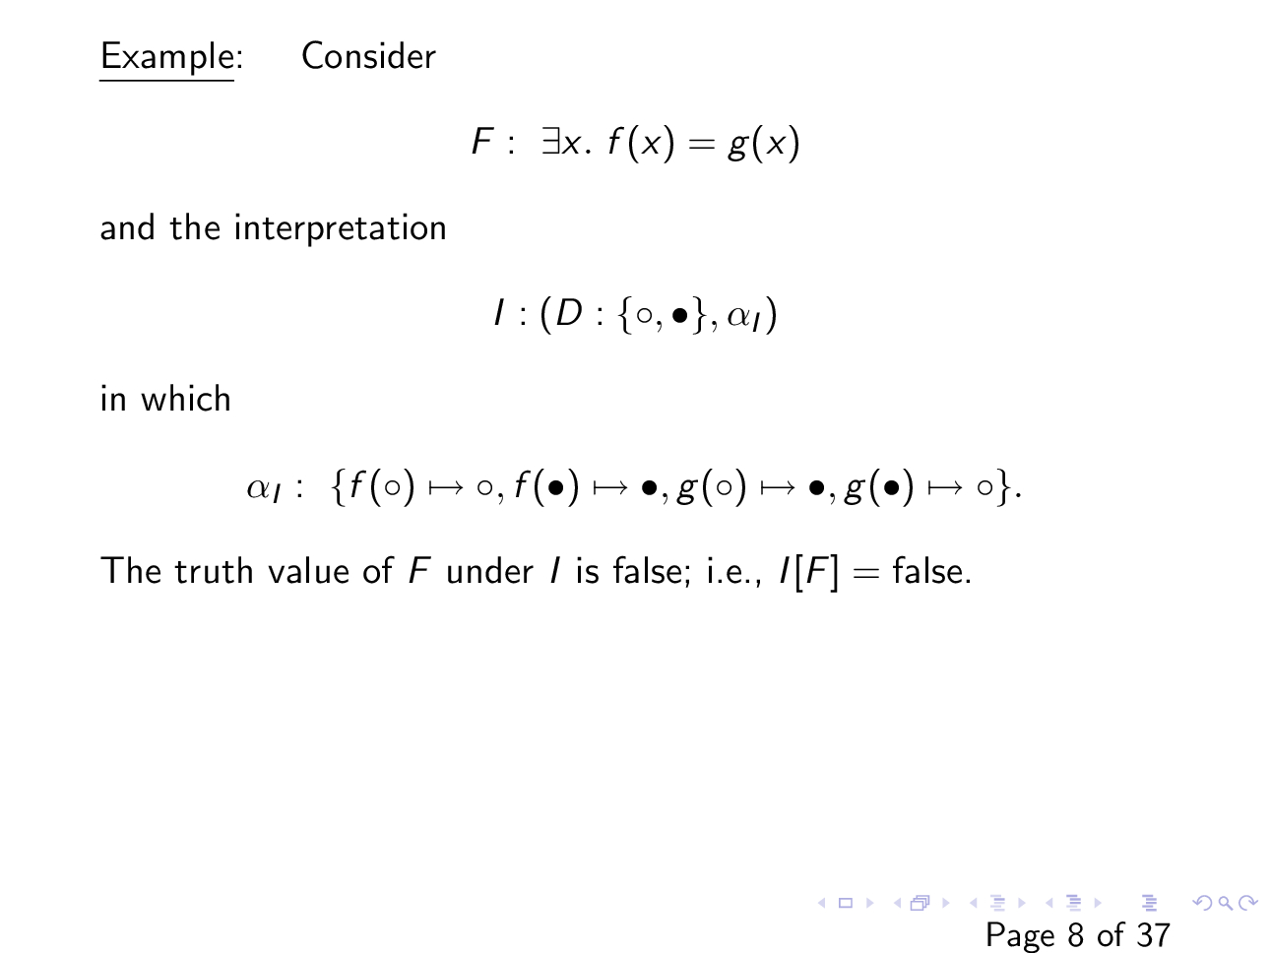

Slide 9
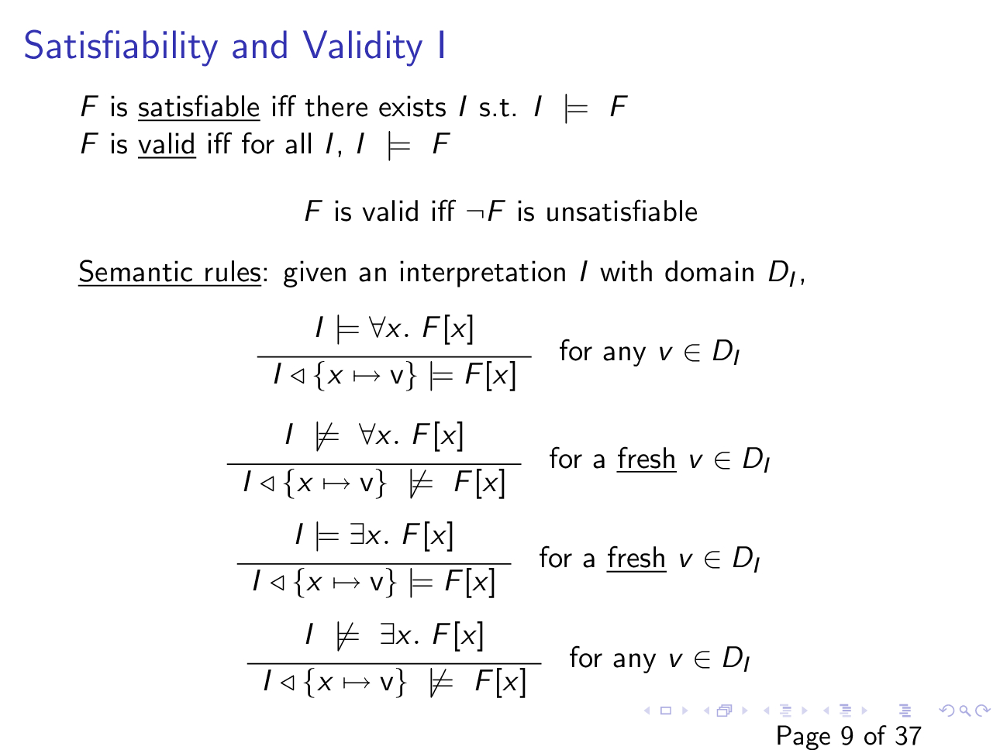

Slide 10
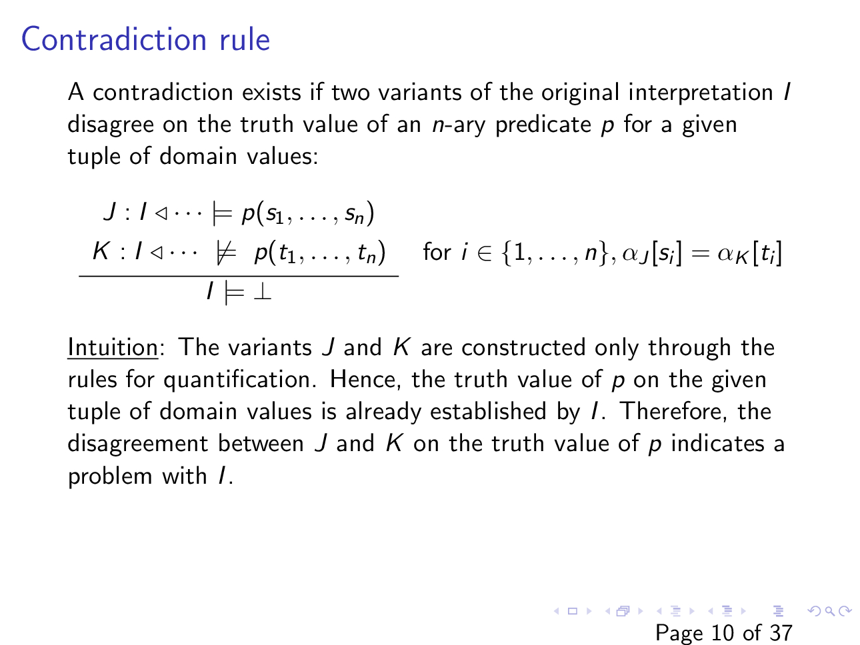

Slide 11

Example
Is $\left(∀x. p\left(x\right)\right)→(∀y. p(y))$ valid?

Slide 12

Example
Is $\left(∀x. p\left(x\right)\right)↔(¬∃x. ¬p(x))$ valid?

Slide 13
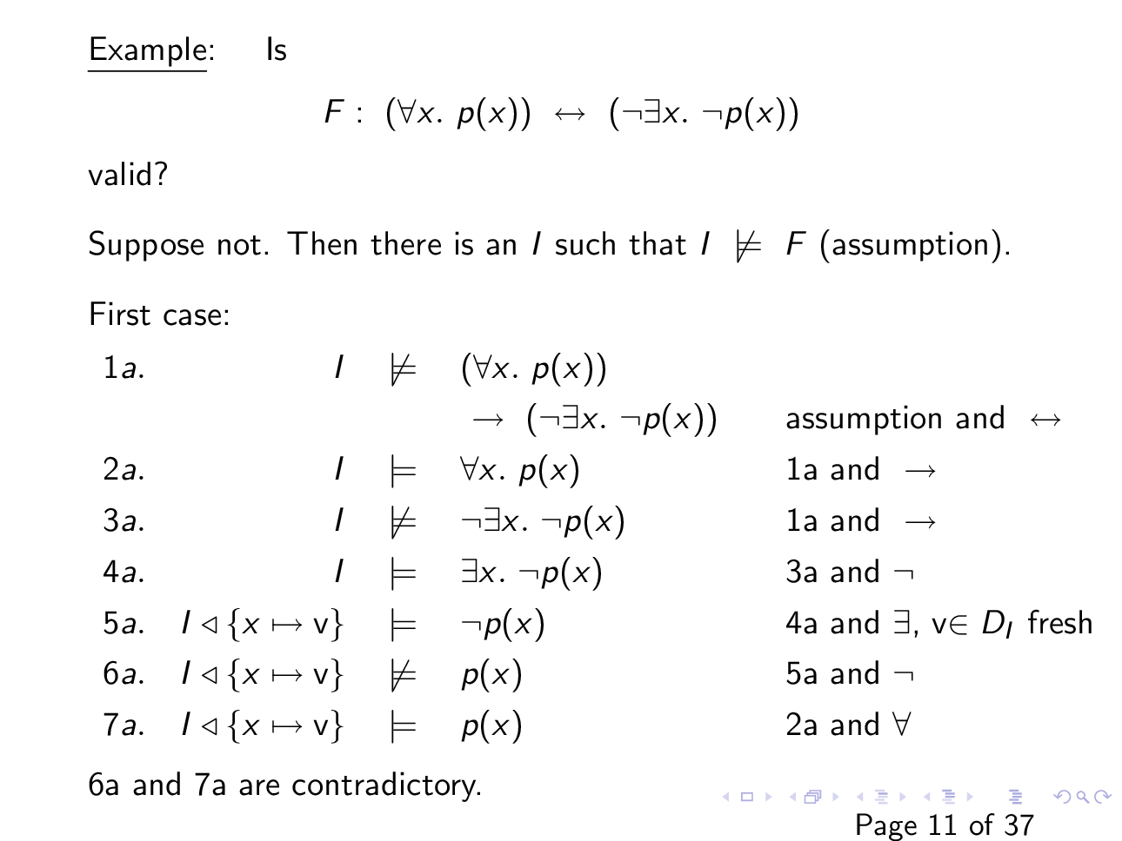

Slide 14
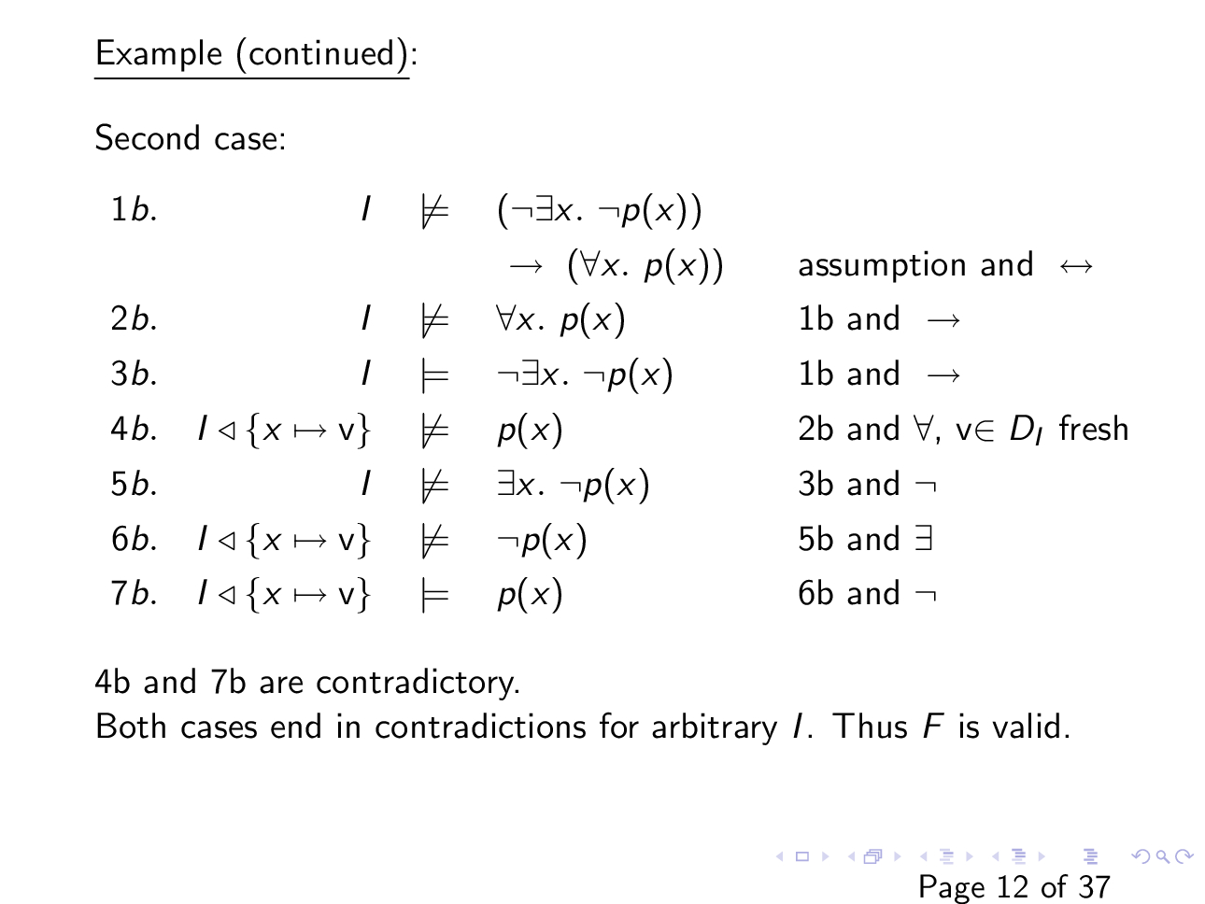

Slide 15

Example
Is $p(a)→(∃x. p(x))$ valid?

Slide 16
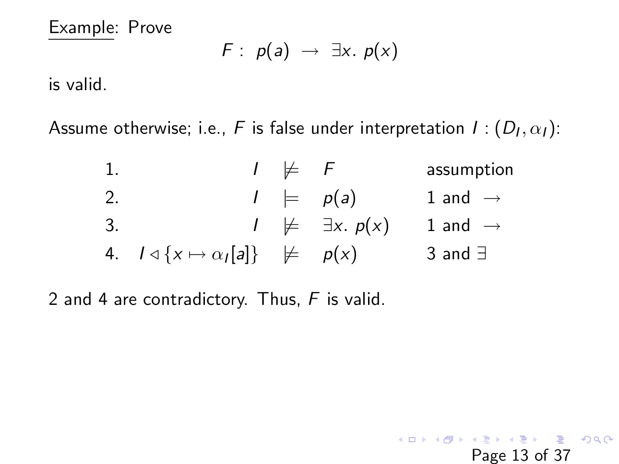

Slide 17

Example
Is $\left(∀x. p\left(x\right)\right)↔(∃x. p(x))$ valid?

Slide 18

Example
Is $\left(∀x. p\left(x,x\right)\right)→(∃x. ∀y. p(x, y))$ valid?

Slide 19
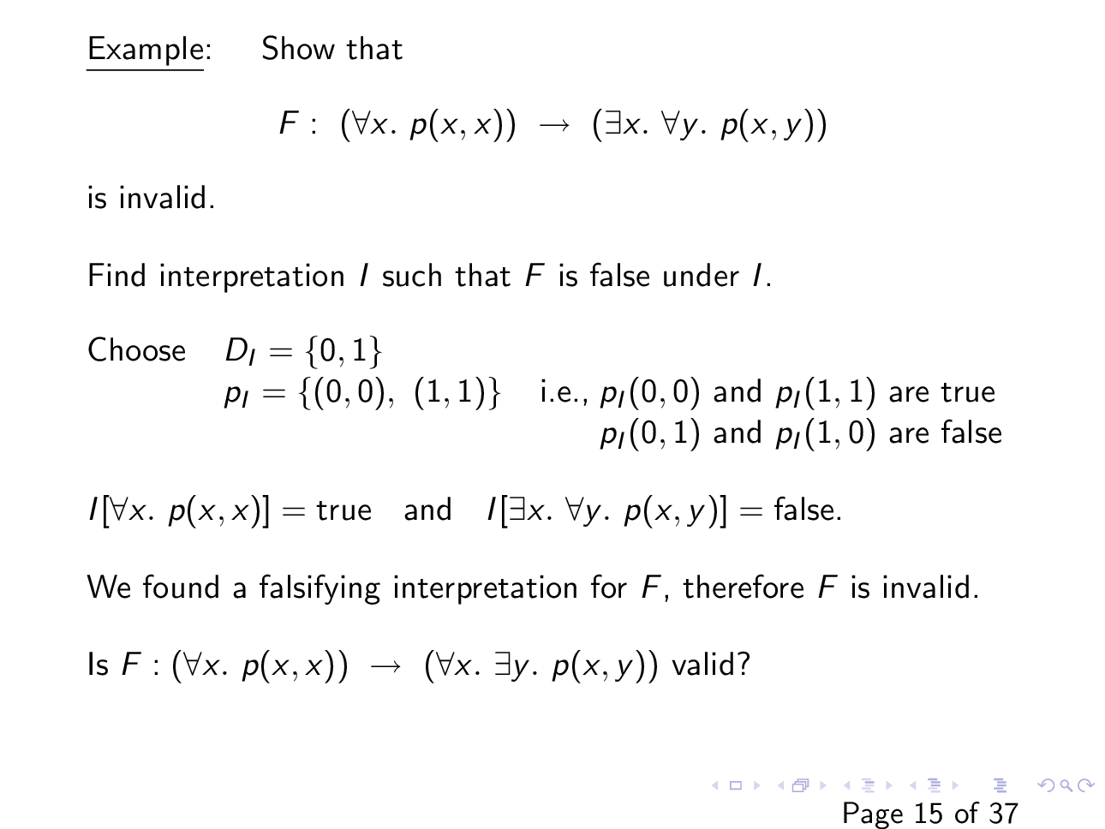

Slide 20

Example
Is $\left(∃x.∀y. p\left(x,y\right)\right)→(∀x. ∃y. p(y, x))$ valid?

Slide 21
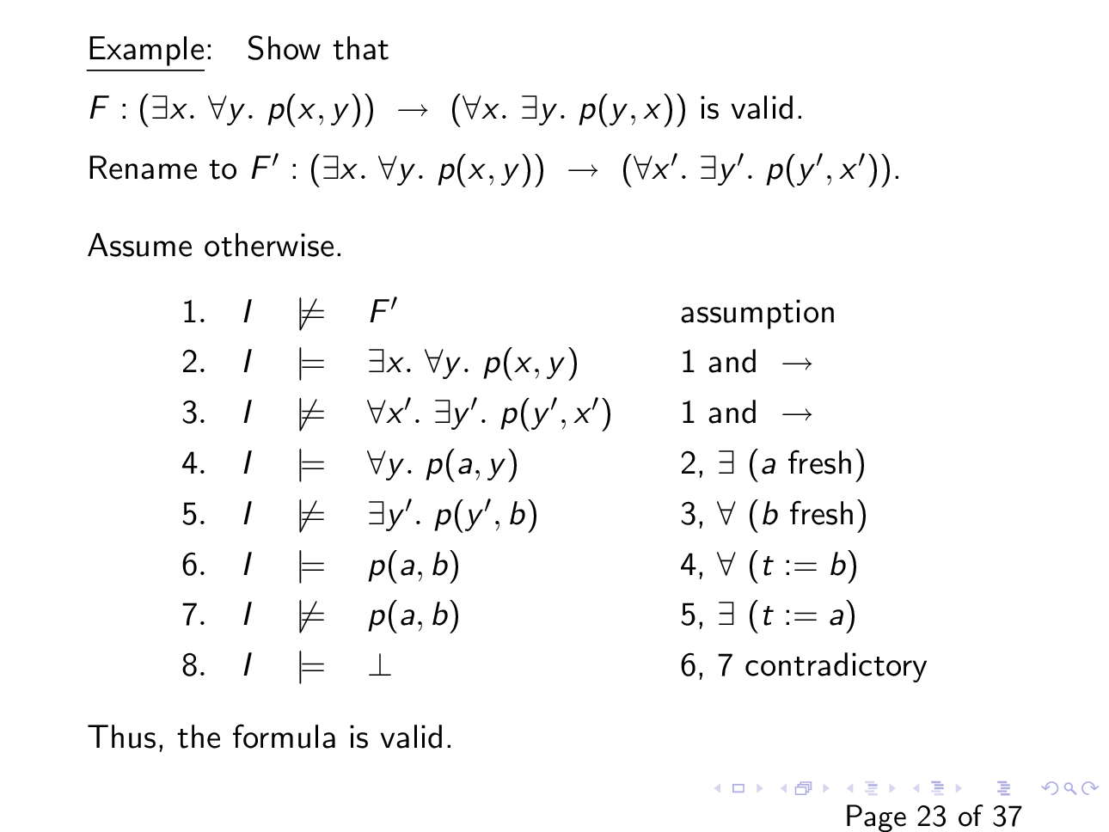

Slide 22
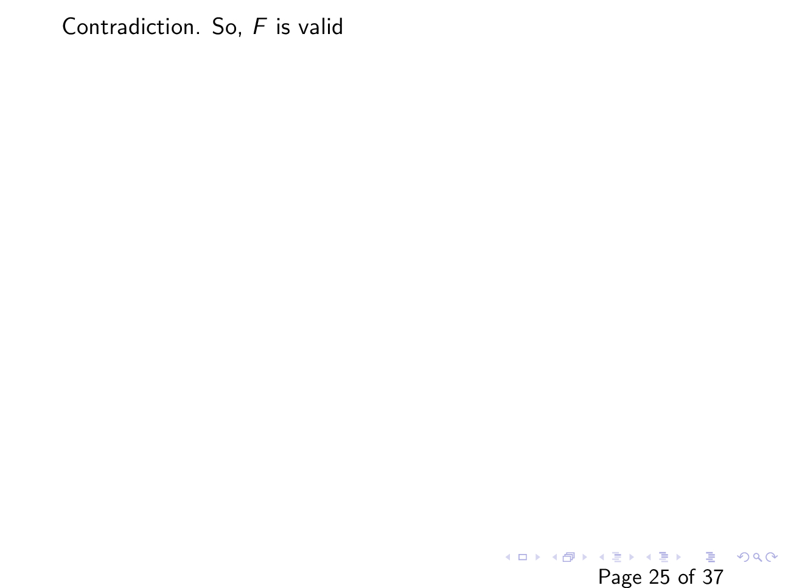

Slide 23

Example
Is $\left(∀x,y. p\left(x,y\right) →p(y,x)\right)→∀z. p(z, z)$ valid?

Slide 24
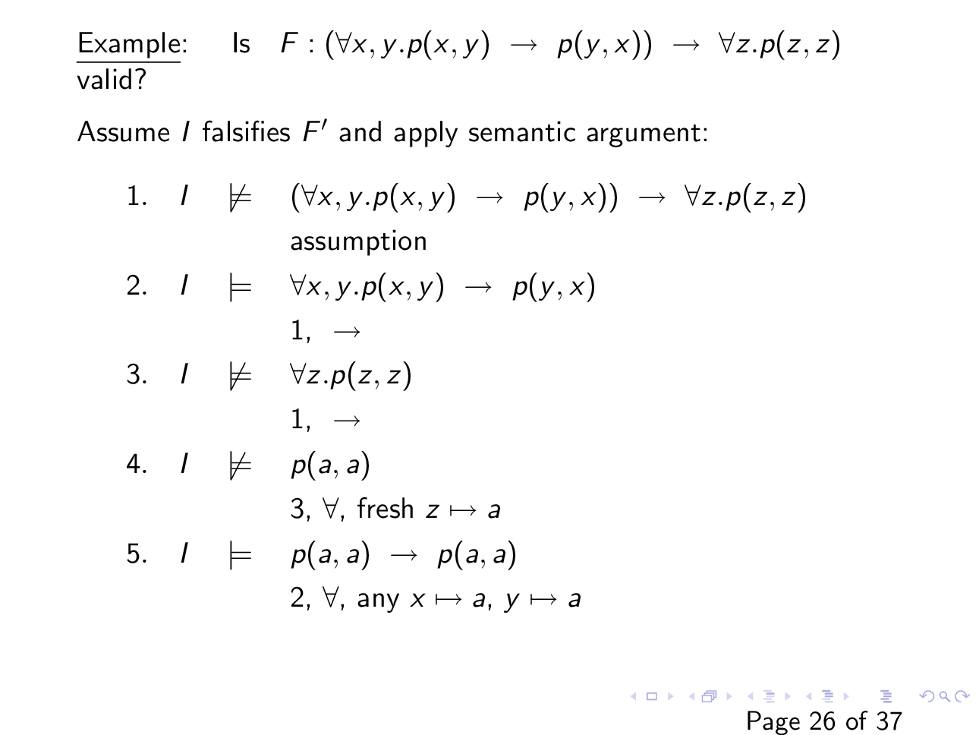

Slide 25
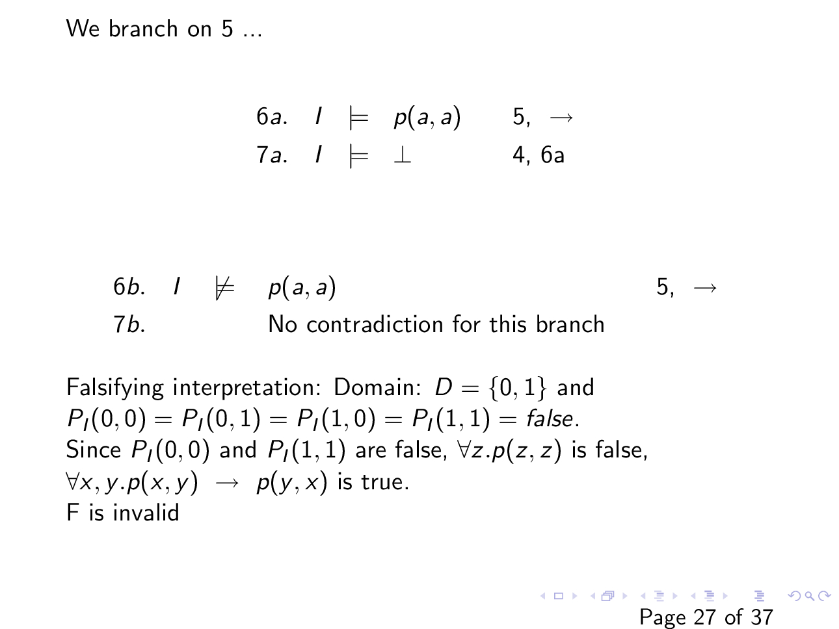

Slide 26
Subformula
The subformula of a FOL formula is defined as follows
The only subformula of $p(t_{1}, …, t_{n})$ is $p\left(t_{1}, …, t_{n}\right)$
The subformulae for $¬F$ are $¬F$ and subformulae of $F$
The subfromulae of $F_{1}∧F_{2}$, $F_{1}∨F_{2}$, $F_{1}→F_{2}$, $F_{1}↔F_{2}$ are the formula itself and the subformulae of $F_{1}$ and $F_{2}$
The subformulae of $∃x. F$ and $∀x. F$ are the formula itself and the subformulae of $F$

Slide 27

Subformula
What are the subformulae of $F : ∀x. p\left(f\left(x\right), y\right)→∀y.p\left(f\left(x\right), y\right)$

Slide 28

Subformula
The subformulae of $F : ∀x. p\left(f\left(x\right), y\right)→∀y.p\left(f\left(x\right), y\right)$ are
F
$p\left(f\left(x\right), y\right)→∀y.p(f\left(x\right),y)$
$p\left(f\left(x\right),y\right)$
$∀y.p\left(f\left(x\right), y\right)$

Slide 29
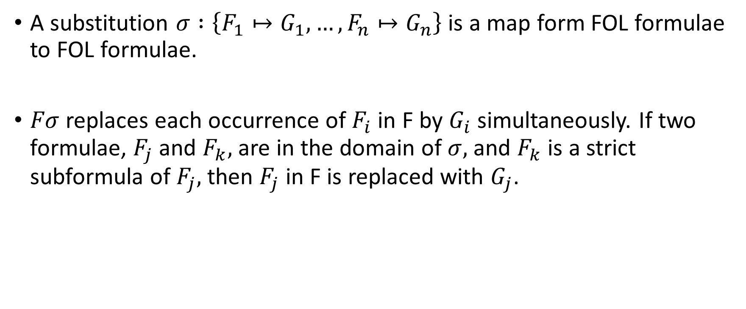
Substitution
A substitution $σ :\left\{F_{1}↦G_{1}, …, F_{n}↦G_{n}\right\}$ is a map form FOL formulae to FOL formulae.
$Fσ$ replaces each occurrence of $F_{i}$ in F by $G_{i}$ simultaneously. If two formulae, $F_{j}$ and $F_{k},$ are in the domain of $σ,$ and $F_{k}$ is a strict subformula of $F_{j},$ then $F_{j}$ in F is replaced with $G_{j}$.

Slide 30

Substitution
$$F:\left(∀x.p\left(x, y\right)\right)→q(f\left(y\right), x)$$
and a substitution
$$σ:\{x↦g\left(x\right), y↦f\left(x\right), q\left(f\left(y\right),x\right)↦∃x.h(x,y)\}$$

Slide 31
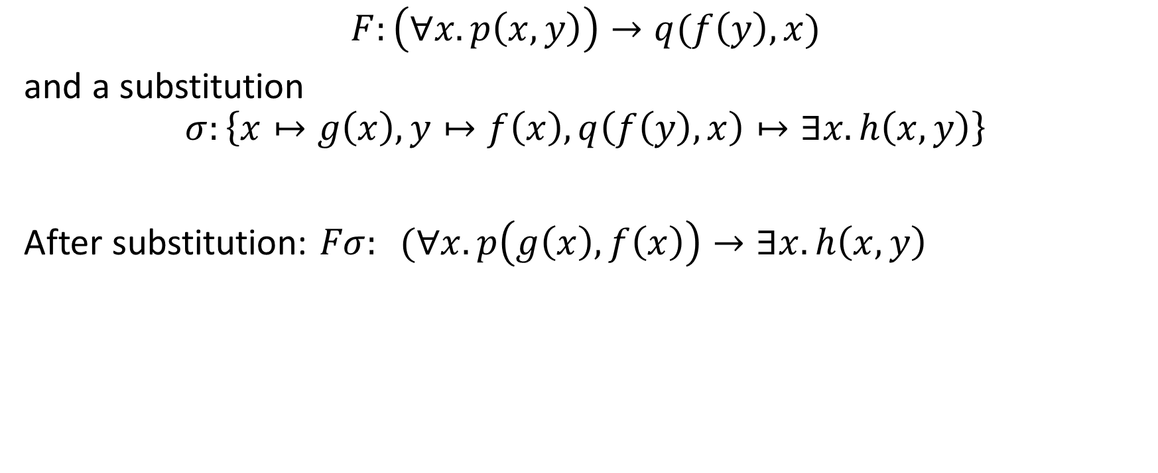
Substitution
$$F:\left(∀x.p\left(x, y\right)\right)→q(f\left(y\right), x)$$
and a substitution
$$σ:\left\{x↦g\left(x\right), y↦f\left(x\right), q\left(f\left(y\right),x\right)↦∃x.h\left(x,y\right)\right\}$$
After substitution: $Fσ: (∀x.p\left(g\left(x\right), f\left(x\right)\right)→∃x.h\left(x,y\right)$

Slide 32

Substitution
$$F:∃y.p\left(x,y\right)∧p(y,x)$$
and a substitution
$$σ:\{∃y.p\left(x,y\right)↦p(x,a)\}$$

Slide 33

Substitution
$$F:∃y.p\left(x,y\right)∧p(y,x)$$
and a substitution
$$σ:\left\{∃y.p\left(x,y\right)↦p\left(x,a\right)\right\}$$
$∃y.p\left(x,y\right)$is not a subformula. Substitution not needed.

Slide 34
Safe substitution
The semantics of substitution is confusing because of the quantifiers
A free variable may become a bound variable and vice versa due to a substitution
Safe substitution prevents the above situation
Safe substitution enables the generation of equivalent formula

Slide 35
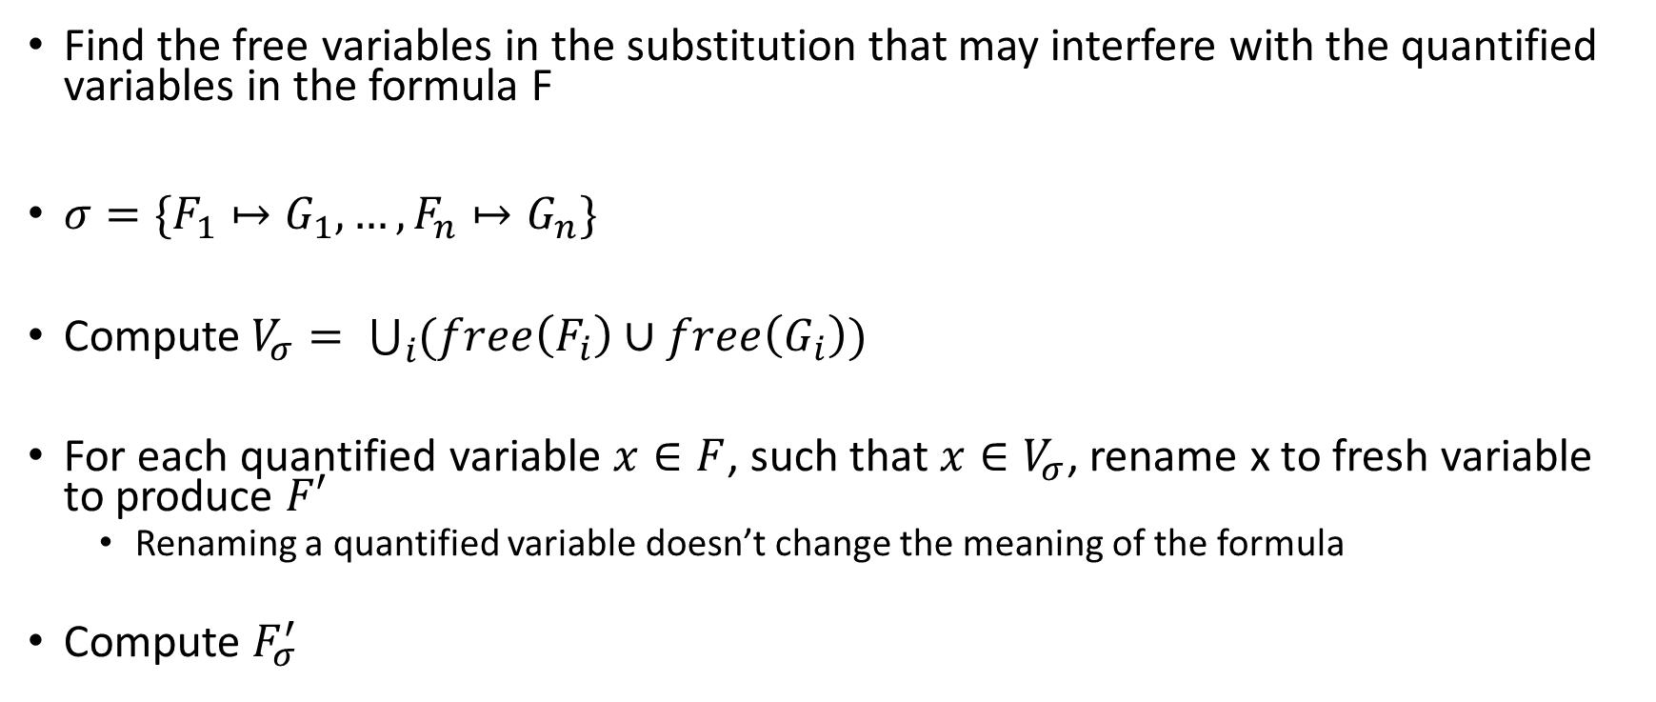
Safe substitution
Find the free variables in the substitution that may interfere with the quantified variables in the formula F
$σ=\{F_{1}↦G_{1}, …, F_{n}↦G_{n}\}$
Compute$V_{σ}= \bigcup_{i}{(free\left(F_{i}\right)∪free\left(G_{i}\right))}$
For each quantified variable $x∈F$, such that $x∈V_{σ}$, rename x to fresh variable to produce $F′$
Renaming a quantified variable doesn’t change the meaning of the formula
Compute $F_{σ}^{′}$

Slide 36
Safe substitution
$$F:\left(∀x.p\left(x, y\right)\right)→q(f\left(y\right), x)$$
and a substitution
$$σ:\{x↦g\left(x\right), y↦f\left(x\right), q\left(f\left(y\right),x\right)↦∃x.h(x,y)\}$$

Slide 37
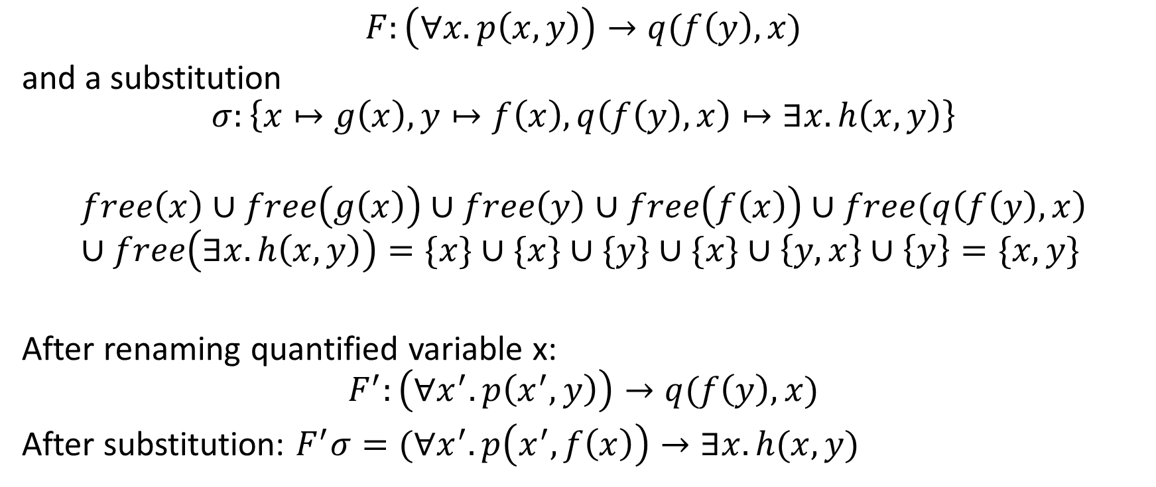
Safe substitution
$$F:\left(∀x.p\left(x, y\right)\right)→q(f\left(y\right), x)$$
and a substitution
$$σ:\left\{x↦g\left(x\right), y↦f\left(x\right), q\left(f\left(y\right),x\right)↦∃x.h\left(x,y\right)\right\}$$
$$free\left(x\right)∪free\left(g\left(x\right)\right)∪free\left(y\right)∪free\left(f\left(x\right)\right)∪free(q\left(f\left(y\right), x\right)∪free\left(∃x.h\left(x,y\right)\right)=\{x\}∪\{x\}∪\{y\}∪\{x\}∪\left\{y, x\right\}∪\left\{y\right\}=\{x, y\}$$
After renaming quantified variable x:
$$F^{′}:\left(∀x^{′}.p\left(x^{′}, y\right)\right)→q(f\left(y\right),x)$$
After substitution: $F^{′}σ=(∀x^{′}.p\left(x^{′}, f\left(x\right)\right)→∃x.h(x,y)$

Slide 38

Safe substitution
$$F:\left(∀z.p\left(z, y\right)\right)→q(f\left(y\right), x)$$
and a substitution
$$σ:\{x↦g\left(x\right), y↦f\left(y\right), q\left(f\left(y\right),x\right)↦∃x.h(x,y)\}$$

Slide 39
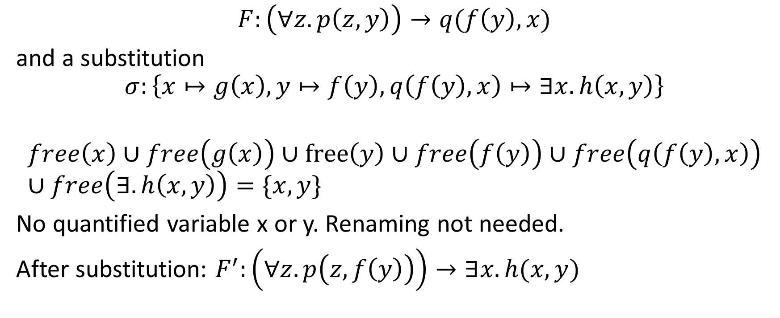
Safe substitution
$$F:\left(∀z.p\left(z, y\right)\right)→q(f\left(y\right), x)$$
and a substitution
$$σ:\left\{x↦g\left(x\right), y↦f\left(y\right), q\left(f\left(y\right),x\right)↦∃x.h\left(x,y\right)\right\}$$
$$free\left(x\right)∪free\left(g\left(x\right)\right)∪free\left(y\right)∪free\left(f\left(y\right)\right)∪free\left(q\left(f\left(y\right),x\right)\right)∪free\left(∃.h\left(x,y\right)\right)=\{x, y\}$$
No quantified variable x or y. Renaming not needed.
After substitution: $F^{′}:\left(∀z.p\left(z,f\left(y\right)\right)\right)→∃x.h(x,y)$

Slide 40

Equivalent formula using safe substitution
Consider substitution
$σ :\{F_{1}↦G_{1}, …, F_{n}↦G_{n}\}$
such that for each i, $F_{i}⟺G_{i}$,
then $F_{i}⟺Fσ$, when $Fσ$ is computed as a safe substitution

