Slide 2
References
Read chapter-2, 3 from the COC book
Read chapter-3 from the DP book

Slide 3
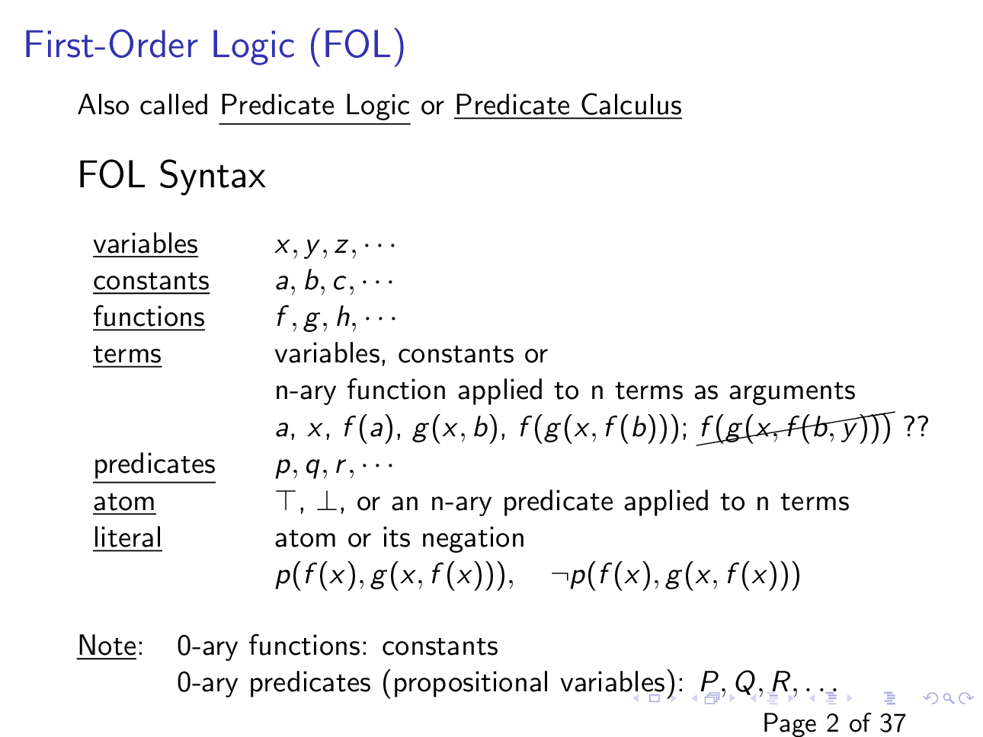

Slide 4
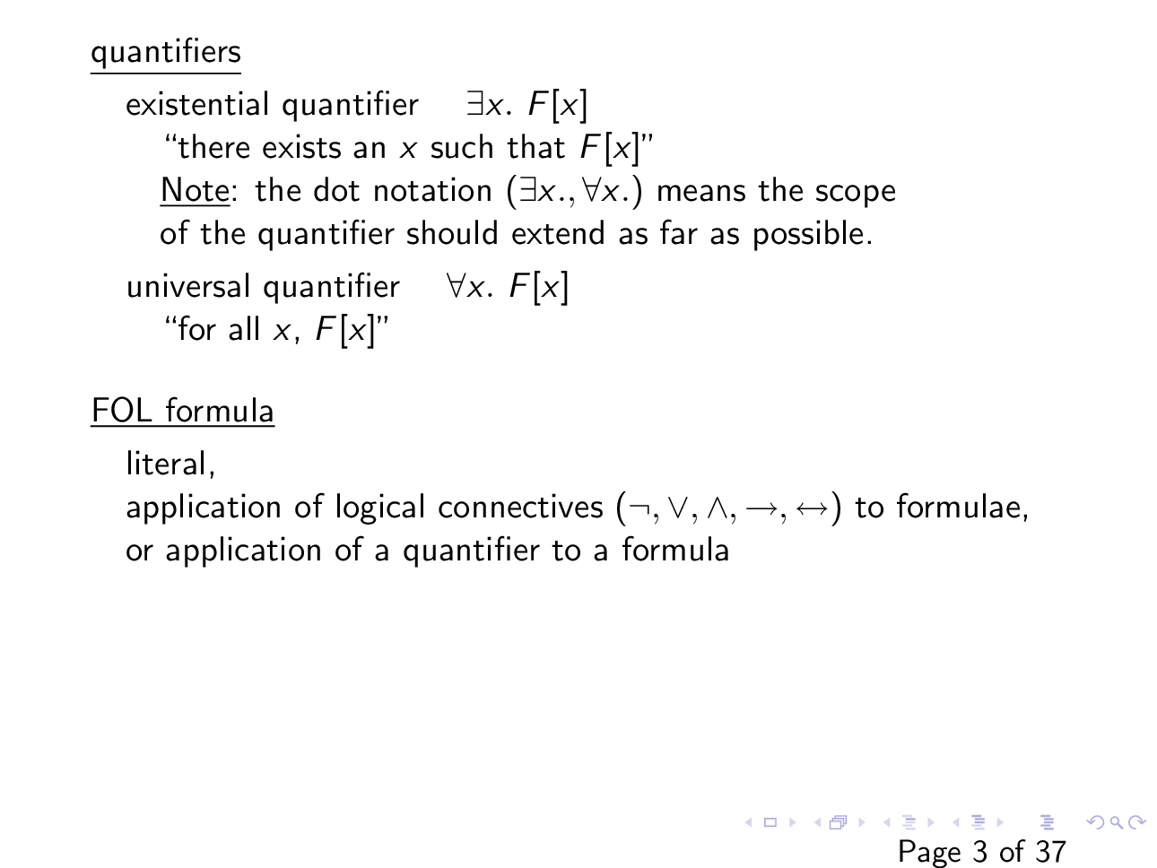

Slide 5
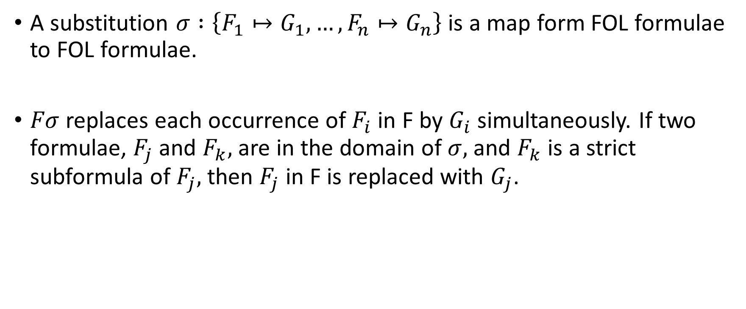
Substitution
A substitution $σ :\left\{F_{1}↦G_{1}, …, F_{n}↦G_{n}\right\}$ is a map form FOL formulae to FOL formulae.
$Fσ$ replaces each occurrence of $F_{i}$ in F by $G_{i}$ simultaneously. If two formulae, $F_{j}$ and $F_{k},$ are in the domain of $σ,$ and $F_{k}$ is a strict subformula of $F_{j},$ then $F_{j}$ in F is replaced with $G_{j}$.

Slide 6

Substitution
$$F:\left(∀x.p\left(x, y\right)\right)→q(f\left(y\right), x)$$
and a substitution
$$σ:\{x↦g\left(x\right), y↦f\left(x\right), q\left(f\left(y\right),x\right)↦∃x.h(x,y)\}$$

Slide 7

Substitution
$$F:∃y.p\left(x,y\right)∧p(y,x)$$
and a substitution
$$σ:\{∃y.p\left(x,y\right)↦p(x,a)\}$$

Slide 8
Safe substitution
The semantics of substitution is confusing because of the quantifiers
A free variable may become a bound variable and vice versa due to a substitution
Safe substitution prevents the above situation
Safe substitution enables the generation of equivalent formula

Slide 9
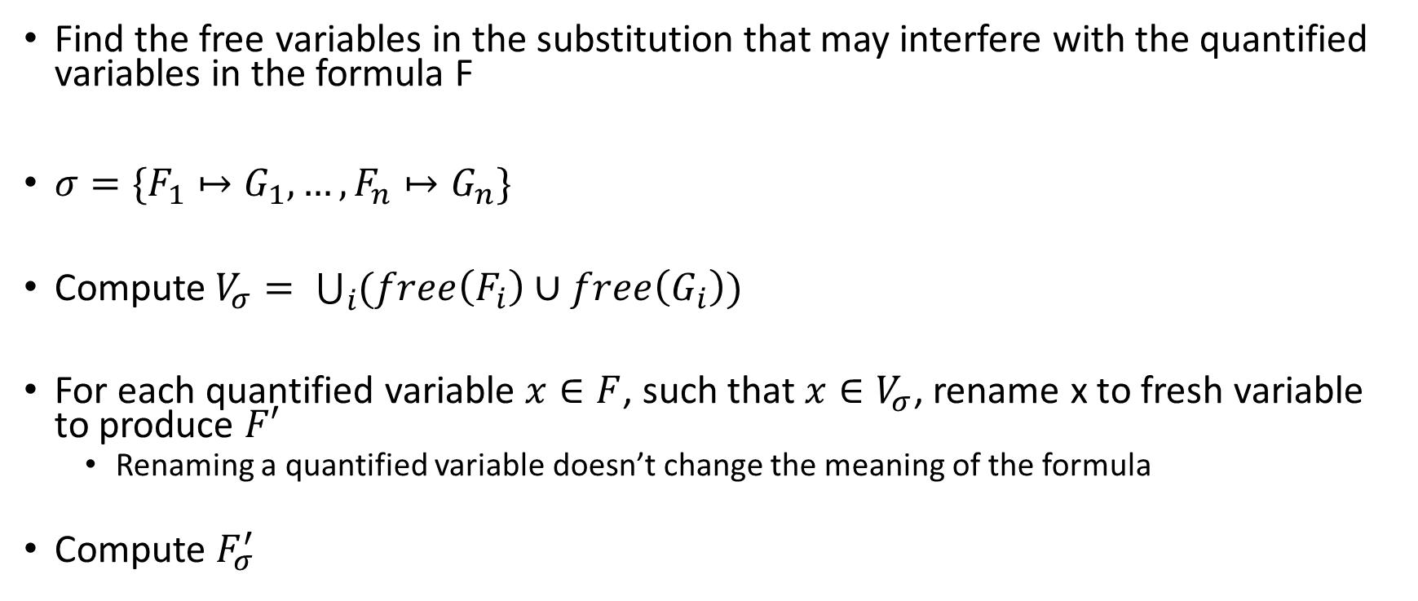
Safe substitution
Find the free variables in the substitution that may interfere with the quantified variables in the formula F
$σ=\{F_{1}↦G_{1}, …, F_{n}↦G_{n}\}$
Compute$V_{σ}= \bigcup_{i}{(free\left(F_{i}\right)∪free\left(G_{i}\right))}$
For each quantified variable $x∈F$, such that $x∈V_{σ}$, rename x to fresh variable to produce $F′$
Renaming a quantified variable doesn’t change the meaning of the formula
Compute $F_{σ}^{′}$

Slide 10
Safe substitution
$$F:\left(∀x.p\left(x, y\right)\right)→q(f\left(y\right), x)$$
and a substitution
$$σ:\{x↦g\left(x\right), y↦f\left(x\right), q\left(f\left(y\right),x\right)↦∃x.h(x,y)\}$$

Slide 11

Safe substitution
$$F:\left(∀z.p\left(z, y\right)\right)→q(f\left(y\right), x)$$
and a substitution
$$σ:\{x↦g\left(x\right), y↦f\left(y\right), q\left(f\left(y\right),x\right)↦∃x.h(x,y)\}$$

Slide 12

Equivalent formula using safe substitution
Consider substitution
$σ :\{F_{1}↦G_{1}, …, F_{n}↦G_{n}\}$
such that for each i, $F_{i}⟺G_{i}$,
then $F_{i}⟺Fσ$, when $Fσ$ is computed as a safe substitution

Slide 13
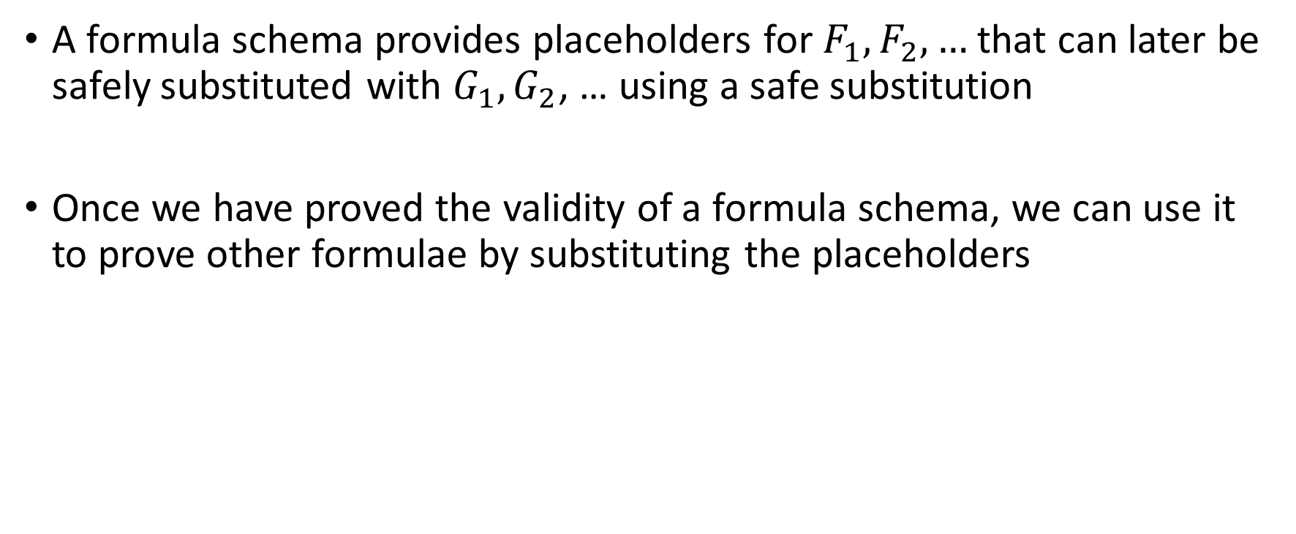
Formula schema
A formula schema provides placeholders for $F_{1}, F_{2}, …$that can later be safely substituted with $G_{1},G_{2}$, … using a safe substitution
Once we have proved the validity of a formula schema, we can use it to prove other formulae by substituting the placeholders

Slide 14

Formula schema
Prove the validity of
$\left(∀x.F_{1}∧F_{2}\right)↔\left(∀x. F_{1}\right)∧(∀x.F_{2}))$

Slide 15

Formula schema with side condition
Prove the validity of
$\left(∀x.F\right)↔F$ provided $x∉free(F)$

Slide 16
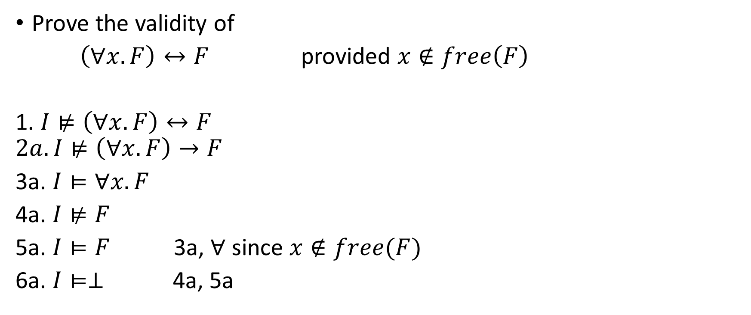
Formula schema with side condition
Prove the validity of
$\left(∀x.F\right)↔F$ provided $x∉free\left(F\right)$
1. $I⊭\left(∀x.F\right)↔F$
$$2a. I⊭\left(∀x.F\right)→F$$
3a. $I⊨∀x.F$
4a. $I⊭F$
5a. $I⊨F$ 3a, $∀$ since $x∉free(F)$
6a. $I⊨⊥$ 4a, 5a

Slide 17
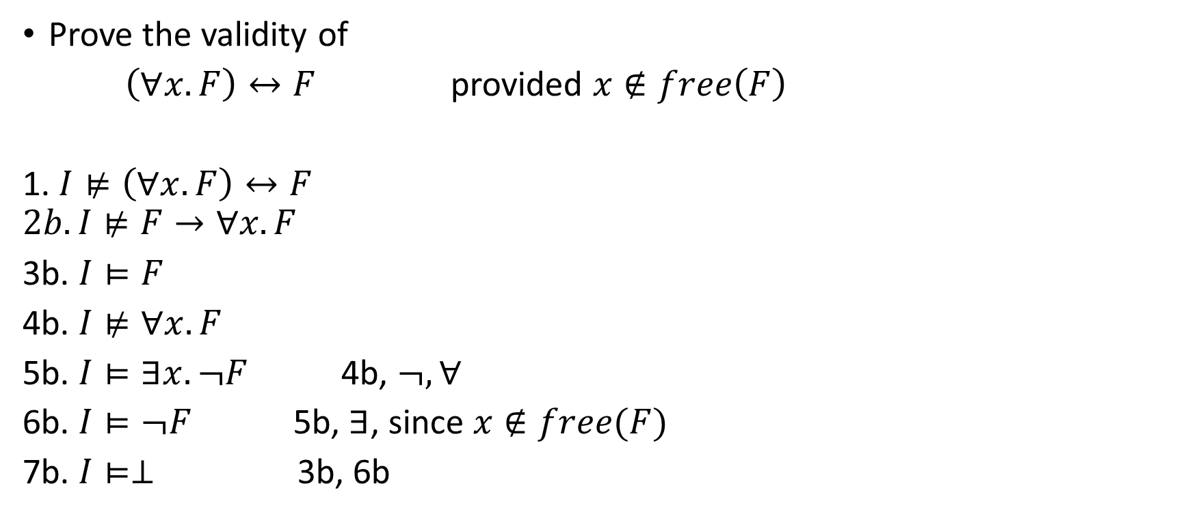
Formula schema with side condition
Prove the validity of
$\left(∀x.F\right)↔F$ provided $x∉free\left(F\right)$
1. $I⊭\left(∀x.F\right)↔F$
$$2b. I⊭F→∀x.F$$
3b. $I⊨F$
4b. $I⊭∀x. F$
5b. $I⊨∃x. ¬F$ 4b, $¬, ∀$
6b. $I⊨¬F$ 5b, $∃$, since $x∉free(F)$
7b. $I⊨⊥$ 3b, 6b

Slide 18

Formula schema with side condition
Prove the validity of
$\left(∀x.F_{1}∧F_{2}\right)↔{(∀x.F}_{1})∧F_{2}$ provided $x∉free(F_{2})$

Slide 19
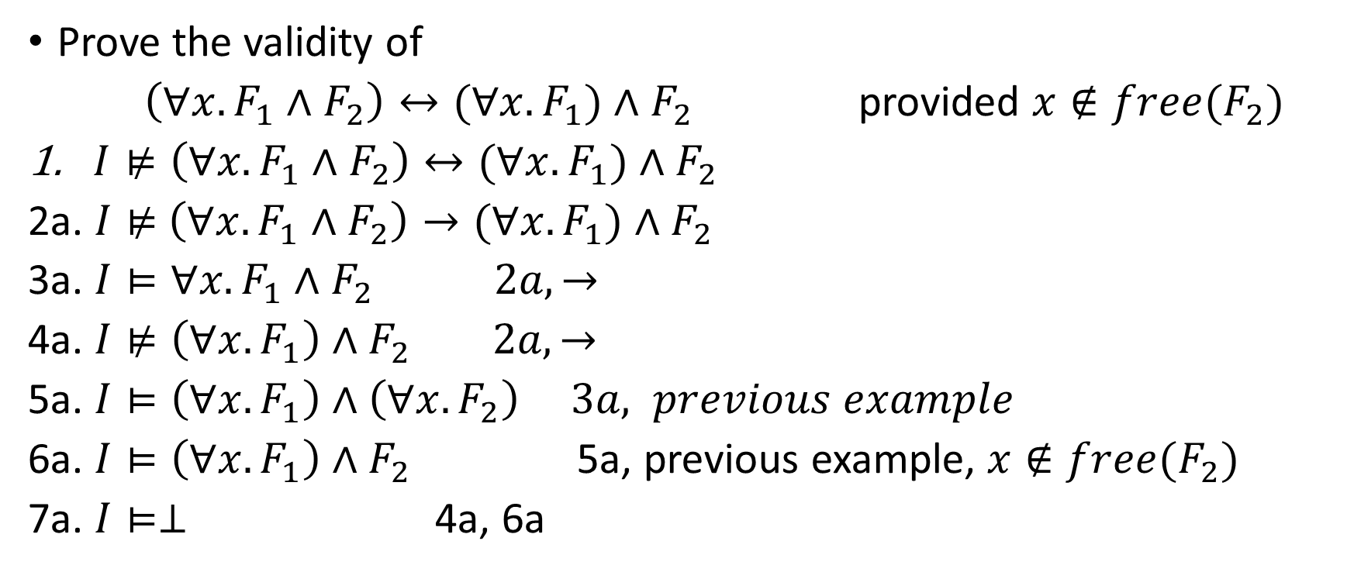
Formula schema with side condition
Prove the validity of
$\left(∀x.F_{1}∧F_{2}\right)↔{(∀x.F}_{1})∧F_{2}$ provided $x∉free(F_{2})$
$I⊭\left(∀x.F_{1}∧F_{2}\right)↔{(∀x.F}_{1})∧F_{2}$
2a. $I⊭$ $\left(∀x.F_{1}∧F_{2}\right)→{(∀x.F}_{1})∧F_{2}$
3a. $I⊨∀x.F_{1}∧F_{2} 2a, →$
4a. $I⊭\left(∀x.F_{1}\right)∧F_{2} 2a, →$
5a. $I⊨\left(∀x.F_{1}\right)∧\left(∀x. F_{2}\right) 3a, previous example$
6a. $I⊨\left(∀x.F_{1}\right)∧F_{2}$ 5a, previous example, $x∉free(F_{2})$
7a. $I⊨⊥$ 4a, 6a

Slide 20
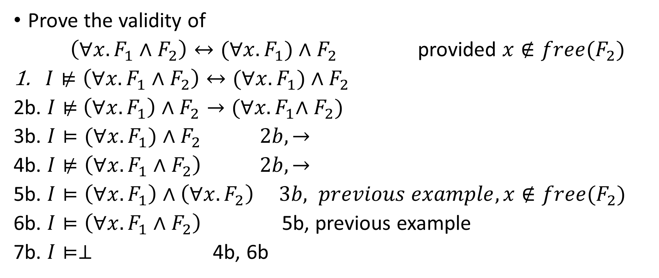
Formula schema with side condition
Prove the validity of
$\left(∀x.F_{1}∧F_{2}\right)↔{(∀x.F}_{1})∧F_{2}$ provided $x∉free(F_{2})$
$I⊭\left(∀x.F_{1}∧F_{2}\right)↔{(∀x.F}_{1})∧F_{2}$
2b. $I⊭$ $\left(∀x.F_{1}\right)∧F_{2}→{(∀x.F}_{1}∧F_{2})$
3b. $I⊨(∀x.F_{1})∧F_{2} 2b, →$
4b. $I⊭\left(∀x.F_{1}∧F_{2}\right) 2b, →$
5b. $I⊨\left(∀x.F_{1}\right)∧\left(∀x. F_{2}\right) 3b, previous example, x∉free(F_{2})$
6b. $I⊨\left(∀x.F_{1}∧F_{2}\right)$ 5b, previous example
7b. $I⊨⊥$ 4b, 6b

Slide 21
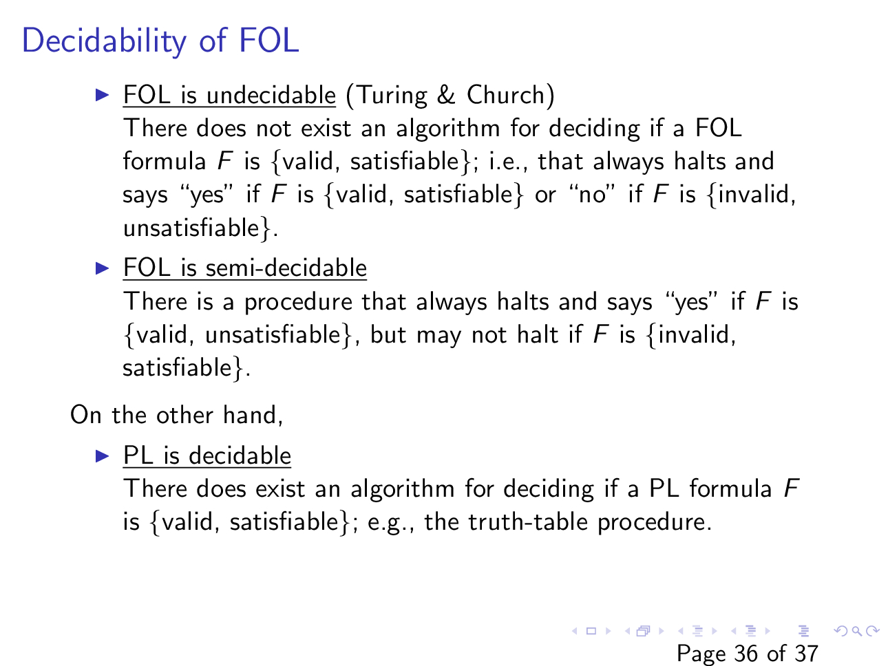

Slide 22
First order theories

Slide 23
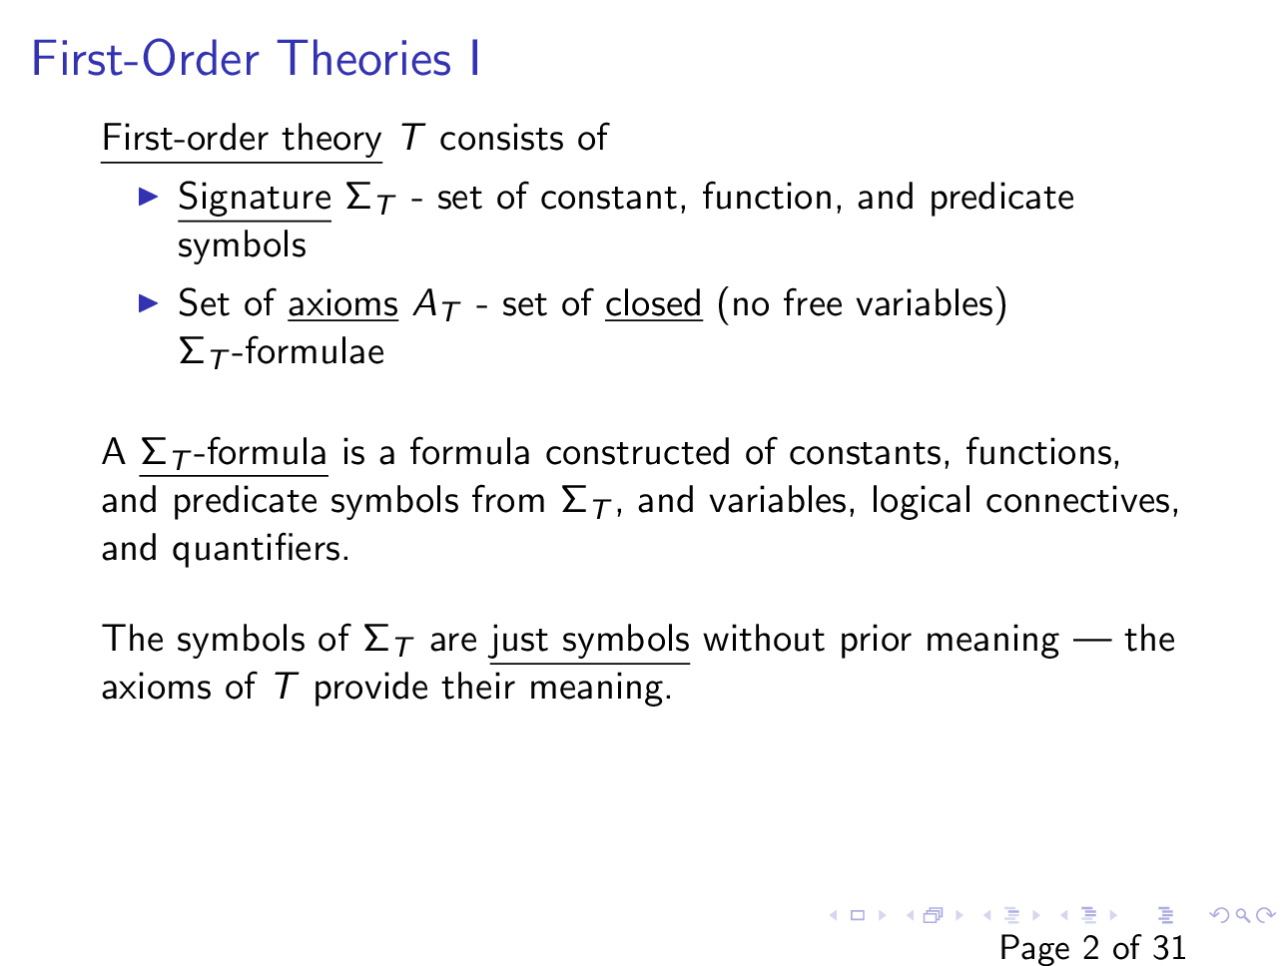

Slide 24
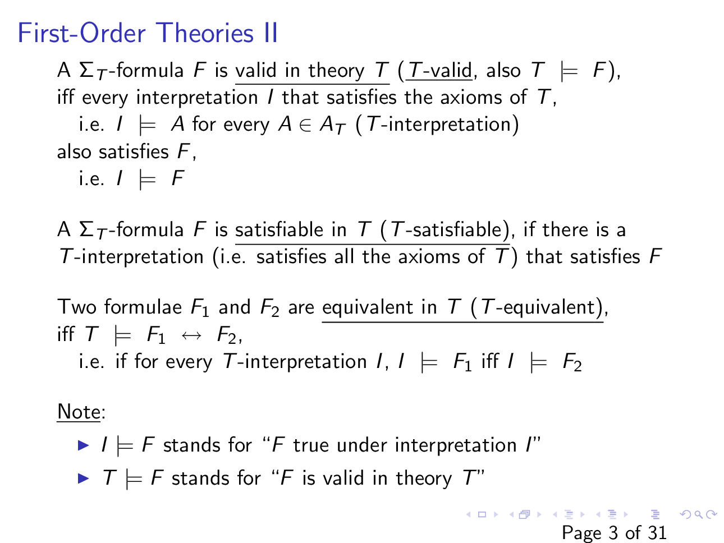

Slide 25
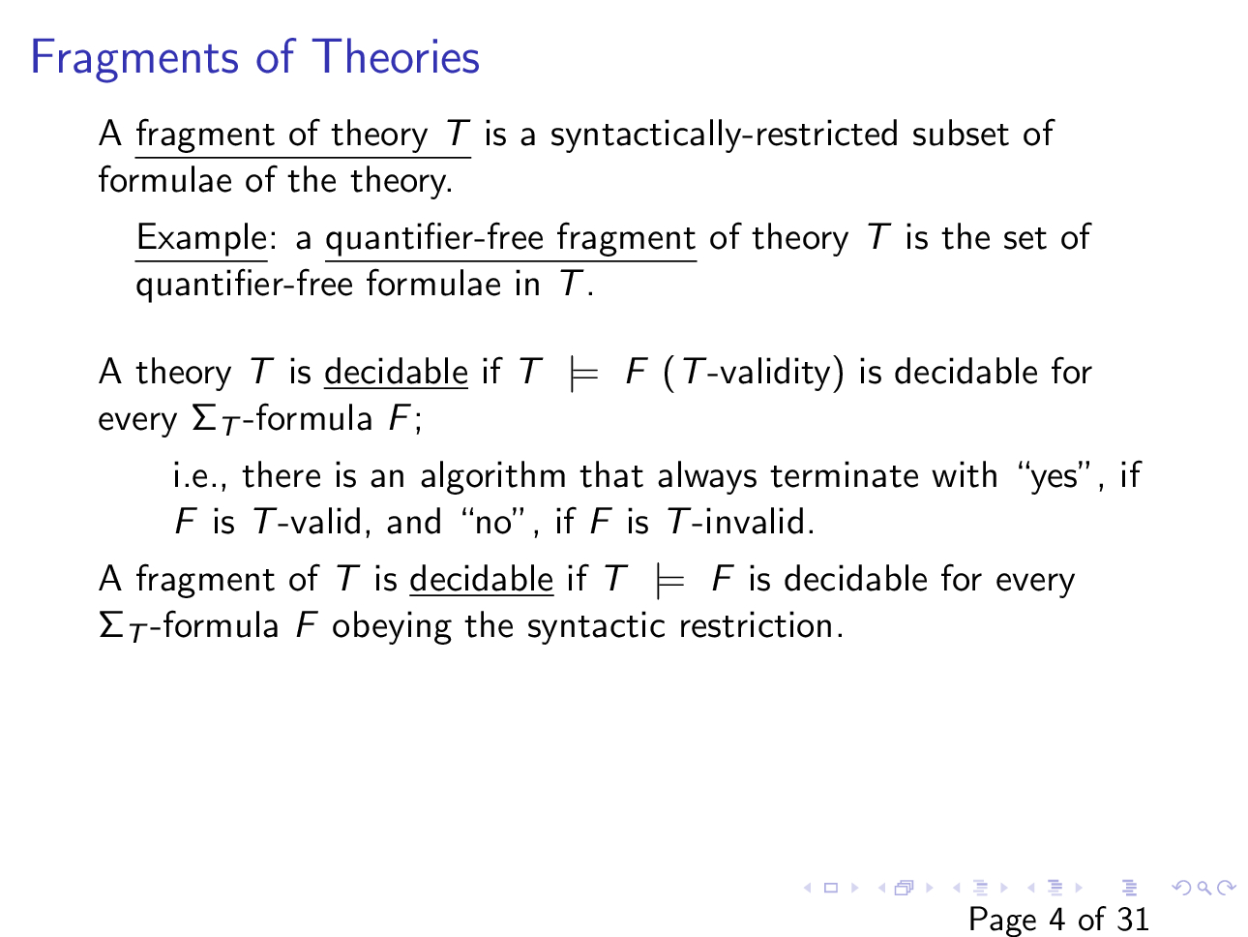

Slide 26
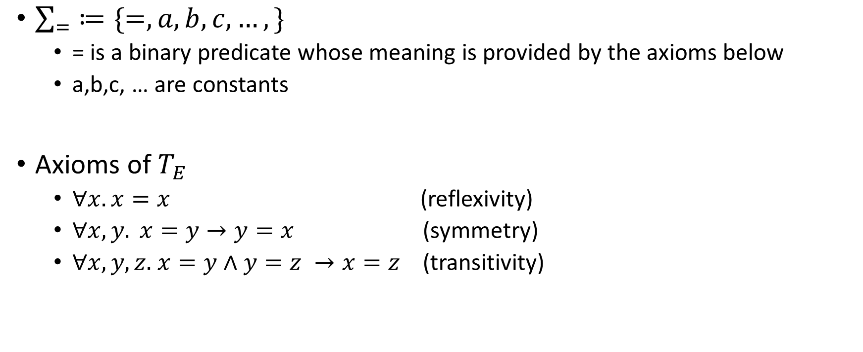

Theory of equality ($T_{E})$
$\sum_{=}{≔\{=, a,b,c,…,\}}$
= is a binary predicate whose meaning is provided by the axioms below
a,b,c, … are constants
Axioms of $T_{E}$
$∀x.x=x$ (reflexivity)
$∀x,y. x=y→y=x$ (symmetry)
$∀x,y,z.$ $x=y∧y=z →x=z$ (transitivity)

Slide 27

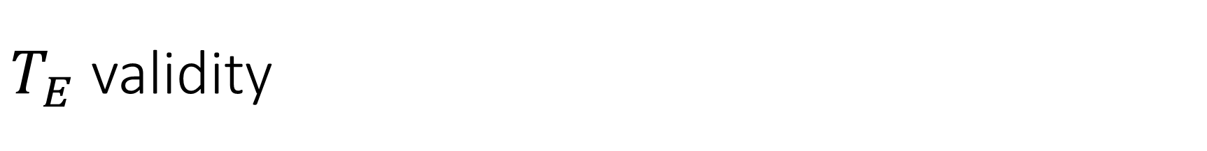
$T_{E}$ validity
Is $\left(a=b\right)∧\left(\left(b=c\right)∨\left(b=d\right)\right)→\left(a=c\right)∨(a=d)$ $T_{E}$ valid?

Slide 28
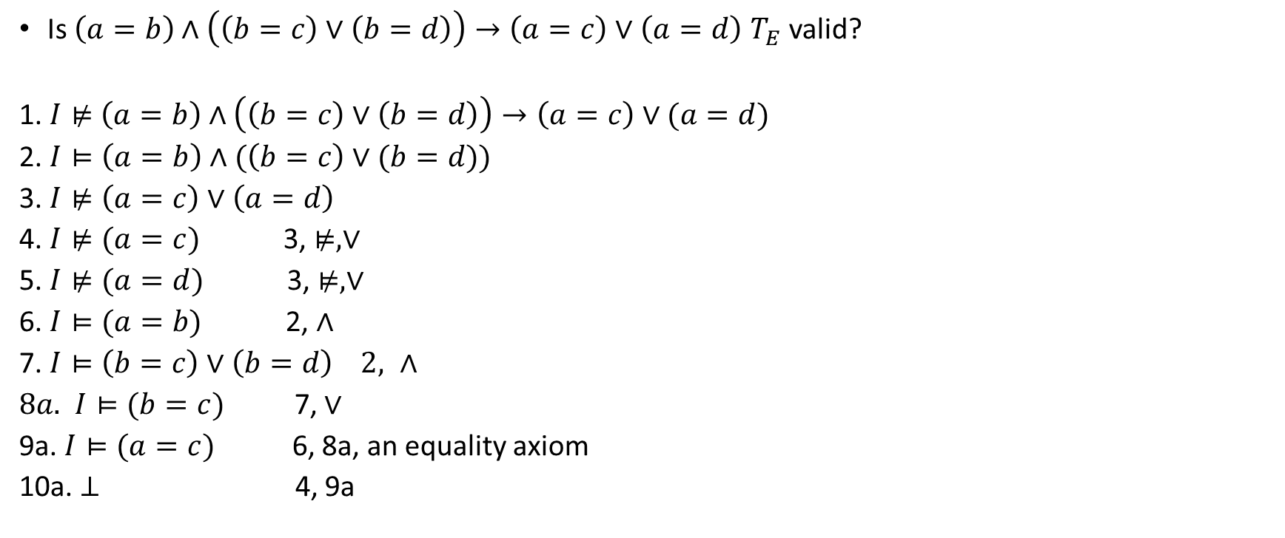
$T_{E}$ validity
Is $\left(a=b\right)∧\left(\left(b=c\right)∨\left(b=d\right)\right)→\left(a=c\right)∨\left(a=d\right)$ $T_{E}$ valid?
1. $I⊭$ $\left(a=b\right)∧\left(\left(b=c\right)∨\left(b=d\right)\right)→\left(a=c\right)∨(a=d)$
2. $I⊨\left(a=b\right)∧(\left(b=c\right)∨(b=d))$
3. $I⊭\left(a=c\right)∨\left(a=d\right)$
4. $I⊭(a=c)$ 3, $⊭, ∨$
5. $I⊭(a=d)$ 3, $⊭,∨$
6. $I⊨(a=b)$ 2, $∧$
7. $I⊨\left(b=c\right)∨\left(b=d\right) 2, ∧$
$8a.$ $I⊨(b=c)$ 7, $∨$
9a. $I⊨(a=c)$ 6, 8a, an equality axiom
10a. $⊥$ 4, 9a

Slide 29
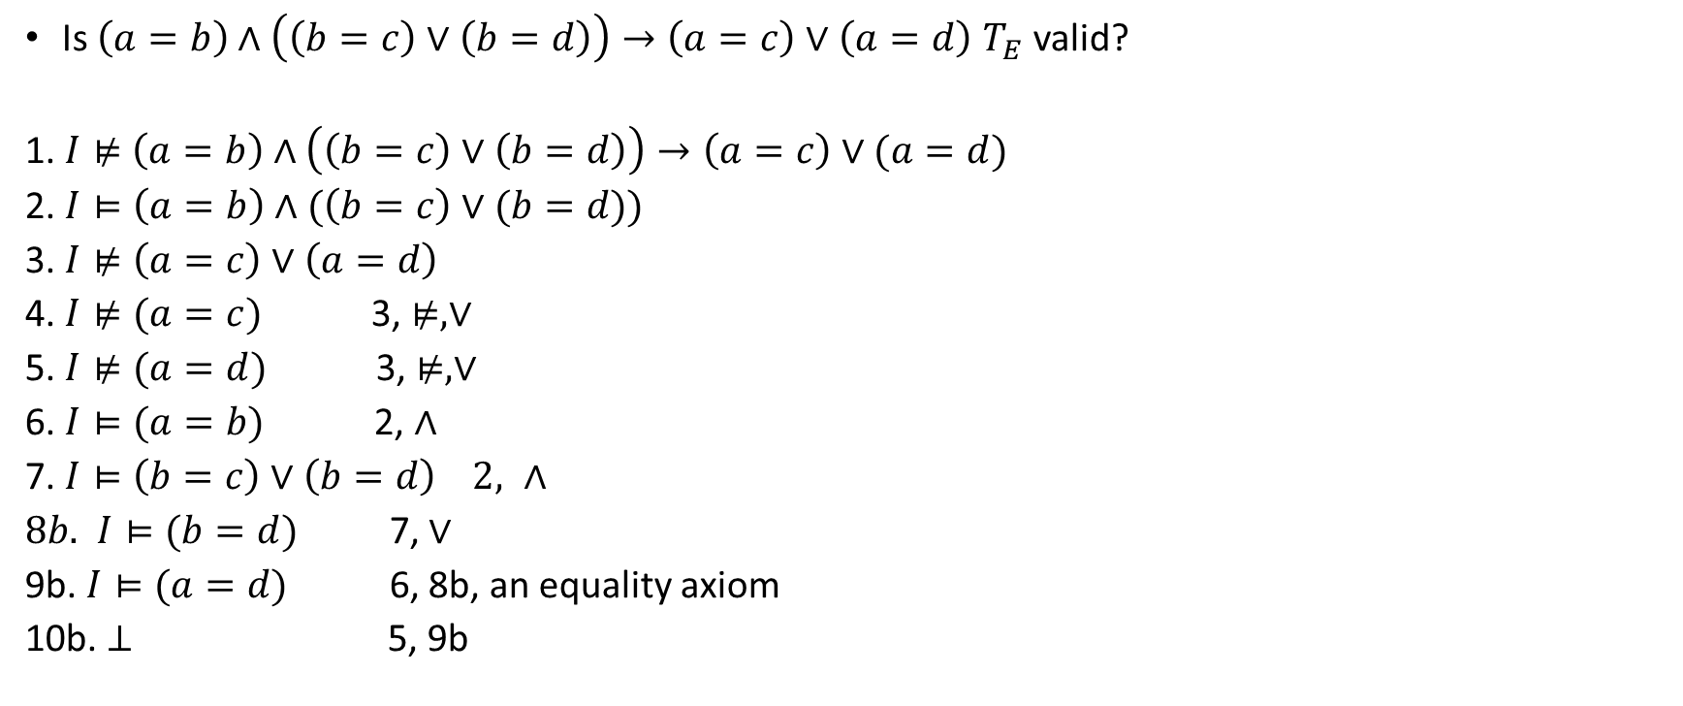
$T_{E}$ validity
Is $\left(a=b\right)∧\left(\left(b=c\right)∨\left(b=d\right)\right)→\left(a=c\right)∨\left(a=d\right)$ $T_{E}$ valid?
1. $I⊭$ $\left(a=b\right)∧\left(\left(b=c\right)∨\left(b=d\right)\right)→\left(a=c\right)∨(a=d)$
2. $I⊨\left(a=b\right)∧(\left(b=c\right)∨(b=d))$
3. $I⊭\left(a=c\right)∨\left(a=d\right)$
4. $I⊭(a=c)$ 3, $⊭, ∨$
5. $I⊭(a=d)$ 3, $⊭,∨$
6. $I⊨(a=b)$ 2, $∧$
7. $I⊨\left(b=c\right)∨\left(b=d\right) 2, ∧$
$8b.$ $I⊨(b=d)$ 7, $∨$
9b. $I⊨(a=d)$ 6, 8b, an equality axiom
10b. $⊥$ 5, 9b

Slide 30
Theory of equality
The quantifier-free fragment of the theory of equality is decidable
How do we write a decision procedure for the theory of equality for quantifier-free formulae?
Notice that even though the formulae are free from quantifiers, the axioms have quantifiers
How do we generate the correct instantiation that can give us the desired contradiction?
The set (say S) of variables/ constants in the formula is finite -- for axioms, we can generate all possible instantiations from the elements of S
However, this could be very inefficient

Slide 31
Theory of equality
We use the DPLL algorithm along with the theory-specific decision procedure (DP_{T}) to solve the formulae in the theory
This framework is also called DPLL(T)

Slide 32
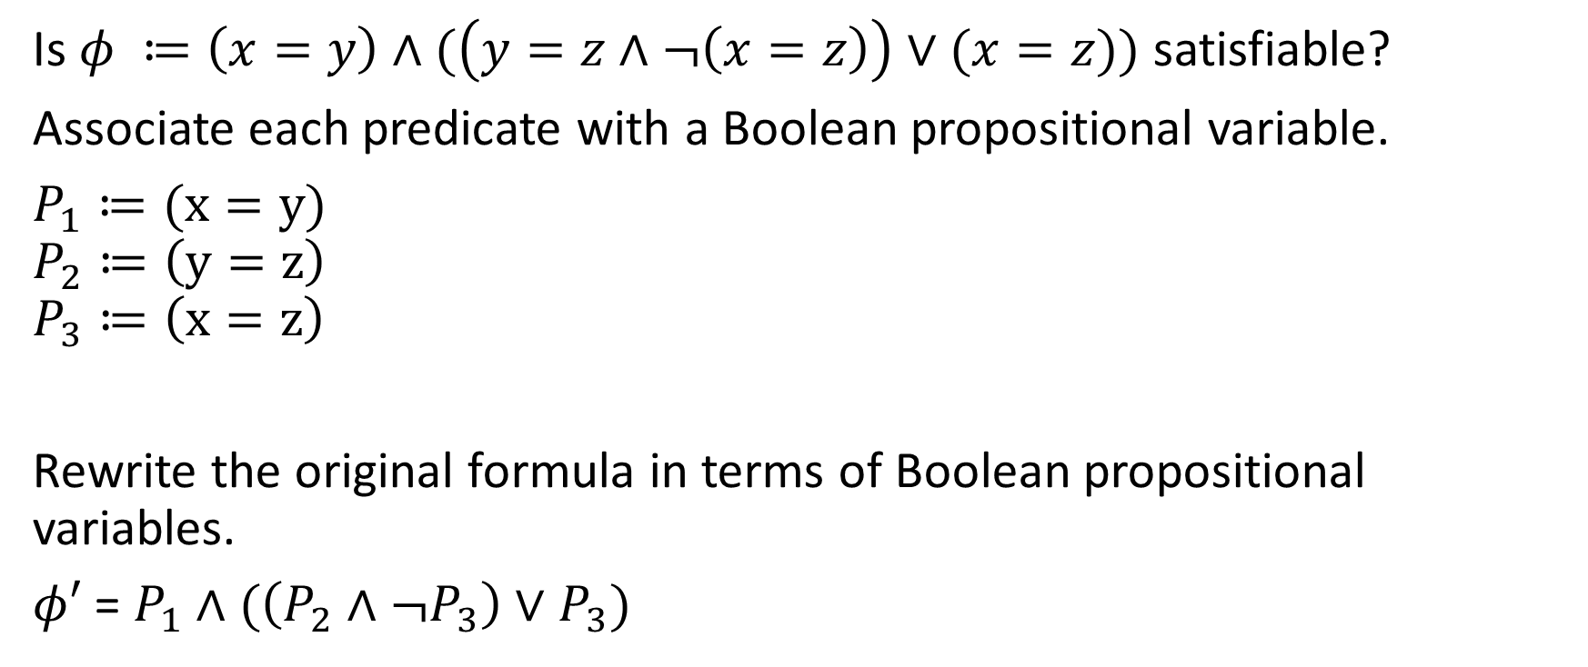
Example
Is $φ ≔\left(x=y\right)∧(\left(y=z∧¬\left(x=z\right)\right)∨(x=z))$ satisfiable?
Associate each predicate with a Boolean propositional variable.
$P_{1}≔(x=y)$
$$P_{2}≔\left(y=z\right)$$
$$P_{3}≔\left(x=z\right)$$
Rewrite the original formula in terms of Boolean propositional variables.
$φ′$ = $P_{1}∧(\left(P_{2}∧¬P_{3}\right)∨P_{3})$

Slide 33
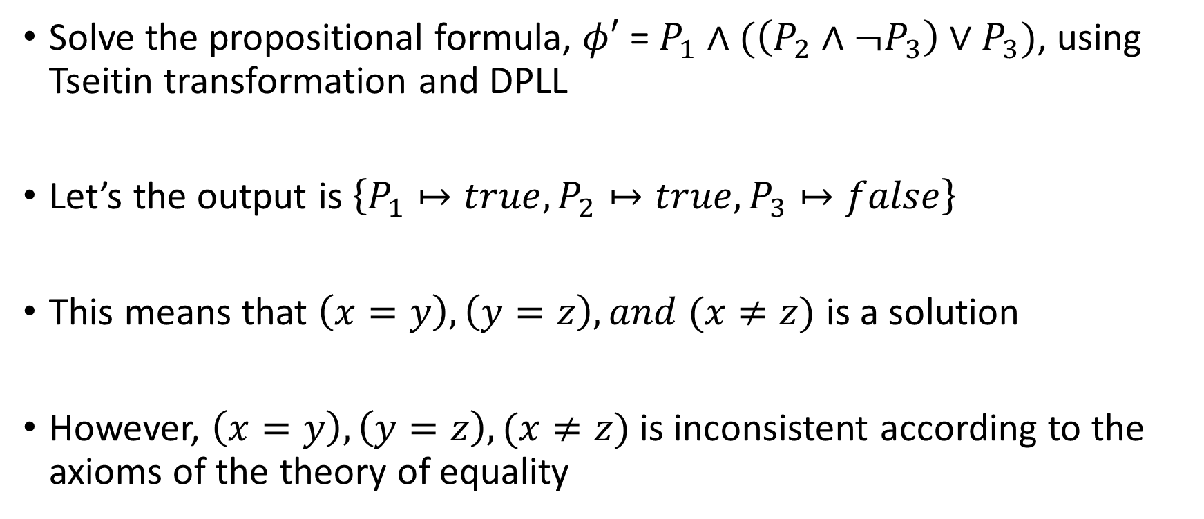
Example
Solve the propositional formula, $φ′$ = $P_{1}∧(\left(P_{2}∧¬P_{3}\right)∨P_{3})$, using Tseitin transformation and DPLL
Let’s the output is $\left\{P_{1}↦true, P_{2}↦true, P_{3}↦false\right\}$
This means that $\left(x=y\right), \left(y=z\right), and (x≠z)$ is a solution
However, $\left(x=y\right), \left(y=z\right), (x≠z)$ is inconsistent according to the axioms of the theory of equality

Slide 34
Example
The decision procedure for a theory (DP_{T}) checks if a satisfying assignment returned by DPLL is consistent according to the axioms of the theory

Slide 35
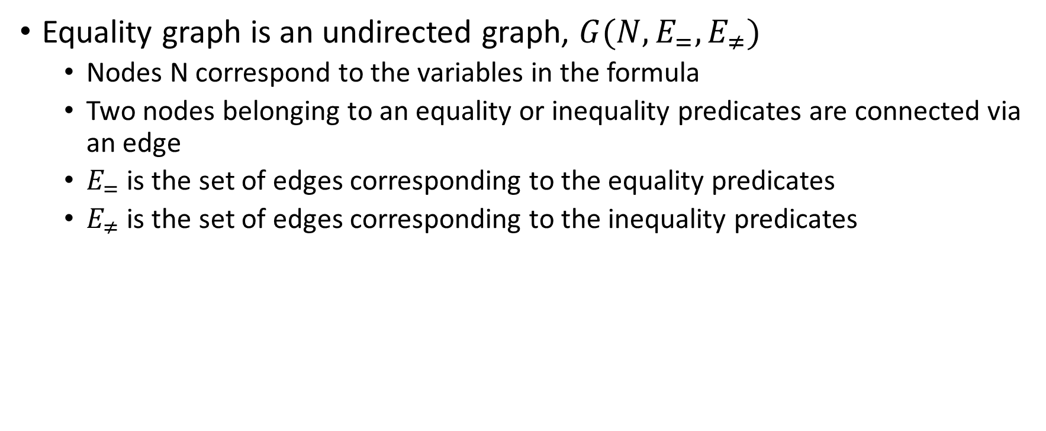
Equality graph
Equality graph is an undirected graph, $G(N,E_{=},E_{≠})$
Nodes N correspond to the variables in the formula
Two nodes belonging to an equality or inequality predicates are connected via an edge
$E_{=}$ is the set of edges corresponding to the equality predicates
$E_{≠}$ is the set of edges corresponding to the inequality predicates

Slide 36
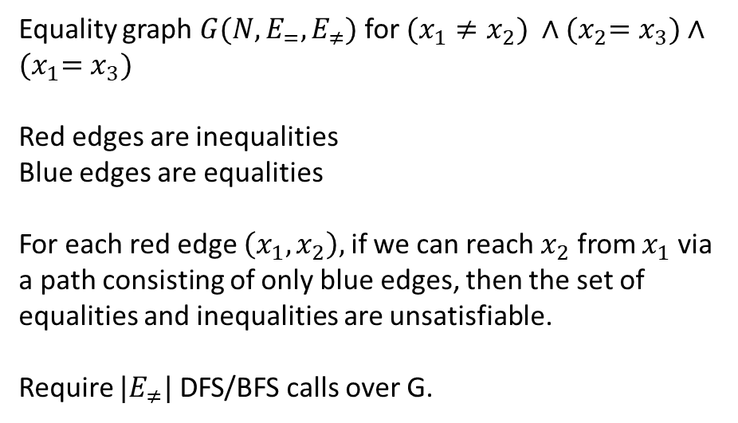
Equality graph
Equality graph $G(N,E_{=},E_{≠})$ for $(x_{1}≠x_{2}) ∧{(x}_{2}=x_{3})∧{(x}_{1}=x_{3})$
Red edges are inequalities
Blue edges are equalities
For each red edge $\left(x_{1}, x_{2}\right),$ if we can reach $x_{2}$ from $x_{1}$ via a path consisting of only blue edges, then the set of equalities and inequalities are unsatisfiable.
Require $|E_{≠}|$ DFS/BFS calls over G.
x₁
x₂
x₃

Slide 37
Example
Now coming back to our example

Slide 38
Example
Is $φ ≔\left(x=y\right)∧(\left(y=z∧¬\left(x=z\right)\right)∨(x=z))$ satisfiable?
Associate each predicate with a Boolean propositional variable.
$P_{1}≔(x=y)$
$$P_{2}≔\left(y=z\right)$$
$$P_{3}≔\left(x=z\right)$$
Rewrite the original formula in terms of Boolean propositional variables.
$φ′$ = $P_{1}∧(\left(P_{2}∧¬P_{3}\right)∨P_{3})$

Slide 39
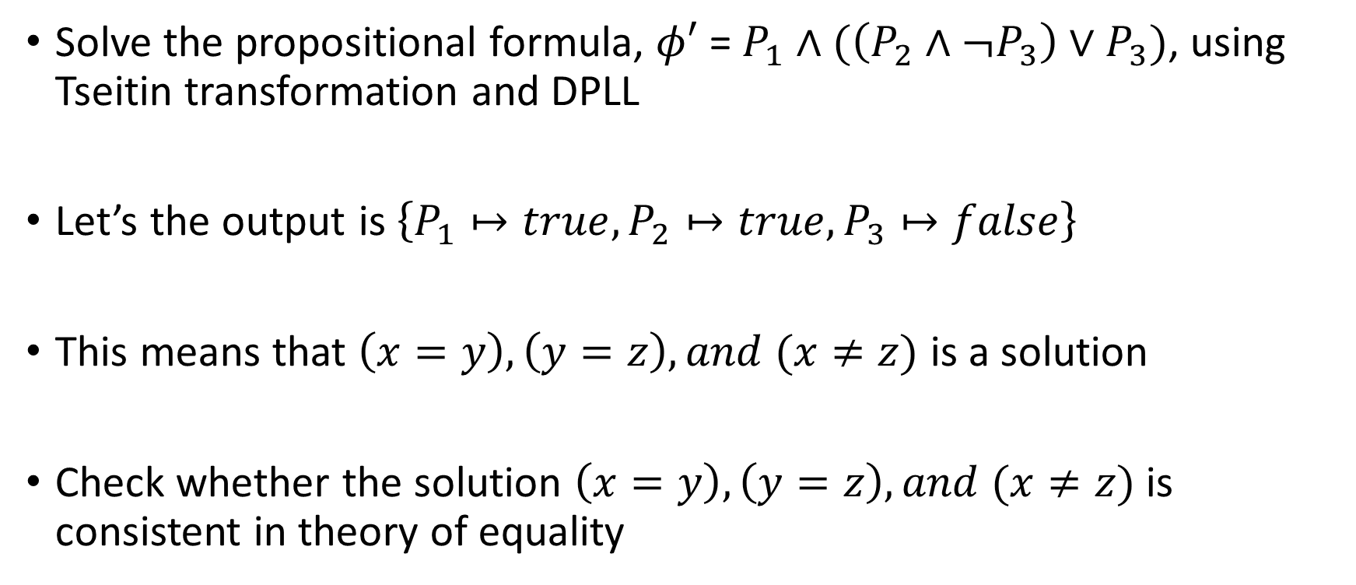
Example
Solve the propositional formula, $φ′$ = $P_{1}∧(\left(P_{2}∧¬P_{3}\right)∨P_{3})$, using Tseitin transformation and DPLL
Let’s the output is $\left\{P_{1}↦true, P_{2}↦true, P_{3}↦false\right\}$
This means that $\left(x=y\right), \left(y=z\right), and (x≠z)$ is a solution
Check whether the solution $\left(x=y\right), \left(y=z\right), and (x≠z)$ is consistent in theory of equality

Slide 40

Example
Equality graph for $\left(x=y\right), \left(y=z\right), and (x≠z)$
(x, z) is a red edge.
We can reach z from x via path xyz, which consists of only blue edges.
Therefore, the solution is not consistent.
x
y
z

Slide 41
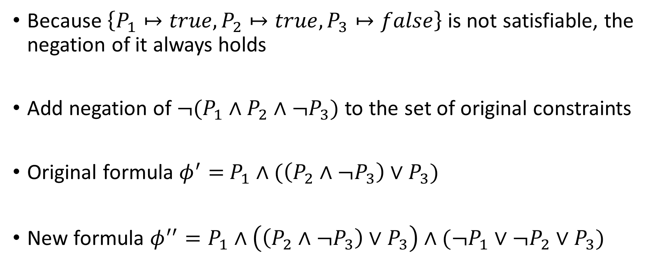
Example
Because $\left\{P_{1}↦true, P_{2}↦true, P_{3}↦false\right\}$ is not satisfiable, the negation of it always holds
Add negation of ${¬(P}_{1}∧P_{2}∧¬P_{3})$ to the set of original constraints
Original formula $φ^{′}=$ $P_{1}∧(\left(P_{2}∧¬P_{3}\right)∨P_{3})$
New formula $φ^{′′}=P_{1}∧\left(\left(P_{2}∧¬P_{3}\right)∨P_{3}\right)∧(¬P_{1}∨¬P_{2}∨P_{3})$

Slide 42
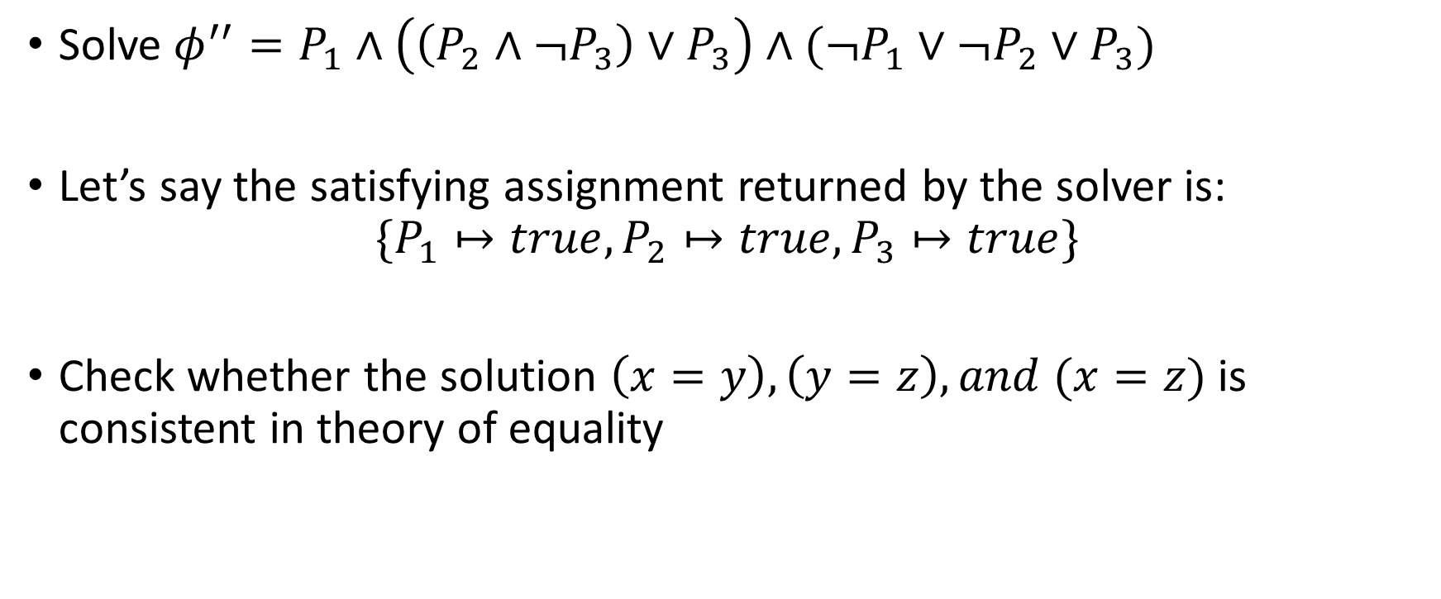
Example
Solve $φ^{′′}=P_{1}∧\left(\left(P_{2}∧¬P_{3}\right)∨P_{3}\right)∧(¬P_{1}∨¬P_{2}∨P_{3})$
Let’s say the satisfying assignment returned by the solver is:
$$\{P_{1}↦true, P_{2}↦true, P_{3}↦true\}$$
Check whether the solution $\left(x=y\right), \left(y=z\right), and (x=z)$ is consistent in theory of equality

Slide 43

Example
Equality graph for $\left(x=y\right), \left(y=z\right), and (x=z)$
No red edge.
Therefore, the solution is consistent.
x
y
z

Slide 44
Example
Because the set of assignments is also consistent in the theory of equality; therefore, the algorithm has found a solution and terminates
If the solver can’t find a satisfying assignment for the input set of constraints, then the input formula is unsatisfiable

