Slide 2
References
Section-9.2.2 from the COC book
Chapter-3, 4 from the DP book

Slide 3
Theory of equality
We use the DPLL algorithm along with the theory-specific decision procedure (DP_{T}) to solve the formulae in the theory
This framework is also called DPLL(T)

Slide 4
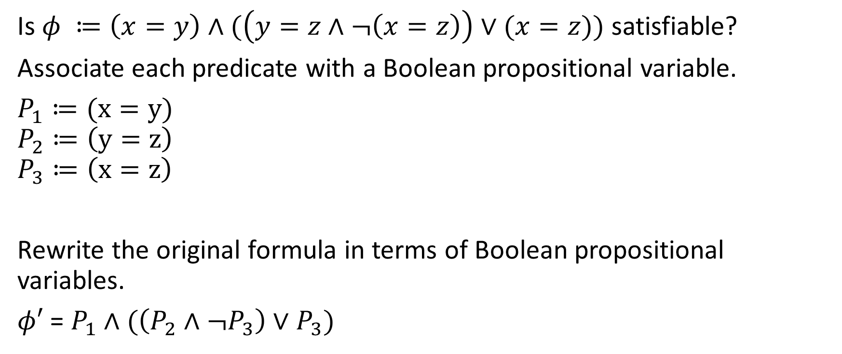
Example
Is $φ ≔\left(x=y\right)∧(\left(y=z∧¬\left(x=z\right)\right)∨(x=z))$ satisfiable?
Associate each predicate with a Boolean propositional variable.
$P_{1}≔(x=y)$
$$P_{2}≔\left(y=z\right)$$
$$P_{3}≔\left(x=z\right)$$
Rewrite the original formula in terms of Boolean propositional variables.
$φ′$ = $P_{1}∧(\left(P_{2}∧¬P_{3}\right)∨P_{3})$

Slide 5
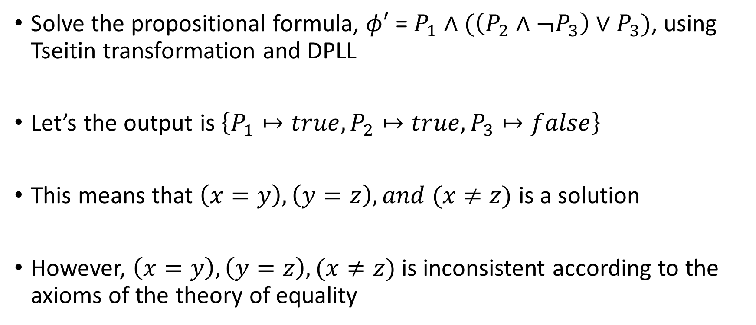
Example
Solve the propositional formula, $φ′$ = $P_{1}∧(\left(P_{2}∧¬P_{3}\right)∨P_{3})$, using Tseitin transformation and DPLL
Let’s the output is $\left\{P_{1}↦true, P_{2}↦true, P_{3}↦false\right\}$
This means that $\left(x=y\right), \left(y=z\right), and (x≠z)$ is a solution
However, $\left(x=y\right), \left(y=z\right), (x≠z)$ is inconsistent according to the axioms of the theory of equality

Slide 6
Example
The decision procedure for a theory (DP_{T}) checks if a satisfying assignment returned by DPLL is consistent according to the axioms of the theory

Slide 7
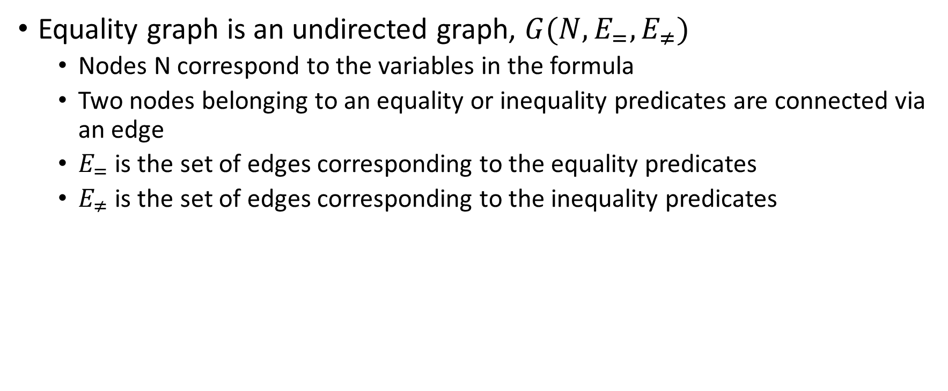
Equality graph
Equality graph is an undirected graph, $G(N,E_{=},E_{≠})$
Nodes N correspond to the variables in the formula
Two nodes belonging to an equality or inequality predicates are connected via an edge
$E_{=}$ is the set of edges corresponding to the equality predicates
$E_{≠}$ is the set of edges corresponding to the inequality predicates

Slide 8
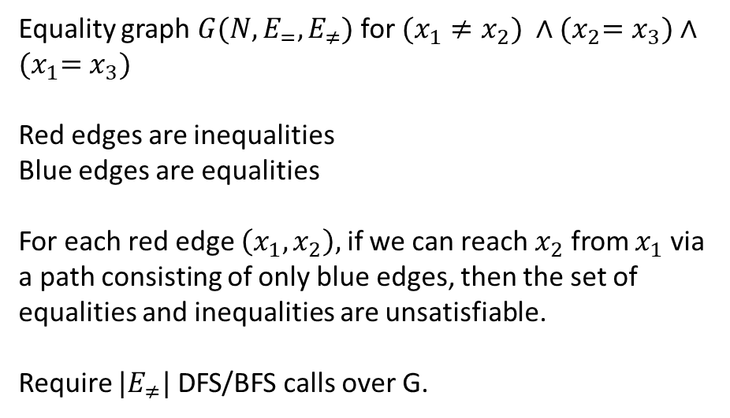
Equality graph
Equality graph $G(N,E_{=},E_{≠})$ for $(x_{1}≠x_{2}) ∧{(x}_{2}=x_{3})∧{(x}_{1}=x_{3})$
Red edges are inequalities
Blue edges are equalities
For each red edge $\left(x_{1}, x_{2}\right),$ if we can reach $x_{2}$ from $x_{1}$ via a path consisting of only blue edges, then the set of equalities and inequalities are unsatisfiable.
Require $|E_{≠}|$ DFS/BFS calls over G.
x₁
x₂
x₃

Slide 9
Example
Now coming back to our example

Slide 10
Example
Is $φ ≔\left(x=y\right)∧(\left(y=z∧¬\left(x=z\right)\right)∨(x=z))$ satisfiable?
Associate each predicate with a Boolean propositional variable.
$P_{1}≔(x=y)$
$$P_{2}≔\left(y=z\right)$$
$$P_{3}≔\left(x=z\right)$$
Rewrite the original formula in terms of Boolean propositional variables.
$φ′$ = $P_{1}∧(\left(P_{2}∧¬P_{3}\right)∨P_{3})$

Slide 11
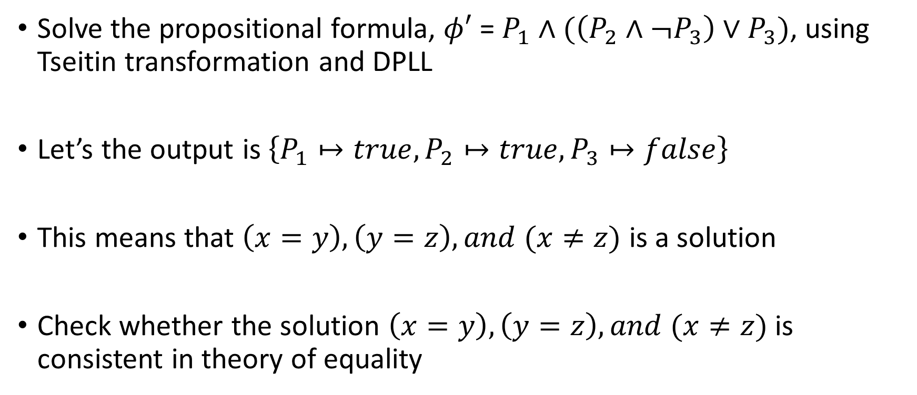
Example
Solve the propositional formula, $φ′$ = $P_{1}∧(\left(P_{2}∧¬P_{3}\right)∨P_{3})$, using Tseitin transformation and DPLL
Let’s the output is $\left\{P_{1}↦true, P_{2}↦true, P_{3}↦false\right\}$
This means that $\left(x=y\right), \left(y=z\right), and (x≠z)$ is a solution
Check whether the solution $\left(x=y\right), \left(y=z\right), and (x≠z)$ is consistent in theory of equality

Slide 12

Example
Equality graph for $\left(x=y\right), \left(y=z\right), and (x≠z)$
(x, z) is a red edge.
We can reach z from x via path xyz, which consists of only blue edges.
Therefore, the solution is not consistent.
x
y
z

Slide 13
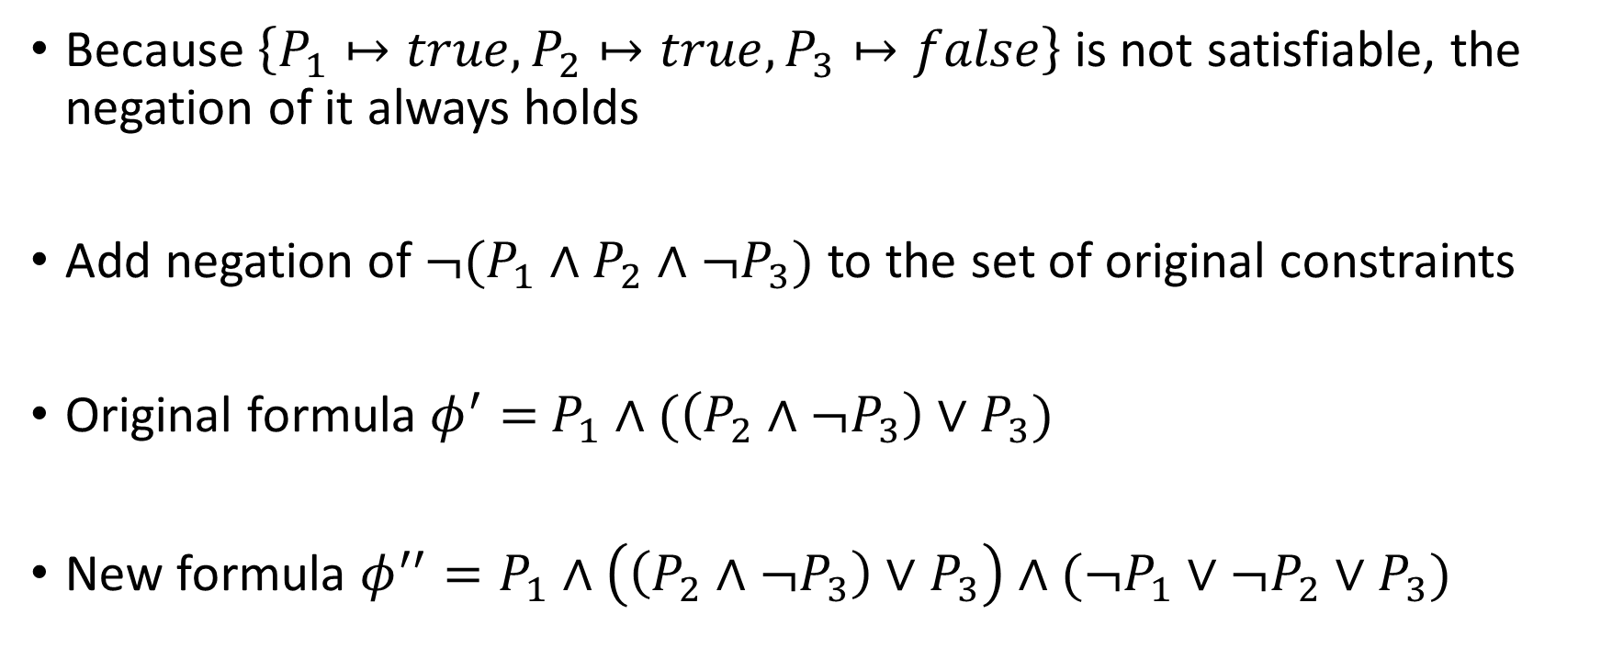
Example
Because $\left\{P_{1}↦true, P_{2}↦true, P_{3}↦false\right\}$ is not satisfiable, the negation of it always holds
Add negation of ${¬(P}_{1}∧P_{2}∧¬P_{3})$ to the set of original constraints
Original formula $φ^{′}=$ $P_{1}∧(\left(P_{2}∧¬P_{3}\right)∨P_{3})$
New formula $φ^{′′}=P_{1}∧\left(\left(P_{2}∧¬P_{3}\right)∨P_{3}\right)∧(¬P_{1}∨¬P_{2}∨P_{3})$

Slide 14
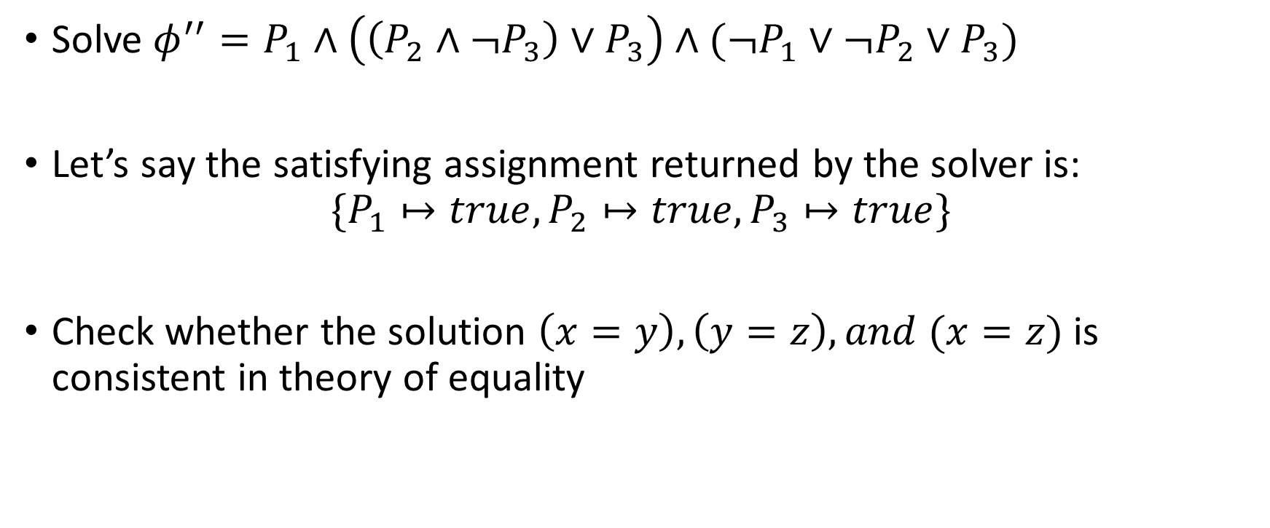
Example
Solve $φ^{′′}=P_{1}∧\left(\left(P_{2}∧¬P_{3}\right)∨P_{3}\right)∧(¬P_{1}∨¬P_{2}∨P_{3})$
Let’s say the satisfying assignment returned by the solver is:
$$\{P_{1}↦true, P_{2}↦true, P_{3}↦true\}$$
Check whether the solution $\left(x=y\right), \left(y=z\right), and (x=z)$ is consistent in theory of equality

Slide 15

Example
Equality graph for $\left(x=y\right), \left(y=z\right), and (x=z)$
No red edge.
Therefore, the solution is consistent.
x
y
z

Slide 16
Example
Because the set of assignments is also consistent in the theory of equality; therefore, the algorithm has found a solution and terminates
If the solver can’t find a satisfying assignment for the input set of constraints, then the input formula is unsatisfiable

Slide 17
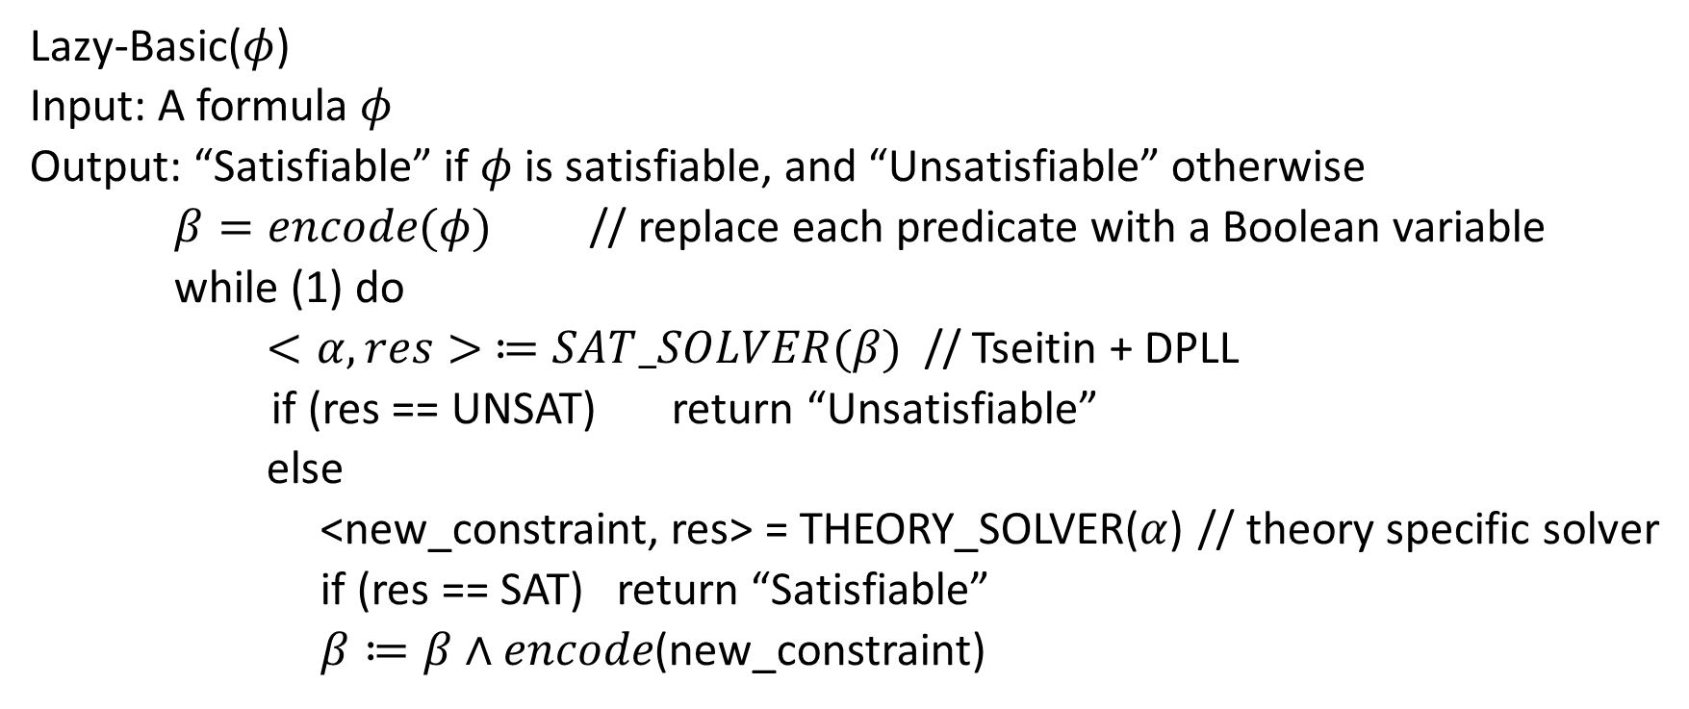
Algorithm
Lazy-Basic($φ$)
Input: A formula $φ$
Output: “Satisfiable” if $φ$ is satisfiable, and “Unsatisfiable” otherwise
$β=encode(φ)$ // replace each predicate with a Boolean variable
while (1) do
$<α,res> ≔SAT_SOLVER(β)$ // Tseitin + DPLL
if (res == UNSAT) return “Unsatisfiable”
else
<new_constraint, res> = THEORY_SOLVER($α$) // theory specific solver
if (res == SAT) return “Satisfiable”
$β≔β∧encode$(new_constraint)

Slide 18
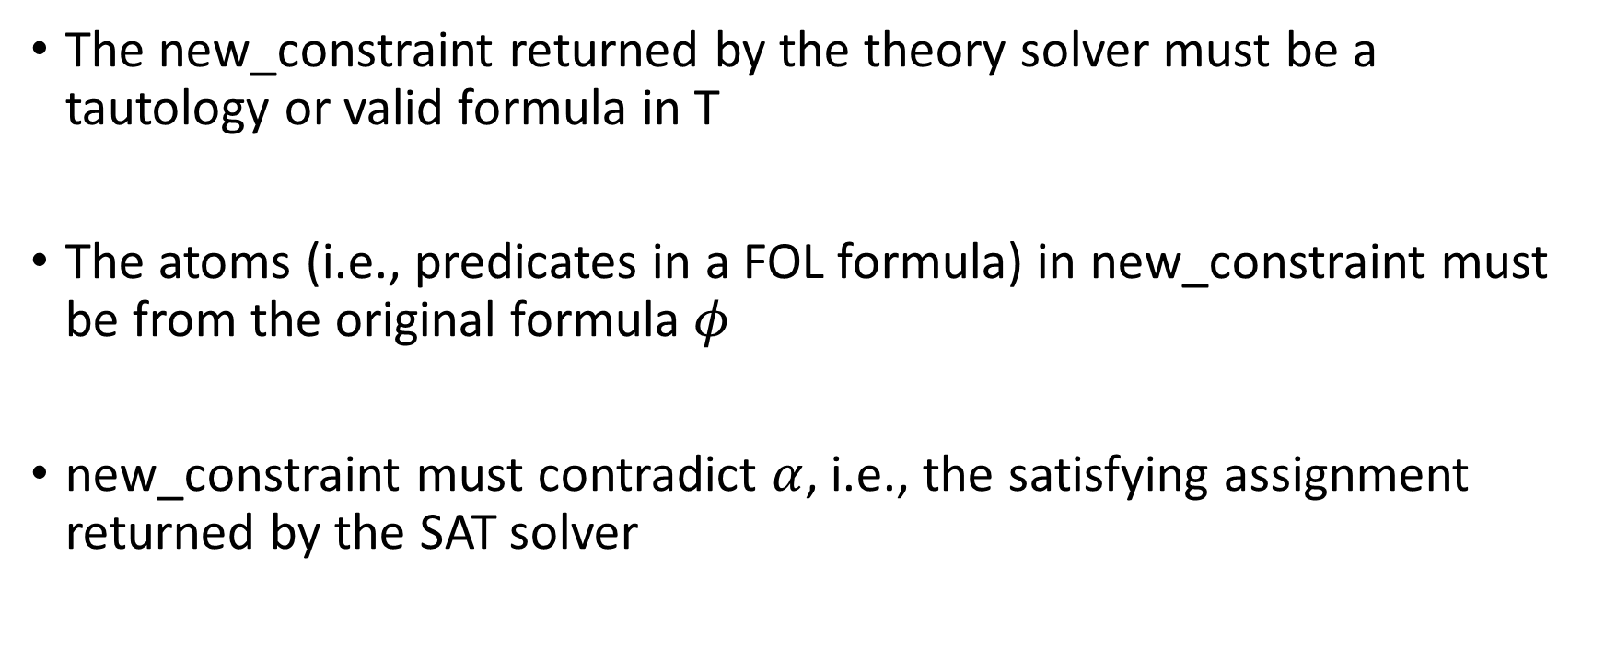
Theory solver
The new_constraint returned by the theory solver must be a tautology or valid formula in T
The atoms (i.e., predicates in a FOL formula) in new_constraint must be from the original formula $φ$
new_constraint must contradict $α$, i.e., the satisfying assignment returned by the SAT solver

Slide 19
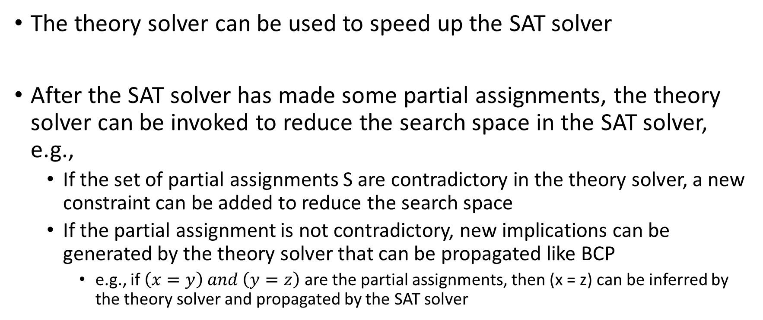
Optimization
The theory solver can be used to speed up the SAT solver
After the SAT solver has made some partial assignments, the theory solver can be invoked to reduce the search space in the SAT solver, e.g.,
If the set of partial assignments S are contradictory in the theory solver, a new constraint can be added to reduce the search space
If the partial assignment is not contradictory, new implications can be generated by the theory solver that can be propagated like BCP
e.g., if $\left(x=y\right) and \left(y=z\right)$ are the partial assignments, then (x = z) can be inferred by the theory solver and propagated by the SAT solver

Slide 20
Context free grammar

Slide 21
Context free grammar
$$E →\left(E\right)$$
$$E →ε$$
E can be replaced with (E) or $ε$
All possible strings that don’t include E can be accepted by this grammar

Slide 22
Exercise
Write a grammar to accept a^{n}b^{n}, where n >= 1
$$E →\left(E\right)$$
$$E →ε$$
Rules for nested parenthesis

Slide 23
Context-free grammar
E → E + E
E → E * E
E → (E)
E → id
A context-free grammar (grammar) consists of terminals, non-terminals, a start symbol, and productions.

Slide 24
Context-free grammar
Terminals are the part of speech of a language
Nonterminals are syntactic variables (uppercase letters)
Production rules are of the form of “A → $α$,” where $α$ is a string of zero or more terminals and non-terminals
The LHS of the production rule is always a non-terminal
$α$ can also be $ε$
Start symbol is the LHS (nonterminal) in the first production rule

Slide 25
Production rules
E → E + E
E → E * E
E → (E)
E → id
Shorthand notation:
E → E + E | E * E | (E) | id

Slide 26
Derivation
E → E + E
E → E * E
E → (E)
E → id
Consider, the following grammar
S → $αAβ$
A → $γ$
Where, Greek symbols are strings (possibly empty) of terminals and non-terminals, we can write:
$$αAβ⇒αγβ$$
Here, $⇒$ means derives in one step

Slide 27
Derivation
$$α_{1}⇒α_{2}⇒ …⇒α_{n}$$
$α_{1}\underset{⇒}{∗} α_{n}$
(reads derives in zero or more steps)
$α \underset{⇒}{∗} α$
$If α\underset{⇒}{∗} β and β⇒γ, then α \underset{⇒}{∗} γ$

Slide 28
Sentential form
$$If S\underset{⇒}{∗} α, where S is the start symbol of grammar G$$
$$α is the sentential form of G$$
E → E + E
T → E * T
T → E
T → (E)
E → id
Let’s say E is the start symbol.
Is “E * id” a sentential form?
Is “E + id” a sentential form?
Is “id * id” a sentential form?
Is “id + id” a sentential form?

Slide 29
Sentence
A sentence of a grammar G is a sentential form with no non-terminals
The language of a grammar (denoted L(G)) is its set of sentences
A string of parts of speech (terminals) “w” is in L(G) if
$S \underset{⇒}{∗} w$

Slide 30
Language of grammar
E → E + E
E → E * E
E → (E)
E → id
The set of all sentences (strings of terminals derived from E) is the language of the grammar.

Slide 31
Derivation
E → E + E | E * E | (E) | id
Does “id * id + id” belong to language of above grammar?
The start symbol is “E”.
Goal:
E $\underset{⇒}{∗}$ id * id + id

Slide 32
Derivation
E → E + E | E * E | (E) | id
E $\underset{⇒}{∗}$ id * id + id

Slide 33
Derivation
E → E + E | E * E | (E) | id
E $\underset{⇒}{∗}$ id * id + id
$E⇒E+E⇒E ∗E+E⇒id ∗E+E⇒id ∗id+E⇒id ∗id+id$

Slide 34
Leftmost Derivation
The leftmost nonterminal is always chosen for replacement
E → E + E | E * E | (E) | id
E $\underset{⇒}{∗}$ id * id + id

Slide 35
Leftmost Derivation
The leftmost nonterminal is always chosen for replacement
E → E + E | E * E | (E) | id
E $\underset{⇒}{∗}$ id * id + id
$$E⇒E+E⇒$$
$E ∗E+E⇒$
$id ∗E+E⇒$
$id ∗id+E⇒$
$id ∗id+id$

Slide 36
Rightmost Derivation
The rightmost nonterminal is always chosen for replacement
E → E + E | E * E | (E) | id
E $\underset{⇒}{∗}$ id * id + id

Slide 37
Rightmost Derivation
The rightmost nonterminal is always chosen for replacement
E → E + E | E * E | (E) | id
E $\underset{⇒}{∗}$ id * id + id
$$E⇒E+E⇒$$
$E+id⇒$
$E ∗E+id⇒$
$E ∗id+id⇒$
$id ∗id+id$

Slide 38
Parse tree

Slide 39
Parse tree
A parse tree is the graphical representation of a derivation that filters out the order in which the productions are applied to replace non-terminals

Slide 40
Parse tree
E → E + E | E * E | (E) | id
E $\underset{⇒}{∗}$ id * id + id
(Leftmost)

Slide 41

Parse tree
E
E
E
STEP-1
E
+
E
E
+
E
E → E + E | E * E | (E) | id
E $\underset{⇒}{∗}$ id * id + id
(Leftmost)
STEP-2
E
*
E
STEP-3
E
E
E
E
+
E
E
+
E
E
+
E
E
*
E
E
*
E
id
E
*
E
id
STEP-4
id
STEP-5
id
id
STEP-6
id

Slide 42
Parse tree
E → E + E | E * E | (E) | id
E $\underset{⇒}{∗}$ id * id + id
(Rightmost)

Slide 43

Parse tree
E
E
E
STEP-1
E
+
E
E
+
E
E → E + E | E * E | (E) | id
E $\underset{⇒}{∗}$ id * id + id
(Rightmost)
STEP-2
STEP-3
id
E
E
E
E
+
E
E
+
E
E
+
E
id
E
*
E
E
*
E
id
E
*
E
STEP-4
STEP-5
id
id
STEP-6
id

Slide 44
Parse tree
Both leftmost and rightmost derivations yields the same final parse tree.

Slide 45
Ambiguity
A grammar is ambiguous if it produces more than one leftmost (or rightmost) derivation for the same sentence

Slide 46
Ambiguity
Why ambiguity is bad?
E → E + E | E * E | (E) | id
id * id + id
(Leftmost)
E
E
E
+
E
E
*
E
id
E
*
E
id
E
+
E
id
id
id
id
Leftmost derivation - 1
Leftmost derivation - 2

Slide 47
Ambiguity
Why ambiguity is bad?
E → E + E | E * E | (E) | id
id * id + id
(Leftmost)
E
E
E
+
E
E
*
E
id
E
*
E
id
E
+
E
(id*id) + id
id
id
id
id
id * (id + id)
Leftmost derivation - 1
Leftmost derivation - 2
Notes:
Ambiguity is bad because, during code generation, the codes for children are generated before the code for a parent node in an AST. Therefore, we may have two different code generations possible for a program if two different parse trees exist for the program.

Slide 48
Theory of equality

Slide 49

Theory of equality (equality logic)
The theory of equality is defined by the following grammar:
$$formula →formula∧formula \left| ¬formula \right|\left(formula\right)|atom$$
$$atom →term=term$$
$$term →identifier | constant$$

Slide 50
Example
Equality with constants and variables
x = 10
y = 20
x = y

Slide 51
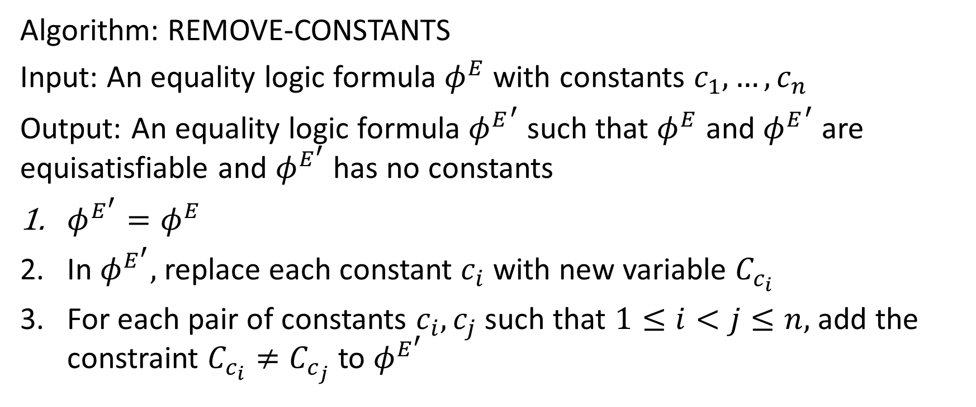
Removing constants
Algorithm: REMOVE-CONSTANTS
Input: An equality logic formula $φ^{E}$ with constants $c_{1}, …, c_{n}$
Output: An equality logic formula ${φ^{E}}^{′}$ such that $φ^{E}$ and ${φ^{E}}^{′}$ are equisatisfiable and $φ^{E^{′}}$ has no constants
$φ^{E^{′}}=φ^{E}$
In $φ^{E^{′}},$ replace each constant $c_{i}$ with new variable $C_{c_{i}}$
For each pair of constants $c_{i}, c_{j}$ such that $1≤i<j≤n,$ add the constraint $C_{c_{i}}≠C_{c_{j}}$ to $φ^{E^{′}}$

Slide 52
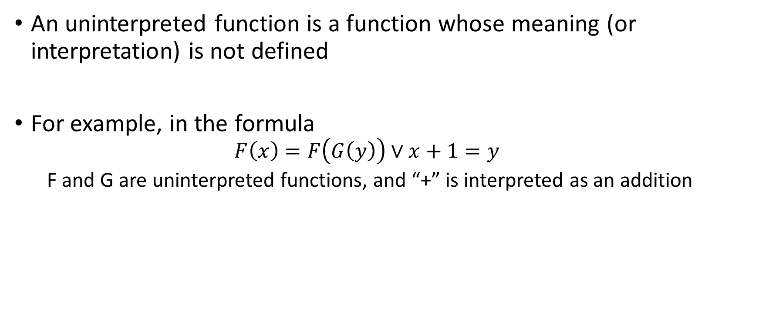
Uninterpreted function
An uninterpreted function is a function whose meaning (or interpretation) is not defined
For example, in the formula
$$F\left(x\right)=F\left(G\left(y\right)\right)∨x+1=y$$
F and G are uninterpreted functions, and “+” is interpreted as an addition

Slide 53
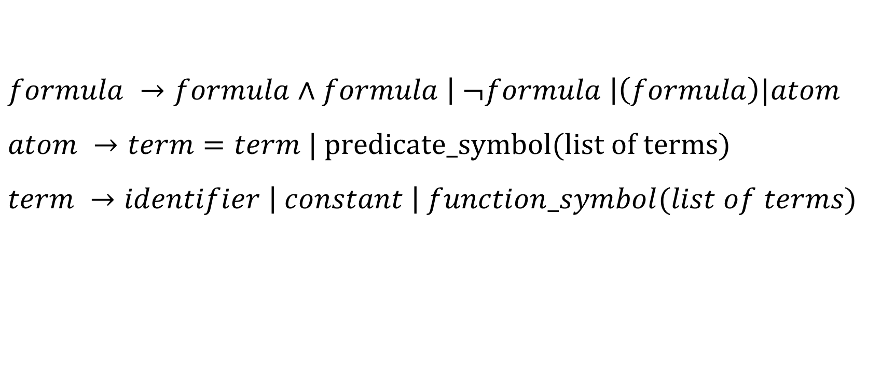
Equality logic with uninterpreted functions (EUF)
$$formula →formula∧formula \left| ¬formula \right|\left(formula\right)|atom$$
$$atom →term=term | predicate_symbol(list of terms)$$
$$term →identifier \left| constant \right| function_symbol(list of terms)$$

Slide 54
EUF
We will use capital letters to denote uninterpreted functions and superscript “UF” to denote EUF formulae.

Slide 55

Additional axioms for EUF
Congruence rule
$$∀t_{1},…,t_{n},t_{1}^{′}…,t_{n}^{′}. \bigwedge_{i}{t_{i}=t_{i}^{′} →f\left(t_{1}, …, t_{n}\right)=f\left(t_{1}^{′}, …, t_{n}^{′}\right)}$$
$$∀t_{1},…,t_{n},t_{1}^{′}…,t_{n}^{′}. \bigwedge_{i}{t_{i}=t_{i}^{′} →(p\left(t_{1}, …, t_{n}\right)↔p\left(t_{1}^{′}, …, t_{n}^{′}\right))}$$

Slide 56
Functional consistency
A function is consistent if it returns the same output when invoked with the same arguments
The additional axiom for uninterpreted function uses the functional consistency

Slide 57
Uninterpreted functions
Uninterpreted functions can be useful to prove the validity of a formula that contains interpreted functions, and checking the validity of interpreted functions is hard, e.g., functions have loops or use complex data structures
Transforming a hard-to-validate interpreted function to an uninterpreted function during the verification makes the task of the verification feasible when the validity check doesn’t really depend on the interpretation of the functions in the formula

Slide 58
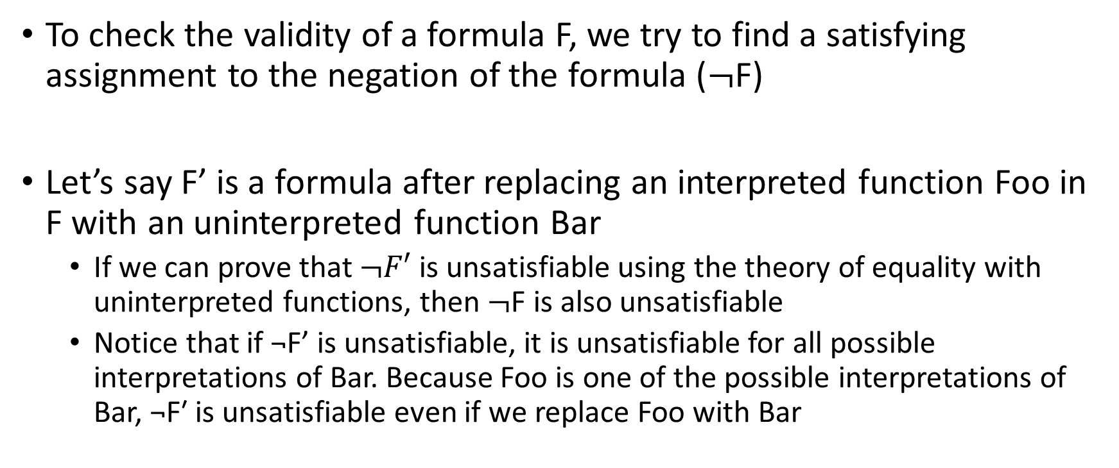
Uninterpreted functions
To check the validity of a formula F, we try to find a satisfying assignment to the negation of the formula ($¬$F)
Let’s say F’ is a formula after replacing an interpreted function Foo in F with an uninterpreted function Bar
If we can prove that $¬F′$ is unsatisfiable using the theory of equality with uninterpreted functions, then $¬$F is also unsatisfiable
Notice that if ¬F’ is unsatisfiable, it is unsatisfiable for all possible interpretations of Bar. Because Foo is one of the possible interpretations of Bar, ¬F′ is unsatisfiable even if we replace Foo with Bar

Slide 59
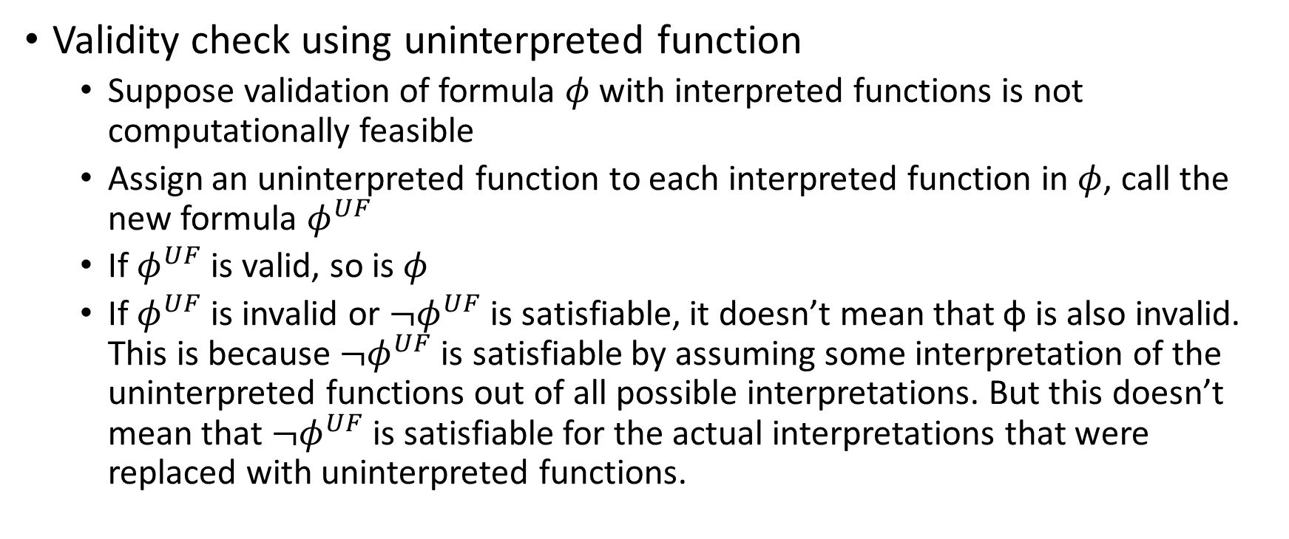
Uninterpreted functions
Validity check using uninterpreted function
Suppose validation of formula $φ$ with interpreted functions is not computationally feasible
Assign an uninterpreted function to each interpreted function in $φ$, call the new formula $φ^{UF}$
If $φ^{UF}$ is valid, so is $φ$
If $φ^{UF}$ is invalid or ${¬φ}^{UF}$ is satisfiable, it doesn’t mean that ϕ is also invalid. This is because ${¬φ}^{UF}$ is satisfiable by assuming some interpretation of the uninterpreted functions out of all possible interpretations. But this doesn’t mean that ${¬φ}^{UF}$ is satisfiable for the actual interpretations that were replaced with uninterpreted functions.

Slide 60
Example (program equivalence)
int power3(int in)
{
int i, out_a;
out_a = in;
for (i = 0; i < 2; i++)
out_a = out_a * in;
return out_a;
}
int power3_new(int in)
{
int out_b;
out_b = (in * in) * in;
return out_b;
}

Slide 61
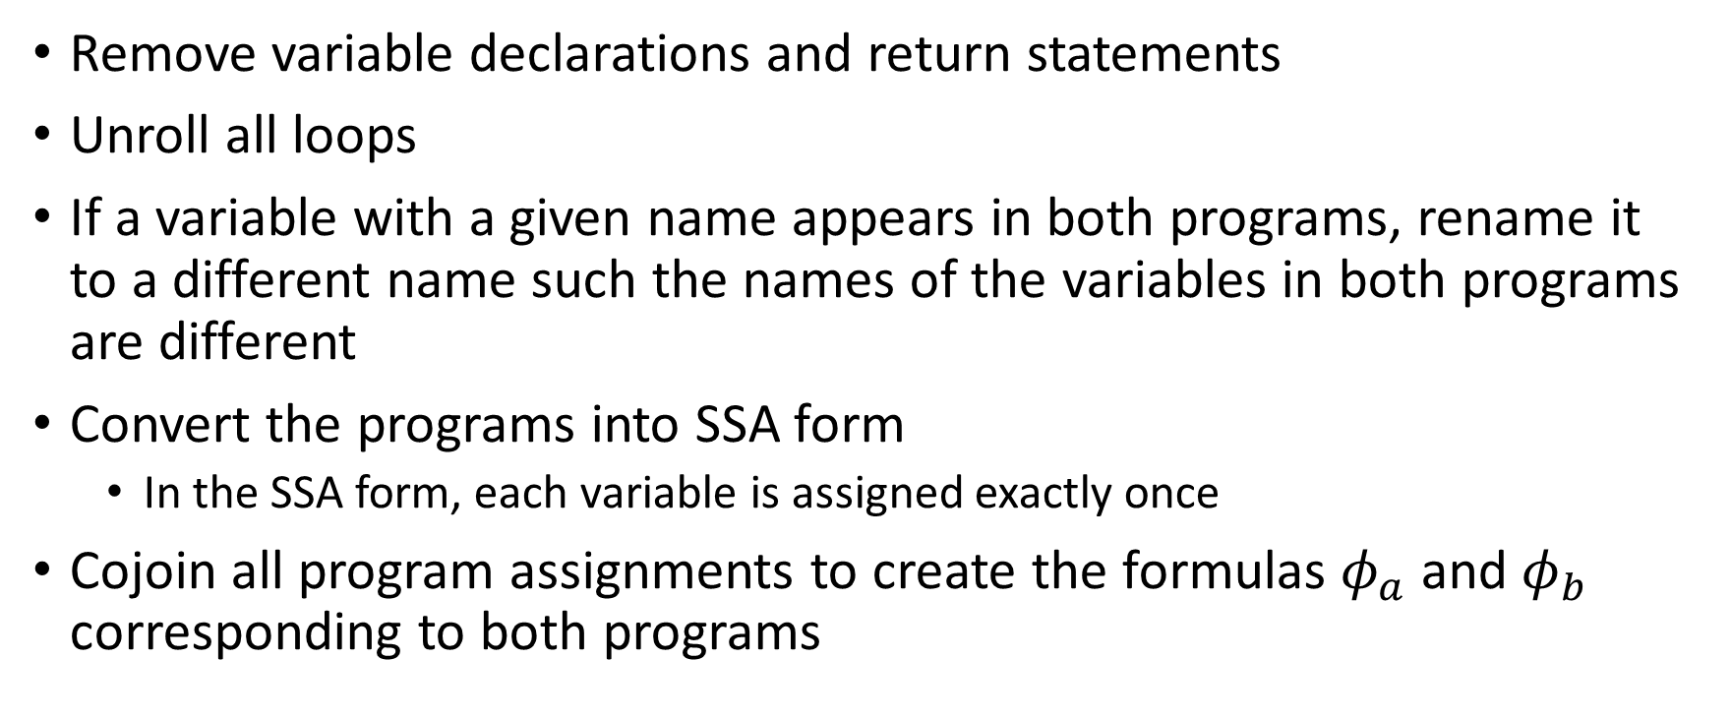
Approach
Remove variable declarations and return statements
Unroll all loops
If a variable with a given name appears in both programs, rename it to a different name such the names of the variables in both programs are different
Convert the programs into SSA form
In the SSA form, each variable is assigned exactly once
Cojoin all program assignments to create the formulas $φ_{a}$ and $φ_{b}$ corresponding to both programs

Slide 62
Converting to SSA
Replace the LHS variable in each assignment with a new auxiliary variable
Whenever a variable is read, replace it with the auxiliary variable at the last assignment to it

Slide 63
Example (after loop unrolling)
int power3(int in)
{
int i, out_a;
out_a = in;
out_a = out_a * in;
out_a = out_a * in;
return out_a;
}
int power3_new(int in)
{
int out_b;
out_b = (in * in) * in;
return out_b;
}

Slide 64
Example (after renaming)
out_a = in_a;
out_a = out_a * in_a;
out_a = out_a * in_a;
out_b = (in_b * in_b) * in_b;

Slide 65
Example (SSA form)
out0_a = in_a;
out1_a = out0_a * in_a;
out2_a = out1_a * in_a;
out0_b = (in_b * in_b) * in_b;

Slide 66


Example (formulae)
$φ_{a}$ =
(out0_a = in_a) $∧$
(out1_a = out0_a * in_a) $∧$
(out2_a = out1_a * in_a);
$$φ_{b}=$$
(out0_b = (in_b * in_b) * in_b)

Slide 67

Condition for equivalence
The programs are equivalent when the outputs of the programs are the same if the inputs are the same
Inputs: in_a, in_b
Outputs: out2_a, out0_b
Formulae for the programs: $φ_{a}$, $φ_{b}$

Slide 68
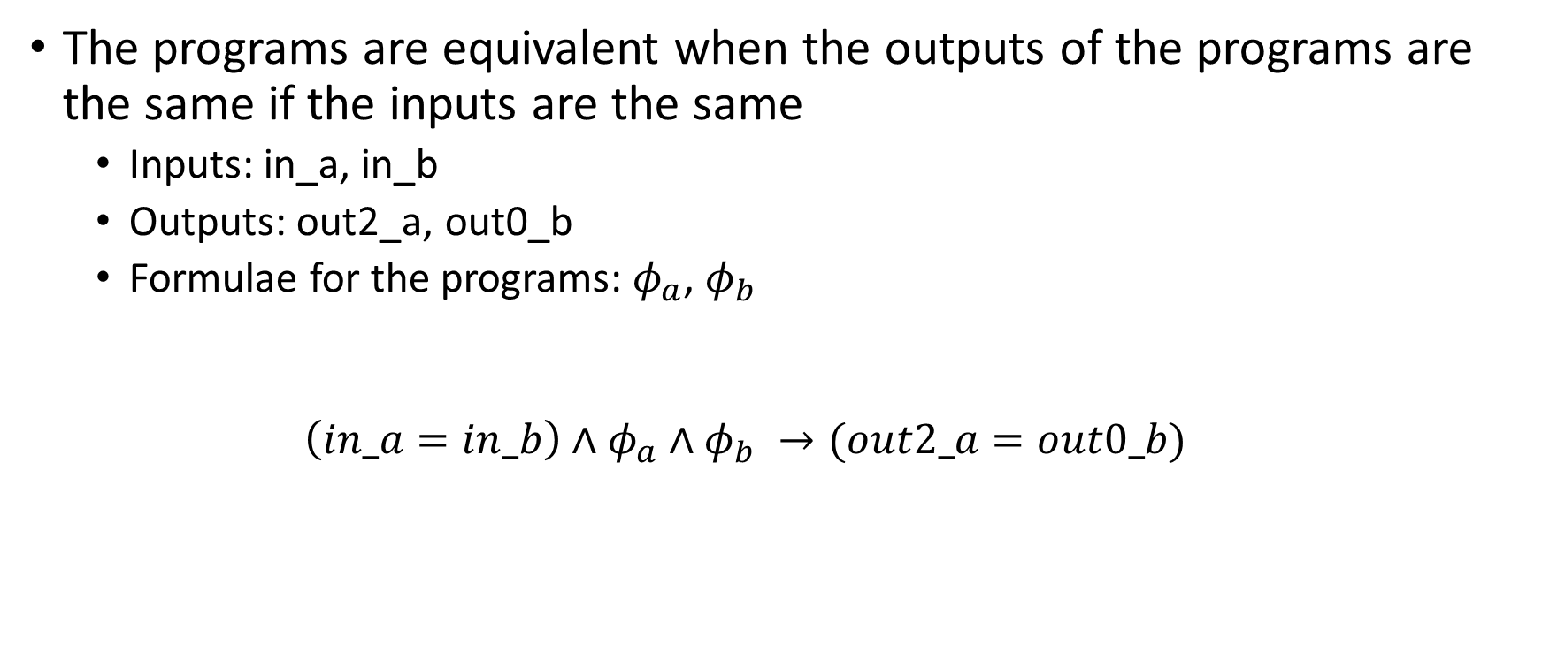
Condition for equivalence
The programs are equivalent when the outputs of the programs are the same if the inputs are the same
Inputs: in_a, in_b
Outputs: out2_a, out0_b
Formulae for the programs: $φ_{a}$, $φ_{b}$
$$\left(in_a=in_b\right)∧φ_{a}∧φ_{b} →(out2_a=out0_b)$$

Slide 69
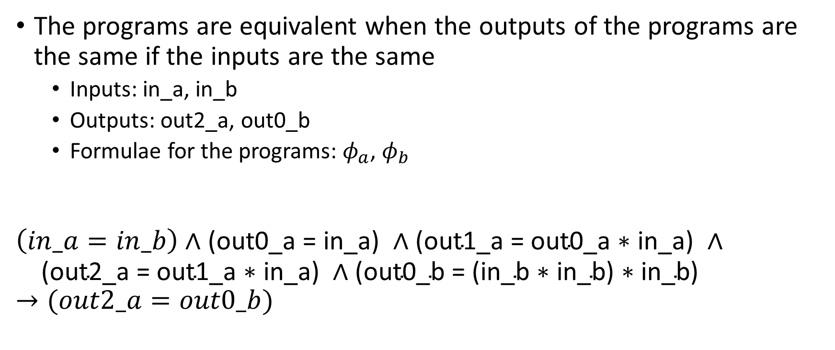
Condition for equivalence
The programs are equivalent when the outputs of the programs are the same if the inputs are the same
Inputs: in_a, in_b
Outputs: out2_a, out0_b
Formulae for the programs: $φ_{a}$, $φ_{b}$
$$\left(in_a=in_b\right)∧\text{(}\text{out}\text{0_}\text{a}\text{ = }\text{in}\text{_}\text{a}\text{) }∧\text{(}\text{out}\text{1_}\text{a}\text{ = }\text{out}\text{0_}\text{a}\text{ ∗ }\text{in}\text{_}\text{a}\text{) }∧$$
$$\text{ (}\text{out}\text{2_}\text{a}\text{ = }\text{out}\text{1_}\text{a}\text{ ∗ }\text{in}\text{_}\text{a}\text{)} ∧\text{(}\text{out}\text{0_}\text{b}\text{ = (}\text{in}\text{_}\text{b}\text{ ∗ }\text{in}\text{_}\text{b}\text{) ∗ }\text{in}\text{_}\text{b}\text{)}→(out2_a=out0_b)$$

Slide 70

Converting to EUF
$$φ= \left(in_a=in_b\right)∧\text{(}\text{out}\text{0_}\text{a}\text{ = }\text{in}\text{_}\text{a}\text{) }∧\text{(}\text{out}\text{1_}\text{a}\text{ = }\text{out}\text{0_}\text{a}\text{ ∗ }\text{in}\text{_}\text{a}\text{) }∧$$
$$\text{(}\text{out}\text{2_}\text{a}\text{ = }\text{out}\text{1_}\text{a}\text{ ∗ }\text{in}\text{_}\text{a}\text{)} ∧\text{(}\text{out}\text{0_}\text{b}\text{ = (}\text{in}\text{_}\text{b}\text{ ∗ }\text{in}\text{_}\text{b}\text{) ∗ }\text{in}\text{_}\text{b}\text{)}$$
$→(out2_a=out0_b)$

Slide 71
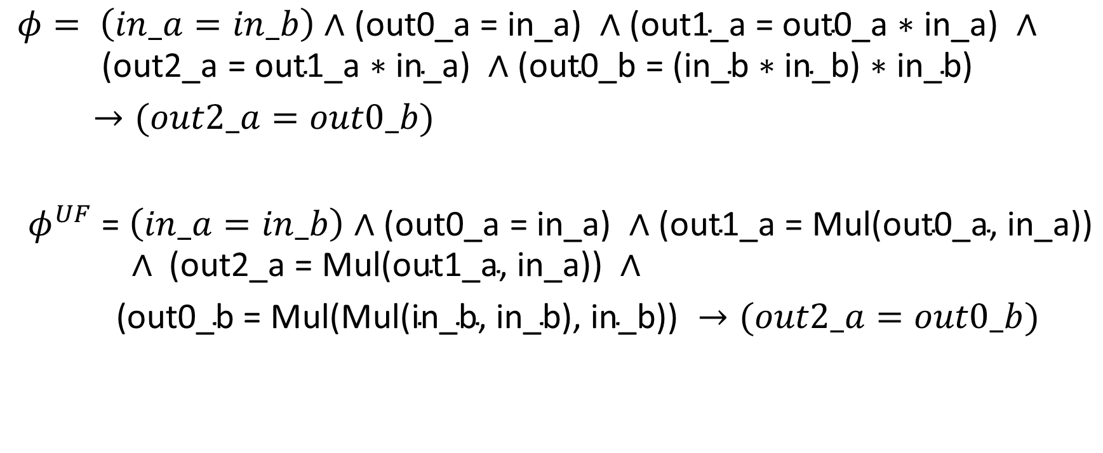
Converting to EUF
$$φ= \left(in_a=in_b\right)∧\text{(}\text{out}\text{0_}\text{a}\text{ = }\text{in}\text{_}\text{a}\text{) }∧\text{(}\text{out}\text{1_}\text{a}\text{ = }\text{out}\text{0_}\text{a}\text{ ∗ }\text{in}\text{_}\text{a}\text{) }∧$$
$$\text{(}\text{out}\text{2_}\text{a}\text{ = }\text{out}\text{1_}\text{a}\text{ ∗ }\text{in}\text{_}\text{a}\text{)} ∧\text{(}\text{out}\text{0_}\text{b}\text{ = (}\text{in}\text{_}\text{b}\text{ ∗ }\text{in}\text{_}\text{b}\text{) ∗ }\text{in}\text{_}\text{b}\text{)}$$
$→(out2_a=out0_b)$
$φ^{UF}$ = $\left(in_a=in_b\right)∧\text{(}\text{out}\text{0_}\text{a}\text{ = }\text{in}\text{_}\text{a}\text{) }∧\text{(}\text{out}\text{1_}\text{a}\text{ = }\text{Mul}\text{(}\text{out}\text{0_}\text{a}\text{,} \text{in}\text{_}\text{a}\text{)}\text{)}$
$$∧ \text{(}\text{out}\text{2_}\text{a}\text{ = }\text{Mul}\text{(}\text{out}\text{1_}\text{a}\text{,} \text{in}\text{_}\text{a}\text{)}\text{)} ∧$$
$\text{(}\text{out}\text{0_}\text{b}\text{ = }\text{Mul}\text{(}\text{Mul}\text{(}\text{in}\text{_}\text{b}\text{,} \text{in}\text{_}\text{b}\text{), }\text{in}\text{_}\text{b}\text{))} →(out2_a=out0_b)$

Slide 72
Theory solver

Slide 73
Theory solver
As discussed earlier, the DPLLT framework first transforms the formula into a Boolean formula by replacing each equality predicate with a Boolean variable
The Boolean formula is then passed to a SAT solver
If the formula is satisfiable, then the SAT solver returns a satisfying assignment
The theory solver checks if the conjunction of equalities hold

Slide 74
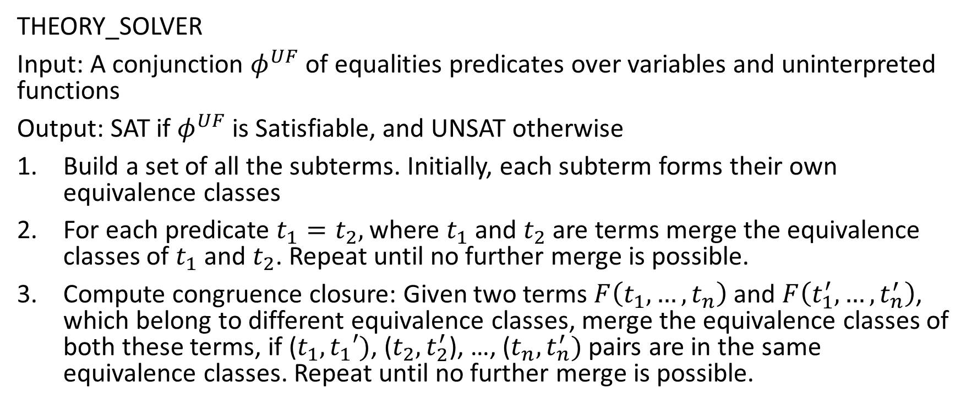
Theory solver
THEORY_SOLVER
Input: A conjunction $φ^{UF}$ of equalities predicates over variables and uninterpreted functions
Output: SAT if $φ^{UF}$ is Satisfiable, and UNSAT otherwise
Build a set of all the subterms. Initially, each subterm forms their own equivalence classes
For each predicate $t_{1}=t_{2},$ where $t_{1}$ and $t_{2}$ are terms merge the equivalence classes of $t_{1}$ and $t_{2}$. Repeat until no further merge is possible.
Compute congruence closure: Given two terms $F\left(t_{1}, …,t_{n}\right)$ and $F\left(t_{1}^{′}, …,t_{n}^{′}\right)$, which belong to different equivalence classes, merge the equivalence classes of both these terms, if ($t_{1}, t_{1}′)$, ($t_{2},t_{2}^{′}$), …, ($t_{n}, t_{n}^{′})$ pairs are in the same equivalence classes. Repeat until no further merge is possible.

Slide 75

Theory solver
4. If there exists inequality $t_{i}≠t_{j}$ in $φ^{UF}$ such that $t_{i}$ and $t_{j}$ are in the same equivalence class, return UNSAT; otherwise, return SAT

Slide 76
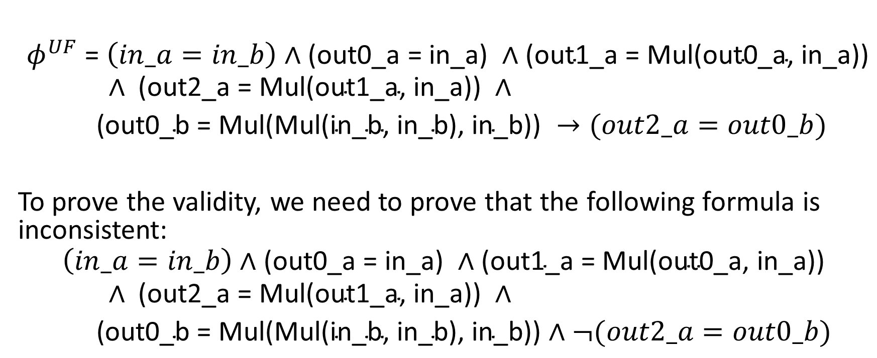
Converting to EUF
$φ^{UF}$ = $\left(in_a=in_b\right)∧\text{(}\text{out}\text{0_}\text{a}\text{ = }\text{in}\text{_}\text{a}\text{) }∧\text{(}\text{out}\text{1_}\text{a}\text{ = }\text{Mul}\text{(}\text{out}\text{0_}\text{a}\text{,} \text{in}\text{_}\text{a}\text{)}\text{)}$
$$∧ \text{(}\text{out}\text{2_}\text{a}\text{ = }\text{Mul}\text{(}\text{out}\text{1_}\text{a}\text{,} \text{in}\text{_}\text{a}\text{)}\text{)} ∧$$
$\text{(}\text{out}\text{0_}\text{b}\text{ = }\text{Mul}\text{(}\text{Mul}\text{(}\text{in}\text{_}\text{b}\text{,} \text{in}\text{_}\text{b}\text{), }\text{in}\text{_}\text{b}\text{))} →(out2_a=out0_b)$
To prove the validity, we need to prove that the following formula is inconsistent:
$$\left(in_a=in_b\right)∧\text{(}\text{out}\text{0_}\text{a}\text{ = }\text{in}\text{_}\text{a}\text{) }∧\text{(}\text{out}\text{1_}\text{a}\text{ = }\text{Mul}\text{(}\text{out}\text{0_}\text{a}\text{,} \text{in}\text{_}\text{a}\text{)}\text{)}$$
$$∧ \text{(}\text{out}\text{2_}\text{a}\text{ = }\text{Mul}\text{(}\text{out}\text{1_}\text{a}\text{,} \text{in}\text{_}\text{a}\text{)}\text{)} ∧$$
$\text{(}\text{out}\text{0_}\text{b}\text{ = }\text{Mul}\text{(}\text{Mul}\text{(}\text{in}\text{_}\text{b}\text{,} \text{in}\text{_}\text{b}\text{), }\text{in}\text{_}\text{b}\text{))}∧¬(out2_a=out0_b)$

Slide 77
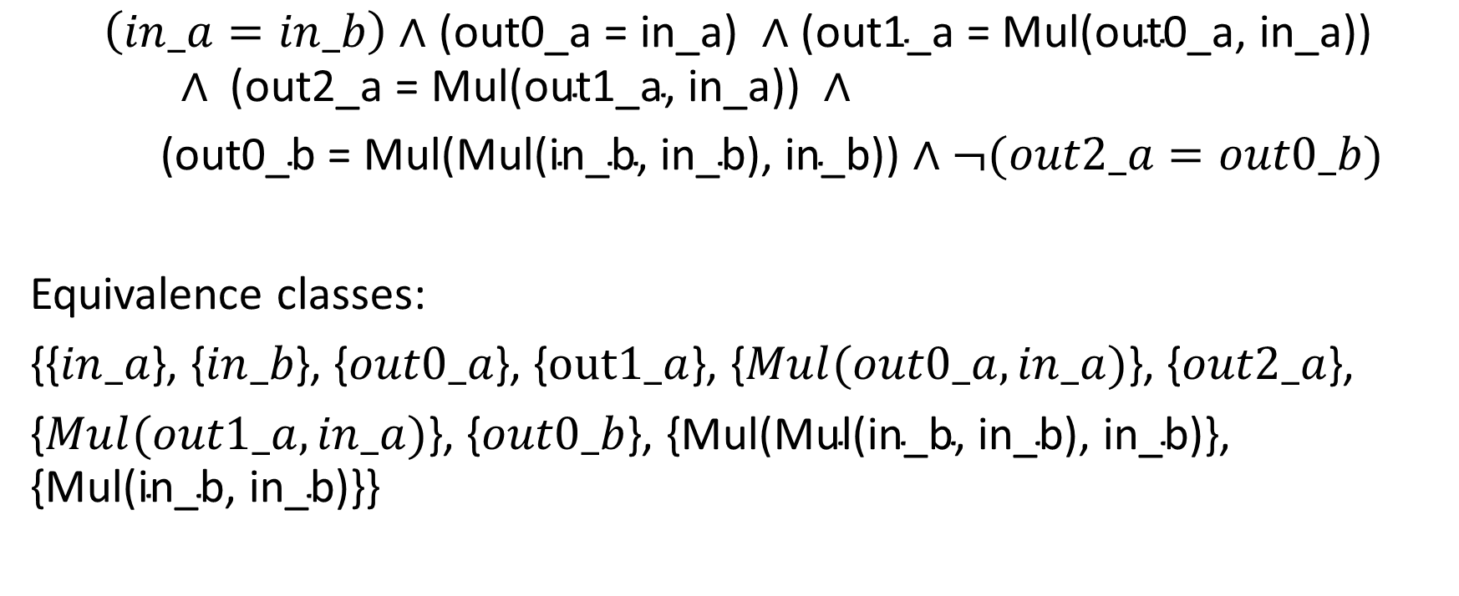
Converting to EUF
$$\left(in_a=in_b\right)∧\text{(}\text{out}\text{0_}\text{a}\text{ = }\text{in}\text{_}\text{a}\text{) }∧\text{(}\text{out}\text{1_}\text{a}\text{ = }\text{Mul}\text{(}\text{out}\text{0_}\text{a}\text{,} \text{in}\text{_}\text{a}\text{)}\text{)}$$
$$∧ \text{(}\text{out}\text{2_}\text{a}\text{ = }\text{Mul}\text{(}\text{out}\text{1_}\text{a}\text{,} \text{in}\text{_}\text{a}\text{)}\text{)} ∧$$
$\text{(}\text{out}\text{0_}\text{b}\text{ = }\text{Mul}\text{(}\text{Mul}\text{(}\text{in}\text{_}\text{b}\text{,} \text{in}\text{_}\text{b}\text{), }\text{in}\text{_}\text{b}\text{))}∧¬(out2_a=out0_b)$
Equivalence classes:
{{$in_a$}, {$in_b$}, {$out0_a$}, {$out1_a$}, {$Mul(out0_a, in_a)$}, {$out2_a$},
{$Mul(out1_a, in_a)$}, {$out0_b$}, {$\text{Mul}\text{(}\text{Mul}\text{(}\text{in}\text{_}\text{b}\text{, }\text{in}\text{_}\text{b}\text{), }\text{in}\text{_}\text{b}\text{)}$}, {$\text{Mul}\text{(}\text{in}\text{_}\text{b}\text{, }\text{in}\text{_}\text{b}\text{)\}\}}$

Slide 78
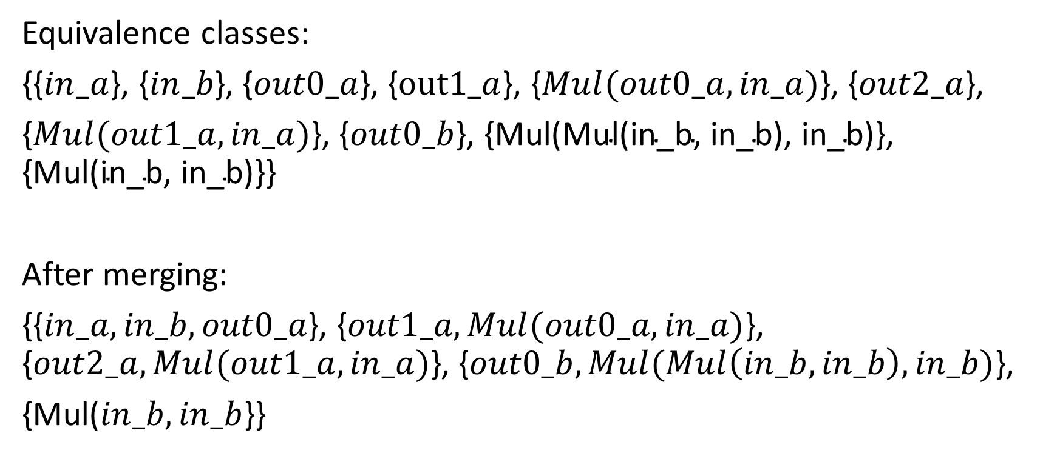
Converting to EUF
Equivalence classes:
{{$in_a$}, {$in_b$}, {$out0_a$}, {$out1_a$}, {$Mul(out0_a, in_a)$}, {$out2_a$},
{$Mul(out1_a, in_a)$}, {$out0_b$}, {$\text{Mul}\text{(}\text{Mul}\text{(}\text{in}\text{_}\text{b}\text{, }\text{in}\text{_}\text{b}\text{), }\text{in}\text{_}\text{b}\text{)}$}, {$\text{Mul}\text{(}\text{in}\text{_}\text{b}\text{, }\text{in}\text{_}\text{b}\text{)\}\}}$
After merging:
{{$in_a, in_b,out0_a$}, {$out1_a, Mul(out0_a, in_a)$}, {$out2_a, Mul(out1_a, in_a)$}, {$out0_b, Mul(Mul\left(in_b, in_b\right), in_b)$},
{Mul($in_b, in_b$}}

