Slide 2
References
Section-9.2.2 from the COC book
Chapter-4 from the DP book

Slide 3
Theory of equality

Slide 4
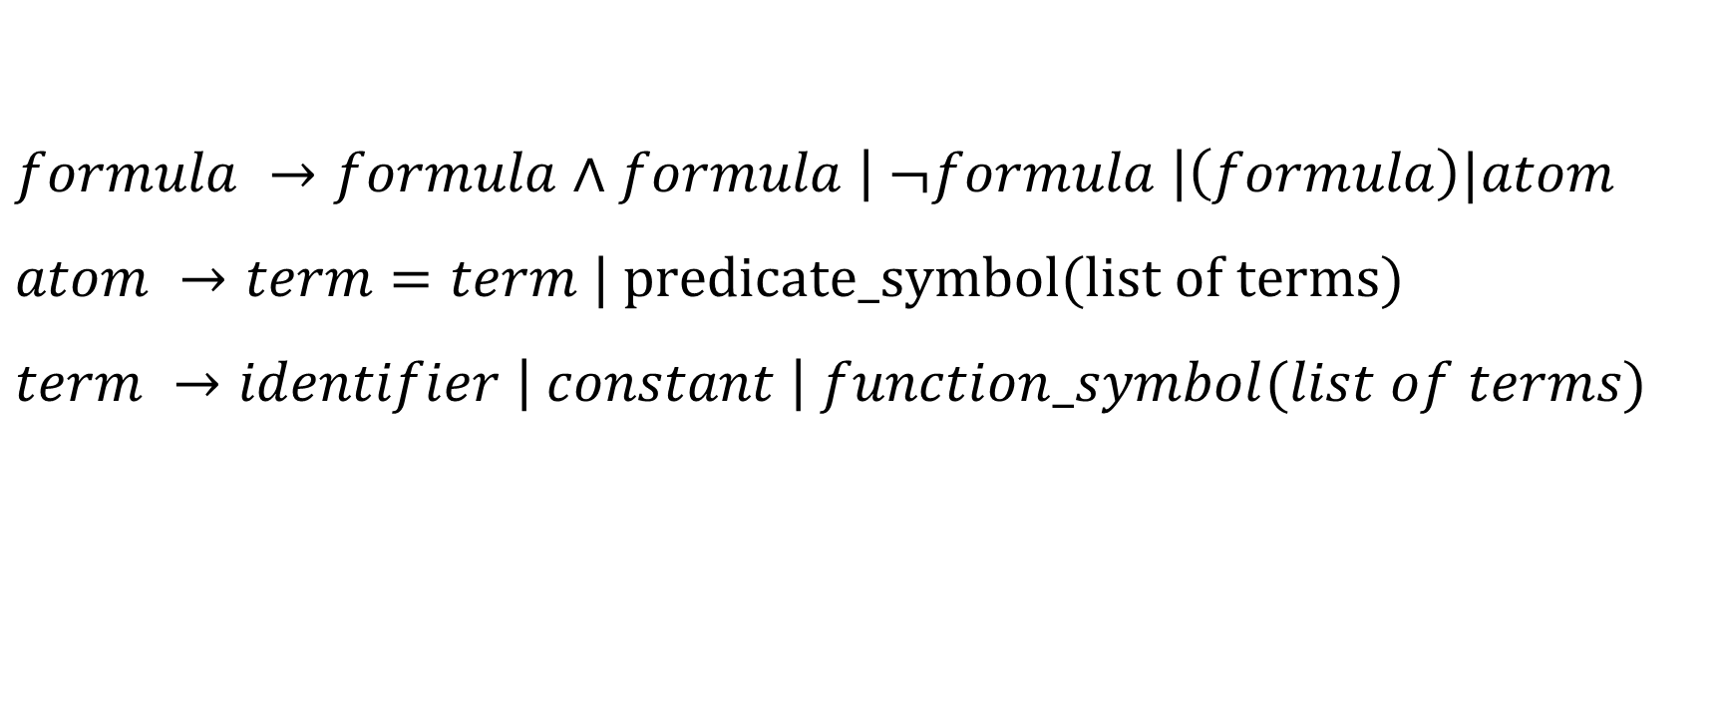
Equality logic with uninterpreted functions (EUF)
$$formula →formula∧formula \left| ¬formula \right|\left(formula\right)|atom$$
$$atom →term=term | predicate_symbol(list of terms)$$
$$term →identifier \left| constant \right| function_symbol(list of terms)$$

Slide 5
EUF
We will use capital letters to denote uninterpreted functions and superscript “UF” to denote EUF formulae.

Slide 6

Additional axioms for EUF
Congruence rule
$$∀t_{1},…,t_{n},t_{1}^{′}…,t_{n}^{′}. \bigwedge_{i}{t_{i}=t_{i}^{′} →f\left(t_{1}, …, t_{n}\right)=f\left(t_{1}^{′}, …, t_{n}^{′}\right)}$$
$$∀t_{1},…,t_{n},t_{1}^{′}…,t_{n}^{′}. \bigwedge_{i}{t_{i}=t_{i}^{′} →(p\left(t_{1}, …, t_{n}\right)↔p\left(t_{1}^{′}, …, t_{n}^{′}\right))}$$

Slide 7
Functional consistency
A function is consistent if it returns the same output when invoked with the same arguments
The additional axiom for uninterpreted function uses the functional consistency

Slide 8
Uninterpreted functions
Uninterpreted functions can be useful to prove the validity of a formula that contains interpreted functions, and checking the validity of interpreted functions is hard, e.g., functions have loops or use complex data structures
Transforming a hard-to-validate interpreted function to an uninterpreted function during the verification makes the task of the verification feasible when the validity check doesn’t really depend on the interpretation of the functions in the formula

Slide 9
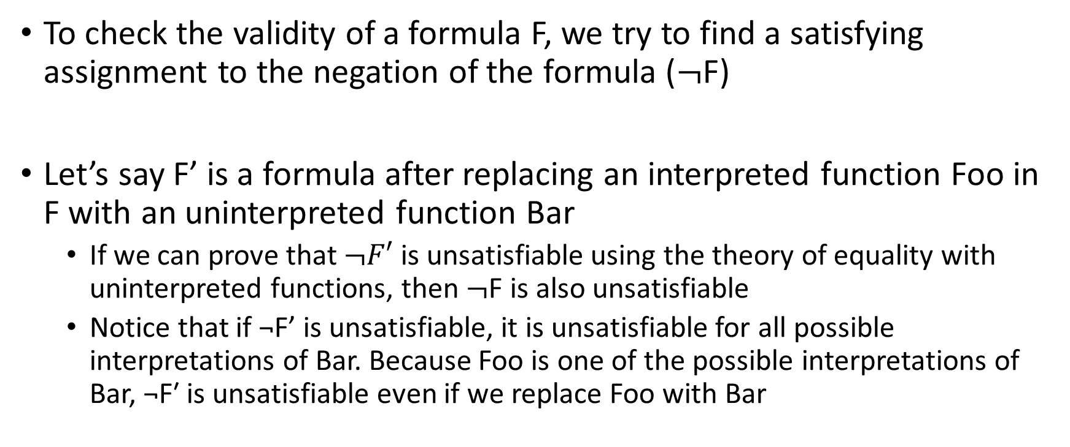
Uninterpreted functions
To check the validity of a formula F, we try to find a satisfying assignment to the negation of the formula ($¬$F)
Let’s say F’ is a formula after replacing an interpreted function Foo in F with an uninterpreted function Bar
If we can prove that $¬F′$ is unsatisfiable using the theory of equality with uninterpreted functions, then $¬$F is also unsatisfiable
Notice that if ¬F’ is unsatisfiable, it is unsatisfiable for all possible interpretations of Bar. Because Foo is one of the possible interpretations of Bar, ¬F′ is unsatisfiable even if we replace Foo with Bar

Slide 10
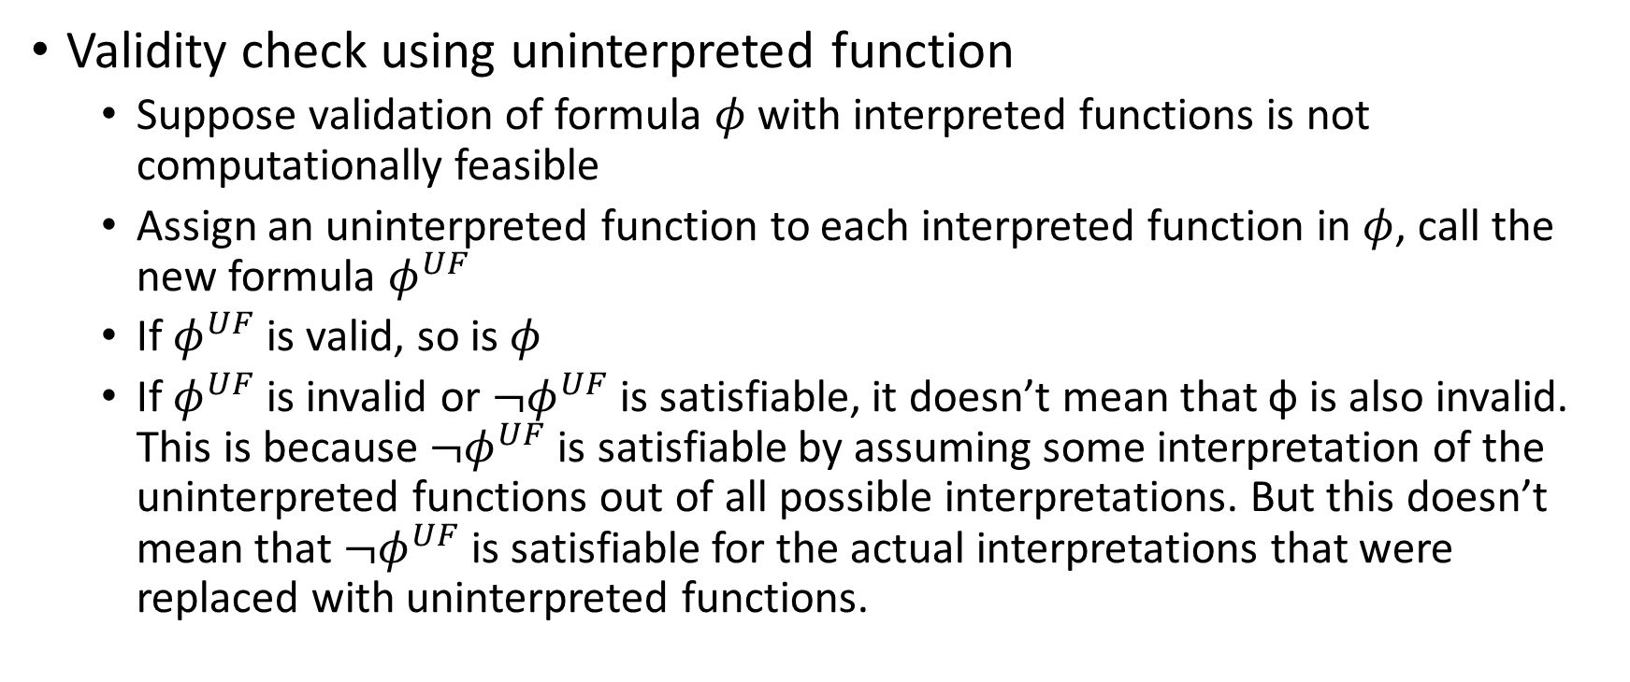
Uninterpreted functions
Validity check using uninterpreted function
Suppose validation of formula $φ$ with interpreted functions is not computationally feasible
Assign an uninterpreted function to each interpreted function in $φ$, call the new formula $φ^{UF}$
If $φ^{UF}$ is valid, so is $φ$
If $φ^{UF}$ is invalid or ${¬φ}^{UF}$ is satisfiable, it doesn’t mean that ϕ is also invalid. This is because ${¬φ}^{UF}$ is satisfiable by assuming some interpretation of the uninterpreted functions out of all possible interpretations. But this doesn’t mean that ${¬φ}^{UF}$ is satisfiable for the actual interpretations that were replaced with uninterpreted functions.

Slide 11
Example (program equivalence)
int power3(int in)
{
int i, out_a;
out_a = in;
for (i = 0; i < 2; i++)
out_a = out_a * in;
return out_a;
}
int power3_new(int in)
{
int out_b;
out_b = (in * in) * in;
return out_b;
}

Slide 12
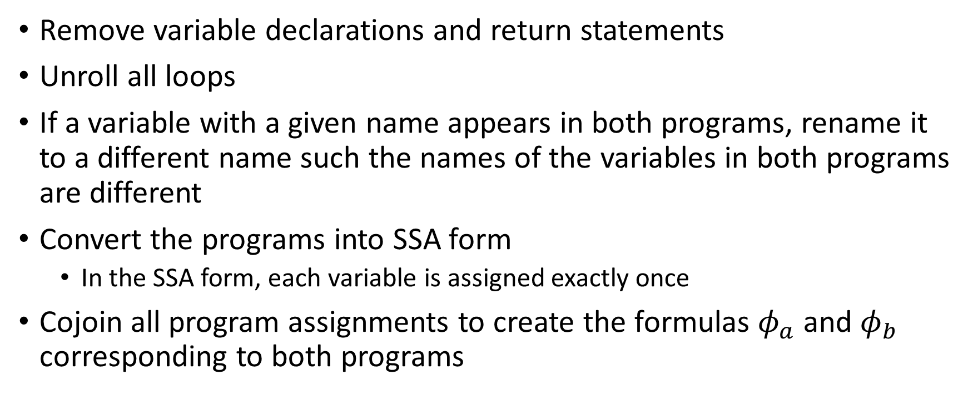
Approach
Remove variable declarations and return statements
Unroll all loops
If a variable with a given name appears in both programs, rename it to a different name such the names of the variables in both programs are different
Convert the programs into SSA form
In the SSA form, each variable is assigned exactly once
Cojoin all program assignments to create the formulas $φ_{a}$ and $φ_{b}$ corresponding to both programs

Slide 13
Converting to SSA
Replace the LHS variable in each assignment with a new auxiliary variable
Whenever a variable is read, replace it with the auxiliary variable at the last assignment to it

Slide 14
Example (after loop unrolling)
int power3(int in)
{
int i, out_a;
out_a = in;
out_a = out_a * in;
out_a = out_a * in;
return out_a;
}
int power3_new(int in)
{
int out_b;
out_b = (in * in) * in;
return out_b;
}

Slide 15
Example (after renaming)
out_a = in_a;
out_a = out_a * in_a;
out_a = out_a * in_a;
out_b = (in_b * in_b) * in_b;

Slide 16
Example (SSA form)
out0_a = in_a;
out1_a = out0_a * in_a;
out2_a = out1_a * in_a;
out0_b = (in_b * in_b) * in_b;

Slide 17


Example (formulae)
$φ_{a}$ =
(out0_a = in_a) $∧$
(out1_a = out0_a * in_a) $∧$
(out2_a = out1_a * in_a);
$$φ_{b}=$$
(out0_b = (in_b * in_b) * in_b)

Slide 18

Condition for equivalence
The programs are equivalent when the outputs of the programs are the same if the inputs are the same
Inputs: in_a, in_b
Outputs: out2_a, out0_b
Formulae for the programs: $φ_{a}$, $φ_{b}$

Slide 19
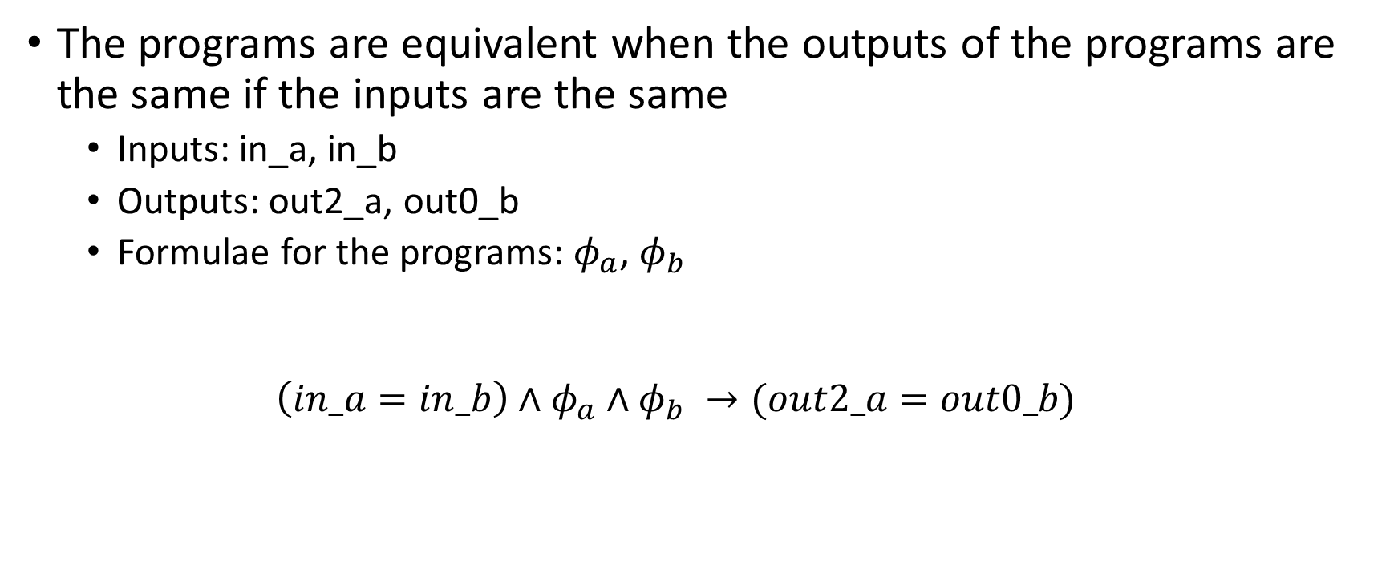
Condition for equivalence
The programs are equivalent when the outputs of the programs are the same if the inputs are the same
Inputs: in_a, in_b
Outputs: out2_a, out0_b
Formulae for the programs: $φ_{a}$, $φ_{b}$
$$\left(in_a=in_b\right)∧φ_{a}∧φ_{b} →(out2_a=out0_b)$$

Slide 20
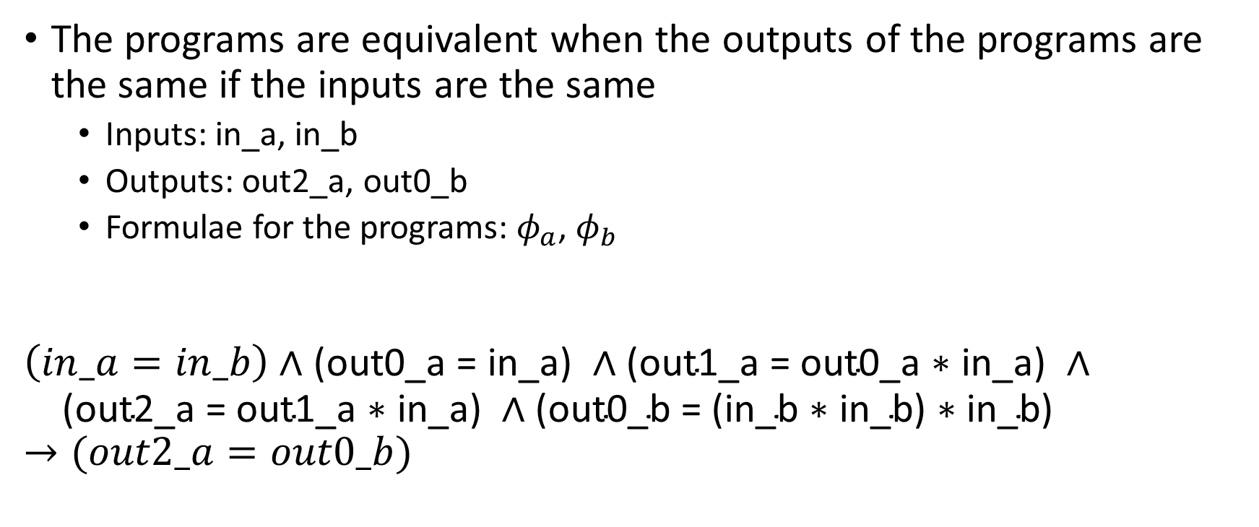
Condition for equivalence
The programs are equivalent when the outputs of the programs are the same if the inputs are the same
Inputs: in_a, in_b
Outputs: out2_a, out0_b
Formulae for the programs: $φ_{a}$, $φ_{b}$
$$\left(in_a=in_b\right)∧\text{(}\text{out}\text{0_}\text{a}\text{ = }\text{in}\text{_}\text{a}\text{) }∧\text{(}\text{out}\text{1_}\text{a}\text{ = }\text{out}\text{0_}\text{a}\text{ ∗ }\text{in}\text{_}\text{a}\text{) }∧$$
$$\text{ (}\text{out}\text{2_}\text{a}\text{ = }\text{out}\text{1_}\text{a}\text{ ∗ }\text{in}\text{_}\text{a}\text{)} ∧\text{(}\text{out}\text{0_}\text{b}\text{ = (}\text{in}\text{_}\text{b}\text{ ∗ }\text{in}\text{_}\text{b}\text{) ∗ }\text{in}\text{_}\text{b}\text{)}→(out2_a=out0_b)$$

Slide 21

Converting to EUF
$$φ= \left(in_a=in_b\right)∧\text{(}\text{out}\text{0_}\text{a}\text{ = }\text{in}\text{_}\text{a}\text{) }∧\text{(}\text{out}\text{1_}\text{a}\text{ = }\text{out}\text{0_}\text{a}\text{ ∗ }\text{in}\text{_}\text{a}\text{) }∧$$
$$\text{(}\text{out}\text{2_}\text{a}\text{ = }\text{out}\text{1_}\text{a}\text{ ∗ }\text{in}\text{_}\text{a}\text{)} ∧\text{(}\text{out}\text{0_}\text{b}\text{ = (}\text{in}\text{_}\text{b}\text{ ∗ }\text{in}\text{_}\text{b}\text{) ∗ }\text{in}\text{_}\text{b}\text{)}$$
$→(out2_a=out0_b)$

Slide 22
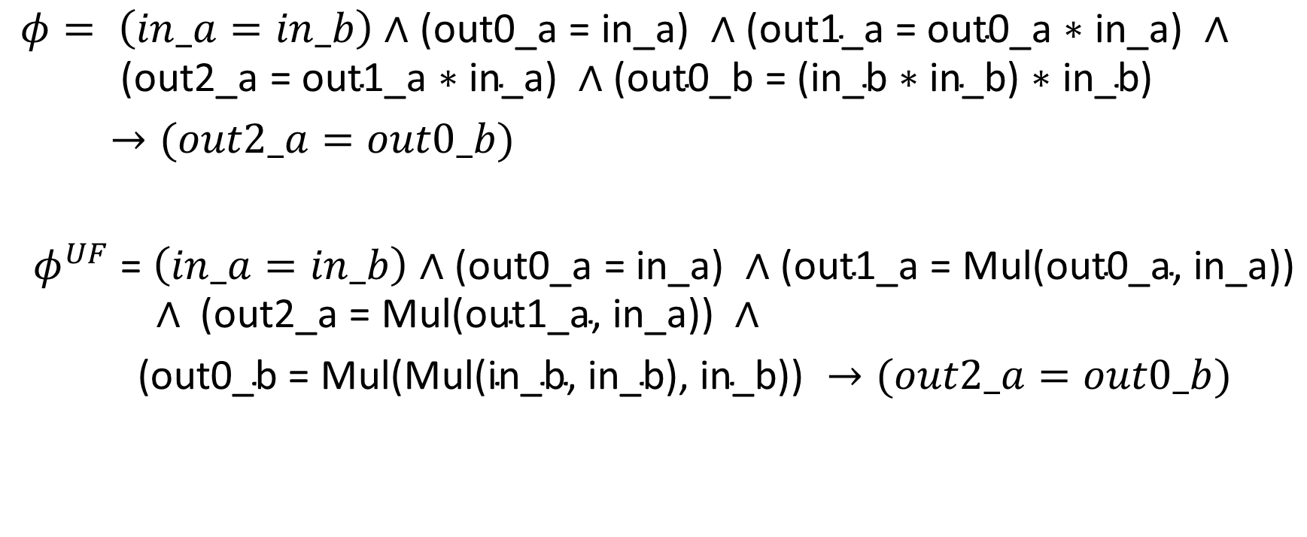
Converting to EUF
$$φ= \left(in_a=in_b\right)∧\text{(}\text{out}\text{0_}\text{a}\text{ = }\text{in}\text{_}\text{a}\text{) }∧\text{(}\text{out}\text{1_}\text{a}\text{ = }\text{out}\text{0_}\text{a}\text{ ∗ }\text{in}\text{_}\text{a}\text{) }∧$$
$$\text{(}\text{out}\text{2_}\text{a}\text{ = }\text{out}\text{1_}\text{a}\text{ ∗ }\text{in}\text{_}\text{a}\text{)} ∧\text{(}\text{out}\text{0_}\text{b}\text{ = (}\text{in}\text{_}\text{b}\text{ ∗ }\text{in}\text{_}\text{b}\text{) ∗ }\text{in}\text{_}\text{b}\text{)}$$
$→(out2_a=out0_b)$
$φ^{UF}$ = $\left(in_a=in_b\right)∧\text{(}\text{out}\text{0_}\text{a}\text{ = }\text{in}\text{_}\text{a}\text{) }∧\text{(}\text{out}\text{1_}\text{a}\text{ = }\text{Mul}\text{(}\text{out}\text{0_}\text{a}\text{,} \text{in}\text{_}\text{a}\text{)}\text{)}$
$$∧ \text{(}\text{out}\text{2_}\text{a}\text{ = }\text{Mul}\text{(}\text{out}\text{1_}\text{a}\text{,} \text{in}\text{_}\text{a}\text{)}\text{)} ∧$$
$\text{(}\text{out}\text{0_}\text{b}\text{ = }\text{Mul}\text{(}\text{Mul}\text{(}\text{in}\text{_}\text{b}\text{,} \text{in}\text{_}\text{b}\text{), }\text{in}\text{_}\text{b}\text{))} →(out2_a=out0_b)$

Slide 23
Theory solver

Slide 24
Theory solver
As discussed earlier, the DPLLT framework first transforms the formula into a Boolean formula by replacing each equality predicate with a Boolean variable
The Boolean formula is then passed to a SAT solver
If the formula is satisfiable, then the SAT solver returns a satisfying assignment
The theory solver checks if the conjunction of equalities hold

Slide 25
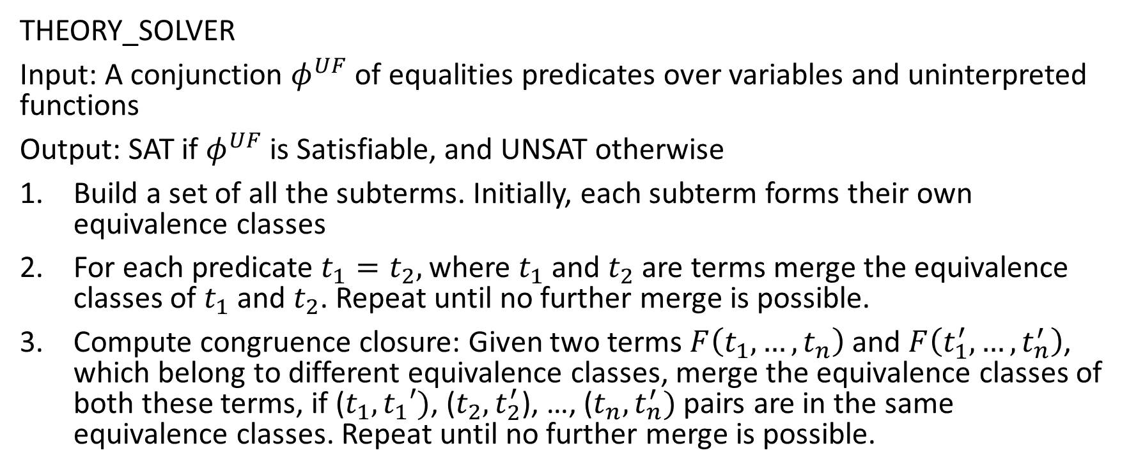
Theory solver
THEORY_SOLVER
Input: A conjunction $φ^{UF}$ of equalities predicates over variables and uninterpreted functions
Output: SAT if $φ^{UF}$ is Satisfiable, and UNSAT otherwise
Build a set of all the subterms. Initially, each subterm forms their own equivalence classes
For each predicate $t_{1}=t_{2},$ where $t_{1}$ and $t_{2}$ are terms merge the equivalence classes of $t_{1}$ and $t_{2}$. Repeat until no further merge is possible.
Compute congruence closure: Given two terms $F\left(t_{1}, …,t_{n}\right)$ and $F\left(t_{1}^{′}, …,t_{n}^{′}\right)$, which belong to different equivalence classes, merge the equivalence classes of both these terms, if ($t_{1}, t_{1}′)$, ($t_{2},t_{2}^{′}$), …, ($t_{n}, t_{n}^{′})$ pairs are in the same equivalence classes. Repeat until no further merge is possible.

Slide 26

Theory solver
4. If there exists inequality $t_{i}≠t_{j}$ in $φ^{UF}$ such that $t_{i}$ and $t_{j}$ are in the same equivalence class, return UNSAT; otherwise, return SAT

Slide 27
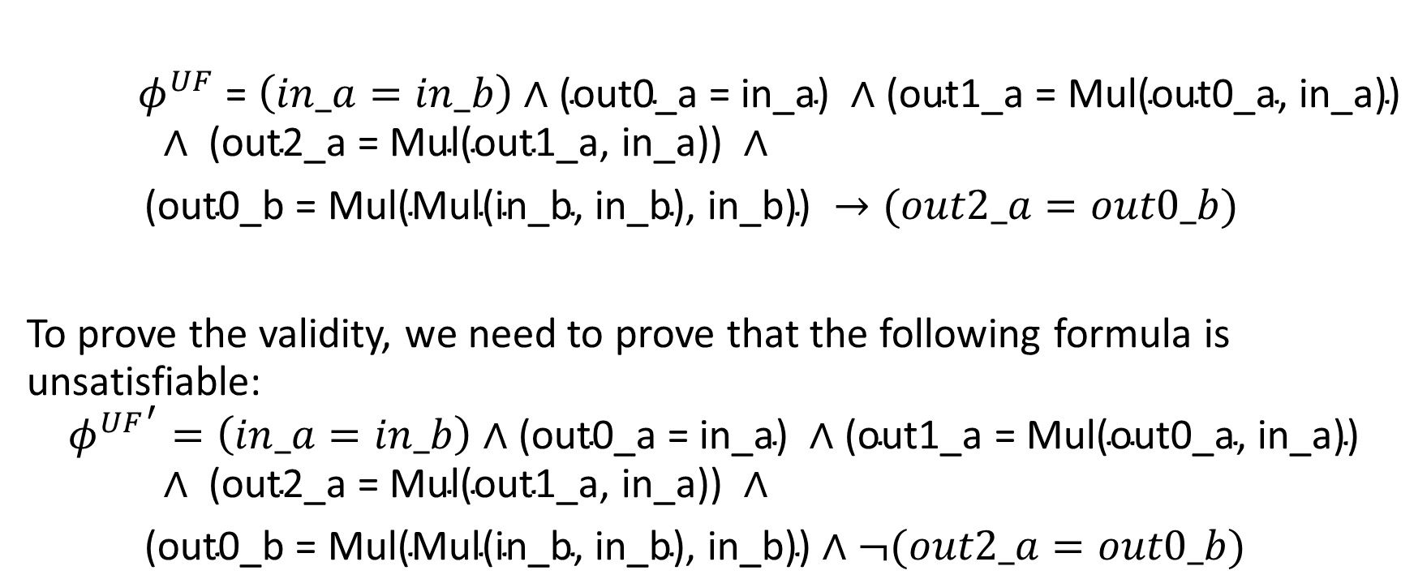
Converting to EUF
$φ^{UF}$ = $\left(in_a=in_b\right)∧\text{(}\text{out}\text{0_}\text{a}\text{ = }\text{in}\text{_}\text{a}\text{) }∧\text{(}\text{out}\text{1_}\text{a}\text{ = }\text{Mul}\text{(}\text{out}\text{0_}\text{a}\text{,} \text{in}\text{_}\text{a}\text{)}\text{)}$
$$∧ \text{(}\text{out}\text{2_}\text{a}\text{ = }\text{Mul}\text{(}\text{out}\text{1_}\text{a}\text{,} \text{in}\text{_}\text{a}\text{)}\text{)} ∧$$
$\text{(}\text{out}\text{0_}\text{b}\text{ = }\text{Mul}\text{(}\text{Mul}\text{(}\text{in}\text{_}\text{b}\text{,} \text{in}\text{_}\text{b}\text{), }\text{in}\text{_}\text{b}\text{))} →(out2_a=out0_b)$
To prove the validity, we need to prove that the following formula is unsatisfiable:
$${φ^{UF}}^{′}=\left(in_a=in_b\right)∧\text{(}\text{out}\text{0_}\text{a}\text{ = }\text{in}\text{_}\text{a}\text{) }∧\text{(}\text{out}\text{1_}\text{a}\text{ = }\text{Mul}\text{(}\text{out}\text{0_}\text{a}\text{,} \text{in}\text{_}\text{a}\text{)}\text{)}$$
$$∧ \text{(}\text{out}\text{2_}\text{a}\text{ = }\text{Mul}\text{(}\text{out}\text{1_}\text{a}\text{,} \text{in}\text{_}\text{a}\text{)}\text{)} ∧$$
$\text{(}\text{out}\text{0_}\text{b}\text{ = }\text{Mul}\text{(}\text{Mul}\text{(}\text{in}\text{_}\text{b}\text{,} \text{in}\text{_}\text{b}\text{), }\text{in}\text{_}\text{b}\text{))}∧¬(out2_a=out0_b)$

Slide 28
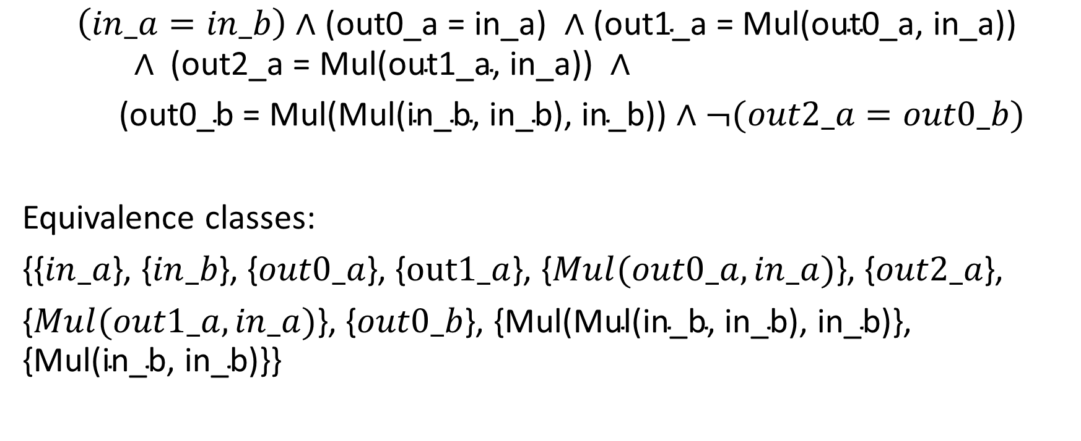
Converting to EUF
$$\left(in_a=in_b\right)∧\text{(}\text{out}\text{0_}\text{a}\text{ = }\text{in}\text{_}\text{a}\text{) }∧\text{(}\text{out}\text{1_}\text{a}\text{ = }\text{Mul}\text{(}\text{out}\text{0_}\text{a}\text{,} \text{in}\text{_}\text{a}\text{)}\text{)}$$
$$∧ \text{(}\text{out}\text{2_}\text{a}\text{ = }\text{Mul}\text{(}\text{out}\text{1_}\text{a}\text{,} \text{in}\text{_}\text{a}\text{)}\text{)} ∧$$
$\text{(}\text{out}\text{0_}\text{b}\text{ = }\text{Mul}\text{(}\text{Mul}\text{(}\text{in}\text{_}\text{b}\text{,} \text{in}\text{_}\text{b}\text{), }\text{in}\text{_}\text{b}\text{))}∧¬(out2_a=out0_b)$
Equivalence classes:
{{$in_a$}, {$in_b$}, {$out0_a$}, {$out1_a$}, {$Mul(out0_a, in_a)$}, {$out2_a$},
{$Mul(out1_a, in_a)$}, {$out0_b$}, {$\text{Mul}\text{(}\text{Mul}\text{(}\text{in}\text{_}\text{b}\text{, }\text{in}\text{_}\text{b}\text{), }\text{in}\text{_}\text{b}\text{)}$}, {$\text{Mul}\text{(}\text{in}\text{_}\text{b}\text{, }\text{in}\text{_}\text{b}\text{)\}\}}$

Slide 29
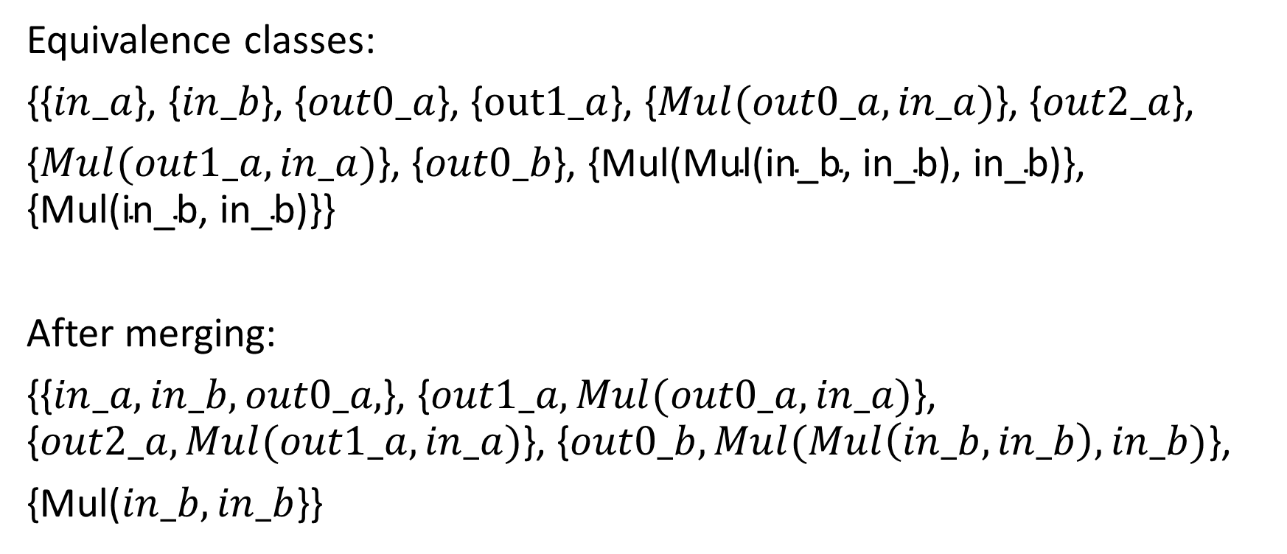
Converting to EUF
Equivalence classes:
{{$in_a$}, {$in_b$}, {$out0_a$}, {$out1_a$}, {$Mul(out0_a, in_a)$}, {$out2_a$},
{$Mul(out1_a, in_a)$}, {$out0_b$}, {$\text{Mul}\text{(}\text{Mul}\text{(}\text{in}\text{_}\text{b}\text{, }\text{in}\text{_}\text{b}\text{), }\text{in}\text{_}\text{b}\text{)}$}, {$\text{Mul}\text{(}\text{in}\text{_}\text{b}\text{, }\text{in}\text{_}\text{b}\text{)\}\}}$
After merging:
{{$in_a, in_b, out0_a,$}, {$out1_a, Mul(out0_a, in_a)$}, {$out2_a, Mul(out1_a, in_a)$}, {$out0_b, Mul(Mul\left(in_b, in_b\right), in_b)$},
{Mul($in_b, in_b$}}

Slide 30
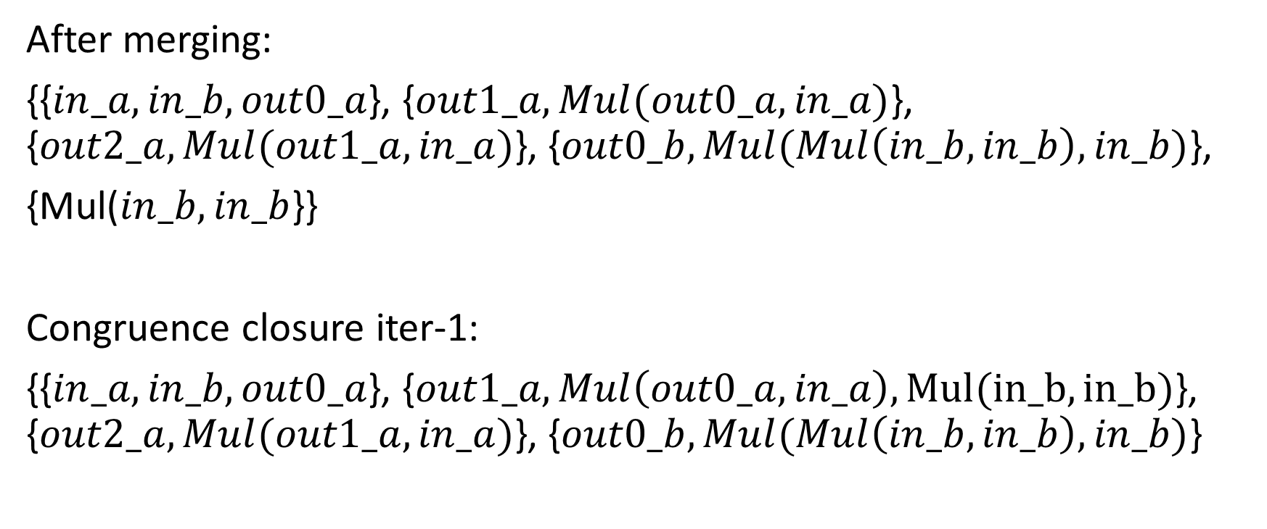
Converting to EUF
After merging:
{{$in_a, in_b,out0_a$}, {$out1_a, Mul(out0_a, in_a)$}, {$out2_a, Mul(out1_a, in_a)$}, {$out0_b, Mul(Mul\left(in_b, in_b\right), in_b)$},
{Mul($in_b, in_b$}}
Congruence closure iter-1:
{{$in_a, in_b,out0_a$}, {$out1_a, Mul\left(out0_a, in_a\right), Mul(in_b,in_b)$}, {$out2_a, Mul(out1_a, in_a)$}, {$out0_b, Mul(Mul\left(in_b, in_b\right), in_b)$}

Slide 31
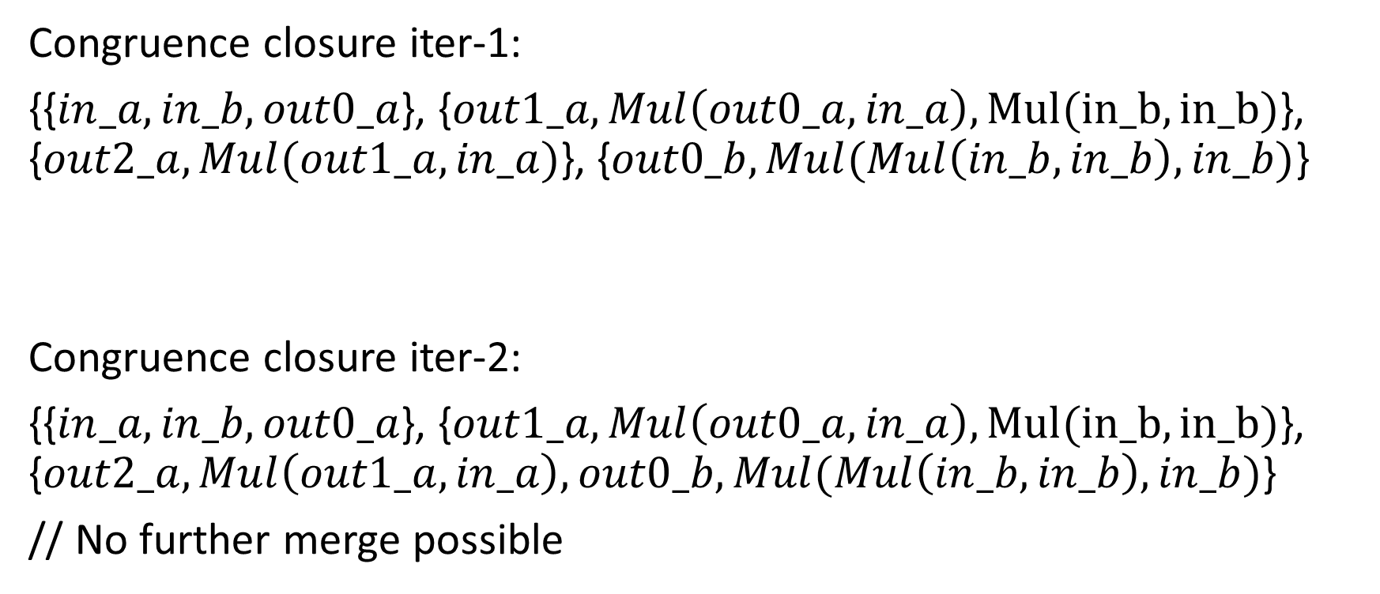
Converting to EUF
Congruence closure iter-1:
{{$in_a, in_b,out0_a$}, {$out1_a, Mul\left(out0_a, in_a\right), Mul(in_b,in_b)$}, {$out2_a, Mul(out1_a, in_a)$}, {$out0_b, Mul(Mul\left(in_b, in_b\right), in_b)$}
Congruence closure iter-2:
{{$in_a, in_b,out0_a$}, {$out1_a, Mul\left(out0_a, in_a\right), Mul(in_b,in_b)$}, {$out2_a, Mul\left(out1_a, in_a\right), out0_b, Mul(Mul\left(in_b, in_b\right), in_b)$}
// No further merge possible

Slide 32
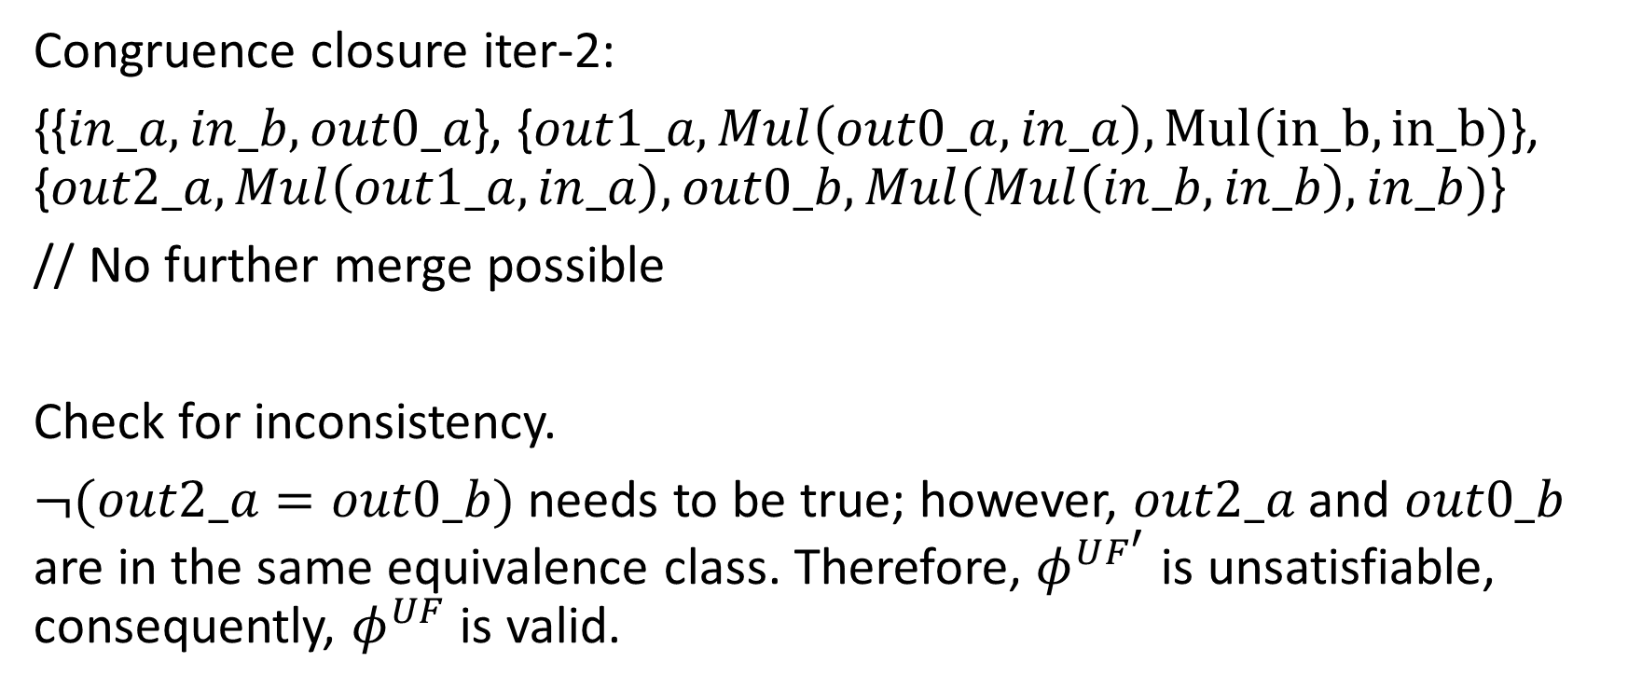
Converting to EUF
Congruence closure iter-2:
{{$in_a, in_b,out0_a$}, {$out1_a, Mul\left(out0_a, in_a\right), Mul(in_b,in_b)$}, {$out2_a, Mul\left(out1_a, in_a\right), out0_b, Mul(Mul\left(in_b, in_b\right), in_b)$}
// No further merge possible
Check for inconsistency.
$¬(out2_a=out0_b)$ needs to be true; however, $out2_a$ and $out0_b$ are in the same equivalence class. Therefore, $φ^{UF^{′}}$ is unsatisfiable, consequently, $φ^{UF}$ is valid.

Slide 33

Example
Is $F :f\left(a, b\right)=a∧f\left(f\left(a,b\right),b\right)≠a$ satisfiable?

Slide 34
Implementation

Slide 35

Create a DAG of all subterms
$$F :f\left(a, b\right)=a∧f\left(f\left(a,b\right),b\right)≠a$$
$S_{F}$ = {$\left\{a\right\}, \left\{b\right\}, \left\{f\left(a,b\right)\right\}, \{f(f\left(a,b\right), b)\}$}
f
f
a
b

Slide 36
Implementation
Create a directed acyclic graph of all the terms in the formula
DAG node structure
struct DAG {
int id;
char fn[32];
int n_args; // number of children
int *args; // array of arguments’ ids
int cc; // congruence class
int *ccpar; // array of parents’ ids of all nodes in the congruence class
};

Slide 37
Create a DAG of all subterms
$$F :f\left(a, b\right)=a∧f\left(f\left(a,b\right),b\right)≠a$$
$S_{F}$ = {$\left\{a\right\}, \left\{b\right\}, \left\{f\left(a,b\right)\right\}, \{f(f\left(a,b\right), b)\}$}
f
{id = 1, fn = “f”, n_args = 2, args={2, 4}, cc = 1, ccpar = $φ$}
f
{id = 2, fn = “f”, n_args = 2, args={3, 4}, cc = 2, ccpar = {1}}
a
b
{id = 4, fn = “b”, n_args = 0, args={}, cc = 4, ccpar = {1, 2}}
{id = 3, fn = “a”, n_args = 0, args={}, cc = 3, ccpar = {2}}

Slide 38
Basic operations
struct DAG* Node(i) // returns a node with identifier i
int Find(i) { // returns the congruence class of a node with identifier i
n = Node(i);
return (n->cc == i) ? i : Find(n->cc);
}

Slide 39
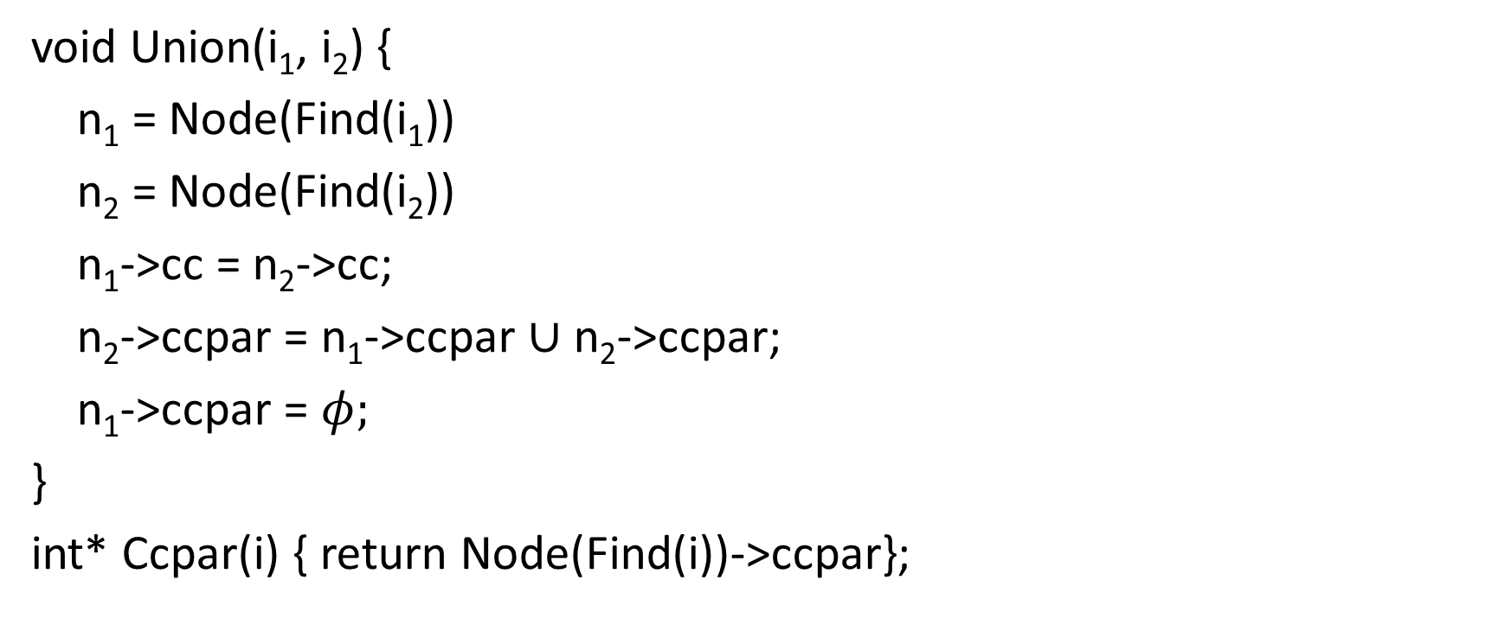
Basic operations
void Union(i₁, i₂) {
n₁ = Node(Find(i₁))
n₂ = Node(Find(i₂))
n₁->cc = n₂->cc;
n₂->ccpar = n₁->ccpar $∪$ n₂->ccpar;
n₁->ccpar = $φ;$
}
int* Ccpar(i) { return Node(Find(i))->ccpar};

Slide 40
Basic operations
Congruent(i, j) {
n_{i} = Node(i);
n_{j} = Node(j);
if (strcmp(n_{i}->fn, n_{j}->fn) != 0 || n_{i}->n_args != n_{j}->n_args)
return 0;
for (i = 0; i < n_args; i++) {
if (Find(n_{i}->n_args[i]) != Find(n_{j}->n_args[j])) {
return 0;
}
}
return 1;
}

Slide 41
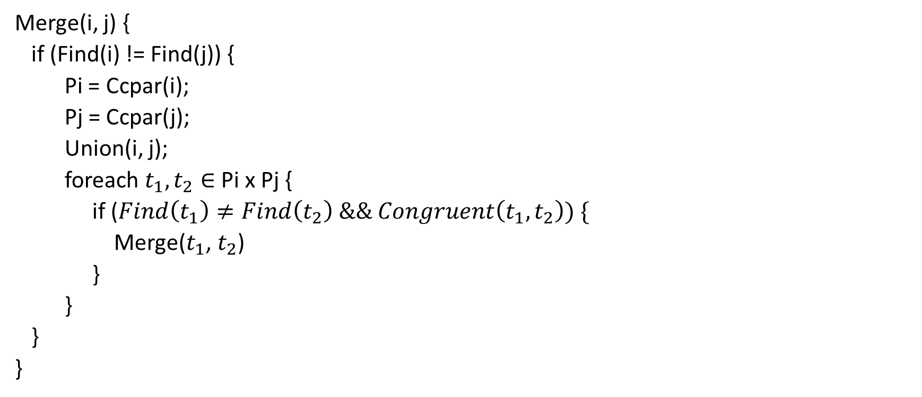
Basic operations
Merge(i, j) {
if (Find(i) != Find(j)) {
Pi = Ccpar(i);
Pj = Ccpar(j);
Union(i, j);
foreach $t_{1}, t_{2}∈$ Pi x Pj {
if ($Find\left(t_{1}\right)≠Find\left(t_{2}\right) \&\& Congruent\left(t_{1},t_{2}\right)) \{$
Merge($t_{1}$, $t_{2}$)
}
}
}
}

Slide 42
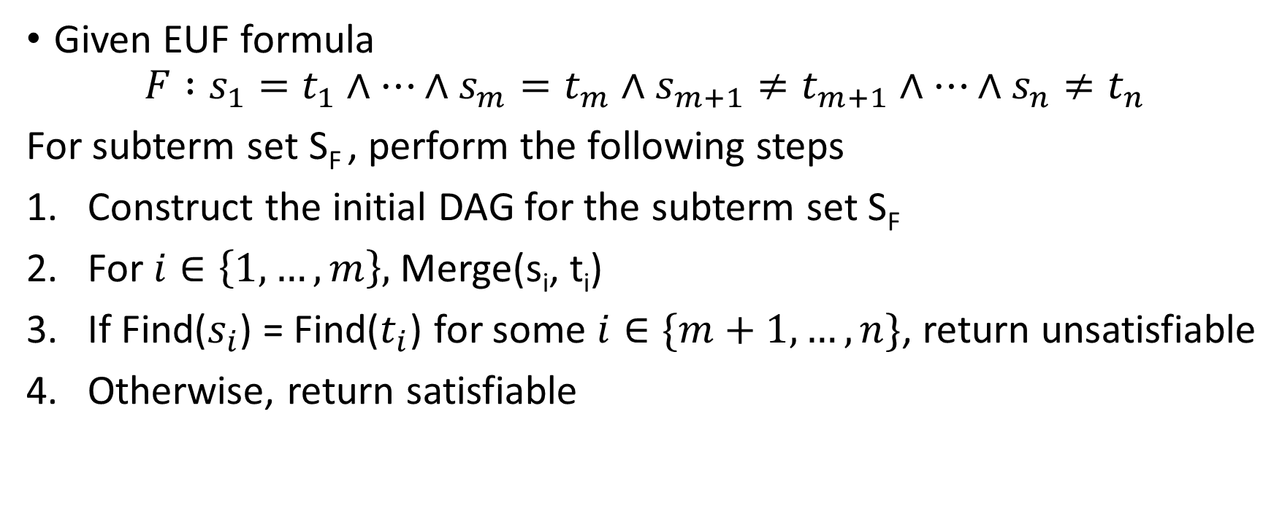
Decision procedure for EUF formulae
Given EUF formula
$$F :s_{1}=t_{1}∧…∧s_{m}=t_{m}∧s_{m+1}≠t_{m+1}∧…∧s_{n}≠t_{n}$$
For subterm set S_{F} , perform the following steps
Construct the initial DAG for the subterm set S_{F}
For $i∈\left\{1, …,m\right\},$Merge(s_{i}, t_{i})
If Find($s_{i}$) = Find($t_{i}$) for some $i∈\{m+1, …, n\}$, return unsatisfiable
Otherwise, return satisfiable

Slide 43
STEP-1, creating DAG
$$F :f\left(a, b\right)=a∧f\left(f\left(a,b\right),b\right)≠a$$
$S_{F}$ = {$\left\{a\right\}, \left\{b\right\}, \left\{f\left(a,b\right)\right\}, \{f(f\left(a,b\right), b)\}$}
f
{id = 1, fn = “f”, n_args = 2, args={2, 4}, cc = 1, ccpar = $φ$}
f
{id = 2, fn = “f”, n_args = 2, args={3, 4}, cc = 2, ccpar = {1}}
a
b
{id = 4, fn = “b”, n_args = 0, args={}, cc = 4, ccpar = {1, 2}}
{id = 3, fn = “a”, n_args = 0, args={}, cc = 3, ccpar = {2}}

Slide 44
STEP-2a, merge 2, 3
$$F :f\left(a, b\right)=a∧f\left(f\left(a,b\right),b\right)≠a$$
$S_{F}$ = {$\left\{a\right\}, \left\{b\right\}, \left\{f\left(a,b\right)\right\}, \{f(f\left(a,b\right), b)\}$}
f
{id = 1, fn = “f”, n_args = 2, args={2, 4}, cc = 1, ccpar = $φ$}
f
{id = 2, fn = “f”, n_args = 2, args={3, 4}, cc = 3, ccpar = $φ$}
a
b
{id = 4, fn = “b”, n_args = 0, args={}, cc = 4, ccpar = {1, 2}}
{id = 3, fn = “a”, n_args = 0, args={}, cc = 3, ccpar = {2, 1}}

Slide 45
STEP-2b, merge 2, 3
$$F :f\left(a, b\right)=a∧f\left(f\left(a,b\right),b\right)≠a$$
$S_{F}$ = {$\left\{a\right\}, \left\{b\right\}, \left\{f\left(a,b\right)\right\}, \{f(f\left(a,b\right), b)\}$}
f
{id = 1, fn = “f”, n_args = 2, args={2, 4}, cc = 3, ccpar = $φ$}
f
{id = 2, fn = “f”, n_args = 2, args={3, 4}, cc = 3, ccpar = $φ$}
a
b
{id = 4, fn = “b”, n_args = 0, args={}, cc = 4, ccpar = {1, 2}}
{id = 3, fn = “a”, n_args = 0, args={}, cc = 3, ccpar = {2, 1}}

Slide 46
STEP-3, find 1, 3
Find(1) == Find(3) == 3
Therefore, return UNSAT.
$$F :f\left(a, b\right)=a∧f\left(f\left(a,b\right),b\right)≠a$$
$S_{F}$ = {$\left\{a\right\}, \left\{b\right\}, \left\{f\left(a,b\right)\right\}, \{f(f\left(a,b\right), b)\}$}
f
{id = 1, fn = “f”, n_args = 2, args={2, 4}, cc = 3, ccpar = $φ$}
f
{id = 2, fn = “f”, n_args = 2, args={3, 4}, cc = 3, ccpar = $φ$}
a
b
{id = 4, fn = “b”, n_args = 0, args={}, cc = 4, ccpar = {1, 2}}
{id = 3, fn = “a”, n_args = 0, args={}, cc = 3, ccpar = {2, 1}}

