Slide 2
References
Section-9.2.2 from the COC book
Chapter-4 from the DP book
Chapter-5 from the DP book

Slide 3
Theory of equality

Slide 4
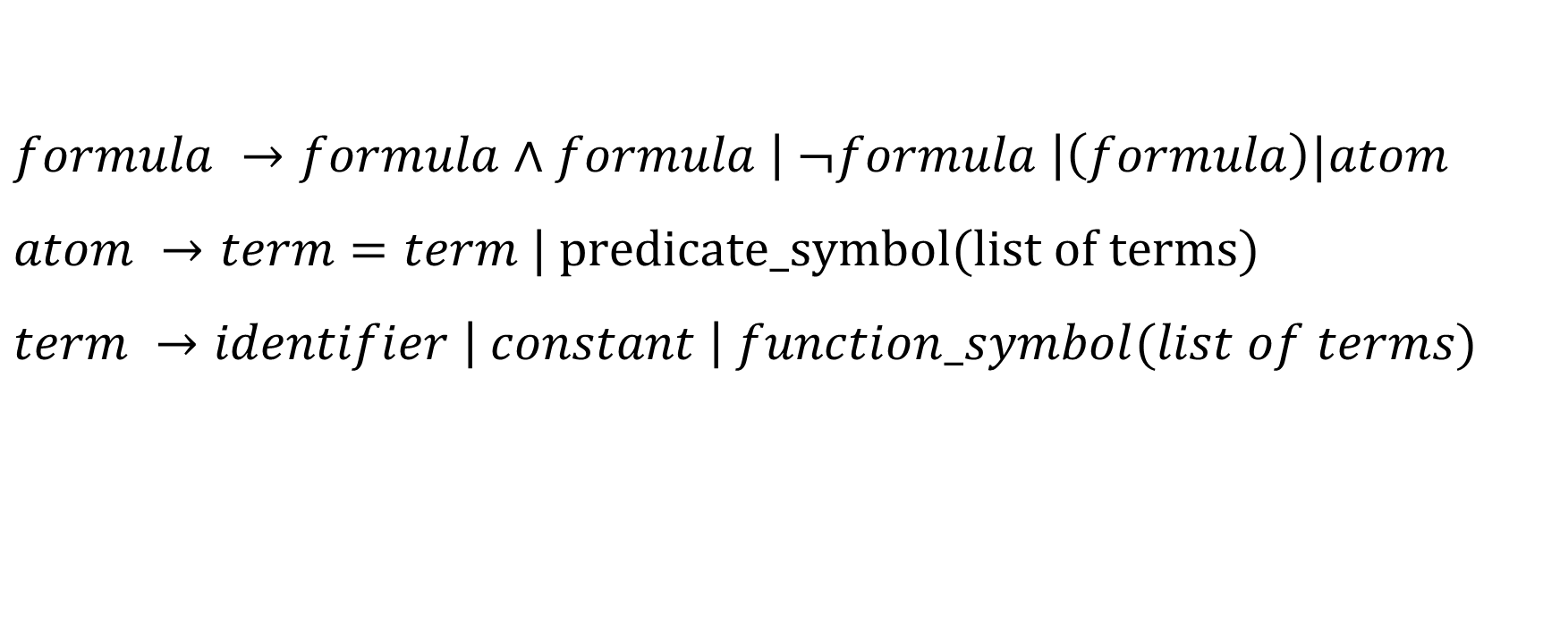
Equality logic with uninterpreted functions (EUF)
$$formula →formula∧formula \left| ¬formula \right|\left(formula\right)|atom$$
$$atom →term=term | predicate_symbol(list of terms)$$
$$term →identifier \left| constant \right| function_symbol(list of terms)$$

Slide 5

Additional axioms for EUF
Congruence rule
$$∀t_{1},…,t_{n},t_{1}^{′}…,t_{n}^{′}. \bigwedge_{i}{t_{i}=t_{i}^{′} →f\left(t_{1}, …, t_{n}\right)=f\left(t_{1}^{′}, …, t_{n}^{′}\right)}$$
$$∀t_{1},…,t_{n},t_{1}^{′}…,t_{n}^{′}. \bigwedge_{i}{t_{i}=t_{i}^{′} →(p\left(t_{1}, …, t_{n}\right)↔p\left(t_{1}^{′}, …, t_{n}^{′}\right))}$$

Slide 6
Implementation

Slide 7

Create a DAG of all subterms
$$F :f\left(a, b\right)=a∧f\left(f\left(a,b\right),b\right)≠a$$
$S_{F}$ = {$\left\{a\right\}, \left\{b\right\}, \left\{f\left(a,b\right)\right\}, \{f(f\left(a,b\right), b)\}$}
f
f
a
b

Slide 8
Implementation
Create a directed acyclic graph of all the terms in the formula
DAG node structure
struct DAG {
int id;
char fn[32];
int n_args; // number of children
int *args; // array of arguments’ ids
int cc; // congruence class
int *ccpar; // array of parents’ ids of all nodes in the congruence class
};

Slide 9
Create a DAG of all subterms
$$F :f\left(a, b\right)=a∧f\left(f\left(a,b\right),b\right)≠a$$
$S_{F}$ = {$\left\{a\right\}, \left\{b\right\}, \left\{f\left(a,b\right)\right\}, \{f(f\left(a,b\right), b)\}$}
f
{id = 1, fn = “f”, n_args = 2, args={2, 4}, cc = 1, ccpar = $φ$}
f
{id = 2, fn = “f”, n_args = 2, args={3, 4}, cc = 2, ccpar = {1}}
a
b
{id = 4, fn = “b”, n_args = 0, args={}, cc = 4, ccpar = {1, 2}}
{id = 3, fn = “a”, n_args = 0, args={}, cc = 3, ccpar = {2}}

Slide 10
Basic operations
struct DAG* Node(i) // returns a node with identifier i
int Find(i) { // returns the congruence class of a node with identifier i
n = Node(i);
return (n->cc == i) ? i : Find(n->cc);
}

Slide 11
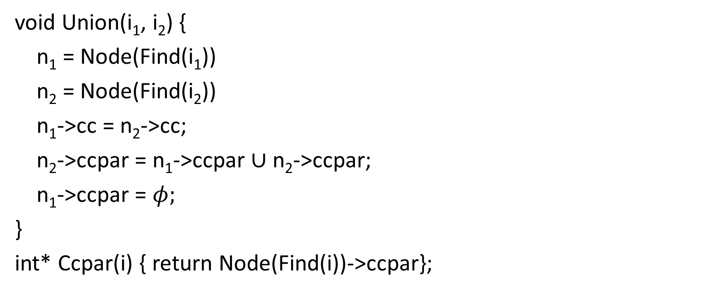
Basic operations
void Union(i₁, i₂) {
n₁ = Node(Find(i₁))
n₂ = Node(Find(i₂))
n₁->cc = n₂->cc;
n₂->ccpar = n₁->ccpar $∪$ n₂->ccpar;
n₁->ccpar = $φ;$
}
int* Ccpar(i) { return Node(Find(i))->ccpar};

Slide 12
Basic operations
Congruent(i, j) {
n_{i} = Node(i);
n_{j} = Node(j);
if (strcmp(n_{i}->fn, n_{j}->fn) != 0 || n_{i}->n_args != n_{j}->n_args)
return 0;
for (i = 0; i < n_args; i++) {
if (Find(n_{i}->n_args[i]) != Find(n_{j}->n_args[j])) {
return 0;
}
}
return 1;
}

Slide 13
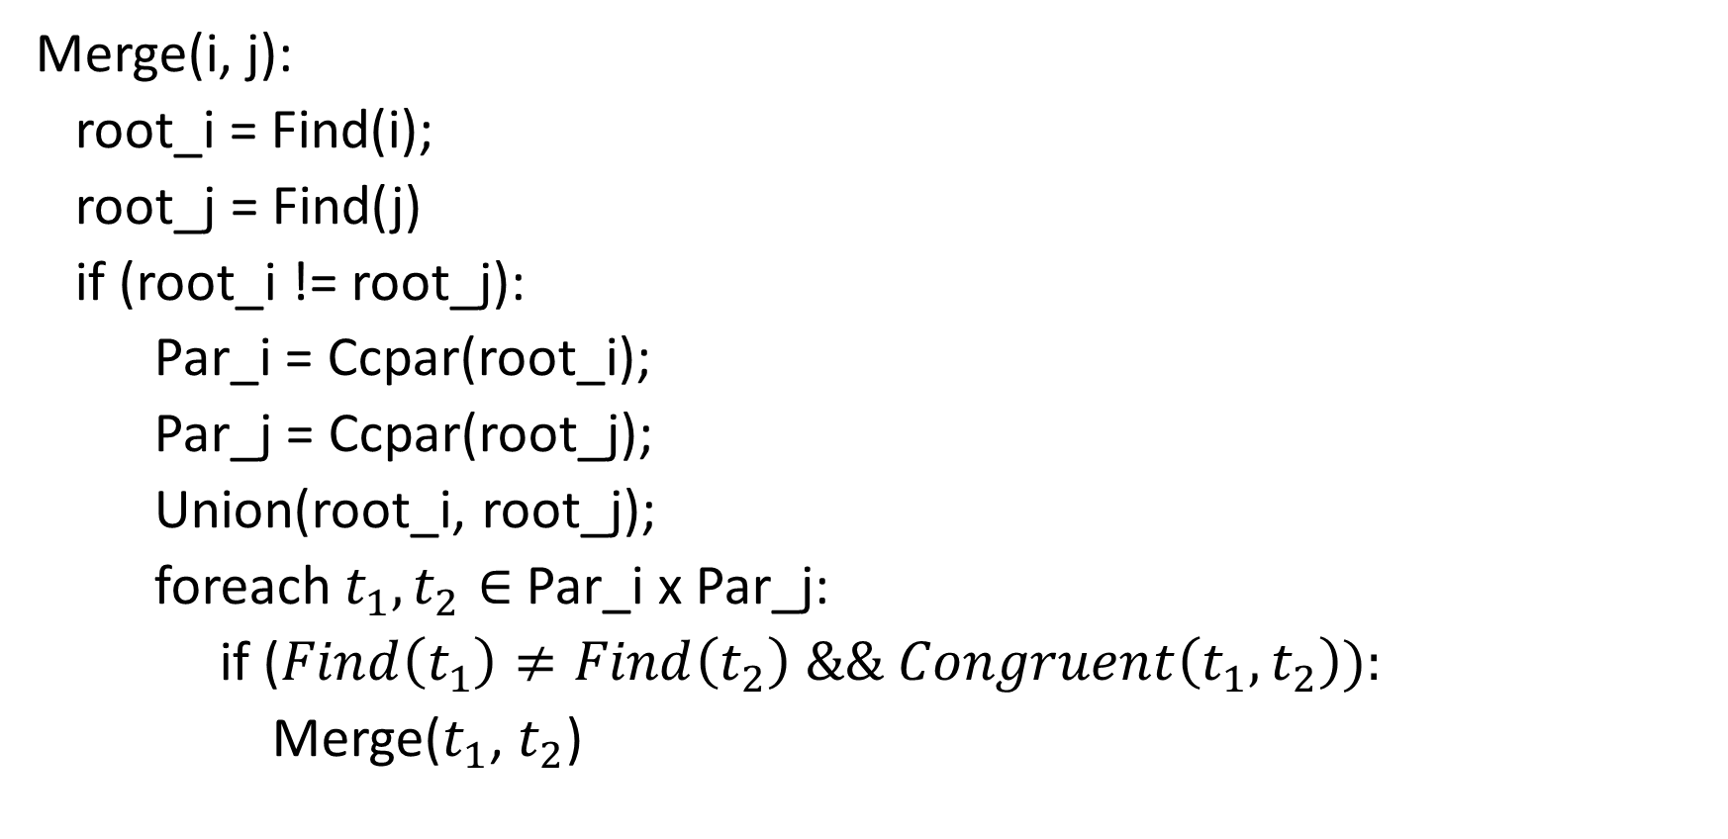
Basic operations
Merge(i, j):
root_i = Find(i);
root_j = Find(j)
if (root_i != root_j):
Par_i = Ccpar(root_i);
Par_j = Ccpar(root_j);
Union(root_i, root_j);
foreach $t_{1}, t_{2}∈$ Par_i x Par_j:
if ($Find\left(t_{1}\right)≠Find\left(t_{2}\right) \&\& Congruent\left(t_{1},t_{2}\right)):$
Merge($t_{1}$, $t_{2}$)

Slide 14
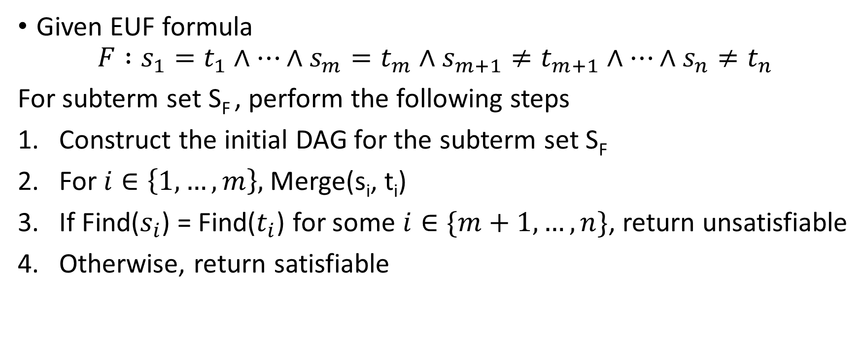
Decision procedure for EUF formulae
Given EUF formula
$$F :s_{1}=t_{1}∧…∧s_{m}=t_{m}∧s_{m+1}≠t_{m+1}∧…∧s_{n}≠t_{n}$$
For subterm set S_{F} , perform the following steps
Construct the initial DAG for the subterm set S_{F}
For $i∈\left\{1, …,m\right\},$Merge(s_{i}, t_{i})
If Find($s_{i}$) = Find($t_{i}$) for some $i∈\{m+1, …, n\}$, return unsatisfiable
Otherwise, return satisfiable

Slide 15
STEP-1, creating DAG
$$F :f\left(a, b\right)=a∧f\left(f\left(a,b\right),b\right)≠a$$
$S_{F}$ = {$\left\{a\right\}, \left\{b\right\}, \left\{f\left(a,b\right)\right\}, \{f(f\left(a,b\right), b)\}$}
f
{id = 1, fn = “f”, n_args = 2, args={2, 4}, cc = 1, ccpar = $φ$}
f
{id = 2, fn = “f”, n_args = 2, args={3, 4}, cc = 2, ccpar = {1}}
a
b
{id = 4, fn = “b”, n_args = 0, args={}, cc = 4, ccpar = {1, 2}}
{id = 3, fn = “a”, n_args = 0, args={}, cc = 3, ccpar = {2}}

Slide 16
STEP-2a, merge 2, 3
$$F :f\left(a, b\right)=a∧f\left(f\left(a,b\right),b\right)≠a$$
$S_{F}$ = {$\left\{a\right\}, \left\{b\right\}, \left\{f\left(a,b\right)\right\}, \{f(f\left(a,b\right), b)\}$}
f
{id = 1, fn = “f”, n_args = 2, args={2, 4}, cc = 1, ccpar = $φ$}
f
{id = 2, fn = “f”, n_args = 2, args={3, 4}, cc = 3, ccpar = $φ$}
a
b
{id = 4, fn = “b”, n_args = 0, args={}, cc = 4, ccpar = {1, 2}}
{id = 3, fn = “a”, n_args = 0, args={}, cc = 3, ccpar = {2, 1}}

Slide 17
STEP-2b, merge 2, 3
$$F :f\left(a, b\right)=a∧f\left(f\left(a,b\right),b\right)≠a$$
$S_{F}$ = {$\left\{a\right\}, \left\{b\right\}, \left\{f\left(a,b\right)\right\}, \{f(f\left(a,b\right), b)\}$}
f
{id = 1, fn = “f”, n_args = 2, args={2, 4}, cc = 3, ccpar = $φ$}
f
{id = 2, fn = “f”, n_args = 2, args={3, 4}, cc = 3, ccpar = $φ$}
a
b
{id = 4, fn = “b”, n_args = 0, args={}, cc = 4, ccpar = {1, 2}}
{id = 3, fn = “a”, n_args = 0, args={}, cc = 3, ccpar = {2, 1}}

Slide 18
STEP-3, find 1, 3
Find(1) == Find(3) == 3
Therefore, return UNSAT.
$$F :f\left(a, b\right)=a∧f\left(f\left(a,b\right),b\right)≠a$$
$S_{F}$ = {$\left\{a\right\}, \left\{b\right\}, \left\{f\left(a,b\right)\right\}, \{f(f\left(a,b\right), b)\}$}
f
{id = 1, fn = “f”, n_args = 2, args={2, 4}, cc = 3, ccpar = $φ$}
f
{id = 2, fn = “f”, n_args = 2, args={3, 4}, cc = 3, ccpar = $φ$}
a
b
{id = 4, fn = “b”, n_args = 0, args={}, cc = 4, ccpar = {1, 2}}
{id = 3, fn = “a”, n_args = 0, args={}, cc = 3, ccpar = {2, 1}}

Slide 19

Example
Check the satisfiability of the following formula
$F :f\left(f\left(f\left(a\right)\right)\right)=a∧f\left(f\left(f\left(f\left(f\left(a\right)\right)\right)\right)\right)=a∧f\left(a\right)≠a$

Slide 20
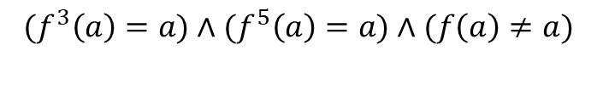
Example
f
{id = 5, fn = “f”, n_args = 1, args={4}, cc = 5, ccpar = $φ$}
$${(f}^{3}\left(a\right)=a)∧{(f}^{5}\left(a\right)=a)∧(f\left(a\right)≠a)$$
f
{id = 4, fn = “f”, n_args = 1, args={3}, cc = 4, ccpar = $\{5\}$}
f
{id = 3, fn = “f”, n_args = 1, args={2}, cc = 3, ccpar = $\{4\}$}
f
{id = 2, fn = “f”, n_args = 1, args={1}, cc = 1, ccpar = $\{3\}$}
f
{id = 1, fn = “f”, n_args = 1, args={0}, cc = 1, ccpar = $\{2\}$}
a
{id = 0, fn = “a”, n_args = 0, args={}, cc = 0, ccpar = $\{1\}$}

Slide 21
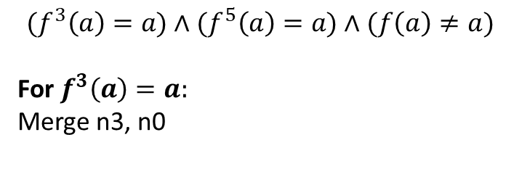
Example
f
{id = 5, fn = “f”, n_args = 1, args={4}, cc = 5, ccpar = $φ$}
$${(f}^{3}\left(a\right)=a)∧{(f}^{5}\left(a\right)=a)∧(f\left(a\right)≠a)$$
For $f^{3}\left(a\right)=a:$
Merge n3, n0
f
{id = 4, fn = “f”, n_args = 1, args={3}, cc = 4, ccpar = $\{5\}$}
f
{id = 3, fn = “f”, n_args = 1, args={2}, cc = 3, ccpar = $\{4\}$}
f
{id = 2, fn = “f”, n_args = 1, args={1}, cc = 1, ccpar = $\{3\}$}
f
{id = 1, fn = “f”, n_args = 1, args={0}, cc = 1, ccpar = $\{2\}$}
a
{id = 0, fn = “a”, n_args = 0, args={}, cc = 0, ccpar = $\{1\}$}

Slide 22
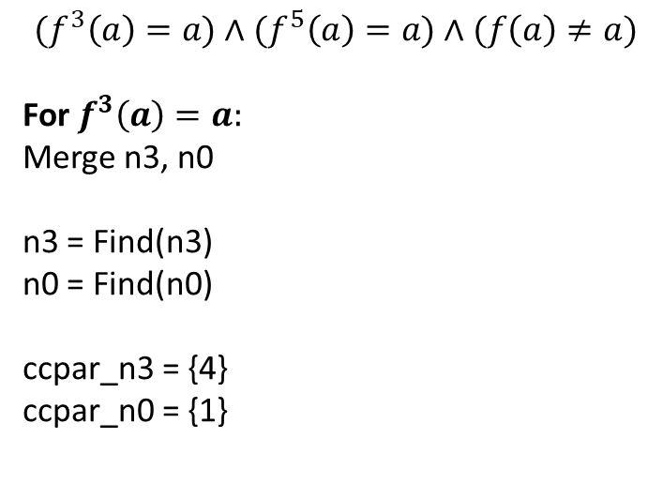
Example
f
{id = 5, fn = “f”, n_args = 1, args={4}, cc = 5, ccpar = $φ$}
$${(f}^{3}\left(a\right)=a)∧{(f}^{5}\left(a\right)=a)∧(f\left(a\right)≠a)$$
For $f^{3}\left(a\right)=a:$
Merge n3, n0
n3 = Find(n3)
n0 = Find(n0)
ccpar_n3 = {4}
ccpar_n0 = {1}
f
{id = 4, fn = “f”, n_args = 1, args={3}, cc = 4, ccpar = $\{5\}$}
f
{id = 3, fn = “f”, n_args = 1, args={2}, cc = 3, ccpar = $\{4\}$}
f
{id = 2, fn = “f”, n_args = 1, args={1}, cc = 1, ccpar = $\{3\}$}
f
{id = 1, fn = “f”, n_args = 1, args={0}, cc = 1, ccpar = $\{2\}$}
a
{id = 0, fn = “a”, n_args = 0, args={}, cc = 0, ccpar = $\{1\}$}

Slide 23
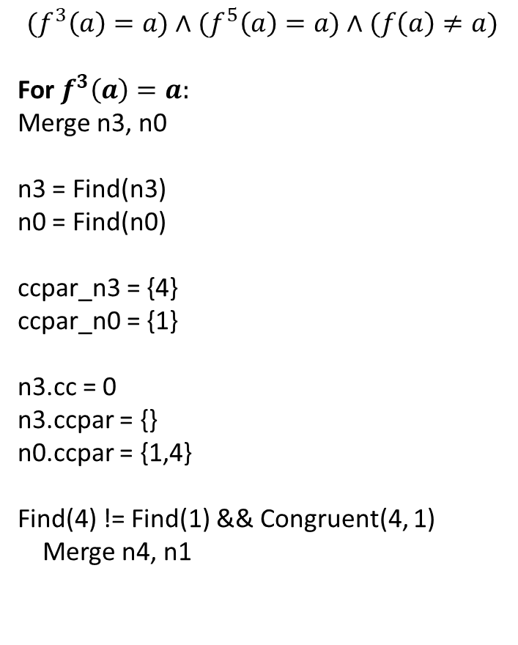
Example
f
{id = 5, fn = “f”, n_args = 1, args={4}, cc = 5, ccpar = $φ$}
$${(f}^{3}\left(a\right)=a)∧{(f}^{5}\left(a\right)=a)∧(f\left(a\right)≠a)$$
For $f^{3}\left(a\right)=a:$
Merge n3, n0
n3 = Find(n3)
n0 = Find(n0)
ccpar_n3 = {4}
ccpar_n0 = {1}
n3.cc = 0
n3.ccpar = {}
n0.ccpar = {1,4}
Find(4) != Find(1) && Congruent(4, 1)
Merge n4, n1
f
{id = 4, fn = “f”, n_args = 1, args={3}, cc = 4, ccpar = $\{5\}$}
f
{id = 3, fn = “f”, n_args = 1, args={2}, cc = 0, ccpar = $\{\}$}
f
{id = 2, fn = “f”, n_args = 1, args={1}, cc = 1, ccpar = $\{3\}$}
f
{id = 1, fn = “f”, n_args = 1, args={0}, cc = 1, ccpar = $\{2\}$}
a
{id = 0, fn = “a”, n_args = 0, args={}, cc = 0, ccpar = $\{1,4\}$}

Slide 24
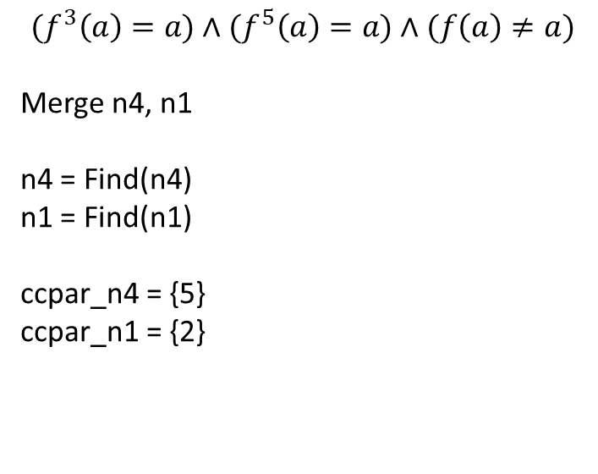
Example
f
{id = 5, fn = “f”, n_args = 1, args={4}, cc = 5, ccpar = $φ$}
$${(f}^{3}\left(a\right)=a)∧{(f}^{5}\left(a\right)=a)∧(f\left(a\right)≠a)$$
Merge n4, n1
n4 = Find(n4)
n1 = Find(n1)
ccpar_n4 = {5}
ccpar_n1 = {2}
f
{id = 4, fn = “f”, n_args = 1, args={3}, cc = 4, ccpar = $\{5\}$}
f
{id = 3, fn = “f”, n_args = 1, args={2}, cc = 0, ccpar = $\{\}$}
f
{id = 2, fn = “f”, n_args = 1, args={1}, cc = 1, ccpar = $\{3\}$}
f
{id = 1, fn = “f”, n_args = 1, args={0}, cc = 1, ccpar = $\{2\}$}
a
{id = 0, fn = “a”, n_args = 0, args={}, cc = 0, ccpar = $\{1,4\}$}

Slide 25
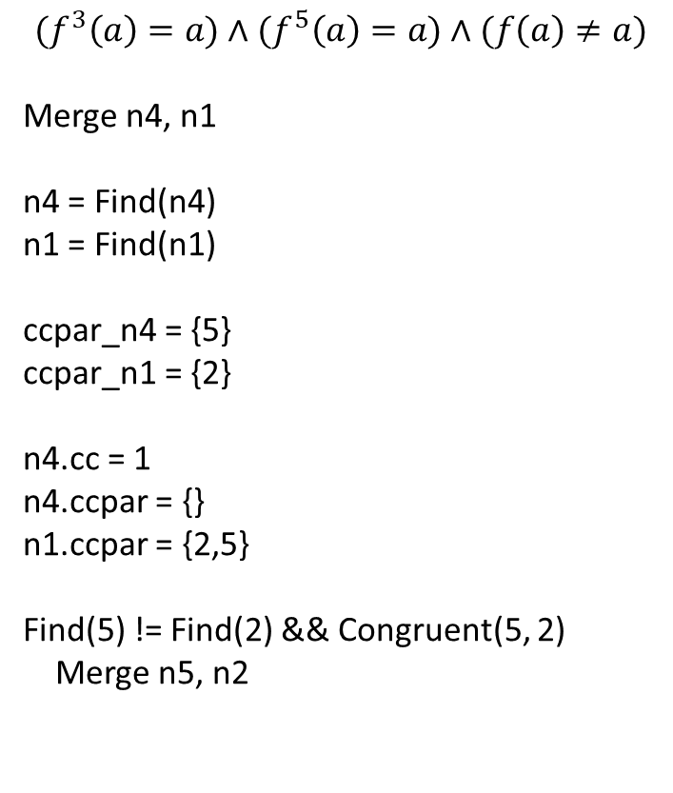
Example
f
{id = 5, fn = “f”, n_args = 1, args={4}, cc = 5, ccpar = $φ$}
$${(f}^{3}\left(a\right)=a)∧{(f}^{5}\left(a\right)=a)∧(f\left(a\right)≠a)$$
Merge n4, n1
n4 = Find(n4)
n1 = Find(n1)
ccpar_n4 = {5}
ccpar_n1 = {2}
n4.cc = 1
n4.ccpar = {}
n1.ccpar = {2,5}
Find(5) != Find(2) && Congruent(5, 2)
Merge n5, n2
f
{id = 4, fn = “f”, n_args = 1, args={3}, cc = 1, ccpar = $\{\}$}
f
{id = 3, fn = “f”, n_args = 1, args={2}, cc = 0, ccpar = $\{\}$}
f
{id = 2, fn = “f”, n_args = 1, args={1}, cc = 1, ccpar = $\{3\}$}
f
{id = 1, fn = “f”, n_args = 1, args={0}, cc = 1, ccpar = $\{2,5\}$}
a
{id = 0, fn = “a”, n_args = 0, args={}, cc = 0, ccpar = $\{1,4\}$}

Slide 26
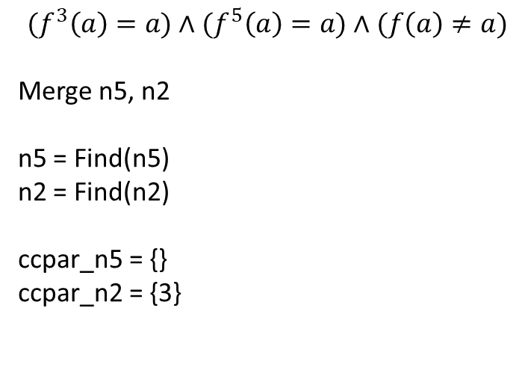
Example
f
{id = 5, fn = “f”, n_args = 1, args={4}, cc = 5, ccpar = $φ$}
$${(f}^{3}\left(a\right)=a)∧{(f}^{5}\left(a\right)=a)∧(f\left(a\right)≠a)$$
Merge n5, n2
n5 = Find(n5)
n2 = Find(n2)
ccpar_n5 = {}
ccpar_n2 = {3}
f
{id = 4, fn = “f”, n_args = 1, args={3}, cc = 1, ccpar = $\{\}$}
f
{id = 3, fn = “f”, n_args = 1, args={2}, cc = 0, ccpar = $\{\}$}
f
{id = 2, fn = “f”, n_args = 1, args={1}, cc = 1, ccpar = $\{3\}$}
f
{id = 1, fn = “f”, n_args = 1, args={0}, cc = 1, ccpar = $\{2,5\}$}
a
{id = 0, fn = “a”, n_args = 0, args={}, cc = 0, ccpar = $\{1,4\}$}

Slide 27
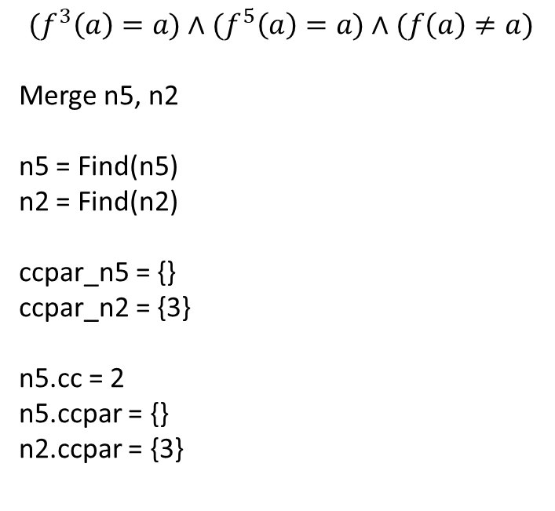
Example
f
{id = 5, fn = “f”, n_args = 1, args={4}, cc = 2, ccpar = $φ$}
$${(f}^{3}\left(a\right)=a)∧{(f}^{5}\left(a\right)=a)∧(f\left(a\right)≠a)$$
Merge n5, n2
n5 = Find(n5)
n2 = Find(n2)
ccpar_n5 = {}
ccpar_n2 = {3}
n5.cc = 2
n5.ccpar = {}
n2.ccpar = {3}
f
{id = 4, fn = “f”, n_args = 1, args={3}, cc = 1, ccpar = $\{\}$}
f
{id = 3, fn = “f”, n_args = 1, args={2}, cc = 0, ccpar = $\{\}$}
f
{id = 2, fn = “f”, n_args = 1, args={1}, cc = 1, ccpar = $\{3\}$}
f
{id = 1, fn = “f”, n_args = 1, args={0}, cc = 1, ccpar = $\{2,5\}$}
a
{id = 0, fn = “a”, n_args = 0, args={}, cc = 0, ccpar = $\{1,4\}$}

Slide 28
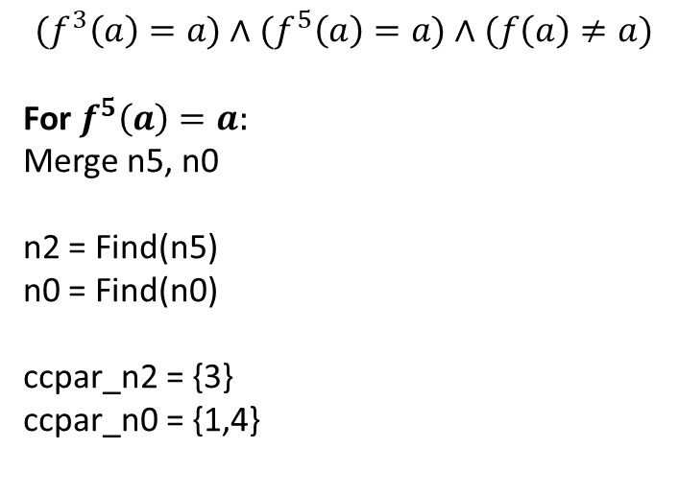
Example
f
{id = 5, fn = “f”, n_args = 1, args={4}, cc = 2, ccpar = $φ$}
$${(f}^{3}\left(a\right)=a)∧{(f}^{5}\left(a\right)=a)∧(f\left(a\right)≠a)$$
For $f^{5}\left(a\right)=a:$
Merge n5, n0
n2 = Find(n5)
n0 = Find(n0)
ccpar_n2 = {3}
ccpar_n0 = {1,4}
f
{id = 4, fn = “f”, n_args = 1, args={3}, cc = 1, ccpar = $\{\}$}
f
{id = 3, fn = “f”, n_args = 1, args={2}, cc = 0, ccpar = $\{\}$}
f
{id = 2, fn = “f”, n_args = 1, args={1}, cc = 1, ccpar = $\{3\}$}
f
{id = 1, fn = “f”, n_args = 1, args={0}, cc = 1, ccpar = $\{2,5\}$}
a
{id = 0, fn = “a”, n_args = 0, args={}, cc = 0, ccpar = $\{1,4\}$}

Slide 29
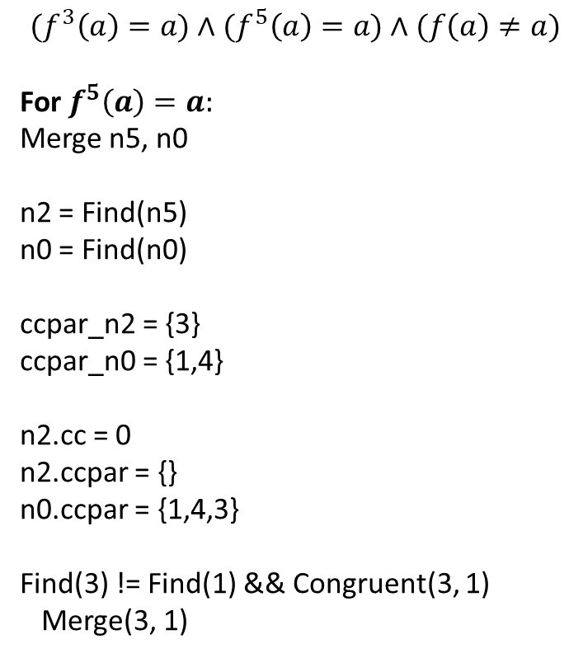
Example
f
{id = 5, fn = “f”, n_args = 1, args={4}, cc = 2, ccpar = $φ$}
$${(f}^{3}\left(a\right)=a)∧{(f}^{5}\left(a\right)=a)∧(f\left(a\right)≠a)$$
For $f^{5}\left(a\right)=a:$
Merge n5, n0
n2 = Find(n5)
n0 = Find(n0)
ccpar_n2 = {3}
ccpar_n0 = {1,4}
n2.cc = 0
n2.ccpar = {}
n0.ccpar = {1,4,3}
Find(3) != Find(1) && Congruent(3, 1)
Merge(3, 1)
f
{id = 4, fn = “f”, n_args = 1, args={3}, cc = 1, ccpar = $\{\}$}
f
{id = 3, fn = “f”, n_args = 1, args={2}, cc = 0, ccpar = $\{\}$}
f
{id = 2, fn = “f”, n_args = 1, args={1}, cc = 0, ccpar = $\{\}$}
f
{id = 1, fn = “f”, n_args = 1, args={0}, cc = 1, ccpar = $\{2,5\}$}
a
{id = 0, fn = “a”, n_args = 0, args={}, cc = 0, ccpar = $\{1,4,3\}$}

Slide 30
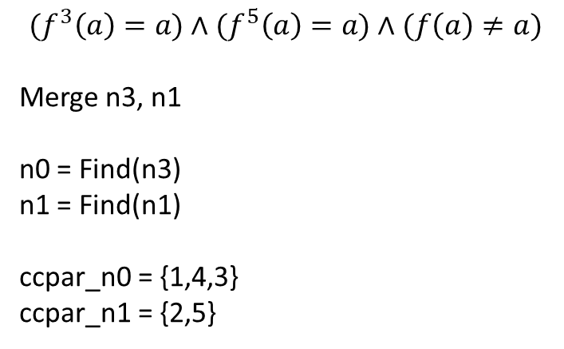
Example
f
{id = 5, fn = “f”, n_args = 1, args={4}, cc = 2, ccpar = $φ$}
$${(f}^{3}\left(a\right)=a)∧{(f}^{5}\left(a\right)=a)∧(f\left(a\right)≠a)$$
Merge n3, n1
n0 = Find(n3)
n1 = Find(n1)
ccpar_n0 = {1,4,3}
ccpar_n1 = {2,5}
f
{id = 4, fn = “f”, n_args = 1, args={3}, cc = 1, ccpar = $\{\}$}
f
{id = 3, fn = “f”, n_args = 1, args={2}, cc = 0, ccpar = $\{\}$}
f
{id = 2, fn = “f”, n_args = 1, args={1}, cc = 0, ccpar = $\{\}$}
f
{id = 1, fn = “f”, n_args = 1, args={0}, cc = 1, ccpar = $\{2,5\}$}
a
{id = 0, fn = “a”, n_args = 0, args={}, cc = 0, ccpar = $\{1,4,3\}$}

Slide 31
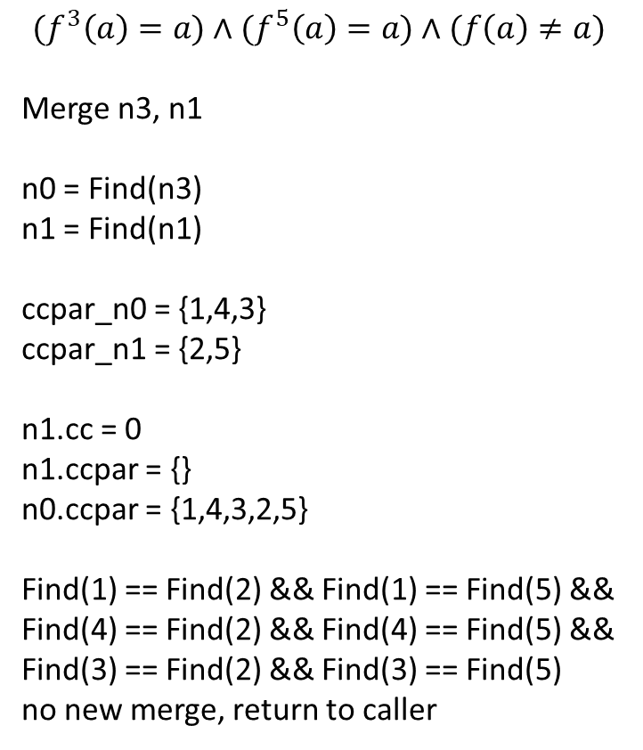
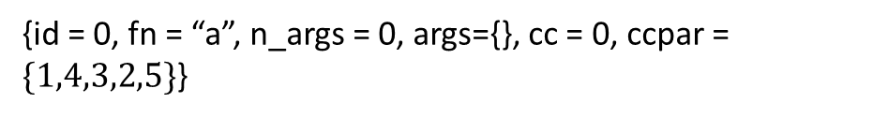
Example
f
{id = 5, fn = “f”, n_args = 1, args={4}, cc = 2, ccpar = $φ$}
$${(f}^{3}\left(a\right)=a)∧{(f}^{5}\left(a\right)=a)∧(f\left(a\right)≠a)$$
Merge n3, n1
n0 = Find(n3)
n1 = Find(n1)
ccpar_n0 = {1,4,3}
ccpar_n1 = {2,5}
n1.cc = 0
n1.ccpar = {}
n0.ccpar = {1,4,3,2,5}
Find(1) == Find(2) && Find(1) == Find(5) && Find(4) == Find(2) && Find(4) == Find(5) &&
Find(3) == Find(2) && Find(3) == Find(5)
no new merge, return to caller
f
{id = 4, fn = “f”, n_args = 1, args={3}, cc = 1, ccpar = $\{\}$}
f
{id = 3, fn = “f”, n_args = 1, args={2}, cc = 0, ccpar = $\{\}$}
f
{id = 2, fn = “f”, n_args = 1, args={1}, cc = 0, ccpar = $\{\}$}
f
{id = 1, fn = “f”, n_args = 1, args={0}, cc = 0, ccpar = $\{\}$}
a
{id = 0, fn = “a”, n_args = 0, args={}, cc = 0, ccpar = $\{1,4,3,2,5\}$}

Slide 32
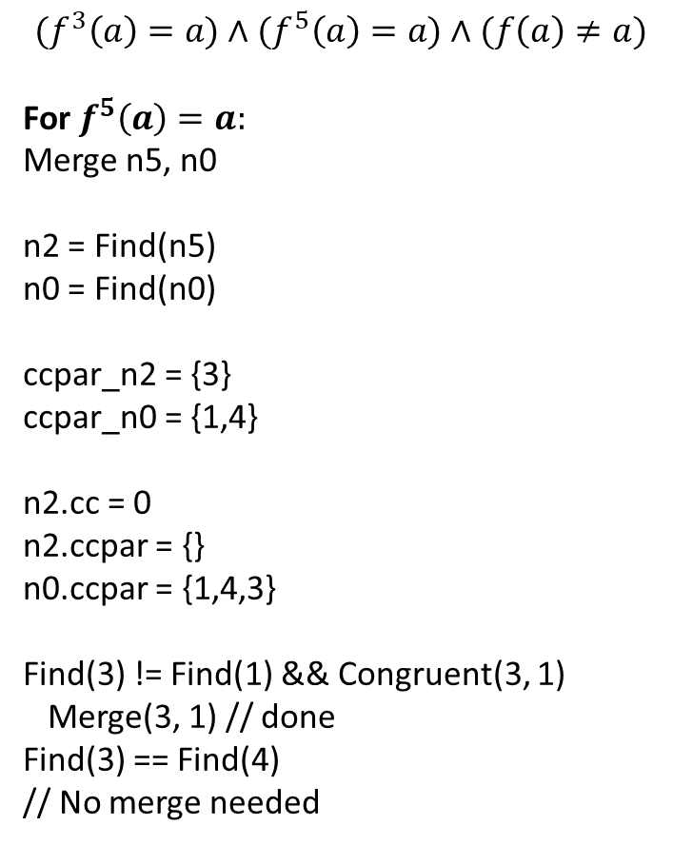
Example
f
{id = 5, fn = “f”, n_args = 1, args={4}, cc = 2, ccpar = $φ$}
$${(f}^{3}\left(a\right)=a)∧{(f}^{5}\left(a\right)=a)∧(f\left(a\right)≠a)$$
For $f^{5}\left(a\right)=a:$
Merge n5, n0
n2 = Find(n5)
n0 = Find(n0)
ccpar_n2 = {3}
ccpar_n0 = {1,4}
n2.cc = 0
n2.ccpar = {}
n0.ccpar = {1,4,3}
Find(3) != Find(1) && Congruent(3, 1)
Merge(3, 1) // done
Find(3) == Find(4)
// No merge needed
f
{id = 4, fn = “f”, n_args = 1, args={3}, cc = 1, ccpar = $\{\}$}
f
{id = 3, fn = “f”, n_args = 1, args={2}, cc = 0, ccpar = $\{\}$}
f
{id = 2, fn = “f”, n_args = 1, args={1}, cc = 0, ccpar = $\{\}$}
f
{id = 1, fn = “f”, n_args = 1, args={0}, cc = 0, ccpar = $\{\}$}
a
{id = 0, fn = “a”, n_args = 0, args={}, cc = 0, ccpar = $\{1,4,3,2,5\}$}

Slide 33
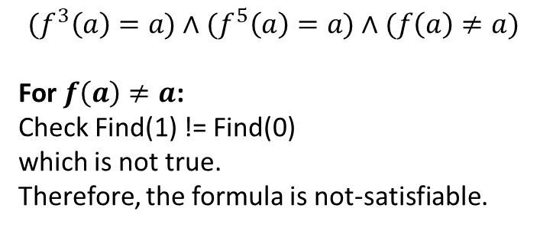
Example
f
{id = 5, fn = “f”, n_args = 1, args={4}, cc = 2, ccpar = $φ$}
$${(f}^{3}\left(a\right)=a)∧{(f}^{5}\left(a\right)=a)∧(f\left(a\right)≠a)$$
For $f\left(a\right)≠a$:
Check Find(1) != Find(0)
which is not true.
Therefore, the formula is not-satisfiable.
f
{id = 4, fn = “f”, n_args = 1, args={3}, cc = 1, ccpar = $\{\}$}
f
{id = 3, fn = “f”, n_args = 1, args={2}, cc = 0, ccpar = $\{\}$}
f
{id = 2, fn = “f”, n_args = 1, args={1}, cc = 0, ccpar = $\{\}$}
f
{id = 1, fn = “f”, n_args = 1, args={0}, cc = 0, ccpar = $\{\}$}
a
{id = 0, fn = “a”, n_args = 0, args={}, cc = 0, ccpar = $\{1,4,3,2,5\}$}

Slide 34

Example
Check the satisfiability of the following formula
$F :(f\left(x\right)=f\left(y\right))∧¬(x=y)$

Slide 35
Checking equivalence
struct list {
struct list *n;
int data;
};
int mul3(struct list *in) {
int i, out_a;
struct list *a;
a = in;
out_a = in->data;
for (i = 0; i < 2; i++) {
a = a->n;
out_a = out_a * a->data;
}
return out_a;
}
struct list {
struct list *n;
int data;
};
int mul3_new(struct list *in) {
int out_b;
out_b = in->data * in->n->data *
in->n->n->data;
return out_b;
}

Slide 36
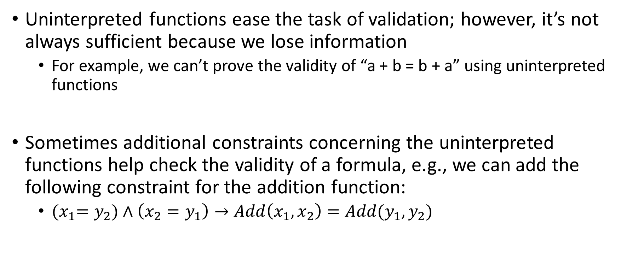
Abstraction refinement
Uninterpreted functions ease the task of validation; however, it’s not always sufficient because we lose information
For example, we can’t prove the validity of “a + b = b + a” using uninterpreted functions
Sometimes additional constraints concerning the uninterpreted functions help check the validity of a formula, e.g., we can add the following constraint for the addition function:
${(x}_{1}=y_{2})∧\left(x_{2}=y_{1}\right)→Add\left(x_{1},x_{2}\right)=Add(y_{1},y_{2})$

Slide 37
Abstraction refinement
Additional constraints make the uninterpreted function partially interpreted
The reason we use uninterpreted functions is that they make the formula simpler, thus making it computationally feasible to find a solution
The goal of the abstract refinement is to find the right level of abstraction that is sufficient to validate the formula

Slide 38
Abstraction refinement
The right level of abstraction can be discovered using a trial-and-error process
This process is also called the abstraction-refinement loop

Slide 39
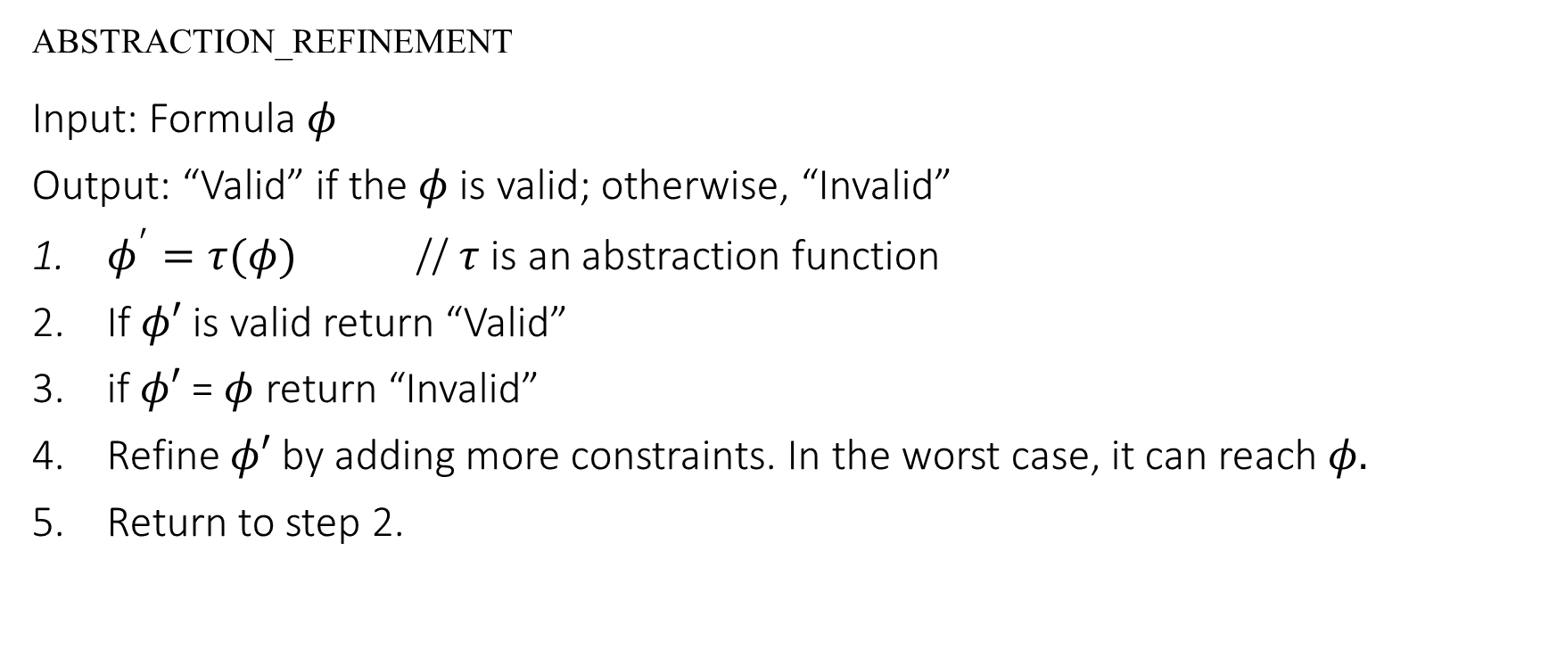
Abstraction refinement
ABSTRACTION_REFINEMENT
Input: Formula $φ$
Output: “Valid” if the $φ$ is valid; otherwise, “Invalid”
$φ^{′}=τ(φ)$ // $τ$ is an abstraction function
If $φ′$ is valid return “Valid”
if $φ′$ = $φ$ return “Invalid”
Refine $φ′$ by adding more constraints. In the worst case, it can reach $φ.$
Return to step 2.

