Slide 2
References
Introduction to Algorithms, Third Edition
Thomas H. Cormen. Charles E. Leiserson. Ronald L. Rivest, Clifford Stein
Data Structures & Algorithms Analysis in C, Second Edition
Mark Allen Weiss
Data Structures & Algorithms Made Easy
Narasimha Karumanchi
Online C reference: https://users.cs.cf.ac.uk/Dave.Marshall/C/CE.html

Slide 3
Intro to C

Slide 4
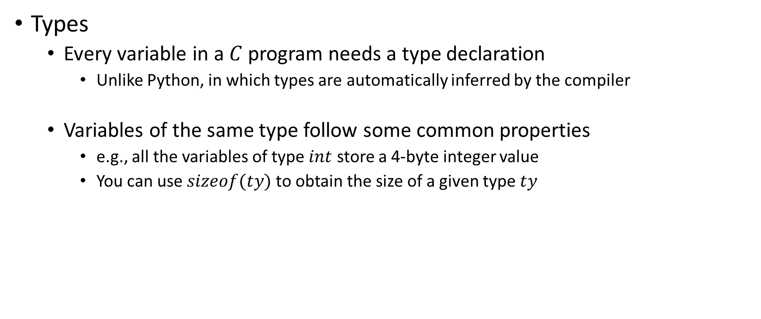
Intro to C
Types
Every variable in a $C$ program needs a type declaration
Unlike Python, in which types are automatically inferred by the compiler
Variables of the same type follow some common properties
e.g., all the variables of type $int$ store a 4-byte integer value
You can use $sizeof(ty)$ to obtain the size of a given type $ty$

Slide 5

Basic types
TYPE | SIZE (TYPICAL SIZE) | RANGE (TYPICAL SIZE)
char | 1 | -128 to 127
unsigned char | 1 | 0 to 255
short int | 2 | -32,768 to 32,767
unsigned short | 2 | 0 to 65,535
int | >=2 (4) | -2,147,483,648 to 2,147,483,647
unsigned int | >=2 (4) | 0 to 4,294,967,295
long long int | 8 | -2⁶³ to 2⁶³-1
unsigned long long | 8 | 0 to 2⁶⁴-1
float | 4 | 1.175494e-38 to 3.402823e+38
double | 8 | 2.225074e-308 to 1.797693e+308

Slide 6
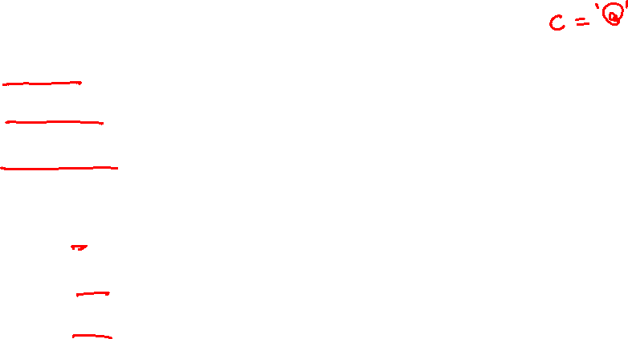
Variable declaration
int i;
char c;
float f;
i = 0;
c = ‘a’;
f = 1.0;
Notes:
Every variable must be declared before its use. The declaration must specify the type of the variable.

Slide 7
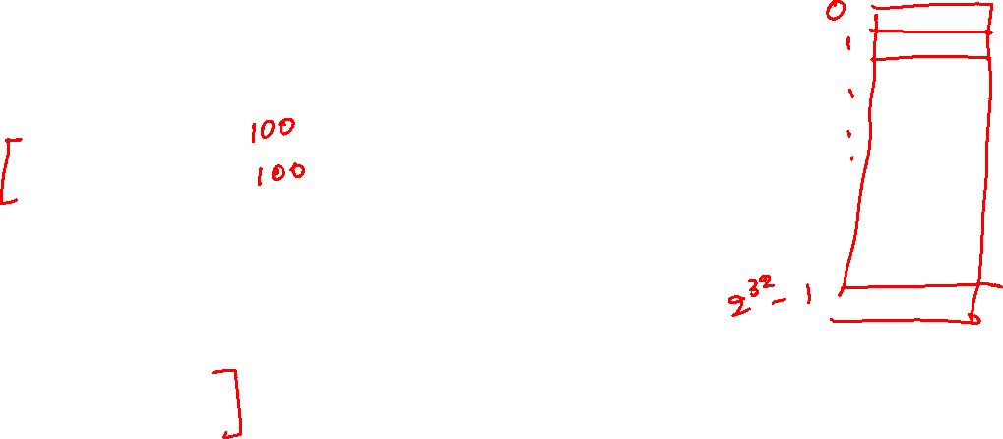
Address of a variable
int i;
char c;
char d;
float f;
i = 0;
c = ‘a’;
d = ‘B’;
f = 1.0;
Notes:
The variables are stored in RAM. Each byte of the RAM has a unique address. Suppose you have 4GB RAM; the total number of bytes would be 4*1024*1024*1024. Now, if the address of the first byte of the RAM is zero, the address of the second byte would be one, and so on. Similarly, the address of the 4*1024*1024*1024th byte would be 4*1024*1024*1024 -1. When you write a program, you don’t decide at which address the variable will be stored in the RAM. It is decided by the compiler and the OS. However, all the bytes corresponding to a data type are stored at consecutive addresses. For example, the size of a variable, say "x", of type “int” is four bytes. If the compiler decides to store “x” at an address “xa”, then the first byte of “x” is stored at address “xa”, the second byte of “x” is stored at “xa+1”, the third byte at “xa+2”, and the fourth byte at “xa+3”.

Slide 8
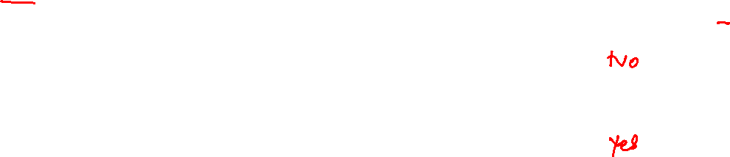
Address of a variable
int i;
char c;
char d;
float f;
i = 0;
c = ‘a’;
d = ‘B’;
f = 1.0;
If the address of variable i is ia, is it possible that the address of variable c is ia+3?
If the address of variable i is ia, is it possible that the address of variable c is ia+7?
Notes:
The address of the variable c can’t be ia+3 because the variable i is four bytes long, and the addresses ia to ia+3 are occupied by i.

Slide 9
Address of a variable
int i;
char c;
char d;
float f;
i = 0;
c = ‘a’;
d = ‘B’;
f = 1.0;
If the address of variable c is ca, can we obtain the address of variable d from ca?
Notes:
The compiler/OS can store the variable d at any address. There is no correlation between ca and the address of d.

Slide 10

“char” type
The size of a variable of type “char” is one byte
“char” can store one alphabetic letter or symbol
char ch;
ch = ‘a’; // valid
ch = ‘A’; // valid
ch = ‘@’; // valid
ch = ‘ab’; // invalid

Slide 11
“char” type
How can we store a character in one byte?

Slide 12
“char” type
How can we store a character in one byte?
We can store -128 to 127 in one byte
Total number of characters is less than 127
We can assign a unique value between 0-127 to each of the characters
The corresponding encoding is also called ASCII code, e.g.,
ASCII value of ‘$’ is 36
ASCII value to ‘A’ is 65, ‘B’ is 66, and so on.
ASCII value of ‘a’ is 97, ‘b’ is 98, and so on.
ASCII value of ‘<’ is 60
etc.

Slide 13

Array type
An array is a collection of elements of the same type
int arr[100]; // declaring an array of 100 elements
// the first element is indexed using 0, second is 1,
// and so on ..
a[2] = 20; // updating the 3rd element
a[139] = 2; // allowed but the behavior is undefined
// it might corrupt the values of the other variables

Slide 14
One-dimensional array
int arr[10]; // 1-d array
a[0] | a[1] | a[2] | a[3] | a[4] | a[5] | a[6] | a[7] | a[8] | a[9]
Let’s say the starting address of the array is X; what is the address of each element of the array?
Notes:
All the elements of an array are stored at consecutive addresses.

Slide 15
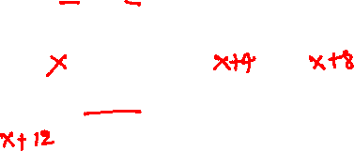
Two-dimensional array
int arr[5][3]; // 2-d array
a[0][0] | a[0][1] | a[0][2]
a[1][0] | a[1][1] | a[1][2]
a[2][0] | a[2][1] | a[2][2]
a[3][0] | a[3][1] | a[3][2]
a[4][0] | a[4][1] | a[4][2]
Let’s say the starting address of the array is X; what is the address of each element of the array?
Notes:
All the elements of a two-dimensional array are stored at consecutive addresses. If we know the address of any element of the array, we can calculate the address of the other elements of the array. All the elements in the rows are stored at consecutive addresses. Rows are also stored at consecutive addresses.

Slide 16
n-dimension array
Similarly, you can have n-dimensional array

Slide 17

Type
All variables and functions must be declared before their use
The function declaration contains the types of arguments and the return value
Every $C$ program must have the $main$ function

Slide 18
The main routine
int main(int argc, const char *argv[]) {
return 0;
}
int main() {
return 0;
}
Notes:
You can define the main routine in two ways, as listed on this slide. The first definition is needed when your program takes command line input. Here, argc corresponds to the number of arguments, and argv is an array that contains the argument strings.

Slide 19
Hello world!
int main(){
printf(“Hello World!”);
// printf prints to console
return 0;
}

Slide 20
Hello world!
int main(){
printf(“Hello World!”);
// printf prints to console
// compiler gives a warning because
// printf is not declared
return 0;
}

Slide 21
Hello world!
#include <stdio.h>
// stdio.h contains a declaration for printf
int main(){
printf(“Hello World!”);
// printf prints to console
return 0;
}

Slide 22
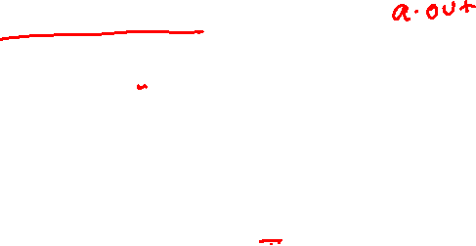
Compiling and running
gcc hello.c
./a.out
gcc hello.c –o hello
./hello

Slide 23
Compiling and running
gcc –O3 hello.c // -O3 corresponds to the optimization level
./a.out
gcc –O3 hello.c –o hello
./hello

Slide 24
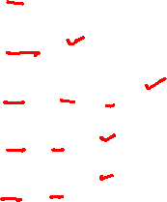
Compiler optimizations
int main() {
int x;
x = 10;
x = x * x * x;
x = x + x;
x = x / x;
return x;
}

Slide 25
Compiler optimizations
int main() {
int x;
x = 10;
x = x * x * x;
x = x + x;
x = x / x;
return x;
}
AFTER
O3
int main() {
return 1;
}
Notes:
Notice that the only observable behavior of the main routine in LHS is the return value, which is always one. Therefore, when optimizations are enabled, the compiler can transform the code in LHS to the code in RHS.

Slide 26
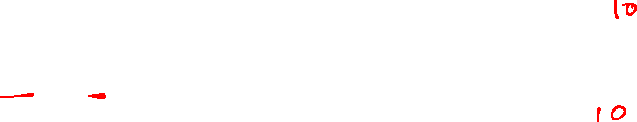
Input from user
int n;
printf(“Enter a number\n”);
scanf(“%d”, &n);
printf(“The number is: %d\n”, n);
Notes:
The ‘&’ operator is used to get the address of the variable (i.e., the address at which the variable is stored in the RAM). The scanf routine will read the input from the keyboard and store it in the address of n. After the scanf returns that when we print the value of n, it will print the value entered by the user.

Slide 27
Loop (for)
for (initialization; condition; update) {
// body of the for loop
}

Slide 28
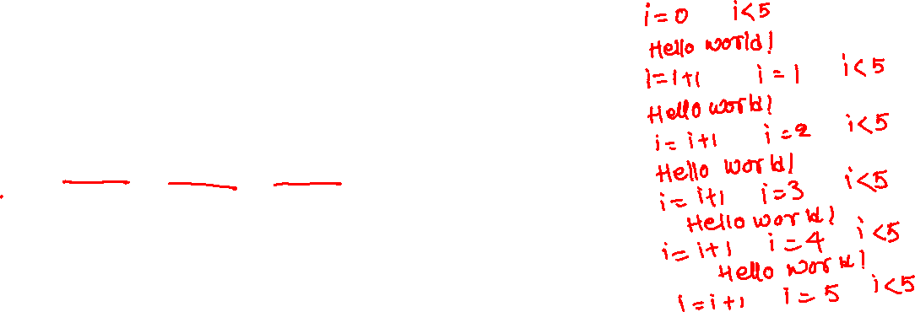
Loop (for)
int i;
for (i = 0; i < 5; i += 1) {
printf(“Hello world!”);
}
The initialization is done only once on entry
The loop body is executed if the condition is satisfied
The update is done after the execution of the loop body
The loop condition is again checked after the update

Slide 29
Loop (while)
while (condition) {
// body of the while loop
}

Slide 30
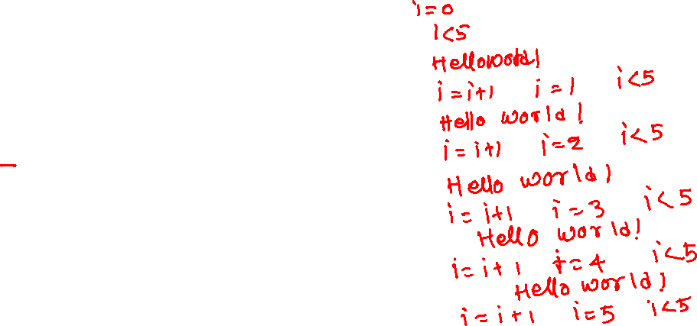
Loop (while)
int i = 0;
while (i < 5) {
printf(“Hello world!”);
i += 1;
}
Loop body is executed if the condition is true
Condition is again checked after the execution of the loop body

Slide 31
Conditional
if (condition) {
// if body
}
if (condition) {
// if body
}
else {
// else body
}
if (condition) {
// if body
}
else if (condition) {
// else-if body
}
else {
// else-body
}

Slide 32
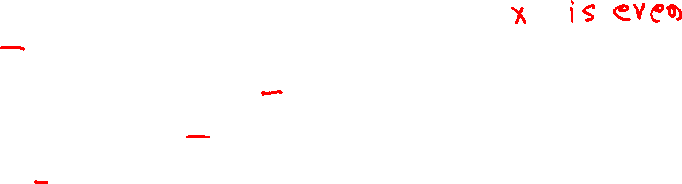
Conditional
What will be the output when input is:
10
13
int main() {
int x;
printf(“Enter a number\n”);
scanf(“%d”, &x);
if ((x % 2) == 0) {
printf(“x is even\n”);
}
return 0;
}

Slide 33

Conditional
int main() {
int x;
printf(“Enter a number\n”);
scanf(“%d”, &x);
if ((x % 2) == 0) {
printf(“input is even\n”);
}
else {
printf(“input is odd\n”);
}
return 0;
}
What will be the output when input is:
10
13

Slide 34
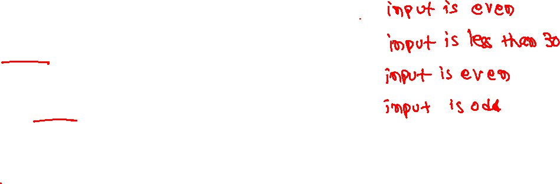
Conditional
int main() {
int x;
printf(“Enter a number\n”);
scanf(“%d”, &x);
if ((x % 2) == 0) {
printf(“input is even\n”);
}
else if (x < 30) {
printf(“input is less than 30\n”);
}
else {
printf(“input is odd\n”);
}
return 0;
}
What will be the output when input is:
10
13
50
51

Slide 35
Function declaration
RETURN
TYPE
ARG1
TYPE
ARG2
TYPE
ARG3
TYPE
int foo(int arg1[2], char arg2, float arg3);
A function must be declared/defined before its use

Slide 36
Function definition
int foo(int arg1[2], char arg2, float arg3) {
// function body
}
A function must be declared/defined before its use

