Slide 2
Today’s class
Assignment-1
Linked lists

Slide 3
DSA assignment-1

Slide 4
DSA assignment-1
Store records corresponding to users in a dynamic array
Implement dynamic arrays with O(1) amortized cost for an insert and a delete operation
Implement merge sort, quick sort, and selection sort to enable fast searching

Slide 5
DSA assignment-1
struct record represents a record corresponding to a user
It has several fields name, uid, age, etc.
For this assignment, name, uid, and status fields are relevant
uid is a 16-byte character array (not ‘\0’ terminated) that is unique to every user
name is ‘\0’ terminated string (maximum 16 bytes) that may not be unique
You are not allowed to change the structure of struct record
Store the address of the dynamic array in record_arr
Initially, record_arr is set to NULL
You can think of NULL as an invalid address
Dereferencing a NULL address may cause an access violation

Slide 6
DSA assignment-1
You are to implement a library that implements a dynamic array to insert and delete records
Implement quick sort, merge sort, and selection sort to sort the dynamic array, using uid as the key
Code to compare two uids are already provided
Implement linear and binary search algorithms to search the record corresponding to a given uid

Slide 7
DSA assignment-1
Implement quick sort to sort the dynamic array, using name as the key
Implement an API to find the number of records corresponding to a given name using binary and linear search algorithms

Slide 8
DSA assignment-1
We have provided three test cases to test your library
Submit the output of the “make submit1”, “make submit2”, and “make submit3” in the final report
These commands will compile and run the test cases
You can compile the test cases using the “make” command in the PA1 folder
Use allocate_memory/free_memory instead of malloc/free

Slide 9
DSA assignment-1
Submit the “p1.c” file and your report in the pdf format
Make sure that you follow all the submission instructions properly; otherwise, you will receive ZERO in the assignment
Late submissions are not allowed
Our test scripts may not work if you leave print statements, use malloc or free directly in your code
Make sure to remove all print statements and only use the allocator APIs provided to you

Slide 10
How to debug?
Use printf to debug your program
Try testing your program for smaller input size first before moving on to the large input size
Make sure to remove all the print statements before submitting

Slide 11
Doubts
Post any assignment-related queries on the Google Classroom
You can also meet me during my office hours or after the class
Make sure that you can compile and run the skeleton code on your machine at the earliest
Any installation-related queries after the first three days from releasing the assignment will not be answered

Slide 12
Other details
We inserted NOT_IMPLEMENTED macros at different places in “pa1.c”, where implementation is not available. Remove these calls before implementing these routines.

Slide 13
Bonus part
In the bonus component, you need to implement an O(n) algorithm to find the median and use that as the pivot in your quick sort implementation

Slide 14
Linked lists

Slide 15
References
Read section-10.2 from the CLRS
Read chapter-3 from Mark Allen Weiss

Slide 16
Problems with dynamic arrays

Slide 17
Problems with dynamic arrays
The entire array needs to be consecutive
On a 32-bit system, the size of an address is just 32-bit, and allocating a large consecutive buffer might be an issue
Memory wastage: half of the array could be empty at a given point. This could be an issue if the array size is very large.
A large number of copy operations when the array is full or only 25% occupied

Slide 18
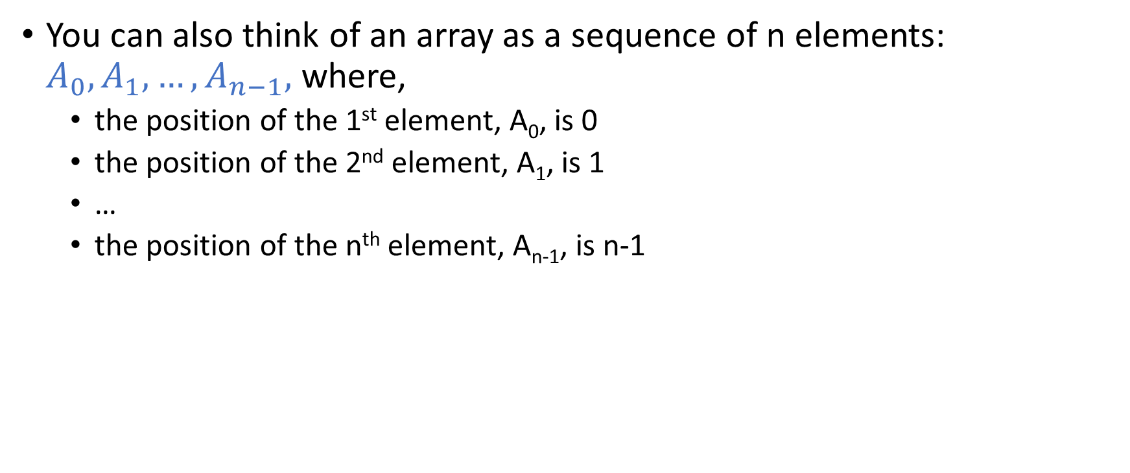
Arrays
You can also think of an array as a sequence of n elements: $A_{0}, A_{1},…,A_{n−1},$where,
the position of the 1st element, A₀, is 0
the position of the 2nd element, A₁, is 1
…
the position of the n^{th} element, A_{n-1}, is n-1

Slide 19
Arrays
We want to support the following operations without changing the order of the elements in the sequence
Insert an element at the i^{th} position
Delete the element at the i^{th} position
Find the element at the i^{th} position

Slide 20
Inserting an element
3 | 9 | 13 | 17 | 18 | 23 | 29 | 33 | 39 | 47 | 55 | 61 | 73 | 84 | 88 | 92 | 94
Insert 1 at position 0 without changing the order.

Slide 21
Inserting an element
3 | 9 | 13 | 17 | 18 | 23 | 29 | 33 | 39 | 47 | 55 | 61 | 73 | 84 | 88 | 92 | 94
Insert 1 at position 0 without changing the order.
Notes:
Let’s say there are n elements in the array. The first element is at position 0, the second element is at position 1, and so on. Inserting a value at position zero without changing the order of the elements, we need to shift all the elements by one, starting from the last element. First, we need to copy the element at position n-1 to n, followed by n-2 to n-1, and so on in that order. Notice that this will take O(n) operations.

Slide 22
Deleting an element
3 | 9 | 13 | 17 | 18 | 23 | 29 | 33 | 39 | 47 | 55 | 61 | 73 | 84 | 88 | 92 | 94 | 96 | 98 | 99
Delete 3 without changing the order.

Slide 23
Deleting an element
3 | 9 | 13 | 17 | 18 | 23 | 29 | 33 | 39 | 47 | 55 | 61 | 73 | 84 | 88 | 92 | 94 | 96 | 98 | 99
Delete 3 without changing the order.
Notes:
To delete the element at position 0 without altering the order, we need to copy the element from position 1 to 0, position 2 to 1, and so on in that order. This also requires O(n) operations.

Slide 24
Problems with dynamic arrays
Can we insert an element at position zero in O(1) operations without changing the order of other elements?

Slide 25
Problems with dynamic arrays
Can we insert an element at position zero in O(1) operations without changing the order of other elements?
How about allocating a new array of size one and storing the element in the new array? Subsequently, the new array is used to access the first element, and the original array is used to access the other elements.
What is the problem with the above approach?

Slide 26
Problems with dynamic arrays
Can we insert an element at position zero in O(1) operations without changing the order of other elements?
How about allocating a new array of size one and storing the element in the new array? Subsequently, the new array is used to access the first element, and the original array is used to access the other elements.
What is the problem with the above approach?
The array elements must be stored at consecutive addresses. Two different allocations are not guaranteed to be consecutive.

Slide 27
Linked list
To facilitate fast insertion while preserving the order, we need to ensure that the array elements can be stored in non-contiguous memory
This is the basic idea behind linked-lists

Slide 28
Linked list
Linked list is almost like an array, except the addresses of two consecutive elements in the list may not be consecutive
Thus, we don’t need to copy elements during linked-list insertion and deletion
The elements of a linked list are also called nodes

Slide 29
Linked list
Suppose the base address of an array is stored in the variable ptr
How can we access the fifth element of the array?
Suppose the base address of a linked list is stored in the variable ptr
How can we access the fifth element of the linked list?

Slide 30
Linked list
Every node in a linked list also stores the address of the next node
The address of the first node is stored in a pointer variable
Generally, this variable is called head
head
10
12
15
18
19
10 | 12 | 15 | 18 | 19
ARRAY
Notes:
In this example, the address of the first node of the linked list is 100, the second node is 200, and so on. The first node stores the address of the second node, i.e., 200. The second node stores the address of the third node, i.e., 300, and so on. The last node stores the NULL address, which is an invalid address or the address of an empty list.

Slide 31
Linked list
The last node of the linked list contains NULL in the address field
You can think of NULL as an invalid address or the address of an empty list

Slide 32
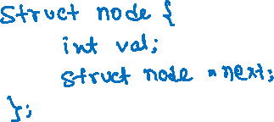
Type
What is the type of a linked-list node that stores integer values?
Notes:
In addition to the value field, a linked list node also contains the address of the next node. If the type of a linked-list node is “struct node”, the type of the address of the linked-list node would be “struct node*”. Therefore, “struct node” contains a field of type “struct node*” to store the address of the next node.

Slide 33

Allocation
struct node {
int val;
struct node *next;
};
struct node* allocate_node(int val) {
struct node *n = (struct node*)malloc(sizeof(struct node));
if (n == NULL) {
printf(“Unable to allocate more memory\n”);
return NULL;
}
n->val = val;
n->next = NULL;
return n;
}
Allocating a linked list node.
Notes:
allocate_node allocates a new node, stores the element's value in the val field, and stores NULL corresponding to the address of the next node.

Slide 34
Printing Linked-List

Slide 35
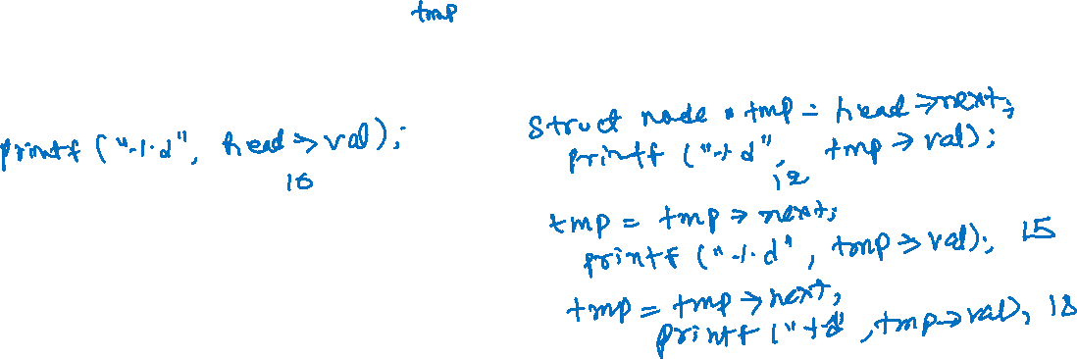
Printing list
struct node {
int val;
struct node *next;
};
head
10
12
15
18
19 | NULL
Notes:
To print the entire linked list, we can store the address of the head in a temporary variable, tmp. Until tmp is not NULL, we can print the value of tmp and update tmp with the address of the next node in a loop.

Slide 36
Printing list
struct node {
int val;
struct node *next;
};
head
10
12
15
18
19 | NULL
tmp
tmp = head
printf(“%d ”, tmp->val); 10

Slide 37
Printing list
struct node {
int val;
struct node *next;
};
head
10
12
15
18
19 | NULL
tmp
tmp = head
printf(“%d ”, tmp->val); 10
tmp = tmp->next;
printf(“%d ”, tmp->val); 12

Slide 38
Printing list
struct node {
int val;
struct node *next;
};
head
10
12
15
18
19 | NULL
tmp
tmp = head
printf(“%d ”, tmp->val); 10
tmp = tmp->next;
printf(“%d ”, tmp->val); 12
tmp = tmp->next;
printf(“%d ”, tmp->val); 15

Slide 39
Printing list
struct node {
int val;
struct node *next;
};
head
10
12
15
18
19 | NULL
tmp
tmp = head
printf(“%d ”, tmp->val); 10
tmp = tmp->next;
printf(“%d ”, tmp->val); 12
tmp = tmp->next;
printf(“%d ”, tmp->val); 15
tmp = tmp->next;
printf(“%d ”, tmp->val); 18

Slide 40
Printing list
struct node {
int val;
struct node *next;
};
head
10
12
15
18
19 | NULL
tmp
tmp = head
printf(“%d ”, tmp->val); 10
tmp = tmp->next;
printf(“%d ”, tmp->val); 19
tmp = tmp->next;
printf(“%d ”, tmp->val); 12
tmp = tmp->next;
printf(“%d ”, tmp->val); 15
tmp = tmp->next;
printf(“%d ”, tmp->val); 18

Slide 41
Printing list
struct node {
int val;
struct node *next;
};
head
10
12
15
18
19 | NULL
tmp = NULL
tmp = head
printf(“%d ”, tmp->val); 10
tmp = tmp->next;
printf(“%d ”, tmp->val); 19
tmp = tmp->next
tmp = tmp->next;
printf(“%d ”, tmp->val); 12
tmp = tmp->next;
printf(“%d ”, tmp->val); 15
tmp = tmp->next;
printf(“%d ”, tmp->val); 18

Slide 42
Printing list
struct node {
int val;
struct node *next;
};
void print_list(struct node *head) {
struct node *tmp = head;
while (tmp != NULL) {
printf(“%d ”, tmp->val);
tmp = tmp->next;
}
printf(“\n”);
}

Slide 43
Insertion (front)

Slide 44
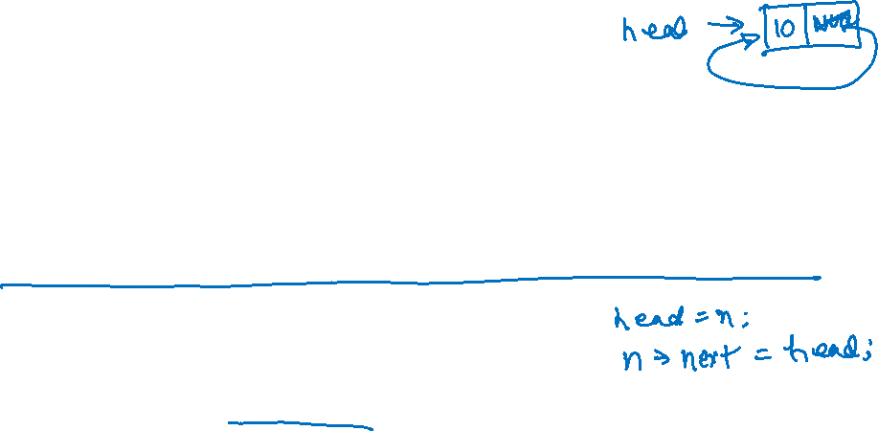
Insertion (front)
Before insertion
After insertion
head
12
18
19 | NULL
15
n
10 | NULL
head
10
12
15
18
19 | NULL
Notes:
In this example, head points to the first node of the linked list. n points to a new node. After inserting the new node in the front, the head will point to the new node, and the new node will store the address of the node that was the first node before the insertion. If we first update the head to point to the new node, we will lose the reference to the original linked list. Therefore, we first need to store the address of the first node in the new node and then make the new node the first node of the linked list.

Slide 45

Insertion (front)
head
12
18
19 | NULL
15
n
10 | NULL

Slide 46
Insertion (front)
head
12
18
19 | NULL
15
n
10 | NULL

Slide 47
Insertion (front)
head
12
18
19 | NULL
15
n
10
n->next = head;

Slide 48
Insertion (front)
12
15
18
19 | NULL
n
10
head
n->next = head;
head = n

Slide 49
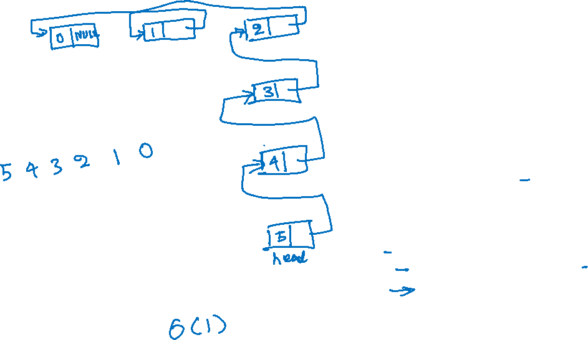
Insertion (front)
struct node {
int val;
struct node *next;
};
// returns the new head
struct node* insert_front(struct node *head,
struct node *n) {
n->next = head;
return n;
}
int main() {
struct node *head = NULL;
struct node *n;
int i;
for (i = 0; i <= 5; i++) {
n = allocate_node(i);
head = insert_front(head, n);
}
print_list(head);
return 0;
}
Time complexity:
Notes:
In this program, insert_front takes a pointer to the starting node (or head) of the linked list and a pointer to the node that needs to be inserted. This function returns the new head after inserting the new node at the front of the linked list. insert_front requires O(1) operations.

Slide 50
Insertion (rear)

Slide 51
Insertion (rear)
Before insertion
After insertion
head
10
15
18 | NULL
12
n
19 | NULL
head
10
12
15
18
19 | NULL

Slide 52
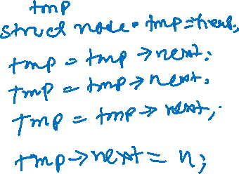
Insertion (rear)
head
10
15
18 | NULL
12
n
19 | NULL
Notes:
To insert a node at the rear end of the list, we first need to find the address of the last node. To compute the address of the last node, we can initialize a temporary variable tmp with the value of head and keep updating it with the address of the next node in a loop until we reach a node that stores NULL in its next field. At this point, we can store the address of the new node in the next field of tmp. Consequently, the new node will be inserted at the rear end of the linked list.

Slide 53
Insertion (rear)
head
10
15
18 | NULL
12
n
19 | NULL

Slide 54
Insertion (rear)
head
10
15
18 | NULL
12
tmp
tmp = head
n
19 | NULL

Slide 55
Insertion (rear)
head
10
15
18 | NULL
12
tmp
tmp = head
tmp = tmp->next
n
19 | NULL

Slide 56
Insertion (rear)
head
10
15
18 | NULL
12
tmp
tmp = head
tmp = tmp->next
tmp = tmp->next
n
19 | NULL

Slide 57
Insertion (rear)
head
10
15
18 | NULL
12
tmp
tmp = head
tmp = tmp->next
tmp = tmp->next
tmp = tmp->next
n
19 | NULL

Slide 58
Insertion (rear)
head
10
15
18
12
tmp
tmp = head
tmp = tmp->next
tmp = tmp->next
tmp = tmp->next
tmp->next = n
n
19 | NULL

Slide 59
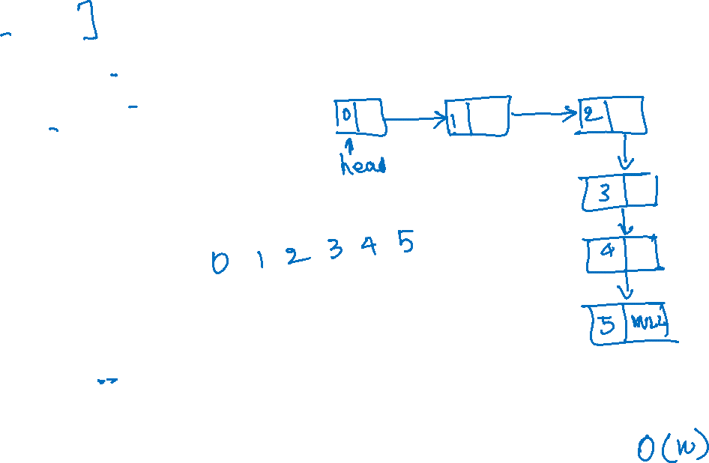
struct node* insert_rear(struct node *head, struct node *n) {
if (head == NULL) {
return n;
}
struct node *tmp = head;
while (tmp->next != NULL) {
tmp = tmp->next;
}
tmp->next = n;
return head;
}
int main() {
struct node *head = NULL;
struct node *n;
int i;
for (i = 0; i <= 5; i++) {
n = allocate_node(i);
head = insert_rear(head, n);
}
print_list(head);
return 0;
}
Insertion at rear
Time complexity:
Notes:
Notice that the insertion at the rear takes O(n) operations. insert_rear returns the new head of the linked list. The head can change if the original list is an empty list.

Slide 60
Insertion (rear)
How can we implement insertion rear in O(1) operations?

Slide 61
Insertion (rear)
How can we implement insertion rear in O(1) operations?
Keep track of the tail (last node) of the linked list in addition to head
No need to walk the entire list to find the tail
After insertion, update the tail to point to the inserted node

Slide 62
Insertion (at specific position)

Slide 63

Insertion (at specific position)
Before insertion
After inserting the new node n at position two
pos = 0
pos = 1
pos = 2
pos = 3
head
10
18
19 | NULL
12
n
15 | NULL
pos = 0
pos = 1
pos = 2
pos = 3
pos = 4
head
10
12
15
18
19 | NULL
Notes:
The position of the first node is 0, the second node is 1, and so on. After inserting a new node at a specific position i, the node at position i-1 will point to the new node, and the new node will point to the node that was previously at position i. In other words, the positions of all the nodes starting from i will be increased by one in the final list after the insertion.

Slide 64
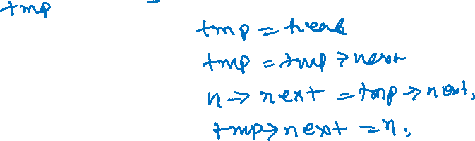
Insertion (at specific position)
pos = 0
pos = 1
pos = 2
pos = 3
head
10
18
19 | NULL
12
n
15 | NULL
Insert the node n at position two in the linked list.
Notes:
To insert a node at position two, we first need to initialize a temporary variable tmp with the head of the linked list. Now we node to update tmp with the address of the next node in a loop until we reach the node at position i-1. At this point, we need to first store the address of the ith node in the address field of n, followed by storing the address of n in the address field of tmp. This will give us the desired list.

Slide 65
Insertion (at specific position)
pos = 0
pos = 1
pos = 2
pos = 3
head
10
18
19 | NULL
12
n
15 | NULL

Slide 66
Insertion (at specific position)
pos = 0
pos = 1
pos = 2
pos = 3
head
10
18
19 | NULL
12
tmp
n
15 | NULL
tmp = head
pos = 0

Slide 67
Insertion (at specific position)
pos = 0
pos = 1
pos = 2
pos = 3
head
10
18
19 | NULL
12
tmp
n
15 | NULL
tmp = head
pos = 0
tmp = tmp->next
pos = 1

Slide 68
Insertion (at specific position)
pos = 0
pos = 1
pos = 2
pos = 3
head
10
18
19 | NULL
12
tmp
n
15
tmp = head
pos = 0
tmp = tmp->next
pos = 1
n->next = tmp->next

Slide 69
Insertion (at specific position)
pos = 0
pos = 1
pos = 2
pos = 3
head
10
18
19 | NULL
12
tmp
n
15
tmp = head
pos = 0
tmp = tmp->next
pos = 1
n->next = tmp->next
tmp->next = n

Slide 70
Insertion (at specific position)
pos = 0
pos = 1
pos = 3
pos = 4
head
10
18
19 | NULL
12
tmp
n
15
tmp = head
pos = 0
tmp = tmp->next
pos = 1
n->next = tmp->next
tmp->next = n
pos = 2

Slide 71

// insert the node n at position pos, returns the new head
// the insertion is successful if 0 <= pos <= N,
// where N is the total number of elements in the list
struct node* insert_pos(struct node *head, struct node *n, int pos) {
if (pos == 0) {
n->next = head;
return n;
}
struct node *tmp = head;
int i = 0;
while (i != pos - 1 && tmp != NULL) {
tmp = tmp->next;
i = i + 1;
}
if (tmp != NULL) {
n->next = tmp->next;
tmp->next = n;
}
return head;
}
Insertion at specific position
Time complexity:
Notes:
If we insert at pos=0, it is the same as inserting at the front. If we insert at pos=n, it is the same as inserting at the rear. We need to be careful when pos>n because, in that case, we can’t insert the element. Notice that an insert operation may take O(n) operations in the worst case. insert_pos returns the new head of the linked list.

Slide 72
Search

Slide 73

Search
head
10
12
15
18
19 | NULL
Search a linked list node that contains 18 in the value field.
If the node exists, the search routine returns the node; otherwise, it returns NULL. The search operation doesn’t modify the linked list.
Time complexity:
Notes:
We can iterate all the elements in the linked list as we have done so far, and if any node contains the value we are searching for, we can return the address of that node.

Slide 74

Search
// Returns a linked list node that contains
// the input argument val
struct node* search(struct node *head, int val) {
struct node *tmp = head;
while (tmp != NULL) {
if (tmp->val == val) {
return tmp;
}
tmp = tmp->next;
}
return NULL;
}

Slide 75
Deleting the front node

Slide 76
Delete (front)
Before delete
After delete
head
10
12
15
18
19 | NULL
head
12
15
18
19 | NULL
10
new head and deleted node are returned to the caller
Notes:
After deleting the first node, the head of the linked list will be changed. The delete procedure returns two values: the new head of the linked list and the address of the deleted node.

Slide 77

Delete (front)
head
10
12
15
18
19 | NULL
Notes:
If the list is not empty, the deleted node is head, and the new head is head->next.

Slide 78
Delete (front)
head
10
12
15
18
19 | NULL
tmp
tmp = head

Slide 79
Delete (front)
head
12
15
18
19 | NULL
tmp
10
tmp = head
head = head->next

Slide 80

Delete (front)
struct delete_info {
struct node *head;
struct node *deleted_node;
};
// update the head
// return the deleted node
struct delete_info delete_front(struct node *head) {
struct delete_info ret;
if (head == NULL) {
ret.head = NULL;
ret.deleted_node = NULL;
return ret;
}
ret.head = head->next;
ret.deleted_node = head;
return ret;
}
Time complexity:
Notes:
We can use a structure as we did earlier to return two values. The time complexity of delete_front is O(1).

