Slide 2
Today’s topics
Trees
Binary search trees

Slide 3
References
Read chapter-4 from Mark Allen Weiss
Read chapter-12 from Cormen et al.

Slide 4
Linear data structures
Array and Linked Lists are linear structures that contain a sequence of elements

Slide 5
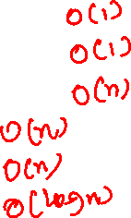
Linear data structures
Array and Linked Lists are linear structures that contain a sequence of elements
What is the time complexity of an insert operation in an unordered array?
What is the time complexity of a delete operation in an unordered array?
What is the time complexity of a search operation in an unordered array?
What is the time complexity of an insert operation in a sorted array?
What is the time complexity of a delete operation in a sorted array?
What is the time complexity of a search operation in a sorted array?

Slide 6
O(n) vs O(log(n))
n | log(n)
1024 | 10
2048 | 11
4096 | 12
8192 | 13
16384 | 14
32768 | 15
65536 | 16
131072 | 17
262144 | 18
524288 | 19
1048576 | 20
From this table, it’s evident that O(log(n)) is much better than O(n). For most practical purposes, log(n) is somewhat close to a constant time operation. For a problem size of 1M, an O(log(n)) algorithm takes merely 20 operations. In 100 operations, we can solve a problem size of 2^100. If the space complexity of the problem is also O(n), we can not even store the input for the problem size 2^100 (10^9 Billion TB) on probably any machine.
It would be great if we could do all search, insert, and delete operations in O(log(n)).

Slide 7
Search and update
Why is search important?
We do search all the time
Web search engines (the input is the list of all web pages and their contents)
Searching for a file on your system (the input is the list of all files and directories)
YouTube (input is the list of the captions and descriptions of all videos)
Twitter (searching for a particular hashtag)
In these applications, new contents are added or removed all the time
search, delete, and insert usually go hand in hand

Slide 8
Search and update
We can’t do search and update (insert or delete) operations simultaneously in O(log n) time using linear data structures ☹
A non-linear (hierarchical) data structure called a tree is used to perform all these operations in O(log n) ☺

Slide 9
Tree

Slide 10
Tree structure
The top element (node) of a non-empty tree is called the root node
Each node (other than root) in the tree has exactly one parent node
Each node in the tree has zero or more children nodes
Nodes with the same parents are siblings
Trees are drawn upside down

Slide 11
Family tree (Ramayana)
ROOT
PARENT
CHILDREN
SIBLING
DASHRATHA
RAMA
BHARATHA
LAKSHMANA
SHATRUGHANA
LUVA
KUSHA
SUBAHU
SHATRUGHATI
CHANDRAKETU
TAKSHA
PUSHKALA
ANGADA
ATITHI
KANAKAMALIKA
Notes:
An outgoing edge in every node connects a node to its children. The source of the edge is called the parent node. Every node has exactly one parent node except the root node, which has no parents. In this case, DASHRATHA is the root node. Two nodes with the same parents are called siblings, e.g., LUVA and KUSHA are siblings of each other.

Slide 12
Terminology
A node with no children is called a leaf node
A node that is not a leaf is called an internal node

Slide 13
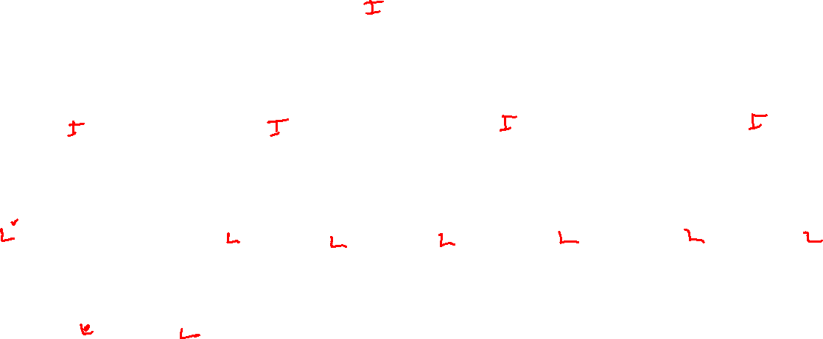
Family tree (Ramayana)
INTERNAL NODE
LEAF
Which are the leaf nodes?
Which are the internal nodes?
DASHRATHA
RAMA
BHARATHA
LAKSHMANA
SHATRUGHANA
LUVA
KUSHA
SUBAHU
SHATRUGHATI
CHANDRAKETU
TAKSHA
PUSHKALA
ANGADA
ATITHI
KANAKAMALIKA
Notes:
LUVA, ATITHI, KANAKAMALIKA, etc., are the leaf nodes because they don’t have any children. RAMA, KUSHA, BHARATHA, etc., are internal nodes because they have at least one child.

Slide 14
Terminology
A path from node n₁ to n_{k} is defined as a sequence of nodes n₁, n₂, …, n_{k} such that n_{i} is the parent of n_{i+1} for all 1 <= i < k
The length of the path is the number of edges on the path
There is a path of length zero from every node to itself
There is at most one path between any pairs of nodes in a tree
There is a path from the root to every other node in a tree

Slide 15

Family tree (Ramayana)
PATH
Is there a path from DASRATHA to ANGADA?
Is there a path from TAKSHA to PUSHKALA?
Is there a path from RAMA to RAMA?
Length?
DASHRATHA
RAMA
BHARATHA
LAKSHMANA
SHATRUGHANA
LUVA
KUSHA
SUBAHU
SHATRUGHATI
CHANDRAKETU
TAKSHA
PUSHKALA
ANGADA
ATITHI
KANAKAMALIKA
Notes:
There is a path between DASRATHA and ANGADA, i.e., DASRATHA-SATRUGHANA-ANGADA. This is because DASRATHA is the parent of SATRUGHANA, and STARUGHANA is the parent of ANGADA. The length of this path is two, i.e., the number of edges in the path. There is no path between TAKSHA and PUSHKALA. TAKSHA-BHARATHA-PUSHKALA is not a path because TAKSHA is not a parent of BHARATHA. There is a path from RAMA to RAMA of length zero. There is a path from the root (DASHRATHA) to every other node in the tree.

Slide 16

Terminology
If there is a path from n₁ to n₂, then n₁ is an ancestor of n₂ and n₂ is a descendant of n₁
If $n_{1}≠n_{2},$ n₁ is a proper ancestor of n₂ and n₂ is a proper descendant of n₁
Every node is an ancestor and descendant of itself

Slide 17

Family tree (Ramayana)
ANCESTOR
DESCENDANT
PROPER ANCESTOR
PROPER DESCENDANT
DASHRATHA
RAMA
BHARATHA
LAKSHMANA
SHATRUGHANA
LUVA
KUSHA
SUBAHU
SHATRUGHATI
CHANDRAKETU
TAKSHA
PUSHKALA
ANGADA
ATITHI
KANAKAMALIKA
Notes:
RAMA is an ancestor of ATITHI because there is a path from RAMA to ATITHI. ATITHI is an ancestor of himself; however, ATITHI is not a proper ancestor of himself.

Slide 18
Terminology
There is a path from the root to every other node in a tree
The depth (or level) of a node is the length of the path from the root to itself
The depth of the tree is the maximum of the depths of all nodes

Slide 19
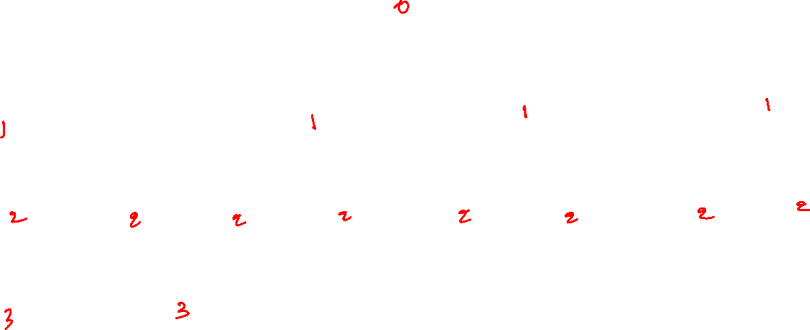
Family tree (Ramayana)
PATH
What is the depth (or level) of each node?
DASHRATHA
RAMA
BHARATHA
LAKSHMANA
SHATRUGHANA
LUVA
KUSHA
SUBAHU
SHATRUGHATI
CHANDRAKETU
TAKSHA
PUSHKALA
ANGADA
ATITHI
KANAKAMALIKA
Notes:
The depth of ATITHI is 3, i.e., the length of the path from the root (DASHRATHA). The depths of the other nodes are also shown on this slide.

Slide 20
Terminology
There is a path from every node to a leaf node
The height of a node n is the length of the longest path from the n to a leaf
All leaves are at the height of zero
The height of the tree is equal to the height of the root
The height of an empty tree is -1

Slide 21
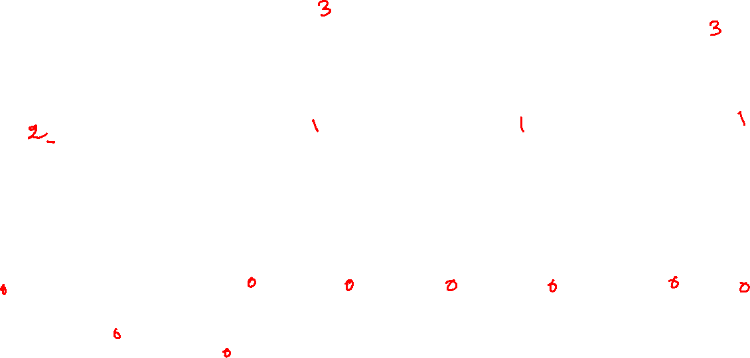
Family tree (Ramayana)
PATH
What is the height of each node?
What is the height of the tree?
DASHRATHA
RAMA
BHARATHA
LAKSHMANA
SHATRUGHANA
LUVA
KUSHA
SUBAHU
SHATRUGHATI
CHANDRAKETU
TAKSHA
PUSHKALA
ANGADA
ATITHI
KANAKAMALIKA
Notes:
The height of RAMA is two because there is a path from RAMA to leaf nodes LUVA, ATHITHI, and KANKAMALIKA. Out of these paths, the maximum length is two, and therefore two is the height of the node corresponding to RAMA. The height of the tree is the height of DASHRATHA, i.e., three.

Slide 22
Depth vs. Height
The depth of a tree is equal to the height of the tree

Slide 23
Terminology
The maximum children in any node is called the degree of a tree
Trees of degree two are called binary trees

Slide 24

Family tree (Ramayana)
PATH
What is the degree of this tree?
What would be the degree of the tree for the family tree of Mahabharata?
DASHRATHA
RAMA
BHARATHA
LAKSHMANA
SHATRUGHANA
LUVA
KUSHA
SUBAHU
SHATRUGHATI
CHANDRAKETU
TAKSHA
PUSHKALA
ANGADA
ATITHI
KANAKAMALIKA
Notes:
The degree of this tree is four because DASRATHA has the maximum number of children, i.e., four. If we draw the family tree of Mahabharata, the degree would be 100 because DHRITRASTRA had 100 children.

Slide 25
Binary tree

Slide 26
Binary tree
The degree of a binary tree is two
Recursive definition
A binary tree is either empty or consists of
a root node
two distinct binary trees called the left and right subtrees
root contains references to (or addresses of) left and right subtrees

Slide 27
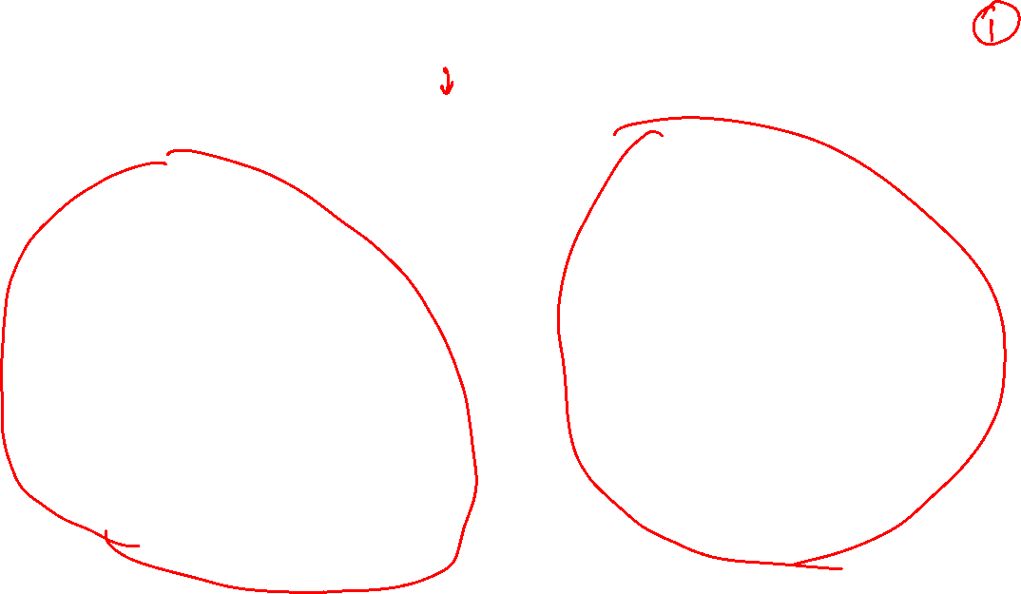
Binary tree
DEGREE?
1
2
3
4
5
6
7
8
10
9
Notes:
This is a binary tree because the maximum number of children in any node is two.

Slide 28
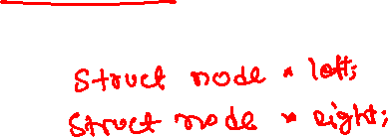
Type (Binary Tree)
struct node {
int val;
};

Slide 29
Complete binary tree
In a complete binary tree, all the leaves have the same depth
All the internal nodes have degree two

Slide 30
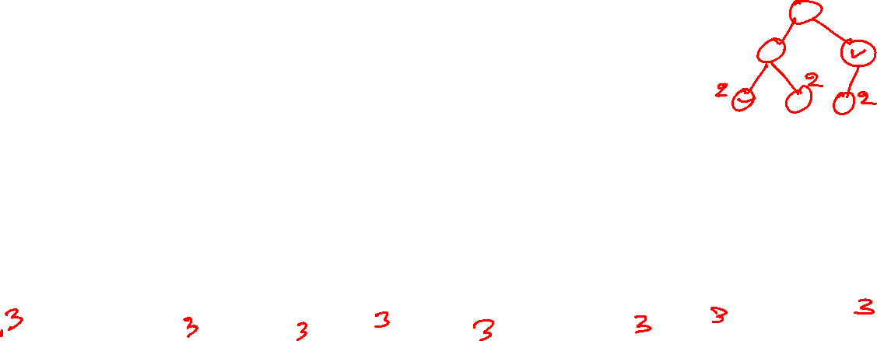
Complete binary tree
Why is this a complete binary tree?
1
2
3
4
5
6
7
8
9
10
11
13
14
15
12
Notes:
This is a complete binary tree because all leaves are at the same depth (or level). All internal nodes have two children.

Slide 31
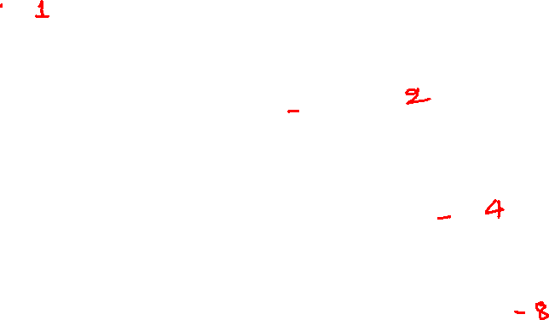
Height = f(number of nodes)
1
2
3
4
5
6
7
8
9
10
11
13
14
15
12

Slide 32
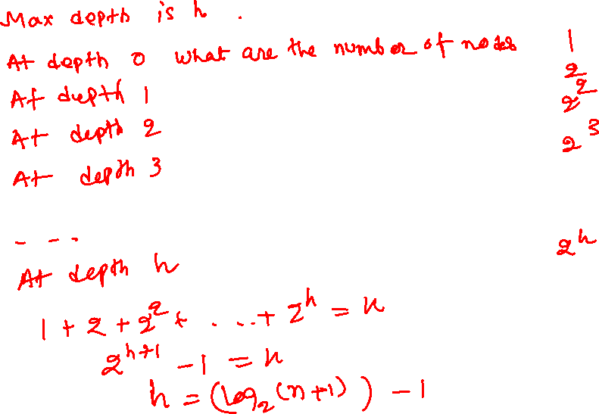
Height = f(number of nodes)

Slide 33
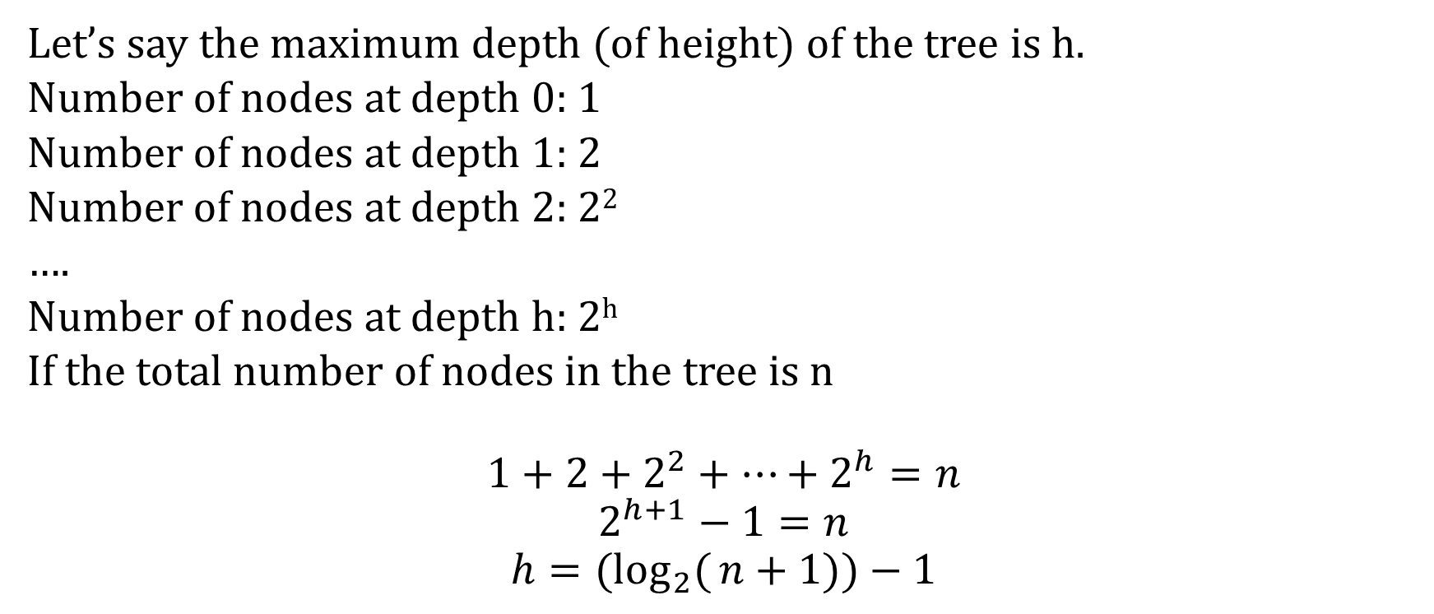
Height = f(number of nodes)
Let’s say the maximum depth (of height) of the tree is h.
Number of nodes at depth 0: 1
Number of nodes at depth 1: 2
Number of nodes at depth 2: 2²
….
Number of nodes at depth h: 2^{h}
If the total number of nodes in the tree is n
$$1+2+2^{2}+…+2^{h}=n$$
$$2^{h+1}−1=n$$
$$h={(log}_{2}({n+1}))−1$$

Slide 34
Skewed tree
In a skewed binary tree, all the nodes have at most one child
10
11
Right Skewed
Left Skewed
7
19
23
3
27
2

Slide 35
Tree traversal

Slide 36
Tree traversal
The aim of the traversal is to visit each node in the tree exactly once
Generally, we traverse the tree in the following orders
Preorder traversal
Inorder traversal
Postorder traversal
The above algorithms are recursive in nature

Slide 37
Preorder traversal
root
1. visit the root node
2. recursively traverse the left subtree
3. recursively traverse the right subtree
LEFT
RIGHT

Slide 38
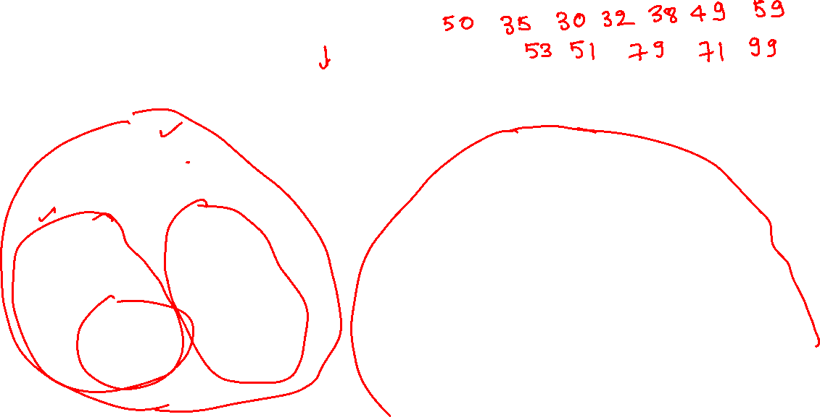
Preorder
PREORDER: ROOT LEFT RIGHT
50
35
59
30
38
53
79
32
49
51
71
99
Notes:
In preorder traversal, we can first print (or traverse) the node and then recursively traverse the left subtree followed by the right subtree. To traverse this tree, we first print 50 and then traverse the left subtree rooted at 35. To traverse the tree rooted at 35, we first print 35 and then traverse the tree rooted at 30. To traverse the tree rooted at 30, we first print 30 and then traverse the empty left subtree. After we are done with the left subtree, we traverse the right subtree of 30 to traverse the tree rooted at 30 completely. The right subtree of 30 is 32. Traversing the subtree rooted at 32 prints 32. We continue this until we have completely traversed the root of the original tree, i.e., 50. The result of the preorder traversal is shown on this slide.

Slide 39
Inorder traversal
root
1. recursively traverse the left subtree
2. visit the root node
3. recursively traverse the right subtree
LEFT
RIGHT

Slide 40
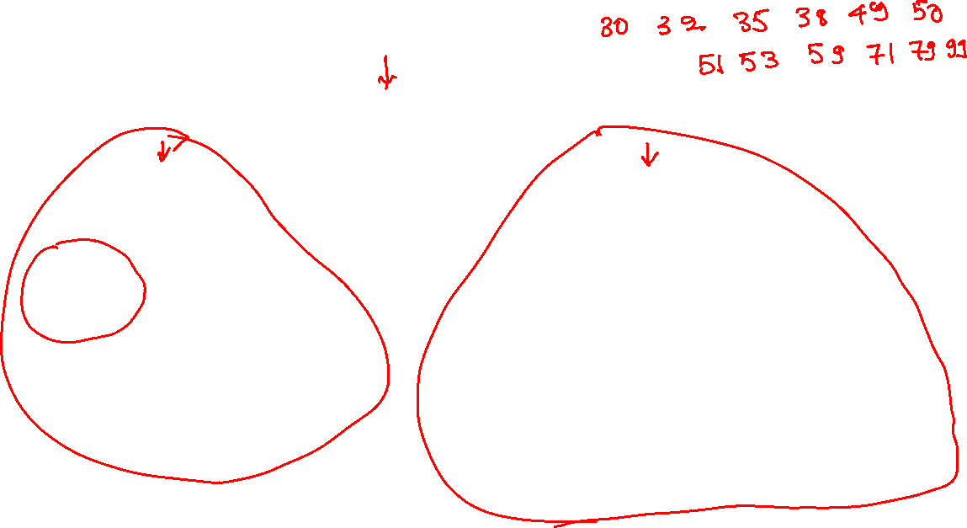
Inorder
INORDER: LEFT ROOT RIGHT
50
35
59
30
38
53
79
32
49
51
71
99
Notes:
In inorder traversal, we first print (or traverse) the left subtree before printing the value of the root node. After that, we traverse the right subtree. The output of the inorder traversal is shown on this slide.

Slide 41
Postorder traversal
root
1. recursively traverse the left subtree
3. recursively traverse the right subtree
3. visit the root node
LEFT
RIGHT

Slide 42
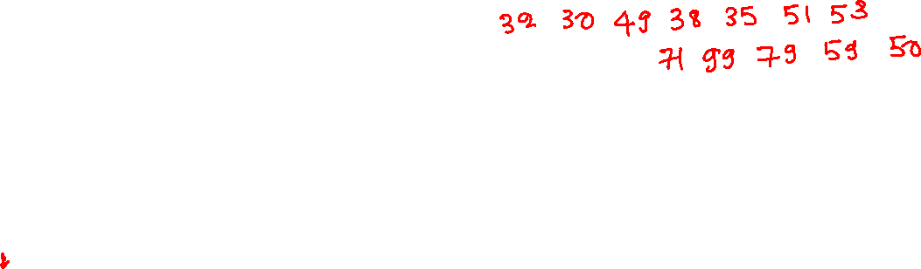
Postorder
POSTORDER: LEFT RIGHT ROOT
50
35
59
30
38
53
79
32
49
51
71
99
Notes:
In postorder traversal, we first print (or traverse) the left subtree followed by the right subtree before finally printing the value of the root. The result of the postorder traversal is shown on this slide.

Slide 43
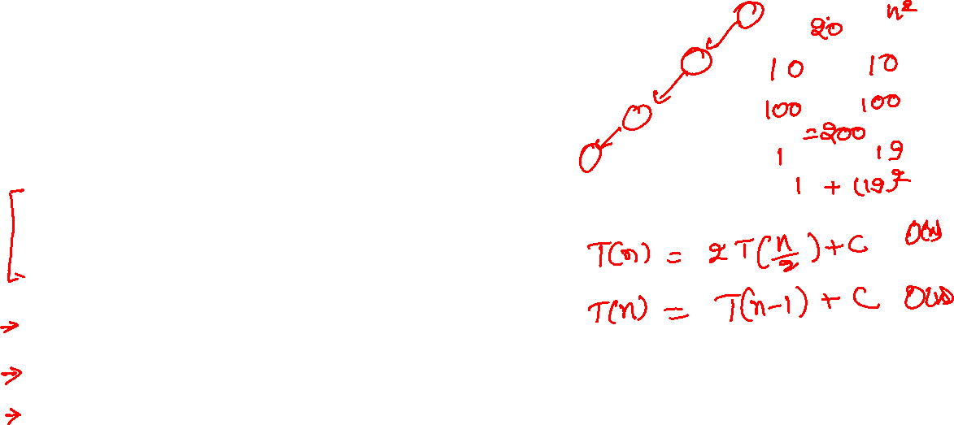
Preorder traversal
void preorder(struct node *root) {
if (root == NULL) {
return;
}
printf("%d ", root->val);
preorder(root->left);
preorder(root->right);
}
Time complexity:
Notes:
This is the recursive algorithm for doing the postorder traversal. The time complexity can’t be better than O(n) because we need to visit all the nodes at least once. If both the left and right subtrees always contain roughly the same number of nodes (i.e., n/2), the time complexity would be T(n) = 2T(n/2) + c, which is O(n). In the worst case, we will always encounter a skewed tree, i.e., the number of nodes in the left-subtree is n-1, and the right subtree is empty, or vice-versa; in this case, the time complexity T(n) = T(n-1) + c, which is again O(n).

Slide 44

Inorder traversal
void inorder(struct node *root) {
if (root == NULL) {
return;
}
inorder(root->left);
printf("%d ", root->val);
inorder(root->right);
}

Slide 45
Postorder traversal
void postorder(struct node *root) {
if (root == NULL) {
return;
}
postorder(root->left);
postorder(root->right);
printf("%d ", root->val);
}

Slide 46
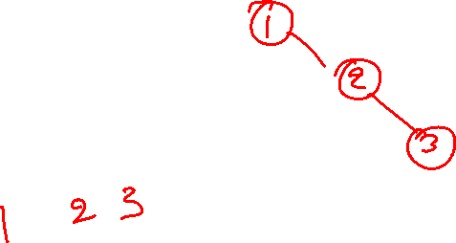
Reconstructing binary tree
Given preorder traversal, can we reconstruct the original binary tree
1
2
3
Notes:
We can not reconstruct the original tree from a given preorder traversal because multiple trees can have the same preorder traversal.

Slide 47

Reconstructing binary tree
Given inorder traversal, can we reconstruct the original binary tree
1
2
3
Notes:
We can not reconstruct the original tree from a given inorder traversal because multiple trees can have the same inorder traversal.

Slide 48
Exercise
Write an algorithm to reconstruct the unique tree from given inorder and preorder traversals (assuming no duplicates)
Write an algorithm to reconstruct the unique tree from given inorder and postorder traversals (assuming no duplicates)
Give an example to demonstrate that we can’t reconstruct a unique tree from given preorder and postorder traversals (assuming no duplicates)

Slide 49
Tree algorithms

Slide 50
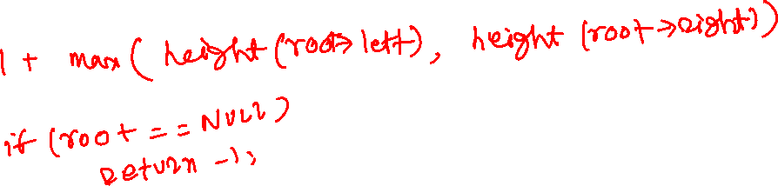
Height of a binary tree
a
b
e
c
d
f
g
h
i
Notes:
Let’s say the heights of the left subtree and the right subtree are lh and rh; the height of the tree would be one more than the maximum of lh and rh.

Slide 51
Height of a binary tree
Recursive step
h_left = Recursively calculate the height of the left subtree
h_right = Recursively calculate the height of the right subtree
the height of the tree is 1 + max(h_left, h_right)
Base case
if the tree is empty, return -1

Slide 52
Height of a binary tree
int height(struct node *root)
{
if (root == NULL) {
return -1;
}
return 1 + max(height(root->left), height(root->right));
}

Slide 53
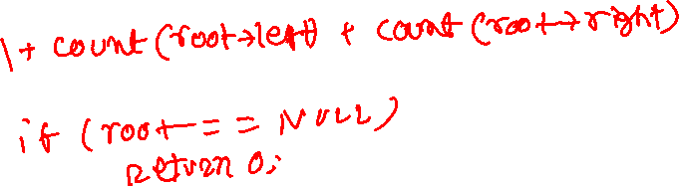
Count the number of nodes
a
b
e
c
d
f
g
h
i
Notes:
The total number of nodes in a tree is one more than the sum of the total number of nodes in the left subtree and the total number of nodes in the right subtree plus one.

Slide 54
Count the number of nodes
Recursive step
l_count = recursively count the number of nodes in the left subtree
r_count = recursively count the number of nodes in the right subtree
The total number of nodes is l_count + rcount + 1
Base case
If the tree is empty, return 0

Slide 55
Count the number of nodes
int count(struct node *root) {
if (root == NULL) {
return 0;
}
return 1 + count(root->left) + count(root->right);
}

Slide 56
Binary search tree

Slide 57
Binary search tree (BST)
BST is a binary tree and has the following properties
The values of all the keys in the left subtree are less than the value of the key stored at root
The values of all the keys in the right subtree are more than the value of the key stored at root
The left and right subtrees in a BST are BSTs

Slide 58
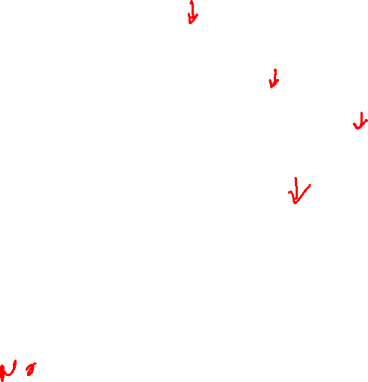
BST
55
22
85
17
27
62
95
19
30
92
99
57
63
91
Is this a BST?
Notes:
All the keys on the right of 55 are more than 55, and all the keys on the left of 55 are less than 55; therefore, this tree is BST if both the left and right subtrees are also BST. Let’s look at the right subtree. All the nodes on the right of 85 contain larger keys, and all the nodes on the left of 85 contain smaller keys; therefore, the tree rooted at 85 is a BST if both the left and right subtrees are also BST. Now look at 95, all the keys on the right are greater, and all the nodes on the left are lesser; therefore, it could be a BST if the left and right subtrees are also BSTs. Let’s look at 92; the node on the right is less than 92; therefore, 92 is not a BST. This also means that the trees rooted at 95, 85, and 55 are not BSTs.

Slide 59

BST
55
22
85
17
27
62
95
19
30
92
99
57
63
93
Is this a BST?
Notes:
This is the BST because it satisfies all properties of a BST.

Slide 60
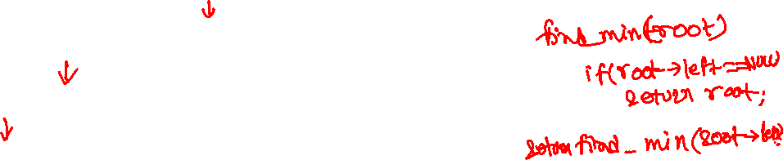
BST
55
22
85
17
27
62
95
19
30
92
99
57
63
93
How can we find the smallest element in a BST?
Notes:
If the left subtree is empty, root must be the smallest element because of the property of a BST. Otherwise, the smallest element must be the smallest in the left subtree because all the keys in the left subtrees are smaller. Similarly, the smallest element in the left subtree is the smallest element in the left subtree of the left subtree. If we go this way, the smallest element would be the leftmost element. To find the smallest element, we need to go from the root of the tree to a node that is the leftmost leaf node or the parent of leaf nodes. Therefore, the time complexity would be the height of the tree. Because, in the worst case, the height can be n-1, where n is the number of nodes in the tree, therefore the time complexity is O(n).

Slide 61
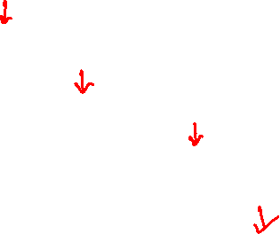
BST
55
22
85
17
27
62
95
19
30
92
99
57
63
93
How can we find the largest element in a BST?
Notes:
The largest element is the rightmost element.

Slide 62
BST ADT
Search(T, X): finds a node with key X in the BST rooted at T
Insert(T, X): Inserts a new node with value X in the BST rooted at T
Delete(T, X): Deletes a node with key X in the BST rooted at T
FindMin(T): Returns a node with the minimum key value
FindMax(T): Returns a node with the maximum key value

Slide 63
BST
In our future discussions, we are assuming that each node in the BST contains an integer value that is also the key
In general, a BST may contain any user-defined type with a combination of one or more fields used as the key
In addition to defining the key, we also need to provide a way to compare two keys

Slide 64
Insertion

Slide 65
Insertion
The insert routine inserts a new node in the BST with a given input value

Slide 66
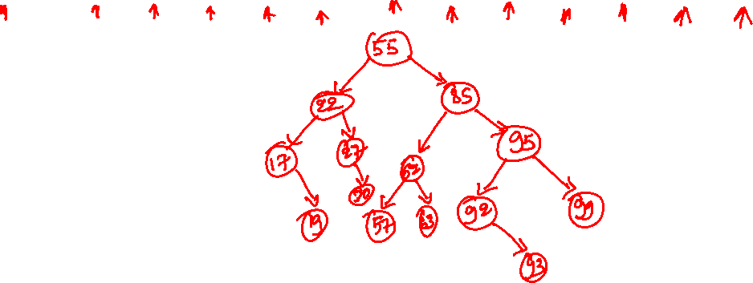
BST insertion
55 22 85 95 92 17 99 62 93 19 27 57 63 30
Notes:
We next show how to insert nodes one by one in a BST. If the key we are inserting is larger than the root node, then we insert it in the right subtree; otherwise, we insert it in the left subtree. If the tree is empty, we create a new node with the given value and return the address of that node.

Slide 67
BST insertion
55
55 22 85 95 92 17 99 62 93 19 27 57 63 30

Slide 68
BST insertion
55
22
55 22 85 95 92 17 99 62 93 19 27 57 63 30

Slide 69
BST insertion
55
22
85
55 22 85 95 92 17 99 62 93 19 27 57 63 30

Slide 70
BST insertion
55
22
85
95
55 22 85 95 92 17 99 62 93 19 27 57 63 30

Slide 71
BST insertion
55
22
85
95
92
55 22 85 95 92 17 99 62 93 19 27 57 63 30

Slide 72
BST insertion
55
22
85
17
95
92
55 22 85 95 92 17 99 62 93 19 27 57 63 30

Slide 73
BST insertion
55
22
85
17
95
92
99
55 22 85 95 92 17 99 62 93 19 27 57 63 30

Slide 74
BST insertion
55
22
85
17
62
95
92
99
55 22 85 95 92 17 99 62 93 19 27 57 63 30

Slide 75
BST insertion
55
22
85
17
62
95
92
99
93
55 22 85 95 92 17 99 62 93 19 27 57 63 30

Slide 76
BST insertion
55
22
85
17
62
95
19
92
99
93
55 22 85 95 92 17 99 62 93 19 27 57 63 30

Slide 77
BST insertion
55
22
85
17
27
62
95
19
92
99
93
55 22 85 95 92 17 99 62 93 19 27 57 63 30

Slide 78
BST insertion
55
22
85
17
27
62
95
19
92
99
57
93
55 22 85 95 92 17 99 62 93 19 27 57 63 30

Slide 79
BST insertion
55
22
85
17
27
62
95
19
92
99
57
63
93
55 22 85 95 92 17 99 62 93 19 27 57 63 30

Slide 80
BST insertion
55
22
85
17
27
62
95
19
30
92
99
57
63
93
55 22 85 95 92 17 99 62 93 19 27 57 63 30

Slide 81
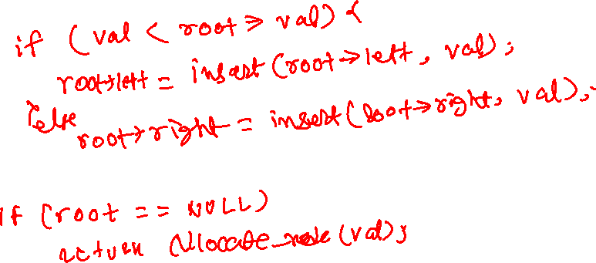
BST insertion (recursive algorithm)
insert returns the root (possibly new) of the tree after inserting a node with a given value (val) (we are assuming val is also the key)
Recursive step
Base step
Notes:
This is the recursive algorithm for the insertion. If the tree is empty, we create a new node with the given value and return its address; otherwise, if the key is less than root, we insert the node in the left subtree and store the possibly updated root of the left subtree (because of the insertion) in root->left. If the key is greater, we insert it in the right subtree and store the possibly updated root in root->right.

