Slide 2
Today’s topics
Binary search trees
AVL trees

Slide 3
Binary search tree

Slide 4
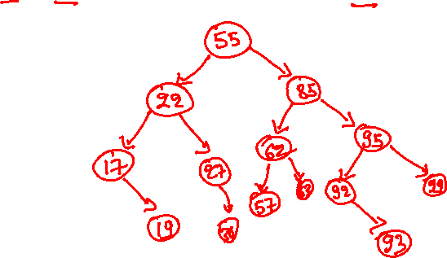
BST insertion
55 22 85 95 92 17 99 62 93 19 27 57 63 30

Slide 5
BST insertion
55
55 22 85 95 92 17 99 62 93 19 27 57 63 30

Slide 6
BST insertion
55
22
55 22 85 95 92 17 99 62 93 19 27 57 63 30

Slide 7
BST insertion
55
22
85
55 22 85 95 92 17 99 62 93 19 27 57 63 30

Slide 8
BST insertion
55
22
85
95
55 22 85 95 92 17 99 62 93 19 27 57 63 30

Slide 9
BST insertion
55
22
85
95
92
55 22 85 95 92 17 99 62 93 19 27 57 63 30

Slide 10
BST insertion
55
22
85
17
95
92
55 22 85 95 92 17 99 62 93 19 27 57 63 30

Slide 11
BST insertion
55
22
85
17
95
92
99
55 22 85 95 92 17 99 62 93 19 27 57 63 30

Slide 12
BST insertion
55
22
85
17
62
95
92
99
55 22 85 95 92 17 99 62 93 19 27 57 63 30

Slide 13
BST insertion
55
22
85
17
62
95
92
99
93
55 22 85 95 92 17 99 62 93 19 27 57 63 30

Slide 14
BST insertion
55
22
85
17
62
95
19
92
99
93
55 22 85 95 92 17 99 62 93 19 27 57 63 30

Slide 15
BST insertion
55
22
85
17
27
62
95
19
92
99
93
55 22 85 95 92 17 99 62 93 19 27 57 63 30

Slide 16
BST insertion
55
22
85
17
27
62
95
19
92
99
57
93
55 22 85 95 92 17 99 62 93 19 27 57 63 30

Slide 17
BST insertion
55
22
85
17
27
62
95
19
92
99
57
63
93
55 22 85 95 92 17 99 62 93 19 27 57 63 30

Slide 18
BST insertion
55
22
85
17
27
62
95
19
30
92
99
57
63
93
55 22 85 95 92 17 99 62 93 19 27 57 63 30

Slide 19
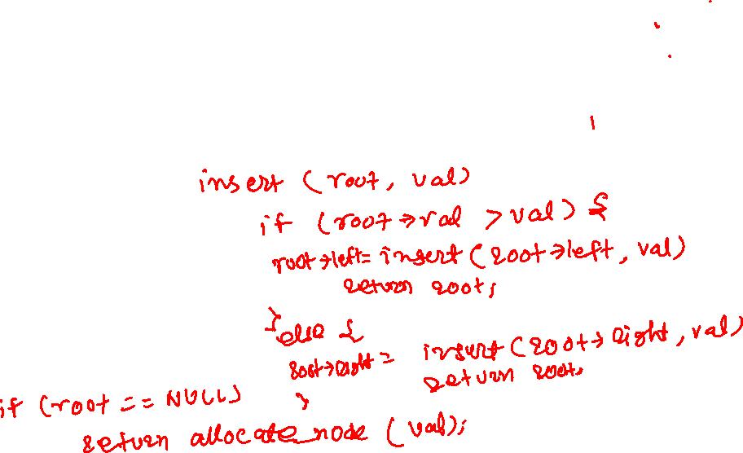
BST insertion (recursive algorithm)
insert returns the root (possibly new) of the tree after inserting a node with a given value (val) (we are assuming val is also the key)
Recursive step
Base step
Notes:
The insert routine returns the address of the root (possibly new) after the insertion. If the tree is empty, we allocate a new node with a given value and return its address. Otherwise, if the val is less than the key stored in the root, we recursively insert in the left subtree that returns the root (possibly new) of the left subtree, which is stored in root->left. If the val is greater than the key stored in root, we recursively insert in the right subtree and update root->right.

Slide 20
BST insertion (recursive algorithm)
insert returns the root (possibly new) of the tree after inserting a node with a given value (val) (we are assuming val is also the key)

Slide 21
Recursive step
If val is greater than or equal to the key stored at root
recursively insert in the right subtree
store root (possibly new) of the right subtree after insertion in root->right
If val is less than the key stored at root
recursively insert in the left subtree
store root (possibly new) of the left subtree after insertion in root->left

Slide 22
Base step
if the tree is empty (root == NULL), allocate and return a new node that stores val

Slide 23
BST insertion
struct node* insert(struct node *root, int val) {
if (root == NULL) {
/* allocate_node sets the left and right fields to NULL */
root = allocate_node(val);
return root;
}
if (val >= root->val) {
root->right = insert(root->right, val);
}
else {
root->left = insert(root->left, val);
}
return root;
}

Slide 24
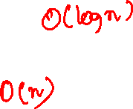
Time complexity
Complete binary tree
Skewed tree

Slide 25
Search

Slide 26
Search
The search routine returns a node in the BST that contains a given key value
If none of the nodes contains the key, the search returns NULL

Slide 27
BST search
55
22
85
17
27
62
95
search 93
19
30
92
99
57
63
93
55 22 85 95 92 17 99 62 93 19 27 57 63 30

Slide 28
BST search
55
22
85
17
27
62
95
search 93
19
30
92
99
57
63
93
55 22 85 95 92 17 99 62 93 19 27 57 63 30

Slide 29
BST search
55
22
85
17
27
62
95
search 93
19
30
92
99
57
63
93
55 22 85 95 92 17 99 62 93 19 27 57 63 30

Slide 30
BST search
55
22
85
17
27
62
95
search 93
19
30
92
99
57
63
93
55 22 85 95 92 17 99 62 93 19 27 57 63 30

Slide 31
BST search
55
22
85
17
27
62
95
search 93
19
30
92
99
57
63
93
55 22 85 95 92 17 99 62 93 19 27 57 63 30

Slide 32
BST search
55
22
85
17
27
62
95
search 93
19
30
92
99
57
63
93
55 22 85 95 92 17 99 62 93 19 27 57 63 30

Slide 33
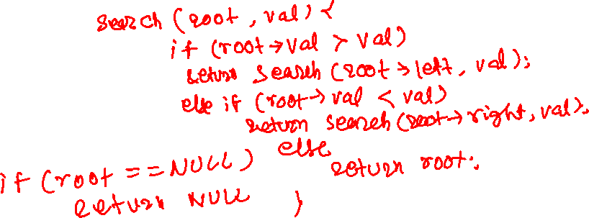
BST search (recursive algorithm)
search returns a node that contains the key (val) being searched
if val is not stored in any of the nodes, the search returns NULL
Recursive step
Base step
Notes:
The search routine returns the address of the node that contains a given key. If the tree is empty, we return NULL. Otherwise, if the key is less than the key stored in the root, search returns the result of the search operation in the left subtree. If the key is greater than the key stored in the root, search returns the result of the search operation in the right subtree. Otherwise, if the key is the same as the root, it returns the address of the root.

Slide 34
BST search (recursive algorithm)
search returns a node that contains the key (val) being searched
if val is not stored in any of the nodes, the search returns NULL

Slide 35
Recursive step
If val is greater than the key stored at root
recursively search in the right subtree
If val is less than the key stored at root
recursively search in the left subtree

Slide 36
Base step
if tree is empty (root == NULL), return NULL
If the value of the key stored at root is val, return root

Slide 37
BST search
struct node *search(struct node *root, int val) {
if (root == NULL) {
return NULL;
}
if (root->val == val) {
return root;
}
else if (val > root->val) {
return search(root->right, val);
}
else {
return search(root->left, val);
}
}

Slide 38

Time complexity
Complete binary tree
Skewed tree

Slide 39
Find minimum

Slide 40
Find minimum (find_min)
The goal of find_min is to find a node that stores the key with the minimum value in a BST
The leftmost element in a BST contains the minimum key

Slide 41
BST find_min
55
22
85
17
27
62
95
19
30
92
99
57
63
93
55 22 85 95 92 17 99 62 93 19 27 57 63 30

Slide 42
BST find_min
55
22
85
17
27
62
95
19
30
92
99
57
63
93
55 22 85 95 92 17 99 62 93 19 27 57 63 30

Slide 43
BST find_min
55
22
85
17
27
62
95
19
30
92
99
57
63
93
55 22 85 95 92 17 99 62 93 19 27 57 63 30

Slide 44
BST find_min
55
22
85
17
27
62
95
19
30
92
99
57
63
93
17 is the minimum node because it has no left subtree.
55 22 85 95 92 17 99 62 93 19 27 57 63 30

Slide 45
BST find_min
struct node* find_min(struct node *root) {
if (root == NULL) {
return NULL;
}
if (root->left == NULL) {
return root;
}
else {
return find_min(root->left);
}
}
Notes:
find_min returns the leftmost node.

Slide 46
Deletion

Slide 47
Delete
The goal of the delete operation is to delete a node from a BST that stores the input key

Slide 48
BST deletion
55
22
85
17
27
62
95
19
30
92
99
57
63
93
55 22 85 95 92 17 99 62 93 19 27 57 63 30

Slide 49
BST deletion
DELETING A LEAF NODE
55
22
85
17
27
62
95
delete 30
19
30
92
99
57
63
93
55 22 85 95 92 17 99 62 93 19 27 57 63 30
Notes:
The goal of the deletion is to delete a node with a given key value. If the node that needs to be deleted is a leaf, we simply unlink it from the parent by setting its reference in the parent to NULL.

Slide 50
BST deletion
55
22
85
17
27
62
95
19
92
99
57
63
93
55 22 85 95 92 17 99 62 93 19 27 57 63 30

Slide 51

BST deletion
DELETING A NODE WITH ONE CHILD
55
22
85
17
27
62
95
delete 17
19
92
99
57
63
93
55 22 85 95 92 17 99 62 93 19 27 57 63 30
Notes:
If the node that needs to be deleted has only one child, we replace its reference in the parent with the address of the child.

Slide 52
BST deletion
55
22
85
19
27
62
95
92
99
57
63
93
55 22 85 95 92 17 99 62 93 19 27 57 63 30

Slide 53
BST deletion
DELETING A NODE WITH TWO CHILDREN
55
22
85
19
27
62
95
delete 85
92
99
57
63
93
55 22 85 95 92 17 99 62 93 19 27 57 63 30
Notes:
Now that we know how to delete a node with one or zero children let's look at the case when the node we want to delete, say n, has two children. One way of deleting n is to copy the value of some other node in n and delete the other node, ensuring that the key/value stored in n is not present in the tree. But we can't copy an arbitrary node; otherwise, the BST property will not hold at n. Let's assume that the smallest value in the right subtree of n is stored in node p. To delete n, we copy the value of p to n and delete p. This will not violate the BST property at n. Notice that p is the leftmost node in the right subtree and can have at most one child. Instead of copying the value of the p in n, we can also replace n with p directly by removing p from the right subtree, replacing the reference to n in its parent with p, and updating left and right children in p to point to the left and right children of n. This scheme is better when a node's size is large, and copying could be expensive.

Slide 54
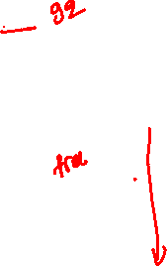
BST deletion
55
22
85
19
27
62
95
delete 85
delete a node with the minimum key in the right subtree (i.e., 92)
92
99
57
63
93
55 22 85 95 92 17 99 62 93 19 27 57 63 30

Slide 55
BST deletion
55
22
85
19
27
62
95
delete 85
delete a node with the minimum key in the right subtree (i.e., 92)
93
99
57
63
55 22 85 95 92 17 99 62 93 19 27 57 63 30

Slide 56
BST deletion
55
22
85
19
27
62
95
delete 85
delete a node with the minimum key in the right subtree (i.e., 92)
replace 85 with 92
93
99
57
63
55 22 85 95 92 17 99 62 93 19 27 57 63 30

Slide 57
BST deletion
55
22
92
19
27
62
95
delete 85
delete a node with the minimum key in the right subtree (i.e., 92)
replace 85 with 92
93
99
57
63
55 22 85 95 92 17 99 62 93 19 27 57 63 30

Slide 58
BST deletion
55
22
85
19
27
62
95
92
99
57
63
93
55 22 85 95 92 17 99 62 93 19 27 57 63 30

Slide 59
BST deletion
delete 85
replace the value of the node with the value of the minimum key node in the right subtree (i.e., 92)
What is the other alternative?
55
22
85
19
27
62
95
92
99
57
63
93
55 22 85 95 92 17 99 62 93 19 27 57 63 30
Notes:
Another alternative is to replace the node with the largest node in the left subtree.

Slide 60
BST deletion
delete 85
replace the value of the node with the value of the minimum key node in the right subtree (i.e., 92)
What is the other alternative?
replace the value of the node with the value of the maximum key node in the left subtree (i.e., 63)
55
22
85
19
27
62
95
92
99
57
63
93
55 22 85 95 92 17 99 62 93 19 27 57 63 30

Slide 61
BST deletion (recursive algorithm)
delete returns the root (possibly new) of the tree after deleting a node that contains a given key (val)
Recursive step
Base step

Slide 62
BST deletion (recursive algorithm)
delete returns the root (possibly new) of the tree after deleting a node that contains a given key (val)

Slide 63
Recursive step
If val is greater than the value stored at root, recursively delete from the right subtree
store the root (possibly new) of the right subtree after the deletion in root->right
If val is less than the value stored at root, recursively delete from the left subtree
store the root (possibly new) of the left subtree after the deletion in root->left

Slide 64
Base step
if tree is empty (root == NULL) then val is not present, return NULL
if val is stored at root
if root has both left and right children
recursively delete the node with the minimum key from the right subtree and copy the value of the deleted node in root
if root has at most one child
if root is a leaf node, return the empty tree
if root is not a leaf, return the child node

Slide 65
BST deletion
struct node* delete(struct node *root, int val) {
if (root == NULL) {
return NULL;
}
if (root->val == val) {
if (root->left == NULL) {
struct node *ret = root->right;
free(root);
return ret;
}
else if (root->right == NULL) {
struct node *ret = root->left;
free(root);
return ret;
}
else if (root->right != NULL && root->left != NULL) {
struct node *min_node = find_min(root->right);
root->val = min_node->val;
root->right = delete(root->right, min_node->val);
return root;
}
}
else if (val > root->val) {
root->right = delete(root->right, val);
}
else {
root->left = delete(root->left, val);
}
return root;
}
Notes:
As in the case of insertion, the delete routine returns the address of the root (possibly new) after the delete. If the node that needs to be deleted has only one child (line-6,11), we make the child the new root of the subtree that is returned to its caller. If the node that needs to be deleted has two children (line-16), the address of the root is not changed. In line-17, we find the minimum node in the right subtree; in line-18, we copy the value of the minimum node in the root; in line 19, we delete the minimum node from the right subtree and store the address of the root (possibly new) of the right subtree after the deletion in the root->right. Finally, the root is returned to its caller.

Slide 66

Time complexity
Complete binary tree
Skewed tree

Slide 67
AVL tree

Slide 68
References
Section-4.4 from Mark Allen Weiss

Slide 69
AVL tree
AVL tree is a BST that satisfies the height-balance property
height-balance property: For each node in the tree, the heights of the left and right subtrees differ by at most one

Slide 70

AVL tree
55
22
85
17
27
62
95
19
30
92
99
57
63
93
Is this an AVL tree?
Notes:
This is an AVL tree because the height-balance property is satisfied at every node.

Slide 71

AVL tree
55
22
85
17
27
62
95
19
92
99
57
63
93
Is this an AVL tree?
Notes:
This is an AVL tree because the height-balance property is satisfied at every node.

Slide 72

AVL tree
55
22
85
17
62
95
92
99
57
63
93
Is this an AVL tree?
Notes:
This is not an AVL tree because the height of the left subtree of 55 is 1, and the height of the right subtree of 55 is 3. So, the height balance property is not satisfied.

Slide 73

AVL tree
55
22
85
17
62
95
92
99
57
63
Is this an AVL tree?

Slide 74
Balance factor
balance_factor(root) = height(root->left) – height(root->right)
A node is not balanced
if balance_factor < -1 or balance_factor > 1
If any node in a BST is not balanced, then the tree is not an AVL tree

Slide 75
Left heavy and right heavy
A node is heavy if the balance_factor is not zero
A node, n, is left heavy if the balance_factor(n) > 0
A node, n, is right heavy if balance_factor(n) < 0

Slide 76

AVL tree
55
22
85
17
95
92
99
Identify which nodes are left heavy, right heavy, and not heavy.
Notes:
A node is heavy if the balance factor is not zero.

Slide 77
AVL tree
What are all possible BSTs that store 1, 2 3?
Which ones of them are AVL trees?
How can we convert a non-AVL tree to an AVL tree?

Slide 78
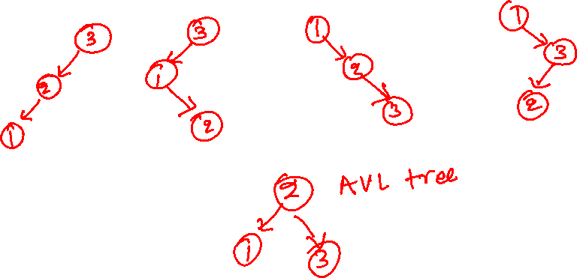
AVL tree
What are all possible BSTs that store 1, 2 3?
Which ones of them are AVL trees?
How can we convert a non-AVL tree to an AVL tree?

Slide 79
AVL tree
3
1
3
1
3
1
2
2
2
`
3
2
1
2
What are all possible BSTs that store 1, 2 3?
Which ones of them are AVL trees?
How can we convert a non-AVL tree to an AVL tree?
1
3
Notes:
Out of these five possible BSTs for the given numbers, the below one is an AVL tree. If a BST is in the form of any of the above ones, the tree is converted into the tree at the bottom.

Slide 80
LL rotation
3
2
1
How can we convert this BST to an AVL tree?
Notes:
After inserting node 1, node 3 becomes imbalanced. Here imbalance happened at 3 after inserting 2 in the left of its left child. LL stands for imbalance at node n due to an insertion in the left subtree of the left child of n.

Slide 81
LL rotation
3
2
2
1
3
1
How can we identify the LL case?

Slide 82
LL rotation
3
2
2
1
3
1
How can we identify the LL case?
if (balance_factor(root) > 1 and root->left is not right heavy)
Notes:
In the case of LL rotation, to balance, we need to rotate the root node once in the right direction. Rotating a node in the right direction can be visualized as attaching a thread to the node and pulling it in the right downward direction such that the left child becomes the root.

Slide 83
RR rotation
1
2
3
How can we convert this BST to an AVL tree?
Notes:
RR stands for imbalance at node n due to an insertion in the right subtree of the right child of n.

Slide 84
RR rotation
1
2
2
1
3
3
How can we identify the RR case?

Slide 85
RR rotation
1
2
2
1
3
3
How can we identify the RR case?
if (balance_factor(root) < -1 and root->right is not left heavy)
Notes:
In the case of RR rotation, to balance, we need to rotate the root node once in the left direction. Rotating a node in the left direction can be visualized as attaching a thread to the node and pulling it in the left downward direction such that the right child becomes the root.

Slide 86
LR rotation
3
1
`
2
How can we convert this BST to an AVL tree?
Notes:
LR stands for imbalance at node n due to an insertion in the right subtree of the left child of n.

Slide 87
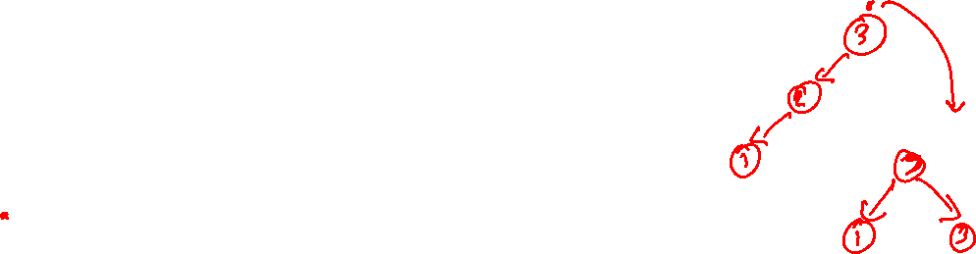
LR rotation
3
2
1
3
1
`
2
How can we identify the LR case?

Slide 88
LR rotation
3
2
1
3
1
`
2
How can we identify the LR case?
if (balance_factor(root) > 1 and root->left is right heavy)

Slide 89
LR rotation
3
3
rotate 1 in the left direction
rotate 3 in the right direction
2
2
1
3
1
`
1
`
2
How can we identify the LR case?
if (balance_factor(root) > 1 and root->left is right heavy)
Notes:
In the case of LR rotation, first, we need to rotate the left child once in the left direction and then rotate the root of the resulting tree in the right direction. As discussed earlier, rotating a node in the left direction can be visualized as attaching a thread to the node and pulling it in the left downward direction such that the right child becomes the root. Rotating a node in the right direction can be visualized as attaching a thread to the node and pulling it in the right downward direction such that the left child becomes the root.

Slide 90
RL rotation
1
3
2
How can we convert this BST to an AVL tree?
Notes:
RL stands for imbalance at node n due to the insertion in the left subtree of the right child of n.

Slide 91
RL rotation
1
2
3
1
3
2
How can we identify the RL case?

Slide 92
RL rotation
1
2
3
1
3
2
How can we identify the RL case?
if (balance_factor(root) < -1 and root->right is left heavy)

Slide 93
RL rotation
rotate 3 in the right direction
1
rotate 1 in the left direction
1
2
2
3
1
3
3
2
How can we identify the RL case?
if (balance_factor(root) < -1 and root->right is left heavy)
Notes:
In the case of RL rotation, first, we need to rotate the right child once in the right direction and then rotate the root of the resulting tree in the left direction. As discussed earlier, rotating a node in the left direction can be visualized as attaching a thread to the node and pulling it in the left downward direction such that the right child becomes the root. Rotating a node in the right direction can be visualized as attaching a thread to the node and pulling it in the right downward direction such that the left child becomes the root.

Slide 94
AVL tree height
What is the lower bound for the height of an AVL tree with n nodes?

Slide 95
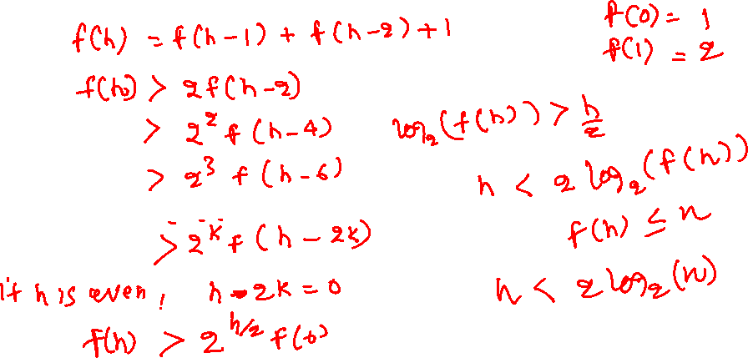
AVL tree height (upper bound)
Let’s say f(h) represents the minimum number of nodes in an AVL tree of height h
Notes:
To compute the upper bound on the height of the tree, we first write a recurrence relation for the minimum number of nodes in an AVL. Let f(h) represents the minimum number of nodes in an AVL of height h. If the height of an AVL tree is h, the height of one of the subtrees must be h-1. The height of the other subtree would be either h-1 or h-2 because of the height balance property. To compute the minimum number of nodes, we need to take the height of the other tree as h-2. Thus, the final recurrence relation for the minimum number of nodes f(h) would be equal to f(h-1) + f(h-2) +1. Notice that f(h) <= n because it represents the minimum number of nodes in an AVL tree of height h. Solving this equation gives us the upper bound of h as O(log(n)).

Slide 96
AVL tree height (upper bound)
Let’s say f(h) represents the minimum number of nodes in an AVL tree of height h
f(0) = 1, f(1) = 2
f(h) = 1 + f(h-1) + f(h-2)
f(h) > 2f(h-2)
> 2²f(h-4)
> 2³f(h-6)
…
> 2^{k}f(h-2k)
If h is even, substitute h = 2k
f(h) > 2^{h/2} * f(0)
f(h) > 2^{h/2}
h < 2 * log₂(f(h))
because, f(h) <= n
h < 2 * log₂(n) = O(log(n))

Slide 97
AVL tree height (upper bound)
Let’s say f(h) represents the minimum number of nodes in an AVL tree of height h
f(0) = 1, f(1) = 2
f(h) = 1 + f(h-1) + f(h-2)
f(h) > 2f(h-2)
> 2²f(h-4)
> 2³f(h-6)
…
> 2^{k}f(h-2k)
If h is odd, substitute h - 2k = 1
f(h) > 2^{h-1/2} * f(1)
f(h) > 2^{h-1/2} * 2
f(h) > 2^{h+1/2}
h < (2 * log₂(f(h))) - 1
because, f(h) <= n
h < (2 * log₂(n)) – 1 = O(log(n))

Slide 98
Rotations

Slide 99
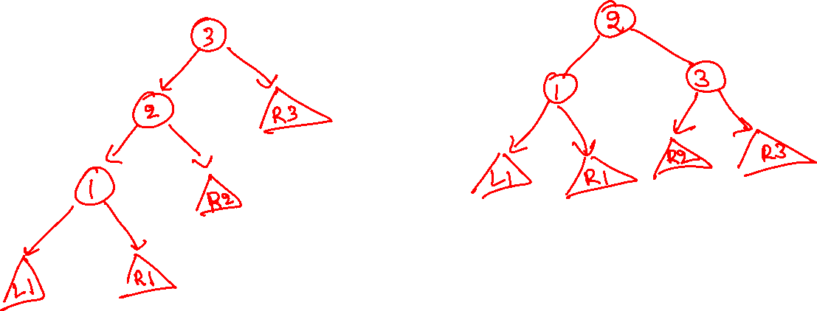
LL rotation
Left heavy : balance factor > 0
Right heavy : balance factor < 0
Notes:
This is the general structure of an LL rotation. Notice that three nodes involved in the imbalance can have other balanced subtrees as children. After a rotation, as we discussed before, we need to find a place for these children in the rotated (balanced) tree. Notice that L1, R1, and R3 can stay in the same position as they were before the rotation. However, node 2 adopted a new child 3 and abandoned R2, so we need to find a new place for R2. Notice that there is a vacancy on the left of 3. Because all nodes in R2 are greater than 2 and less than 3, we can make R2 a left child of 3.

Slide 100
LL rotation
We perform LL rotation on a node n, if
balance_factor(n) > 1 and n->left is not right heavy
Left heavy : balance factor > 0
Right heavy : balance factor < 0

Slide 101
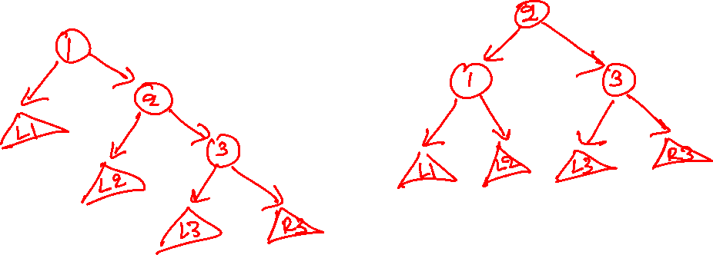
RR rotation
Left heavy : balance factor > 0
Right heavy : balance factor < 0
Notes:
This is the general structure of an RR rotation. Notice that three nodes involved in the imbalance can have other balanced subtrees as children. After a rotation, as we discussed before, we need to find a place for these children in the rotated (balanced) tree. Notice that L1, L3, and R3 can stay in the same position as they were before the rotation. However, node 2 has now become the parent of its old parent (1) and abandoned L2, so we need to find a new place for L2. Notice that there is a vacancy in the right of 1. Because all nodes in L2 are greater than 1 and less than 2, we can make L2 the right child of 1.

Slide 102
RR rotation
We perform RR rotation on a node n, if
balance_factor(n) < -1 and n->right is not left heavy
Left heavy : balance factor > 0
Right heavy : balance factor < 0

Slide 103
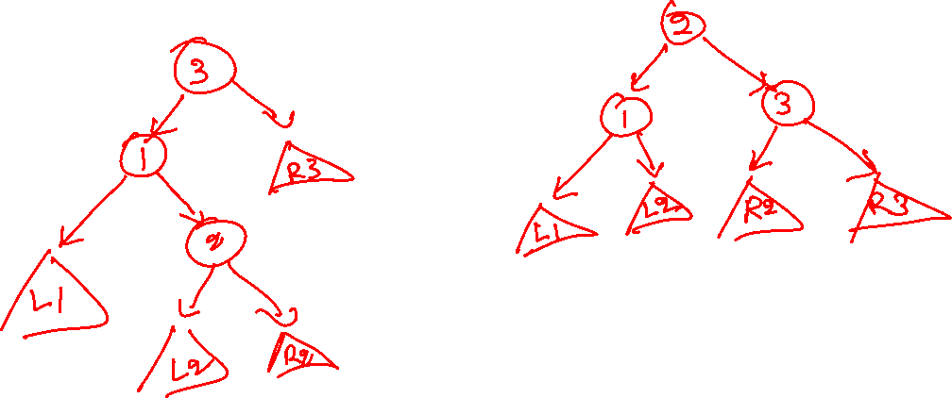
LR rotation
Left heavy : balance factor > 0
Right heavy : balance factor < 0
Notes:
This is the general structure of an LR rotation. Notice that three nodes involved in the imbalance can have other balanced subtrees as children. After a rotation, as we discussed before, we need to find a place for these children in the rotated (balanced) tree. Notice that L1 and R3 can stay in the same position as they were before the rotation. However, node 2 has now become the parent of its previous parent (1) and grandparent(3) and abandoned L2 and R2, so we need to find a new place for L2 and R2. Notice that there is a vacancy on the right of 1 and the left of 3. Because all nodes in L2 are greater than 1 and less than 2, we can make L2 the right child of 1. Similarly, all the nodes in R2 are greater than 2 and left than 3; we can make R2 the left child of 3.

Slide 104
LR rotation
We perform LR rotation on a node n, if
balance_factor(n) > 1 and n->left is right heavy
Left heavy : balance factor > 0
Right heavy : balance factor < 0

Slide 105
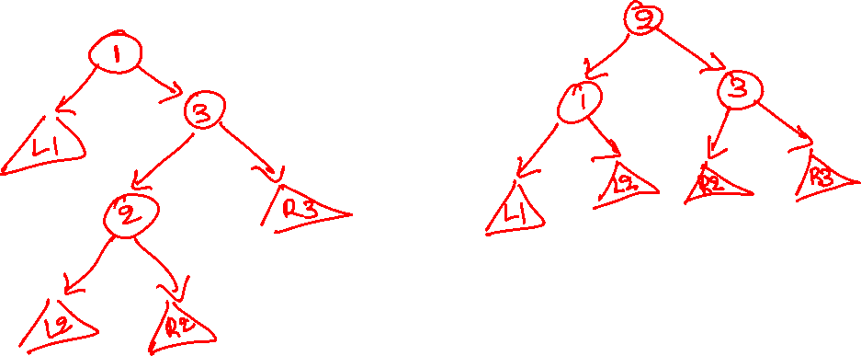
RL rotation
Left heavy : balance factor > 0
Right heavy : balance factor < 0
Notes:
This is the general structure of an RL rotation. Notice that three nodes involved in the imbalance can have other balanced subtrees as children. After a rotation, as we discussed before, we need to find a place for these children in the rotated (balanced) tree. Notice that L1 and R3 can stay in the same position as before the rotation. However, node 2 has now become the parent of its previous parent (3) and grandparent(1) and abandoned L2 and R2, so we need to find a new place for L2 and R2. Notice that there is a vacancy on the right of 1 and the left of 3. Because all nodes in L2 are greater than 1 and less than 2, we can make L2 the right child of 1. Similarly, all the nodes in R2 are greater than 2 and less than 3; we can make R2 the left child of 3.

Slide 106
RL rotation
We perform RL rotation on a node n, if
balance_factor(n) < -1 and n->right is left heavy
Left heavy : balance factor > 0
Right heavy : balance factor < 0

Slide 107
Insertion

Slide 108
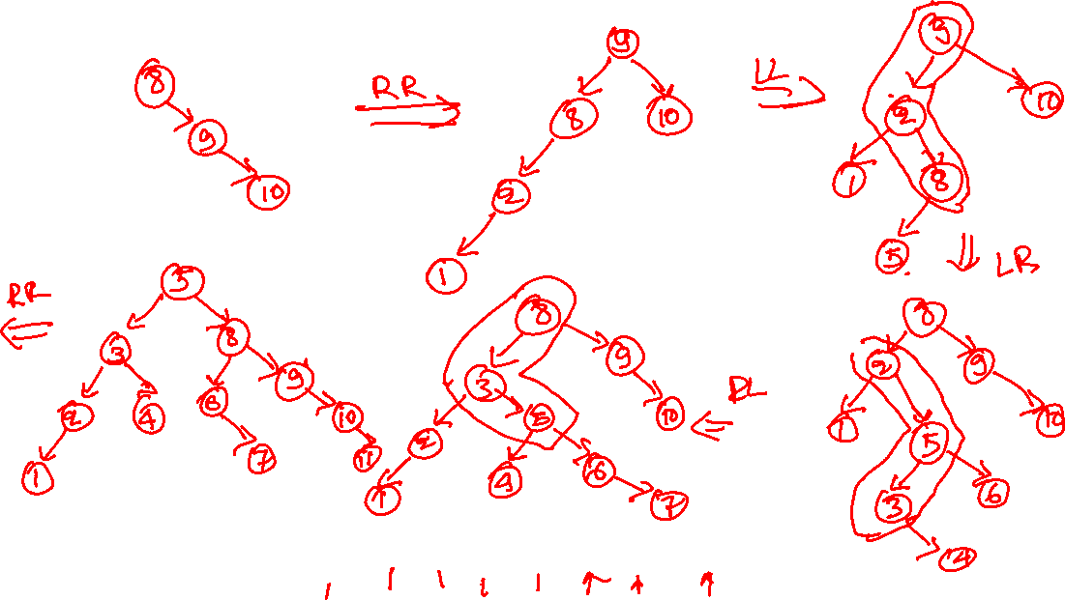
AVL insertion
8 9 10 2 1 5 3 6 4 7 11 12
Notes:
In this example, we are inserting these elements individually in an AVL tree in the given order. After inserting a node n in the tree, when we return back from n to the root (like we did in the case of BST insertion), we check the balance at each intermediate node. If a node is imbalanced, we use the conditions that we discussed earlier to find its category, i.e., LL, RR, LR, and RL, and perform the rotation accordingly. After the rotation, we return the new root to its caller. We keep doing this for each intermediate node in the path until we reach the root. Notice that the maximum number of rotations in this scheme is equal to the height of the tree. Because each rotation requires a constant number of operations and the height of the tree is O(log(n)), the time complexity of the AVL insertion is O(log(n)). We will later show that the maximum number of rotations required for an insertion is actually one.

Slide 109
AVL insertion
8 9 10 2 1 5 3 6 4 7 11 12

Slide 110
AVL insertion
8 9 10 2 1 5 3 6 4 7 11 12

Slide 111
AVL insertion
8 9 10 2 1 5 3 6 4 7 11 12

Slide 112
AVL insertion
8 9 10 2 1 5 3 6 4 7 11 12

Slide 113
AVL insertion
8
8 9 10 2 1 5 3 6 4 7 11 12

Slide 114
AVL insertion
8
9
8 9 10 2 1 5 3 6 4 7 11 12

Slide 115
AVL insertion
8
need RR rotation
9
10
8 9 10 2 1 5 3 6 4 7 11 12

Slide 116
AVL insertion
9
after RR rotation
8
10
8 9 10 2 1 5 3 6 4 7 11 12

Slide 117
AVL insertion
9
8
10
2
8 9 10 2 1 5 3 6 4 7 11 12

Slide 118
AVL insertion
9
need LL rotation
8
10
2
1
8 9 10 2 1 5 3 6 4 7 11 12

Slide 119
AVL insertion
9
after LL rotation
2
10
1
8
8 9 10 2 1 5 3 6 4 7 11 12

Slide 120
AVL insertion
9
2
10
need LR rotation
1
8
5
8 9 10 2 1 5 3 6 4 7 11 12

Slide 121
AVL insertion
8
2
9
after LR rotation
1
5
10
8 9 10 2 1 5 3 6 4 7 11 12

Slide 122
AVL insertion
8
2
9
1
5
10
3
8 9 10 2 1 5 3 6 4 7 11 12

Slide 123
AVL insertion
8
2
9
1
5
10
3
6
8 9 10 2 1 5 3 6 4 7 11 12

Slide 124
AVL insertion
8
need RL rotation
2
9
1
5
10
3
6
4
8 9 10 2 1 5 3 6 4 7 11 12

Slide 125
AVL insertion
8
after RL rotation
3
9
2
5
10
4
6
1
8 9 10 2 1 5 3 6 4 7 11 12

Slide 126
AVL insertion
8
need LR rotation
3
9
2
5
10
4
6
1
7
8 9 10 2 1 5 3 6 4 7 11 12

Slide 127
AVL insertion
5
after LR rotation
3
8
2
4
6
9
7
10
1
8 9 10 2 1 5 3 6 4 7 11 12

Slide 128
AVL insertion
5
3
8
need RR rotation
2
4
6
9
7
10
1
11
8 9 10 2 1 5 3 6 4 7 11 12

Slide 129
AVL insertion
after RR rotation
5
3
8
2
4
6
10
7
9
11
1
8 9 10 2 1 5 3 6 4 7 11 12

Slide 130
AVL insertion
5
3
8
2
4
6
10
7
9
11
1
12
8 9 10 2 1 5 3 6 4 7 11 12

