Slide 2
Today’s topics
Heap
Heapsort

Slide 3
References
Read chapter-6 from Cormen et al.

Slide 4
Complete binary tree
A complete binary tree is a binary tree in which all the levels are completely filled

Slide 5
Complete binary tree
20
17
18
16
15
13
5
7
3
2
6
8
9
1
4

Slide 6
Nearly complete binary tree
In a nearly complete binary tree, all the levels are completely filled except the last level, which is filled from the left up to a point

Slide 7
Nearly complete binary tree
Is this a nearly complete binary tree?
20
17
18
16
15
13
5
7
3
2
6
8
9
1
Notes:
Yes, because all the levels from 0 to 2 are completely filled, and there is no gap between the leftmost position and the position of the last leaf in the last level.

Slide 8
Nearly complete binary tree
Is this a nearly complete binary tree?
20
17
18
16
15
13
5
7
3
2
6
9
1
Notes:
No, because an element (left child of 13) is missing between the leftmost position and the position of the last leaf in the last level.

Slide 9
Nearly complete binary tree in an array
20
17
18
16
15
13
5
7
3
2

Slide 10
Nearly complete binary tree in an array
We can store a nearly complete binary array in a tree as follows:
The starting index of the array is 1
The elements are stored one by one in the array in the following order
The root is stored first
Then, all elements at level-1 are stored one by one from left to right
Then, all elements at level-2 are stored one by one from left to right
and so on
Finally, all elements at the last level are stored one by one from left to right

Slide 11
Nearly complete binary tree in an array
20
INDEX:1
INDEX:2
INDEX:3
17
18
INDEX:5
INDEX:4
16
15
13
5
INDEX:6
INDEX:7
7
3
2
INDEX:8
INDEX:9
INDEX:10
Notes:
The root is stored at index-1, followed by the elements at level-1 from left to right, followed by the elements at level-2 from left to right, and so on. Notice that for a given node at index i, its left child is stored at index 2i, and the right child is stored at index 2i+1. The parent of i is stored at the index floor(i/2).

Slide 12
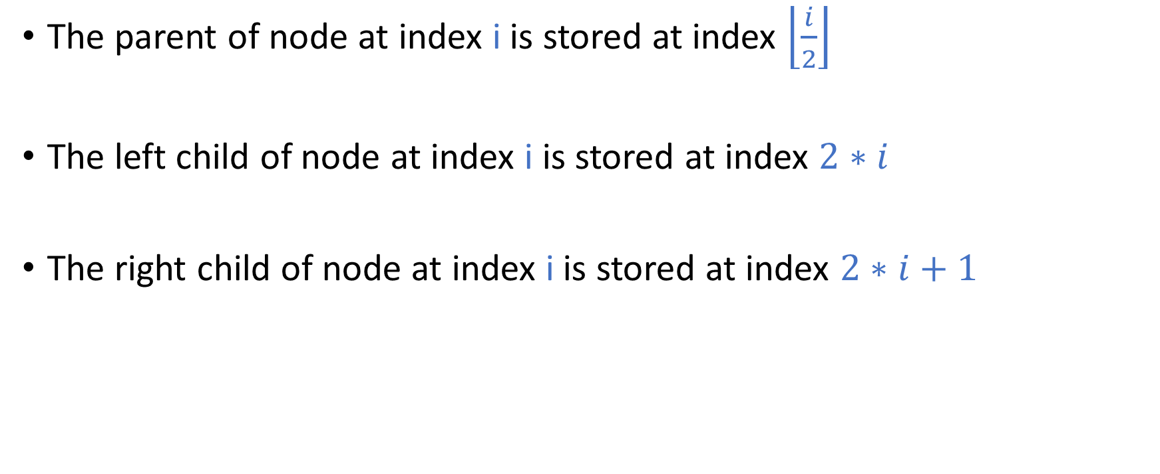
Nearly complete binary tree
The parent of node at index i is stored at index $\left\lfloor \frac{i}{2}\right\rfloor$
The left child of node at index i is stored at index $2∗i$
The right child of node at index i is stored at index $2∗i+1$

Slide 13

Nearly complete binary tree
PARENT(i)
return $\left\lfloor \frac{i}{2}\right\rfloor$
LEFT(i)
return 2*i
RIGHT(i)
return 2*i + 1

Slide 14
Max heap

Slide 15
Max heap
The max heap follows the following properties
Max heap is a nearly complete binary tree
The value stored at any node is greater than or equal to the values of all of its descendants

Slide 16
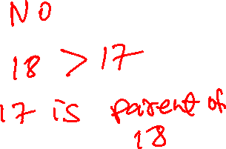
Max heap
Is this a max heap?
A max heap is:
1. nearly complete binary tree
2. value at any node is greater than or equal to its descendants
20
17
18
16
18
13
5
7
3
2
Notes:
This is not a max heap because the parent of the node containing 18 contains 17, which is less than 18.

Slide 17
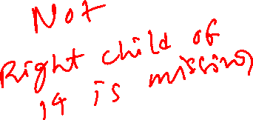
Max heap
Is this a max heap?
A max heap is:
1. nearly complete binary tree
2. value at any node is greater than or equal to its descendants
20
17
18
16
14
13
5
7
3
2
4
Notes:
This is not a max heap because the tree is not a nearly complete binary tree. The right child of 14 is missing between the leftmost position and the position of the last leaf in the last level.

Slide 18

Max heap
Is this a max heap?
A max heap is:
1. nearly complete binary tree
2. value at any node is greater than or equal to its descendants
20
17
18
16
14
13
5
7
3
2
Notes:
Yes, this is a max heap because all the properties of the max heap are satisfied.

Slide 19
Min heap
The min heap follows the following properties
Min heap is a nearly complete binary tree
The value stored at any node is less than or equal to the values of all of its descendants

Slide 20
Min heap
The tree on the left is a nearly complete binary tree.
The value stored at any node is less than or equal to the values of all of its descendants.
Therefore, the tree is a min heap.
2
7
8
16
12
13
15
27
23
22

Slide 21
Max heap ADT
Max-Heapify(H, i): Build max heap when the max heap property is satisfied at all descendants of node i
Build-Max-Heap(H): Build max heap from an unsorted array
Max-Heap-Maximum(H): Return the value stored at root (maximum key)
Max-Heap-Extract-Max(H): Delete the root node (maximum key) from H and returns its value
Heapsort(H): Sort the elements of max heap H
Max-Heap-Insert(H, k): Insert a new key (k) in the max heap H
Max-Heap-Increase-Key(H, i, keyval): Increase key at index i to a new value (keyval) in the max heap H

Slide 22
Max heap insert

Slide 23
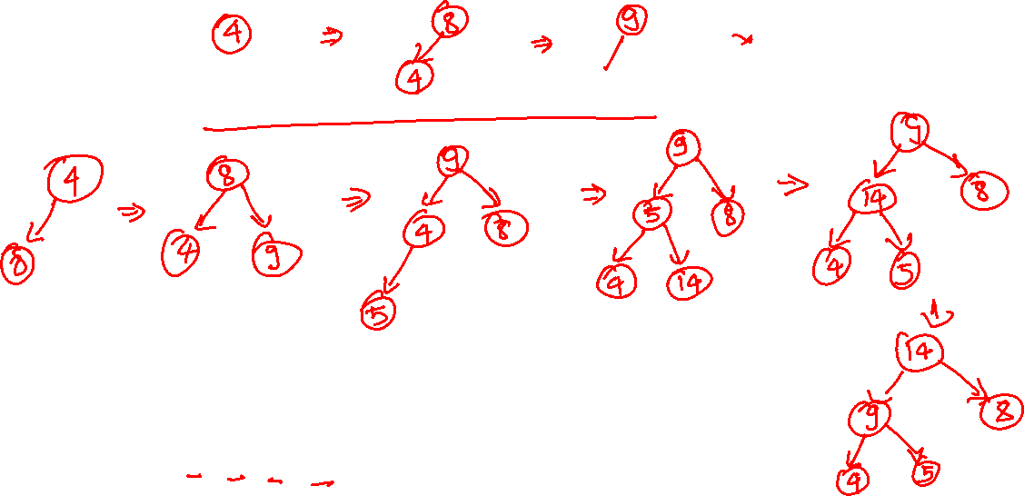
Insertion
4 8 9 5 14 13 10 3 11 7 16
Notes:
To insert a value in a max-heap, first, we store the new value at the first available index, say i, in the nearly complete binary tree. Afterward, we are done if the parent of i contains a key greater than or equal to the key stored at node i. Otherwise, we exchange the value of node i with its parent. Now, we repeat the same steps for the parent of i, until we are done or reach the root node.

Slide 24
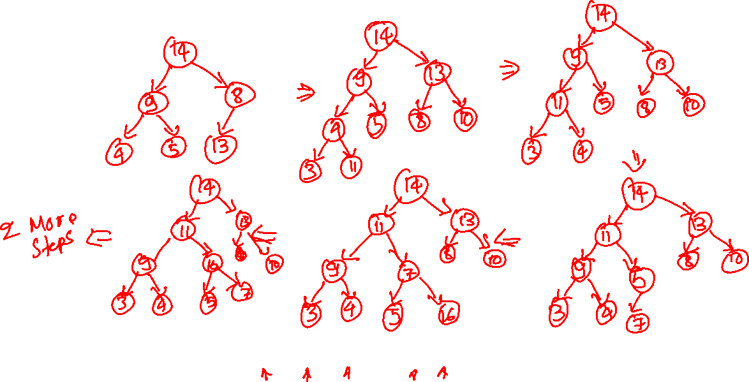
Insertion
4 8 9 5 14 13 10 3 11 7 16

Slide 25
Insertion
4 8 9 5 14 13 10 3 11 7 16

Slide 26
Insertion
4
4 8 9 5 14 13 10 3 11 7 16

Slide 27
Insertion
4
8
4 8 9 5 14 13 10 3 11 7 16

Slide 28
Insertion
8
4
4 8 9 5 14 13 10 3 11 7 16

Slide 29
Insertion
8
4
9
4 8 9 5 14 13 10 3 11 7 16

Slide 30
Insertion
9
4
8
4 8 9 5 14 13 10 3 11 7 16

Slide 31
Insertion
9
4
8
5
4 8 9 5 14 13 10 3 11 7 16

Slide 32
Insertion
9
5
8
4
4 8 9 5 14 13 10 3 11 7 16

Slide 33
Insertion
9
5
8
4
14
4 8 9 5 14 13 10 3 11 7 16

Slide 34
Insertion
9
14
8
4
5
4 8 9 5 14 13 10 3 11 7 16

Slide 35
Insertion
14
9
8
4
5
4 8 9 5 14 13 10 3 11 7 16

Slide 36
Insertion
14
9
8
4
5
13
4 8 9 5 14 13 10 3 11 7 16

Slide 37
Insertion
14
9
13
4
5
8
4 8 9 5 14 13 10 3 11 7 16

Slide 38
Insertion
14
9
13
4
5
8
10
4 8 9 5 14 13 10 3 11 7 16

Slide 39
Insertion
14
9
13
4
5
8
10
3
4 8 9 5 14 13 10 3 11 7 16

Slide 40
Insertion
14
9
13
4
5
8
10
3
11
4 8 9 5 14 13 10 3 11 7 16

Slide 41
Insertion
14
9
13
11
5
8
10
3
4
4 8 9 5 14 13 10 3 11 7 16

Slide 42
Insertion
14
11
13
9
5
8
10
3
4
4 8 9 5 14 13 10 3 11 7 16

Slide 43
Insertion
14
11
13
9
5
8
10
3
4
7
4 8 9 5 14 13 10 3 11 7 16

Slide 44
Insertion
14
11
13
9
7
8
10
3
4
5
4 8 9 5 14 13 10 3 11 7 16

Slide 45
Insertion
14
11
13
9
7
8
10
3
4
5
16
4 8 9 5 14 13 10 3 11 7 16

Slide 46
Insertion
14
11
13
9
16
8
10
3
4
5
7
4 8 9 5 14 13 10 3 11 7 16

Slide 47
Insertion
14
16
13
9
11
8
10
3
4
5
7
4 8 9 5 14 13 10 3 11 7 16

Slide 48
Insertion
16
14
13
9
11
8
10
3
4
5
7
4 8 9 5 14 13 10 3 11 7 16

Slide 49
Insertion algorithm
struct Heap {
int *arr;
int capacity; // maximum size of heap
int heap_size; // number of elements in the heap
};
Max_Heap_insert(H, x)
// H is a reference to the heap of type struct Heap
// x is an integer input that needs to be inserted
// Output: insert x in the heap
if H->heap_size == H->capacity
perror(“heap overflow”)
H->heap_size = H->heap_size + 1
H->arr[H->heap_size] = x
i = H->heap_size
while i > 1 and H->arr[PARENT(i)] < H->arr[i]
exchange H->arr[i] with H->arr[PARENT(i)]
i = PARENT(i)
Notes:
In this algorithm, we are using a fixed-size array. In “struct Heap”, capacity is the maximum number of elements that can be stored in the heap. The heap_size contains the actual number of elements in the heap. This algorithm first checks the overflow condition. If there is sufficient space in the heap, at line-13, it inserts the element at the first available position in the nearly complete binary tree. The loop at line 15 iterates from the leaf node to the root, exchanging the value of the child with its parent until the heap property is satisfied at the parent.

Slide 50
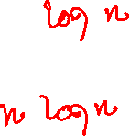
Insertion
What is the time complexity of a single insertion?
What is the time complexity of n insertions?

Slide 51
Max-Heapify

Slide 52
Max-Heapify
Max_Heapify(H, i)
Binary trees rooted at indices LEFT(i) and RIGHT(i) are max heaps.
The Max_Heapify procedure ensures that the binary tree rooted at index i follows the max heap property

Slide 53
Max-Heapify
4
16
13
11
14
10
9
3
5
8
7
Notes:
The Max-Heapify function can be applied on a node whose left and right children are already the max heaps. If Max-Heapify is applied to node n, it ensures that node n follows the max heap property after the Max-Heapify operation. The Max-Heapify works as follows. First, we compute the largest key among the key at node n, the key at the left child of n, and the key at the right child of n. If the largest key is the same as the key at n, then we are done. Otherwise, the key at n is exchanged with the largest key, and the same steps are performed at the node that previously contained the largest key.

Slide 54
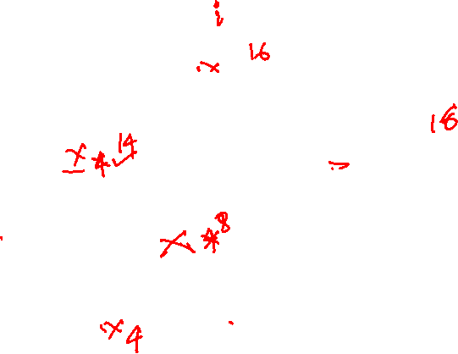
Max-Heapify
4
16
13
11
14
10
9
3
5
8
7

Slide 55
Max-Heapify
4
16
13
11
14
10
9
3
5
8
7

Slide 56
Max-Heapify
16
STEP-1
4
13
11
14
10
9
3
5
8
7

Slide 57
Max-Heapify
16
STEP-2
14
13
11
4
10
9
3
5
8
7

Slide 58
Max-Heapify
16
STEP-3
14
13
11
8
10
9
3
5
4
7

Slide 59
Max-Heapify
Base case: if key at index i greater or equal to key at both LEFT(i) and RIGHT(i), then the tree is already a max heap, return
Recursive step: Swap the value of the root node with the largest of left and right children (say node j)
recursively call Max-Heapify for the node j
Time complexity : O(log n)

Slide 60
Max_Heapify
struct Heap {
int *arr;
int capacity; // maximum size of heap
int heap_size; // number of elements in the heap
};
Max_Heapify(H, i)
// H is a reference to the heap of type struct Heap
// i is the index at which the Max_Heapify needs to be performed
// Output: node at index i satisfies the max heap property
l = LEFT(i)
r = RIGHT(i)
if (l <= H->heap_size and H->arr[l] > H->arr[i]
largest = l
else largest = i
if r <= H->heap_size and H->arr[r] > H->arr[largest]
largest = r
if largest != i
exchange H->arr[i] with H->arr[largest]
Max_Heapify(H, largest)
Notes:
If the Max_Heapify is performed at the node at index i, at lines 12-16, we are computing an index among i, LEFT(i), and RIGHT(i) that contains the largest key, called largest. If the largest is not i, then at line-18, we exchange the node's value at index i with the node's value at index largest, and at line-19, we perform the Max_Heapify operation at index largest.

Slide 61
Build-Max-Heap

Slide 62
Build-Max-Heap
The goal is to make max heap from an unordered array

Slide 63
Build-Max-Heap
Can we use the Max_Heapify operation in a way that the final tree is a max heap?
4
8
9
5
14
13
10
3
11
7
16
4 8 9 5 14 13 10 3 11 7 16
Notes:
To build the max heap from a nearly complete binary tree of height h, we first apply the Max_Heapify operations on all the nodes at level h-1 that have at least one child, followed by Max_Hapify operations at all the nodes at level h-2, followed by Max_Heapify operations at all the nodes at level h-3, and so on, until we reach the root node.

Slide 64
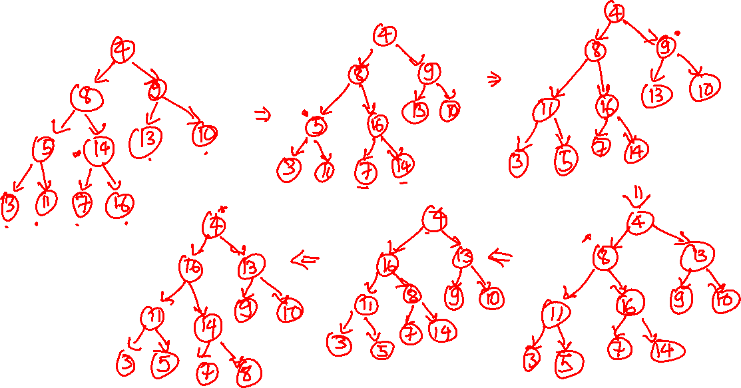
Build-Max-Heap

Slide 65
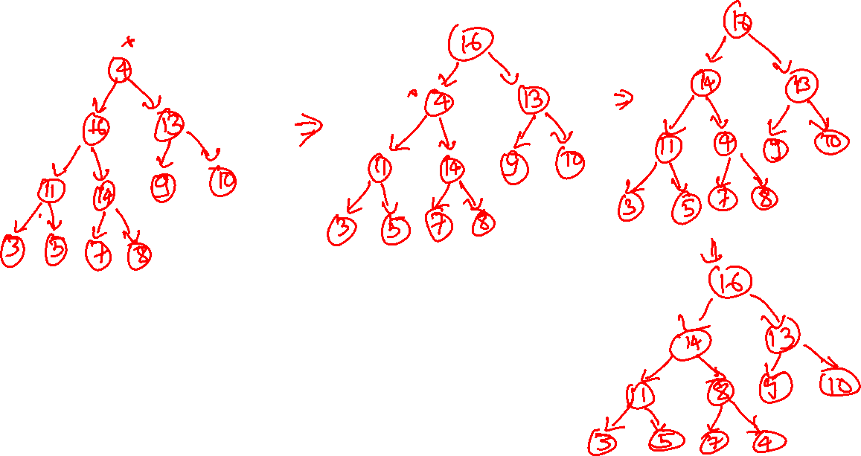
Build Max-Heap

Slide 66

Build-Max-Heap
The leaf nodes are already max heaps
for i = $\left\lfloor \frac{n}{2}\right\rfloor$ downto 1
Max_Heapify(H, i)

Slide 67
Build-Max-Heap
4
idx:1
heapify idx - 5
idx:2
idx:3
8
9
idx:4
idx:5
idx:6
idx:7
5
14
13
10
3
11
7
16
idx:8
idx:9
idx:10
idx:11

Slide 68
Build-Max-Heap
4
idx:1
heapify idx - 5
idx:2
idx:3
8
9
idx:4
idx:5
idx:6
idx:7
5
16
13
10
3
11
7
14
idx:8
idx:9
idx:10
idx:11

Slide 69
Build-Max-Heap
4
idx:1
heapify idx – 5
heapify idx – 4
idx:2
idx:3
8
9
idx:4
idx:5
idx:6
idx:7
5
16
13
10
3
11
7
14
idx:8
idx:9
idx:10
idx:11

Slide 70
Build-Max-Heap
4
idx:1
heapify idx – 5
heapify idx – 4
idx:2
idx:3
8
9
idx:4
idx:5
idx:6
idx:7
11
16
13
10
3
5
7
14
idx:8
idx:9
idx:10
idx:11

Slide 71
Build-Max-Heap
4
idx:1
heapify idx – 5
heapify idx – 4
heapify idx – 3
idx:2
idx:3
8
9
idx:4
idx:5
idx:6
idx:7
11
16
13
10
3
5
7
14
idx:8
idx:9
idx:10
idx:11

Slide 72
Build-Max-Heap
4
idx:1
heapify idx – 5
heapify idx – 4
heapify idx – 3
idx:2
idx:3
8
13
idx:4
idx:5
idx:6
idx:7
11
16
9
10
3
5
7
14
idx:8
idx:9
idx:10
idx:11

Slide 73
Build-Max-Heap
4
idx:1
heapify idx – 5
heapify idx – 4
heapify idx – 3
heapify idx – 2
idx:2
idx:3
8
13
idx:4
idx:5
idx:6
idx:7
11
16
9
10
3
5
7
14
idx:8
idx:9
idx:10
idx:11

Slide 74
Build-Max-Heap
4
idx:1
heapify idx – 5
heapify idx – 4
heapify idx – 3
heapify idx – 2
idx:2
idx:3
16
13
idx:4
idx:5
idx:6
idx:7
11
8
9
10
3
5
7
14
idx:8
idx:9
idx:10
idx:11

Slide 75
Build-Max-Heap
4
idx:1
heapify idx – 5
heapify idx – 4
heapify idx – 3
heapify idx – 2
idx:2
idx:3
16
13
idx:4
idx:5
idx:6
idx:7
11
14
9
10
3
5
7
8
idx:8
idx:9
idx:10
idx:11

Slide 76
Build-Max-Heap
4
idx:1
heapify idx – 5
heapify idx – 4
heapify idx – 3
heapify idx – 2
heapify idx - 1
idx:2
idx:3
16
13
idx:4
idx:5
idx:6
idx:7
11
14
9
10
3
5
7
8
idx:8
idx:9
idx:10
idx:11

Slide 77
Build-Max-Heap
16
idx:1
heapify idx – 5
heapify idx – 4
heapify idx – 3
heapify idx – 2
heapify idx - 1
idx:2
idx:3
4
13
idx:4
idx:5
idx:6
idx:7
11
14
9
10
3
5
7
8
idx:8
idx:9
idx:10
idx:11

Slide 78
Build-Max-Heap
16
idx:1
heapify idx – 5
heapify idx – 4
heapify idx – 3
heapify idx – 2
heapify idx - 1
idx:2
idx:3
14
13
idx:4
idx:5
idx:6
idx:7
11
4
9
10
3
5
7
8
idx:8
idx:9
idx:10
idx:11

Slide 79
Build-Max-Heap
16
idx:1
heapify idx – 5
heapify idx – 4
heapify idx – 3
heapify idx – 2
heapify idx - 1
idx:2
idx:3
14
13
idx:4
idx:5
idx:6
idx:7
11
8
9
10
3
5
7
4
idx:8
idx:9
idx:10
idx:11

Slide 80
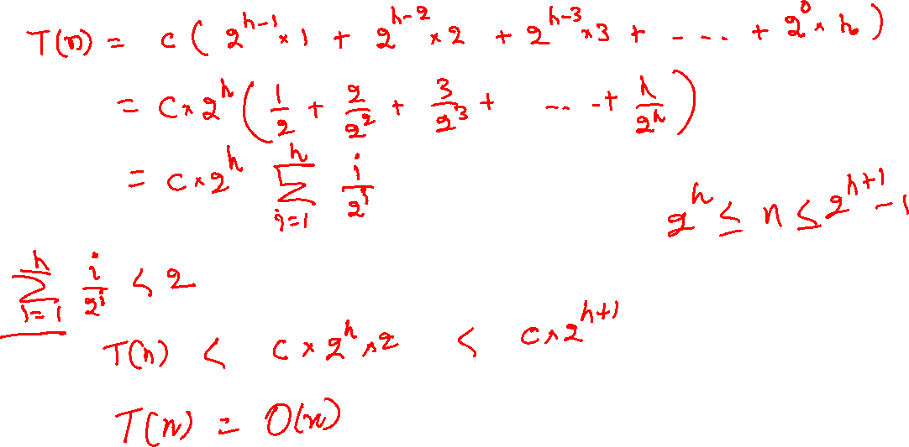
Build-Max-Heap time complexity
Notes:
The Max_Heapify operation at index i takes O(h) operations, where h is the height of the subtree rooted at index i. Therefore, for some constant c, the Max_Heapify operations at level h-1 take c * 1 operations for each node. The Max_Heapify operations at level h-2 take c * 2 operations for each node. The Max_Heapify operations at level h-3 take c * 3 operations for each node, and so on. Finally, the Max-Heapify operation will take c * h operations for the node at height 0. In a nearly complete binary tree, the number of nodes at level h-1 is 2^(h-1), the number of elements at level h-2 is 2^(h-2), and so on. The number of elements at level 0 is 1. Plugging all these values, we get an equation for the time complexity as listed on this slide.

Slide 81
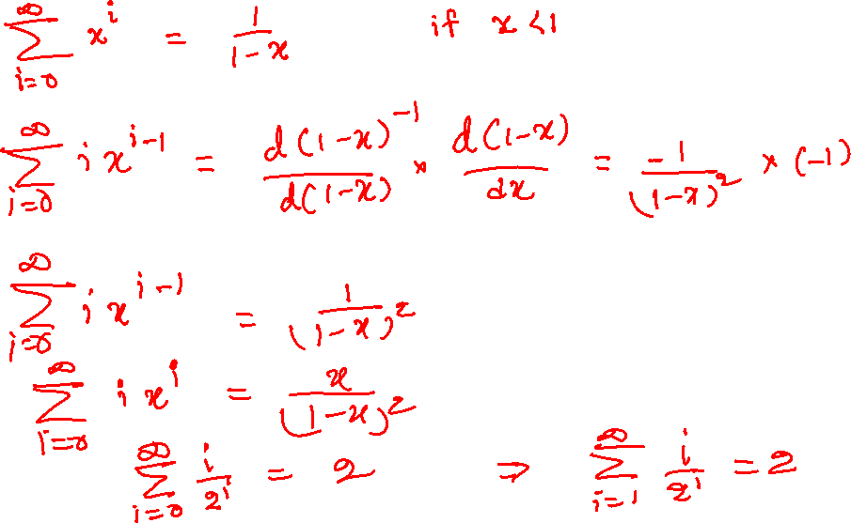
Build-Max-Heap time complexity

Slide 82

Build-Max-Heap time complexity
$$T\left(n\right)≤{c∗(2}^{h−1}∗1+2^{h−2}∗2+2^{h−3}∗3+ …+2^{0}∗h)$$
$$≤{c∗2}^{h}\left(\frac{1}{2}+\frac{2}{2^{2}}+\frac{3}{2^{3}}+ ….+\frac{h }{2^{h}}\right)$$
$≤{c∗2}^{h}\sum_{i=1}^{h}{\frac{i}{2^{i} }}$
$\sum_{i=1}^{h}{\frac{i}{2^{i} }}$ $<2$
$$T\left(n\right)<{c∗2}^{h+1}$$
$$2^{h}≤n≤2^{h+1}−1$$
$$T\left(n\right)=O(n)$$

Slide 83
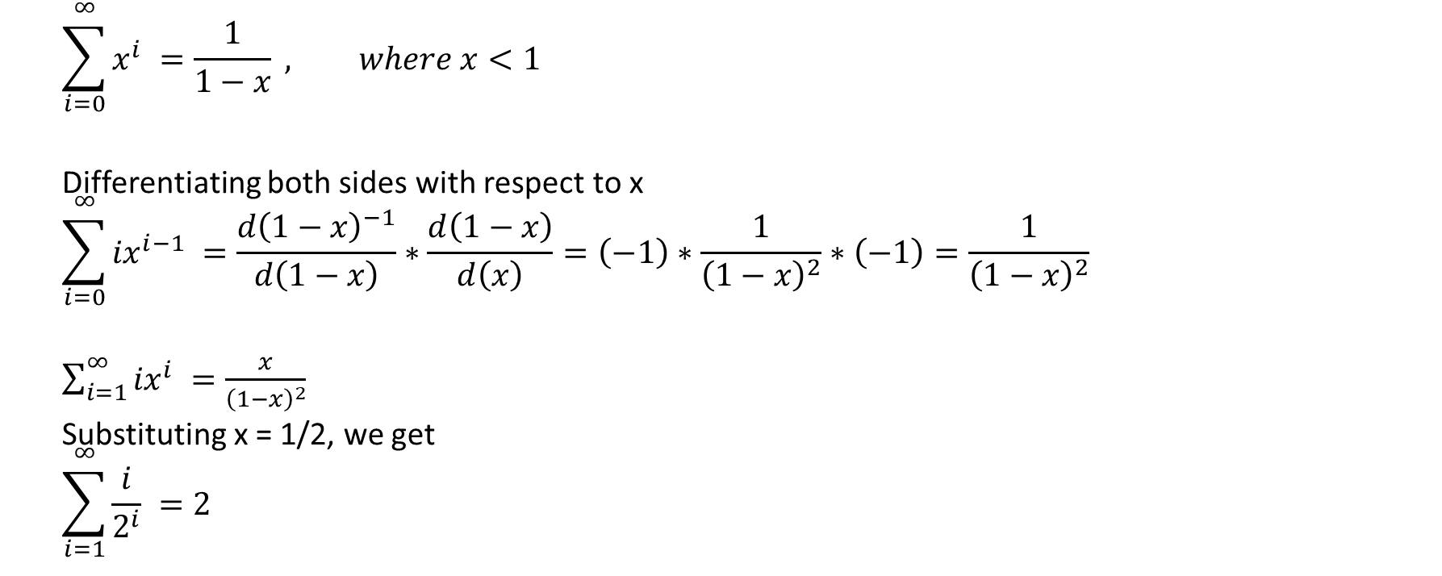
Build-Max-Heap time complexity
$$\sum_{i=0}^{\begin{aligned}∞ \\ \end{aligned}}{x^{i} =\frac{1}{1−x} , where x<1}$$
Differentiating both sides with respect to x
$$\sum_{i=0}^{\begin{aligned}∞ \\ \end{aligned}}{{ix}^{i−1} =\frac{d{\left(1−x\right)}^{−1}}{d\left(1−x\right)}∗\frac{d\left(1−x\right)}{d\left(x\right)}=\left(−1\right)∗\frac{1}{{\left(1−x\right)}^{2}}∗\left(−1\right)=\frac{1}{{\left(1−x\right)}^{2}} }$$
$\sum_{i=1}^{\begin{aligned}∞ \\ \end{aligned}}{{ix}^{i} =\frac{x}{{\left(1−x\right)}^{2}} }$
Substituting x = 1/2, we get
$$\sum_{i=1}^{\begin{aligned}∞ \\ \end{aligned}}{\frac{i}{2^{i}} =2 }$$

Slide 84
Max-Heap-Extract-Max

Slide 85
Max-Heap-Extract-Max
The goal is to remove and return the maximum key

Slide 86
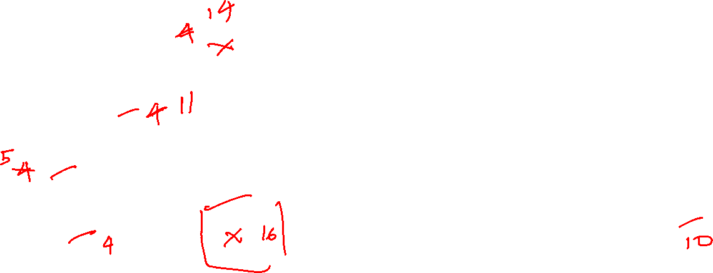
Max-Heap-Extract-Max
16
idx:1
idx:2
idx:3
14
13
idx:4
idx:5
idx:6
idx:7
11
8
9
10
3
5
7
4
heap_len = 11
idx:8
idx:9
idx:10
idx:11
 | 16 | 14 | 13 | 11 | 8 | 9 | 10 | 3 | 5 | 7 | 4
Notes:
To delete the root and return its value, we can first save the value of the node at index 1 in some variable. After that, we copy the value of the rightmost leaf at the last level to the node at index 1 and decrement the number of elements in the heap by one. This will make sure that the root node is deleted from the heap. But at this point, the heap at index 1 doesn’t necessarily satisfy the max heap property even though the subtree rooted at its left and right children are the max heaps. Therefore, to enforce the max heap property at index 1 we perform the Max_Heapify operation at index 1.

Slide 87
Max-Heap-Extract-Max
16
idx:1
idx:2
idx:3
14
13
idx:4
idx:5
idx:6
idx:7
11
8
9
10
3
5
7
4
heap_len = 11
idx:8
idx:9
idx:10
idx:11
 | 16 | 14 | 13 | 11 | 8 | 9 | 10 | 3 | 5 | 7 | 4

Slide 88
Max-Heap-Extract-Max
replace arr[1] with arr[heap_len]
heap_len -= 1
4
idx:1
idx:2
idx:3
14
13
idx:4
idx:5
idx:6
idx:7
11
8
9
10
3
5
7
16
heap_len = 10
idx:8
idx:9
idx:10
idx:11
 | 4 | 14 | 13 | 11 | 8 | 9 | 10 | 3 | 5 | 7 | 16

Slide 89
Max-Heap-Extract-Max
replace arr[1] with arr[heap_len]
heap_len -= 1
Max_Heapify(H, 1)
4
idx:1
idx:2
idx:3
14
13
idx:4
idx:5
idx:6
idx:7
11
8
9
10
3
5
7
16
heap_len = 10
idx:8
idx:9
idx:10
idx:11
 | 4 | 14 | 13 | 11 | 8 | 9 | 10 | 3 | 5 | 7 | 16

Slide 90
Max-Heap-Extract-Max
replace arr[1] with arr[heap_len]
heap_len -= 1
Max_Heapify(H, 1)
14
idx:1
idx:2
idx:3
4
13
idx:4
idx:5
idx:6
idx:7
11
8
9
10
3
5
7
16
heap_len = 10
idx:8
idx:9
idx:10
idx:11
 | 14 | 4 | 13 | 11 | 8 | 9 | 10 | 3 | 5 | 7 | 16

Slide 91
Max-Heap-Extract-Max
replace arr[1] with arr[heap_len]
heap_len -= 1
Max_Heapify(H, 1)
14
idx:1
idx:2
idx:3
11
13
idx:4
idx:5
idx:6
idx:7
4
8
9
10
3
5
7
16
heap_len = 10
idx:8
idx:9
idx:10
idx:11
 | 14 | 11 | 13 | 4 | 8 | 9 | 10 | 3 | 5 | 7 | 16

Slide 92
Max-Heap-Extract-Max
replace arr[1] with arr[heap_len]
heap_len -= 1
Max_Heapify(H, 1)
14
idx:1
idx:2
idx:3
11
13
idx:4
idx:5
idx:6
idx:7
5
8
9
10
3
4
7
16
heap_len = 10
idx:8
idx:9
idx:10
idx:11
 | 14 | 11 | 13 | 5 | 8 | 9 | 10 | 3 | 4 | 7 | 16

Slide 93
Max-Heap-Extract-Max
struct Heap {
int *arr;
int capacity; // maximum size of heap
int heap_size; // number of elements in the heap
};
Max_Heap_Max(H)
// H is a reference to the heap of type struct Heap
// Output: return the value of the maximum element
if H->heap_size == 0
perror(“Heap underflow”)
return H->arr[1]
Max_Heap_Extract_Max(H)
// H is a reference to the heap of type struct Heap
// Output: delete the maximum element and return its value
max = Max_Heap_Max(H)
H->arr[1] = H->arr[H->heap_size]
H->heap_size = H->heap_size – 1
Max_Heapify(H, 1)
return max
Time complexity:
Notes:
At line-15, we save the value of the root in the variable max. The Max_Heap_Max routine at line-6 returns the value of the root node if the heap is not empty. At line 16, we copy the value of the rightmost leaf at the last level to the node at index 1. At line-17, we are reducing the number of elements in the heap by one. At line-18, we are performing the Max_heapify operation at index 1.

Slide 94
Heapsort

Slide 95
Heap-Sort
How to implement heap sort using Max-Heap-Extract-Max.
16
idx:1
idx:2
idx:3
14
13
idx:4
idx:5
idx:6
idx:7
11
8
9
10
3
5
7
4
heap_len = 11
idx:8
idx:9
idx:10
idx:11
 | 16 | 14 | 13 | 11 | 8 | 9 | 10 | 3 | 5 | 7 | 4
Notes:
Because the Max-Heap-Extract-Max always deletes the maximum element, we can use it to delete the maximum element n-1 times. Instead of copying the value of the rightmost leaf at the last level (say node at index j) to index 1, we can swap the value at index 1 with the value at index j. Notice that index j is not part of the heap after the deletion, but it is still a valid array index. After deleting the n-1 element in this manner, the array contains the element in a sorted, increasing order.

Slide 96
Heap-Sort
Max-Heap-Extract-Max(H)
14
idx:1
idx:2
idx:3
11
13
idx:4
idx:5
idx:6
idx:7
5
8
9
10
3
4
7
heap_len = 10
idx:8
idx:9
idx:10
 | 14 | 11 | 13 | 5 | 8 | 9 | 10 | 3 | 4 | 7 | 16

Slide 97
Heap-Sort
Max-Heap-Extract-Max(H)
Max-Heap-Extract-Max(H)
13
idx:1
idx:2
idx:3
11
10
idx:4
idx:5
idx:6
idx:7
5
8
9
7
3
4
heap_len = 9
idx:8
idx:9
 | 13 | 11 | 10 | 5 | 8 | 9 | 7 | 3 | 4 | 14 | 16

Slide 98
Heap-Sort
Max-Heap-Extract-Max(H)
Max-Heap-Extract-Max(H)
Max-Heap-Extract-Max(H)
11
idx:1
idx:2
idx:3
8
10
idx:4
idx:5
idx:6
idx:7
5
4
9
7
3
heap_len = 8
idx:8
 | 11 | 8 | 10 | 5 | 4 | 9 | 7 | 3 | 13 | 14 | 16

Slide 99
Heap-Sort
Max-Heap-Extract-Max(H)
Max-Heap-Extract-Max(H)
Max-Heap-Extract-Max(H)
Max-Heap-Extract-Max(H)
10
idx:1
idx:2
idx:3
8
9
idx:4
idx:5
idx:6
idx:7
5
4
3
7
heap_len = 7
 | 10 | 8 | 9 | 5 | 4 | 3 | 7 | 11 | 13 | 14 | 16

Slide 100
Heap-Sort
Max-Heap-Extract-Max(H)
Max-Heap-Extract-Max(H)
Max-Heap-Extract-Max(H)
Max-Heap-Extract-Max(H)
Max-Heap-Extract-Max(H)
9
idx:1
idx:2
idx:3
8
7
idx:4
idx:5
idx:6
5
4
3
heap_len = 6
 | 9 | 8 | 7 | 5 | 4 | 3 | 10 | 11 | 13 | 14 | 16

Slide 101
Heap-Sort
Max-Heap-Extract-Max(H)
Max-Heap-Extract-Max(H)
Max-Heap-Extract-Max(H)
Max-Heap-Extract-Max(H)
Max-Heap-Extract-Max(H)
Max-Heap-Extract-Max(H)
8
idx:1
idx:2
idx:3
5
7
idx:4
idx:5
3
4
heap_len = 5
 | 8 | 5 | 7 | 3 | 4 | 9 | 10 | 11 | 13 | 14 | 16

Slide 102
Heap-Sort
Max-Heap-Extract-Max(H)
Max-Heap-Extract-Max(H)
Max-Heap-Extract-Max(H)
Max-Heap-Extract-Max(H)
Max-Heap-Extract-Max(H)
Max-Heap-Extract-Max(H)
Max-Heap-Extract-Max(H)
7
idx:1
idx:2
idx:3
5
4
idx:4
3
heap_len = 4
 | 7 | 5 | 4 | 3 | 8 | 9 | 10 | 11 | 13 | 14 | 16

Slide 103
Heap-Sort
Max-Heap-Extract-Max(H)
Max-Heap-Extract-Max(H)
Max-Heap-Extract-Max(H)
Max-Heap-Extract-Max(H)
Max-Heap-Extract-Max(H)
Max-Heap-Extract-Max(H)
Max-Heap-Extract-Max(H)
Max-Heap-Extract-Max(H)
5
idx:1
idx:2
idx:3
3
4
heap_len = 3
 | 5 | 3 | 4 | 7 | 8 | 9 | 10 | 11 | 13 | 14 | 16

Slide 104
Heap-Sort
Max-Heap-Extract-Max(H)
Max-Heap-Extract-Max(H)
Max-Heap-Extract-Max(H)
Max-Heap-Extract-Max(H)
Max-Heap-Extract-Max(H)
Max-Heap-Extract-Max(H)
Max-Heap-Extract-Max(H)
Max-Heap-Extract-Max(H)
Max-Heap-Extract-Max(H)
4
idx:1
idx:2
3
heap_len = 2
 | 4 | 3 | 5 | 7 | 8 | 9 | 10 | 11 | 13 | 14 | 16

Slide 105
Heap-Sort
Max-Heap-Extract-Max(H)
Max-Heap-Extract-Max(H)
Max-Heap-Extract-Max(H)
Max-Heap-Extract-Max(H)
Max-Heap-Extract-Max(H)
Max-Heap-Extract-Max(H)
Max-Heap-Extract-Max(H)
Max-Heap-Extract-Max(H)
Max-Heap-Extract-Max(H)
Max-Heap-Extract-Max(H)
3
idx:1
heap_len = 1
 | 3 | 4 | 5 | 7 | 8 | 9 | 10 | 11 | 13 | 14 | 16

Slide 106
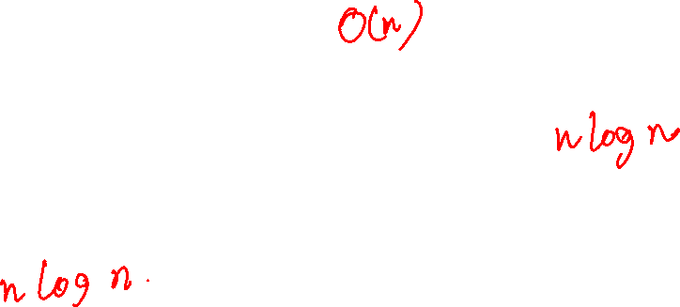
Heapsort
Build a max heap from the array elements
Perform the Max-Heap-Extract-Max operation n-1 times
Time complexity:

Slide 107
Building max heap
Option-1
Insert n elements in the array
Use the Build_Max_Heap algorithm on the unordered array
Option-2
Insert n elements one by one starting from an empty heap

Slide 108
Building max heap
Why does Build-Max-Heap take O(n) time, whereas inserting n elements take O(nlog n) time?

Slide 109
Building max heap
Why does Build-Max-Heap take O(n) time, whereas inserting n elements take O(nlog n) time?
Except for the last level, the number of elements at a given level is twice the number of elements at the preceding level
Per-node number of operations increases for a higher level in the Insert-Max-Heap algorithm
Per-node number of operations decreases for a higher level in the Build-Max-Heap algorithm
There are roughly (n/2) leaf nodes for which the insertion takes O(log n) operations
Build-Max-Heap doesn’t require any operations on the leaf node

Slide 110
Exercise
Max_Heap_Increase_Key(H, i, keyval): Increase key at index i to a new value (keyval) in the max heap H

