Slide 2
Today’s topics
Priority queue
Tries
Graphs

Slide 3
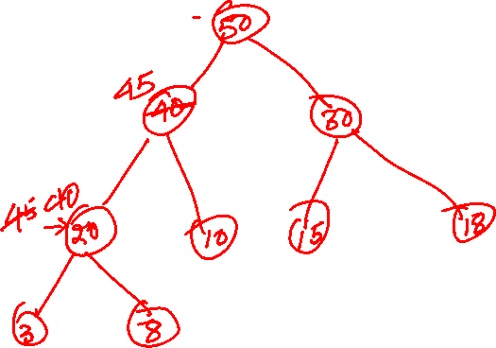
Exercise
Max_Heap_Increase_Key(H, i, keyval): Increase key at index i to a new value (keyval) in the max heap H
Notes:
In the Max_Heap_Increase_Key operation, we replace the value of the key at some index i, with a larger value. After increasing the key, the final tree might not be a max heap. To ensure the max heap property, we can walk all the nodes from nodes in the path from i to the root and swap values until we reach a parent node that is larger than or equal to its child node or we reach the root, similar to insert.

Slide 4
Priority queues

Slide 5
Priority Queues
There are two types of priority queues
max-priority queue
min-priority queue

Slide 6
Priority queues
ENQUEUE
DELETE_MAX
MAX-PRIORITY-QUEUE
ENQUEUE
MIN-PRIORITY-QUEUE
DELETE_MIN
Notes:
Each element in a priority queue has a priority. In a max priority queue, a larger value means high priority. The elements are inserted in the priority queue using the enqueue operation, but when we delete an element, we always delete a node with the highest priority. In a min priority queue, a smaller value indicates higher priority.

Slide 7
Priority scheduler
Let’s look at the problem of application scheduling in which every application has a priority associated with it
A new application can come at any time
We always schedule an application with the highest priority
Which data structures can be efficient for this problem?

Slide 8
Priority process scheduling
A higher value means high priority.
FIREFOX
PRIORITY: 5
SKYPE
DOWNLOAD
WHTSAPP
PRIORITY: 4
BATTERY
STATUS
PRIORITY: 2
UPDATES
ANTIVIRUS
PRIORITY: 1
Notes:
We can use a max-heap to implement the priority scheduling. If we want some ordering among applications with the same priority, we can keep additional information in a node, e.g., the arrival time of an application (which can be implemented using a counter). We can use arrival time to decide which application to prioritize among the applications with the same priority.

Slide 9
Priority process scheduling
FIREFOX
PRIORITY: 5
PRIORITY: 4
PRIORITY: 4
SKYPE
DOWNLOAD
BATTERY
STATUS
UPDATES
WHTSAPP
ANTIVIRUS
PRIORITY: 2
PRIORITY: 1
PRIORITY: 4
PRIORITY: 1

Slide 10
Max-priority queue ADT
Greater value means higher priority
Insert(S, x) : inserts an element x to set S
Maximum(S): returns the element of S with the largest key
Extract-Max(S): removes and returns the element with largest key
Increase-Key(S, i, k): increases the key value of the ith element to k
We can use a max heap to implement max-priority queue

Slide 11
Min-priority queue ADT
Smaller value means lower priority
Insert(S, x) : inserts an element x to set S
Minimum(S): returns the element of S with the smallest key
Extract-Min(S): removes and returns the element with smallest key
Decrease-Key(S, i, k): decreases the key value of the ith element to k
We can use a min heap to implement min-priority queue

Slide 12
Reference book
Algorithm Design, Goodrich and Tamassia

Slide 13
Tries

Slide 14
Tries
Read chapter-9.2 from Goodrich and Tamassia
https://en.wikipedia.org/wiki/Trie

Slide 15
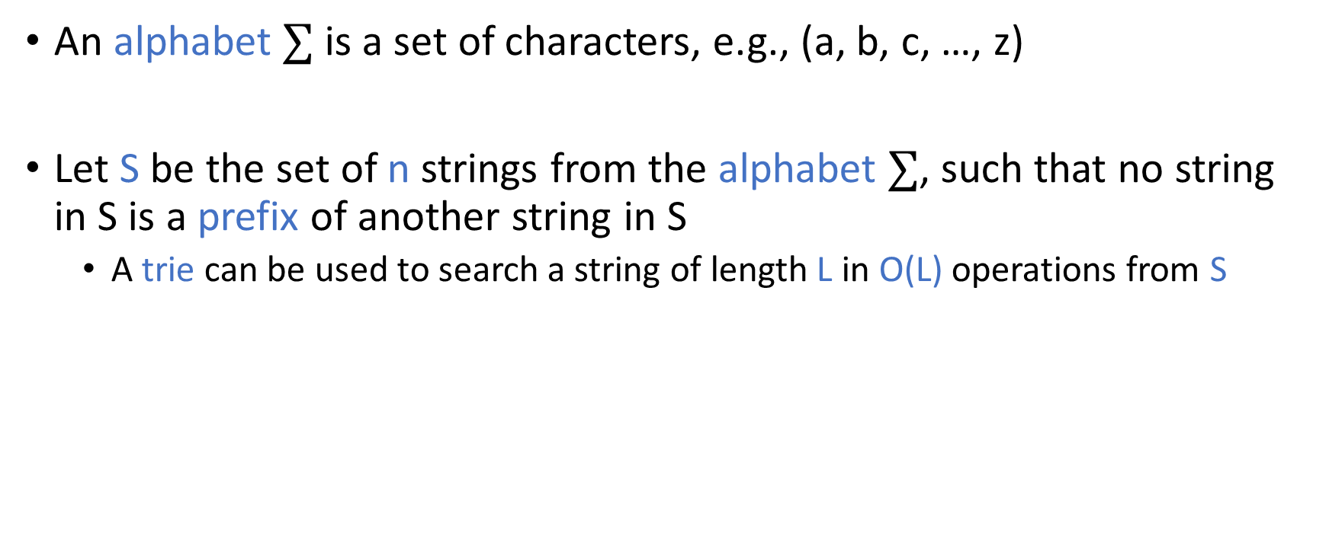
Tries
An alphabet $∑$ is a set of characters, e.g., (a, b, c, …, z)
Let S be the set of n strings from the alphabet $∑$, such that no string in S is a prefix of another string in S
A trie can be used to search a string of length L in O(L) operations from S

Slide 16

Tries
What is the time complexity of searching a string of length L from a sequence of n strings stored in an AVL tree?

Slide 17

Tries
{bear, bell, bid, bull, buy, sell, stock, stop}
b
s
e
i
u
e
t
a
l
d
l
o
l
y
c
p
l
l
r
l
k
Notes:
A trie can be visualized as follows. Lets S be the set of all strings in the trie. S1 contains the set of unique characters at the starting position in the strings in S. If n1 is the size of S1, then there will be n1 children of the root corresponding to the characters in S1. Notice that S1 contains only two characters, b and s. The subtree rooted at child b of the root contains nodes corresponding to all strings that start with b. Let S2 be the set of substrings of all strings in S that start with b after skipping the starting b. If S3 is the set of unique characters at the starting position of the strings in S2 and n3 is the number of elements in S3, then there will be n3 children of node b corresponding to the characters in S3. Notice that S3 contains three characters e, i, and u. The subtree rooted at child e of b contains nodes corresponding to all the strings that start from string “be”.

Slide 18
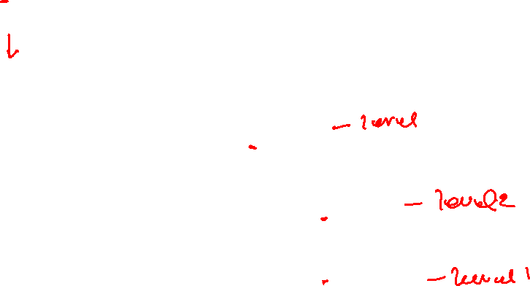
Tries
Search “stone”
b
s
e
i
u
e
t
a
l
d
l
o
l
y
c
p
l
l
r
l
k
Notes:
To search a word stone, we first check if s is a child of the root; if yes, we check if t is a child of s; if yes, we check if o is a child of t; if yes, we check if n is a child of o; if yes, we check if e is a child of n; if yes, we check if e is a leaf (external) node; if yes then “stone” is present in the trie. If the answer to a check is no at any point, then “stone” is not present in the trie. All the square nodes are external nodes representing the last character of a word stored in the trie.

Slide 19
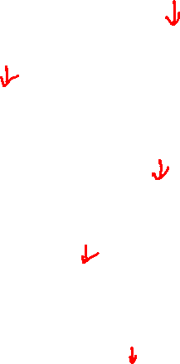
Tries
Search “bull”
b
s
e
i
u
e
t
a
l
d
l
o
l
y
c
p
l
l
r
l
k

Slide 20
Tries
Search “bea”
b
s
e
i
u
e
t
a
l
d
l
o
l
y
c
p
l
l
r
l
k

Slide 21
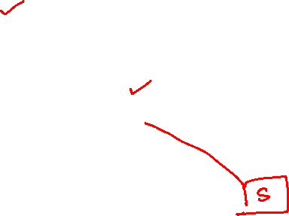
Tries
Insert “bus”
b
s
e
i
u
e
t
a
l
d
l
o
l
y
c
p
l
l
r
l
k
Notes:
To insert "bus", we check if b is a child of the root. Because the answer is true, we move to b. We now check if u is a child of b. Because the answer is true, we move to u. We now check if s is a child of u. Because this is not true, we create a new node containing s. Because s is the last character of the input string, we make this node a square (external) node.

Slide 22
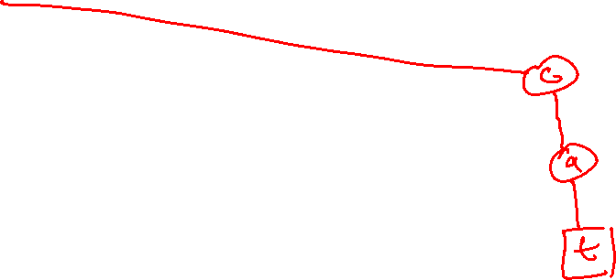
Tries
Insert “cat”
b
s
e
i
u
e
t
a
l
d
l
o
l
y
c
p
l
l
r
l
k

Slide 23
Tries
A standard trie, T, storing n strings from an alphabet of size d, has the following properties
Every internal node of T has at most d children
T has n external nodes
The height of T is equal to the length of the longest string in S

Slide 24
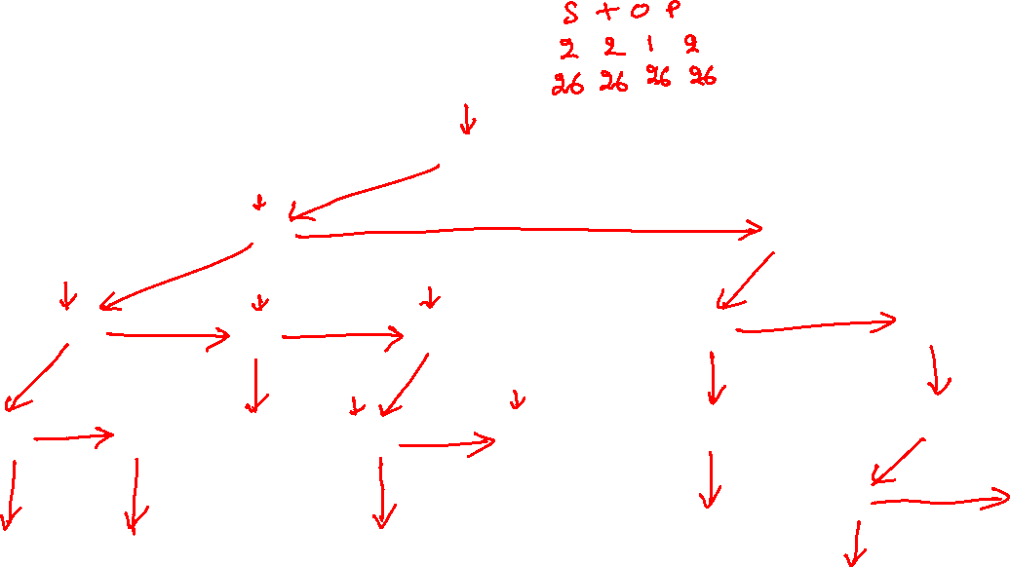
Linked-list
struct TrieNode {
char val;
// first child
struct TrieNode *child;
// right sibling
struct TrieNode *next;
};
b
s
e
i
u
e
t
a
l
d
l
o
l
y
c
p
l
l
r
l
k
Notes:
We can store the children of a node in a linked-list. A node contains a reference to its first child. A node also contains a reference to its right (or next) sibling. The resulting tree looks something like this.

Slide 25

External node
How do we identify an external node?

Slide 26
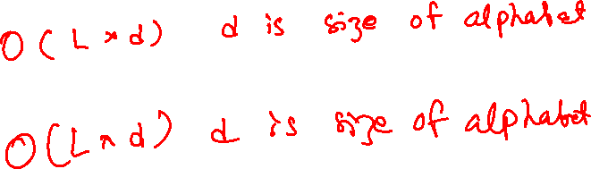
Time complexity
Searching a word of length L
Inserting a word of length L
Notes:
At every level, we may need to walk the entire linked list to search for a particular child. The maximum number of nodes in a linked list can be d, where d is the size of the alphabet.

Slide 27
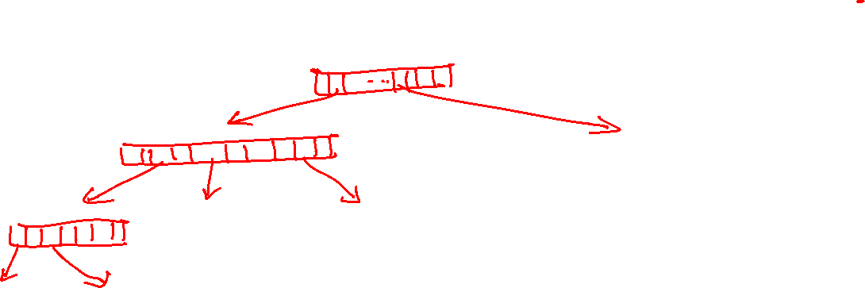
Array
struct TrieNode {
bool isExternal;
struct TrieNode *children[26];
};
b
s
e
i
u
e
t
a
l
d
l
o
l
y
c
p
l
l
r
l
k
Notes:
In an array representation, each node contains references to d children, where d is the size of the alphabet. Additionally, a tree node also has an additional field to track the external nodes. To make the kth character of the alphabet a child of node n, we can create a new node and insert it at index k in the children field of n. Searching the kth character in the children can be done in O(1) step using an array. In contrast, the linked-list based implementation takes O(d) operations to search the kth character in the children.

Slide 28
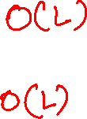
Time complexity
Searching a word of length L
Inserting a word of length L

Slide 29
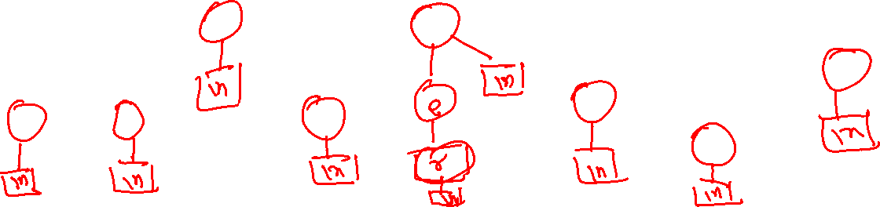
Tries
Insert “buyer”
b
s
e
i
u
e
t
a
l
d
l
o
l
y
c
p
l
l
r
l
k
Notes:
To support the insertion of a word that is a prefix of another word in the trie, we can allow internal nodes to become a square. Alternatively, if we want all square nodes to be leaf nodes, we can append a terminating character (e.g., ‘\n’) that is not part of the alphabet. This ensures that a string can’t be a prefix of another string in the trie.

Slide 30
Graphs

Slide 31
References
Read chapter-20 of the CLRS book
Read chapter-6 from Goodrich and Tamassia book

Slide 32
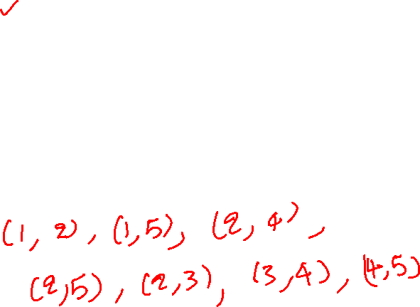
Terminology
Graphs have vertices and edges
Nodes 1 2 3 4 5 are vertices.
The unordered pairs
(1, 2), (1, 5), (2, 3), (2, 4), (2, 5),
(3, 4), (4, 5) are edges.
This is also called an undirected graph. In an undirected graph, the vertices in the edges are unordered.
1
2
3
5
4

Slide 33
Terminology
Graphs have vertices and edges
Nodes 1 2 3 4 5 6 are vertices.
The ordered pairs
(1, 2), (1, 4), (2, 5), (3, 5), (3, 6),
(4, 2), (5, 4), (6, 6) are edges.
This is also called a directed graph. In a directed graph, the vertices in the edges are ordered.
1
2
3
4
5
6

Slide 34
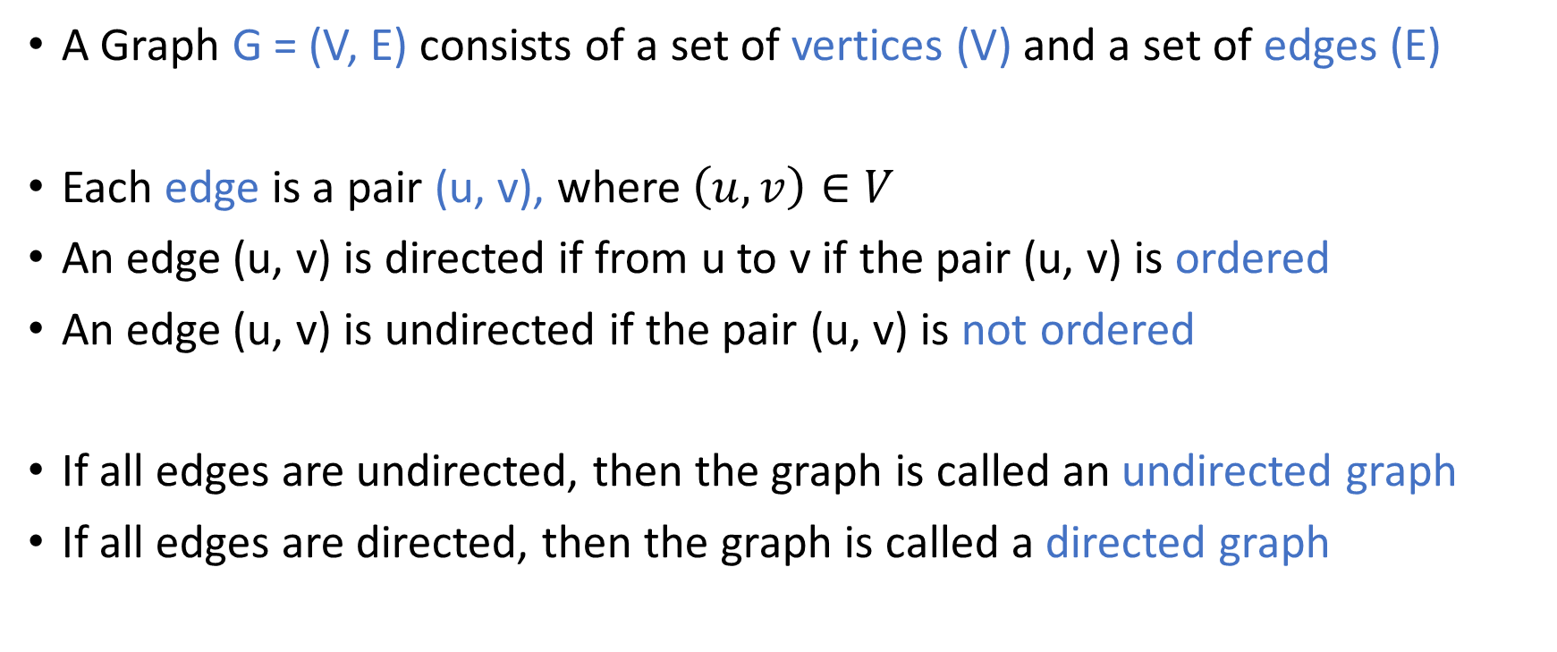
Graph terminology
A Graph G = (V, E) consists of a set of vertices (V) and a set of edges (E)
Each edge is a pair (u, v), where $\left(u, v\right)∈V$
An edge (u, v) is directed if from u to v if the pair (u, v) is ordered
An edge (u, v) is undirected if the pair (u, v) is not ordered
If all edges are undirected, then the graph is called an undirected graph
If all edges are directed, then the graph is called a directed graph

Slide 35
Graph terminology
Two endpoints of an edge are called end vertices of an edge
Two vertices are adjacent if they are the endpoints of the same edge
An edge e is incident on a vertex v, if v is one of the endpoints of e
The degree of a vertex v is the number of incident edges on v

Slide 36
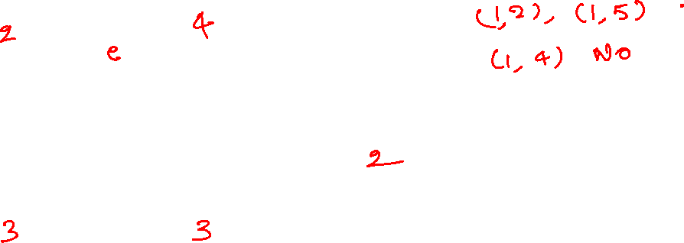
Terminology
Which are the adjacent vertices?
What is the degree of each vertex?
1
2
3
5
4
Notes:
There are two edges that are incident to node 1; therefore, the degree of node 1 is 2. The degree of node 2 is four because four edges are incident on it. Vertices 1 and 4 are not adjacent because they are not the endpoints of the same edge.

Slide 37
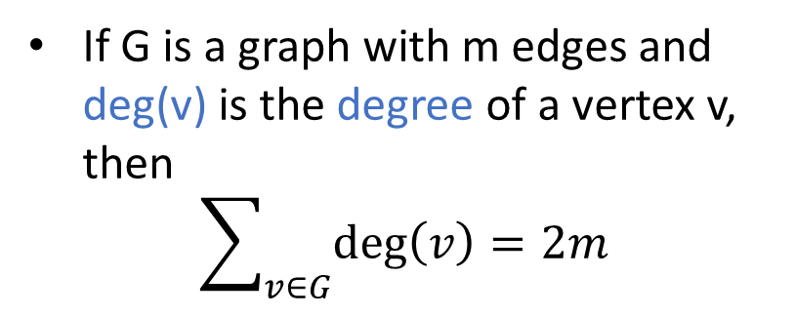
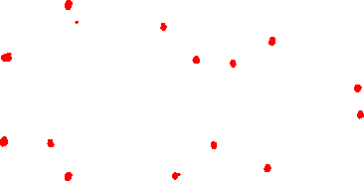
Sum of degree
If G is a graph with m edges and deg(v) is the degree of a vertex v, then
$$\sum_{v∈G}{\deg\left(v\right)=2m}$$
1
2
3
5
4

Slide 38
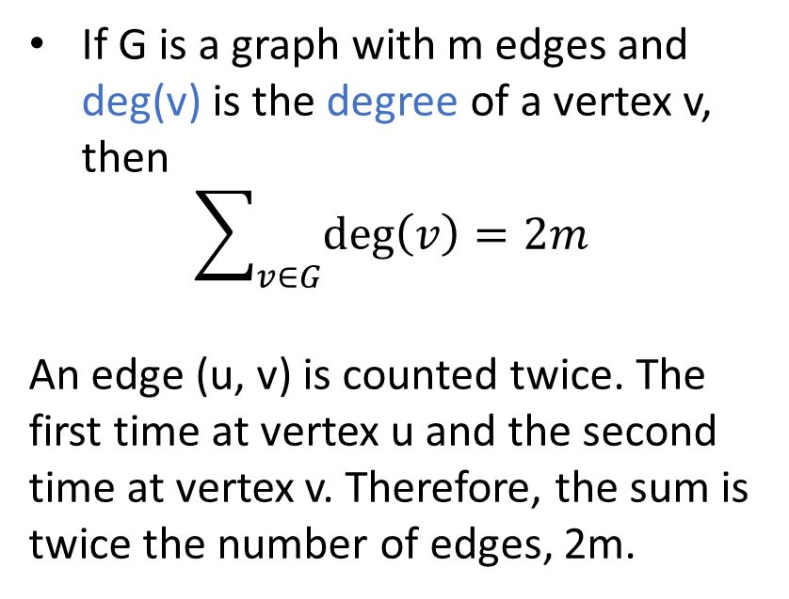
Sum of degree
If G is a graph with m edges and deg(v) is the degree of a vertex v, then
$$\sum_{v∈G}{\deg\left(v\right)=2m}$$
An edge (u, v) is counted twice. The first time at vertex u and the second time at vertex v. Therefore, the sum is twice the number of edges, 2m.
1
2
3
5
4

Slide 39
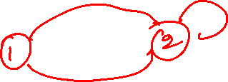
Simple graph
Simple graph doesn’t contain two undirected edges between the same pair of vertices or an edge from a vertex to itself
The graphs that we are going to study are simple

Slide 40
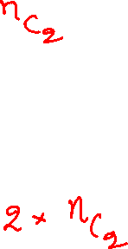
Maximum edges
What is the maximum number of edges in an undirected graph with n vertices?
What is the maximum number of edges in a directed graph with n vertices?
1
2
3
5
4

Slide 41
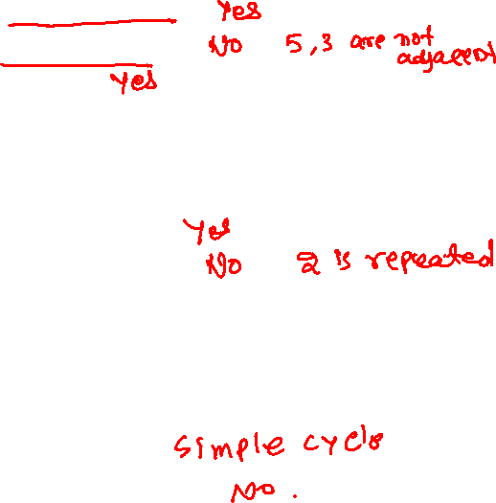
Path
A path in a graph is a sequence of vertices such that two consecutive vertices are adjacent
1 2 4 5 2 3
2 5 3 2 1
1 2
A path is simple if each vertex in the path is distinct
1 2 4 5
1 2 3 4 2
A simple cycle is a path that is simple, except the last vertex is the same as the first vertex
2 4 5 2
1 2 4 5 2 1
1
2
3
5
4

Slide 42
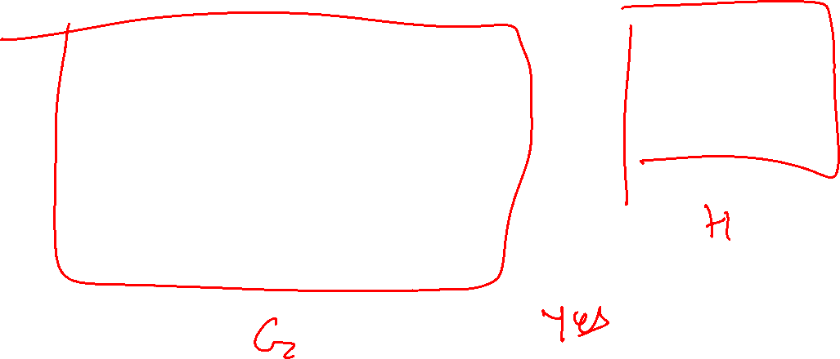
Subgraph
A subgraph of a graph G is a graph H whose vertices and edges are a subset of G
1
2
1
3
5
4
Notes:
H is a subgraph of G because it contains no edge (a subset of the edges in G) and vertex 1 (a subset of the vertices in G).

Slide 43
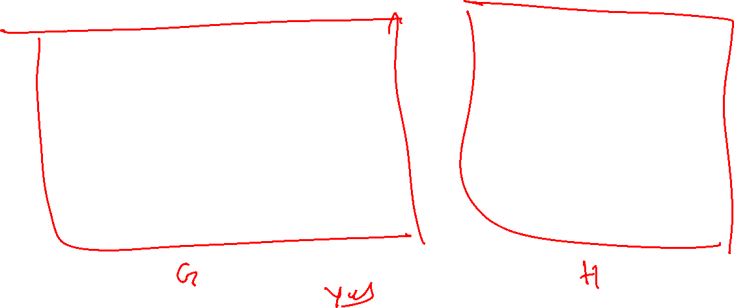
Subgraph
A subgraph of a graph G is a graph H whose vertices and edges are a subset of G
1
2
1
3
5
4
4
Notes:
H is a subgraph of G because it contains no edge (a subset of the edges in G) and vertices 1 and 4 (a subset of the vertices in G).

Slide 44
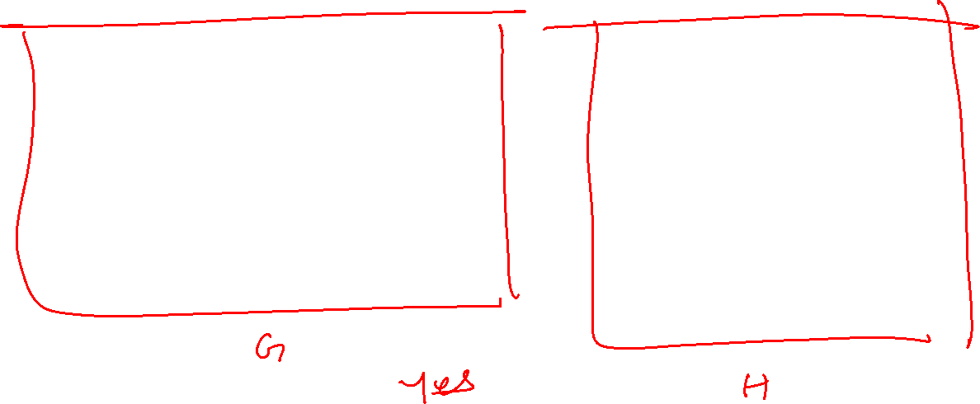
Subgraph
A subgraph of a graph G is a graph H whose vertices and edges are a subset of G
1
2
1
2
3
5
4
5
3
4

Slide 45
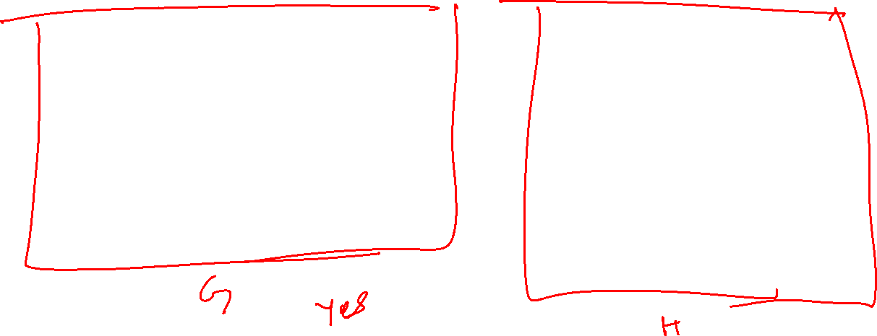
Spanning subgraph
A spanning subgraph of G is a subgraph H that contains all the vertices of the graph G
1
2
1
2
3
5
4
5
3
4

Slide 46

Connected graph
A graph is connected if there is a path between any two vertices
1
2
3
5
4

Slide 47

Connected graph
A graph is connected if there is a path between any two vertices
1
2
3
5
4

Slide 48

Connected graph
A graph is connected if there is a path between any two vertices
1
2
3
5
4
Notes:
No path from 3 to any other vertex.

Slide 49
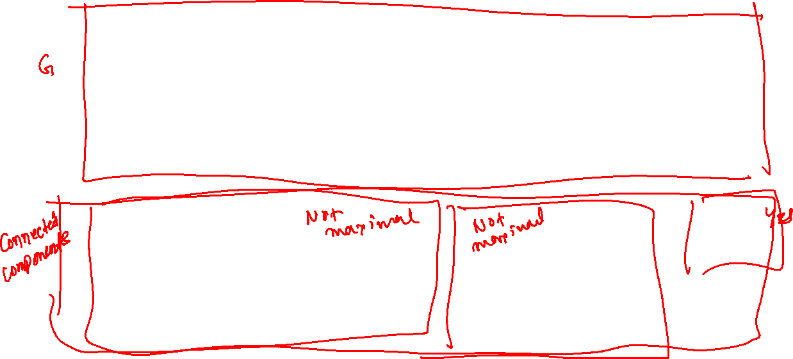
Connected components
If a graph is not connected, its maximum connected subgraphs are called the connected components of G
1
2
6
9
3
5
4
7
8
1
2
6
9
3
5
4
7
8
Notes:
A connected subgraph has two properties. It is a subgraph that is also connected. A maximal connected subgraph is a subgraph to which we can’t add more edges or vertices without violating the properties of a connected subgraph. The top rectangle is the original graph. We are trying to determine whether the subgraphs in the bottom half are maximal connected subgraphs. The leftmost subgraph at the bottom is a connected subgraph; however, it is not a maximal connected subgraph because we can add more edges to it without violating the property of a connected subgraph. Similarly, the middle subgraph at the bottom is not a maximal connected subgraph. Node 9 is a maximal connected subgraph because we can’t add more edges or vertices to it while preserving the property of a connected subgraph.

Slide 50
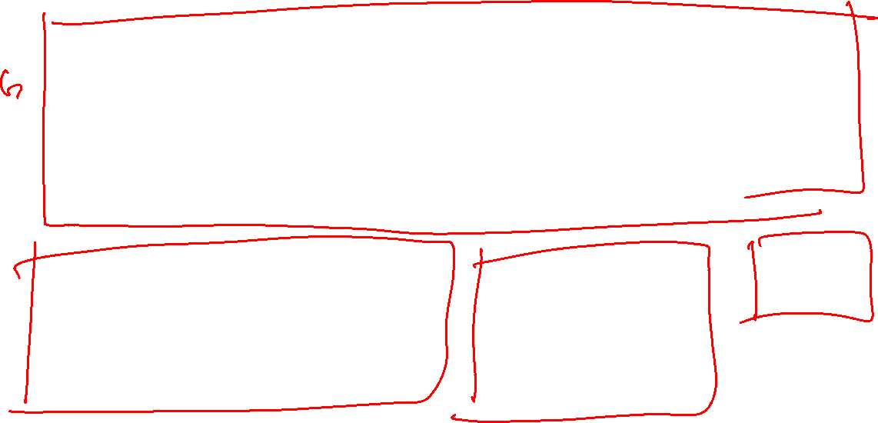
Connected components
If a graph is not connected, its maximum connected subgraphs are called the connected components of G
1
2
6
9
3
5
4
7
8
1
2
6
9
3
5
4
7
8
Notes:
The three subgraphs at the bottom are maximal connected subgraphs.

Slide 51

Tree
A tree is connected graph without cycles
No notion of a root node, unlike the rooted tree that we discussed earlier
Is this a tree?
1
2
3
5
4
Notes:
This is not a tree because the path 1 2 5 1 is a cycle.

Slide 52

Tree
A tree is connected graph without cycles
No notion of a root node, unlike the rooted tree that we discussed earlier
Is this a tree?
1
2
3
5
4
Notes:
This is not a tree because the path 1 2 5 1 is a cycle.

Slide 53

Tree
A tree is connected graph without cycles
No notion of a root node, unlike the rooted tree that we discussed earlier
Is this a tree?
1
2
3
5
4
Notes:
This is not a tree because the path 1 2 5 1 is a cycle.

Slide 54

Tree
A tree is connected graph without cycles
No notion of a root node, unlike the rooted tree that we discussed earlier
Is this a tree?
1
2
3
5
4
Notes:
This is a tree because there are no cycles.

Slide 55
Tree
A tree is connected graph without cycles
No notion of a root node, unlike the rooted tree that we discussed earlier
Is this a tree?
No. Not a connected graph
1
2
3
5
4
Notes:
This is not a tree because the graph is not connected.

