Slide 2
Today’s topics
Graphs
BFS

Slide 3
Assignment-3
void post_a_msg(char msg[MAX_MSG_LEN], struct record *r)
Insert msg in the trie
Update history in the square node
push a reference to the square node in the stack of posts by the user(r)
int delete_latest_post(struct record *r)
Pop the latest post from the stack of posts by the user(r)
Update history in the square node
int read_latest_post(struct record *r, char msg[MAX_MSG_LEN])
The top element in the stack of posts contains a reference to the latest post
Use the parent field in the trie node to read the message

Slide 4
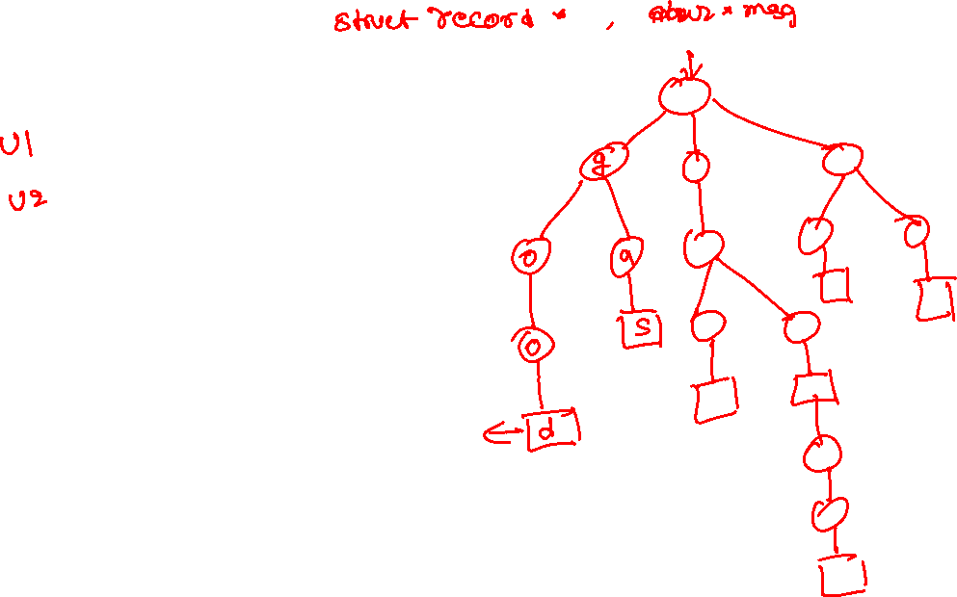
Post

Slide 5
Delete

Slide 6
Read

Slide 7
Assignment-3
void delete_all_posts(struct record *r)
void cleanup_history(struct record *r)
void destroy_trie()
struct list_events* get_history(char msg[MAX_MSG_LEN])
struct list_events* get_clean_history(char msg[MAX_MSG_LEN])

Slide 8

Assignment-3
USER-3 deleted
USER-1 deleted
USER-4 posted
USER-3 posted
USER-1 posted
USER-4 posted
USER-3 posted
USER-1 deleted
USER-3 posted
USER-2 posted
USER-1 posted
USER-1 posted
Clean history

Slide 9
Assignment-3
USER-3 deleted
USER-1 deleted
USER-4 posted
USER-3 posted
USER-1 posted
USER-4 posted
USER-3 posted
USER-1 deleted
USER-3 posted
USER-2 posted
USER-1 posted
USER-1 posted
Clean history

Slide 10
Assignment-3
USER-4 posted
USER-4 posted
USER-3 posted
USER-3 posted
USER-2 posted
USER-1 posted
Cleanup history

Slide 11
Assignment-3
void delete_all_posts(struct record *r)
void destroy_trie()
struct list_events* get_history(char msg[MAX_MSG_LEN])
struct list_events* get_clean_history(char msg[MAX_MSG_LEN])

Slide 12
References
Read chapter-20 of the CLRS book
Read chapter-6 from Goodrich and Tamassia book

Slide 13
Tree
A tree is connected graph without cycles
No notion of a root node, unlike the rooted tree that we discussed earlier
Is this a tree?
1
2
3
5
4

Slide 14
Tree
A tree is connected graph without cycles
No notion of a root node, unlike the rooted tree that we discussed earlier
Is this a tree?
1
2
3
5
4

Slide 15
Tree
A tree is connected graph without cycles
No notion of a root node, unlike the rooted tree that we discussed earlier
Is this a tree?
1
2
3
5
4

Slide 16
Forest
A forest is a collection of trees
Is this a forest?
1
2
3
5
4

Slide 17
Spanning tree
Every connected graph has a spanning tree
A spanning tree of a connected graph is a spanning subgraph that is also a tree
1
2
3
5
4

Slide 18
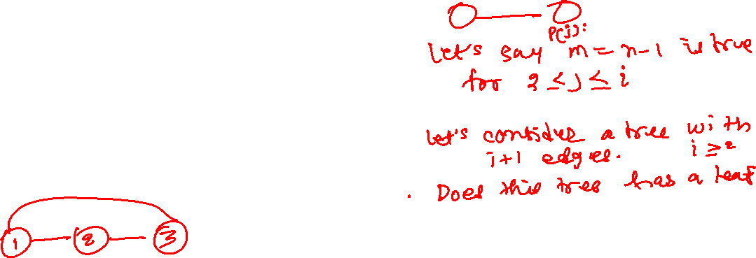
Spanning tree
Let G be an undirected graph with n vertices and m edges
Prove that if G is a tree, then
m = n-1
1
2
3
5
4
Notes:
The proof is shown on the next slide.

Slide 19
Spanning tree
Let G be an undirected graph with n vertices and m edges
Prove that if G is a tree, then the statement P(n): m = n-1 holds
Proof by induction:
Base case n = 2
Number of edges = 1 == n-1, thus P(2) holds
Show that if P(j) holds for every 2 <= j <= i, P(i+1) also holds
Let’s look at a tree with i+1 vertices
Because a tree has no cycle, it must have a leaf node
After removing the leaf node, the rest of the tree with i vertices is still going to be all connected
The number of edges in the disconnected tree with i vertices is i-1 because P(i) holds
After adding the leaf node back, the number of edges in the tree with i+1 vertices is i
Thus P(i+1) also holds.
Hence proved by induction.
1
2
3
5
4

Slide 20
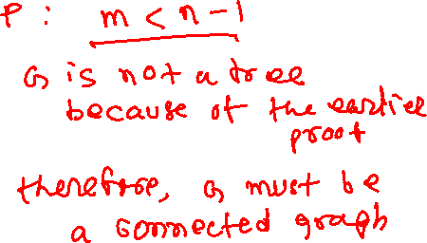
Spanning tree
Let G be an undirected graph with n vertices and m edges
Prove that if G is connected, then
m >= n-1
1
2
3
5
4
Notes:
The proof is shown on the next slide.

Slide 21
Spanning tree
Let G be an undirected graph with n vertices and m edges
Prove that if G is connected, then
m >= n-1
Proof by contradiction:
Let’s assume that G is connected if m < n-1
G can’t be a tree because the number of edges in a tree with n vertices is n-1, as proved earlier
It means that G has cycles
We can remove cycles from G while keeping it connected
If we remove all cycles while keeping the graph connected, it becomes a tree
The number of edges after removing the cycles is less than m, and thus less than n-1
However, the number of nodes in a tree must be n-1
Hence, proved by contradiction.
1
2
3
5
4

Slide 22
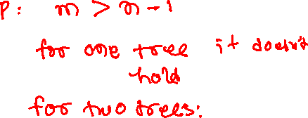
Spanning tree
Let G be an undirected graph with n vertices and m edges
Prove that if G is forest, then
m <= n-1
1
2
3
5
4
Notes:
The proof is shown on the next slide.

Slide 23
Spanning tree
Let G be an undirected graph with n vertices and m edges
Prove that if G is forest, then
m <= n-1
Proof by contradiction:
Let’s assume that G is a forest if m > n-1
Let’s say the forest contains only one tree
The assumption doesn’t hold because a tree has n-1 nodes
If the forest contains two trees
We can make the forest a tree by adding an edge between both trees
Therefore, the total number of edges in the final tree is m+1, i.e., greater than n-1
But the number of nodes in a tree is n-1. Therefore the assumption doesn’t hold for a forest with two trees.
Let’s say there are k trees in the forest, where k >= 2. We can combine all trees to create one tree by adding k-1 additional edges.
Therefore, the number of edges in the final tree is m+k-1, which is greater than n-1.
However, the number of nodes in a tree is n-1
Hence proved by contradiction.
1
2
3
5
4

Slide 24
Terminology
For a graph G = (V, E), we will use |V| for number of vertices and |E| for number of edges

Slide 25
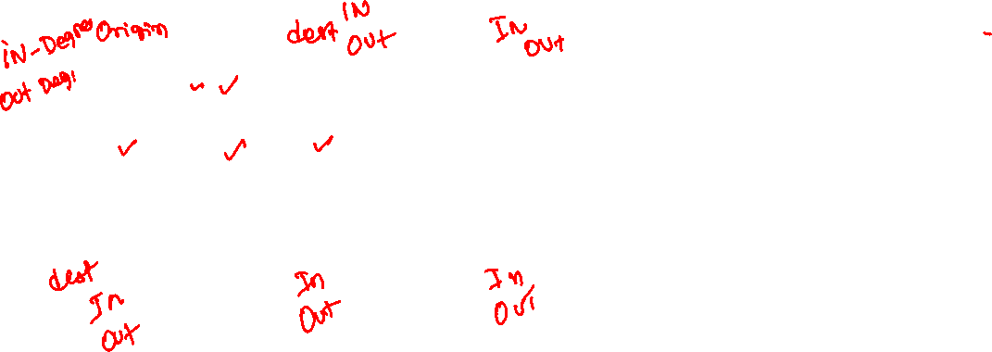
Terminology (directed graph)
origin and destination of an edge
Incoming edges of a vertex v
all edges whose destination is v
Outgoing edges of a vertex v
all edges whose origin is v
in-degree
number of incoming edges
out-degree
number of outgoing edges
1
2
3
4
5
6

Slide 26

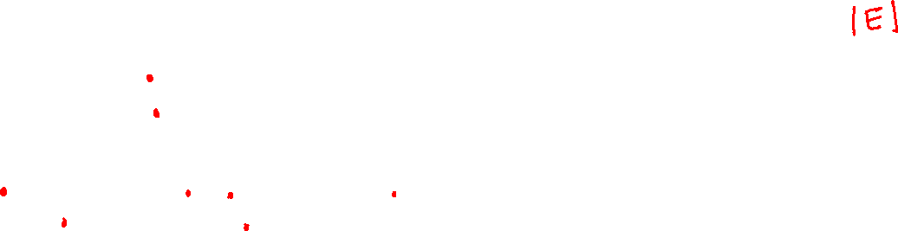
Terminology (directed graph)
$$\sum_{v∈V}{in_degree\left(v\right)=}$$
1
2
3
4
5
6
Notes:
While computing the sum of all in degrees, we are counting every edge only once. Therefore, the sum of the in degrees of all nodes is |E|.

Slide 27


Terminology (directed graph)
$$\sum_{v∈V}{out_degree\left(v\right)=}$$
1
2
3
4
5
6
Notes:
While computing the sum of all out degrees, we are counting every edge only once. Therefore, the sum of the in degrees of all nodes is |E|.

Slide 28
Applications of graphs
Graphs are used in many real-world applications
Google Maps use graphs
Vertices are intersections of roads
An edge is a road connecting two intersections
Airline routes can be represented using graphs
Each airport is a vertex
Two airports are connected using an edge if there is a nonstop flight between them
We would like the graph to be connected such that it is possible to reach from any airport to any other airport
Web pages can be stored as vertices in a graph
Vertices A and B are connected using a directed edge if A contains a reference to B

Slide 29
Representations of graphs

Slide 30
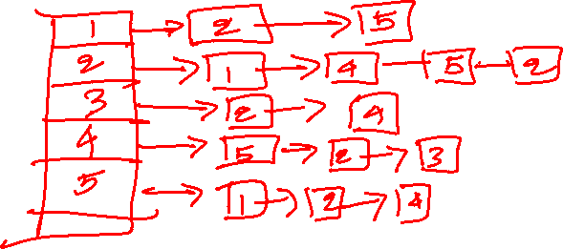
Representation of graphs
How can we store a graph?
walk all vertices
walk all edges
determine whether an edge exists between two given vertices
traverse all outgoing edges from a vertex
1
2
3
5
4
Notes:
We can store a graph like a tree, in which every node is a vertex, and the children of a node are all the outgoing edges. The children can be stored in a linked list. A node in the graph contains a reference to the first children. The problem with this approach is that in order to walk all vertices, we may need to walk all edges, which could be very expensive. Another approach is to store all vertices in an array, where vertices are numbered from 1 to |V| or 0 to |V|-1. An entry corresponding to a vertex in the array also contains a reference to the list of vertices connected using outgoing edges. This representation is also called the adjacency list, as we discuss next.

Slide 31
Adjacency list
In the adjacency list representation, for every vertex, we keep a list of all the adjacent vertices
The size of a list is the degree of the corresponding vertex
The total space requirement for graph G = (V, E) is O(|E|+|V|)
For undirected graphs, each edge (u,v) appears in two lists corresponding to the vertices u and v

Slide 32
Adjacency list (undirected)
walk all vertices
walk all edges
determine whether an edge exists between two given vertices
traverse all outgoing edges from a vertex
Space requirement
1
2
3
5
4

Slide 33
Adjacency list (undirected)
1
2
3
4
5
2
5 | /
1
2
1
5
3
4 | /
3
2
4 | /
2
5
3 | /
5
4
4
1
2 | /
walk all vertices
walk all edges
determine whether an edge exists between two given vertices
traverse all outgoing edges from a vertex
Space requirement
Notes:
In an adjacency list representation, the vertices are stored in an array. Each vertex points to a linked list that contains all the adjacent vertices. The space requirement for the linked list is the sum of degrees of all vertices, i.e., 2*|E|. The space requirement for the array of vertices is |V|. Therefore, the total space requirement is O(|V| + |E|). Walk all vertices requires O(|V|) operations. Walk all edges requires O(|E|) operations. Determining whether an edge exists between vertex u and v requires minimum(degree(u), degree(v)) operations. Traverse all outgoing edges from a vertex v requires degree(v) operations. This representation is better for sparse graphs, where |E| is much less than |V|².

Slide 34
Adjacency matrix
In the adjacency matrix representation, we store edges in a two-dimensional array of size n x n, where n is the number of vertices
If A is an adjacency matrix, A[u][v] is set to one if there is an edge between u and v; otherwise, A[u][v] is set to zero
The space requirement for graph G= (V, E) is O(|V|²)

Slide 35
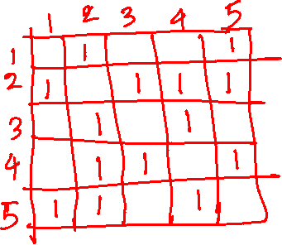
Adjacency matrix (undirected)
walk all vertices
walk all edges
determine whether an edge exists between two given vertices
traverse all outgoing edges from a vertex
Space requirement
1
2
3
5
4

Slide 36
Adjacency matrix (undirected)
1
2
 | 1 | 2 | 3 | 4 | 5
1 | 0 | 1 | 0 | 0 | 1
2 | 1 | 0 | 1 | 1 | 1
3 | 0 | 1 | 0 | 1 | 0
4 | 0 | 1 | 1 | 0 | 1
5 | 1 | 1 | 0 | 1 | 0
3
5
4
Notes:
In an adjacency matrix representation, the edges are stored in 2 dimensional |V| x |V| array. If A is an adjacency matrix, A[u][v] is set to one if there is an edge between u and v; otherwise, A[u][v] is set to zero. The space requirement for the two-dimensional array is O(|V|²). Walking all vertices requires O(|V|) operations. Walking all edges requires O(|V|²) operations. Determining whether an edge exists between vertex u and v requires O(1) operations. Traverse all outgoing edges from a vertex v requires O(|V|) operations. This representation is better for dense graphs, where |E| is close to |V|².

Slide 37
Adjacency list (directed)
1
2
3
4
5
6

Slide 38
Adjacency list (directed)
1
2
3
4
5
6
2
4 | /
1
2
3
5 | /
6
5 | /
2 | /
4
5
6
4 | /
5 | /
Notes:
In a directed adjacency list, only outgoing edges are stored in the linked list. The number of linked list nodes in an adjacency list is |E|. Checking if there is an edge between two vertices u, v can be done in O(out_degree(u)+out_degree(v)).

Slide 39
Adjacency matrix (directed)
1
2
3
4
5
6

Slide 40
Adjacency matrix (directed)
1
2
3
 | 1 | 2 | 3 | 4 | 5 | 6
1 | 0 | 1 | 0 | 1 | 0 | 0
2 | 0 | 0 | 0 | 0 | 1 | 0
3 | 0 | 0 | 0 | 0 | 1 | 1
4 | 0 | 1 | 0 | 0 | 0 | 0
5 | 0 | 0 | 0 | 1 | 0 | 0
6 | 0 | 0 | 0 | 0 | 1 | 0
4
5
6
Notes:
Only outgoing edges are stored in the linked list in a directed adjacency matrix.

Slide 41
Adjacency matrix vs. adjacency list
Checking if there is an edge between two vertices can be done in O(1)
Adjacency-matrix is beneficial for dense graphs in which |E| is close to |V|²
Space requirement is O(|V|²)
Iterating all outgoing edges from a vertex v requires O(|V|) operations
Checking if there is an edge between two vertices u, v can be done in O(out_degree(u)+out_degree(v)), in a directed graph and min(degree(u), degree(v)) in an undirected graph
Adjacency-list is beneficial for sparse graphs in which the |E| is much less than |V|²
Space requirement is O(|V|+|E|)
Iterating all outgoing edges from a vertex v requires O(degree(v)) operations

