Slide 2
Today’s topics
BFS
DFS

Slide 3
References
Read chapter-20 of the CLRS book
Read chapter-6 from Goodrich and Tamassia book
https://en.wikipedia.org/wiki/Depth-first_search

Slide 4
Adjacency list (undirected)
1
2
3
4
5
2
5 | /
1
2
1
5
3
4 | /
3
2
4 | /
2
5
3 | /
5
4
4
1
2 | /

Slide 5
Adjacency matrix (undirected)
1
2
 | 1 | 2 | 3 | 4 | 5
1 | 0 | 1 | 0 | 0 | 1
2 | 1 | 0 | 1 | 1 | 1
3 | 0 | 1 | 0 | 1 | 0
4 | 0 | 1 | 1 | 0 | 1
5 | 1 | 1 | 0 | 1 | 0
3
5
4

Slide 6
Adjacency list (directed)
1
2
3
4
5
6
2
4 | /
1
2
3
5 | /
6
5 | /
2 | /
4
5
6
4 | /
5 | /

Slide 7
Adjacency matrix (directed)
1
2
3
 | 1 | 2 | 3 | 4 | 5 | 6
1 | 0 | 1 | 0 | 1 | 0 | 0
2 | 0 | 0 | 0 | 0 | 1 | 0
3 | 0 | 0 | 0 | 0 | 1 | 1
4 | 0 | 1 | 0 | 0 | 0 | 0
5 | 0 | 0 | 0 | 1 | 0 | 0
6 | 0 | 0 | 0 | 0 | 1 | 0
4
5
6

Slide 8
Adjacency matrix vs. adjacency list
Checking if there is an edge between two vertices can be done in O(1)
Adjacency-matrix is beneficial for dense graphs in which |E| is close to |V|²
Space requirement is O(|V|²)
Iterating all outgoing edges from a vertex v requires O(|V|) operations
Checking if there is an edge between two vertices u, v can be done in O(out_degree(u)+out_degree(v)), in a directed graph and min(degree(u), degree(v)) in an undirected graph
Adjacency-list is beneficial for sparse graphs in which the |E| is much less than |V|²
Space requirement is O(|V|+|E|)
Iterating all outgoing edges from a vertex v requires O(degree(v)) operations

Slide 9
Shortest path

Slide 10


Distance
distance(s, v) is defined as the minimum number of edges needed to go from s to v.
w
x
r
s
v
z
$$0$$
What is the distance of all nodes from s?
y
t
u
Notes:
The distance of all vertices form s is shown on this slide.

Slide 11
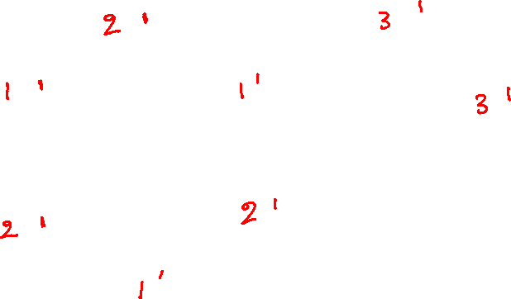
Distance
distance(s, v) is defined as the minimum number of edges needed to go from s to v.
w
x
r
s
v
z
$$0$$
How can we compute the distance of all vertices from s?
y
t
u
Notes:
To compute the distance of each vertex from s, first, we can find all adjacent vertices of s and update the distance of those vertices to 1. Next, we find the adjacent vertices of the set of vertices at a distance of 1 (as computed in the previous step) and set the distance of these vertices to 2. Next, we can identify the set of vertices adjacent to the set of vertices at a distance of 2 and set the distance of these vertices to 3. We can continue in this manner until we update the distance of each vertex reachable from s. Notice that we need to process all vertices with distance 1 before we can process the vertices at a distance 2 and so on. We can keep the vertices that still need to be processed in a queue. Because we are discovering vertices with distance 1 before distance 2 and so on, we want to process a vertex at the larger distance after the vertices at a smaller distance; we can add a vertex to the queue when it is discovered and process them in the order in which they are added to the queue. We need to update the distance only once when a vertex is added to the queue. If we reach a vertex that has already been added to the queue (or discovered) while traversing the neighbors, we ignore the vertex.

Slide 12

Distance
distance(s, v) is defined as the minimum number of edges needed to go from s to v.
w
x
r
s
v
z
$$0$$
How can we also store the shortest path to every node from vertex s, along with the distance?
y
t
u
Notes:
To store the shortest path whenever a new vertex is discovered, in addition to distance, we also store the predecessor vertex information in the node corresponding to the vertex.

Slide 13
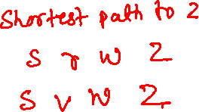
Distance
distance(s, v) is defined as the minimum number of edges needed to go from s to v.
w
x
r
s
v
z
$$0$$
Apart from the shortest paths reported by the algorithm, are other shortest paths possible?
y
t
u
Notes:
Yes, multiple shortest paths are possible. For example, there are two shortest paths to reach z from s listed on this slide. The algorithm we discussed identifies one of the shortest paths.

Slide 14
Breadth-first search (BFS)

Slide 15
Breadth-first search (BFS)
Given a graph G = (V, E) and a source vertex s, BFS explores all the vertices that can be reached from s
BFS also computes the distance from s to every other reachable vertices v, where distance is the smallest number of edges needed to go from s to v
BFS also produces a breadth-first tree which is a spanning tree that connects all the vertices reachable from s
In the breadth-first tree, a simple path from s to any other vertex v is also a shortest path from s to v

Slide 16
BFS
The BFS(G, s) works as follows
First, we identify all vertices that are at a distance 1 from the source vertex s
We also call them vertices at level 1
The predecessor of all these vertices in the BFS tree is s
Next, we identify all vertices that are at a distance 2 from the source vertex s
We also call them vertices at level 2
The predecessors of all these vertices in the BFS tree are one of the vertices at level 1
Next, we identify all vertices that are at a distance 3 from the source vertex s
We also call them vertices at level 3
The predecessors of all these vertices in the BFS tree are one of the vertices at level 2
And so on
until we have discovered all vertices that can be reached from vertex s

Slide 17








BFS
w
x
$$∞$$
$$∞$$
r
$$∞$$
$$∞$$
$$∞$$
s
v
z
$$0$$
$$∞$$
$$∞$$
y
t
$$∞$$
u

Slide 18
BFS
w
x
$$∞$$
$$∞$$
r
$$∞$$
$$∞$$
$$∞$$
s
v
z
$$0$$
$$∞$$
$$∞$$
y
t
$$∞$$
u
s,0
Notes:
The following slides show the working of the BFS algorithm in detail. Whenever a vertex is added to the queue, it’s marked gray. Whenever a vertex is removed from the queue, it’s marked black. The edges on the shortest path (discovered using BFS) are shown in red. The edges traversed during the BFS algorithm but not on the shortest path are shown in black.

Slide 19

BFS
w
x
$$∞$$
$$∞$$
r
$$∞$$
$$∞$$
$$∞$$
s
v
z
$$0$$
$$∞$$
$$∞$$
y
t
$$∞$$
u
s,0

Slide 20

BFS
w
x
$$∞$$
$$∞$$
r
$$1$$
$$∞$$
$$∞$$
s
v
z
$$0$$
$$∞$$
$$∞$$
y
t
$$∞$$
u
r,1

Slide 21

BFS
w
x
$$∞$$
$$∞$$
r
$$1$$
$$∞$$
$$∞$$
s
v
z
$$0$$
$$∞$$
$$∞$$
y
t
$$1$$
u
r,1 | u,1

Slide 22

BFS
w
x
$$∞$$
$$∞$$
r
$$1$$
$$1$$
$$∞$$
s
v
z
$$0$$
$$∞$$
$$∞$$
y
t
$$1$$
u
r,1 | u,1 | v,1

Slide 23

BFS
w
x
$$∞$$
$$∞$$
r
$$1$$
$$1$$
$$∞$$
s
v
z
$$0$$
$$∞$$
$$∞$$
y
t
$$1$$
u
r,1 | u,1 | v,1

Slide 24

BFS
w
x
$$∞$$
$$∞$$
r
$$1$$
$$1$$
$$∞$$
s
v
z
$$0$$
$$∞$$
$$2$$
y
t
$$1$$
u
u,1 | v,1 | t,2

Slide 25

BFS
w
x
$$2$$
$$∞$$
r
$$1$$
$$1$$
$$∞$$
s
v
z
$$0$$
$$∞$$
$$2$$
y
t
$$1$$
u
u,1 | v,1 | t,2 | w,2

Slide 26

BFS
w
x
$$2$$
$$∞$$
r
$$1$$
$$1$$
$$∞$$
s
v
z
$$0$$
$$∞$$
$$2$$
y
t
$$1$$
u
u,1 | v,1 | t,2 | w,2

Slide 27
BFS
w
x
$$2$$
$$∞$$
r
$$1$$
$$1$$
$$∞$$
s
v
z
$$0$$
$$∞$$
$$2$$
y
t
$$1$$
u
v,1 | t,2 | w,2

Slide 28

BFS
w
x
$$2$$
$$∞$$
r
$$1$$
$$1$$
$$∞$$
s
v
z
$$0$$
$$2$$
$$2$$
y
t
$$1$$
u
v,1 | t,2 | w,2 | y,2

Slide 29

BFS
w
x
$$2$$
$$∞$$
r
$$1$$
$$1$$
$$∞$$
s
v
z
$$0$$
$$2$$
$$2$$
y
t
$$1$$
u
v,1 | t,2 | w,2 | y,2

Slide 30
BFS
w
x
$$2$$
$$∞$$
r
$$1$$
$$1$$
$$∞$$
s
v
z
$$0$$
$$2$$
$$2$$
y
t
$$1$$
u
t,2 | w,2 | y,2

Slide 31
BFS
w
x
$$2$$
$$∞$$
r
$$1$$
$$1$$
$$∞$$
s
v
z
$$0$$
$$2$$
$$2$$
y
t
$$1$$
u
t,2 | w,2 | y,2

Slide 32

BFS
w
x
$$2$$
$$∞$$
r
$$1$$
$$1$$
$$∞$$
s
v
z
$$0$$
$$2$$
$$2$$
y
t
$$1$$
u
t,2 | w,2 | y,2

Slide 33
BFS
w
x
$$2$$
$$∞$$
r
$$1$$
$$1$$
$$∞$$
s
v
z
$$0$$
$$2$$
$$2$$
y
t
$$1$$
u
w,2 | y,2

Slide 34

BFS
w
x
$$2$$
$$∞$$
r
$$1$$
$$1$$
$$∞$$
s
v
z
$$0$$
$$2$$
$$2$$
y
t
$$1$$
u
w,2 | y,2

Slide 35

BFS
w
x
$$2$$
$$3$$
r
$$1$$
$$1$$
$$∞$$
s
v
z
$$0$$
$$2$$
$$2$$
y
t
$$1$$
u
y,2 | x,3

Slide 36

BFS
w
x
$$2$$
$$3$$
r
$$1$$
$$1$$
$$3$$
s
v
z
$$0$$
$$2$$
$$2$$
y
t
$$1$$
u
y,2 | x,3 | z,3

Slide 37

BFS
w
x
$$2$$
$$3$$
r
$$1$$
$$1$$
$$3$$
s
v
z
$$0$$
$$2$$
$$2$$
y
t
$$1$$
u
y,2 | x,3 | z,3

Slide 38
BFS
w
x
$$2$$
$$3$$
r
$$1$$
$$1$$
$$3$$
s
v
z
$$0$$
$$2$$
$$2$$
y
t
$$1$$
u
x,3 | z,3

Slide 39

BFS
w
x
$$2$$
$$3$$
r
$$1$$
$$1$$
$$3$$
s
v
z
$$0$$
$$2$$
$$2$$
y
t
$$1$$
u
x,3 | z,3

Slide 40
BFS
w
x
$$2$$
$$3$$
r
$$1$$
$$1$$
$$3$$
s
v
z
$$0$$
$$2$$
$$2$$
y
t
$$1$$
u
z,3

Slide 41

BFS
w
x
$$2$$
$$3$$
r
$$1$$
$$1$$
$$3$$
s
v
z
$$0$$
$$2$$
$$2$$
y
t
$$1$$
u
z,3

Slide 42

BFS
w
x
$$2$$
$$3$$
r
$$1$$
$$1$$
$$3$$
s
v
z
$$0$$
$$2$$
$$2$$
y
t
$$1$$
u
$$φ$$

Slide 43
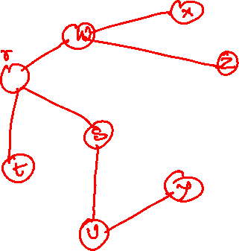

BFS
w
x
$$2$$
$$3$$
r
$$1$$
$$1$$
$$3$$
s
v
z
$$0$$
$$2$$
$$2$$
y
t
$$1$$
u
$$φ$$

Slide 44
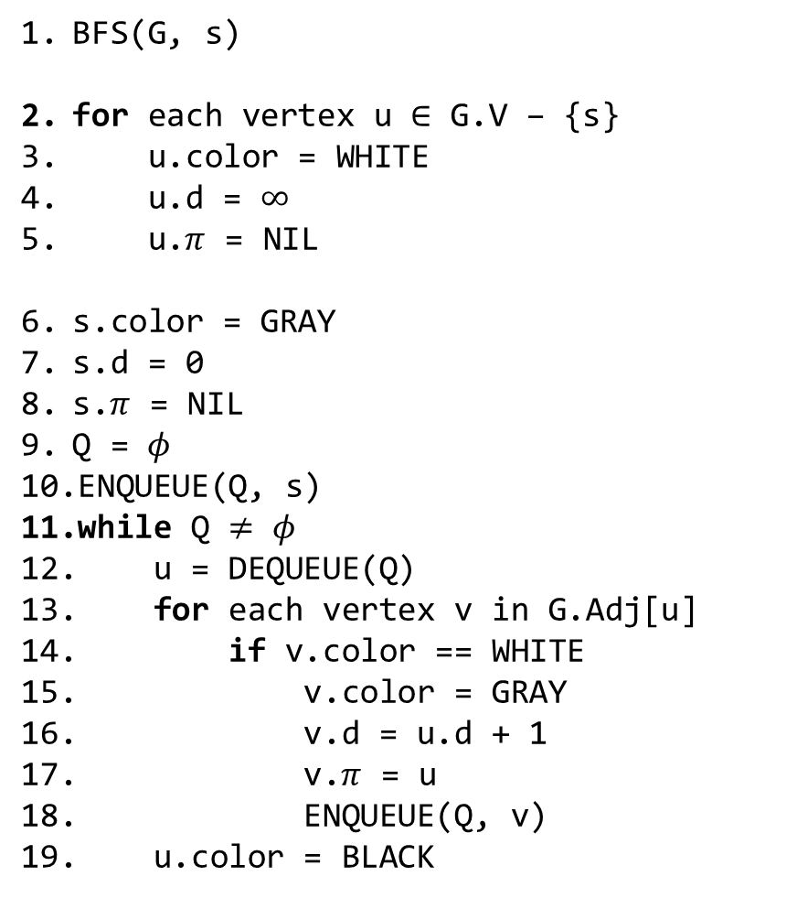
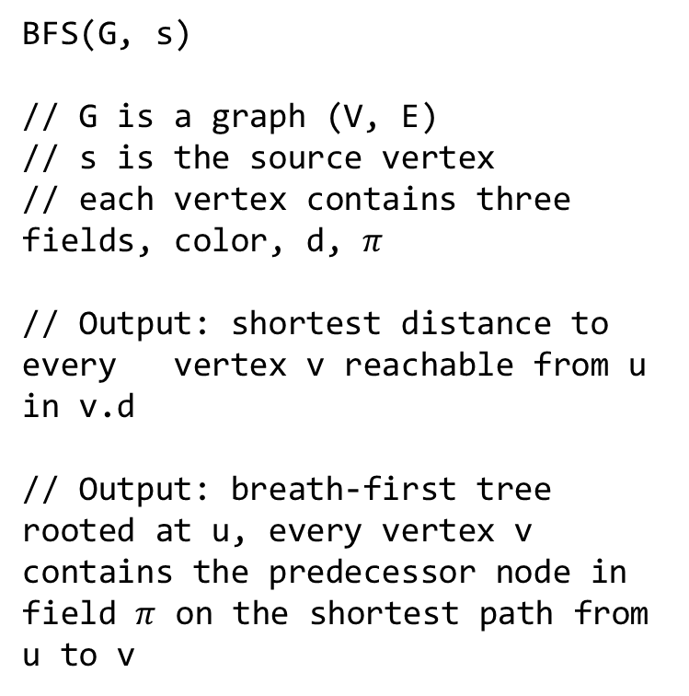
BFS
BFS(G, s)
for each vertex u $∈$ G.V – {s}
u.color = WHITE
u.d = $∞$
u.$π$ = NIL
s.color = GRAY
s.d = 0
s.$π$ = NIL
Q = $φ$
ENQUEUE(Q, s)
while Q $≠$ $φ$
u = DEQUEUE(Q)
for each vertex v in G.Adj[u]
if v.color == WHITE
v.color = GRAY
v.d = u.d + 1
v.$π$ = u
ENQUEUE(Q, v)
u.color = BLACK
BFS(G, s)
// G is a graph (V, E)
// s is the source vertex
// each vertex contains three fields, color, d, $π$
// Output: shortest distance to every vertex v reachable from u in v.d
// Output: breath-first tree rooted at u, every vertex v contains the predecessor node in field $π$ on the shortest path from u to v
Notes:
The color field in vertex stores the color of a node (we can use an integer to represent a color). Field π contains a reference to the predecessor on the shortest path. Field d stores the shortest distance.

Slide 45
BFS
Time complexity

Slide 46
BFS
Time complexity
After the initialization, BFS never whitens a vertex
At line-18, it only enqueues a white vertex
It marks a vertex as gray before enqueuing
Therefore, the dequeue operation at line-12 can take place at most |V| times
After dequeuing a vertex v, the for loop at line-13 traverse all outgoing edges from v, i.e., out_degree(v) times
Therefore, the for loop runs at most the sum of out degrees of all vertices, which is |E| for directed graph and 2*|E| for undirected graph
The algorithm is doing a constant number of operations inside the loop
Thus, the time complexity is O(|V| + |E|)

Slide 47
BFS
Let’s BFS is performed on graph G = (V, E) for the source vertex s
Why is a BFS tree also a spanning tree that contains all the vertices reachable from s?
Let’s say BFS tree is graph G1 = (V1, E1), where V1 are the vertices reachable from s

Slide 48
BFS
Let’s BFS is performed on graph G = (V, E) for the source vertex s
Why is a BFS tree also a spanning tree that contains all the vertices reachable from s?
Let’s say BFS tree is graph G1 = (V1, E1), where V1 are the vertices reachable from s
Each vertex in V1 has exactly one predecessor except s
Therefore, the number of edges is |V1|-1
The way we are constructing G1 is that every vertex in G1 has a path to s
Therefore, G1 is a connected graph
G1 is a tree because it’s a connected graph with |V1| vertices and |V1|-1 edges
G1 it’s also a spanning tree because it contains all vertices

Slide 49
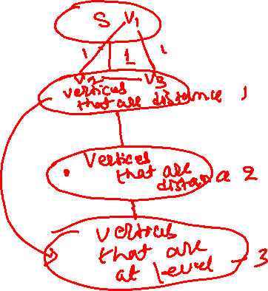
BFS
Why does BFS(G, s) always give a shortest path from s?

Slide 50
BFS
Why does BFS(G, s) always give a shortest path from s?
In the first step, we first discover all the vertices are at a distance of 1
In the second step, we discover all vertices that are at a distance 2
Is it possible that we may discover a vertex with a distance < 2 during this step
No, because if that is the case, we may have discovered that vertex during the previous step
In the third step, we discover all vertices that are at a distance of 3
Is it possible that we may discover a vertex with a distance < 3 during this step
No, because if that is the case, we may have discovered that vertex during the previous steps
Intuitively, during i^{th} step, we can’t discover a vertex that is at a distance <i from the source vertex; therefore, BFS gives a shortest path to each vertex

Slide 51
BFS
Tree edges are shown in red
Non-tree edges are shown in black
w
x
$$2$$
$$3$$
r
$$1$$
$$1$$
$$3$$
s
v
z
$$0$$
$$2$$
$$2$$
y
t
$$1$$
u
$$φ$$

Slide 52
BFS
If (u, v) is an edge that is not in the BFS tree, then the level numbers of u and v differ by at most 1
In other words, non-tree edges are between the vertices of the same level or adjacent levels
Notes:
The endpoints of a tree edge always belong to two adjacent levels. The endpoints of a non-tree edge are either at the adjacent levels or at the same level. If the levels of a non-tree edge (u, v) are (l1, l2), where l2 > l1, then l1 and l2 can differ by at most 1. This is because if we can reach u in l1 steps, we can reach v in l1+1 steps, and therefore the distance of v can’t be more than l1+1.

Slide 53
Finding all connected components

Slide 54

Finding connected components
q
w
x
r
s
v
z
$$0$$
y
t
u

Slide 55
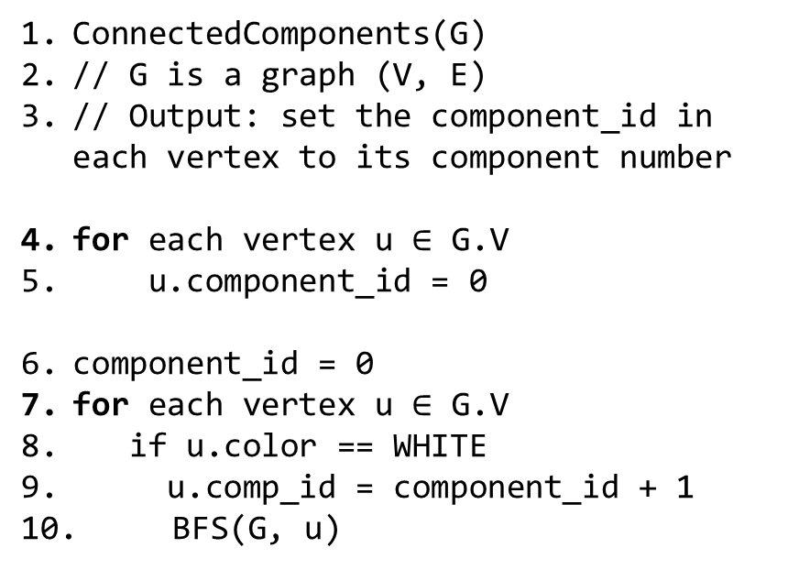
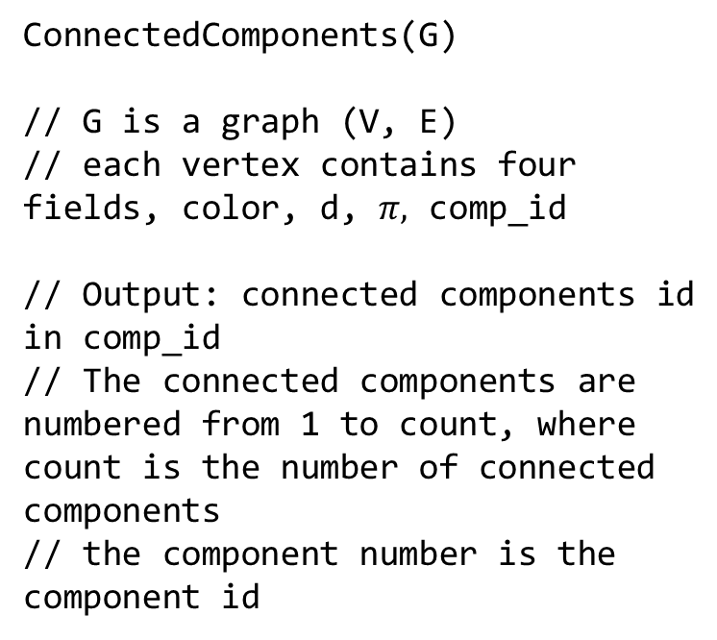
Finding connected components
ConnectedComponents(G)
// G is a graph (V, E)
// each vertex contains four fields, color, d, $π,$ comp_id
// Output: connected components id
in comp_id
// The connected components are numbered from 1 to count, where count is the number of connected components
// the component number is the component id
ConnectedComponents(G)
// G is a graph (V, E)
// Output: set the component_id in each vertex to its component number
for each vertex u $∈$ G.V
u.component_id = 0
component_id = 0
for each vertex u $∈$ G.V
if u.color == WHITE
u.comp_id = component_id + 1
BFS(G, u)
Notes:
We can add an additional field to a vertex called component id (comp_id) to find all connected components. The BFS algorithm identifies all vertices of a component connected to a given vertex. We can store the component id in the vertex when it is discovered, as shown in line-18 on the next slide. We call BFS for each vertex in a loop if its component id hasn’t been identified yet, as shown in lines-7,8.

Slide 56
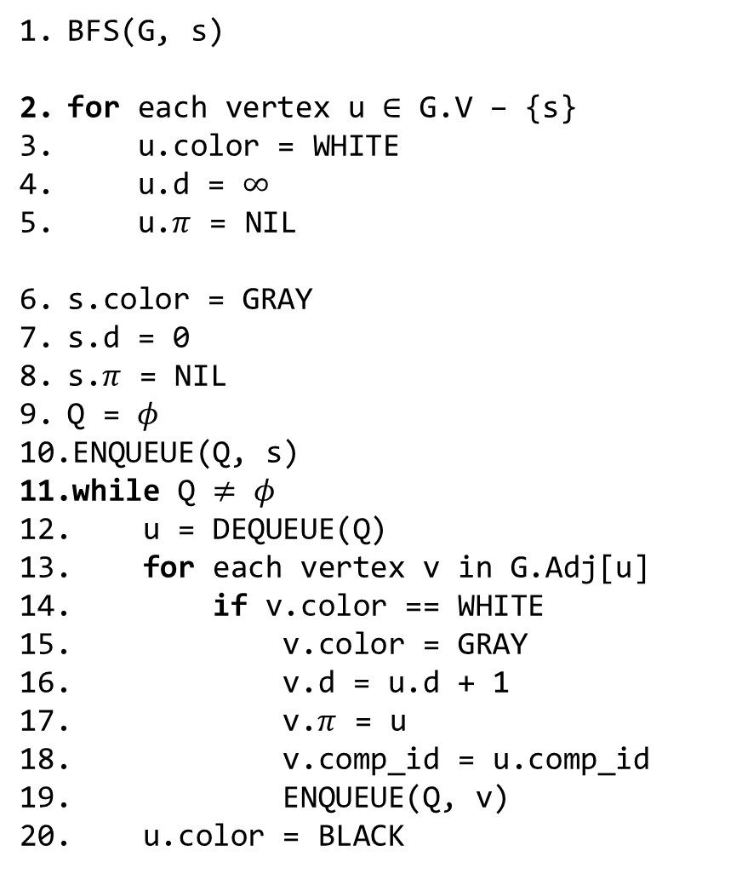
BFS
BFS(G, s)
for each vertex u $∈$ G.V – {s}
u.color = WHITE
u.d = $∞$
u.$π$ = NIL
s.color = GRAY
s.d = 0
s.$π$ = NIL
Q = $φ$
ENQUEUE(Q, s)
while Q $≠$ $φ$
u = DEQUEUE(Q)
for each vertex v in G.Adj[u]
if v.color == WHITE
v.color = GRAY
v.d = u.d + 1
v.$π$ = u
v.comp_id = u.comp_id
ENQUEUE(Q, v)
u.color = BLACK
BFS(G, s)
// G is a graph (V, E)
// s is the source vertex
// each vertex contains three fields, color, d, $π$
// Output: shortest distance to every vertex v reachable from u in v.d
// Output: breath-first tree rooted at u, every vertex v contains the predecessor node in field $π$ on the shortest path from u to v

Slide 57
Finding cycles

Slide 58

Finding cycle
w
r
s
v
$$0$$
y
t
u
Notes:
Notice that BFS generates a BFS spanning tree that connects all the vertices reachable via a given node. If, during the BFS algorithm, we identify a non-tree edge, it means that the graph has at least one cycle because the number of edges is more than what is needed for a spanning tree. If, during the BFS algorithm, we reach a vertex v from u and v has already been discovered, then it’s a tree edge if v is not the predecessor of u. The corresponding logic is shown in lines-16,17 on the next slide. Another quick way to check if the graph has a cycle is to find the number of edges. If the number of edges is more than or equal to the number of vertices, then it’s definitely not a tree and thus has cycle(s). However, if the number of edges is less than the number of vertices, then we need to check if the graph has a non-tree edge because the graph may not be connected.

Slide 59
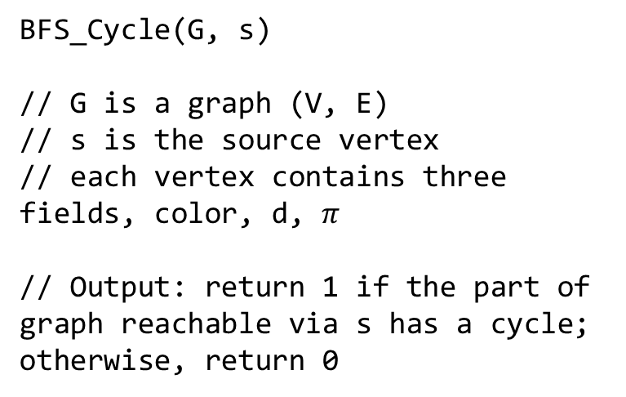
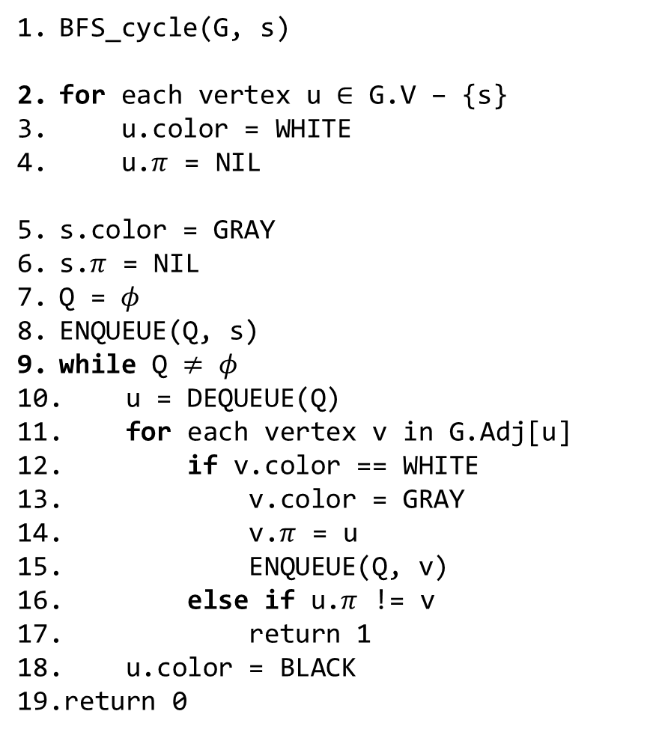
BFS
BFS_cycle(G, s)
for each vertex u $∈$ G.V – {s}
u.color = WHITE
u.$π$ = NIL
s.color = GRAY
s.$π$ = NIL
Q = $φ$
ENQUEUE(Q, s)
while Q $≠$ $φ$
u = DEQUEUE(Q)
for each vertex v in G.Adj[u]
if v.color == WHITE
v.color = GRAY
v.$π$ = u
ENQUEUE(Q, v)
else if u.$π$ != v
return 1
u.color = BLACK
return 0
BFS_Cycle(G, s)
// G is a graph (V, E)
// s is the source vertex
// each vertex contains three fields, color, d, $π$
// Output: return 1 if the part of graph reachable via s has a cycle; otherwise, return 0

