Slide 2
Today’s topics
DFS
Topological sort

Slide 3
References
Read chapter-20 of the CLRS book
Read chapter-6 from Goodrich and Tamassia book
https://en.wikipedia.org/wiki/Depth-first_search

Slide 4
Path finding

Slide 5


Path finding
Is there a path from vertex s to vertex z?
We can use BFS
w
x
r
s
v
z
$$0$$
y
t
u

Slide 6
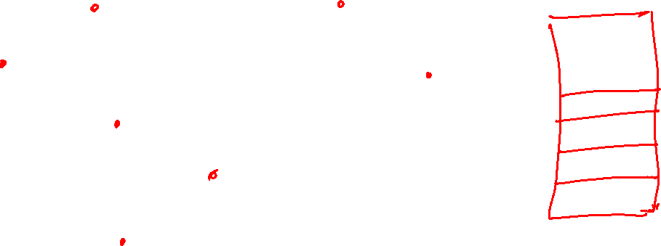
Path finding
Is there a path from vertex s to vertex z?
Is there any other alternative?
w
x
r
s
v
z
$$0$$
y
t
u

Slide 7
Depth-first search (DFS)

Slide 8
Depth-first search (DFS)
Given a graph G = (V, E), DFS is a graph search algorithm that searches deeper into the graph whenever possible
DFS visits all the vertices in the graph exactly once
DFS at a given vertex s recursively explores all outgoing edges of s one-by-one using DFS

Slide 9
Depth-first search (DFS)
Similar to BFS, in DFS algorithm marks the vertices as white, gray, and black
Initially, all the vertices are marked as white
When a white vertex v is visited for the first time, it is marked as gray
DFS algorithm backtracks if it encounters a non-white vertex
After visiting all the vertices that are reachable via v using DFS, the DFS algorithm finally marks v as black before leaving v

Slide 10
Depth-first search (DFS)
DFS also timestamps each vertex to record the order in which the vertices are visited
Each vertex v contains two timestamps
The first timestamp, discovery time (v.d), corresponds to the time when the vertex v is first discovered (or grayed)
The second timestamp, finish time (v.f), corresponds to the time when the algorithm leaves the vertex v (or blackens v)

Slide 11
Depth-first search (DFS)
Discovery edge
Whenever a vertex is marked gray, the corresponding edge is called a discovery edge or tree edge
DFS at a given vertex v finds all vertices that are reachable via v
The discovery edges in the connected component of v form a spanning tree

Slide 12
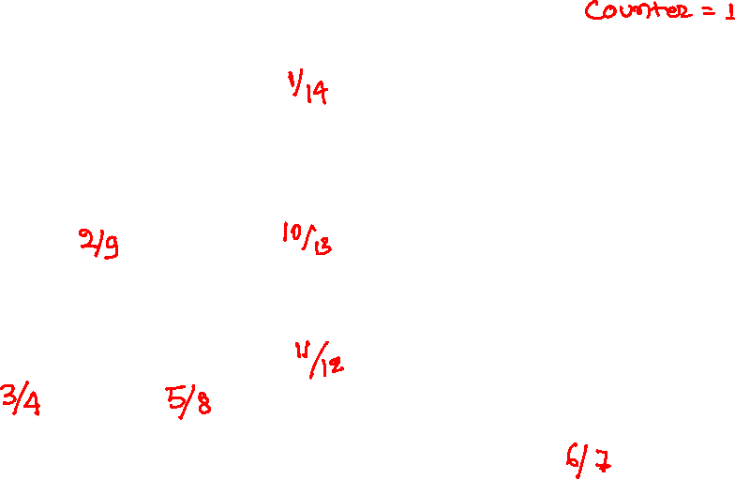
DFS
A
A
B
C
G
D
F
E

Slide 13
DFS
A
1/
B
C
G
D
F
E
Notes:
In the DFS algorithm, when a vertex is visited for the first time, it is marked as gray. A vertex is marked as black when we backtrack from the vertex. DFS also maintains a global counter that is incremented every time a vertex is marked as gray or black. A vertex contains two fields: discovery time and finish time. When a node is marked as gray, the discovery time is set to the current counter value. When a node is marked as black, the finish time is set to the current counter value. Initially, the counter value is one. In this example, we start from vertex A. Initially, vertex A is marked as gray, and the discovery time is set to the counter value, i.e., 1. The counter value is updated to 2. The DFS algorithm now picks one neighbor and explores it completely before moving on to the next neighbor.

Slide 14
DFS
A
1/
B
C
2/
G
D
F
E
Notes:
The algorithm picked neighbor B. The discovery time of B is set to the current counter value, i.e., 2. Afterward, the counter is set to 3. When a vertex is discovered for the first time, the corresponding edge is called a tree edge or a discovery edge. Tree edges are shown in red. The DFS will now explore one of the neighbors of B that hasn’t been discovered yet.

Slide 15
DFS
A
1/
B
C
2/
G
D
F
3/
E
Notes:
The algorithm picked 3. The discovery time is set to 3. Now DFS will explore neighbors of F.

Slide 16
DFS
A
1/
B
C
2/
G
D
F
3/
E
4/
Notes:
The algorithm has now picked E. The discovery time is set to 4. Now, the algorithm will explore the neighbors of E.

Slide 17
DFS
A
1/
B
C
2/
G
D
F
3/
E
4/
Notes:
The neighbors of E (A and F) have already been visited. Edge (E, A) is not a tree edge because A has already been discovered. We have shown non-tree edges in black. The edges that are yet to be explored are blue. Now, we have reached a dead end, as there are no more vertices to explore. In that case, we can backtrack from E to a node from which we have reached E, i.e., F. We can maintain a stack or use the predecessor field in the vertex (similar to the one we maintained in BFS) for backtracking. However, a simpler approach would be to use recursion because it implicitly maintains a stack that can be used for backtracking. After backtracking from E, the DFS algorithm will track other undiscovered vertices of F. We mark a node as black just before the backtracking.

Slide 18
DFS
A
1/
B
C
2/
G
D
F
3/
E
4/5
Notes:
While marking a vertex as black, we also need to update the finish time of the vertex, which is set to the current counter value. The counter is incremented before backtracking to the predecessor.

Slide 19
DFS
A
1/
B
C
2/
G
D
F
3/6
E
4/5
Notes:
There are no other vertices to explore at F, so we updated the finish time and marked the vertex black. The DFS algorithm will now backtrack to B.

Slide 20
DFS
A
1/
B
C
2/
G
D
F
7/
3/6
E
4/5
Notes:
After backtracking, we reach vertex B. The vertex D is an unexplored neighbor of B. D is marked as gray.

Slide 21
DFS
A
1/
B
C
2/
G
D
F
7/8
3/6
E
4/5
Notes:
There is no other vertex to explore at D. We mark D as black and backtrack to B.

Slide 22
DFS
A
1/
B
C
2/9
G
D
F
7/8
3/6
E
4/5
Notes:
We need to backtrack from B as well because we have explored all undiscovered neighbors. After backtracking, we reach vertex A.

Slide 23
DFS
A
1/
B
C
2/9
10/
G
D
F
7/8
3/6
E
4/5
Notes:
Neighbour C of A has not been explored yet. The DFS algorithm marks C as gray.

Slide 24
DFS
A
1/
B
C
2/9
10/
G
D
F
11/
7/8
3/6
E
4/5
Notes:
Neighbour G of C hasn’t been explored yet. The DFS algorithm marks G as gray.

Slide 25
DFS
A
1/
B
C
2/9
10/
G
D
F
11/12
7/8
3/6
E
4/5
Notes:
Backtracking from G to C because there is no other vertex to explore.

Slide 26
DFS
A
1/
B
C
2/9
10/13
G
D
F
11/12
7/8
3/6
E
4/5
Notes:
Backtracking from C to A.

Slide 27
DFS
A
1/
14
B
C
2/9
10/13
G
D
F
11/12
7/8
3/6
E
4/5
Notes:
There is nothing to backtrack at A. The algorithm stops at this point after marking A as black and updating its finish time.

Slide 28
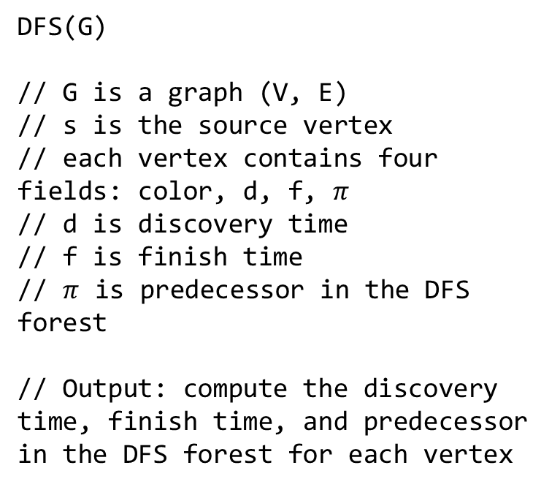
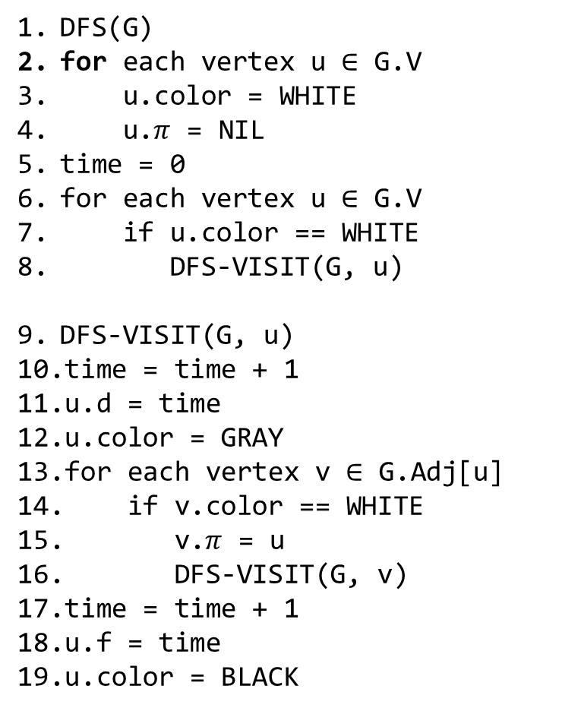
DFS
DFS(G)
for each vertex u $∈$ G.V
u.color = WHITE
u.$π$ = NIL
time = 0
for each vertex u $∈$ G.V
if u.color == WHITE
DFS-VISIT(G, u)
DFS-VISIT(G, u)
time = time + 1
u.d = time
u.color = GRAY
for each vertex v $∈$ G.Adj[u]
if v.color == WHITE
v.$π$ = u
DFS-VISIT(G, v)
time = time + 1
u.f = time
u.color = BLACK
DFS(G)
// G is a graph (V, E)
// s is the source vertex
// each vertex contains four fields: color, d, f, $π$
// d is discovery time
// f is finish time
// $π$ is predecessor in the DFS forest
// Output: compute the discovery time, finish time, and predecessor in the DFS forest for each vertex

Slide 29
Time complexity
O(|V| + |E|)
Notes:
The justification is given on the next slide.

Slide 30
Time complexity
DFS-visit is called at line-8,16 for every white vertex
The vertex is marked gray at the start of DFS-visit at line-12
A vertex never gets whitened after it changes its color
Therefore DFS-visit is called |V| times, one for each vertex
At line-13, the adjacency list of a vertex is traversed
Therefore, line-13 executes the sum of the degree of all vertices time, which is O(|E|)
The for loop body at lines 14-16 does a constant number of operations
Therefore, the time complexity is O(|V|+|E|)

Slide 31
DFS-tree
A
1/
14
B
C
2/9
10/13
G
D
F
11/12
7/8
3/6
E
4/5

Slide 32

DFS-tree
1/
14
A
A
1/
14
B
10/13
2/9
C
B
C
2/9
10/13
D
G
7/8
F
11/12
3/6
G
D
F
11/12
7/8
3/6
E
E
4/5
4/5

Slide 33
DFS-tree
Why do discovery edges form a tree?
A
1/
14
B
C
2/9
10/13
D
F
G
7/8
3/6
11/12
E
4/5

Slide 34
DFS-tree
Why do discovery edges form a tree?
A vertex is discovered only once; therefore, each vertex has a single predecessor except the source vertex, which doesn’t have any predecessor. Thus the number of edges is n-1.
There is a path from each vertex to the source vertex. Therefore, all vertices are connected.
Hence, it is a tree.
A
1/
14
B
C
2/9
10/13
D
F
G
7/8
3/6
11/12
E
4/5

Slide 35
Back-edges
A
Why is a non-tree edge always a back-edge/forward-edge, i.e., an edge between nodes with a descendent ancestor relationship in the BFS tree?
1/
14
B
C
2/9
10/13
D
F
G
7/8
3/6
11/12
E
Edge (D, E) is not possible.
4/5
Notes:
There can't be a non-tree edge between nodes that don't have an ancestor/descendent relationship. Suppose there is an edge between D and F (D and F don't have an ancestor/descendent relationship). When we arrive at D, only the ancestors of D can be gray. Therefore, E is either black or white. If E is white, the DFS algorithm will explore vertex E right now; thus, edge (D, E) will become a tree edge. Let's say E is black. In this case, when the DFS algorithm reaches E, D must have been white because D has not been blackened yet, and only an ancestor can be gray. Therefore, the DFS algorithm must have traversed edge (E, D) then, making it a tree edge. Therefore, non-tree edges are not possible for edges whose endpoints don't have an ancestor-descendent relationship.

Slide 36
DFS on directed graph

Slide 37
DFS on a directed graph
The algorithm for a directed graph is the same as an undirected graph
The tree generated during DFS on a directed graph for a given vertex v generates a directed DFS tree
In a directed DFS tree, there is a path from v to all other vertices that are reachable via v; however, the opposite is not true

Slide 38
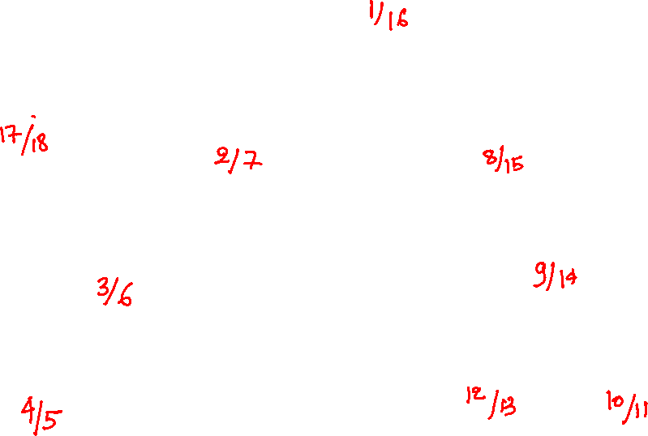
DFS
A
I
B
C
D
E
F
G
H

Slide 39
DFS
A
I
B
C
D
E
F
G
H

Slide 40
DFS
A
1/
I
B
C
D
E
F
G
H

Slide 41
DFS
A
1/
I
B
C
2/
D
E
F
G
H

Slide 42
DFS
A
1/
I
B
C
2/
D
3/
E
F
G
H

Slide 43
DFS
A
1/
I
B
C
2/
D
3/
E
F
4/
H
G

Slide 44
DFS
A
1/
I
B
C
2/
D
3/
E
F
4/
H
G

Slide 45
DFS
A
1/
I
B
C
2/
D
3/
E
F
4/5
H
G

Slide 46
DFS
A
1/
I
B
C
2/
D
3/6
E
F
4/5
H
G

Slide 47
DFS
A
1/
I
B
C
2/7
D
3/6
E
F
4/5
H
G

Slide 48
DFS
A
1/
I
B
C
2/7
8/
D
3/6
E
F
4/5
H
G

Slide 49
DFS
A
1/
I
B
C
2/7
8/
D
9/
3/6
E
F
4/5
H
G

Slide 50
DFS
A
1/
I
B
C
2/7
8/
D
9/
3/6
E
F
4/5
H
G

Slide 51
DFS
A
1/
I
B
C
2/7
8/
D
9/
3/6
E
F
10/
4/5
H
G

Slide 52
DFS
A
1/
I
B
C
2/7
8/
D
9/
3/6
E
F
10/11
4/5
H
G

Slide 53
DFS
A
1/
I
B
C
2/7
8/
D
9/
3/6
E
F
10/11
12/
4/5
H
G

Slide 54
DFS
A
1/
I
B
C
2/7
8/
D
9/
3/6
E
F
10/11
12/13
4/5
H
G

Slide 55
DFS
A
1/
I
B
C
2/7
8/
D
9/
14
3/6
E
F
10/11
12/13
4/5
H
G

Slide 56
DFS
A
1/
I
B
C
2/7
8/
15
D
9/
14
3/6
E
F
10/11
12/13
4/5
H
G

Slide 57
DFS
A
1/
I
B
C
2/7
8/
15
D
9/
14
3/6
E
F
10/11
12/13
4/5
H
G

Slide 58
DFS
A
1/
16
I
B
C
2/7
8/
15
D
9/
14
3/6
E
F
10/11
12/13
4/5
H
G

Slide 59
DFS
A
1/
16
I
17/
B
C
2/7
8/
15
D
9/
14
3/6
E
F
10/11
12/13
4/5
H
G

Slide 60
DFS
A
1/
16
I
17/
B
C
2/7
8/
15
D
9/
14
3/6
E
F
10/11
12/13
4/5
H
G

Slide 61
DFS
A
1/
16
I
17/
B
C
2/7
8/
15
D
9/
14
3/6
E
F
10/11
12/13
4/5
H
G

Slide 62
DFS
A
1/
16
I
17/
18
B
C
2/7
8/
15
D
9/
14
3/6
E
F
10/11
12/13
4/5
H
G

Slide 63
Edges
Edge classification
Red ones are tree edges
Green ones are forward edges
edge to a descendent node in the tree
Black ones are back edges
edge to an ancestor node in the tree
Blue ones are cross edges
endpoints don’t have ancestor/descendent relationship
A
1/
16
I
17/
18
B
C
2/7
8/
15
D
9/
14
3/6
E
F
10/11
12/13
4/5
H
G

Slide 64

Edges
for vertex v, v.d is the discovery time
for vertex v, v.f is the finish time
edge (u, v) is a back edge if
A
1/
16
I
17/
18
B
C
2/7
8/
15
D
9/
14
3/6
E
F
10/11
12/13
4/5
H
G
Notes:
This is the condition for a back edge.

Slide 65
Edges
for vertex v, v.d is the discovery time
for vertex v, v.f is the finish time
edge (u, v) is a back edge if
v.d < u.d < u.f < v.f
A
1/
16
I
17/
18
B
C
2/7
8/
15
D
9/
14
3/6
E
F
10/11
12/13
4/5
H
G

Slide 66
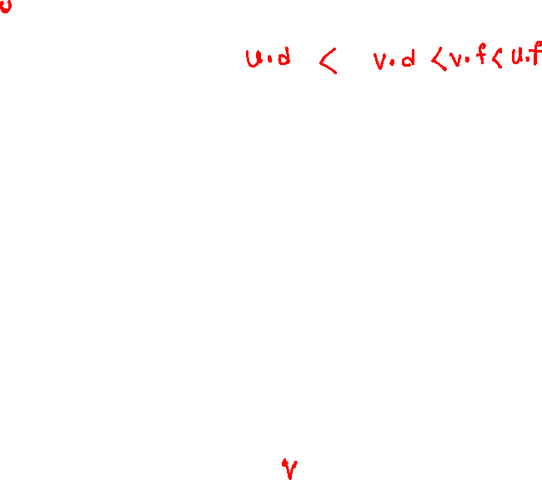
Edges
for vertex v, v.d is the discovery time
for vertex v, v.f is the finish time
edge (u, v) is a forward edge if
A
1/
16
I
17/
18
B
C
2/7
8/
15
D
9/
14
3/6
E
F
10/11
12/13
4/5
H
G
Notes:
This is the condition for a forward edge.

Slide 67
Edges
for vertex v, v.d is the discovery time
for vertex v, v.f is the finish time
edge (u, v) is a forward edge if
u.d < v.d < v.f < u.f
A
1/
16
I
17/
18
B
C
2/7
8/
15
D
9/
14
3/6
E
F
10/11
12/13
4/5
H
G

Slide 68

Edges
for vertex v, v.d is the discovery time
for vertex v, v.f is the finish time
edge (u, v) is a cross edge if
A
1/
16
I
17/
18
B
C
2/7
8/
15
D
9/
14
3/6
E
F
10/11
12/13
4/5
H
G
Notes:
This is the condition for a cross edge.

Slide 69
Edges
for vertex v, v.d is the discovery time
for vertex v, v.f is the finish time
edge (u, v) is a cross edge if
v.d < v.f < u.d < u.f
A
1/
16
I
17/
18
B
C
2/7
8/
15
D
9/
14
3/6
E
F
10/11
12/13
4/5
H
G

Slide 70
Ordering
A
1/
16
I
17/
18
B
C
2/7
8/
15
D
9/
14
3/6
E
F
10/11
12/13
4/5
H
G

Slide 71
Ordering
Arrange vertices in the reverse order in which they are blackened

Slide 72
Ordering
Arrange vertices in the reverse order in which they are blackened
I
A
C
E
H
G
B
D
F
Notes:
The explanation is given on the following slides.

Slide 73
Ordering
Let’s arrange vertices in the reverse order in which they are blackened
In the DFS tree, a descendent node always finishes (gets blackened) before its ancestor node, therefore
A tree edge (ancestor to descendent) will always be from left to right
A forward edge (ancestor to descendent) will always be from left to right

Slide 74
Ordering
For a cross edge (u, v), there is no ancestor/descendent relationship between the u and v, therefore
v must be black
If v is gray, then it is one of the ancestors
If v is white, then v is discovered for the first time; thus, it is a tree edge
Consequently, v is blackened before u
It means that the cross edge will also be from left to right
For a back edge (u, v), the destination vertex is an ancestor in the tree; therefore, the back edge will be from right to left
Because u is reachable from all ancestor vertices, including v, and v is reachable via u using the back edge, therefore a back edge must create a cycle

Slide 75
Ordering
If we redraw the graph, which has only tree edges, forward edges, and cross edges in the reverse order in which they are blackened, then all the edges will be from left to right, and therefore there will be no cycle

Slide 76
Detecting cycle in directed graph

Slide 77
Detecting cycle
A
1/
16
I
17/
18
B
C
2/7
8/
15
D
9/
14
3/6
E
F
10/11
12/13
4/5
H
G
Notes:
A back edge in a directed graph indicated the presence of a cycle. A back edge is between a descendent and an ancestor in the DFS tree. The ancestor is marked black only when all its descendants have been marked black. When we encounter a back edge (u, v), where u is the descendent of v, it means u hasn’t been blackened yet, and so it v. Thus, to check if an edge is a back edge, we just need to check the color of the destination vertex. If the color of the destination vertex is gray, it means it’s a back edge.

Slide 78
Detecting cycle
During DFS, if we encounter a destination vertex that is neither white (tree edge) nor black (cross or forward edge), then the graph has a cycle

Slide 79
Topological sort

Slide 80
Example
Build_Max_Heap
Max_Heap_Extract_Max
Max_Heap_Insert
Max_Heap_Maximum
Max_Heapify
Heapsort
Max_Heap_Increase_Key

Slide 81

Example
Is this a valid topological order?
Heapify, Build_Heap, Extract_Max, Heapsort, Maximum, Increase_Key, Insert
Heapify
Build_Heap
Maximum
Extract_Max
Heapsort
Increase_Key
Insert
Notes:
An edge represents dependency. In this example, Build_Heap implementation depends on Heapify. Similarly, Heapsort implementation depends on Extract_Max, and so on. If we can order vertices so that if a vertex v comes before another vertex u in the ordering means v must doesn't depend on u, then it's a topologically sorted order.

Slide 82

Example
Is this a valid topological order?
Heapify, Maximum, Build_Heap, Extract_Max, Heapsort, Increase_Key, Insert
Heapify
Build_Heap
Maximum
Extract_Max
Heapsort
Increase_Key
Insert

Slide 83

Example
Is this a valid topological order?
Maximum, Heapify, Build_Heap, Extract_Max, Heapsort, Increase_Key, Insert
Heapify
Build_Heap
Maximum
Extract_Max
Heapsort
Increase_Key
Insert

