Slide 2
Today’s topics
Topological sort
Bipartite graph
Strongly connected components

Slide 3
References
Read chapter-20 of the CLRS book
Read chapter-6 from Goodrich and Tamassia book
https://en.wikipedia.org/wiki/Depth-first_search
https://en.wikipedia.org/wiki/Bipartite_graph

Slide 4
Topological sort

Slide 5
Example
Build_Max_Heap
Max_Heap_Extract_Max
Max_Heap_Insert
Max_Heap_Maximum
Max_Heapify
Heapsort
Max_Heap_Increase_Key

Slide 6
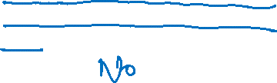
Example
Is this a valid topological order?
Heapify, Build_Heap, Extract_Max, Heapsort, Maximum, Increase_Key, Insert
Heapify
Build_Heap
Maximum
Extract_Max
Heapsort
Increase_Key
Insert

Slide 7

Example
Is this a valid topological order?
Heapify, Maximum, Build_Heap, Extract_Max, Heapsort, Increase_Key, Insert
Heapify
Build_Heap
Maximum
Extract_Max
Heapsort
Increase_Key
Insert

Slide 8

Example
Is this a valid topological order?
Maximum, Heapify, Build_Heap, Extract_Max, Heapsort, Increase_Key, Insert
Heapify
Build_Heap
Maximum
Extract_Max
Heapsort
Increase_Key
Insert

Slide 9
Example
Is this a valid topological order?
Increase_Key, Maximum, Heapify, Build_Heap, Extract_Max, Heapsort, Insert
Heapify
Build_Heap
Maximum
Extract_Max
Heapsort
Increase_Key
Insert

Slide 10

Example
Is this a valid topological order?
Increase_Key, Insert, Maximum, Heapify, Build_Heap, Extract_Max, Heapsort
Heapify
Build_Heap
Maximum
Extract_Max
Heapsort
Increase_Key
Insert

Slide 11
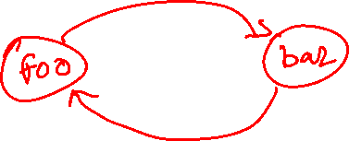
Example
int bar(int m, int n) {
if (m == n)
return m;
if (m < n)
return foo(m, n);
return bar(m-2, n+1);
}
int foo(int m, int n) {
if (m == n)
return m;
if (m > n)
return bar(m, n);
return foo(m+1, n-1);
}
What is the dependency graph?
Notes:
If there is a cycle, a topological sorted order is not possible.

Slide 12
Applications
Job scheduling
Creating a course plan for a set of courses with prerequisites

Slide 13
Topological sort
A directed graph is acyclic if it doesn’t have any cycle
Topological sort is the ordering of vertices in a directed acyclic graph G such that if (u, v) is an edge in G, then u appears before v in the ordering
Notice that no such ordering exists for an undirected graph or a directed cyclic graph

Slide 14
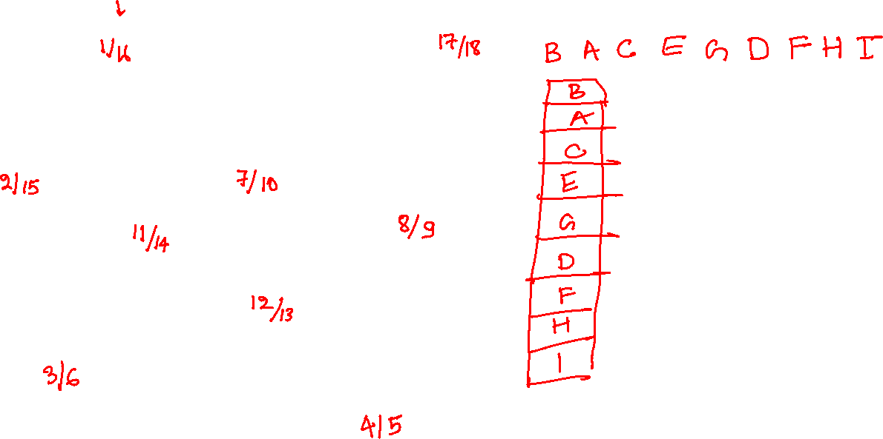
Topological sort
A
B
C
F
D
E
G
H
I

Slide 15
Topological sort
A
B
1/
C
F
D
E
G
H
I
Notes:
To do the topological sort, we can do DFS and then order the vertices in the reverse order of their finish time. Notice that in the DFS tree, the finish time of an ancestor is always larger than its decedents, and an ancestor will always come before in the topologically sorted order; therefore, printing the vertices in the reverse order of their finish time will always print an ancestor before its descendants. In this example, A is an ancestor of C and D in the DFS tree. But what if we start DFS from D. In that case, how the finish time of A will be larger than D? Notice that if we start from D, A will not appear in the DFS tree corresponding to D because A is not reachable from D. After doing a DFS at D when we iterate through the unvisited vertices, we will encounter A and start DFS at A. At this point also, the finish time of A is guaranteed to be more than D.

Slide 16
Topological sort
A
B
1/
C
2/
F
D
E
G
H
I

Slide 17
Topological sort
A
B
1/
C
2/
F
3/
D
E
G
H
I

Slide 18
Topological sort
A
B
1/
C
2/
F
3/
D
E
4/
G
H
I

Slide 19
Topological sort
A
B
1/
C
2/
F
3/
D
E
4/
G
H
5/
I

Slide 20
Topological sort
A
B
1/
I
C
2/
F
3/
D
E
4/
G
H
5/6
I
Notes:
When the finish time is available (i.e., the vertex is marked as black), we add them to a stack. Because the finish time of vertices added later to the stack must have a higher finish time, when this algorithm terminates, the stack already contains all the vertices in the topological order, starting from top to bottom.

Slide 21
Topological sort
A
B
1/
G
I
C
2/
F
3/
D
E
4/7
G
H
5/6
I

Slide 22
Topological sort
A
B
1/
E
G
I
C
2/
F
3/8
D
E
4/7
G
H
5/6
I

Slide 23
Topological sort
A
B
1/
E
G
I
C
2/
9/
F
3/8
D
E
4/7
G
H
5/6
I

Slide 24
Topological sort
A
B
1/
E
G
I
C
2/
9/
10/
F
3/8
D
E
4/7
G
H
5/6
I

Slide 25
Topological sort
A
B
1/
F
E
G
I
C
2/
9/
10/
11
F
3/8
D
E
4/7
G
H
5/6
I

Slide 26
Topological sort
A
B
1/
D
F
E
G
I
C
2/
9/
12
10/
11
F
3/8
D
E
4/7
G
H
5/6
I

Slide 27
Topological sort
A
B
1/
D
F
E
G
I
C
2/
9/
12
10/
11
F
3/8
D
E
4/7
G
13/
H
5/6
I

Slide 28
Topological sort
A
B
1/
D
F
E
G
I
C
2/
9/
12
10/
11
F
3/8
D
E
4/7
G
13/
H
5/6
I

Slide 29
Topological sort
A
B
1/
H
D
F
E
G
I
C
2/
9/
12
10/
11
F
3/8
D
E
4/7
G
13/14
H
5/6
I

Slide 30
Topological sort
A
B
1/
C
H
D
F
E
G
I
C
2/
15
9/
12
10/
11
F
3/8
D
E
4/7
G
13/14
H
5/6
I

Slide 31
Topological sort
A
B
1/
C
H
D
F
E
G
I
C
2/
15
9/
12
10/
11
F
3/8
D
E
4/7
G
13/14
H
5/6
I

Slide 32
Topological sort
A
B
1/
16
A
C
H
D
F
E
G
I
C
2/
15
9/
12
10/
11
F
3/8
D
E
4/7
G
13/14
H
5/6
I

Slide 33
Topological sort
A
B
1/
16
17/
A
C
H
D
F
E
G
I
C
2/
15
9/
12
10/
11
F
3/8
D
E
4/7
G
13/14
H
5/6
I

Slide 34
Topological sort
A
B
1/
16
17/
A
C
H
D
F
E
G
I
C
2/
15
9/
12
10/
11
F
3/8
D
E
4/7
G
13/14
H
5/6
I

Slide 35
Topological sort
A
B
1/
16
17/
A
C
H
D
F
E
G
I
C
2/
15
9/
12
10/
11
F
3/8
D
E
4/7
G
13/14
H
5/6
I

Slide 36
Topological sort
A
B
1/
16
17/18
B
A
C
H
D
F
E
G
I
C
2/
15
9/
12
10/
11
F
3/8
D
E
4/7
G
13/14
H
5/6
I

Slide 37
Topological sort
TOPOLOGICAL_SORT(G)
// Input graph G
// Output: A linked list that contains
// vertices in topological sorted order
L = DFS_TSORT(G)
// DFS_TSORT computes v.f for each vertex
// and returns a list that contains
// vertices in the decreasing order of
// their finish time

Slide 38
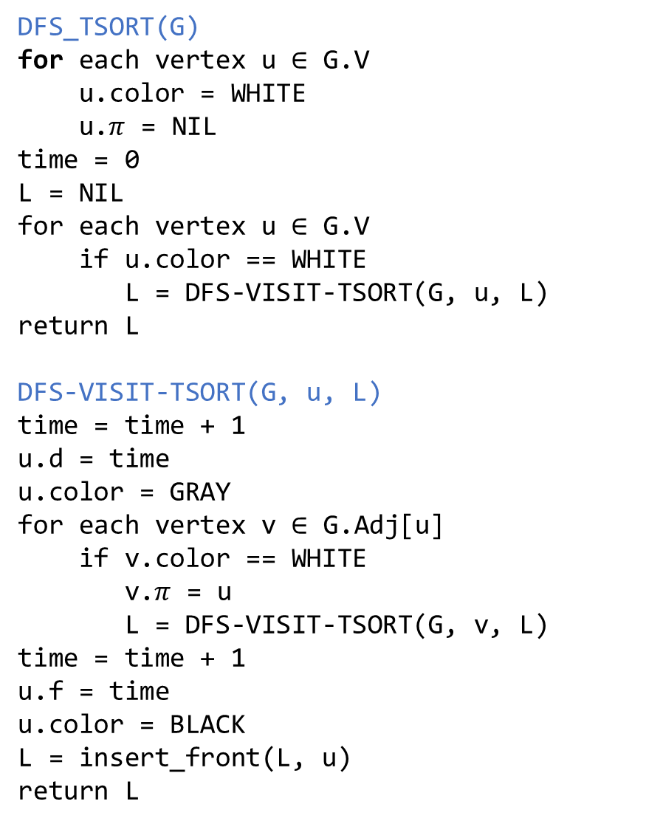

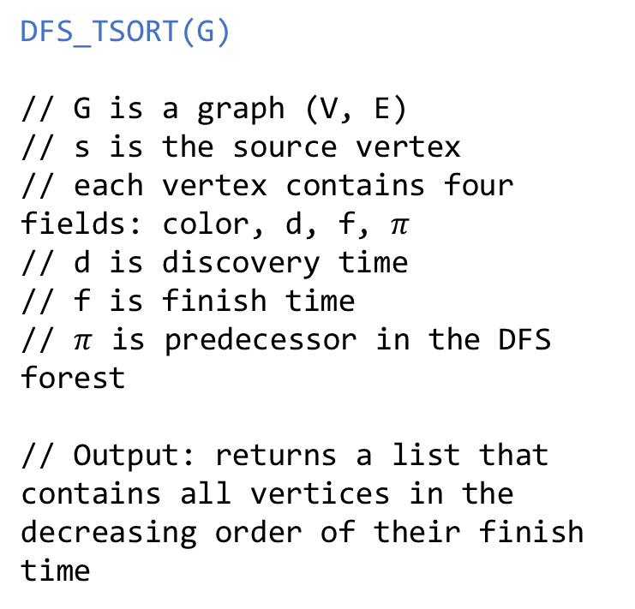
DFS_TSORT
DFS_TSORT(G)
for each vertex u $∈$ G.V
u.color = WHITE
u.$π$ = NIL
time = 0
L = NIL
for each vertex u $∈$ G.V
if u.color == WHITE
L = DFS-VISIT-TSORT(G, u, L)
return L
DFS-VISIT-TSORT(G, u, L)
time = time + 1
u.d = time
u.color = GRAY
for each vertex v $∈$ G.Adj[u]
if v.color == WHITE
v.$π$ = u
L = DFS-VISIT-TSORT(G, v, L)
time = time + 1
u.f = time
u.color = BLACK
L = insert_front(L, u)
return L
DFS_TSORT(G)
// G is a graph (V, E)
// s is the source vertex
// each vertex contains four fields: color, d, f, $π$
// d is discovery time
// f is finish time
// $π$ is predecessor in the DFS forest
// Output: returns a list that contains all vertices in the decreasing order of their finish time
Notes:
In this modified algorithm, we add a vertex to the front of a linked list whenever its finish time is updated. Finally, this algorithm returns the linked list that stores the vertices in topologically sorted order.

Slide 39
Applications of BFS and DFS

Slide 40
Applications
Bipartite graph
Strongly connected component

Slide 41
Path finding
For finding a path between given two vertices, which algorithm is better: BFS or DFS
Notes:
DFS is better if the target vertex is far from the source vertex. If the target is near the source vertex, BFS might give a better result.

Slide 42
Bipartite graph

Slide 43
Bipartite graph
https://en.wikipedia.org/wiki/Bipartite_graph

Slide 44
Bipartite graph
A undirected connected graph is bipartite if the vertices can be partitioned into two sets, X and Y, such that all the edges have one endpoint in X and the other endpoint in Y
Another way of looking at this problem is a graph coloring problem in which you need to color the graph using two colors in such a way that two adjacent vertices can’t have the same color

Slide 45
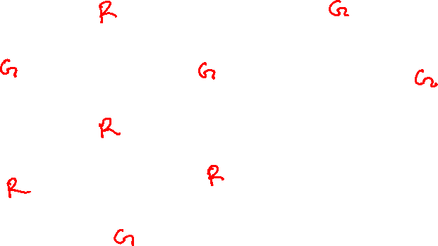
Bipartite graph
Can we color this graph using two colors?
w
x
r
s
v
z
y
t
u
Notes:
In the graph coloring problem, we want to assign a color to each vertex in such a way that two adjacent vertices do not have the same color. We cannot color this graph using two colors.

Slide 46

Can we color a tree using two colors
w
x
r
s
v
z
y
t
u

Slide 47
Can we color a tree using two colors
w
x
r
s
v
z
Yes, because we can always assign a color to a child different from its parent. Every child has exactly one parent.
y
t
u

Slide 48
Bipartite graph
BFS already partitions the vertices into different levels
Can we check that a graph is bipartite by assigning colors to different levels?

Slide 49
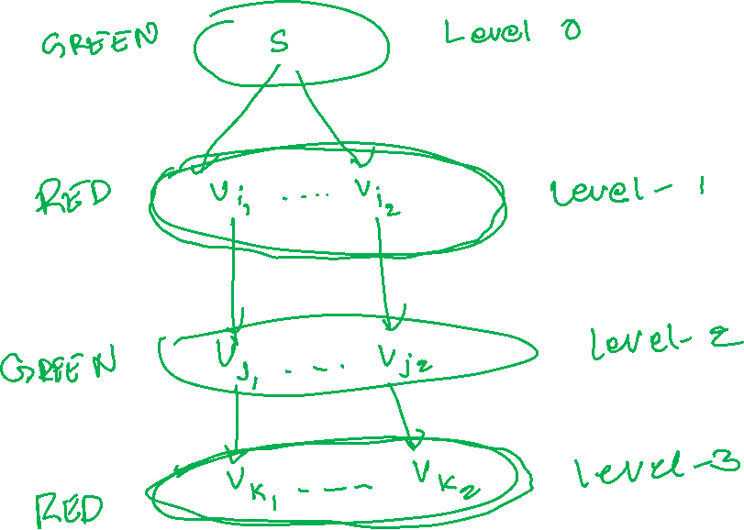
Bipartite graph
Notes:
We can assign alternate colors to alternate levels. Let’s say we have two colors, green and red; we can assign green to level-0, red to level-1, green to level-2, and so on. If the edges are only between the adjacent levels, then the graph is bipartite. If the edges are between the vertices at the same level, then the graph is not bipartite. Notice that the endpoints of a tree edge are always between adjacent levels. A non-tree edge can be between vertices at adjacent levels or at the same level.

Slide 50
Bipartite graph
We can assign different colors to adjacent levels, e.g.,
Level-0 can be assigned color-1
Level-1 can be assigned color-2
Level-2 can be assigned color-1
Level-3 can be assigned color-2
and so on
The graph is bipartite if the endpoints of all edges are between adjacent levels only
The graph is not bipartite if both endpoints of an edge belong to the same level

Slide 51
Tree edges
Tree edges are always between adjacent levels, and therefore, the graph is always bipartite
We already discussed that a tree is always bipartite

Slide 52
Non-tree edge
The endpoints of a non-tree edge can be between vertices at the same level or at an adjacent level
In both cases, it will create a cycle

Slide 53
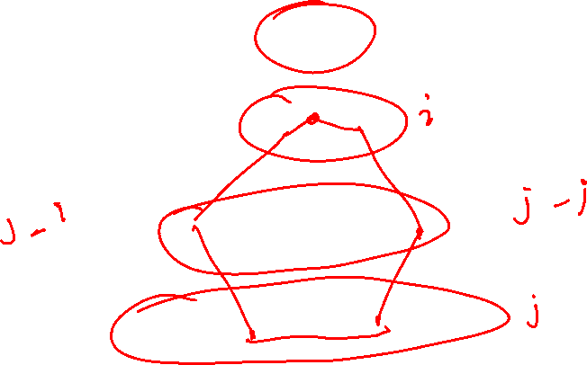
Non-tree edge
Is the total number of edges in the cycle created by a non-tree edge (u, v) with endpoints at the same level always odd?

Slide 54
Non-tree edge
Is the total number of edges in the cycle created by a non-tree edge (u, v) with endpoints at the same level always odd?
Let’s consider a vertex s is at the lowest level out of all the vertices in the cycle
The length of the path from s to u and s to v must be the same, say L
Therefore, the number of edges in the cycle is 2 * L + 1, i.e., an odd number

Slide 55
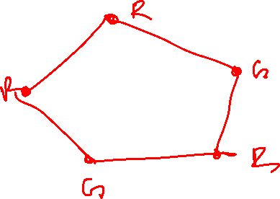
Non-tree edge
We can’t color a cycle with an odd number of edges with two colors when the number of edges is more than two
Therefore, the graph is not bipartite

Slide 56
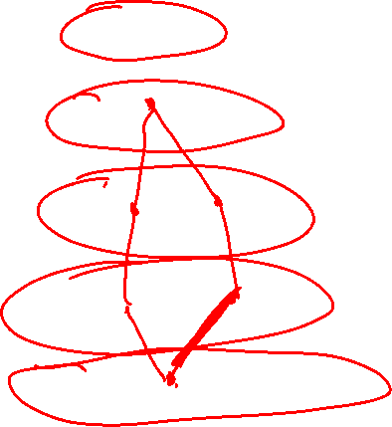
Non-tree edge
Is the total number of edges in the cycle created by a non-tree edge (u, v) with endpoints at adjacent levels always even?

Slide 57
Non-tree edge
Is the total number of edges in the cycle created by a non-tree edge (u, v) with endpoints at adjacent levels always even?
Let’s consider s is at the lowest level out of all the vertices in the cycle
Therefore, the number of edges in the cycle is 2 * L, where L is the length of the path from s to v (assuming v is at the higher level)

Slide 58
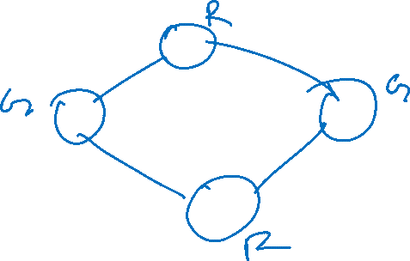
Non-tree edge
We can always color a cycle with an even number of edges with two colors
Therefore, the graph is bipartite

Slide 59
Bipartite graph
How can we check if the endpoints of a non-tree edge are at the same level?

Slide 60
Bipartite graph
How can we check if the endpoints of a non-tree edge are at the same level?
We can use the distance field in the vertex. Distance and level are the same.
If during BFS, we encounter a vertex v that has been visited and its distance from the source is the same as the current vertex u, this means that (u, v) is a non-tree edge whose endpoints are at the same level

Slide 61
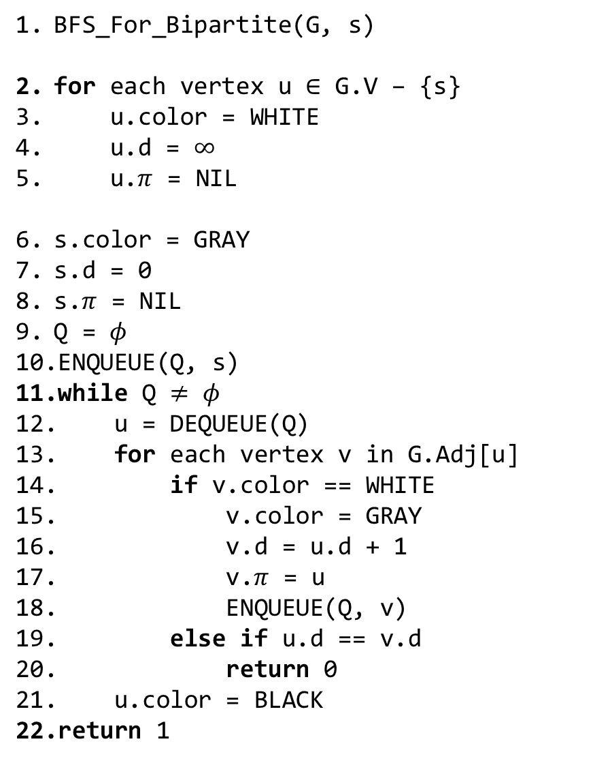

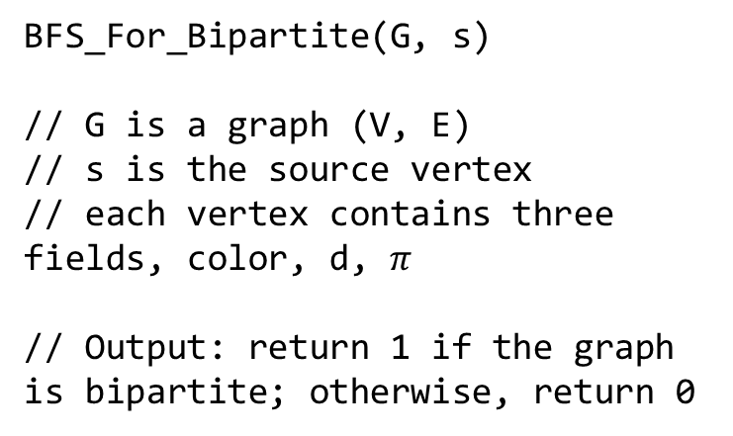
Bipartite graph
BFS_For_Bipartite(G, s)
for each vertex u $∈$ G.V – {s}
u.color = WHITE
u.d = $∞$
u.$π$ = NIL
s.color = GRAY
s.d = 0
s.$π$ = NIL
Q = $φ$
ENQUEUE(Q, s)
while Q $≠$ $φ$
u = DEQUEUE(Q)
for each vertex v in G.Adj[u]
if v.color == WHITE
v.color = GRAY
v.d = u.d + 1
v.$π$ = u
ENQUEUE(Q, v)
else if u.d == v.d
return 0
u.color = BLACK
return 1
BFS_For_Bipartite(G, s)
// G is a graph (V, E)
// s is the source vertex
// each vertex contains three fields, color, d, $π$
// Output: return 1 if the graph is bipartite; otherwise, return 0
Notes:
We are checking the distances at line-19.

Slide 62
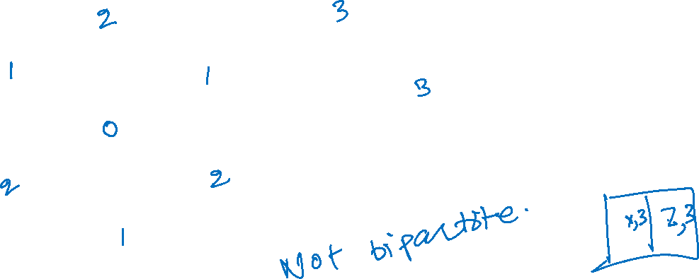
Bipartite graph
w
x
r
s
v
z
y
t
u

Slide 63
Strong connectivity

Slide 64
Strong connectivity
Section-20.5 from the CLRS book
Section-6.4 from the Goodrich and Tamassia book
https://en.wikipedia.org/wiki/Strongly_connected_component

Slide 65
Strong connectivity
A directed graph is strongly connected if every vertex is reachable from all other vertices

Slide 66
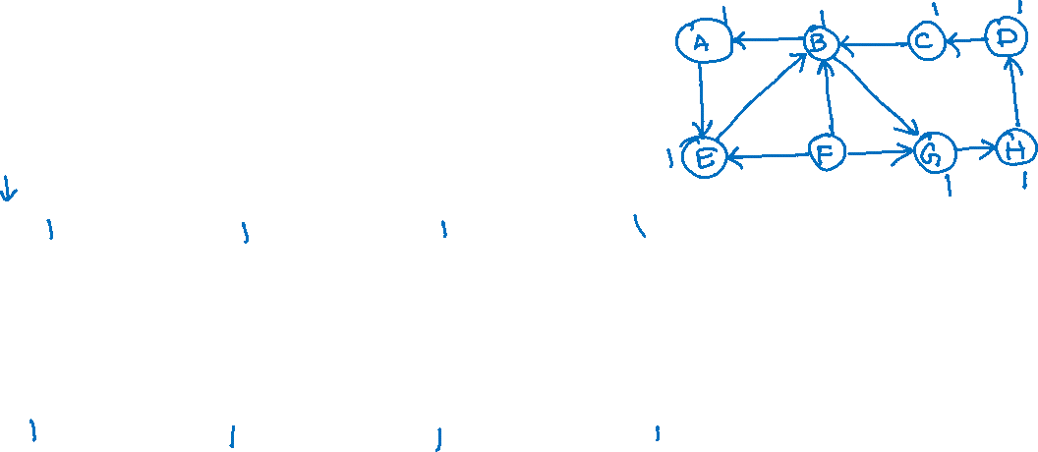
Strong connectivity
A
B
C
D
E
F
G
H

Slide 67
Strong connectivity
A
B
C
D
E
F
G
H
Notes:
First, we will do a DFS to find all vertices reachable from A.

Slide 68
Strong connectivity
A
B
C
D
E
F
G
H

Slide 69
Strong connectivity
A
B
C
D
E
F
G
H

Slide 70
Strong connectivity
A
B
C
D
E
F
G
H

Slide 71
Strong connectivity
A
B
C
D
E
F
G
H

Slide 72
Strong connectivity
A
B
C
D
E
F
G
H

Slide 73
Strong connectivity
A
B
C
D
E
F
G
H

Slide 74
Strong connectivity
A
B
C
D
E
F
G
H

Slide 75
Strong connectivity
A
B
C
D
E
F
G
H

Slide 76
Strong connectivity
A
B
C
D
E
F
G
H

Slide 77
Strong connectivity
A
B
C
D
E
F
G
H

Slide 78
Strong connectivity
A
B
C
D
E
F
G
H

Slide 79
Strong connectivity
A
B
C
D
E
F
G
H

Slide 80
Strong connectivity
A
B
C
D
E
F
G
H

Slide 81
Strong connectivity
A
B
C
D
E
F
G
H

Slide 82
Strong connectivity
A
B
C
D
E
F
G
H
Notes:
The graph can be strongly connected because all vertices are reachable from A. Next, we need to check whether we can reach A from all other vertices to conclude that this graph is indeed strongly connected.

Slide 83
Strong connectivity
Reverse all edges if all vertices are reachable via some starting vertex
Run DFS again on the starting vertex

Slide 84
Strong connectivity
Reversing edges
A
B
C
D
E
F
G
H
Notes:
To find out that A is reachable from all other vertices, we can reverse all edges and run BFS at A again. If all vertices are reachable via A, it means that we can reach A via all vertices because the path from A to another vertex computed during DFS is a reversed path from A to that vertex.

Slide 85
Strong connectivity
Reversing edges
Reset all colors
A
B
C
D
E
F
G
H

Slide 86
Strong connectivity
Reversing edges
Reset all colors
Running DFS on A
A
B
C
D
E
F
G
H

Slide 87
Strong connectivity
A
B
C
D
E
F
G
H

Slide 88
Strong connectivity
A
B
C
D
E
F
G
H

Slide 89
Strong connectivity
A
B
C
D
E
F
G
H

Slide 90
Strong connectivity
A
B
C
D
E
F
G
H

Slide 91
Strong connectivity
A
B
C
D
E
F
G
H

Slide 92
Strong connectivity
A
B
C
D
E
F
G
H

Slide 93
Strong connectivity
A
B
C
D
E
F
G
H

Slide 94
Strong connectivity
A
B
C
D
E
F
G
H

Slide 95
Strong connectivity
A
B
C
D
E
F
G
H

Slide 96
Strong connectivity
A
B
C
D
E
F
G
H

Slide 97
Strong connectivity
A
B
C
D
E
F
G
H

Slide 98
Strong connectivity
A
B
C
D
E
F
G
H

Slide 99
Strong connectivity
The graph is not strongly connected because not all vertices are reachable from A in the reversed graph.
A
B
C
D
E
F
G
H

Slide 100
Strong connectivity
D
Exercise:
Try finding strongly connected components for this graph.
A
B
C
E
F
G
H

Slide 101
Strongly connected components (SCC)

Slide 102
SCC
A strongly connected component of a directed graph G is a strongly connected maximal subgraph

Slide 103
SCC
Find all strongly connected components of a graph

Slide 104
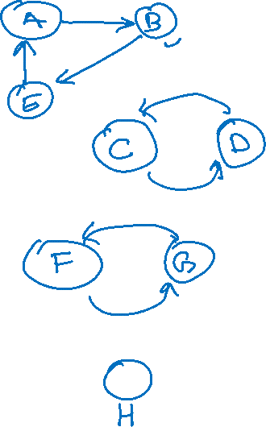
SCC
A
B
C
D
E
F
G
H
Notes:
A strongly connected component is a maximal subgraph that is also strongly connected. We have listed four subgraphs on this slide that are strongly connected and maximal. Notice that we can’t add other vertices or edges to these subgraphs without violating the strongly connected property.

Slide 105
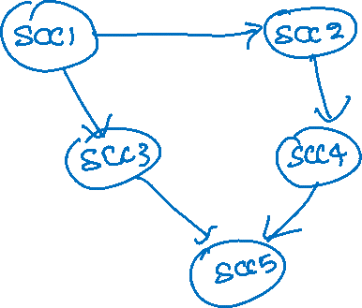
SCC
A
B
C
D
E
F
G
H
Notes:
To find the strongly connected components (SCCs), we can run DFS at a given vertex (say A) to find all vertices reachable from A and then again run DFS of the reversed graph to find the vertices from which A is reachable. The intersection of vertices computed in these two passes will give us the SCC that contains A. We can then remove the vertices present in the SCC for A and rerun this algorithm. Notice that this algorithm works correctly; however, it is very inefficient. If we create a graph G whose vertices are SCCs and edges are edges between SCCs, the resulting graph must be acyclic. The reason behind this is that if G contains a cycle, and S1 and S2 are two SCCs on a cyclic path, in that case, we can reach from S1 to S2 and vice versa. It means that S1 and S2 combined can also be considered as an SCC. As in the presence of a cycle, S1 and S2 will not be SCCs; G must be acyclic. We will use this observation to compute SCCs efficiently.

