Slide 2
Today’s topics
Strongly connected components
Single-source shortest-paths

Slide 3
Strong connectivity

Slide 4
Strong connectivity
Section-20.5 from the CLRS book
Section-6.4 from the Goodrich and Tamassia book
https://en.wikipedia.org/wiki/Strongly_connected_component

Slide 5
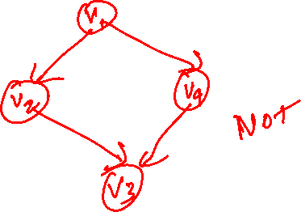
Strong connectivity
A directed graph is strongly connected if every vertex is reachable from all other vertices

Slide 6
Strongly connected components (SCC)

Slide 7
SCC
A strongly connected component of a directed graph G is a strongly connected maximal subgraph

Slide 8
SCC
Find all strongly connected components of a graph

Slide 9
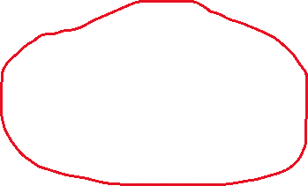
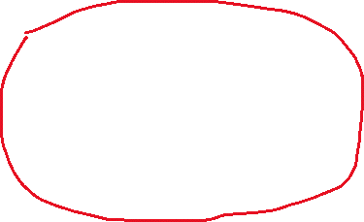
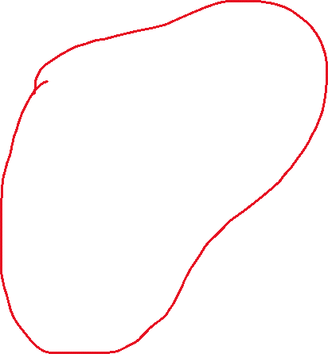
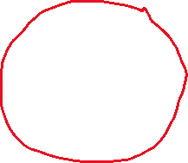



SCC
A
B
C
D
E
F
G
H

Slide 10
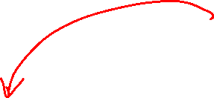
SCC
SCC-2
SCC-1
SCC-4
SCC-3
Notes:
If we construct a graph whose vertices are the SCCs and edges are the edges between SCCs, then the resulting graph must be acyclic.

Slide 11
SCC
If we consider all vertices in an SCC as a single vertex and draw edges between SCCs, then the resulting graph G^{SCC} must be acyclic
If the graph G^{SCC} is cyclic then there would be at least two vertices that are reachable from each other
Notice that the vertices in G^{SCC} are strongly connected components, and two strongly connected components can’t reach from each other

Slide 12
SCC
Every acyclic graph has a topologically sorted order
If an SCC, say S1, comes before another SCC, say S2, in the topologically sorted order, then the finish time of all the vertices in S1 must be greater than all vertices in S2

Slide 13
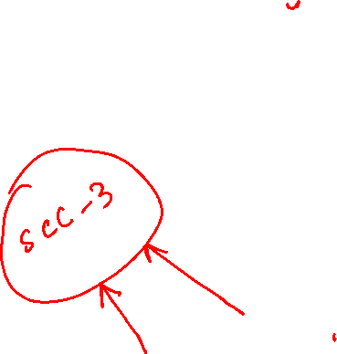
SCC
If DFS starts from SCC-1, then none of the vertices in SCC-1 will be finished until all vertices in SCC-2 are finished. Notice that all vertices in SCC-2 are reachable from all vertices in SCC-1; however, none of the vertices in SCC-1 are reachable from any vertex in SCC-2.
If DFS starts from SCC-2, then none of the vertices of SCC-1 will be visited because they are not reachable from any vertex in SCC-2. Vertices in SCC-1 will only be visited when DFS is called later on a vertex in SCC-1 or a vertex in a different SCC from which SCC-1 is reachable.
SCC-1
b
c
a
d
e
f
g
h
SCC-2
Notes:
The finish time of all the vertices in SCC-1 must be higher than that of the vertices in SCC-2.

Slide 14
SCC
If we reverse all edges
the destination of an outgoing edge from an SCC will always have a larger finish time than the corresponding origin of the edge
The other edges that were not going outside the SCC will remain inside the SCC

Slide 15
SCC
Because the direction of all the edges between SCC-1 and SCC-2 are from SCC-1 to SCC-2, the direction of the reversed edges will be from SCC-2 to SCC-1. As discussed earlier, the finish times of all vertices in SCC-1 are higher than the vertices in SCC-2; therefore, the finish time of the destination end of a reversed edge between two strongly connected components will always be higher than its origin.
SCC-1
b
c
a
d
e
f
g
h
SCC-2
Notes:
If we reverse the edges, the edge originated from SCC-2 will be either in SCC2 or will go to an SCC that comes before SCC-2 in a topologically sorted order.

Slide 16
SCC
Computing SCC
The outgoing reversed edges within an SCC will always go to a vertex in another SCC with a higher finish time or go to a vertex within the SCC

Slide 17
SCC
Let’s say a graph G = (V, E) has k SCCs numbered from 1 to k, such that SCC-i comes before SCC-j in topologically sorted order for all 1 <= i < j <= k
If vertex v has the highest finish time, then v belongs to SCC-1
If we run DFS at v on the reversed graph, which all vertices will be visited?

Slide 18
SCC
Let’s say a graph G = (V, E) has k SCCs numbered from 1 to k, such that SCC-i comes before SCC-j in topologically sorted order for all 1 <= i < j <= k
If vertex v has the highest finish time, then v belongs to SCC-1
If we run DFS at v on the reversed graph, which all vertices will be visited?
All vertices that belong to SCC-1

Slide 19
SCC
Let’s say a graph G = (V, E) has k SCCs numbered from 1 to k, such that SCC-i comes before SCC-j in topologically sorted order for all 1 <= i < j <= k
If vertex v has the highest finish time among the vertices that don’t belong to SSC-1, then v belongs to SCC-2
If we run DFS at v on the reversed graph, which all vertices will be visited?

Slide 20
SCC
Let’s say a graph G = (V, E) has k SCCs numbered from 1 to k, such that SCC-i comes before SCC-j in topologically sorted order for all 1 <= i < j <= k
If vertex v has the highest finish time among the vertices that don’t belong to SSC-1, then v belongs to SCC-2
If we run DFS at v on the reversed graph, which all vertices will be visited?
All vertices that belong to SCC-2. Vertices in SCC-1 may also be visited.

Slide 21
SCC
Let’s say a graph G = (V, E) has k SCCs numbered from 1 to k, such that SCC-i comes before SCC-j in topologically sorted order for all 1 <= i < j <= k
If vertex v has the highest finish time among the vertices that don’t belong to SSC-1 and SSC-2, then v belongs to SCC-2
If we run DFS at v on the reversed graph, which all vertices will be visited?

Slide 22
SCC
Let’s say a graph G = (V, E) has k SCCs numbered from 1 to k, such that SCC-i comes before SCC-j in topologically sorted order for all 1 <= i < j <= k
If vertex v has the highest finish time among the vertices that don’t belong to SSC-1 and SSC-2, then v belongs to SCC-2
If we run DFS at v on the reversed graph, which all vertices will be visited?
All vertices that belong to SCC-2. Vertices in SCC-1 and SCC-2 may also be visited.

Slide 23
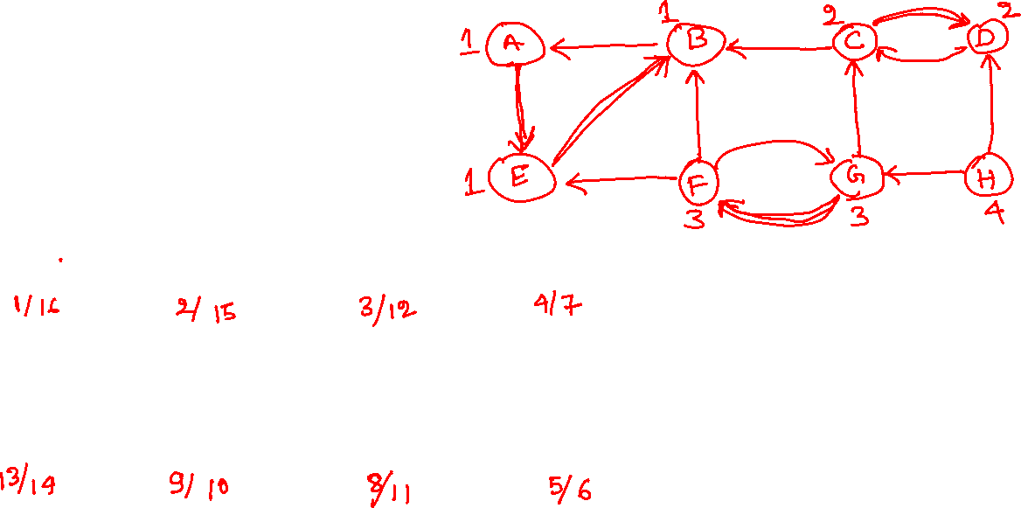
SCC
A
B
C
D
E
F
G
H

Slide 24
SCC
A
B
C
D
E
F
G
H
Notes:
The first step in computing SCCs is to run DFS on the graph. Here, we are starting DFS from vertex A.

Slide 25
SCC
A
B
C
D
1/
E
F
G
H

Slide 26
SCC
A
B
C
D
1/
2/
E
F
G
H

Slide 27
SCC
A
B
C
D
1/
2/
3/
E
F
G
H

Slide 28
SCC
A
B
C
D
1/
2/
3/
4/
E
F
G
H

Slide 29
SCC
A
B
C
D
1/
2/
3/
4/
5/
E
F
G
H

Slide 30
SCC
A
B
C
D
1/
2/
3/
4/
5/6
E
F
G
H

Slide 31
SCC
A
B
C
D
1/
2/
3/
4/7
5/6
E
F
G
H

Slide 32
SCC
A
B
C
D
1/
2/
3/
4/7
8/
5/6
E
F
G
H

Slide 33
SCC
A
B
C
D
1/
2/
3/
4/7
9/
8/
5/6
E
F
G
H

Slide 34
SCC
A
B
C
D
1/
2/
3/
4/7
9/10
8/
5/6
E
F
G
H

Slide 35
SCC
A
B
C
D
1/
2/
3/
4/7
9/10
8/11
5/6
E
F
G
H

Slide 36
SCC
A
B
C
D
1/
2/
3/12
4/7
9/10
8/11
5/6
E
F
G
H

Slide 37
SCC
A
B
C
D
1/
2/
3/12
4/7
13/
9/10
8/11
5/6
E
F
G
H

Slide 38
SCC
A
B
C
D
1/
2/
3/12
4/7
13/
14
9/10
8/11
5/6
E
F
G
H

Slide 39
SCC
A
B
C
D
1/
2/15
3/12
4/7
13/
14
9/10
8/11
5/6
E
F
G
H

Slide 40
SCC
A
B
C
D
1/16
2/15
3/12
4/7
13/
14
9/10
8/11
5/6
E
F
G
H
Notes:
Now we have computed the finish times of all vertices.

Slide 41
SCC
Reversing edges

Slide 42
SCC
Run DFS at the vertex with the highest finish time, i.e., A.
A
B
C
D
1/16
2/15
3/12
4/7
13/
14
9/10
8/11
5/6
E
F
G
H
Notes:
This is the reversed graph. Now we will run DFS-VISIT at the vertex that has the maximum finish time. At the end of the DFS-VISIT, all the nodes that belong to SSC-1 will be marked as black.

Slide 43
SCC
A
B
C
D
1/16
2/15
3/12
4/7
13/
14
9/10
8/11
5/6
E
F
G
H

Slide 44
SCC
A
B
C
D
1/16
2/15
3/12
4/7
13/
14
9/10
8/11
5/6
E
F
G
H

Slide 45
SCC
A
B
C
D
1/16
2/15
3/12
4/7
13/
14
9/10
8/11
5/6
E
F
G
H

Slide 46
SCC
A
B
C
D
1/16
2/15
3/12
4/7
13/
14
9/10
8/11
5/6
E
F
G
H

Slide 47
SCC
A
B
C
D
1/16
2/15
3/12
4/7
13/
14
9/10
8/11
5/6
E
F
G
H

Slide 48
SCC
A
B
C
D
1/16
2/15
3/12
4/7
13/
14
9/10
8/11
5/6
E
F
G
H
Notes:
We have identified the vertices in SSC-1. Now from the remaining vertices, the vertex that has the highest finish time, i,e., C must belong to SSC-2. If we run DFS-VISIT at C, all the nodes in SCC-2 will be marked as black. During DFS, we may also encounter vertices from SCC-1. We can easily identify them because they are already black.

Slide 49
SCC
Run DFS at the vertex with the highest finish time among the remaining vertices, i.e., C.
A
B
C
D
1/16
2/15
3/12
4/7
13/
14
9/10
8/11
5/6
E
F
G
H

Slide 50
SCC
A
B
C
D
1/16
2/15
3/12
4/7
13/
14
9/10
8/11
5/6
E
F
G
H

Slide 51
SCC
A
B
C
D
1/16
2/15
3/12
4/7
13/
14
9/10
8/11
5/6
E
F
G
H

Slide 52
SCC
A
B
C
D
1/16
2/15
3/12
4/7
13/
14
9/10
8/11
5/6
E
F
G
H
Notes:
We have identified SCC-2. Vertex G belongs to SCC-3. We will now run DFS-VISIT for G, which will visit all the vertices in SSC-3. We may also encounter some vertices from SCC-1 and SCC-2, but they are already marked as black.

Slide 53
SCC
Run DFS at the vertex with the highest finish time among the remaining vertices, i.e., G.
A
B
C
D
1/16
2/15
3/12
4/7
13/
14
9/10
8/11
5/6
E
F
G
H

Slide 54
SCC
A
B
C
D
1/16
2/15
3/12
4/7
13/
14
9/10
8/11
5/6
E
F
G
H

Slide 55
SCC
A
B
C
D
1/16
2/15
3/12
4/7
13/
14
9/10
8/11
5/6
E
F
G
H

Slide 56
SCC
A
B
C
D
1/16
2/15
3/12
4/7
13/
14
9/10
8/11
5/6
E
F
G
H
Notes:
We have found the vertices in SCC-3. Only vertex H is remaining; that will be part of SCC-4.

Slide 57
SCC
Run DFS at the vertex with the highest finish time among the remaining vertices, i.e., H.
A
B
C
D
1/16
2/15
3/12
4/7
13/
14
9/10
8/11
5/6
E
F
G
H

Slide 58
SCC
We are done.
The trees in the depth-first forest are the strongly connected components.
A
B
C
D
1/16
2/15
3/12
4/7
13/
14
9/10
8/11
5/6
E
F
G
H

Slide 59
SCC
We are done.
The trees in the depth-first forest are the strongly connected components.
A
B
C
D
1/16
2/15
3/12
4/7
13/
14
9/10
8/11
5/6
E
F
G
H

Slide 60
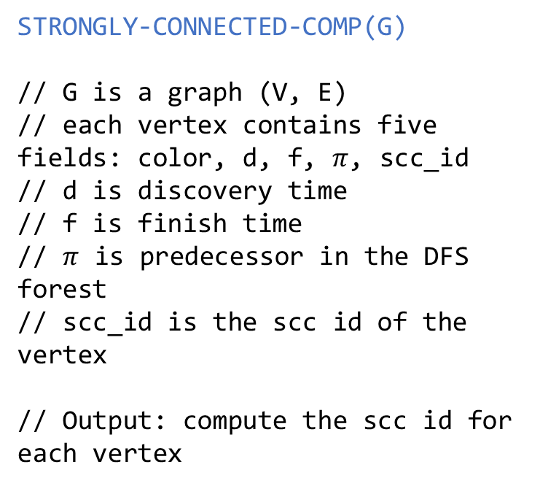
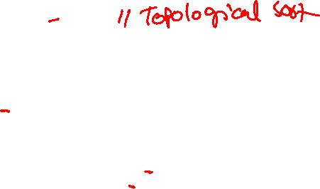
STRONGLY-CONNECTED_COMP
STRONGLY-CONNECTED-COMP(G)
// G is a graph (V, E)
// each vertex contains five fields: color, d, f, $π$, scc_id
// d is discovery time
// f is finish time
// $π$ is predecessor in the DFS forest
// scc_id is the scc id of the vertex
// Output: compute the scc id for each vertex
STRONGLY-CONNECTED-COMP(G)
L = DFS-SCC(G)
REVERSE-ALL-EDGES(G)
RESET-COLORS(G)
scc_id = 0
foreach vertex v in L
if v.color == WHITE
scc_id = scc_id + 1
v.scc_id = scc_id
DFS-VISIT-SCC-ID(G, v)

Slide 61
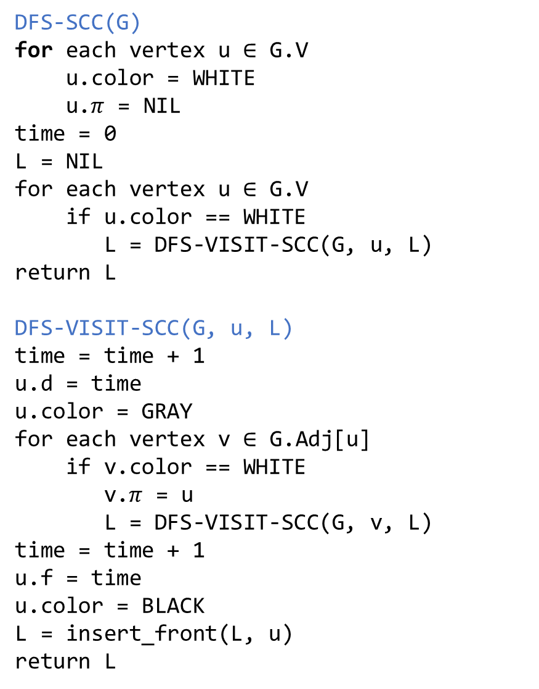
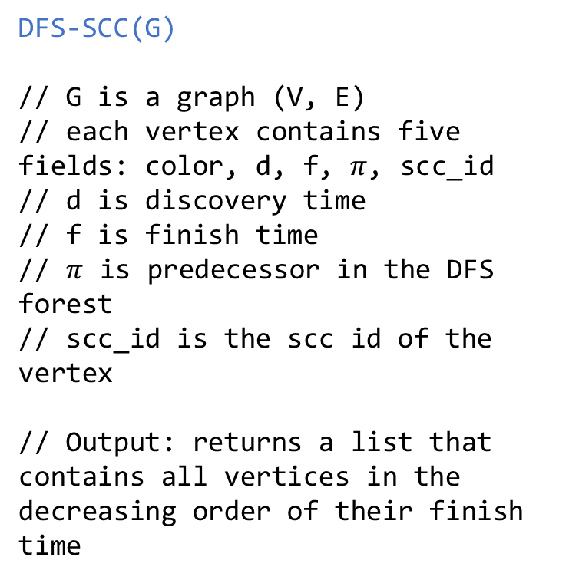
DFS-SCC
DFS-SCC(G)
for each vertex u $∈$ G.V
u.color = WHITE
u.$π$ = NIL
time = 0
L = NIL
for each vertex u $∈$ G.V
if u.color == WHITE
L = DFS-VISIT-SCC(G, u, L)
return L
DFS-VISIT-SCC(G, u, L)
time = time + 1
u.d = time
u.color = GRAY
for each vertex v $∈$ G.Adj[u]
if v.color == WHITE
v.$π$ = u
L = DFS-VISIT-SCC(G, v, L)
time = time + 1
u.f = time
u.color = BLACK
L = insert_front(L, u)
return L
DFS-SCC(G)
// G is a graph (V, E)
// each vertex contains five fields: color, d, f, $π$, scc_id
// d is discovery time
// f is finish time
// $π$ is predecessor in the DFS forest
// scc_id is the scc id of the vertex
// Output: returns a list that contains all vertices in the decreasing order of their finish time

Slide 62
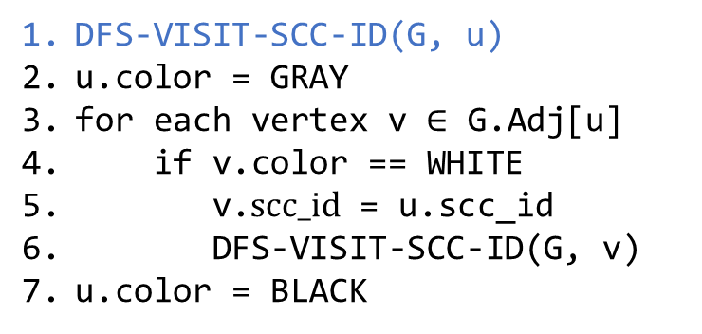
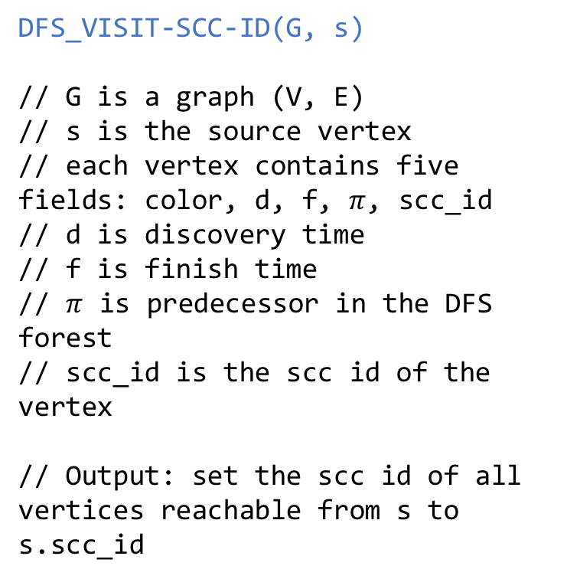
DFS-VISIT-SCC-ID
DFS_VISIT-SCC-ID(G, s)
// G is a graph (V, E)
// s is the source vertex
// each vertex contains five fields: color, d, f, $π$, scc_id
// d is discovery time
// f is finish time
// $π$ is predecessor in the DFS forest
// scc_id is the scc id of the vertex
// Output: set the scc id of all vertices reachable from s to s.scc_id
DFS-VISIT-SCC-ID(G, u)
u.color = GRAY
for each vertex v $∈$ G.Adj[u]
if v.color == WHITE
v.$scc_id$ = u.scc_id
DFS-VISIT-SCC-ID(G, v)
u.color = BLACK

Slide 63
Weighted graph

Slide 64
Weighted graph
A weighted graph, G = (V, E, w), contains a weight function, w : E -> R, that maps an edge in the graph to a real numeric value called the weight of the edge

Slide 65
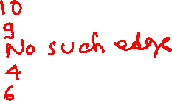
Weighted graph
1
w(s, t) =
w(y, x) =
w(x, y) =
w(x, z) =
w(z, x) =
t
x
10
2
9
3
6
s
4
5
7
y
z
2

Slide 66
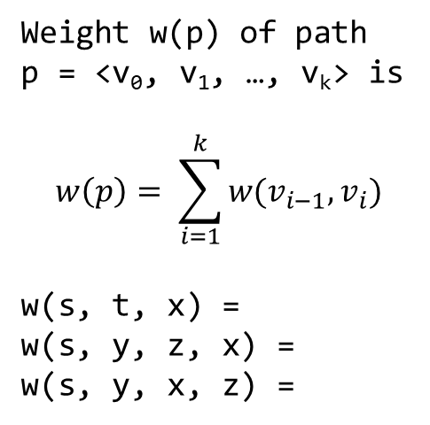

Weighted graph
1
Weight w(p) of path
p = <v₀, v₁, …, v_{k}> is
$$w\left(p\right)= \sum_{i=1}^{k}{w(v_{i−1}, v_{i})}$$
w(s, t, x) =
w(s, y, z, x) =
w(s, y, x, z) =
t
x
10
2
9
3
6
s
4
5
7
y
z
2

Slide 67
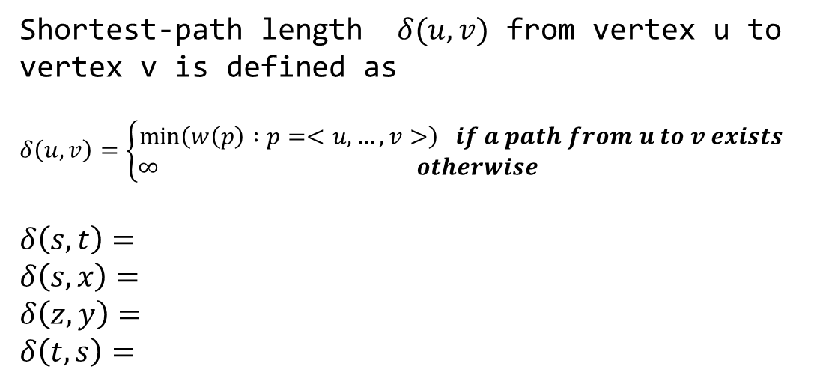

Shortest path
1
Shortest-path length $δ(u, v)$ from vertex u to vertex v is defined as
$$δ\left(u, v\right)=\left\{\begin{aligned}\min\left(w\left(p\right) :p=<u, …, v>\right) if a path from u to v exists \\ ∞ otherwise \end{aligned}\right.$$
$$δ\left(s, t\right)=$$
$$δ\left(s, x\right)=$$
$$δ\left(z, y\right)=$$
$$δ\left(t, s\right)=$$
t
x
10
2
9
3
6
s
4
5
7
y
z
2

Slide 68
Properties of shortest path
If all edges have non-negative weights, can a shortest path contain a cycle?
Notes:
A cycle is always going to add more weight to the path in addition to adding repeating edges. A cyclic shortest path is only possible if the weight of the circular path is zero. Even in that case, we can remove the cycle and get a shortest path. Therefore, we can safely say that if a shortest path exists, then a shortest simple path (i.e., acyclic path) also exists.

Slide 69
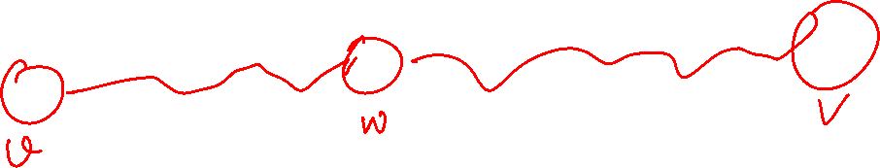
Properties of shortest path
The subpaths of a shortest path are also shortest paths
Notes:
Let’s say the path between vertices u and v is the shortest path. For any intermediate vertex w, the path from u to w (say path-1) is also a shortest path. If this is not true, then there exists another path to w from u (say path-2) with the shortest length. In that case, the path from u to v is not a shortest path because we can take path-2 instead of path-1 to reach w. Hence, there is a contradiction.

Slide 70
Single-source shortest-paths (SSSP)

Slide 71
SSSP
Read chapter-24 from the CLRS book

Slide 72

SSSP
Single-source shortest-paths (SSSP)
Given a graph G = (V, E, w), find a shortest path from a given source vertex $s∈V$ to every vertex $v∈V$

Slide 73








Shortest Path
t
x
t
x
$$∞$$
1
$$∞$$
1
$$8$$
$$9$$
10
10
2
9
9
0
3
6
2
3
4
0
6
4
s
s
5
7
7
$$∞$$
$$∞$$
5
$$5$$
$$7$$
2
2
y
z
z
y
Notes:
The goal is to find a shortest path to each vertex from s.

Slide 74
Shortest Path
t
x
$$∞$$
1
$$∞$$
Using BFS.
10
2
9
0
3
6
4
s
5
7
$$∞$$
$$∞$$
2
y
z
Notes:
We can use BFS to find a shortest path. The BFS algorithm only works if the weight of an edge is one. We can transform this graph to an unweighted graph by adding k-1 additional vertices between two adjacent vertices, where k is the weight of the corresponding edge. However, this solution is inefficient because the weights on the edges can be very large.

Slide 75
Shortest Path
t
x
$$∞$$
1
$$∞$$
Finding all paths.
10
2
9
0
3
6
4
s
5
7
$$∞$$
$$∞$$
2
y
z
Notes:
Another solution is to find all possible paths and select a path that has the shortest distance. However, as we show next, the number of possible paths can grow exponentially. Therefore, this solution is also very expensive.

Slide 76
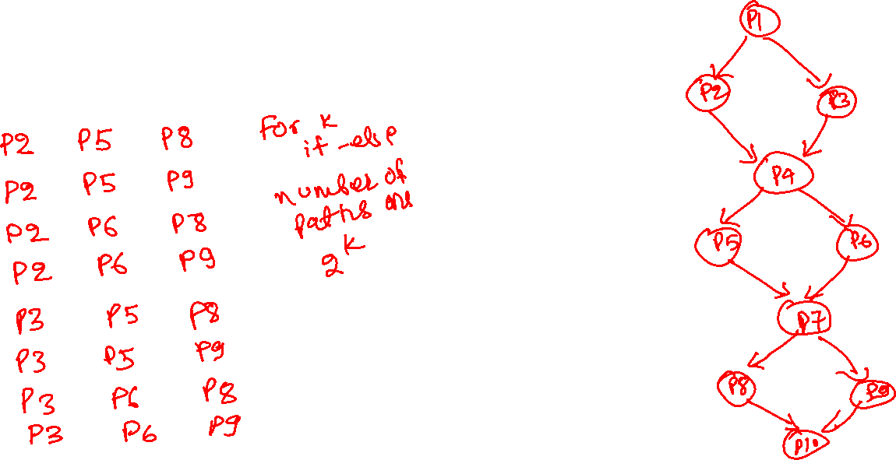
Finding all paths
if (cond1) { // P1
… // P2
}
else {
… // P3
}
if (cond2) { // P4
… // P5
}
else {
… // P6
}
if (cond3) { // P7
… // P8
}
else {
… // P9
}
// P10
How many different program paths are possible?
Notes:
This example contains three if-else conditions. At runtime, the program may take eight different paths. For four if-else conditions, the program may take sixteen different paths at runtime. In general, for k if-else conditions, the program may take 2^k different paths. Therefore the number of paths in a graph can be exponential.

Slide 77




Shortest Path
0
t
x
t
x
$$∞$$
1
$$∞$$
1
$$8$$
$$9$$
$$5$$
10
10
2
9
9
0
3
6
2
3
4
0
6
$$7$$
4
s
s
5
7
7
$$∞$$
$$∞$$
$$8$$
5
$$5$$
$$7$$
2
2
y
z
z
y
$$9$$
Notes:
We can also use gravity to find the shortest path. Let’s say vertices are some solid objects. If we connect the adjacent objects using a thread of length equal to the weight of the corresponding edge and hang the source object to a hook in the ceiling, then the order in which the objects will appear from top the bottom, would be the order in which we are going to compute the shortest path. All the threads that are not loose are on the shortest path. We also need to remove the threads that are going in the upward direction after hanging them.

Slide 78
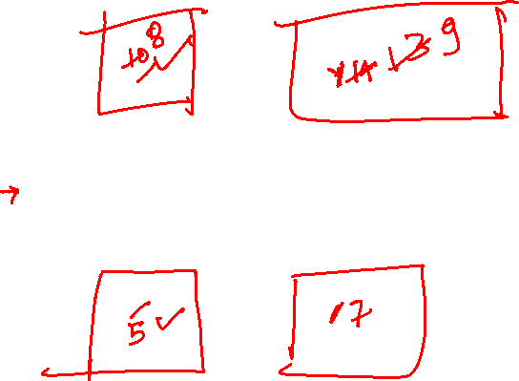
Shortest Path
t
x
$$∞$$
1
$$∞$$
10
2
9
0
3
6
4
s
5
7
$$∞$$
$$∞$$
2
y
z

Slide 79




Shortest Path
Vertices that are in the min-heap are shown in yellow.
Vertices whose shortest paths are known are shown in white.
Red edges are edges on the shortest path.
The origins of the orange edges are the white vertices, and the destinations are the yellow ones. These edges lie on the shortest path to the destination vertex, consisting of only white vertices.
t
x
$$∞$$
1
$$∞$$
10
2
9
0
3
6
4
s
5
7
$$∞$$
$$∞$$
2
y
z
Notes:
Let’s look at this example. Initially, the distance of all vertices except s is infinity. After hanging the source object, the first object that will appear after the source object will be connected to it. Therefore we first need to update the distance of adjacent vertices of s to the shortest known distance from s at this point.

Slide 80


Shortest Path
Vertices that are in the min-heap are shown in yellow.
Vertices whose shortest paths are known are shown in white.
Red edges are edges on the shortest path.
The origins of the orange edges are the white vertices, and the destinations are the yellow ones. These edges lie on the shortest path to the destination vertex, consisting of only white vertices.
t
x
$$10$$
1
$$∞$$
10
2
9
0
3
6
4
s
5
7
$$5$$
$$∞$$
2
y
z
Notes:
This is the resulting graph after updating the distances. The first vertex that will appear after hanging s will be either y or t. Because y is at a shorter distance than t, therefore, it will appear next.

Slide 81

Shortest Path
Vertices that are in the min-heap are shown in yellow.
Vertices whose shortest paths are known are shown in white.
Red edges are edges on the shortest path.
The origins of the orange edges are the white vertices, and the destinations are the yellow ones. These edges lie on the shortest path to the destination vertex, consisting of only white vertices.
t
x
$$10$$
1
$$∞$$
10
2
9
0
3
6
4
s
5
7
$$5$$
$$∞$$
2
y
z
Notes:
Now we know the first two objects are s and y; the next object that will appear after s and y will be connected to one of them. The next goal is to update the distances of all vertices connected to y. Notice that we have already updated the distance from s previously.

Slide 82



Shortest Path
Vertices that are in the min-heap are shown in yellow.
Vertices whose shortest paths are known are shown in white.
Red edges are edges on the shortest path.
The origins of the orange edges are the white vertices, and the destinations are the yellow ones. These edges lie on the shortest path to the destination vertex, consisting of only white vertices.
t
x
$$8$$
1
$$14$$
10
2
9
0
3
6
4
s
5
7
$$5$$
$$7$$
2
y
z
Notes:
The next vertex that will appear could be connected to either s or y. The one with the shortest distance known so far, i.e., z, will appear next.

Slide 83
Shortest Path
Vertices that are in the min-heap are shown in yellow.
Vertices whose shortest paths are known are shown in white.
Red edges are edges on the shortest path.
The origins of the orange edges are the white vertices, and the destinations are the yellow ones. These edges lie on the shortest path to the destination vertex, consisting of only white vertices.
t
x
$$8$$
1
$$14$$
10
2
9
0
3
6
4
s
5
7
$$5$$
$$7$$
2
y
z

Slide 84

Shortest Path
Vertices that are in the min-heap are shown in yellow.
Vertices whose shortest paths are known are shown in white.
Red edges are edges on the shortest path.
The origins of the orange edges are the white vertices, and the destinations are the yellow ones. These edges lie on the shortest path to the destination vertex, consisting of only white vertices.
t
x
$$8$$
1
$$14$$
10
2
9
0
3
6
4
s
5
7
$$5$$
$$7$$
2
y
z
Notes:
Once we have seen z, the next vertex that may appear could be connected to either s, y, or z. First, we need to update the distances of the adjacent vertices of z if a shorter path exists via z.

Slide 85

Shortest Path
Vertices that are in the min-heap are shown in yellow.
Vertices whose shortest paths are known are shown in white.
Red edges are edges on the shortest path.
The origins of the orange edges are the white vertices, and the destinations are the yellow ones. These edges lie on the shortest path to the destination vertex, consisting of only white vertices.
t
x
$$8$$
1
$$13$$
10
2
9
0
3
6
4
s
5
7
$$5$$
$$7$$
2
y
z
Notes:
After we have updated the distances of the adjacent vertices of z, the next vertex that will appear in the downward direction would be the vertex with a minimum distance from the remaining vertices. Notice that t has the minimum distance.

Slide 86
Shortest Path
Vertices that are in the min-heap are shown in yellow.
Vertices whose shortest paths are known are shown in white.
Red edges are edges on the shortest path.
The origins of the orange edges are the white vertices, and the destinations are the yellow ones. These edges lie on the shortest path to the destination vertex, consisting of only white vertices.
t
x
$$8$$
1
$$13$$
10
2
9
0
3
6
4
s
5
7
$$5$$
$$7$$
2
y
z

Slide 87

Shortest Path
Vertices that are in the min-heap are shown in yellow.
Vertices whose shortest paths are known are shown in white.
Red edges are edges on the shortest path.
The origins of the orange edges are the white vertices, and the destinations are the yellow ones. These edges lie on the shortest path to the destination vertex, consisting of only white vertices.
t
x
$$8$$
1
$$13$$
10
2
9
0
3
6
4
s
5
7
$$5$$
$$7$$
2
y
z
Notes:
The next object can also be connected to all other objects that we have seen so far. We need to update the distances of the nearby objects of t. We have updated the distance from the other objects that appeared before t.

Slide 88

Shortest Path
Vertices that are in the min-heap are shown in yellow.
Vertices whose shortest paths are known are shown in white.
Red edges are edges on the shortest path.
The origins of the orange edges are the white vertices, and the destinations are the yellow ones. These edges lie on the shortest path to the destination vertex, consisting of only white vertices.
t
x
$$8$$
1
$$9$$
10
2
9
0
3
6
4
s
5
7
$$5$$
$$7$$
2
y
z
Notes:
After updating the distance of x, which was also reachable via t, we need to find the vertex that will appear next. Notice that we don't have much of a choice now. Our only choice is x, which will finally appear at the end.

Slide 89
Shortest Path
Vertices that are in the min-heap are shown in yellow.
Vertices whose shortest paths are known are shown in white.
Red edges are edges on the shortest path.
The origins of the orange edges are the white vertices, and the destinations are the yellow ones. These edges lie on the shortest path to the destination vertex, consisting of only white vertices.
t
x
$$8$$
1
$$9$$
10
2
9
0
3
6
4
s
5
7
$$5$$
$$7$$
2
y
z

Slide 90

Shortest Path
Vertices that are in the min-heap are shown in yellow.
Vertices whose shortest paths are known are shown in white.
Red edges are edges on the shortest path.
The origins of the orange edges are the white vertices, and the destinations are the yellow ones. These edges lie on the shortest path to the destination vertex, consisting of only white vertices.
t
x
$$8$$
1
$$9$$
10
2
9
0
3
6
4
s
5
7
$$5$$
$$7$$
2
y
z

