Slide 2
Today’s topics
Minimum spanning tree

Slide 3
References
Chapter-7.3 from Goodrich and Tamassia
Chapter-4.2 from Goodrich and Tamassia
Chapter-21 from CLRS
Chapter-19 from CLRS

Slide 4
Minimum spanning tree
Every connected undirected graph has a spanning tree
The weight of a spanning tree is the sum of the weights of all the edges
Out of all possible spanning trees for a connected undirected graph, the one with the minimum weight is the minimum spanning tree

Slide 5



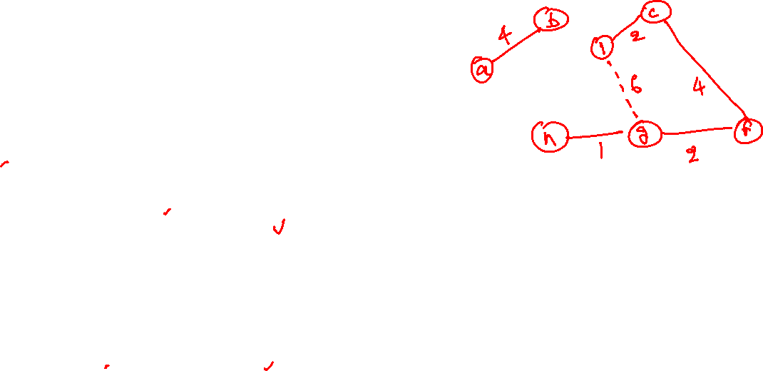





Kruskal’s algorithm
$$b$$
8
$$c$$
7
$$d$$
4
9
2
a
11
$$i$$
4
$$e$$
14
7
6
8
10
$$h$$
$$g$$
$$f$$
1
2
Notes:
Kruskal’s algorithm computes an MST T from graph G. Initially, T contains all the vertices of G without any edges. Afterward, we remove an edge with the minimum weight and add it to T if it doesn’t create a cycle. We can ignore the edge if it creates a cycle. We keep removing and adding edges until |V|-1 edges are added to T. After the algorithm terminates, T is actually an MST. One challenging part of this algorithm is to find out whether adding an edge creates a cycle. We will discuss this next.

Slide 6
Kruskal’s algorithm
$$b$$
8
$$c$$
7
$$d$$
4
9
2
a
11
$$i$$
4
$$e$$
14
7
6
8
10
$$h$$
$$g$$
$$f$$
1
2

Slide 7
Kruskal’s algorithm
Red edges are part of a MST.
$$b$$
8
$$c$$
7
$$d$$
4
9
2
a
11
$$i$$
4
$$e$$
14
7
6
8
10
$$h$$
$$g$$
$$f$$
1
2

Slide 8
Kruskal’s algorithm
$$b$$
8
$$c$$
7
$$d$$
4
9
2
a
11
$$i$$
4
$$e$$
14
7
6
8
10
$$h$$
$$g$$
$$f$$
1
2

Slide 9
Kruskal’s algorithm
$$b$$
8
$$c$$
7
$$d$$
4
9
2
a
11
$$i$$
4
$$e$$
14
7
6
8
10
$$h$$
$$g$$
$$f$$
1
2

Slide 10
Kruskal’s algorithm
$$b$$
8
$$c$$
7
$$d$$
4
9
2
a
11
$$i$$
4
$$e$$
14
7
6
8
10
$$h$$
$$g$$
$$f$$
1
2

Slide 11
Kruskal’s algorithm
$$b$$
8
$$c$$
7
$$d$$
4
9
2
a
11
$$i$$
4
$$e$$
14
7
6
8
10
$$h$$
$$g$$
$$f$$
1
2

Slide 12
Kruskal’s algorithm
Yellow edges are ignored.
$$b$$
8
$$c$$
7
$$d$$
4
9
2
a
11
$$i$$
4
$$e$$
14
7
6
8
10
$$h$$
$$g$$
$$f$$
1
2

Slide 13
Kruskal’s algorithm
$$b$$
8
$$c$$
7
$$d$$
4
9
2
a
11
$$i$$
4
$$e$$
14
7
6
8
10
$$h$$
$$g$$
$$f$$
1
2

Slide 14
Kruskal’s algorithm
$$b$$
8
$$c$$
7
$$d$$
4
9
2
a
11
$$i$$
4
$$e$$
14
7
6
8
10
$$h$$
$$g$$
$$f$$
1
2

Slide 15
Kruskal’s algorithm
$$b$$
8
$$c$$
7
$$d$$
4
9
2
a
11
$$i$$
4
$$e$$
14
7
6
8
10
$$h$$
$$g$$
$$f$$
1
2

Slide 16
Kruskal’s algorithm
$$b$$
8
$$c$$
7
$$d$$
4
9
2
a
11
$$i$$
4
$$e$$
14
7
6
8
10
$$h$$
$$g$$
$$f$$
1
2

Slide 17
Kruskal’s algorithm
$$b$$
8
$$c$$
7
$$d$$
4
9
2
a
11
$$i$$
4
$$e$$
14
7
6
8
10
$$h$$
$$g$$
$$f$$
1
2

Slide 18
Kruskal’s algorithm
$$b$$
8
$$c$$
7
$$d$$
4
9
2
a
11
$$i$$
4
$$e$$
14
7
6
8
10
$$h$$
$$g$$
$$f$$
1
2

Slide 19
Kruskal’s algorithm
$$b$$
8
$$c$$
7
$$d$$
4
9
2
a
11
$$i$$
4
$$e$$
14
7
6
8
10
$$h$$
$$g$$
$$f$$
1
2

Slide 20
Kruskal’s algorithm
$$b$$
8
$$c$$
7
$$d$$
4
9
2
a
11
$$i$$
4
$$e$$
14
7
6
8
10
$$h$$
$$g$$
$$f$$
1
2

Slide 21
Kruskal’s algorithm
How can we cheaply find the yellow edges during Kruskal’s algorithm?

Slide 22
Kruskal’s algorithm
How can we cheaply find the yellow edges during Kruskal’s algorithm?
We will discuss some algorithms to do this in a while

Slide 23
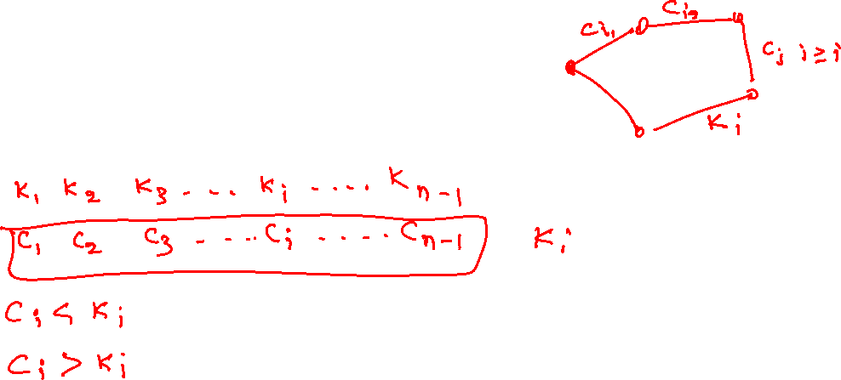
Kruskal’s algorithm
Why does Kruskal’s algorithm work?

Slide 24
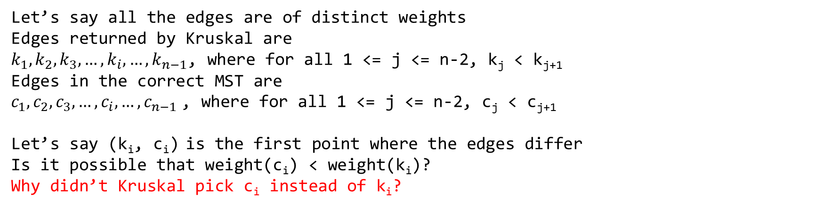
Kruskal’s algorithm
Why does Kruskal’s algorithm work?
Let’s say all the edges are of distinct weights
Edges returned by Kruskal are
$k_{1}, k_{2},k_{3},…, k_{i}, …,k_{n−1}$, where for all 1 <= j <= n-2, k_{j} < k_{j+1}
Edges in the correct MST are
$c_{1},c_{2},c_{3},…, c_{i}, …, c_{n−1}$, where for all 1 <= j <= n-2, c_{j} < c_{j+1}
Let’s say (k_{i}, c_{i}) is the first point where the edges differ
Is it possible that weight(c_{i}) < weight(k_{i})?
Why didn’t Kruskal pick c_{i} instead of k_{i}?

Slide 25

Kruskal’s algorithm
Why does Kruskal’s algorithm work?
Let’s say all the edges are of distinct weights
Edges returned by Kruskal are
$k_{1}, k_{2},k_{3},…, k_{i}, …,k_{n−1}$, where for all 1 <= j <= n-2, k_{j} < k_{j+1}
Edges in the correct MST are
$c_{1},c_{2},c_{3},…, c_{i}, …, c_{n−1}$, where for all 1 <= j <= n-2, c_{j} < c_{j+1}
Let’s say (k_{i}, c_{i}) is the first point where the edges differ
Is it possible that weight(c_{i}) < weight(k_{i})?
Why didn’t Kruskal pick c_{i} instead of k_{i}?
The only reason why Kruskal didn’t pick c_{i} is that c_{i} was part of a cycle containing a subset of edges from the set (k_{1,} k_{2, …,} k_{i-1}). Notice that all k-edges before k_{i} are the same as corresponding c-edges. Therefore, c_{i} is not part of an MST.

Slide 26
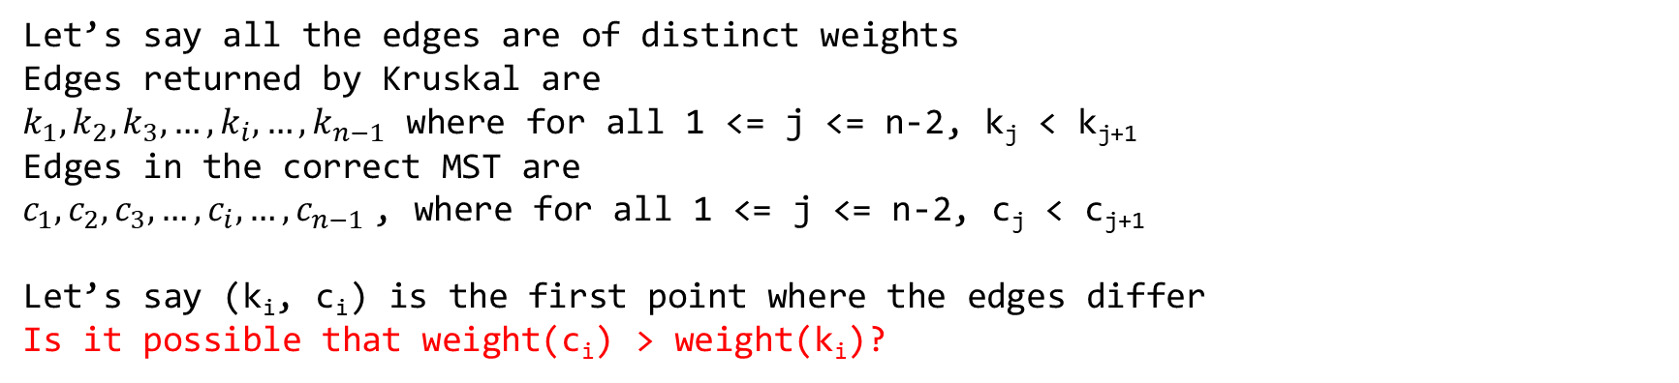
Kruskal’s algorithm
Why does Kruskal’s algorithm work?
Let’s say all the edges are of distinct weights
Edges returned by Kruskal are
$k_{1}, k_{2},k_{3},…, k_{i}, …,k_{n−1}$ where for all 1 <= j <= n-2, k_{j} < k_{j+1}
Edges in the correct MST are
$c_{1},c_{2},c_{3},…, c_{i}, …, c_{n−1}$, where for all 1 <= j <= n-2, c_{j} < c_{j+1}
Let’s say (k_{i}, c_{i}) is the first point where the edges differ
Is it possible that weight(c_{i}) > weight(k_{i})?

Slide 27

Kruskal’s algorithm
Why does Kruskal’s algorithm work?
Let’s say all the edges are of distinct weights
Edges returned by Kruskal are
$k_{1}, k_{2},k_{3},…, k_{i}, …,k_{n−1}$ where for all 1 <= j <= n-2, k_{j} < k_{j+1}
Edges in the correct MST are
$c_{1},c_{2},c_{3},…, c_{i}, …, c_{n−1}$, where for all 1 <= j <= n-2, c_{j} < c_{j+1}
Let’s say (k_{i}, c_{i}) is the first point where the edges differ
Is it possible that weight(c_{i}) > weight(k_{i})?
If this is the case, then k_{i} must be part of a cycle. Notice that edges from the set (k₁, k₂, …, k_{i}) don’t create a cycle. Therefore, the cycle that contains k_{i} must have at least one of the edges from c_{i} to c_{n-1}. But because all edges from c_{i} to c_{n-1} have more weight than k_{i}; therefore, removing k_{i} from the cycle gives an incorrect MST.

Slide 28
Data structures for disjoint sets

Slide 29
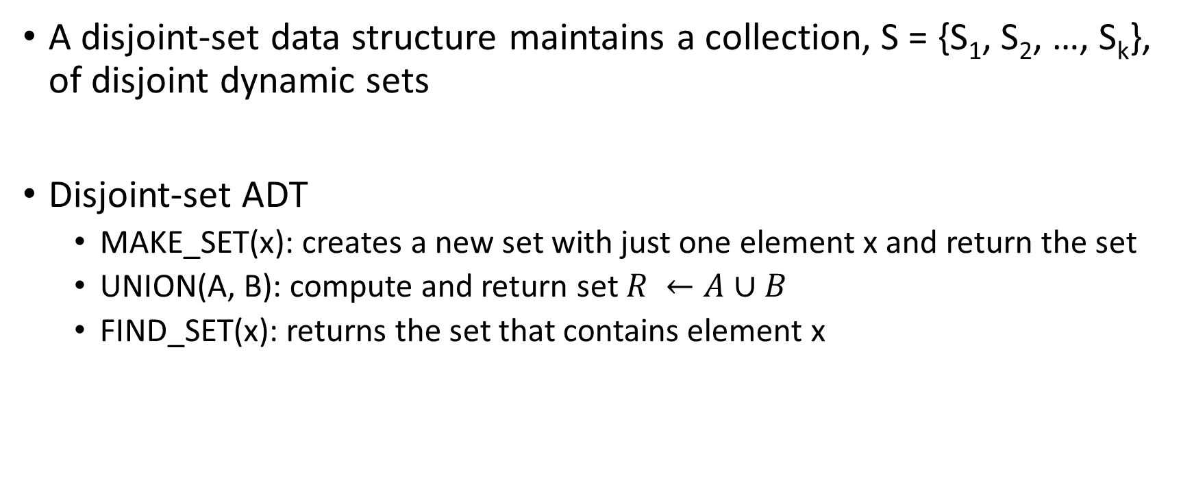
Disjoint-set
A disjoint-set data structure maintains a collection, S = {S₁, S₂, …, S_{k}}, of disjoint dynamic sets
Disjoint-set ADT
MAKE_SET(x): creates a new set with just one element x and return the set
UNION(A, B): compute and return set $R ←A∪B$
FIND_SET(x): returns the set that contains element x

Slide 30
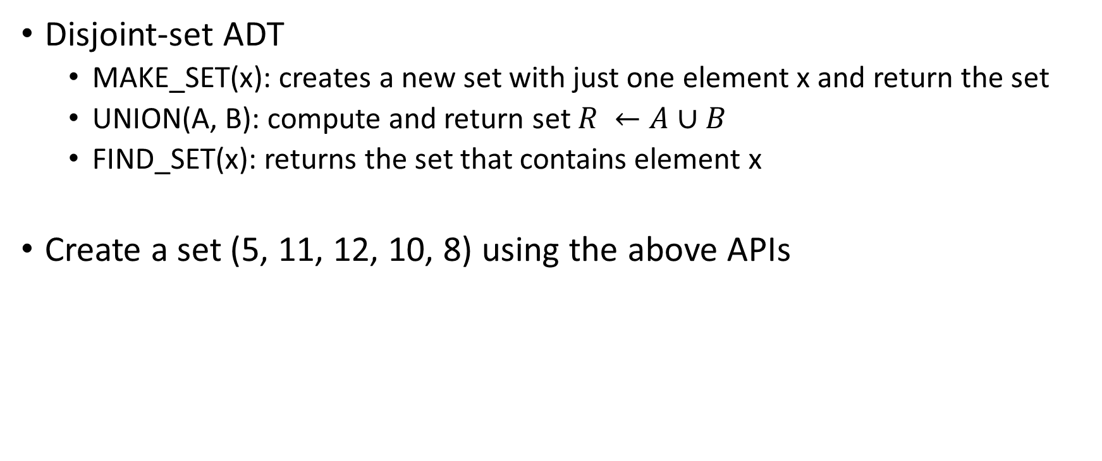
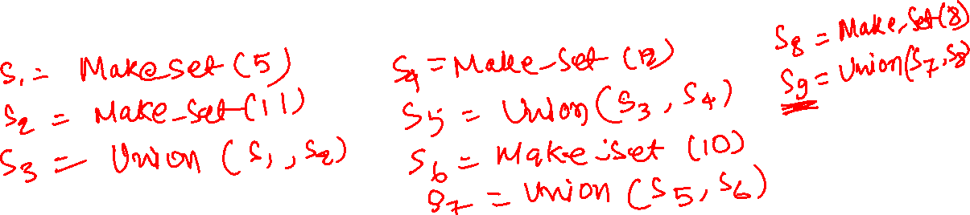
Disjoint-set
Disjoint-set ADT
MAKE_SET(x): creates a new set with just one element x and return the set
UNION(A, B): compute and return set $R ←A∪B$
FIND_SET(x): returns the set that contains element x
Create a set (5, 11, 12, 10, 8) using the above APIs

Slide 31
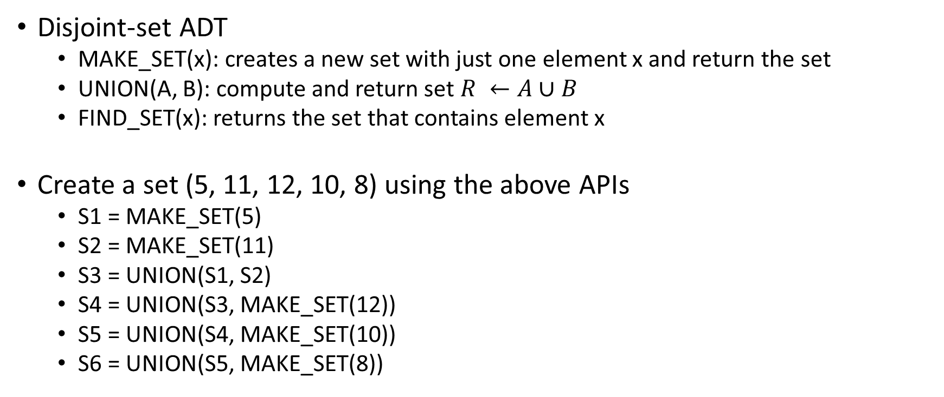
Disjoint-set
Disjoint-set ADT
MAKE_SET(x): creates a new set with just one element x and return the set
UNION(A, B): compute and return set $R ←A∪B$
FIND_SET(x): returns the set that contains element x
Create a set (5, 11, 12, 10, 8) using the above APIs
S1 = MAKE_SET(5)
S2 = MAKE_SET(11)
S3 = UNION(S1, S2)
S4 = UNION(S3, MAKE_SET(12))
S5 = UNION(S4, MAKE_SET(10))
S6 = UNION(S5, MAKE_SET(8))

Slide 32
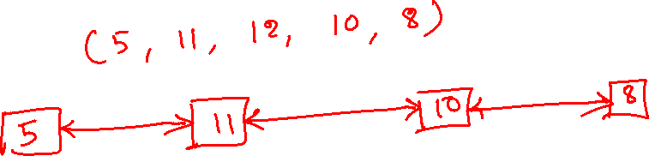
Disjoint-set

Slide 33
Disjoint-set
Use a doubly linked-list; the head of the list represents the set
Create set (5, 11, 12, 10, 8)

Slide 34
Disjoint-set
Use a doubly linked-list; the head of the list represents the set
Create set (5, 11, 12, 10, 8)

Slide 35
Disjoint-set
Use a doubly linked-list; the head of the list represents the set
Create set (5, 11, 12, 10, 8)
S1 = MAKE_SET(5)
5
Notes:
MAKE_SET creates a doubly linked list with just one node corresponding to the input element.

Slide 36
Disjoint-set
Use a doubly linked-list; the head of the list represents the set
Create set (5, 11, 12, 10, 8)
S1 = MAKE_SET(5)
S2 = MAKE_SET(11)
5
11

Slide 37
Disjoint-set
Use a doubly linked-list; the head of the list represents the set
Create set (5, 11, 12, 10, 8)
S1 = MAKE_SET(5)
S2 = MAKE_SET(11)
S3 = UNION(S1, S2)
5
11
Notes:
A set is identified using the head of the linked list. The union operation takes two linked lists representing two disjoint sets and appends the second linked list at the rear end of the first linked list.

Slide 38
Disjoint-set
Use a doubly linked-list; the head of the list represents the set
Create set (5, 11, 12, 10, 8)
S1 = MAKE_SET(5)
S2 = MAKE_SET(11)
S3 = UNION(S1, S2)
S4 = MAKE_SET(12)
5
11
12

Slide 39
Disjoint-set
Use a doubly linked-list; the head of the list represents the set
Create set (5, 11, 12, 10, 8)
S1 = MAKE_SET(5)
S2 = MAKE_SET(11)
S3 = UNION(S1, S2)
S4 = MAKE_SET(12)
S5 = UNION(S3, S4)
5
11
12

Slide 40
Disjoint-set
Use a doubly linked-list; the head of the list represents the set
Create set (5, 11, 12, 10, 8)
S1 = MAKE_SET(5)
S2 = MAKE_SET(11)
S3 = UNION(S1, S2)
S4 = MAKE_SET(12)
S5 = UNION(S3, S4)
S6 = MAKE_SET(10)
5
11
12
10

Slide 41
Disjoint-set
Use a doubly linked-list; the head of the list represents the set
Create set (5, 11, 12, 10, 8)
S1 = MAKE_SET(5)
S2 = MAKE_SET(11)
S3 = UNION(S1, S2)
S4 = MAKE_SET(12)
S5 = UNION(S3, S4)
S6 = MAKE_SET(10)
S7 = MAKE_SET(8)
5
11
12
10
8

Slide 42
Disjoint-set
Use a doubly linked-list; the head of the list represents the set
Create set (5, 11, 12, 10, 8)
S1 = MAKE_SET(5)
S2 = MAKE_SET(11)
S3 = UNION(S1, S2)
S4 = MAKE_SET(12)
S5 = UNION(S3, S4)
S6 = MAKE_SET(10)
S7 = MAKE_SET(8)
S8 = UNION(S6, S7)
5
11
12
10
8

Slide 43
Disjoint-set
Use a doubly linked-list; the head of the list represents the set
Create set (5, 11, 12, 10, 8)
S1 = MAKE_SET(5)
S2 = MAKE_SET(11)
S3 = UNION(S1, S2)
S4 = MAKE_SET(12)
S5 = UNION(S3, S4)
S6 = MAKE_SET(10)
S7 = MAKE_SET(8)
S8 = UNION(S6, S7)
S9 = UNION(S7, S8)
5
11
12
10
8

Slide 44

Disjoint-set
Storing an identifier to locate the corresponding set in each element of the set
Time complexity:
MAKE_SET(x)
UNION(A, B)
FIND_SET(x)
Notes:
The find operation takes the address of an element in the linked list and returns the corresponding set by finding the head of the linked list. The time complexity of the FIND_SET is thus O(n).

Slide 45
Disjoint-set
How can we improve the time complexity of find?

Slide 46
Disjoint-set
A tree-based implementation in which the root of the tree is the identifier of the set, and the tree nodes are the elements in the set
There is one tree for every set

Slide 47
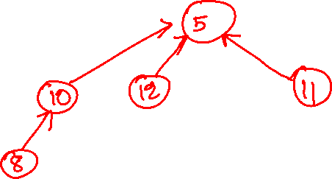
Disjoint-set
Tree-based implementation
Create set (5, 11, 12, 10, 8)

Slide 48
Disjoint-set
Tree-based implementation
Create set (5, 11, 12, 10, 8)
S1 = MAKE_SET(5)
5
Notes:
MAKE_SET simply creates a new tree with just one node corresponding to the input element.

Slide 49
Disjoint-set
Tree-based implementation
Create set (5, 11, 12, 10, 8)
S1 = MAKE_SET(5)
S2 = MAKE_SET(11)
5
11

Slide 50
Disjoint-set
Tree-based implementation
Create set (5, 11, 12, 10, 8)
S1 = MAKE_SET(5)
S2 = MAKE_SET(11)
S3 = UNION(S1, S2)
5
11
Notes:
To unify two trees, make the root of one tree the parent of the root of the other tree.

Slide 51
Disjoint-set
Tree-based implementation
Create set (5, 11, 12, 10, 8)
S1 = MAKE_SET(5)
S2 = MAKE_SET(11)
S3 = UNION(S1, S2)
S4 = MAKE_SET(12)
5
11

Slide 52
Disjoint-set
Tree-based implementation
Create set (5, 11, 12, 10, 8)
S1 = MAKE_SET(5)
S2 = MAKE_SET(11)
S3 = UNION(S1, S2)
S4 = MAKE_SET(12)
5
12
11

Slide 53
Disjoint-set
Tree-based implementation
Create set (5, 11, 12, 10, 8)
S1 = MAKE_SET(5)
S2 = MAKE_SET(11)
S3 = UNION(S1, S2)
S4 = MAKE_SET(12)
S5 = UNION(S3, S4)
5
12
11

Slide 54
Disjoint-set
Tree-based implementation
Create set (5, 11, 12, 10, 8)
S1 = MAKE_SET(5)
S2 = MAKE_SET(11)
S3 = UNION(S1, S2)
S4 = MAKE_SET(12)
S5 = UNION(S3, S4)
S6 = MAKE_SET(10)
5
10
12
11

Slide 55
Disjoint-set
Tree-based implementation
Create set (5, 11, 12, 10, 8)
S1 = MAKE_SET(5)
S2 = MAKE_SET(11)
S3 = UNION(S1, S2)
S4 = MAKE_SET(12)
S5 = UNION(S3, S4)
S6 = MAKE_SET(10)
S7 = MAKE_SET(8)
5
10
12
11
8

Slide 56
Disjoint-set
Tree-based implementation
Create set (5, 11, 12, 10, 8)
S1 = MAKE_SET(5)
S2 = MAKE_SET(11)
S3 = UNION(S1, S2)
S4 = MAKE_SET(12)
S5 = UNION(S3, S4)
S6 = MAKE_SET(10)
S7 = MAKE_SET(8)
S8 = UNION(S6, S7)
5
10
12
11
8

Slide 57
Disjoint-set
Tree-based implementation
Create set (5, 11, 12, 10, 8)
S1 = MAKE_SET(5)
S2 = MAKE_SET(11)
S3 = UNION(S1, S2)
S4 = MAKE_SET(12)
S5 = UNION(S3, S4)
S6 = MAKE_SET(10)
S7 = MAKE_SET(8)
S8 = UNION(S6, S7)
S9 = UNION(S5, S8)
5
10
12
11
8

Slide 58

Disjoint-set
Tree-based implementation
Time complexity
MAKE_SET(x)
UNION(A, B)
FIND_SET(x)

Slide 59
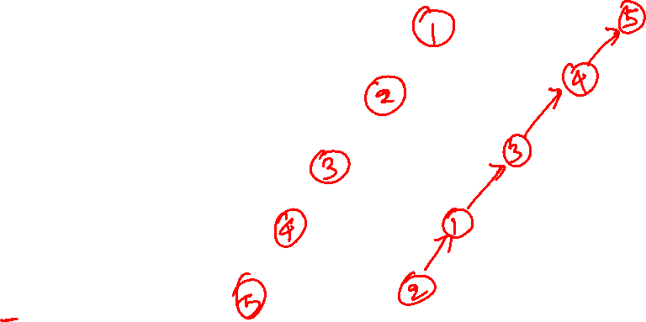
Tree-based implementation
Worst-case
S1 = MAKE_SET(1)
S2 = MAKE_SET(2)
S3 = MAKE_SET(3)
S4 = MAKE_SET(4)
S5 = MAKE_SET(5)
S6 = UNION(S1, S2)
S7 = UNION(S3, S6)
S8 = UNION(S4, S7)
S9 = UNION(S5, S8)

Slide 60
Disjoint-set
Tree-based implementation
Optimizations

Slide 61
Disjoint-set
Tree-based implementation
Optimizations
During union, always make the root of the tree with the larger height the parent of the root of the tree with the smaller height

Slide 62
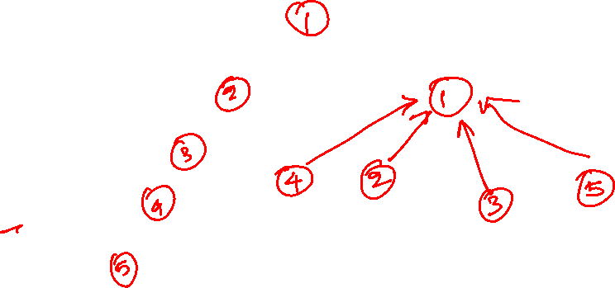
Tree-based implementation
Optimized implementation
S1 = MAKE_SET(1)
S2 = MAKE_SET(2)
S3 = MAKE_SET(3)
S4 = MAKE_SET(4)
S5 = MAKE_SET(5)
S6 = UNION(S1, S2)
S7 = UNION(S3, S6)
S8 = UNION(S4, S7)
S9 = UNION(S5, S8)

Slide 63
Tree-based implementation
Optimized implementation

Slide 64
Tree-based implementation
Optimized implementation
S1 = MAKE_SET(1)
1

Slide 65
Tree-based implementation
Optimized implementation
S1 = MAKE_SET(1)
S2 = MAKE_SET(2)
1
2

Slide 66
Tree-based implementation
Optimized implementation
S1 = MAKE_SET(1)
S2 = MAKE_SET(2)
S3 = MAKE_SET(3)
1
2
3

Slide 67
Tree-based implementation
Optimized implementation
S1 = MAKE_SET(1)
S2 = MAKE_SET(2)
S3 = MAKE_SET(3)
S4 = MAKE_SET(4)
1
2
3
4

Slide 68
Tree-based implementation
Optimized implementation
S1 = MAKE_SET(1)
S2 = MAKE_SET(2)
S3 = MAKE_SET(3)
S4 = MAKE_SET(4)
S5 = MAKE_SET(5)
1
2
3
4
5

Slide 69
Tree-based implementation
Optimized implementation
S1 = MAKE_SET(1)
S2 = MAKE_SET(2)
S3 = MAKE_SET(3)
S4 = MAKE_SET(4)
S5 = MAKE_SET(5)
S6 = UNION(S1, S2)
1
2
3
4
5

Slide 70
Tree-based implementation
Optimized implementation
S1 = MAKE_SET(1)
S2 = MAKE_SET(2)
S3 = MAKE_SET(3)
S4 = MAKE_SET(4)
S5 = MAKE_SET(5)
S6 = UNION(S1, S2)
S7 = UNION(S3, S6)
1
2
3
4
5
Notes:
Make the root of the tree of the larger height the parent of the root of the node of the smaller height.

Slide 71
Tree-based implementation
Optimized implementation
S1 = MAKE_SET(1)
S2 = MAKE_SET(2)
S3 = MAKE_SET(3)
S4 = MAKE_SET(4)
S5 = MAKE_SET(5)
S6 = UNION(S1, S2)
S7 = UNION(S3, S6)
S8 = UNION(S4, S5)
1
2
3
4
5

Slide 72
Tree-based implementation
Optimized implementation
S1 = MAKE_SET(1)
S2 = MAKE_SET(2)
S3 = MAKE_SET(3)
S4 = MAKE_SET(4)
S5 = MAKE_SET(5)
S6 = UNION(S1, S2)
S7 = UNION(S3, S6)
S8 = UNION(S4, S5)
S9 = UNION(S7, S8)
1
2
3
4
5
Notes:
If the heights of both trees are the same, any tree can be the parent of the other tree. The height of the new tree is one more than the height of the trees before the union.

Slide 73
Disjoint-set
Tree-based implementation
Optimizations
The height of a tree is also called the rank of a tree
During the union operation, the root of the tree with the larger rank becomes the parent of the root of the smaller tree
This is also called union-by-rank

Slide 74

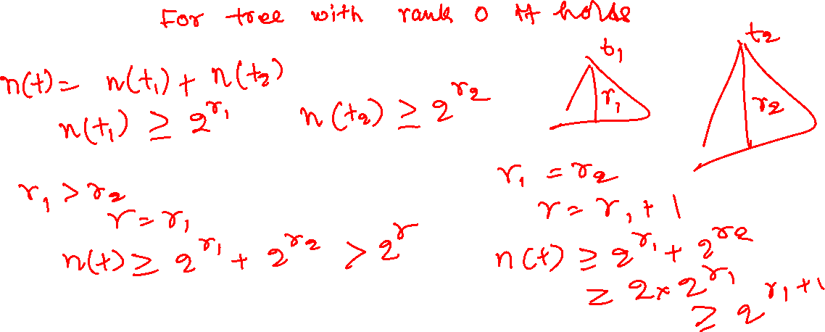
Disjoint-set
If $n(t)$ is the number of nodes in a tree t of rank r, then $n\left(t\right)≥2^{r}$

Slide 75
Disjoint-set
If $n(t)$ is the number of nodes in a tree t of rank r, then $n\left(t\right)≥2^{r}$

Slide 76
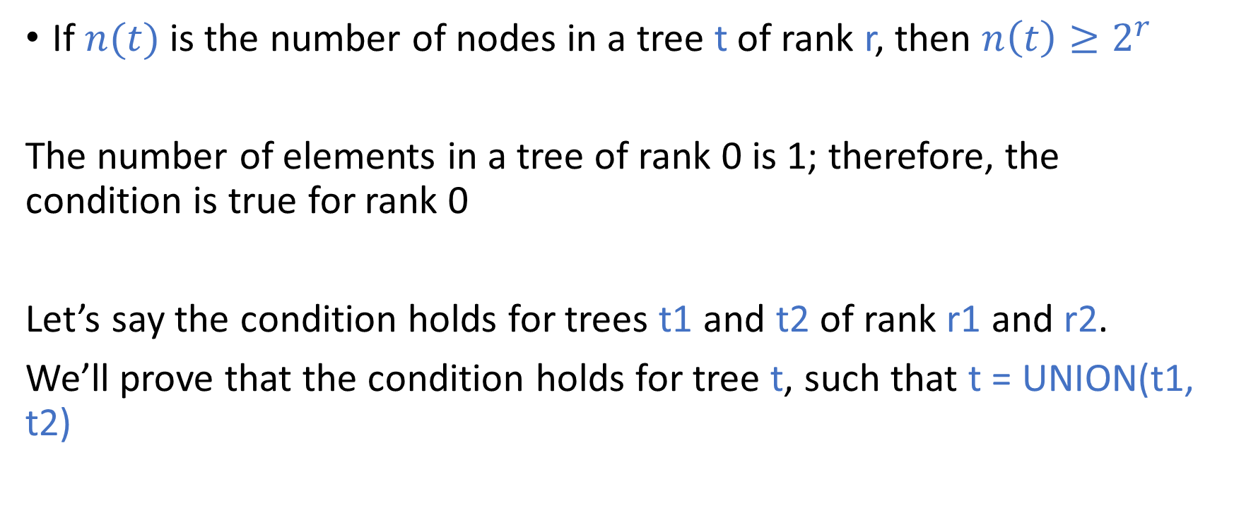
Disjoint-set
If $n(t)$ is the number of nodes in a tree t of rank r, then $n\left(t\right)≥2^{r}$
The number of elements in a tree of rank 0 is 1; therefore, the condition is true for rank 0
Let’s say the condition holds for trees t1 and t2 of rank r1 and r2.
We’ll prove that the condition holds for tree t, such that t = UNION(t1, t2)

Slide 77
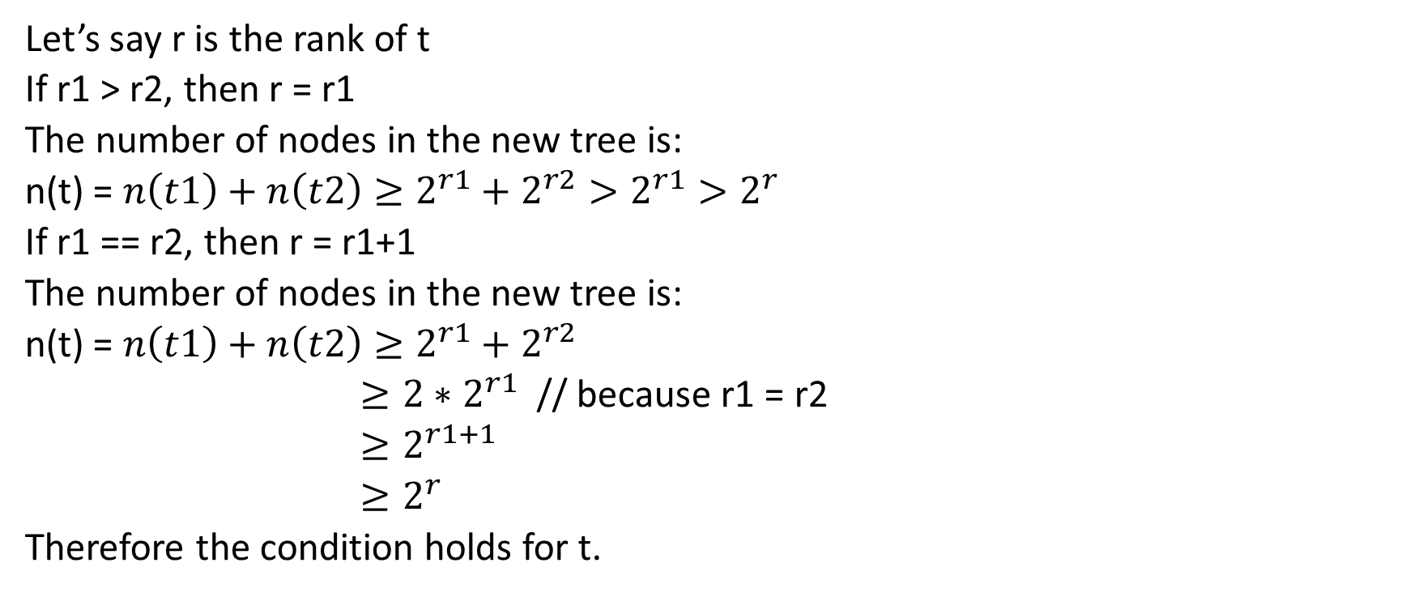
Disjoint-set
Let’s say r is the rank of t
If r1 > r2, then r = r1
The number of nodes in the new tree is:
n(t) = $n\left(t1\right)+n\left(t2\right)≥2^{r1}+2^{r2}>2^{r1}>2^{r}$
If r1 == r2, then r = r1+1
The number of nodes in the new tree is:
n(t) = $n\left(t1\right)+n\left(t2\right)≥2^{r1}+2^{r2}$
$≥2∗2^{r1}$ // because r1 = r2
$≥2^{r1+1}$
$≥2^{r}$
Therefore the condition holds for t.

Slide 78

Disjoint-set
If n is the number of nodes in a tree representing a disjoint-set, what is the upper bound of the height of the tree

Slide 79

Disjoint-set
UNION(X, Y)
// X and Y are the roots of the tree
// return the new root after union
if X.rank > Y.rank
Y.p = X
return X
else
X.p = Y
if X.rank == Y.rank
Y.rank = Y.rank + 1
return Y
FIND_SET(x)
// x is an element in the tree
// Output: root of the tree
while x.p != x
x = x.p
return x
MAKE_SET(x)
// x is the element in the set
// x has two fields p and rank
// p contains the parent of x in the tree
// rank field in the root node is the rank of the tree
x.p = x
x.rank = 0
Notes:
If the rank of X is greater than Y, then we make X the parent of Y at line-5. Otherwise, Y becomes the parent of X at line-8. If the ranks of both the tree are the same, then the rank (or height) of the new tree is incremented by one at line-10. In the FIND_SET algorithm, we keep iterating the parent nodes until we find a node that is the parent of itself. This node is the root of the tree and is returned to the caller. The MAKE_SET procedure creates a tree with a single node, also the root. The rank of the root is set to zero at line-7, and the parent of the root is set to itself at line-6.

Slide 80
Disjoint-set
Further optimizations
After a find operation, can we make subsequent find operations on the same node cheaper

Slide 81
Disjoint-set
Further optimizations
After a find operation, can we make subsequent find operations on the same node cheaper
Path compression: update the parent pointer in each node visited during a find operation to point to the root node

Slide 82
Disjoint set
2
FIND_SET(12)
3
6
5
9
8
10
11
12
Notes:
During the FIND_SET operation, we walk from the element to the root using the parent field in the tree nodes. The parent of the root node is set to itself.

Slide 83
Disjoint set
2
FIND_SET(12)
3
6
5
9
8
10
11
12

Slide 84
Disjoint set
2
FIND_SET(12)
3
6
5
9
8
10
11
12

Slide 85
Disjoint set
2
FIND_SET(12)
3
6
5
9
8
10
11
12

Slide 86
Disjoint set
2
FIND_SET(12)
3
6
5
9
8
10
11
12
Notes:
Nodes 12, 11, 8, 5, 2 lie on the path from 12 to 2. The original FIND_SET walk all these nodes and return the root. In the path-compression algorithm, the parents of nodes 12, 11, and 8 are set to node 2, as shown in the next slide.

Slide 87
Disjoint set
2
After FIND_SET(12)
3
6
5
9
8
10
11
12
Notes:
Before returning the root of the tree, the parents of all the nodes in the path from 12 to root are set to root.

Slide 88
Disjoint-set
UNION(X, Y)
// X and Y are the roots of the tree
// return the new root after union
if X.rank > Y.rank
Y.p = X
return X
else
X.p = Y
if X.rank == Y.rank
Y.rank = Y.rank + 1
return Y
FIND_SET(x)
// x is an element in the tree
// Output: root of the tree
if x.p != x
x.p = FIND_SET(x.p)
return x.p
MAKE_SET(x)
// x is the element in the set
// x has two fields p and rank
// p contains parent of x in the tree
// rank field in the root node is the rank of the tree
x.p = x
x.rank = 0
Notes:
Here, FIND_SET demonstrates the path compression algorithm. FIND_SET returns the root of the tree. While finding the set of an element, the parents of all the nodes from the element to the root are set to the root of the tree. Notice that the path compression algorithm may reduce the height, and if we don’t change the rank, the rank of the tree can be more than the height of the tree. Even though the rank of the tree is greater than or equal to the height of the tree, the find and union operations will work correctly, and the invariant n(t) >= 2^r still holds. Thus even in this case, the height of the tree is O(log (n)) because r is O(log(n)) and the height is less than or equal to r.

Slide 89
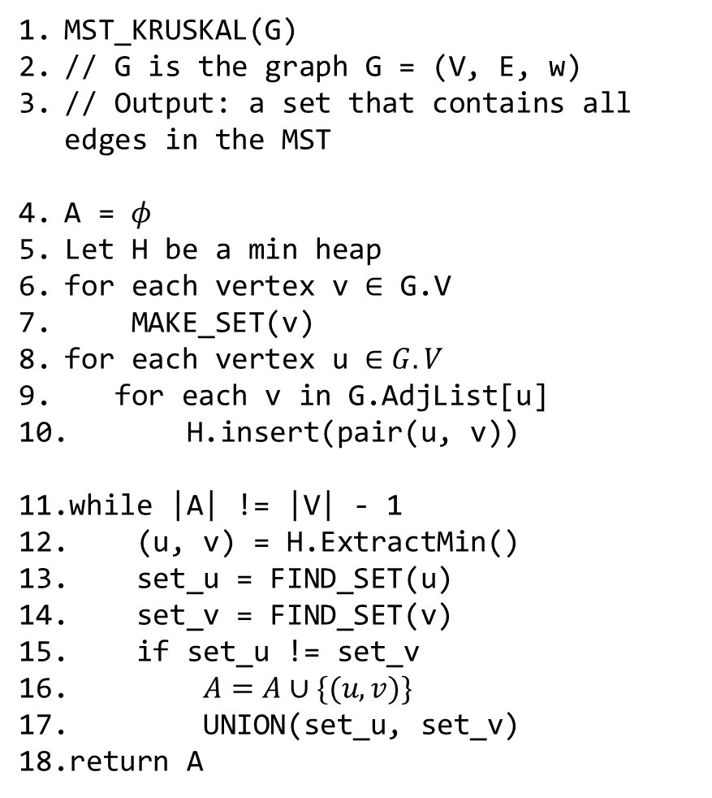
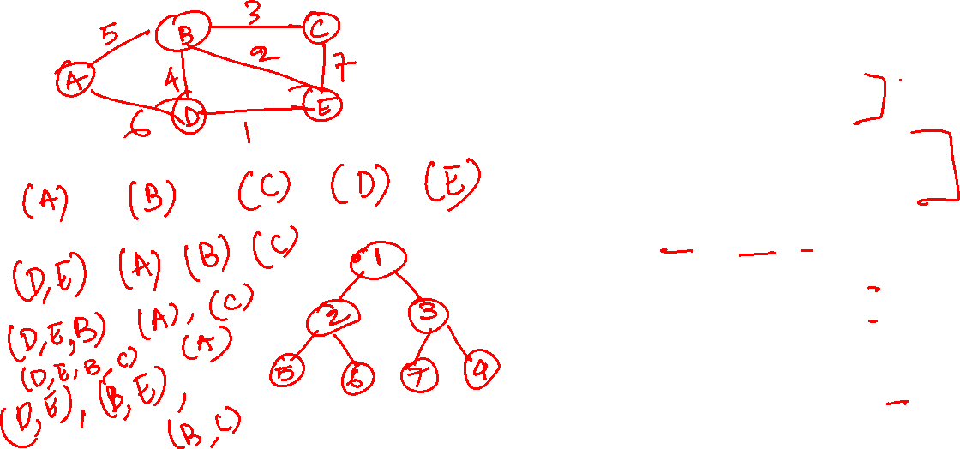
Kruskal’s algorithm
MST_KRUSKAL(G)
// G is the graph G = (V, E, w)
// Output: a set that contains all edges in the MST
A = $φ$
Let H be a min heap
for each vertex v $∈$ G.V
MAKE_SET(v)
for each vertex u $∈G.V$
for each v in G.AdjList[u]
H.insert(pair(u, v))
while |A| != |V| - 1
(u, v) = H.ExtractMin()
set_u = FIND_SET(u)
set_v = FIND_SET(v)
if set_u != set_v
$A=A∪\{(u, v)\}$
UNION(set_u, set_v)
return A
Notes:
Initially, all the vertices are their own disjoint sets. All the edges are stored in a min-heap. An edge is only added to MST if its endpoints belong to different sets (see line-15). We an edge (u, v) is added to the MST; the algorithm unifies the sets corresponding to u and v at line-17. The unification ensures that all the vertices within a disjoint-set are connected, and therefore if an edge whose both endpoints belong to the same set always creates a cycle and thus is not added to the MST.

Slide 90
Kruskal’s algorithm
MST_KRUSKAL(G)
// G is the graph G = (V, E, w)
// Output: a set that contains all edges in the MST
A = $φ$
Let H be a min heap
for each vertex v $∈$ G.V
MAKE_SET(v)
for each vertex u $∈G.V$
for each v in G.AdjList[u]
H.insert(pair(u, v))
while |A| != |V| - 1
(u, v) = H.ExtractMin()
set_u = FIND_SET(u)
set_v = FIND_SET(v)
if set_u != set_v
$A=A∪\{(u, v)\}$
UNION(set_u, set_v)
return A
Time complexity

Slide 91
Time complexity
Line-7 makes O(|V|) operations
Line-8,9,10 can be implemented using BUILD_MIN_HEAP, which requires O(|E|) operations
The loop at line-11 may execute |E| times
The total number of operations at line-12 are O(|E| * log(|E|))
The total number of operations at Line-13 and Line-14 are O(|E|*log(|V|))
The other operations in the loop take constant time during every iteration
Therefore, the time complexity of Kruskal’s algorithm is O(|E| * log (|V|))
Notice that in a connected graph |E| >= |V|-1
log(|E|) <= 2 * log(|V|)

