Slide 2
Today’s topics
Prim’s algorithm
Hash table

Slide 3
References
Chapter-21.2 from the CLRS book
Chapter-11 from the CLRS book
Chapter-7.3 from Goodrich and Tamassia
Chapter-5 from Mark Allen Weiss
Chapter-2.5 from Goodrich and Tamassia

Slide 4
A crucial fact

Slide 5
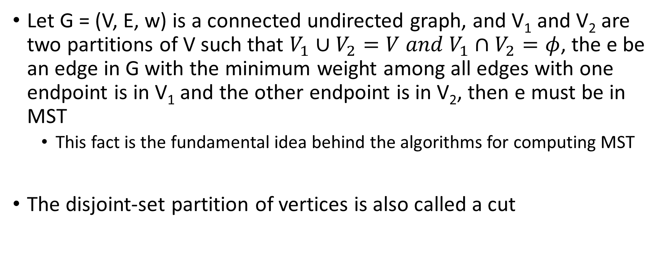
A crucial fact
Let G = (V, E, w) is a connected undirected graph, and V₁ and V₂ are two partitions of V such that $V_{1}∪V_{2}=V and V_{1}∩V_{2}=φ$, the e be an edge in G with the minimum weight among all edges with one endpoint is in V₁ and the other endpoint is in V₂, then e must be in MST
This fact is the fundamental idea behind the algorithms for computing MST
The disjoint-set partition of vertices is also called a cut

Slide 6
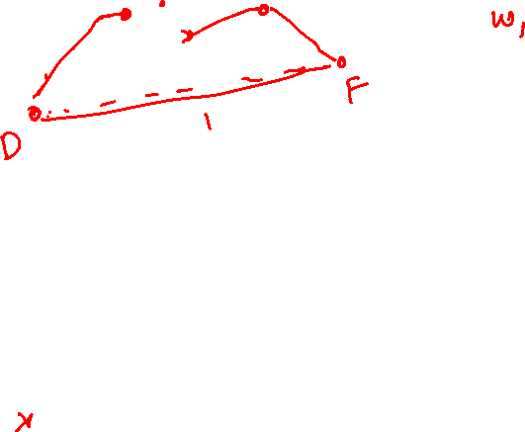
A crucial fact
V2
V1
5
I
A
6
7
B
C
F
1
D
G
E
3
H
J
Notes:
If we partition all vertices in the graph into two disjoint sets, V1 and V2, and S is the set of all edges between V1 and V2, the edge with the minimum weight in S must be part of the MST. In this example, edge (D, F) has the minimum weight. If this is not on the MST, then there must be an alternative path from D to F in the MST that contains at least one edge, say e, from the set S – {(D, F)}. Let's say T is the MST that doesn't contain (D, F). If we add edge (D, F) to T, the resulting graph must have the cycle containing both edges (D, F) and e. If we remove e from this cycle, the rest of the graph will still be connected and is a spanning tree. The weight of the new spanning tree is smaller than T because the weight of e is greater than that of (D, E). Thus T is not an MST.

Slide 7
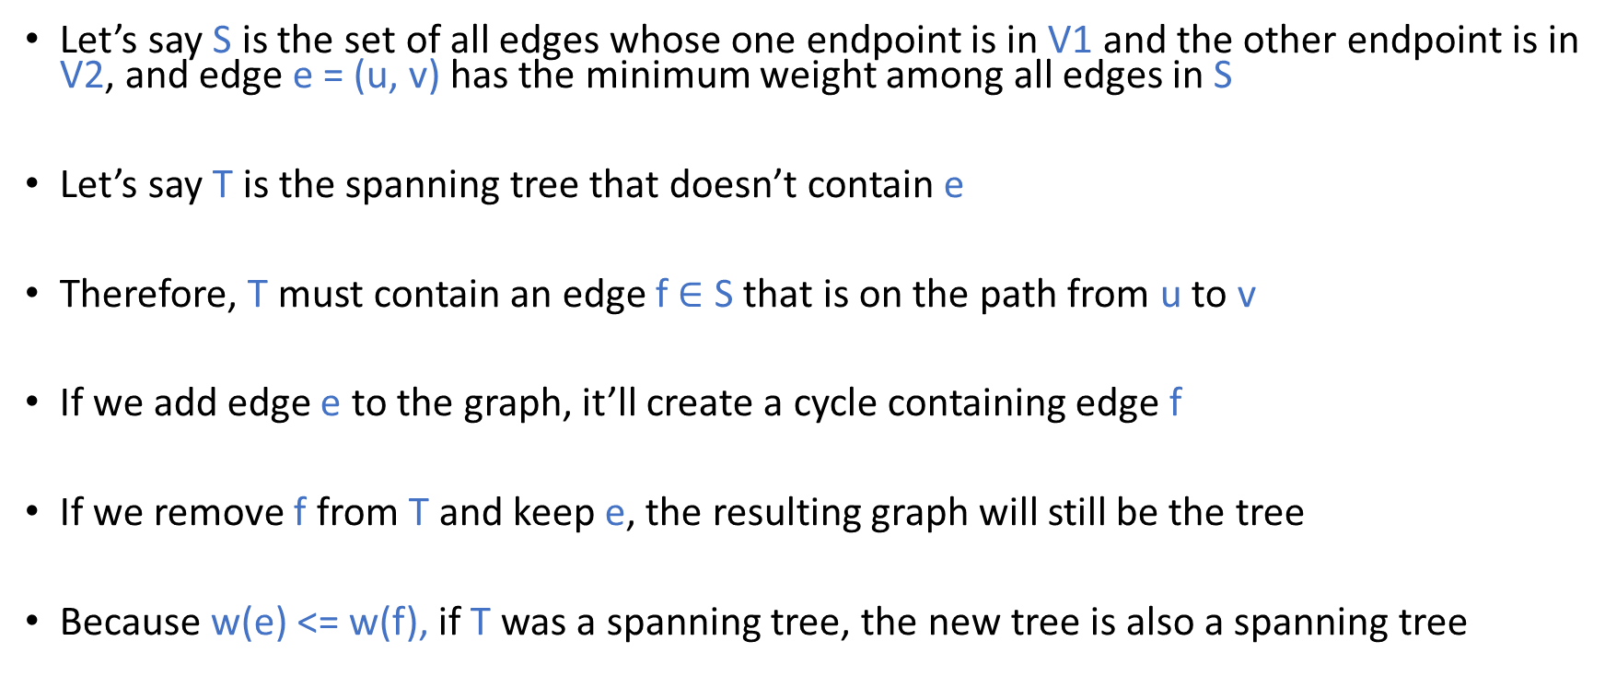
A crucial fact
Let’s say S is the set of all edges whose one endpoint is in V1 and the other endpoint is in V2, and edge e = (u, v) has the minimum weight among all edges in S
Let’s say T is the spanning tree that doesn’t contain e
Therefore, T must contain an edge f $∈$ S that is on the path from u to v
If we add edge e to the graph, it’ll create a cycle containing edge f
If we remove f from T and keep e, the resulting graph will still be the tree
Because w(e) <= w(f), if T was a spanning tree, the new tree is also a spanning tree

Slide 8
Prim’s algorithm

Slide 9



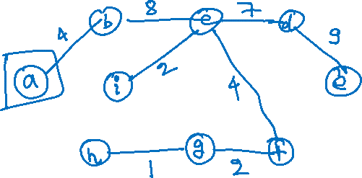





Prim’s algorithm
$$b$$
8
$$c$$
7
$$d$$
4
9
2
a
11
$$i$$
4
$$e$$
14
7
6
8
10
$$h$$
$$g$$
$$f$$
1
2
Notes:
Prim’s algorithm starts with a root vertex. It partitions the vertices into two sets: the first set contains just the root vertex, and the other set contains the remaining vertices. Now the algorithm picks the minimum edge from all the edges between the vertices of the first and second sets. The target vertex of the minimum edge is removed from the second set and added to the first set. Afterward, the same set of steps are executed on the first and second sets to move a vertex from the first set to the second set. This algorithm continues until all the vertices are added to the first set. Whenever a vertex is added to the first set, the corresponding minimum edge is part of the MST.

Slide 10








Prim’s algorithm
$$b$$
8
$$c$$
7
$$d$$
4
9
2
a
11
$$i$$
4
$$e$$
14
7
6
8
10
$$h$$
$$g$$
$$f$$
1
2
Notes:
Initially, all vertices are in the second set.

Slide 11
Prim’s algorithm
$$b$$
8
$$c$$
7
$$d$$
4
9
2
a
11
$$i$$
4
$$e$$
14
7
6
8
10
$$h$$
$$g$$
$$f$$
1
2
Notes:
The root vertex a is added to the first set, and the rest of the vertices are in the second set.

Slide 12
Prim’s algorithm
$$b$$
8
$$c$$
7
$$d$$
4
9
2
a
11
$$i$$
4
$$e$$
14
7
6
8
10
$$h$$
$$g$$
$$f$$
1
2
Notes:
There are two edges, 4 and 8, going from the first set to the second set. We are adding the smaller edge, i.e., 4, to the MST and moving vertex b to the first set.

Slide 13
Prim’s algorithm
$$b$$
8
$$c$$
7
$$d$$
4
9
2
a
11
$$i$$
4
$$e$$
14
7
6
8
10
$$h$$
$$g$$
$$f$$
1
2
Notes:
Now edges (a,h), (b.h), and (b,c) are going from the first set {a, b} to the second set {c, d, e, f, g, h, i}. We can pick either (b,c) or (a,h) because both are minimum. In this case, we pick (b,c); therefore, c is moved to the first set.

Slide 14
Prim’s algorithm
$$b$$
8
$$c$$
7
$$d$$
4
9
2
a
11
$$i$$
4
$$e$$
14
7
6
8
10
$$h$$
$$g$$
$$f$$
1
2

Slide 15
Prim’s algorithm
$$b$$
8
$$c$$
7
$$d$$
4
9
2
a
11
$$i$$
4
$$e$$
14
7
6
8
10
$$h$$
$$g$$
$$f$$
1
2

Slide 16
Prim’s algorithm
$$b$$
8
$$c$$
7
$$d$$
4
9
2
a
11
$$i$$
4
$$e$$
14
7
6
8
10
$$h$$
$$g$$
$$f$$
1
2

Slide 17
Prim’s algorithm
$$b$$
8
$$c$$
7
$$d$$
4
9
2
a
11
$$i$$
4
$$e$$
14
7
6
8
10
$$h$$
$$g$$
$$f$$
1
2

Slide 18
Prim’s algorithm
$$b$$
8
$$c$$
7
$$d$$
4
9
2
a
11
$$i$$
4
$$e$$
14
7
6
8
10
$$h$$
$$g$$
$$f$$
1
2

Slide 19
Prim’s algorithm
$$b$$
8
$$c$$
7
$$d$$
4
9
2
a
11
$$i$$
4
$$e$$
14
7
6
8
10
$$h$$
$$g$$
$$f$$
1
2

Slide 20
Implementation

Slide 21
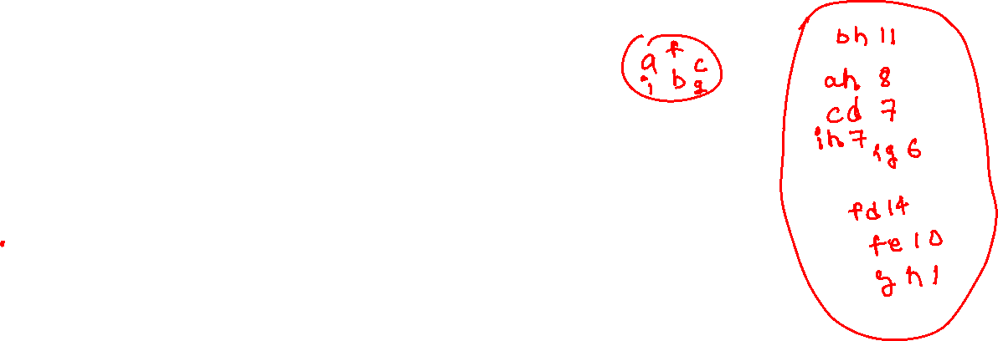
Prim’s algorithm
$$b$$
8
$$c$$
7
$$d$$
4
9
2
a
11
$$i$$
4
$$e$$
14
7
6
8
10
$$h$$
$$g$$
$$f$$
1
2

Slide 22


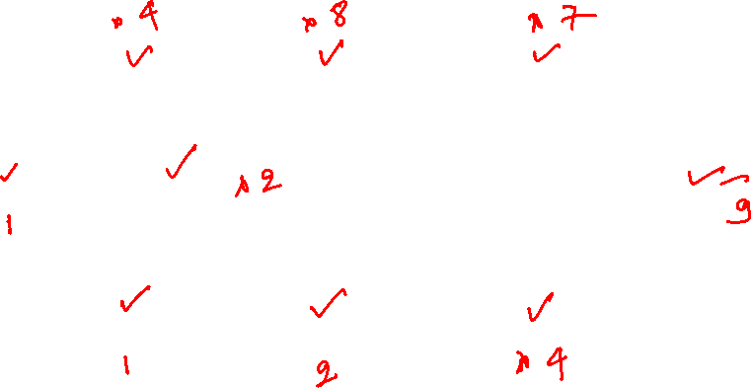







Prim’s algorithm
$$∞$$
$$∞$$
$$∞$$
$$b$$
8
$$c$$
7
$$d$$
4
9
2
$$0$$
a
11
$$i$$
$$∞$$
4
$$e$$
$$∞$$
14
7
6
8
10
$$h$$
$$g$$
$$f$$
1
2
$$∞$$
$$∞$$
$$∞$$

Slide 23
Prim’s algorithm
v = Extract min
add v to spanning tree
update minimum edges incident to other yellow vertices adjacent to v
$$∞$$
$$∞$$
$$∞$$
$$b$$
8
$$c$$
7
$$d$$
4
9
2
$$0$$
a
11
$$i$$
$$∞$$
4
$$e$$
$$∞$$
14
7
6
8
10
$$h$$
$$g$$
$$f$$
1
2
$$∞$$
$$∞$$
$$∞$$

Slide 24
Prim’s algorithm
v = Extract min
add v to spanning tree
update minimum edges incident to other yellow vertices adjacent to v
$$∞$$
$$∞$$
$$∞$$
$$b$$
8
$$c$$
7
$$d$$
4
9
2
$$0$$
a
11
$$i$$
$$∞$$
4
$$e$$
$$∞$$
14
7
6
8
10
$$h$$
$$g$$
$$f$$
1
2
$$∞$$
$$∞$$
$$∞$$
Notes:
We can use an approach similar to Dijkstra. Each vertex contains a key field that stores the weight of the minimum weight edge among all edges incident to that vertex from the white vertices. Whenever a node becomes white, the keys of its yellow neighbors are updated if applicable.

Slide 25


Prim’s algorithm
v = Extract min
add v to spanning tree
update minimum edges incident to other yellow vertices adjacent to v
$$4$$
$$∞$$
$$∞$$
$$b$$
8
$$c$$
7
$$d$$
4
9
2
$$0$$
a
11
$$i$$
$$∞$$
4
$$e$$
$$∞$$
14
7
6
8
10
$$h$$
$$g$$
$$f$$
1
2
$$8$$
$$∞$$
$$∞$$

Slide 26
Prim’s algorithm
v = Extract min
add v to spanning tree
update minimum edges incident to other yellow vertices adjacent to v
$$4$$
$$∞$$
$$∞$$
$$b$$
8
$$c$$
7
$$d$$
4
9
2
$$0$$
a
11
$$i$$
$$∞$$
4
$$e$$
$$∞$$
14
7
6
8
10
$$h$$
$$g$$
$$f$$
1
2
$$8$$
$$∞$$
$$∞$$

Slide 27

Prim’s algorithm
v = Extract min
add v to spanning tree
update minimum edges incident to other yellow vertices adjacent to v
$$4$$
$$8$$
$$∞$$
$$b$$
8
$$c$$
7
$$d$$
4
9
2
$$0$$
a
11
$$i$$
$$∞$$
4
$$e$$
$$∞$$
14
7
6
8
10
$$h$$
$$g$$
$$f$$
1
2
$$8$$
$$∞$$
$$∞$$

Slide 28
Prim’s algorithm
v = Extract min
add v to spanning tree
update minimum edges incident to other yellow vertices adjacent to v
$$4$$
$$8$$
$$∞$$
$$b$$
8
$$c$$
7
$$d$$
4
9
2
$$0$$
a
11
$$i$$
$$∞$$
4
$$e$$
$$∞$$
14
7
6
8
10
$$h$$
$$g$$
$$f$$
1
2
$$8$$
$$∞$$
$$∞$$

Slide 29



Prim’s algorithm
v = Extract min
add v to spanning tree
update minimum edges incident to other yellow vertices adjacent to v
$$4$$
$$8$$
$$7$$
$$b$$
8
$$c$$
7
$$d$$
4
9
2
$$0$$
a
11
$$i$$
$$2$$
4
$$e$$
$$∞$$
14
7
6
8
10
$$h$$
$$g$$
$$f$$
1
2
$$8$$
$$∞$$
$$4$$

Slide 30
Prim’s algorithm
v = Extract min
add v to spanning tree
update minimum edges incident to other yellow vertices adjacent to v
$$4$$
$$8$$
$$7$$
$$b$$
8
$$c$$
7
$$d$$
4
9
2
$$0$$
a
11
$$i$$
$$2$$
4
$$e$$
$$∞$$
14
7
6
8
10
$$h$$
$$g$$
$$f$$
1
2
$$8$$
$$∞$$
$$4$$

Slide 31


Prim’s algorithm
v = Extract min
add v to spanning tree
update minimum edges incident to other yellow vertices adjacent to v
$$4$$
$$8$$
$$7$$
$$b$$
8
$$c$$
7
$$d$$
4
9
2
$$0$$
a
11
$$i$$
$$2$$
4
$$e$$
$$∞$$
14
7
6
8
10
$$h$$
$$g$$
$$f$$
1
2
$$7$$
$$6$$
$$4$$

Slide 32
Prim’s algorithm
v = Extract min
add v to spanning tree
update minimum edges incident to other yellow vertices adjacent to v
$$4$$
$$8$$
$$7$$
$$b$$
8
$$c$$
7
$$d$$
4
9
2
$$0$$
a
11
$$i$$
$$2$$
4
$$e$$
$$∞$$
14
7
6
8
10
$$h$$
$$g$$
$$f$$
1
2
$$7$$
$$6$$
$$4$$

Slide 33


Prim’s algorithm
v = Extract min
add v to spanning tree
update minimum edges incident to other yellow vertices adjacent to v
$$4$$
$$8$$
$$7$$
$$b$$
8
$$c$$
7
$$d$$
4
9
2
$$0$$
a
11
$$i$$
$$2$$
4
$$e$$
$$10$$
14
7
6
8
10
$$h$$
$$g$$
$$f$$
1
2
$$7$$
$$2$$
$$4$$

Slide 34
Prim’s algorithm
v = Extract min
add v to spanning tree
update minimum edges incident to other yellow vertices adjacent to v
$$4$$
$$8$$
$$7$$
$$b$$
8
$$c$$
7
$$d$$
4
9
2
$$0$$
a
11
$$i$$
$$2$$
4
$$e$$
$$10$$
14
7
6
8
10
$$h$$
$$g$$
$$f$$
1
2
$$7$$
$$2$$
$$4$$

Slide 35

Prim’s algorithm
v = Extract min
add v to spanning tree
update minimum edges incident to other yellow vertices adjacent to v
$$4$$
$$8$$
$$7$$
$$b$$
8
$$c$$
7
$$d$$
4
9
2
$$0$$
a
11
$$i$$
$$2$$
4
$$e$$
$$10$$
14
7
6
8
10
$$h$$
$$g$$
$$f$$
1
2
$$1$$
$$2$$
$$4$$

Slide 36
Prim’s algorithm
v = Extract min
add v to spanning tree
update minimum edges incident to other yellow vertices adjacent to v
$$4$$
$$8$$
$$7$$
$$b$$
8
$$c$$
7
$$d$$
4
9
2
$$0$$
a
11
$$i$$
$$2$$
4
$$e$$
$$10$$
14
7
6
8
10
$$h$$
$$g$$
$$f$$
1
2
$$1$$
$$2$$
$$4$$

Slide 37
Prim’s algorithm
v = Extract min
add v to spanning tree
update minimum edges incident to other yellow vertices adjacent to v
$$4$$
$$8$$
$$7$$
$$b$$
8
$$c$$
7
$$d$$
4
9
2
$$0$$
a
11
$$i$$
$$2$$
4
$$e$$
$$10$$
14
7
6
8
10
$$h$$
$$g$$
$$f$$
1
2
$$1$$
$$2$$
$$4$$

Slide 38

Prim’s algorithm
v = Extract min
add v to spanning tree
update minimum edges incident to other yellow vertices adjacent to v
$$4$$
$$8$$
$$7$$
$$b$$
8
$$c$$
7
$$d$$
4
9
2
$$0$$
a
11
$$i$$
$$2$$
4
$$e$$
$$9$$
14
7
6
8
10
$$h$$
$$g$$
$$f$$
1
2
$$1$$
$$2$$
$$4$$

Slide 39
Prim’s algorithm
v = Extract min
add v to spanning tree
update minimum edges incident to other yellow vertices adjacent to v
$$4$$
$$8$$
$$7$$
$$b$$
8
$$c$$
7
$$d$$
4
9
2
$$0$$
a
11
$$i$$
$$2$$
4
$$e$$
$$9$$
14
7
6
8
10
$$h$$
$$g$$
$$f$$
1
2
$$1$$
$$2$$
$$4$$

Slide 40
Implementation
We can implement Prim’s algorithm in the similar way we implemented the Dijkstra algorithm
The vertices that are added to the spanning tree are marked as white
Other vertices are marked as yellow
For yellow vertices, we maintain the minimum edge that is coming from the set of white vertices
At each step, we find the vertex that is at the shortest distance from the set of white vertices and make it white
After a yellow vertex, x, becomes a white vertex, the minimum distances from the white vertices may change for all yellow vertices adjacent to x. If applicable, we update the minimum distance of these vertices

Slide 41

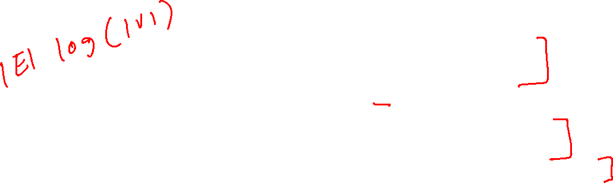
Prim’s algorithm
MST_PRIM(G, r)
// G is the graph G = (V, E, w)
// r is the root node
// each vertex v has two fields key and $π$
// Output: a set that contains all edges in the MST
for each vertex $u∈G.V$
u.key = $∞$
u.$π$ = NIL
r.key = 0
Q = $φ$
for each vertex u in G.V
INSERT(Q, u)
while Q != $φ$
u = EXTRACT_MIN(Q)
for each vertex v in G.Adj[u]
if $v∈Q$ and w(u, v) < v.key
v.$π$ = u
v.key = w(u, v)
DECREASE_KEY(Q, v, w(u,v))
Notes:
A vertex contains two fields: key and $π$. key is the weight of the minimum edge incident to the vertex from white vertices. $π$ contains the other endpoint of the edge whose weight is stored in key.

Slide 42

Prim’s algorithm
MST_PRIM(G, r)
// G is the graph G = (V, E, w)
// r is the root node
// each vertex v has two fields key and $π$
// Output: a set that contains all edges in the MST; for each vertex v, $π$ contains the predecessor of v in the MST
for each vertex $u∈G.V$
u.key = $∞$
u.$π$ = NIL
r.key = 0
Q = $φ$
for each vertex u in G.V
INSERT(Q, u)
while Q != $φ$
u = EXTRACT_MIN(Q)
for each vertex v in G.Adj[u]
if $v∈Q$ and w(u, v) < v.key
v.$π$ = u
v.key = w(u, v)
DECREASE_KEY(Q, v, w(u,v))
Time complexity

Slide 43
Time complexity
Line-11,12 takes O(|V|) operations if implemented using BUILD_MIN_HEAP
Line-14 executes |V| times and thus takes O(|V|*log(|V|)) operation
Line-19 may execute |E| times and thus the number of operations take O(|E| * log(|V|)) time
Therefore, the overall time complexity is O(|E| * log(|V|))
Notice the graph is connected and therefore |E| >= |V|-1

Slide 44

Prim’s algorithm invariants
In min-heap
In MST
A
B
D
C
E
F
G
H
Invariant-1 : The white vertices are already in the MST.
Invariant-2: For a yellow vertex v, if $v≠∞$ and $v. π ≠NIL$, then v.key is equal to the weight of the minimum weight edge out of all the edges incident to v from the set of white vertices.
Can you identify any similarity with the Dijkstra algorithm?

Slide 45
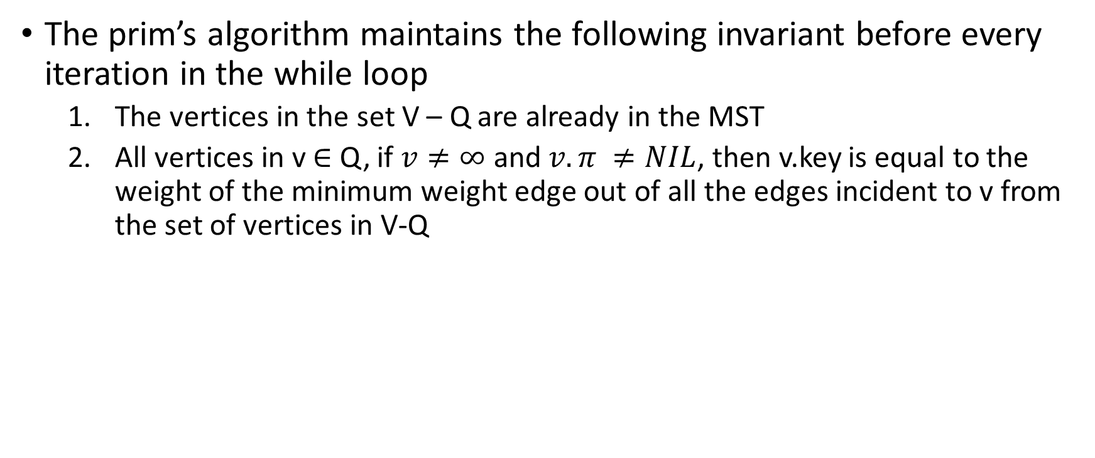
Prim’s algorithm invariants
The prim’s algorithm maintains the following invariant before every iteration in the while loop
The vertices in the set V – Q are already in the MST
All vertices in v $∈$ Q, if $v≠∞$ and $v. π ≠NIL$, then v.key is equal to the weight of the minimum weight edge out of all the edges incident to v from the set of vertices in V-Q

Slide 46
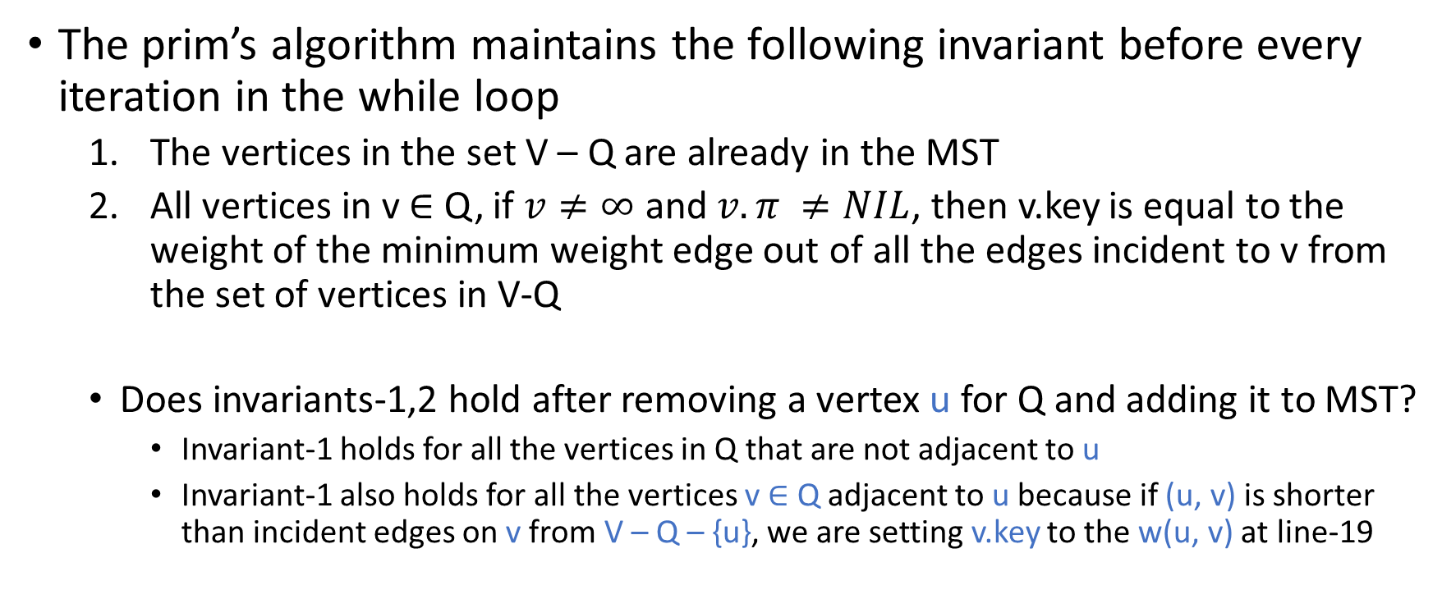
Prim’s algorithm invariants
The prim’s algorithm maintains the following invariant before every iteration in the while loop
The vertices in the set V – Q are already in the MST
All vertices in v $∈$ Q, if $v≠∞$ and $v. π ≠NIL$, then v.key is equal to the weight of the minimum weight edge out of all the edges incident to v from the set of vertices in V-Q
Does invariants-1,2 hold after removing a vertex u for Q and adding it to MST?
Invariant-1 holds for all the vertices in Q that are not adjacent to u
Invariant-1 also holds for all the vertices v $∈$ Q adjacent to u because if (u, v) is shorter than incident edges on v from V – Q – {u}, we are setting v.key to the w(u, v) at line-19

Slide 47
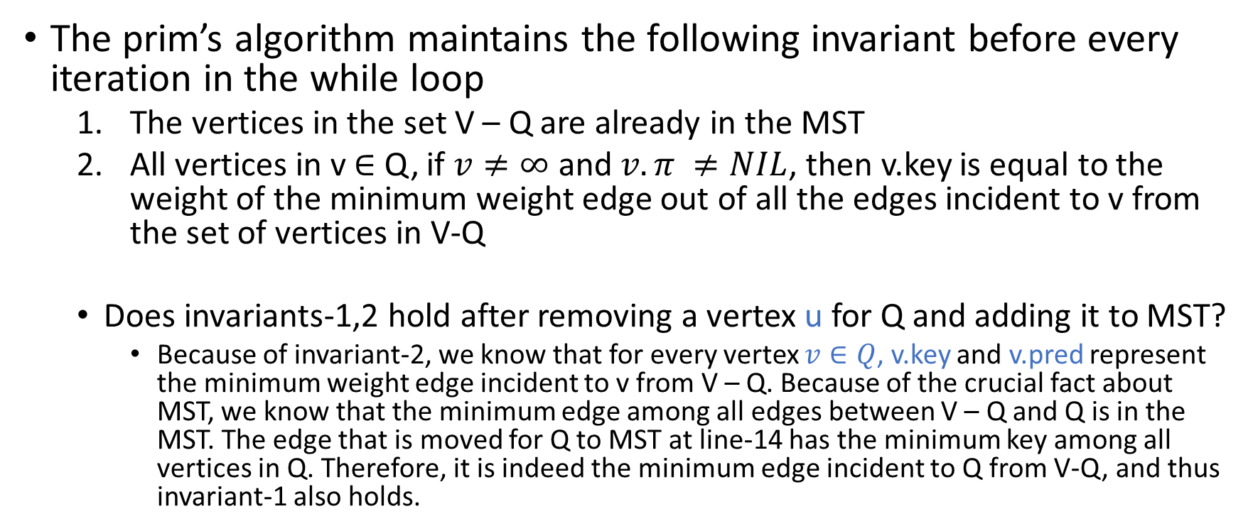
Prim’s algorithm invariants
The prim’s algorithm maintains the following invariant before every iteration in the while loop
The vertices in the set V – Q are already in the MST
All vertices in v $∈$ Q, if $v≠∞$ and $v. π ≠NIL$, then v.key is equal to the weight of the minimum weight edge out of all the edges incident to v from the set of vertices in V-Q
Does invariants-1,2 hold after removing a vertex u for Q and adding it to MST?
Because of invariant-2, we know that for every vertex $v∈Q$, v.key and v.pred represent the minimum weight edge incident to v from V – Q. Because of the crucial fact about MST, we know that the minimum edge among all edges between V – Q and Q is in the MST. The edge that is moved for Q to MST at line-14 has the minimum key among all vertices in Q. Therefore, it is indeed the minimum edge incident to Q from V-Q, and thus invariant-1 also holds.

Slide 48
Hash table

Slide 49
Hash table
Let’s say we have the following key-value pairs. All values are positive. How can we efficiently store these key-value pairs in a data-structure such that finding the value corresponding to a key is cheaper? The maximum value of a key is 100. There are no duplicate keys.
[0, 100], [1, 101], [81, 102], [4, 103], [64, 104], [25, 105], [16, 106], [36, 107], [9, 108], [49, 109]

Slide 50
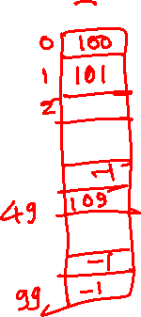
Hash table
[0, 100], [1, 101], [81, 102], [4, 103], [64, 104], [25, 105], [16, 106], [36, 107], [9, 108], [49, 109]
Notes:
We can create an array of size 100 and store the value at arr[key].

Slide 51
Hash table
Let’s say we have the following key-value pairs. All values are positive. How can we efficiently store these key-value pairs in a data-structure such that finding the value corresponding to a key is cheaper? The maximum number of key-value pairs can be 100. There are no duplicate keys.
[0, 100], [1, 101], [1081, 102], [40004, 103], [64, 104], [25, 105], [16, 106], [36, 107], [9, 108], [49, 109]

Slide 52
Hash table
[0, 100], [1, 101], [1081, 102], [40004, 103], [64, 104], [25, 105], [16, 106], [36, 107], [9, 108], [49, 109]
Notes:
In this case, we need to use a large array because the key is very large. Another alternative is to store the value at (key%100). However, in this case, we need to store both key and value, because the array index is no longer the key.

Slide 53
Hash table
Let’s say we have the following key-value pairs. All values are positive. How can we efficiently store these key-value pairs in a data-structure such that finding the value corresponding to a key is cheaper? The maximum number of key-value pairs can be 100. There are no duplicate keys.
[“Amar”, 100], [“Akbar”, 101], [“Anthony”, 102], [“Carlos”, 103], [“Robert”, 104], [“Pran”, 105], [“Amrish”, 106], [“Amjad”, 107], [“Danny”, 108], [“Shakti”, 109]

Slide 54
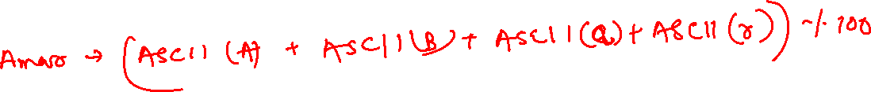
Hash table
[“Amar”, 100], [“Akbar”, 101], [“Anthony”, 102], [“Carlos”, 103], [“Robert”, 104], [“Pran”, 105], [“Amrish”, 106], [“Amjad”, 107], [“Danny”, 108], [“Shakti”, 109]
Notes:
We can use the sum of the ASCII values of all characters as an index in the array.

Slide 55
Hash table
The hash table is a key value store
The primary use case of a hash table is to find the value associated with a key if the key is present in the hash table
The hash table operations are: insert, delete, and find

Slide 56
Hash table
Hash table leverages the fact that the array indexing is fast
We can store the value at an index equal to the associated key
To find the value associated with a key, we can directly look at the corresponding index

Slide 57
Hash table
There are several challenges in implementing a hash table
If the key is equal to the index, then the key must be an integer
If the number of elements in the hash table is small, but the values of some keys are large, then the size of the array would be very large
To address these problems, we can map the key to an integer value lower than the size of the hash table; the new value is used to index in the array
The function that is used to map the key to an integer value is called a hash function

Slide 58
Hash function
If the key is a string, we can convert it into an integer by adding the ASCII values of all characters in the string
We can also use an equation that uses the ASCII values of the characters and their positions in the strings to generate an integer value
For integer keys, we can use key % m, where m is the size of the hash table
You can define the hash function in whatever ways you like as long as it maps the key to a valid index in the hash table

Slide 59
Hash function
One problem with the hash functions is that two keys can map to a single index in the hash table even if the hash table is large enough to store all (key, value) pairs
This event is called a hash collision
A good hash function tries to minimize the hash collisions, but completely avoiding hash collisions for arbitrary data may not be possible

Slide 60
Hash function
Therefore, the hash table must implement a strategy to deal with the hash collisions
The first strategy that is used is called chaining

Slide 61
Chaining

Slide 62
Chaining
In the chaining strategy, keys with the same hash values are stored in a linked list
The hash table maintains m linked-lists, one for every slot, where m is the number of slots in the hash table
During insertion, the key-value pair is inserted in the linked-list at an index equal to the hash value of the key
To find an element corresponding to a key, we need to iterate the linked list stored at the index equal to the hash value of key

Slide 63
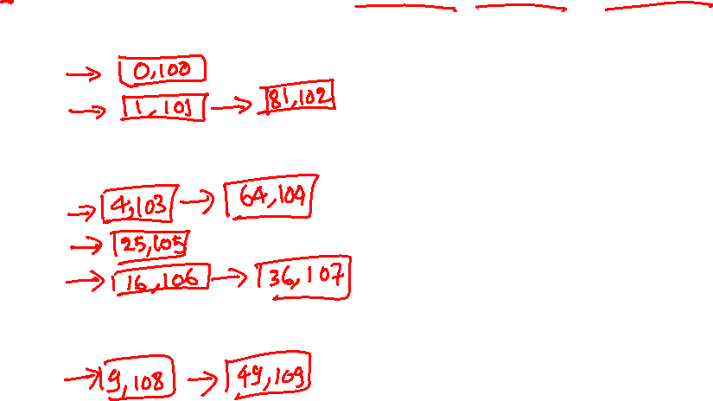
Chaining
Insert [0, 100], [1, 101], [81, 102], [4, 103], [64, 104], [25, 105], [16, 106], [36, 107], [9, 108], [49, 109] into a hash table with chaining.
0
1
2
3
4
5
6
7
8
9
int HashFun(int x) {
return x % 10;
}
Notes:
Each slot in the hash table points to a linked-list containing all key-value pairs mapped to that slot.

Slide 64
Chaining
Insert [0, 100], [1, 101], [81, 102], [4, 103], [64, 104], [25, 105], [16, 106], [36, 107], [9, 108], [49, 109] into a hash table with chaining.
0
1
2
3
4
5
6
7
8
9
int HashFun(int x) {
return x % 10;
}

Slide 65
Chaining
Insert [0, 100], [1, 101], [81, 102], [4, 103], [64, 104], [25, 105], [16, 106], [36, 107], [9, 108], [49, 109] into a hash table with chaining.
0
1
2
3
4
5
6
7
8
9
0, 100
int HashFun(int x) {
return x % 10;
}

Slide 66
Chaining
Insert [0, 100], [1, 101], [81, 102], [4, 103], [64, 104], [25, 105], [16, 106], [36, 107], [9, 108], [49, 109] into a hash table with chaining.
0
1
2
3
4
5
6
7
8
9
0, 100
1, 101
int HashFun(int x) {
return x % 10;
}

Slide 67
Chaining
Insert [0, 100], [1, 101], [81, 102], [4, 103], [64, 104], [25, 105], [16, 106], [36, 107], [9, 108], [49, 109] into a hash table with chaining.
0
1
2
3
4
5
6
7
8
9
0, 100
1, 101
81, 102
int HashFun(int x) {
return x % 10;
}

Slide 68
Chaining
Insert [0, 100], [1, 101], [81, 102], [4, 103], [64, 104], [25, 105], [16, 106], [36, 107], [9, 108], [49, 109] into a hash table with chaining.
0
1
2
3
4
5
6
7
8
9
0, 100
1, 101
81, 102
4, 103
int HashFun(int x) {
return x % 10;
}

Slide 69
Chaining
Insert [0, 100], [1, 101], [81, 102], [4, 103], [64, 104], [25, 105], [16, 106], [36, 107], [9, 108], [49, 109] into a hash table with chaining.
0
1
2
3
4
5
6
7
8
9
0, 100
1, 101
81, 102
4, 103
64, 104
int HashFun(int x) {
return x % 10;
}

Slide 70
Chaining
Insert [0, 100], [1, 101], [81, 102], [4, 103], [64, 104], [25, 105], [16, 106], [36, 107], [9, 108], [49, 109] into a hash table with chaining.
0
1
2
3
4
5
6
7
8
9
0, 100
1, 101
81, 102
4, 103
64, 104
25, 105
int HashFun(int x) {
return x % 10;
}

Slide 71
Chaining
Insert [0, 100], [1, 101], [81, 102], [4, 103], [64, 104], [25, 105], [16, 106], [36, 107], [9, 108], [49, 109] into a hash table with chaining.
0
1
2
3
4
5
6
7
8
9
0, 100
1, 101
81, 102
4, 103
64, 104
25, 105
16, 106
int HashFun(int x) {
return x % 10;
}

Slide 72
Chaining
Insert [0, 100], [1, 101], [81, 102], [4, 103], [64, 104], [25, 105], [16, 106], [36, 107], [9, 108], [49, 109] into a hash table with chaining.
0
1
2
3
4
5
6
7
8
9
0, 100
1, 101
81, 102
4, 103
64, 104
25, 105
16, 106
36, 107
int HashFun(int x) {
return x % 10;
}

Slide 73
Chaining
Insert [0, 100], [1, 101], [81, 102], [4, 103], [64, 104], [25, 105], [16, 106], [36, 107], [9, 108], [49, 109] into a hash table with chaining.
0
1
2
3
4
5
6
7
8
9
0, 100
1, 101
81, 102
4, 103
64, 104
25, 105
16, 106
36, 107
int HashFun(int x) {
return x % 10;
}
9, 108

Slide 74
Chaining
Insert [0, 100], [1, 101], [81, 102], [4, 103], [64, 104], [25, 105], [16, 106], [36, 107], [9, 108], [49, 109] into a hash table with chaining.
0
1
2
3
4
5
6
7
8
9
0, 100
1, 101
81, 102
4, 103
64, 104
25, 105
16, 106
36, 107
int HashFun(int x) {
return x % 10;
}
9, 108
49, 109

Slide 75

Chaining
Time complexity (assuming hash function is O(1))
Insert
Find
Delete

Slide 76
Hash function
The efficiency of the hash tables depends upon how good the hash function is
A good hash function uniformly distributes the key, i.e., each key is equally likely to hash to any of the m slots, where m is the number of slots in the hash table

Slide 77
Hash function
The division method
h(k) = k mod m, where m is the number of slots in the hash table

Slide 78
Hash function
The division method
h(k) = k mod m, where m is the number of slots in the hash table
In this hash function, the choice of m is critical:
If m = 2^{P}, h(k) is lowest p bits of k
If the lowest p bits are not equally likely, then this might not be a good hash function
If m is 10 and most keys end in zero, then it’s not a good choice
A prime number is considered a good choice for m

Slide 79
Hash function
What is the problem with the following hash function?
// key is a null terminated character array
// m is the number of slots in the hash table
int HashFn(char *key, int m)
{
unsigned int HashVal = 0;
int i;
for (i = 0; key[i] != ‘\0’; i++)
HashVal += key[i];
return HashVal % m;
}

Slide 80
Hash function
What is the problem with the following hash function?
// key is a null terminated character array
// m is the number of slots in the hash table
int HashFn(char *key, int m)
{
unsigned int HashVal = 0;
int i;
for (i = 0; key[i] != ‘\0’; i++)
HashVal += key[i];
return HashVal % m;
}
Because the ASCII value of a character is less than 128, the calculated HashVal could be much lower than m. Also, two different strings with the same characters will be mapped to the same index in the hash table.

Slide 81
Hash function
What is the problem of the following hash function?
// key is a null terminated character array
// m is the number of slots in the hash table
// this code assumes that the string has at least three characters
int HashFn(char *key, int m)
{
return (key[0] + (27 * key[1]) + (729 * key[2])) % m;
}

Slide 82
Hash function
What is the problem of the following hash function?
// key is a null terminated character array
// m is the number of slots in the hash table
// this code assumes that the string has at least three characters
int HashFn(char *key, int m)
{
return (key[0] + (27 * key[1]) + (729 * key[2])) % m;
}
Even though there are 26 * 26 * 26 = 17,276 different possible strings of length three, if the keys are valid English words, then the possible valid strings are roughly 2,851. If m is around 10000, only 28% of the table will be occupied even if there are no hash collisions.

Slide 83
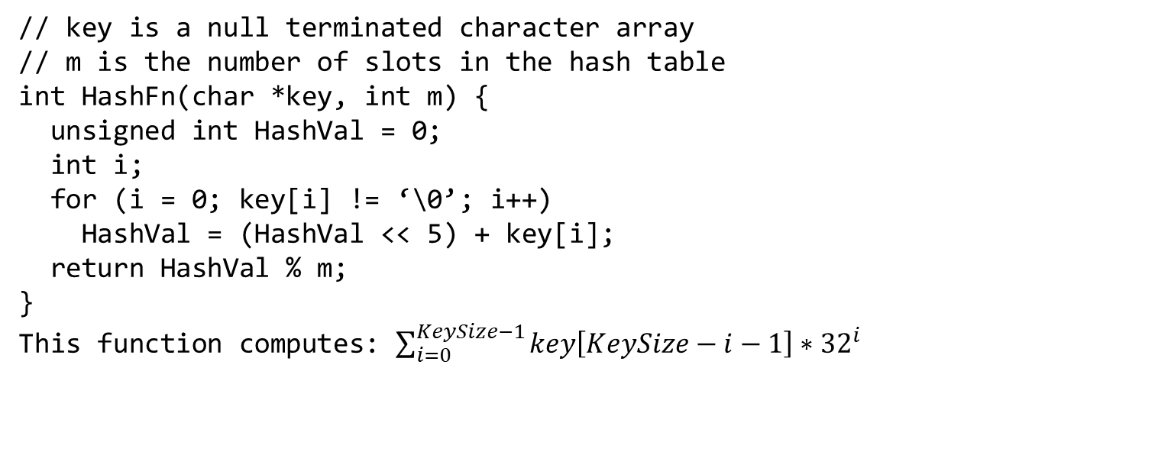
Hash function
A good hash function.
// key is a null terminated character array
// m is the number of slots in the hash table
int HashFn(char *key, int m) {
unsigned int HashVal = 0;
int i;
for (i = 0; key[i] != ‘\0’; i++)
HashVal = (HashVal << 5) + key[i];
return HashVal % m;
}
This function computes: $\sum_{i=0}^{KeySize−1}{key\left[KeySize−i−1\right]∗{32}^{i}}$

Slide 84

Hash function
A good hash function.
// key is a null terminated character array
// m is the number of slots in the hash table
int HashFn(char *key, int m) {
unsigned int HashVal = 0;
int i;
for (i = 0; key[i] != ‘\0’; i++)
HashVal = (HashVal << 5) + key[i];
return HashVal % m;
}
This function computes: $\sum_{i=0}^{KeySize−1}{key\left[KeySize−i−1\right]∗{32}^{i}}$
It computes a polynomial function on all characters and their positions in the string. The computed result is expected to distribute well. This hash function is also efficient.

Slide 85

Hash function
A good hash function.
// key is a null terminated character array
// m is the number of slots in the hash table
int HashFn(char *key, int m) {
unsigned int HashVal = 0;
int i;
for (i = 0; key[i] != ‘\0’; i++)
HashVal = (HashVal << 5) + key[i];
return HashVal % m;
}
This function computes: $\sum_{i=0}^{KeySize−1}{key\left[KeySize−i−1\right]∗{32}^{i}}$
However, this hash function might take a long time if the length of the string is large. In addition, the earlier characters may not contribute to the hash value at all because of the overflow. A common practice is to not use all characters. The length and properties of the key are crucial in designing the hash function for a given workload.

Slide 86
Chaining
The average number of elements stored in a linked-list is also called the load factor
A uniform hash function returns any of the m slots with equal probability for an input key
What is the load factor of a hash table with m slots and n entries if a uniform hash function is used?

Slide 87
Chaining
The average number of elements stored in a linked-list is also called the load factor
A uniform hash function returns any of the m slots with equal probability for an input key
What is the load factor of a hash table with m slots and n entries if a uniform hash function is used?
n/m

Slide 88
Chaining
What is the average time complexity of the search and delete operations in a hash table with chaining?

Slide 89
Chaining
What is the average time complexity of the search and delete operations in a hash table with chaining?
O(load factor)

Slide 90
Open addressing

Slide 91
Open addressing
In open addressing, all elements are stored in hash table slots only
No additional linked list is created
Linear probing and quadratic probing are some of the techniques that are used to handle hash collisions

Slide 92
Linear probing

Slide 93
Linear probing
In the linear probing scheme, if slot i returned by the hash function is already occupied
the element is inserted into the first available slot between i+1 to m-1, where m is the number of slots in the hash table
If none of the slots is available between i+1 to m-1, the element is inserted at the first available slot between 0 to i-1

