Slide 2
Today’s topics
Hash table
Sorting

Slide 3
References
Chapter-11 from the CLRS book
Chapter-5 from Mark Allen Weiss
Chapter-2.5 from Goodrich and Tamassia

Slide 4
Open addressing

Slide 5
Open addressing
In open addressing, all elements are stored in hash table slots only
No additional linked list is created
Linear probing and quadratic probing are some of the techniques that are used to handle hash collisions

Slide 6
Linear probing

Slide 7
Linear probing
In the linear probing scheme, if slot i returned by the hash function is already occupied
the element is inserted into the first available slot between i+1 to m-1, where m is the number of slots in the hash table
If none of the slots is available between i+1 to m-1, the element is inserted at the first available slot between 0 to i-1

Slide 8
Insert

Slide 9
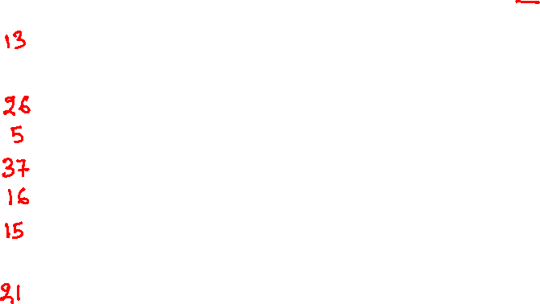
Linear probing
0
1
2
3
4
5
6
7
8
9
10
Insert keys 13, 21, 26, 5, 37, 16, 15
int HashFun(int x) {
return x % 11;
}

Slide 10
Linear probing
0
1
2
3
4
5
6
7
8
9
10
Insert keys 13, 21, 26, 5, 37, 16, 15
int HashFun(int x) {
return x % 11;
}

Slide 11
Linear probing
0
1
2 | 13
3
4
5
6
7
8
9
10
Insert keys 13, 21, 26, 5, 37, 16, 15
int HashFun(int x) {
return x % 11;
}

Slide 12
Linear probing
0
1
2 | 13
3
4
5
6
7
8
9
10 | 21
Insert keys 13, 21, 26, 5, 37, 16, 15
int HashFun(int x) {
return x % 11;
}

Slide 13
Linear probing
0
1
2 | 13
3
4 | 26
5
6
7
8
9
10 | 21
Insert keys 13, 21, 26, 5, 37, 16, 15
int HashFun(int x) {
return x % 11;
}

Slide 14
Linear probing
0
1
2 | 13
3
4 | 26
5 | 5
6
7
8
9
10 | 21
Insert keys 13, 21, 26, 5, 37, 16, 15
int HashFun(int x) {
return x % 11;
}

Slide 15
Linear probing
0
1
2 | 13
3
4 | 26
5 | 5
6 | 37
7
8
9
10 | 21
Insert keys 13, 21, 26, 5, 37, 16, 15
Inserting 37.
37 % 11 = 4
Index 4 is already occupied.
check index 5.
Index 5 is already occupied.
check index 6.
Insert at index 6.
int HashFun(int x) {
return x % 11;
}

Slide 16
Linear probing
0
1
2 | 13
3
4 | 26
5 | 5
6 | 37
7 | 16
8
9
10 | 21
Insert keys 13, 21, 26, 5, 37, 16, 15
Inserting 16.
16 % 11 = 5
5 is already occupied
check index 6
6 is already occupied
check index 7
insert at index 7
int HashFun(int x) {
return x % 11;
}

Slide 17
Linear probing
0
1
2 | 13
3
4 | 26
5 | 5
6 | 37
7 | 16
8 | 15
9
10 | 21
Insert keys 13, 21, 26, 5, 37, 16, 15
Inserting 15.
15 % 11 = 4
4 is already occupied
check index 5.
5 is already occupied
check index 6.
6 is already occupied
check index 7.
7 is already occupied.
check index 8.
Insert at index 8.
int HashFun(int x) {
return x % 11;
}

Slide 18

Insert
HASH_INSERT(h, e, m)
// h is the hash table
// m is the total number of slots in the hash table
// e is the element that has two fields: key and value
// Output: Insert e in the hash table h and return the index in the hash table
idx = hash_function(e.key, m)
i = 0
while i < m
if h[idx] == NIL
h[idx] = e
return idx
idx = (idx + 1) % m
i = i + 1
error “hash table overflow”

Slide 19
Search

Slide 20

Linear probing
0
1
2 | 13
3
4 | 26
5 | 5
6 | 37
7 | 16
8 | 15
9
10 | 21
Search 12
int HashFun(int x) {
return x % 11;
}

Slide 21
Linear probing
0
1
2 | 13
3
4 | 26
5 | 5
6 | 37
7 | 16
8 | 15
9
10 | 21
Search 12
12 % 11 = 1
hash[1] == NIL
12 is not present in the hash table
int HashFun(int x) {
return x % 11;
}

Slide 22
Linear probing
0
1
2 | 13
3
4 | 26
5 | 5
6 | 37
7 | 16
8 | 15
9
10 | 21
Search 15
int HashFun(int x) {
return x % 11;
}

Slide 23
Linear probing
0
1
2 | 13
3
4 | 26
5 | 5
6 | 37
7 | 16
8 | 15
9
10 | 21
Search 15
15 % 11 = 4
hash[4] != 15 and hash[4] != NIL
check 5
hash[5] != 15 and hash[4] != NIL
check 6
hash[6] != 15 and hash[5] != NIL
check 7
hash[7] != 15 and hash[7] != NIL
check 8
hash[8] == 15 and hash[8] != NIL
return the corresponding entry
int HashFun(int x) {
return x % 11;
}

Slide 24
Search
HASH_SEARCH(h, k, m)
// h is the hash table
// m is the total number of slots in the hash table
// k is the key being searched
// Output: Return NIL if the element is not stored in the table; otherwise, return the stored element
idx = hash_function(k, m)
i = 0
while i < m and h[idx] != NIL
if h[idx].key == k
return h[idx]
idx = (idx + 1) % m
i = i + 1
return NIL

Slide 25
Delete

Slide 26
Linear probing
0
1
2 | 13
3
4 | 26
5 | 5
6 | 37
7 | 16
8 | 15
9
10 | 21
Delete 37
int HashFun(int x) {
return x % 11;
}

Slide 27
Linear probing
0
1
2 | 13
3
4 | 26
5 | 5
6 | 37
7 | 16
8 | 15
9
10 | 21
Delete 37
37 % 11 = 4
hash[4] != 37 and hash[4] != NIL
check 5
hash[5] != 37 and hash[5] != NIL
check 6
hash[6] == 37 and hash[6] != NIL
int HashFun(int x) {
return x % 11;
}

Slide 28
Linear probing
0
1
2 | 13
3
4 | 26
5 | 5
6
7 | 16
8 | 15
9
10 | 21
Delete 37
37 % 11 = 4
hash[4] != 37 and hash[4] != NIL
check 5
hash[5] != 37 and hash[5] != NIL
check 6
hash[6] == 37 and hash[6] != NIL
hash[6] = NIL
int HashFun(int x) {
return x % 11;
}

Slide 29
Linear probing
0
1
2 | 13
3
4 | 26
5 | 5
6
7 | 16
8 | 15
9
10 | 21
Search 15
int HashFun(int x) {
return x % 11;
}

Slide 30
Linear probing
0
1
2 | 13
3
4 | 26
5 | 5
6
7 | 16
8 | 15
9
10 | 21
Search 15
15 % 11 = 4
hash[4] != 15 and hash[4] != NIL
check 5
hash[5] != 15 and hash[5] != NIL
check 6
hash[6] == NIL
stop.
15 is not present in the hash table, which is not true.
int HashFun(int x) {
return x % 11;
}

Slide 31
Linear probing
During delete, simply setting the corresponding hash slot to NIL may create issues because the subsequent slots may contain entries corresponding to the current and previous slots
A special marker is used for deleted slots to skip the deleted slot and continue probing during search and delete operations

Slide 32
Linear probing
0
1
2 | 13
3
4 | 26
5 | 5
6 | 37
7 | 16
8 | 15
9
10 | 21
Delete 37
int HashFun(int x) {
return x % 11;
}

Slide 33
Linear probing
0
1
2 | 13
3
4 | 26
5 | 5
6 | 37
7 | 16
8 | 15
9
10 | 21
Delete 37
37 % 11 = 4
hash[4] != 37 and hash[4] != NIL
check 5
hash[5] != 37 and hash[5] != NIL
check 6
hash[6] == 37 and hash[6] != NIL
int HashFun(int x) {
return x % 11;
}

Slide 34
Linear probing
0
1
2 | 13
3
4 | 26
5 | 5
6 | DEL
7 | 16
8 | 15
9
10 | 21
Delete 37
37 % 11 = 4
hash[4] != 37 and hash[4] != NIL
check 5
hash[5] != 37 and hash[5] != NIL
check 6
hash[6] == 37 and hash[6] != NIL
hash[6] = DEL // special marker
int HashFun(int x) {
return x % 11;
}

Slide 35

Linear probing
0
1
2 | 13
3
4 | 26
5 | 5
6 | DEL
7 | 16
8 | 15
9
10 | 21
Search 15
int HashFun(int x) {
return x % 11;
}

Slide 36
Linear probing
0
1
2 | 13
3
4 | 26
5 | 5
6 | DEL
7 | 16
8 | 15
9
10 | 21
Search 15
15 % 11 = 4
hash[4] != 15 and hash[4] != NIL
check 5
hash[5] != 15 and hash[5] != NIL
check 6
hash[6] != 15 and hash[6] != NIL
check 7
hash[7] != 15 and hash[7] != NIL
check 8
hash[8] == 15
The key is present.
Return corresponding entry.
int HashFun(int x) {
return x % 11;
}

Slide 37
Search
HASH_SEARCH(h, k, m)
// h is the hash table
// m is the total number of slots in the hash table
// k is the key being searched
// Output: Return NIL if the element is not stored in the table; otherwise, return the stored element
idx = hash_function(k, m)
i = 0
while i < m and h[idx] != NIL
if h[idx] != DEL and h[idx].key == k
return h[idx]
idx = (idx + 1) % m
i = i + 1
return NIL

Slide 38
Delete
HASH_DELETE(h, k, m)
// h is the hash table
// m is the total number of slots in the hash table
// k is the key that needs to be deleted
// Output: Delete an entry that contains k
idx = hash_function(k, m)
i = 0
while i < m and h[idx] != NIL
if h[idx] != DEL and h[idx].key == k
h[idx] = DEL
return
idx = (idx + 1) % m
i = i + 1
return NIL

Slide 39
Insert
HASH_INSERT(h, e, m)
// h is the hash table
// m is the total number of slots in the hash table
// e is the element that has two fields: key and value
// Output: Insert e in the hash table h and return the index in the hash table
idx = hash_function(e.key, m)
i = 0
while i < m
if h[idx] == NIL or h[idx] == DEL
h[idx] = e
return idx
idx = (idx + 1) % m
i = i + 1
error “hash table overflow”

Slide 40
Linear probing
Does the performance of a search operation in the linear probing mechanism is the same as chaining?

Slide 41
Linear probing
Does the performance of a search operation in the linear probing mechanism is the same as chaining?
No, because in the case of hash collisions, all the elements corresponding to a hash slot may not be consecutive. There could be entries corresponding to the other hash table slots in between.

Slide 42
Linear probing
The linear probing may create clustering (also called primary clustering) because an empty slot preceded by n occupied slots gets filled next with the probability of (n+1)/m. Therefore, the average search time increases.

Slide 43
Quadratic probing

Slide 44
Quadratic probing
In quadratic probing, if the i^{th} slot returned by the hash function is already occupied, slots at indices (i + j²) mod m are tried for j = 1, 2,3, …; where m is the total number of slots in the hash table
Quadratic probing doesn’t quarantine that all slots will be visited; however, if m is a prime number, then it definitely finds a slot in the hash table if more than half slots are available

Slide 45
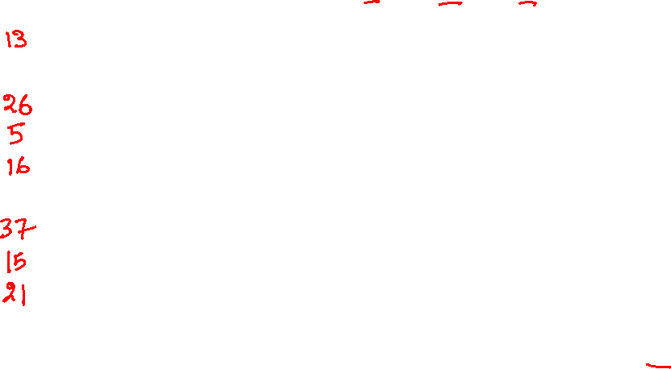
Quadratic probing
0
1
2
3
4
5
6
7
8
9
10
Insert keys 13, 21, 26, 5, 37, 16, 15
Probing strategy:
i = HashFun(key)
Try (i + j²) mod 11 for j = 1, 2,3, …
int HashFun(int x) {
return x % 11;
}

Slide 46
Quadratic probing
0
1
2
3
4
5
6
7
8
9
10
Insert keys 13, 21, 26, 5, 37, 16, 15
Probing strategy:
i = HashFun(key)
Try (i + j²) mod 11 for j = 1, 2,3, …
int HashFun(int x) {
return x % 11;
}

Slide 47
Quadratic probing
0
1
2 | 13
3
4
5
6
7
8
9
10
Insert keys 13, 21, 26, 5, 37, 16, 15
Inserting 13
Probing strategy:
i = HashFun(key)
Try (i + j²) mod 11 for j = 1, 2,3, …
int HashFun(int x) {
return x % 11;
}

Slide 48
Quadratic probing
0
1
2 | 13
3
4
5
6
7
8
9
10 | 21
Insert keys 13, 21, 26, 5, 37, 16, 15
Inserting 21
Probing strategy:
i = HashFun(key)
Try (i + j²) mod 11 for j = 1, 2,3, …
int HashFun(int x) {
return x % 11;
}

Slide 49
Quadratic probing
0
1
2 | 13
3
4 | 26
5
6
7
8
9
10 | 21
Insert keys 13, 21, 26, 5, 37, 16, 15
Inserting 26
Probing strategy:
i = HashFun(key)
Try (i + j²) mod 11 for j = 1, 2,3, …
int HashFun(int x) {
return x % 11;
}

Slide 50
Quadratic probing
0
1
2 | 13
3
4 | 26
5 | 5
6
7
8
9
10 | 21
Insert keys 13, 21, 26, 5, 37, 16, 15
Inserting 5
Probing strategy:
i = HashFun(key)
Try (i + j²) mod 11 for j = 1, 2,3, …
int HashFun(int x) {
return x % 11;
}

Slide 51
Quadratic probing
0
1
2 | 13
3
4 | 26
5 | 5
6
7
8 | 37
9
10 | 21
Insert keys 13, 21, 26, 5, 37, 16, 15
Inserting 37
37 % 11 = 4 is occupied
(4 + 1) % 11 = 5 is occupied
(4 + 4) % 11 = 8 is available
Probing strategy:
i = HashFun(key)
Try (i + j²) mod 11 for j = 1, 2,3, …
int HashFun(int x) {
return x % 11;
}

Slide 52
Quadratic probing
0
1
2 | 13
3
4 | 26
5 | 5
6 | 16
7
8 | 37
9
10 | 21
Insert keys 13, 21, 26, 5, 37, 16, 15
Inserting 16
16 % 11 = 5 is occupied
(5 + 1) % 11 = 6 is available
Probing strategy:
i = HashFun(key)
Try (i + j²) mod 11 for j = 1, 2,3, …
int HashFun(int x) {
return x % 11;
}

Slide 53
Quadratic probing
0
1
2 | 13
3
4 | 26
5 | 5
6 | 16
7
8 | 37
9 | 15
10 | 21
Insert keys 13, 21, 26, 5, 37, 16, 15
Inserting 15
15 % 11 = 4 is occupied
(4 + 1) % 11 = 5 is occupied
(4 + 4) % 11 = 8 is occupied
(4 + 9) % 11 = 2 is occupied
(4 + 16) % 11 = 9 is available
Probing strategy:
i = HashFun(key)
Try (i + j²) mod 11 for j = 1, 2,3, …
int HashFun(int x) {
return x % 11;
}

Slide 54

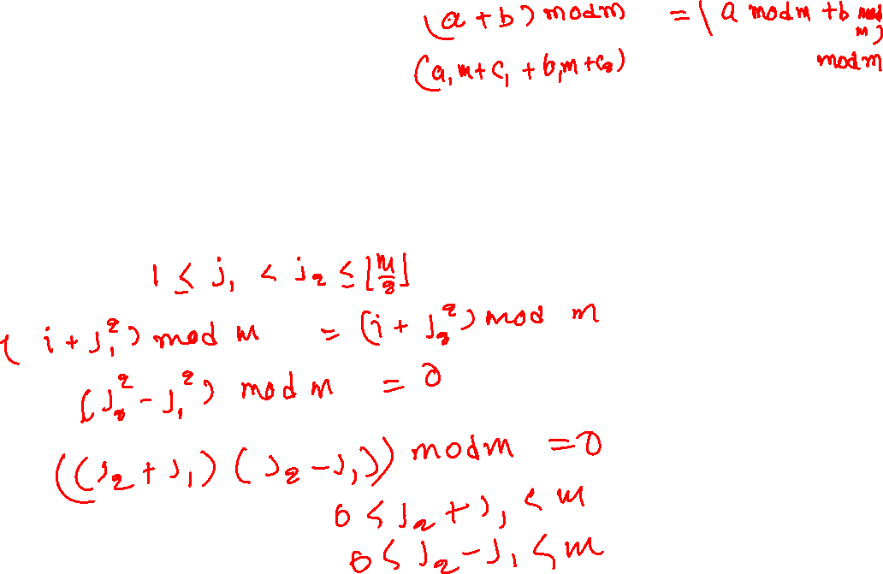
Quadratic probing
If quadratic probing is used and m is prime, then first $\left\lfloor \frac{m}{2}\right\rfloor$ alternative locations given by the quadratic probing algorithm are distinct

Slide 55

Quadratic probing
If quadratic probing is used and m is prime, then first $\left\lfloor \frac{m}{2}\right\rfloor$ alternative locations given by the quadratic probing algorithm are distinct
Let’s say this is not true.
It means there exists, $j_{1}, j_{2}$ such that ${1≤ j}_{1}<j_{2}≤\left\lfloor m/2\right\rfloor$
and
$$\left(i+j_{1}^{2}\right) mod m=\left(i+j_{2}^{2}\right) mod m$$
$$j_{1}^{2} mod m=j_{2}^{2} mod m$$
$$\left(j_{2}^{2}−j_{1}^{2}\right) mod m=0$$
$$(\left(j_{2}+j_{1}\right)\left(j_{2}−j_{1}\right)) mod m=0$$
The above condition only holds if ${(j}_{2}+j_{1})$ ($j_{2}−j_{1})$ is either zero or a multiple of m. However, none of these can be true because ${1≤ j}_{2}−j_{1}<j_{2}+j_{1}<m$ and m is prime. Therefore, for first $\left\lfloor \frac{m}{2}\right\rfloor$ probes always give distinct values.

Slide 56
Quadratic probing
Although quadratic probing eliminates primary clustering, it creates its own kind of clustering called secondary clustering. This is because elements that hash to the same positions will probe at similar slots.

Slide 57
Double hashing
Double hashing scheme uses two hash functions, hash1 and hash2
hash2 never returns zero
i = hash1(key) is already occupied, then an offset o = hash2(key) is computed
probing is done at index (i+o)%m, (i+(2*o))%m, (i+(3*o))%m, and so on until an empty slot is encountered, where m is the size of the hash table
if o < m and m is not divisible by o, then we can always find an empty slot during insertion if a slot is available

Slide 58
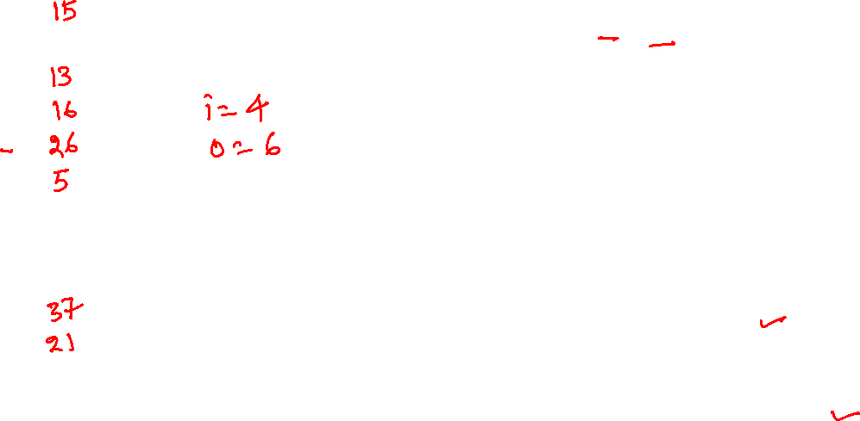
Double hashing
0
1
2
3
4
5
6
7
8
9
10
Insert keys 13, 21, 26, 5, 37, 16, 15
Probing strategy:
i = hash1(key)
o = hash2(key)
Try (i + (j*o)) mod 11 for j = 1, 2,3, …
int hash1(int x) {
return x % 11;
}
int hash2(int x) {
return 7 – (x % 7);
}

Slide 59
Double hashing
0
1
2
3
4
5
6
7
8
9
10
Insert keys 13, 21, 26, 5, 37, 16, 15
Probing strategy:
i = hash1(key)
o = hash2(key)
Try (i + (j*o)) mod 11 for j = 1, 2,3, …
int hash1(int x) {
return x % 11;
}
int hash2(int x) {
return 7 – (x % 7);
}

Slide 60
Double hashing
0
1
2 | 13
3
4
5
6
7
8
9
10
Insert keys 13, 21, 26, 5, 37, 16, 15
Inserting 13 at 13 % 11 = 2
Probing strategy:
i = hash1(key)
o = hash2(key)
Try (i + (j*o)) mod 11 for j = 1, 2,3, …
int hash1(int x) {
return x % 11;
}
int hash2(int x) {
return 7 – (x % 7);
}

Slide 61
Double hashing
0
1
2 | 13
3
4
5
6
7
8
9
10 | 21
Insert keys 13, 21, 26, 5, 37, 16, 15
Inserting 21 at 21 % 11 = 10
Probing strategy:
i = hash1(key)
o = hash2(key)
Try (i + (j*o)) mod 11 for j = 1, 2,3, …
int hash1(int x) {
return x % 11;
}
int hash2(int x) {
return 7 – (x % 7);
}

Slide 62
Double hashing
0
1
2 | 13
3
4 | 26
5
6
7
8
9
10 | 21
Insert keys 13, 21, 26, 5, 37, 16, 15
Inserting 26 at 26 % 11 = 4
Probing strategy:
i = hash1(key)
o = hash2(key)
Try (i + (j*o)) mod 11 for j = 1, 2,3, …
int hash1(int x) {
return x % 11;
}
int hash2(int x) {
return 7 – (x % 7);
}

Slide 63
Double hashing
0
1
2 | 13
3
4 | 26
5 | 5
6
7
8
9
10 | 21
Insert keys 13, 21, 26, 5, 37, 16, 15
Inserting 5 at 5 % 11 = 5
Probing strategy:
i = hash1(key)
o = hash2(key)
Try (i + (j*o)) mod 11 for j = 1, 2,3, …
int hash1(int x) {
return x % 11;
}
int hash2(int x) {
return 7 – (x % 7);
}

Slide 64
Double hashing
0
1
2 | 13
3
4 | 26
5 | 5
6
7
8
9 | 37
10 | 21
Insert keys 13, 21, 26, 5, 37, 16, 15
Inserting 37 at 37 % 11 = 4, which is occupied
off = 7 – (37 % 7) = 5
Inserting 37 at (4 + 5) % 11 = 9
Probing strategy:
i = hash1(key)
o = hash2(key)
Try (i + (j*o)) mod 11 for j = 1, 2,3, …
int hash1(int x) {
return x % 11;
}
int hash2(int x) {
return 7 – (x % 7);
}

Slide 65
Double hashing
Probing strategy:
i = hash1(key)
o = hash2(key)
Try (i + (j*o)) mod 11 for j = 1, 2,3, …
0
1
2 | 13
3 | 16
4 | 26
5 | 5
6
7
8
9 | 37
10 | 21
Insert keys 13, 21, 26, 5, 37, 16, 15
Inserting 16 at 16 % 11 = 5, which is occupied
off = 7 – (16 % 7) = 5
Inserting 16 at (5 + 5) % 11 = 10, which is occupied
Inserting 16 at (5 + (2*5)) % 11 = 4, which is occupied
Inserting 16 at (5 + (3*5)) % 11 = 9, which is occupied
Inserting 16 at (5 + (4*5)) % 11 = 3
int hash1(int x) {
return x % 11;
}
int hash2(int x) {
return 7 – (x % 7);
}

Slide 66
Double hashing
Probing strategy:
i = hash1(key)
o = hash2(key)
Try (i + (j*o)) mod 11 for j = 1, 2,3, …
0 | 15
1
2 | 13
3 | 16
4 | 26
5 | 5
6
7
8
9 | 37
10 | 21
Insert keys 13, 21, 26, 5, 37, 16, 15
Inserting 15 at 15 % 11 = 4, which is occupied
off = 7 – (15 % 7) = 6
Inserting 15 at (4 + 6) % 11 = 10, which is occupied
Inserting 15 at (4 + (2*6)) % 11 = 5, which is occupied
Inserting 15 at (4 + (3*6)) % 11 = 0
int hash1(int x) {
return x % 11;
}
int hash2(int x) {
return 7 – (x % 7);
}

Slide 67
Rehashing

Slide 68
Rehashing
In the open addressing approach, what can we do when the hash table is full?

Slide 69
Rehashing
In the open addressing approach, what can we do when the hash table is full?
We use an approach similar to the dynamic arrays
Create a new hash table with a size equal to a prime number close to twice the size of the previous hash table
The hash function for the new hash table is adjusted according to the new size of the hash table
Scan the old table and insert all elements one by one in the new hash table
Delete the old hash table
This approach is also called rehashing
Doubling the size reduces the amortized cost of an insert operation

Slide 70

Rehashing
Time complexity

Slide 71
Delete
If there are too many deleted slots in that hash table, the search may unnecessarily take a lot of time
How can we get rid of the deleted slots to search faster?

Slide 72
Delete
If there are too many deleted slots in that hash table, the search may unnecessarily take a lot of time
How can we get rid of the deleted slots to search faster?
We can use a rehash operation in which the size of the new hash table is the same as the old hash table

Slide 73
Decision tree

Slide 74
References
Chapter-7.9 from Mark Allen Weiss
Chapter-4.4 from Goodrich and Tamassia

Slide 75
Decision tree
The binary search take O(log n) time to search an element from the sorted array
If the hash table is sufficiently large, the search can be done in O(1)
What is the key difference between binary search and the hash table search?

Slide 76
Decision tree
The binary search doesn’t care about the type of the key
It needs a comparison function that acts as a black box
The return value of the comparison function could be <, >, <=, >=, ==, !=
The hash table will not work if the key can’t be mapped to an integer

Slide 77
Decision tree
The decision tree is an abstraction to find a lower bound
We’ll use a binary decision tree to find the lower bound of sorting algorithms
Each internal node in the decision tree is a comparison operation that may take place during the execution of the algorithm
The leaf nodes are the output of the algorithm
The goal is to obtain a lower bound on the number of comparisons to generate the output

Slide 78
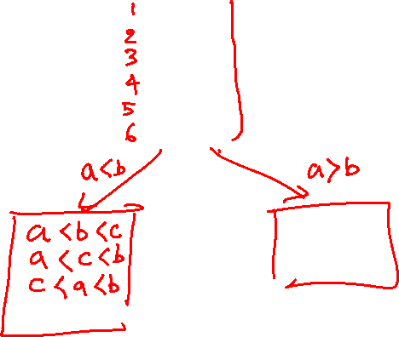
Decision tree
a < b < c
a < c < b
b < a < c
b < c < a
c < a < b
c < b < a

Slide 79
Decision tree
a < b < c
a < c < b
b < a < c
b < c < a
c < a < b
c < b < a
a < b
b < a
a < b < c
a < c < b
c < a < b
b < a < c
b < c < a
c < b < a
a < c
c < a
b < c
c < b
a < b < c
a < c < b
c < a < b
b < a < c
b < c < a
c < b < a
b < c
c < b
a < c
c < a
a < b < c
a < c < b
b < a < c
b < c < a

Slide 80
Decision tree
The previous slide shows a decision tree for sorting three distinct elements a, b, c using just the comparison operations
The leaf nodes correspond to the possible outputs of the program
Notice that for three elements, there could be six different possible outcomes; the program may take different paths during runtime to generate an outcome

Slide 81
Decision tree
Notice that, in general, a program may take different paths to derive the same output
Therefore, the number of leaves is at least the number of all possible outcomes
The internal nodes of the decision tree are comparison operations
After every comparison operation, the program may take two different paths, and the only operations we care about are the comparison operations; therefore, the decision tree is a binary tree

Slide 82
Decision tree
The lower bound on the number of comparisons is the height of the decision tree
The height is minimum when the decision tree is a nearly complete or complete binary tree, and the leaves contain only the possible outputs

Slide 83
Decision tree
What is the number of leaf nodes in the decision tree for sorting when we want to sort n numbers?

Slide 84
Decision tree
What is the number of leaf nodes in the decision tree for sorting when we want to sort n numbers?
n!
What is the height, h, of the decision tree when the number of leaves is n!

Slide 85
Decision tree
What is the number of leaf nodes in the decision tree for sorting when we want to sort n numbers?
n!
What is the height, h, of the decision tree when the number of leaves is n!
2^{h} >= n!
h >= log(n!)
The minimum number of comparisons = log(n!)

Slide 86
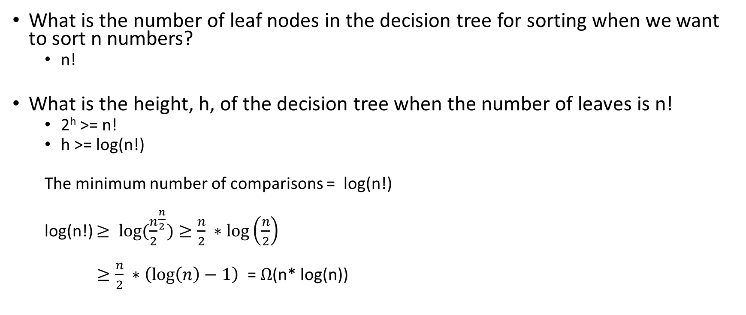
Decision tree
What is the number of leaf nodes in the decision tree for sorting when we want to sort n numbers?
n!
What is the height, h, of the decision tree when the number of leaves is n!
2^{h} >= n!
h >= log(n!)
The minimum number of comparisons = log(n!)
log(n!) $≥ {log⁡(\frac{n}{2}}^{\frac{n}{2}})≥\frac{n}{2} ∗\log\left(\frac{n}{2}\right)$
$≥\frac{n}{2} ∗\left(\log\left(n\right)−1\right)$ = $Ω$(n* log(n))

