Slide 1
Today’s topics
Decision tree
Sorting
Huffman encoding

Slide 2
Huffman encoding

Slide 3
Huffman codes
Read section-16.3 from the Cormen et al. book

Slide 4
Huffman codes
Huffman codes are used to compress data without losing any information

Slide 5
Huffman codes
Suppose we want to store 100,000 characters in a file
What will be the size of the file?

Slide 6
Huffman codes
Suppose we want to store 100,000 characters in a file
What will be the size of the file?
100000 * 8 bits
What if the characters used in the file belong to the set (a,b,c,d,e,f)
Can we do better?

Slide 7
Huffman codes
Suppose we want to store 100,000 characters in a file
What will be the size of the file?
100000 * 8 bits
What if the characters used in the file belong to the set (a,b,c,d,e,f)
Can we do better?
Yes, we can use 3-bit encoding for characters
How many bits will be required?

Slide 8
Huffman codes
Suppose we want to store 100,000 characters in a file
What will be the size of the file?
100000 * 8 bits
What if the characters used in the file belong to the set (a,b,c,d,e,f)
Can we do better?
Yes, we can use 3-bit encoding for characters
How many bits will be required?
100000 * 3 bits

Slide 9
Huffman codes
Suppose we know the frequency of each character
Can we do better?
 | a | b | c | d | e | f
Freq (thousands) | 45 | 13 | 12 | 16 | 9 | 5
Fixed-length code | 000 | 001 | 010 | 011 | 100 | 101

Slide 10
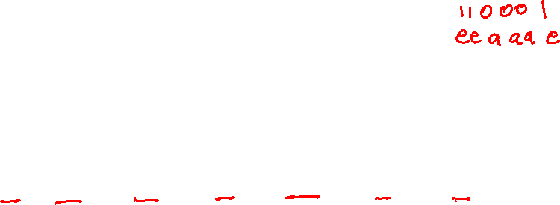
Huffman codes
Suppose we know the frequency of each character
Can we do better?
encode: face
 | a | b | c | d | e | f
Freq (thousands) | 45 | 13 | 12 | 16 | 9 | 5
Fixed-length code | 000 | 001 | 010 | 011 | 100 | 101
variable length | 0 | 01 | 00 | 010 | 1 | 11

Slide 11
Huffman codes
Suppose we know the frequency of each character
Can we do better?
face will be encoded as 11 0 00 1
Can be decoded as ee a aa e
 | a | b | c | d | e | f
Freq (thousands) | 45 | 13 | 12 | 16 | 9 | 5
Fixed-length code | 000 | 001 | 010 | 011 | 100 | 101
variable length | 0 | 01 | 00 | 010 | 1 | 11
If we use a variable-length encoding in which the encoding of one character can be the prefix of another character, it will be difficult to decode the message.

Slide 12
Huffman codes
Suppose we know the frequency of each character
Can we do better?
encode: face
 | a | b | c | d | e | f
Freq (thousands) | 45 | 13 | 12 | 16 | 9 | 5
Fixed-length code | 000 | 001 | 010 | 011 | 100 | 101
variable length | 0 | 101 | 100 | 111 | 1101 | 1100
If we use a variable-length encoding in which the encoding of a character is never a prefix of the encoding of another character, then there will be no ambiguity.

Slide 13
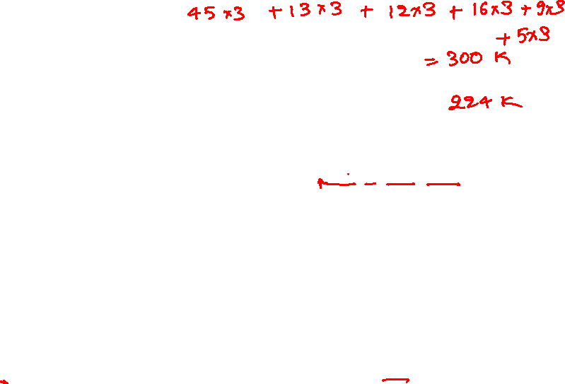
Huffman codes
Suppose we know the frequency of each character
Can we do better?
face will be encoded as 1100 0 100 1101
only possible decoding is f a c e
 | a | b | c | d | e | f
Freq (thousands) | 45 | 13 | 12 | 16 | 9 | 5
Fixed-length code | 000 | 001 | 010 | 011 | 100 | 101
variable length | 0 | 101 | 100 | 111 | 1101 | 1100
If we use a variable-length encoding in which the encoding of a character is never a prefix of the encoding of another character, then there will be no ambiguity.

Slide 14
Prefix-free codes
No codeword is a prefix of some other codeword
 | a | b | c | d | e | f
Freq (thousands) | 45 | 13 | 12 | 16 | 9 | 5
Fixed-length code | 000 | 001 | 010 | 011 | 100 | 101
variable length | 0 | 101 | 100 | 111 | 1101 | 1100

Slide 15
Prefix-free codes
Using prefix-free codes, we can uniquely identify the next character during decoding
No ambiguity during decoding

Slide 16
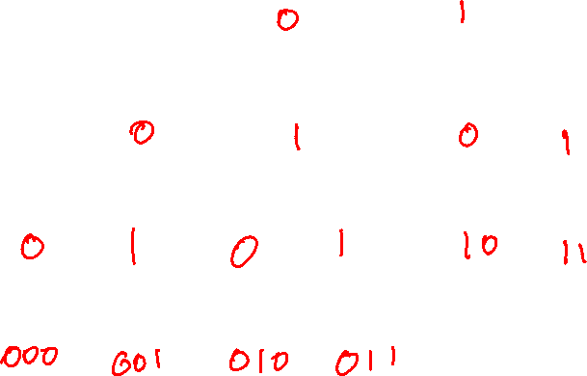
Prefix-free codes
A binary tree can be used to generate prefix-free codes
The square nodes or leaves represent the characters in the file that we want to compress. There is a unique path to each square node from the root.
We can assign prefix-free codes to these paths.
e
f
a
b
c
d

Slide 17
Prefix-free codes
A binary tree can be used to generate prefix-free codes
Each edge on the path is a bit in the corresponding encoding. If we assign different bits to the left and right children, then none of the nodes in the left subtree will be the prefix of a node in the right subtree and vice-versa. If we apply this rule for all nodes, we will get prefix-free codes for the leaf nodes.
0
1
0
1
0
1
e
f
0
1
0
1
a
b
c
d

Slide 18
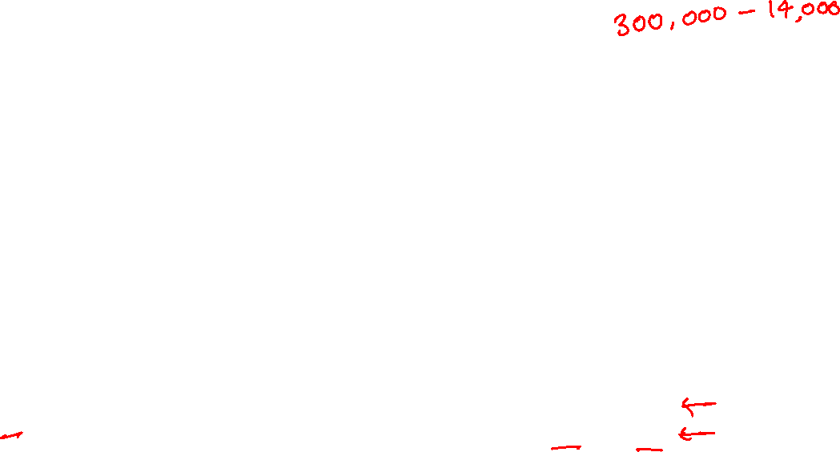
Prefix-free codes
No codeword is a prefix of some other codeword
encoding-1 number of bits
encoding-2 number of bits
 | a | b | c | d | e | f
Freq (thousands) | 45 | 13 | 12 | 16 | 9 | 5
Fixed-length code | 000 | 001 | 010 | 011 | 100 | 101
variable length-1 | 0 | 101 | 100 | 111 | 1101 | 1100
variable length-2 | 000 | 001 | 010 | 011 | 10 | 11

Slide 19
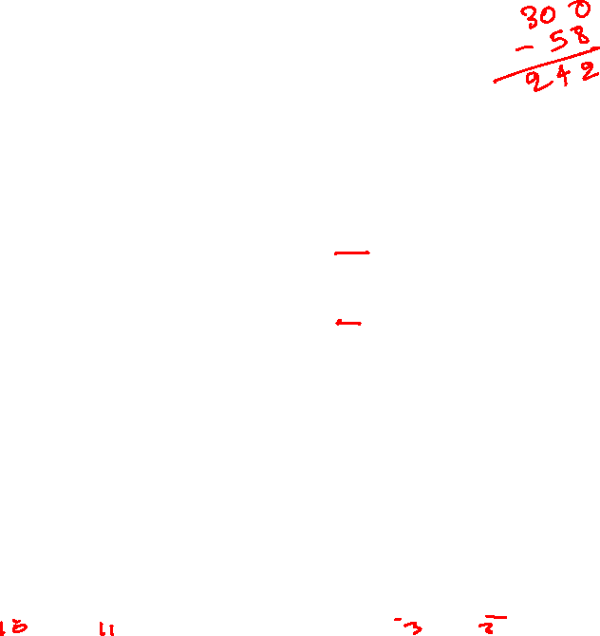
Prefix-free codes
No codeword is a prefix of some other codeword
encoding-1 number of bits
(45 * 1) + (13 * 3) + (12 * 3) + (16 * 3) + (9 * 4) + (5 * 4) = 224 thousands
encoding-2 number of bits
(45 * 3) + (13 * 3) + (12 * 3) + (16 * 3) + (9 * 2) + (5 * 2) = 286 thousands
Even though the encoding-1 scheme uses up to four bits, it is better than the encoding-2 scheme, which uses two and three bits codes
 | a | b | c | d | e | f
Freq (thousands) | 45 | 13 | 12 | 16 | 9 | 5
Fixed-length code | 000 | 001 | 010 | 011 | 100 | 101
encoding-1 | 0 | 101 | 100 | 111 | 1101 | 1100
encoding-2 | 000 | 001 | 010 | 011 | 10 | 11

Slide 20
Prefix-free codes
For better compression, we need to generate smaller length codes for those characters whose frequencies are high
For low-frequency characters, we can use larger codes

Slide 21
Huffman code
Huffman algorithm can be used to generate an optimal prefix-free code

Slide 22
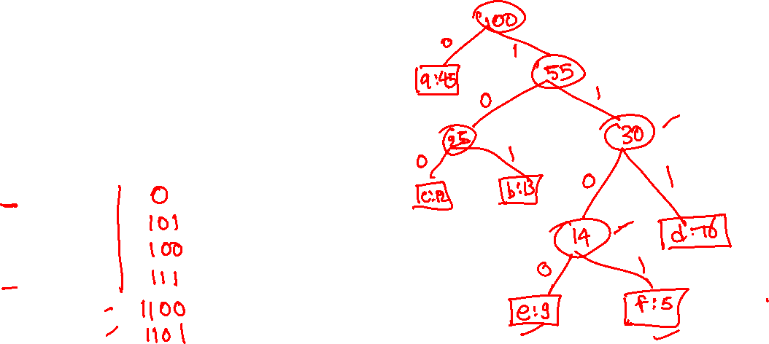
Huffman encoding
CHAR | FREQ | ENC
a | 45
b | 13
c | 12
d | 16
e | 9
f | 5
Keep connecting two nodes with minimum frequencies unless all nodes are connected.

Slide 23
Huffman encoding
CHAR | FREQ | ENC
a | 45
b | 13
c | 12
d | 16
e | 9
f | 5
f:5
e:9
d:16
c:12
b:13
a:45
Keep connecting two nodes with minimum frequencies unless all nodes are connected.

Slide 24
Huffman encoding
CHAR | FREQ | ENC
a | 45
b | 13
c | 12
d | 16
e | 9
f | 5
14
d:16
c:12
b:13
a:45
f:5
e:9
Keep connecting two nodes with minimum frequencies unless all nodes are connected.

Slide 25
Huffman encoding
CHAR | FREQ | ENC
a | 45
b | 13
c | 12
d | 16
e | 9
f | 5
14
25
d:16
a:45
f:5
e:9
c:12
b:13
Keep connecting two nodes with minimum frequencies unless all nodes are connected.

Slide 26
Huffman encoding
CHAR | FREQ | ENC
a | 45
b | 13
c | 12
d | 16
e | 9
f | 5
30
14
d:16
25
a:45
f:5
e:9
c:12
b:13
Keep connecting two nodes with minimum frequencies unless all nodes are connected.

Slide 27
Huffman encoding
55
CHAR | FREQ | ENC
a | 45
b | 13
c | 12
d | 16
e | 9
f | 5
25
30
c:12
b:13
14
d:16
a:45
f:5
e:9
Keep connecting two nodes with minimum frequencies unless all nodes are connected.

Slide 28
Huffman encoding
100
CHAR | FREQ | ENC
a | 45
b | 13
c | 12
d | 16
e | 9
f | 5
a:45
55
25
30
c:12
b:13
14
d:16
Keep connecting two nodes with minimum frequencies unless all nodes are connected.
f:5
e:9

Slide 29
Huffman encoding
100
0
1
CHAR | FREQ | ENC
a | 45
b | 13
c | 12
d | 16
e | 9
f | 5
a:45
55
0
1
25
30
0
1
0
1
c:12
b:13
14
d:16
0
1
Keep connecting two nodes with minimum frequencies unless all nodes are connected.
f:5
e:9

Slide 30
Huffman encoding
Implementation
CHAR | FREQ | ENC
a | 45
b | 13
c | 12
d | 16
e | 9
f | 5

Slide 31
Huffman encoding
CHAR | FREQ | ENC
a | 45
b | 13
c | 12
d | 16
e | 9
f | 5
f:5
e:9
d:16
c:12
b:13
a:45
Red nodes are in the min heap.
Keep connecting two nodes with minimum frequencies unless all nodes are connected.

Slide 32
Huffman encoding
CHAR | FREQ | ENC
a | 45
b | 13
c | 12
d | 16
e | 9
f | 5
14
d:16
c:12
b:13
a:45
f:5
e:9
Red nodes are in the min heap.
Extract two nodes from the min heap, connect them, and add the new node to the min heap.
Keep connecting two nodes with minimum frequencies unless all nodes are connected.

Slide 33
Huffman encoding
CHAR | FREQ | ENC
a | 45
b | 13
c | 12
d | 16
e | 9
f | 5
14
25
d:16
a:45
f:5
e:9
c:12
b:13
Red nodes are in the min heap.
Extract two nodes from the min heap, connect them, and add the new node to the min heap.
Keep connecting two nodes with minimum frequencies unless all nodes are connected.

Slide 34
Huffman encoding
CHAR | FREQ | ENC
a | 45
b | 13
c | 12
d | 16
e | 9
f | 5
30
14
d:16
25
a:45
f:5
e:9
c:12
b:13
Red nodes are in the min heap.
Extract two nodes from the min heap, connect them, and add the new node to the min heap.
Keep connecting two nodes with minimum frequencies unless all nodes are connected.

Slide 35
Huffman encoding
55
CHAR | FREQ | ENC
a | 45
b | 13
c | 12
d | 16
e | 9
f | 5
25
30
c:12
b:13
14
d:16
a:45
f:5
e:9
Red nodes are in the min heap.
Extract two nodes from the min heap, connect them, and add the new node to the min heap.
Keep connecting two nodes with minimum frequencies unless all nodes are connected.

Slide 36
Huffman encoding
100
CHAR | FREQ | ENC
a | 45
b | 13
c | 12
d | 16
e | 9
f | 5
a:45
55
25
30
c:12
b:13
14
d:16
Keep connecting two nodes with minimum frequencies unless all nodes are connected.
f:5
e:9

Slide 37
Huffman encoding
100
0
1
CHAR | FREQ | ENC
a | 45 | 0
b | 13 | 101
c | 12 | 100
d | 16 | 111
e | 9 | 1101
f | 5 | 1100
a:45
55
0
1
25
30
0
1
0
1
c:12
b:13
14
d:16
0
1
Keep connecting two nodes with minimum frequencies unless all nodes are connected.
f:5
e:9

Slide 38

Huffman encoding algorithm
Algorithm Huffman(C):
Input: C is an array of n nodes; each node contains a character and its corresponding frequency, and NULL left and right fields
Output: The root of a tree representing the Huffman codes
n = Num_Elements(C)
Q = Build_Min_Heap(C)
for i = 1 to n – 1 do
z = allocate_node() // allocate a node with empty fields
z.left = x = Extract_Min(Q)
z.right = y = Extract_Min(Q)
z.freq = x.freq + y.freq
Insert(Q, z)
return Extract_Min(Q)
Time complexity:

Slide 39
Time complexity
All the heap operations inside the loop take O(log n) time
The loop runs n-1 time
Build_Min_Heap takes O(n) time
Therefore, the time complexity is O(n * log(n))

Slide 40
Huffman codes
Initially, the resulting code is empty
To generate the Huffman code for a given leaf node x, walk from the root node to x, visiting each node in the path exactly once
For every left turn, append zero to the resulting code
For every right turn, append one to the resulting code

Slide 41
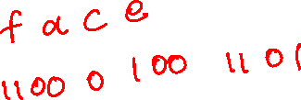
Huffman decoding
CHAR | FREQ | ENC
a | 45 | 0
b | 13 | 101
c | 12 | 100
d | 16 | 111
e | 9 | 1101
f | 5 | 1100

Slide 42
Huffman encoding
Store the mapping from an original sequence to the encoded sequence in the compressed file

Slide 43
Huffman decoding
Retrieve the character encoding from the compressed file
Build the corresponding tree
Read the encoded bits in an array
call HuffmanDecoding until all characters are decoded

Slide 44
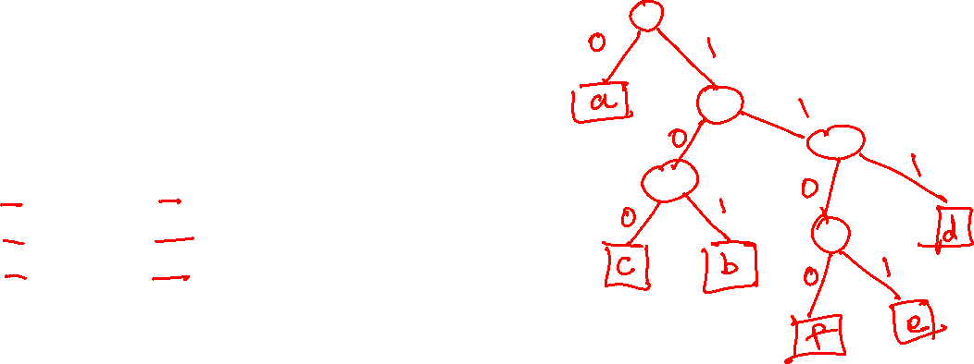
Building tree
CHAR | FREQ | ENC
a | 45 | 0
b | 13 | 101
c | 12 | 100
d | 16 | 111
e | 9 | 1101
f | 5 | 1100

Slide 45
Building tree
CHAR | FREQ | ENC
a | 45 | 0
b | 13 | 101
c | 12 | 100
d | 16 | 111
e | 9 | 1101
f | 5 | 1100

Slide 46
Building tree
CHAR | FREQ | ENC
a | 45 | 0
b | 13 | 101
c | 12 | 100
d | 16 | 111
e | 9 | 1101
f | 5 | 1100
0
a

Slide 47
Building tree
CHAR | FREQ | ENC
a | 45 | 0
b | 13 | 101
c | 12 | 100
d | 16 | 111
e | 9 | 1101
f | 5 | 1100
0
1
a
0
1
b

Slide 48
Building tree
CHAR | FREQ | ENC
a | 45 | 0
b | 13 | 101
c | 12 | 100
d | 16 | 111
e | 9 | 1101
f | 5 | 1100
0
1
a
0
0
1
c
b

Slide 49
Building tree
CHAR | FREQ | ENC
a | 45 | 0
b | 13 | 101
c | 12 | 100
d | 16 | 111
e | 9 | 1101
f | 5 | 1100
0
1
a
0
1
0
1
1
c
b
d

Slide 50
Building tree
CHAR | FREQ | ENC
a | 45 | 0
b | 13 | 101
c | 12 | 100
d | 16 | 111
e | 9 | 1101
f | 5 | 1100
0
1
a
0
1
0
1
0
1
c
b
d
1
e

Slide 51
Building tree
CHAR | FREQ | ENC
a | 45 | 0
b | 13 | 101
c | 12 | 100
d | 16 | 111
e | 9 | 1101
f | 5 | 1100
0
1
a
0
1
0
1
0
1
c
b
d
0
1
f
e

Slide 52
Building tree
We can store the encoding differently in the compressed file to build the tree faster during the decoding; however, because the total number of characters is usually small, building the tree is not a very time-consuming step

Slide 53

Huffman decoding
CHAR | FREQ | ENC
a | 45 | 0
b | 13 | 101
c | 12 | 100
d | 16 | 111
e | 9 | 1101
f | 5 | 1100
0
1
a
0
1
0
1
0
1
c
b
d
0
1
decode: 110001001101
f
e

Slide 54

Huffman decoding
Algorithm HuffmanDecoding(root, in)
Input: root is the root of the tree, in points to next bit in the encoded input sequence
Output: decodes and prints one character, returns the pointer to the first bit of the next character in the encoded sequence
if (is_leaf(root)) then
print(root->val);
return in;
if (in[0] = 0) then
return HuffmanDecoding(root->left, in+1)
else
return HuffmanDecoding(root->right, in+1)

Slide 55
Decision tree

Slide 56
References
Chapter-7.9 from Mark Allen Weiss
Chapter-4.4 from Goodrich and Tamassia

Slide 57
Decision tree
The binary search take O(log n) time to search an element from the sorted array
If the hash table is sufficiently large, the search can be done in O(1)
What is the key difference between binary search and the hash table search?

Slide 58
Decision tree
The binary search doesn’t care about the type of the key
It needs a comparison function that acts as a black box
The return value of the comparison function could be <, >, <=, >=, ==, !=
The hash table will not work if the key can’t be mapped to an integer

Slide 59
Decision tree
The decision tree is an abstraction to find a lower bound
We’ll use a binary decision tree to find the lower bound of sorting algorithms
Each internal node in the decision tree is a comparison operation that may take place during the execution of the algorithm
The leaf nodes are the output of the algorithm
The goal is to obtain a lower bound on the number of comparisons to generate the output

Slide 60
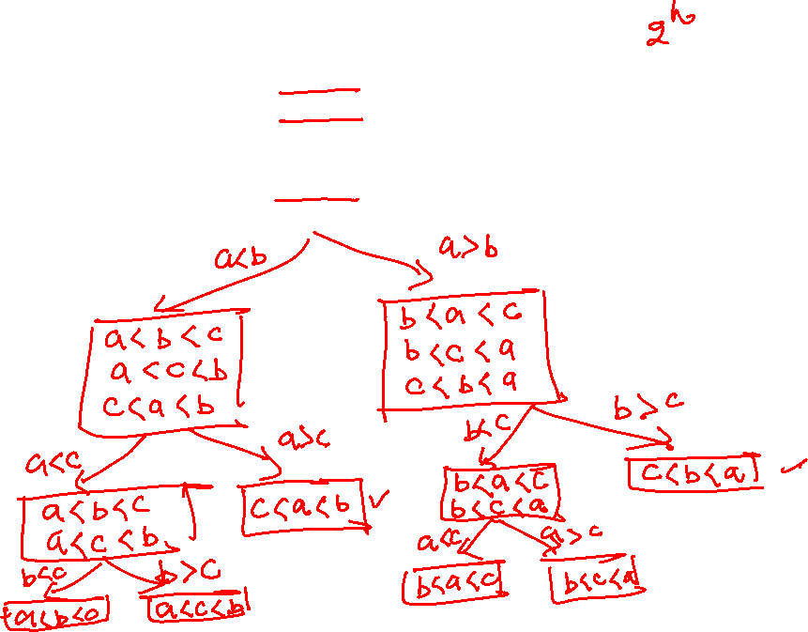
Decision tree
a < b < c
a < c < b
b < a < c
b < c < a
c < a < b
c < b < a

Slide 61
Decision tree
a < b < c
a < c < b
b < a < c
b < c < a
c < a < b
c < b < a
a < b
b < a
a < b < c
a < c < b
c < a < b
b < a < c
b < c < a
c < b < a
a < c
c < a
b < c
c < b
a < b < c
a < c < b
c < a < b
b < a < c
b < c < a
c < b < a
b < c
c < b
a < c
c < a
a < b < c
a < c < b
b < a < c
b < c < a

Slide 62
Decision tree
The previous slide shows a decision tree for sorting three distinct elements a, b, c using just the comparison operations
The leaf nodes correspond to the possible outputs of the program
Notice that for three elements, there could be six different possible outcomes; the program may take different paths during runtime to generate an outcome

Slide 63
Decision tree
Notice that, in general, a program may take different paths to derive the same output
Therefore, the number of leaves is at least the number of all possible outcomes
The internal nodes of the decision tree are comparison operations
After every comparison operation, the program may take two different paths, and the only operations we care about are the comparison operations; therefore, the decision tree is a binary tree

Slide 64
Decision tree
The lower bound on the number of comparisons is the height of the decision tree
The height is minimum when the decision tree is a nearly complete or complete binary tree, and the leaves contain only the possible outputs

Slide 65
Decision tree
What is the number of leaf nodes in the decision tree for sorting when we want to sort n numbers?

Slide 66
Decision tree
What is the number of leaf nodes in the decision tree for sorting when we want to sort n numbers?
n!
What is the height, h, of the decision tree when the number of leaves is n!

Slide 67
Decision tree
What is the number of leaf nodes in the decision tree for sorting when we want to sort n numbers?
n!
What is the height, h, of the decision tree when the number of leaves is n!
2^{h} >= n!
h >= log(n!)
The minimum number of comparisons = log(n!)

Slide 68
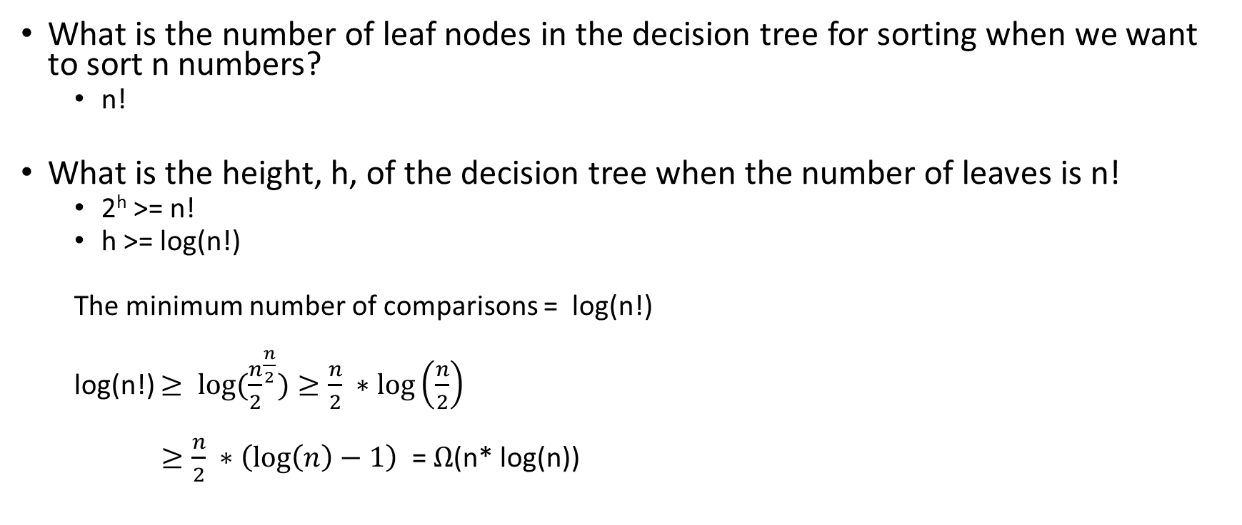

Decision tree
What is the number of leaf nodes in the decision tree for sorting when we want to sort n numbers?
n!
What is the height, h, of the decision tree when the number of leaves is n!
2^{h} >= n!
h >= log(n!)
The minimum number of comparisons = log(n!)
log(n!) $≥ {log⁡(\frac{n}{2}}^{\frac{n}{2}})≥\frac{n}{2} ∗\log\left(\frac{n}{2}\right)$
$≥\frac{n}{2} ∗\left(\log\left(n\right)−1\right)$ = $Ω$(n* log(n))

Slide 69
Decision tree
Decision tree for searching

Slide 70
Decision tree
Decision tree for searching
How many different outcomes are possible to search an element from an array of n elements?
What is the number of leaves?
What would be the height of the decision tree?
What is the lower bound on the number of comparisons?

Slide 71
Sorting

Slide 72
References
Read chapter-4.5 from the Goodrich and Tamassia book

Slide 73
Sorting
The comparison based sorting algorithms take at least O(n*log(n)) time
The order sorting algorithms that are not based on the comparisons may execute faster than O(n * log(n))

Slide 74
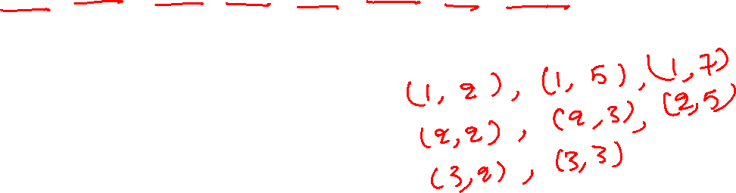
Sorting
Consider the following sequence S:
S = ((3, 3), (1, 5), (2, 5), (1, 2), (2, 3), (1, 7), (3, 2), (2, 2))
is a sequence of (k, l) pairs of keys
such that, 0 <= k <= 9 and 0 <= l <= 9
An element (k₁, l₁) < (k₂, l₂), if
k₁ < k₂ or
k₁ = k₂ and l₁ < l₂

Slide 75
Sorting
Consider the following sequence S:
S = ((3, 3), (1, 5), (2, 5), (1, 2), (2, 3), (1, 7), (3, 2), (2, 2))
is a sequence of (k, l) pairs of keys
such that, 0 <= k <= 9 and 0 <= l <= 9
An element (k₁, l₁) < (k₂, l₂), if
k₁ < k₂ or
k₁ = k₂ and l₁ < l₂
Sorted sequence:

Slide 76
Sorting
How to sort S = ((3, 3), (1, 5), (2, 5), (1, 2), (2, 3), (1, 7), (3, 2), (2, 2))

Slide 77
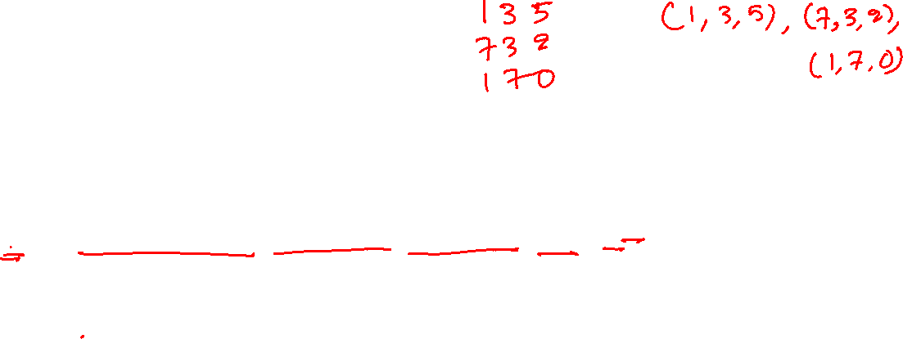
Sorting
To sort S = ((3, 3), (1, 5), (2, 5), (1, 2), (2, 3), (1, 7), (3, 2), (2, 2))
We can first sort the second component
S₂ = ((1, 2), (3, 2), (2, 2), (3, 3), (2, 3), (1, 5), (2, 5), (1, 7))
Then we can sort the first component
S_{2,1} = ((1,2), (1,5), (1,7), (2,2), (2,3), (2,5), (3,2), (3, 3))
How much time is required to sort the second component?

Slide 78
Sorting
How much time is required to sort the second component?
Store the occurrences of 0, 1, 2, 3, …, 9 in the second component in array count[0:9]
Create another sequence S₂
copy all elements with zero in the second component at indices 0 to count[0] in S₂
copy all elements with one in the second component at indices count[0] to count[1] in S₂
copy all elements with two in the second component at indices count[1] to count[2] in S₂
…
copy all elements with nine in the second component at indices count[8] to count[9] in S₂
Total time is O(n)

Slide 79
Sorting
What is the time complexity of sorting S
O(2*n)
What is the time complexity if the number of keys in an element of the sequence is d
O(d*n)
What is the time complexity of sorting n integers with maximum digits d
O(d*n)

Slide 80
Sorting
How can we sort 32-bit integers?

Slide 81
Sorting
To sort 32-bit integers, we can first sort the lowest 8-bits, followed by the next 8-bits, followed by the next 8-bits, followed by the most significant 8-bits
The size of the count array will be 256 in this case

